Slide 1



Nanocrystal Enhancement of Low-Cost Scintillators for PET Imaging Application
Declan Mahony, James Keaveney, Mark Blumenthal
University of Cape Town

Slide 2
Roadmap
PET overview
Scintillator requirements
Available options
Preliminary CdS nanocrystal pixels
Characterisation methods
Current progress, challenges and next steps

Slide 3
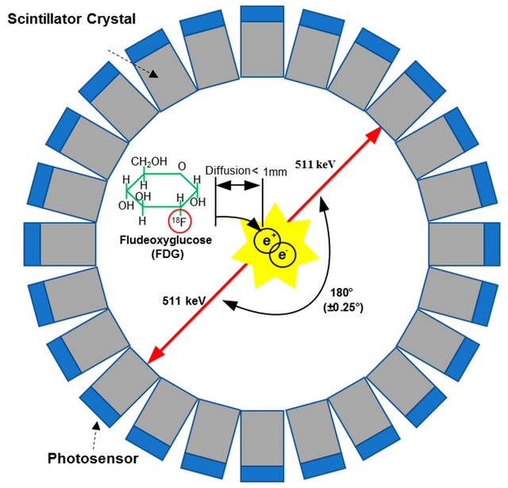
Overview of PET
Inject positron radiotracer
Preferential uptake in tumour
Line of response
Triangulate points
Image reconstruction

Slide 4
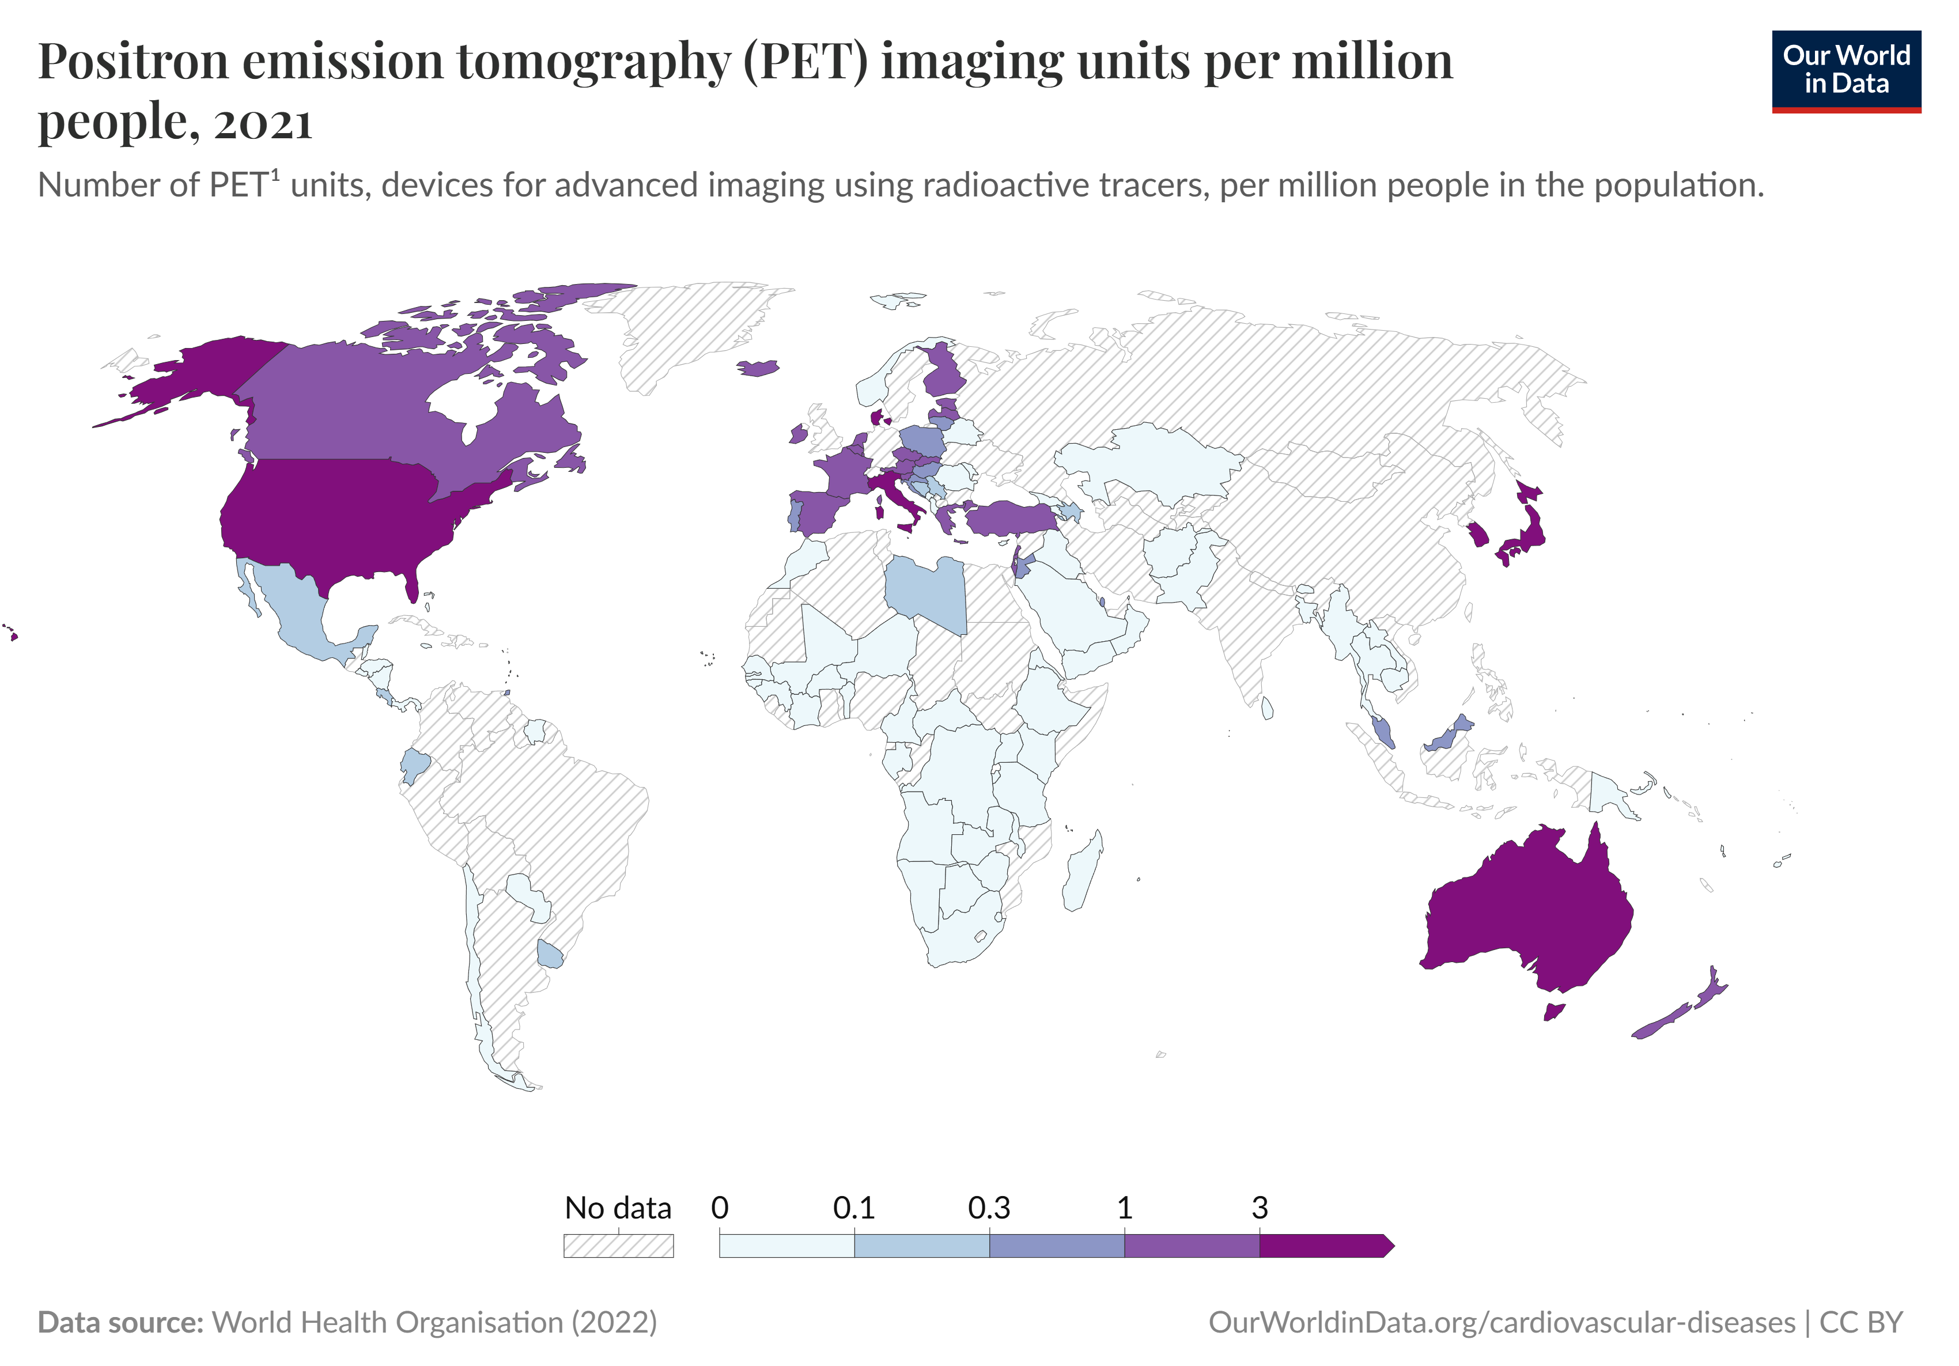
South African Context
Equipment | Total | Density per 1 000 000
MRI | 12 | 0.20
CT | 51 | 0.86
PET | 3 | 0.05

Slide 5
What makes a “good” scintillator?

Slide 6
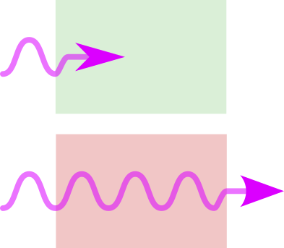
What makes a “good” scintillator?
High stopping power

Slide 7
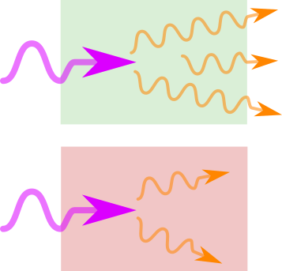
What makes a “good” scintillator?
High stopping power
High light yield

Slide 8
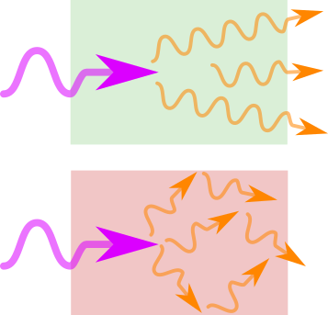
What makes a “good” scintillator?
High stopping power
High light yield
Fast response times

Slide 9
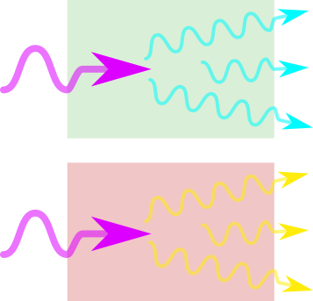
What makes a “good” scintillator?
High stopping power
High light yield
Fast response times
Optimal scintillation wavelength

Slide 10
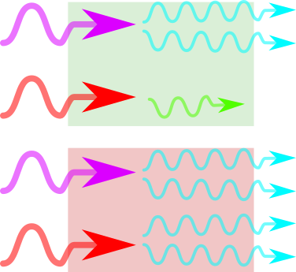
What makes a “good” scintillator?
High stopping power
High light yield
Fast response times
Optimal scintillation wavelength
Good energy resolution (ideally…)

Slide 11
Current Landscape of Scintillators
Crystals
Plastics
Ceramics

Slide 12
Current Landscape of Scintillators
Crystals
✅High Z
Plastics
Ceramics
✅High LY
✅Good ER
✅Fast RT
❌Expensive

Slide 13
Current Landscape of Scintillators
Crystals
✅High Z
Plastics
❌Low Z
Ceramics
✅High LY
✅Good ER
✅Fast RT
❌Expensive
✅High LY
✅Fast RT
❌Poor ER
✅Cheaper…

Slide 14
Current Landscape of Scintillators
Crystals
✅High Z
Plastics
❌Low Z
Ceramics
✅High LY
✅Good ER
✅Fast RT
❌Expensive
✅High LY
✅Fast RT
❌Poor ER
✅Cheaper…
✅High Z
❌Low LY
❌Fast RT
✅Good ER
✅Cheaper…

Slide 15
Current Landscape of Scintillators
Crystals
✅High Z
Plastics
❌Low Z
Ceramics
✅High LY
✅Good ER
✅Fast RT
❌Expensive
✅High LY
✅Fast RT
❌Poor ER
✅Cheaper…
✅High Z
❌Low LY
❌Slow RT
✅Good ER
✅Cheaper…
NC Composites
✅High Z
⚠️Good LY?
✅Fast RT
✅Good ER
✅Inexpensive

Slide 16
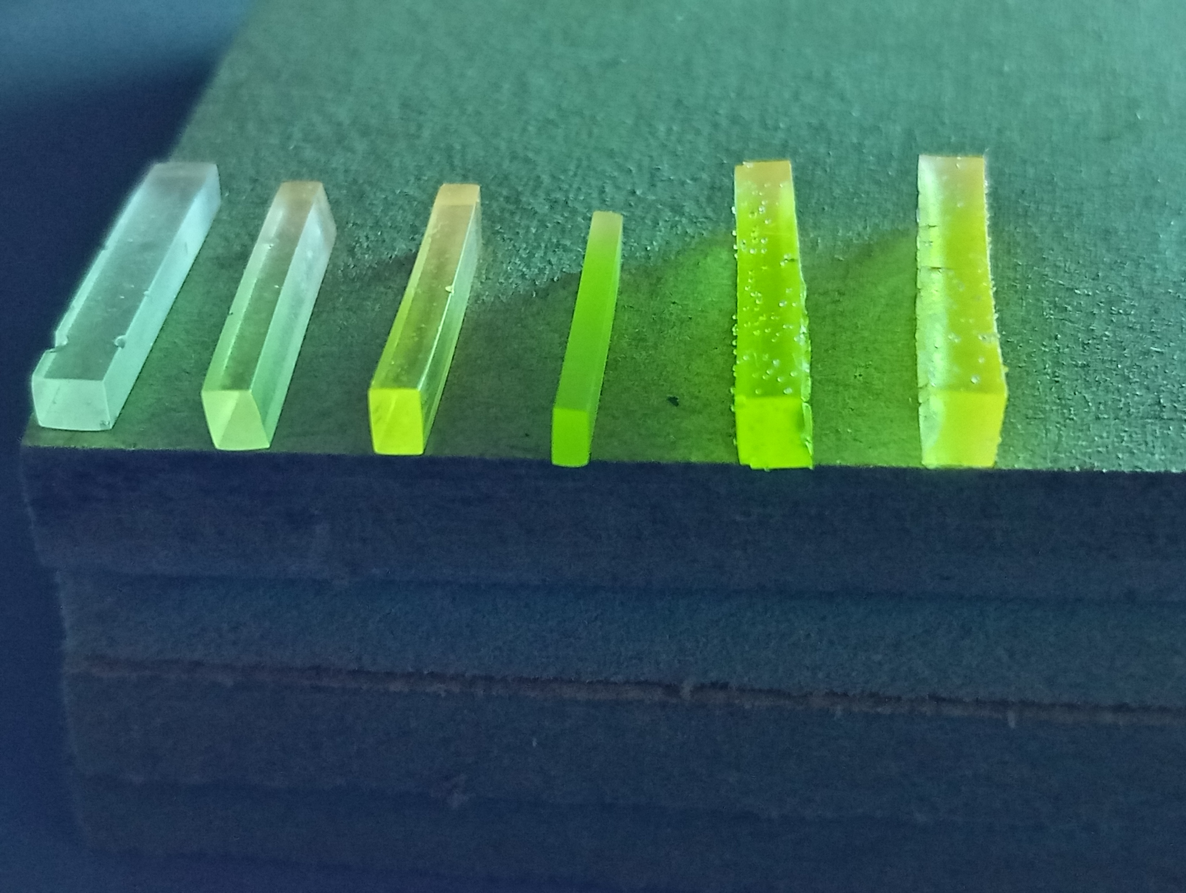
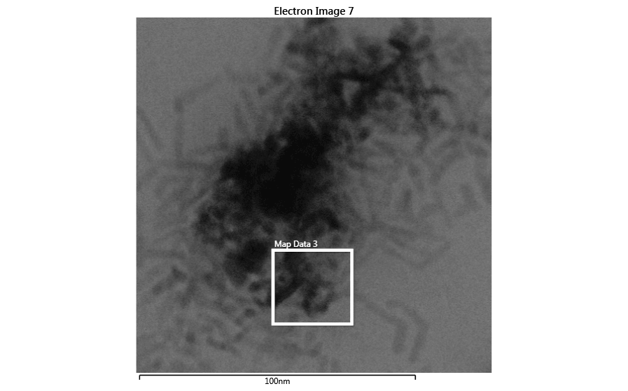

CdS Nanocrystals
0.05
0.10
0.20
0.30
0.40
0.60
Wt. % CdS
CdS epoxy composites

Slide 17
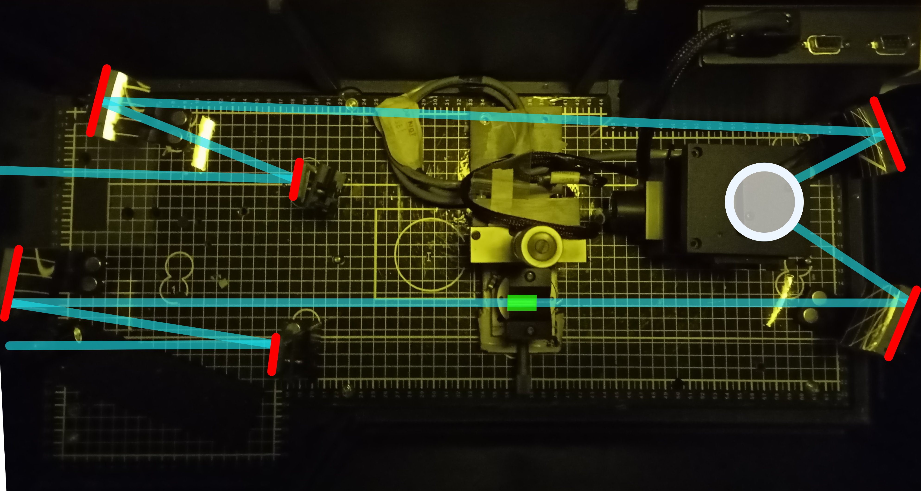
Transmittance

Slide 18
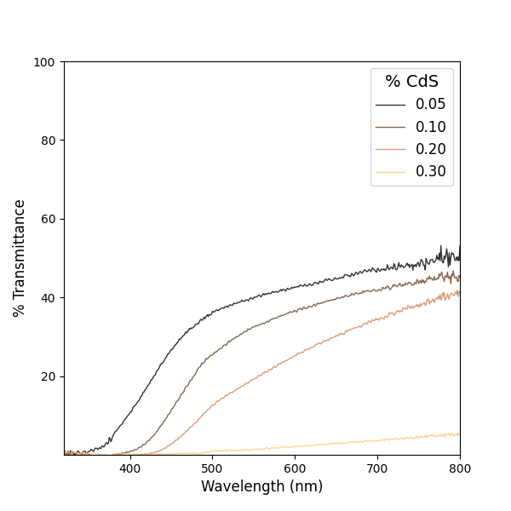
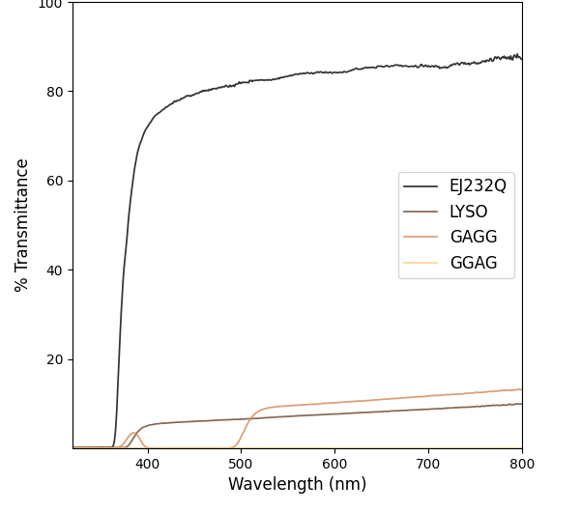
Transmittance
Industry Standard
CdS Composites

Slide 19
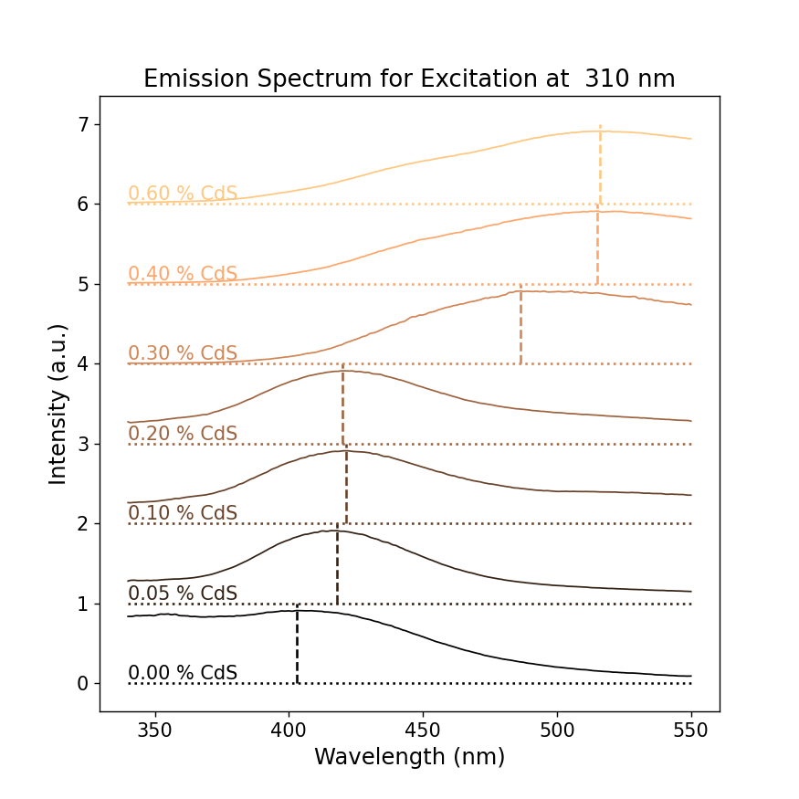
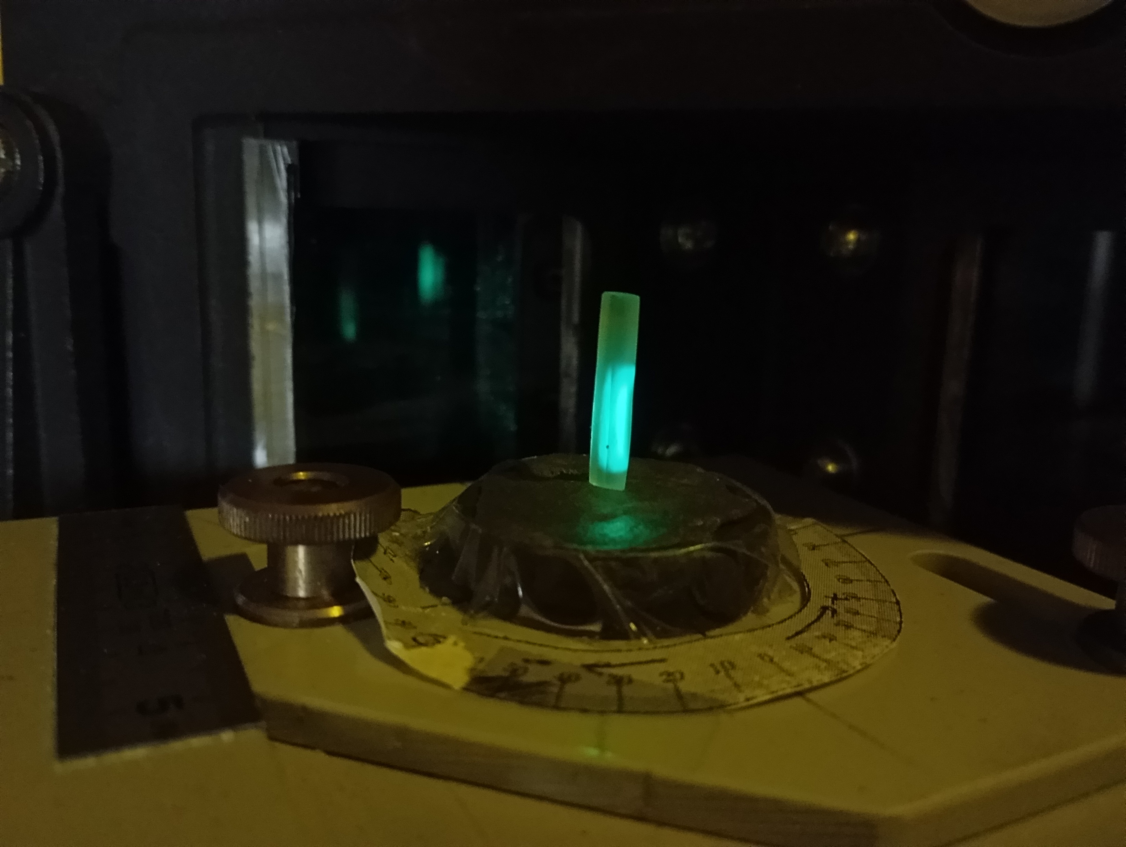
Photoluminescence Spectroscopy

Slide 20
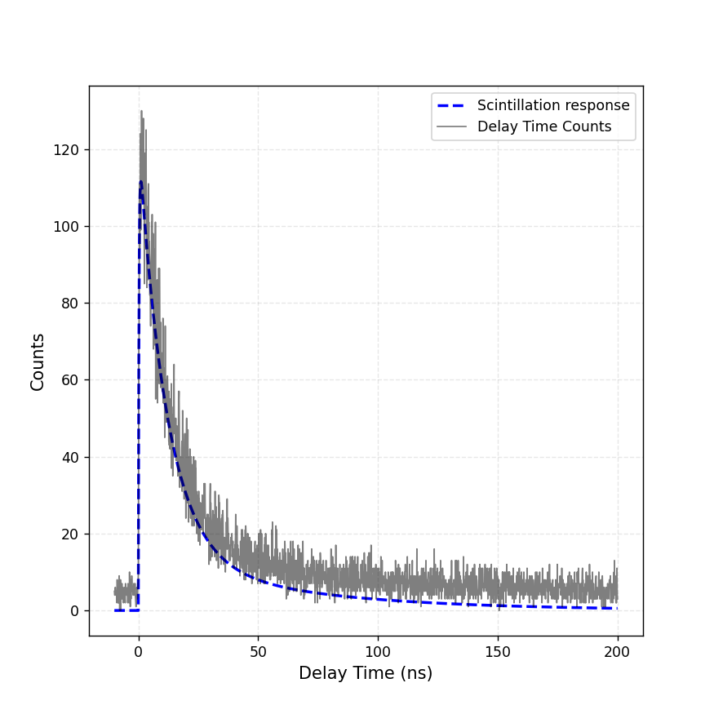
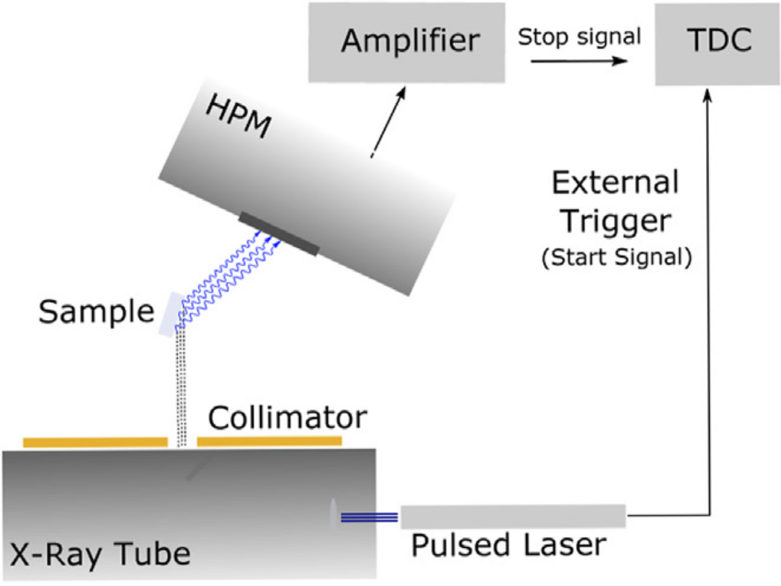
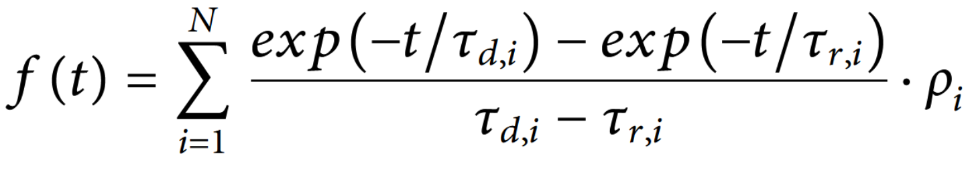
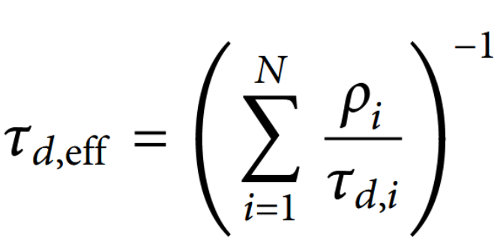
Time Correlated Single Photon Counting

Slide 21
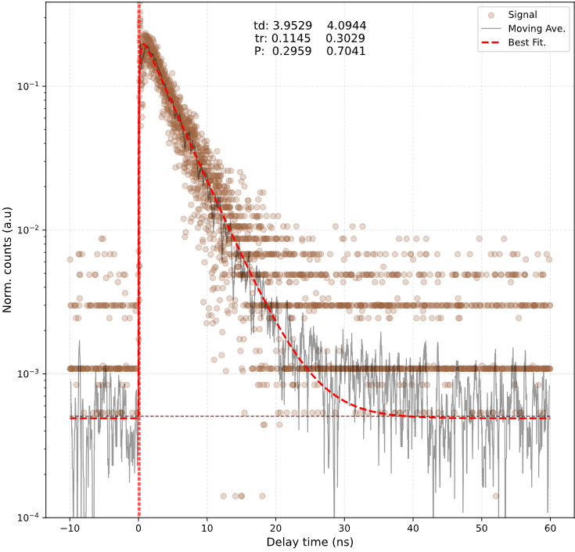
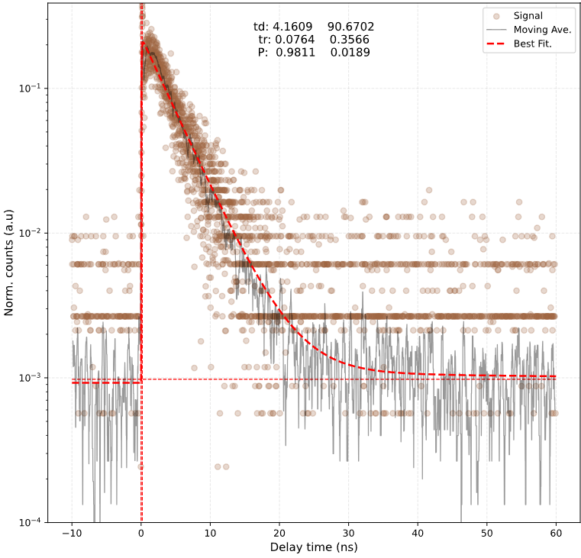
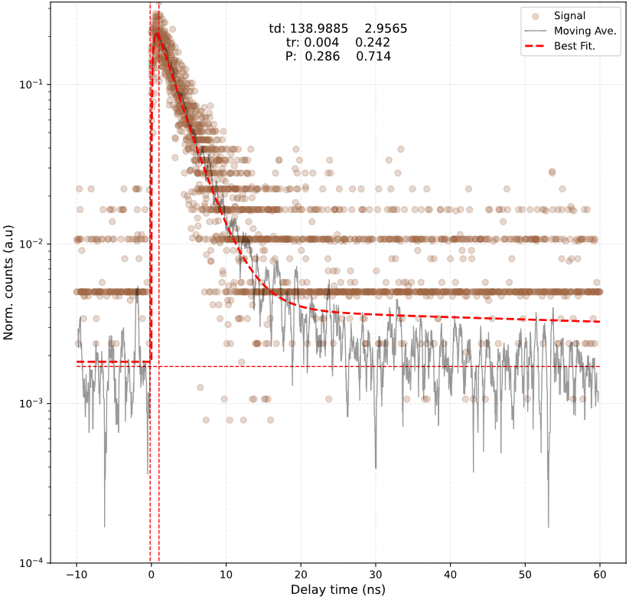
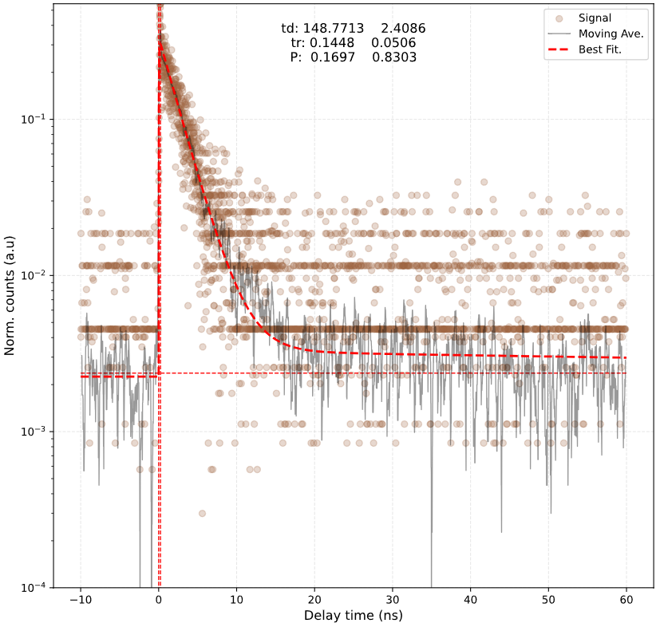
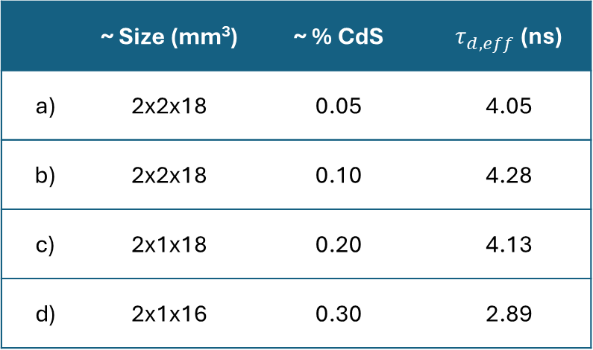
TCSPC – CdS Samples
a)
b)
Effective decay times
 | ~ Size (mm³) | ~ % CdS | $τ_{d,eff}$ (ns)
a) | 2x2x18 | 0.05 | 4.05
b) | 2x2x18 | 0.10 | 4.28
c) | 2x1x18 | 0.20 | 4.13
d) | 2x1x16 | 0.30 | 2.89
c)
d)

Slide 22
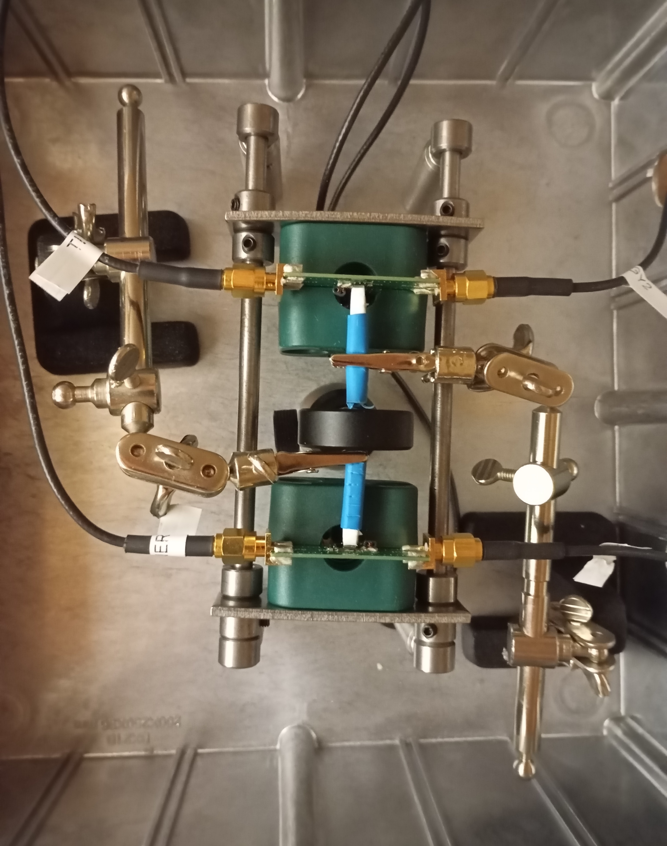
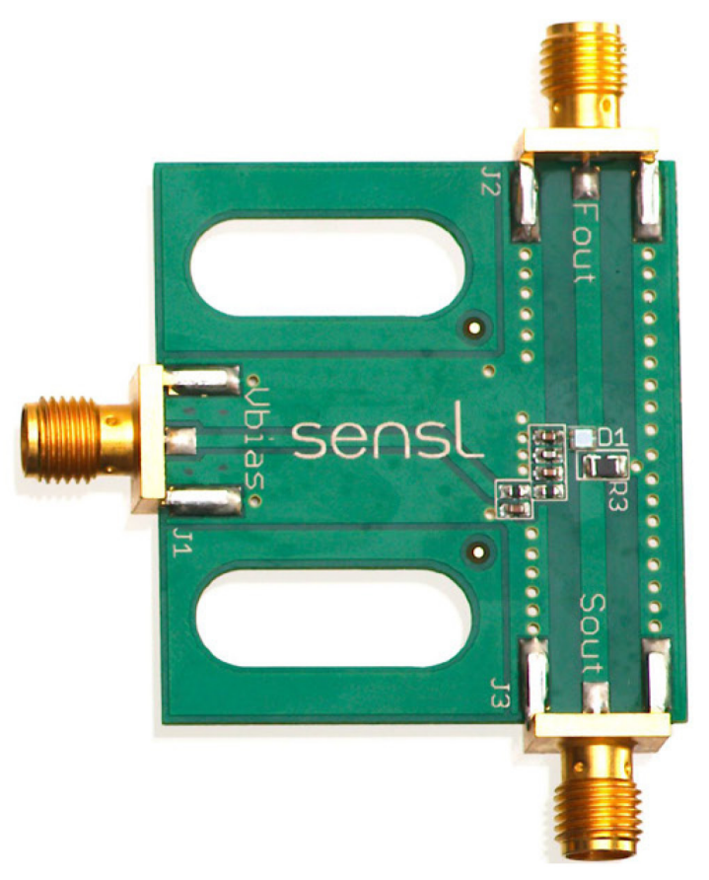
Coincidence Time Resolution

Slide 23
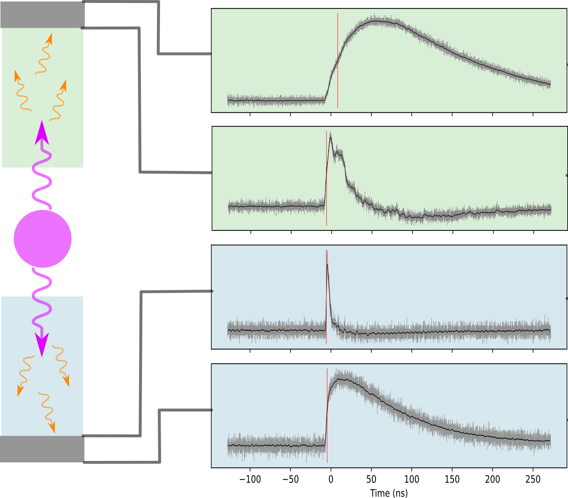
Coincidence Time Resolution: LYSO-LYSO

Slide 24
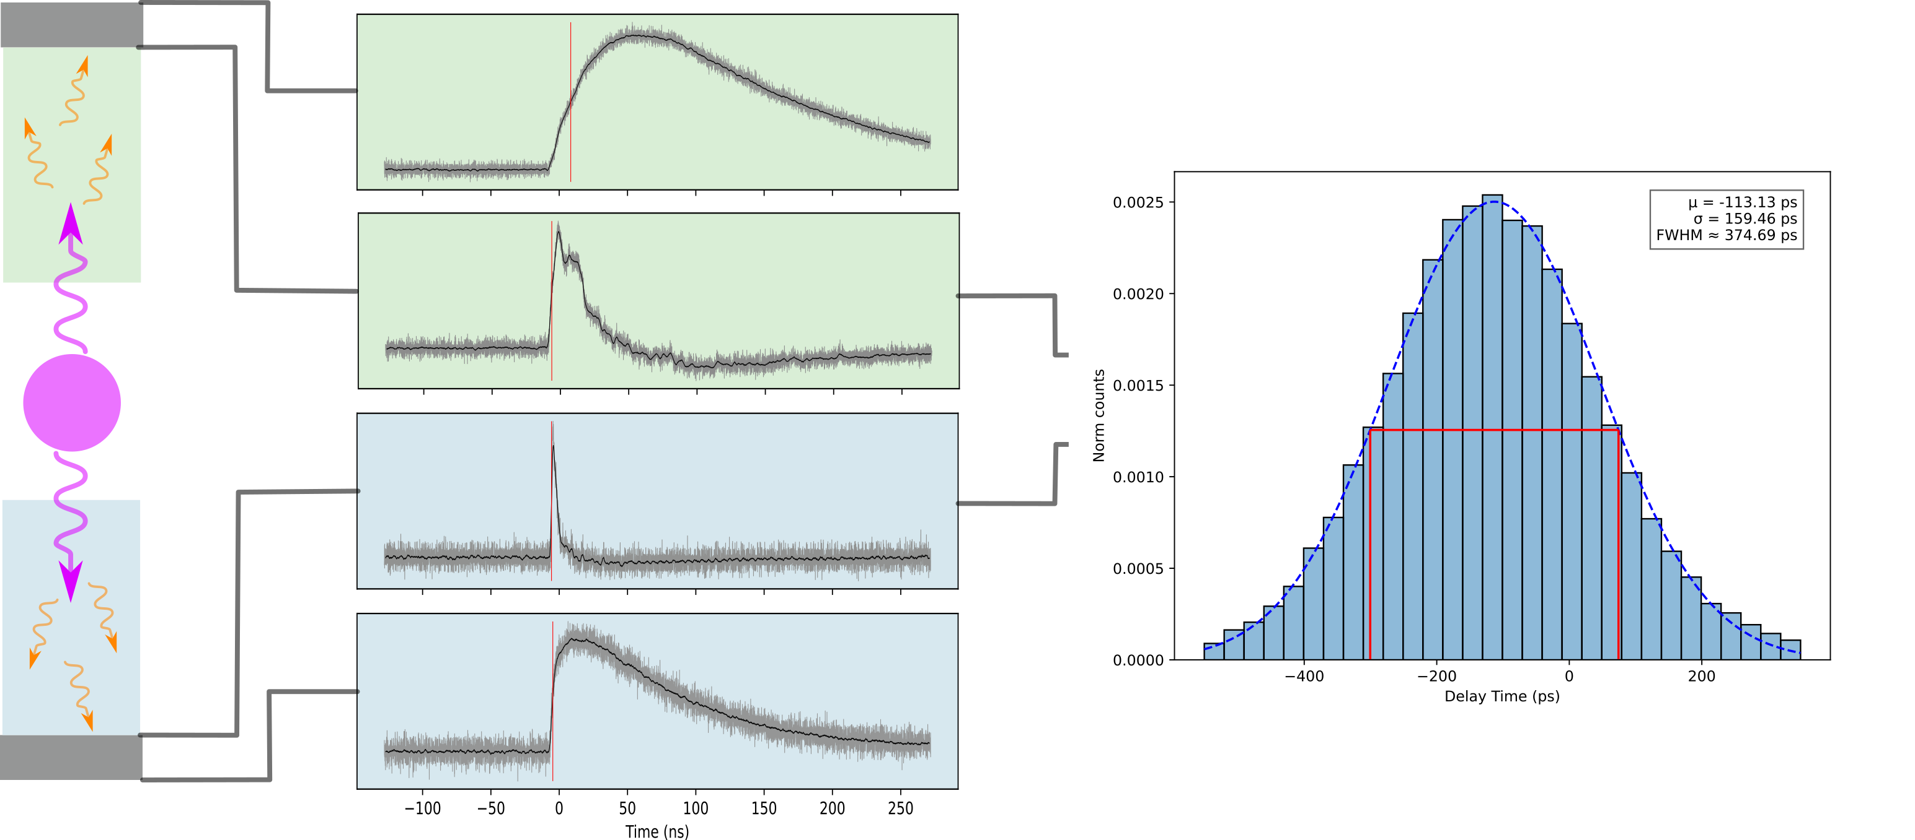
Coincidence Time Resolution

Slide 25
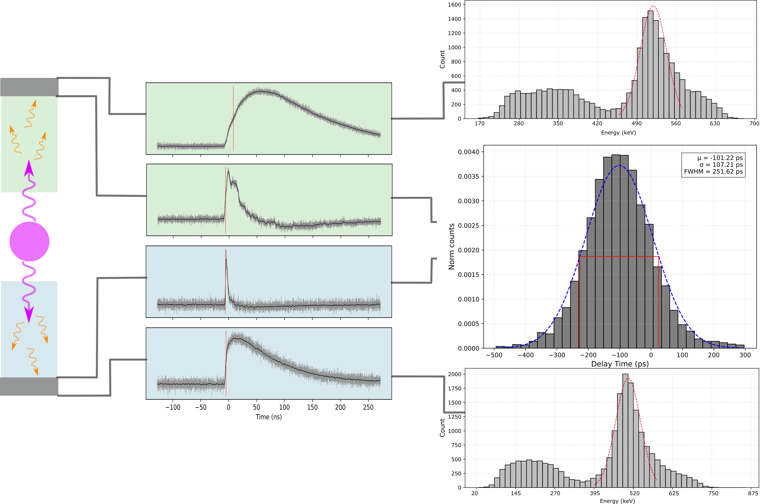
Coincidence Time Resolution

Slide 26
Coincidence Time Resolution

Slide 27
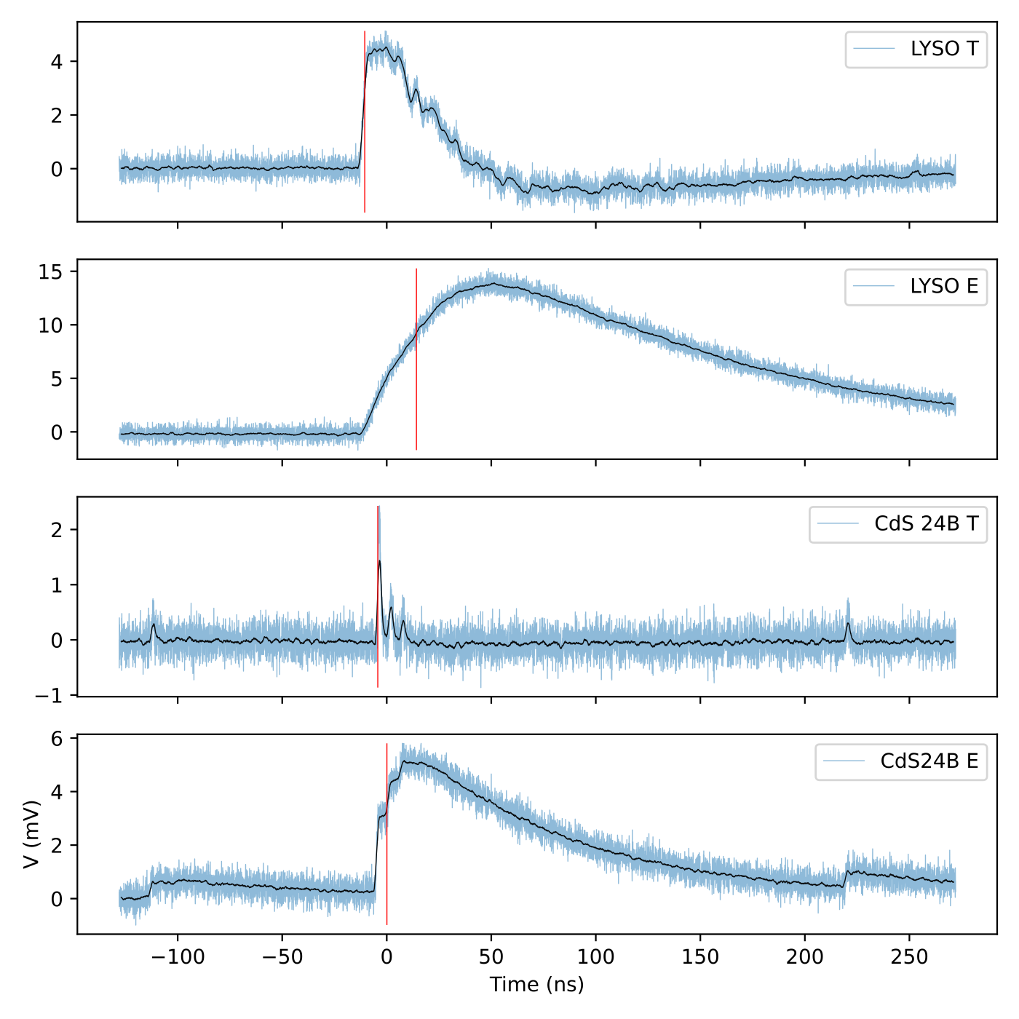
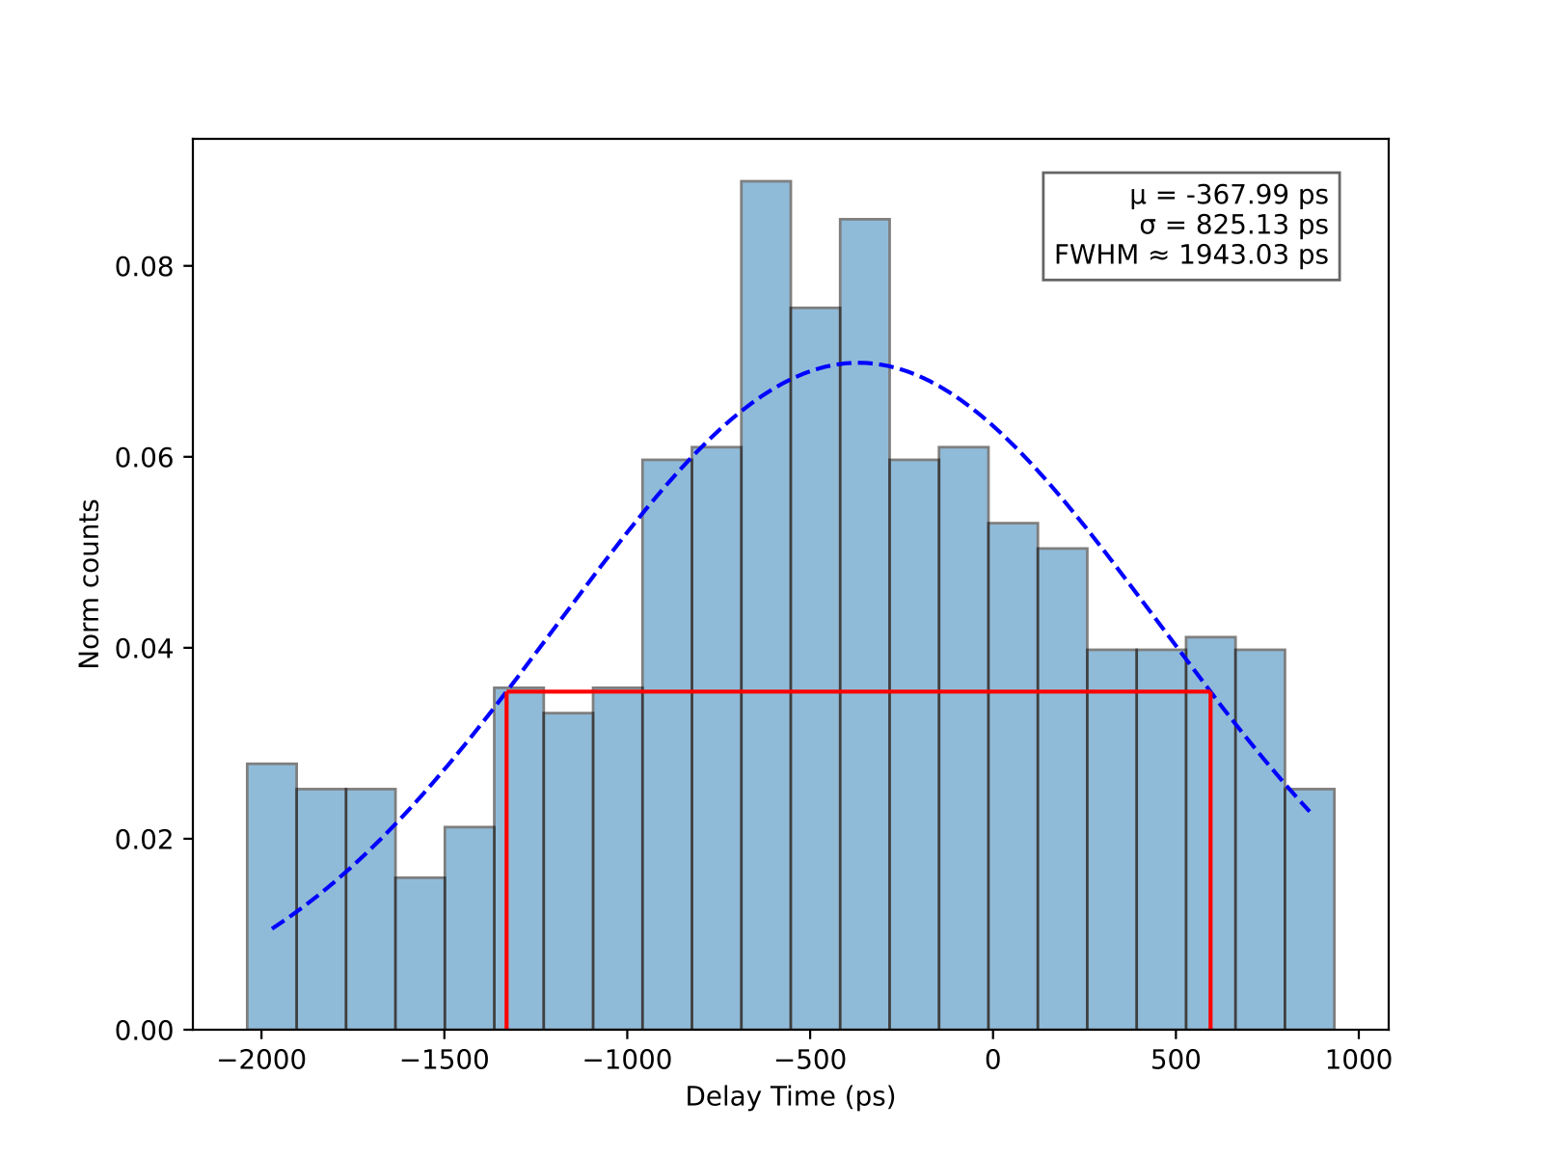
Coincidence Time Resolution: LYSO-CdS

Slide 28
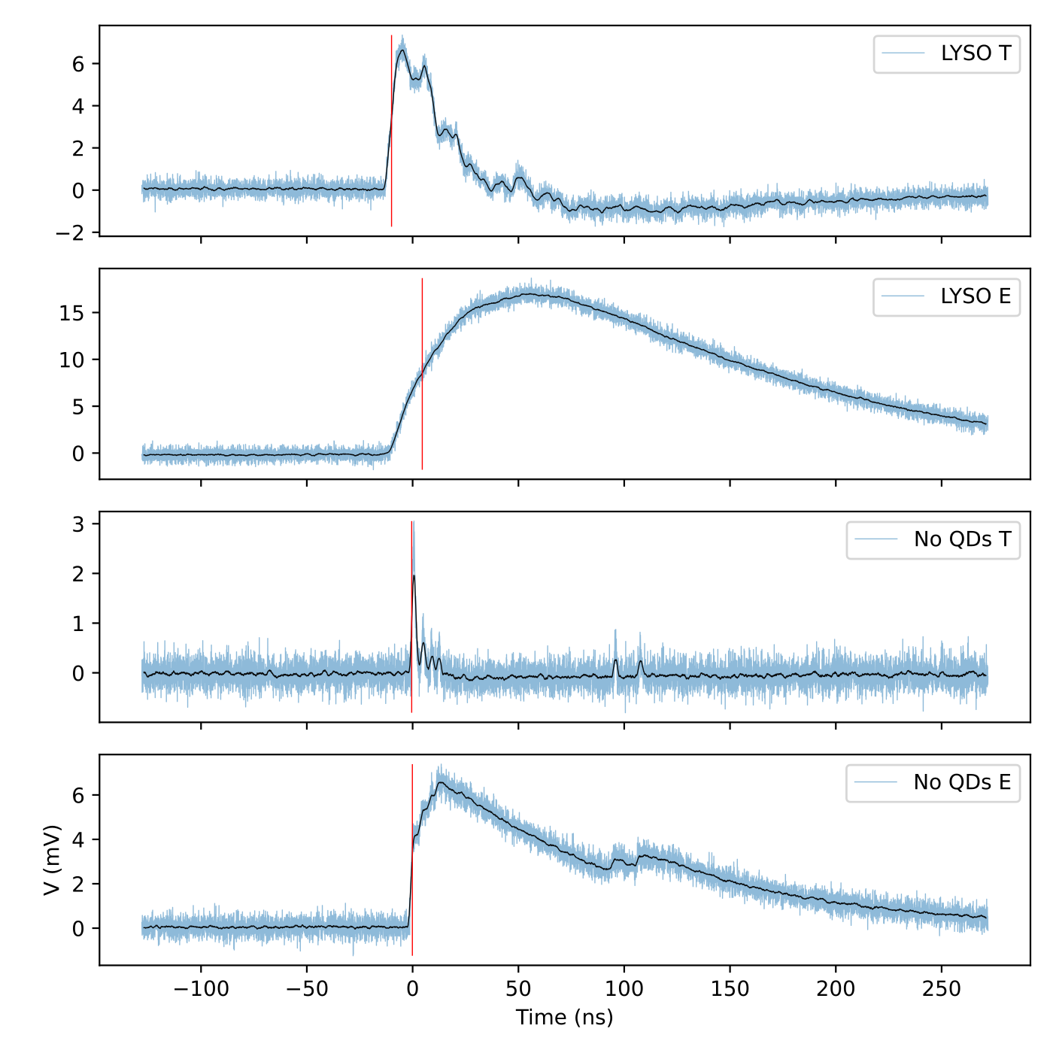
Coincidence Time Resolution: LYSO-Background

Slide 29
Conclusions
Increased absorbance with wt.% CdS
CdS induced red-shift in PL
No gamma excitation
Questionable surface X-ray excitation

Slide 30
Next Steps
Emission spectrum of NCs
PPO/POPOP doping
Urethane matrix
Quantum dots

Slide 31
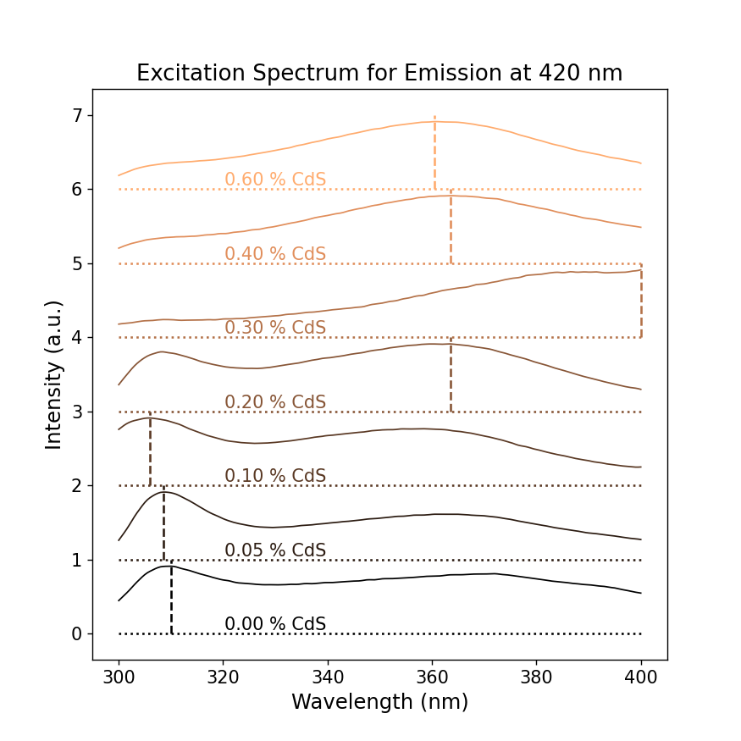
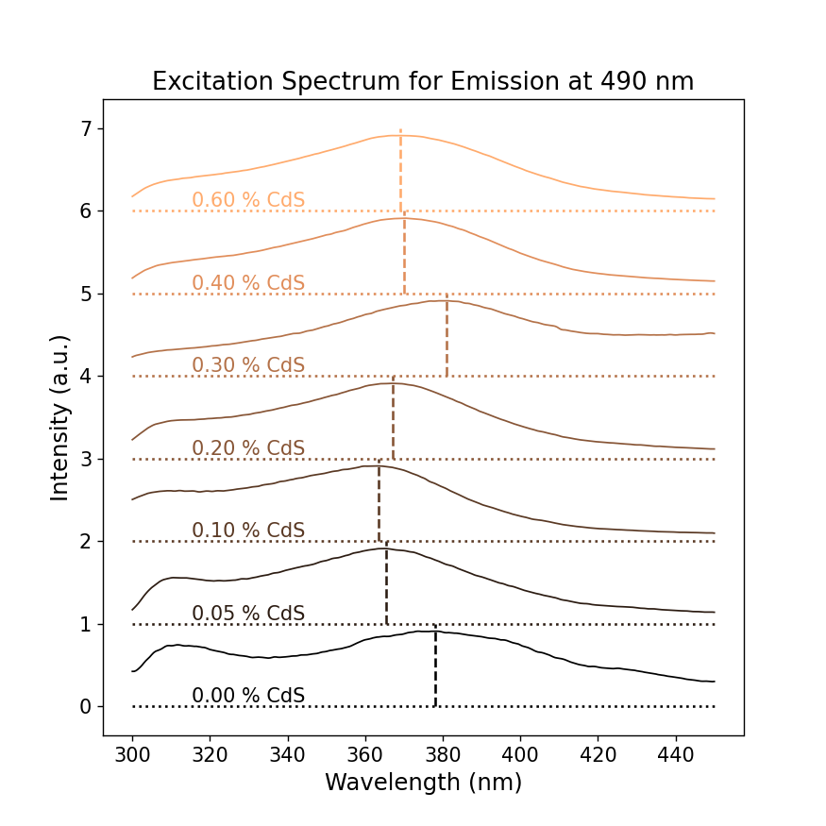
Excitation spectra for CdS samples

Slide 32
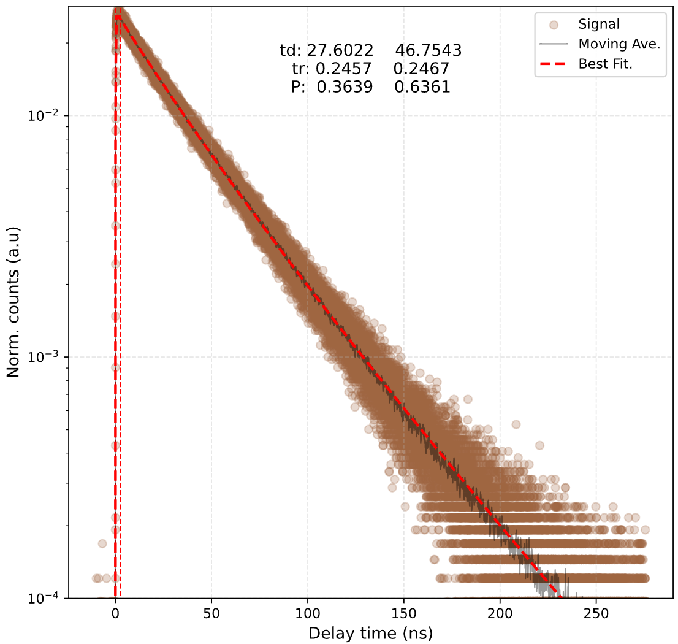
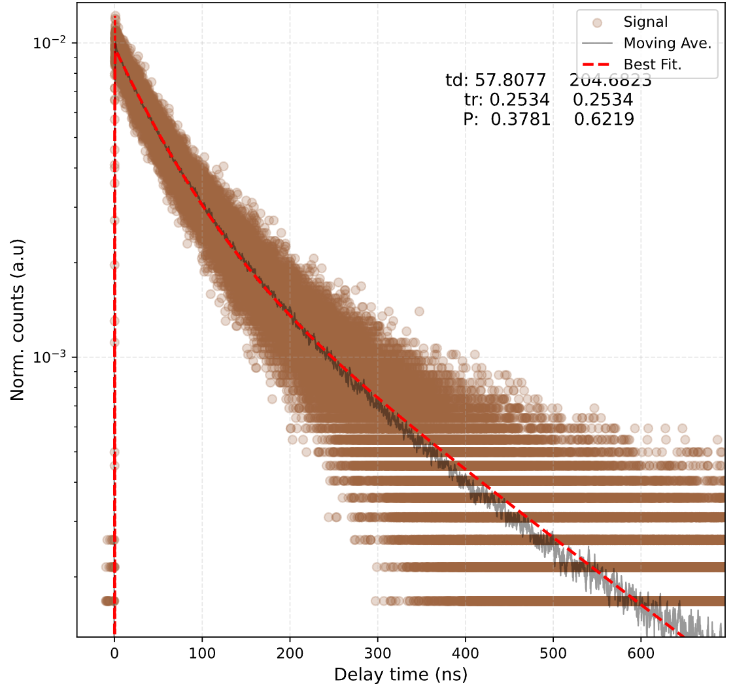
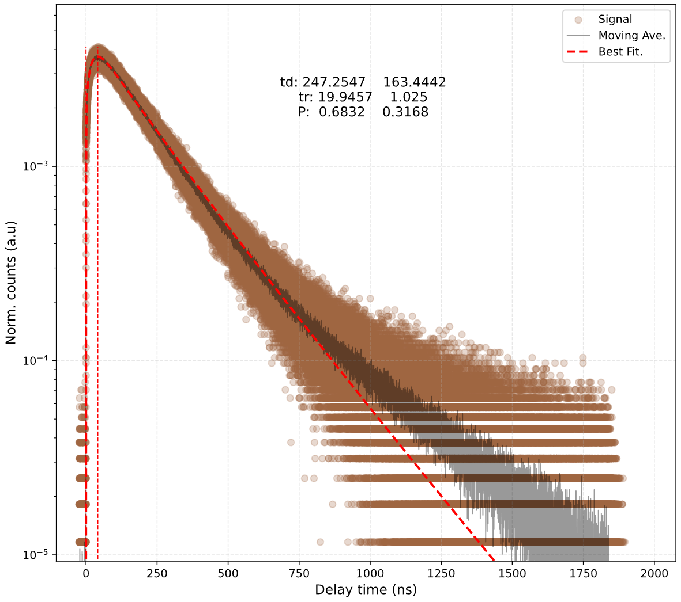
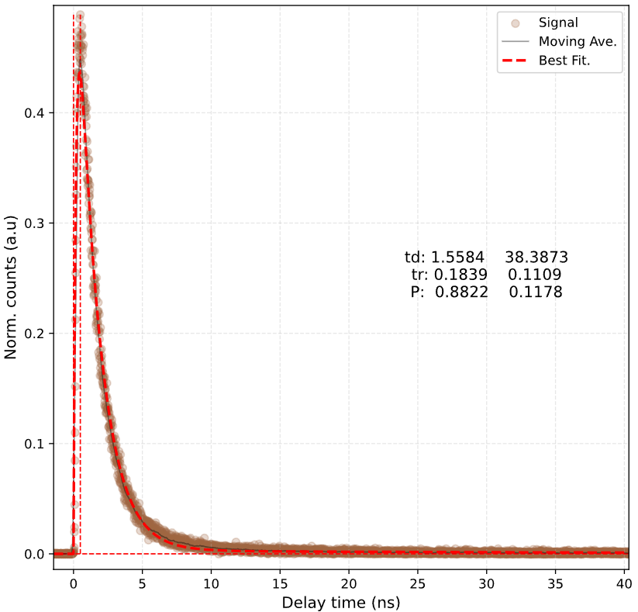
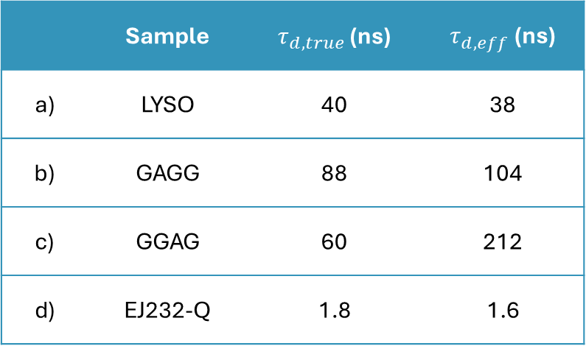
TCSPC – Standard Samples
a)
b)
Effective decay times
 | Sample | $τ_{d,true}$ (ns) | $τ_{d,eff}$ (ns)
a) | LYSO | 40 | 38
b) | GAGG | 88 | 104
c) | GGAG | 60 | 212
d) | EJ232-Q | 1.8 | 1.6
c)
d)

