Slide 1


Machine Learning in MinPET
Tim Brooks, Nicholas Connell
University of Johannesburg
SAIP 2025 Conference

Slide 2
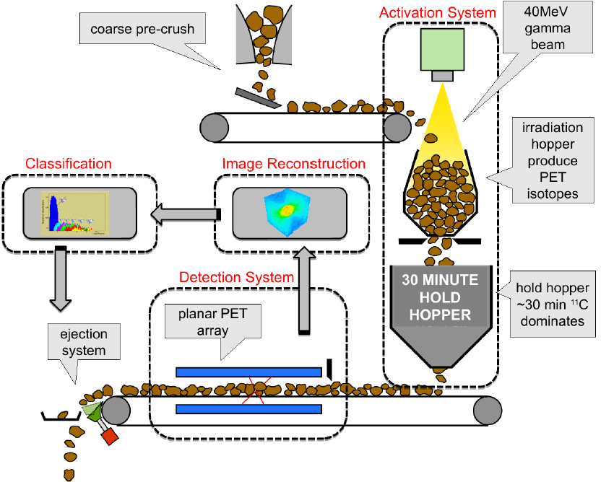
MinPET Overview

Slide 3
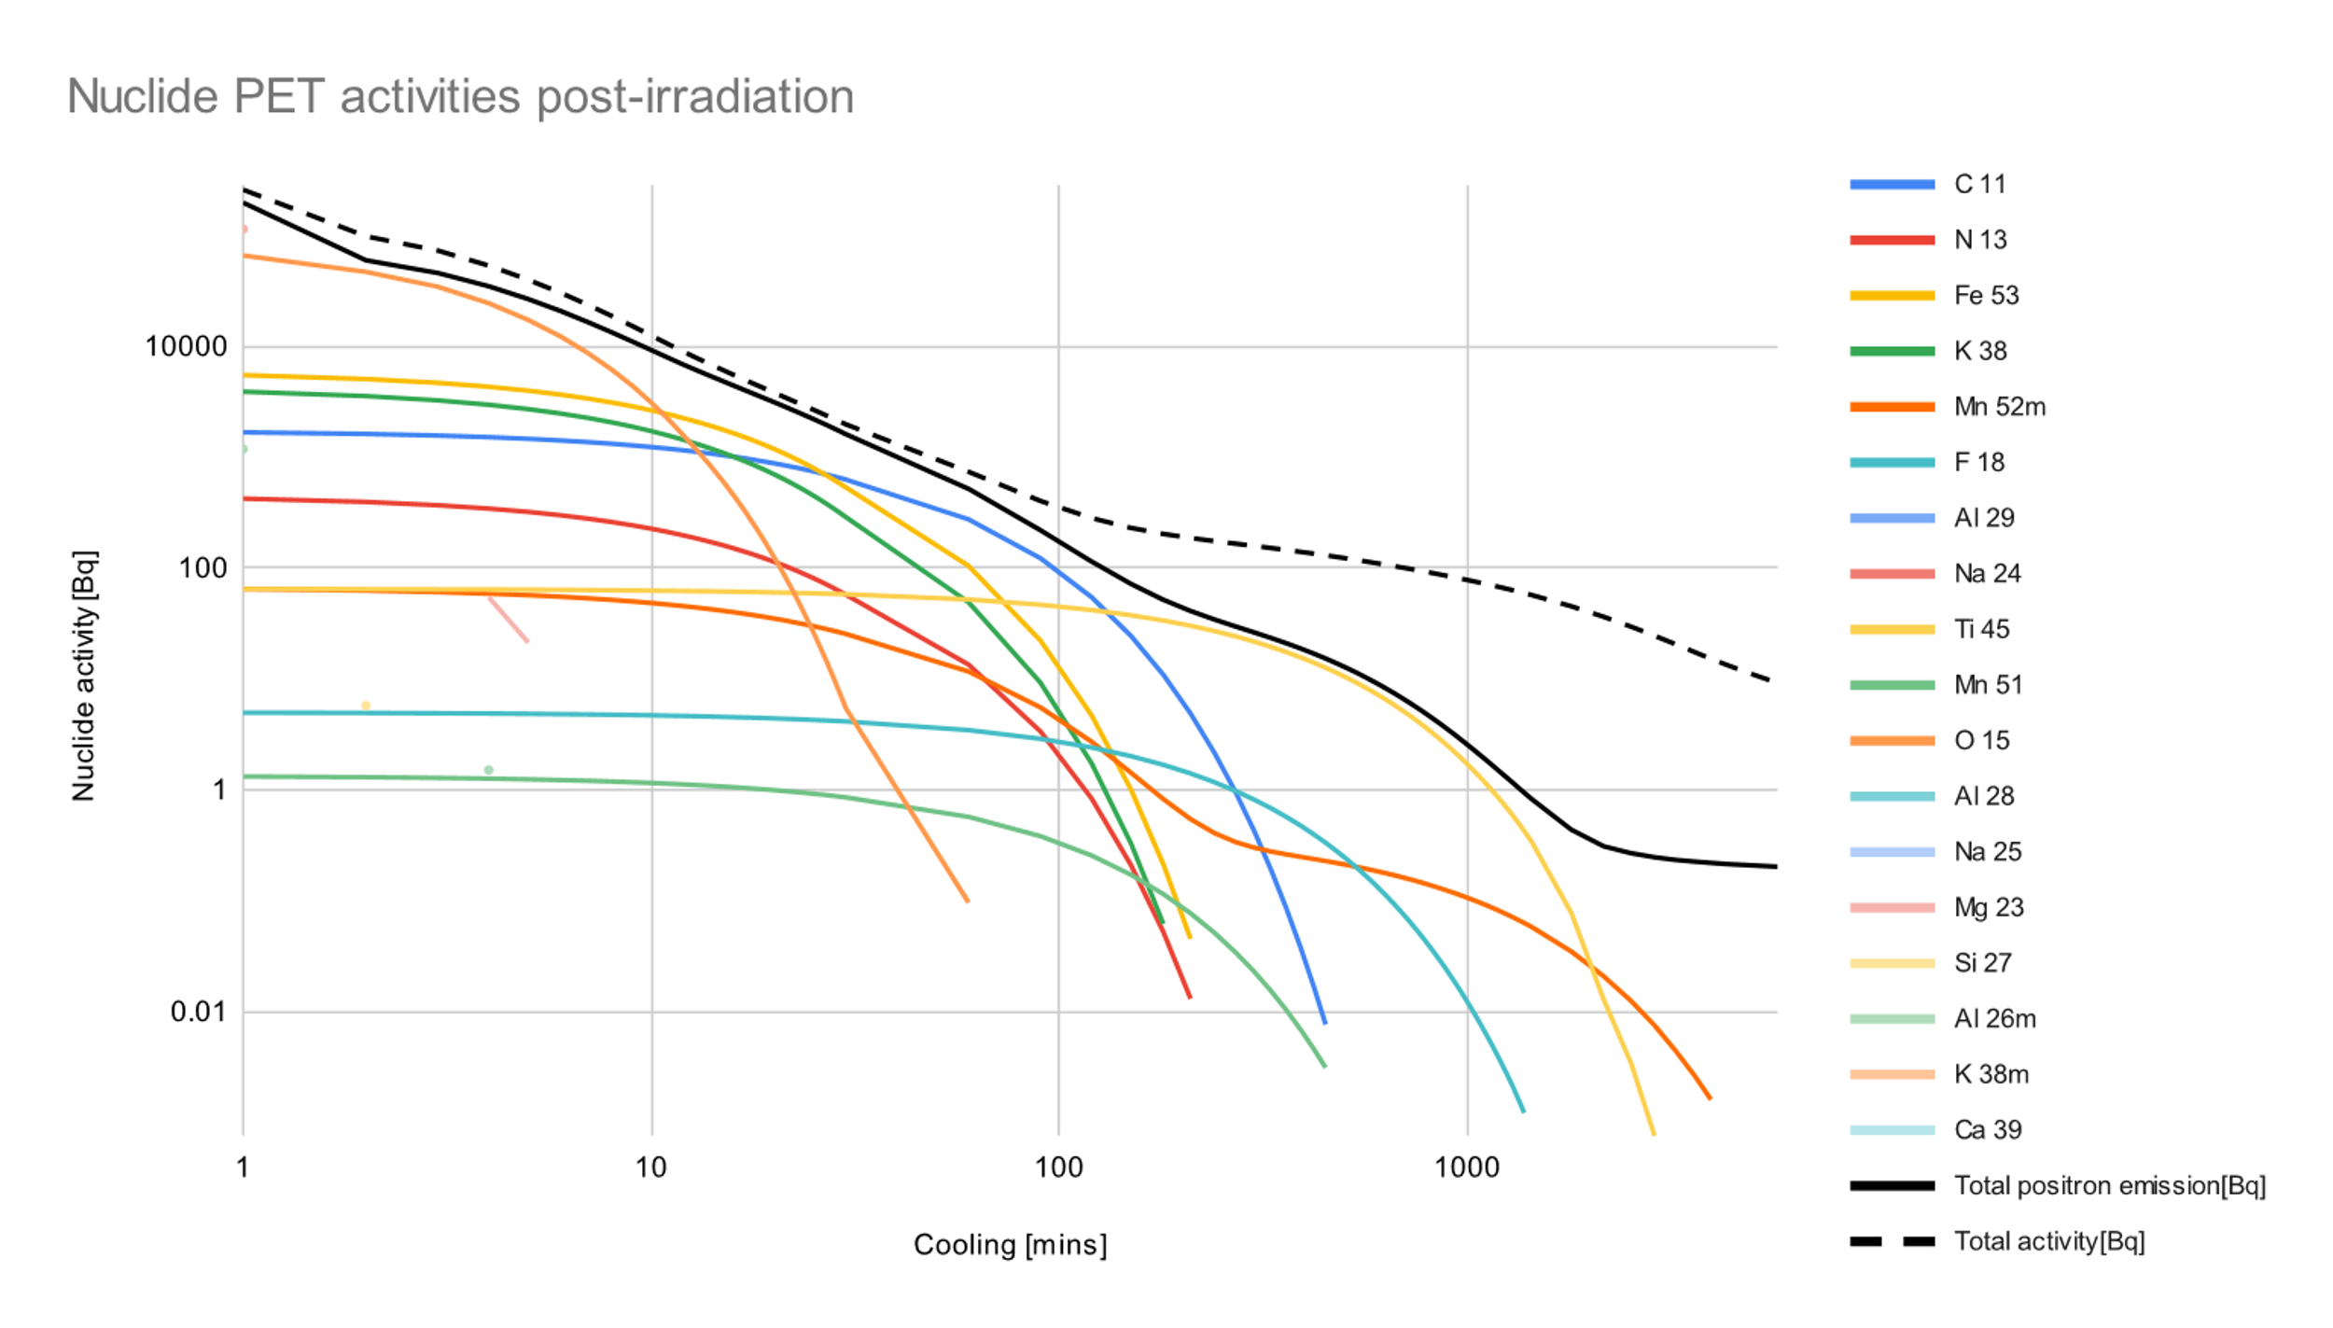
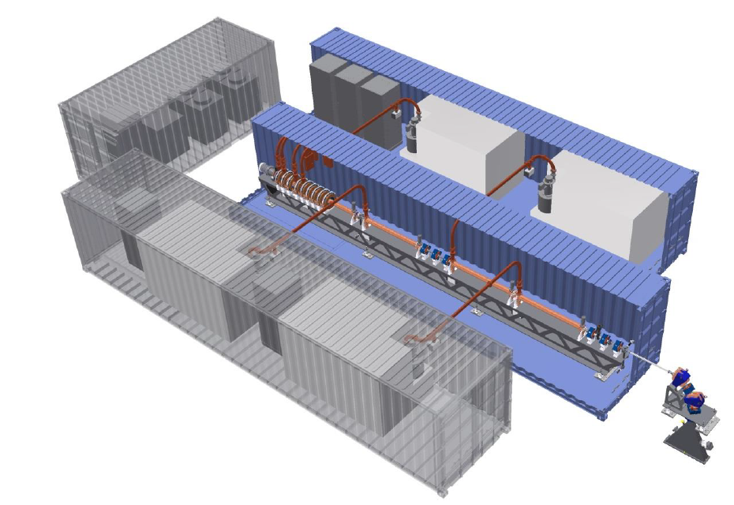

Material activation
Activate ¹²C-(γ,n)->¹¹C on Giant Dipole Resonance with photons above 20MeV.
Wait for other radionuclides to decay for 30min.
Optimum accelerator design at 40MeV with 200kW power.
Technology partner:

Slide 4
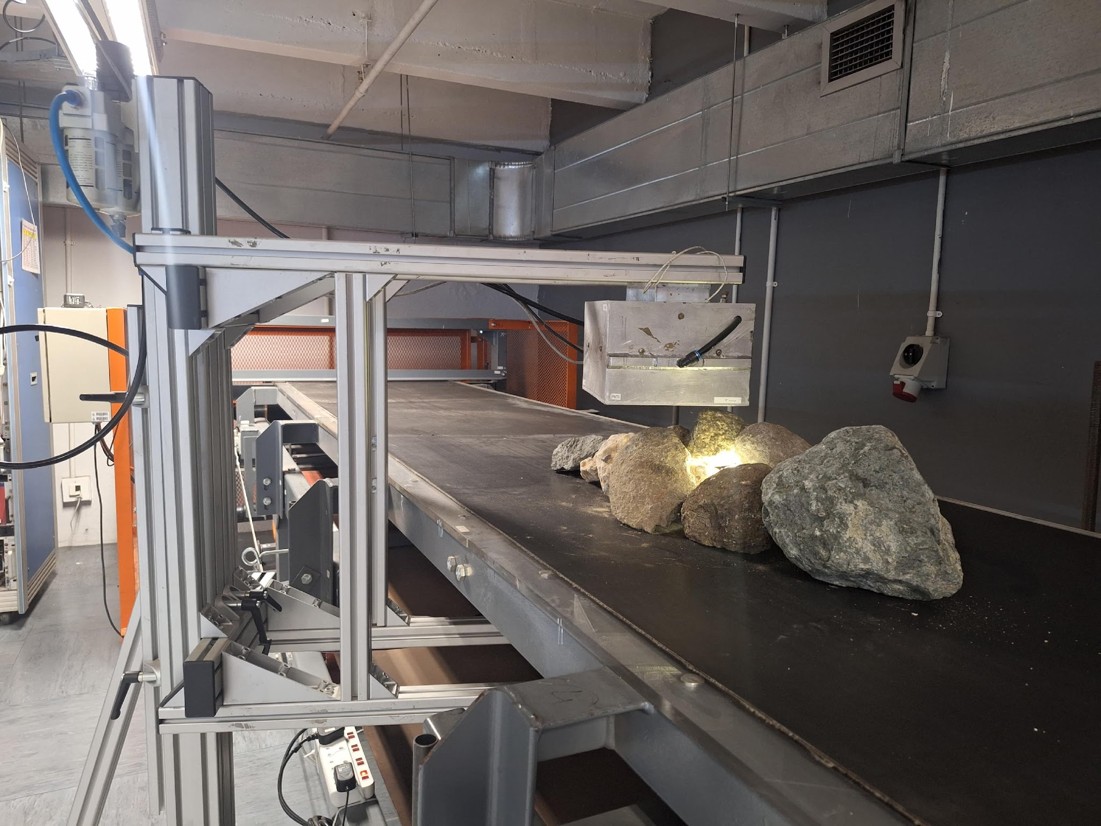
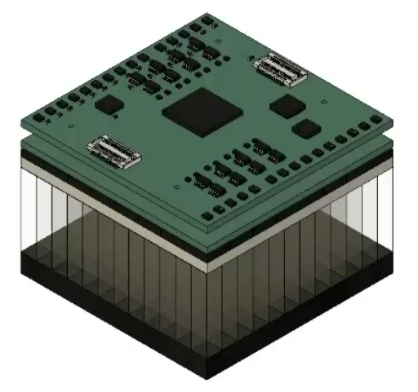
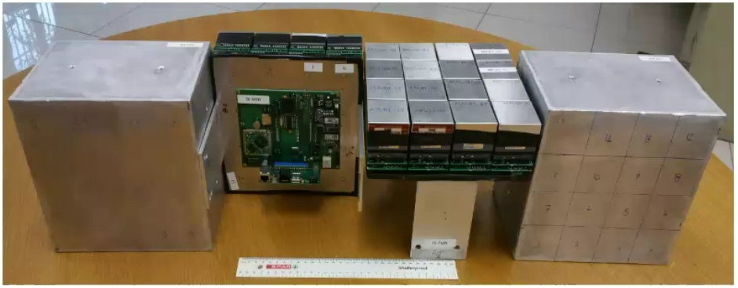

Detection
Coincident photon pairs imaged by planar BGO detectors above and below.
Multiple generations of detector prototypes building maturity.
Reconstruct source distribution from ~1 Million photon pairs per rock
Technology partner:

Slide 5
Collaboration
Other collaborators working on verification of accuracy and fidelity of sims in Geant4
  Tiego Mpai working on quantifying efficiency of detectors through simulation and experiments.
  Thendo Nemakhavni (Gideon Bentum and Timothy Brooks) working on quantifying presence and activity of radiological species in active kimberlite and ensuring diamond damage is undetectable.
  Professional geologist hired to quantify abundance of minerals in kimberlites to build correct kimberlite material in simulation.
  Sergio Ballestrero, Martin Cook, PhD, developed simulation code, verified via experiments on diamond-spiked kimberlite rocks.

Slide 6
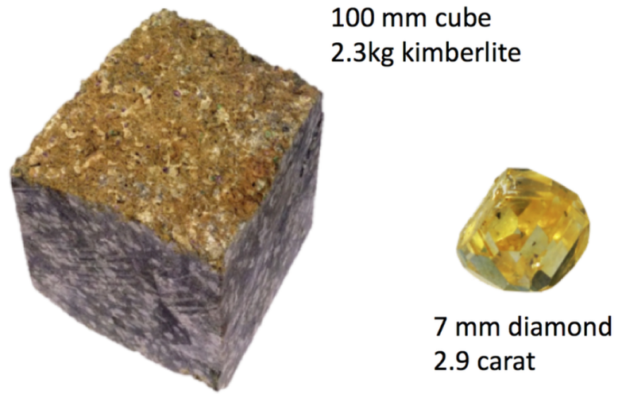
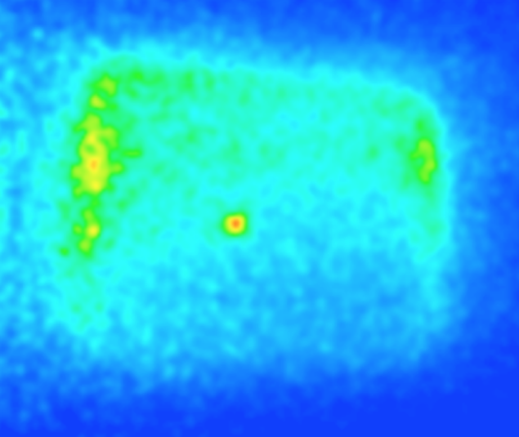
Problem Statement
Identify and separate kimberlite rocks that contain diamonds for further processing from a stream of PET activated rocks.
The goal is to process over 230 kg of kimberlite every second.
Impossible for one human worker.
Financially non-viable for enough human workers.
We show that it is possible to automate distinguishing between rocks with and without diamonds with computer vision and discuss next steps.

Slide 7
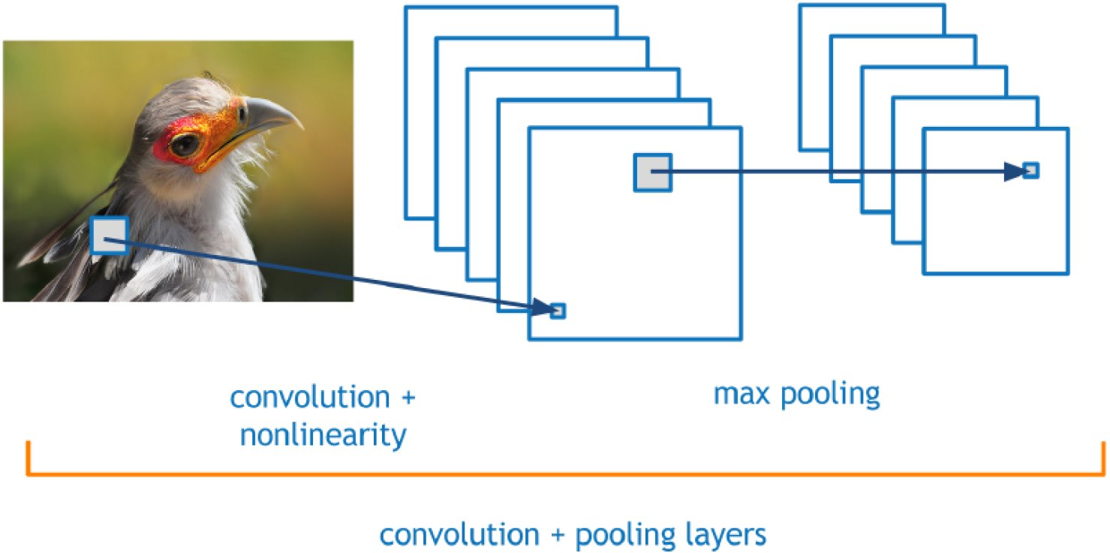
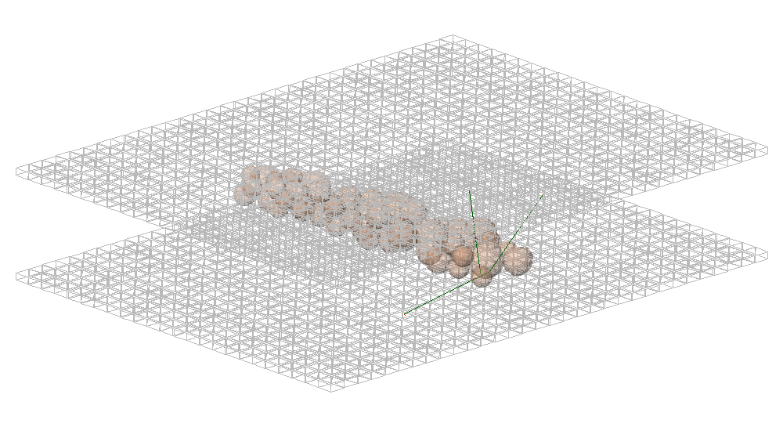
Proposed Solution
Decision making with Convolutional Neural Networks:
  Were designed for analysing image data;
  Are the bleeding edge of image processing;
  Are Fast and Scalable;
  Can achieve high accuracy;
  Are easy to implement with community backed Python Libraries
Data Synthesis with Geant4 Simulations
  Uses Monte-Carlo simulation technique;
  Designed, used, and maintained by Physicists at CERN, Switzerland;
  Can quickly generate tens of thousands of synthetic data samples, where the truth is known and all the simulations are mutually independent.

Slide 8
Methodology:
Data Synthesis:
Each simulation contains 1 kimberlite sphere of 10 cm diameter and 1 diamond sphere placed at random in the kimberlite;
Training data contains 3000 sims where the diamond's diameter is chosen at random from 0 to 1.5 cm;
Test data contains 3000 sims for test data: 300 of the sims have 0.1 cm diamond, 300 have a 0.2 cm diamond, …, 300 have a 1 cm diamond;
The Detector array is approximately 1.6 m x 1.2 m containing BGO crystals with a pitch of 0.42 cm.
The Belt speed is 1m/s.
The Electron Flux is uniform at 2.8086 electrons per cm^2
Simulation Output Data comprises coincident pairs of gamma photons
Data Preparation:
Reconstruct images using ASTRA toolkit in python to run our custom MLEM algorithm.
Denoise images with a gaussian filter with std = 1 and kernel = 6 mm^3.
Rescale image voxel values to [0,1], using global max and min of the dataset.
Sample cubes of size 4.2 cm, 20 with the diamond, 20 without diamond, from each image.
6000 diamond containing cubes and 6000 barren cubes for training and testing.
Notes:
Independence of monte carlo simulations ensured by randomized seed values generated and passed to Geant4 at run time.
Barrenness of cubes was ensured by setting the minimum distance between the cube centre and diamond centre to Half the leading diagonal of the cube (approx 36.4 mm) + radius of the diamond + 92 mm.
Gauss filter has sigma = 1, radius = 1 vox = 2 mm

Slide 9
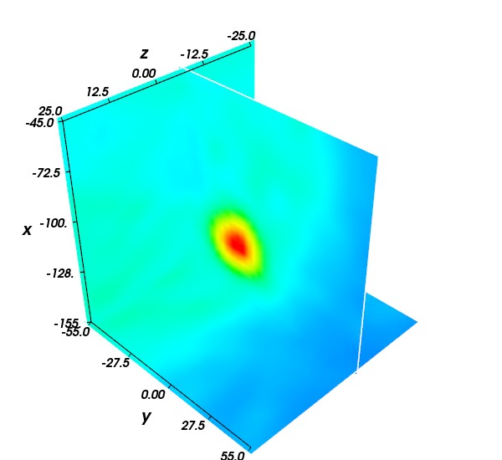
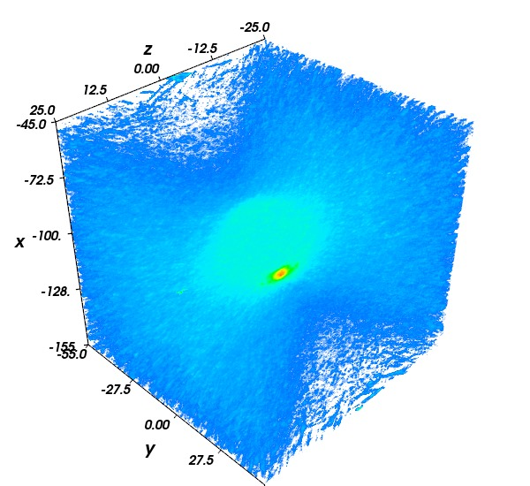
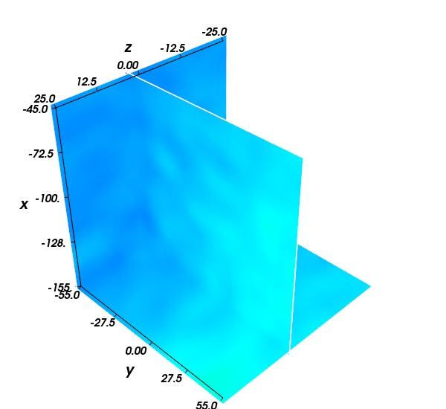
Diamond
Block
Example of a reconstructed PET image with a 10mm diameter diamond
Barren
Block

Slide 10
CNN Architecture
Layer | Type | Conv. Filters | Window size | Step Size | Activation | Output size
Input | Average pool | N/A | 2x2x2 | 2 | None | 11x11x11x1
2 | Convolution > Max pool | 64 | 3x3x3 | 1 | ReLU | 10x10x10x64
3 | Convolution > Max pool | 128 | 3x3x3 | 1 | ReLU | 9x9x9x128
4 | Convolution 2x > Max pool | 256 | 3x3x3 | 1 | ReLU | 8x8x8x256
5 | Convolution 2x > Max pool | 512 | 3x3x3 | 1 | ReLU | 7x7x7x512
6 | Convolution | 64 | 2x2x2 | 1 | ReLU | 6x6x6x64
Final | Convolution | 1 | 6x6x6 | 1 | Sigmoid | 1x1x1x1
Optimizer: Adadelta
Loss Function: Binary cross entropy
Input size: 21x21x21x1
Notes:
ReLU activation preserves gradients during training.
Sigmoid activation good for putting
Adadelta starts with LR=0.001

Slide 11
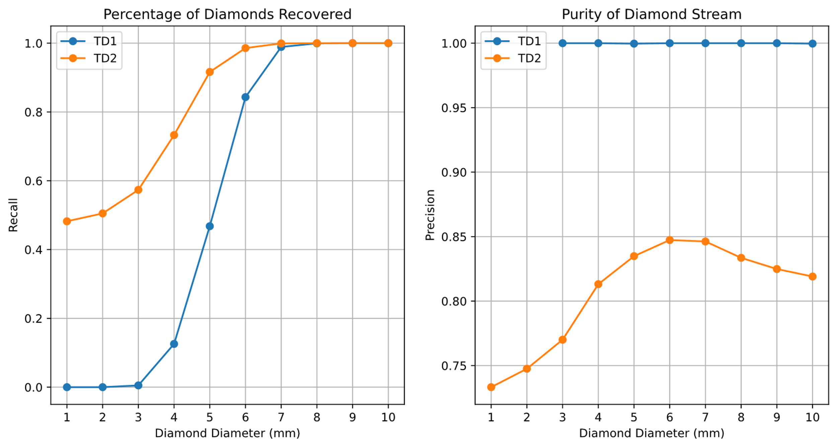
Experimental Results
Training dataset 1 (TD1):
4000 examples of diamonds from 5 to 15mm (and 4000 barrens)​
Training dataset 2 (TD2) :
contains TD1 plus 2000 examples of diamonds under 5mm (and an extra 2000 barrens)

Slide 12
Results Discussion
You can train an AI to identify PET activated rocks that contain a diamond
CNN trained on TD1
  missed at least 50% of diamonds 5mm and under
  achieved an extremely high purity (only 3 false positives)
CNN trained on TD2
  Identifies at least 90% of diamonds 5mm and over, and at least 50% of diamonds under 5mm
  Purity always worse 85%
Diamonds >3mm fade into the background
  Centroid finding algorithms can't find the majority of them (only 30% or less)
  TD2 has hundreds of blocks with diamonds >3mm that may confuse the CNN algorithm
A greater number and variety of diamond and barren blocks can improve performance
  TD2 has 2000 extra barren blocks and several hundred blocks with diamonds >4mm may have improved

Slide 13
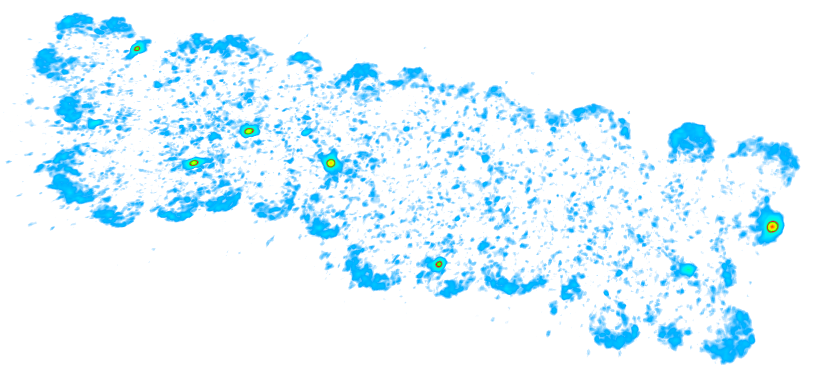
Future Work:
Increase simulation complexity
  More rocks on the belt with greater variance in shape and size
Gather more information from the PET images
  Location, size, and shape of diamonds to aid ejection and extraction
Improve reconstruction and image quality
  Scattering and attenuation degrade image quality and complicate the identification of smaller diamonds
diameter > 8 mm
diameter approx. 6 mm
PET image reconstruction of a bed of kimberlite rocks with ten diamonds. Notice how the smaller diamonds blend in with the background.

