Slide 1
Synopsis of the prototype parabolic trough
Phil Ferrer
Khaled Mohammad
University of the Witwatersrand

Slide 2
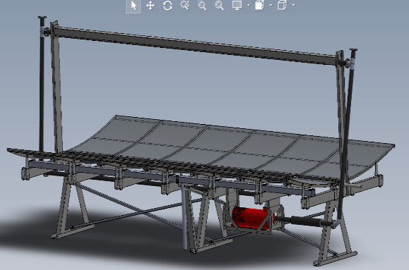
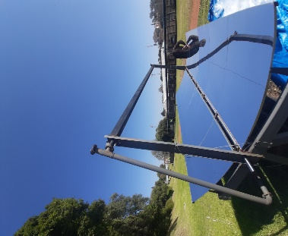
Custom Parabolic Trough System: Design, Collaboration & Operation
What is a Parabolic trough?
Specialized mirror structure (Diemaster industry)
Precision manufacturing in physics workshop
Tilting capability: Up to 45°
Closed-loop oil circulation
Vacuum system minimizes convective losses.
Real-time monitoring via IoT

Slide 3
Key Parameters of the Prototype
Name | Value | Description
L | 4.42 m | Receiver Length
a | 2.4 m | Aperture Width
f | 1.3 m | Focal Length
δ | 0.3 m | Trough Height
ψ | 45° | Rim Angle
d₁ | 0.056 m | Absorber Pipe (Inner)
d₂ | 0.06 m | Absorber Pipe (Outer)
d₃ | 0.08 m | Receiver Cover (Inner)
d₄ | 0.084 m | Receiver Cover (Outer)
R_{col} | 0.88 | Mirror Reflectivity (Visible)
R_{cavity} | 0.9 | Cavity Reflectivity (IR)
I_{o} | 900 W/m² | Solar Irradiance
θ | 0.0 | Incident Angle
ṁ | 0.2 kg/s | Mass Flow Rate
C_{P} | 2288.6 J/kg·K | Specific Heat (Genheat 22)
μ | 1.155×10⁻³ kg/m·s | Viscosity (Genheat 22)
k_{oil} | 0.128 W/m·K | Thermal Conductivity
V | 1.5–2.6 m/s | Wind Speed

Slide 4
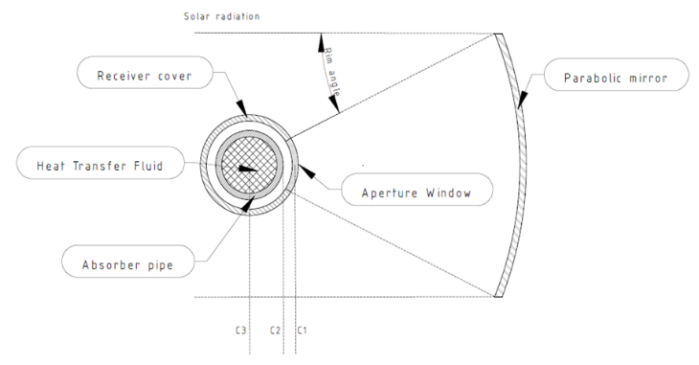
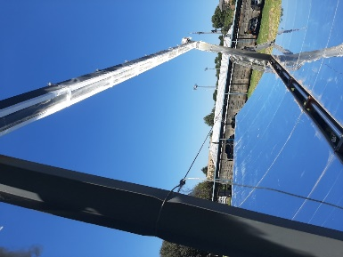
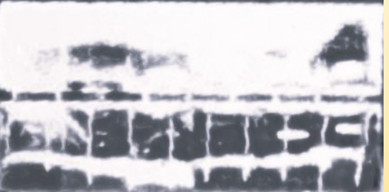
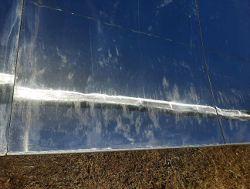
Mirrors and Optics
Mirror configuration functional, not optimized.
Windowed Receiver
Miro 4 (~95% reflectance)
Outdoor exposure led to damage
~19% optical reduction (surface damage)
Pixel analysis (~51% incident)
Total solar radiation efficiency at receiver: ~35% ± 4%.

Slide 5
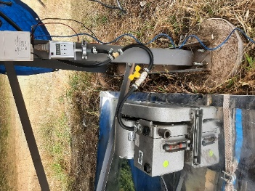
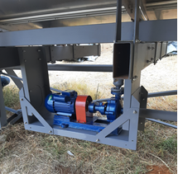
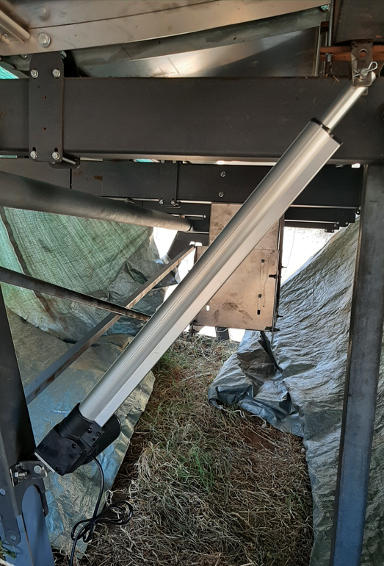
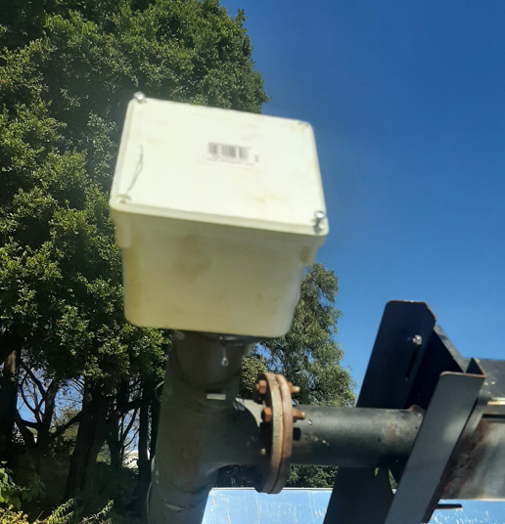
Pump Selection and IoT-Based Control System
Hebei Shenghui Pump Co., Ltd.
Max oil temperature: 350°C, Flow rate: 1.5 m³/h, Power: 0.75 kW, Efficiency: ~30%
Thermal oil: GENHeat 22, operating up to 255°C
Overflow system implemented
IoT-Based Control and Data Logging:
Web-based user interface connected to cloud database
Microcontrollers: HKD WEMOS LOLIN ESP32 (Wi-Fi)
Sensors (K-type thermocouples) inlet/outlet temp
Controllers for actuator, pump, and vacuum system
Data -> Google Firebase for real-time logging & control

Slide 6
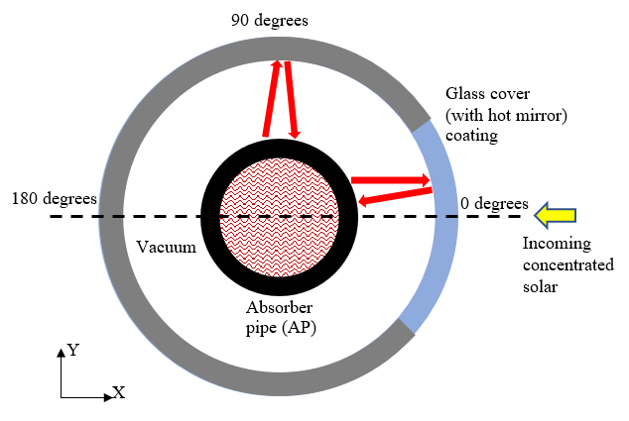
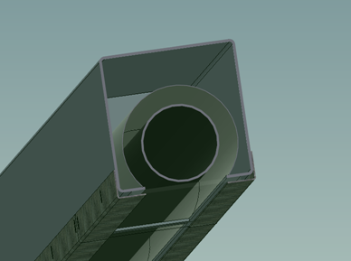
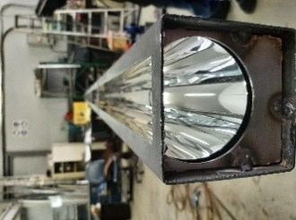
Receiver Design and Construction
Initial concept
Diemaster design
Physics workshop
Infrared mirror inset into housing;
Receiver pipe added concentrically and sealed with glass cover.
Borate silicate glass panels

Slide 7
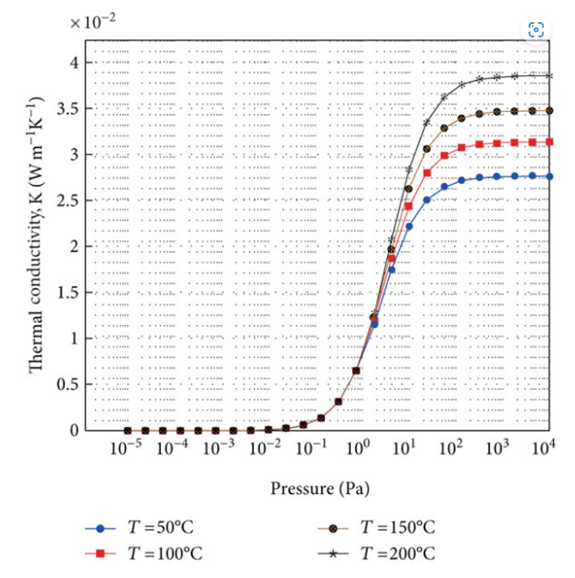
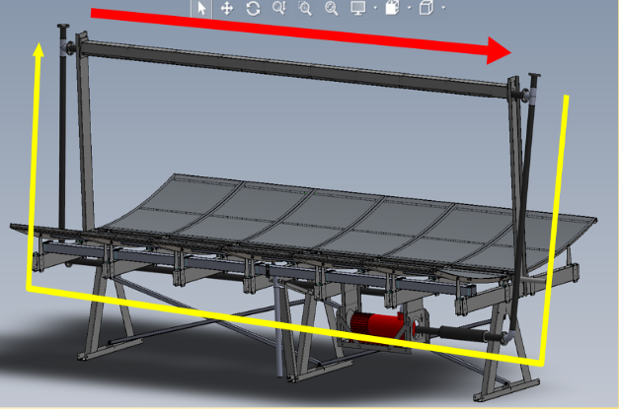
Theory: Heat Transfer in Solar Receiver Prototype
Prototype model similar
Vacuum levels insufficient (~10³ Pa) ->convective heat losses (ΔMODEL!)
HTF flows in a closed loop:
1) Receiver section (RED: heated by solar radiation).
2) Loop pipe (YELLOW: insulated return path).
Temp flow profile (HT coefficient U)

Slide 8
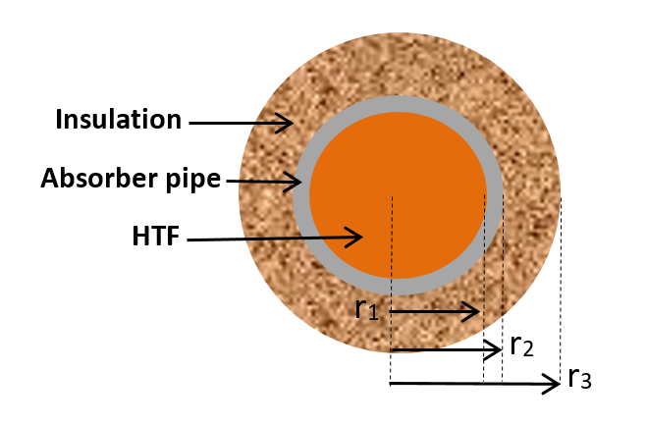
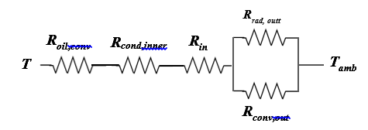
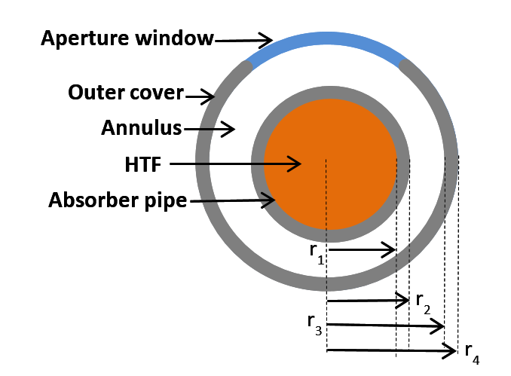
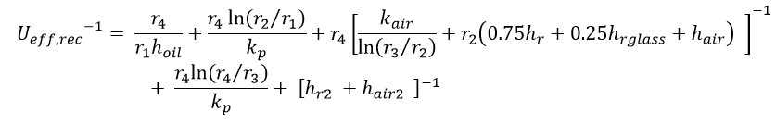
Heat Transfer Analysis: Receiver and Reconnection Pipe
R_{rad,ann}
R_{rad,outer}
R_{oil,conv}
R_{cond,inner}
R_{conv,ann}
R_{cond,outer}
T
R_{conv,outer}
T_{amb}
R_{cond,ann}

Slide 9
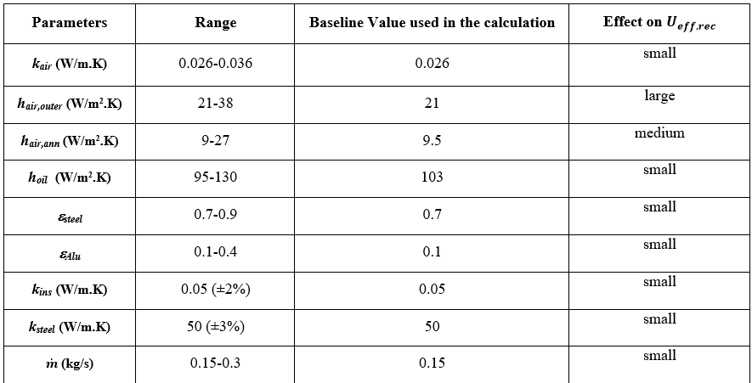
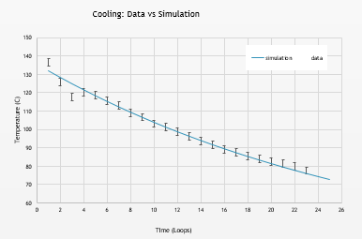
Cooling Cycle Analysis
Cooling cycle without solar input
HTF previously heated to ~136°C, circulated through receiver and loop pipe
Model temperature drop and heat loss
Parameters affecting heat loss
Curve fitting: U = 0.14 W/(m²·K), with R² = 0.98
T_{out}: 57°C, ~ measured value

Slide 10
Heating Cycle Analysis
Heating cycle (baseline)
HTF heated by solar radiation at receiver and loses heat through loop section
Mass flow rate ṁ = 0.15 kg/s
±10% solar input shown
Dip due to cloud cover

Slide 11
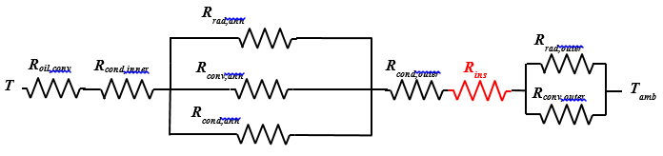
Impact of Thermal Insulation on Receiver Heat Loss
Convective losses: key factors
Insulation reduces surface temp and convective losses.
Insulation: cost-effective alternative to vacuum
Simulation results:
1 cm insulation: T_{out} = 37°C
2 cm insulation: T_{out} = 33°C

Slide 12
Impact of Vacuum Failure on Receiver Efficiency
Vacuum system achieved ~5 kPa, -> Convective heat transfer dominates
IR mirror reflectivity inside receiver high (but ineffective)
Total HTF heating efficiency from solar radiation: ~31% (~659 W/m).
Receiver heat retention efficiency: ~69% , ~89% (1 cm insulation), ~94% (2 cm insulation).
Efficiency approaches commercial units (e.g., PTR70 at ~95%).
Diminishing returns observed with increasing insulation thickness.

Slide 13
Conclusively…
OPTIONS:
Improve Vacuum system (cost, power, maintenance, performance)
Test insulation around receiver (may make IR mirror redundant)
Change direction (include thermodynamic cycle)

