Slide 1


Measurement of fundamental ion-atom interaction parameters for heavy ion beam materials analysis
Mandla Msimanga
Dept of Physics, TUT / IBA Division, iThemba LABS
SAIP 2025, 10 July, WITS University

Slide 2
Talk outline
Ion beams in materials research
Research problem
Measurement of collision parameters
  Stopping force (stopping power)
  X-ray production cross sections

Slide 3
Ion beams in materials research
Quite often the purpose of Ion Beam Analysis (IBA) in materials research is to
Identify
what atomic species are in a given sample ?
Quantify
how much of each is present ?
Give a depth profile
what is the depth distribution of the identified atomic species ?
There are a number of nuclear analytical techniques that are based on energetic ion beams from particle accelerators, each technique with its own particular advantage
The list includes PIXE, RBS, NRA, MeV SIMS, PIGE and ERDA
Prof M Msimanga, Physics Dept, TUT- 2025

Slide 4
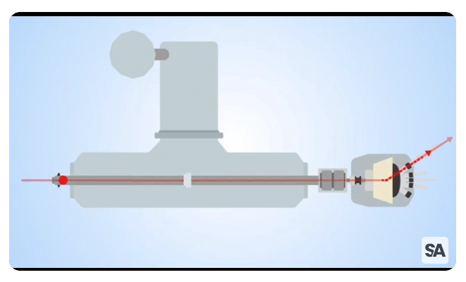
Instrumentation

Slide 5
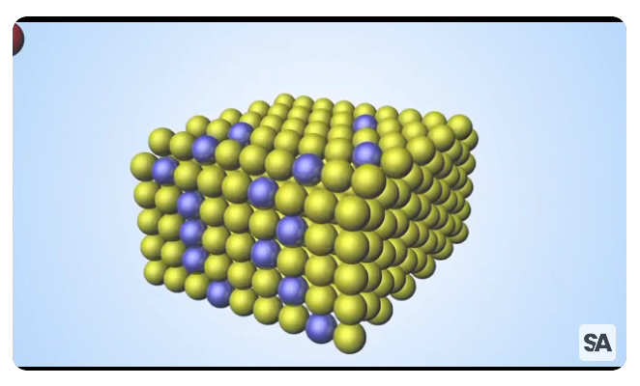
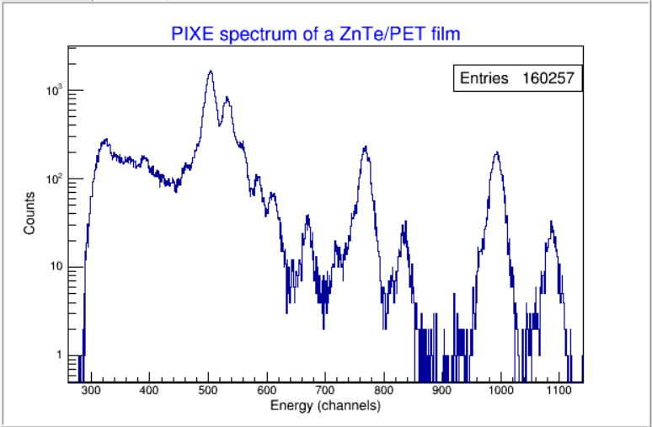
PIXE
Example of a PIXE spectrum of a ZnTe/PET film analysed using 2.4 MeV H⁺ ions
Te - L shell lines
Zn - K shell lines

Slide 6
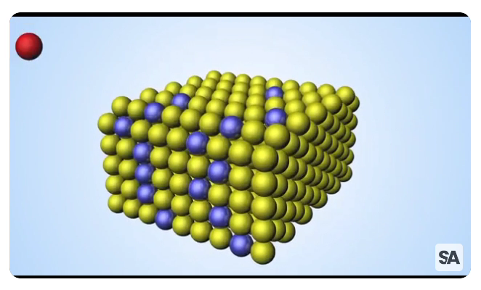
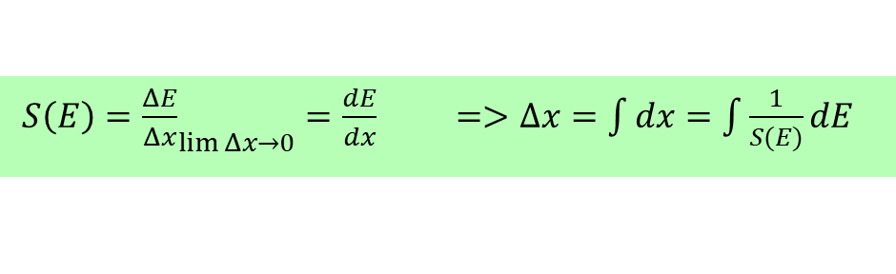
In RBS and ERDA………..
∆x
Knowledge of the energy loss rate facilitates film thickness measurement

Slide 7
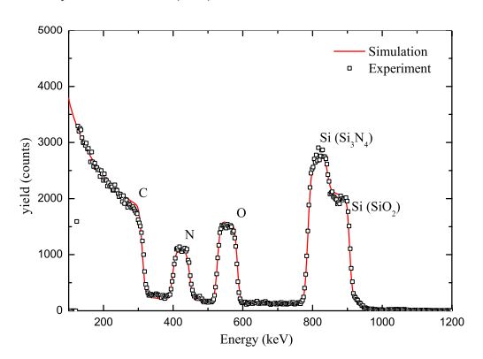
Example…….
SiO₂/Si₃N₄ film thickness measurement and stoichiometric analysis via RBS using 1.6 MeV He⁺ ions
SiO₂ (105 nm)
Si₃N₄ (75 nm)
Backing membrane

Slide 8
Research problem
Existing ion atom interaction theories fare quite well when the collision pair is highly asymmetric in terms of mass
Z₁ << Z₂
Pure Coulomb potential
Z ₁ ≤ Z₂
screening by orbital electrons cannot be neglected
➔Screened potentials

Slide 9
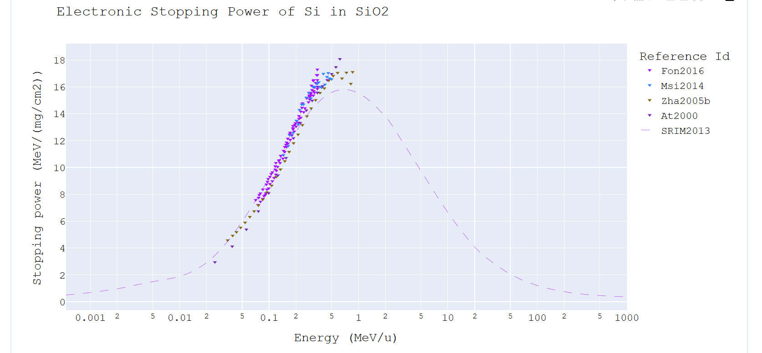
Research problem
Stopping force: Existing theoretical and semi-empirical formulations deviate by as much as 20 – 40% when it comes to predicting stopping force in heavy ion atom collisions
Electronic stopping force of Si in SiO₂
IBA energy region
https://www-nds.iaea.org/stopping/tuples/Si-SiO2

Slide 10
II. X-ray production cross sections: Theoretical predictions of heavy ion induced X-ray production cross sections are generally at variance with experiment, especially for Z₁/Z₂ ≥ 0.4 collision pairs
X-ray production cross sections σ_{X}(E) are required to calculate elemental concentrations from X-ray yields.
There is a need for accurate databases of S(E) and σ_{X}(E) values (among other factors) for accurate IBA data analysis
More experimental data for validation of theory/semi-empirical formulations, especially for heavy ions (i.e. Z > 6)

Slide 11
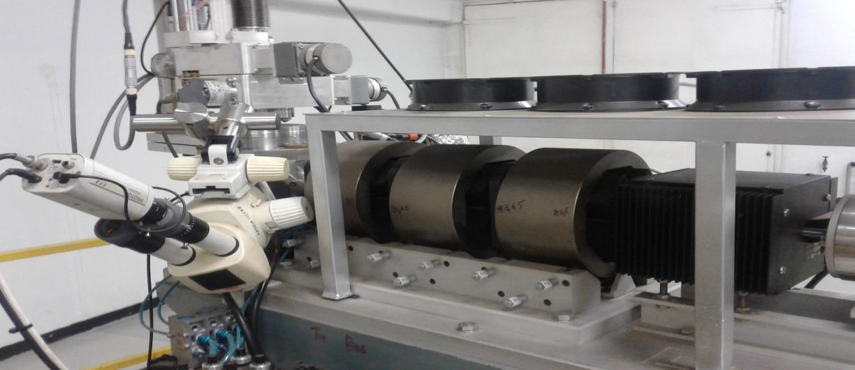
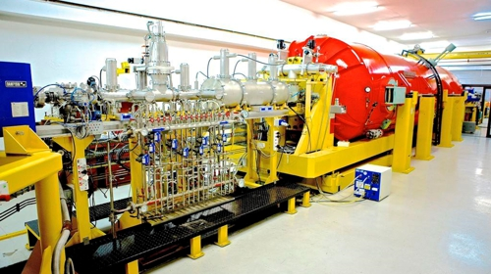
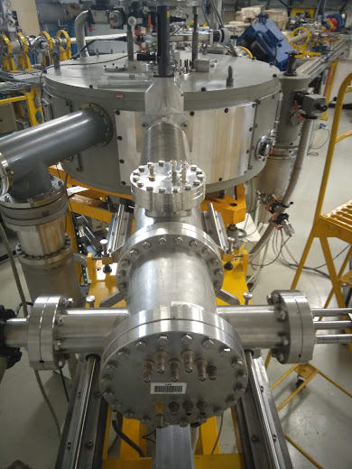
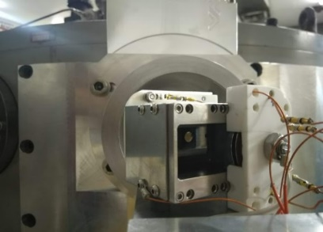
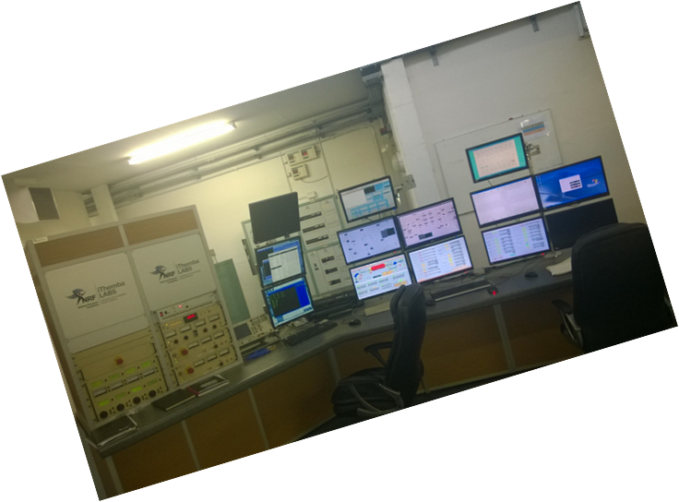
Measurement of heavy ion-atom collision parameters:
..centred around the 6 MV Tandem [High Voltage Engineering] at iThemba LABS TAMS
RBS.
PIXE
NEC Alphatross He ion source
860C SNICS ion source : H - Au
NMP chamber
Timing detector
control room
Heavy Ion – ToF ERDA
ToF-ERDA set up

Slide 12
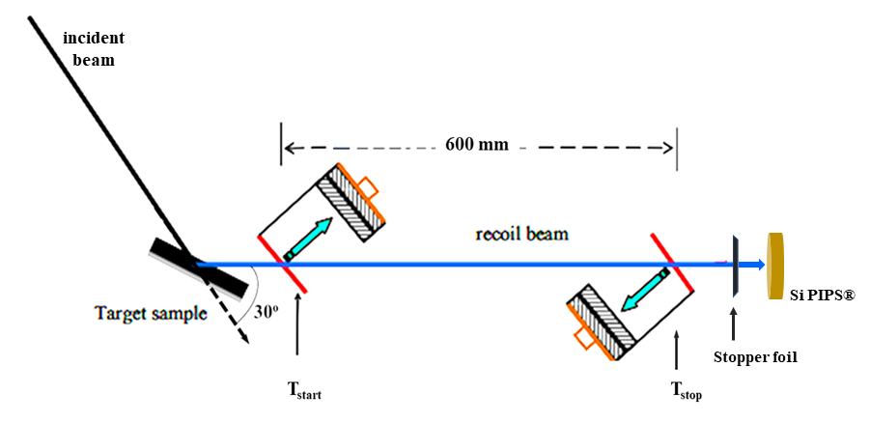
I. Heavy ion stopping force measurement for IBA applications
e.g. Au
Measurement of stopping force using Time of Flight spectrometry at iThemba LABS
e.g. SiO₂
e.g. Cu
T₁, T₂ – Microchannel Plate timing detectors

Slide 13
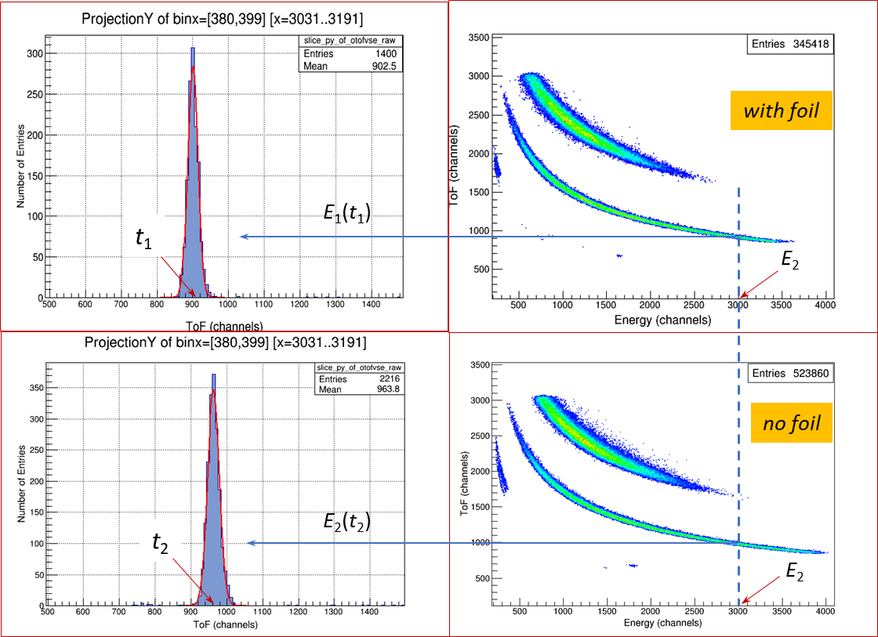
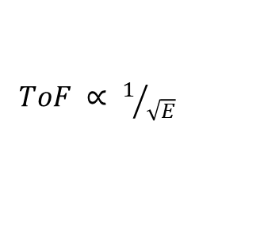
Measurement of stopping force using ToF spectrometry
ToF detector measures incident energy E₁, PIPS detector measures exit energy E₂
1
$ToF ∝ 1/{\sqrt{E}}$
2
ToF and recoil energy E are measured in coincidence

Slide 14
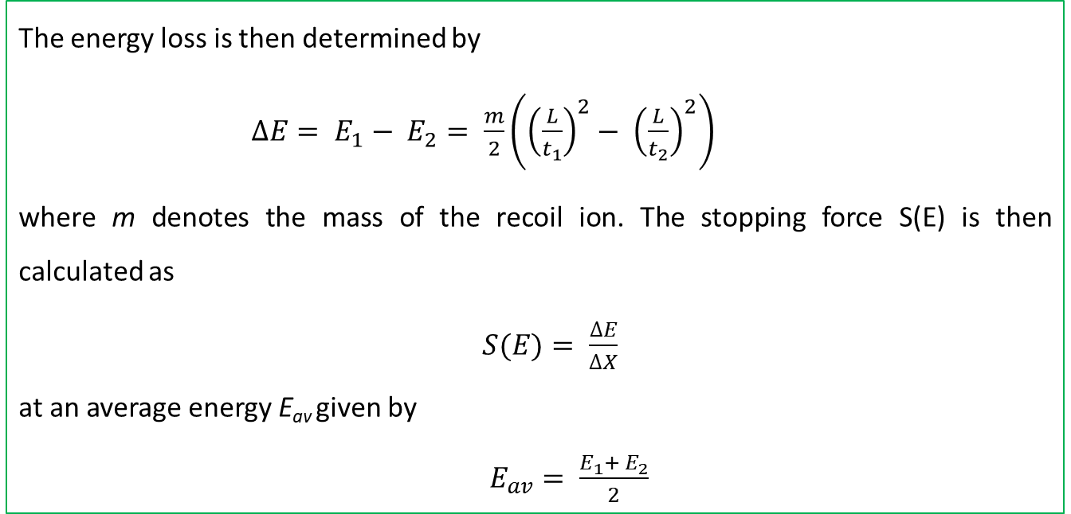
The energy loss is then determined by
$∆E= E_{1}− E_{2}= \frac{m}{2}\left({\left(\frac{L}{t_{1}}\right)}^{2}− {\left(\frac{L}{t_{2}}\right)}^{2}\right)$
where m denotes the mass of the recoil ion. The stopping force S(E) is then calculated as
$S(E)= \frac{∆E}{∆X}$
at an average energy E_{av} given by
$E_{av}= \frac{E_{1}+ E_{2}}{2}$
ToF projections are continued along the energy axis to give a continuous stopping force curve

Slide 15
Comparison with theory
Experimental data is compared to predictions from:
SRIM
  Stopping and Range of Ions in Matter (www.srim.org)
DPass
  Binary Stopping Theory (www.sdu.dk/DPASS)
CasP
  Convolution approximation for Swift Particles (http://www.casp-program.org/)

Slide 16
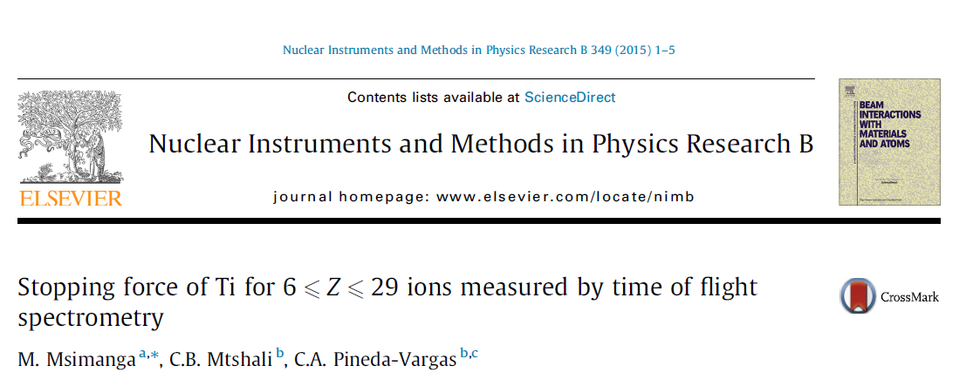
Some results from iThemba LABS…..
Stopper foil -> Ti

Slide 17
Results………..
Carbon
Oxygen
Magnesium
Copper

Slide 18
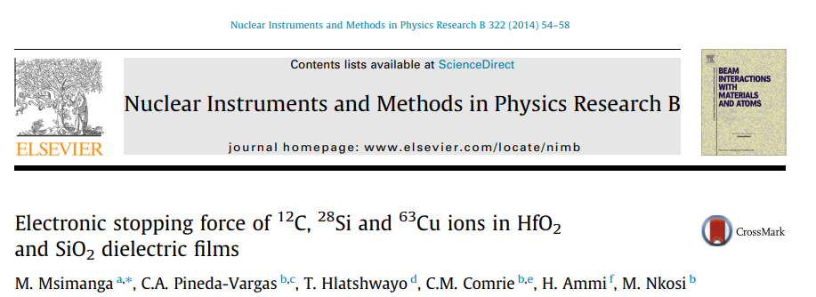
Stopper foils -> SiO₂ and HfO₂

Slide 19
Stopping force through the backing Si₃N₄ membrane
2015
2013
2007
from Barradas et. al NIMB 360 (2015) 90-96,
IAEA Coordinated Research Project

Slide 20
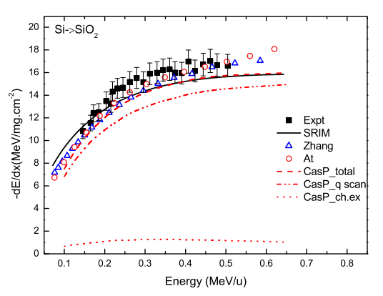
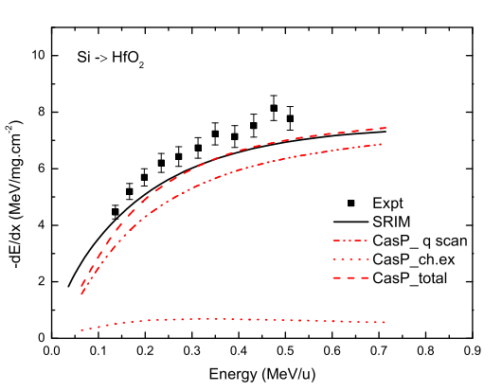
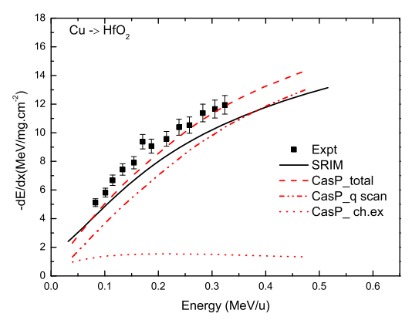
Stopping force measurement results for Si and Cu ions
Data now part of the IAEA stopping force database
https://www-nds.iaea.org/stopping/tuples/Si-SiO2

Slide 21
II. X-ray production cross sections for heavy ion PIXE
Collisions between heavy ions are characterised by multiple ionisation effects in both the target and projectile atoms:
Multiple ionisation leads to changes in:
  X-ray line intensity ratios (e.g. Γ_{α}/Γ_{β})
  Characteristic X-ray energies
  Fluorescence yields ω_{o}
As a result, X-ray production cross sections (σ_{x}) in heavy ion collisions deviate from those of singly ionised cases
Existing X-ray ionisation theories (e.g. PWBA, ECPSSR) do not fully account for these effects

Slide 22
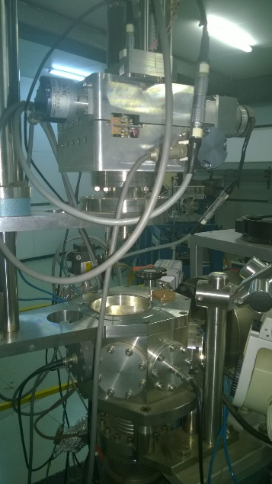
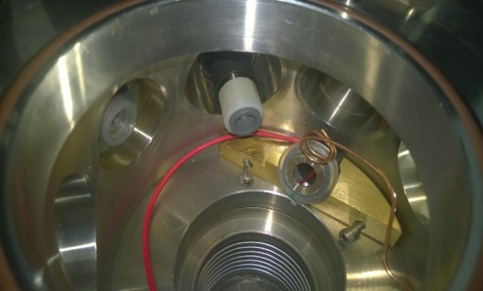
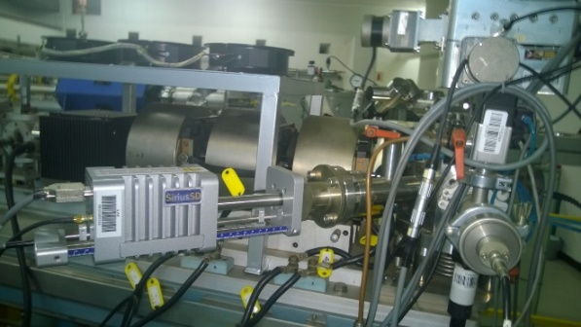
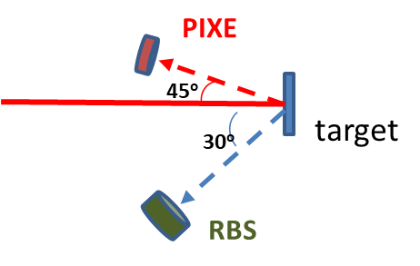

XPCS measurements for heavy ion PIXE
Backscattering cross section
Sample parameters
X-ray yield
projectile (m, Z)
Energy loss correction factor
Backscattering yield
X-ray detector efficiency

Slide 23
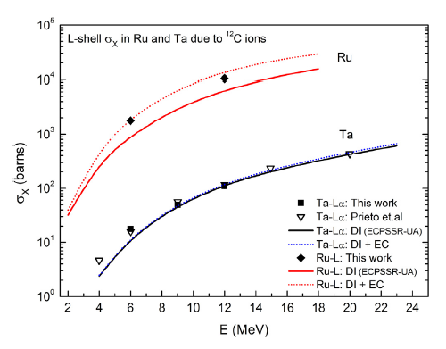
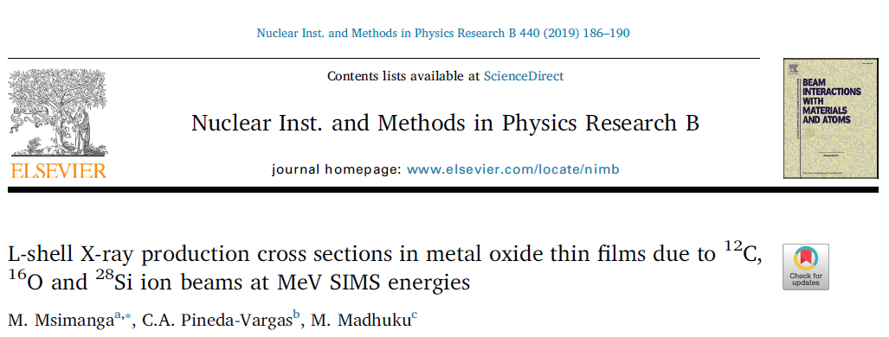
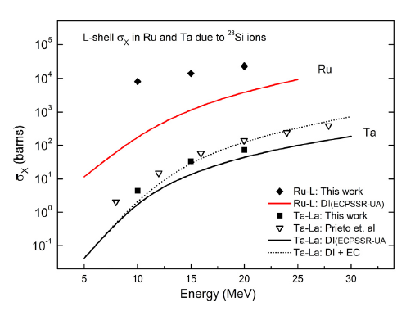
Some XPCS outputs from iThemba LABS
For high velocity and highly asymmetric collisions, i.e. Z₁/Z₂ << 0.5, ECPSSR theory describes the direct ionisation (DI) mechanism fairly well
As Z₁ increases, for nearly symmetric collisions (i.e. Z₁/Z₂ -> 0.5), other effects come into play that are not so well described by theory

Slide 24
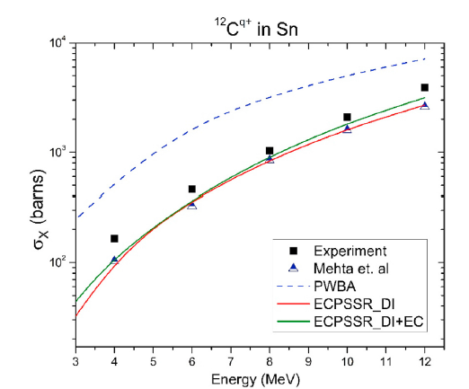
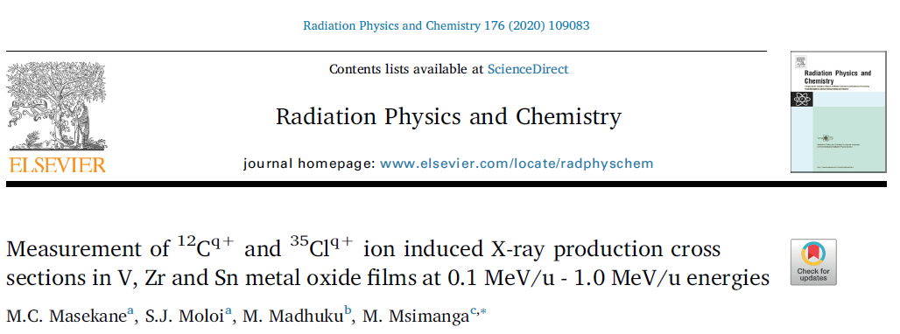
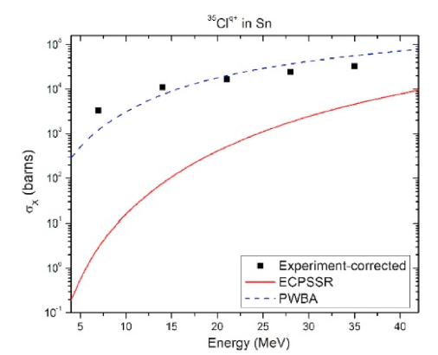
Some XPCS outputs from iThemba LABS
Similar to the C -> Ta case
Similar to the Si -> Ru case

Slide 25
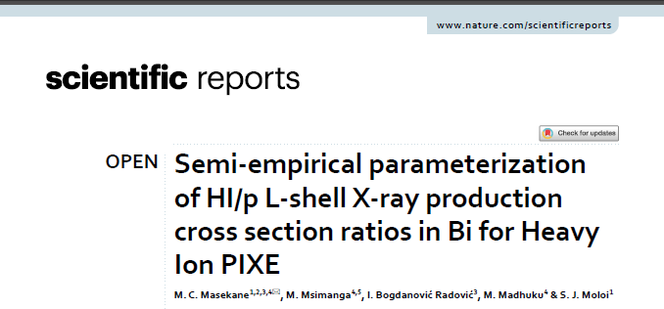

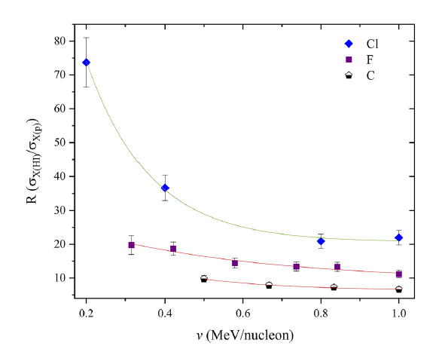
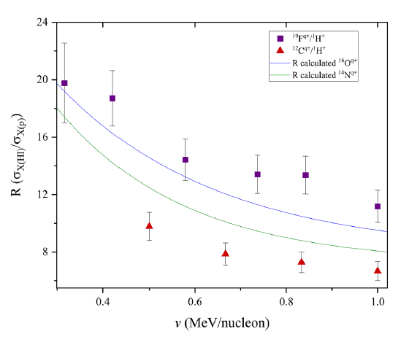
An attempt at predictive formulations……
Heavy ion (HI) induced XPCS compared to proton (p) cross sections:

Slide 26
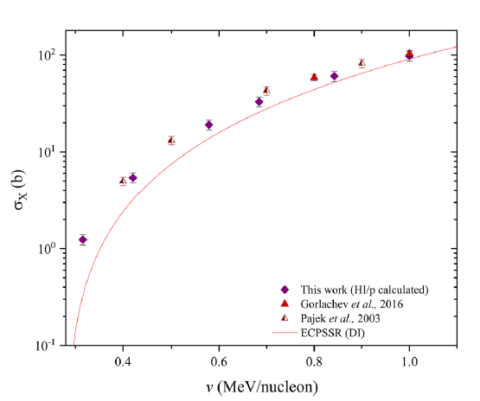
Some XPCS outputs from iThemba LABS
2023
Semi-empirical calculation vs experiment for O -> Bi collision system

Slide 27

Conclusion and future outlook
Experiment shows that, theoretical predictions of heavy ion stopping force deviate from experiment by up to 20% - 40% at times.
In heavy ion induced XPCS the extent of deviations increases as the colliding particle masses increase, especially at low ion velocities
Because of the huge number of possible ion-target-energy permutations, more data intensive approaches need to be explored
E.g. IAEA database for machine learning approaches

Slide 28
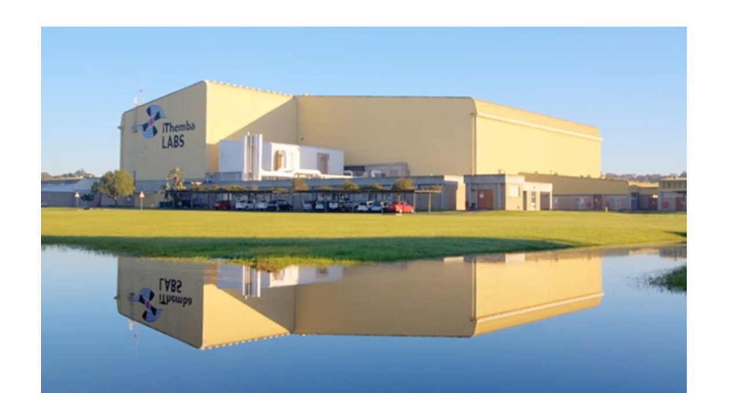
End, thank you

