Slide 1
Automated photovoltaic module imaging for high throughput data capture and analysis
Presented by: Matthew Sivewright, Prof Ernest Van Dyk, Dr Frederik Vorster
SAIP July 2025

Slide 2
Contents
What is PV imaging?
Different techniques showing different defects.
How are PV modules tested with imaging?
Automated on rack imaging.
Results: Lab based testing, building machine.
Process of Image Capture.
Results: Method of image capture.
Results: Visual imaging defects (Pi Cam 3).
Results: Ultra-Violet Fluorescent (UVF) imaging (Pi Cam 3).
Results: Image stitching & challenges.
Further efforts on image processing : rotation and cropping.
Further research.
2

Slide 3
What is PV imaging?
PV Imaging refers to the process of capturing images of Photovoltaic (PV) modules, using specialized cameras and/or imaging techniques to assess their condition, performance, or to detect faults.
Types of PV Imaging:
  Visual : uses visual spectrum to see physical/chemical damage, dirt or cracks.
  UVF : uses ultra-violet fluorescent (UVF) of the encapsulant within modules which may visualise degradation of encapsulants.
  EL : electroluminescence shows invisible cracks or hidden faults by applying power to the panel and capturing the light emitted from the cells.
  IR : shows hotspots resulting from disconnected cells/strings, performed under load.
Can Identify:
  Mishandling
  Encapsulant degradation
  Production defects
  Material faults
3

Slide 4
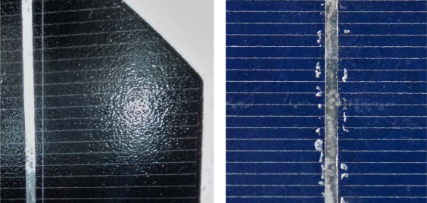
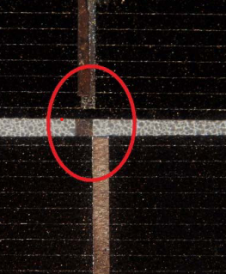
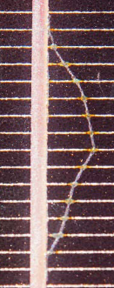
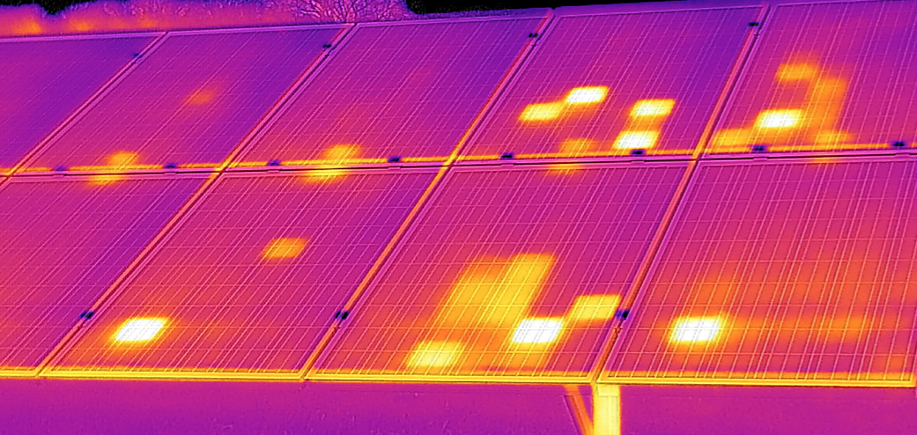
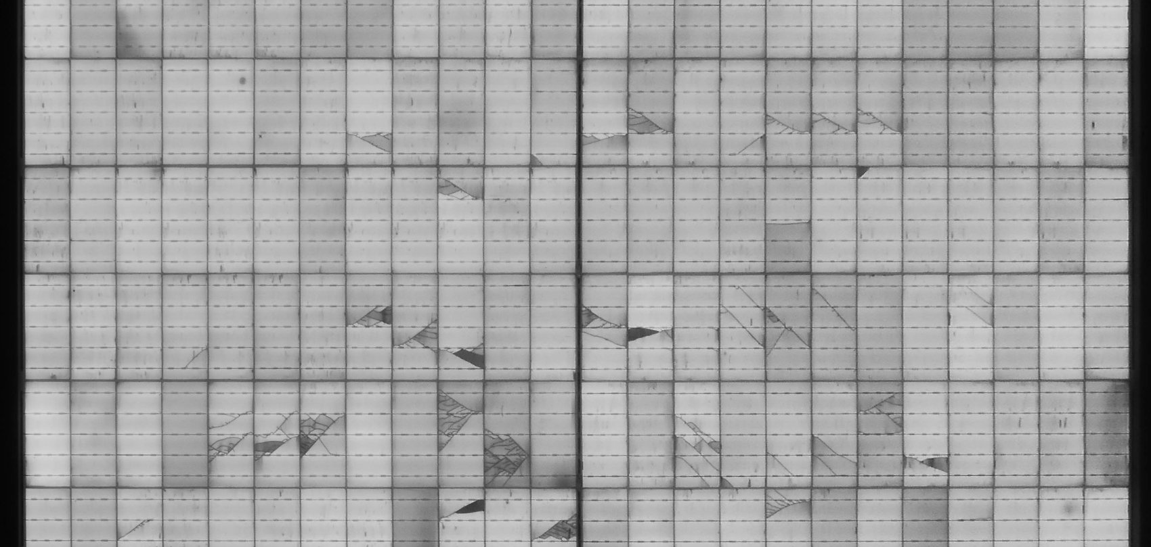
Different techniques showing different defects
[1] Visual imaging showing defects
[2] UVF imaging showing ingress into encapsulant
[3] IR imaging showing hot spot cells
[4] EL imaging showing cell cracks
4

Slide 5
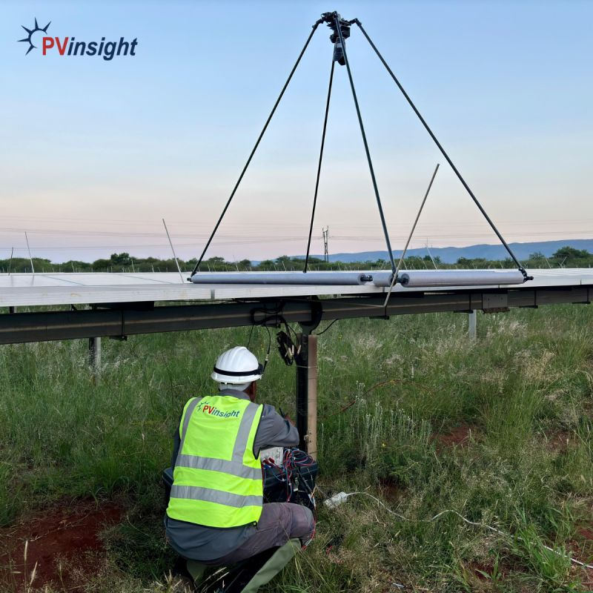
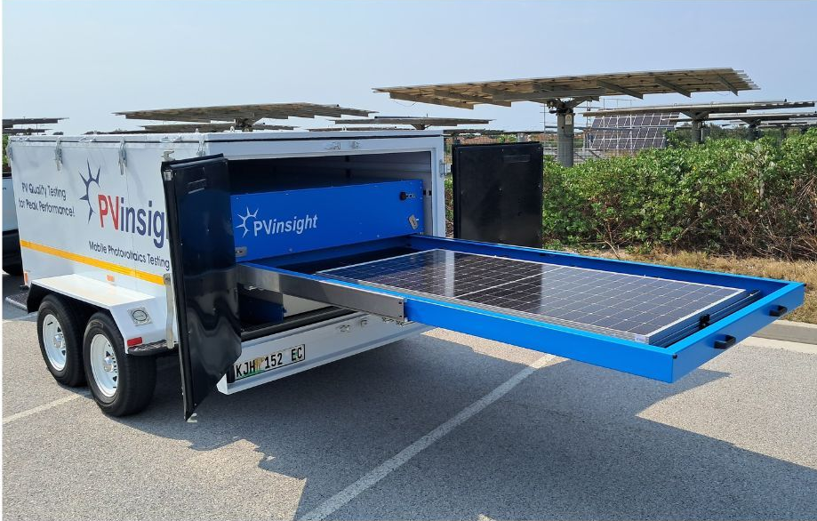
How are PV modules tested with imaging?
On-Rack Off-Rack
[6] High resolution controlled Visual / EL testing
[5] Manual Visual / EL testing
5

Slide 6
Automated on rack imaging
Benefits
  Fully automated (excluding setup)
  Consistent, repeatable inspections, reducing human error
  High-resolution, large-area coverage
  Reduced downtime and manual labour – minimal interaction
  Integrated data collection
  Adaptability to multiple imaging types
  Continuous operation
Limitations
  High initial cost
  Complex setup and maintenance
  Mobility and coverage limitations
6

Slide 7
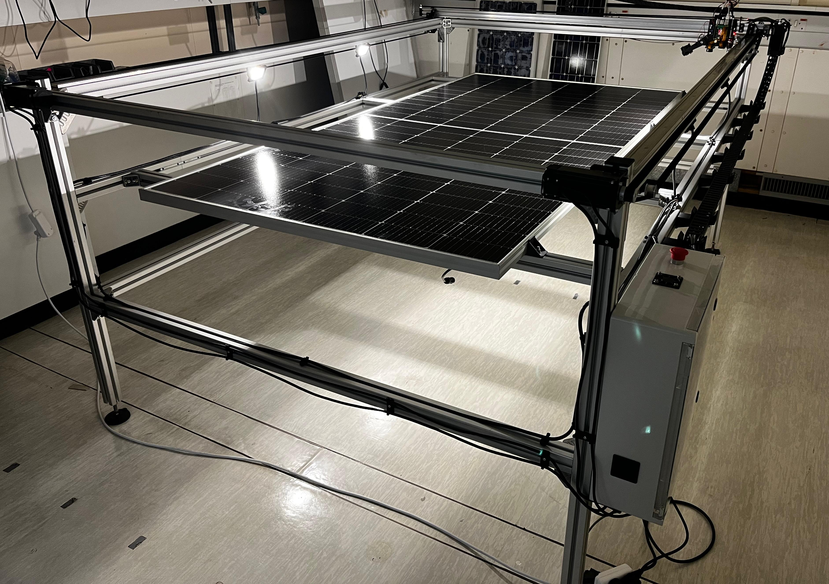
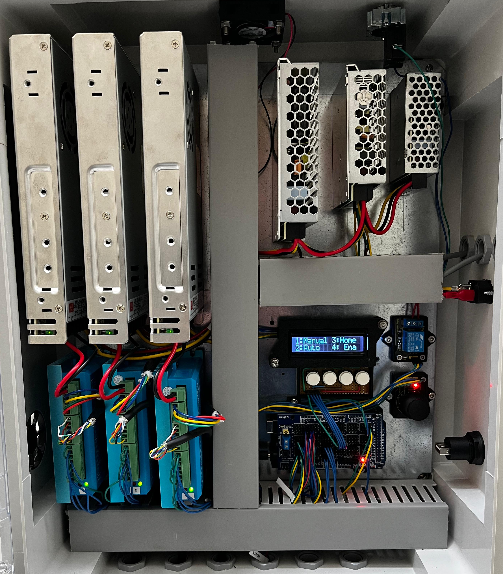
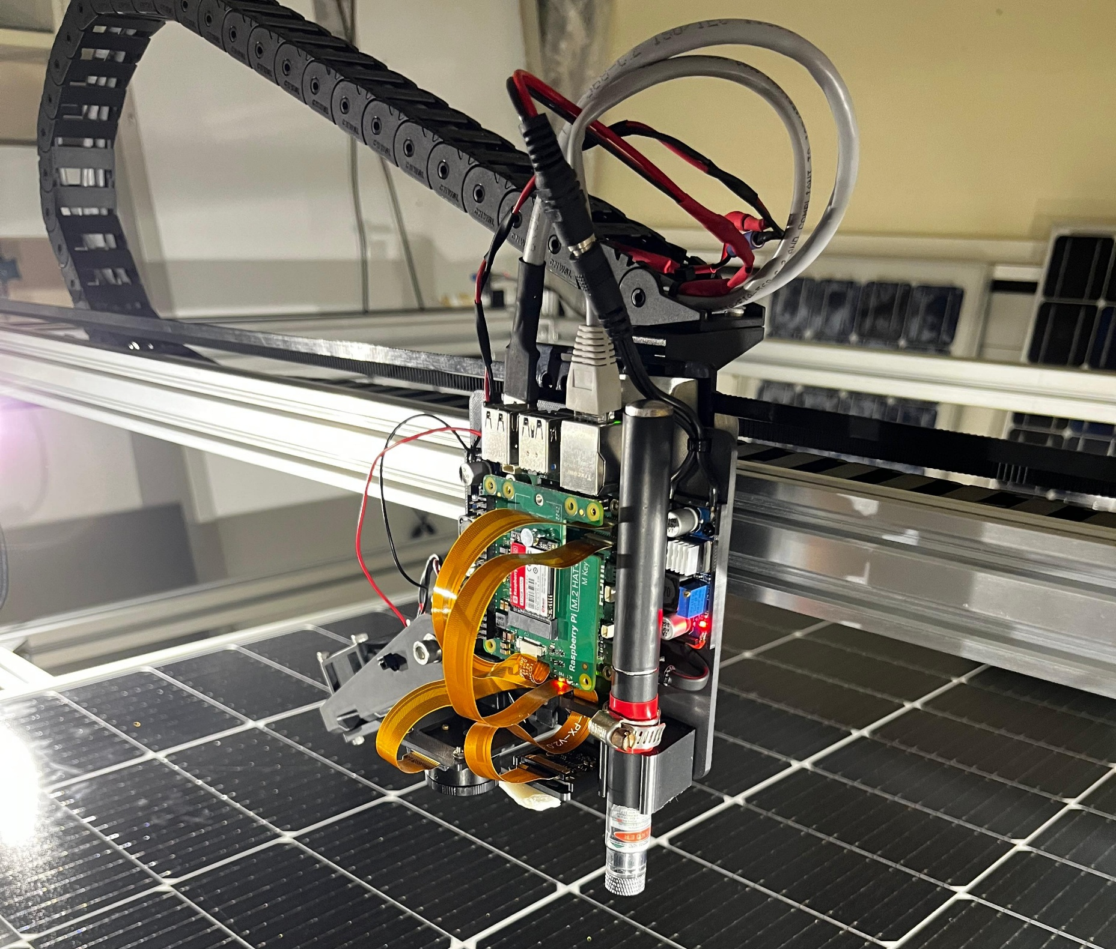
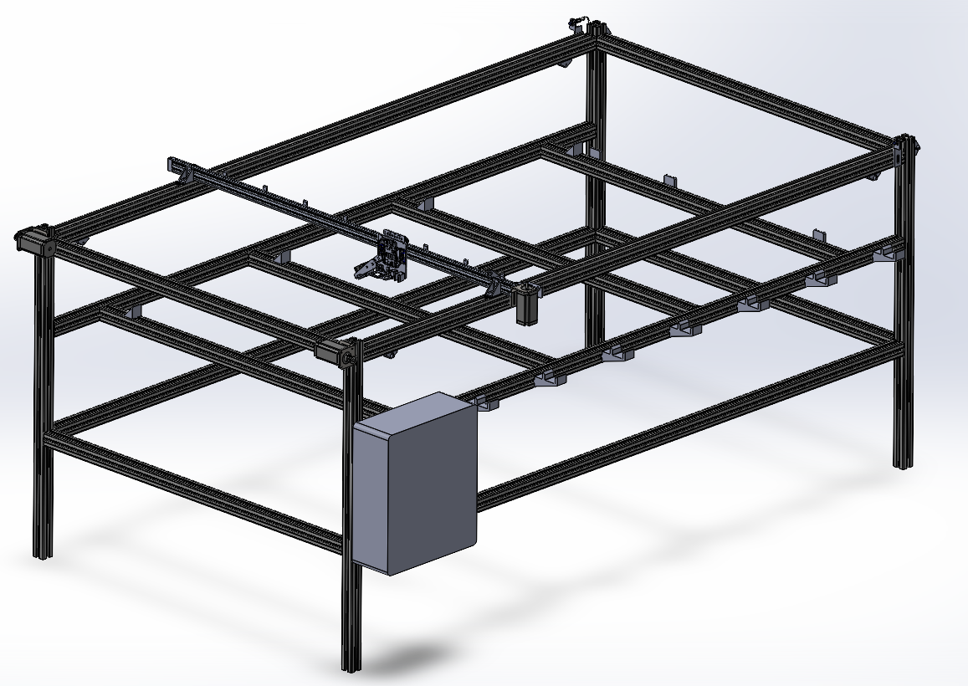
Results: Lab based testing, building machine
Why lab based before field?
Controlled environment
Rapid prototyping and testing
Reduced complexity
Building Machine (Gantry)
  Design / building / programming
    CAD model: mechanical / electrical
    IT: programming and user interface
  Controlled by Raspberry Pi 5 8gb as the microprocessor
  Array of cameras:
    Raspberry Pi cam 3 NOIR Autofocus 12 MP
    Sony IMX77 12.3 MP
    EL camera
  Arduino Mega microcontroller for low level control
  High resolution stepper motors
7

Slide 8
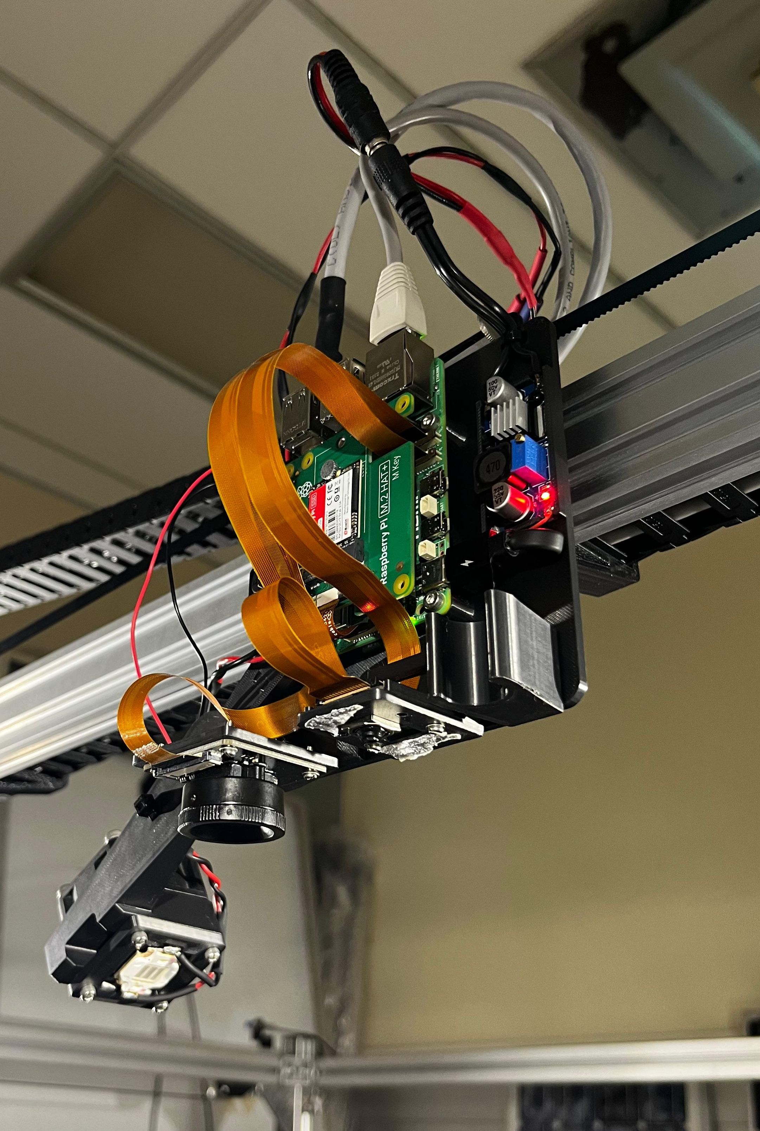
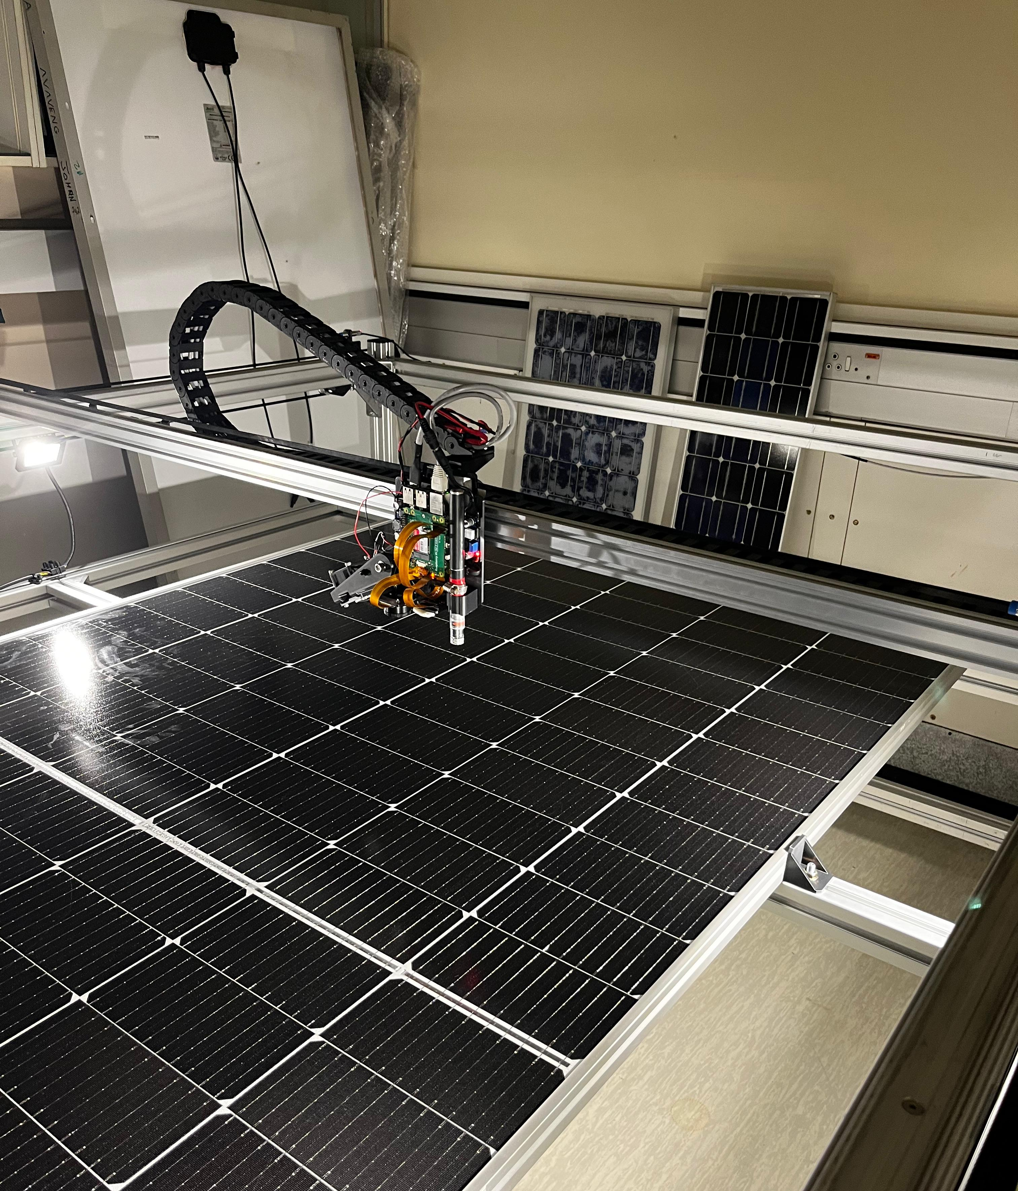
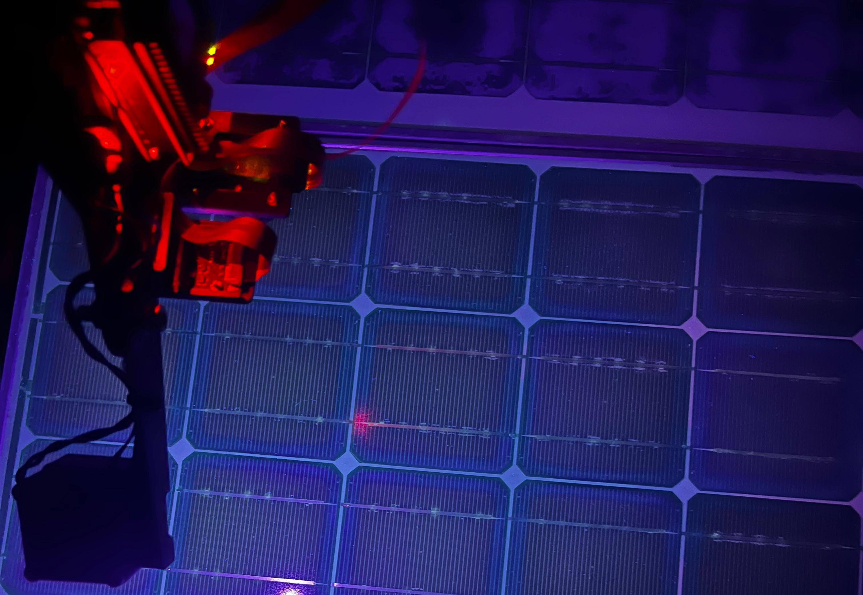
Process of Image Capture
1. Enter setup (via python Cmd. Prompt):
Dimensions of PV module
Selected camera
Select UV or visual imaging
2. 3D Array of positions generated
3. Pi sends each position to Arduino
4. Captures image when Arduino signals that it is in position
5. Pi stores images with an identifying position on a 500GB SSD HAT
1
2
3
Rasbery Pi with cameras and UV LED
Capturing Visual Images
Capturing UV images
8

Slide 9
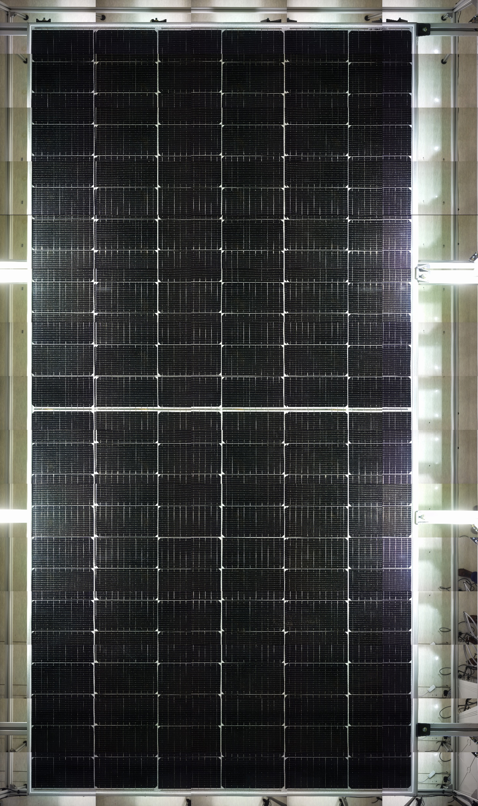
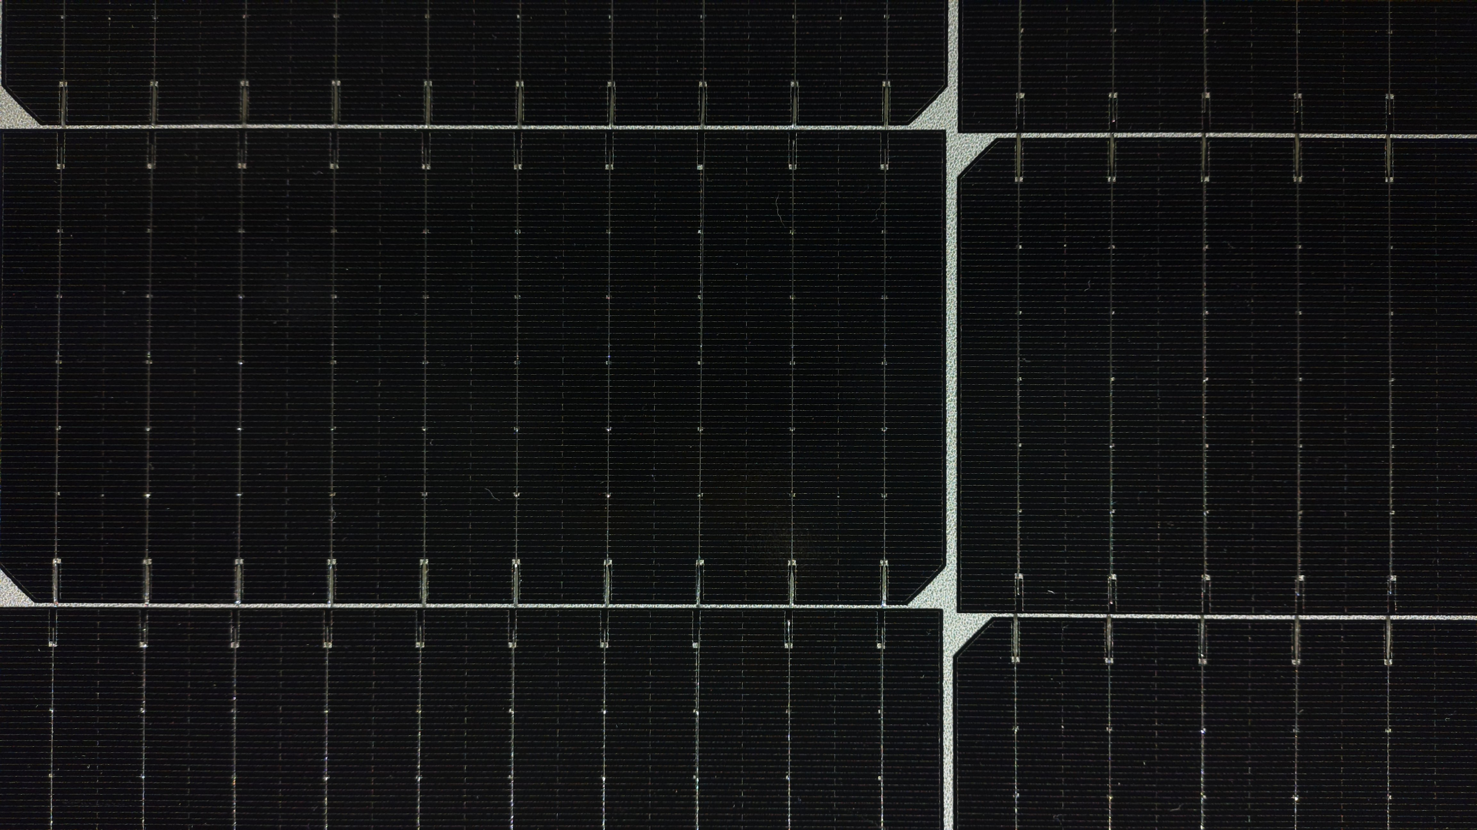
Results: Method of image capture
Programs determines how many images are to be capture based on:
  Size of module
  Camera Image dimensions and overlap
  Single image
  Module Size: 1130 x 2260 mm (540W)
  Filename (R1C1Cam2)
  Image size: 4608 x 2592 (1,9MB)
  Camera: RPI Cam 3 NOIR 12 MP
  Stitched Image
  Captured images: 4 x 14 (56 Images)
  Image size: 23040 x 38880 (223,6MB)
9

Slide 10
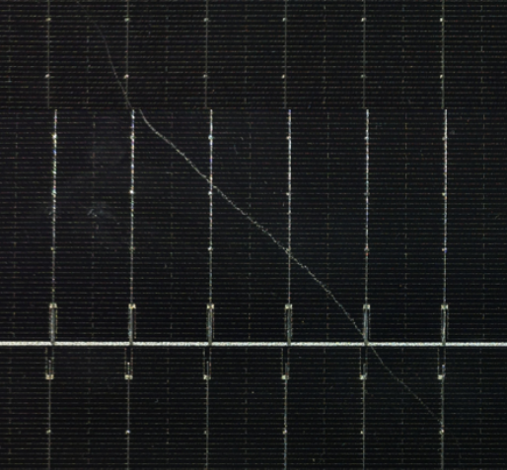
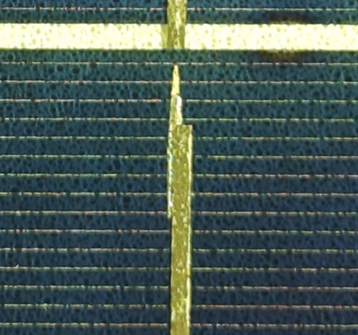
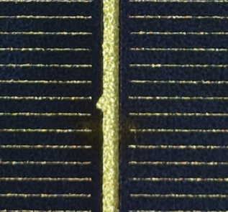
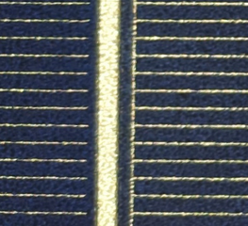
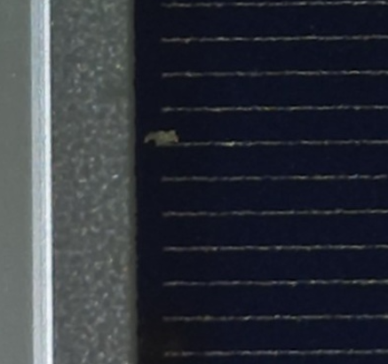
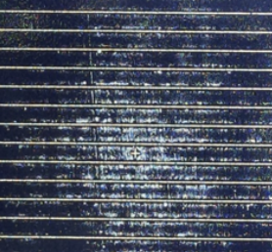
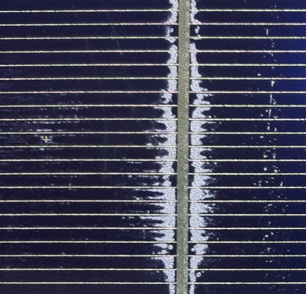
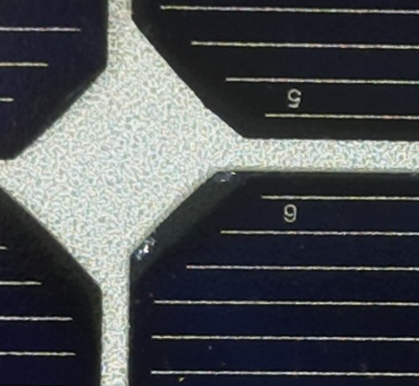
Results: Visual imaging defects (Pi Cam 3)
Scratches
Trace Misalignment
Edge Chips
Cell Patterns
Finger Defect
Mid-Cell Delamination
Flux oxidation
Edge-Cell Encapsulant Delamination
10

Slide 11
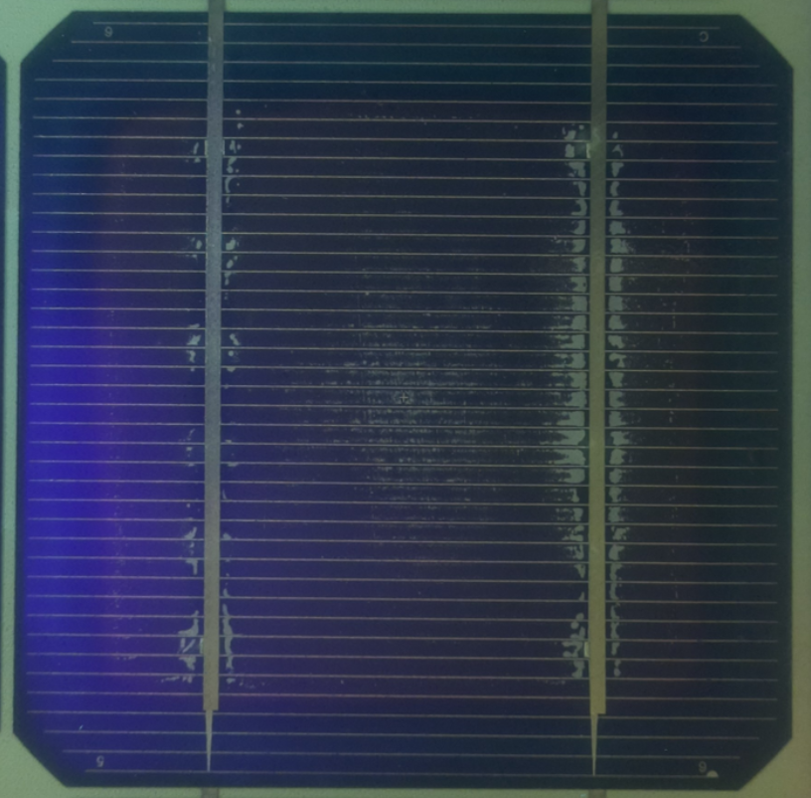
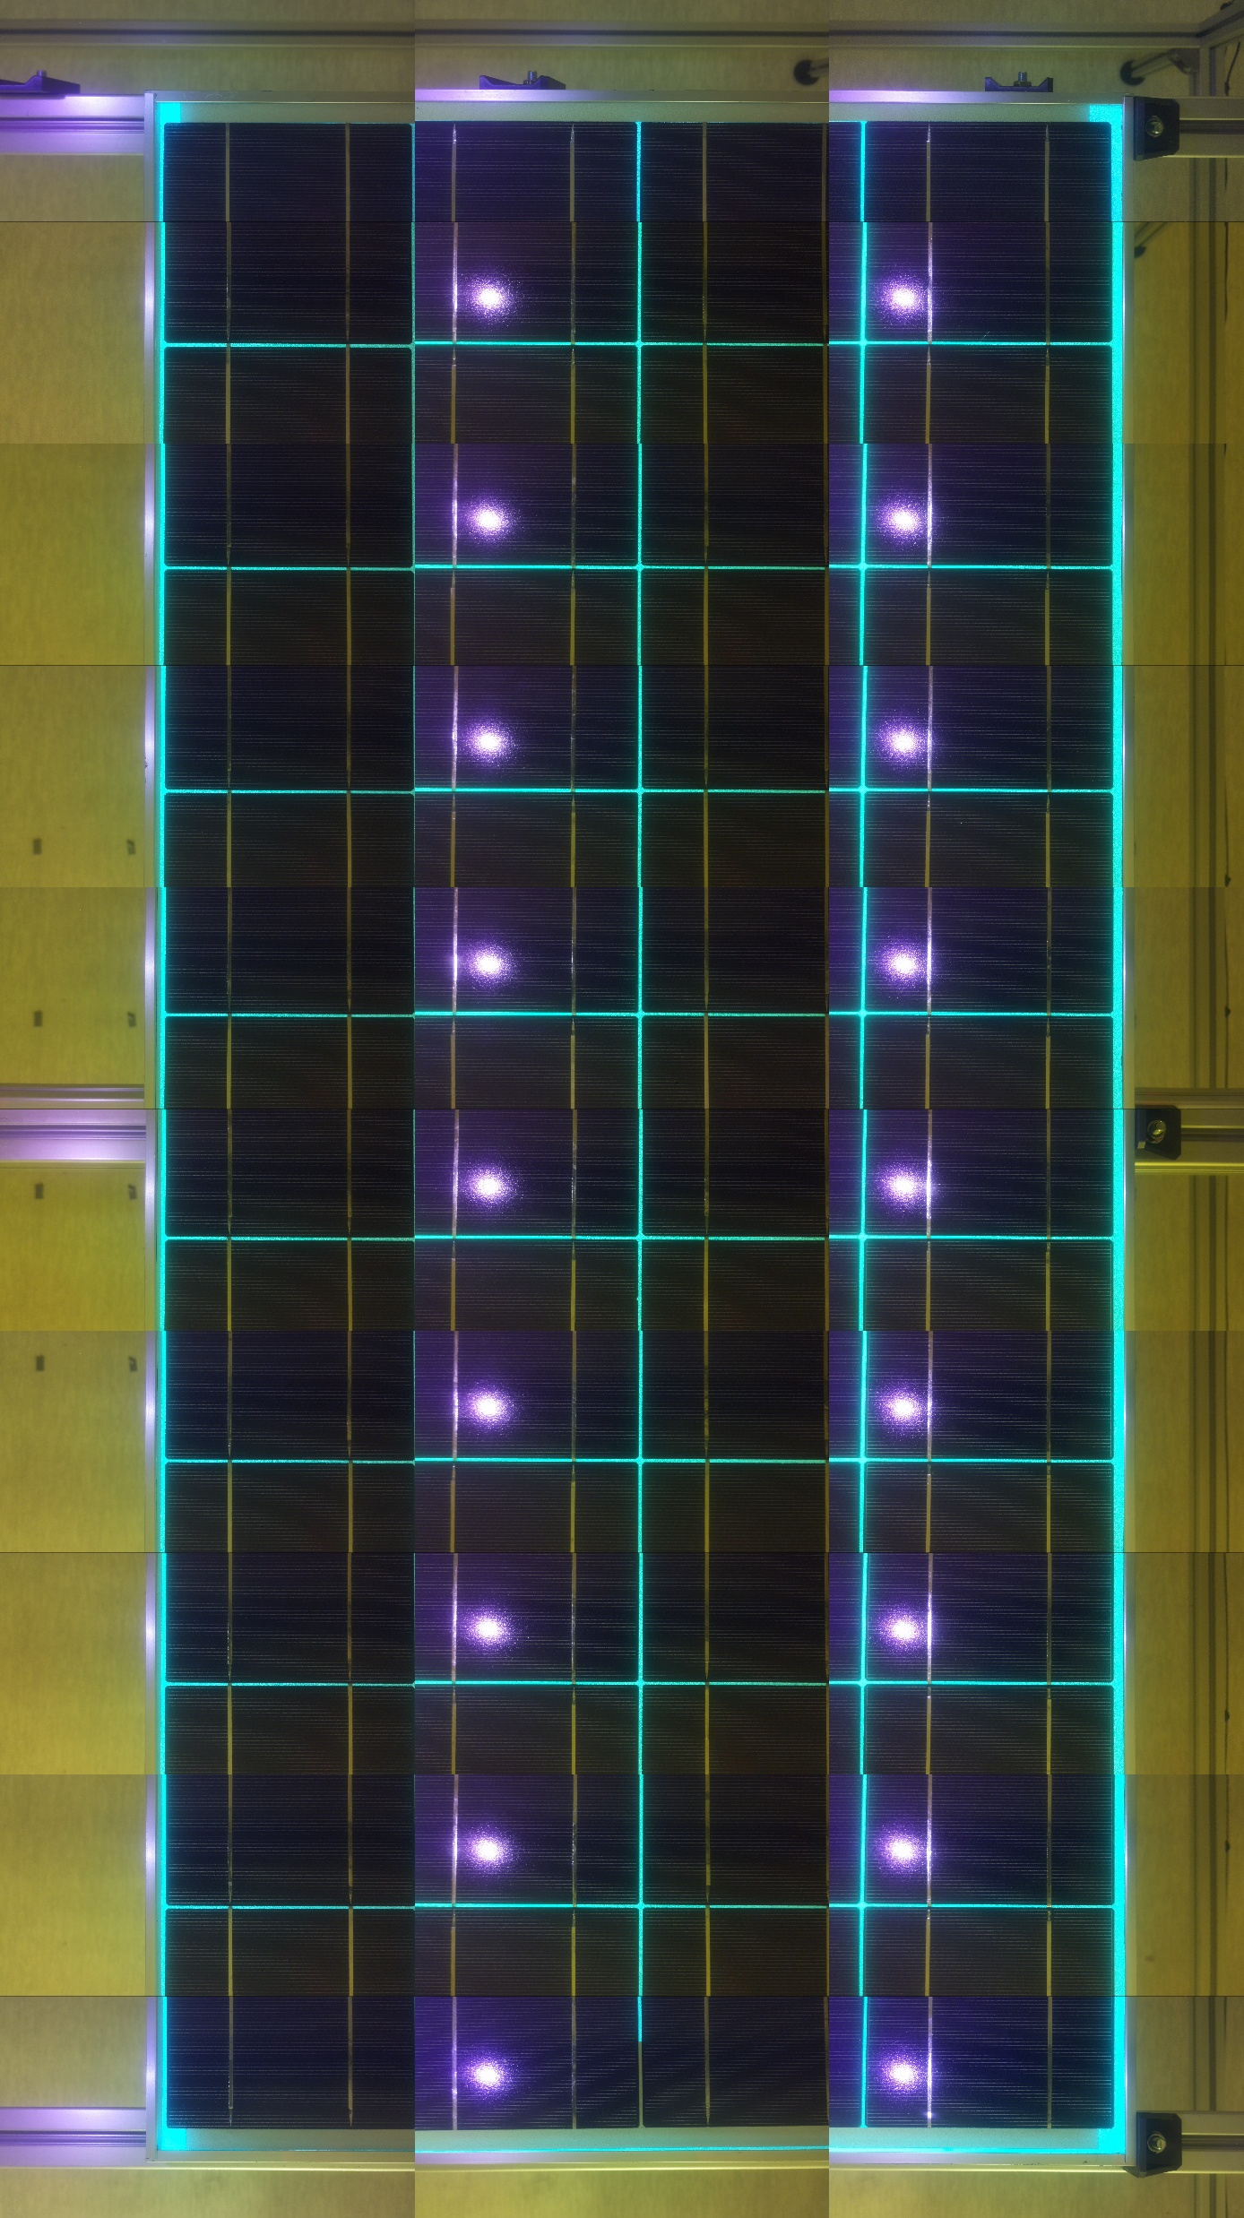
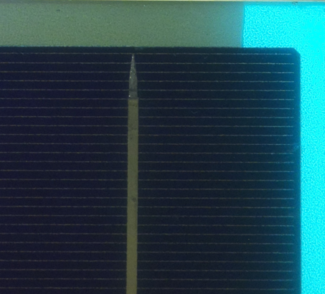
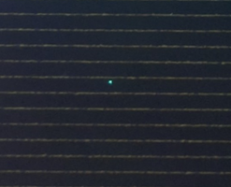
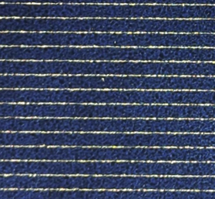
Results: Ultra-Violet Fluorescent (UVF) imaging (Pi Cam 3)
Backsheet fluorescence
Quenching
Stitched UV image
Module Size: 655 x 1460 mm
Image size: 12900 x 23000 (52,7MB)
Camera: RPI Cam 3 NOIR 12 MP
Filter: Low pass filter, LEE filters 101 Yellow
Cell Hole
11

Slide 12
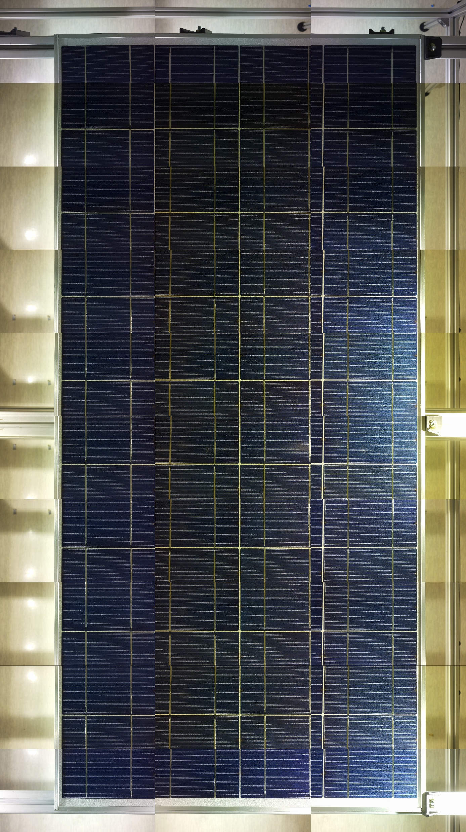
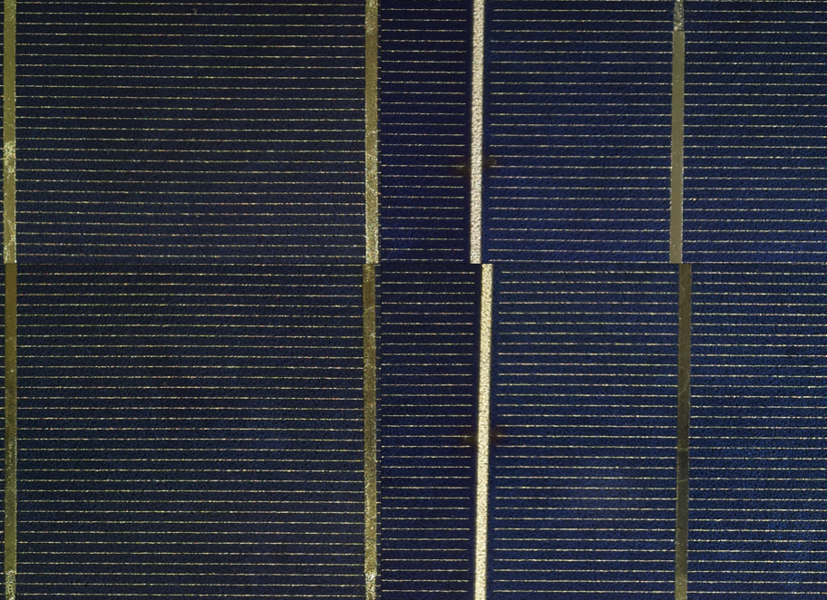
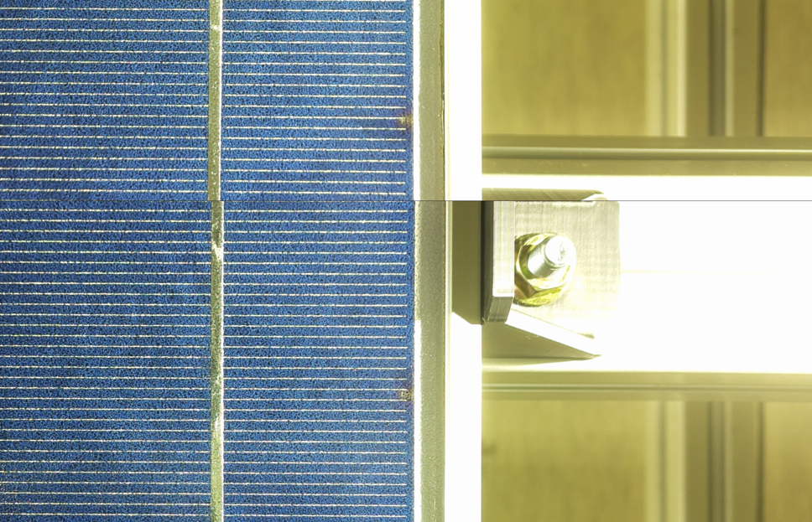
Results: Challenges of image stitching
Basic image stitching with blending
Improvements to be made:
  Increase lighting
  Include distortion correction
  Include rotation correction
  Include edge detection and pattern overlapping
    Difficult as images are not unique
    Possibly improve by indexing image to rough area
    Build from known edges
Alignment and overlapping issues, under exposed
Over Exposure from bed
12

Slide 13
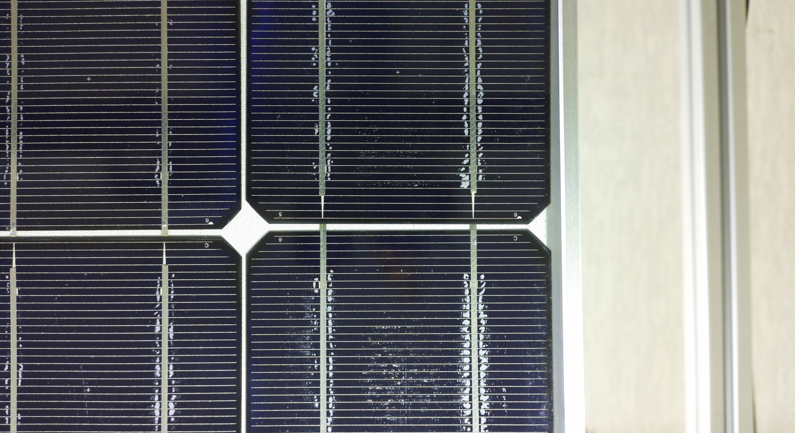
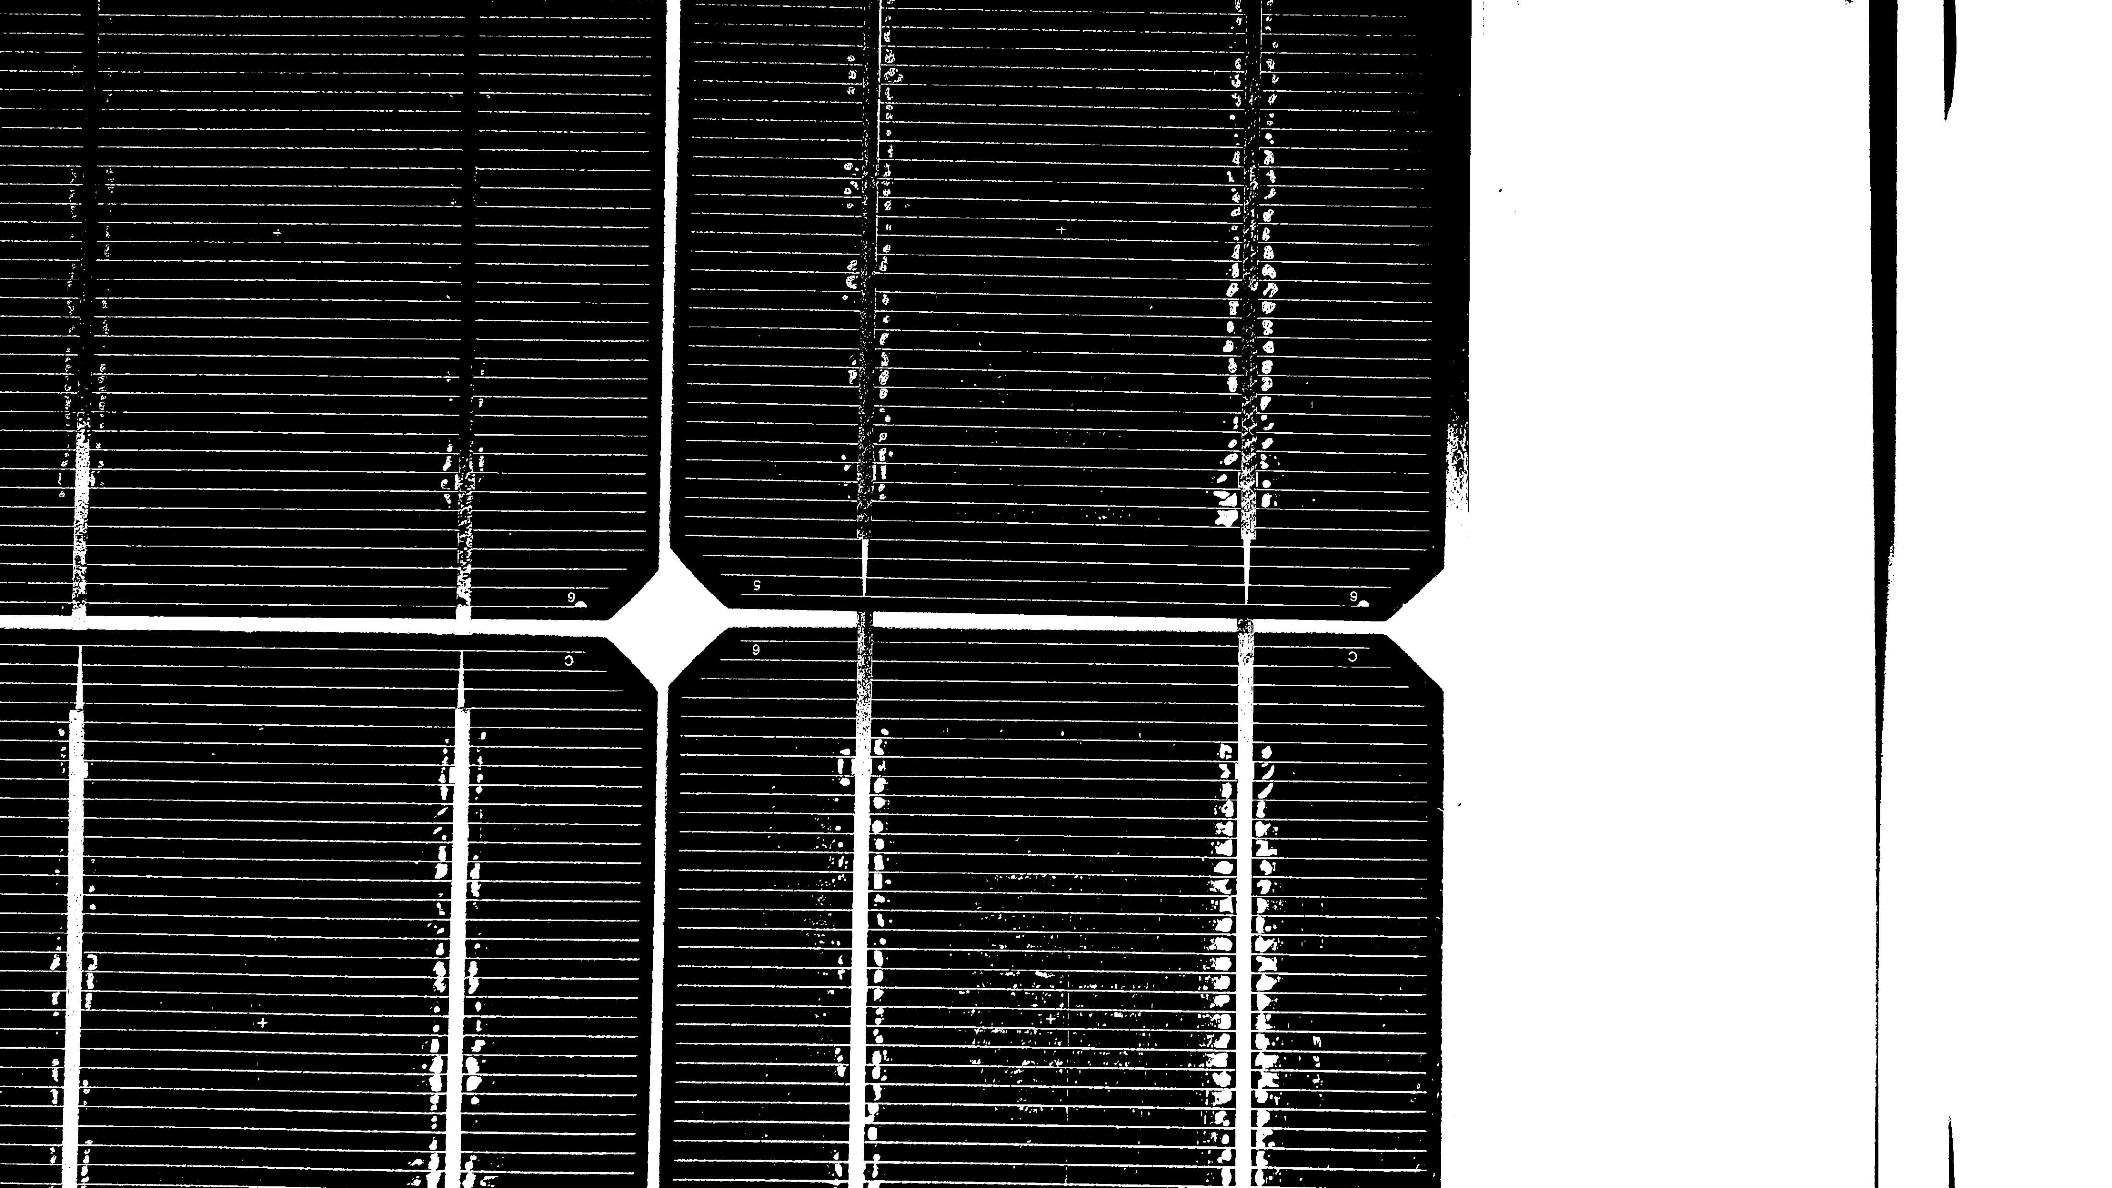
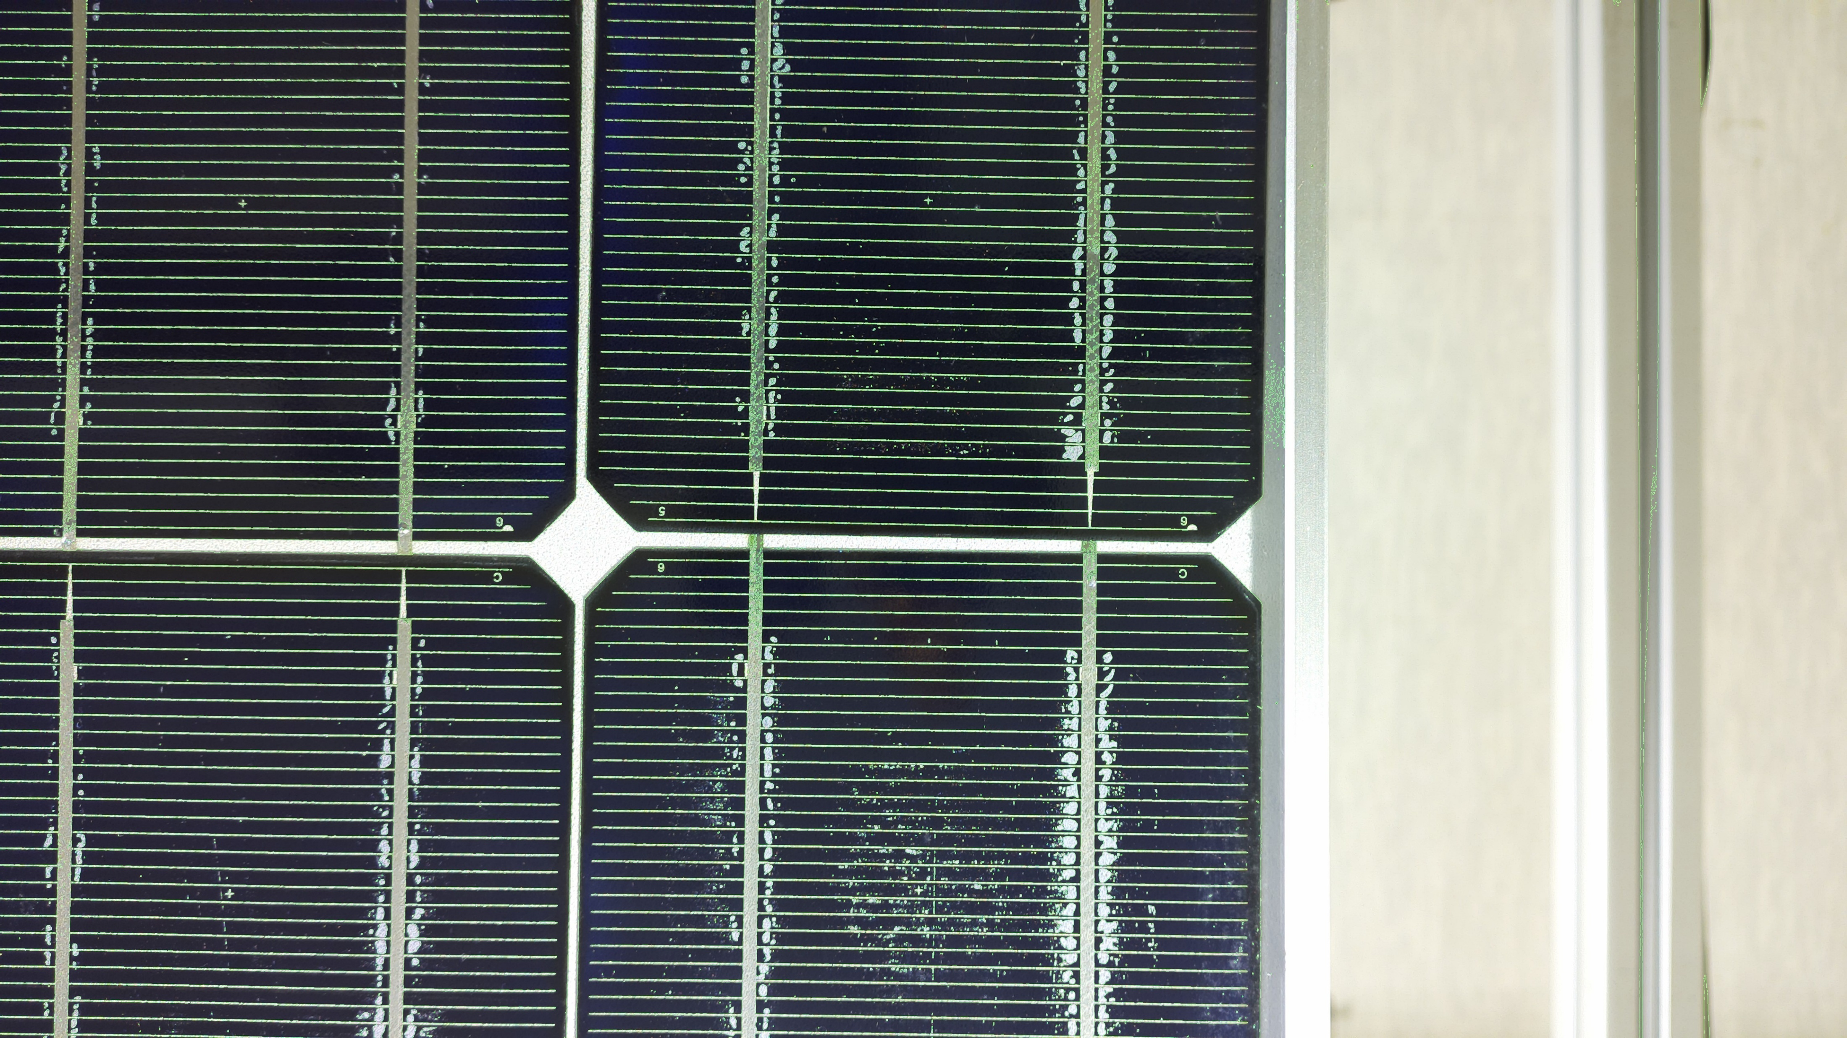
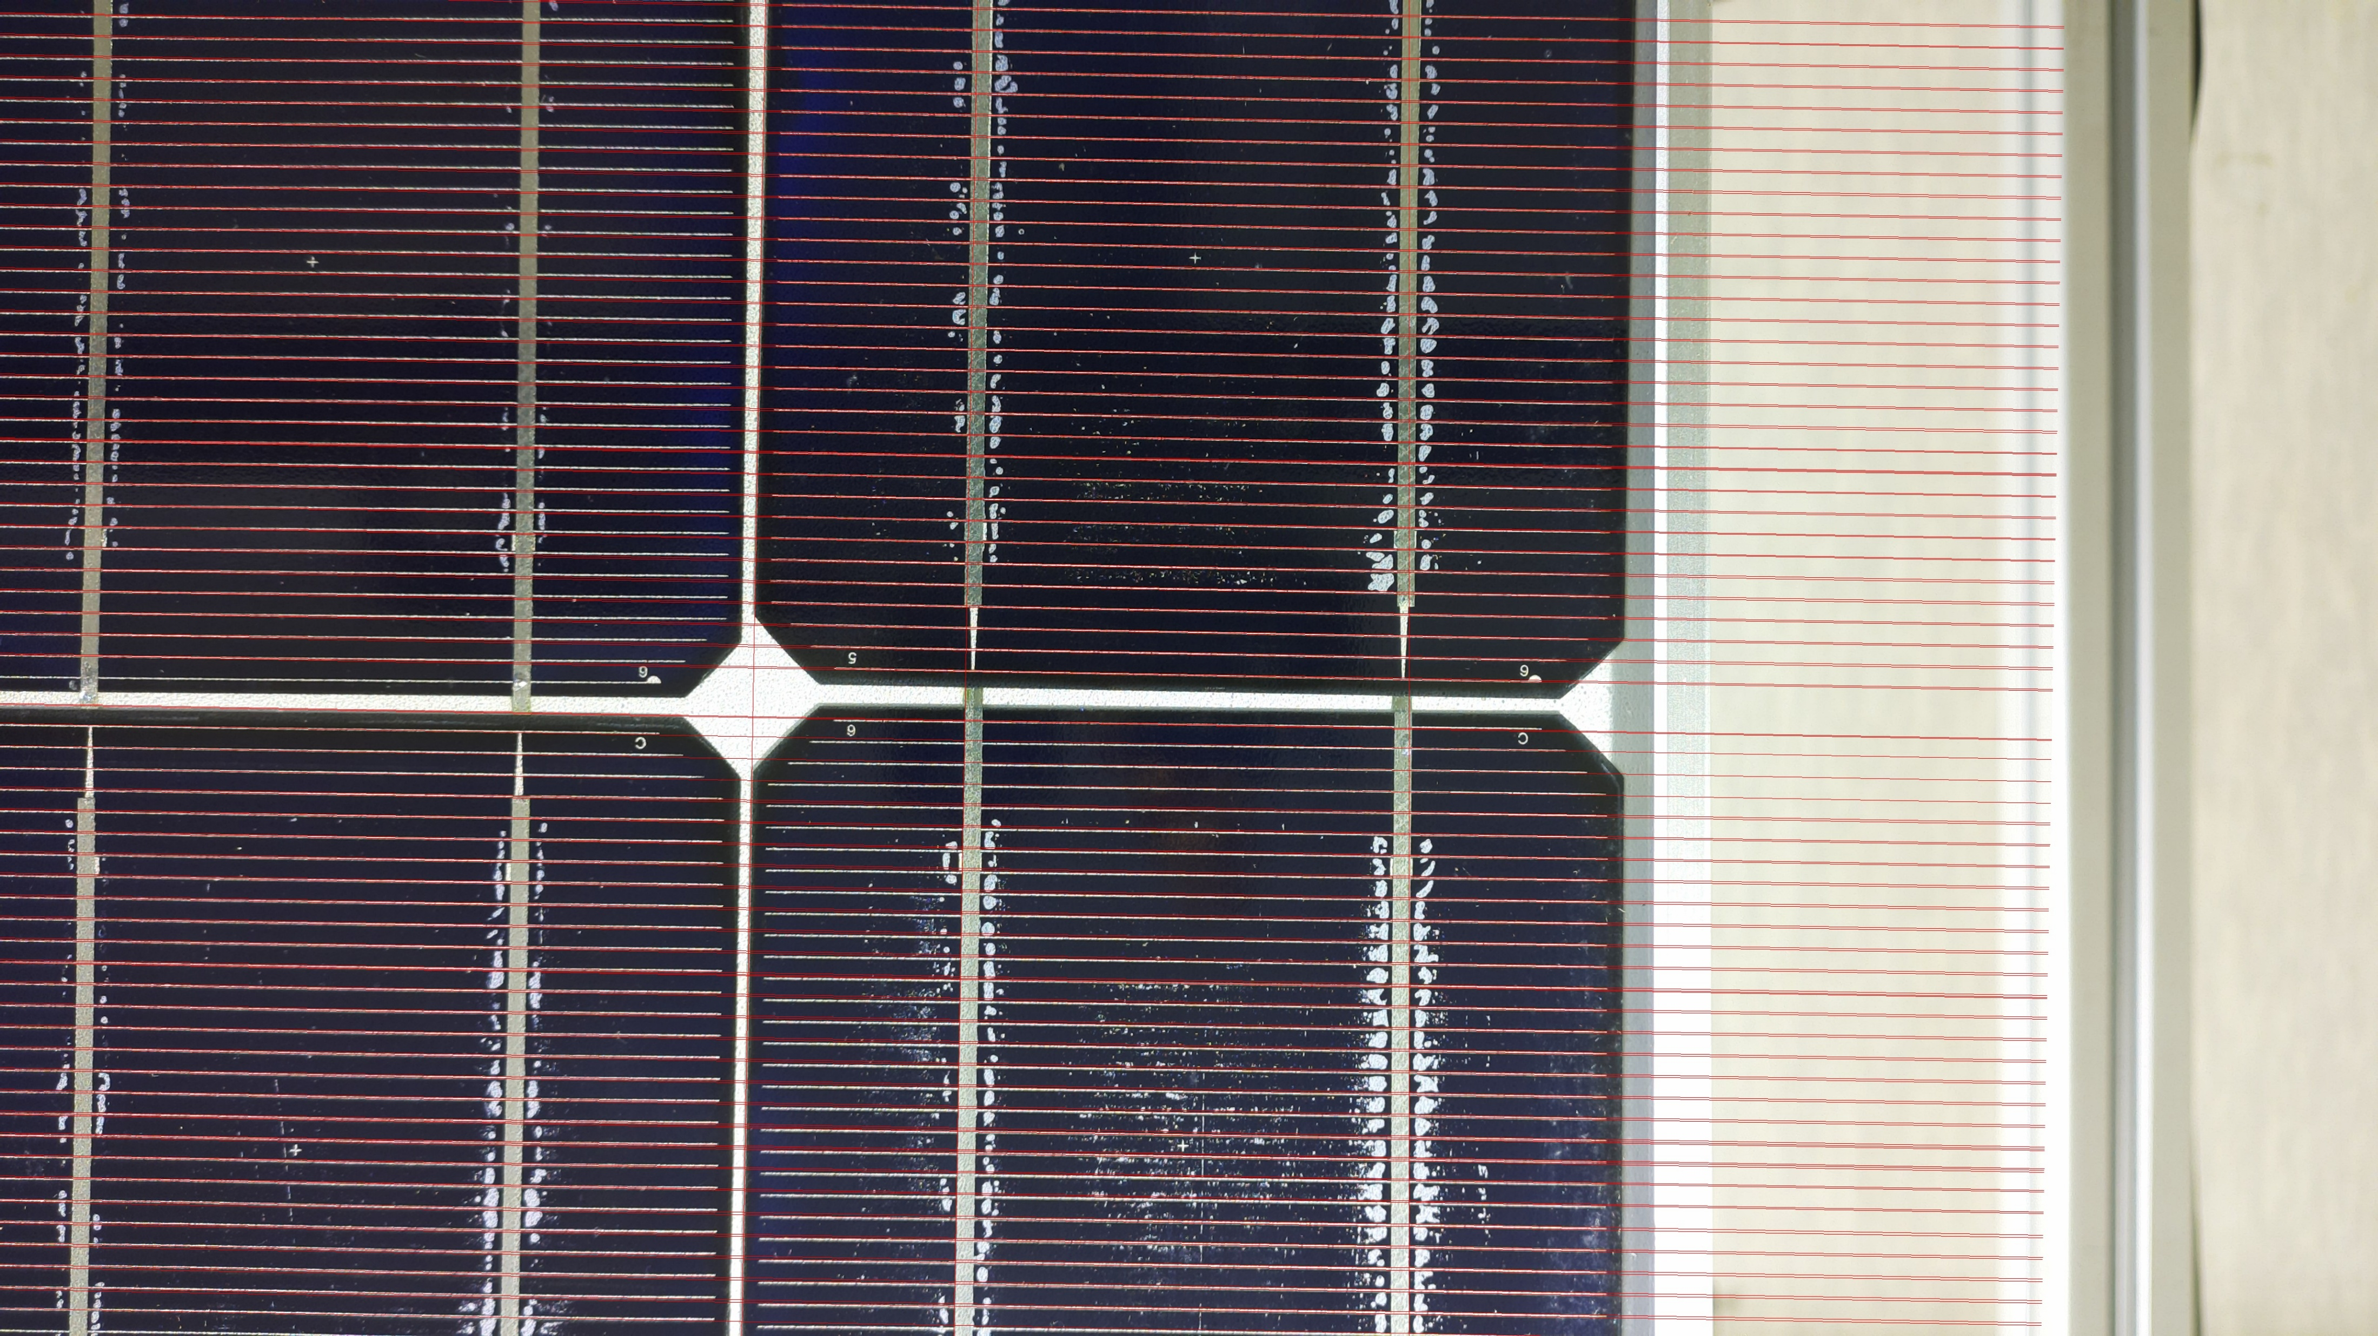
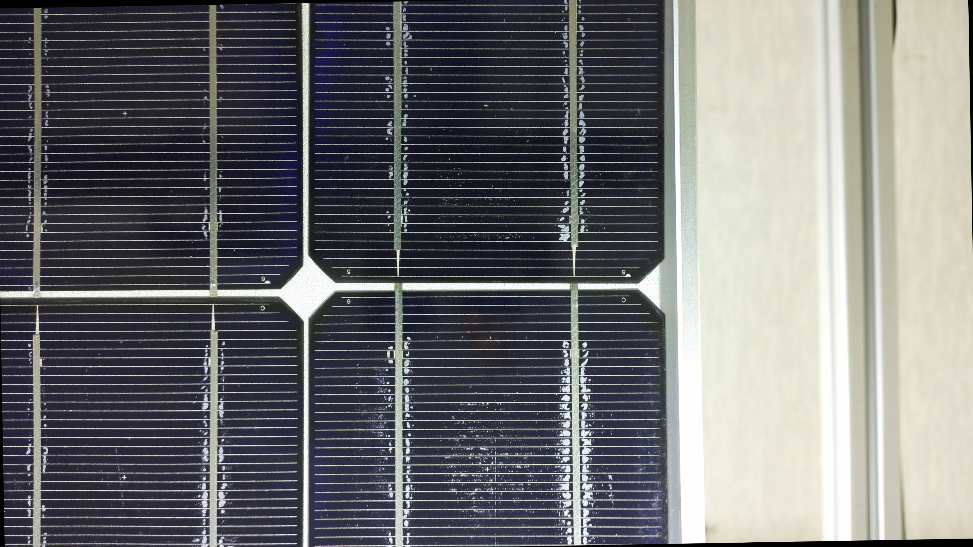
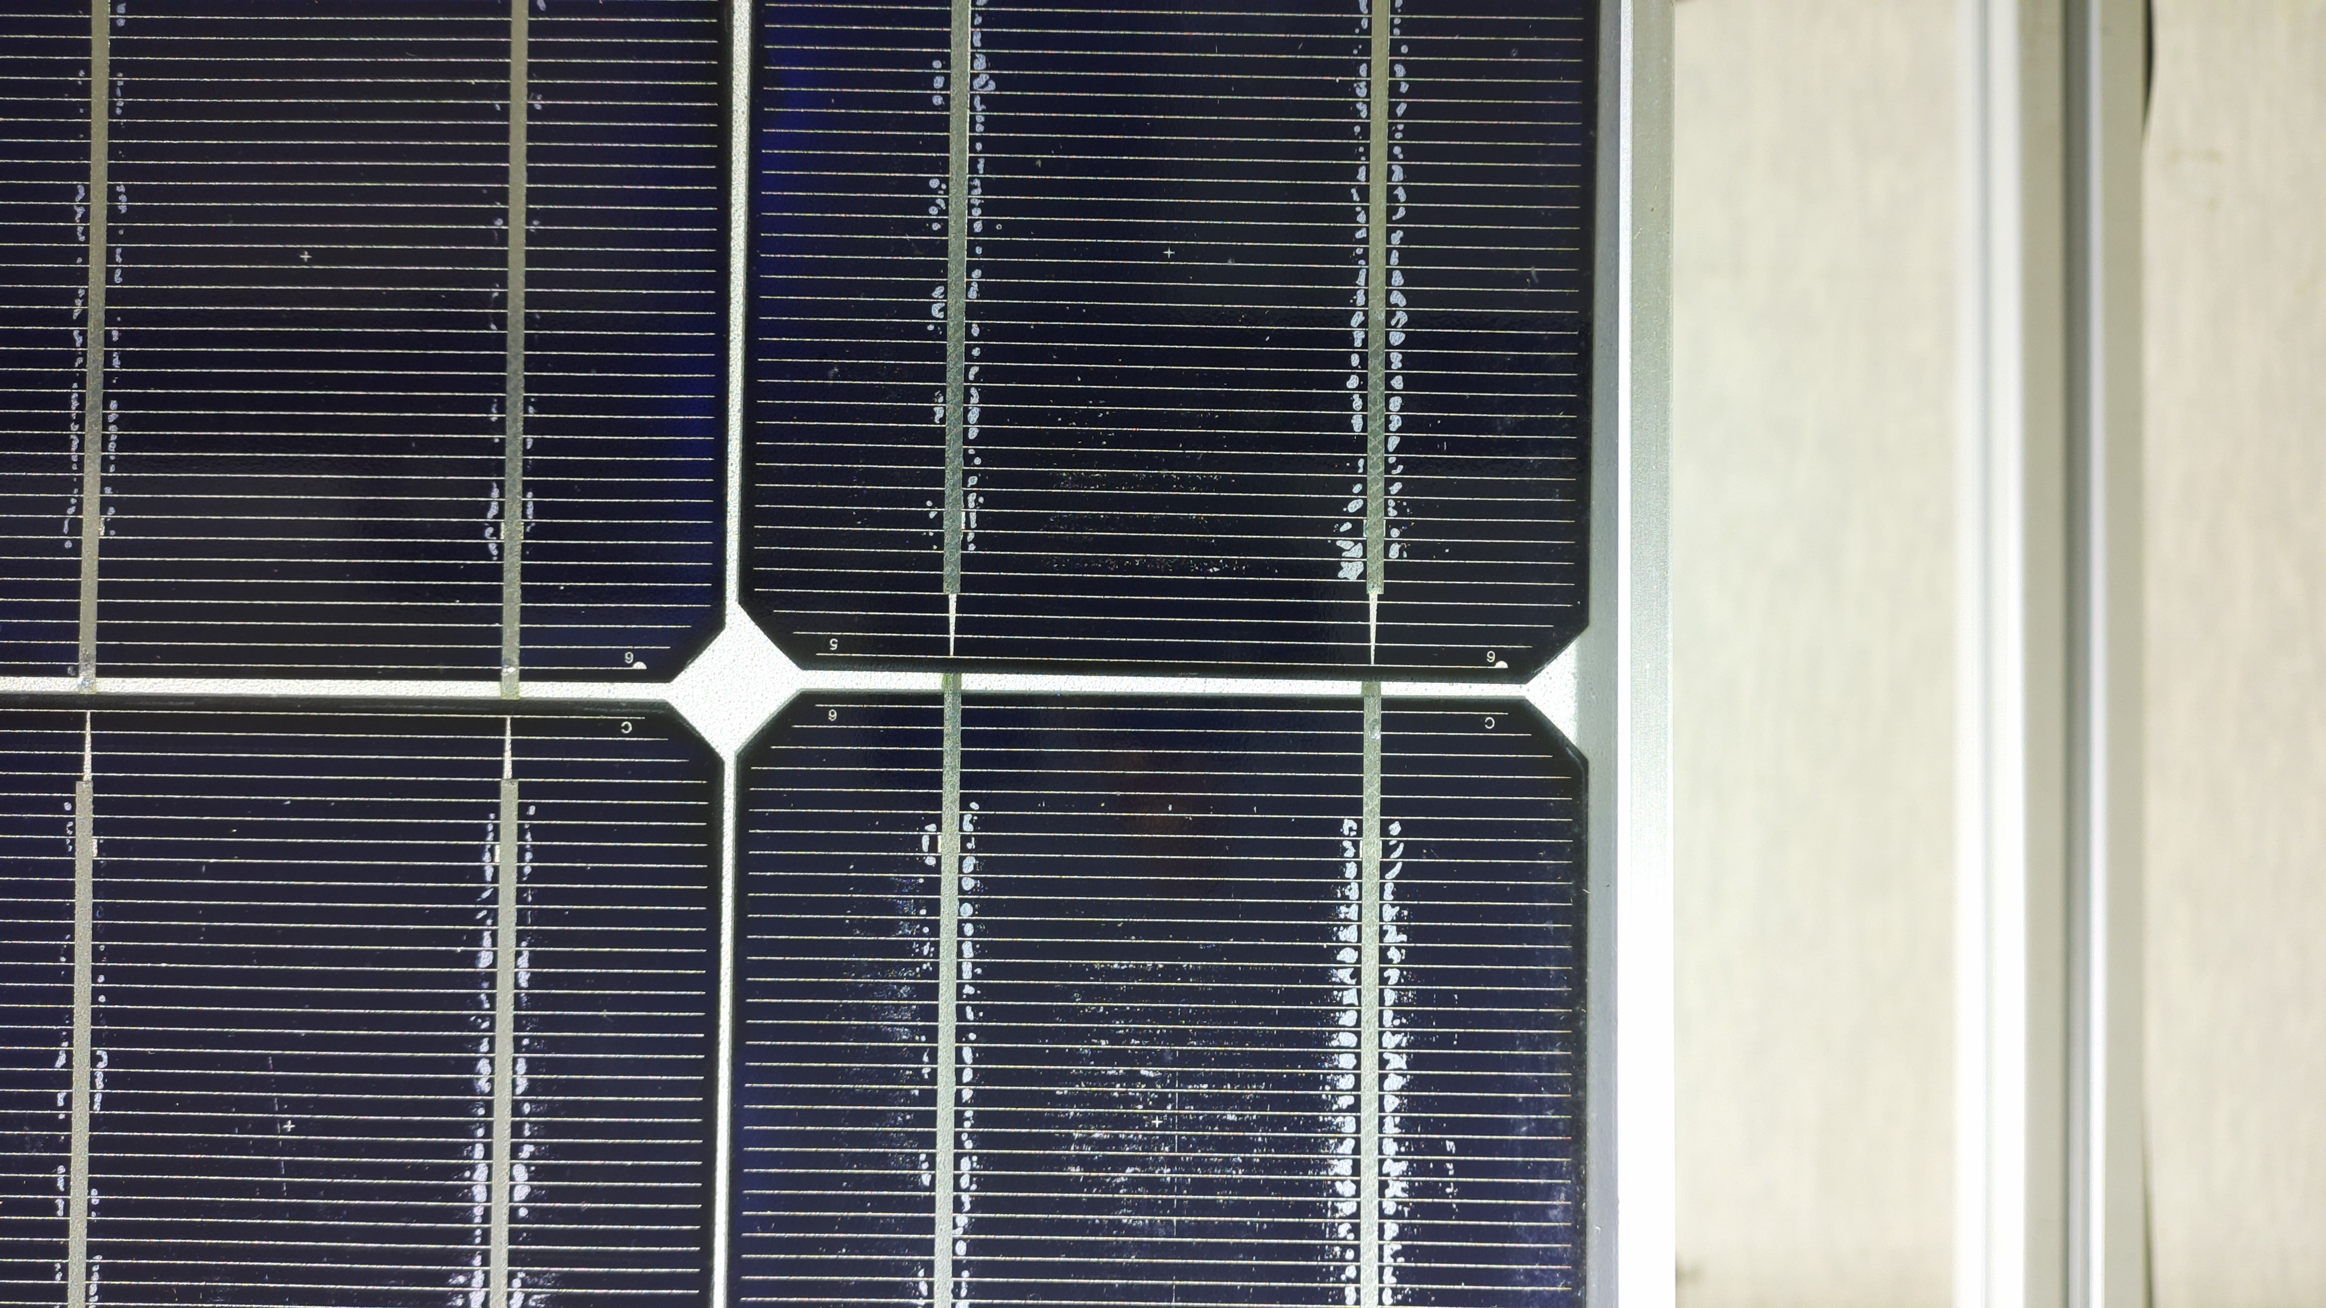
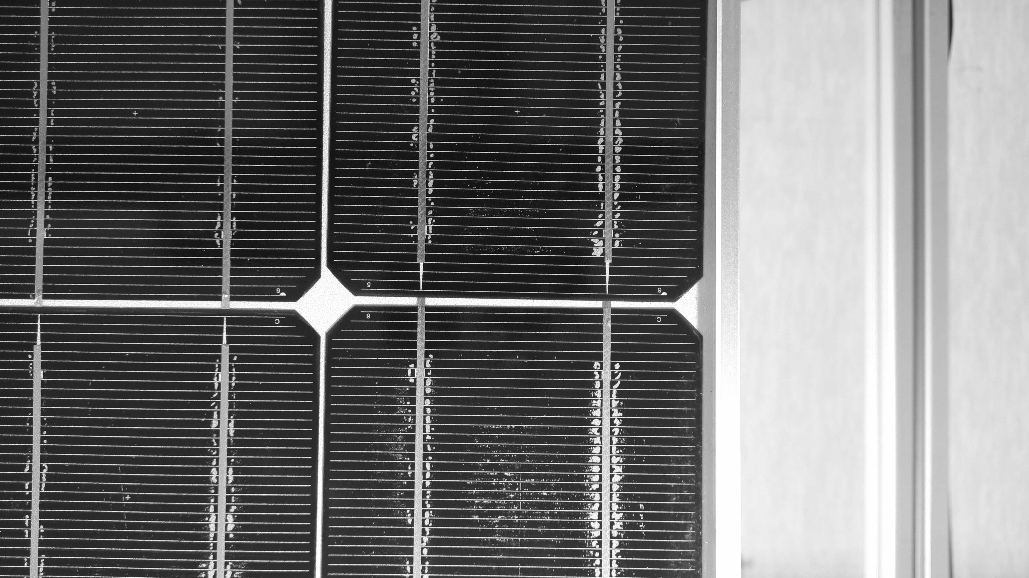
Further efforts on image processing: rotation and cropping
Pattern recognition at cell level to determine if frame is horizontal.
Correct image and crop
How is the frame rotated?
Apply mask to increase contrast
Edge detection
Ignore lines > 5°
Rotate to median of angles
13

Slide 14
Further research
Camera based
  Test Sony IMX477 12MP camera
    16mm telephoto camera lens
    8-50mm Zoom Lens
    Industrial Microscope Lens - 0.12-1.8x
    M12 High Resolution Lens, 12MP, 160°
  EL imaging
Image processing
  Distortion correction
  Complex image stitching
On-site machine
  Machine design and building / testing
14
14

Slide 15
References
[1] https://www.engineeringforchange.org/wp-content/uploads/2017/09/Solar-PV-Product-Visual-Inspection-Guide.pdf
[2] Buerhop, C. (2025, January 30–31). Field Experience of Glass‑Backsheet and Glass‑Glass Modules [Conference presentation].
[3] https://tmt.co.il/product/solar-panels-thermal-visual-inspection
[4] https://www.cea3.com/electroluminescence-el-testing-for-pv-modules
[5] https://www.linkedin.com/company/pvinsight
[6] https://www.linkedin.com/company/pvinsight
15

Slide 16


Acknowledgements:
Department of Science and Innovation of South Africa and Nelson Mandela University
Supervisors Prof Ernest Van Dyk, Dr Frederik Vorster
Notes:
Acknowledgements and thanks go to the Department of Science Innovation, Azur Space and Nelson Mandela University.

Slide 17


