Slide 1



Reconfigurable Payload Power Management System for Rockets
Dr Marco Mariola
And
Tyrone Swanepoel
69th South African Institute of Physics Conference
7th – 11th July 2025
Wits University
Aerospace Systems Research Institute
University of KwaZulu-Natal, South Africa

Slide 2
Outline
Design Objectives
High-Level Diagram
Touchless switching of the power management system
The Switches
Control board activation
Conclusion and Possible Extensions

Slide 3
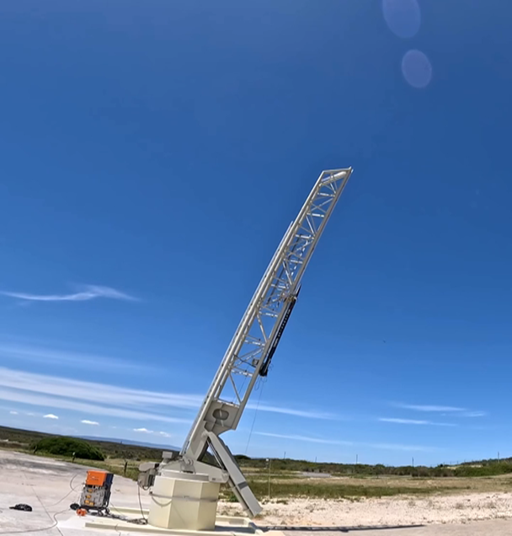
Design Objectives
The device shall be remotely controllable, with the ability to power on and exclude payloads as required.
The project offers flexibility to meet client needs, with an optional dedicated power source.
For spin-stabilized rockets, maintaining dynamic balance about the spin axis is a critical design requirement for the power control system architecture to ensure stable performance.
Grounds are galvanically isolated to eliminate common-mode noise and prevent ground loop currents.
Protection against plasma-induced effects.
The project does not include any electro-mechanical parts.

Slide 4
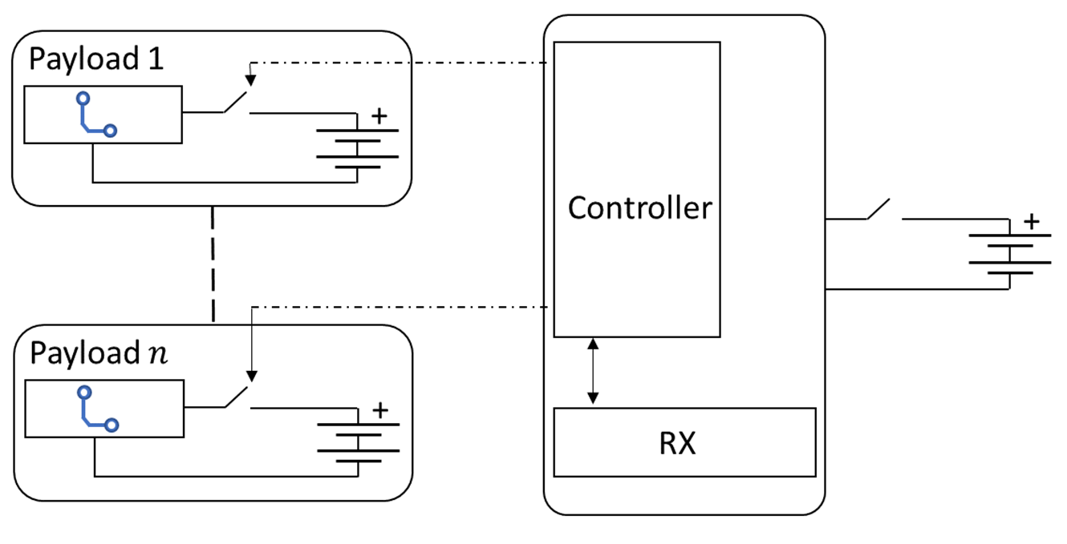
High level diagram

Slide 5
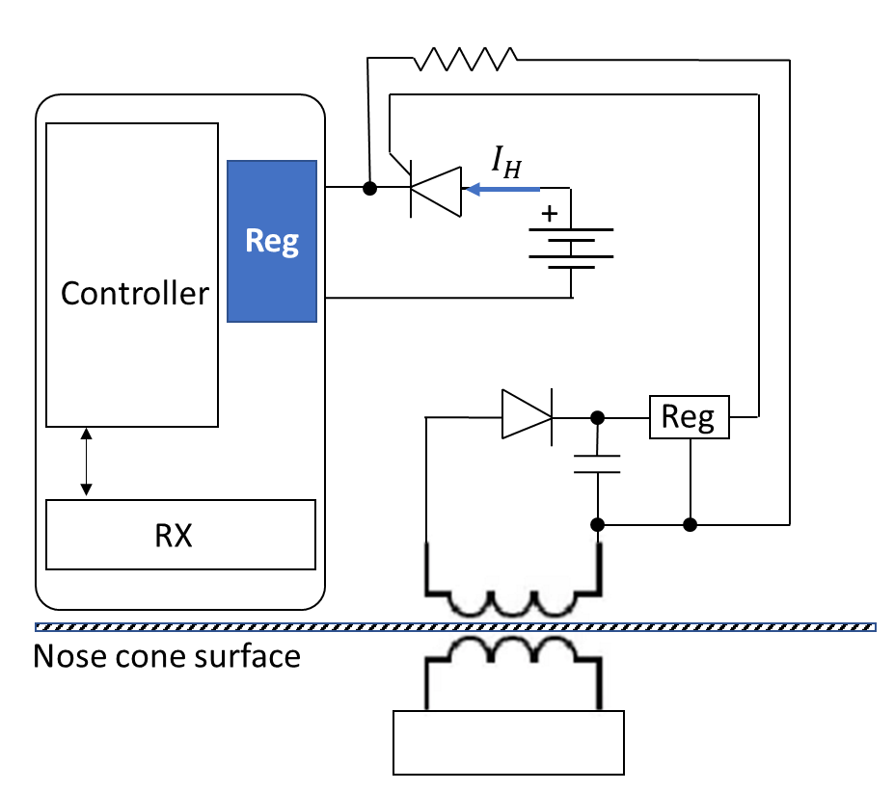
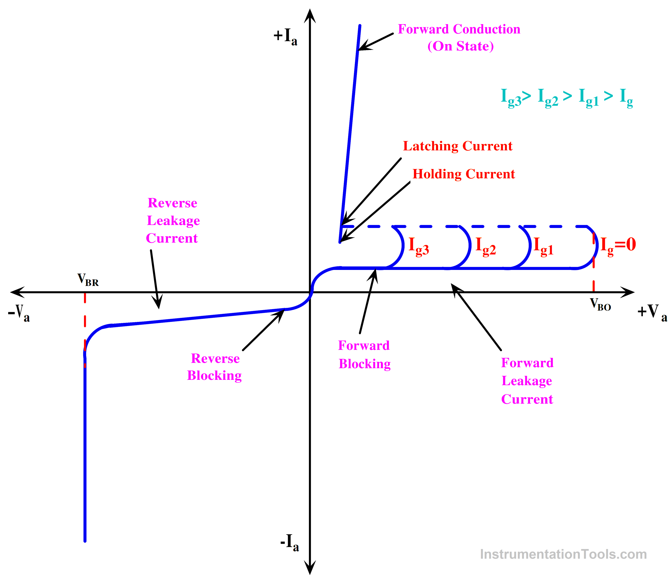
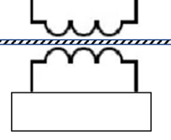

Touchless switching
Payload $n$
Payload 2
Payload 1
Switches
Controller

Slide 6
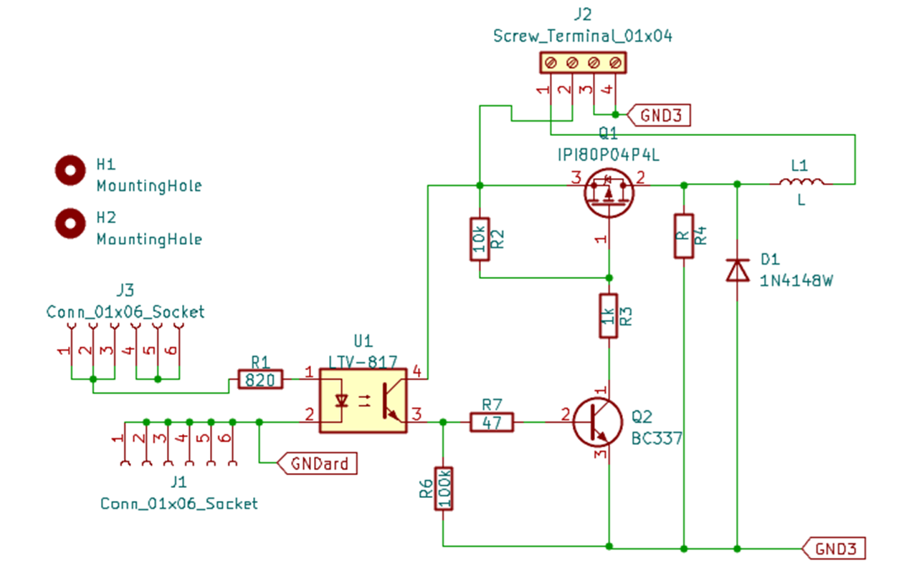
The Switches

Slide 7
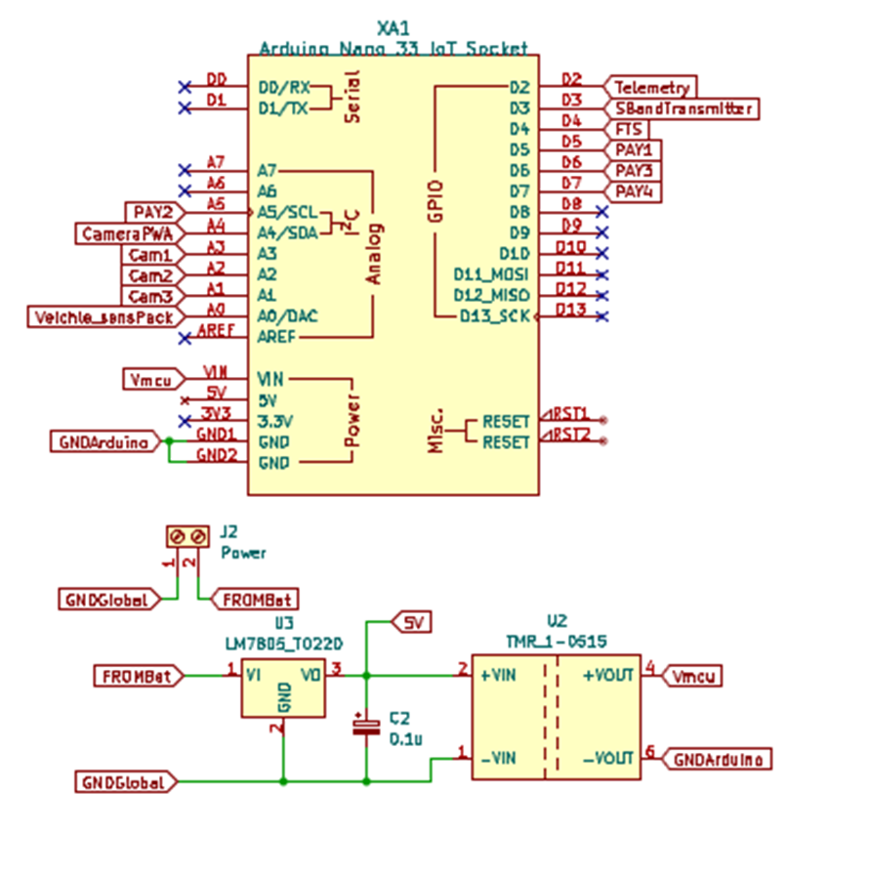
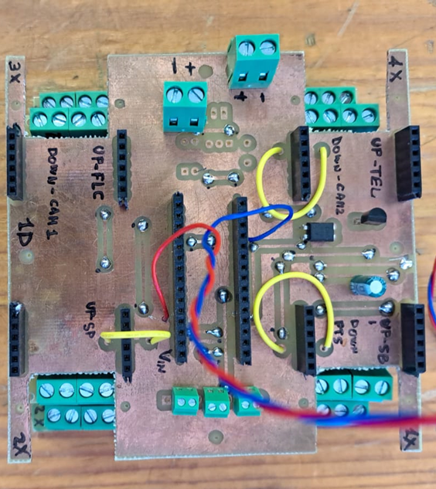
Main Board

Slide 8
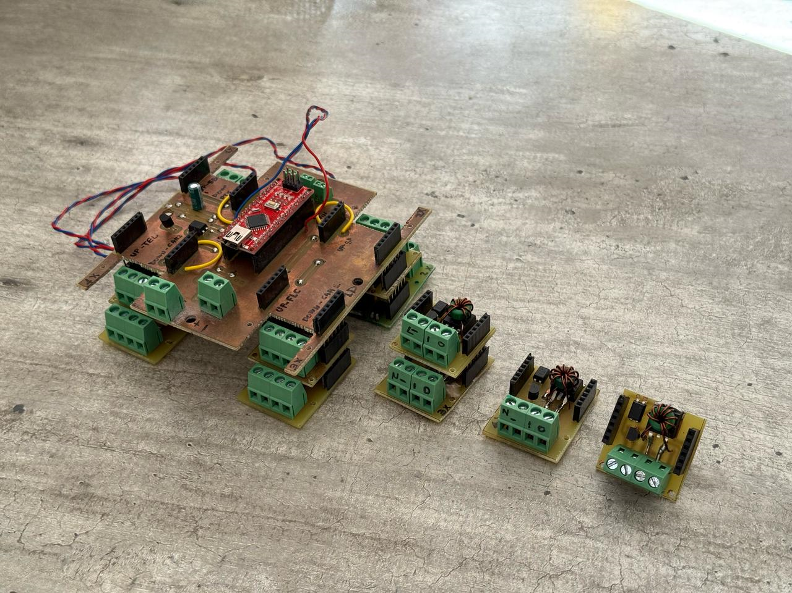
Assembled system

Slide 9
Assembled system

Slide 10
Conclusion
Post-testing, the system has been verified to control each payload through galvanic isolation.
For high currents Heat exchanger is necessary, and may require to reconfigure the main board.
Without the need for in-flight control, the circuit requires a single component replacement.
Future works require the implementation of the reciver.

Slide 11

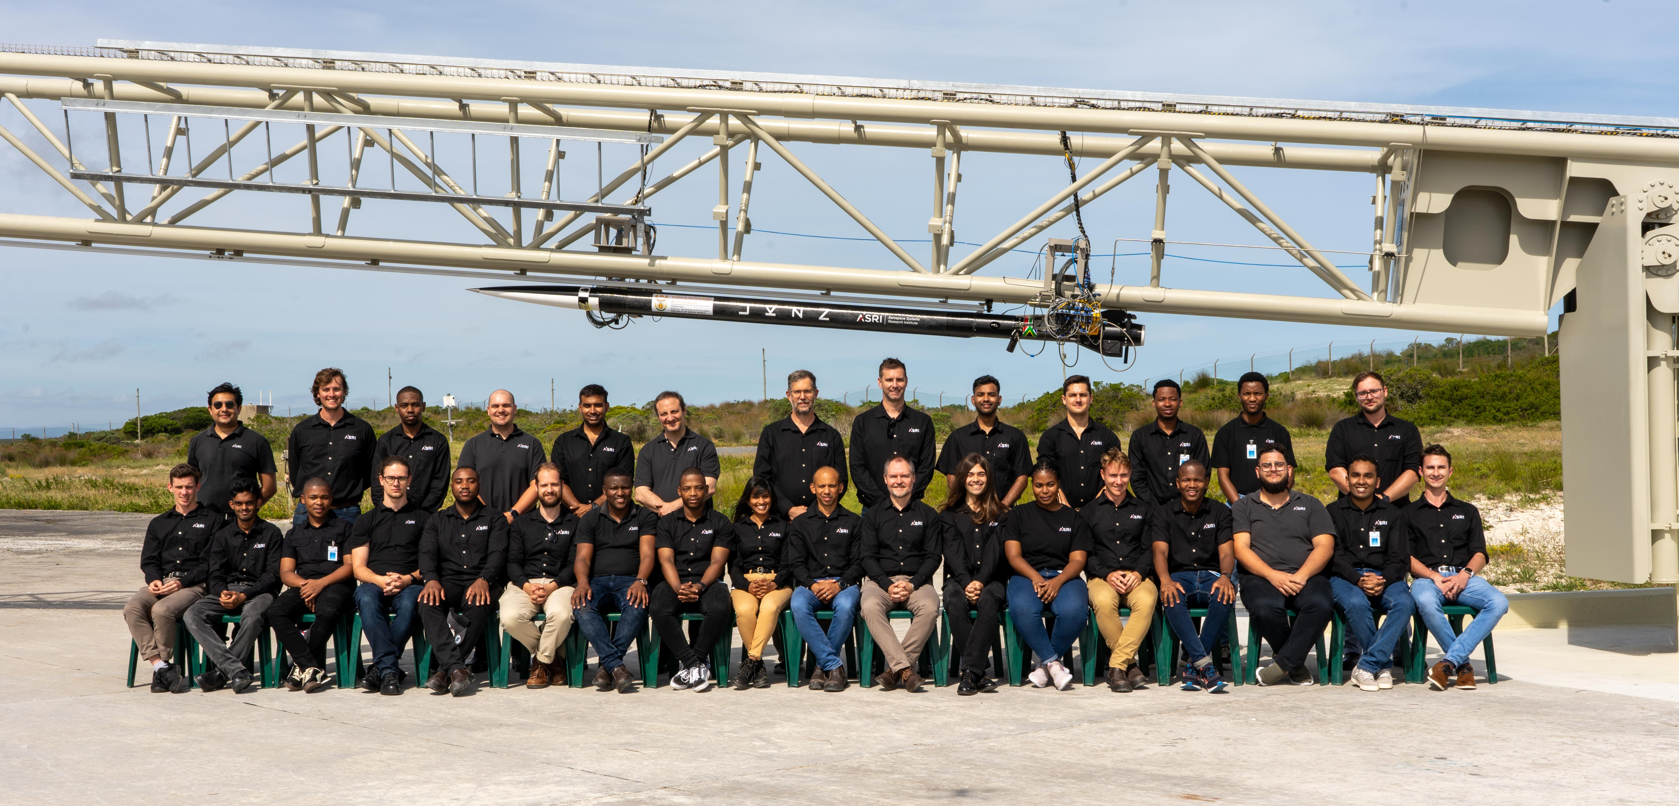
Acknowledgement
THANK YOU

