Slide 1





Faculty of
Health Sciences
Evaluation of Pheophorbide-a Cytotoxicity in Melanoma Cells Grown as Three-Dimensional Multicellular Tumour Spheroids
Nkune Williams Nkune and Prof Heidi Abrahamse
Laser Research Centre
Faculty of Health Sciences
University of Johannesburg

Slide 2
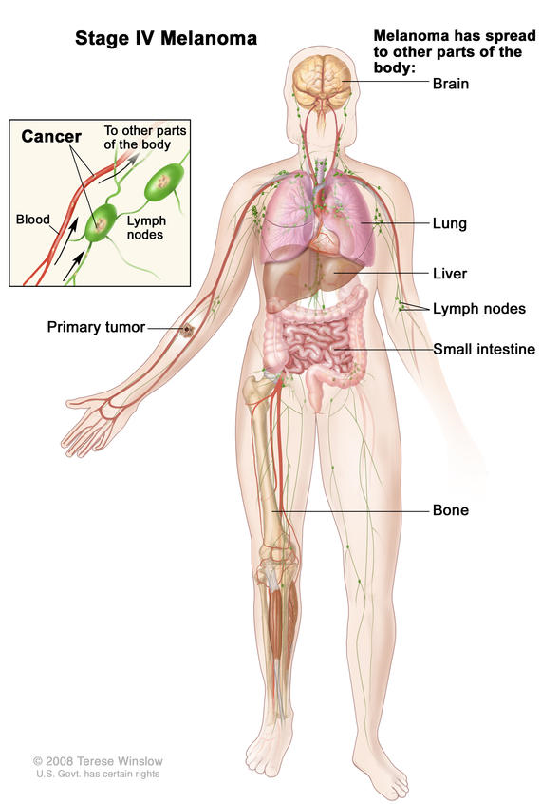
INTRODUCTION
Melanoma is the most aggressive form of skin cancer.
Accounts for only 4% of skin cancers, but results in 79% of skin cancer-related deaths.
Metastatic Melanoma.
Conventional therapies.

Slide 3
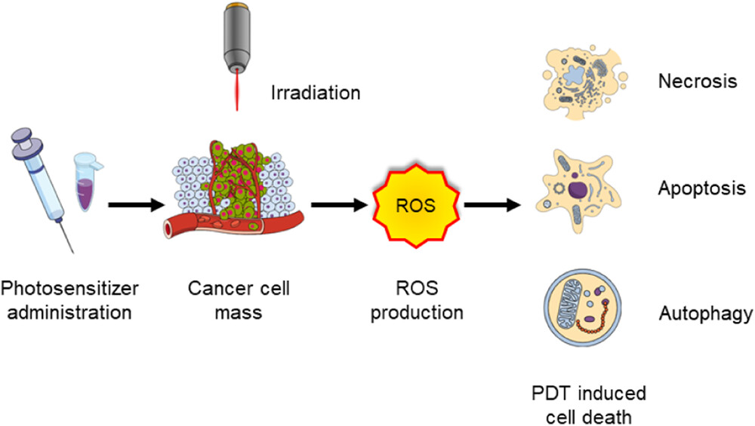
Metastatic Melanoma and Photodynamic Therapy
Photodynamic therapy (PDT) is based on the uptake of photosensitizers (PSs) by tumour cells, followed by their activation using an appropriate wavelength of laser light, which induces cell death, due to the production of reactive oxygen species (ROS).
Pheophorbide-a (650-700 nm).

Slide 4
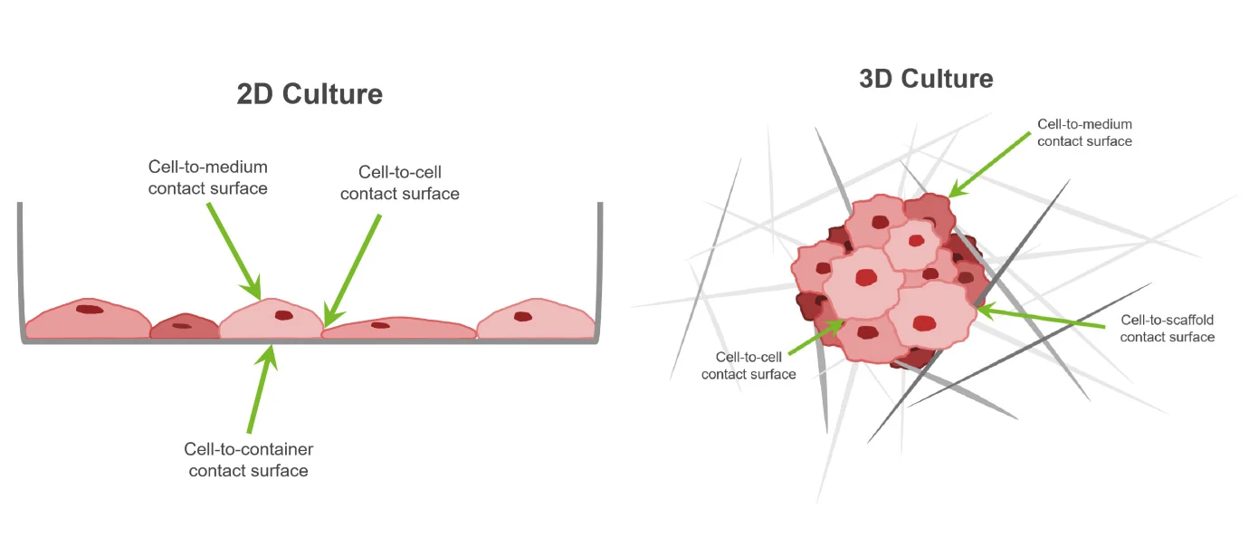
Three-Dimensional Versus Two-Dimensional Cell Culture Models
Two-dimensional cell cultures fail to mimic native tumours.
Significant deviations have been noticed in transferring the results from 2-D culture to in vivo experiments.
Clinical trials.
3-D cell cultures models.
  Cell-cell interactions.
  Gene expression.
  Nutrient and oxygen distribution.
  Drug resistant patterns noted in patients.

Slide 5
AIMS OF THE STUDY
To evaluate the phototoxicity of pheophorbide-a in melanoma cells cultured as monolayers and multicellular tumour spheroids.
To determine the treatment parameters that result in an approximately 50% decrease in cell viability in melanoma monolayers and multicellular tumour spheroids.

Slide 6
METHODOLOGY

Slide 7
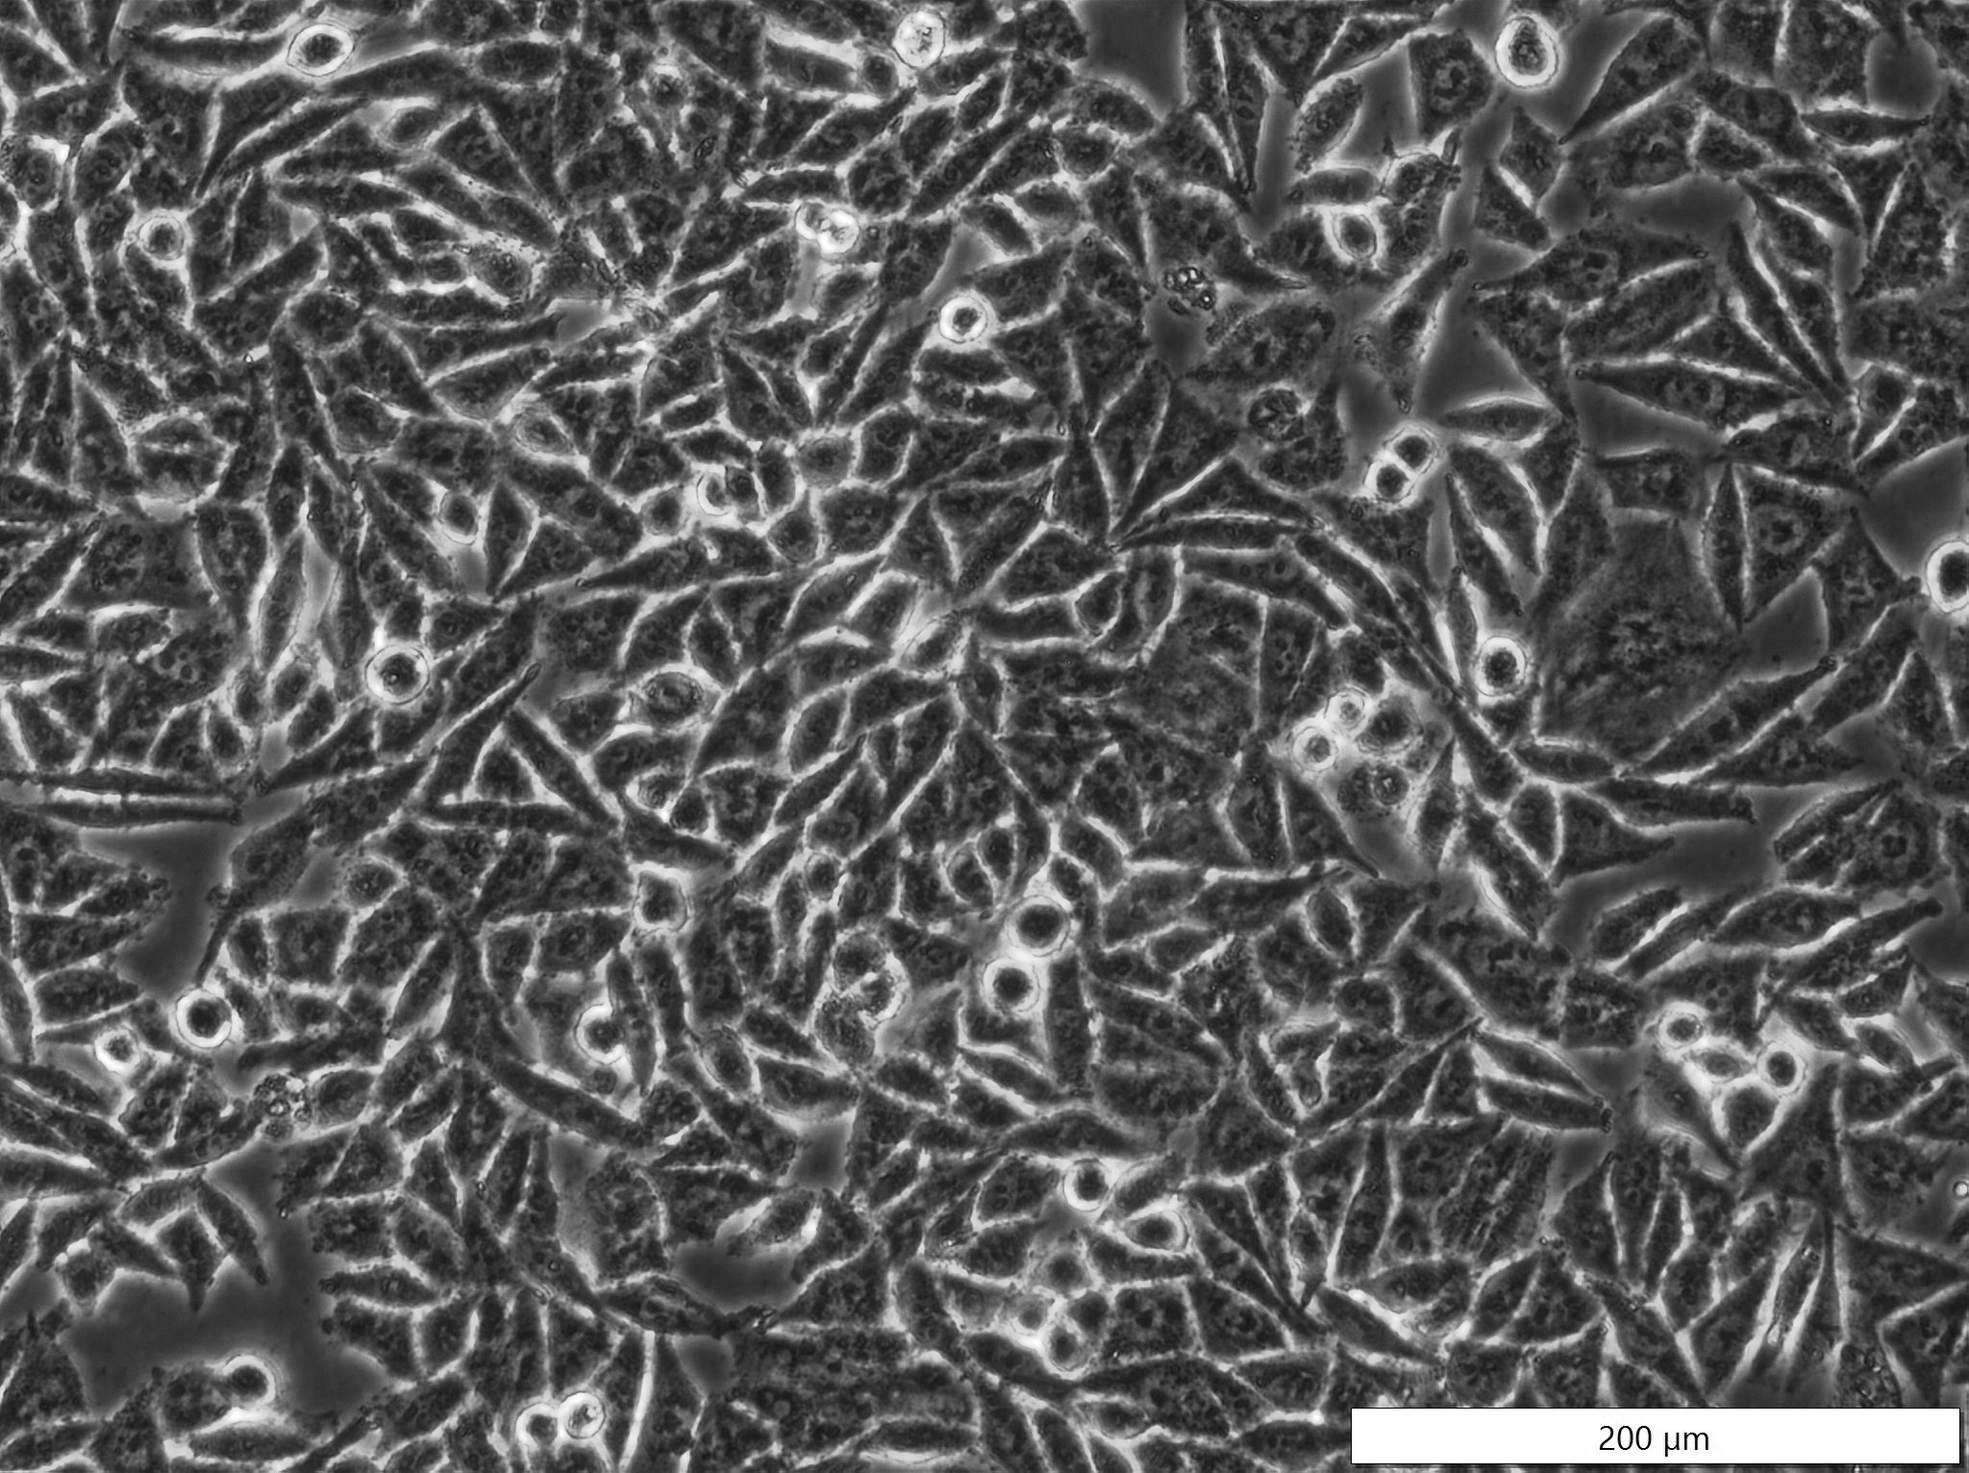
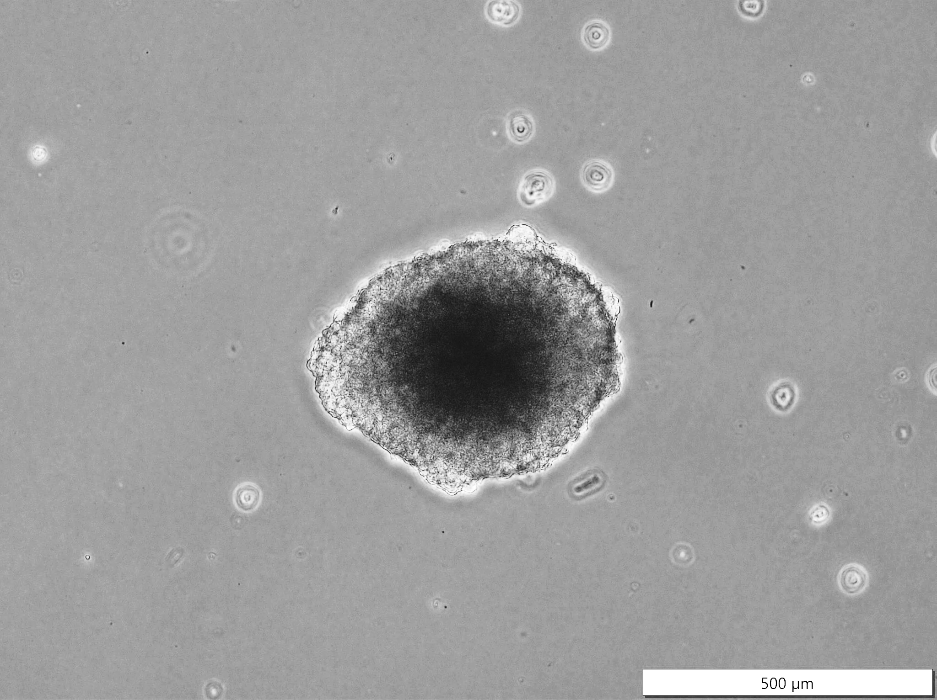
Monolayers
Ppa : 0.1 – 1.6 µM
Spheroids
Ppa : 5 – 40 µM
Melanoma Cancer cells
(A375 Cell line )
4 hours
Pheophorbide-a (Ppa) Incubation
24 hours
660 nm Diode Laser
Power output: 137 mW
Fluency: 10 J/cm²
Exposure time: 11 min:06 sec
660 nm Diode Laser
Power output: 137 mW
Fluency: 1 J/cm²
Exposure time: 1 min:06 sec
Laser Irradiation
Cellular Responses 24 h Post PDT
Morphological changes
Inverted Light Microscope
Cellular Proliferation
Adenosine Triphosphate (ATP)
Live/Dead Acridine orange & ethidium
Cytotoxicity
Dehydrogenase (LDH)

Slide 8
RESULTS AND DISCUSSION

Slide 9
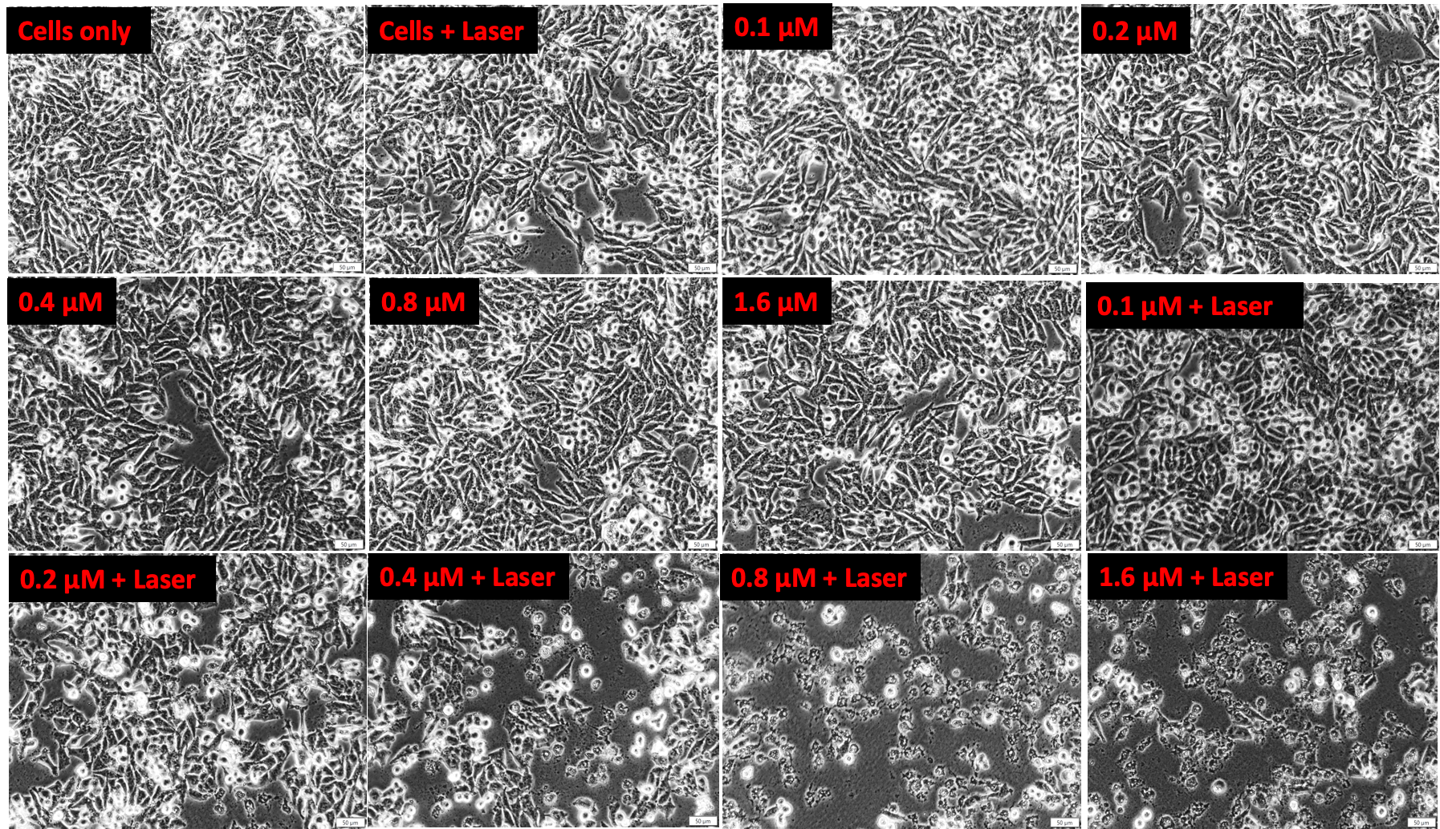
Morphological Features
Figure 1. No morphological changes were noted in cells treated with laser irradiation alone or varying doses of Ppa alone when compared to untreated cells. However, cell blebbing, rounding and shrinkage were noted in PDT-treated cells (0.4-1.6 µM).

Slide 10
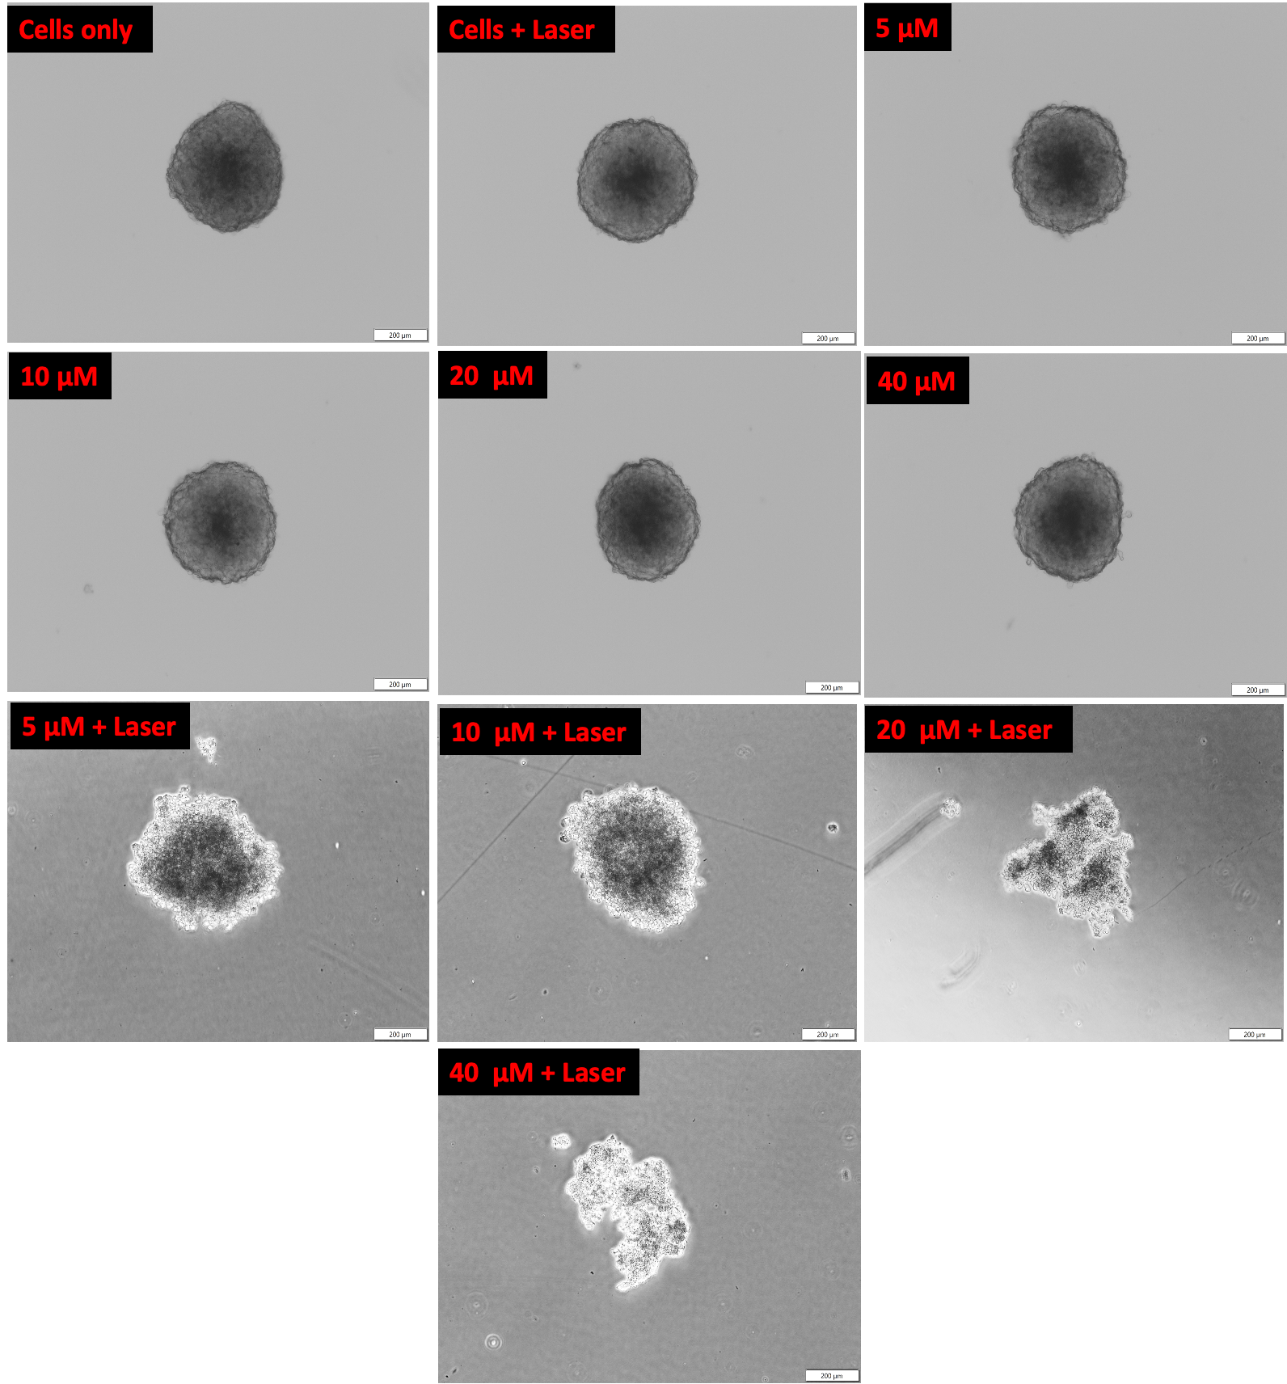
Figure 2. No morphological changes were noted in spheroids treated with laser irradiation alone or varying doses of Ppa alone when compared untreated cells. PDT-treated spheroids (5 & 10 µM) showed a disrupted outer membrane (severe disruption at 20 and 40 µM).

Slide 11
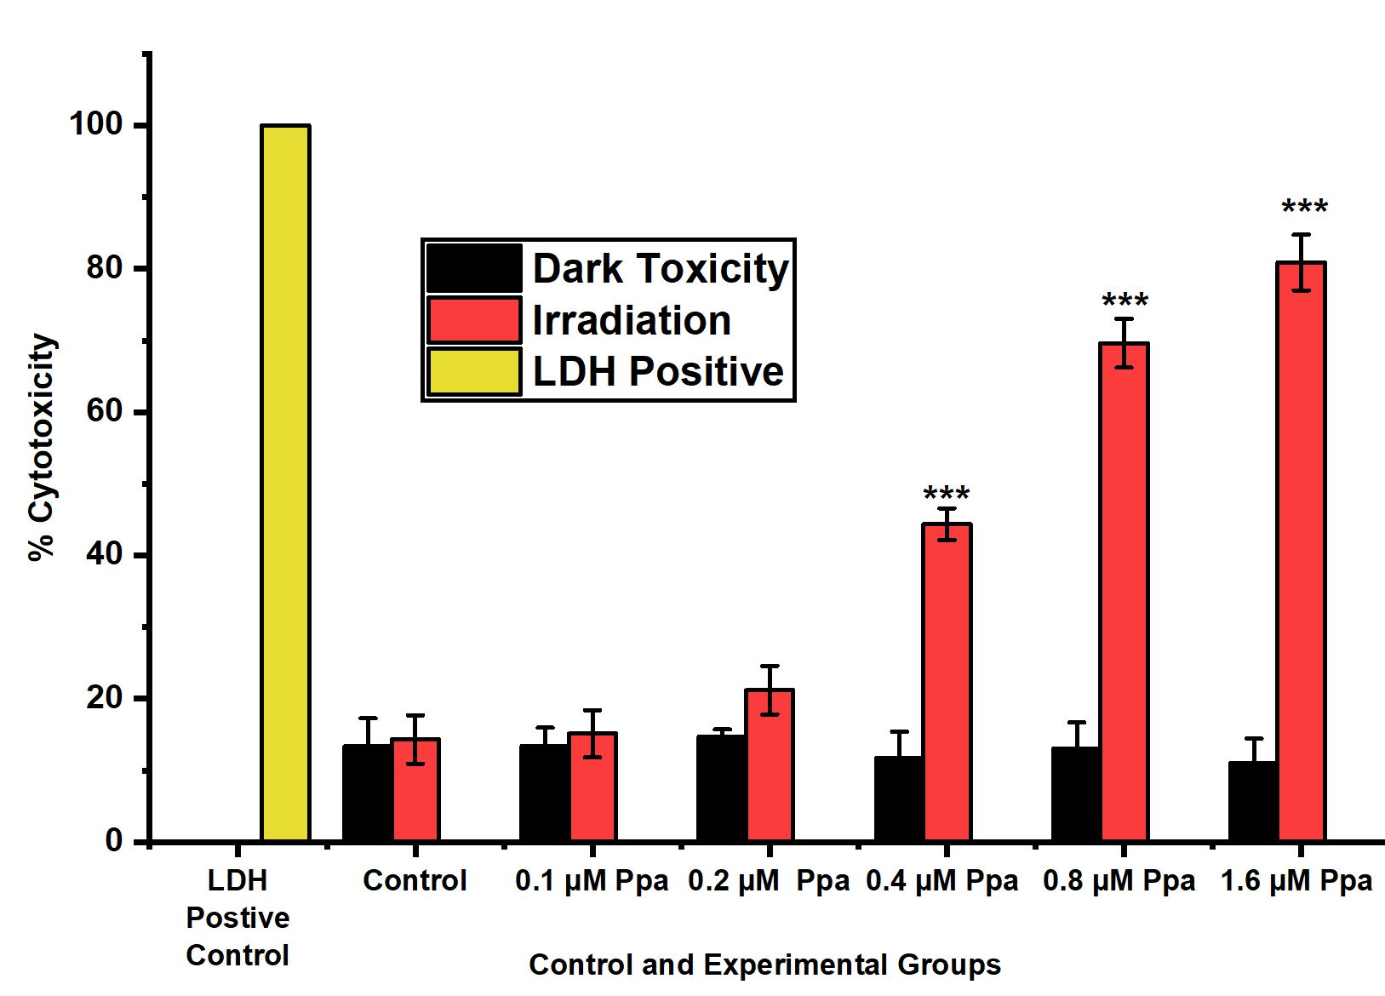
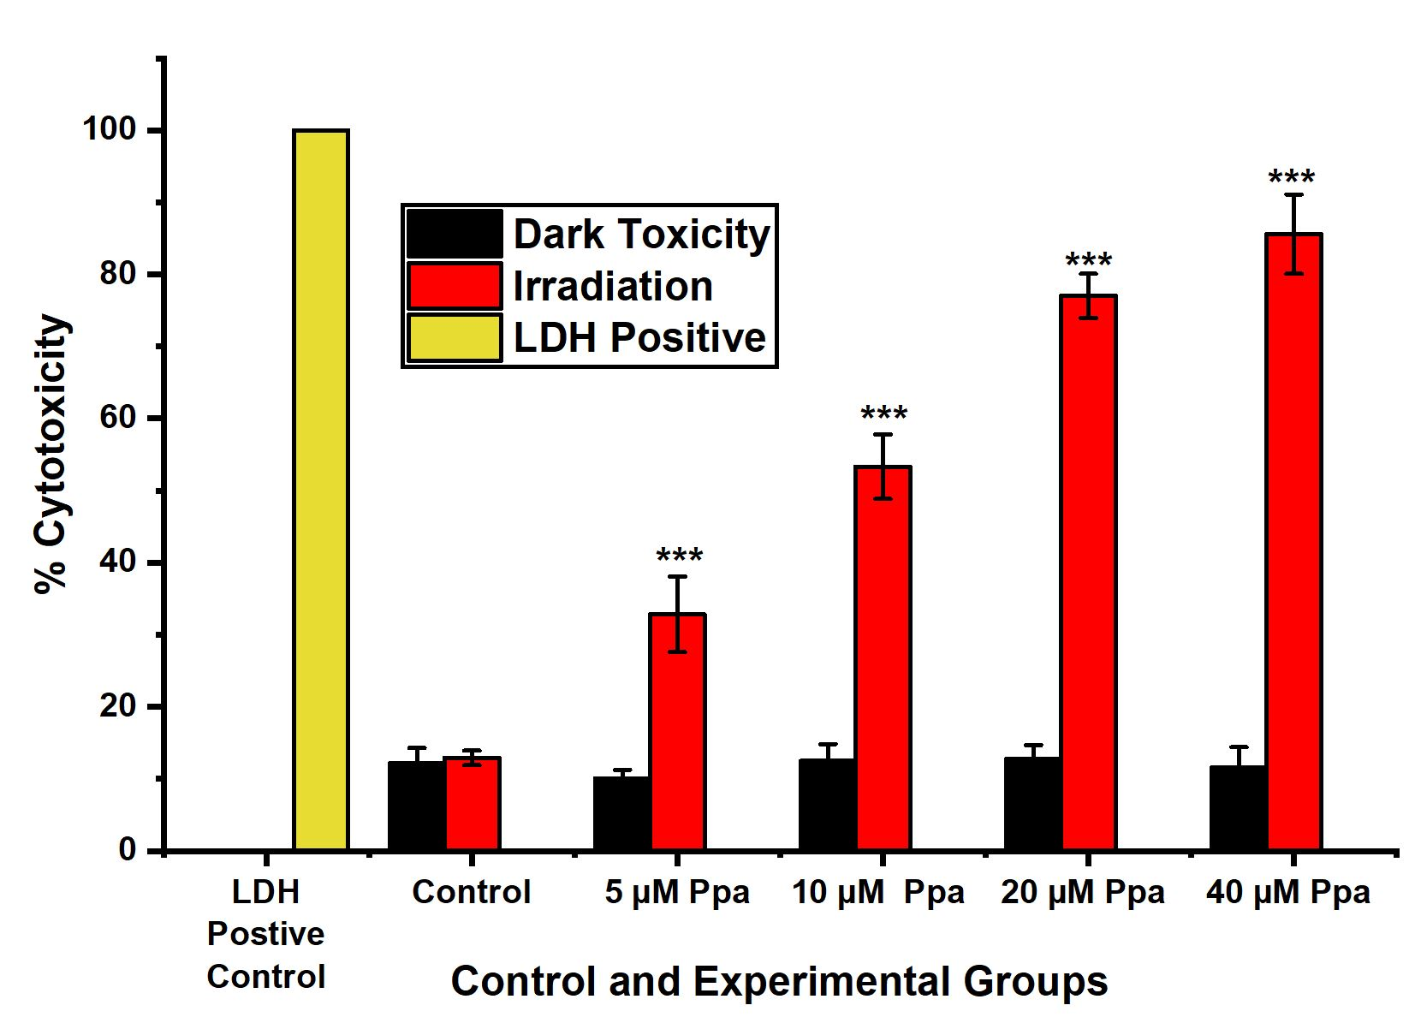
Cytotoxicity [Membrane Integrity Assay]
Monolayers
Spheroids
Figure 3. PDT-treated A375 monolayers showed a significant dose-dependent increase in LDH release when compared to untreated cells (P<0.001***). IC₅₀ of monolayers and spheroids was 0.47 and 9.3 µM, respectively.

Slide 12
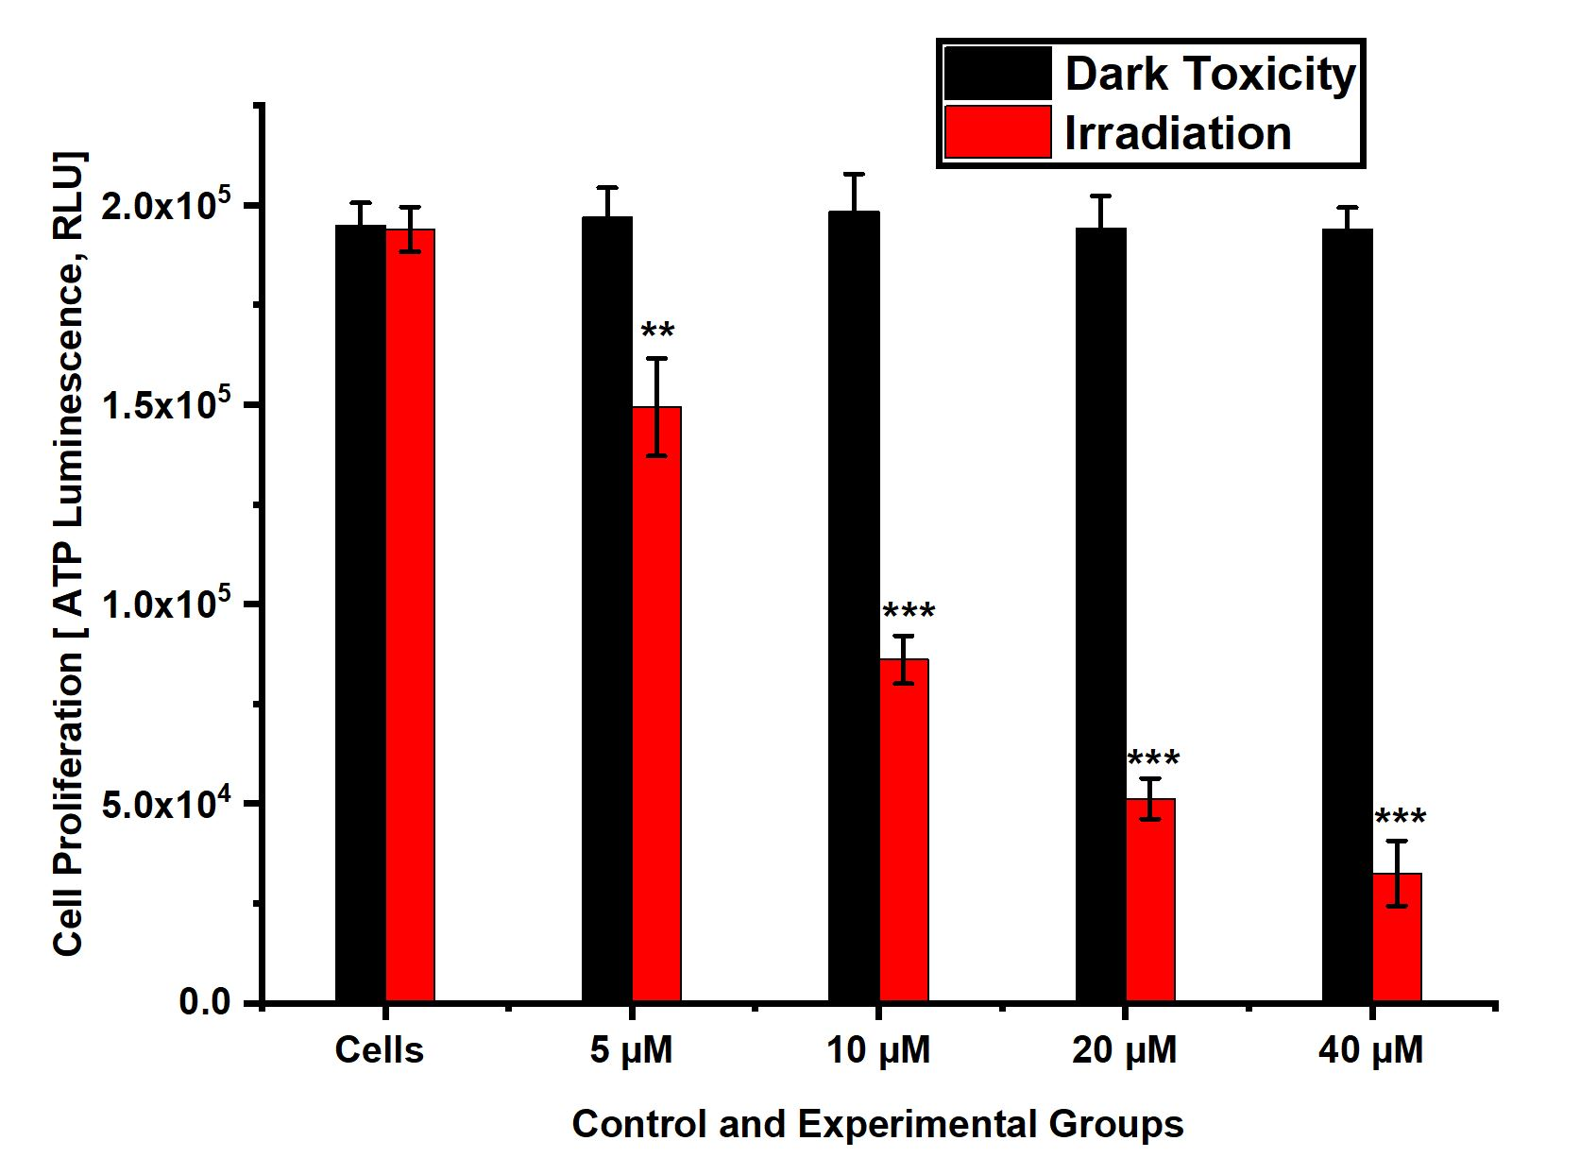
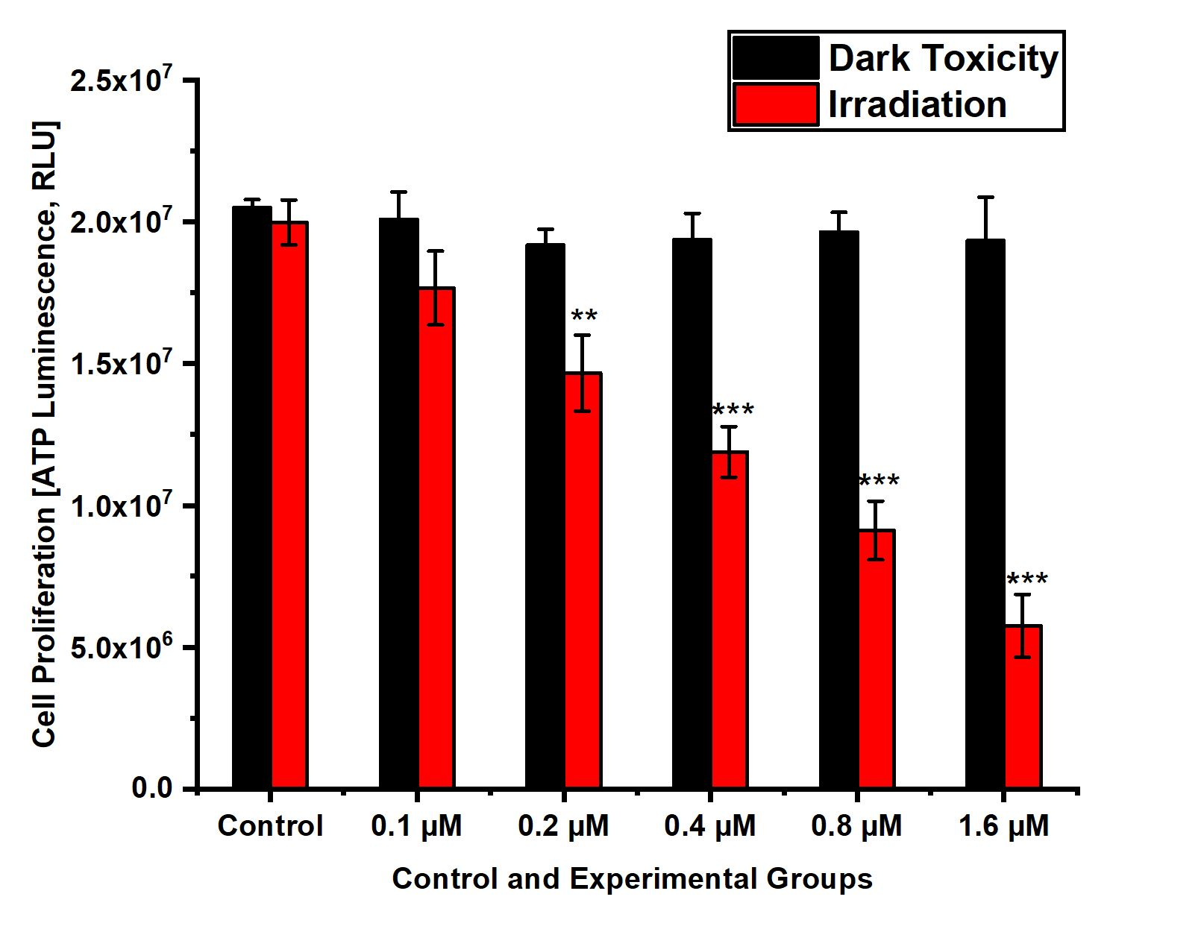
Cellular Proliferation
A
B
Figure 4. PDT-treated A375 monolayers (A) and Spheroids (B) showed a significant dose-dependent decrease cellular proliferation when compared to untreated cells (P<0.01** and P<0.001***).

Slide 13
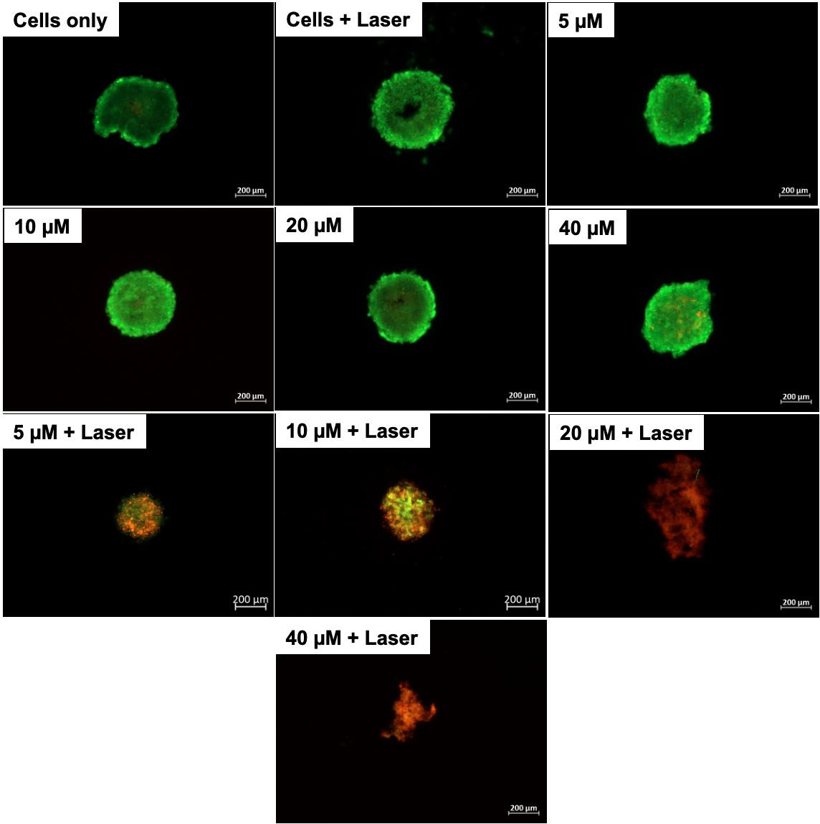
Live/Dead
acri
AO: Green fluorescent signal (Live)
EtBr: Red fluorescent signal (Dead)
Figure 5. Fluorescent images showed that control spheroids did not take up the EtBr staining (red), suggesting a negative cytotoxicity. While PDT-treated spheroids absorbed EtBr stain due to their compromised cytoplasmic membrane.

Slide 14
Conclusion
2-D cell culture models are more susceptible to PDT than 3-D tumour spheroid.
The IC50 concentration of pheophorbide and fluency used in spheroids was higher than in monolayers.
2-D cell culture models often produce misleading results that do not reflect in vivo conditions.
3-D multicellular tumour spheroids provide a more accurate model that can bridge the gap between in vitro and vivo studies.

Slide 15
REFERENCES
Abramczyk, H., Brozek-Pluska, B., Surmacki, J., Tondusson, M., and Freysz, E. (2017). Photostability of biological systems—Femtosecond dynamics of zinc tetrasulfonated phthalocyanine at cancerous and noncancerous human Breast tissues. Journal of Photochemistry and Photobiology A: Chemistry. 332:10-24.
Armstrong, J.L., Hill, D.S., McKee, C.S., Hernandez-Tiedra, S., Lorente, M., Lopez-Valero, I., Anagnostou, M.E., Babatunde, F., Corazzari, M., Redfern, C.P. and Velasco, G., (2015). Exploiting cannabinoid-induced cytotoxic autophagy to drive melanoma cell death. Journal of Investigative Dermatology. 135(6):1629-1637.
Babu, A., Templeton, A.K., Munshi, A. and Ramesh, R.N. (2013). Nanoparticle-based drug delivery for therapy of lung cancer: progress and challenges. Journal of Nanomaterials. http://dx.doi.org/10.1155/2013/863951.
Calavia, P.G., Chambrier, I., Cook, M.J., Haines, A.H., Field, R.A. and Russell, D.A. (2018). Targeted photodynamic therapy of breast cancer cells using lactose-phthalocyanine functionalized gold nanoparticles. Journal of colloid and interface science. 512: 249-259.
Colombeau, L., Acherar, S., Baros, F., Arnoux, P., Gazzali, A.M., Zaghdoudi, K., Toussaint, M., Vanderesse, R. and Frochot, C. (2016). Inorganic nanoparticles for photodynamic therapy. Light-responsive nanostructured systems for applications in nanomedicine (Springer, Cham). 113-134.
Danaee, H., Kalebic, T., Wyant, T., Fassan, M., Mescoli, C., Gao, F., Trepicchio, W.L. and Rugge, M. (2017). Consistent expression of guanylyl cyclase-C in primary and metastatic gastrointestinal cancers. PloS one. 12(12).
Domingues, B., Lopes, J.M., Soares, P. and Populo, H. (2018). Melanoma treatment in review. ImmunoTargets and therapy, 7:35
Dora, C.P., Singh, S.K., Kumar, S., Datusalia, A.K. and Deep, A. (2010). Development and characterization of nanoparticles of glibenclamide by solvent displacement method. Acta Pol Pharm. 67(3): 283-90.
Freeman, K., Dinnes, J., Chuchu, N., Takwoingi, Y., Bayliss, S.E., Matin, R.N., Jain, A., Walter, F.M., Williams, H.C. and Deeks, J.J. 2020. Algorithm based smartphones apps to assess risk of skin cancer in adults: systematic review of diagnostic accuracy studies. British medical journal, 368
Feuerer, L., Lamm, S., Henz, I., Kappelmann-Fenzl, M., Haferkamp, S., Meierjohann, S., Hellerbrand, C., Kuphal, S. and Bosserhoff, A.K. (2019). Role of melanoma inhibitory activity in melamocyte senescence. Pigment cell & melanoma research, 32(6):777-791
Gomez, S., Tsung, A. and Hu, Z. (2020). Current Targets and Bioconjugation Strategies in Photodynamic Diagnosis and Therapy of Cancer. Molecules, 25, 4964. Doi:10.3390/molecules25214964
Gupta, A. and Thakur, S. (2021) Melanoma Detection Among Various Skin Lesions. In proceedings of International Conference on Big Data, Machine Learning and their applications, pp. 245-256, Springer, Singapore
Hoarau-Vechot, J., Rafii, A., Touboul, C. and Pasquier, J., (2018). Halfway between 2D and animal models: are 3D cultures the ideal tool to study cancer-microenvironment interactions? International journal of molecular science, 19(1):181

Slide 16












ACKNOWLEDGEMENTS
THANK YOU
DANKIE
NGIYABONGA
ENKOSI
ASANTE
NANDRI
GRAZIE
DAALỤ
XIÈXIE
GRACIAS
DHANYAVAAD
SHUKRAN
OBRIGADA
SPASIBO
ARIGATŌ
ZIKOMO
MERCI
спасибо

Slide 17
