Slide 1


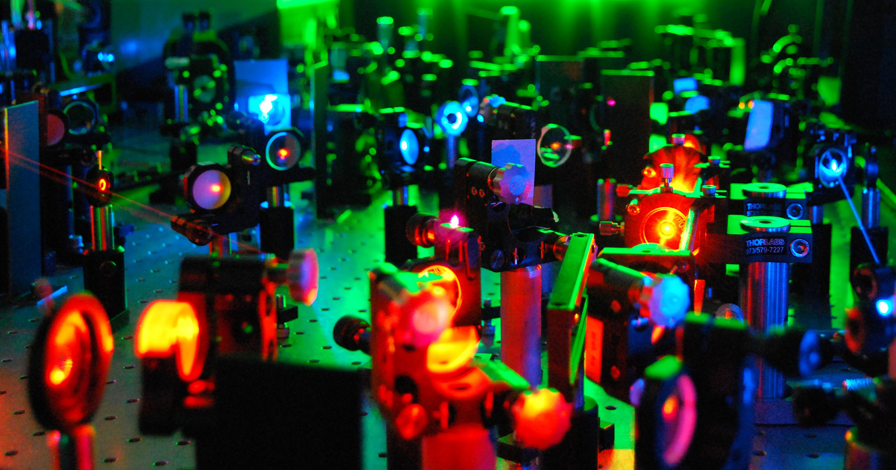

Rate equations for the control of ${}_{}^{171}{Yb}$ ions by Abigail Iyer
Supervisor: Dr Christine Steenkamp
Co-supervisor: Prof Pieter Neethling
Photo by Stefan Els
Stellenbosch Photonics Institute, Department of Physics, Stellenbosch University
Notes:
Good morning, everyone. My name is Abigail Iyer, and I’m currently a master’s student in laser physics at Stellenbosch University. Today, I’ll be presenting my research on using rate equations for the control of ytterbium 171 ions

Slide 2
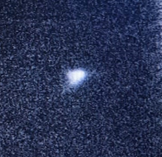
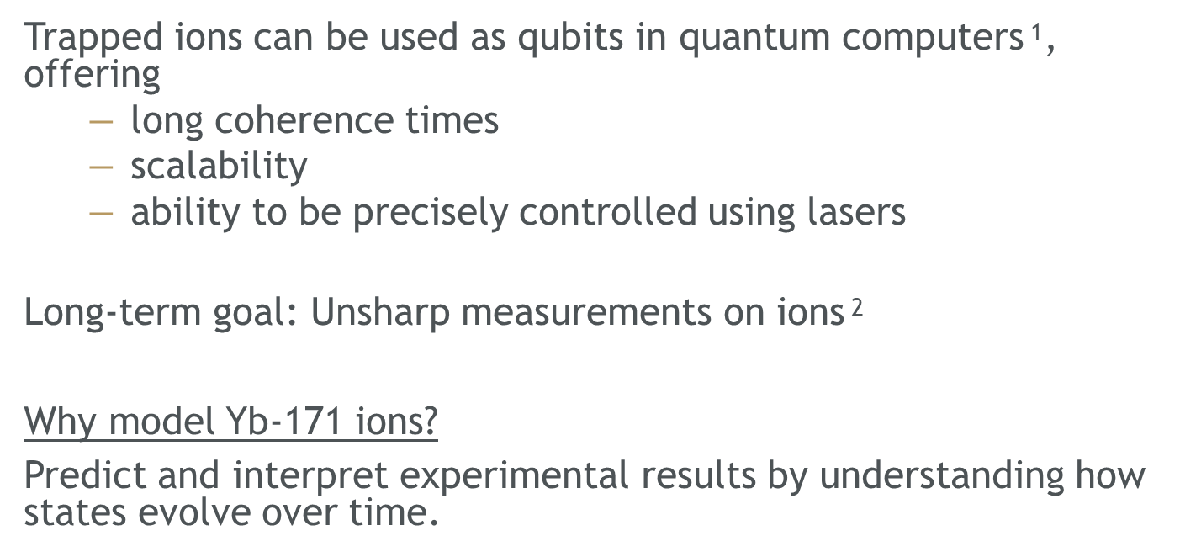
Background
Trapped ions can be used as qubits in quantum computers$^{\text{1}}$, offering
  long coherence times
  scalability
  ability to be precisely controlled using lasers
Long-term goal: Unsharp measurements on ions$^{\text{2}}$
Why model Yb-171 ions?
Predict and interpret experimental results by understanding how states evolve over time.
Single trapped ytterbium ion
Image by Siann Bester PhD student
[1] H. H¨affner, C. Roos, and R. Blatt. Quantum computing with trapped ions. Physics reports, 469(4):155–203, 2008.
[2] S. Choudhary, T. Konrad, and H. Uys. Implementation schemes for unsharp measurements with trapped ions. Phys. Rev. A, 87(1):012131, 2013.
Notes:
Trapped ions are a leading physical implementation of qubits which can be used in quantum computers offering long coherence times, scalability and the ability to be precisely controlled using lasers.
The Stellenbosch University ion-trapping project is a quantum control project with a long-term goal to achieve unsharp measurements between two weakly entangled ions in a linear Paul trap. In other words, extracting information about one qubit using another without fully collapsing its state.
On the right is a really cool image of a single fluorescing ytterbium ion in the trap taken by my lab partner.
So, why do we want to model the ytterbium 171 ions?
Well, we’d like to understand how their states evolve over time as a means of predicting and interpreting the experimental results for the processes we perform on them.

Slide 3


Background: Experimental setup
14.7 GHz
Doppler cooling, state preparation (Yb-171, Yb-174)
state detection,
ionisation (Yb-171)
EOM
Electro-optic modulators (EOMs) add sidebands.
Acousto-optic modulators (AOMs) act as switches.
369nm
AOM
AOM
EOM
399nm
2.1 GHz
Isotope selective ionisation
$${}_{}^{171}{Yb}$$
$${}_{}^{174}{Yb}$$
Electron shelving (Yb-171)
Sideband cooling (Yb-174)
411nm
AOM
EOM
935nm
3.1 GHz
EOM
Repump from dark states
microwaves
638nm
Drive Rabi oscillations for
qubit transitions
Notes:
Here we have a simplified schematic of our experimental setup, consisting of several lasers, some modulated by EOMs and AOMs, leading to a vacuum chamber containing the ytterbium.
On top, is the 369 nm laser driving the primary transitions needed to doppler cool, state prepare, and state detect our ions.
The 399 nm laser is used when selectively ionizing the atoms
We have a 411 nm laser which we may use to sideband cool and electron shelve
The bottom two lasers, 935 nm and 638 nm are repump lasers and drive electrons out of long-lived dark states.
Below are microwaves which we use to drive rabi oscillations for qubit transitions

Slide 4



The hyperfine structure of the ${}_{}^{171}{Yb}$ ion
Atoms
Ionisation
Trapped Ions
Doppler cool
Ions
in mixed state
State prepare
Ions in
ground state
Experiment
Ions in final state
State detect
Ions fluoresce
³[3/2]_{1/2}
F = 0
¹[5/2]_{5/2}
2.2 GHz
F = 2
F = 1
F = 3
²P_{1/2}
F = 1
2.1 GHz
935 nm
F = 0
²D_{5/2}
F = 2
638 nm
F = 3
²D_{3/2}
0.86 GHz
F = 2
369 nm
F = 1
411 nm
F = 4
²F_{7/2}
F = 3
$$|1⟩$$
F = 1
²S_{1/2}
$$|0⟩$$
12.6 GHz
F = 0
Notes:
This is the hyperfine structure of the ytterbium 171 ion we are working with containing 60 hyperfine states interacting with up to 4 lasers
Arrows in colour correspond to laser transitions, dotted lines correspond to decays between levels
Down here are our qubit ground state and excited state, where ions spend most of their time.
###
Above is a little flow chart showing the typical order of events in the lab
We start out with a cloud of atoms, diffused into the vacuum chamber
We ionize them in a 2 step process using both the 369 and 399 nm laser and turn on the rotating electric fields which traps the ions
Initially, ions are hot and may escape the trap, so we doppler cool them with a 369 nm red-detuned laser, driving transitions corresponding to these first two 369nm arrows. Cooling in the model is quantified as the total number of S-P absorption-spontaneous emission cycles, which reduces the ion’s momentum parallel to the laser beam.

Slide 5
The hyperfine structure of the ${}_{}^{171}{Yb}$ ion
Atoms
Ionisation
Trapped Ions
Doppler cool
Ions
in mixed state
State prepare
Ions in
ground state
Experiment
Ions in final state
State detect
Ions fluoresce
³[3/2]_{1/2}
F = 0
¹[5/2]_{5/2}
2.2 GHz
F = 2
F = 1
F = 3
²P_{1/2}
F = 1
2.1 GHz
935 nm
F = 0
²D_{5/2}
F = 2
638 nm
F = 3
²D_{3/2}
0.86 GHz
F = 2
369 nm
F = 1
411 nm
F = 4
²F_{7/2}
F = 3
$$|1⟩$$
F = 1
²S_{1/2}
$$|0⟩$$
12.6 GHz
F = 0
Notes:
This leaves them in a mixed state – which isn’t very useful for experiments
So, we state prepare them into the qubit ground state, down here, using the 2nd and 3rd 369 nm transitions, emptying all other P and S states.
At this point one would perform some sort of quantum experiment on them
Afterwards, you'd like to know what its final state is, so you'd state detect them using the second 369nm transition. Ions in the excited state fluoresce and ions in the ground state do not.
Our main control processes take place here between the S and P level in the order of nanoseconds.
Most electrons will spontaneously decay from P to S, some will decay to D3/2 over here, with a lifetime in the order of milliseconds, and so we consider it a dark state. We repump it to the level above with a shorter lifetime so it spontaneously decays to the S level.
Similarly, when driving the 411nm transition, electrons may decay to this F state with a lifetime in the order of years. The 638nm laser repumps electrons out of this dark state.

Slide 6
Introducing the rate equations
Notes:
To model these ion-radiation interactions and trace the state populations of ions during the processes we use rate equations.

Slide 7



The rate equation model
Generic two-level system
Stimulated absorption
Spontaneous decay
Stimulated emission
E2
E2
E2
E1
E1
E1
$$\frac{dn_{1}}{dt}=−B_{12}Ρ(ω)n_{1}{+A}_{21}n_{2}+B_{21}Ρ(ω)n_{2}$$
(1)
$$\frac{dn_{2}}{dt}={ B}_{12}Ρ(ω)n_{1}−A_{21}n_{2}−B_{21}Ρ(ω)n_{2}$$
(2)
$(B_{ij}Ρ(ω)$and $A_{ij}$have units 1/s)
Notes:
Lets start of a simple, generic 2-level system to demonstrate how we construct rate equations for light interacting with an atom.
Here we have some lower and some upper energy levels E1, E2 with populations n1 and n2.
Below are the constructed einstein rate equations for these two levels.
A and B are the einstein coefficients. They are probabilistic rate constants that quantify how the ions interact with light.To clarify, this is not a P, it’s a capital rho and it is the energy density of the electromagnetic field.
###
During stimulated absorption, a photon is destroyed, and the atom is promoted to the excited state - decreasing the n1 population and increasing the n2 populating in red below
During spontaneously decay, in blue, an ion is demoted and a photon is created, increasing n1, decreasing n2.
Stimulated emission involves an excited ion, interacting with a photon, demoting and creating a photon, also increasing n1, decreasing n2.
These transitions govern how population flows between energy levels. The rate equations quantify this flow by expressing the time evolution of each state’s population based on the associated transition probabilities.

Slide 8
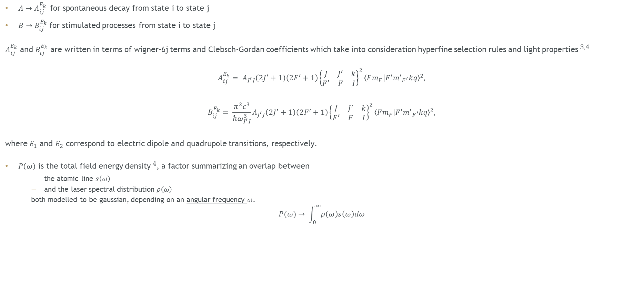
The rate equation model
${A→A}_{ij}^{E_{k}}$for spontaneous decay from state i to state j
${B→B}_{ij}^{E_{k}}$for stimulated processes from state i to state j
$A_{ij}^{E_{k}}$ and $B_{ij}^{E_{k}}$ are written in terms of wigner-6j terms and Clebsch-Gordan coefficients which take into consideration hyperfine selection rules and light properties$^{\text{3,4}}$
$$A_{ij}^{E_{k}}= A_{J^{′}J}\left(2J^{′}+1\right)\left(2F^{′}+1\right){{\left\{\begin{matrix}J & J^{′} & k \\ F^{′} & F & I\end{matrix}\right\}}^{2}\left\langle Fm_{F} | F^{′}{m^{′}}_{F^{′}}kq\right\rangle }^{2},$$
$$B_{ij}^{E_{k}}= \frac{π^{2}c^{3}}{ℏω_{J^{′}J}^{3}}A_{J^{′}J}\left(2J^{′}+1\right)\left(2F^{′}+1\right){{\left\{\begin{matrix}J & J^{′} & k \\ F^{′} & F & I\end{matrix}\right\}}^{2}\left\langle Fm_{F} | F^{′}{m^{′}}_{F^{′}}kq\right\rangle }^{2},$$
where $E_{1}$ and $E_{2}$ correspond to electric dipole and quadrupole transitions, respectively.
$P(ω)$ is the total field energy density$^{\text{4}}$, a factor summarizing an overlap between
  the atomic line $s\left(ω\right)$
  and the laser spectral distribution $ρ\left(ω\right)$
  both modelled to be gaussian, depending on an angular frequency $ω$.
$$P(ω)→ \int_{0}^{∞}{ρ\left(ω\right)s\left(ω\right)dω}$$
(3)
(4)
(5)
[3] G. K. Woodgate. ELEMENTARY ATOMIC STRUCTURE. 1970, 01 1970.
[4] D. A. Steck. Quantum and atom optics, 2006. Available online athttp://steck.us/teaching.
Notes:
Electrons move between states based on several factors like what those states are and what kind of light its interacting with.
We generalize A and B going from state i to state j and write them in terms of wigner-6j symbols and Clebsch-Gordan coefficients which very nicely take into consideration the hyperfine selection rules and light properties. Dashed terms are the initial state and non-dashed terms are the final state.
$E_{1}$ and $E_{2}$ correspond to electric dipole and quadrupole transitions
We extend rho to the total field energy density, a factor summarizing an overlap between
the atomic line $s\left(\right)$which models the fact that an energy level has some width
and the laser spectral distribution $ρ\left(\right)$ which depends on laser properties
− both modelled to be gaussian, depending on an angular frequency $ω$.

Slide 9
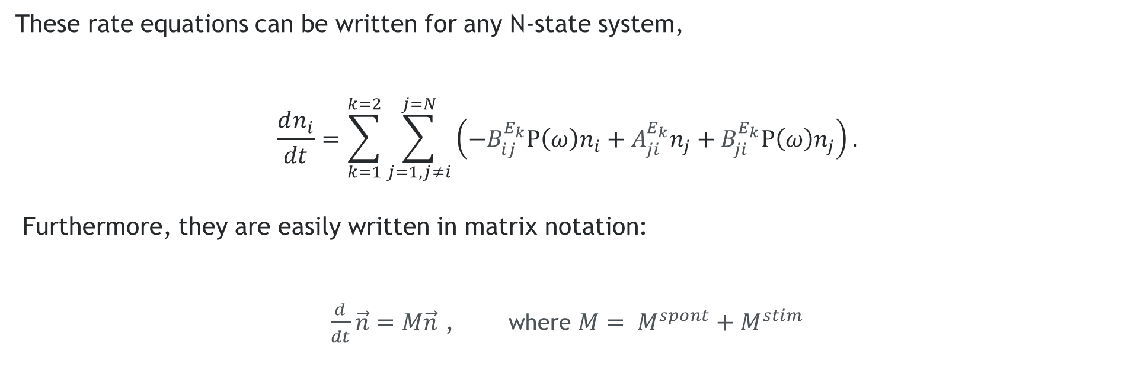
The rate equation model
These rate equations can be written for any N-state system,
$$\frac{dn_{i}}{dt}=\sum_{k=1}^{k=2}{\sum_{j=1,j≠i}^{j=N}{\left(−B_{ij}^{E_{k}}Ρ\left(ω\right)n_{i}+A_{ji}^{E_{k}}n_{j}+B_{ji}^{E_{k}}Ρ\left(ω\right)n_{j}\right)}.}$$
Furthermore, they are easily written in matrix notation:
$\frac{d}{dt}\vec{n}=M\vec{n}$ , where $M= M^{spont}+M^{stim}$
(5)
(6)
Notes:
Writing out each of the equations for 60 states potentially interacting with 60 other states for up to 4 different lasers is pretty impractical
The generalized rate equation for an N state system can be written like this
Furthermore, they are easily written in matrix notation, where M is a 60 by 60 matrix constructed by a spontaneous part and stimulated part.

Slide 10
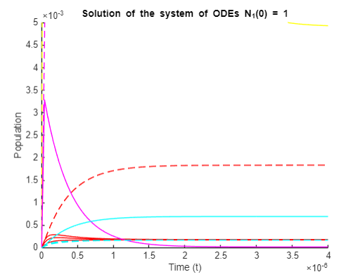
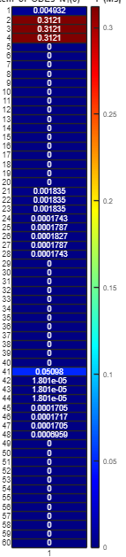
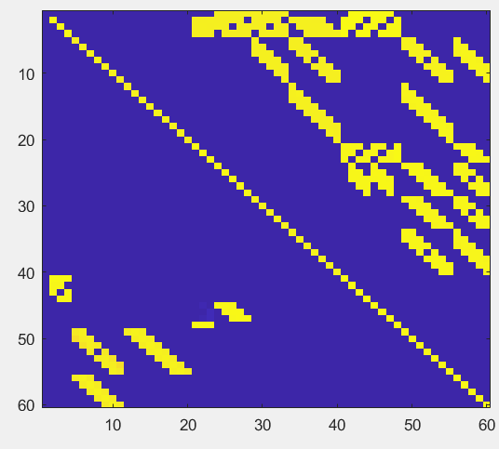
The rate equation model
OUTPUT
We may vary several different parameters:
  Control process
  Initial state
  Timespan (s)
  Wavelength
  Polarisation type
  Polarisation power ratios
  Total power
  Sideband to carrier power ratio
  Bandwidth
  Beam waist
Population evolution
Heatmap of final populations
Interacting levels (M matrix)
Notes:
We may vary several different parameters, I’ve listed some of them here:
You can choose which process you want to model, i.e. when to introduce certain lasers
You pick the initial state, which can be a single hyperfine state with 100% of the population like an idealized qubit in the ground state, or a mixed initial state like what you get after doppler cooling
How long you run each process for, typically in the order of nanoseconds, milliseconds if youre trying to achieve some specific state or cool a hot cloud.
Vary and detune the wavelengths of lasers
The type of polarization of each laser, some processes in the ytterbium 174 ion only require vertical polarization while in 171, a mix of circular and vertical polarization is needed to interact with more states

Slide 11
The rate equation model
OUTPUT
We may vary several different parameters:
  Control process
  Initial state
  Timespan (s)
  Wavelength
  Polarisation type
  Polarisation power ratios
  Total power
  Sideband to carrier power ratio
  Bandwidth
  Beam waist
Population evolution
Heatmap of populations
Interacting levels (M matrix)
Notes:
In the lab, these differently polarized beams have different powers, so you could adjust how strongly you want to drive transitions associated with each polarisation
Varying the power of different lasers changes the rate of processes
We use EOMs to create sidebands; when we increase the power in these sidebands the power of the carrier decreases as total power is conserved. And so, the sideband to carrier power ratio can be adjusted.
Change the bandwidth of a laser to be narrower for certain precise transitions
Finally, one could adjust the beam waist which affects the energy density, rho.

Slide 12
The rate equation model
OUTPUT
We may vary several different parameters:
  Control process
  Initial state
  Timespan (s)
  Wavelength
  Polarisation type
  Polarisation power ratios
  Total power
  Sideband to carrier power ratio
  Bandwidth
  Beam waist
Population evolution
Heatmap of populations
Interacting levels (M matrix)
Notes:
Solving the ODE and looking at the spread in populations tells us how efficient a process was.
OUTPUTs look like
A population vs time graph which visually shows us how populations evolve over time. Its helpful to see how fast a state decays or grows in relation to other states. You can look at the early dynamics before steady state and what timescales they took place on. You can see which states fed into other states and how electrons distributed themselves over a single energy level for different powers and sideband powers.
We represent interacting levels as a matrix to visualize what goes where
Or a convenient heatmap array of the final populations to see where things ended up at a glance

Slide 13
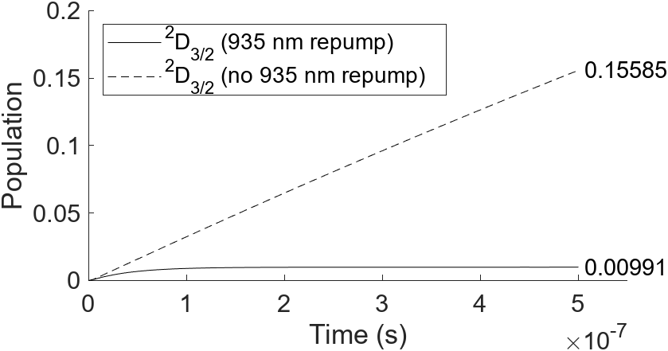
Results
Example 1:
No repump – notable loss of electrons to dark state ²D_{3/2}
Repump – negligible loss of electrons to dark state ²D_{3/2}
Doppler cooling with 369 nm laser
Notes:
Okay, Now that we’ve covered the theory, let’s look at how this numerical model plays out when applying it to Doppler cooling
Example 1:
Adjacent is a graph of the sum hyperfine state populations in D3/2, which considered a dark state during doppler cooling. The dotted line is how the population evolves over 0,5 us in the absence of the repump laser accumulating to over 15% of the total population. The solid line shows a plateau of less than 1%.
This shows how the model underscores the importance of the repump laser

Slide 14
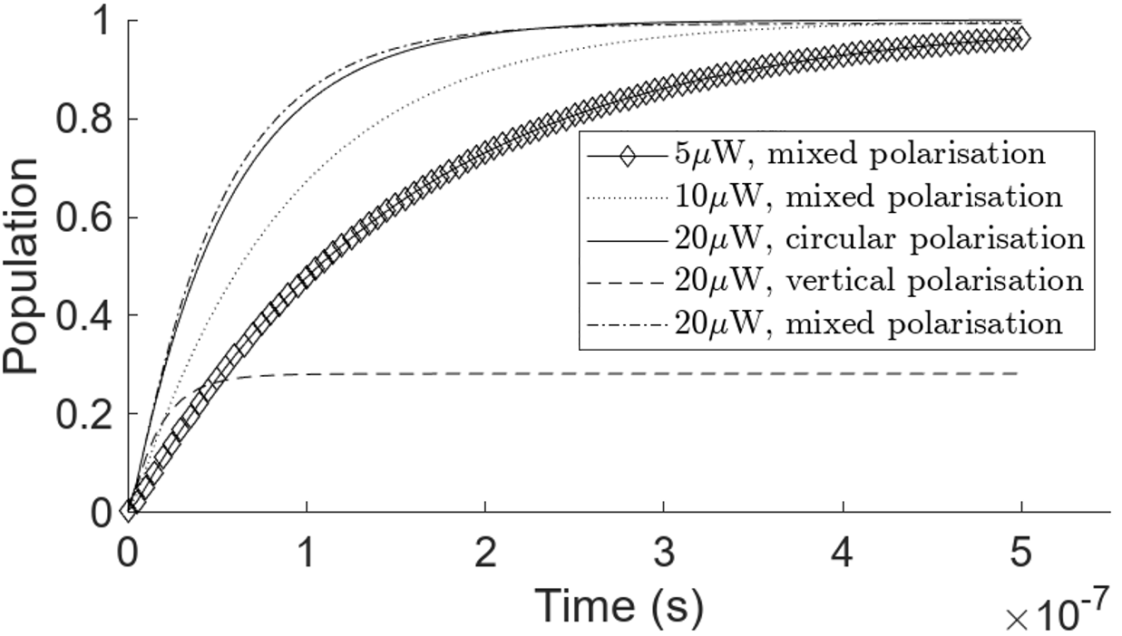
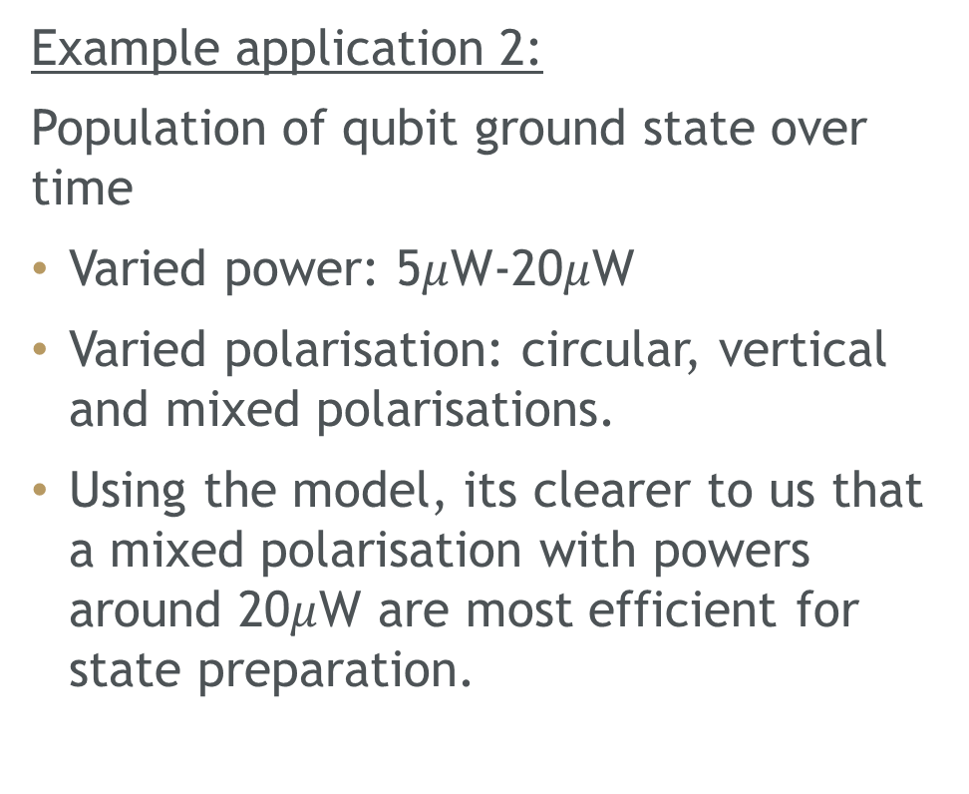
Results
Example application 2:
Population of qubit ground state over time
Varied power: 5$μ$W-20$μ$W
Varied polarisation: circular, vertical and mixed polarisations.
Using the model, its clearer to us that a mixed polarisation with powers around 20$μ$W are most efficient for state preparation.
State preparation with 369 nm laser
Notes:
Example application 2:
The adjacent graph shows the Population of qubit ground state 0.5 us
The graphs are plotted for various powers: 5uW-20uW and polarisations: circular, vertical and mixed, and have the same initial mixed state
###
Using the model, its clearer to us that a mixed polarisation with powers around 20uW are most efficient for state preparation.

Slide 15
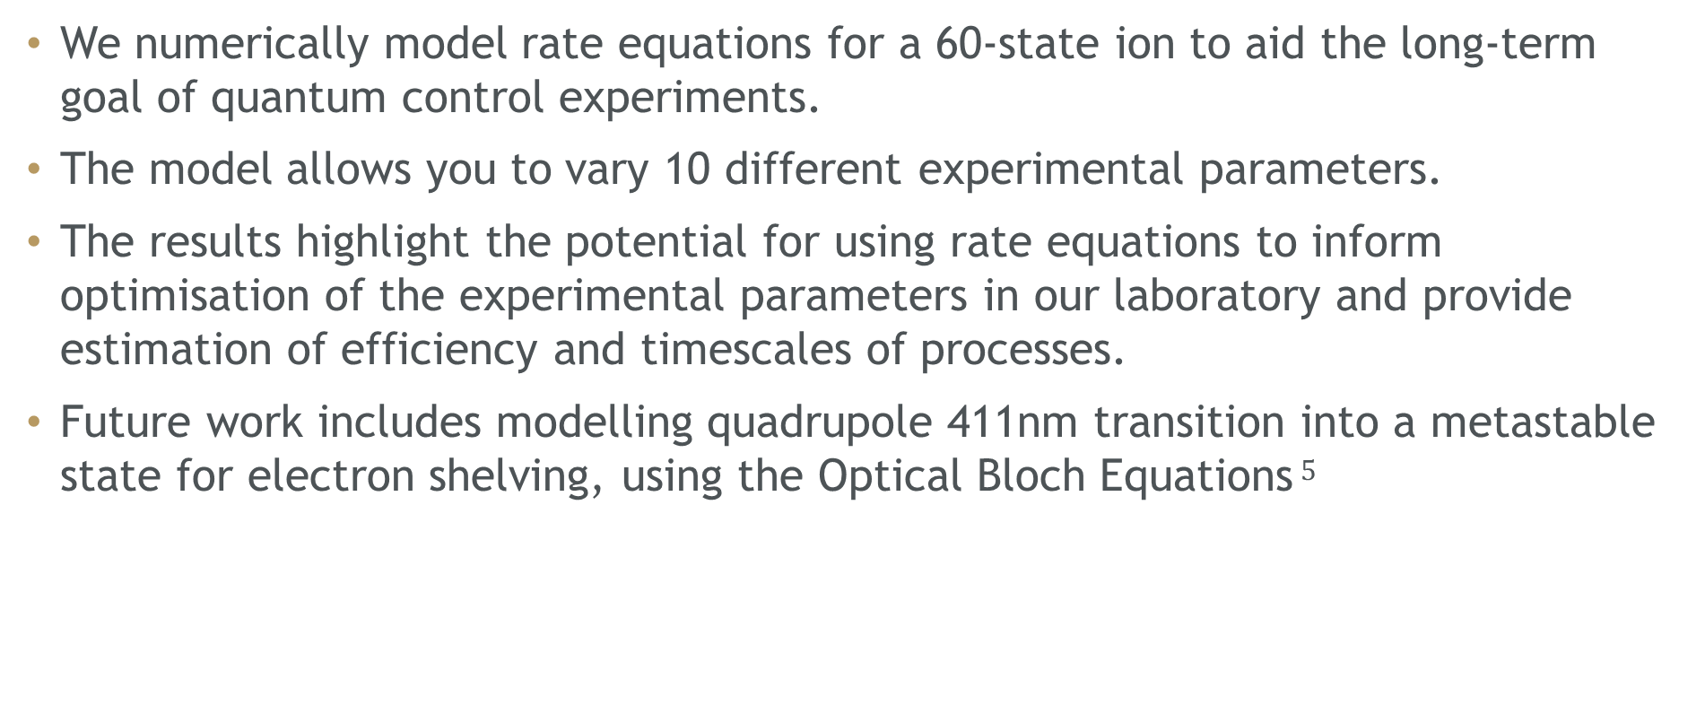
Conclusion
We numerically model rate equations for a 60-state ion to aid the long-term goal of quantum control experiments.
The model allows you to vary 10 different experimental parameters.
The results highlight the potential for using rate equations to inform optimisation of the experimental parameters in our laboratory and provide estimation of efficiency and timescales of processes.
Future work includes modelling quadrupole 411nm transition into a metastable state for electron shelving, using the Optical Bloch Equations$^{\text{5}}$
[5] S. Bester and C. Steenkamp. Optical bloch modeling of magnetic dipole transitions in a four-state system and its application in ion trapping: tutorial. Journal of the Optical Society of America B, 40(4):830–848, 2023.
Notes:
In conclusion, We numerically model rate equations for a 60 state ion to aid the long-term goal of quantum control experiments.
The model allows you to vary 10 different experimental parameters.
The results highlight the potential for using rate equations to inform optimisation of the experimental parameters in our laboratory and provide estimation of efficiency and timescales of processes.
Future work includes modelling quadrupole 411 transition into a metastable state for electron shelving, using the Optical Bloch Equations.
Thank you all for your attention, I’d like to acknowledge the support of the South African Quantum Technology Initiative (SA QuTI) towards this research.
I welcome any questions

Slide 16

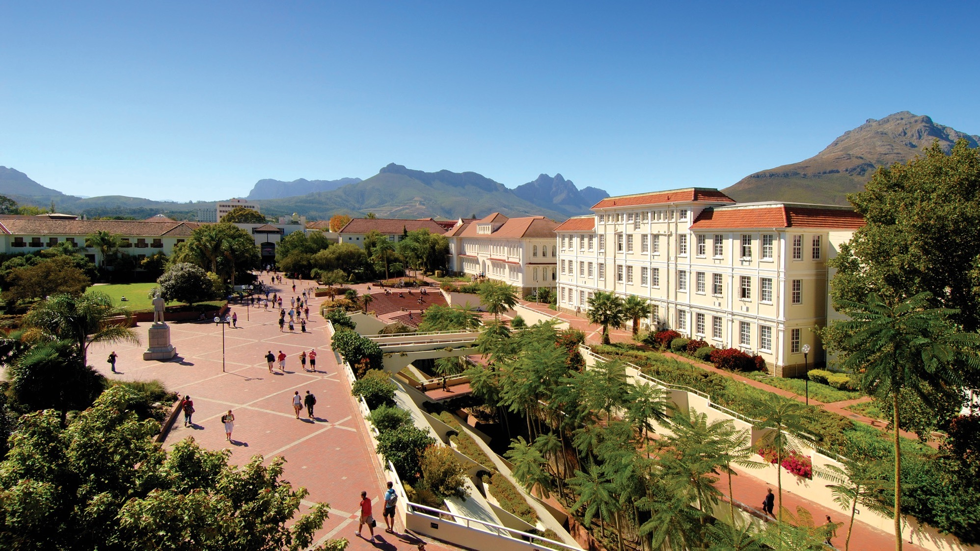
Thank you
Enkosi
Dankie
Acknowledgements: Dr CM Steenkamp, NE Payne
Bursary funding: DSTI and SA QuTI
Photo by Stefan Els

