Slide 1
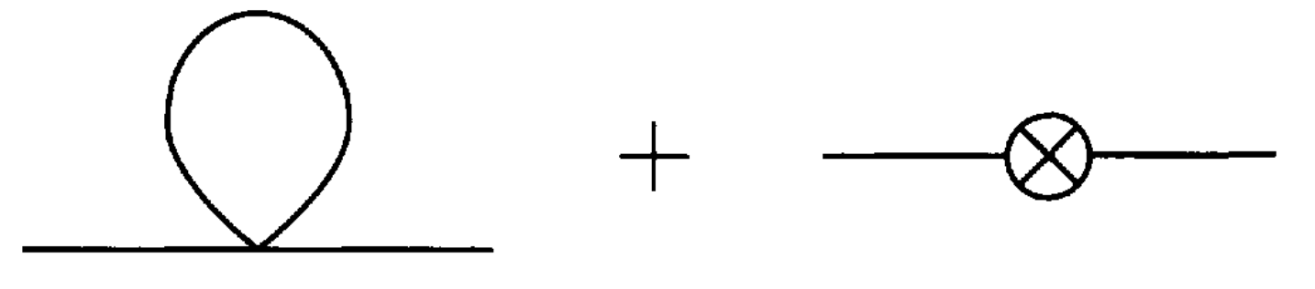
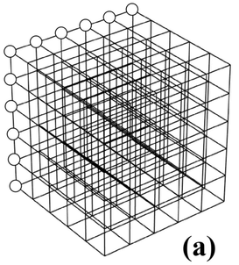




Thermal Field Theory
Path Integrals & Partition Functions on Finite Volumes
Rens Roosenstein
University of Cape Town | Nikhef
SAIP: Theoretical Physics
10 July 2025
Notes:
TFT,
Path integrals & partition functions,
Extension
Combines stat mech & QFT -> describe stat. Ensemble of quantum particles
My research, use TFT bulk thermo
Lay groundwork
first principles, controlled
sketch bigger picture

Slide 2
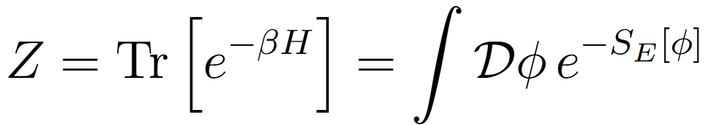
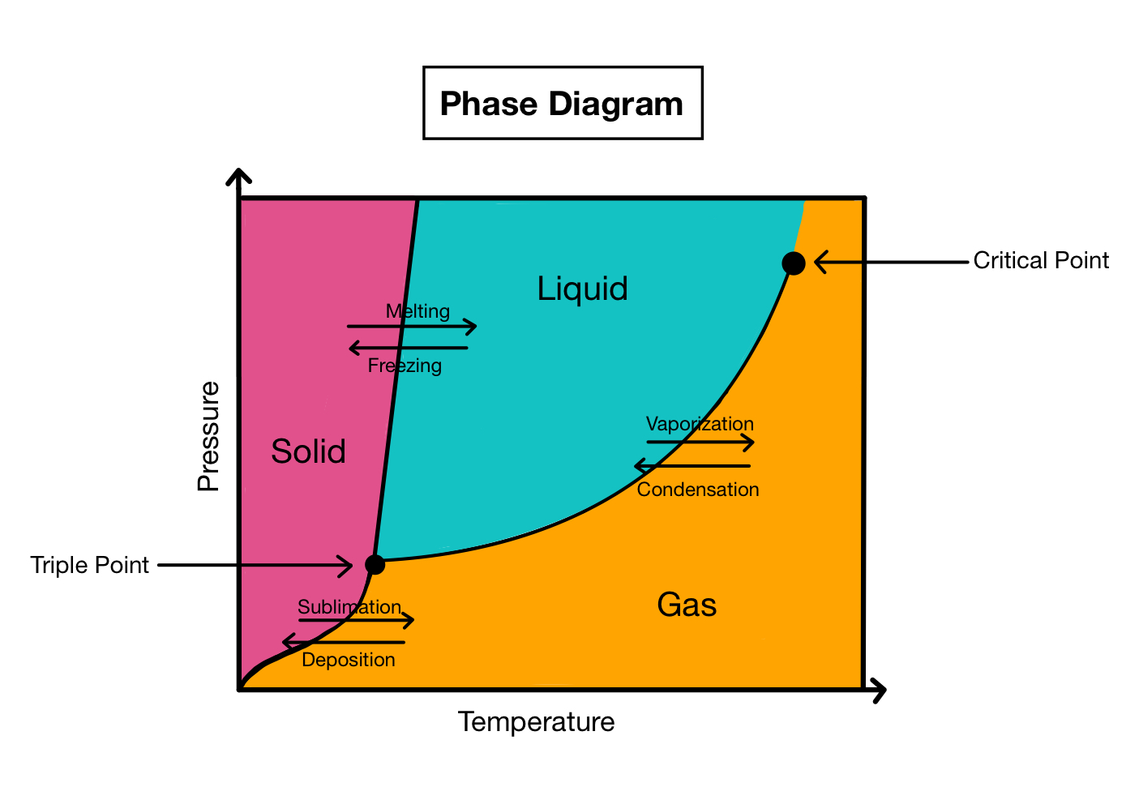
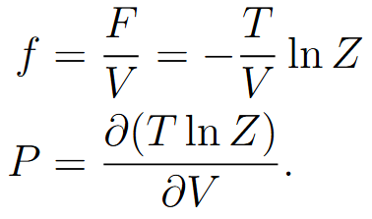
Thermal Field Theory = QFT + Statistical Mechanics
Extends QFT to systems at finite temperature and/or finite density.
?
Describes statistical ensembles of quantum particles.
​
The partition function, central to TFT, captures all thermodynamic information of your system.
​
Enables first-principles calculations of thermodynamic quantities in quantum field theories.

Slide 3
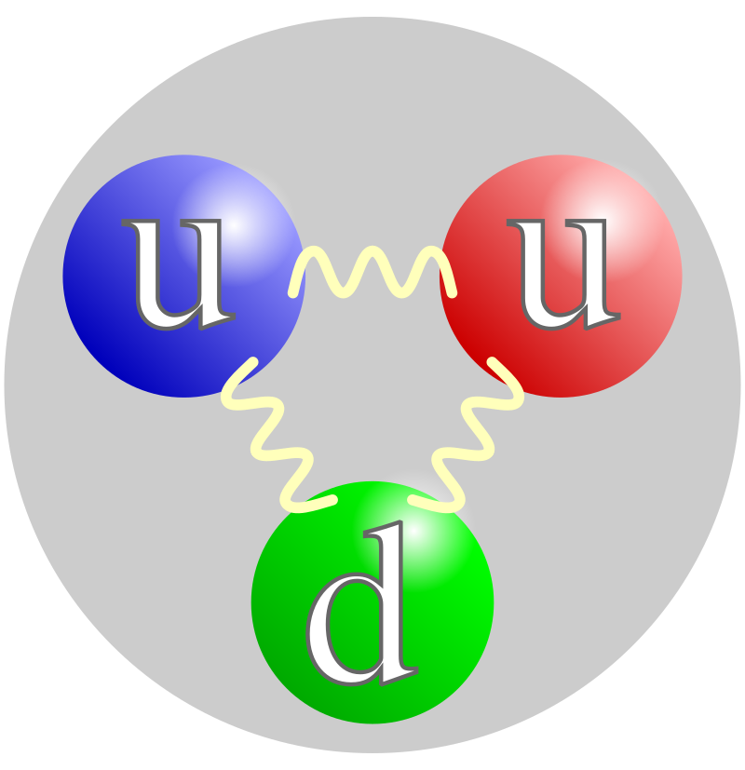
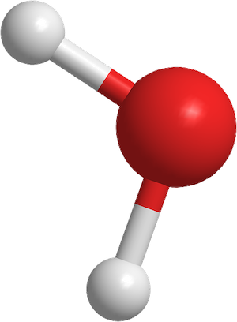
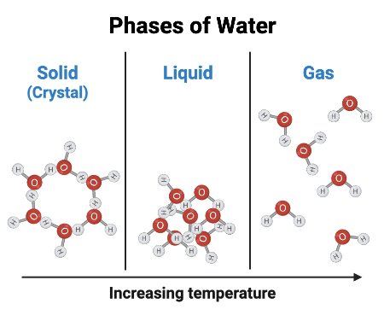
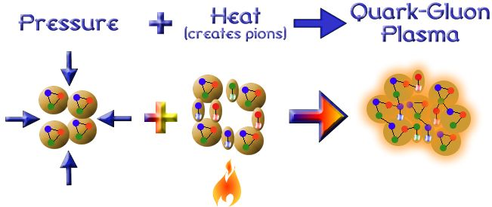
Hadrons, Fluids and the Quark Gluon Plasma
Quarks Confined in Hadron
H2O molecule
Notes:
Hadrons made up of Q & G, strong force
Reason for colliding hadrons is study behavior of QCD @ HE, early U, Stars
Enough energy, collisions overcome strong force
Deconfine Q & G
water

Slide 4
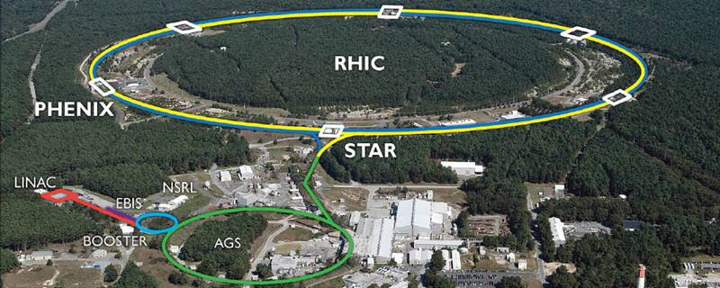
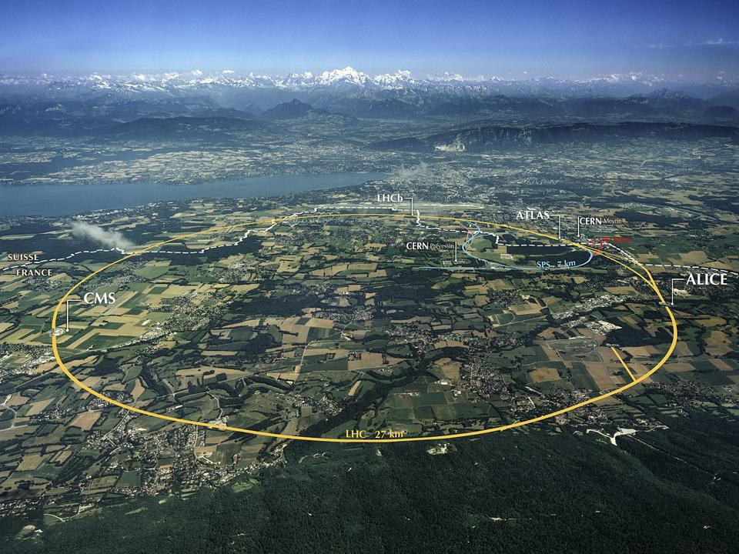

Relativistic Heavy-Ion Collisions
LHC
Notes:
Super colliders LHC BNL
Create extreme conditions by colliding hadrons

Slide 5
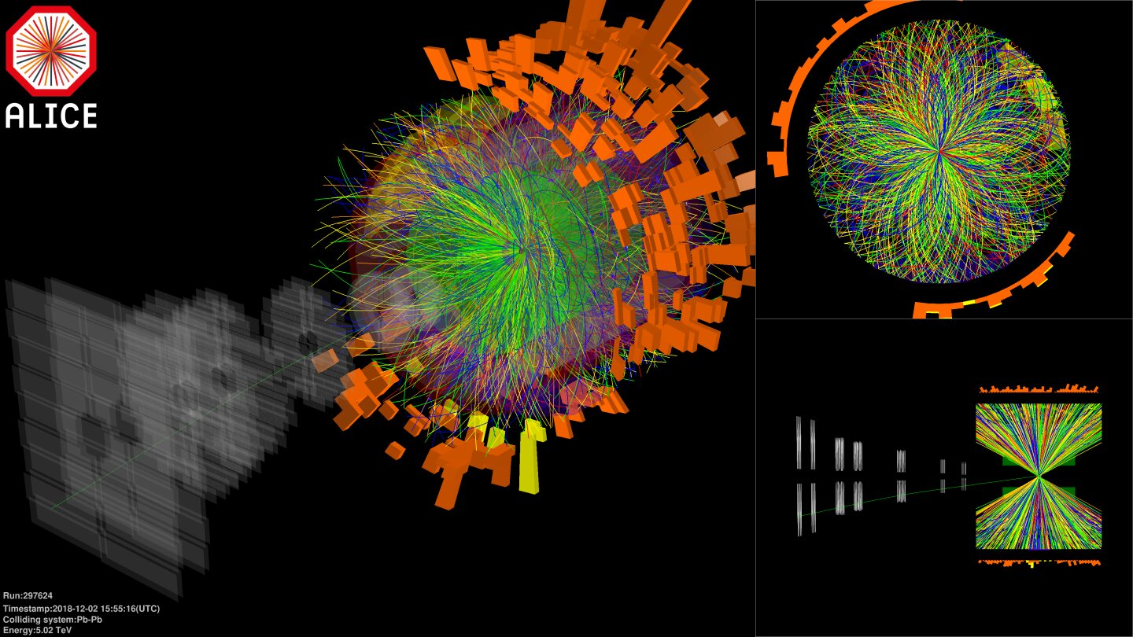
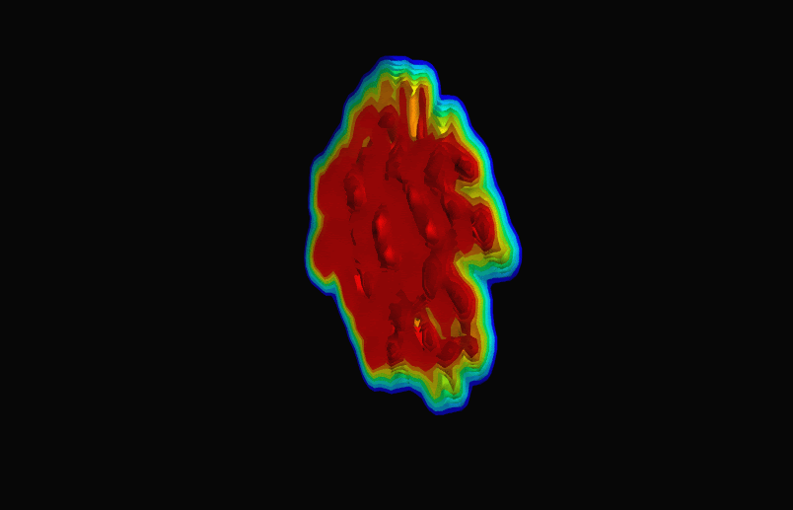
Quark Gluon Plasma in Heavy-Ion Collisions (RHIC + LHC)
Pb-Pb collisions at the LHC (2018)
Quark Gluon Plasma Formation
Small systems in Heavy-ion collisions
  High multiplicity (p+p, p+A, A+A)
  O+O collisions (July 2025)
Notes:
Pb-Pb
Phenomenologically relevant small systems -> pp, pA, AA
Understand bulk thermo properties
OO collisions

Slide 7
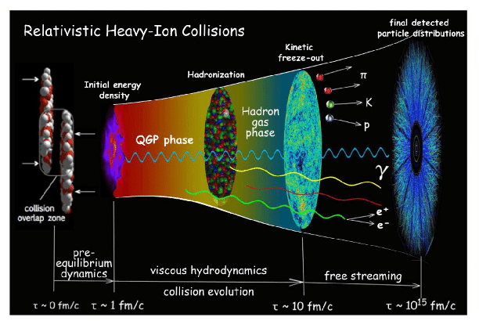
Describing QGP behavior
The QGP behaves like a nearly perfect fluid!!!
Hydrodynamics
Statistical Mechanics
Equation of State
QFT
Thermal Field Theory
Lattice QCD
Notes:
Remarkable discovery
low viscosity -> hydro & Stat Mech
Look at phases of RHIC
Pre equilibrium = DIfficult, once thermalizes,

Slide 8
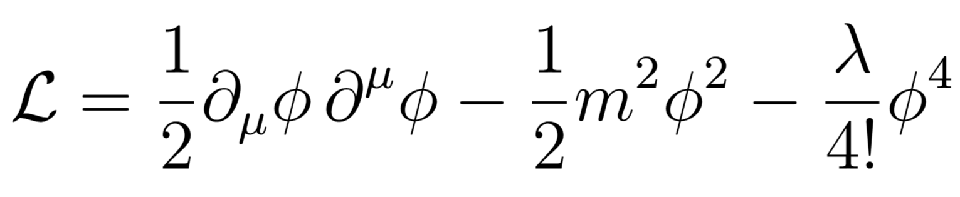
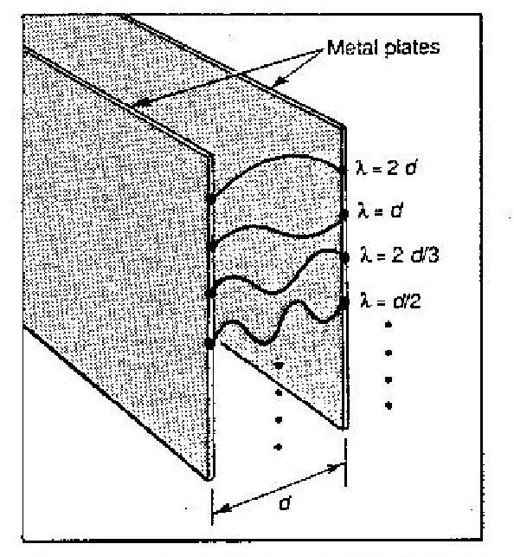
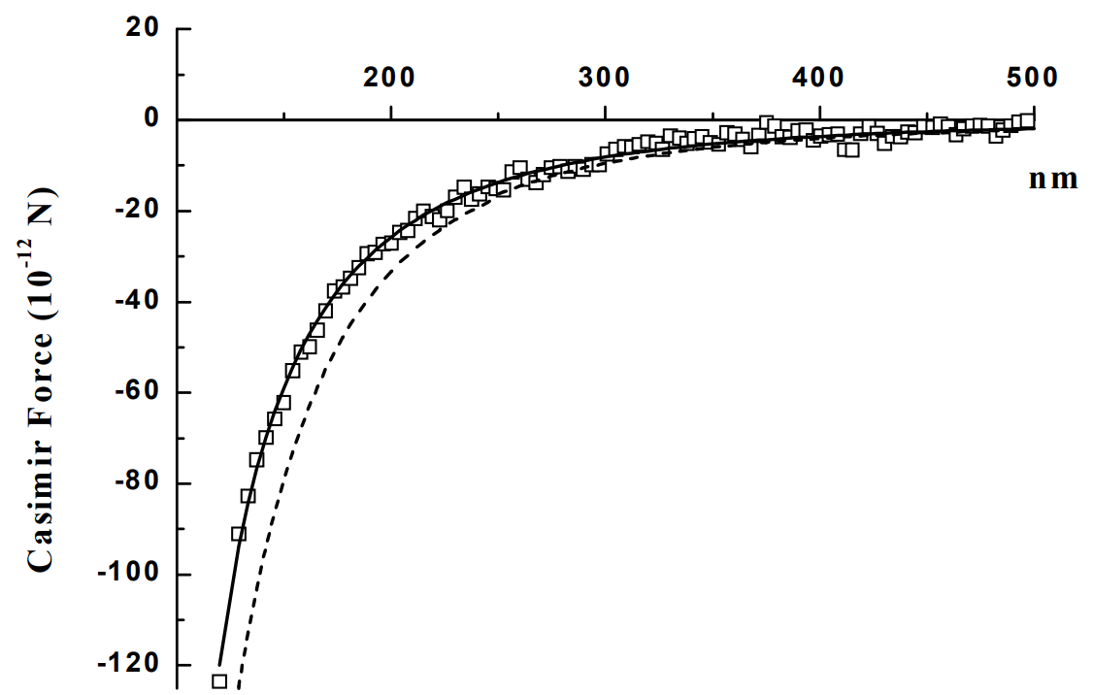
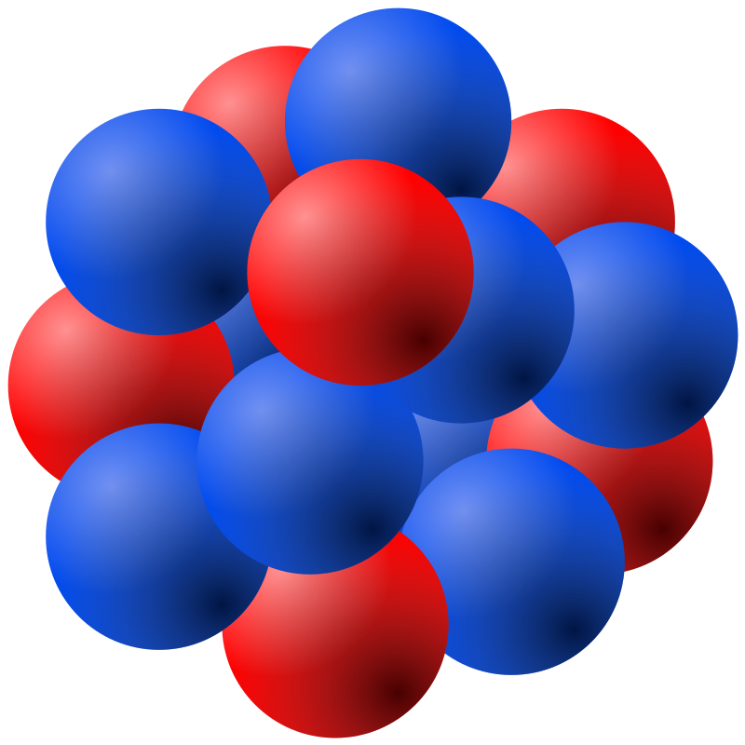
Incorporating Physical Effects in TFT
Effects of interactions
Particle scattering
Mass renormalization
Symmetry breaking
...
ArXiv:quant-ph/0609145 (2006)
System size effects
Casimir effect
Modification of statistical properties (Partition function)
...
~ 1-10 fm
10nm 1 atm !

Slide 9
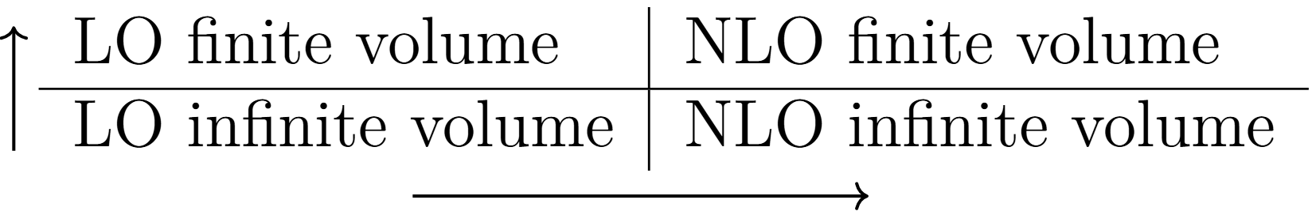
Computing NLO and finite size corrections to the partition function
arXiv:1807.07871v2 [hep-th] (2021)
arXiv:1701.01554v2 [hep-ph] (2022)

Slide 10
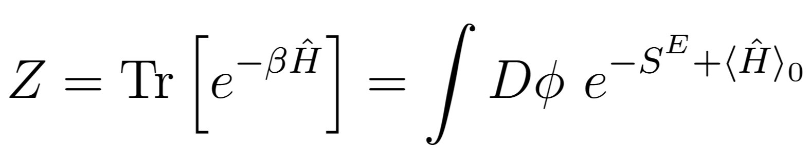
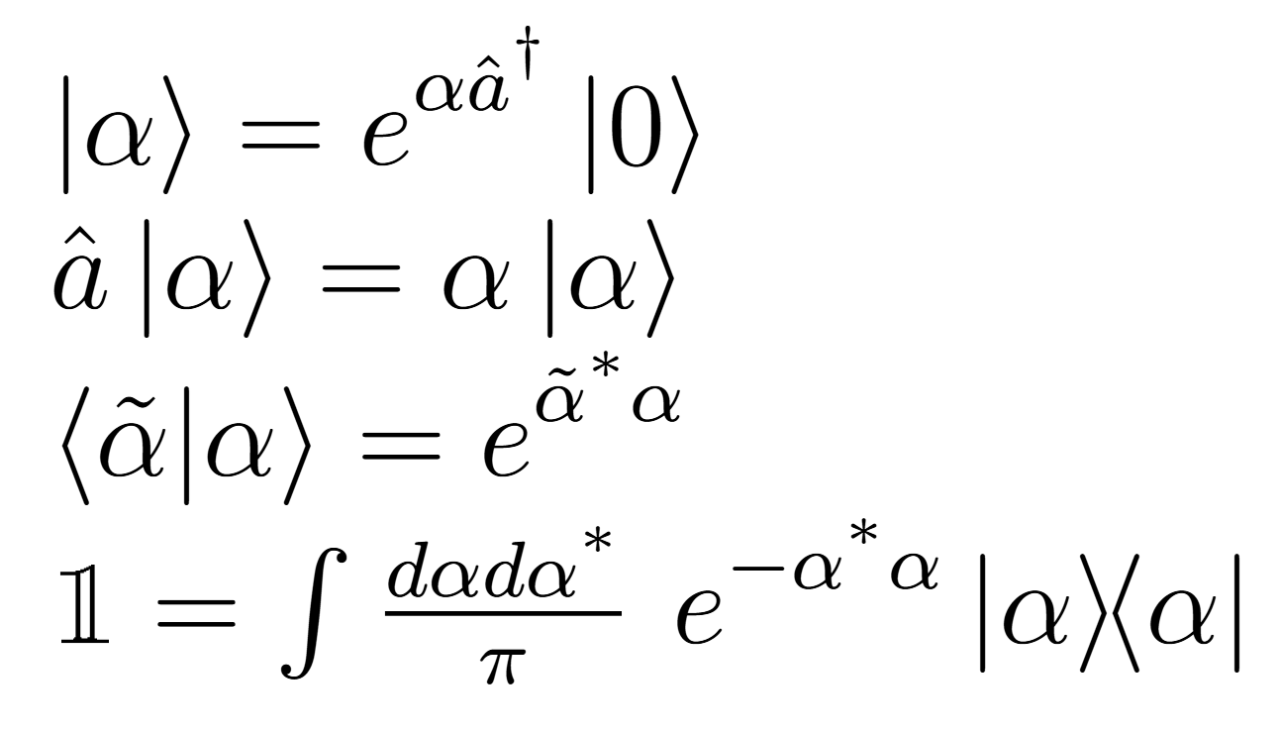
Free Theory Finite Volume Partition Function
Coherent states:
Are eigenstates of the annihilation operator
Minimize Heisenberg uncertainty relation
Approximate classical behaviour of a wave
?

Slide 11
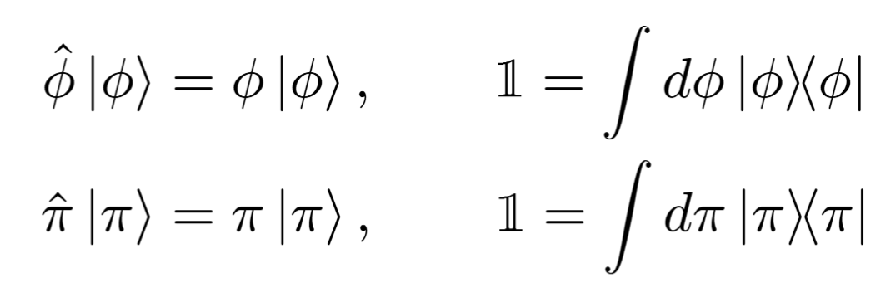
Free Theory Finite Volume Partition Function
?
Field operator Eigenstates?

Slide 12
Free Theory Finite Volume Partition Function
!!
Extra Terms?!
= Vacuum Energy

Slide 13
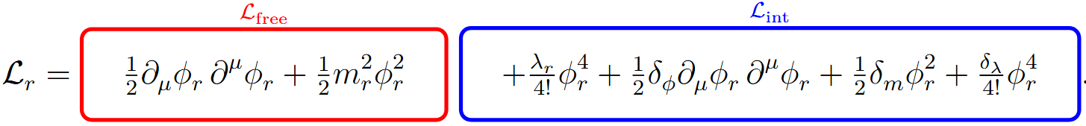

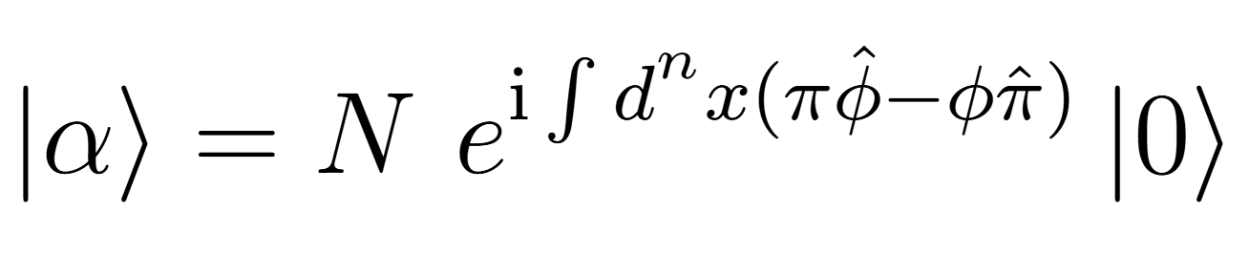
Interacting φ⁴ Theory on a Finite Volume
Interaction picture Unitary operators:
We can use the Interaction picture
Allows real-time interaction dynamics into the thermal trace.

Slide 14
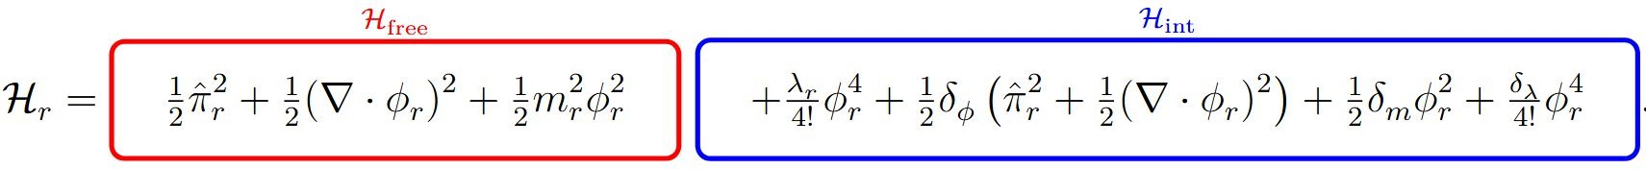
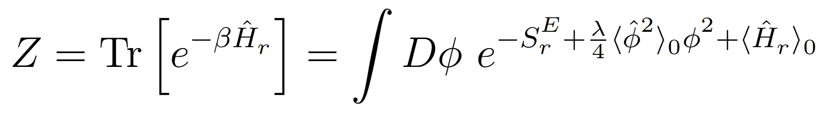
Interacting φ⁴ Theory on a Finite Volume
Novel Vacuum Energy corrections to the partition function in φ⁴ theory

Slide 15
Conclusions & Outlook
We found novel vacuum corrections to the partition function in φ⁴ theory.
Expected to contribute at finite volume such as the Casimir effect
Expected to agree with well established infinite volume QFT results at NLO
Outlook​
Compute finite size NLO corrections to the equation of state and the trace anomaly​
Extension to QED and QCD​
Compute finite size corrections to the QCD equation of state to gain insight in their analytic structure from lattice QCD results
TFT and first-principles QFT provide unique opportunities to gain insights into other systems​
Early universe cosmology, Neutron stars, Spin systems, Energy-energy correlators
Notes:
End with a strong Thank you!

Slide 16
Thank you!
Notes:
End with a strong Thank you!

Slide 17
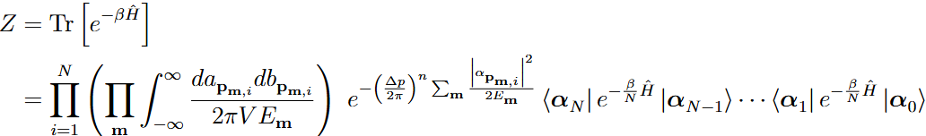
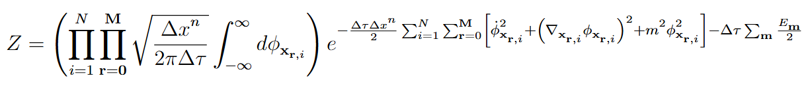
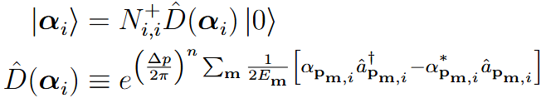
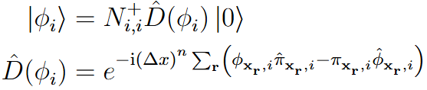
Backup slides: Free scalar field Partition function derivation

Slide 18
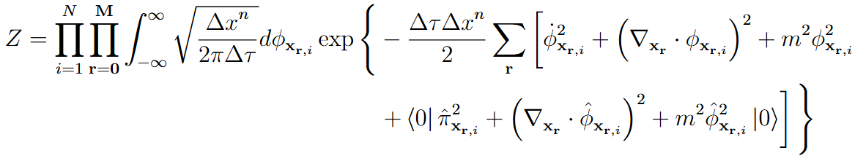
Backup slides: Free scalar field Partition function derivation

Slide 19
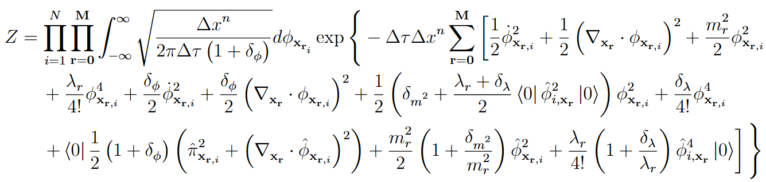
Backup slides: Fully interacting φ⁴ partition function

Slide 20
Backup slides: Fully interacting φ⁴ partition function

Slide 21
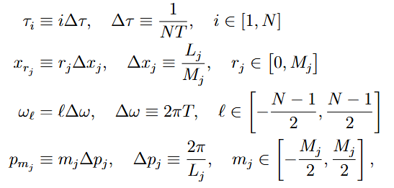
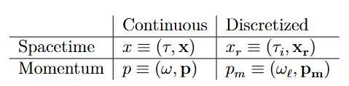
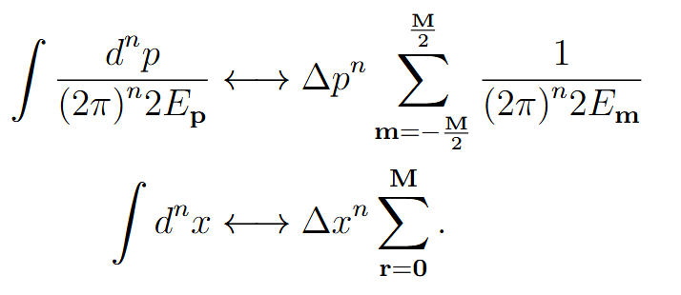
Backup slides: Discretization

Slide 22
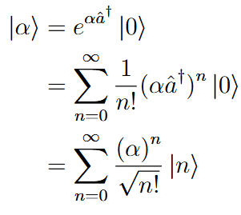
Backup slides: Coherent states

Slide 23
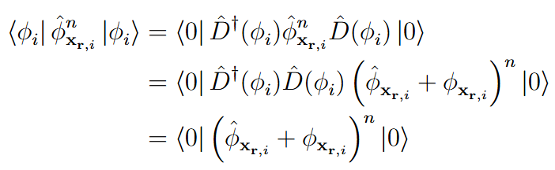
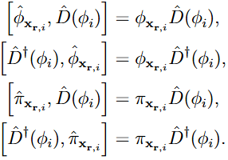
Backup slides: Displacement operators

Slide 24


Backup slides: Classical Equations of motion

