Slide 1


Spin Chains For $𝒩=2$ Quivers
SAIP Oral Presentation
11 July 2025
Jarryd Bath

Slide 2
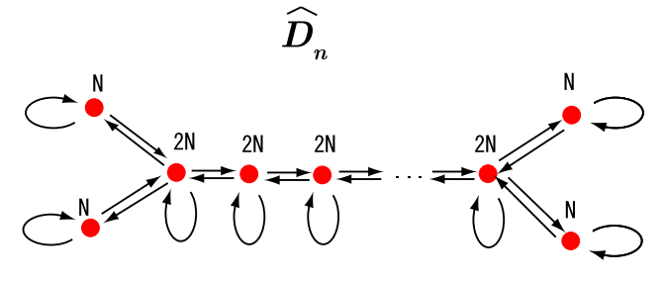
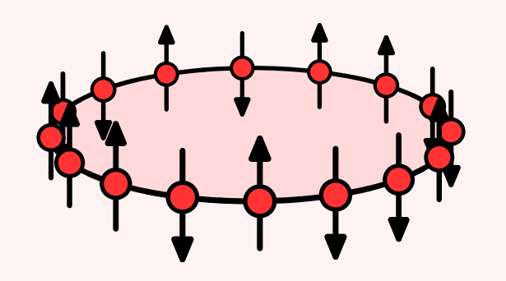
Special thanks to Professor Konstantinos Zoubos for the guidance and supervision in this project
In addition much of this work would have not been possible without the key insights provided by Professor Elli Pomoni.

Slide 3
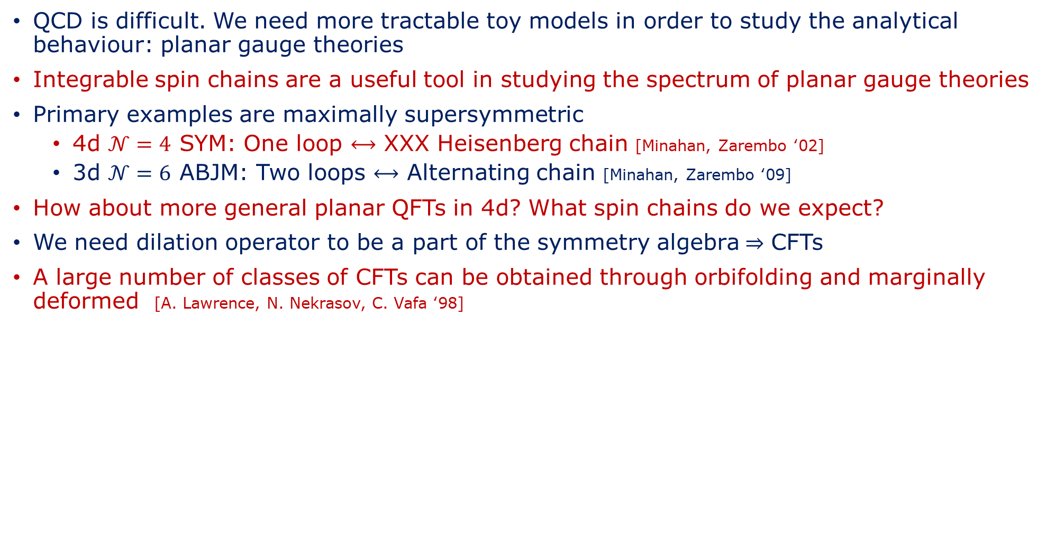
Motivation
QCD is difficult. We need more tractable toy models in order to study the analytical behaviour: planar gauge theories
Integrable spin chains are a useful tool in studying the spectrum of planar gauge theories
Primary examples are maximally supersymmetric
  4d $𝒩=4$ SYM: One loop $⟷$ XXX Heisenberg chain [Minahan, Zarembo ‘02]
  3d $𝒩=6$ ABJM: Two loops $⟷$ Alternating chain [Minahan, Zarembo ‘09]
How about more general planar QFTs in 4d? What spin chains do we expect?
We need dilation operator to be a part of the symmetry algebra$⇒$ CFTs
A large number of classes of CFTs can be obtained through orbifolding and marginally deformed [A. Lawrence, N. Nekrasov, C. Vafa ‘98]

Slide 4
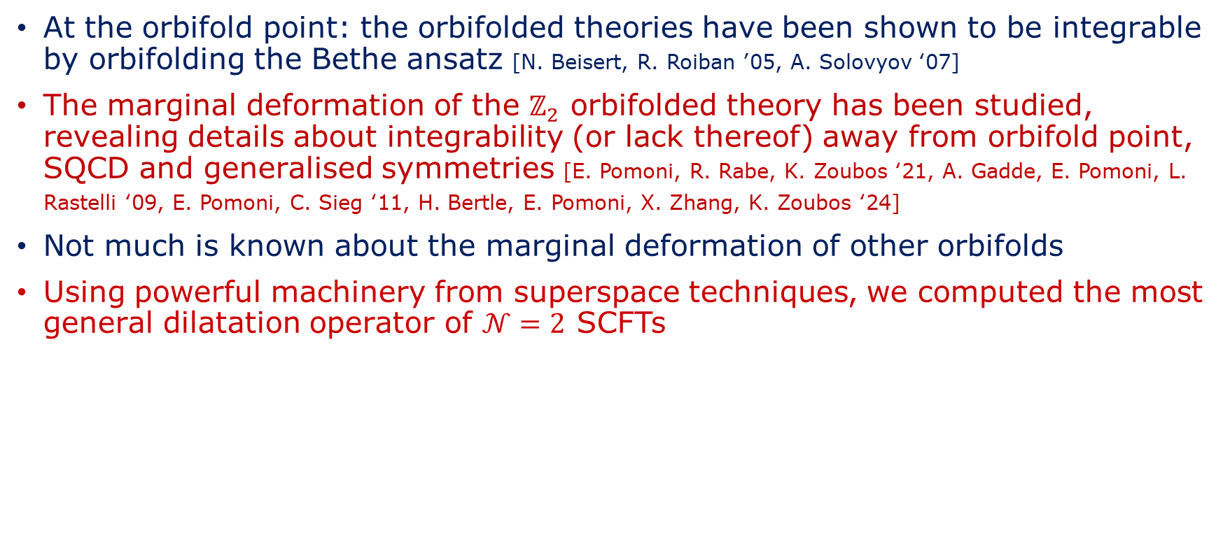
Motivation
At the orbifold point: the orbifolded theories have been shown to be integrable by orbifolding the Bethe ansatz [N. Beisert, R. Roiban ’05, A. Solovyov ‘07]
The marginal deformation of the $ℤ_{2}$ orbifolded theory has been studied, revealing details about integrability (or lack thereof) away from orbifold point, SQCD and generalised symmetries [E. Pomoni, R. Rabe, K. Zoubos ‘21, A. Gadde, E. Pomoni, L. Rastelli ‘09, E. Pomoni, C. Sieg ‘11, H. Bertle, E. Pomoni, X. Zhang, K. Zoubos ‘24]
Not much is known about the marginal deformation of other orbifolds
Using powerful machinery from superspace techniques, we computed the most general dilatation operator of $𝒩=2$ SCFTs

Slide 5

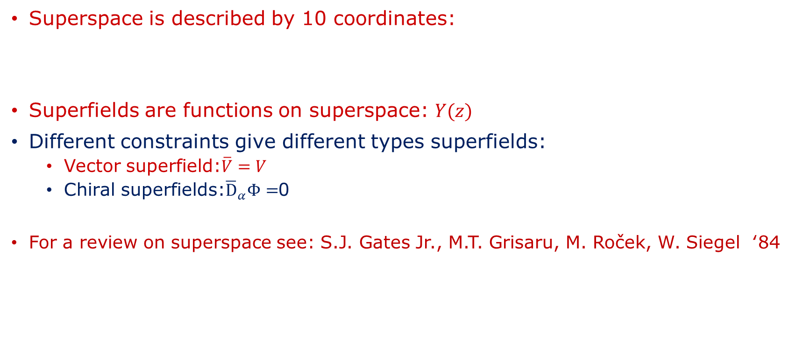
Superspace
Superspace is described by 10 coordinates:
Superfields are functions on superspace: $Y(z)$
Different constraints give different types superfields:
  Vector superfield:$\overline{V}=V$
  Chiral superfields:${\overline{\text{D}}}_{α}Φ=$0
For a review on superspace see: S.J. Gates Jr., M.T. Grisaru, M. Roček, W. Siegel ‘84
$$z^{A}={\left(x^{μ},θ_{α},{\overline{θ}}_{\dot{α}}\right)}^{A}$$

Slide 6
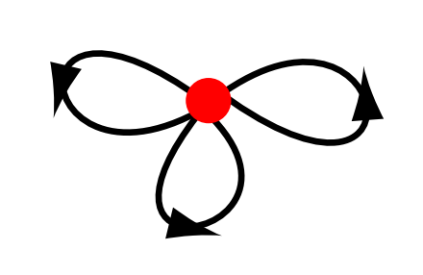




$𝒩=4$ Super-Yang-Mills
Maximally supersymmetric non-gravity theory in d=4
In $𝒩=1$ superspace: 1 vector superfield $V$ and 3 chiral superfields $Φ^{I} (I=1,2,3)$
Supergauge fixing: two chiral ghosts $c, c′$ two antichiral ghosts $\overline{c}, \overline{c}′$
AdS/CFT dual:
Finiteness:
$$AdS_{5}×S^{5}$$
[J. Maldacena ’97]
$β≡μ\frac{dg_{YM}}{dμ}=0$ to all loop level
[M.F. Sohnius, P.C. West ‘81]

Slide 7
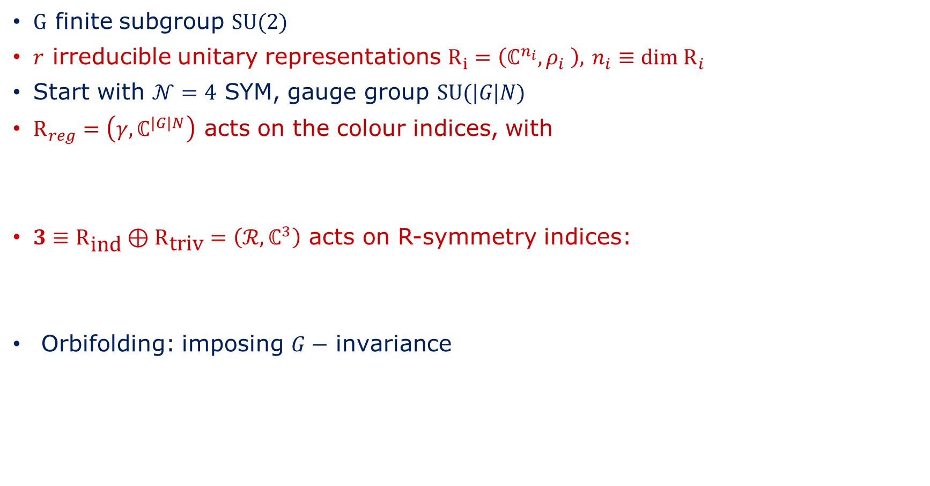
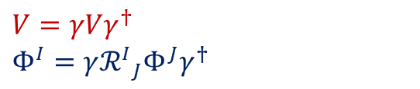
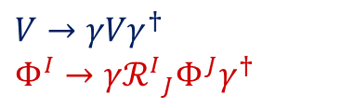

$𝒩=2$SCFTs from Orbifolds
$G$ finite subgroup $\text{SU}\text{(2)}$
$r$ irreducible unitary representations $R_{i}=\left(ℂ^{n_{i}},ρ_{i} \right),$ $n_{i}≡\text{dim} {\text{R}}_{i}$
Start with $𝒩=4$ SYM, gauge group $\text{SU}\text{(|}G\text{|}N\text{)}$
${\text{R}}_{reg}=\left(γ,ℂ^{|G|N}\right)$ acts on the colour indices, with
$3≡{\text{R}}_{\text{ind}}⊕{\text{R}}_{\text{triv}}=\left(ℛ,ℂ^{3}\right)$ acts on R-symmetry indices:
Orbifolding: imposing $G−$ invariance
$$γ≡⨁_{i=1}{ρ_{i}^{⊕n_{i}}⊗I_{N×N}}$$
$$V→γVγ^{†}$$
$$Φ^{I}→γ{ℛ^{I}}_{J}Φ^{J}γ^{†}$$
$$V=γVγ^{†}$$
$$Φ^{I}=γ{ℛ^{I}}_{J}Φ^{J}γ^{†}$$

Slide 8
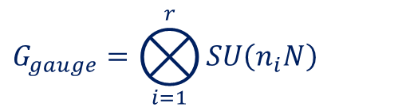


$𝒩=2$ SCTs from Orbifolds
Gauge Group:
Gauge Coupling:
AdS/CFT dual:
$$G_{gauge}=⨂_{i=1}^{r}{SU\left(n_{i}N\right)}$$
$$g_{YM,i}^{2}=\frac{g_{YM}^{2}}{n_{i}}$$
$$AdS_{5}×S^{5}/G$$

Slide 9

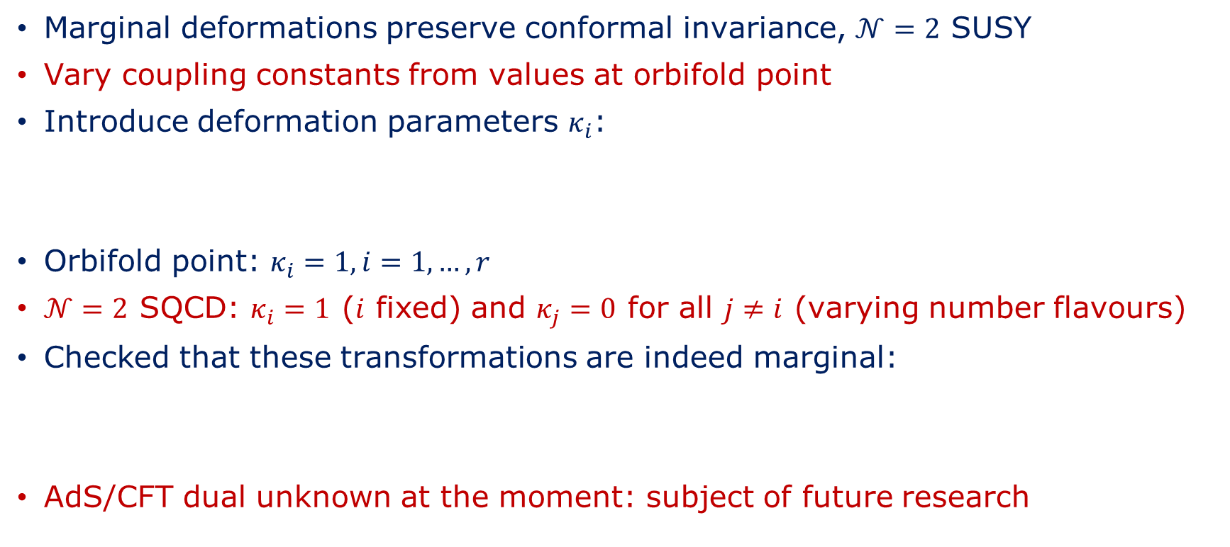
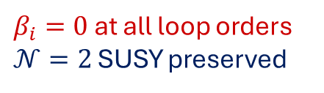
Marginal Deformations
Marginal deformations preserve conformal invariance, $𝒩=2$ SUSY
Vary coupling constants from values at orbifold point
Introduce deformation parameters $κ_{i}$:
Orbifold point: $κ_{i}=1, i=1,…,r$
$𝒩=2$ SQCD: $κ_{i}=1$ ($i$ fixed) and $κ_{j}=0$ for all $j≠i$ (varying number flavours)
Checked that these transformations are indeed marginal:
AdS/CFT dual unknown at the moment: subject of future research
$$g_{YM,i}=\frac{g_{YM}κ_{i}}{\sqrt{n_{i}}}$$
$β_{i}=0$ at all loop orders
$𝒩=2$ SUSY preserved
Using techniques from
[N. Seiberg ‘88 and V.A. Novikov, M. A Shifman, A.I. Vainshtein, V.I. Zakharov ‘83]

Slide 10

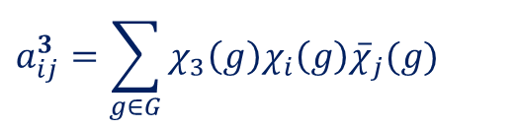

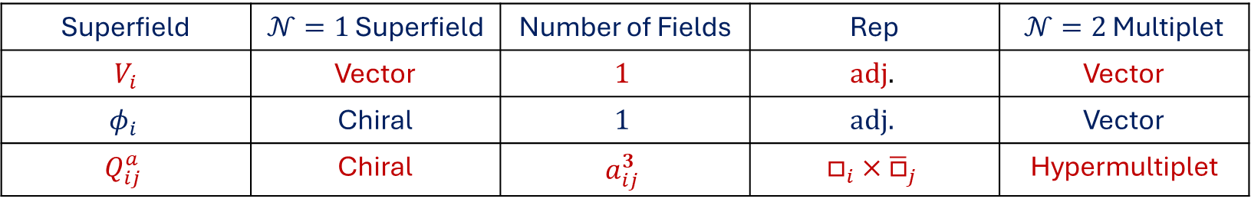
$𝒩=2$ SCFTs from Orbifolds
For $i$ fixed and $j≠i$ we have the following matter content:
Matter Matrix $a_{ij}^{3}$:
Superfield | $𝒩=1$ Superfield | Number of Fields | Rep | $𝒩=2$ Multiplet
$$V_{i}$$ | Vector | $$1$$ | $$\text{adj}\text{.}$$ | Vector
$$φ_{i}$$ | Chiral | $$1$$ | $$\text{adj}\text{.}$$ | Vector
$$Q_{ij}^{a}$$ | Chiral | $$a_{ij}^{3}$$ | $$□_{i}×{\overline{□}}_{j}$$ | Hypermultiplet
$$3⊗{\text{R}}_{i}=⨁_{i}^{r}{a_{ij}^{3}}{\text{R}}_{j}$$
$$a_{ij}^{3}=\sum_{g∈G}{χ_{3}\left(g\right)χ_{i}\left(g\right){\overline{χ}}_{j}(g)}$$

Slide 11
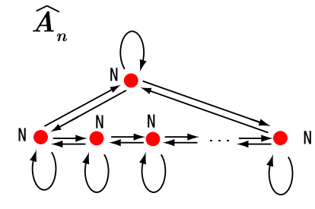
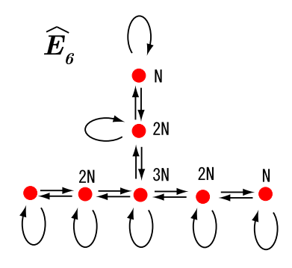
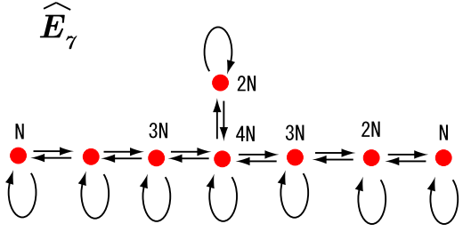
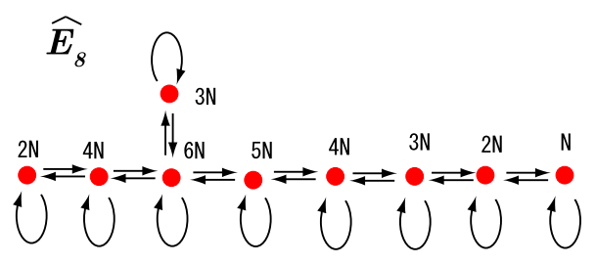

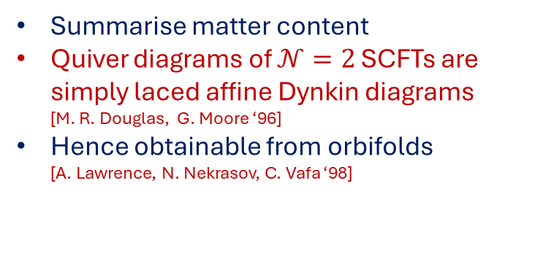
Quiver Diagrams of $𝒩=2$ SCFTs
Summarise matter content
Quiver diagrams of $𝒩=2$ SCFTs are simply laced affine Dynkin diagrams [M. R. Douglas, G. Moore ‘96]
Hence obtainable from orbifolds
[A. Lawrence, N. Nekrasov, C. Vafa ‘98]
Key:
Nodes=Gauge groups (vector superfield)
Arrows=Chiral fields:
  Starting, ending same node: adjoint
  Starting, ending different nodes: bifundamental

Slide 12

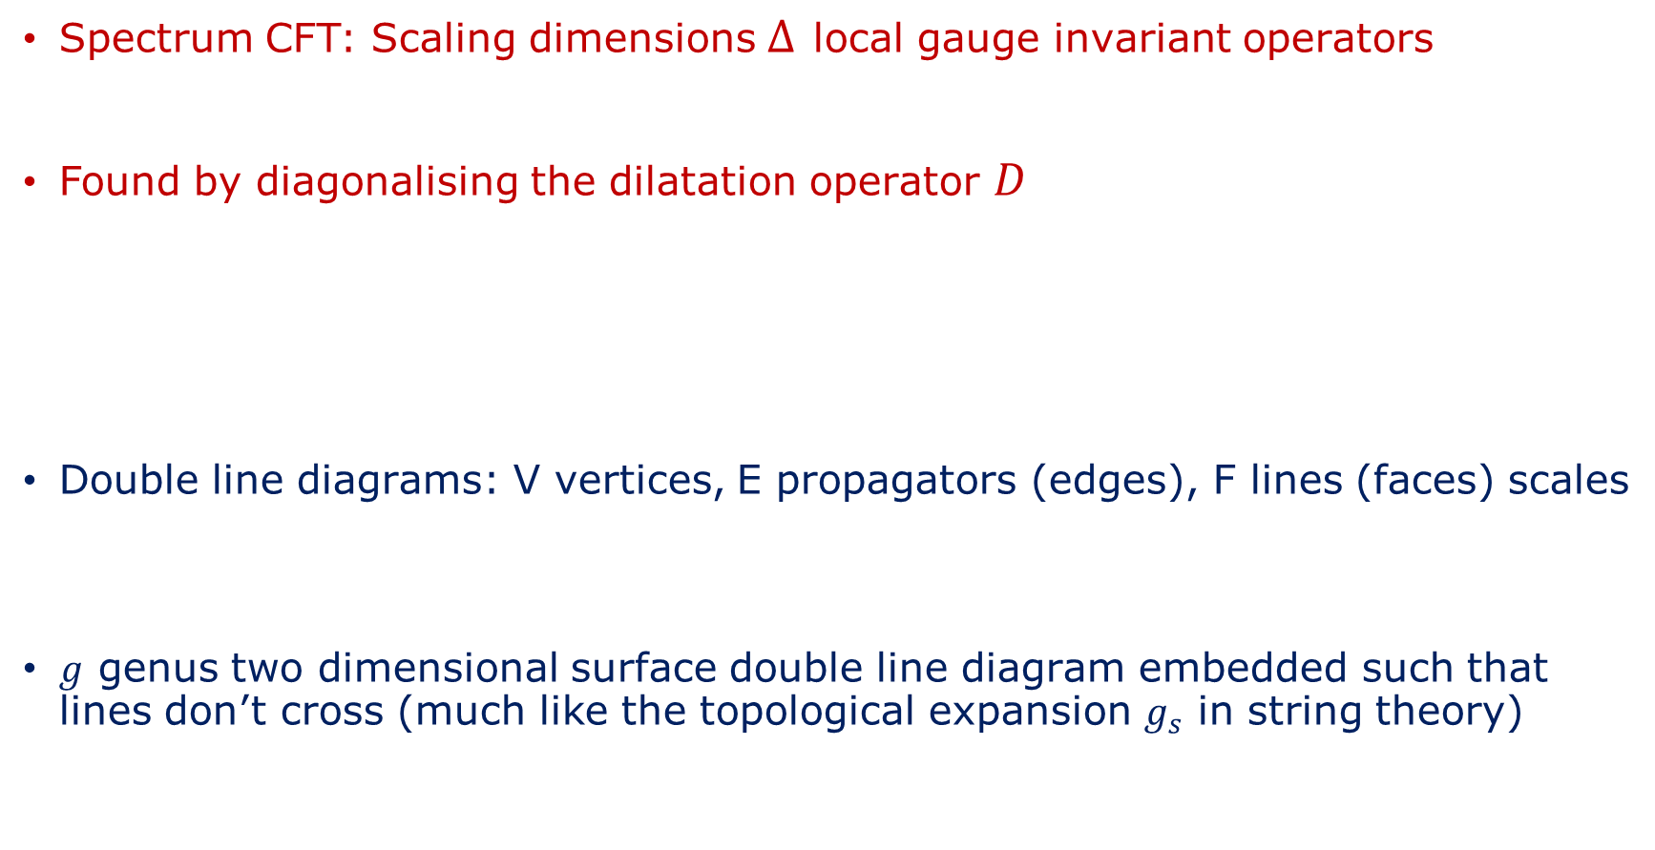


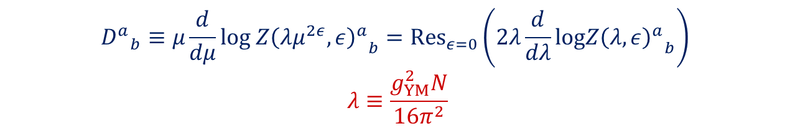
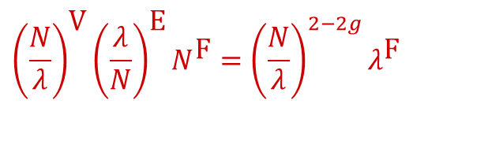
The Dilatation Operator and Spin Chains
Spectrum CFT: Scaling dimensions $Δ$ local gauge invariant operators
Found by diagonalising the dilatation operator $D$
Double line diagrams: V vertices, E propagators (edges), F lines (faces) scales
$g$ genus two dimensional surface double line diagram embedded such that lines don’t cross (much like the topological expansion $g_{s}$ in string theory)
$$𝒪\left(x\right)=\text{Tr}\left(…\right)$$
$${D^{a}}_{b}≡μ\frac{d}{dμ}{{\text{log} Z\left(λμ^{2ε},ε\right)}^{a}}_{b}={\text{Res}}_{ε=0}\left(2λ\frac{d}{dλ}{{\text{log}Z\left(λ,ε\right)}^{a}}_{b}\right)$$
$$λ≡\frac{g_{YM}^{2}N}{16π^{2}}$$
‘t Hooft Coupling:
CFT: $\frac{dλ}{dμ}=0$
$${\left(\frac{N}{λ}\right)}^{\text{V}}{\left(\frac{λ}{N}\right)}^{\text{E}}N^{\text{F}}={\left(\frac{N}{λ}\right)}^{2−2g}λ^{\text{F}}$$

Slide 13
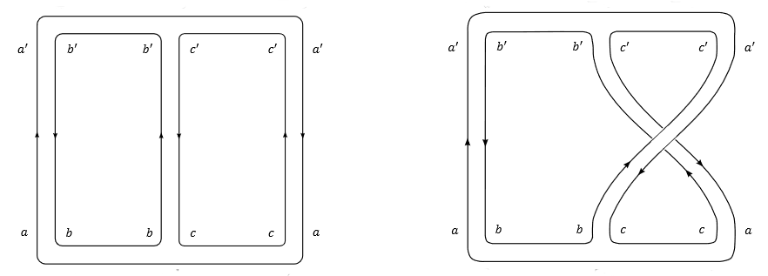


Planar Limit and Spin Chains
Planar limit: $N→∞, g_{YM}→0,$with $λ$ fixed
Planar diagrams (genus: $g=0$) dominate
Only nearest neighbour interactions contribute allows mapping spin chain:
Sites that interact nearest neighbour:
$$ℋ=⨂_{n=1}^{L}{{\text{V}}_{n}}$$
$$H=\sum_{n=1}^{L}{H_{n,n+1}}, L+1≡1$$
$$H_{n,n+1}:{\text{V}}_{n}⊗{\text{V}}_{n+1}→{\text{V}}_{n}⊗{\text{V}}_{n+1}$$

Slide 14


Planar Limit and Spin Chains
Heisenberg XXX spin chain:
Solved Bethe (1931): Bethe Ansatz Equations (BAE)
$Tr\left(X_{1}X_{2}…X_{L−1}X_{L}\right)⟷\left|m_{1}m_{2}…m_{L−1}m_{L}\right\rangle$ $(m_{i}=↑ \text{or} ↓)$
$$D⟷H$$
$$V_{n}=ℂ^{2}$$
$$H_{n,n+1}=σ_{n}^{x}⊗σ_{n+1}^{x}+σ_{n}^{y}⊗σ_{n+1}^{y}+σ_{n}^{z}⊗σ_{n+1}^{z}=𝕀_{n,n+1}−ℙ_{n,n+1}$$
Vacuum: $\left|↓_{1}↓_{2}…↓_{L−1}↓_{L}\right\rangle$ (in SCFT: BPS)
Magnon:$↓_{i}→↑_{i}$

Slide 15
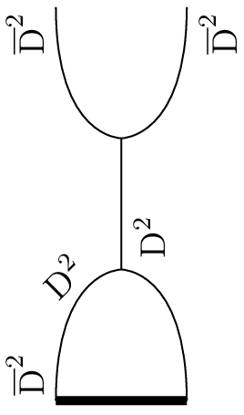
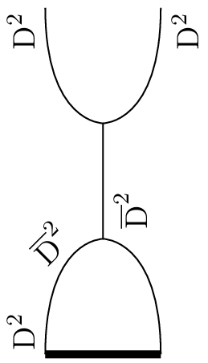
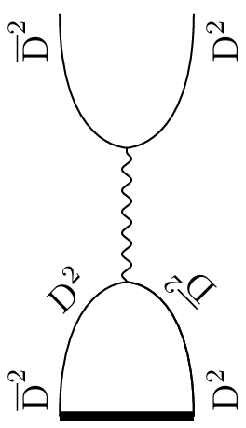
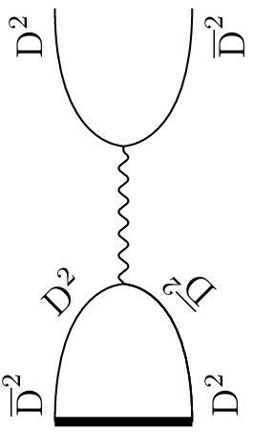
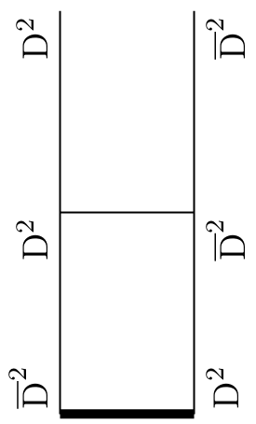
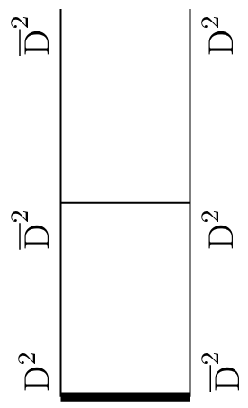
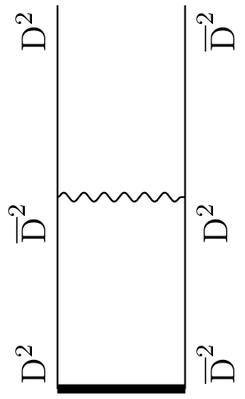
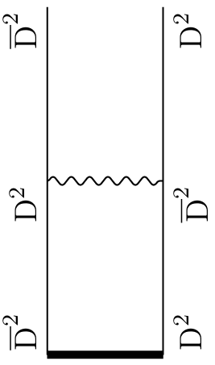
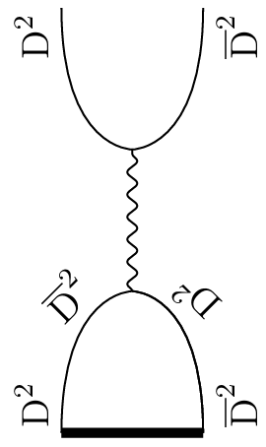
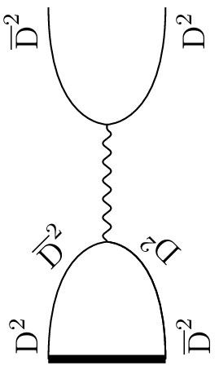
Computing $D^{(1)}$
Supergraph power counting allows for easy identification diagrams that contribute
D-algebra results in simple integrals to compute

Slide 16
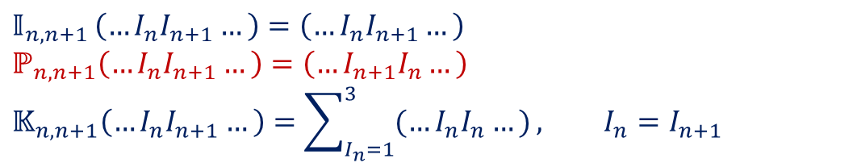
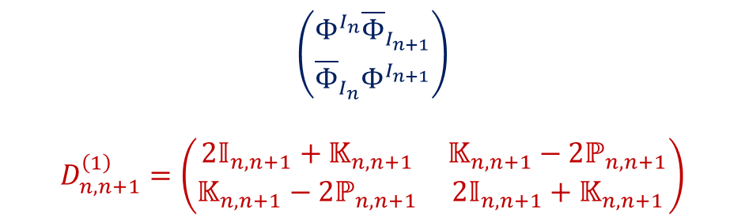
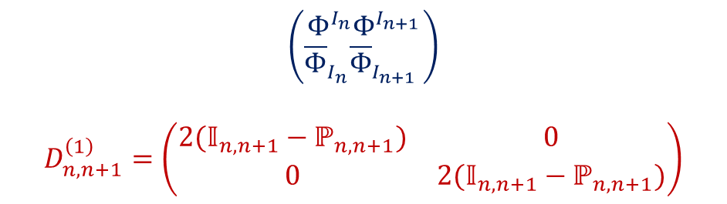

$𝒩=4$ Dilatation Operator
SU(2) subsector ($\left(Z,X\right)≡\left(Φ^{3},Φ^{1}\right)$): isomorphic XXX Heisenberg spin chain
Operators $𝕀, ℙ, 𝕂$ act on R-symmetry indices
$$\left(\begin{matrix}Φ^{I_{n}}Φ^{I_{n+1}} \\ {\overline{Φ}}_{I_{n}}{\overline{Φ}}_{I_{n+1}} \end{matrix}\right)$$
$$D_{n,n+1}^{\left(1\right)}=\left(\begin{matrix}{2(𝕀}_{n,n+1}−ℙ_{n,n+1}) & 0 \\ 0 & 2(𝕀_{n,n+1}−ℙ_{n,n+1})\end{matrix}\right)$$
$$\left(\begin{matrix}Φ^{I_{n}}{\overline{Φ}}_{I_{n+1}} \\ {\overline{Φ}}_{I_{n}}Φ^{I_{n+1}}\end{matrix}\right)$$
$$D_{n,n+1}^{\left(1\right)}=\left(\begin{matrix}{2𝕀}_{n,n+1}+𝕂_{n,n+1} & 𝕂_{n,n+1}−2ℙ_{n,n+1} \\ 𝕂_{n,n+1}−2ℙ_{n,n+1} & {2𝕀}_{n,n+1}+𝕂_{n,n+1}\end{matrix}\right)$$
$𝕀_{n,n+1 }\left(…I_{n}I_{n+1}…\right)=\left(…I_{n}I_{n+1}…\right)$
$$ℙ_{n,n+1}\left(…I_{n}I_{n+1}…\right)=\left(…I_{n+1}I_{n}…\right)$$
$$𝕂_{n,n+1}\left(…I_{n}I_{n+1}…\right)=\sum_{I_{n}=1}^{3}{(…I_{n}I_{n}…)}, I_{n}=I_{n+1}$$

Slide 17



$𝒩=2$ Dilatation Operator
$$d_{ji}^{ab}≡\sum_{n,m=1}^{n_{i},n_{j}}{ε_{IJ3}{\left(K^{a}\right)}_{3I,im}^{jn}{\left(K^{b}\right)}_{3J,jn}^{im}=±n_{i}n_{j}}$$
Holomorphic sector:
Anti-holomorphic sector:
$$D_{n,n+1}^{(1)}\left(φ_{i}φ_{i}\right)=0$$
$$D_{n,n+1 }^{\left(1\right)}\left(Q_{ij}^{a}Q_{ji}^{b}\right)=\frac{2{\overline{d}}_{ij}^{ab}κ_{j}^{2}}{n_{i}^{3}n_{j}}\sum_{k≠i}{\sum_{c,d}{d_{ki}^{dc}Q_{ik}^{c}Q_{kj}^{d}}}$$
$$D_{n,n+1}^{(1)}\left(φ_{i}Q_{ij}^{a}\right)=2\left(κ_{i}^{2}φ_{i}Q_{ij}^{a}−κ_{i}κ_{j}Q_{ij}^{a}φ_{j}\right)$$
$$D_{n,n+1}^{\left(1\right)}\left(Q_{ij}^{a}φ_{j}\right)=2\left(κ_{j}^{2}Q_{ij}^{a}φ_{j}−κ_{i}κ_{j}φ_{i}Q_{ij}^{a}\right)$$
Behaviour depends on which node meet
$$D_{n,n+1}^{(1)}\left({\overline{φ}}_{i}{\overline{φ}}_{i}\right)=0$$
$$D_{n,n+1 }^{\left(1\right)}\left({\overline{Q}}_{ij}^{a}{\overline{Q}}_{ji}^{b}\right)=\frac{2d_{ji}^{ab}κ_{j}^{2}}{n_{i}^{3}n_{j}}\sum_{k≠i}{\sum_{c,d}{{\overline{d}}_{ki}^{cd}{\overline{Q}}_{ik}^{c}{\overline{Q}}_{kj}^{d}}}$$
$$D_{n,n+1}^{(1)}\left({\overline{φ}}_{i}{\overline{Q}}_{ij}^{a}\right)=2\left(κ_{i}^{2}{\overline{φ}}_{i}{\overline{Q}}_{ij}^{a}−κ_{i}κ_{j}{\overline{Q}}_{ij}^{a}{\overline{φ}}_{j}\right)$$
$$D_{n,n+1}^{\left(1\right)}\left({\overline{Q}}_{ij}^{a}{\overline{φ}}_{j}\right)=2\left(κ_{j}^{2}{\overline{Q}}_{ij}^{a}{\overline{φ}}_{j}−κ_{i}κ_{j}{\overline{φ}}_{i}{\overline{Q}}_{ij}^{a}\right)$$
Behaviour depends on which node meet

Slide 18


$𝒩=2$ Dilatation Operator
$$d_{ji}^{ab}≡\sum_{n,m=1}^{n_{i},n_{j}}{ε_{IJ3}{\left(K^{a}\right)}_{3I,im}^{jn}{\left(K^{b}\right)}_{3J,jn}^{im}=±n_{i}n_{j}}$$
Neutral sector:
$$D_{n,n+1}^{(1)}\left(φ_{i}{\overline{φ}}_{i}\right)=κ_{i}^{2}\left(3φ_{i}{\overline{φ}}_{i}+\sum_{j≠i}{n_{j}\sum_{a}{\left(Q_{ij}^{a}{\overline{Q}}_{ji}^{a}+{\overline{Q}}_{ij}^{a}Q_{ji}^{a}\right)}}\right)$$
$$D_{n,n+1}^{(1)}\left({\overline{φ}}_{i}φ_{i}\right)=κ_{i}^{2}\left(3{\overline{φ}}_{i}φ_{i}+\sum_{j≠i}{n_{j}\sum_{a}{\left({\overline{Q}}_{ij}^{a}Q_{ji}^{a}+Q_{ij}^{a}{\overline{Q}}_{ji}^{a}\right)}}\right)$$
$$D_{n,n+1}^{(1)}\left(Q_{ij}^{a}{\overline{Q}}_{jk}^{b}\right)=\frac{κ_{i}δ^{ik}δ^{ab}}{n_{i}}\left(\sum_{l≠i}{\sum_{c}{n_{l}\left(Q_{il}^{c}{\overline{Q}}_{li}^{c}+{\overline{Q}}_{il}^{c}Q_{li}^{c}\right)}+φ_{i}{\overline{φ}}_{i}+{\overline{φ}}_{i}φ_{i} }\right)+2κ_{j}^{2}\left(Q_{ij}^{a}{\overline{Q}}_{jk}^{b}+\sum_{c,d}{\frac{{\overline{d}}_{ij}^{ac}d_{kj}^{bd}}{n_{i}n_{k}n_{j}^{2}} {\overline{Q}}_{ij}^{c}Q_{jk}^{d}}\right)$$
$$D_{n,n+1}^{(1)}\left({\overline{Q}}_{ij}^{a}Q_{jk}^{b}\right)=\frac{κ_{i}δ^{ik}δ^{ab}}{n_{i}}\left(\sum_{l≠i}{\sum_{c}{n_{l}\left({\overline{Q}}_{il}^{c}Q_{li}^{c}+Q_{il}^{c}{\overline{Q}}_{li}^{c}\right)}+{\overline{φ}}_{i}φ_{i}+φ_{i}{\overline{φ}}_{i}}\right)+2κ_{j}^{2}\left({\overline{Q}}_{ij}^{a}Q_{jk}^{b}+\sum_{c,d}{\frac{d_{ij}^{ca}{\overline{d}}_{kj}^{db}}{n_{i}n_{k}n_{j}^{2}} Q_{ij}^{c}{\overline{Q}}_{jk}^{d}}\right)$$
$$D_{n,n+1}^{(1)}\left(φ_{i}{\overline{Q}}_{ij}^{a}\right)=2\left(κ_{i}^{2}φ_{i}{\overline{Q}}_{ij}^{a}−κ_{i}κ_{j}{\overline{Q}}_{ij}^{a}φ_{j}\right)$$
$$D_{n,n+1}^{(1)}\left(Q_{ij}^{a}{\overline{φ}}_{j}\right)=2\left(κ_{j}^{2}Q_{ij}^{a}{\overline{φ}}_{j}−κ_{i}κ_{j}{\overline{φ}}_{i}Q_{ij}^{a}\right)$$
$$D_{n,n+1}^{(1)}\left({\overline{φ}}_{i}Q_{ij}^{a}\right)=2\left(κ_{i}^{2}{\overline{φ}}_{i}Q_{ij}^{a}−κ_{i}κ_{j}Q_{ij}^{a}{\overline{φ}}_{j}\right)$$
$$D_{n,n+1}^{(1)}\left({\overline{Q}}_{ij}^{a}φ_{j}\right)=2\left(κ_{j}^{2}{\overline{Q}}_{ij}^{a}φ_{j}−κ_{i}κ_{j}φ_{i}{\overline{Q}}_{ij}^{a}\right)$$

Slide 19
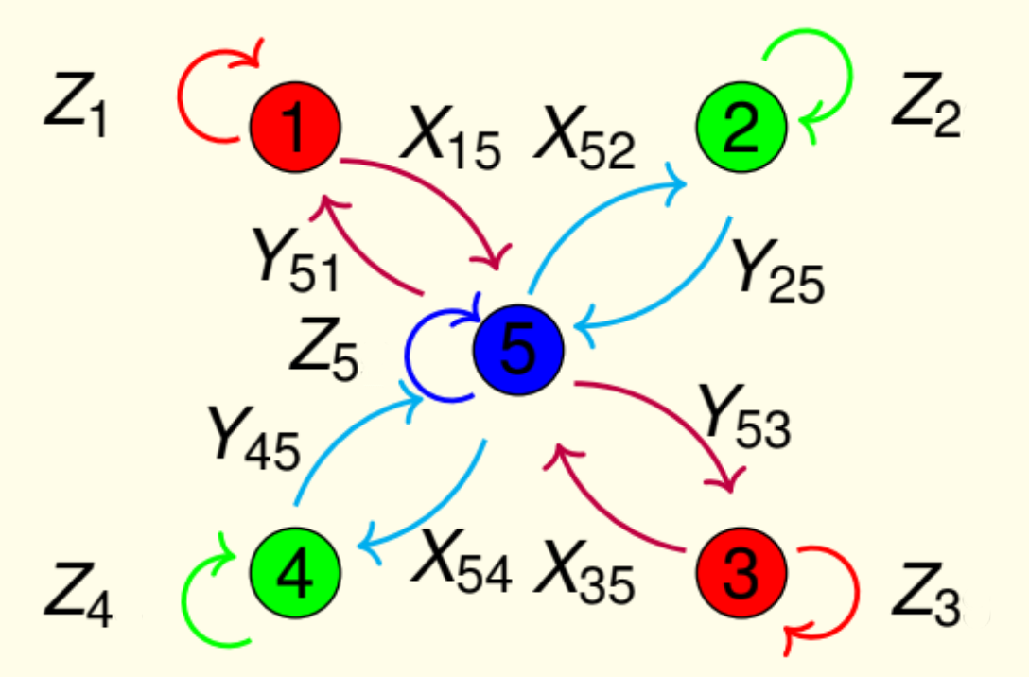

Binary Dihedral Group $2{\text{D}}_{4}$
Simplest non-abelian orbifold
${\text{2}\text{D}}_{4}$ has presentation:
Orbifold field content:
$$\left\langle a,x | a^{4}=e, { x}^{2}=a^{2}, x^{−1}ax=a^{−1}\right\rangle$$
(isomorphic quaternion group Q)

Slide 20
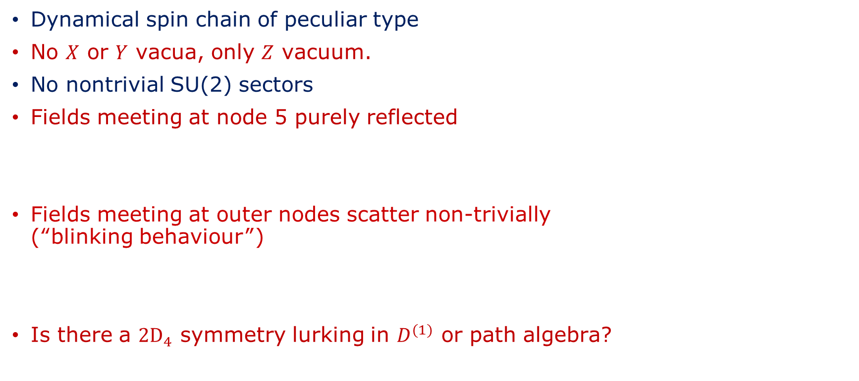

${2\text{D}}_{4}$ Spin Chains
Dynamical spin chain of peculiar type
No $X$ or $Y$ vacua, only $Z$ vacuum.
No nontrivial SU(2) sectors
Fields meeting at node 5 purely reflected
Fields meeting at outer nodes scatter non-trivially (“blinking behaviour”)
Is there a $2{\text{D}}_{4}$ symmetry lurking in $D^{(1)}$ or path algebra?
$$D_{n,n+1}^{\left(1\right)}\left(X_{15}Y_{51}\right)=4κ_{1}^{2}X_{15}Y_{51}$$
$$D_{n,n+1}^{\left(1\right)}\left(Y_{51}X_{15}\right)=κ_{5}^{2}(Y_{15}X_{15}−X_{25}Y_{52}+Y_{35}X_{53}−X_{54}Y_{45})$$

Slide 21



$L=2$ Neutral Sector
Linear combination following 13 operators:
Orbifold point spectrum:
$E=12$ corresponds Konishi operator:
One BPS state sector:
$$\{X_{15}{\overline{X}}_{51},X_{52}{\overline{X}}_{25},X_{35}{\overline{X}}_{53},X_{54}{\overline{X}}_{45},Y_{51}{\overline{Y}}_{15},Y_{25}{\overline{Y}}_{25},Y_{53}{\overline{Y}}_{35},Y_{45}{\overline{Y}}_{54},Z_{i}{\overline{Z}}_{i}\}$$
$$E$$ | $$d\left(E\right)$$
$$12$$ | $$1$$
$$2\left(3+\sqrt{5}\right)$$ | $$3$$
$$8$$ | $$1$$
$$4$$ | $$4$$
$$2\left(3−\sqrt{5}\right)$$ | $$3$$
$$0$$ | $$1$$
$d\left(E\right)=$degeneracy
$$𝒦=X_{15}{\overline{X}}_{51}+X_{52}{\overline{X}}_{25}+X_{35}{\overline{X}}_{53}+X_{54}{\overline{X}}_{45}+Y_{51}{\overline{Y}}_{15}+Y_{25}{\overline{Y}}_{25}+Y_{53}{\overline{Y}}_{35}+Y_{45}{\overline{Y}}_{54}+\frac{1}{2}\left(Z_{1}{\overline{Z}}_{1}+Z_{2}{\overline{Z}}_{2}+Z_{3}{\overline{Z}}_{3}+Z_{4}{\overline{Z}}_{4}+Z_{5}{\overline{Z}}_{5}\right)$$
$$𝒪_{BPS}=X_{15}{\overline{X}}_{51}+X_{52}{\overline{X}}_{25}+X_{35}{\overline{X}}_{53}+X_{54}{\overline{X}}_{45}+Y_{51}{\overline{Y}}_{15}+Y_{25}{\overline{Y}}_{25}+Y_{53}{\overline{Y}}_{35}+Y_{45}{\overline{Y}}_{54}−\left(Z_{1}{\overline{Z}}_{1}+Z_{2}{\overline{Z}}_{2}+Z_{3}{\overline{Z}}_{3}+Z_{4}{\overline{Z}}_{4}+Z_{5}{\overline{Z}}_{5}\right)$$

Slide 22





$L=2$ Neutral Sector Marginal Deformations
Red line=Konishi
Blue line=BPS
$k=0:$ Orbifold Point
$κ_{1}=κ_{2}=κ_{3}=κ_{4}=1+k,{ κ}_{5}=1$:
4 states $E=4$ split into 3+1 states
Otherwise degeneracies preserved
$κ_{1}=κ_{3}=1−k, κ_{2}=κ_{4}=1+k, κ_{5}=1:$
All orbifold degeneracies resolved
Level crossing

Slide 23

$κ_{1}=κ_{2}=κ_{3}=κ_{4}=1+k,{ κ}_{5}=1$:

Slide 24

$$κ_{1}=κ_{3}=1−k, κ_{2}=κ_{4}=1+k, κ_{5}=1$$

Slide 25




$L=3$ Holomorphic Sector
Orbifold spectrum:
$E=12$ corresponds to superpotential:
Five BPS vacua:
$$E$$ | $$d(E)$$
12 | $$1$$
$$2\left(3+\sqrt{5}\right)$$ | $$3$$
$$4$$ | $$1$$
$$2\left(3−\sqrt{5}\right)$$ | $$3$$
0 | $$5$$
$d\left(E\right)=$degeneracies
$$𝒲_{2D_{4}}=Y_{51}Z_{1}X_{15}−X_{52}Z_{2}Y_{25}+Y_{53}Z_{3}X_{35}−X_{54}Z_{4}Y_{45}+Y_{25}Z_{5}X_{52}−X_{15}Z_{5}Y_{51}+Y_{45}Z_{5}X_{54}−X_{35}Z_{5}Y_{53}$$
$𝒪_{BPS,i}=Z_{i}Z_{i}Z_{i}$ for $i=1,2,3,4,5$

Slide 26



$L=3$ Holomorphic Sector Marginally Deformed
Red line= Superpotential
Blue line= BPS vacua
$κ_{1}=κ_{3}=1+k, { κ}_{2}=κ_{4}=1−k, { κ}_{5}=1$
All degeneracies are broken for $k≠0$
$k=0:$ Orbifold Point

Slide 27

$$κ_{1}=κ_{3}=1+k, { κ}_{2}=κ_{4}=1−k, { κ}_{5}=1$$

Slide 28

Conclusion
Through orbifolding and marginal deformation, we found the general actions of $𝒩=2$ SCFTs
The actions allowed us to read off the superspace Feynman rules
Using the one loop exactness of $𝒩=2$ QFTs, we showed that the deformations are marginal (not included in this talk, to be included in upcoming paper)
We found the one loop dilatation operator of any $𝒩=2$ SCFT resulting from marginal deformations of orbifolds
Then, we applied our general formalism to the binary dihedral group 2$D_{2}$
The resulting spin chains displayed peculiar properties such as non-trivial node dependent scatter, splitting of energy levels and level crossing

Slide 29
Outlook
Looking forward, the natural first steps would be applying the coordinate Bethe ansatz to the spin chains and studying the path algebra of the theories
Further, we would like to study and compare the twisted and untwisted sectors
Are there any 1/N enhancements to the two site dilatation operator?
It would be of great interest to consider the possible gravity duals to marginally deformed theories

Slide 30
Extra slides

Slide 31

$𝒩=4$ Super-Yang-Mills
Maximally supersymmetric non-gravity theory in d=4
In $𝒩=1$ superspace: 1 vector superfield $V$ and 3 chiral superfields $Φ^{I} (I=1,2,3)$
Supergauge fixing: two chiral ghosts $c, c′$ two antichiral ghosts $\overline{c}, \overline{c}′$
AdS/CFT dual:
Finiteness:
$$S_{𝒩=4 }=S_{vector}+S_{ghost}+S_{chiral}$$
$$S_{vector}=\frac{1}{g_{YM}^{2}}\int{d^{4}x}\text{Tr}\left(\frac{1}{4}\left(\int{d^{2}θ}W_{α}W^{α}+h.c.\right)−\frac{1}{ξ}\int{{ d}^{4}θ}{\text{D}}^{2}V{\overline{\text{D}}}^{2}V\right)$$
$$S_{ghost}=\int{d^{4}xd^{4}θ}\text{Tr}((c^{′}+{\overline{c}}^{′}){\text{L}}_{\frac{g_{YM}}{2}V}(c+\overline{c}+\coth{{\text{L}}_{\frac{g_{YM}}{2}V}(c−\overline{c})))}$$
$$S_{chiral}=\int{d^{4}x}\text{Tr}\left(\int{d^{4}θ}e^{−g_{YM}V}{\overline{Φ}}_{I}e^{g_{YM}V}Φ^{I}+i\frac{g_{YM}}{3}\left(\int{d^{2}θ}ε_{IJK}Φ^{I}Φ^{J}Φ^{K}+h.c.\right)\right)$$
$$AdS_{5}×S^{5}$$
[J. Maldacena ’97]
$β≡μ\frac{dg_{YM}}{dμ}=0$ to all loop level
[M.F. Sohnius, P.C. West ‘81]

Slide 32












$𝒩=4$ Super-Yang-Mills Feynman Rules
In Fermi-Feynman gauge $ξ=1+𝒪\left(g_{YM}^{2}\right)$
Colour indices (A,B,C) read clockwise
Ghost loops introduce factor $−1$
(supersymmetry manifest, unlike Wess-Zumino gauge)

Slide 33




$𝒩=2$ SCTs from Orbifolds
Matter Matrix $a_{ij}^{3}$:
Clebsch-Gordan coefficients:
$$3⊗{\text{R}}_{i}=⨁_{i}^{r}{a_{ij}^{3}}{\text{R}}_{j}$$
$$a_{ij}^{3}=\sum_{g∈G}{χ_{3}\left(g\right)χ_{i}\left(g\right){\overline{χ}}_{j}(g)}$$
$${\left(e_{3}\right)}_{I}⊗{\left(e_{i}\right)}_{m}=\sum_{i=1}^{r}{\sum_{a=1}^{a_{ij}^{3}}{\sum_{n=1}^{n_{j}}{{\left(K^{a}\right)}_{3I,im}^{j,n}{\left(e_{j,a}\right)}_{n}}}}$$

Slide 34



$𝒩=2$ SCFTs from Orbifolds
For $i$ fixed and $j≠i$ we have the following matter content:
Where:
Superfield | $𝒩=1$ Superfield | Number of Fields | Rep | $𝒩=2$ Multiplet
$$V_{i}$$ | Vector | $$1$$ | $$\text{adj}\text{.}$$ | Vector
$$φ_{i}$$ | Chiral | $$1$$ | $$\text{adj}\text{.}$$ | Vector
$$Q_{ij}^{a}$$ | Chiral | $$a_{ij}^{3}$$ | $$□_{i}×{\overline{□}}_{j}$$ | Hypermultiplet
$$S_{𝒩=2 }=S_{𝒩=2,vector}+S_{ghost}+S_{hyper}$$
$$S_{𝒩=2,vector}=\sum_{i=1}^{r}{\frac{n_{i}}{g_{YM}^{2}κ_{i}^{2}}\int{d^{4}x}{\text{Tr}}_{i}\left(\frac{1}{4}\left(\int{d^{2}θ}{\left(W_{i}\right)}_{α}{\left(W_{i}\right)}^{α}+h.c.\right)+\int{d^{4}θ}\left(g_{YM}^{2}κ_{i}^{2}e^{−g_{YM}κ_{i}V_{i}}{\overline{φ}}_{i}e^{g_{YM}κ_{i}V_{i}}φ_{i}−\frac{1}{ξ}{\text{D}}^{2}V_{i}{\overline{\text{D}}}^{2}V_{i}\right)\right)}$$
$$S_{ghost}=\sum_{i=1}^{r}{n_{i}\int{d^{4}xd^{4}θ}{\text{Tr}}_{i}((c_{i}′+{\overline{c}}_{i}′){\text{L}}_{\frac{g_{YM}κ_{i}}{2}V_{i}}(c_{i}+{\overline{c}}_{i}+\coth{{\text{L}}_{\frac{g_{YM}κ_{i}}{2}V_{i}}(c_{i}−{\overline{c}}_{i})))}}$$
$$S_{hyper}=\sum_{i=1}^{r}{\sum_{j≠i}{\int{d^{4}x}{\text{Tr}}_{j}\left(n_{i}n_{j}\sum_{a}{\int{d^{4}θe^{−g_{YM}κ_{j}V_{j}}{\overline{Q}}_{ji}^{a}e^{g_{YM}κ_{i}}Q_{ij}^{a}+ig_{YM}κ_{i}\sum_{a,b}{\left(\int{d^{2}θd_{ji}^{ab}Q_{ji}^{a}φ_{i}Q_{ij}^{b}}+\int{d^{2}\overline{θ}{\overline{d}}_{ji}^{ab}{\overline{Q}}_{ji}^{b}{\overline{φ}}_{i}{\overline{Q}}_{ij}^{a}}\right)}}}\right)}}$$
$$d_{ji}^{ab}≡\sum_{n,m=1}^{n_{i},n_{j}}{ε_{IJ3}{\left(K^{a}\right)}_{3I,im}^{jn}{\left(K^{b}\right)}_{3J,jn}^{im}=±n_{i}n_{j}}$$

Slide 35














$𝒩=2$ SCFT Feynman rules
In Fermi-Feynman gauge $ξ=1+𝒪\left(g_{YM}^{2}\right)$
Colour indices (A,B,C) read clockwise
Ghost loops introduce factor $−1$

