Slide 1


﻿Search for a heavier Higgs like boson and a dark force boson using ATLAS experimental data
Xola Mapekula
10/07/2025

Slide 2
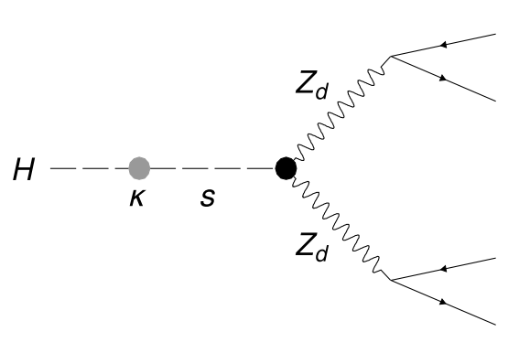

Dark matter Search
Dark gauge boson
Hidden Abelian Higgs Model (HAHM) used in our search
Mixing between the dark Higgs and the SM Higgs via the the mixing parameter 𝜅. This happens when the dark Higgs mechanism spontaneously breaks the ${U(1)}_{d}$ gauge symmetry
Spontaneously broken ${U(1)}_{d}$ dark gauge symmetry mediated by dark gauge boson $Z_{d}$
$Z_{d}$ then decays into SM leptons
SM Higgs
Higgs mixing parameter
Dark Higgs
Notes:
J

Slide 3

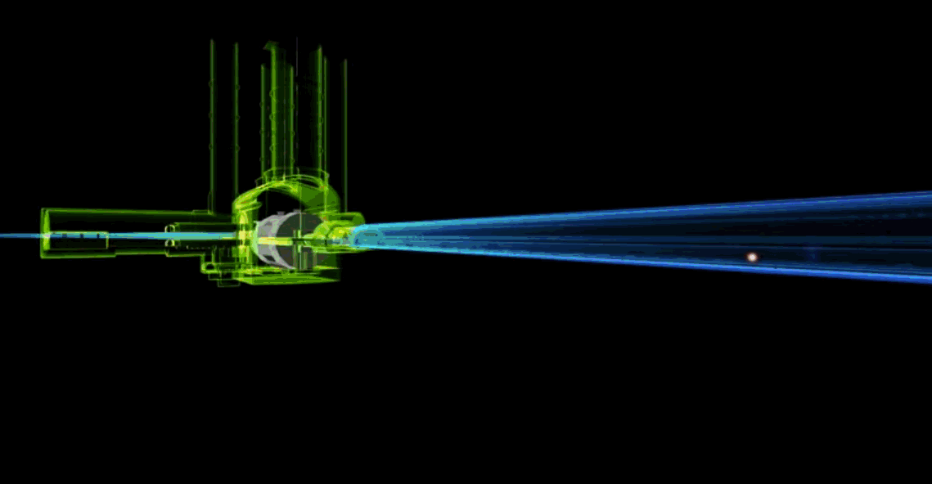
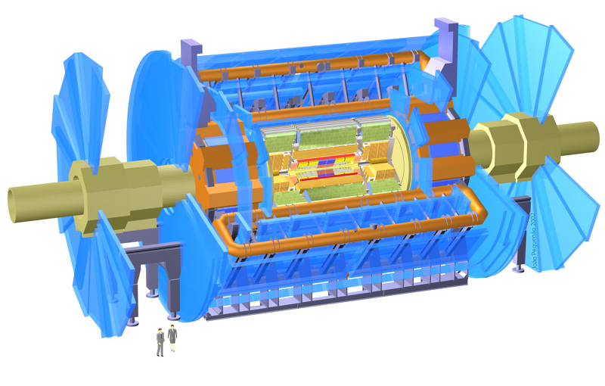
Consists of the inner detector, the electromagnetic calorimeter, the hadronic calorimeter and the muon spectrometer
Inner detector used to track direction, momentum and charge of electrically charged particles and to find primary and displaced vertexes
Electromagnetic and hadronic calorimeters are used to measure energy of particles
Muon spectrometer measures the momentum of muons
One of the general purpose detectors designed to find the Higgs boson and other physics that may deviate from the Standard Model
Takes a snapshot of every collision that occurs at the interaction point

Slide 4
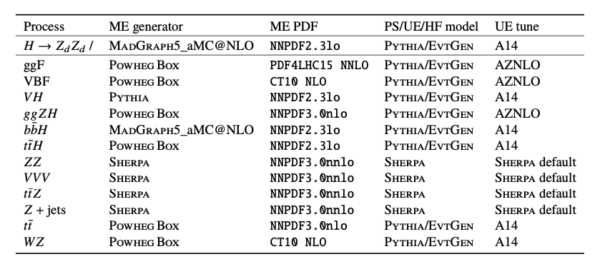

Main backgrounds
Monte Carlo is used to determine the expected shapes and yields for both signal and background events.
Simulations include detector and pileup effects.
Weights are applied to simulated events to correct for small differences relative to data in reconstruction, isolation and impact parameter efficiencies.
Backgrounds comprising of systems with four lepton final states are estimated from simulated data
Dominant background, comprising 90-95% of total is $ZZ^{∗}→4l$
Background from SM Higgs production are suppressed by the requirement $m_{4l}<115 GeV and m_{4l}>130 GeV$

Slide 5

Signal simulation
Signal samples for S->Z_{d} Z_{d} -> 4l with different S and Z_{d} masses were produced in gluon gluon fusion production mode using MadGraph5_aM@NLO v2.2.3
$ε$ and $κ$ were adjusted so that only S->Z_{d} Z_{d} -> 4l decays were generated
Mass of the Higgs was set to be at least twice that of the Z_{d}
Mass of Dark Higgs varied from below SM Higgs mass and above SM Higgs mass
Expected signal distribution shown for SR1 (m_{l4} < 115 GeV ) and SR2 (m_{l4} > 130 GeV)

Slide 6
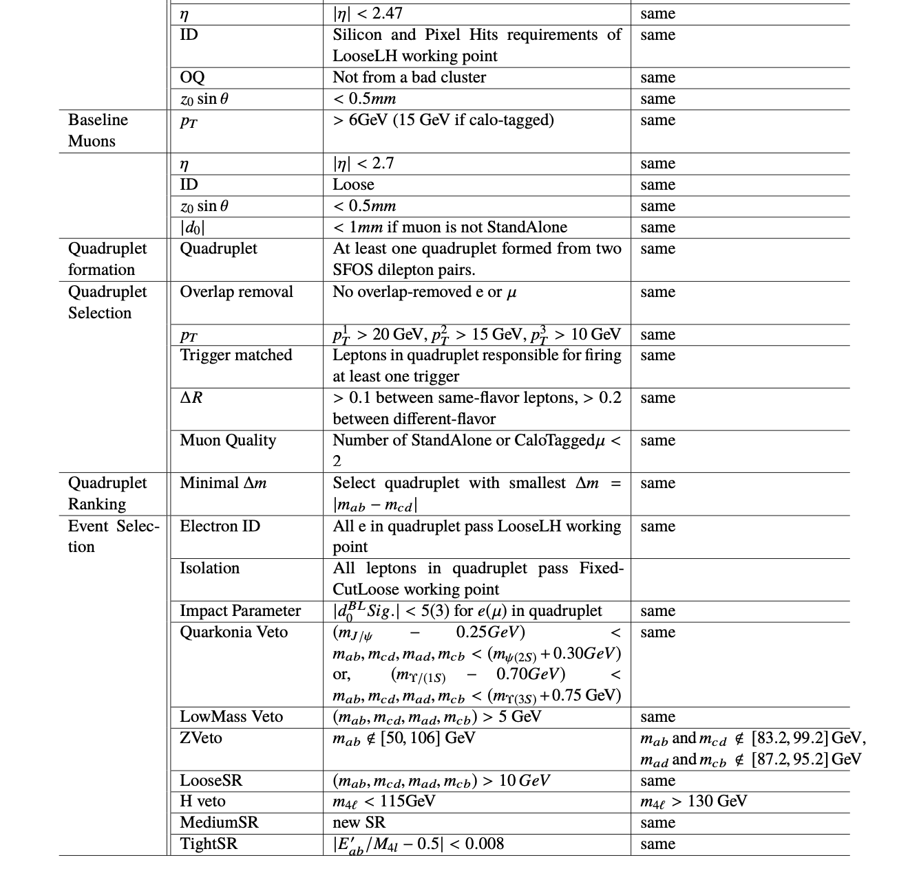
Event Selection
Final state objects of interest are electrons and muons
Electrons are identified from charged particle tracks in Inner Detector that match energy deposits in Calorimeter
No more than one Calorimeter Tagged or Standalone muons are allowed to be in an event. The rest must be Combined muons
Look for quadruplet containing two SFOS lepton pairs. Quadruplet with smallest lepton pair difference is chosen
Leptons in quadruplet must be isolated from other deposits in ID and calorimeter
Electron pairs must not be consistent with SM Z-Boson mass

Slide 7
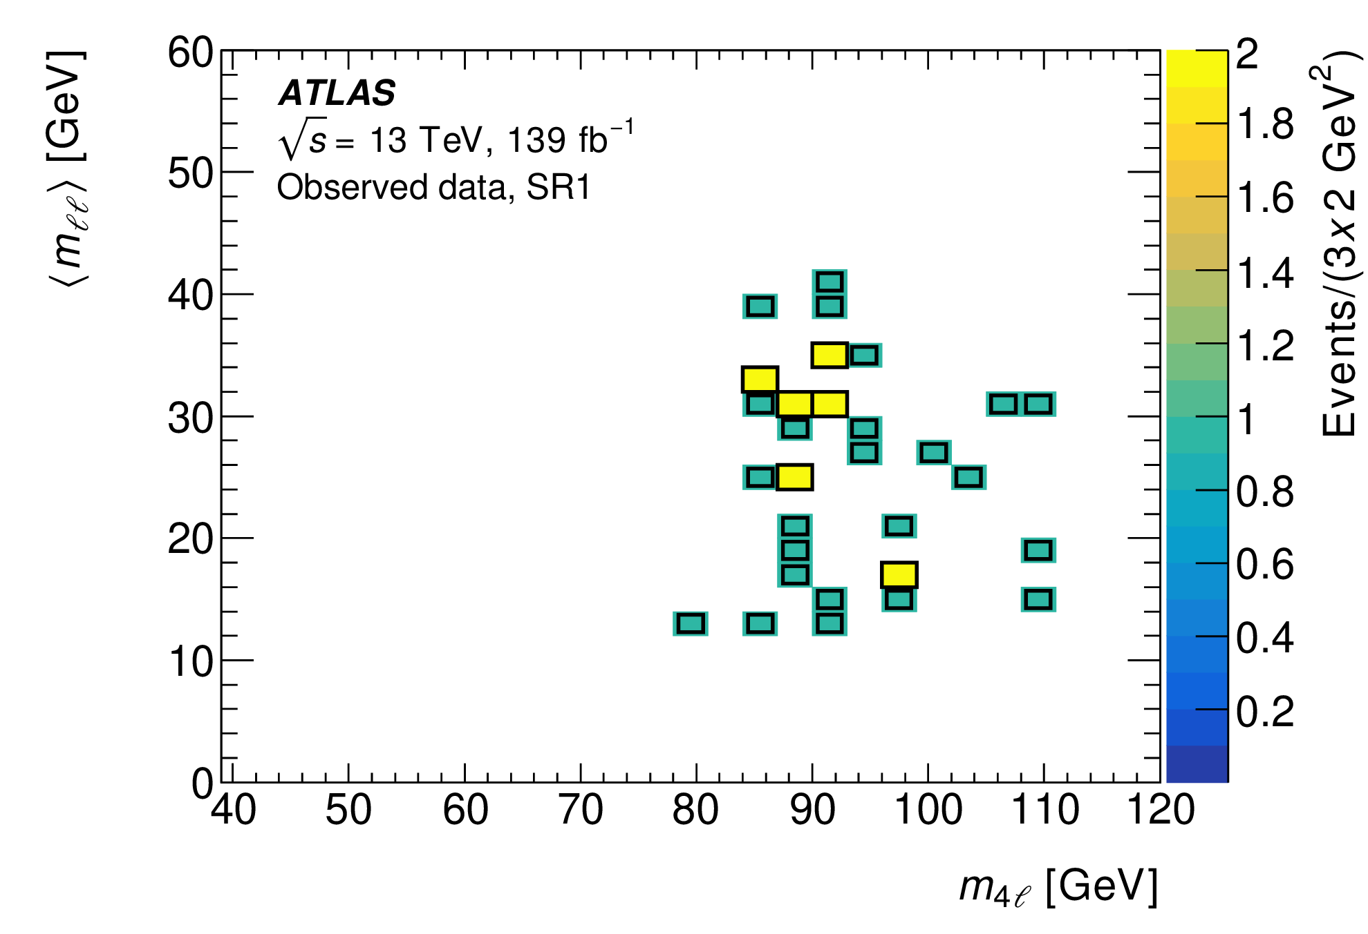
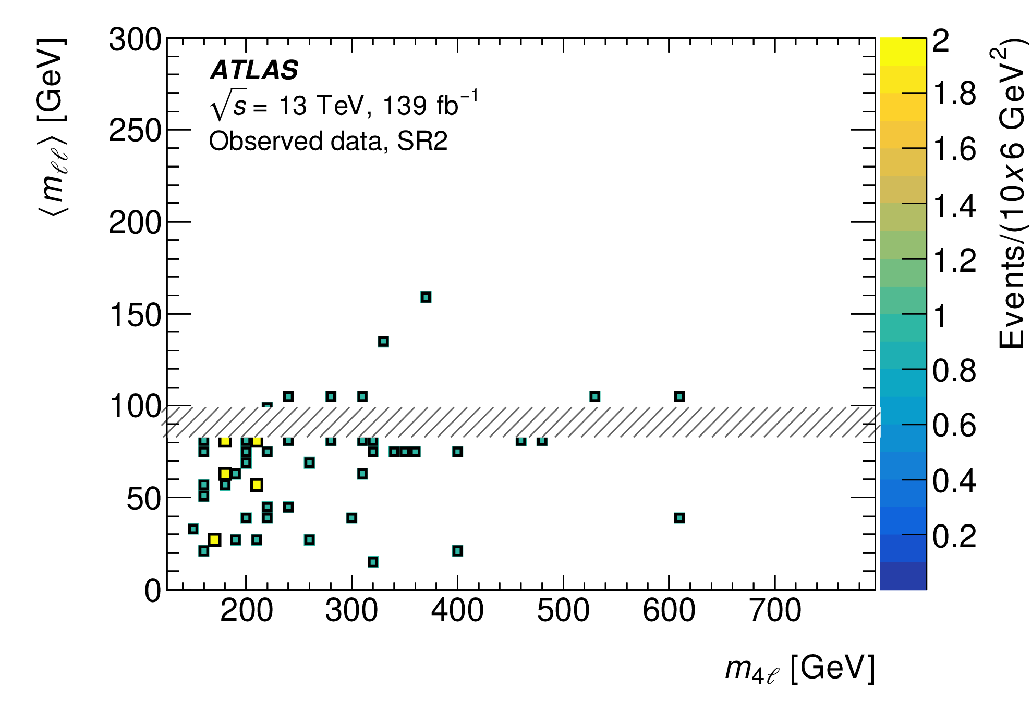

Results
Expected yields for SR1 (m_{l4} < 115 GeV) = 36
Total background yield in SR1 = 32 ± 33
Expected yields for SR2 (m_{l4} > 130 GeV) = 55
Total background yield in SR1 = 68 ± 8
Two-dimensional interpolation procedure used to obtain the shape of $\left\langle m_{ll}\right\rangle$ in the $\left(m_{S},m_{ll}\right)$ plane

Slide 8
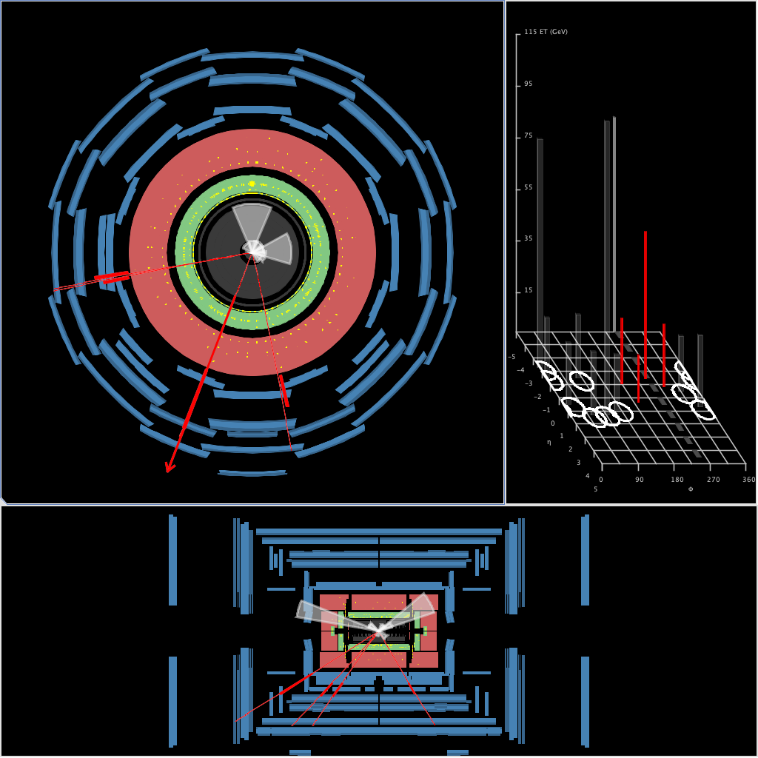
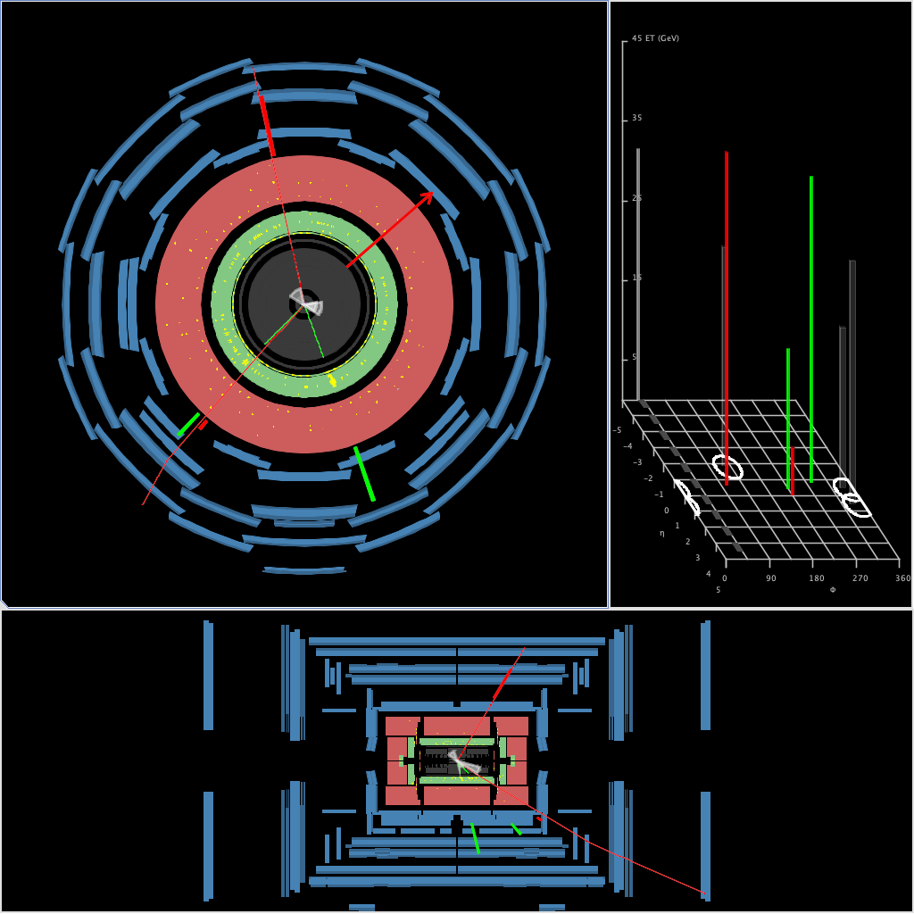
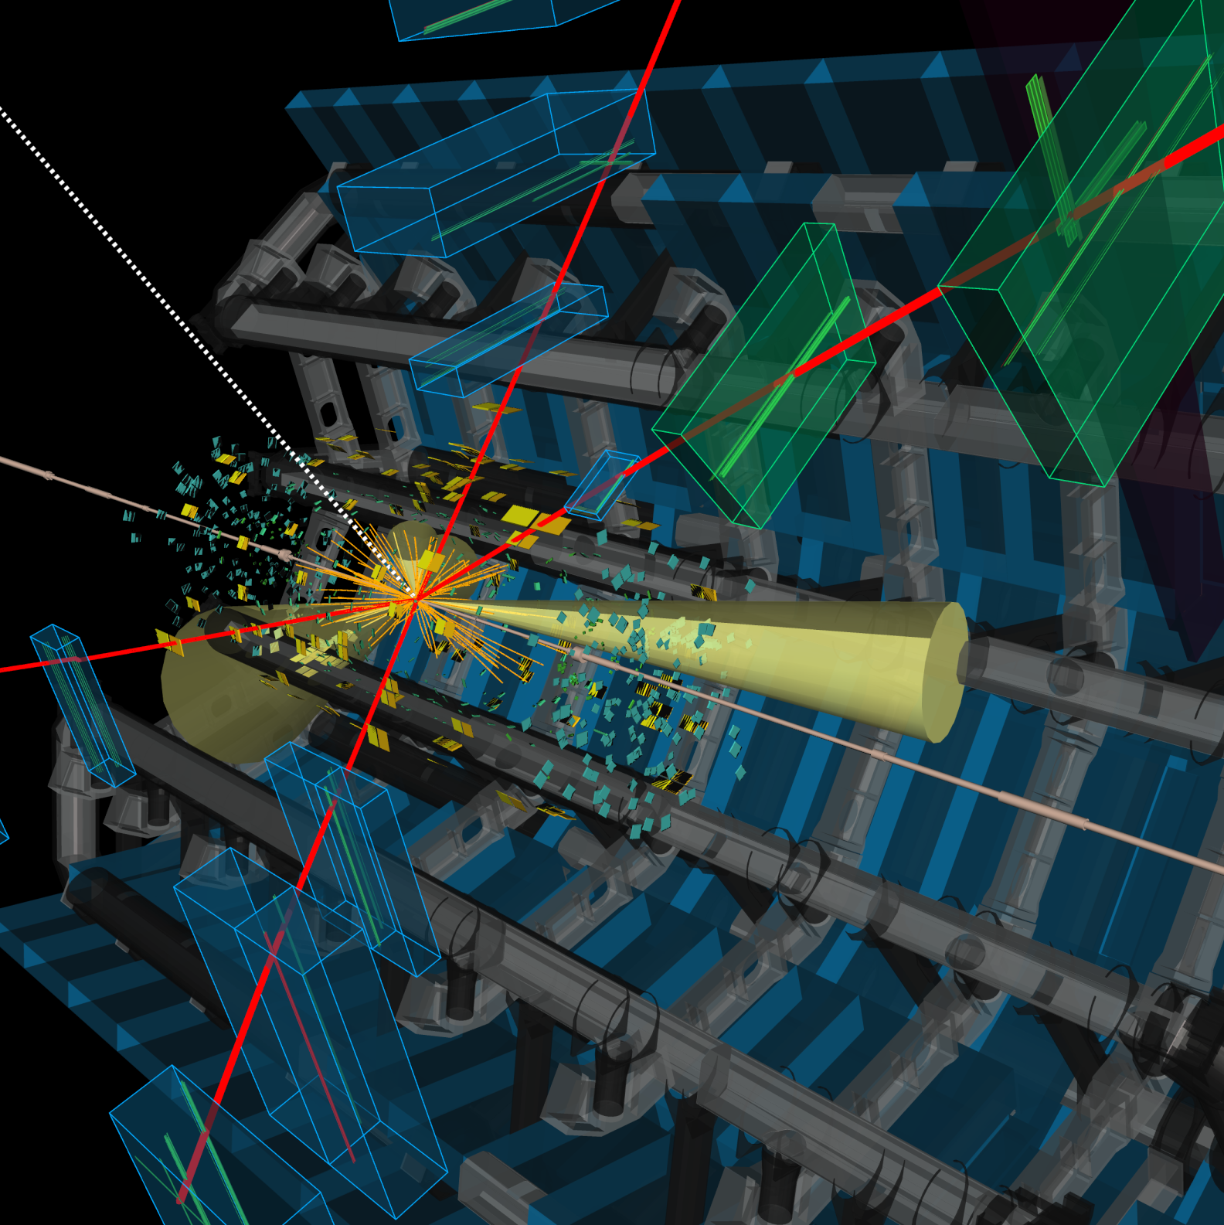
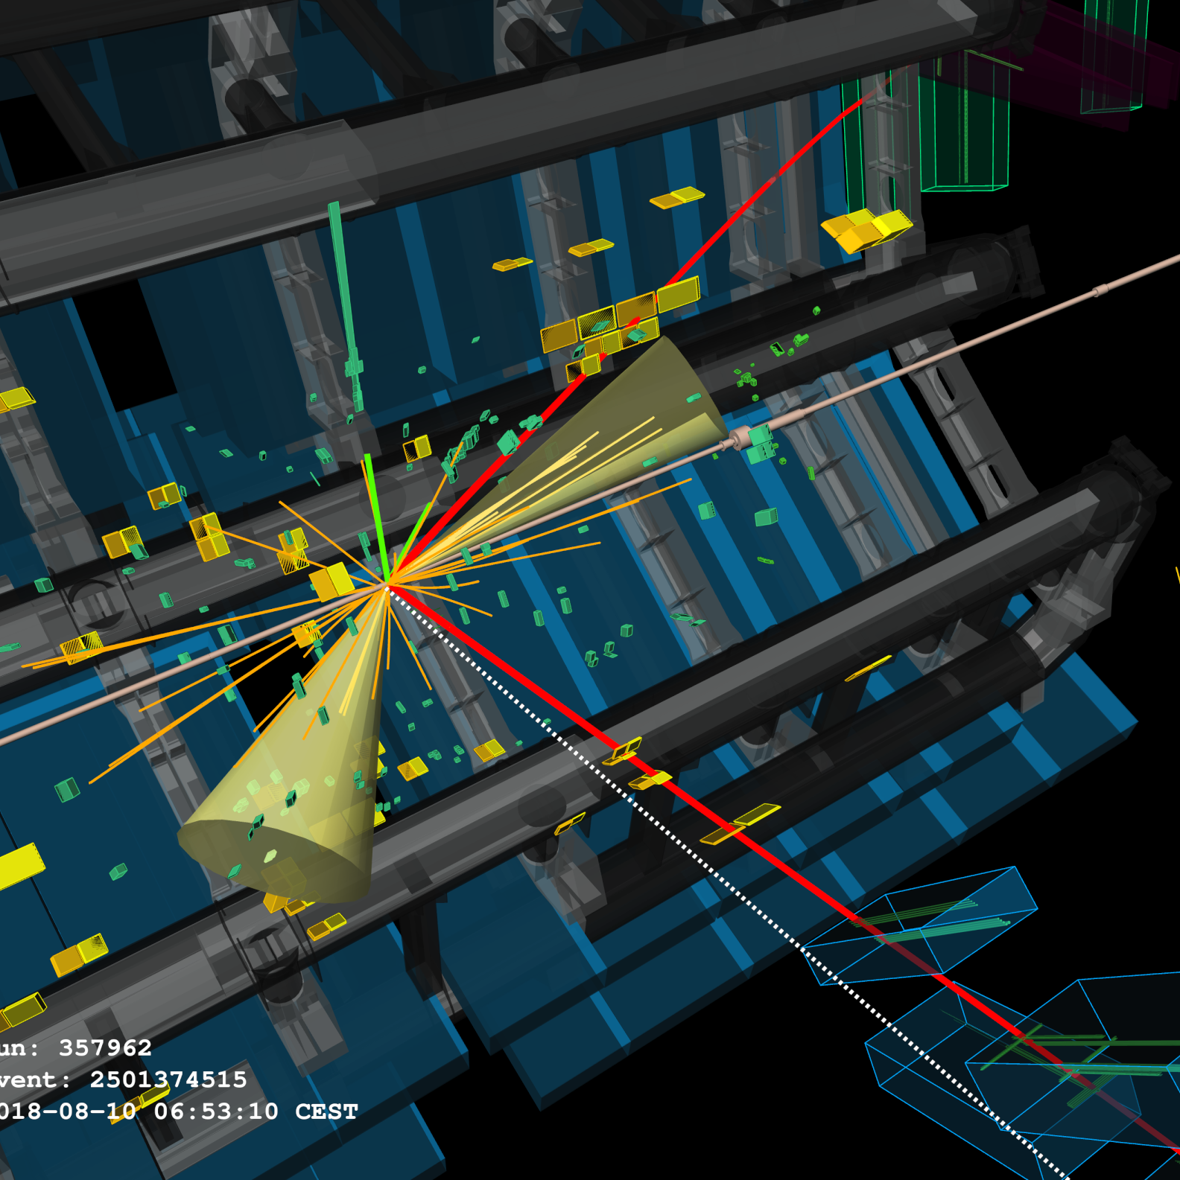
Results
Event display for event 2501374515 (top rght) and 934575124 (top left), in the region around (m_{S}, m_{Zd} ) = (110 GeV, 30 GeV).
Electrons are indicated by green segments/towers, and muons by red segments/towers.
The ovals in the η–φ plane represent jets (p_{T} > 15 GeV) and the red arrow represents the E_{T}^{miss}. For this 2e2μ event, m_{4ℓ} = 106.2 GeV and ⟨m_{ℓℓ}⟩= 30.5 GeV. .

Slide 9
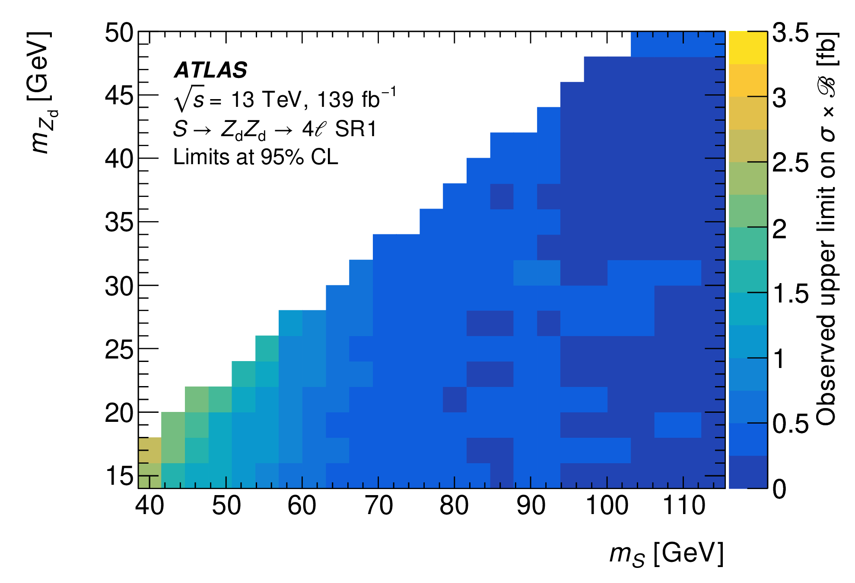
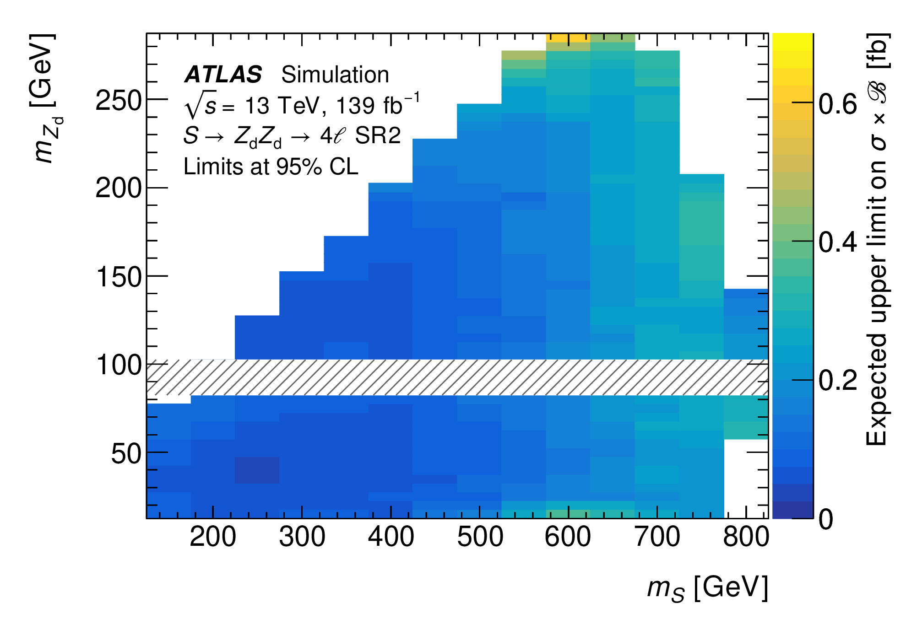
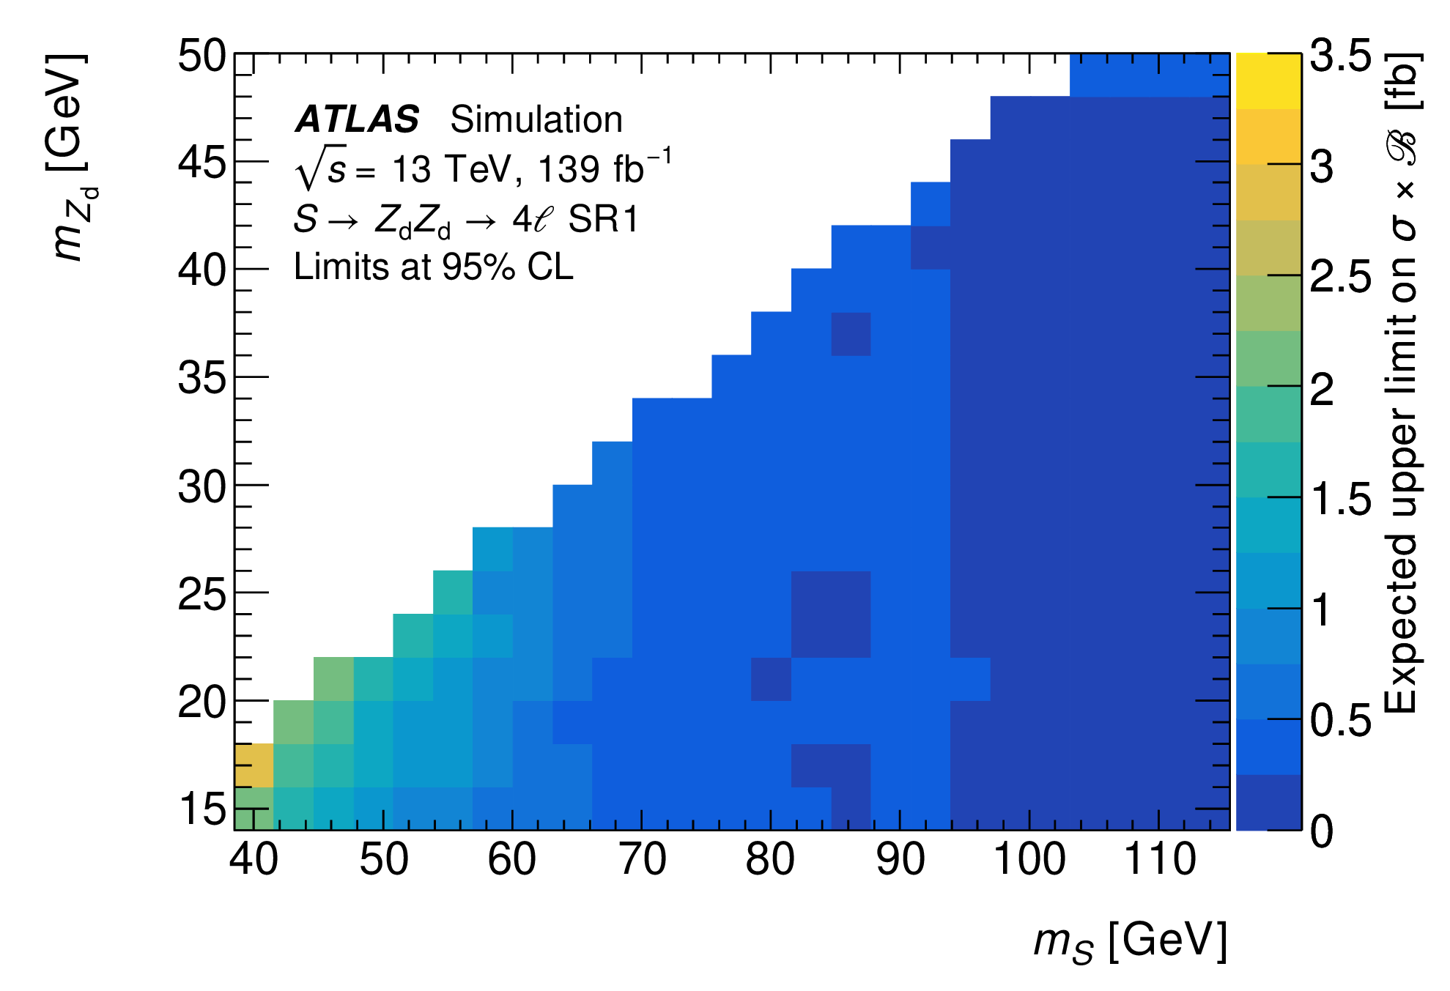
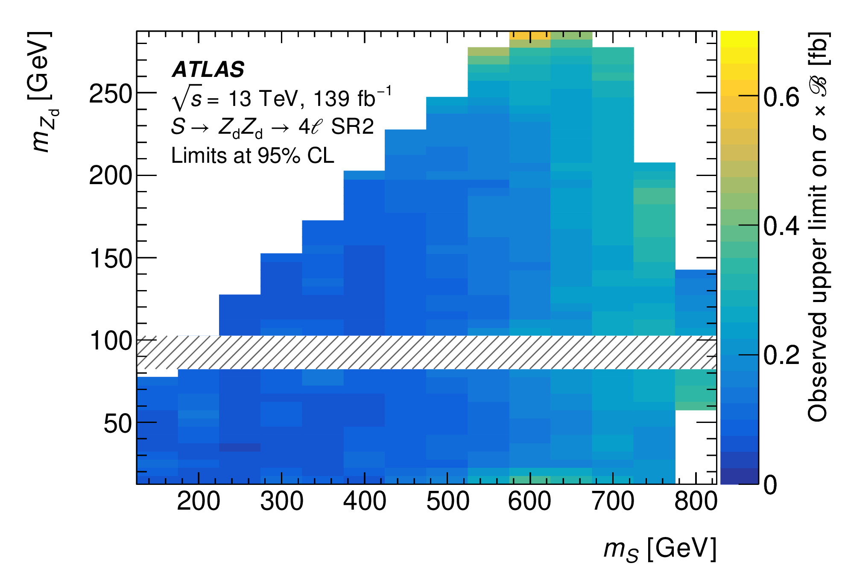

Limit setting
Evaluation limits on $σ\left(gg →S\right)×B\left(S→Z_{d}Z_{d}→4l\right)$ are set using the frequentist significance statistic
CL_{S} frequentist upper limits at 95% confidence level are set on on $σ\left(gg →S\right)×B\left(S→Z_{d}Z_{d}→4l\right)$ as a function of $\left\langle m_{ll}\right\rangle$ and $m_{4l}$
Smallest p-value in SR1 at $\left(m_{S}=110 GeV,m_{Z_{d}}=30 GeV\right)=2.7σ$ local, $0.5σ$ global
Smallest p-value in SR2 at $\left(m_{S}= 350 GeV,m_{Z_{d}}= 75 GeV\right)=2.8σ$ local, $1.6σ$ global
Data consistent with Standard Model

Slide 10
Conclusion
A search is presented for the decay of a new scalar 𝑆 into two new spin-1 particles 𝑆 → 𝑍d𝑍d, with each 𝑍d boson decaying promptly into a pair of electrons or muons, yielding an inclusive four-lepton final state.
Two different signal regions are studied, corresponding to 30 GeV < 𝑚𝑆 < 115 GeV and 130 GeV < 𝑚𝑆 < 800 GeV.
The data are found to be consistent with the Standard Model background expectation, and 95% CL upper limits are set on the total cross-section times branching ratio 𝜎(𝑔𝑔 → 𝑆) × B(𝑆 → 𝑍d𝑍d → 4l) as a function of 𝑚𝑆 and 𝑚𝑍d.
These constraints apply to the dark sector described by the Hidden Abelian Higgs Model, as well as to similar models resulting in a four-lepton final state.

Slide 11


Thank you

