Slide 1




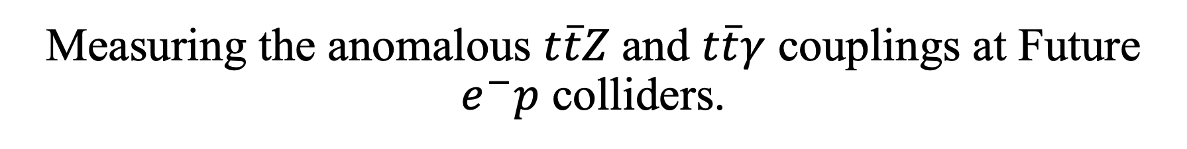
Measuring the anomalous $t\overline{t}Z$and $t\overline{t}γ$ couplings at Future $e^{−}p$ colliders.
Mukesh Kumar
In collaboration with: Katlego Machethe, Pramod Sharma, Bruce Mellado
arXiv:2507.02267

Slide 2
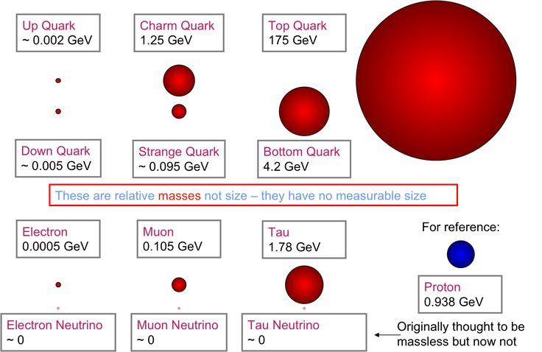
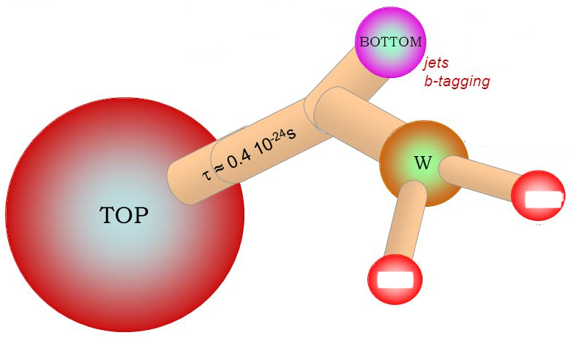
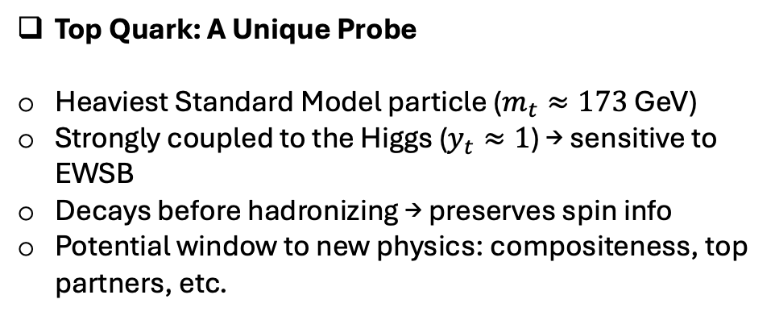

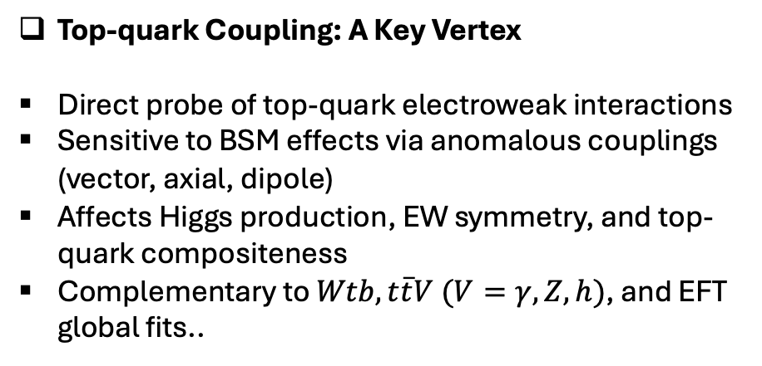
Top Quark: A Unique Probe
Heaviest Standard Model particle ($m_{t}≈173$ GeV)
Strongly coupled to the Higgs ($y_{t}≈1$) → sensitive to EWSB
Decays before hadronizing → preserves spin info
Potential window to new physics: compositeness, top partners, etc.
Top-quark Coupling: A Key Vertex
Direct probe of top-quark electroweak interactions
Sensitive to BSM effects via anomalous couplings (vector, axial, dipole)
Affects Higgs production, EW symmetry, and top-quark compositeness
Complementary to $Wtb, t\overline{t}V (V=γ,Z, h)$, and EFT global fits..
$$t→W^{+}b \left(\overline{t}→W^{−} \overline{b}\right); W^{±}→ℓ^{±}ν_{ℓ}/jj$$

Slide 3
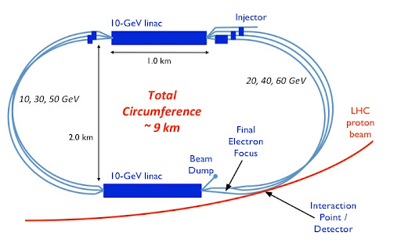
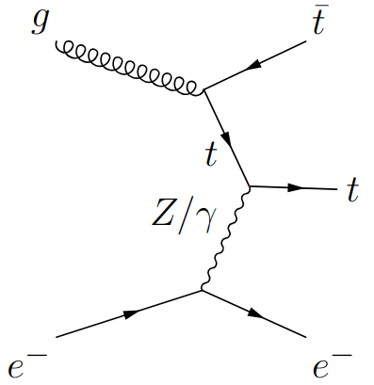
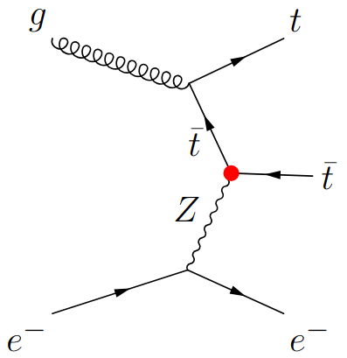
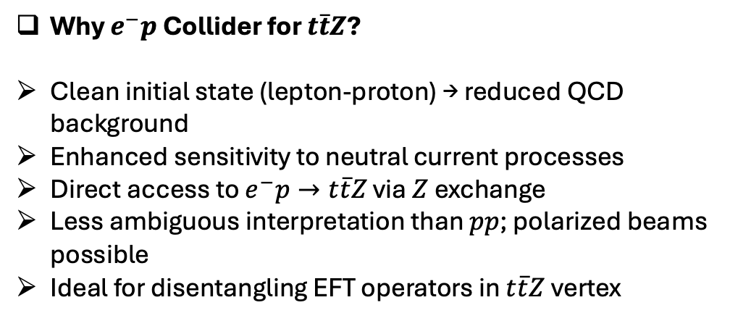
Why $e^{−}p$ Collider for $t\overline{t}Z$?
Clean initial state (lepton-proton) → reduced QCD background
Enhanced sensitivity to neutral current processes
Direct access to $e^{−}p→t\overline{t}Z$ via $Z$exchange
Less ambiguous interpretation than $pp$; polarized beams possible
Ideal for disentangling EFT operators in $t\overline{t}Z$vertex
+

Slide 4


Cross section(s):
Semi-leptonic
$$p_{e^{−}}=−80\%$$
$$N_{SD}=S/\sqrt{S+B+{\left(δ_{S}⋅S\right)}^{2}+{\left(δ_{S}⋅B\right)}^{2}}$$

Slide 5




Sensitive Observable(s)
$$t→W^{+} \left(→ℓ^{+}ν_{ℓ}/jj \right)b$$
$$\overline{t}→W^{−} \left(→{jj/ℓ}^{−}ν_{ℓ} \right)b ̅$$
$$ℓ^{±}=e^{±}, μ^{±}$$
SM-Like
Dipole-structure
(momentum dependence )
$$ΔC_{1V}, ΔC_{1A}$$
$$C_{2V}, C_{2A}$$

Slide 6
Analysis and Results:
One-parameter
The dependence of the inclusive and differential cross sections on the BSM couplings can be modelled as a quadratic function:

Slide 7
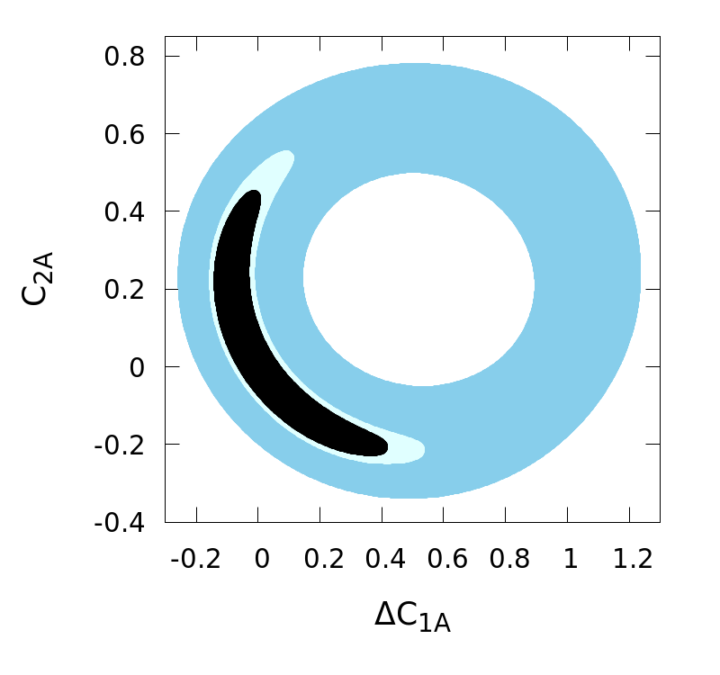
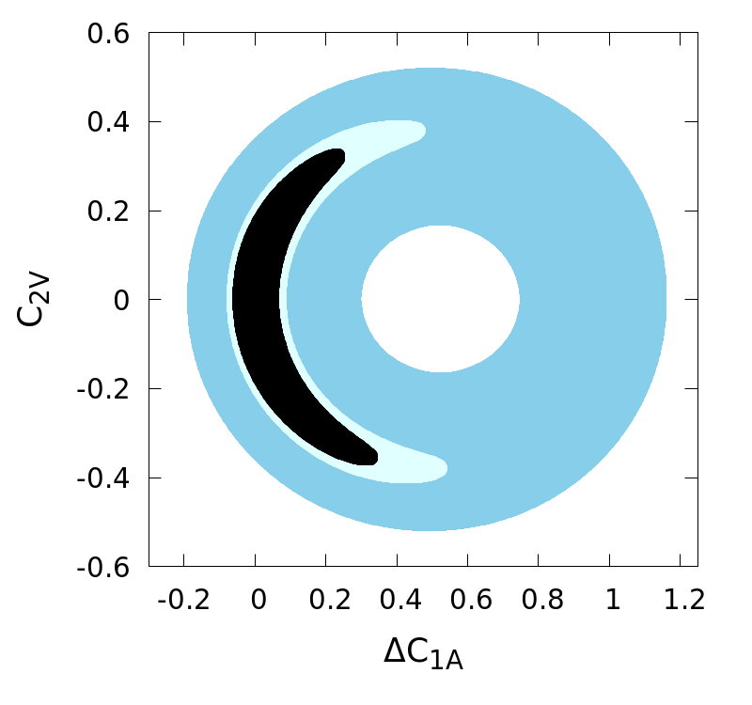
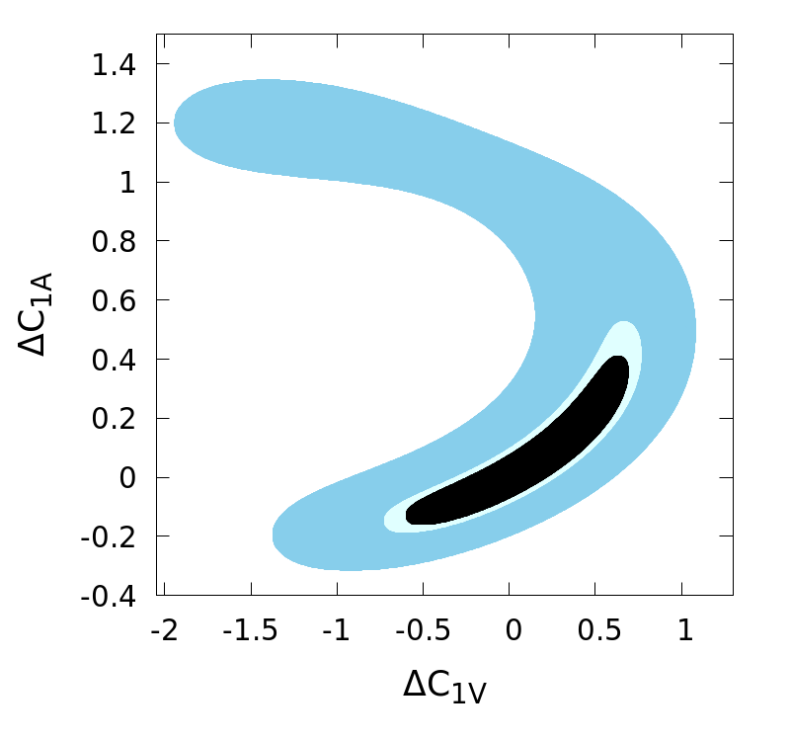
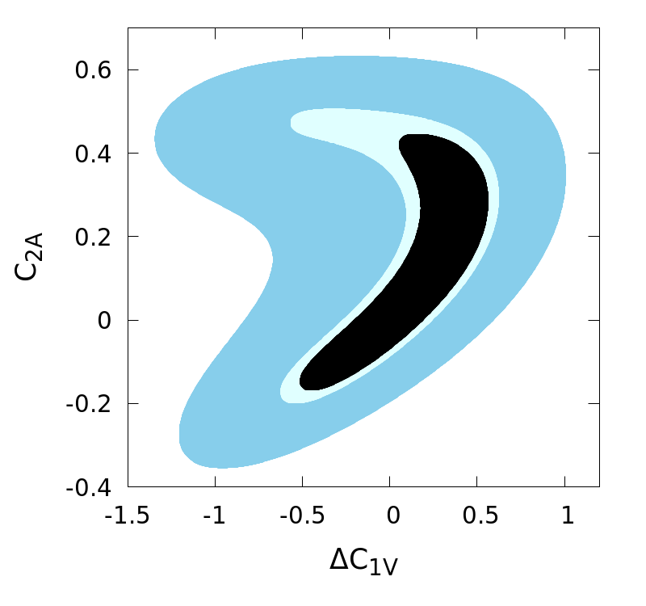
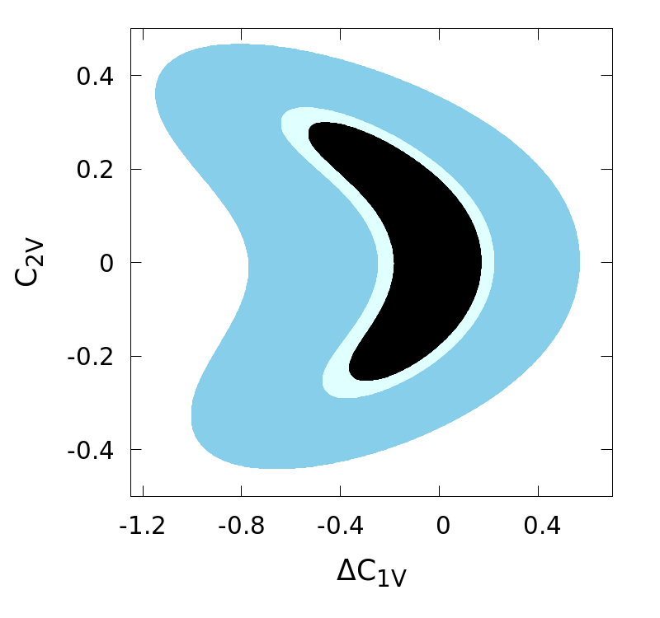
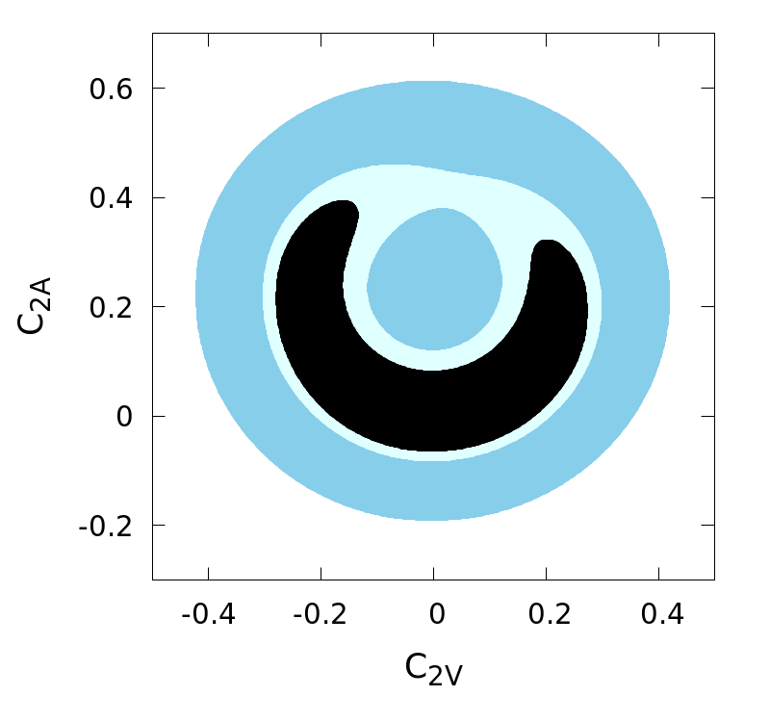
Analysis and Results:
Two-parameter (differential)

Slide 8
Analysis and Results:

Slide 9
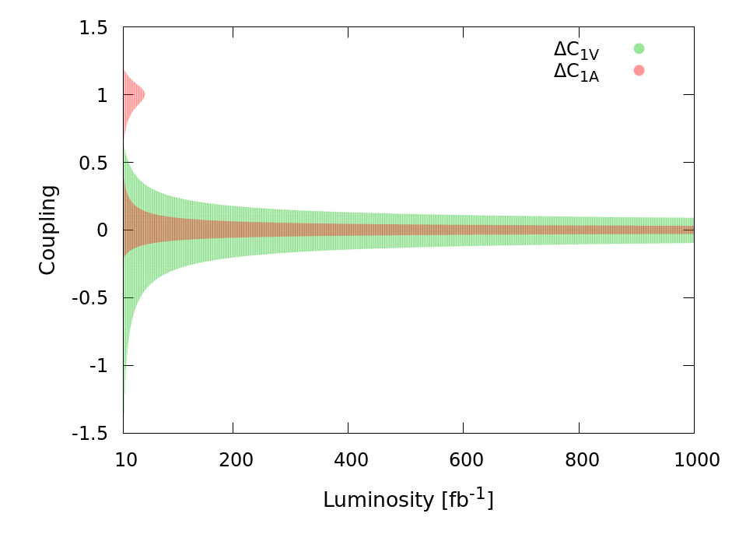
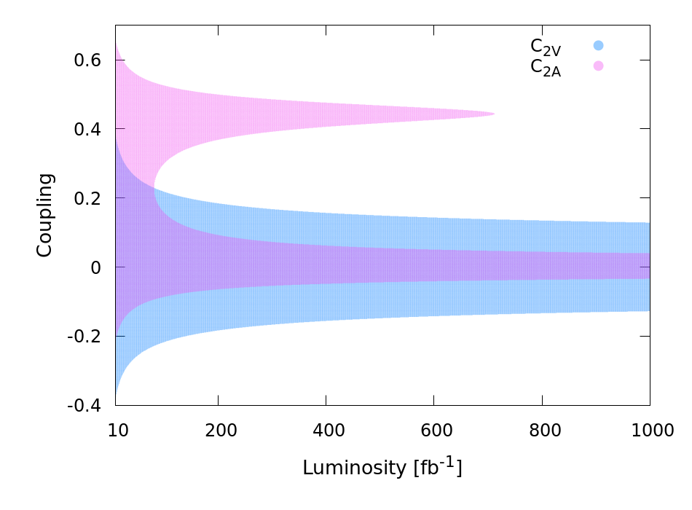
Analysis and Results:

Slide 10
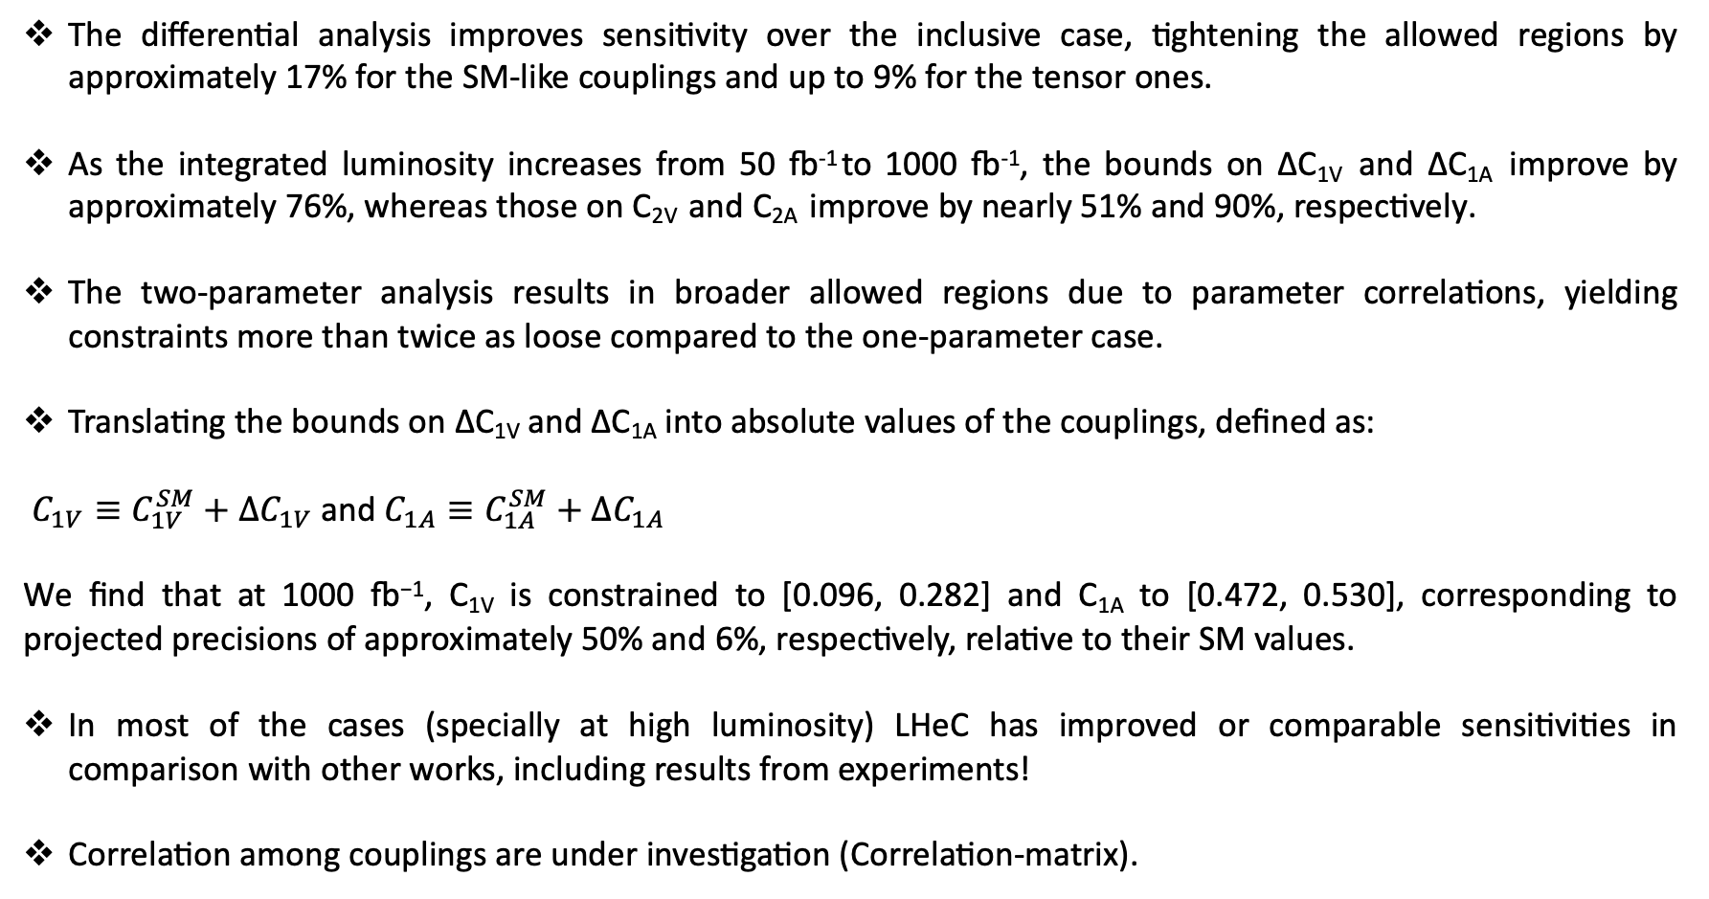
Conclusions and way forward:
The differential analysis improves sensitivity over the inclusive case, tightening the allowed regions by approximately 17% for the SM-like couplings and up to 9% for the tensor ones.
As the integrated luminosity increases from 50 fb⁻¹ to 1000 fb⁻¹, the bounds on ∆C_{1V} and ∆C_{1A} improve by approximately 76%, whereas those on C_{2V} and C_{2A} improve by nearly 51% and 90%, respectively.
The two-parameter analysis results in broader allowed regions due to parameter correlations, yielding constraints more than twice as loose compared to the one-parameter case.
Translating the bounds on ∆C_{1V} and ∆C_{1A} into absolute values of the couplings, defined as:
$C_{1V}≡C_{1V}^{SM}+ΔC_{1V}$ and $C_{1A}≡C_{1A}^{SM}+ΔC_{1A}$
We find that at 1000 fb⁻¹, C_{1V} is constrained to [0.096, 0.282] and C_{1A} to [0.472, 0.530], corresponding to projected precisions of approximately 50% and 6%, respectively, relative to their SM values.
In most of the cases (specially at high luminosity) LHeC has improved or comparable sensitivities in comparison with other works, including results from experiments!
Correlation among couplings are under investigation (Correlation-matrix).

Slide 11
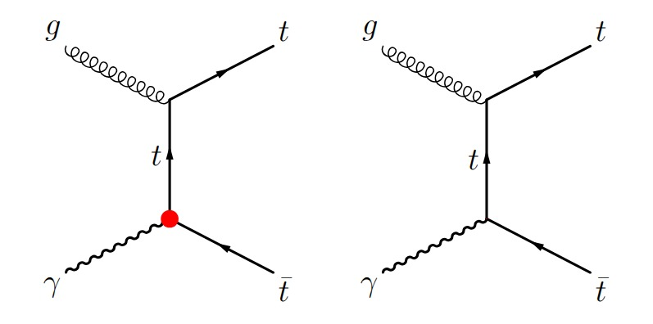
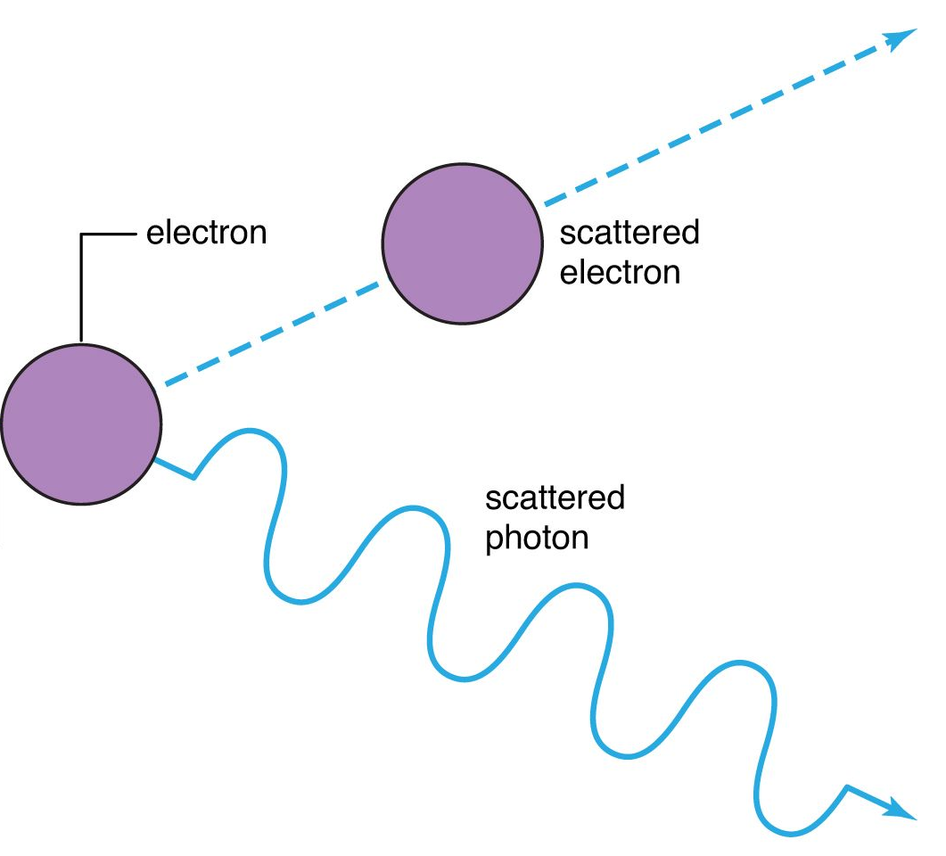
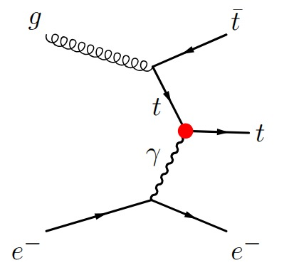
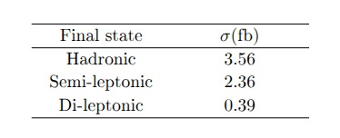
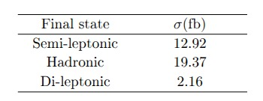

Conclusions and way forward:
The $t\overline{t}γ$ couplings at $e^{−}p$ as ongoing work …
Photoproduction
Thank you!

