Slide 1

Crafting Optical Neural Networks Using Multimode Fibre
Neural Networks, Reservoirs, Benchmarking, OAM Classification
Christopher (Kit) Rawlings
School of Electrical and Information Engineering, University of the Witwatersrand, Johannesburg, South Africa

Slide 2
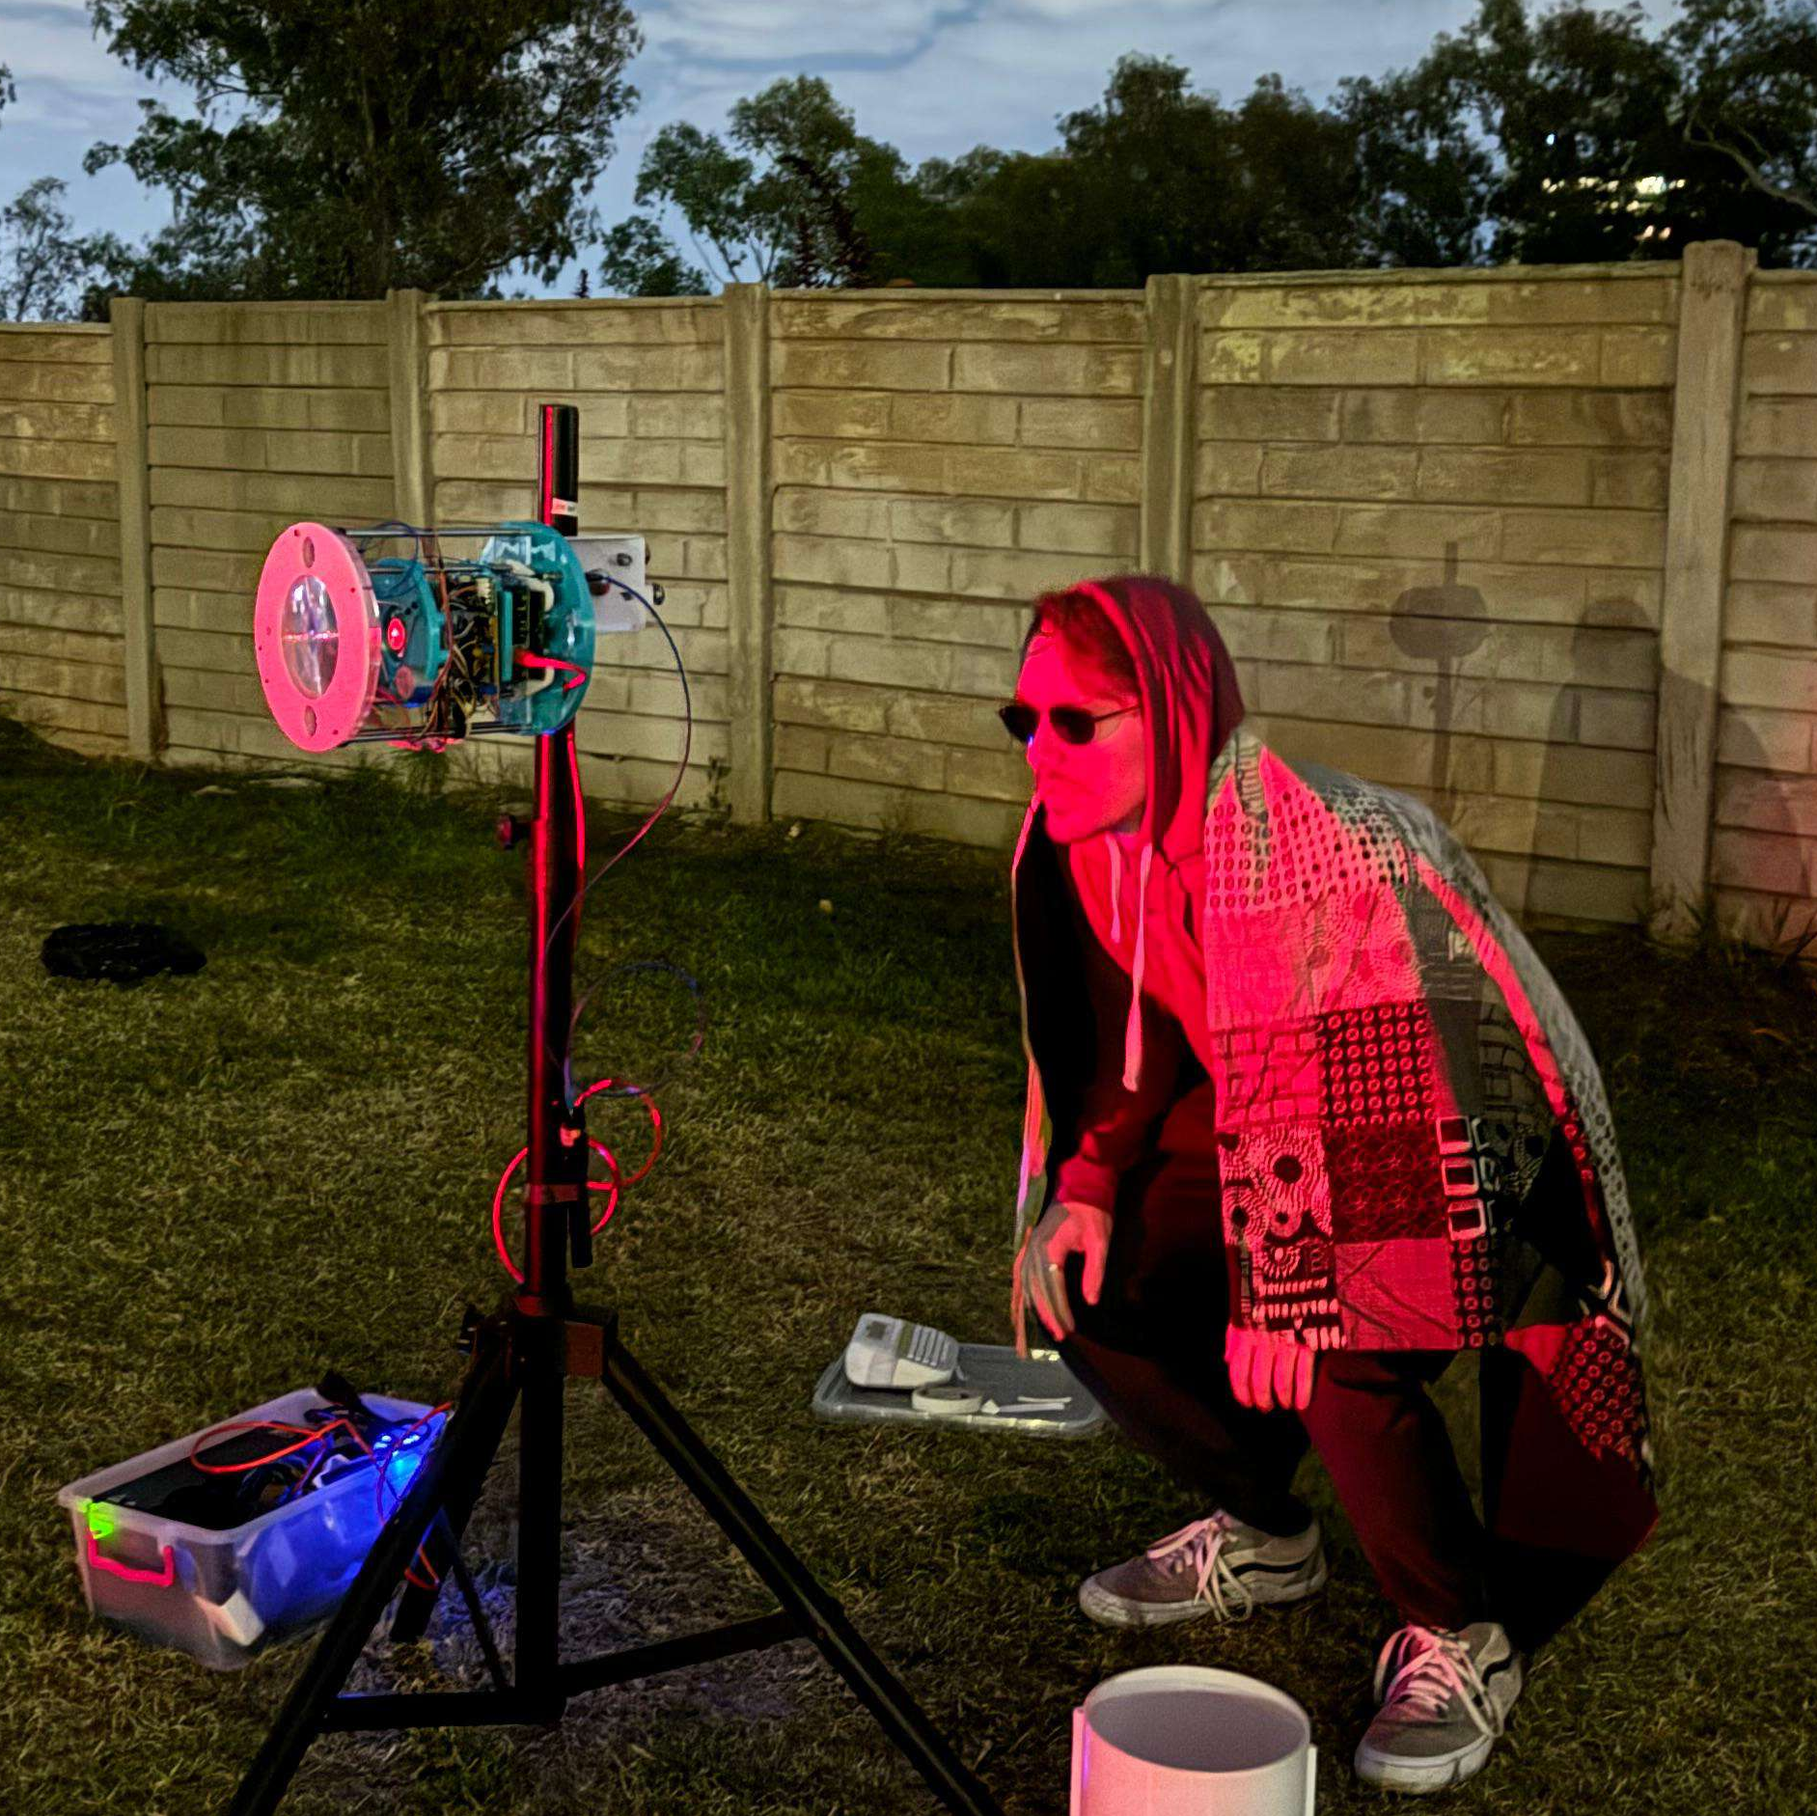

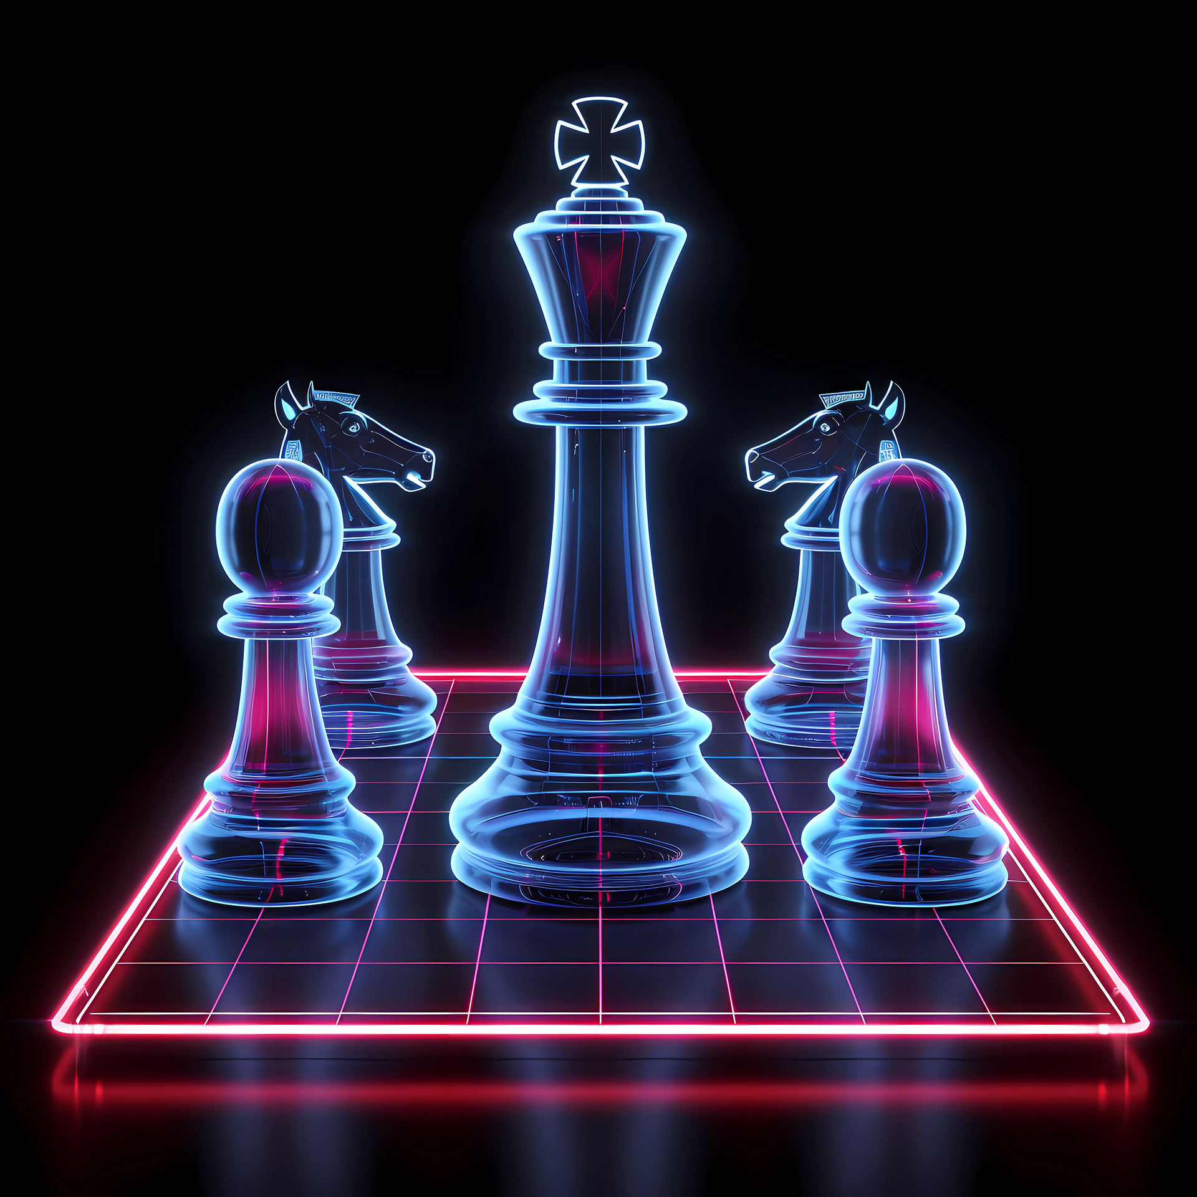
What are Neural Networks?
Artificial Intelligence
Machine Learning
Deep Learning
Neural Networks
Figure 1: Understanding what framework we have.
Figure 2: Practical example of each framework.
Notes:
Introduce AI and neural networks.
AI is the broadest term, encompasses anything in which imitates human behaviour and thinking.AI ranges from incredibly complex system to look up tables with predefined rules. A Good example is the Deep Blue chess engine created by IBM.
Machine learning is a branch of AI in which data is provided, but the rules have to be learnt. An example of this is your spam filter, over time it considers what you consider spam based on email addresses, phrases etc.
Going deeper down the rabbit hole we arrive at neural networks, where we draw inspiration from nature and the human brain, and the internal structure is comprised of layers of interconnected neurons. Deep learning refers to neural networks that have more than two internal layers excluding the input and output layers. Neural networks may offer us a useful tool for dealing with challenges in optics, for example dealing with OAM modes affected by turbulence.

Slide 3
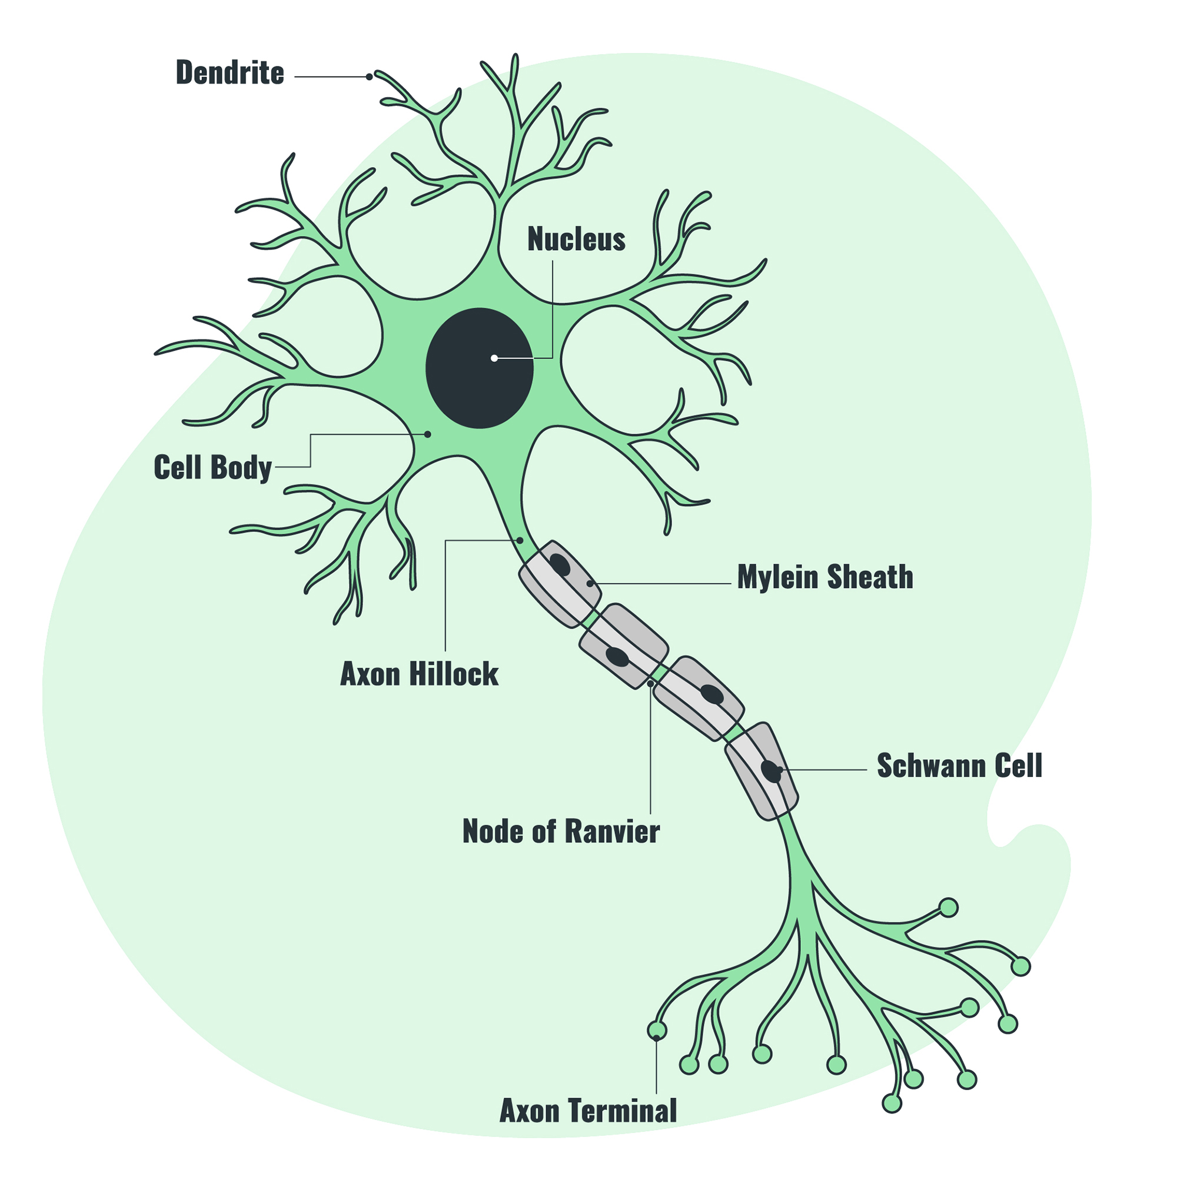
How are neurons formed?
Reality
Model
Dendrite
x₁
w₁
Nucleus
x₂
w₂
Cell Body
∑
f
Myelin Sheath
x₃
w₃
Axon Hillock
Schwann Cell
Node of Ranvier
x₄
w₄
Axon Terminal
Notes:
The Dendrites are modelled as input to the system. Each of the inputs is assigned a weight to deem its importance. The weighted inputs are summed together. In biological neurons the axon hillock checks to see if the sum is greater than a set threshold and if it a full action potential is sent. Our activation function performs very much in the same way. The activation function is typically a nonlinear function and different functions are useful for different things. Primary activation functions such as Sigmoid, Tanh and ReLU can be implemented as is or can be used as a basis to form a complex activation function such as Wide Hidden Expansion, Rectified Linear Tanh, and Self-Learnable activation functions () will link to what they are used for

Slide 4
How do Neural Networks work?
Input (X)
Hidden Layer (H)
Output (Y)
w_{in}
w_{out}
w_{H}
w_{H}
∑
f
∑
f
∑
f
∑
f
∑
f
∑
f
Notes:
Neural networks are made from layers of neurons. The input passes through each of these layers, where it is augmented into the desired output. In traditional neural networks we train the input weights, the weights between the hidden layers as well as the output weights. The neural networks are usually trained iteratively and use some sort of loss function. Neural networks have a wide variety of applications from classification, regression and time series prediction.

Slide 5
What is Reservoir Computing?
Input (X)
Hidden Layer (H)
Output (Y)
w_{in}
w_{out}
w_{H}
w_{H}
∑
f
∑
f
∑
f
∑
f
∑
f
∑
f
Notes:
Reservoir computing takes an interesting approach to neural networks, instead of training the input and hidden weights, all of these weights are randomised and only train the output layer. In doing so you dramatically reduce the computational cost of the system. But how does randomising these weights help you?

Slide 6
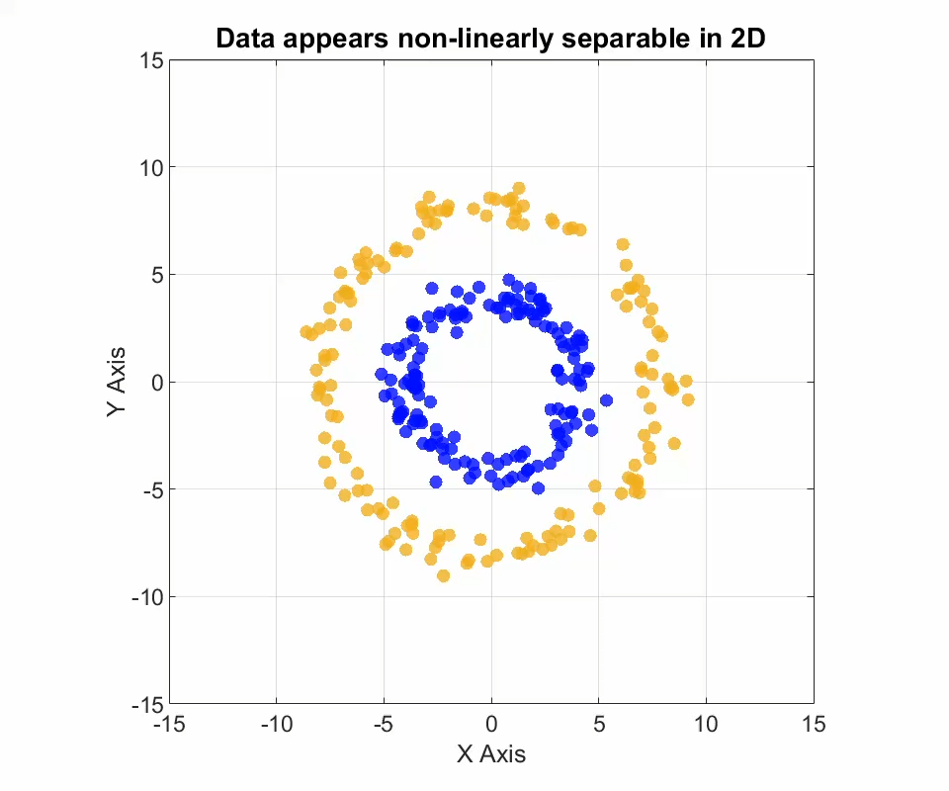
The Fundamentals of Random Projection
Notes:
Reservoir computing is based on random projection and Covers Theorem. Random projection takes the input data, and through its randomised connections, nonlinearly transforms the the data into a higher dimensional space. According to Covers theorem if you take a classification problem that is nonlinearly seperable and cast it into a high enough dimensional space, it becomes linearly seperable. An additional advantage to this is that instead of relying on computationally expensive nonlinear algorithms to train the final layer, you can simply use linear regression.

Slide 7
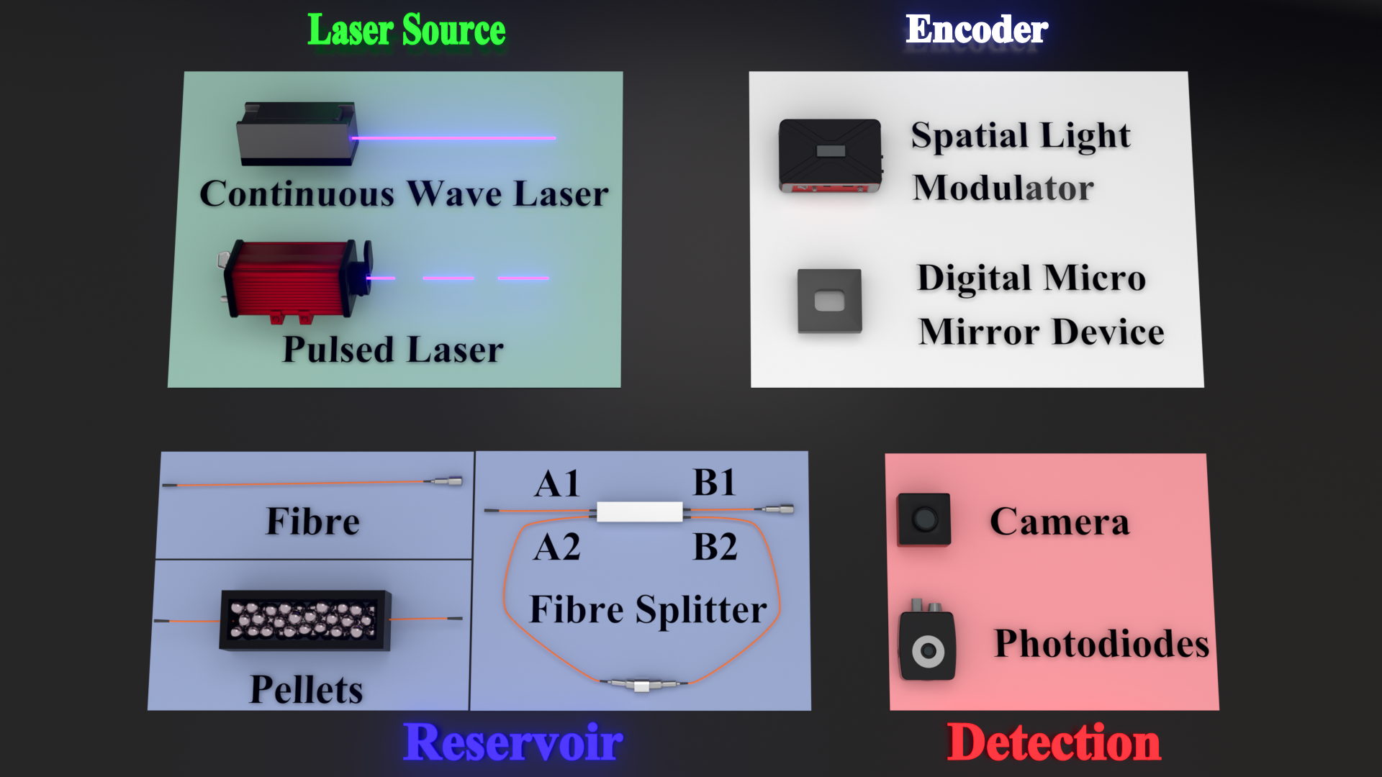
Fibre Optical Neural Networks
R. M. Graphics, “Ryo mizuta graphics website,” https://ryomizuta.com/. Accessed: January 22, 2025.
Notes:
Unlike silicon based computing, where describing your neural network is simple, describing your reservoir is complicated. For example if we code a traditional neural network with 1 layers of hidden neurons, and with no feedback, that is exactly how you would describe the system. There is no redundancy in the system because you would be wasting valuable resources.
However in the case of physical reservoirs, you do not describe what the reservoir is capable of, rather how you interfaces with it. Meaning how you input and how you capture data from the

Slide 8
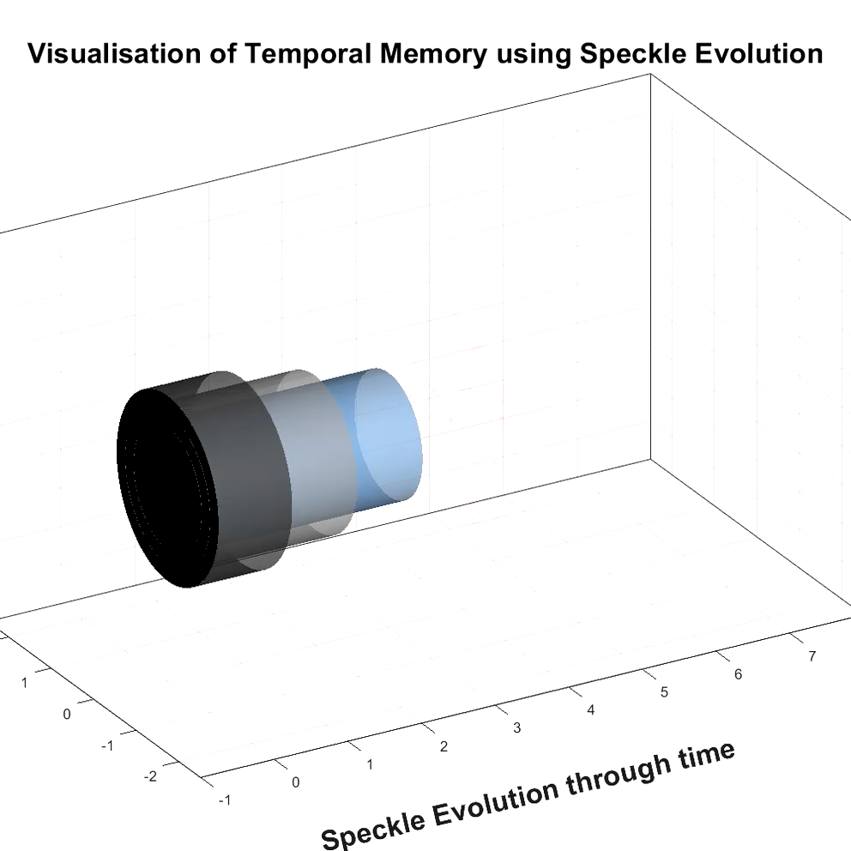
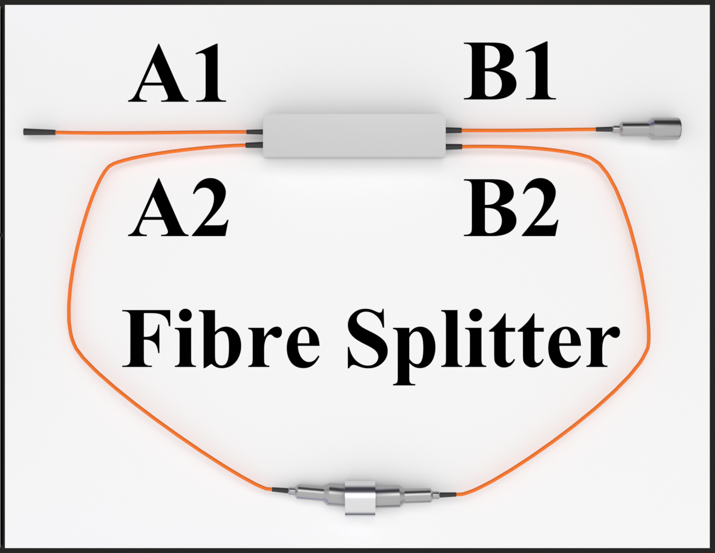
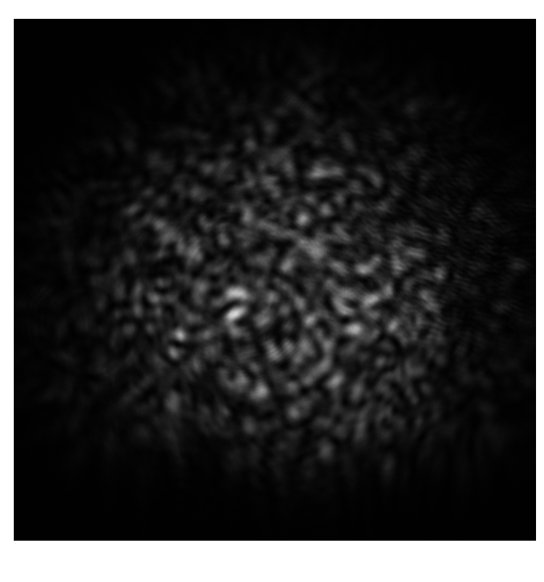

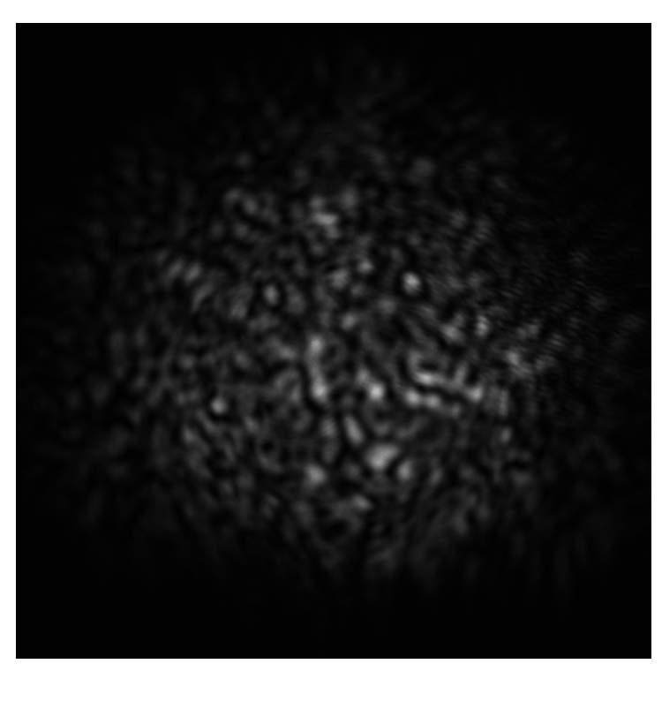
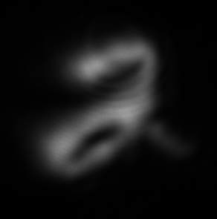
Reservoir Memory
Feedback Loops
Time Multiplexing
Encode
Capture
Notes:
In machine learning, memory refers to a system’s ability to retain and utilise past inputs to inform current or future outputs. In many artificial neural networks and reservoirs, memory fades over time and the system returns to a quiescent state \cite{vanderSande2017photonic}. Physical reservoirs with purely feed-forward architectures lack intrinsic memory. However, memory can be introduced through time-multiplexing. Consider a reservoir formed by a single segment of optical fibre.
If the sampling time is less than the characteristic response time of the reservoir, each measurement allows us to see the dynamic change in the reservoir, which is affected by the reservoirs previous input, giving the system memory. These snapshots into the reservoirs behaviour can be called temporal neurons, these are not spatially distinct from each other. This allows what appears to be a feedforward reservoir to have memory and for us to increase the complexity of our reservoir without making any physical changes to it.
Alternatively, optical feedback can impart memory by routing the reservoir’s output back into its input. If the time taken to input and extract information out of the reservoir is much higher than the time taken for the feedback to travel around the loop, then although the system has feedback it has no memory, and the feedback loop only provides more complexity to the reservoir. If the encoding time is still slower than the time taken around the feedback loop, but our sampling time is higher, we introduce temporal neurons into the system as we can observe how our reservoir changes. If both the encoding and sampling time are after than the feedback time of the loop, then the spatial neurons that we capture are affected by previous inputs and we have a system that is closely related to how feedback works in traditional neural networks.

Slide 9
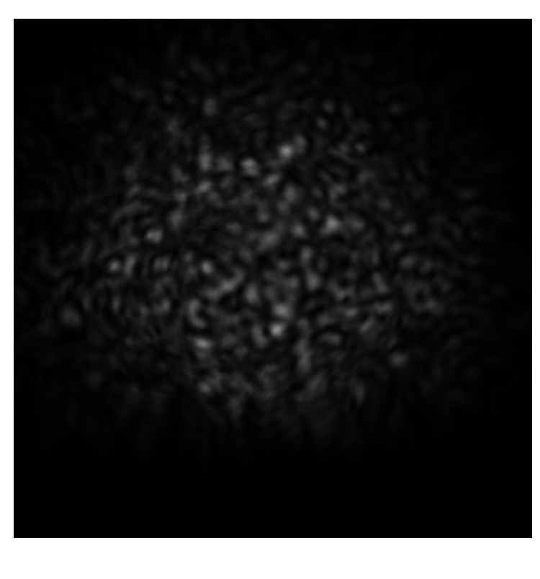

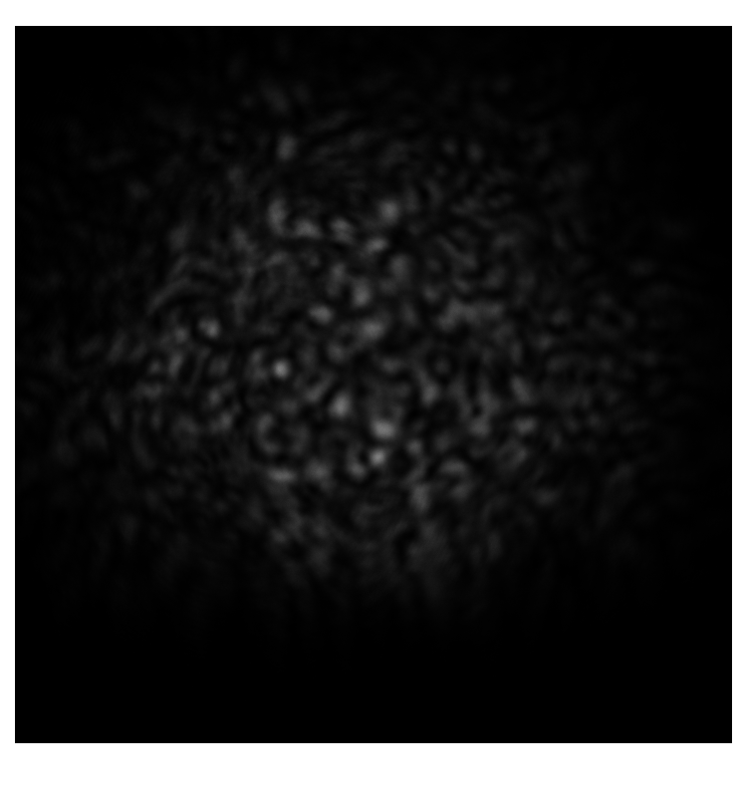
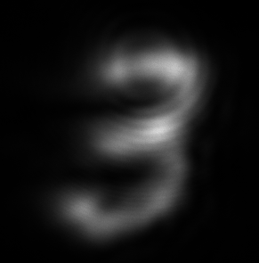
Reservoir Memory
Feedback Loops
Encode
Capture
Notes:
In machine learning, memory refers to a system’s ability to retain and utilise past inputs to inform current or future outputs. In many artificial neural networks and reservoirs, memory fades over time and the system returns to a quiescent state \cite{vanderSande2017photonic}. Physical reservoirs with purely feed-forward architectures lack intrinsic memory. However, memory can be introduced through time-multiplexing. Consider a reservoir formed by a single segment of optical fibre.
If the sampling time is less than the characteristic response time of the reservoir, each measurement allows us to see the dynamic change in the reservoir, which is affected by the reservoirs previous input, giving the system memory. These snapshots into the reservoirs behaviour can be called temporal neurons, these are not spatially distinct from each other. This allows what appears to be a feedforward reservoir to have memory and for us to increase the complexity of our reservoir without making any physical changes to it.
Alternatively, optical feedback can impart memory by routing the reservoir’s output back into its input. If the time taken to input and extract information out of the reservoir is much higher than the time taken for the feedback to travel around the loop, then although the system has feedback it has no memory, and the feedback loop only provides more complexity to the reservoir. If the encoding time is still slower than the time taken around the feedback loop, but our sampling time is higher, we introduce temporal neurons into the system as we can observe how our reservoir changes. If both the encoding and sampling time are after than the feedback time of the loop, then the spatial neurons that we capture are affected by previous inputs and we have a system that is closely related to how feedback works in traditional neural networks.

Slide 10
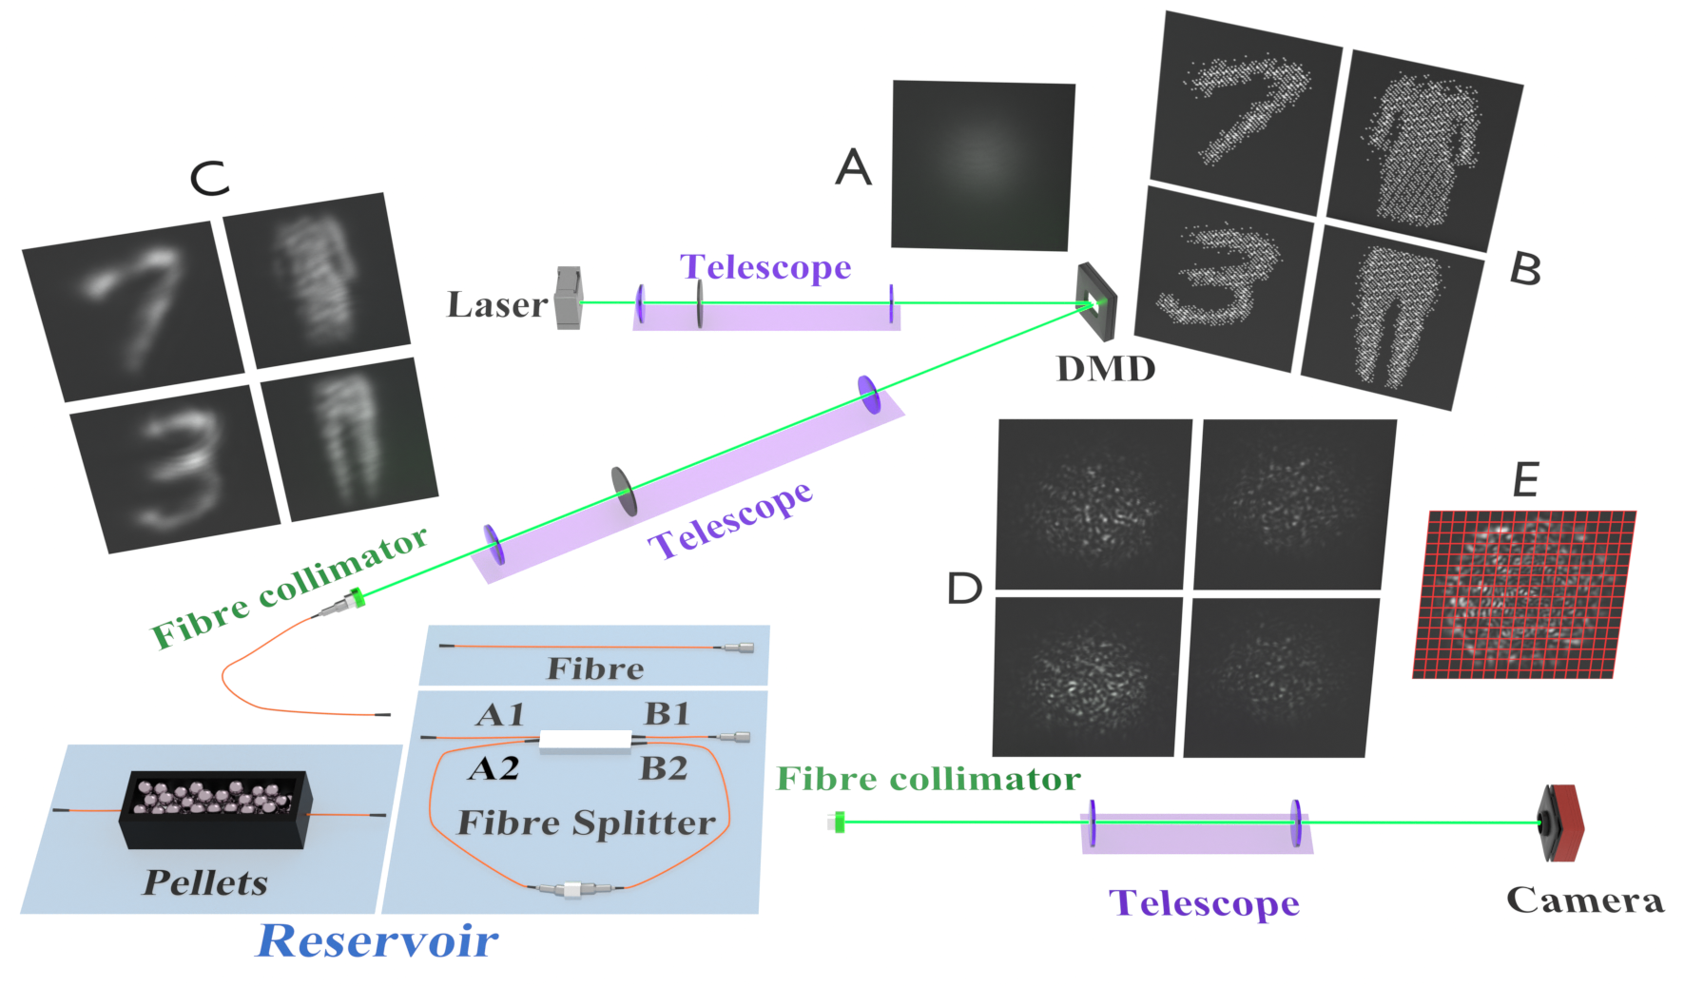
Our Experimental Setup
R. M. Graphics, “Ryo mizuta graphics website,” https://ryomizuta.com/. Accessed: January 22, 2025.
Notes:
One such way to do this is to use physical reservoirs. Physical reservoirs allow us to perform massive amounts of computation for free by exploiting the natural dynamics of the system. Once such example is implementing a fibre reservoir. The move to physical reservoirs addresses both the problems associated with the capacity and speed of our hardware becoming limited as well as the high power consumption. The computation occurs at the speed of light, and thus the only limiting factors in our system are how quickly we can input and capture data from the system. We have removed a large bottleneck, and removed the associated energy costs with a large portion of the system. Additionally we will reduce the training costs as we are only training a single output layer instead of an entire system. Above is an example on how one can implement a fibre reservoir for a classification task. (Explain the figure-Explain different ways of configuring the reservoir).
Detection allows us to add nonlinearity to the system as we have the square detection law at the camera and saturation allows to to add even more nonlinearity.
Another common implementation is using deep diffractive neural networks, which is closer in structure to traditional neural networks but is more computationally expensive to design.

Slide 11
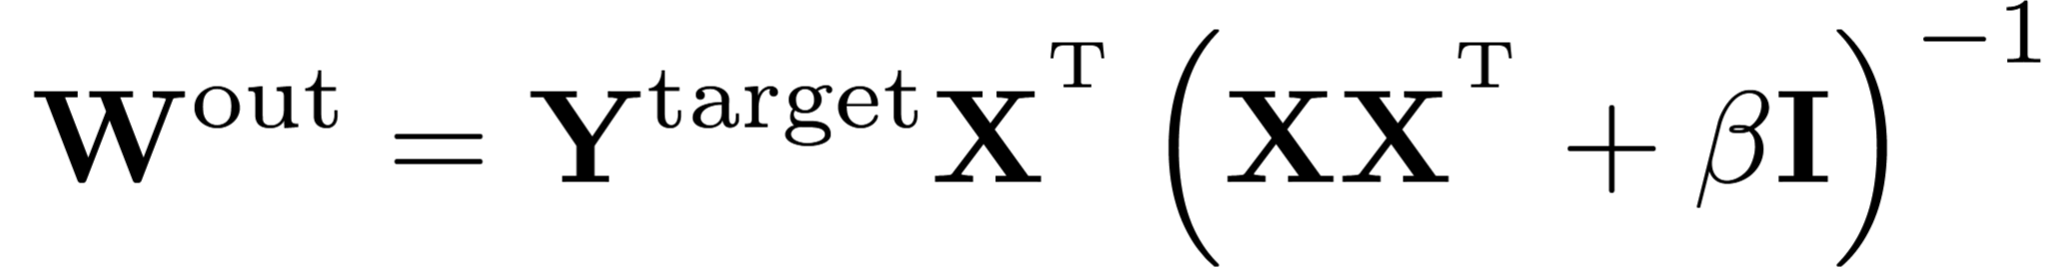
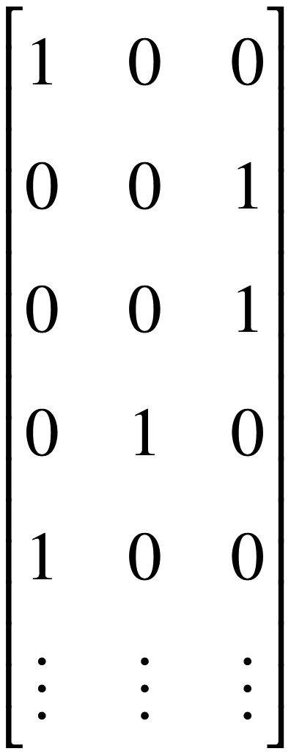
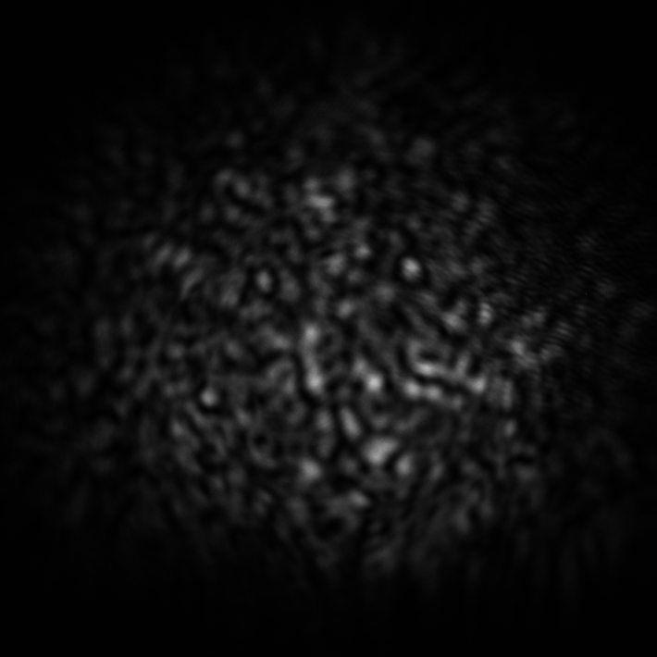
How we extract results from the reservoir
M. Lukoˇseviˇcius, “A practical guide to applying echo state networks,” in Neural Networks:Tricks of the Trade: Second Edition. Berlin, Heidelberg: Springer Berlin Heidelberg, 2012,pp. 659–686.

Slide 12
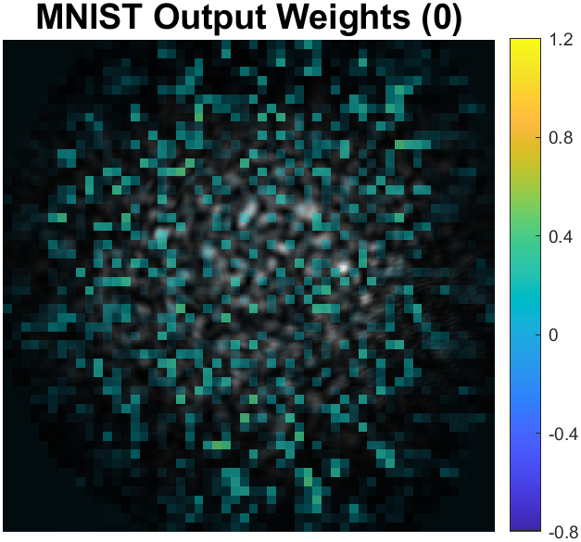
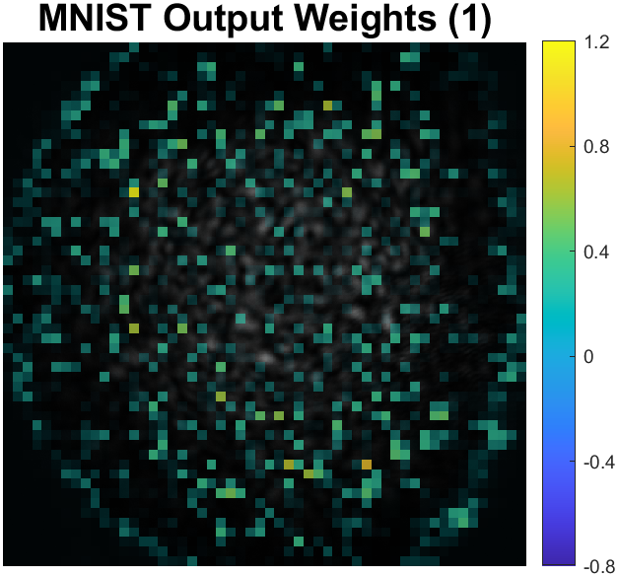
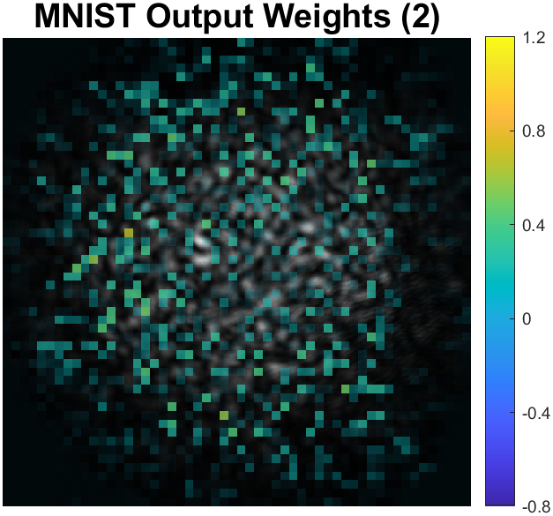
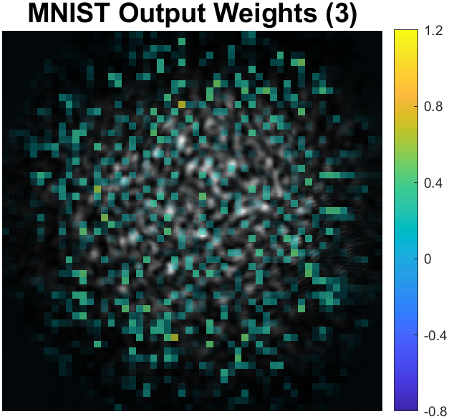
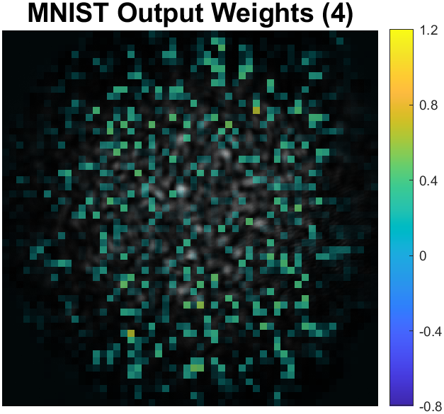
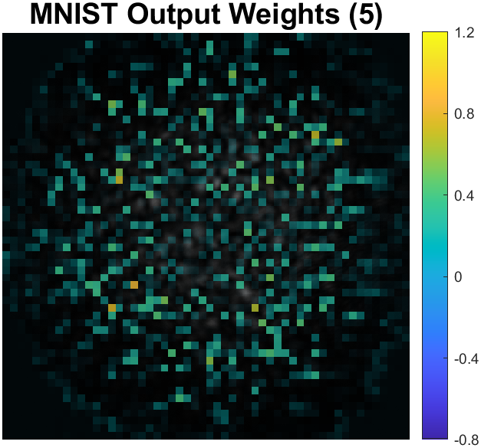
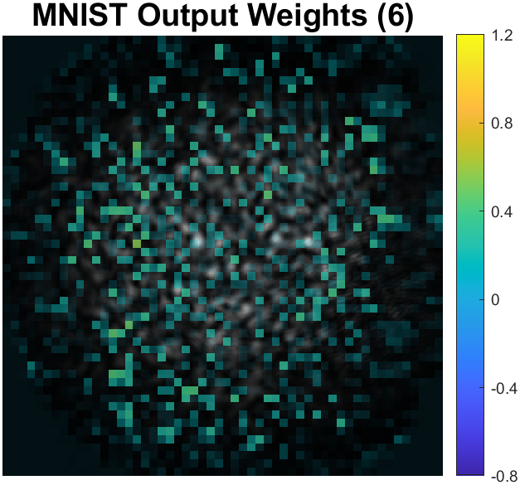
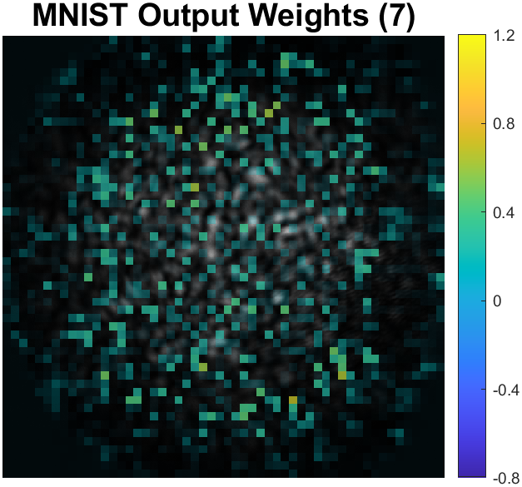
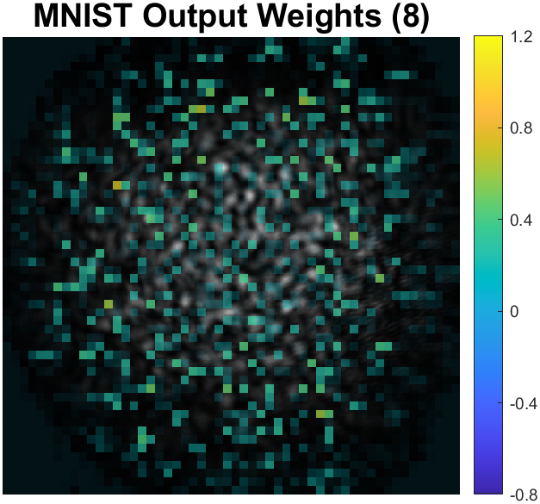
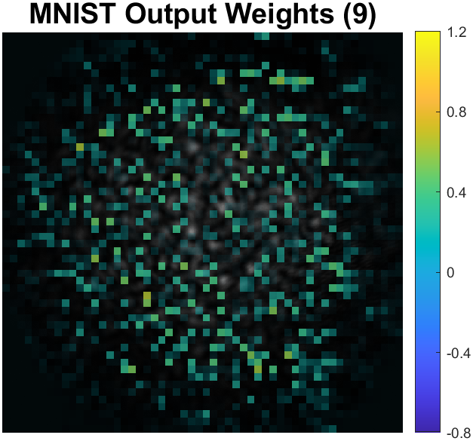
How we extract results from the reservoir

Slide 13
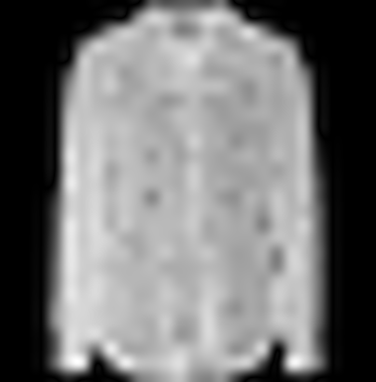
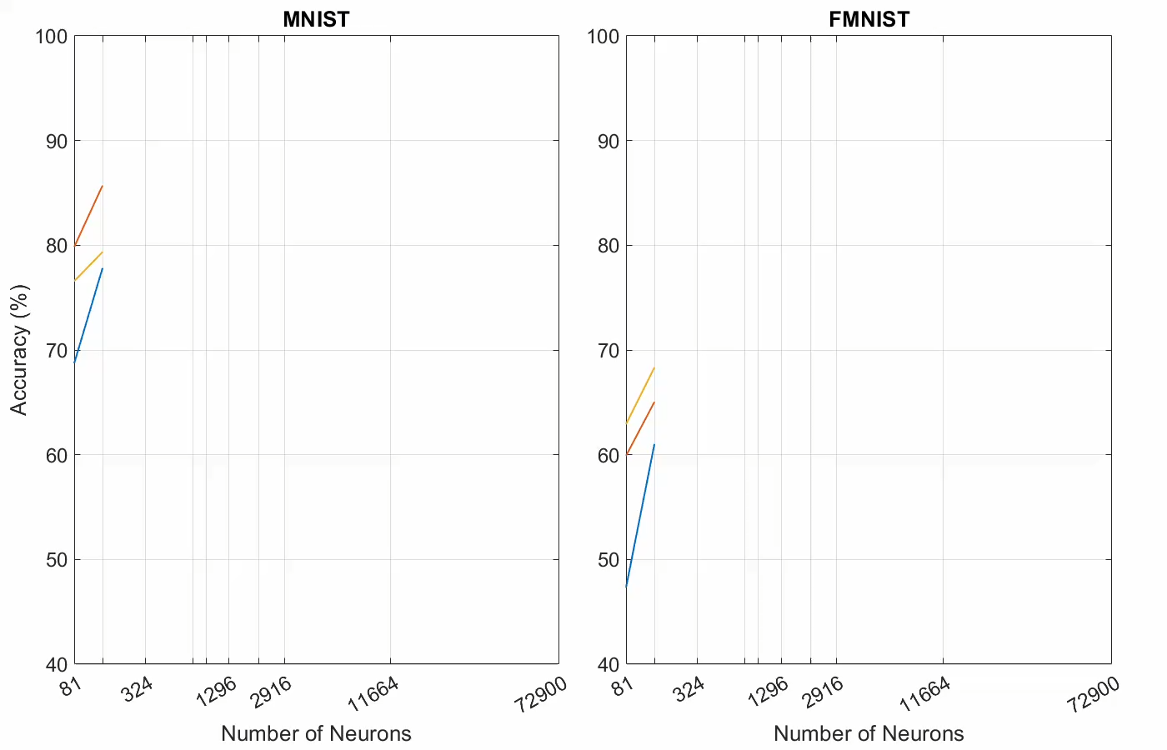
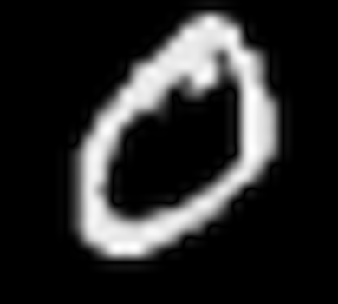
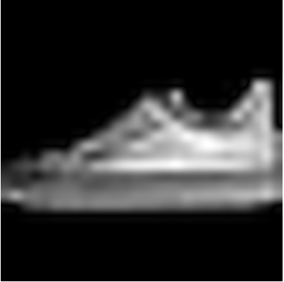
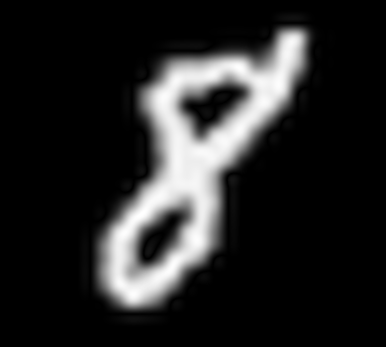

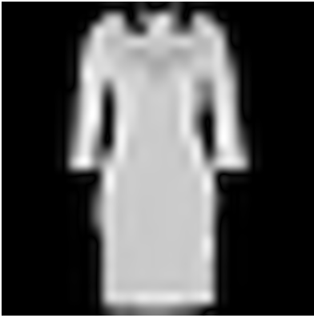
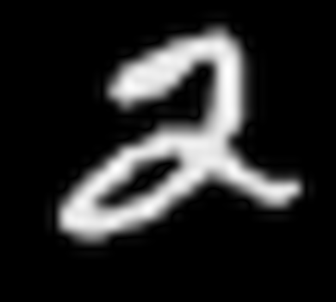
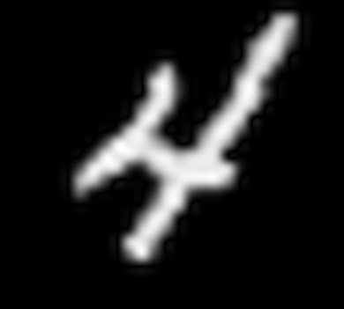
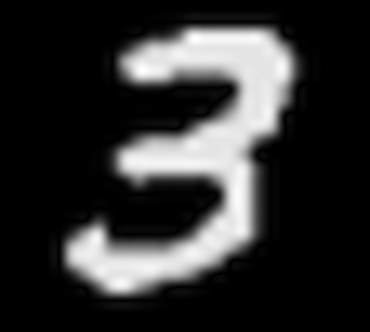
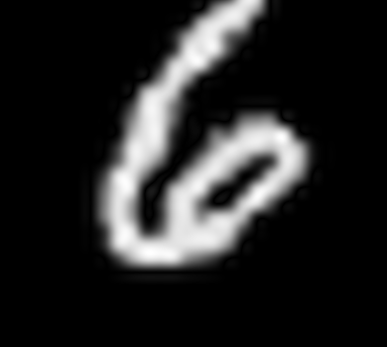
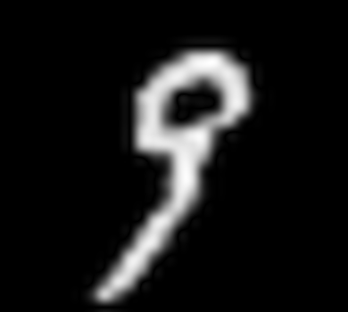
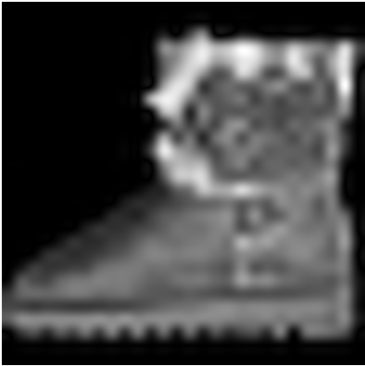
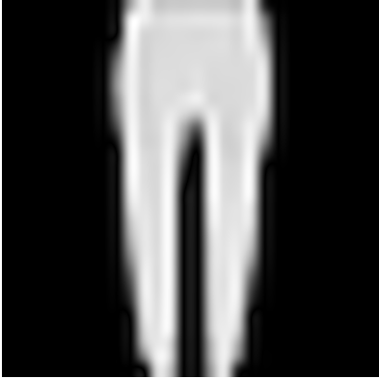
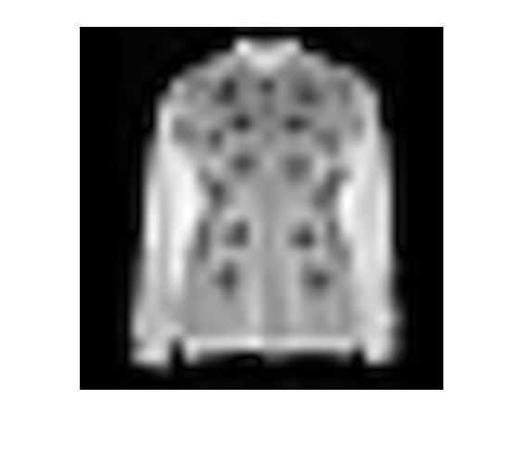
MNIST and FMNIST Performance
Parameter | MNIST | FMNIST
Length |  | ~
Core Diameter
Feedback Loops
Increased Mode Mixing with Pellets | ~
Saturation | ~
Best Classification Accuracies | 96.5% | 87.1%
Notes:
The MNIST dataset is comprised of handdrawn digits and the FMNIST dataset is comprised of fashion items. We can look at the MNIST and FMNIST datasets as two distinct types of data, MNIST as comprised mainly of edge-related features and the FMNIST dataset contrained textural information that was needed to make distinctions between items of clothing.
For the MNIST dataset we found that fibres with larger core diameters performed better. The effect of mode mixing (covering the fibre with weighted pellets) , fibre length and the level of saturation did not appear to have a large effect on the classification results. The biggest improvement to the system was obtained by introducing a feedback loop. We speculate that the variable attenuator modifies the recirculating field, perhaps acting as a spatial filter that enhances reservoir complexity or separability, possibly introducing a kind of structural non-linearity. We were able to achieve a classification accuracy of 96.5%,
For the FMNIST dataset the larger core diameter of the fibres also performed very well. The length of the fibre did not appear to have a notable impact on the systems performance. Moderate saturation reduced configuration discrepancies and increased mode mixing imporived the performance of the system. Funnily enough the introduction of the feedback loop resulted in overtraining, We speculate that the light introduced back into the system caused neurons containing textural information to become saturated, resulting in a decrease in system performance. We achieved a classification accuracy of 87,1%.
Both of these classification accuracies are in line with the top performing fibre reservoir systems and very high performing optical diffractive deep neural networks.

Slide 14

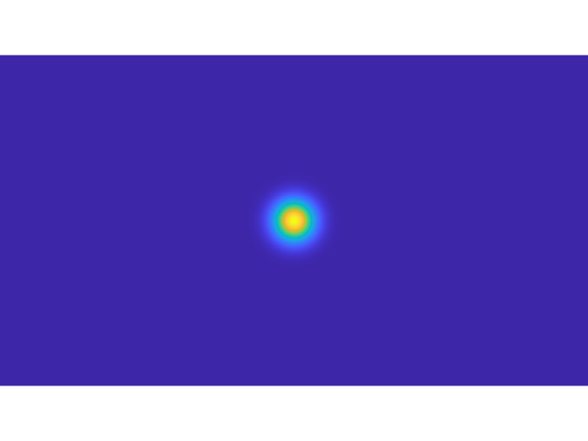
Free Space Optical Communication

Slide 15
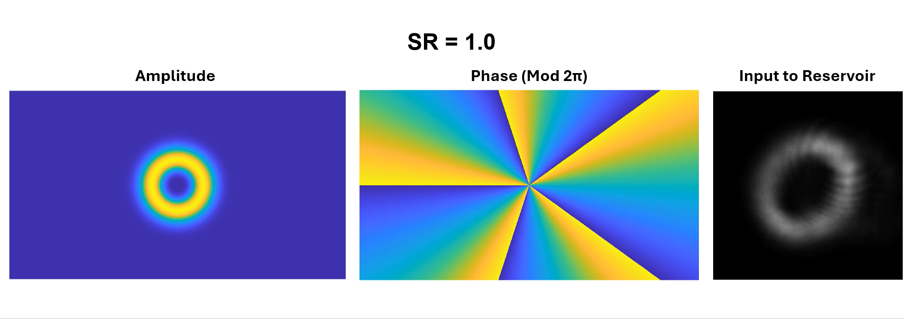
How we Encode Turbulence

Slide 16
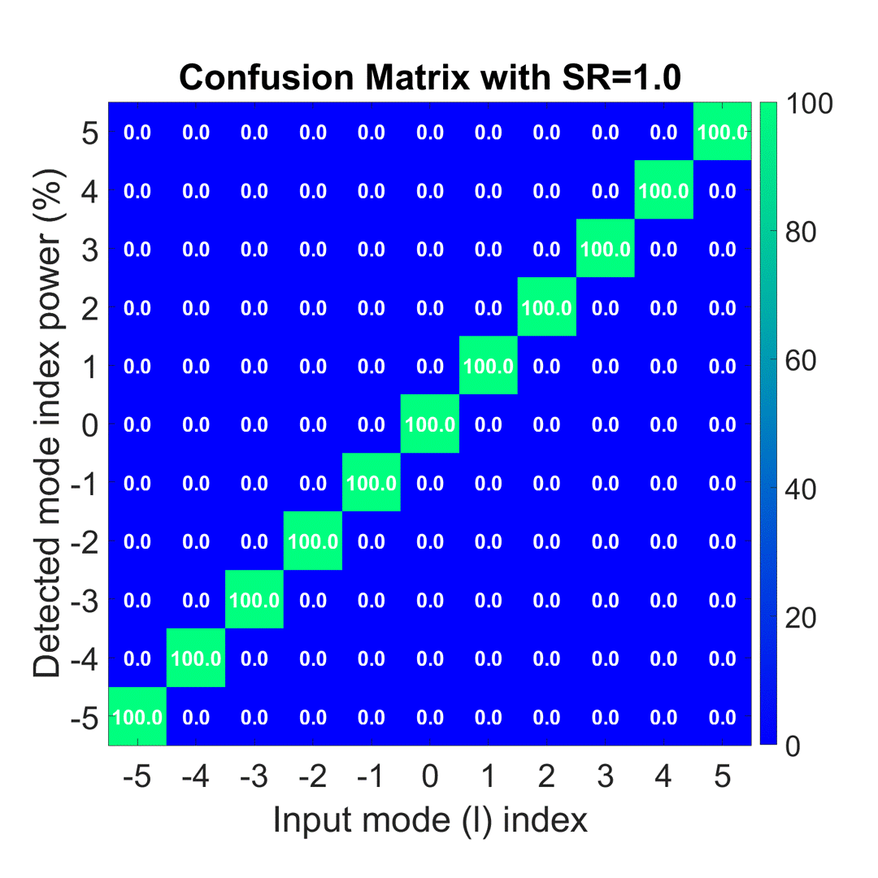
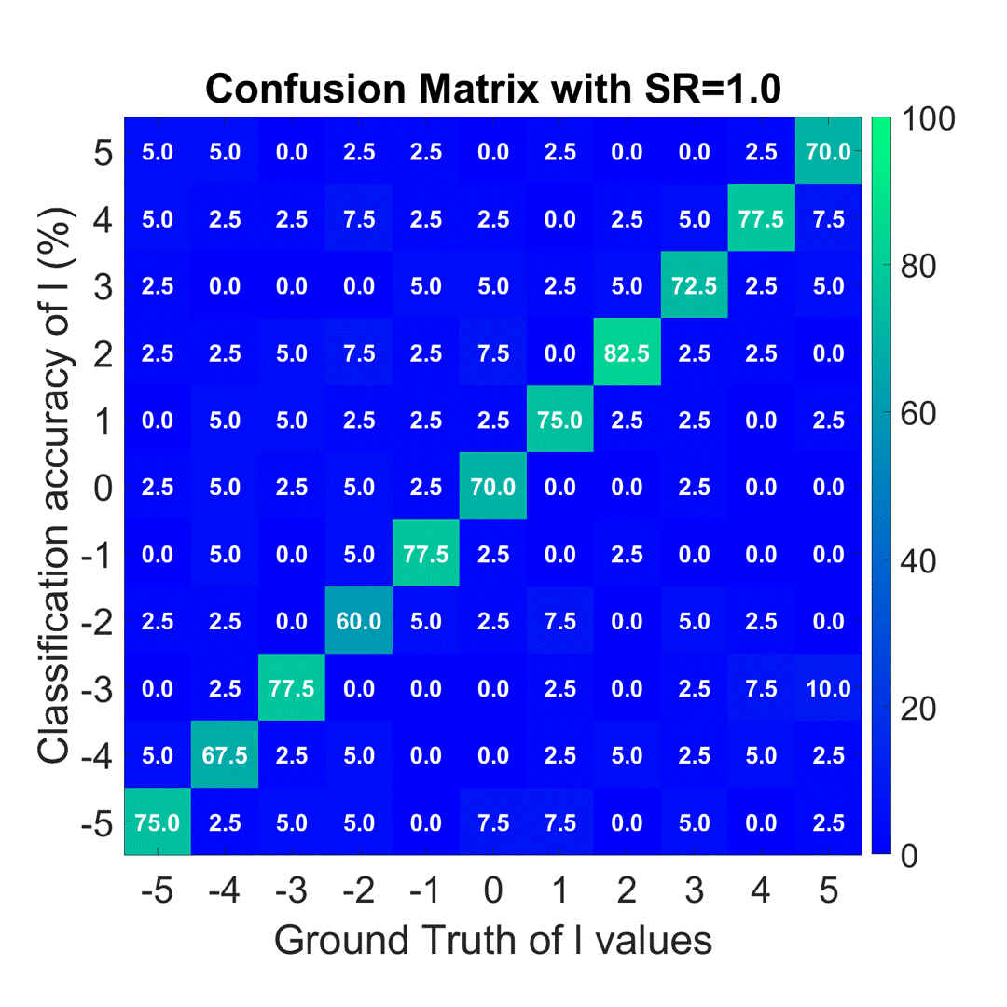
Classifying OAM using a Fibre Reservoir
Simulated Modal Decomposition
Classification with Fibre Reservoir
Below SR=0.5 Fibre Reservoir Classification performs better.
Notes:
On the left you can see a simulated modal decomposition to provide a baseline. On the right you can see preliminary classification results from the fibre reservoir using the same configuration as the FMNIST dataset. The modal decomposition provides better results with less turbulence, however as the turbulence increases the fibre reservoir appeared to be more robust when the SR dropped below 0.5 and may offer better classification to higher OAM modes under more turbulence.
It should be noted that the number of neurons needed to classify the OAM modes in turbulence did increase as the amount of turbulence increased. With very little turbulence the best results were found with around 300 neurons, whereas when the turbulence increased the best results typically utilised around 2000 neurons.

Slide 17
What we have learnt
Reservoirs use random projection.
This lets us use linear techniques.
The reservoir’s behaviour is dictated by interaction.
Use feedback for edge-based data.
Use large core sizes for textural-based data.
Fibre reservoirs work with OAM in turbulence below SR = 0.5.

Slide 18
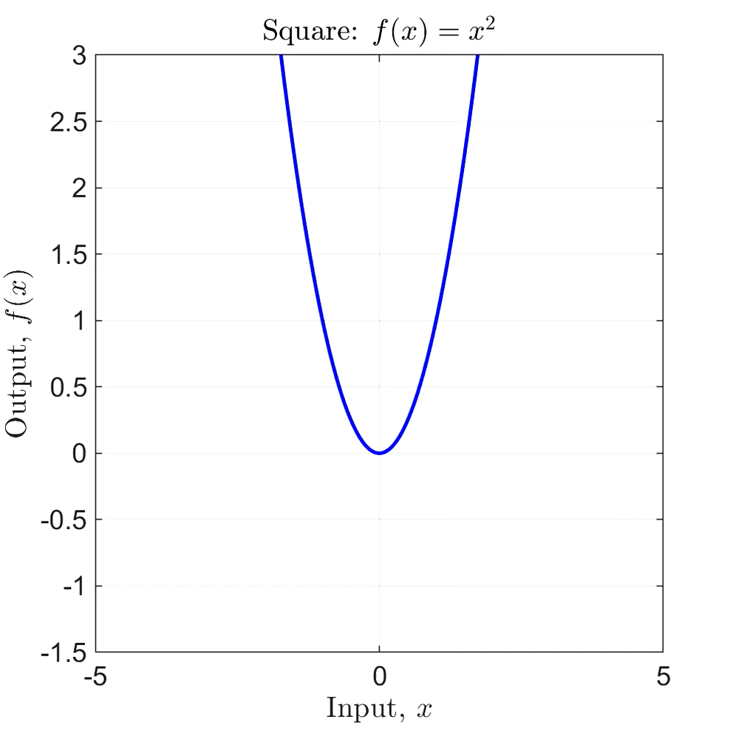
What are the biggest challenge to overcome?

Slide 19
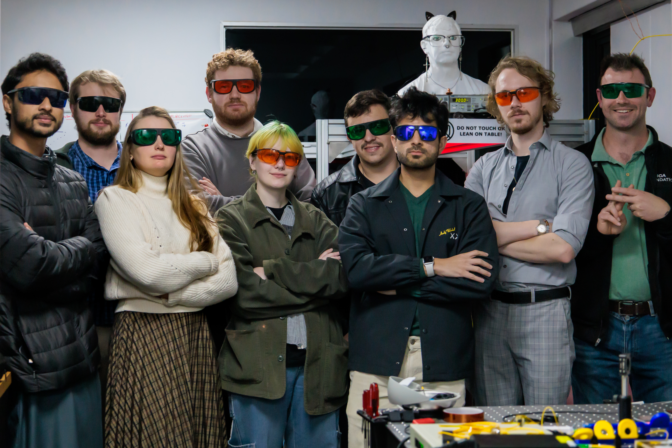

Thank you

