Slide 1




Monte carlo request involving searches of diphoton resonances in association with $τ^{+}τ^{−}$/ 2 $b$ – jets at electroweak scale in atlas detector at the lhc
Presenter: Njokweni Mbuyiswa
In collaboration with Kutlwano Makgetha, Vuyolwethu Kakancu, Paballo Ndhlovu, Kgothatso Ntumbe, REDA MEKOUAR, PHuti rapheeha, Mukesh Kumar, Rachid Mazini and Bruce Mellado

Slide 2
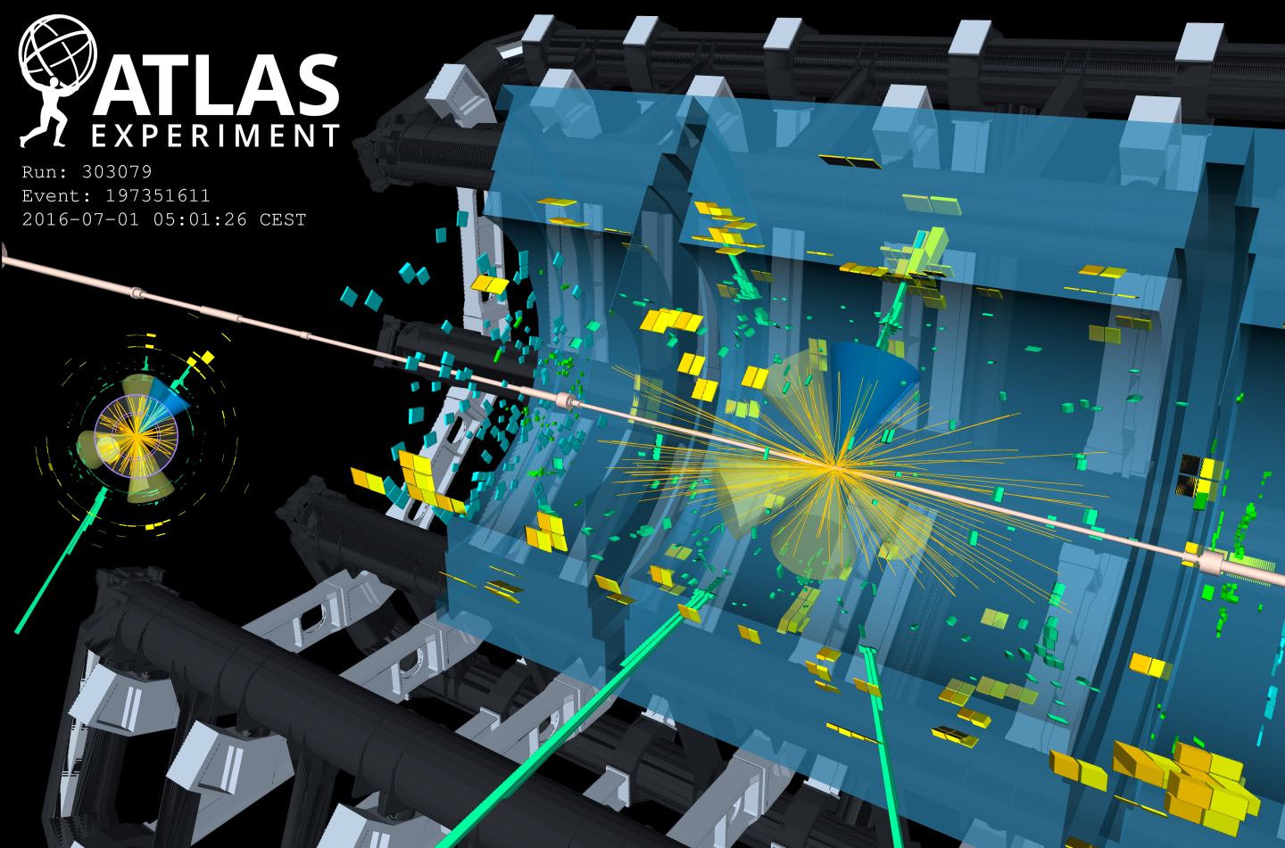
OUTLINE
Simplified Model
Multilepton anomalies and Diphoton excess
Signal MC Generation and Validation
MC Request workflow and Pile-Up campaigns
Progress and Future Work
Conclusion

Slide 3
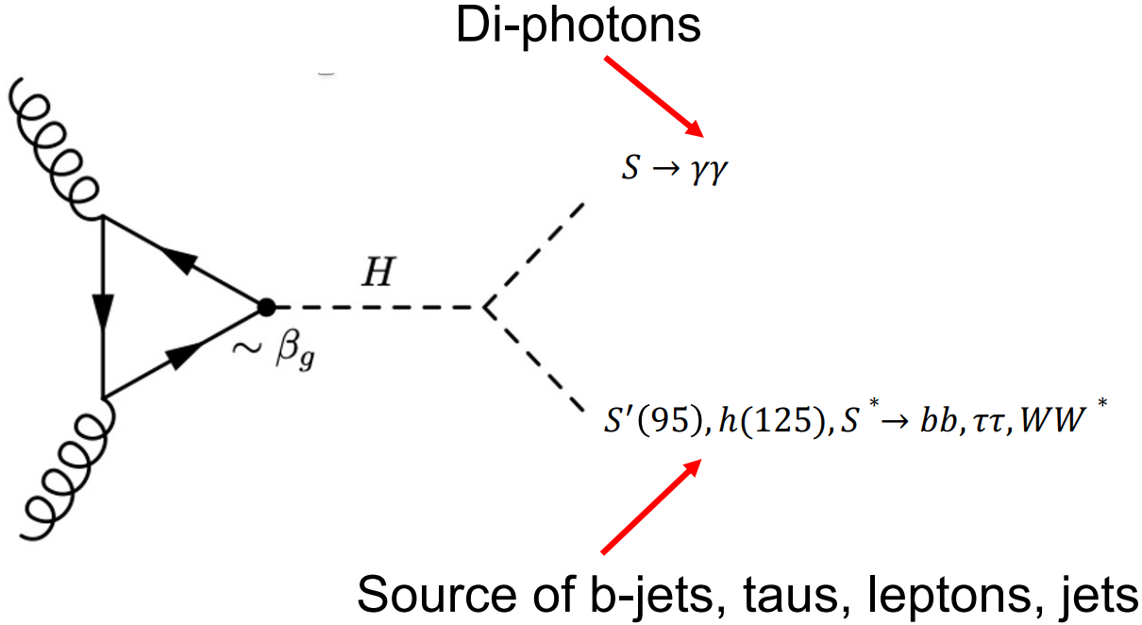
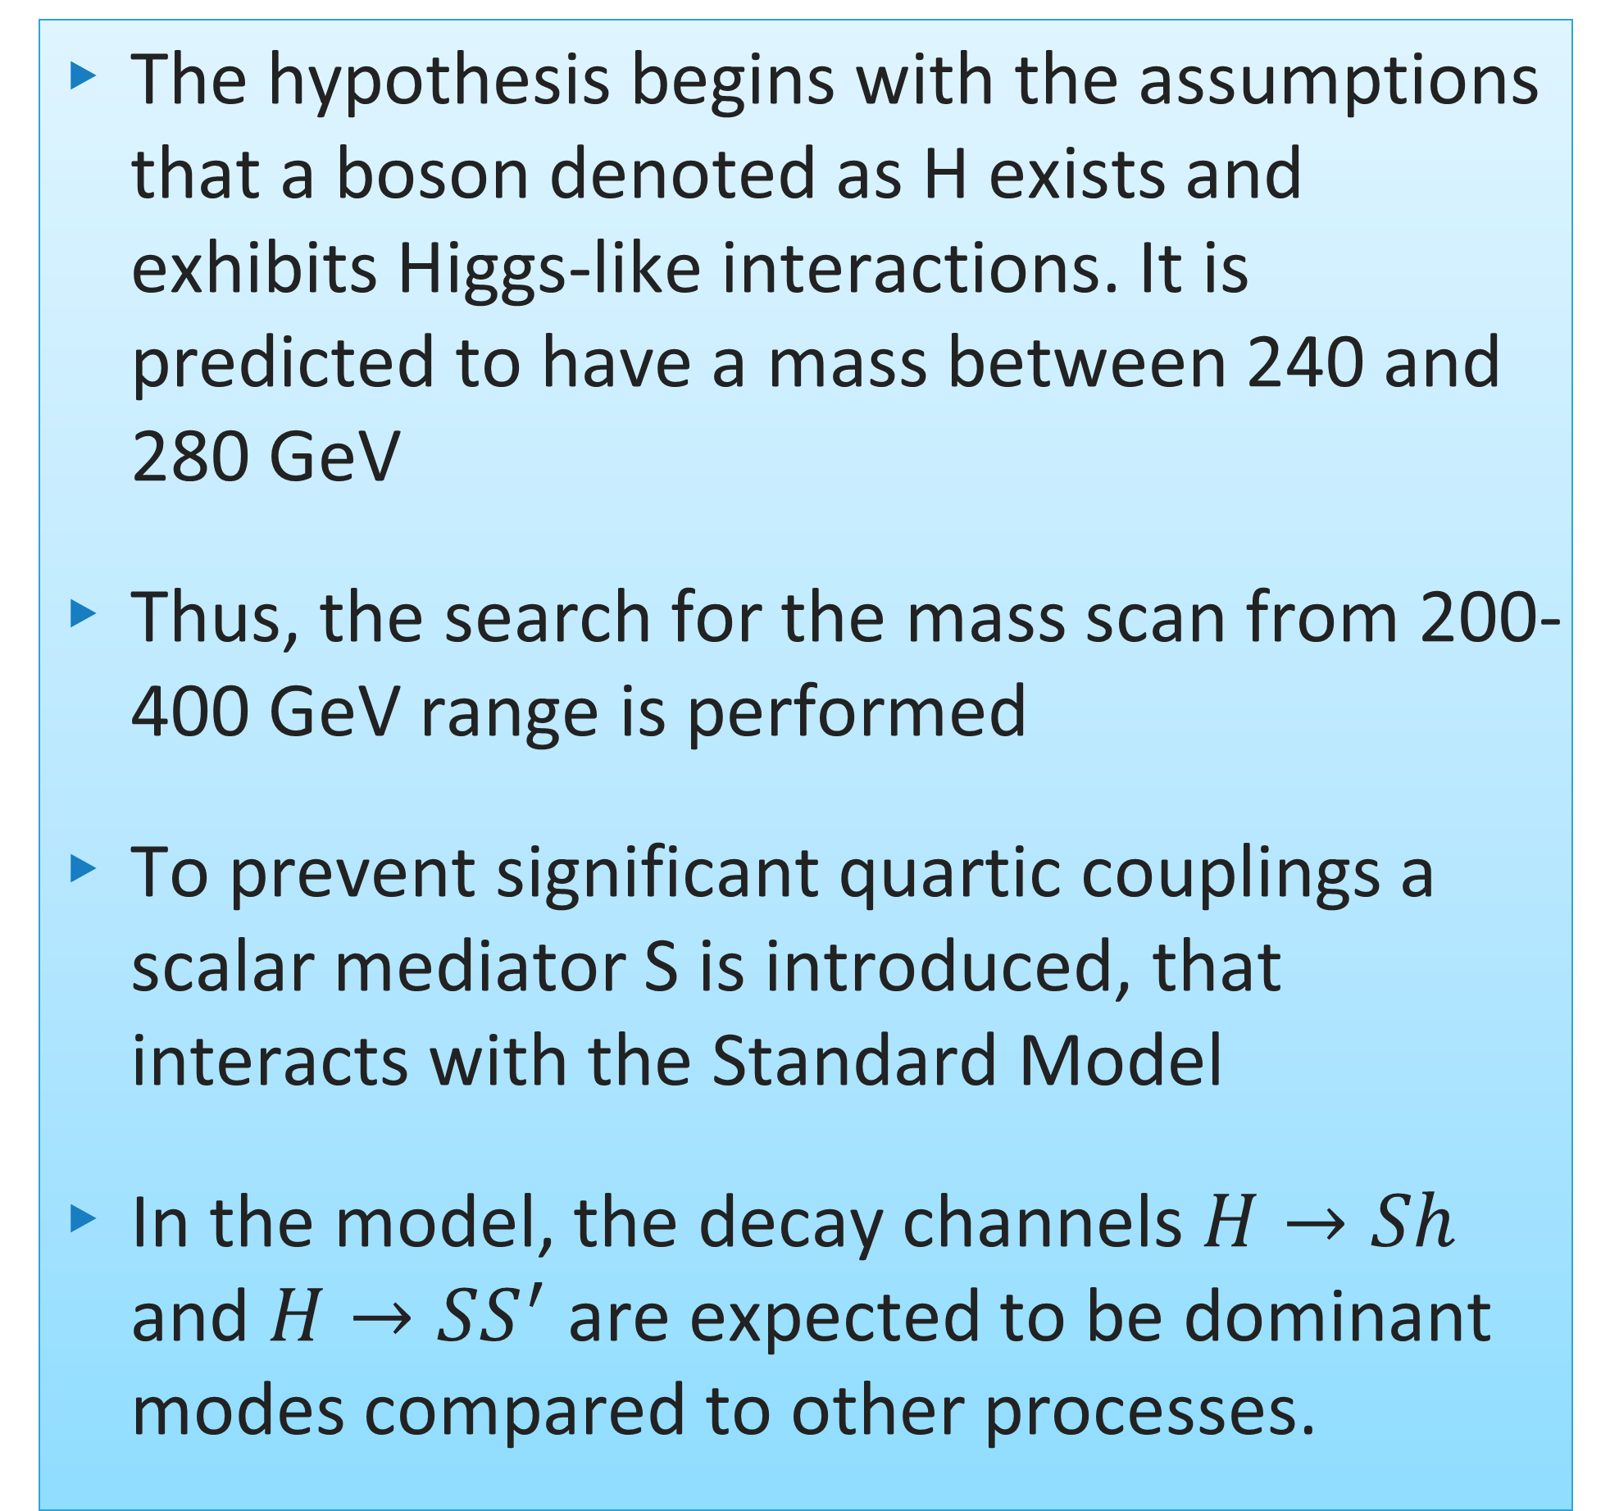
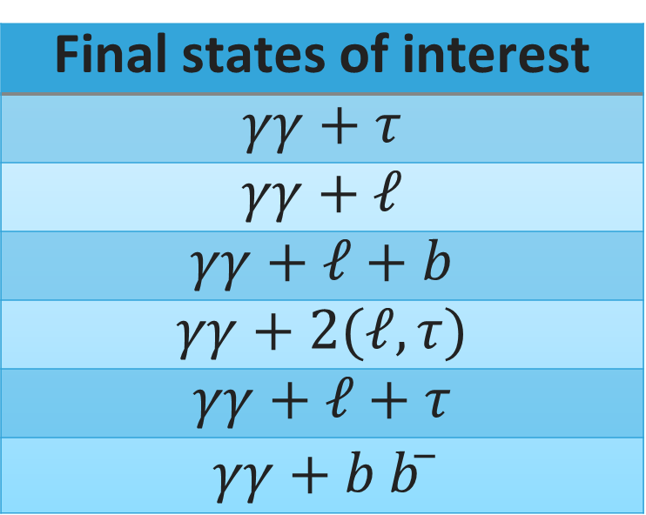
Simplified model
The hypothesis begins with the assumptions that a boson denoted as H exists and exhibits Higgs-like interactions. It is predicted to have a mass between 240 and 280 GeV
Thus, the search for the mass scan from 200-400 GeV range is performed
To prevent significant quartic couplings a scalar mediator S is introduced, that interacts with the Standard Model
In the model, the decay channels $H→Sh$ and $H→SS^{′}$ are expected to be dominant modes compared to other processes.
2HDM+S model, Eur.Phys.J.C 76 (2016) 10, 580
Final states of interest
$$γγ+τ$$
$$γγ+ℓ$$
$$γγ+ℓ+b$$
$$γγ+2(ℓ,τ)$$
$$γγ+ℓ+τ$$
$$γγ+b b ̅$$
SAIP2025 09 JULY 2025

Slide 4
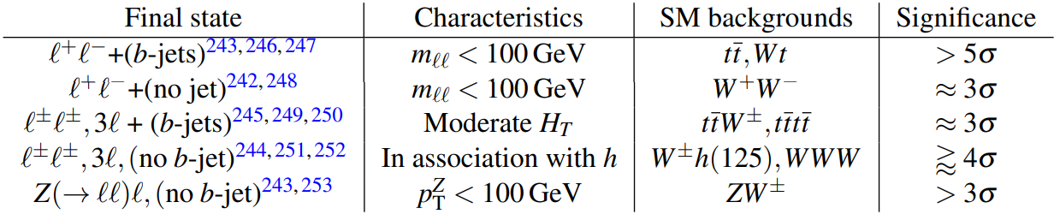
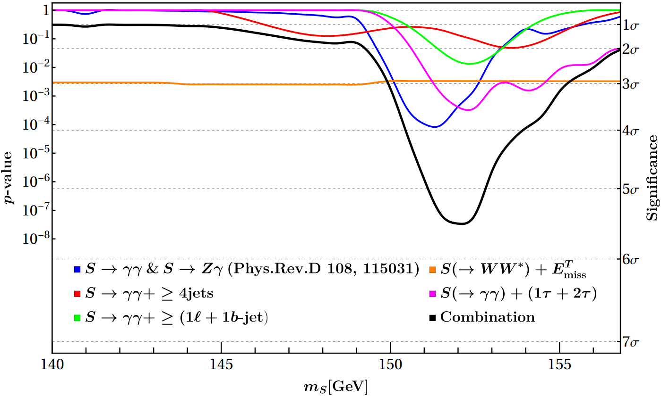
Multilepton anomalies and Diphoton excesses
Nat Rev Phys 6, 294–309 (2024). https://doi.org/10.1038/s42254-024-00703-6
SAIP2025 09 JULY 2025

Slide 5
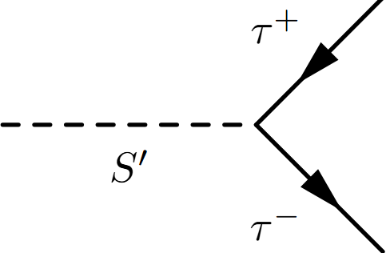
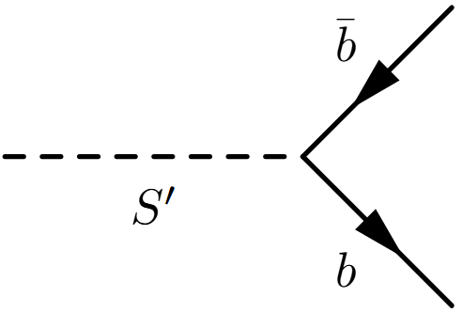
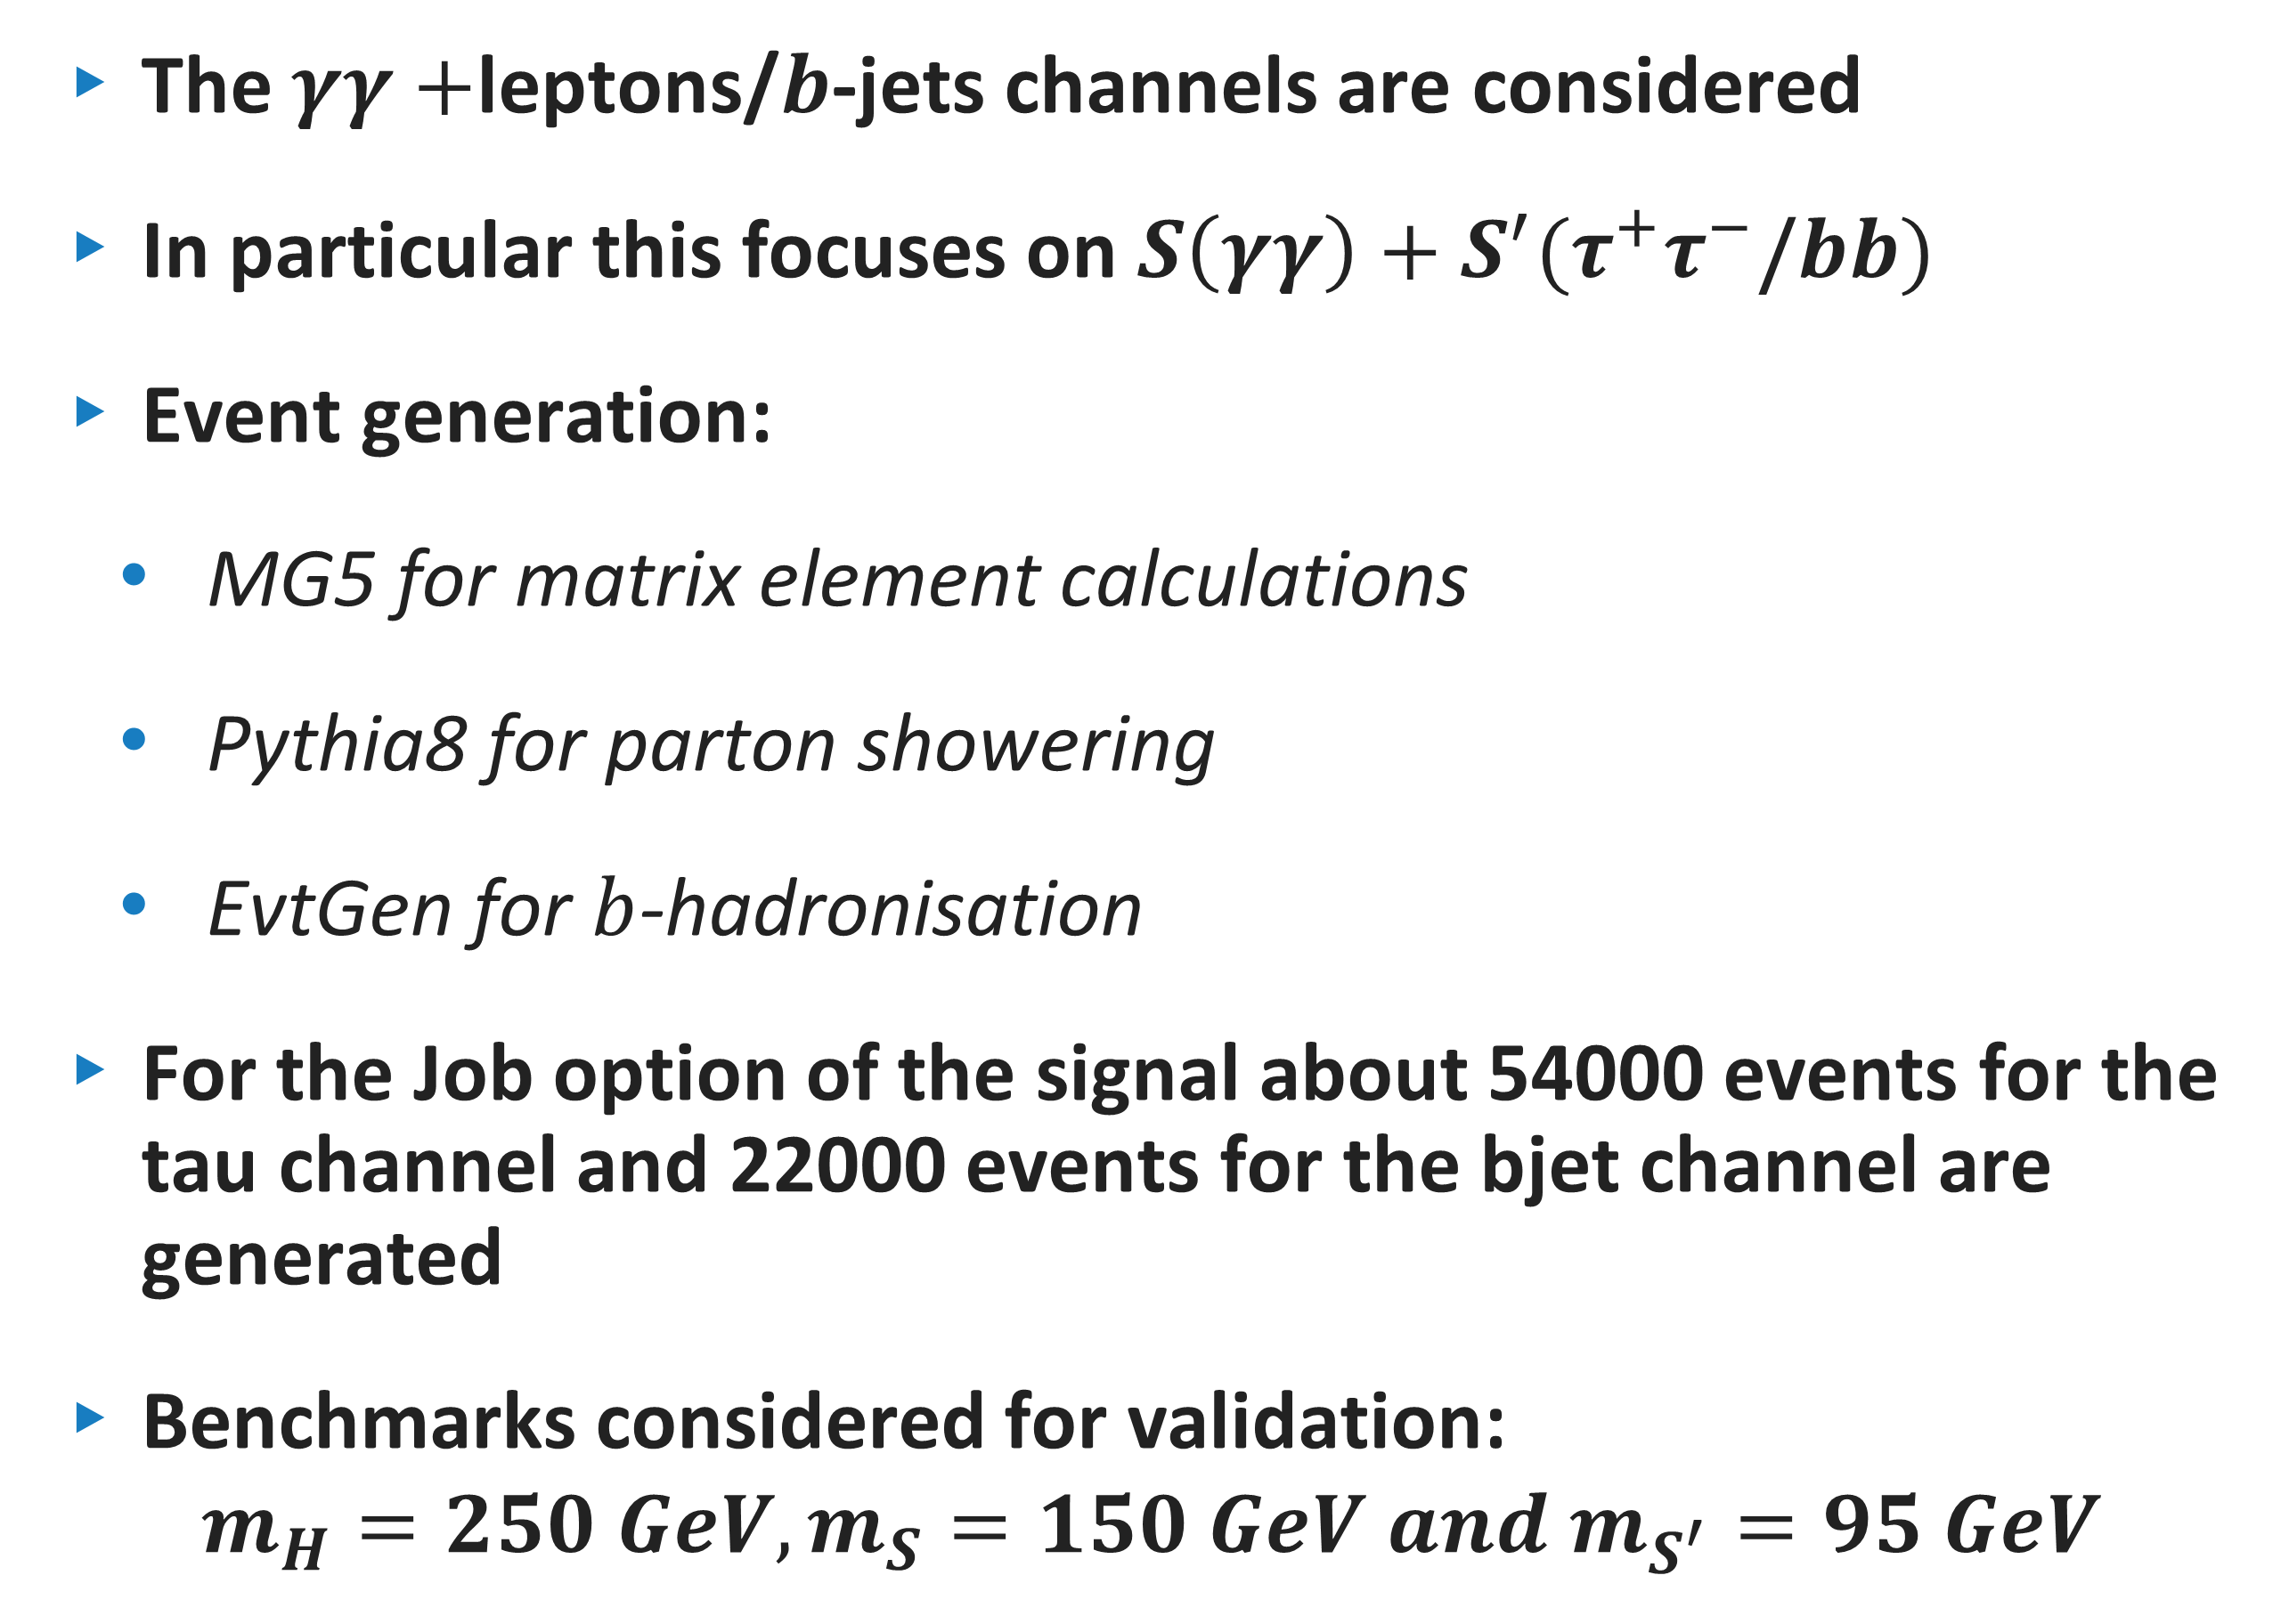
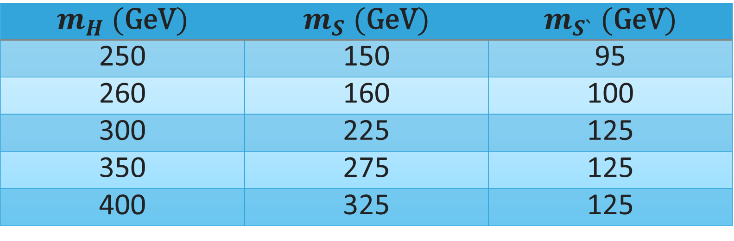
MC Event generation
The $γγ+$leptons/$b$-jets channels are considered
In particular this focuses on $S\left(γγ\right)+S^{′}(τ^{+}τ^{−}\text{/}bb)$
Event generation:
  MG5 for matrix element calculations
  Pythia8 for parton showering
  EvtGen for $b$-hadronisation
For the Job option of the signal about 54000 events for the tau channel and 22000 events for the bjet channel are generated
Benchmarks considered for validation:
$$m_{H}=250 GeV, m_{S}=150 GeV and m_{S^{′}}=95 GeV$$
$$m_{H} (\text{GeV})$$ | $$m_{S} (\text{GeV})$$ | $$m_{S`} (\text{GeV})$$
250 | 150 | 95
260 | 160 | 100
300 | 225 | 125
350 | 275 | 125
400 | 325 | 125
SAIP2025 09 JULY 2025

Slide 6
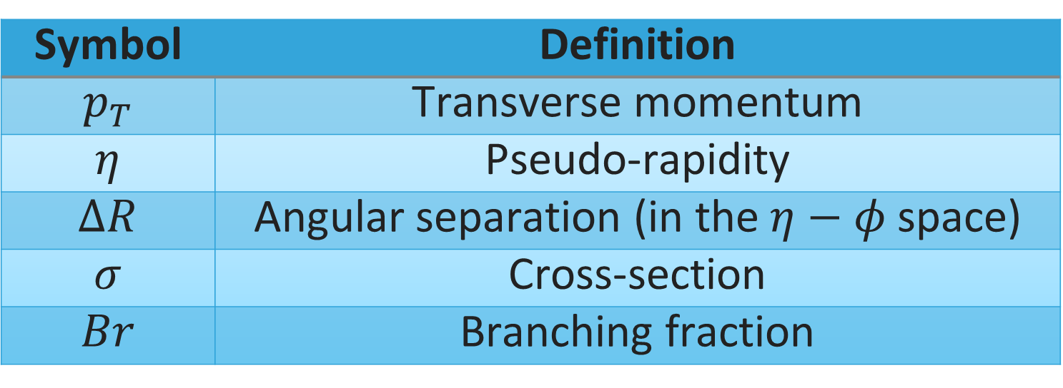
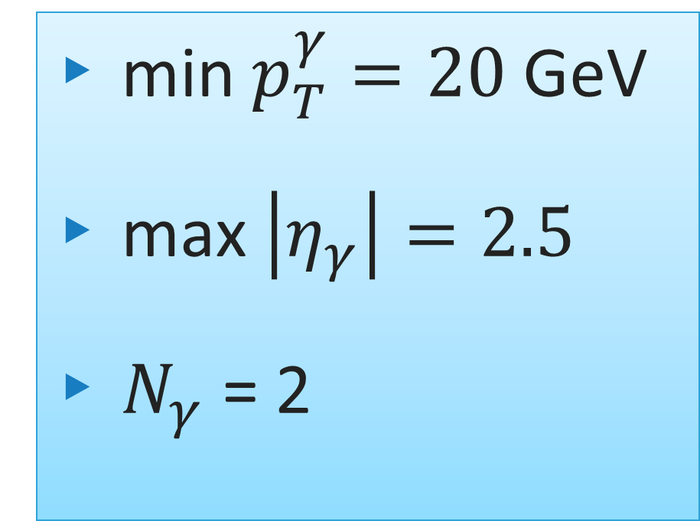
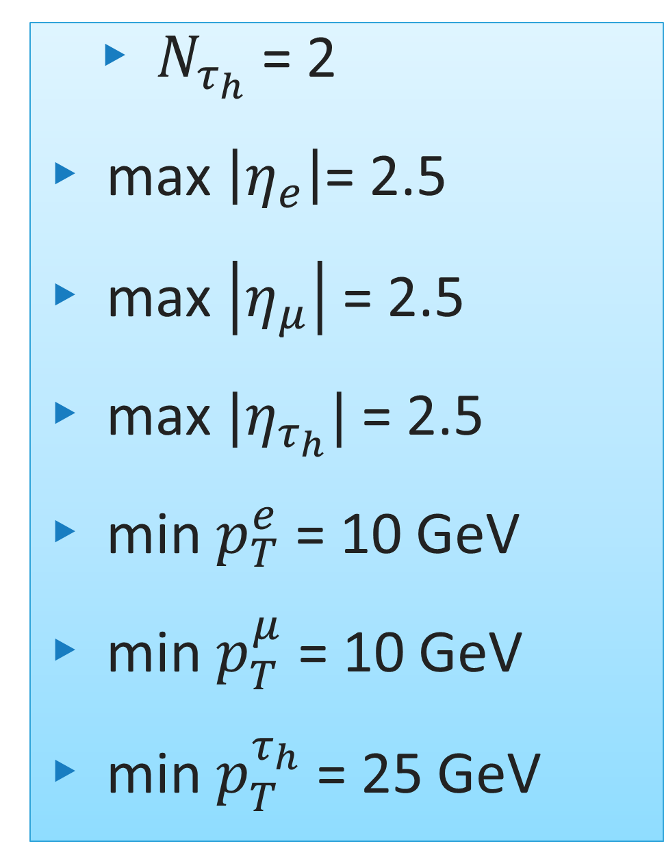
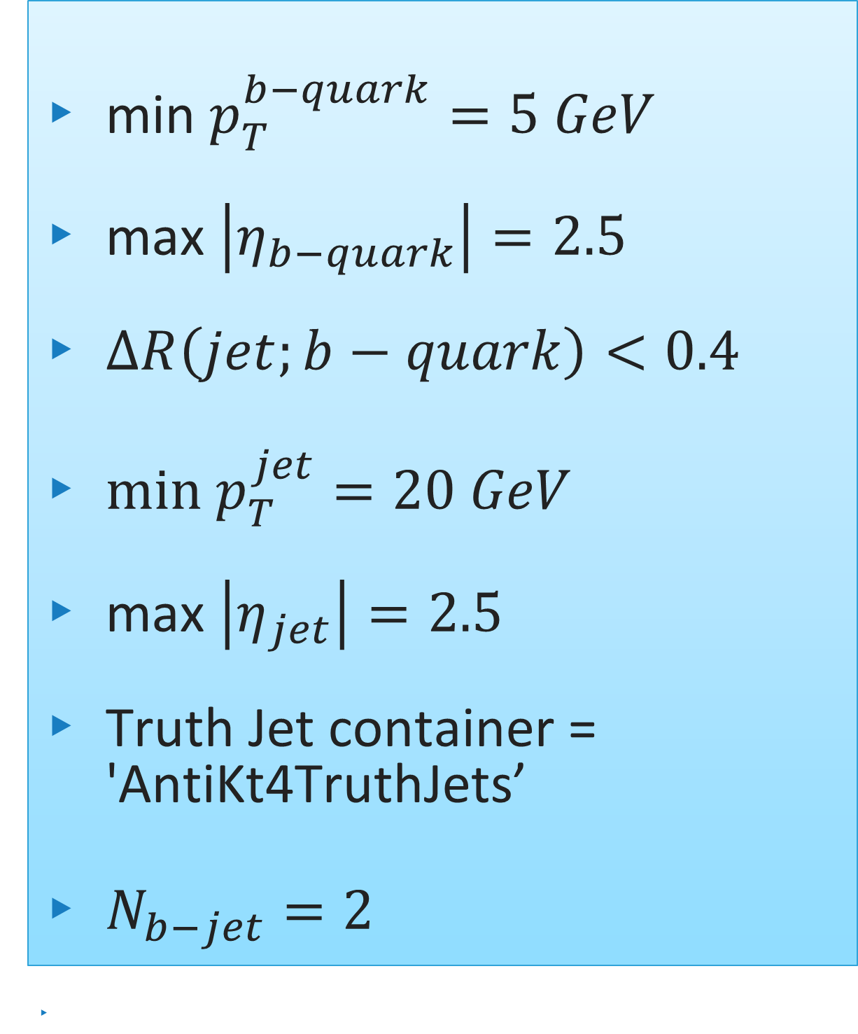
Benchmark cross sections and SELECTIONS
$$σ_{Total}=σ_{gg→H}×Br\left(H→SS′\right)×Br \left(S→γγ\right)×Br\left(S′→τ^{+}τ^{−}\text{/}bb^{\sim }\right)$$
https://twiki.cern.ch/twiki/bin/view/LHCPhysics/CERNYellowReportPageBR
Symbol | Definition
$$p_{T}$$ | Transverse momentum
$$η$$ | Pseudo-rapidity
$$ΔR$$ | Angular separation (in the $η−φ$ space)
$$σ$$ | Cross-section
$$Br$$ | Branching fraction
min $p_{T}^{b−quark}=5 GeV$
max $\left|η_{b−quark}\right|=2.5$
$ΔR\left(jet;b−quark\right)<0.4$
$min p_{T}^{jet}=20 GeV$
max $\left|η_{jet}\right|=2.5$
Truth Jet container = 'AntiKt4TruthJets’
$N_{b−jet}=2$
  $N_{τ_{h}}$ = 2
max $\left|η_{e}\right|$= 2.5
max $\left|η_{μ}\right|$ = 2.5
max $|η_{τ_{h}}|$ = 2.5
min $p_{T}^{e}$ = 10 GeV
min $p_{T}^{μ}$ = 10 GeV
min $p_{T}^{τ_{h}}$ = 25 GeV
min $p_{T}^{γ}=20$GeV
max $\left|η_{γ}\right|=2.5$
$N_{γ}$ = 2
SAIP2025 09 JULY 2025

Slide 7
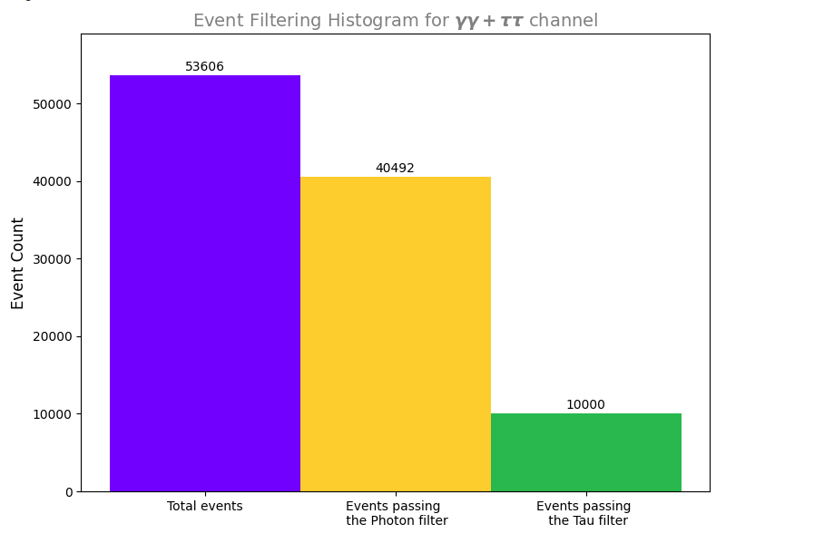
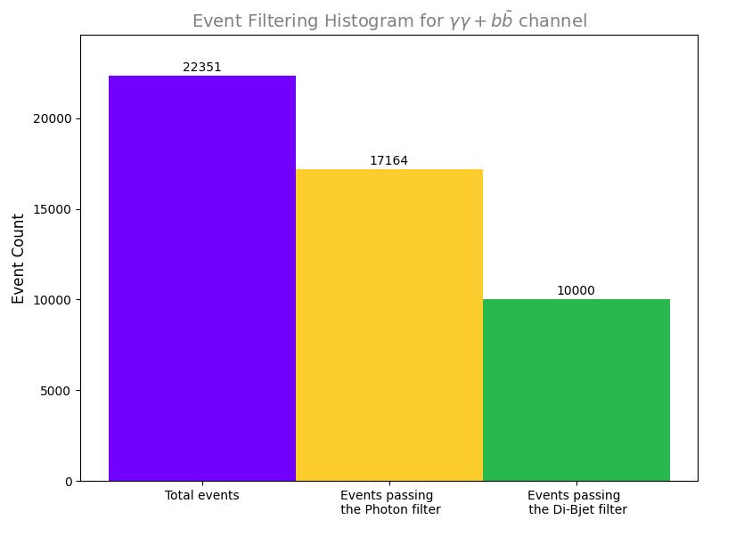
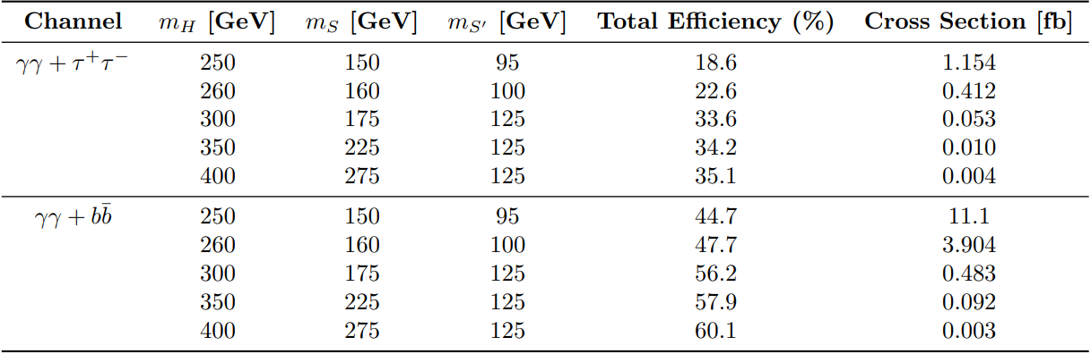
Benchmark cross sections and filters
Total Filter Efficiency : 0.1865
Total Filter Efficiency : 0.4474
SAIP2025 09 JULY 2025

Slide 8
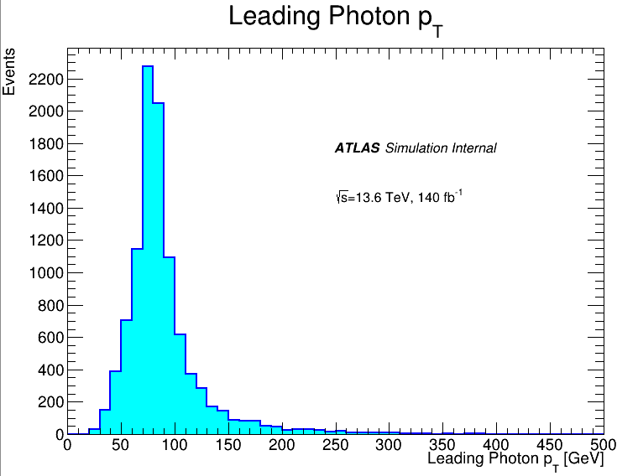
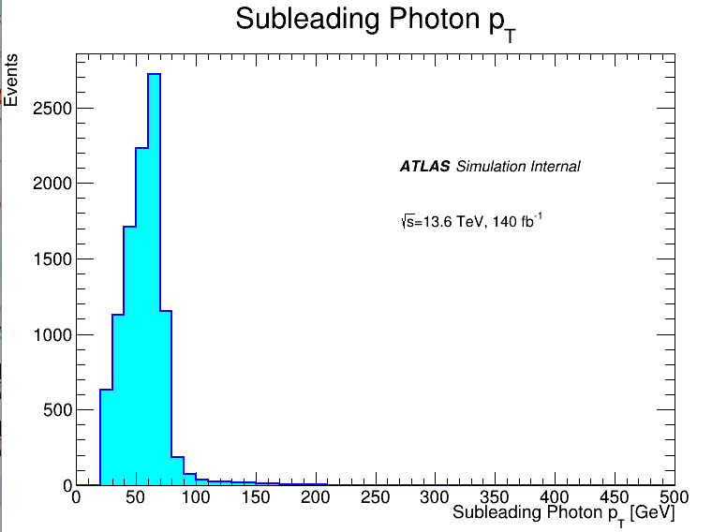
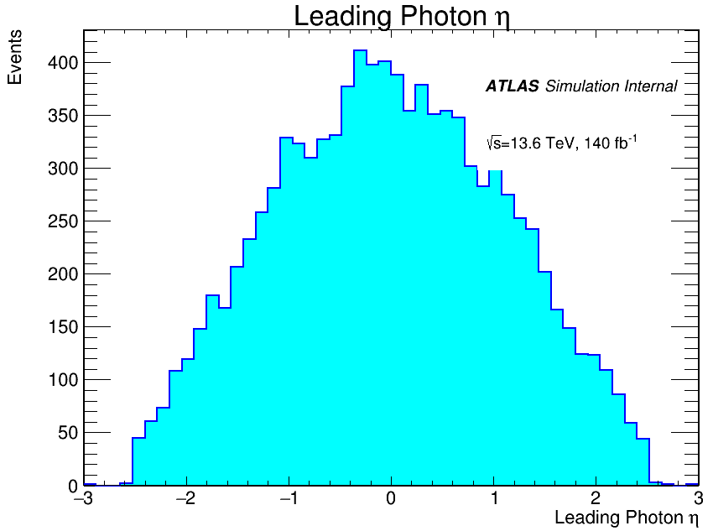
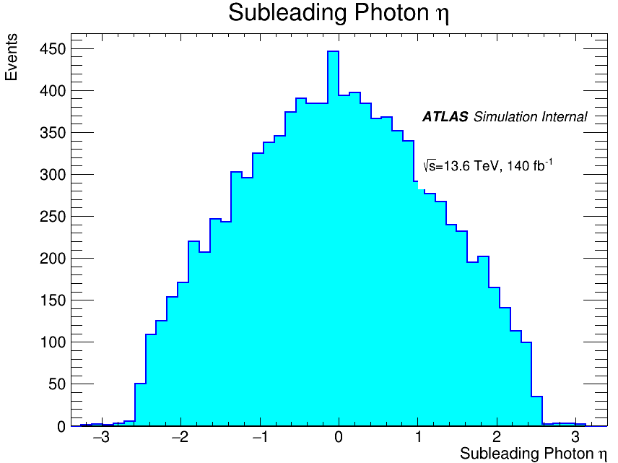
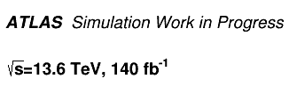
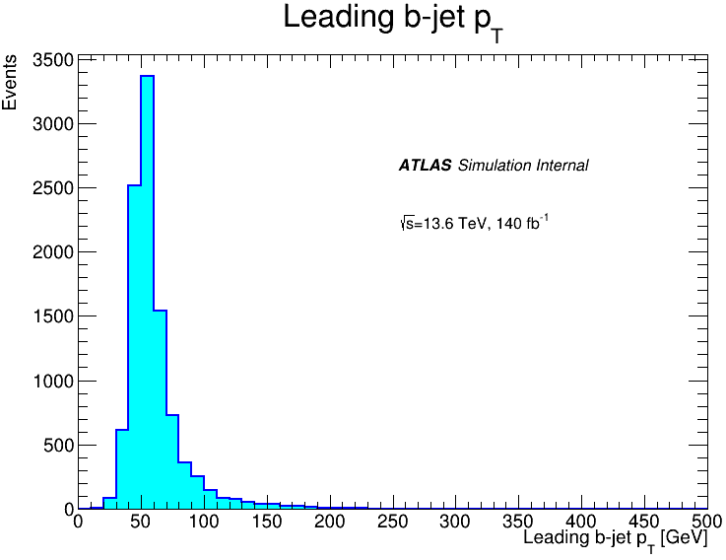
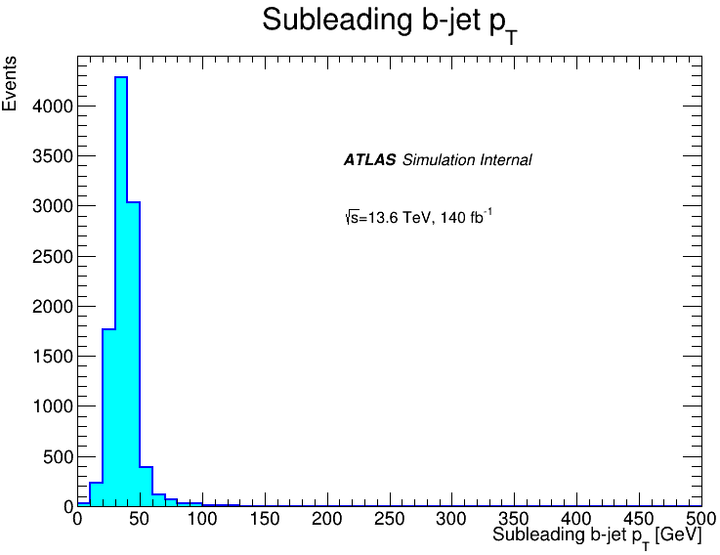
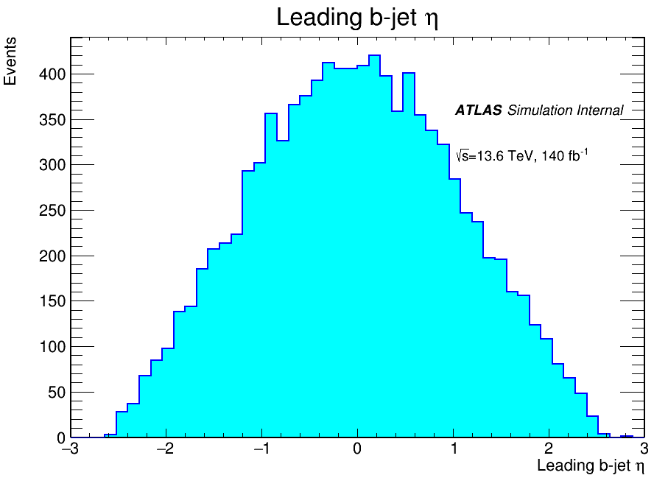
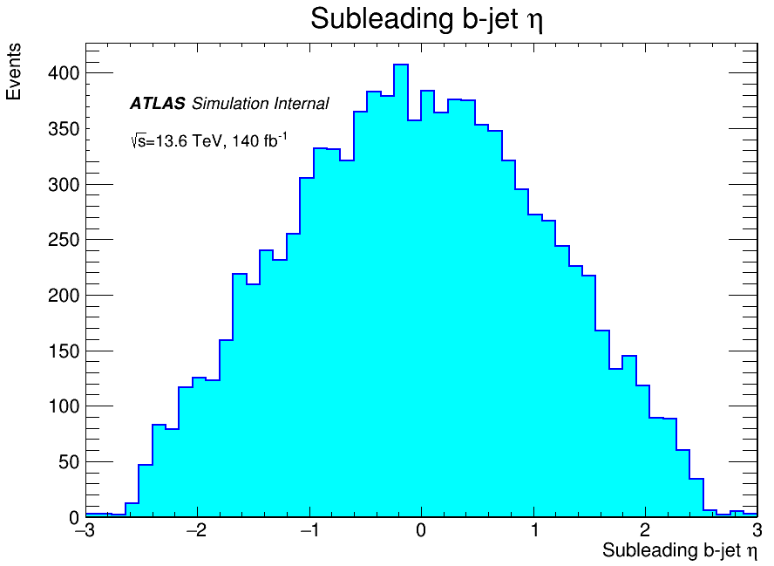
VALIDATION DISTRIBUTIONS
gg → H (250GeV) → S (150 GeV) S’(95GeV)
SAIP2025 09 JULY 2025

Slide 9
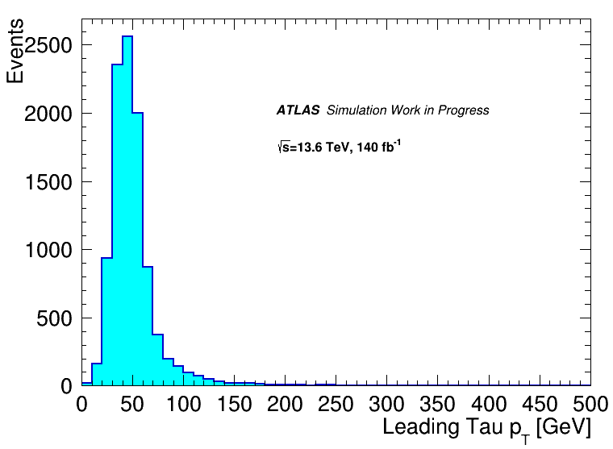
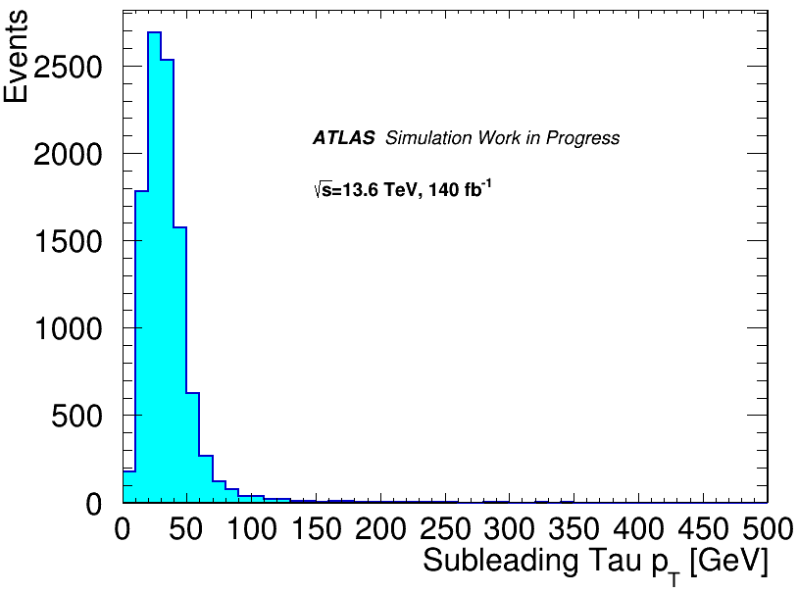
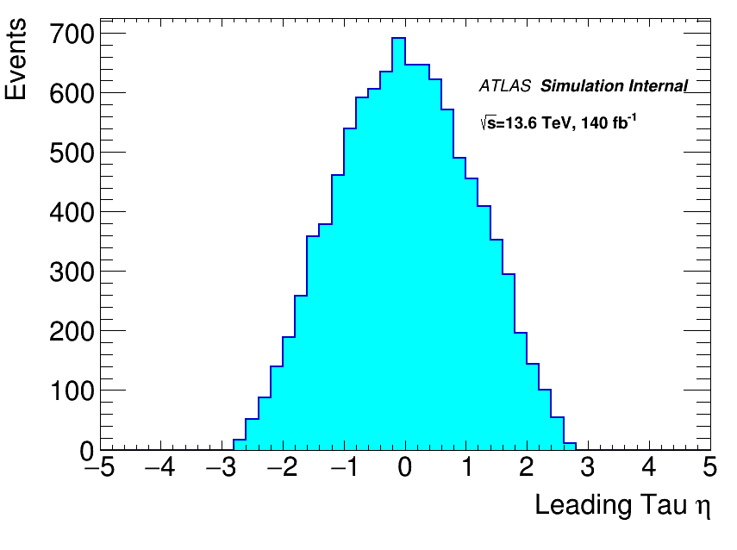
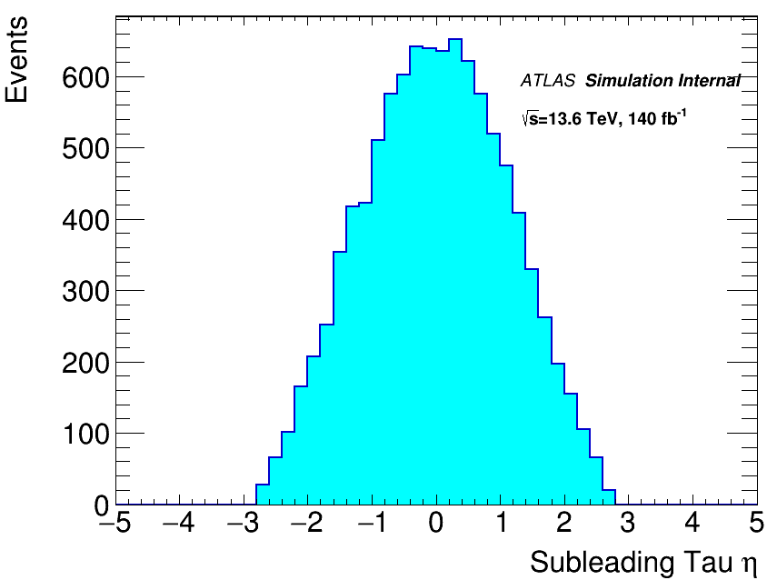




VALIDATION DISTRIBUTIONS
gg → H (250GeV) → S (150 GeV) S’(95GeV)
Leading Tau ${\text{p}}_{\text{T}}$
Subleading Tau ${\text{p}}_{\text{T}}$
Leading tau$η$
SubleadIng tau $η$
SAIP2025 09 JULY 2025

Slide 10
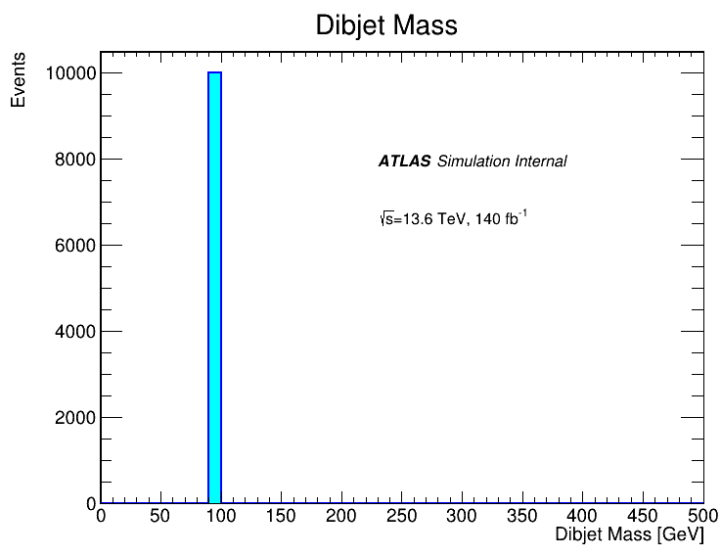
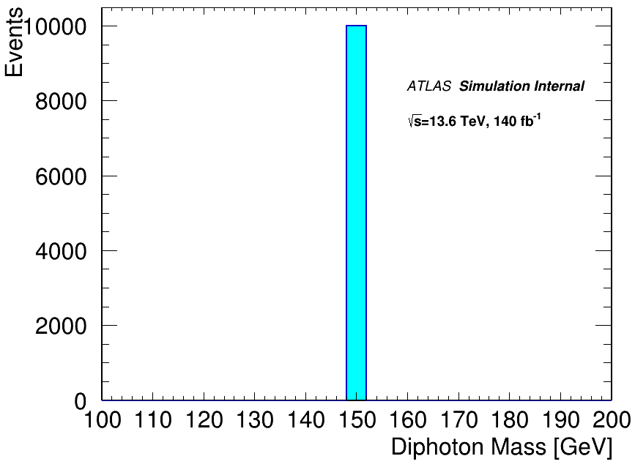
VALIDATION DISTRIBUTIONS
gg → H (250GeV) → S (150 GeV) S’(95GeV)
Diphoton Invariant Mass
SAIP2025 09 JULY 2025

Slide 11

JIRA TICKET SUBMISSION
Validation Complete
JIRA Ticket submission
Review and Comments
Approval and Production
Dataset appears on GRID
Use Dummy DSIDs, make excel spreadsheet, Present to relevant physics group
ATLAS MC production team reviews, may request changes. New DSIDs are assigned
Currrent step
Used for MC Requests to ATLAS production system
Requires validated physics samples
Monitor for comments, status updates
Final datasets are distributed across GRID
MORE INFROMATION ON PRODUCTION PROCESS IN THE NEXT SLIDE
SAIP2025 09 JULY 2025

Slide 12
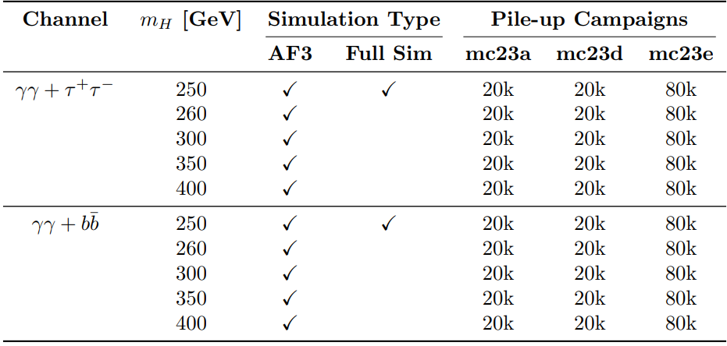
SIMULATION AND PILE-UP CAMPAIGNS
240k events requested
Full Sim:
Low pile-up level = 20k
Medium pile-up level = 20k
High pile-up level = 80k
AF3:
Low pile-up level = 20k
Medium pile-up level = 20k
High pile-up level = 80k
Event Generation
Detector Simulation
Digitization
Reconstruction
ROOTification
SAIP2025 09 JULY 2025

Slide 13
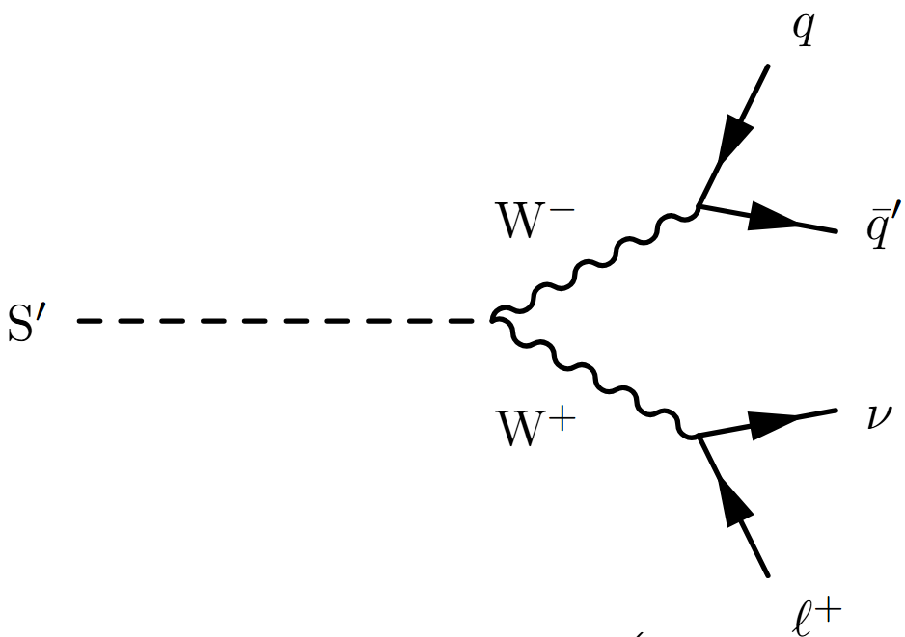
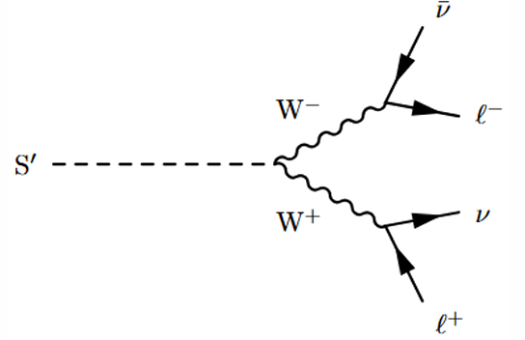
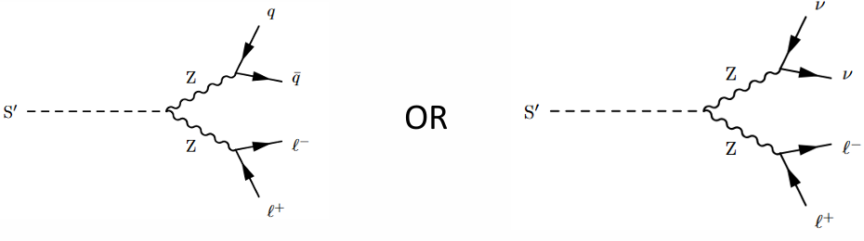
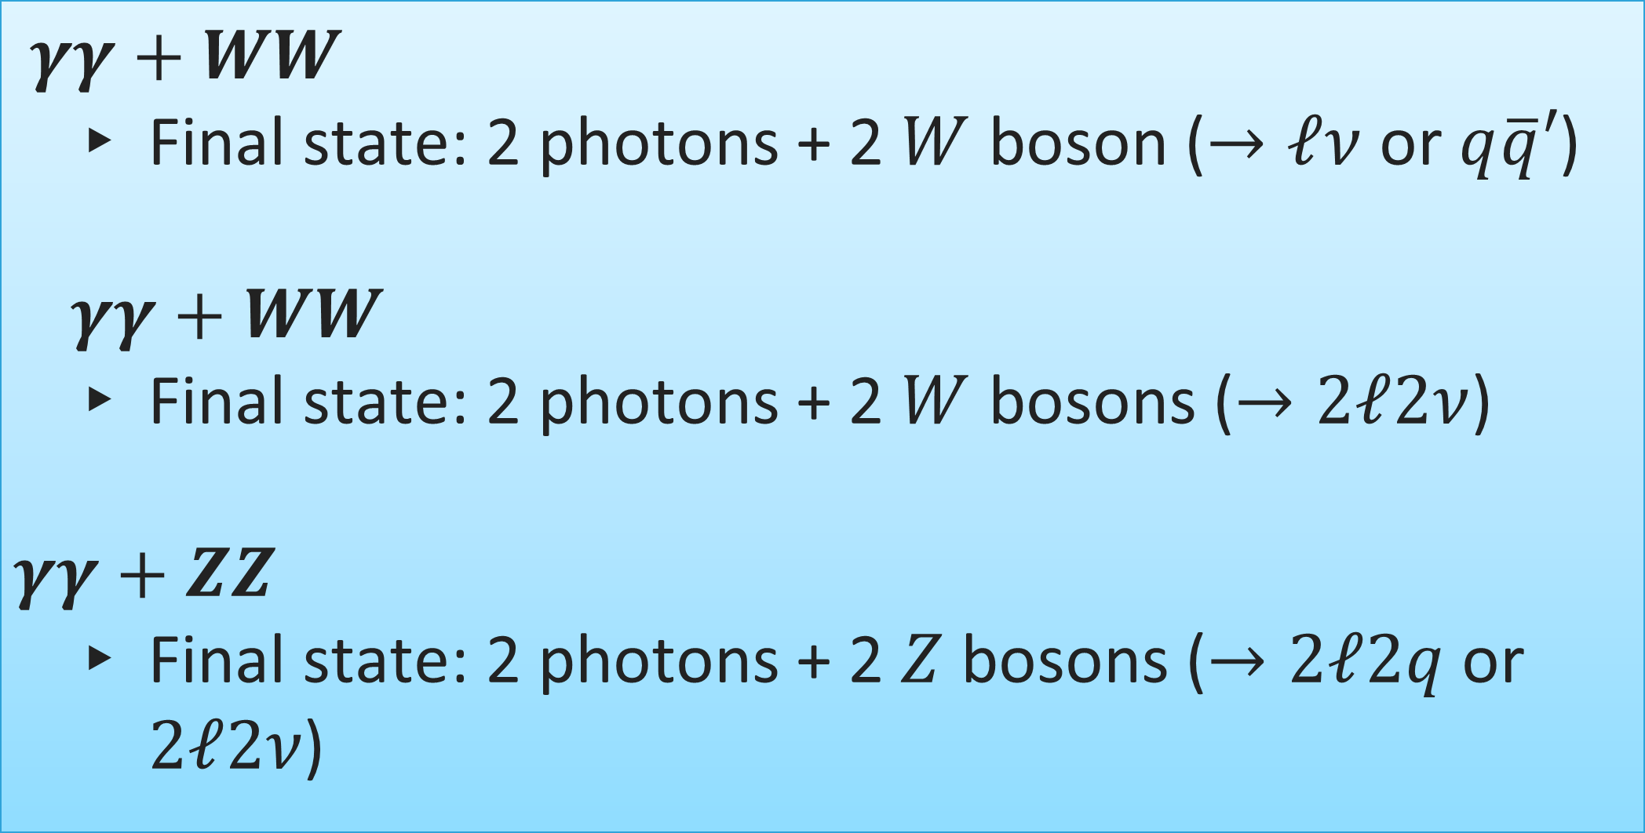
Future MC Request
$γγ+WW$
  Final state: 2 photons + 2 $W$ boson ($→ℓν$ or $q\overline{q}′$)
  $$γγ+WW$$
  Final state: 2 photons + 2 $W$ bosons ($→2ℓ2ν$)
$$γγ+ZZ$$
  Final state: 2 photons + 2 $Z$ bosons ($→2ℓ2q$ or $2ℓ2ν$)
SAIP2025 09 JULY 2025

Slide 14
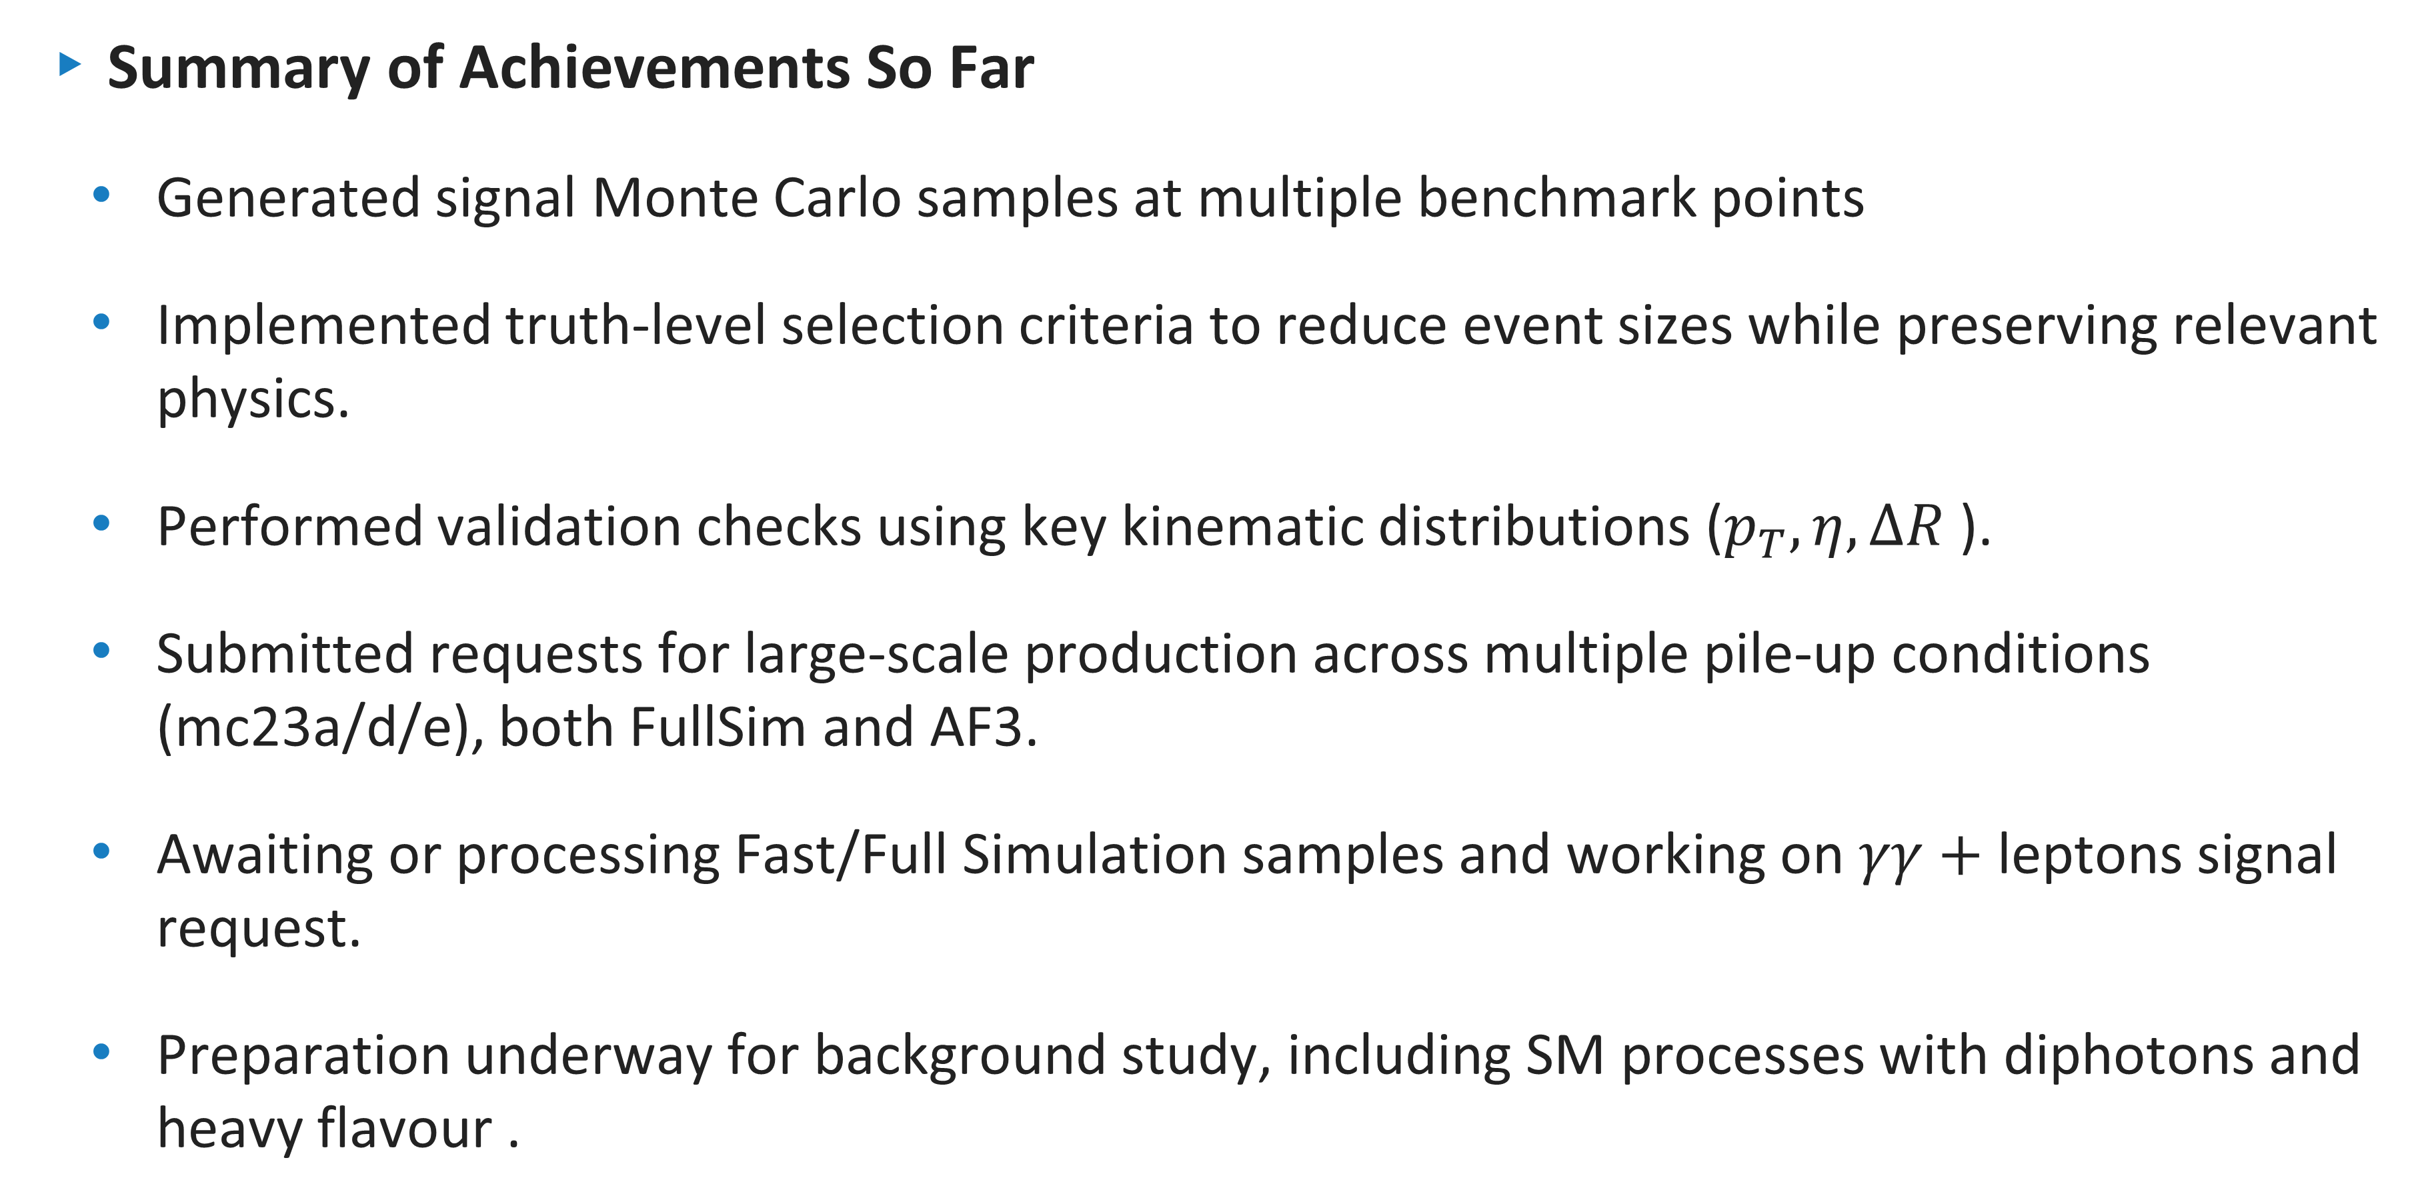
CONCLUSION
Summary of Achievements So Far
  Generated signal Monte Carlo samples at multiple benchmark points
  Implemented truth-level selection criteria to reduce event sizes while preserving relevant physics.
  Performed validation checks using key kinematic distributions ($p_{T},η,ΔR$).
  Submitted requests for large-scale production across multiple pile-up conditions (mc23a/d/e), both FullSim and AF3.
  Awaiting or processing Fast/Full Simulation samples and working on $γγ+$ leptons signal request.
  Preparation underway for background study, including SM processes with diphotons and heavy flavour .
SAIP2025 09 JULY 2025

Slide 15


Slide 16
BACKUP SLIDES

Slide 17
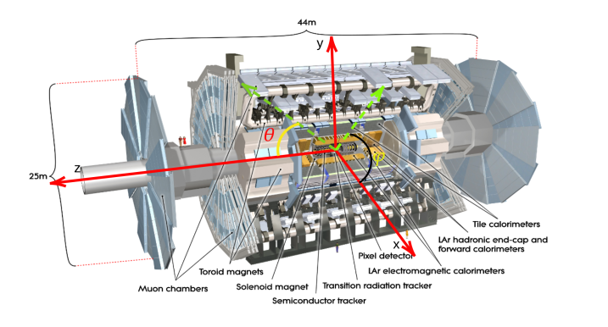
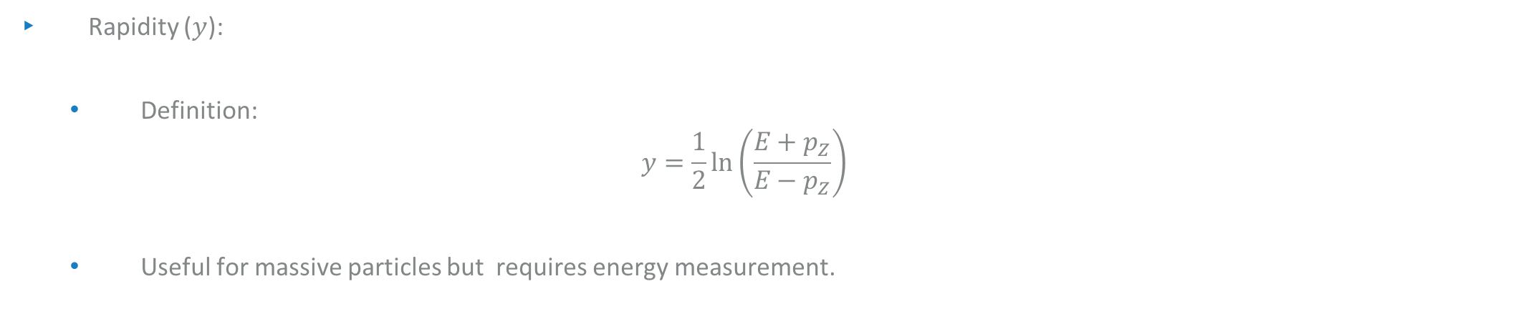
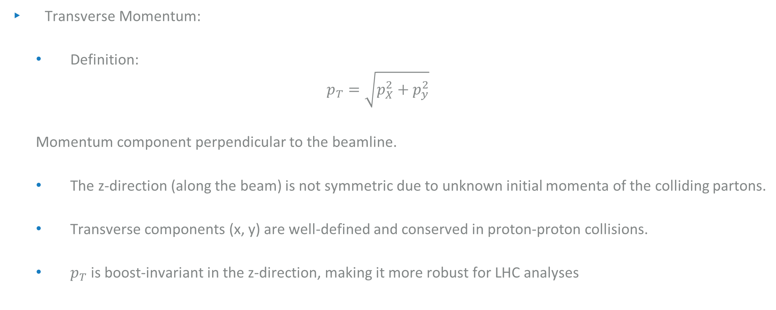
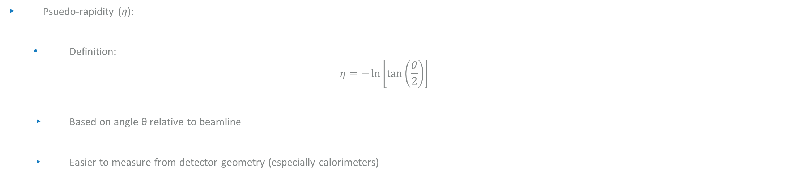
Transverse momentum and PSUEDO-RAPIDITY
Transverse Momentum:
  Definition:
  $$p_{T}=\sqrt{p_{X}^{2}+p_{y}^{2}}$$
  Momentum component perpendicular to the beamline.
  The z-direction (along the beam) is not symmetric due to unknown initial momenta of the colliding partons.
  Transverse components (x, y) are well-defined and conserved in proton-proton collisions.
  $p_{T}$ is boost-invariant in the z-direction, making it more robust for LHC analyses
Rapidity ($y$):
  Definition:
  $$y=\frac{1}{2}\ln\left(\frac{E+p_{Z}}{E−p_{Z}}\right)$$
  Useful for massive particles but requires energy measurement.
$p_{T}$ and $η$ simplify measurements and enhance physics interpretability at hadron colliders.
Psuedo-rapidity ($η$):
  Definition:
  $$η=−\ln\left[\tan\left(\frac{θ}{2}\right)\right]$$
  Based on angle θ relative to beamline
  Easier to measure from detector geometry (especially calorimeters)

Slide 18
TRUTH LABELING IN SIMULATION
Purpose of Truth Labeling
  Identify true particle origins in simulation.
  Helps distinguish between real signal components and background/noise.
Examples in Our Analysis
  Truth Photons: Prompt photons (status=1 or 23) not from hadron decays.
  Truth b-jets: Jets matched to b-hadrons within ΔR < 0.4.
  Truth Taus: From scalar decay, not from background W/Z.
Tools
  TruthParticles, TruthBosons, TruthBottom, and AntiKt4TruthJets containers in the EVNT or Truth1 files.
  Truth labeling enables performance studies, e.g., b-tagging efficiency

Slide 19
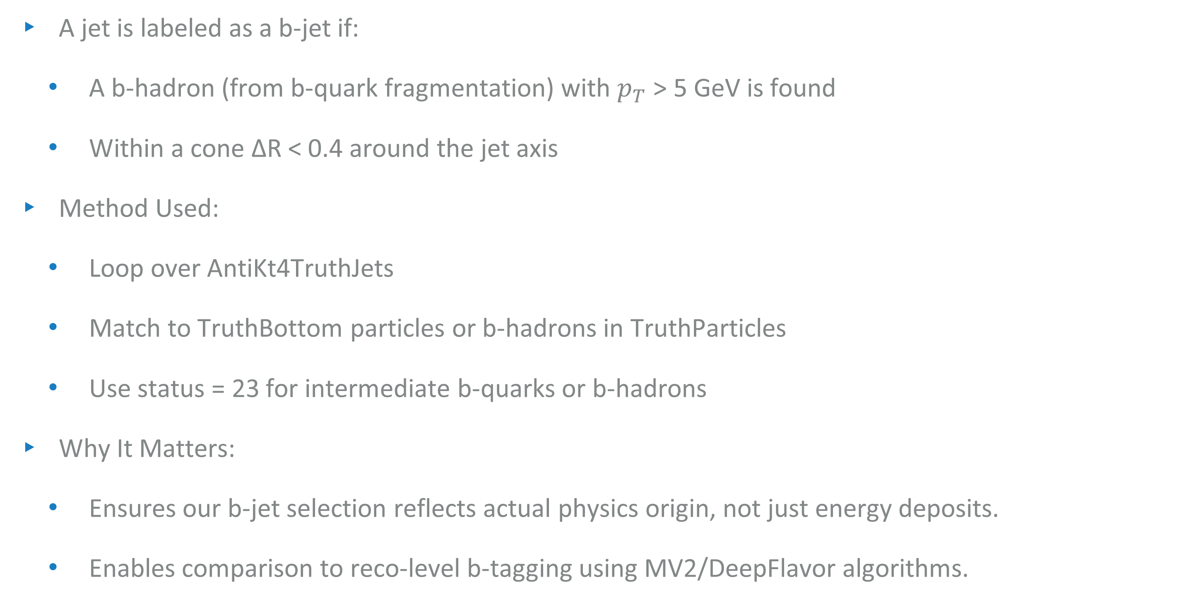
B-Jet tagging at truth level
A jet is labeled as a b-jet if:
  A b-hadron (from b-quark fragmentation) with $p_{T}$ > 5 GeV is found
  Within a cone ΔR < 0.4 around the jet axis
Method Used:
  Loop over AntiKt4TruthJets
  Match to TruthBottom particles or b-hadrons in TruthParticles
  Use status = 23 for intermediate b-quarks or b-hadrons
Why It Matters:
  Ensures our b-jet selection reflects actual physics origin, not just energy deposits.
  Enables comparison to reco-level b-tagging using MV2/DeepFlavor algorithms.

Slide 20
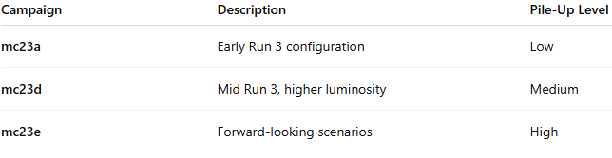
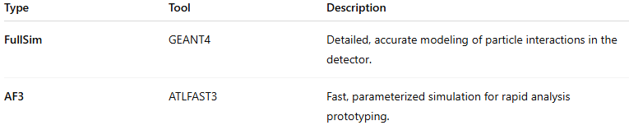
Pile-up and simulation types
Pile-up refers to multiple proton-proton collisions occurring in the same or nearby bunch crossing.
It can distort reconstructed physics objects and affect event selection.
Our samples include pile-up to match real LHC conditions.

Slide 21
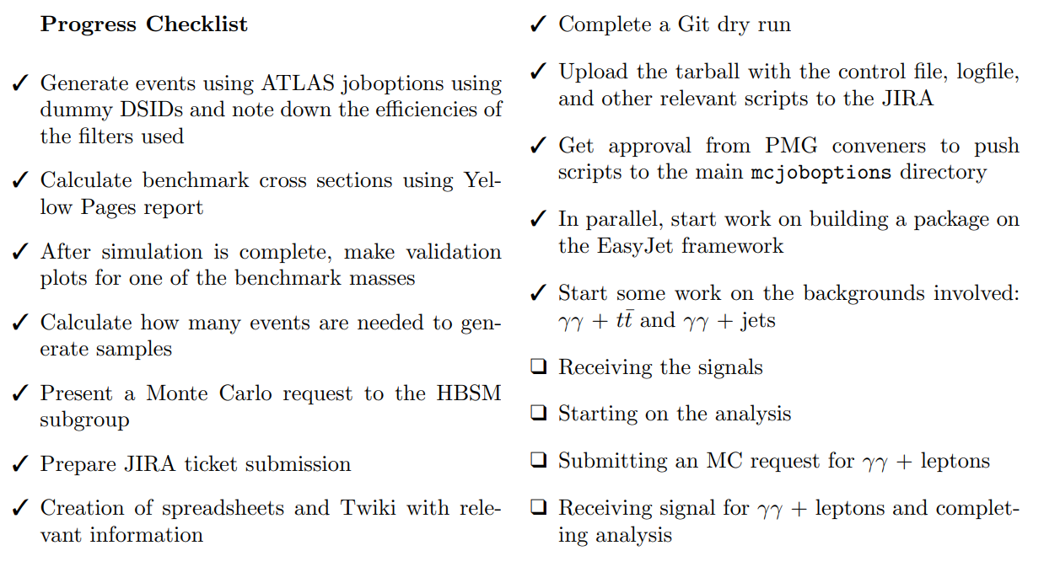
Progress checklist

Slide 22
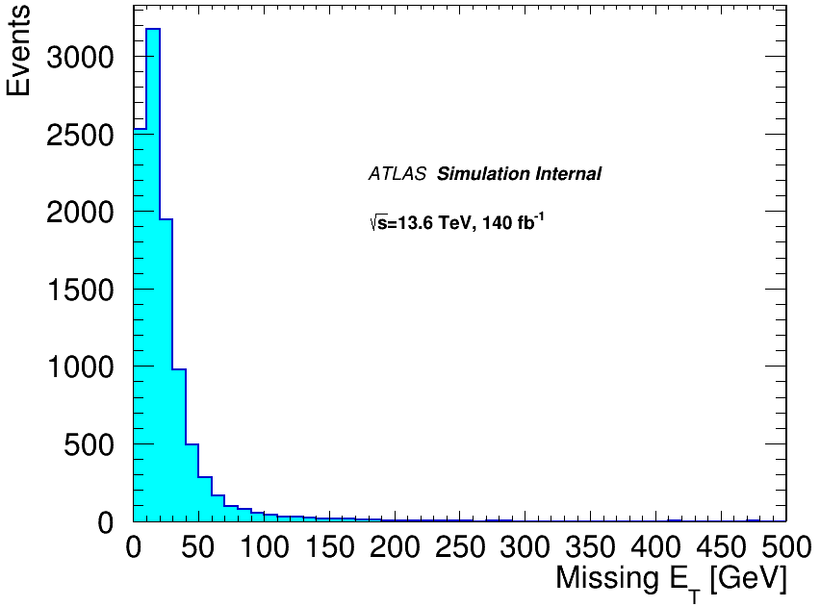
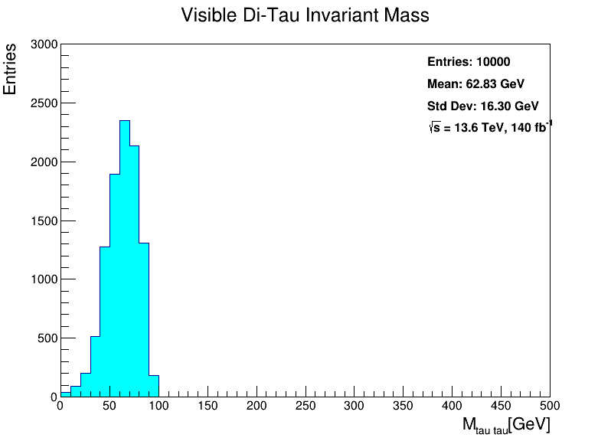
EXTRA DISTRIBUTIONS

Slide 23
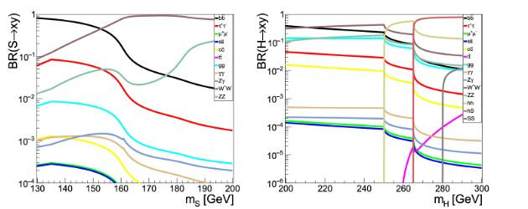
Branching ratios
J. Phys. G 46 (2019) no.11, 115001

Slide 24
WORK PLAN
Simulated signal events for benchmark masses
Validation of samples with basic plots
Submit request for large dataset to physics group
Receive approval and start building analysis framework
Receive full signal
Study requested samples generated/study major backgrounds already generated
Complete analysis
SAIP2025 07 JULY 2025

