Slide 1




Analysing h to $Zγ$ decay at the Large Hadron Collider using SMEFT
Presenter: Njokweni Mbuyiswa
In collaboration with Kutlwano Makgetha, srimoy bhattacharya, Abdualazem fadol, Bruce Mellado, Mukesh Kumar

Slide 2
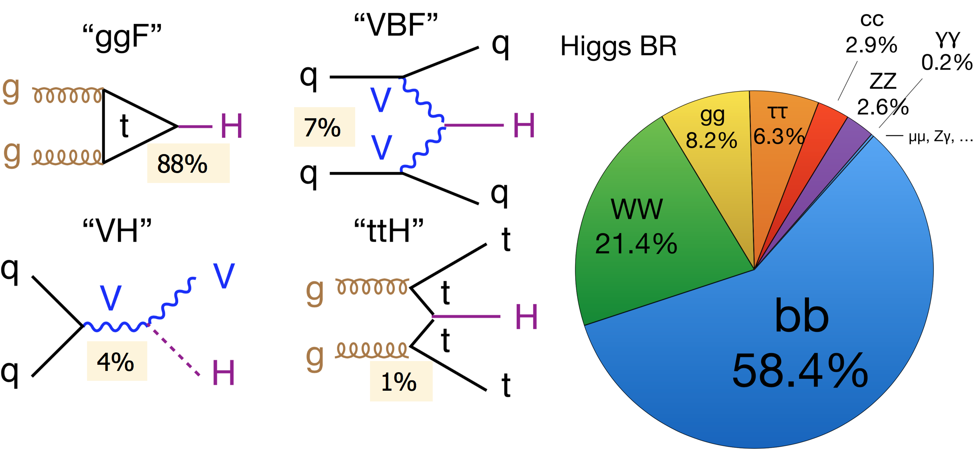


OUTLINE
Introduction
Motivation
SMEFT Framework
MC SIGNAL GENERATION
$χ^{2}$Minimisation
Conclusion

Slide 3
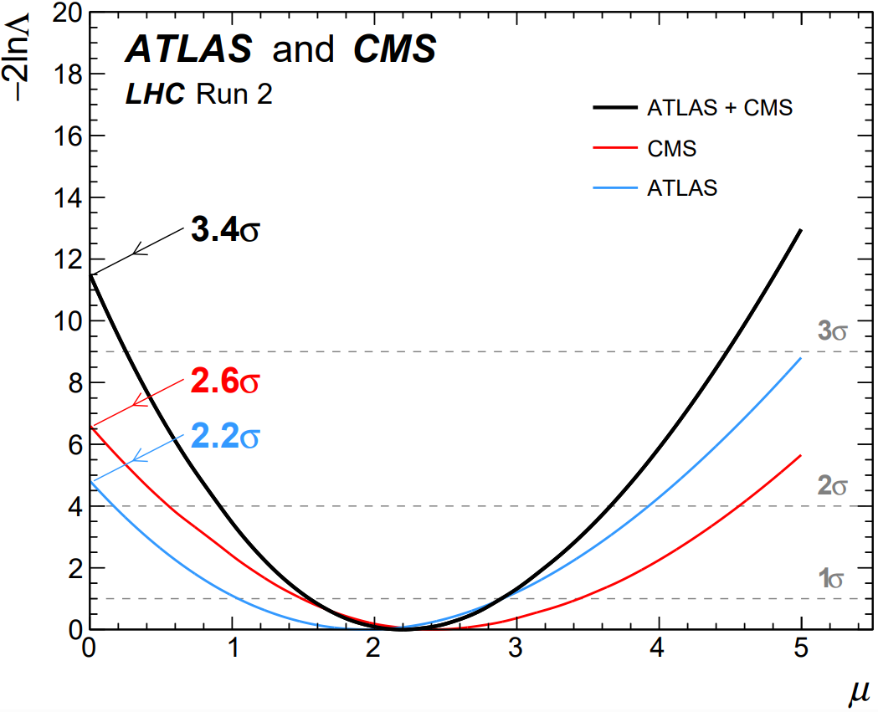
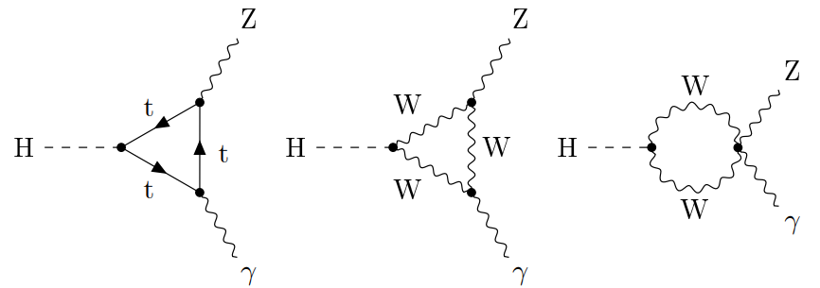
Decay of the Higgs Boson into Photon and Z Boson
Key Findings
Statistical Significance: 3.4σ
Collaborations: CMS and ATLAS
Data: Proton-proton collision datasets from LHC (2015-2018)
Energy: Centre-of-mass energy of 13 TeV
Luminosity: ~140 fb⁻¹
Observations
Signal Count: 2.2 ± 0.7 times the prediction of the Standard Model (SM)
Predicted Branching Fraction (SM): ∼(1.5±0.1)×10⁻³ for Higgs boson mass close to 125 GeV
G. Aad et al. [ATLAS and CMS], Phys. Rev. Lett. 132, no.2, 021803 (2024) [arXiv:2309.03501 [hep-ex]].
SAIP2025 11 JULY 2025

Slide 4
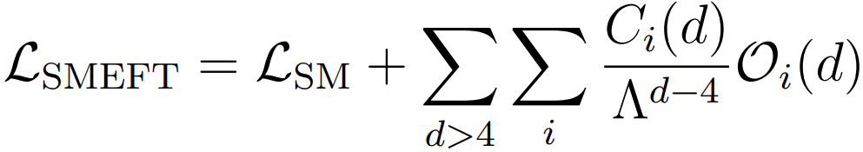
SMEFT FRAMEWORK
The SM Effective Field Theory (SMEFT model from FeynRules) is currently the framework with the most potential to explain deviations from the Standard Model (SM).
SMEFT expands upon the SM by incorporating higher-dimensional operators suppressed by a new physics scale, denoted as Λ.
is the Standard Model Lagrangian
are the Wilson Coefficients
is the mass dimension of the operators
are the higher dimensional operators
SAIP2025 11 JULY 2025

Slide 5
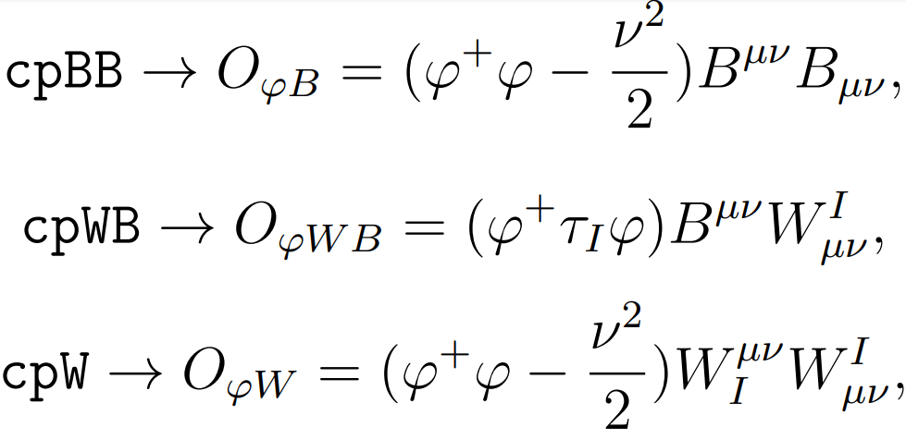
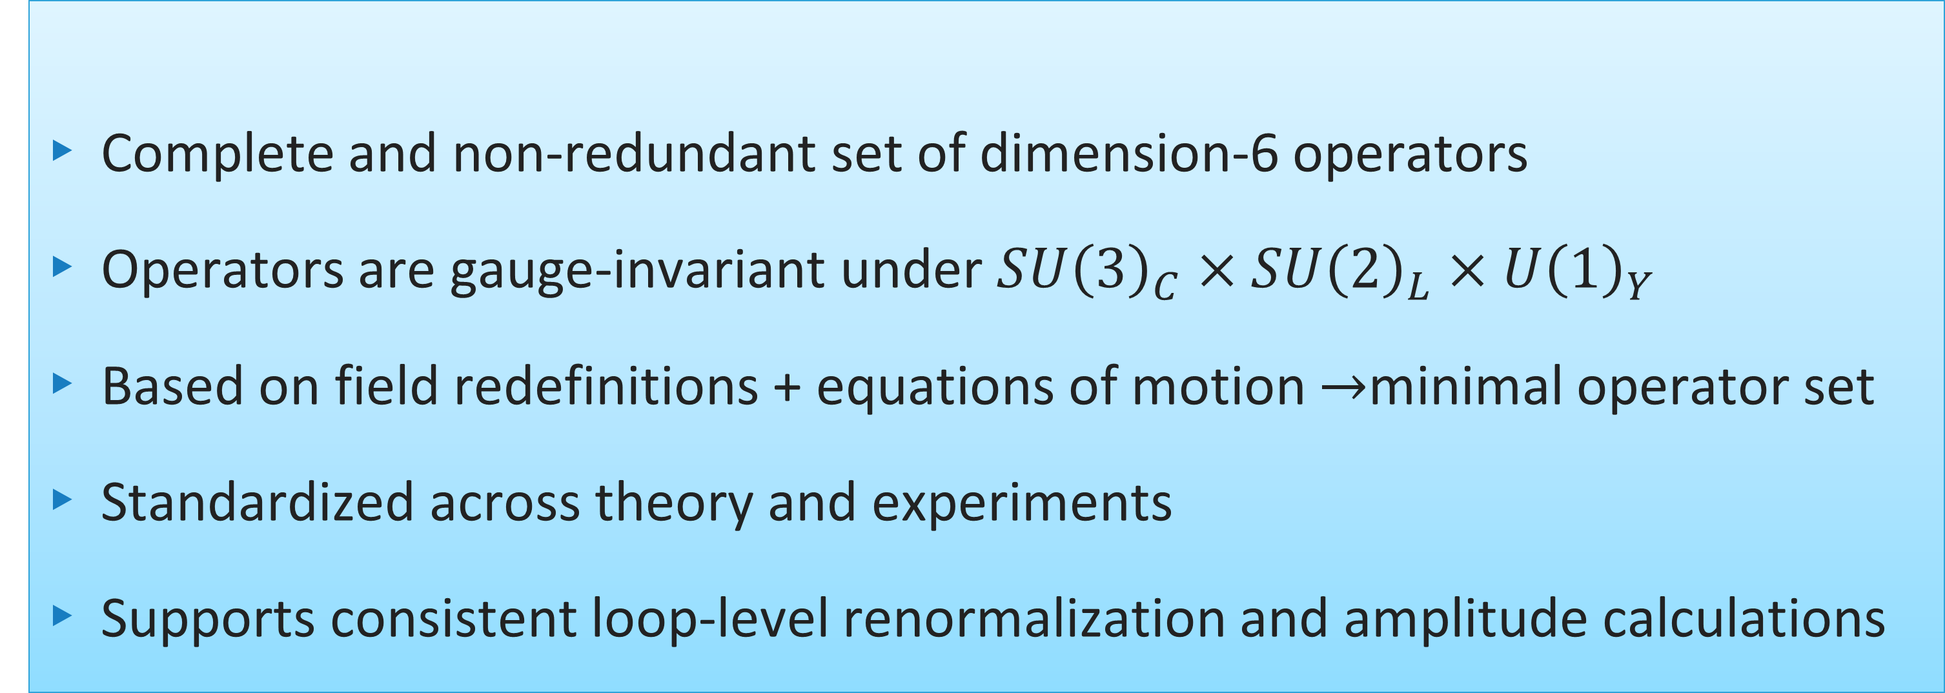
WARSAW BASIS and Wilson coefficients
Complete and non-redundant set of dimension-6 operators
Operators are gauge-invariant under $SU{\left(3\right)}_{C}×SU{\left(2\right)}_{L}×U{\left(1\right)}_{Y}$
Based on field redefinitions + equations of motion $→$minimal operator set
Standardized across theory and experiments
Supports consistent loop-level renormalization and amplitude calculations
Dawson, Sally, and Pier Paolo Giardino. "Higgs decays to ZZ and Z γ in the standard model effective field theory: An NLO analysis." Physical Review D 97.9 (2018): 093003
SAIP2025 11 JULY 2025

Slide 6









CHANNELS BEING CONSIDERED
$$ggF$$
$$Z→ℓ^{+}ℓ^{−}$$
$$VH$$
$$Z→jj$$
$$h→Zγ$$
$$VBF$$
$$Z→νν$$
$$ttH$$
$$Z→b\overline{b}$$
SAIP2025 11 JULY 2025

Slide 7
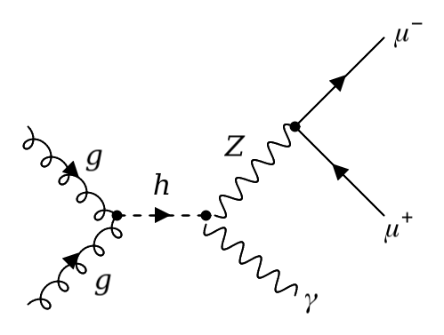
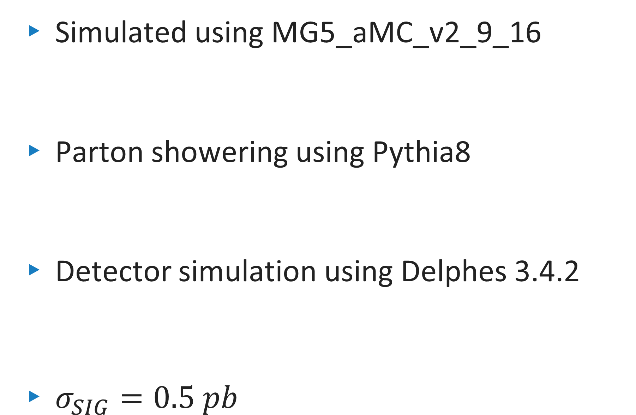


Monte Carlo Generation
Simulated using MG5_aMC_v2_9_16
Parton showering using Pythia8
Detector simulation using Delphes 3.4.2
$σ_{SIG}=0.5 pb$
Backround:
$$pp→ℓ^{+}ℓ^{−}γ$$
$σ_{Background}=17.63 pb$
$$gg→h→Z\left(→ℓ^{+}ℓ^{−}\right)γ$$
SAIP2025 11 JULY 2025

Slide 8
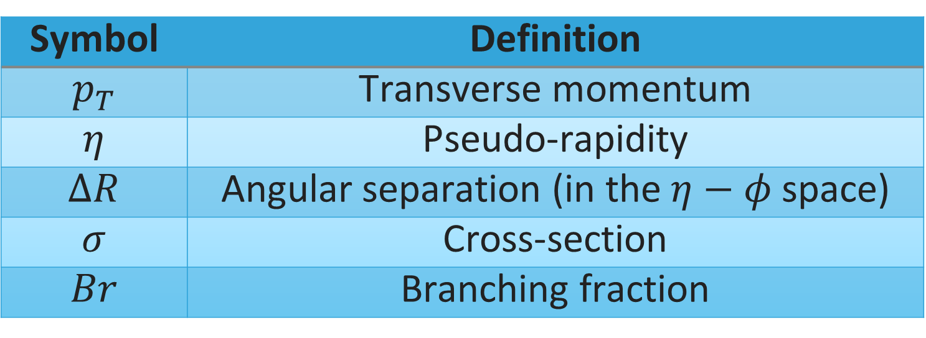

OBJECT SELECTIONS
$\left|η_{μ}\right|<2.7$
$p_{T}^{μ}>10 GeV$
$\left|η_{e}\right|<2.47$ excluding ($1.37<\left|η_{e}\right|<1.52$)
$p_{T}^{e}>10 GeV$
$\left|η_{γ}\right|<2.47$ excluding ($1.37<\left|η_{γ}\right|<1.52$)
$p_{T}^{γ}<10 GeV$
$\left|η_{j}\right|<4.4$
$p_{T}^{j}>25 GeV$
Symbol | Definition
$$p_{T}$$ | Transverse momentum
$$η$$ | Pseudo-rapidity
$$ΔR$$ | Angular separation (in the $η−φ$ space)
$$σ$$ | Cross-section
$$Br$$ | Branching fraction
SAIP2025 11 JULY 2025

Slide 9
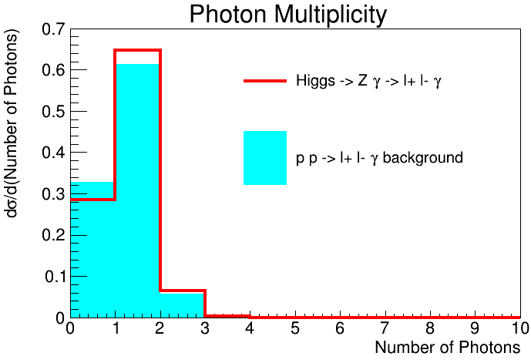
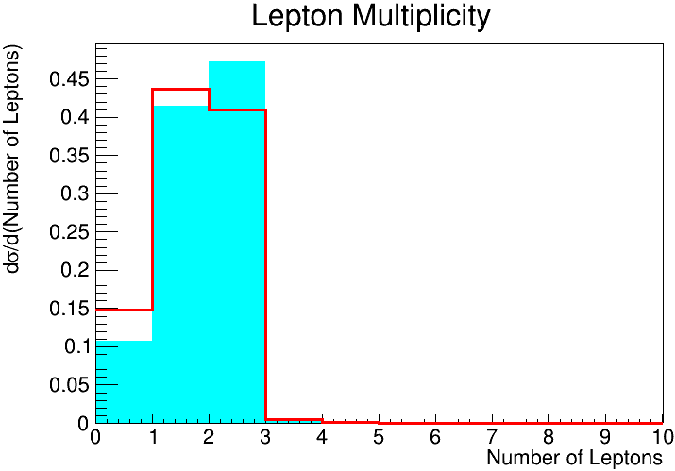
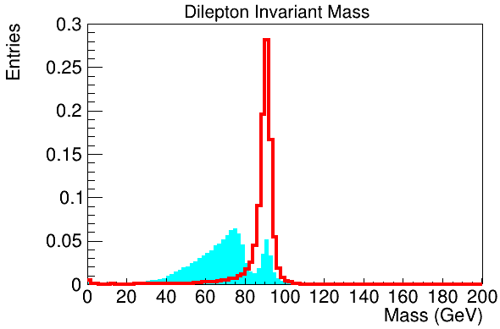
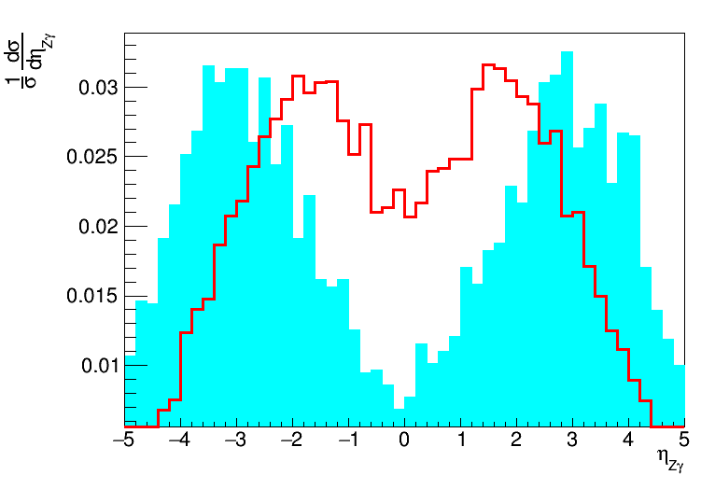
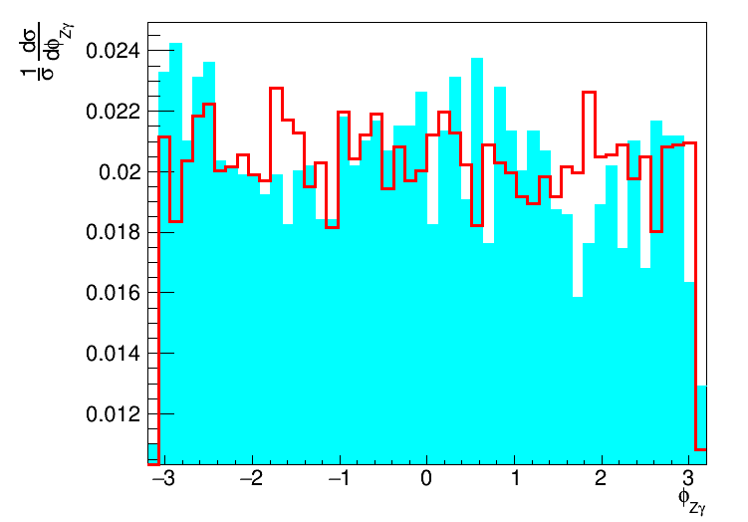
KINEMATIC DISTRIBUTIONS
SAIP2025 11 JULY 2025

Slide 10
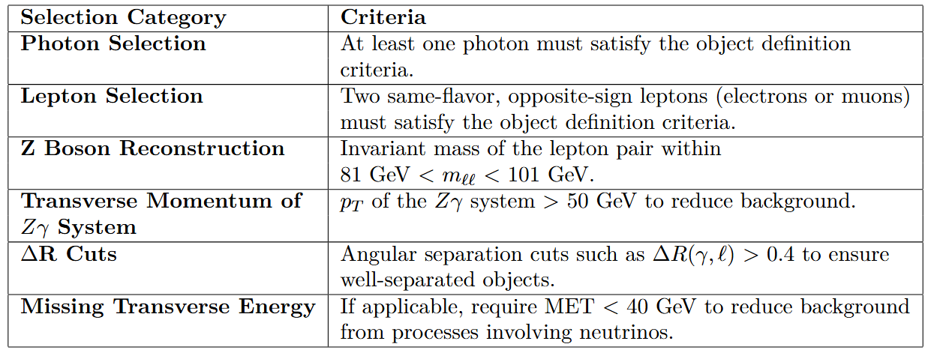
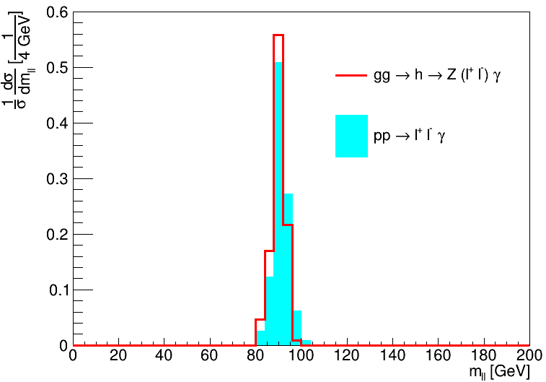
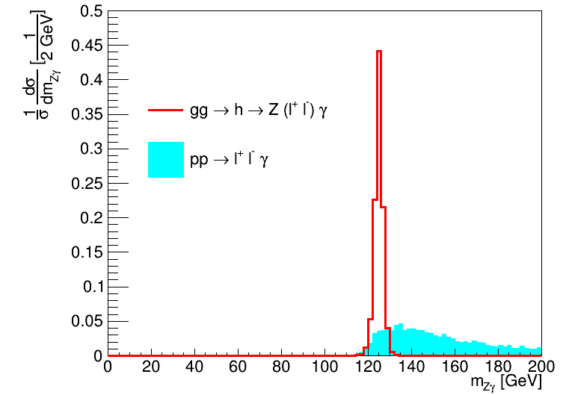
FURTHER SELECTION CRITERIA
SAIP2025 11 JULY 2025

Slide 11
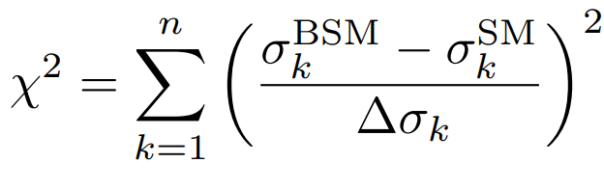
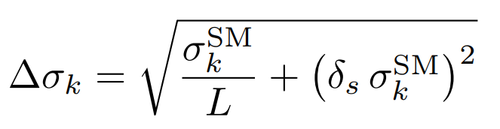
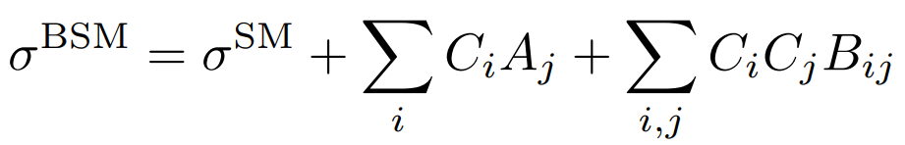


$χ^{2} Minimisation$
where

Slide 12
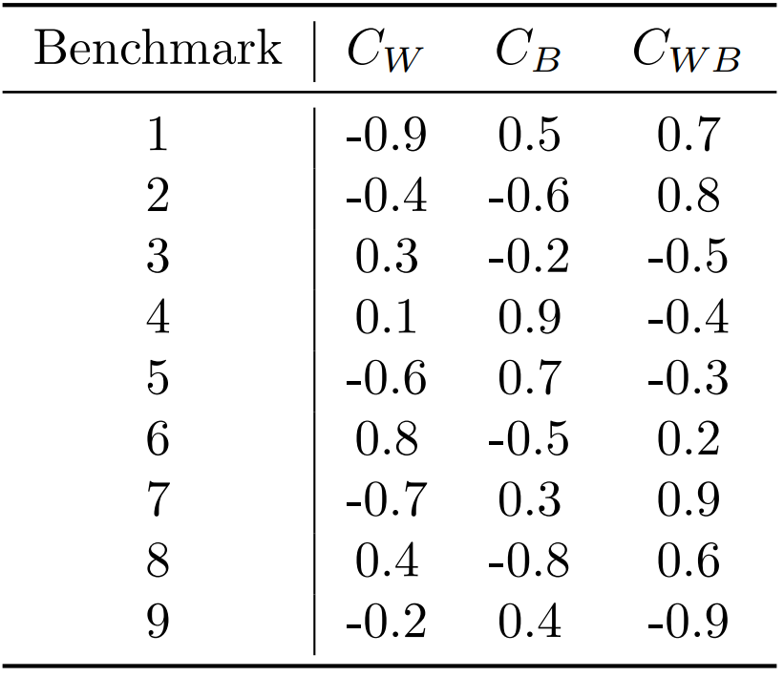
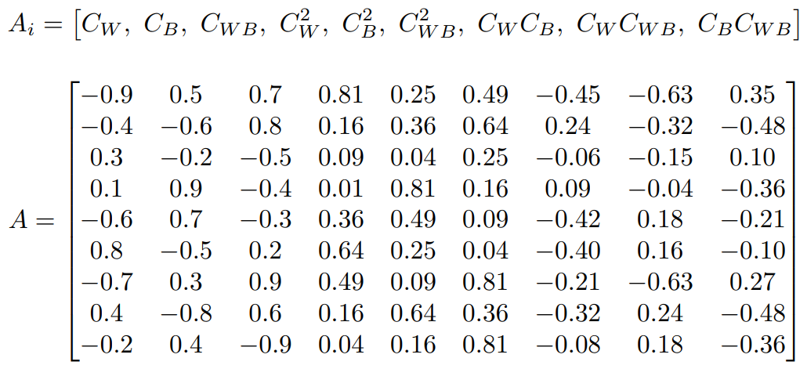
$χ^{2} Minimization$

Slide 13
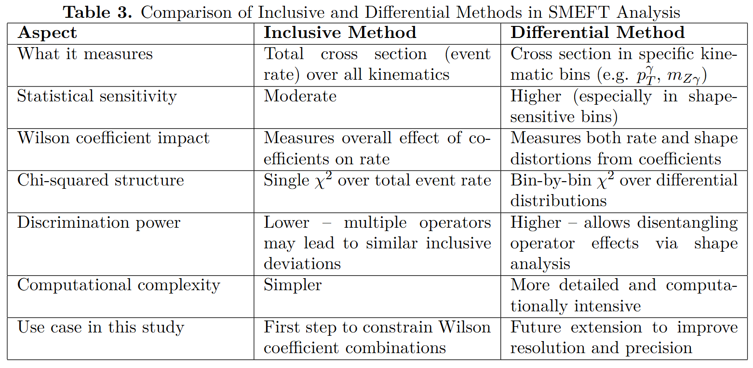
$χ^{2} Minimisation$

Slide 14
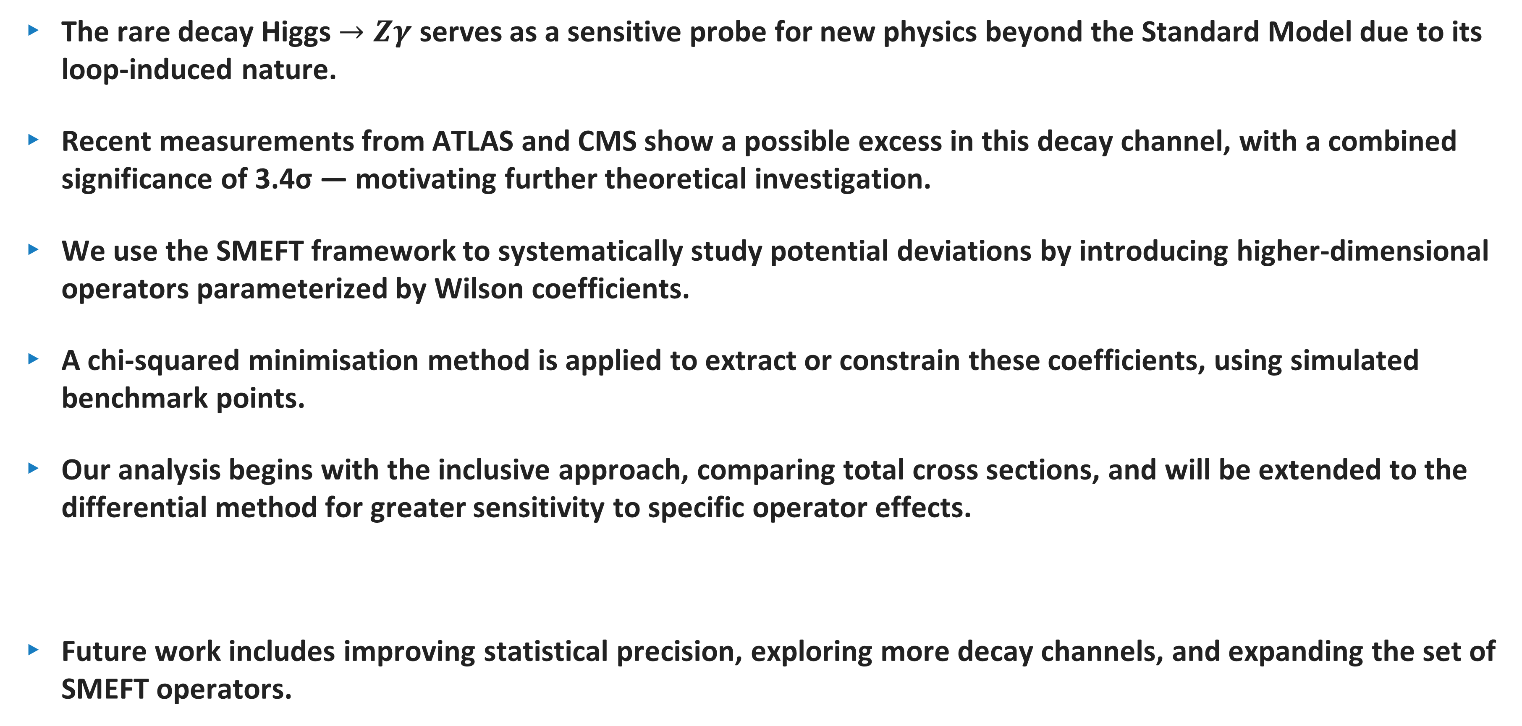
CONCLUSION
The rare decay Higgs $→Zγ$ serves as a sensitive probe for new physics beyond the Standard Model due to its loop-induced nature.
Recent measurements from ATLAS and CMS show a possible excess in this decay channel, with a combined significance of 3.4σ — motivating further theoretical investigation.
We use the SMEFT framework to systematically study potential deviations by introducing higher-dimensional operators parameterized by Wilson coefficients.
A chi-squared minimisation method is applied to extract or constrain these coefficients, using simulated benchmark points.
Our analysis begins with the inclusive approach, comparing total cross sections, and will be extended to the differential method for greater sensitivity to specific operator effects.
Future work includes improving statistical precision, exploring more decay channels, and expanding the set of SMEFT operators.
SAIP2025 11 JULY 2025

Slide 15

BACKUP SLIDES

Slide 16
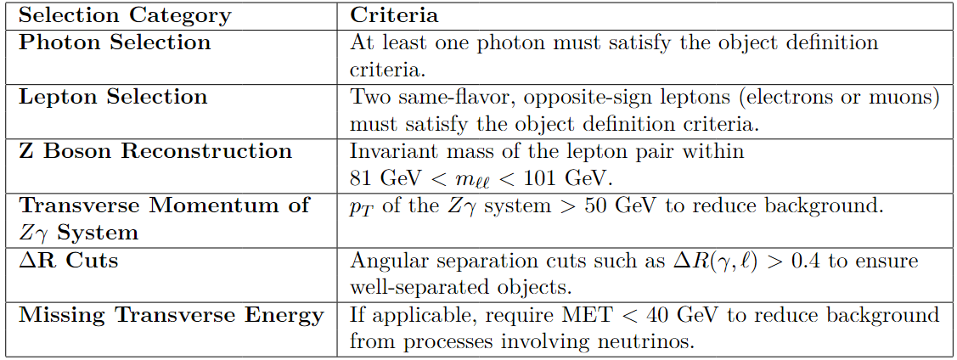
Cuts

Slide 17
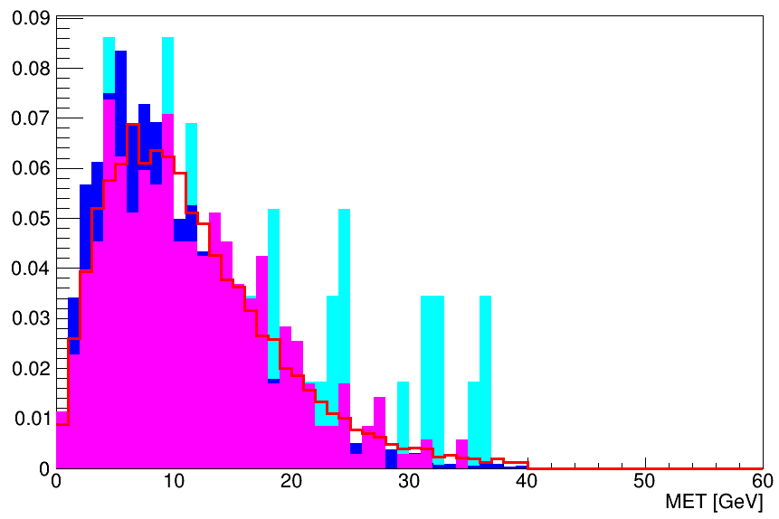
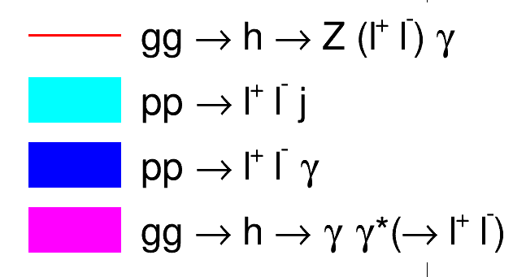
The Red line is the signal and the filled colors are the backgrounds

Slide 18
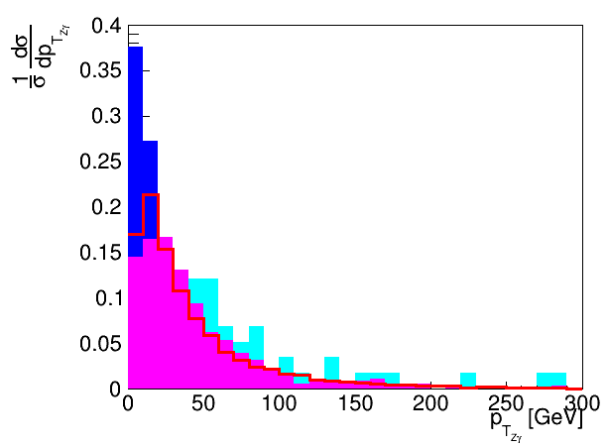
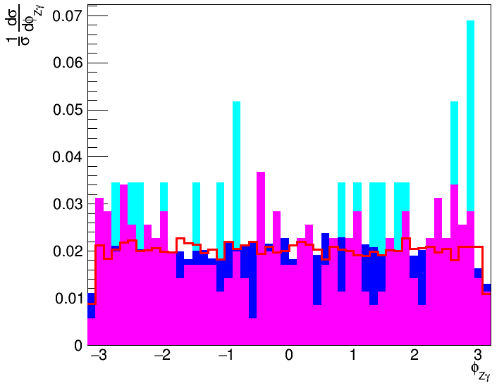
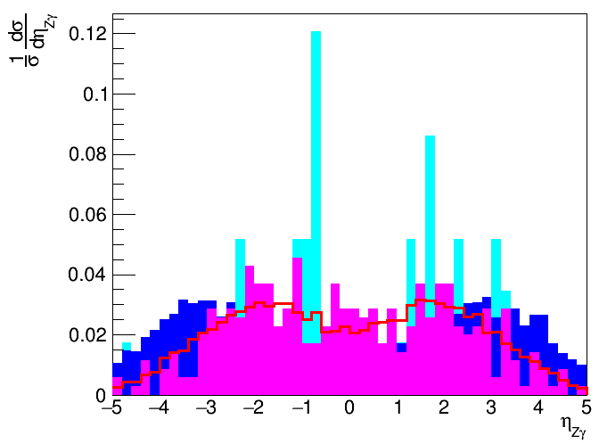

Slide 19
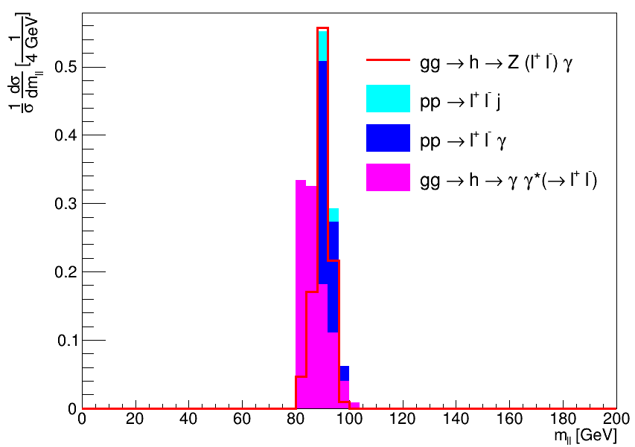
The invariant mass of the dilepton system
All processes seem to peak about the Z mass. The background where the two leptons come from a virtual photon seems to peak slightly below the Z mass (This background was generated using HEFT)

Slide 20
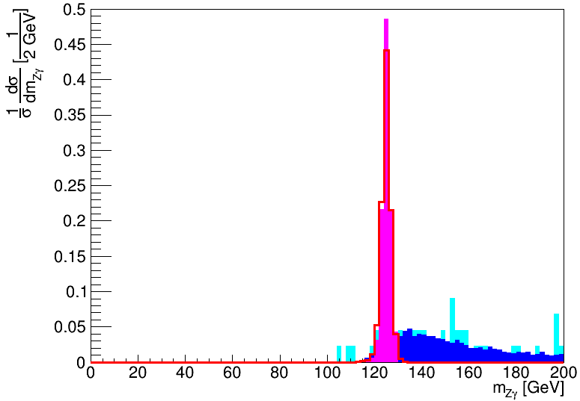

The invariant mass of the $Zγ$ system
The signal clearly peaks at 125 GeV and we see this to be the case for the virtual photon background as well.

Slide 21
Number of events that pass the cuts (100 000 was generated for each process)
14 983
58
6191
353

Slide 22
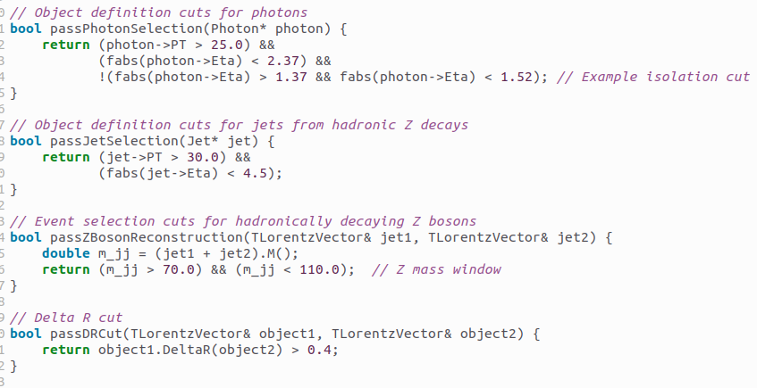
$$gg→h→Z(jj)γ$$

Slide 23
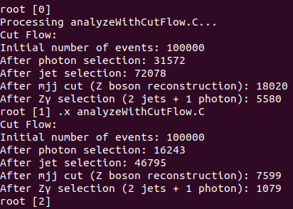
$$gg→h→Z(jj)γ$$

Slide 24
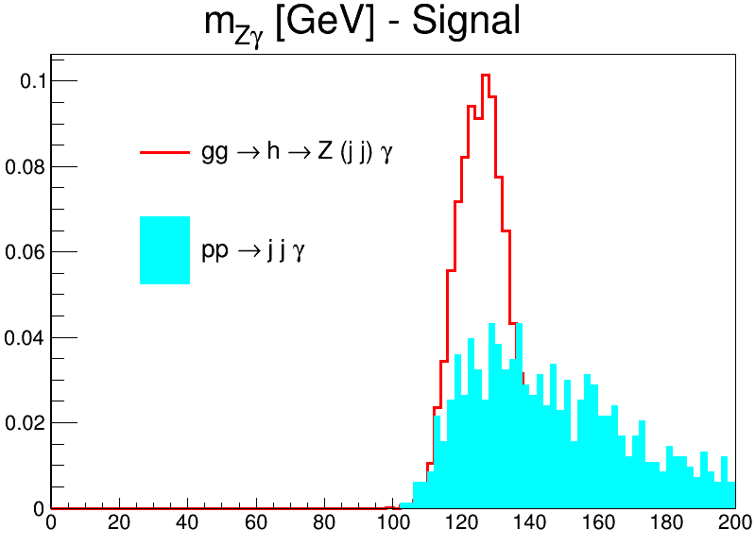

Slide 25
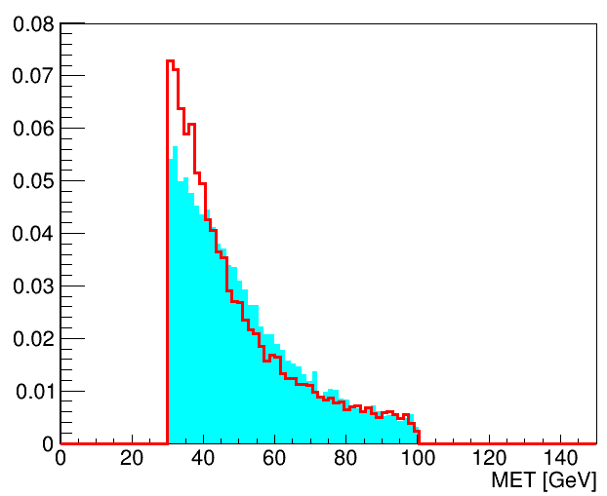
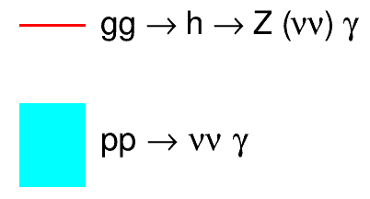
$$gg→h→Z(νν)γ$$
The Red line is the signal, and the filled cyan color is the first backgrounds
(Plots are normalized to unity)

Slide 26
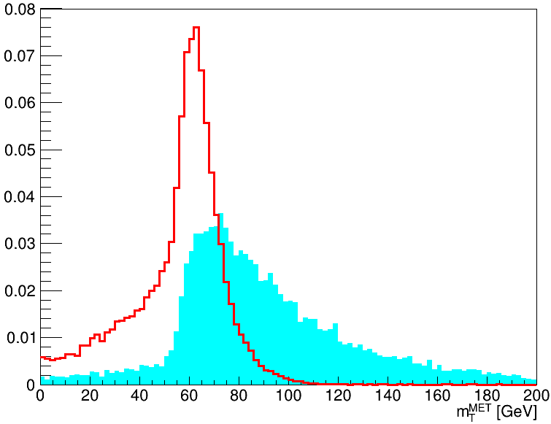
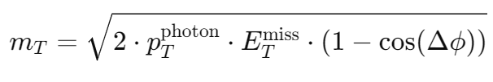

Slide 27
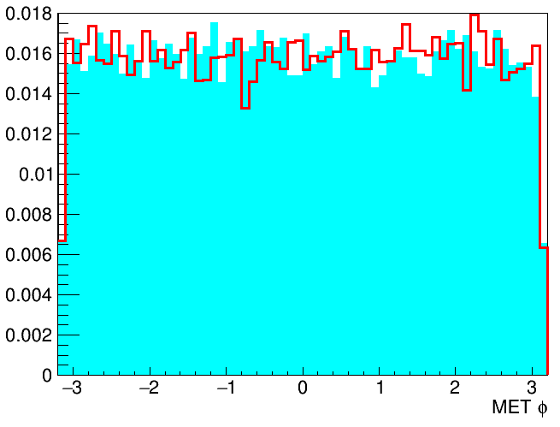
MET phi plot

Slide 28
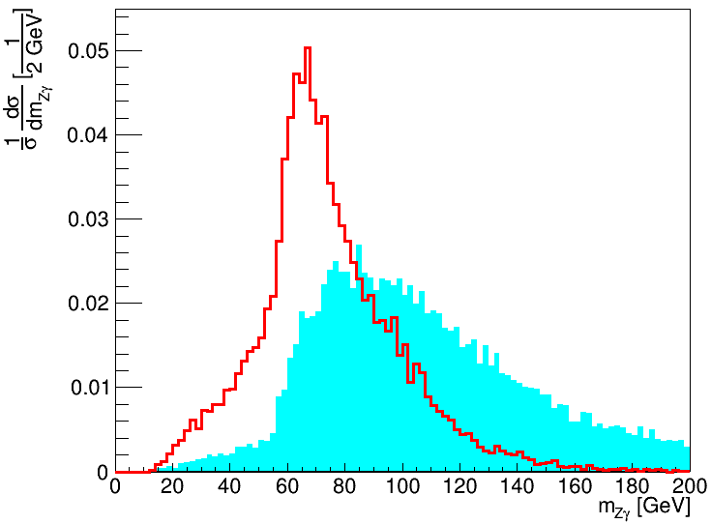

The invariant mass of the $Zγ$ system

Slide 29
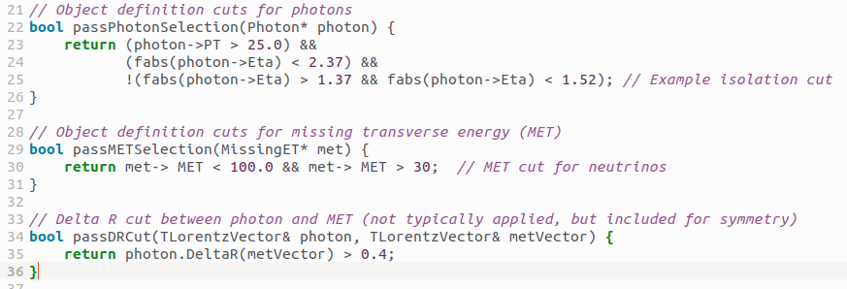
The minimal cuts followed for reconstruction

Slide 30
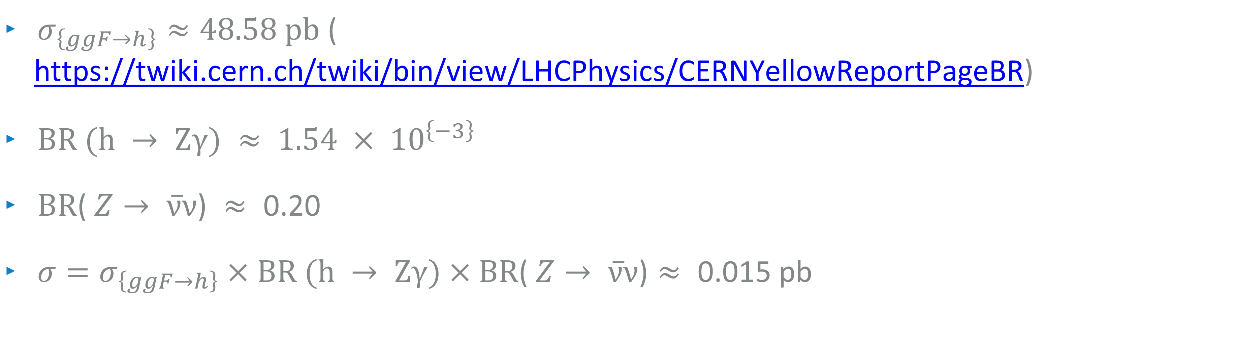
Predicted signal cross-section
$σ_{\left\{ggF→h\right\}}≈48.58 \text{pb}$ ( https://twiki.cern.ch/twiki/bin/view/LHCPhysics/CERNYellowReportPageBR)
$\text{B}\text{R}\text{ (}\text{h} → \text{Z}γ\text{) }≈\text{ 1.54 }× {10}^{\left\{−3\right\}}$
$\text{B}\text{R}\text{(} Z→ ν̅ν\text{) }≈\text{ 0.20}$
$σ=σ_{\left\{ggF→h\right\}}×\text{BR}\text{ (}\text{h} → \text{Z}γ\text{)}×\text{BR}\text{(} Z→ ν̅ν\text{)}≈\text{ 0.}\text{01}\text{5} \text{pb}$

Slide 31
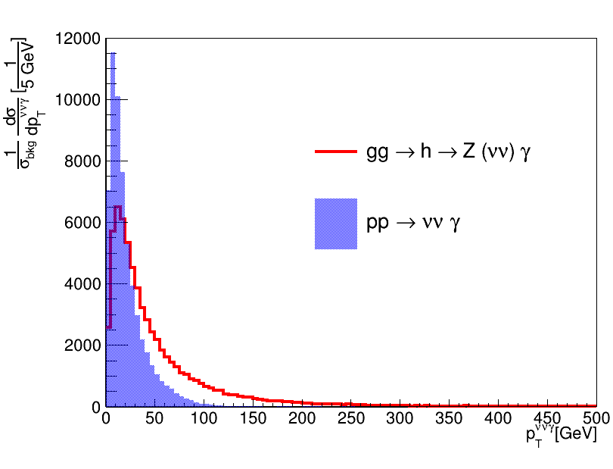

Slide 32
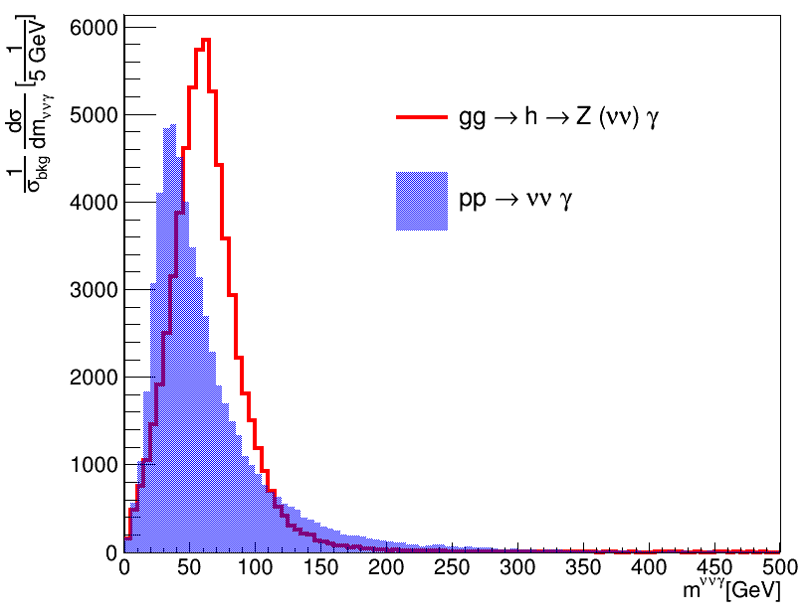

Slide 33
TRUTH LABELING IN SIMULATION
Purpose of Truth Labeling
  Identify true particle origins in simulation.
  Helps distinguish between real signal components and background/noise.
Examples in Our Analysis
  Truth Photons: Prompt photons (status=1 or 23) not from hadron decays.
  Truth b-jets: Jets matched to b-hadrons within ΔR < 0.4.
  Truth Taus: From scalar decay, not from background W/Z.
Tools
  TruthParticles, TruthBosons, TruthBottom, and AntiKt4TruthJets containers in the EVNT or Truth1 files.
  Truth labeling enables performance studies, e.g., b-tagging efficiency

Slide 34
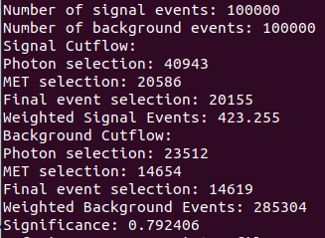
The preliminary signal and background cutflow
Getting a significance of approximately 0.8

Slide 35
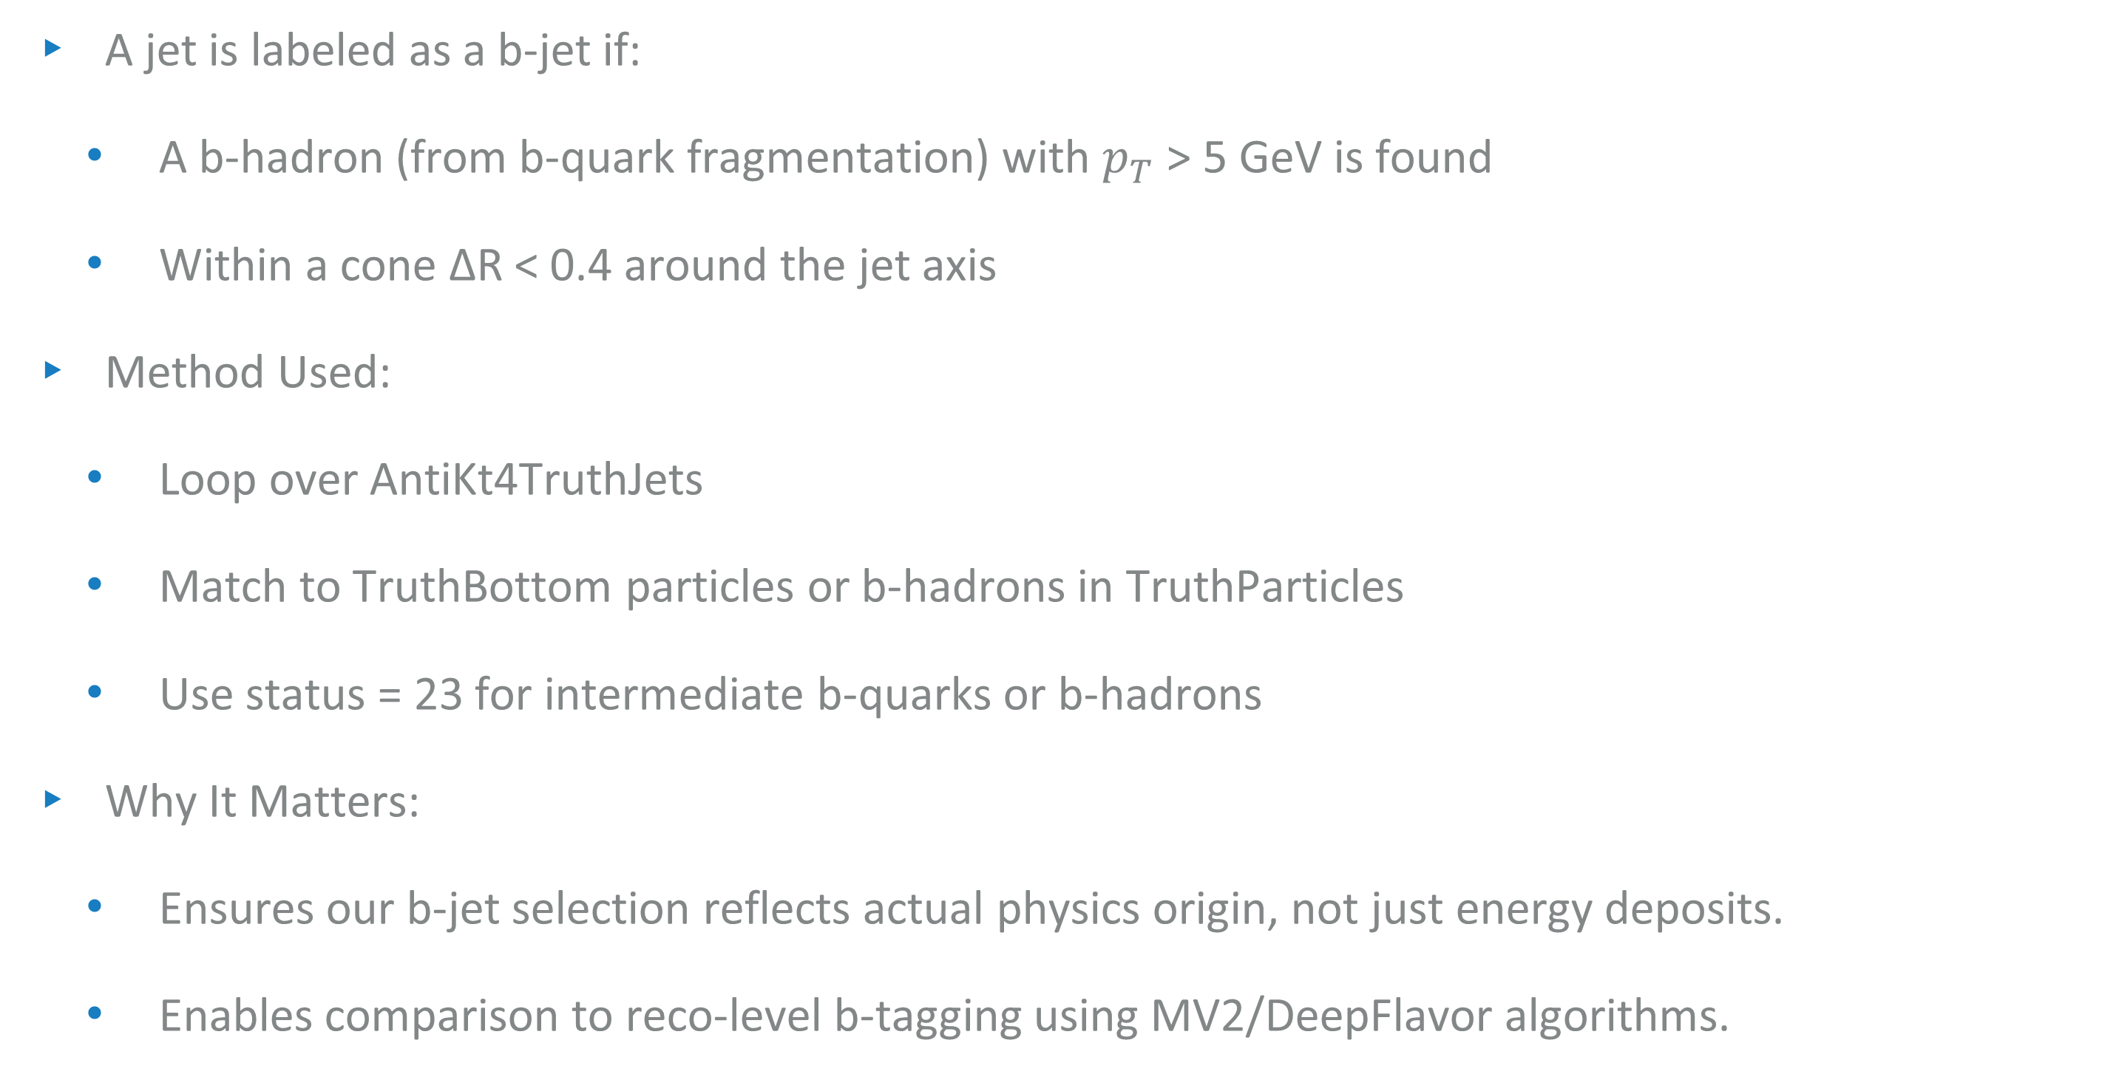
B-Jet tagging at truth level
A jet is labeled as a b-jet if:
  A b-hadron (from b-quark fragmentation) with $p_{T}$ > 5 GeV is found
  Within a cone ΔR < 0.4 around the jet axis
Method Used:
  Loop over AntiKt4TruthJets
  Match to TruthBottom particles or b-hadrons in TruthParticles
  Use status = 23 for intermediate b-quarks or b-hadrons
Why It Matters:
  Ensures our b-jet selection reflects actual physics origin, not just energy deposits.
  Enables comparison to reco-level b-tagging using MV2/DeepFlavor algorithms.

Slide 36


Pile-up and simulation types
Pile-up refers to multiple proton-proton collisions occurring in the same or nearby bunch crossing.
It can distort reconstructed physics objects and affect event selection.
Our samples include pile-up to match real LHC conditions.

Slide 37

Progress checklist

Slide 38


EXTRA DISTRIBUTIONS

Slide 39

Branching ratios
J. Phys. G 46 (2019) no.11, 115001

Slide 40



Wilson Coefficients of the $Zγ$ channel in SMEFT@NLO
Dawson, Sally, and Pier Paolo Giardino. "Higgs decays to ZZ and Z γ in the standard model effective field theory: An NLO analysis." Physical Review D 97.9 (2018): 093003
SAIP2025 09 JULY 2025

