Slide 1




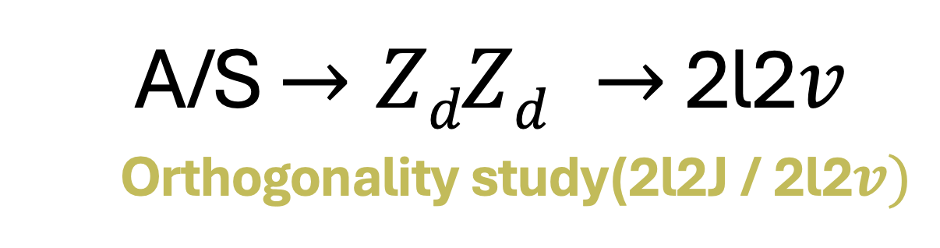
A/S $→ZdZd →$ 2l2$v$
Orthogonality study(2l2J / 2l2$v)$
Doomnull Attah Unwuchola
(University of the Western Cape)

Slide 2
OUTLINE
Motivation
Theory and Definition of the Likelihood Function
Analysis
Results and Conclusions
Backup

Slide 3
Motivation
In our search for A/S→ ZdZd → 2l2ν, we use the Hidden Abelian Higgs model [1] which could provide a viable dark matter (DM) candidate and offer a resolution to the muon g-2 anomaly.
Considering lepton universality which include the decay of Zd to leptons, our search is a follow up to the study of the 4l final states [2], where in our 2l2ν channel, more events and higher sensitivity expected because the Branching Ratio in the Standard Model is: BR(ZZ → 2l2ν) = 6*BR(ZZ → 4l).
The main background is Z+jets with minor contribution from eμ (ttbar,WW,Wt), dibosons and fakes. To suppress the background our chosen mass range is mS ≤ 183 GeV and mZd < 70 GeV.

Slide 4
Motivation : Orthogonality study
There are two channels with potential overlap: 2l2ν and 2l2j
Figure a: 2l2ν channel Figure b: 2l2j channel
Need to make sure there is no overlap between the two analyses, so that data does not get used twice.
To do this, we propose to use a likelihood function that will select events for 2l2j where the di-lepton mass matches with the di-jet mass.

Slide 5
Selected Diagrams for S → Z_{d}Z_{d} → 2l2j Production
Figure c and d are examples of diagrams for S → Z_{d}Z_{d} → 2l2j production
that we would like to select for the 2l2j channel.
Figure c: 2l2j with 2 jets.
Figure d: 2l2j with 3 jets

Slide 6
Invalid Diagrams for S → Z_{d}Z_{d} → 2l2j
Figure e and f are examples of diagrams that we cannot use, since we
cannot reconstruct the Z-dark
Figure e: 2l2j with 1 reconstructed jet. Figure f: 2l2j with 2 reconstructed jets.

Slide 7
Theory and Definition of the Likelihood Function

Slide 8

Likelihood Function Overview
Selection of events for the 2l2j production, only events with jets ≥ 2 are
evaluated by the likelihood function.
We used 5 GeV for the standard deviation of the modified dijet and dilepton invariant mass term.
The likelihood function L is defined to evaluate the compatibility between the dijet and dilepton systems:
.
.
.
.

Slide 9
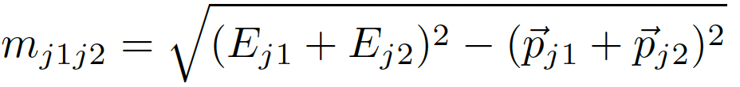
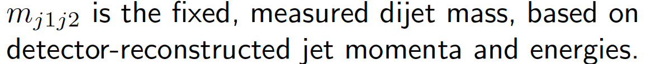
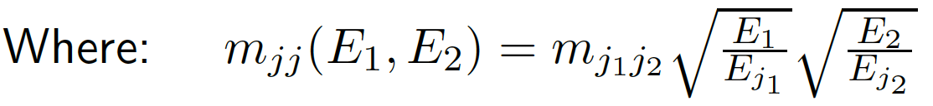
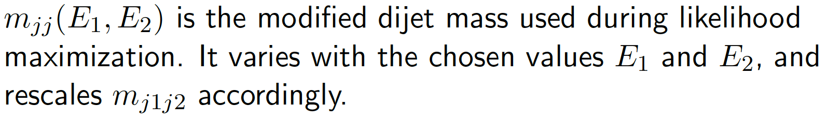
Likelihood Function Overview
.
.
.
.
.

Slide 10


Breakdown of Likelihood Function Terms
Dijet-Dilepton Mass Matching Term :
2. Jet Energy Transfer Functions:

Slide 11
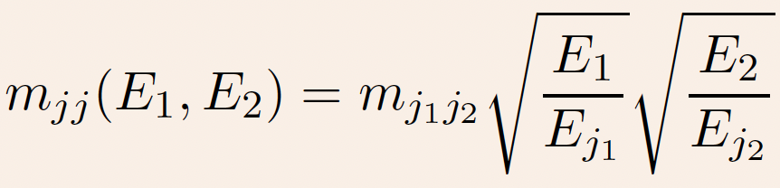
Breakdown of Likelihood Function Terms
3. Adjusted Dijet Mass:

Slide 12
Key Components
Maximization:
Gaussian Terms:
Interpretation:

Slide 13
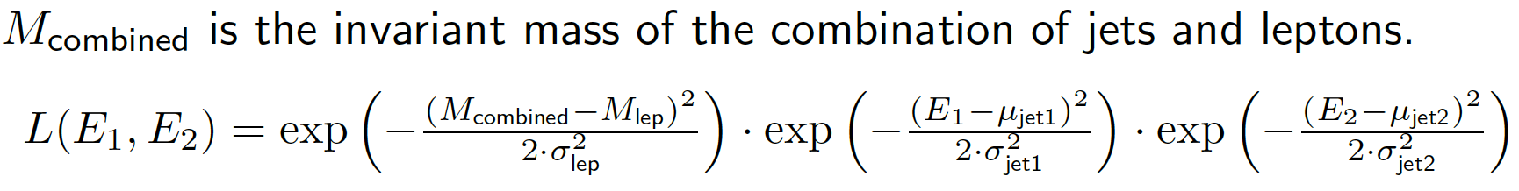
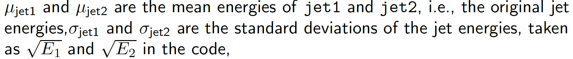
How the terms are reflected in the code

Slide 14
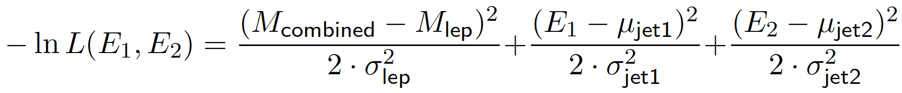


Still on the code

Slide 15
ANALYSIS: After excluding ”< 2j” events, the likelihood function L is implemented to select 2l2j vs. 2l2ν events for
Scalar mass points [mS, mzd] : [70, 20], [70, 35], [84, 31], [110, 30],[110, 55],[183, 50] GeV.

Slide 16


Slide 17
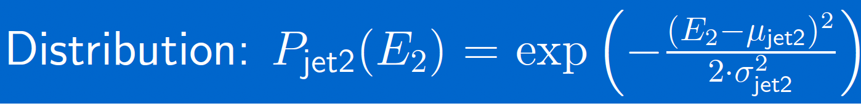
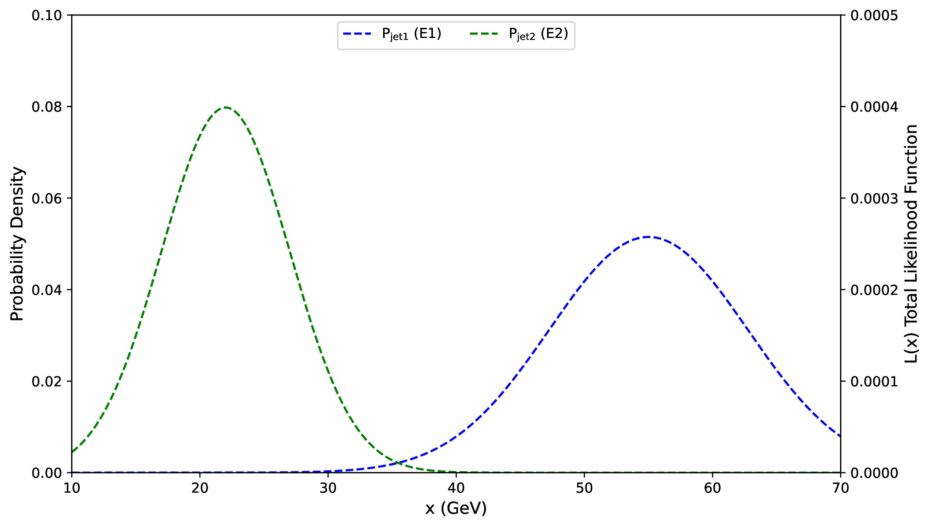

Slide 18
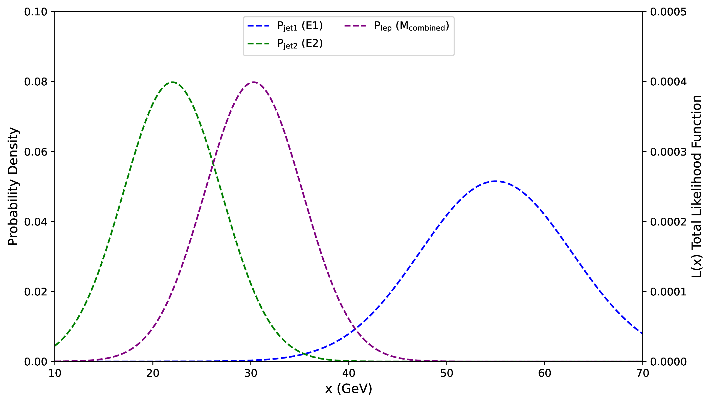

Slide 19
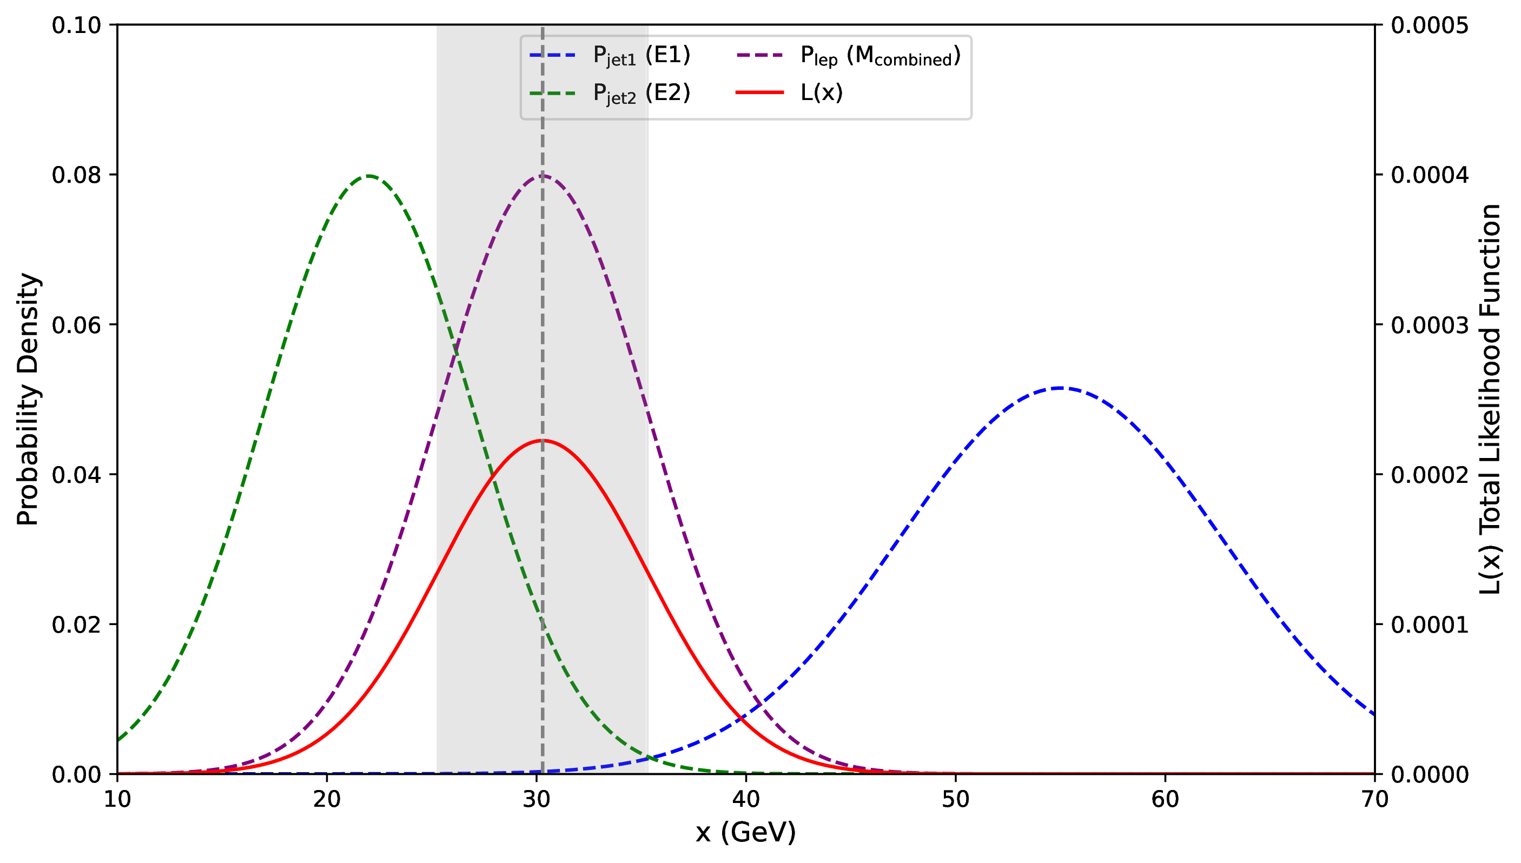

Slide 21
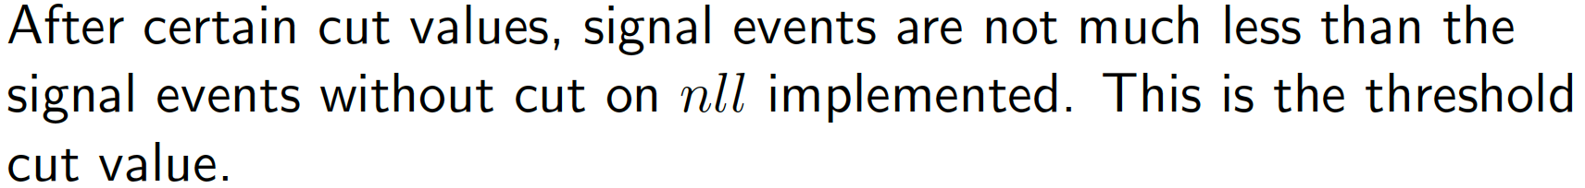

Slide 23
RESULTS & CONCLUSION

Slide 25

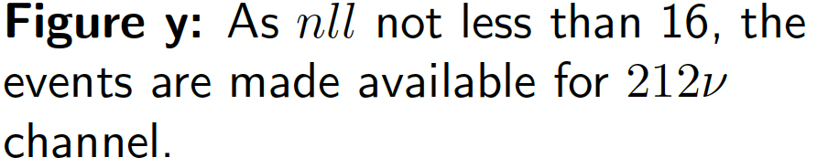

Slide 26
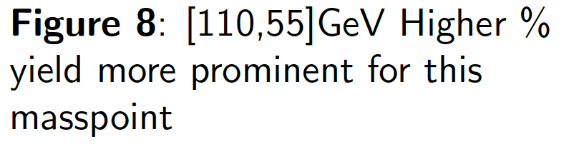
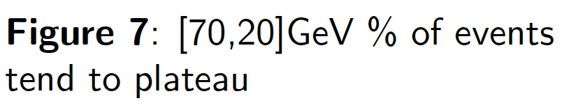

Slide 28
Validation Checks: Likelihood fit function within minitrees
Validation check (I).
Validation check (II).

Slide 29
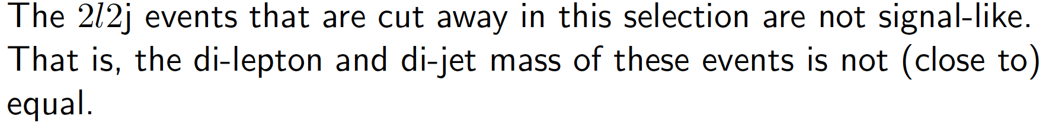
Conclusions and future work

Slide 30
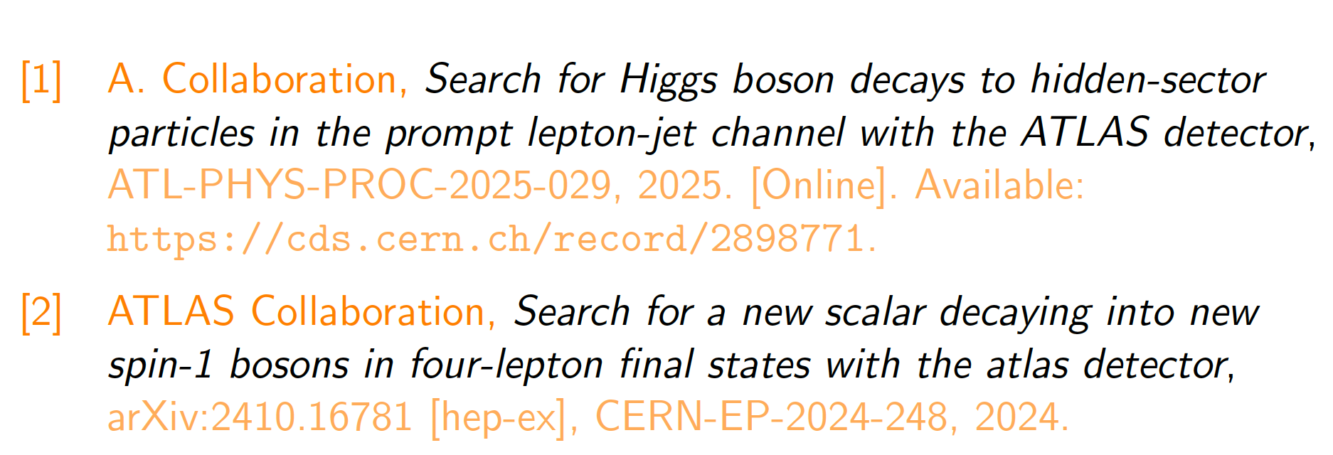
References

Slide 31
THANK YOU

Slide 32
BACKUP

Slide 33
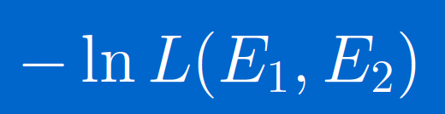
L fit function (max) vs. –ln L fit function (min)

Slide 34


