Slide 1





Searches for a scalar resonance with Di-photon in association with leptons in the range 130 – 200 GeV in the ATLAS detector at the LHC
Vuyolwethu Kakancu, Kutlwano Chongo Makgetha, Njokweni Mbuyiswa, Baballo-Victor Ndhlovu, Kgothatso Tshepo Ntumbe, Phuti Rapheeha, Reda Mekouar, Mukesh Kumar, Rachid Mazini and Bruce Mellado

Slide 2
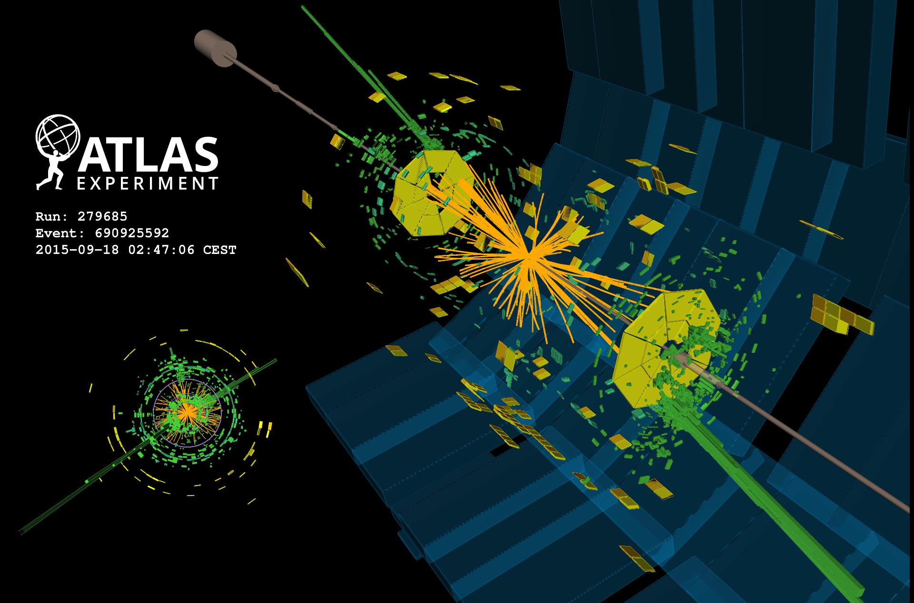
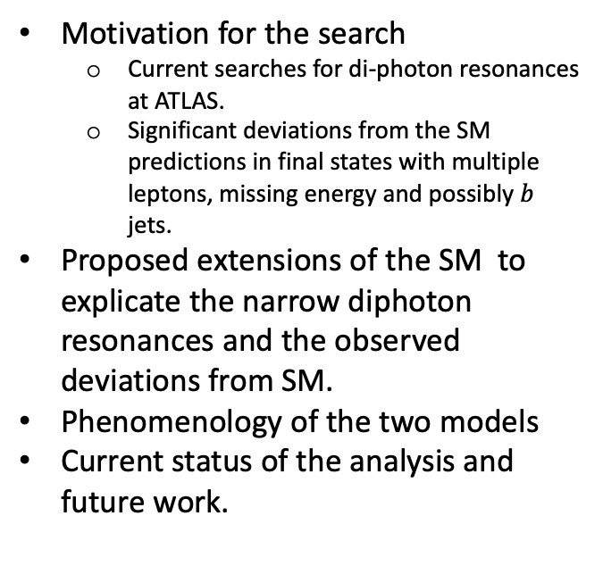
Overview
Motivation for the search
  Current searches for di-photon resonances at ATLAS.
  Significant deviations from the SM predictions in final states with multiple leptons, missing energy and possibly $b$ jets.
Proposed extensions of the SM to explicate the narrow diphoton resonances and the observed deviations from SM.
Phenomenology of the two models
Current status of the analysis and future work.
1

Slide 3
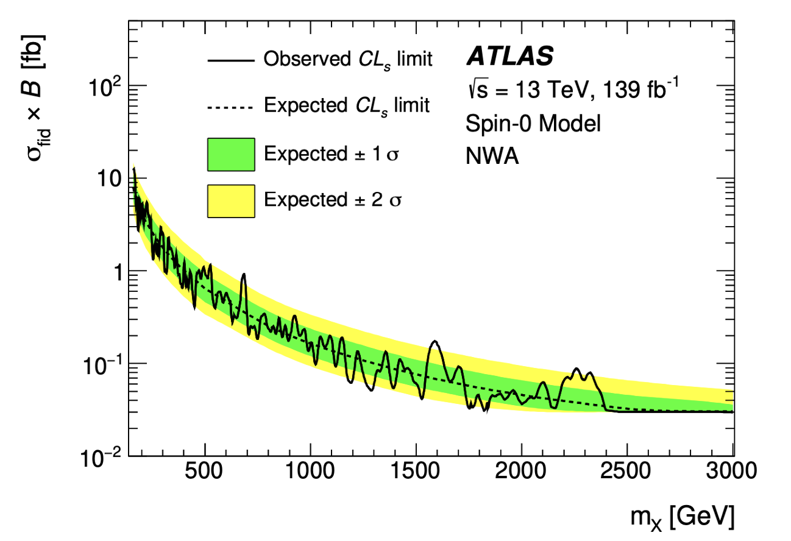
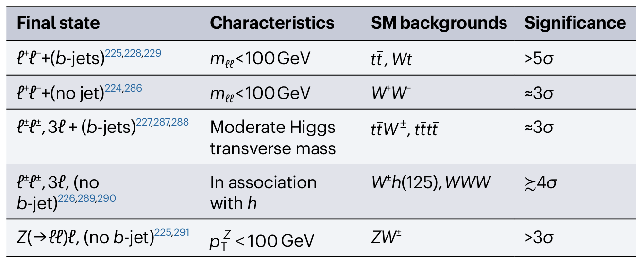
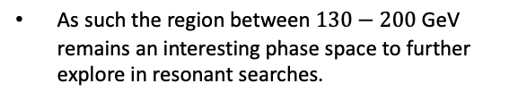
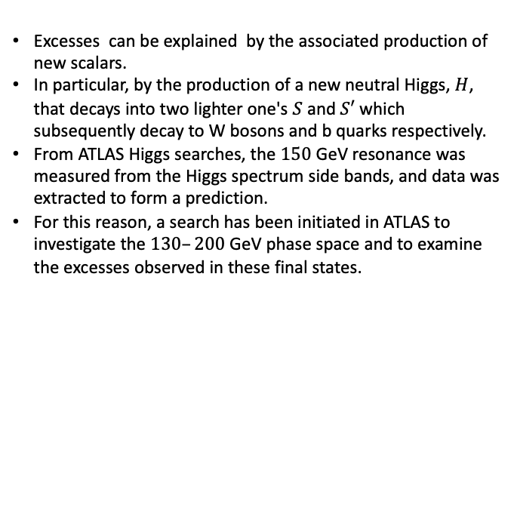
Current searches for di-photon resonances at ATLAS and Excesses often Characterized as Multi-Lepton Anomalies
Current ATLAS searches for diphoton resonances have been primarily focused on the high-mass range of 200–3000 GeV, with additional studies recently conducted in the low-mass range 66–110 GeV in 2024 see(JHEP 01 (2025) 053)
Excesses observed in various literature papers often termed as Multi-lepton anomalies using ATLAS and CMS data in final states with leptons, missing energy and possibly (b-)jets have emerged.
Nature Review. Phys. 6, 294–309 (2024)
Excesses can be explained by the associated production of new scalars.
In particular, by the production of a new neutral Higgs, $H$, that decays into two lighter one's $S$ and $S′$ which subsequently decay to W bosons and b quarks respectively.
From ATLAS Higgs searches, the $150$ GeV resonance was measured from the Higgs spectrum side bands, and data was extracted to form a prediction.
For this reason, a search has been initiated in ATLAS to investigate the $130–200$ GeV phase space and to examine the excesses observed in these final states.
https://arxiv.org/pdf/2102.13405
As such the region between $130−200$ GeV remains an interesting phase space to further explore in resonant searches.
2

Slide 4
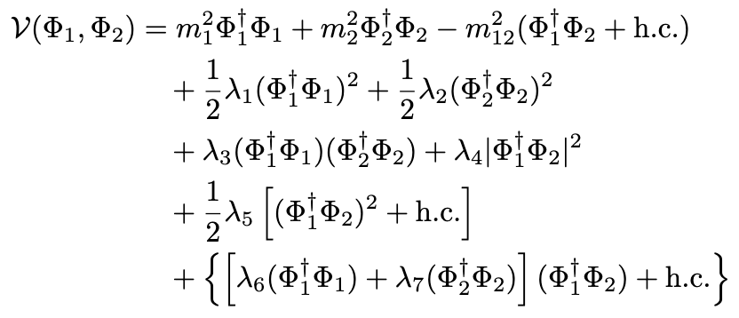
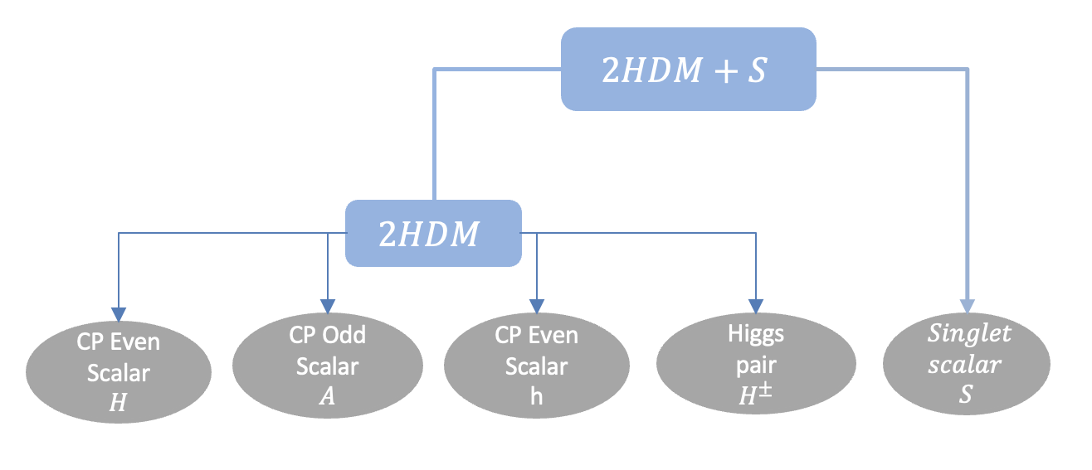
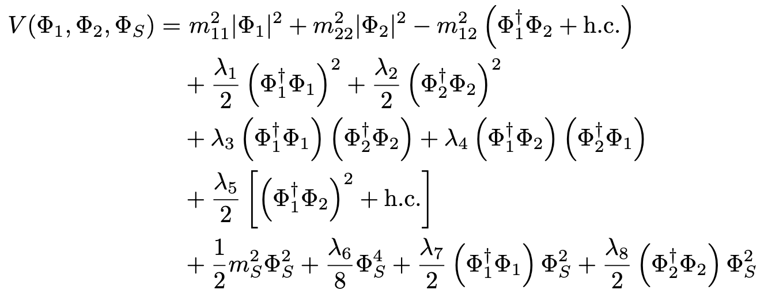

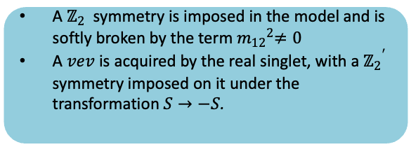
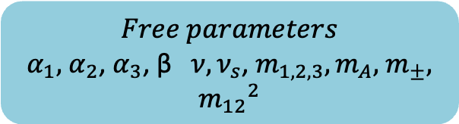



Proposed extensions of SM to explicate the narrow diphoton resonance
Theoretical Framework of the model
A $ℤ_{2}$ symmetry is imposed in the model and is softly broken by the term${ m_{12}}^{2}≠0$
A $vev$ is acquired by the real singlet, with a ${ℤ_{2}}^{′}$ symmetry imposed on it under the transformation $S→−S$.
A $2HDM+S$model is proposed, extending the conventional 2HDM by incorporating a singlet scalar field.
$2HDM$ Potential
The model spectrum, after EWSM breaking
$2HDM+S$Potential
$$Free parameters$$
$α_{1},$ $α_{2}$,${ α}_{3}$, β $ν, ν_{s}$,${ m}_{1,2,3}, m_{A},$ $m_{±}, {m_{12}}^{2}$
Eur.Phys.J.C 76 (2016) 10, 580
mixing angles associated with the doublets $φ_{1}$,$φ_{2}$and the singlet $φ_{S}$
3

Slide 5
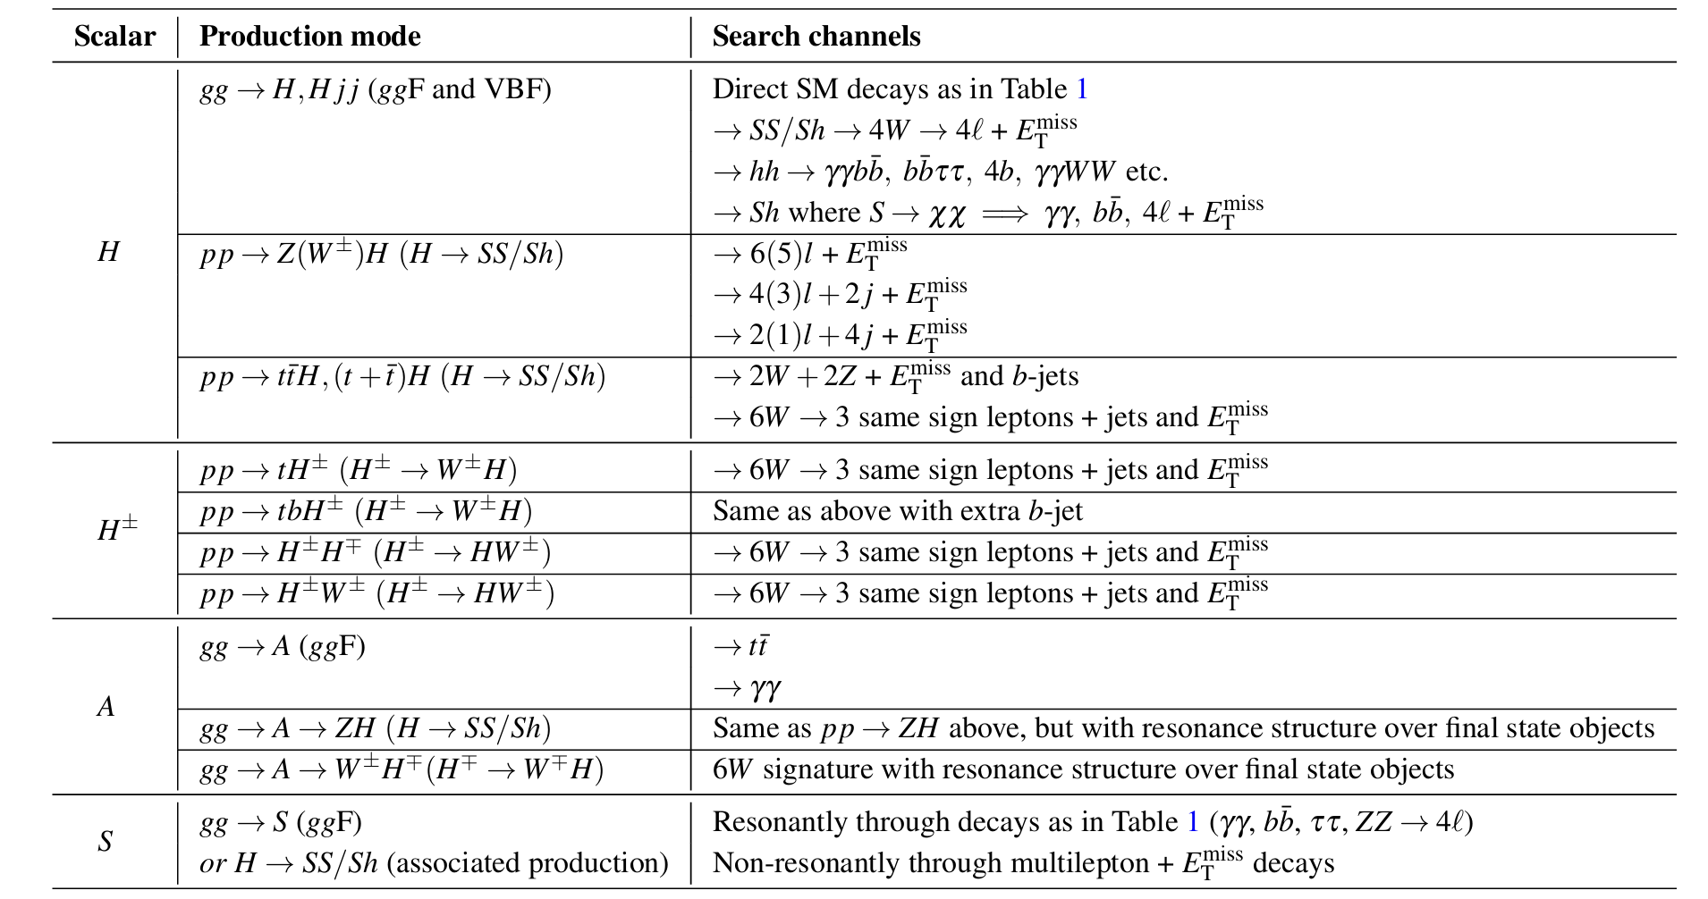
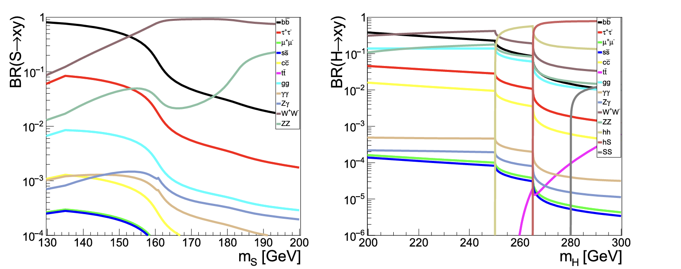
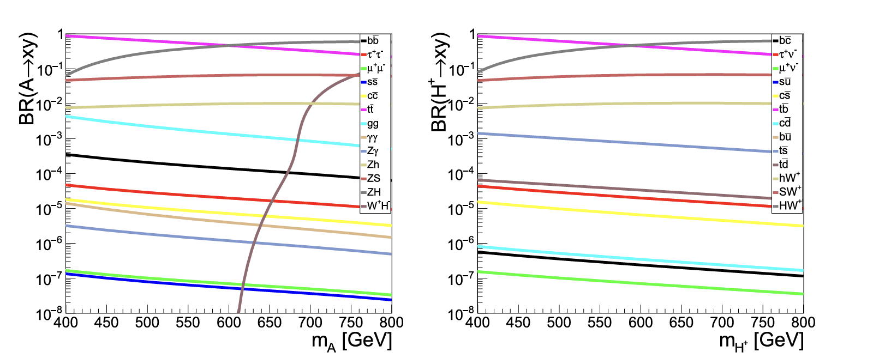
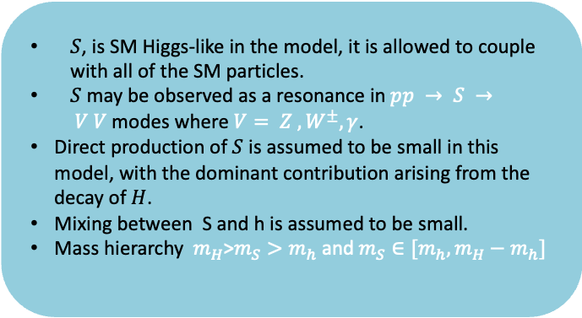

Proposed extensions of SM to explicate the narrow diphoton resonance
$S$, is SM Higgs-like in the model, it is allowed to couple with all of the SM particles.
$S$ may be observed as a resonance in$pp → S → V V$modes where $V= Z , W^{±}, γ$.
Direct production of $S$ is assumed to be small in this model, with the dominant contribution arising from the decay of $H$.
Mixing between S and h is assumed to be small.
Mass hierarchy $m_{H}$>$m_{S}>m_{h}$ and $m_{S}∈[m_{h}, m_{H}−m_{h}]$
Phenomenology of the model
Branching ratios within the model for $H$, $S$
arXiv:1606.01674
J. Phys. G 46 (2019) no.11, 115001
4

Slide 6
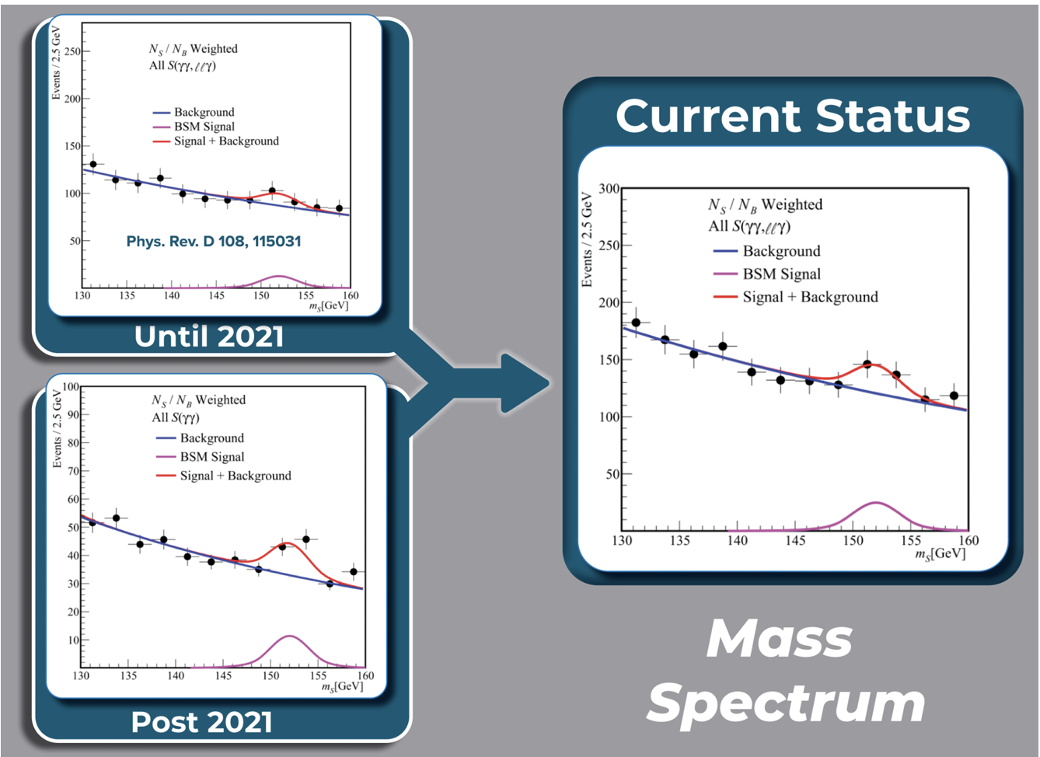
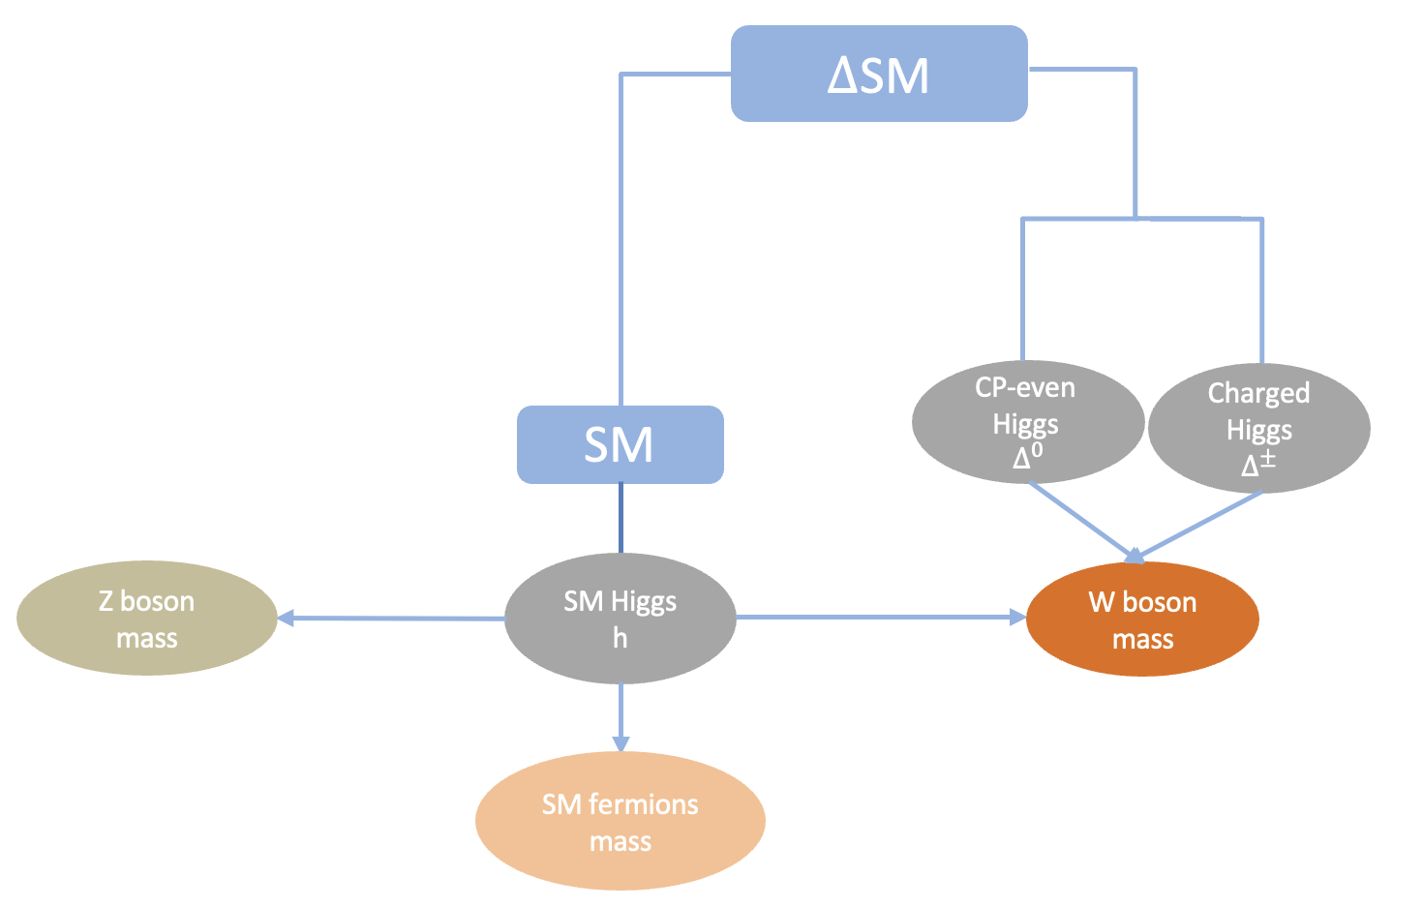
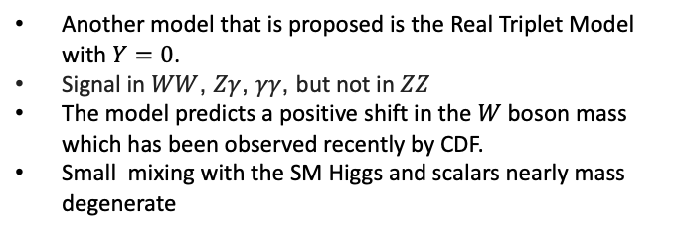


Proposed extensions of SM to explicate the narrow diphoton resonance
Interesting excesses in $γγ+X$
Real Higgs Triplet Potential
arXiv:2411.18618
The model spectrum, after EWSM breaking
arxiv.org/pdf/2503.16245
Theoretical Framework of the model
Another model that is proposed is the Real Triplet Model with $Y=0$.
Signal in $WW$, $Zγ$, $γγ$, but not in $ZZ$
The model predicts a positive shift in the $W$ boson mass which has been observed recently by CDF.
Small mixing with the SM Higgs and scalars nearly mass degenerate
$$Free parameters$$
$α$,$ν_{∆}$,${ m}_{Δ^{0}},{ m}_{Δ^{±}}$
5

Slide 7
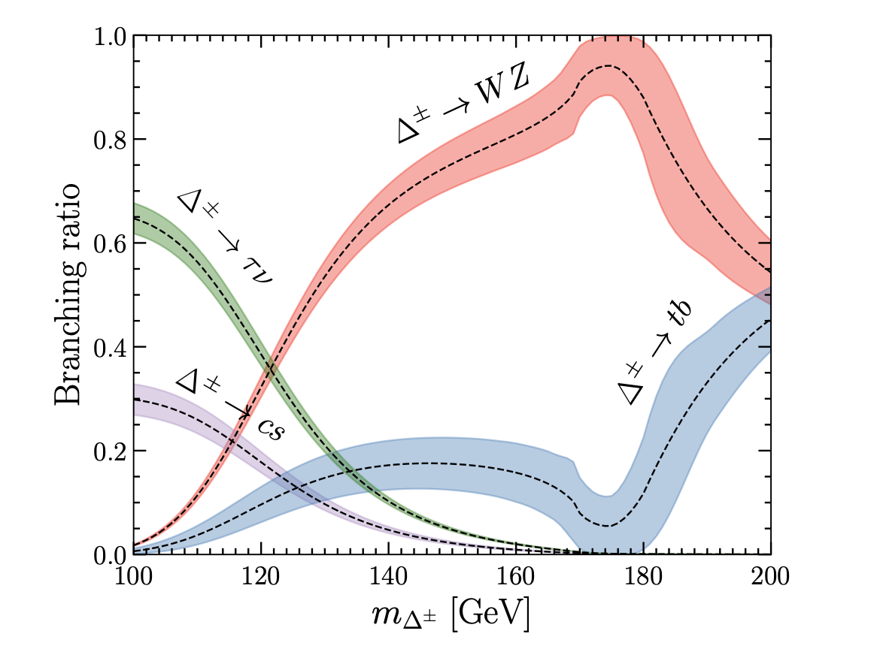
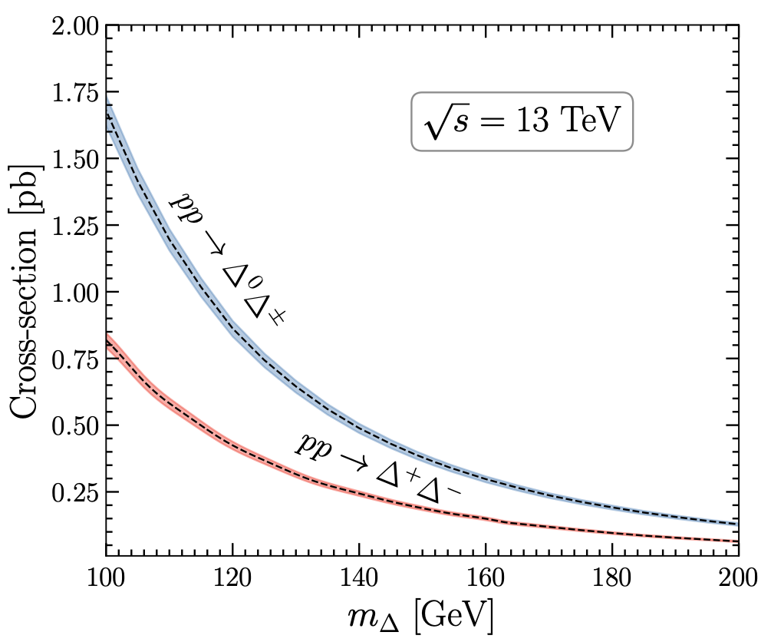
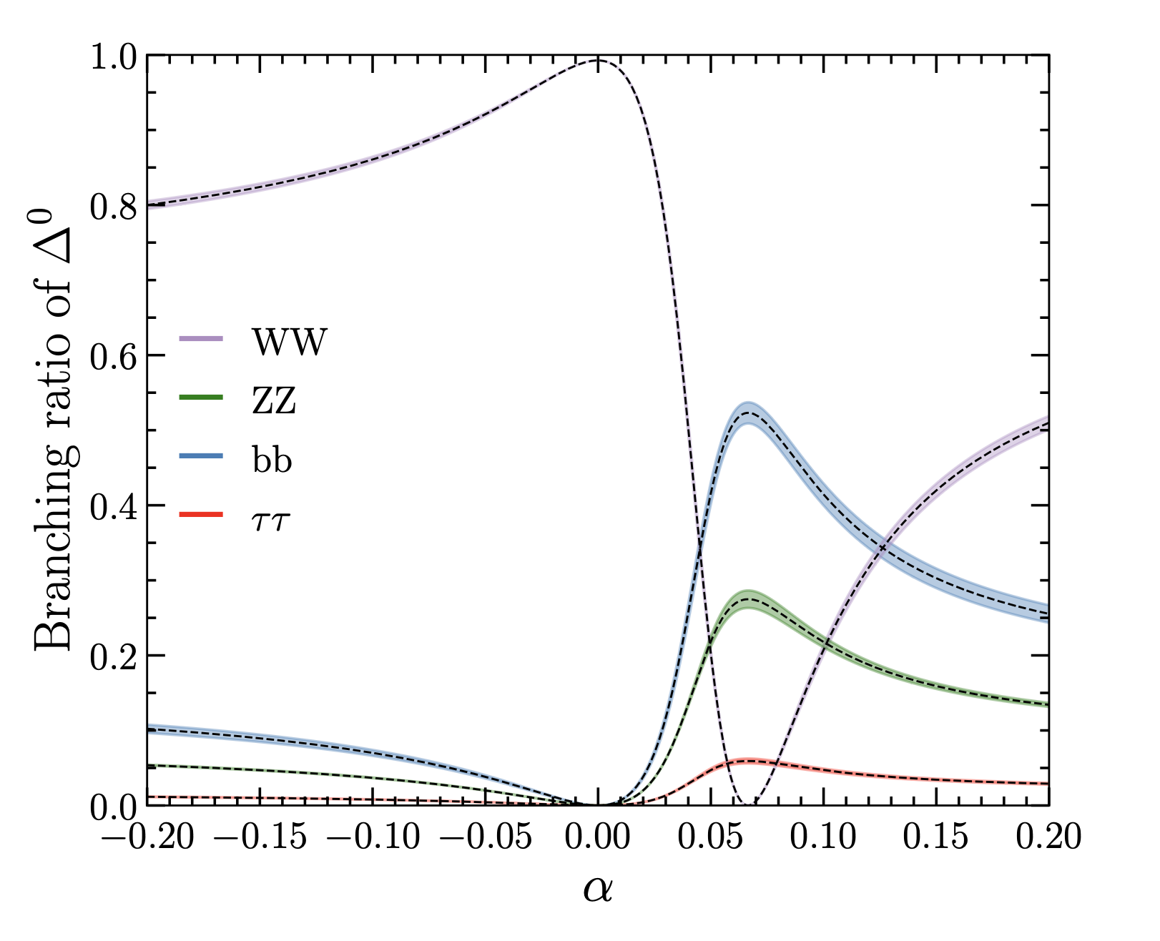
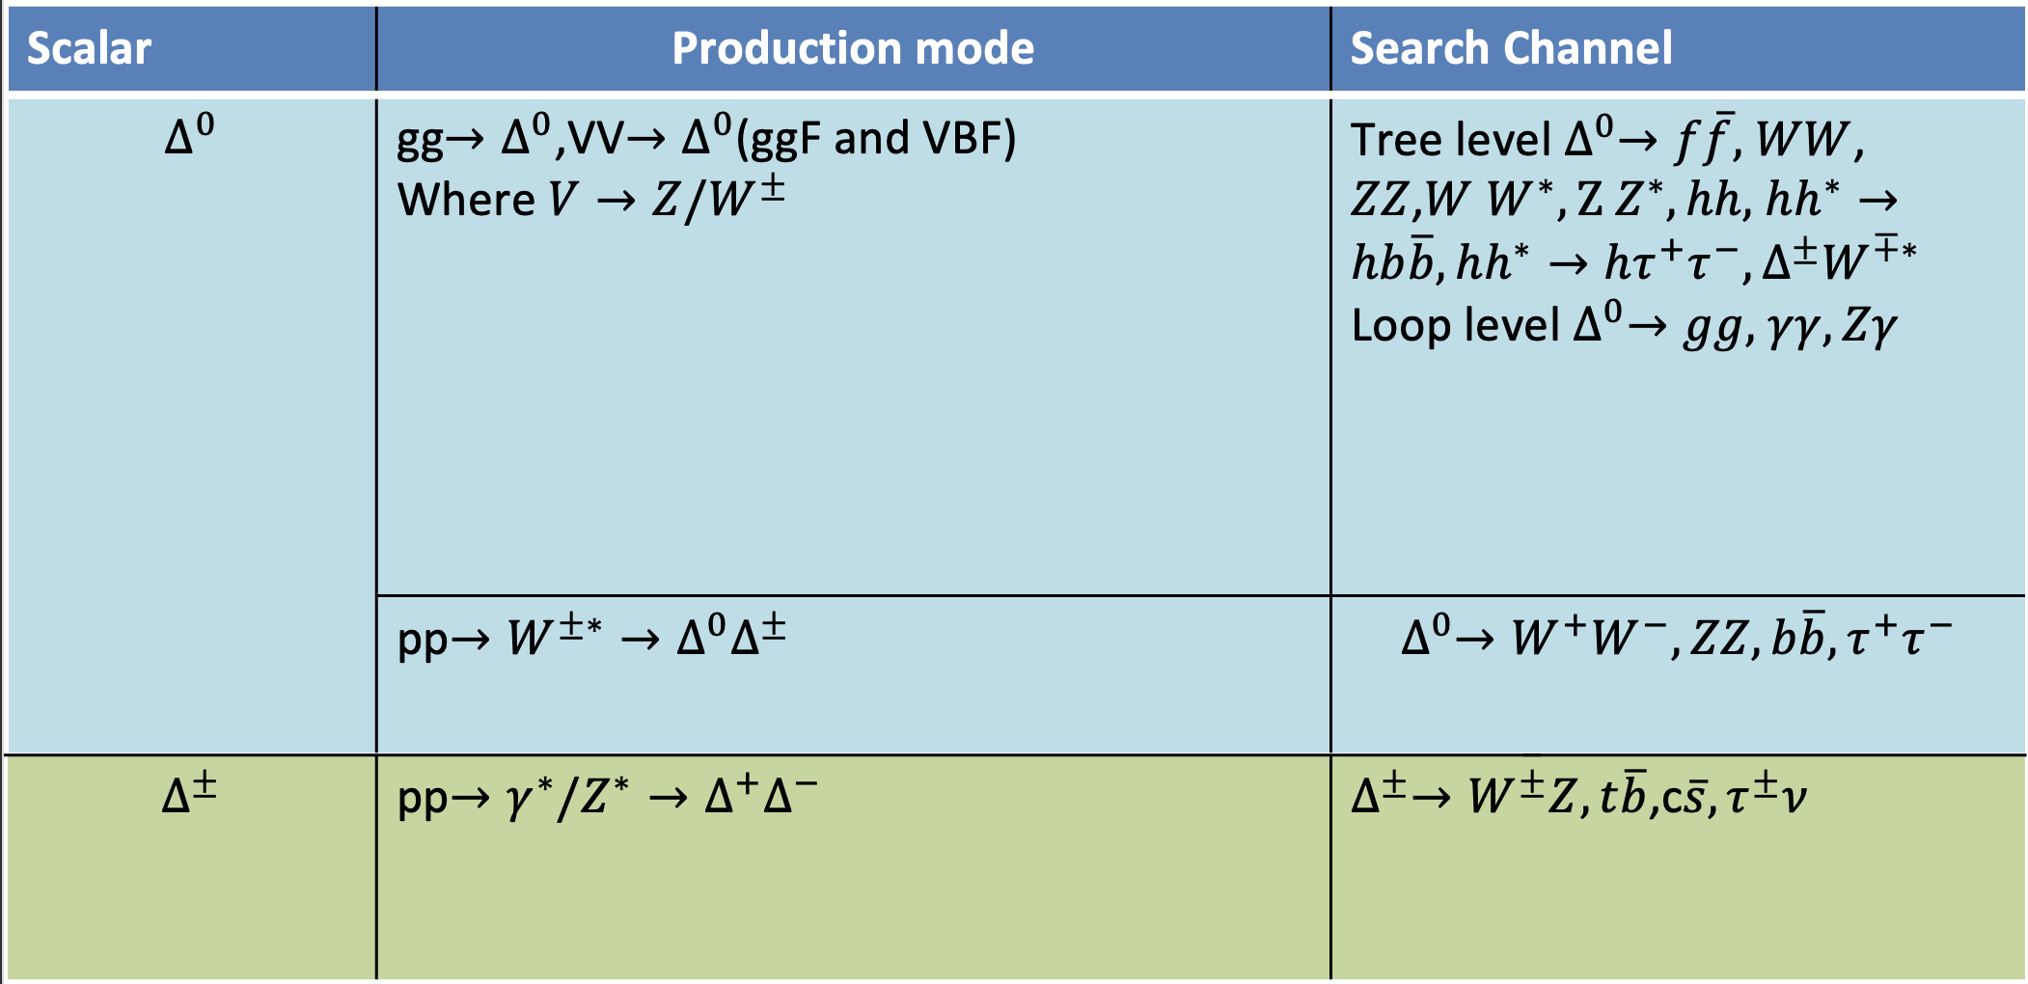

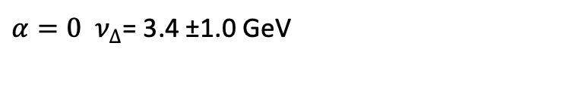

Proposed extensions of SM to explicate the narrow diphoton resonance
Drell-Yan production cross-sections for the triplet-like Higgses
Dominant branching ratios of $∆^{\text{±}}$
$α=0 ν_{∆}$= 3.4 ±1.0 GeV
Dominant branching ratios of $∆^{0}$
Phenomenology of the model
arXiv:2411.18618
6

Slide 8
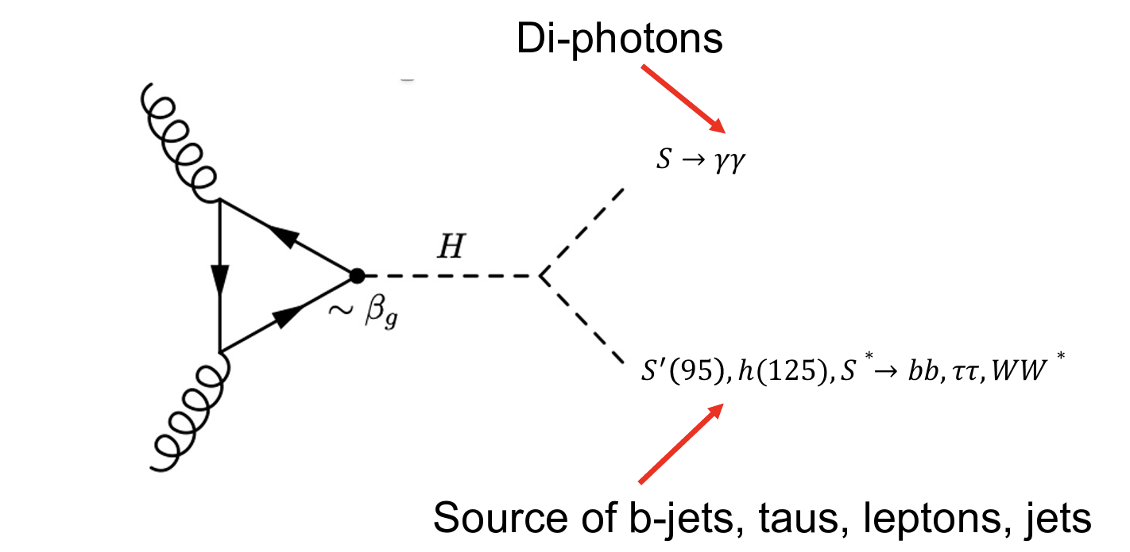
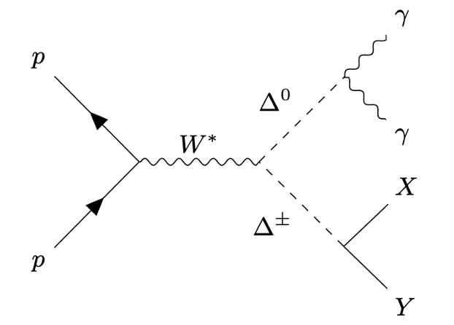
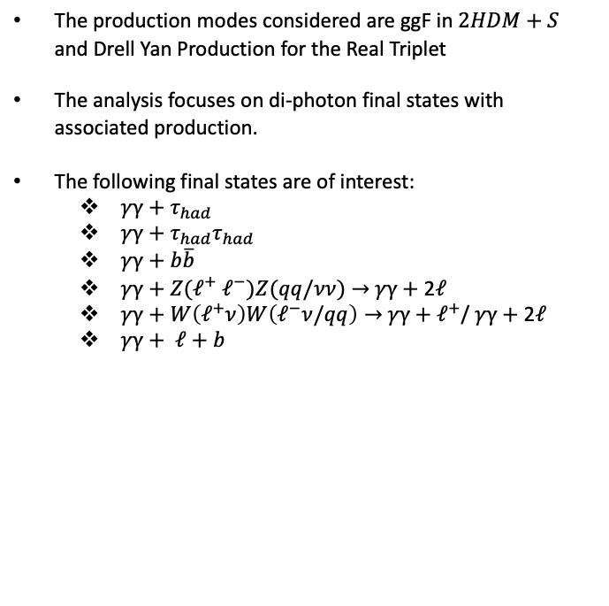
Final states of interest from the BSM and Current status of the analysis and future work.
The production modes considered are ggF in $2HDM+S$ and Drell Yan Production for the Real Triplet
The analysis focuses on di-photon final states with associated production.
The following final states are of interest:
  $γγ+τ_{had}$
  $γγ+τ_{had}τ_{had}$
  $γγ+b\overline{b}$
  $γγ+Z(ℓ^{+} ℓ^{−})Z(qq/νν)$ $→$ $γγ+$ 2$ℓ$
  $γγ+W\left(ℓ^{+}ν\right)W\left(ℓ^{−}ν/qq\right)→$ $γγ+$ $ℓ^{+}$/ $γγ+$ 2$ℓ$
  $γγ+ ℓ+b$
Samples for Simulated final states already in production in the 2HDM+S model
7

Slide 9
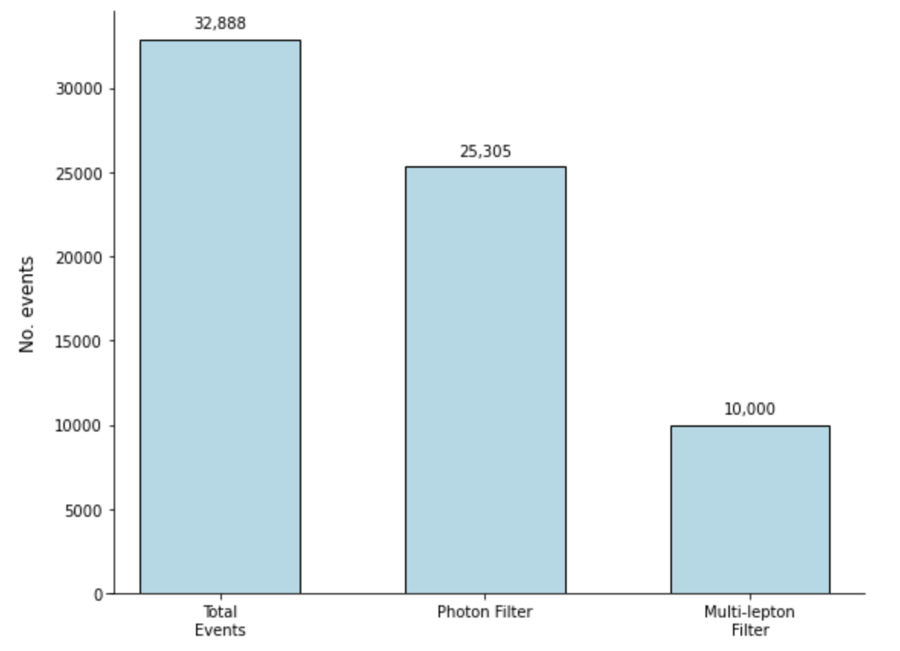
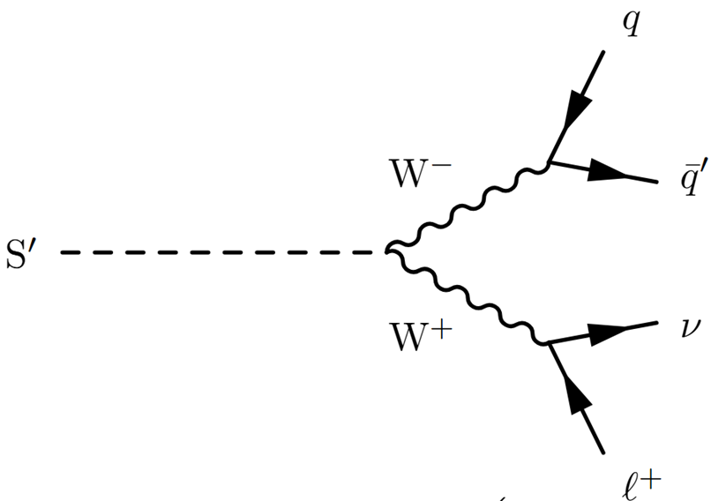
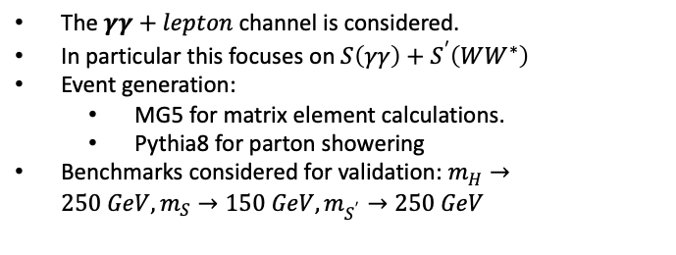
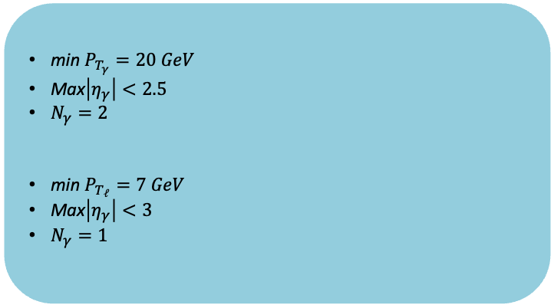

$γγ+ℓ$ Final state
The $γγ+lepton$channel is considered.
In particular this focuses on $S\left(γγ\right)+S^{′}\left(WW^{∗}\right)$
Event generation:
  MG5 for matrix element calculations.
  Pythia8 for parton showering
Benchmarks considered for validation: $m_{H}→250 GeV,m_{S}→150 GeV,m_{S^{′}}→250 GeV$
Cutflow table for $γγ+ℓ$ Final state
min $P_{T_{γ}}=20 GeV$
Max$\left|η_{γ}\right|<2.5$
$N_{γ}=2$
min $P_{T_{ℓ}}=7 GeV$
Max$\left|η_{γ}\right|<3$
$N_{γ}=1$
Photon Filter
Multi-lepton Filter
Total Filter Efficiency : 0.304062
8

Slide 10
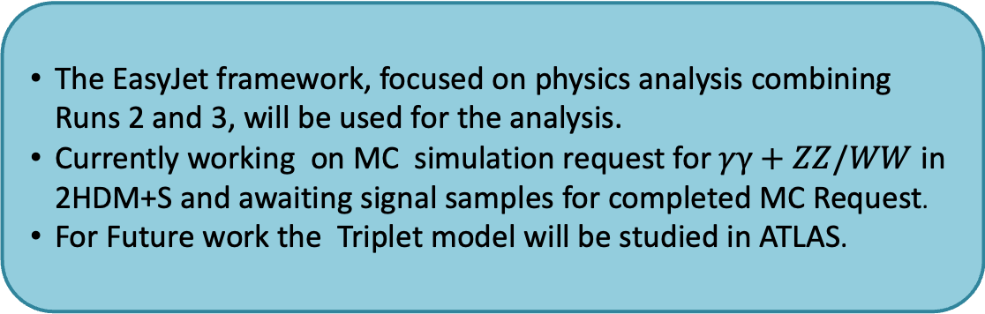
Conclusion and Future Work
The EasyJet framework, focused on physics analysis combining Runs 2 and 3, will be used for the analysis.
Currently working on MC simulation request for $γγ+ZZ/WW$ in 2HDM+S and awaiting signal samples for completed MC Request.
For Future work the Triplet model will be studied in ATLAS.
BACKUP SLIDES
9

Slide 11
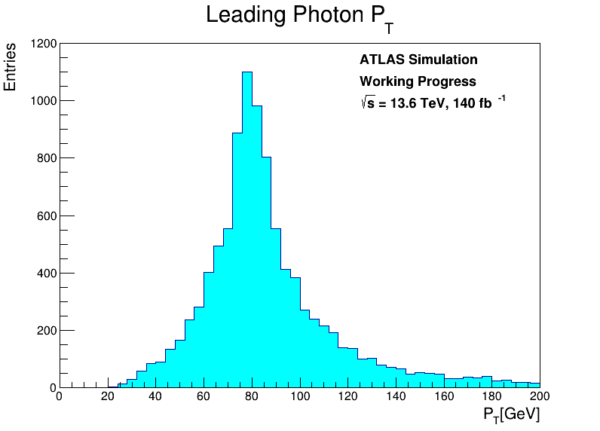
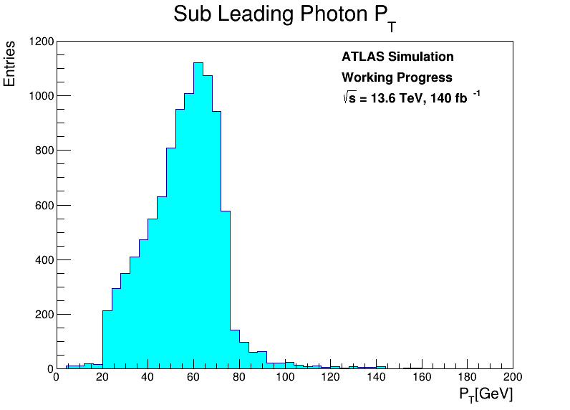

$γγ+ℓ$ Final state Kinematics
$$gg→H\left(250 GeV\right)→S\left(150 GeV\right)+S^{′}(95 GeV)$$
10

Slide 12
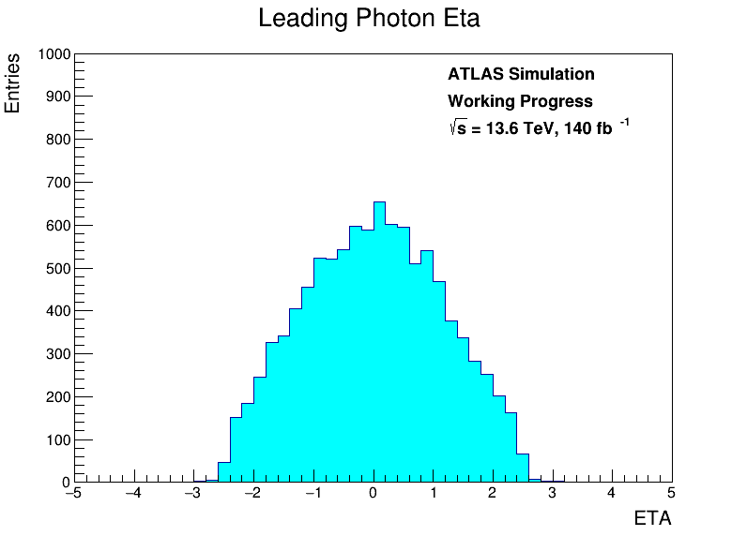
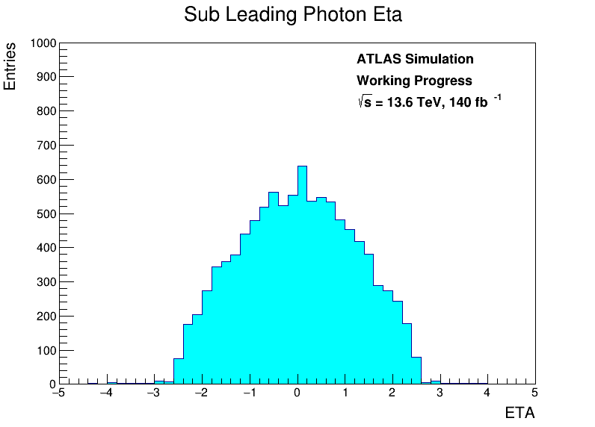
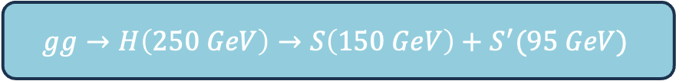
$γγ+ℓ$ Final state Kinematics
$$gg→H\left(250 GeV\right)→S\left(150 GeV\right)+S^{′}(95 GeV)$$
11

Slide 13
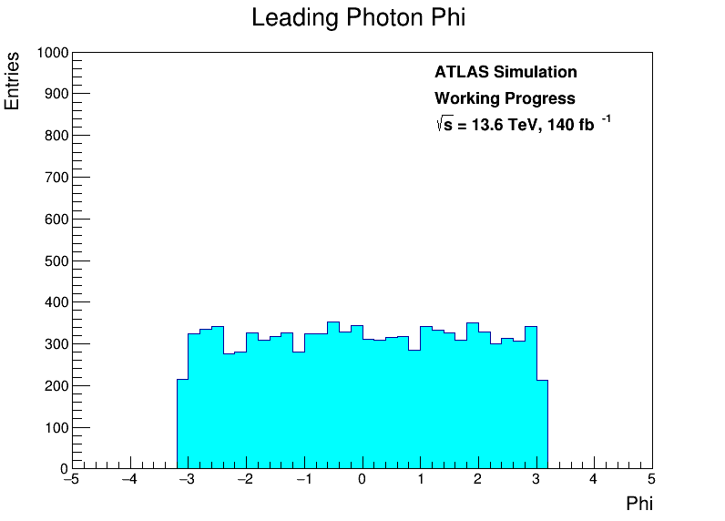
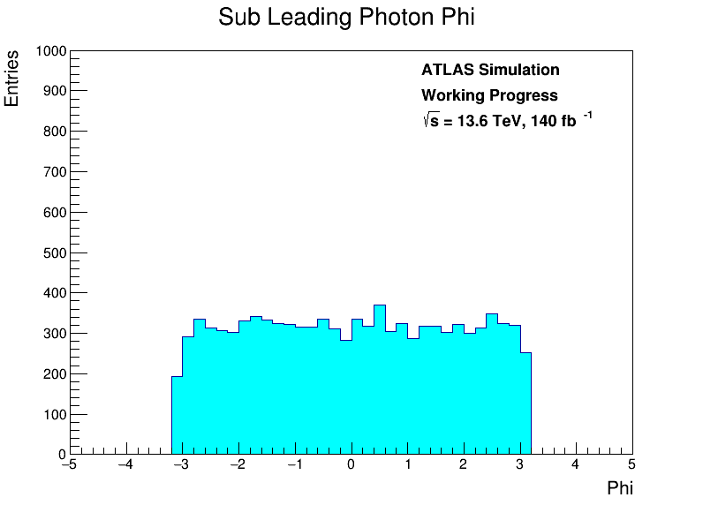
$γγ+ℓ$ Final state Kinematics
$$gg→H\left(250 GeV\right)→S\left(150 GeV\right)+S^{′}(95 GeV)$$
12

Slide 14
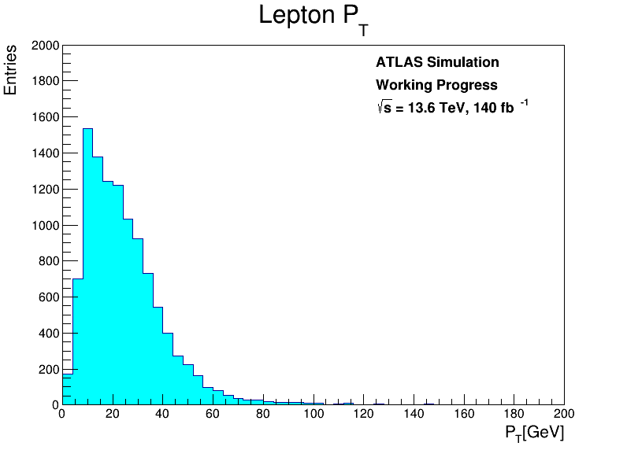
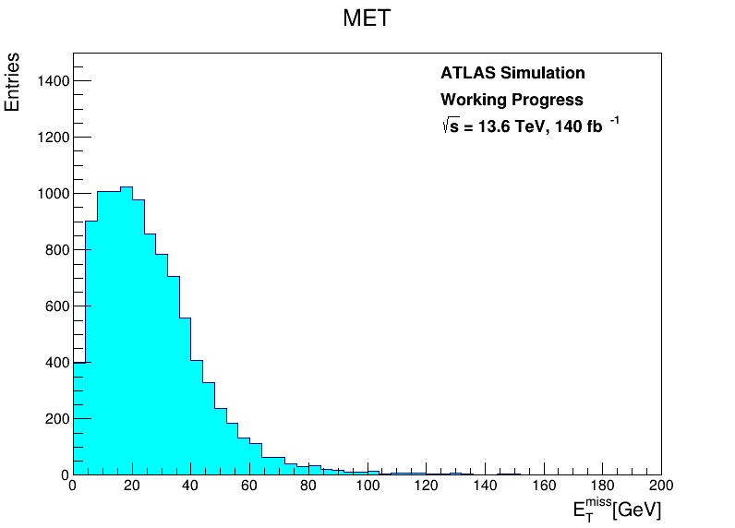

$γγ+ℓ$ Final state Kinematics
$$gg→H\left(250 GeV\right)→S\left(150 GeV\right)+S^{′}(95 GeV)$$
13

Slide 15
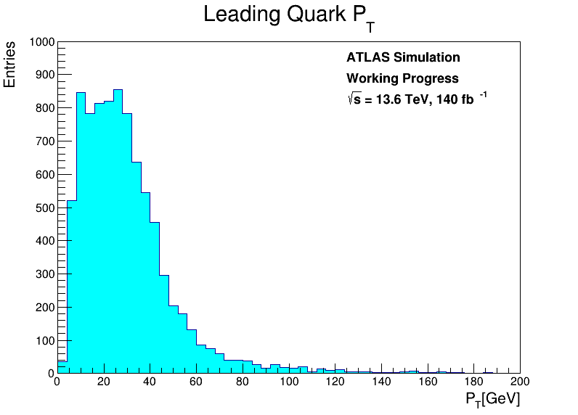
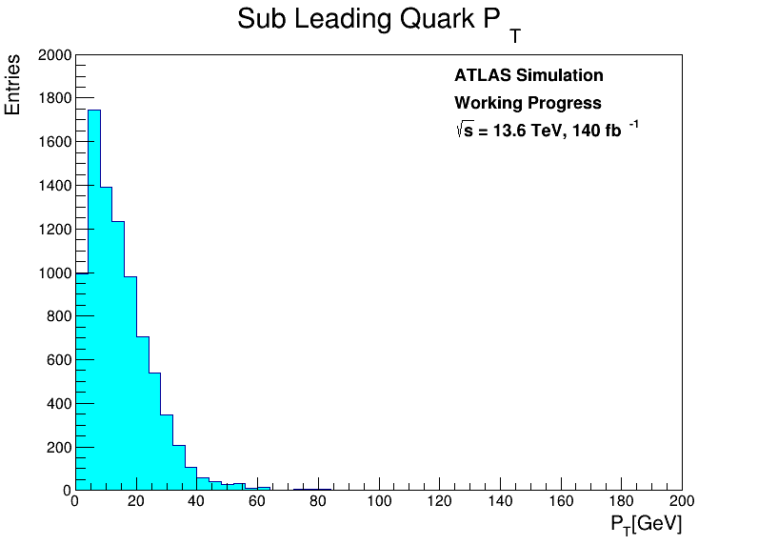

$γγ+ℓ$ Final state Kinematics
$$gg→H\left(250 GeV\right)→S\left(150 GeV\right)+S^{′}(95 GeV)$$
13

Slide 16
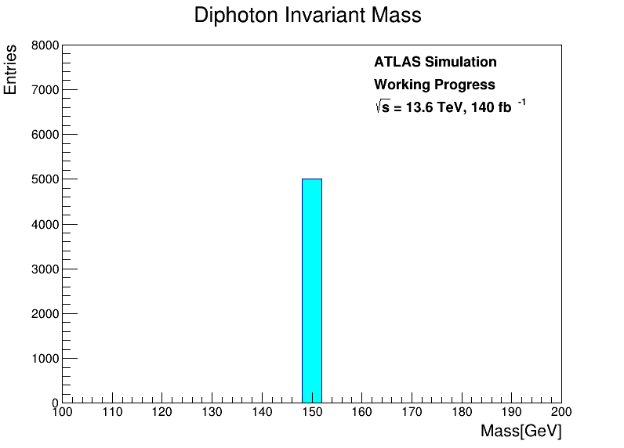
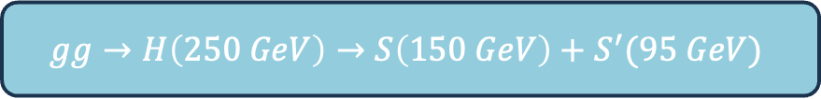
$γγ+ℓ$ Final state Kinematics
$$gg→H\left(250 GeV\right)→S\left(150 GeV\right)+S^{′}(95 GeV)$$
13

