Slide 1




Parameterizing the Geometry of the QGP on an Event-by-Event Basis
W.A. Horowitz
Coleridge Faraday
SAIP 2025

Slide 2
Overview of Presentation
Introduction to Heavy Ion Physics
Understanding the QGP through Energy Loss
Modelling of the QGP’s Geometry and Evolution
Results
Conclusion

Slide 3
Introduction to Heavy Ion Physics

Slide 4
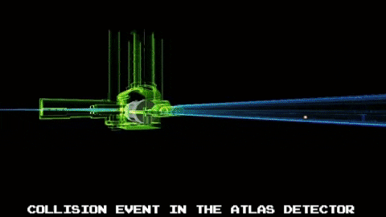
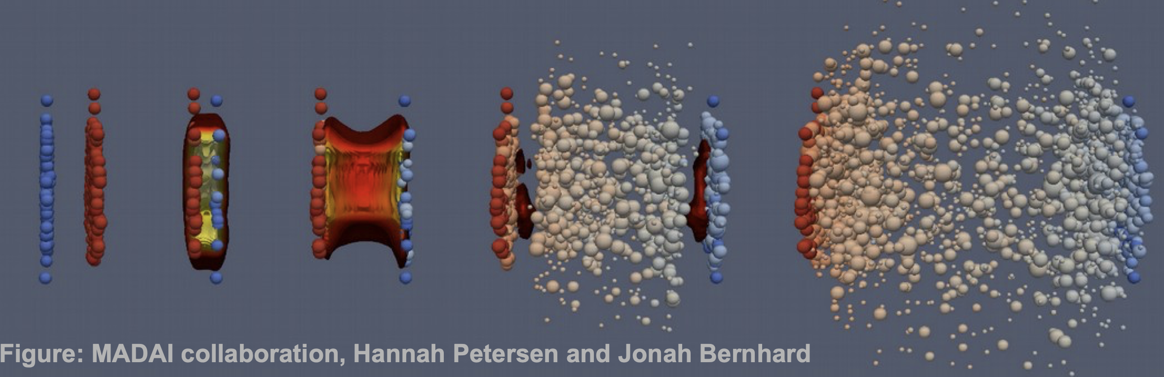
The physics of smashing particles

Slide 5
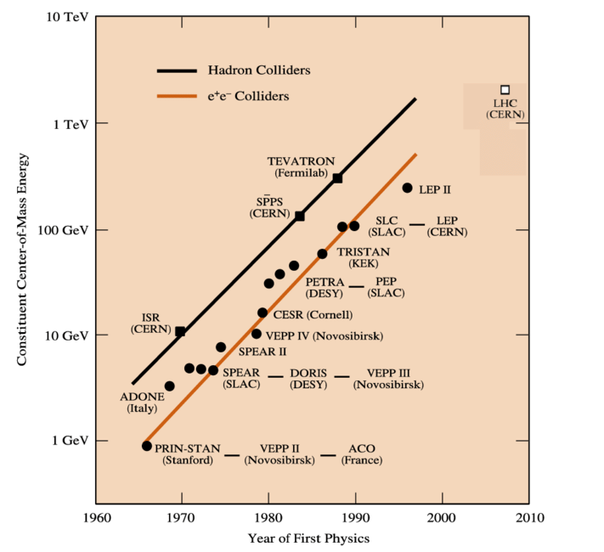
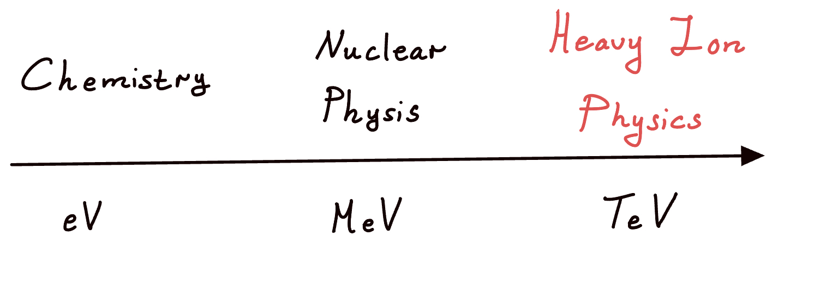
Energy Scales in heavy ion Physics
The energy scales at the LHC are now at ~10TeV
The physics that describes the processes that occur at this energy scale is Quantum Chromodynamics (QCD)
Centre of Mass Energy
DPHEPStudyGroup:2012dsv

Slide 6
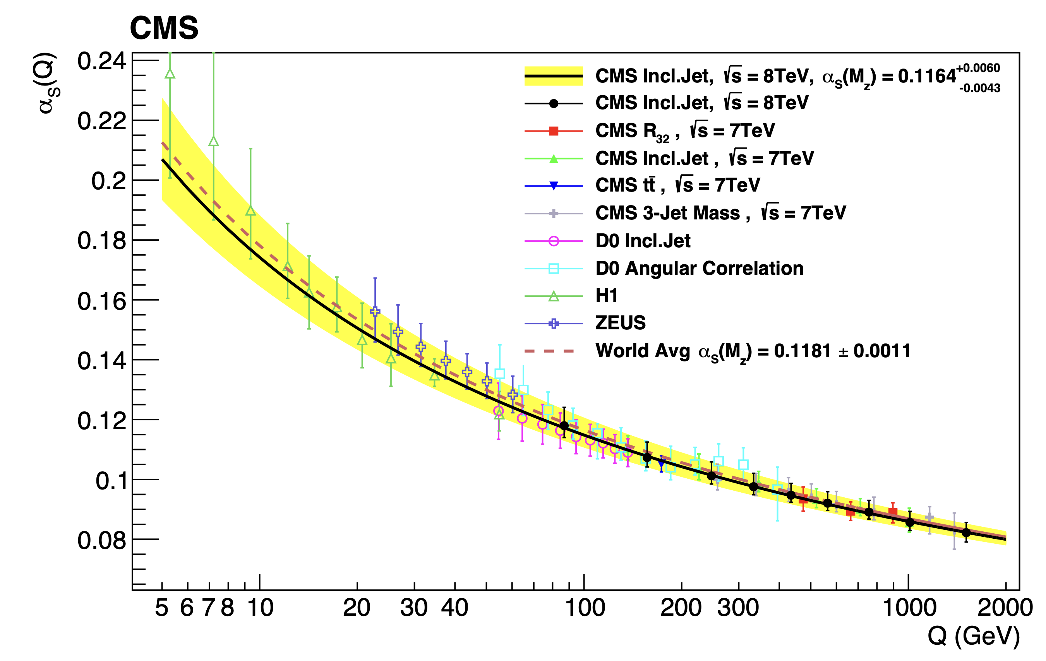
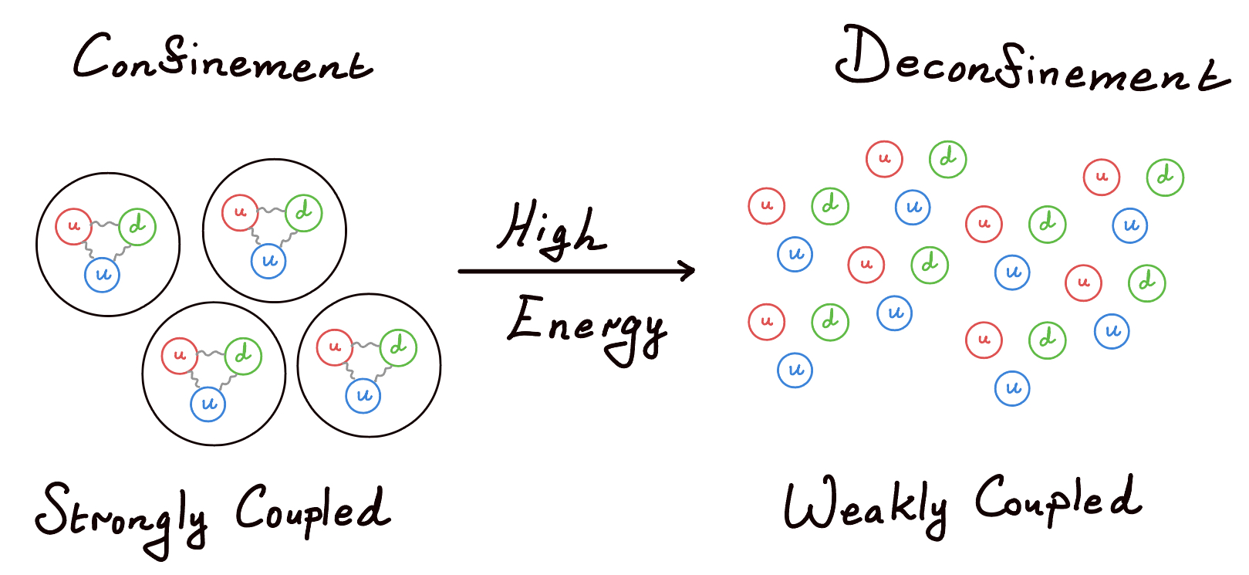



Lessons from QCD
Classically
$$F_{Coloumb}∝\frac{1}{r^{2}}$$
$$F_{Gravity}∝\frac{1}{r^{2}}$$
As distance scales increase, interactions get weaker.
Q$uantum$
QCD teaches about deconfinement. Chromodynamic interactions get weaker as the distance scales get shorter!
CMS:2016lna
Running of the coupling $α_{s}$

Slide 7
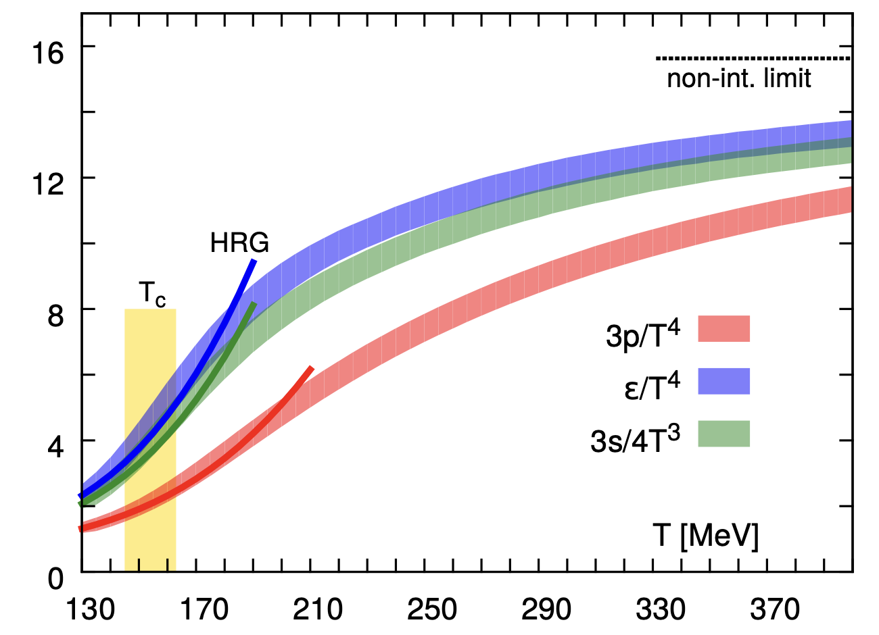

Signatures of the QGP
Theoretical Evidence
Partonic degrees of freedom
ALICE:2022wpn
Hadronic degrees of freedom
$\frac{dε}{dT}∝$ degrees of freedom

Slide 8
Understanding the QGP through Energy Loss

Slide 9

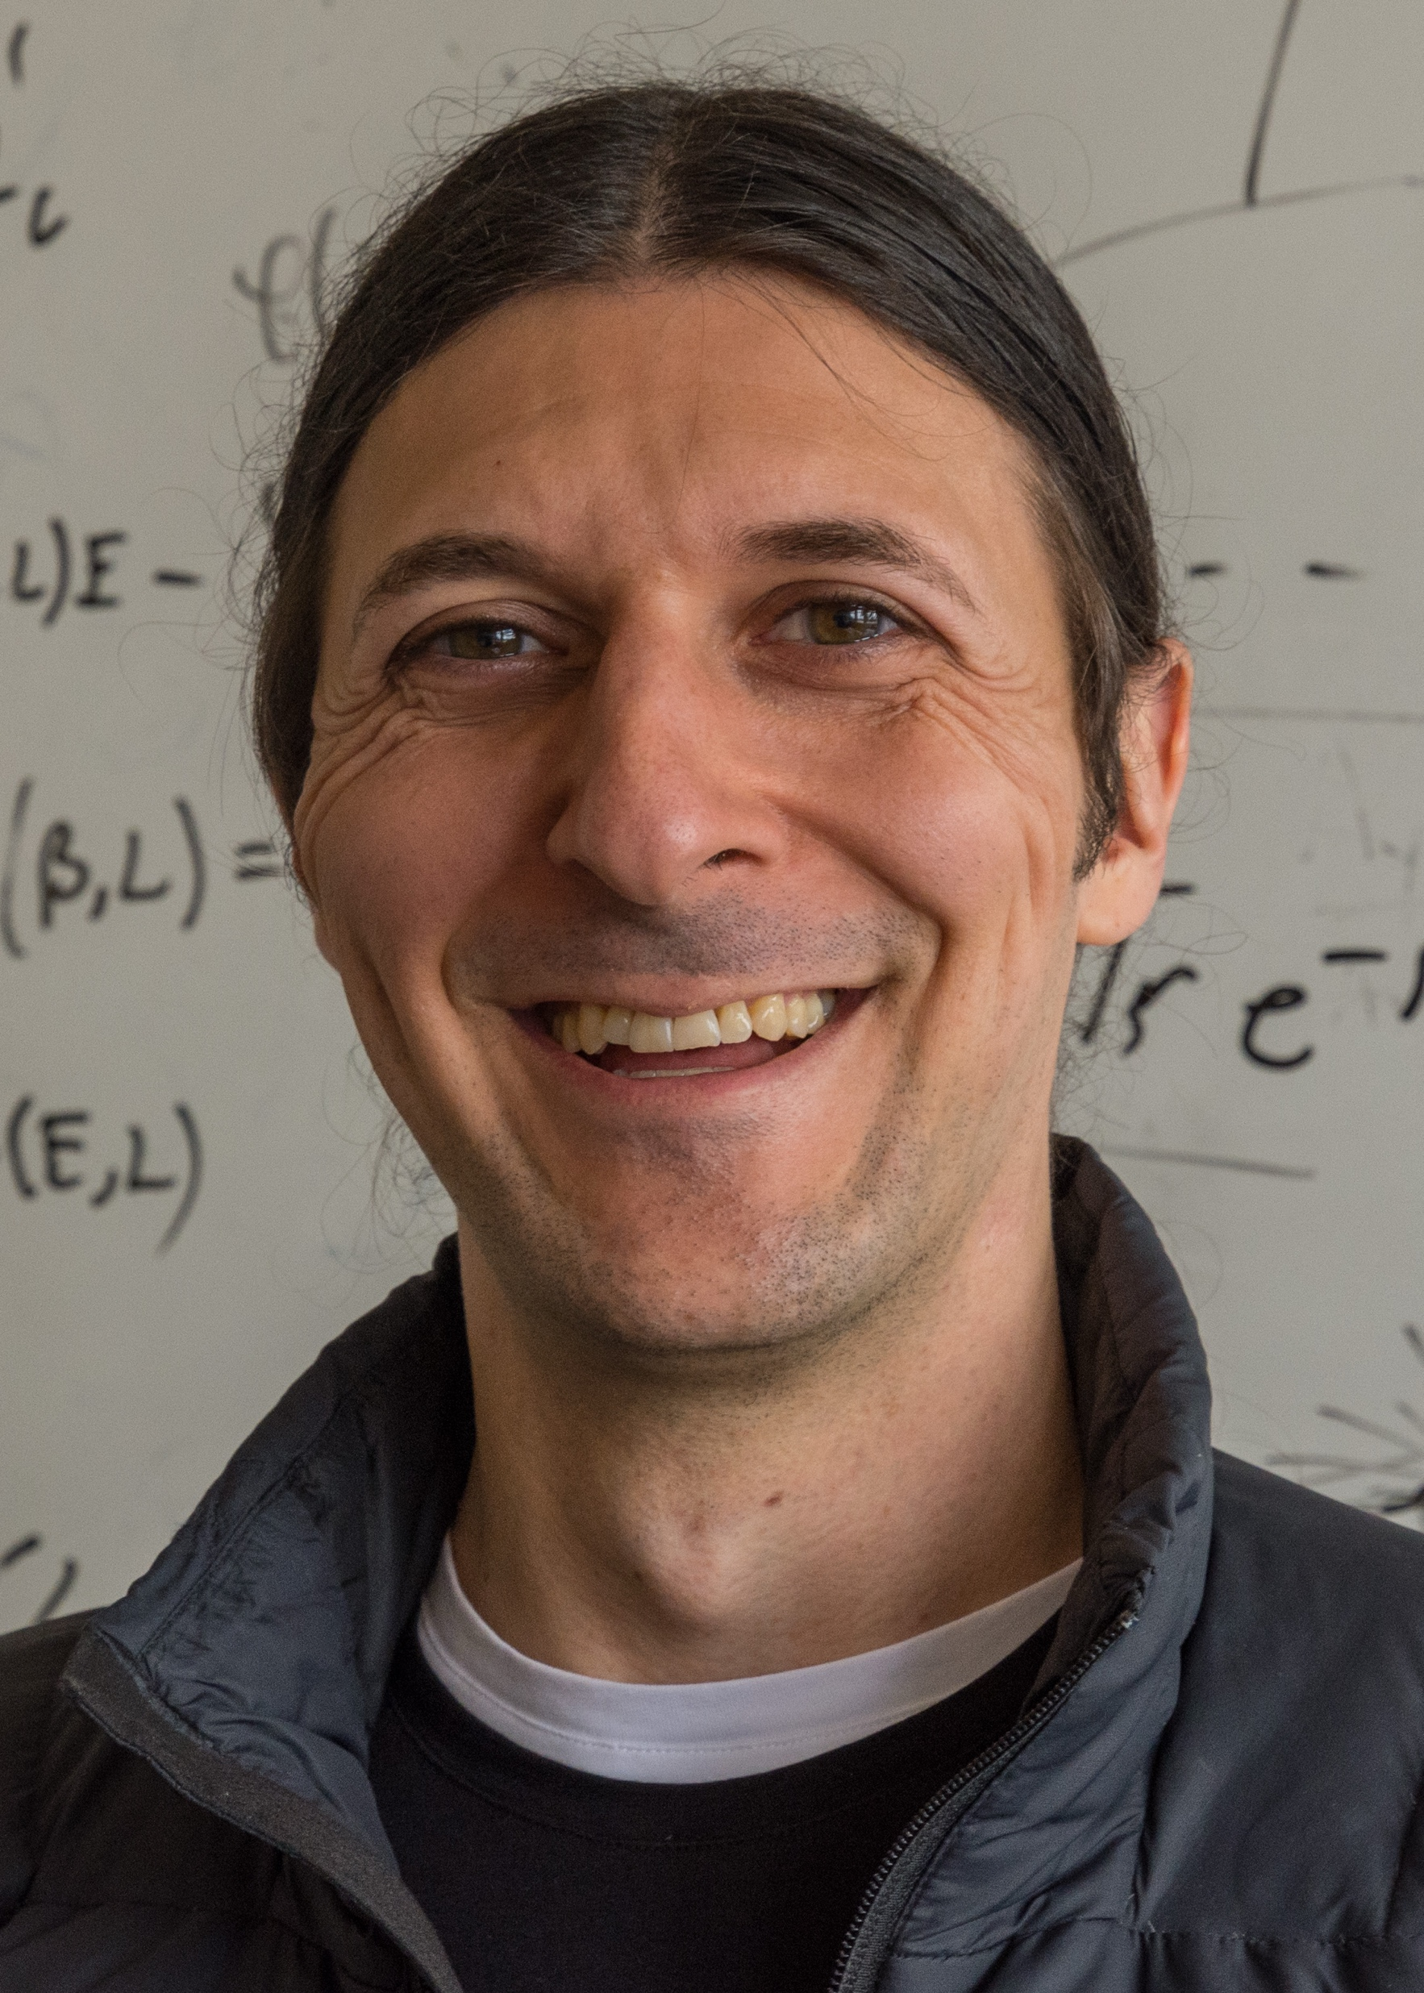




What is my role in this story?
Energy Loss from Cape Town
Our Approach:
One can understand the physics of the QGP by considering the energy loss of a quark moving through the medium.
In particular, we claim that this can be done for small systems (such as pA and pp collisions)

Slide 10
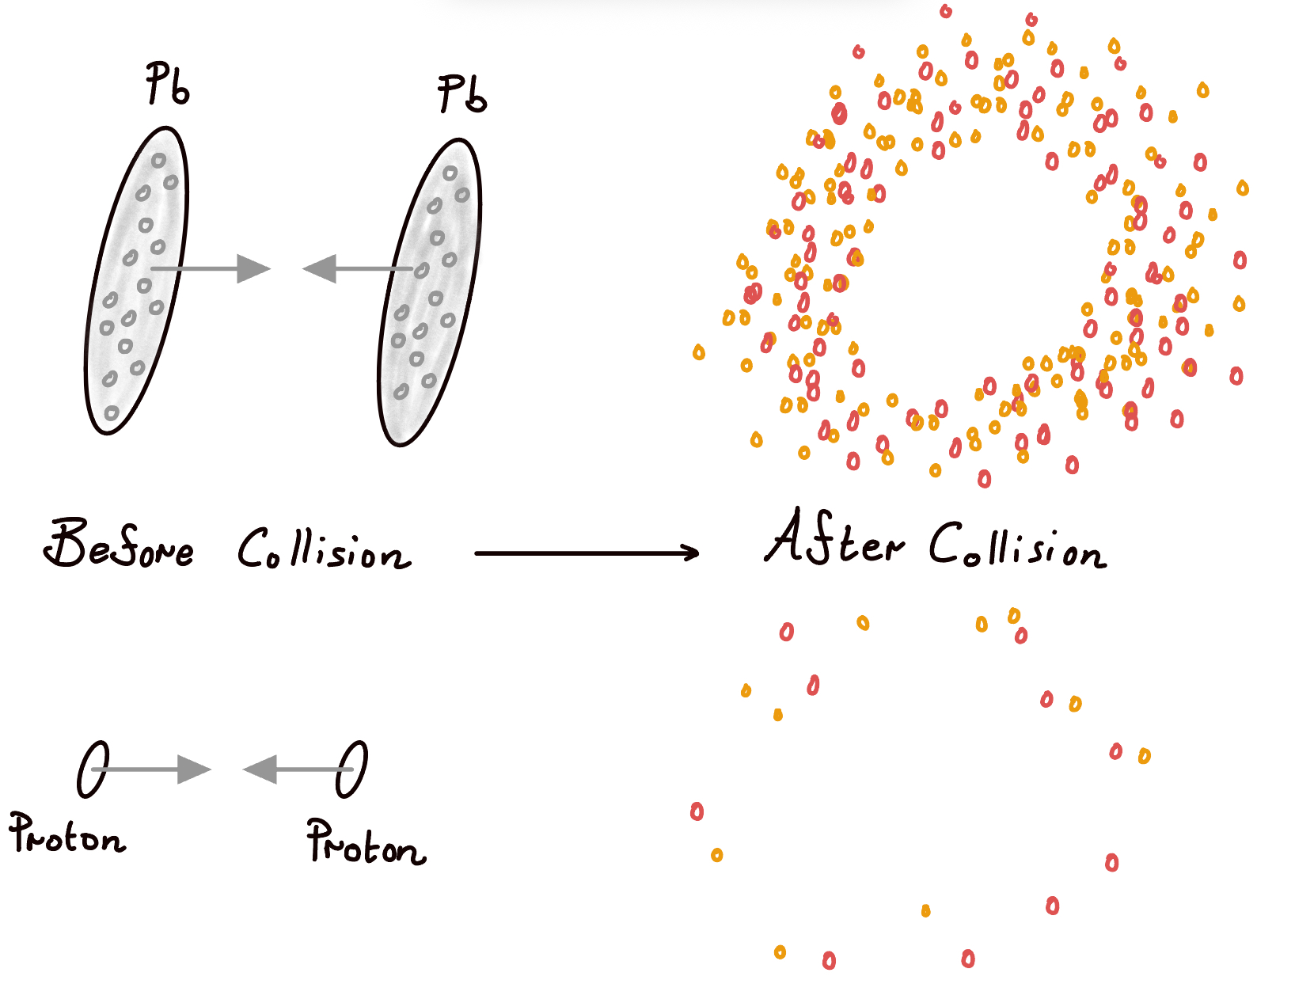


Observable of interest 1: $R_{AA}$
Definition
$$R_{AA}≡\frac{dN^{AA}/dp_{T}}{N_{coll} dN^{pp}/dp_{T}}$$
$$R_{AA}≈1−ΔE/E$$

Slide 11
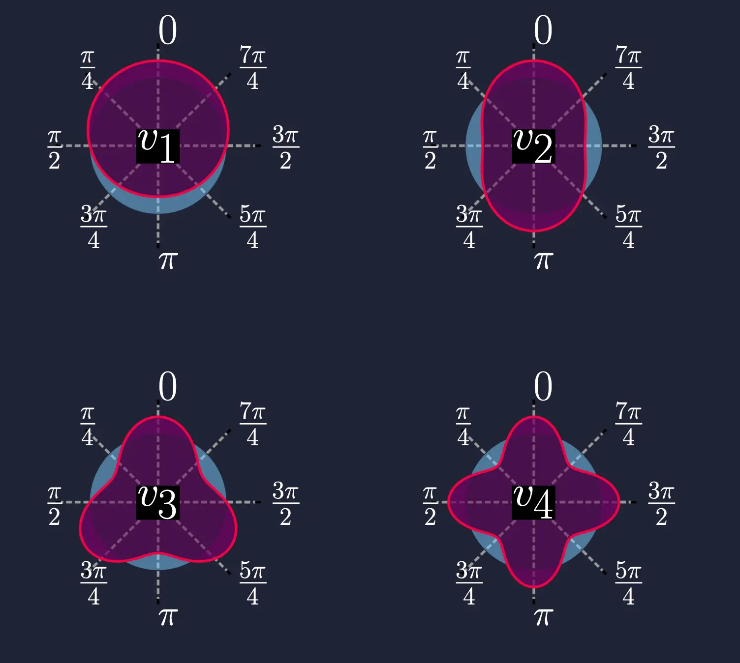
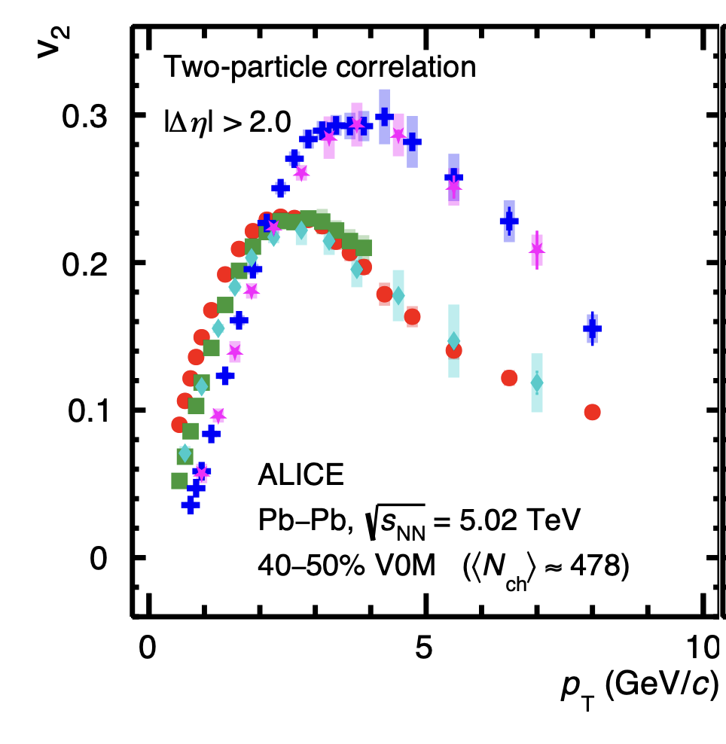
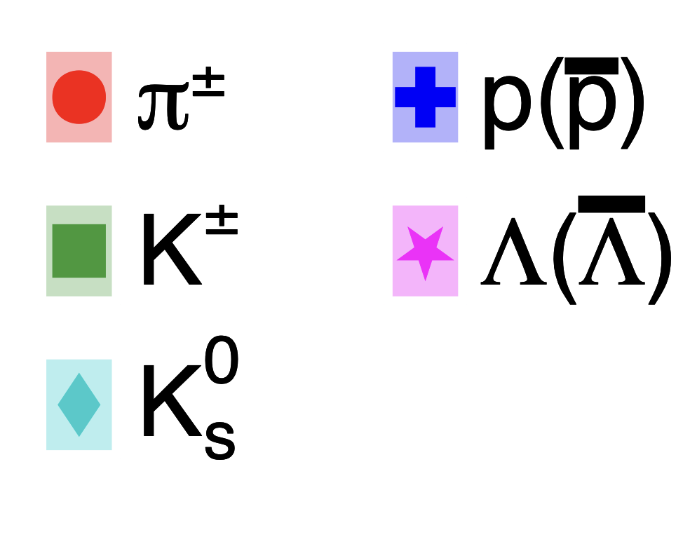
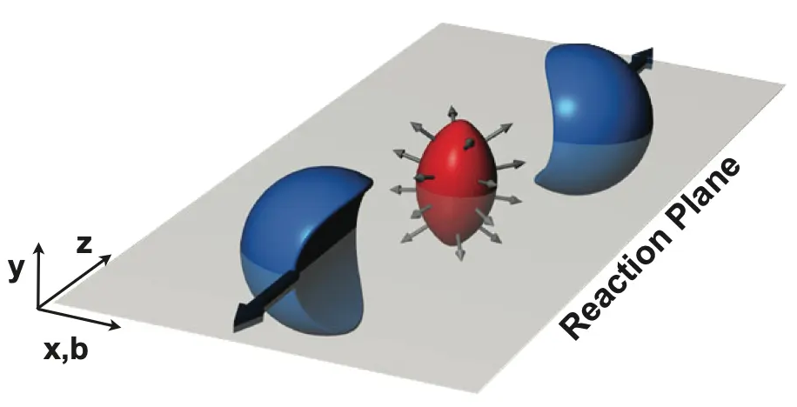
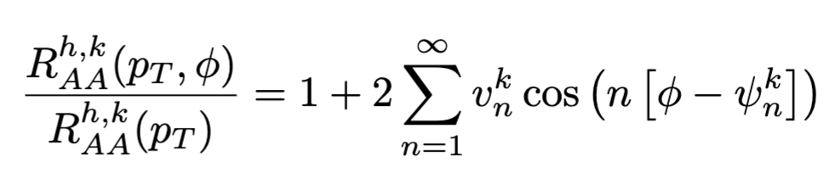

Observable of interest 2: high ${p_{T} v}_{n}$
$$Normalization\frac{dN}{dφ}≡1+2\sum_{n}{v_{n}cos⁡(n[φ−ψ_{n}])}$$
Almond-shaped initial state
ALICE:2024vzv
Snellings:2011sz

Slide 12
Modelling of the QGP’s Geometry and Evolution

Slide 13
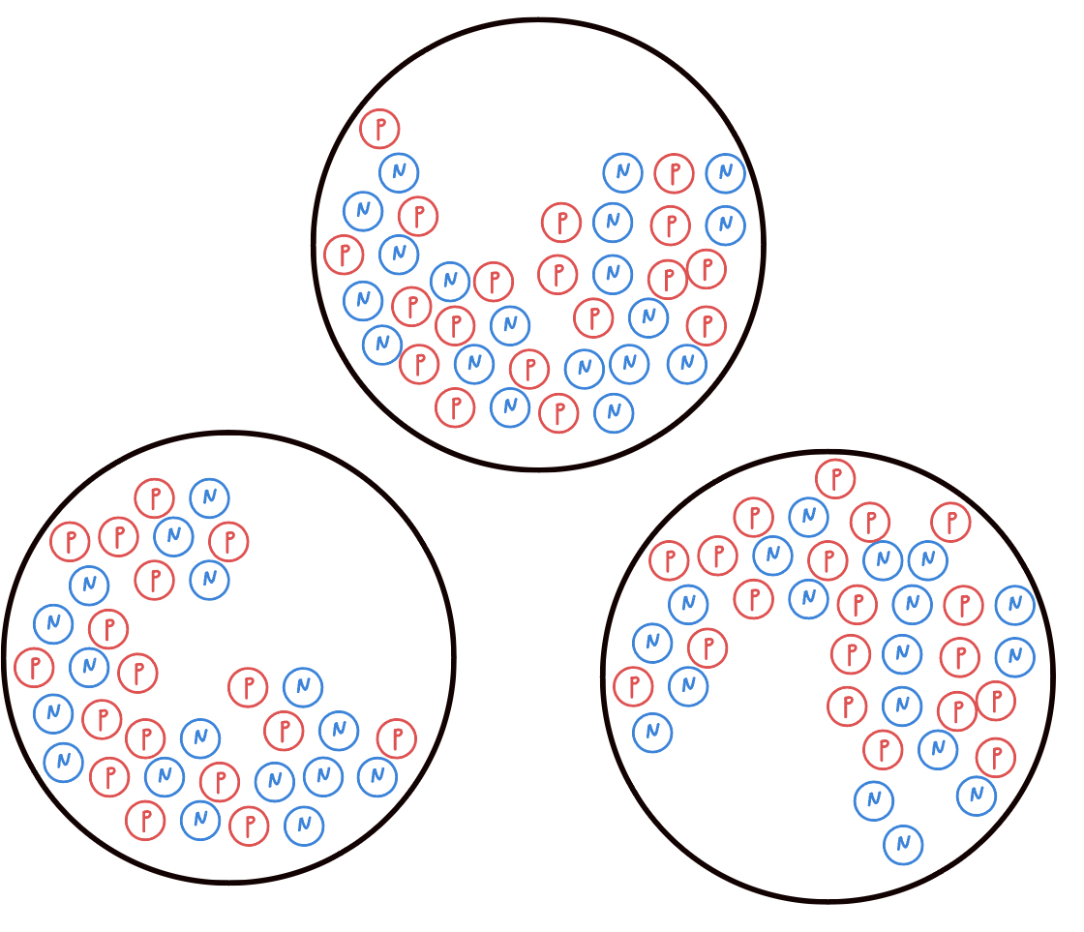
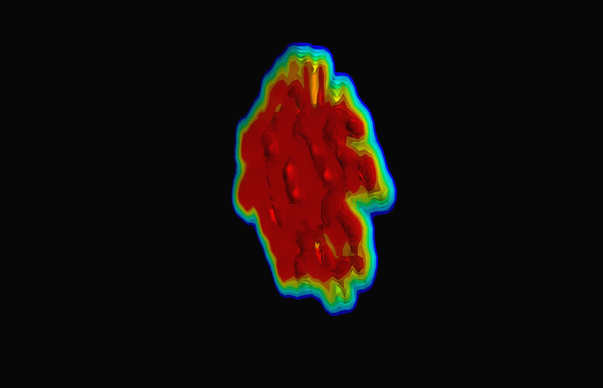
Geometry and Evolution of the Initial State
The QGP is not static!
Centrality is Important
Event-by-event fluctuations are important
Central
vs
Peripheral

Slide 14
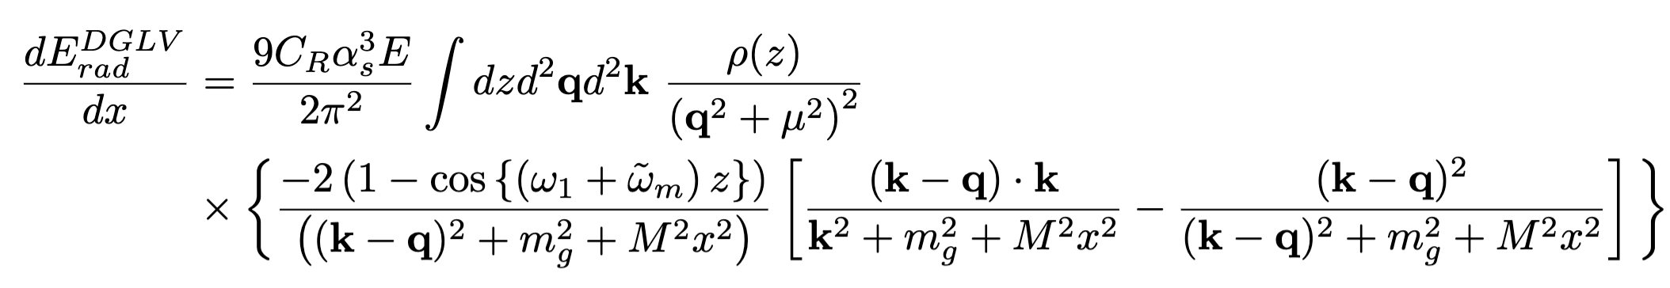

Numerical Challenges in calculating energy loss
high-dimensional integral
geometry and evolution information are all contained in the scattering center $ρ(z)$
Energy loss from pQCD
oscillatory integrand

Slide 15



A clever speed up
Probability distributions for fitted parameters
Simple Power Law
$$ρ_{fit}=ρ_{0}{\left(\frac{τ_{0}}{z}\right)}^{1.2}θ\left(z_{c}−z\right)θ\left(z−τ_{0}\right)$$
$$∴∆E=ΔE(ρ_{0},z_{c})$$
$$\left\langle ΔE\right\rangle =∫P_{geo}\left(ρ_{0},z_{c}\right)ΔE(ρ_{0},z_{c})$$
Calculate energy loss as a function of fitted parameters once
store that data and then average over different probability distributions
This method is 7 orders of magnitude faster than calculating the energy loss directly.

Slide 16




results
$$R_{AA}$$
$$v_{2}$$
$$v_{3}$$
Good agreement with high-$p_{T}$ $R_{AA}$and $v_{n}$ data!

Slide 17
Conclusion
The QGP is a novel and interesting state of matter!
One can understand the properties of the QGP by considering energy loss.
We calculate the energy loss through pQCD methods, which makes things computationally expensive.
We also need to consider many types of collision systems and take event-by-event fluctuations into account, which further increase computational overheads
We have developed an extremely efficient method for calculating the energy loss
So far, we have good agreement with experimental data and comparisons to small systems will follow shortly!

Slide 18
Bonus Slides

Slide 19
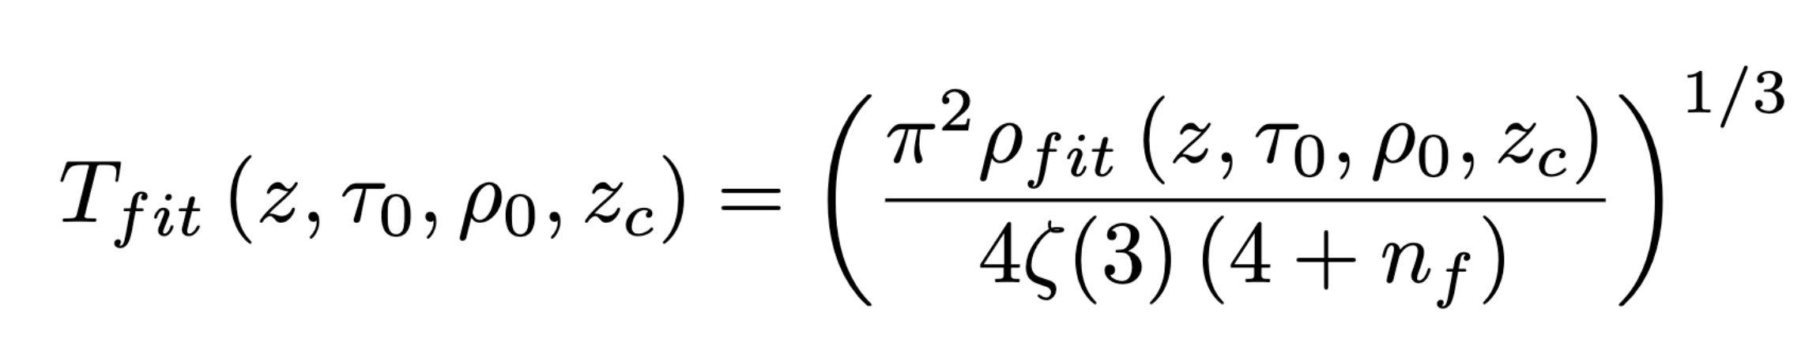
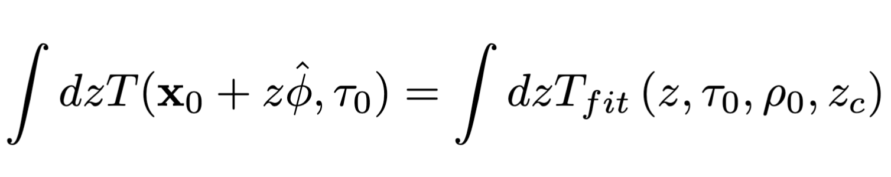
$ρ$ distributions

Slide 20
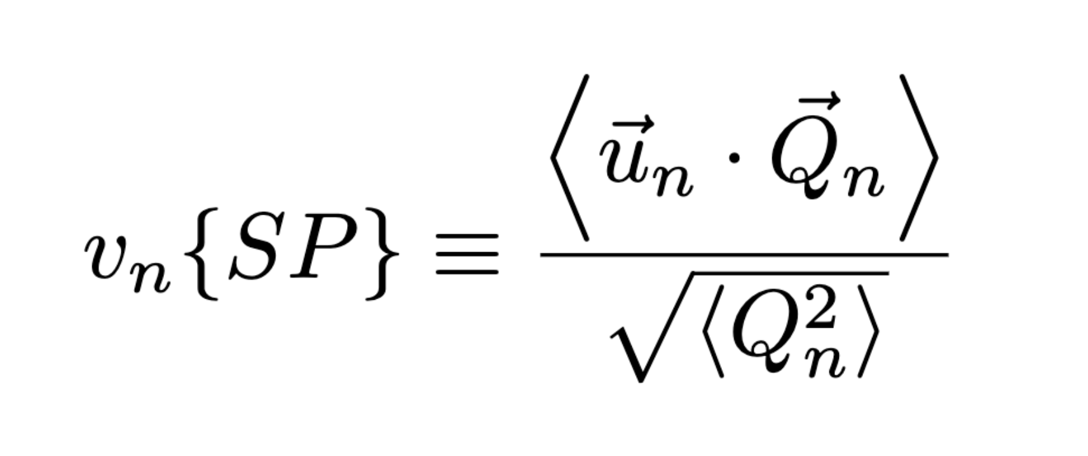
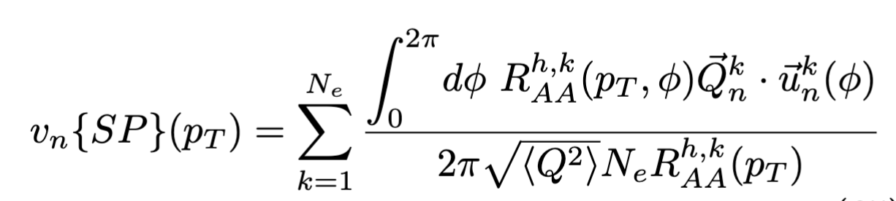
Scalar Product $v_{n}$

Slide 21
Fitted parameters and Energy Loss

Slide 22
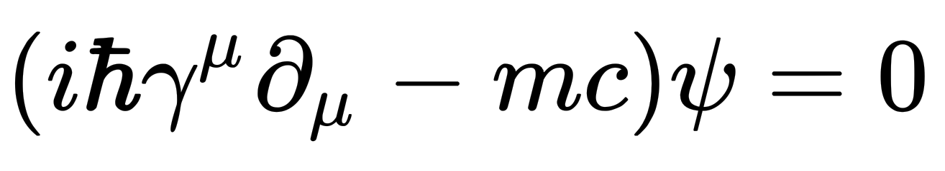

Signatures of the QGP
Theoretical Evidence
Experimental Evidence
ALICE:2022wpn
ALICE:2024vzv
$\frac{dε}{dT}∝$ degrees of freedom
Chiral Symmetry Breaking
Grouping by partonic degrees of freedom and not hadronic degrees of freedom

Slide 23
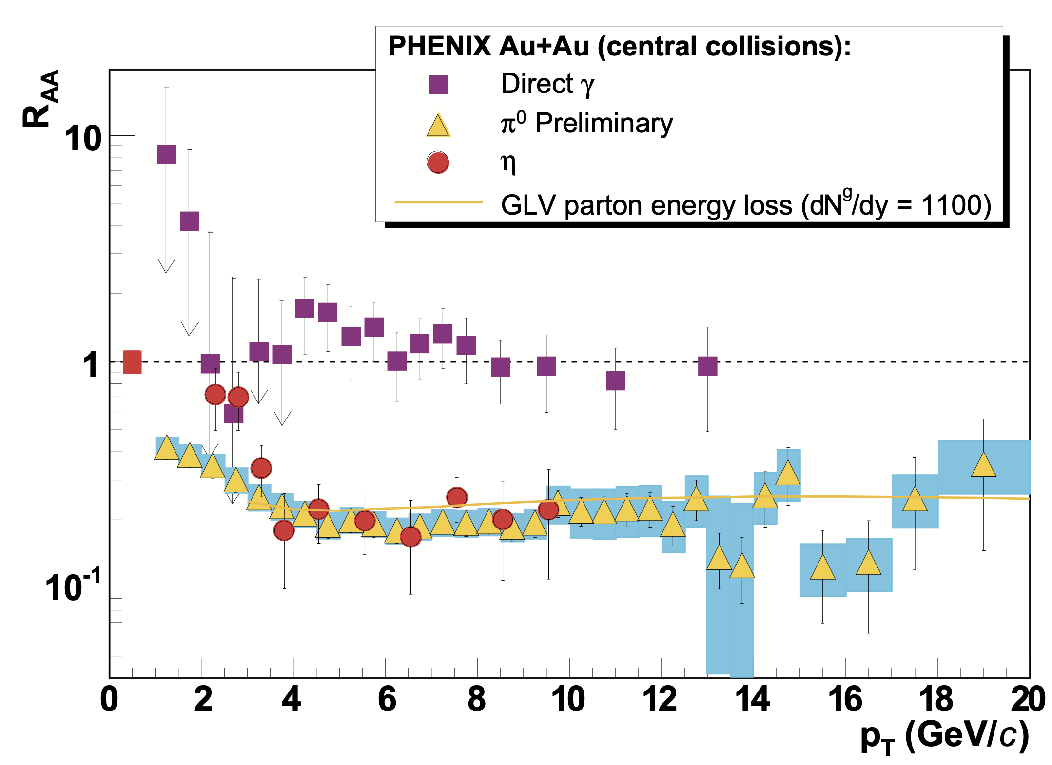

Observable of interest 1: $R_{AA}$
Definition
$$R_{AA}≡\frac{dN^{AA}/dp_{T}}{N_{coll} dN^{pp}/dp_{T}}$$
Isobe:2006ri

Slide 24
Importance of event-by-Event Fluctuations

