Slide 1


Probing Charged Current B-anomalies via a U (1)μ−τ Extension of the Standard Model
Vuyolwethu Kakancu
School of Physics and Institute for Collider Particle Physics
University of the Witwatersrand, Johannesburg, South Africa
An Ongoing Work in collaboration with
Srimoy Bhattacharya, Sneha Jaiswal, Mukesh Kumar, Bruce Mellado, Ammar Abdalgabar and Ashok Goyal

Slide 2
Outline
Introduction
Motivation
Model
Analysis
Conclusion

Slide 3
Introduction
The Standard model of particle physics is currently an accepted theory describing the fundamental constituents of matter and their interactions.
New physics search can follow one of two tracks :
  Direct detection of new particles at the collider
  Indirect probes for new physics from precision measurements
No direct evidence for physics beyond Standard Model (SM) by LHC.
Indirect hints for new physics (NP) in the flavour sector
NP can show up as a deviation of the experimental data from SM prediction.

Slide 4








B Anomalies
B anomalies are deviations seen in B meson decays
In particular these anomalies have been observed in:
  Charge current process $b→c$ quark transitions.
  Neutral current process $b→s$ quark transitions.
The focus within this study is given to $b→cτν_{τ}$
$$b→cτν_{τ}$$
Focus currently!!
$$Inclusive(B→Χ_{c}τν_{τ})$$
$$Exclusive$$
$$B→D^{(∗)}τν_{τ}$$
$$B_{c}→J/ψτν_{τ}$$
${Λ }_{b}→$ ${Λ }_{c}τν_{τ}$
$$B→τν_{τ}$$

Slide 5
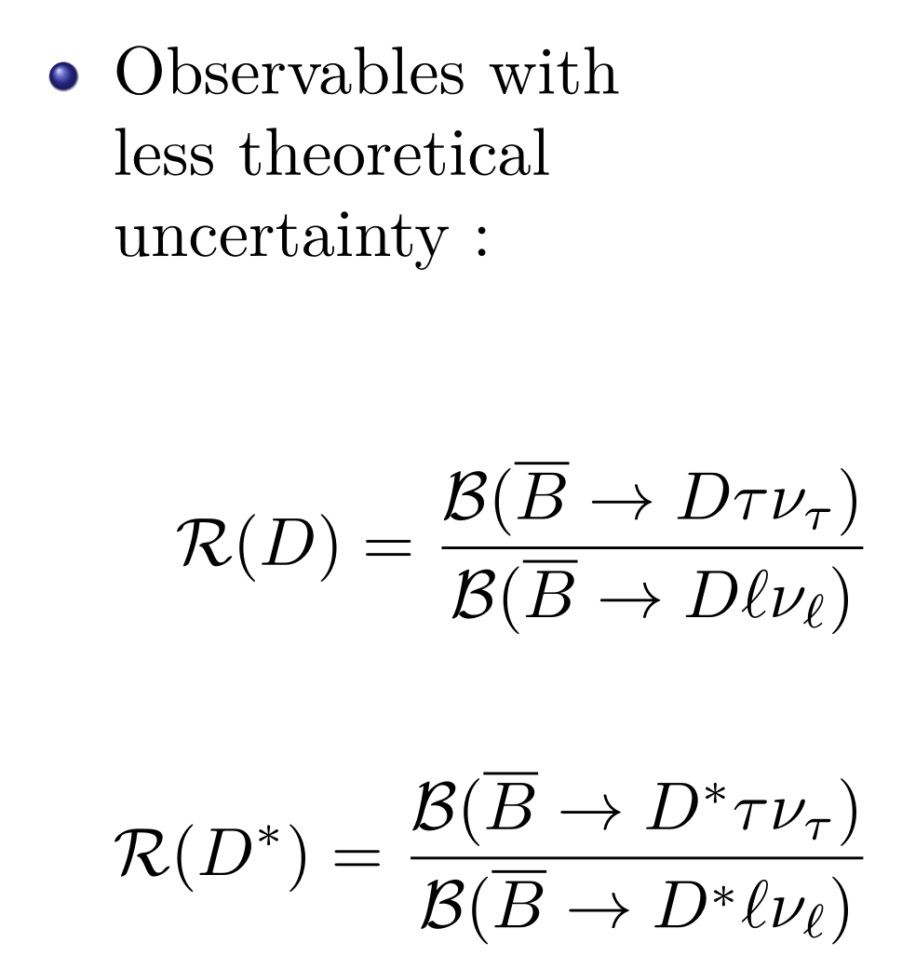
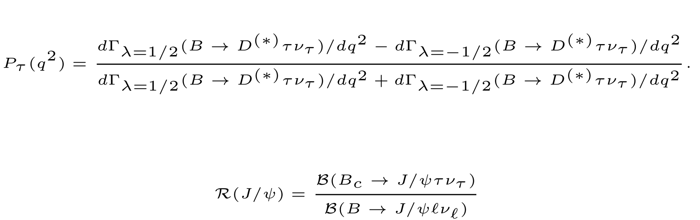
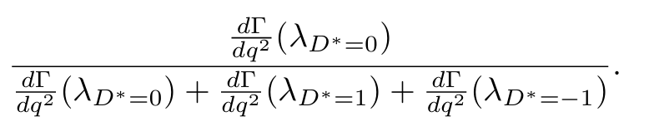




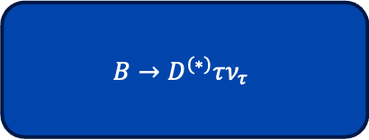




B Anomalies Observables
$$B→D^{(∗)}τν_{τ}$$
$$R_{D^{(∗)}}$$
$P_{τ}$($D^{(∗)})$
$τ$-polarisationasymmetry
$${F_{L}}^{D^{∗}}$$
$D^{∗}$- longitudinal polarization
$$𝒜_{FB}$$
$τ −$Forward-backward asymmetry

Slide 6

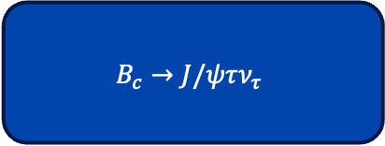



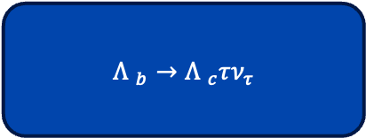

Other Observables
$$B_{c}→J/ψτν_{τ}$$
$$R_{J/ψ}$$
$${R_{Λ}}^{μ}$$
${Λ }_{b}→$ ${Λ }_{c}τν_{τ}$
$${R_{Λ}}^{e}$$
$$B→τν_{τ}$$
$ℬ(B→τν_{τ}$)

Slide 7
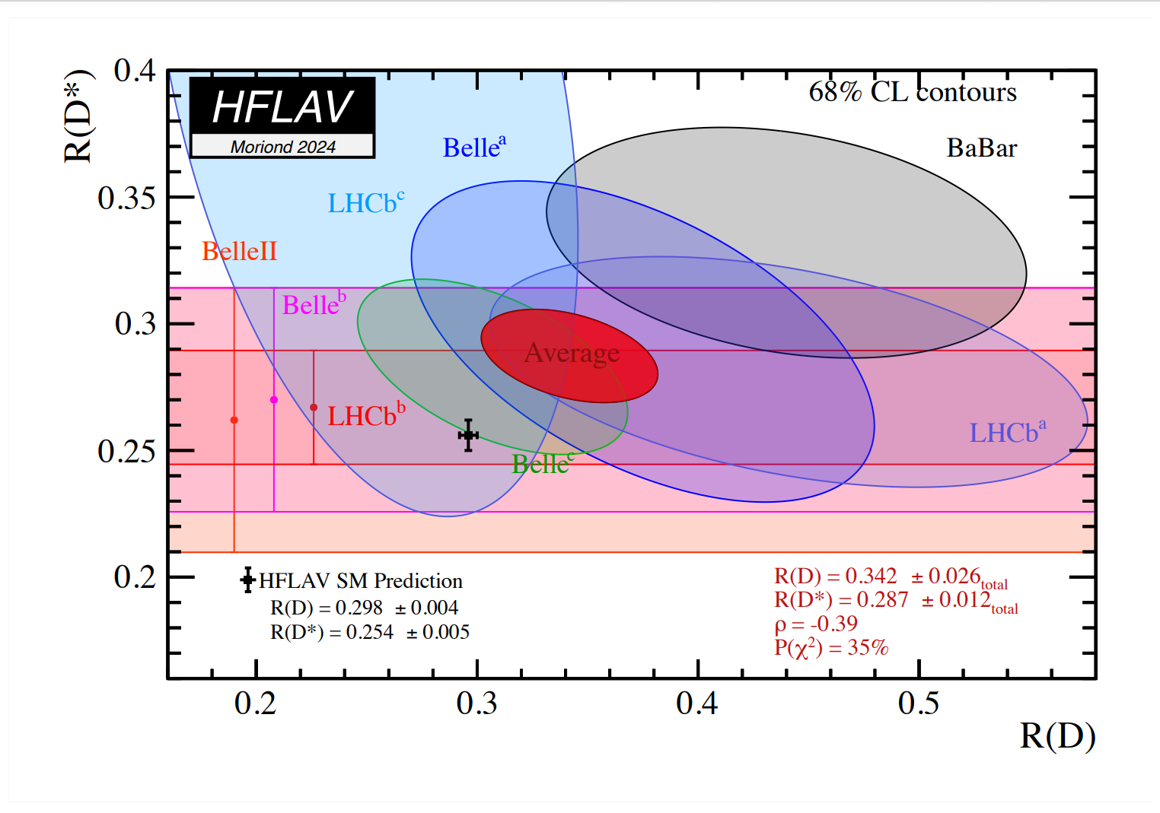
Experimental Status of the LFU Observables
Violation within the LFU Observables
New tension with SM: 3.17 σ

Slide 8
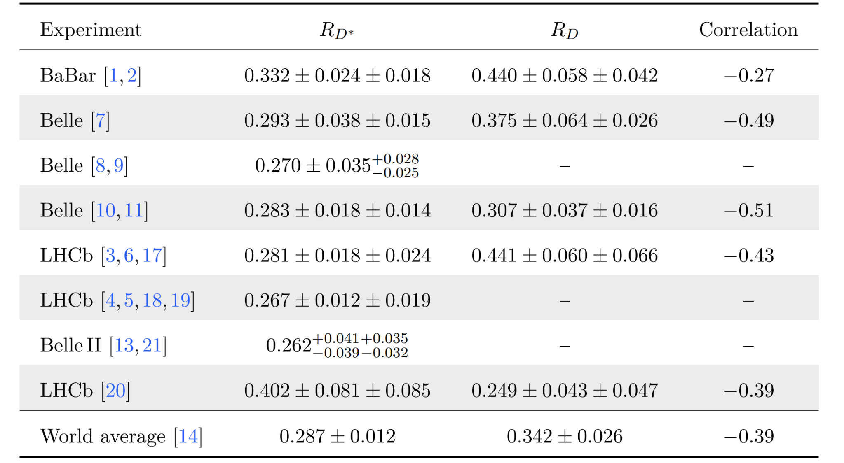
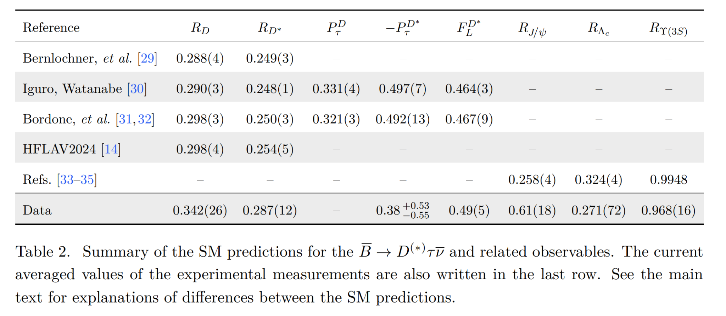
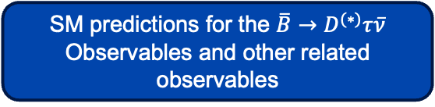

Experimental Status of the LFU Observables
Current status of the independent experimental $R_{D}$and $R_{D^{∗}}$ measurements
SM predictions for the $\overline{B}→D^{(∗)}τ\overline{ν}$ Observables and other related observables
Phys.Rev.D 110 (2024) 7, 075005

Slide 9
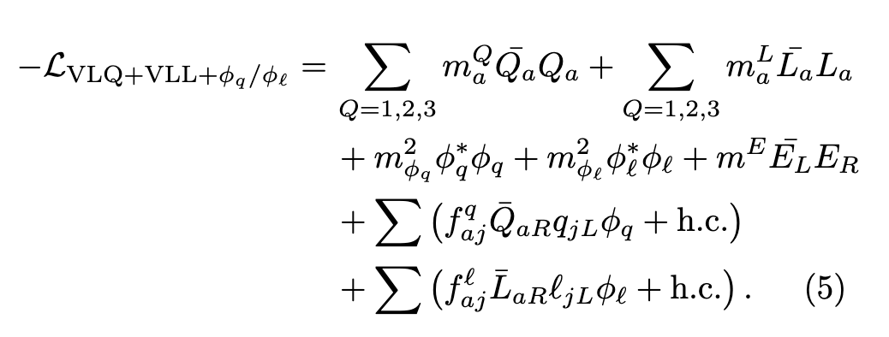
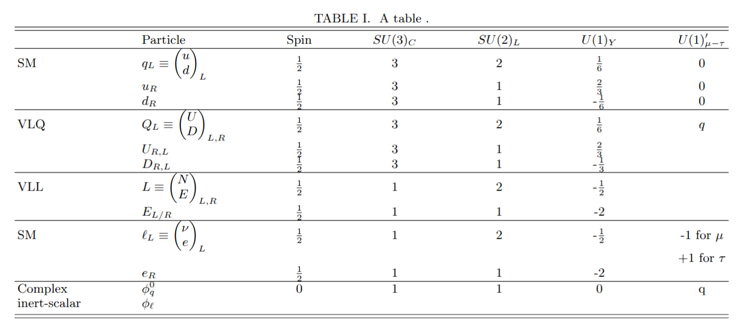
Model
Model lagrangian
Model spectrum

Slide 10
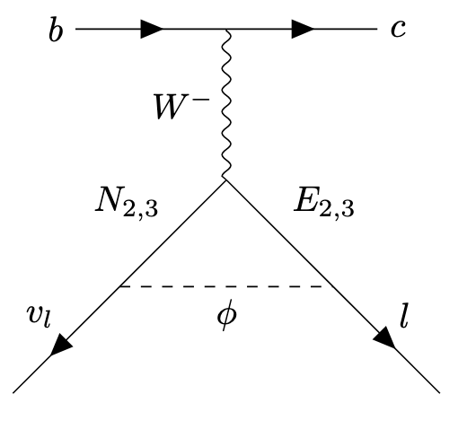
Model
U (1)′μ−τ symmetry is:
Anomaly-free without needing extra fermions
Safe from strong experimental bounds from electrons or quark couplings
Naturally introduces LFUV between muon and tau sectors
Role of Vector-Like Quarks (VLQs)
VLQs do not violate gauge invariance when added to the SM. When VLQs are charged under both SM and the new U(1)μ−τ′​, and mix with SM quarks, they induce effective couplings between SM quarks and the new Z′.
For example:
Introduce VLQs Q′∼(3,2,1/6), D′∼(3,1,−1/3), charged under U(1)μ−τ′
VLQs mix with SM bottom or charm quarks via scalar singlets that break the U(1)′
This mixing allows Z′ to couple to b-> c currents effectively

Slide 11

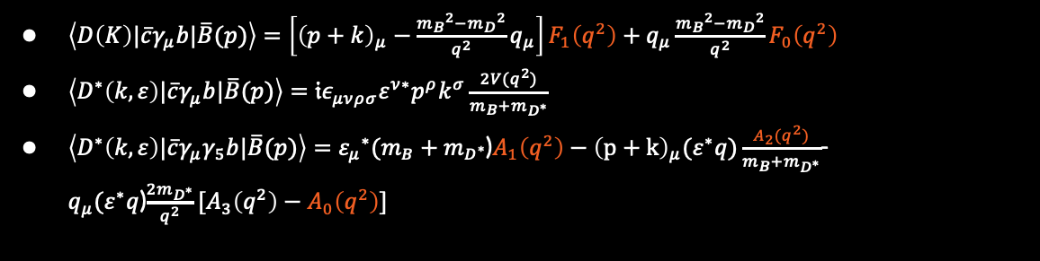
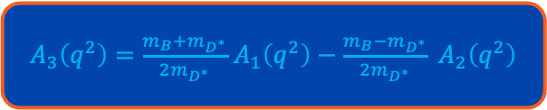

Form Factors
$$b→cτν_{τ}$$
$\left\langle D\left(K\right)|\overline{c}γ_{μ}b|\overline{B}(p)\right\rangle =\left[{\left(p+k\right)}_{μ}−\frac{{m_{B}}^{2}−{m_{D}}^{2}}{q^{2}}q_{μ}\right]F_{1}\left(q^{2}\right)+q_{μ}\frac{{m_{B}}^{2}−{m_{D}}^{2}}{q^{2}}F_{0}\left(q^{2}\right)$
$\left\langle D^{∗}\left(k,ε\right)|\overline{c}γ_{μ}b|\overline{B}(p)\right\rangle =𝔦ε_{μνρσ}ε^{ν∗}p^{ρ}k^{σ}\frac{2V(q^{2})}{m_{B}+m_{D^{∗}}}$
$\left\langle D^{∗}\left(k,ε\right)|\overline{c}γ_{μ}γ_{5}b|\overline{B}(p)\right\rangle ={ε_{μ}}^{∗}(m_{B}+m_{D^{∗}}$)$A_{1}\left(q^{2}\right)−{\left(p+k\right)}_{μ}(ε^{∗}q)\frac{A_{2}(q^{2})}{m_{B}+m_{D^{∗}}}$-$q_{μ}(ε^{∗}q$)$\frac{2m_{D^{∗}}}{q^{2}}[A_{3}\left(q^{2}\right)−A_{0}\left(q^{2}\right)]$
$A_{3}\left(q^{2}\right)=\frac{m_{B}+m_{D^{∗}}}{2m_{D^{∗}}}$ $A_{1}\left(q^{2}\right)−\frac{m_{B}−m_{D^{∗}}}{2m_{D^{∗}}} A_{2}\left(q^{2}\right)$
$$B→D^{(∗)}τν_{τ}$$

Slide 12





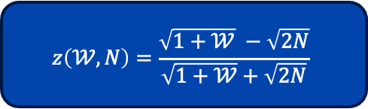

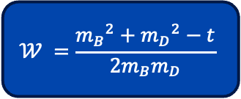
BGL Parametrization
BGL parameterization of the form factors rely on a series expansion about z = 0.
Transformation that maps the complex $q^{2}$ plane onto the unit disc $\left|z\right|≤1$
In the fits we will consider $N = 2,3,4$
$P_{i}\left(z\right)−Blaschkefactor$
$φ_{i}\left(z\right)−$ $outer functions$
$a_{n}$ $−$ Coefficients obeying constraint $\sum_{n=0}^{∞}{{a_{n}}^{2}≤1}$
$$t=q^{2}={\left(p−p^{′}\right)}^{2}$$
$$t_{+}={\left(m_{B}+m_{D}\right)}^{2}$$
$$t_{−}={\left(m_{B}−m_{D}\right)}^{2}$$
$$𝒲 =\frac{{m_{B}}^{2}+{m_{D}}^{2}−t}{2m_{B}m_{D}}$$
$$z\left(𝒲,N\right)=\frac{\sqrt{1+𝒲} −\sqrt{2N}}{\sqrt{1+𝒲}+\sqrt{2N}}$$
$$F_{i}\left(z\right)=\frac{1}{P_{i}(z)φ_{i}(z)}\sum_{n=0}^{N}{{a_{n}}^{ℱ_{i}}z^{n}}$$

Slide 13
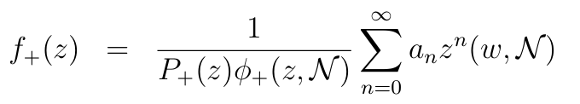
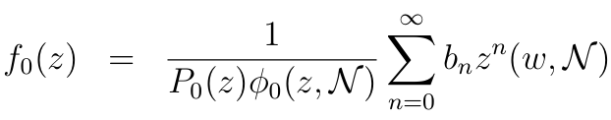
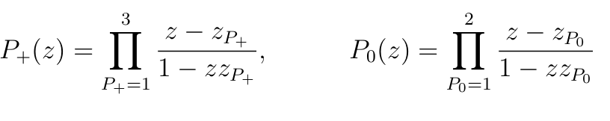
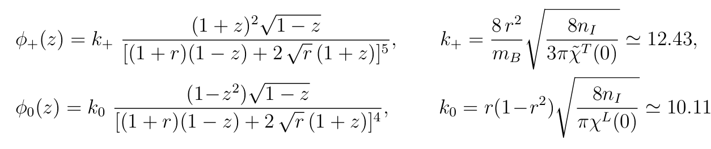



BGL Parametrization
Form factors after BGL Parametrization for $B→Dτν_{τ}$
$$Blaschkefactors$$
$$outer functions$$

Slide 14
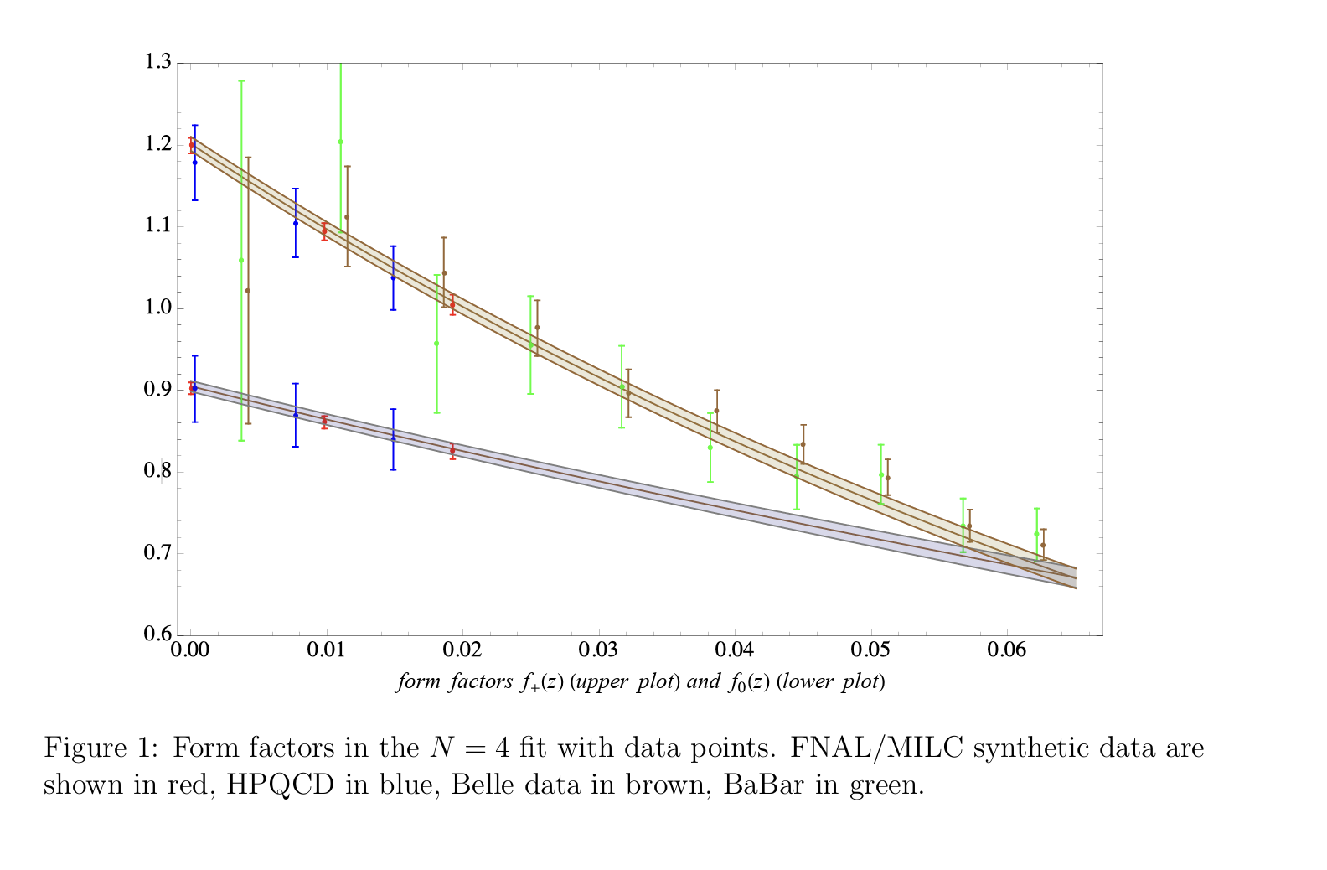

$B→Dτν_{τ}$ form factors $f_{+}$and $f_{0}$
Phys. Rev. D 94, 094008 (2016)

Slide 15
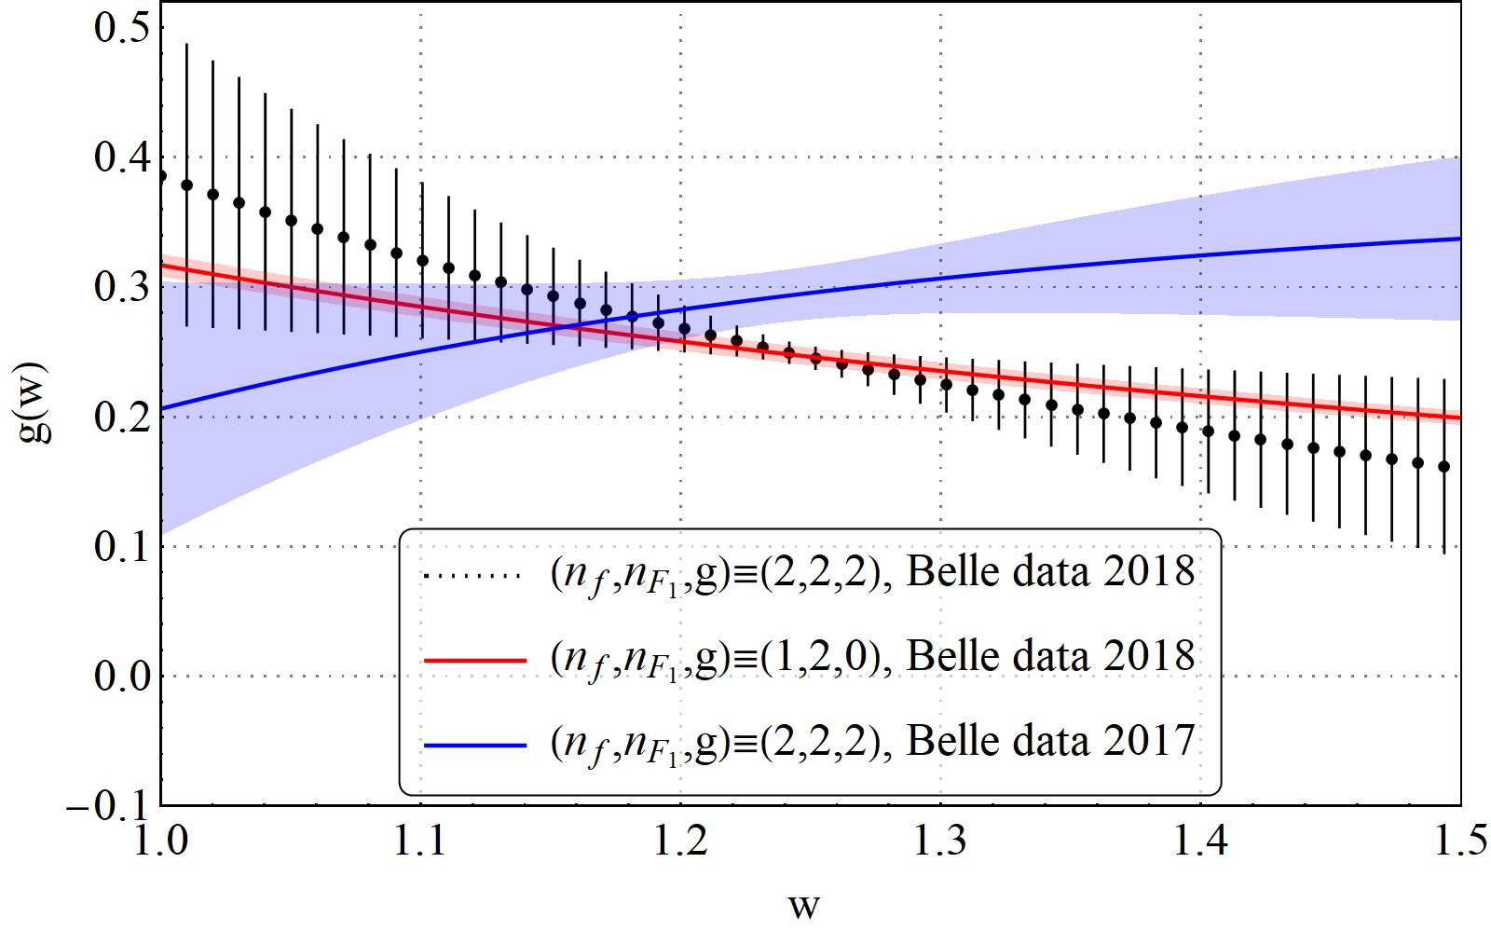
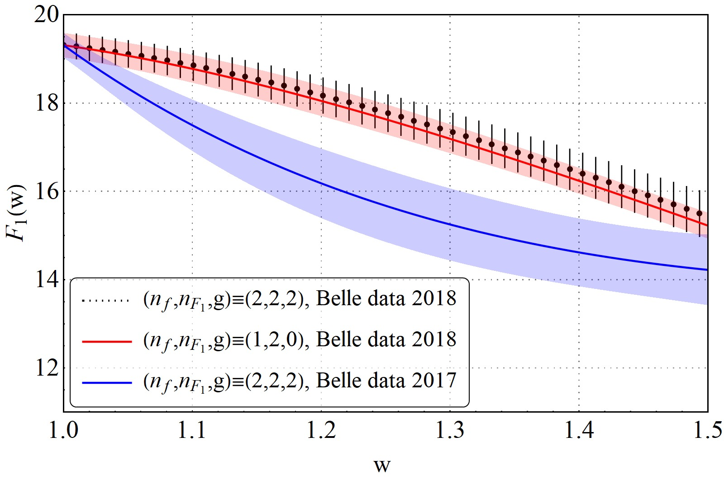

$B→D^{∗}τν_{τ}$ form factors
JHEP 06 (2020) 165

Slide 16
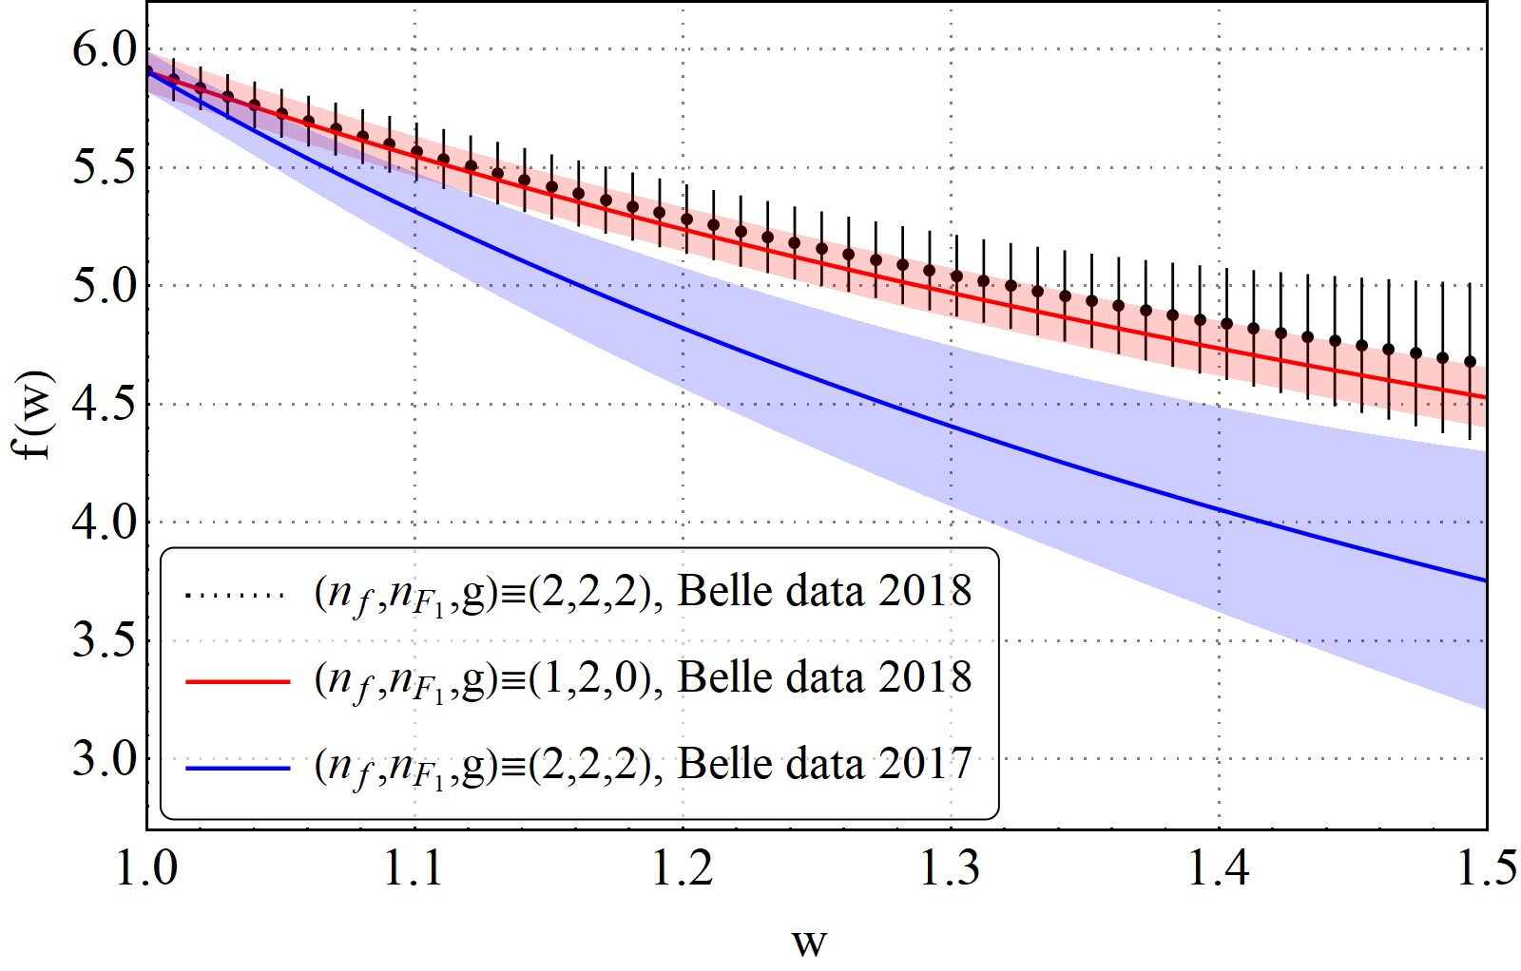
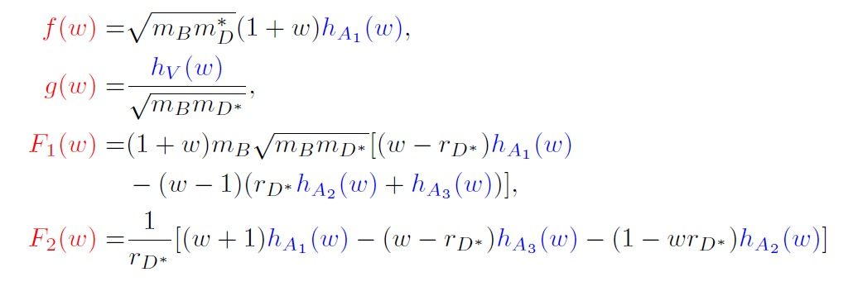
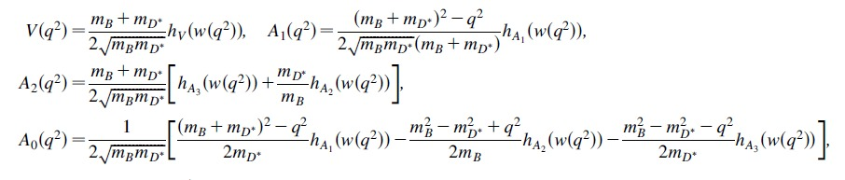

$B→D^{∗}τν_{τ}$ form factors
JHEP 06 (2020) 165

Slide 17
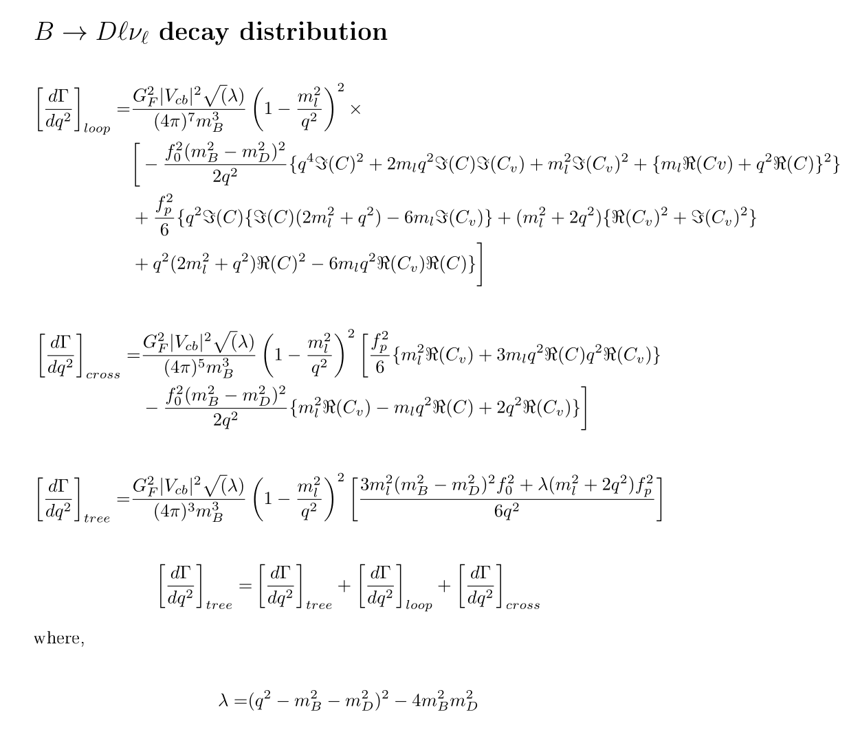

Result of the Decay width of the model
Contributions coming from $f_{0}$ and $f_{p=+}$.

Slide 18

Conclusion
With the motivation from the experimental data, vector like quarks (VLQ) and U (1)′μ−τ gauge symmetry will be implemented to try explain the anomalies in a charged current process .
After preforming fits on $B→Dτν_{τ}$ further work will be done to compute $B→D^{∗}τν_{τ}$ decay width expression and the form factors.
Constraints will be implemented on the model parameters in particular on the couplings ${f_{aj}}^{q}$ and ${f_{aj}}^{ℓ}$, Vectorlike lepton masses $m_{N},$ $m_{E}$ and mass of the scalar $φ$.
Lastly a $χ^{2}$fit will performed to put constrains on the Wilson coefficients.

Slide 19
References
1.Phys. Rev. Lett. 109 (2012) 101802,
2. Phys. Rev. D 88 (2013) 072012,
3. Phys. Rev. Lett. 115 (2015) 111803,
4. Phys. Rev. Lett. 120 (2018) 171802,
5. Phys. Rev. D 97 (2018) 072013,
6. Phys. Rev. Lett. 131 (2023) 111802,
7. Phys. Rev. D 92 (2015) 072014,
8. Phys. Rev. Lett. 118 (2017) 211801,
9. Phys. Rev. D 97 (2018) 012004,
10. arXiv:1904.08794,
11. Phys. Rev. Lett. 124 (2020) 161803,
13. arXiv:2401.02840,
14. https://hflav-eos.web.cern.ch/hflav-eos/semi/moriond24/html/ RDsDsstar/RDRDs.html
17. https://indico.cern.ch/event/1187939/
18. https://indico.cern.ch/event/1231797/
19. Phys. Rev. D 108 (2023) 012018,
20. https://indico.in2p3.fr/event/32664/timetable/?view=standard_numbered# 38-b-to-c-l-nu-decays-at-lhcb,
21. https://indico.cern.ch/event/1114856/contributions/5423684/
29. Phys. Rev. D 106 (2022) 096015
30. JHEP 08 (2020) 006
31. Eur. Phys. J. C 80 (2020) 74
32. Eur. Phys. J. C 80 (2020) 347
33. Phys. Rev. Lett. 125 (2020) 222003
34. Phys. Rev. Lett. 121 (2018) 202001
35. JHEP 06 (2017) 019

