Slide 1
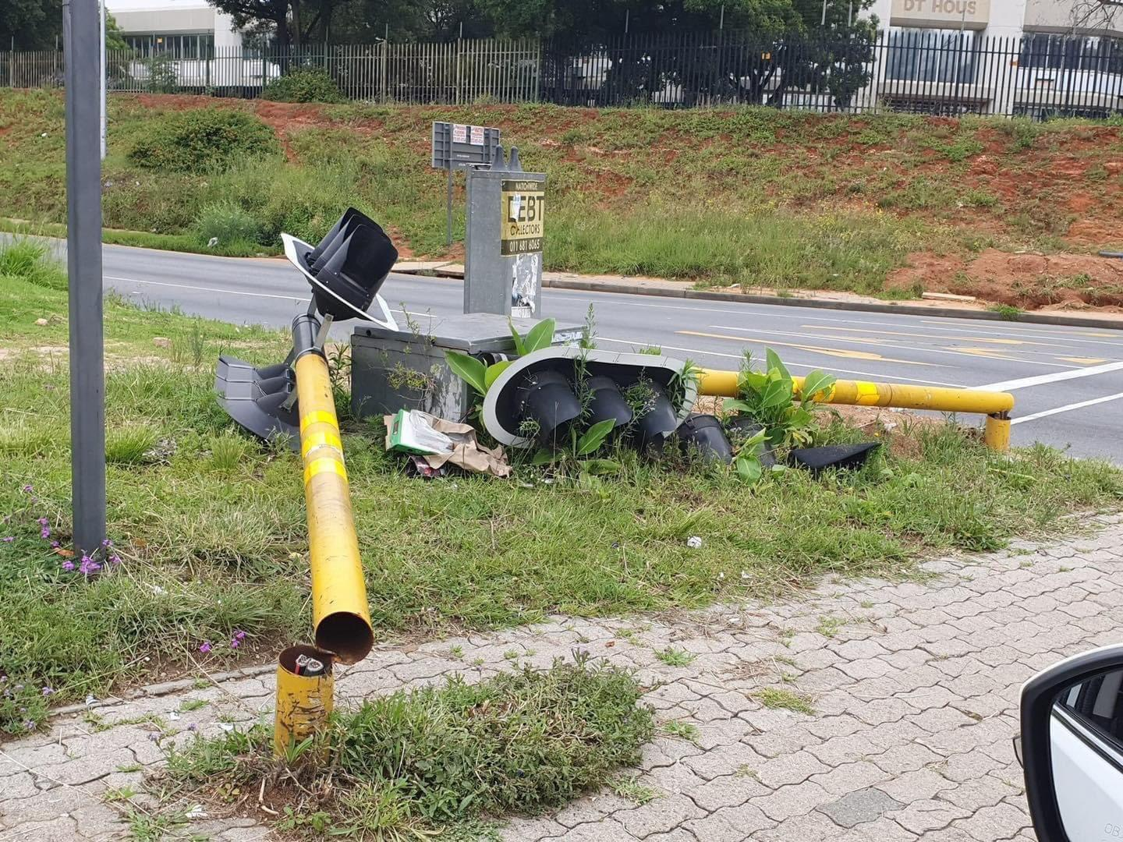
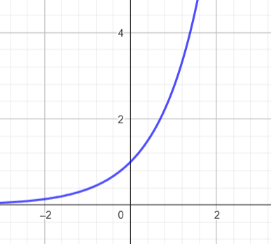
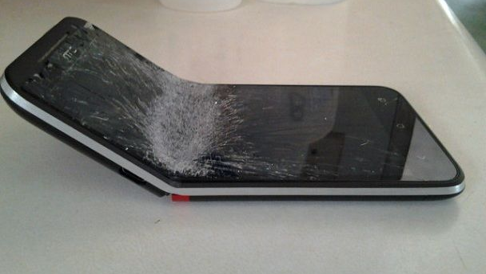
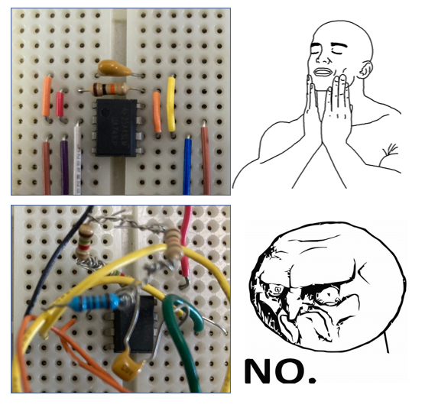
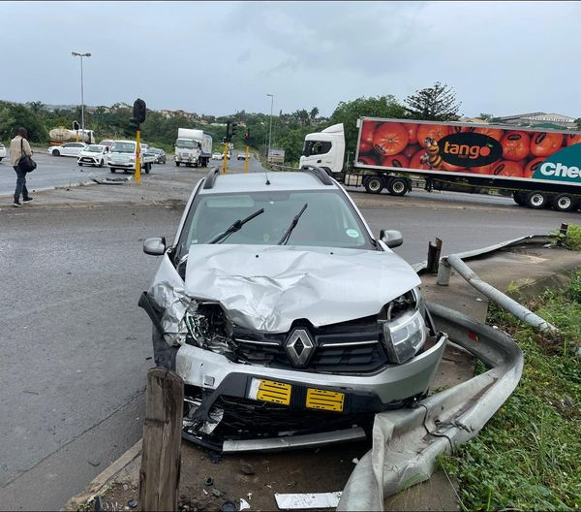


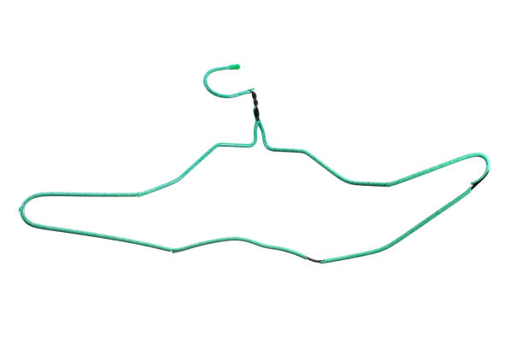
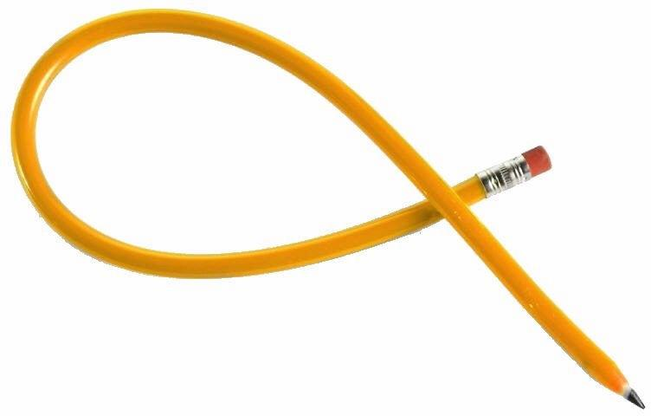

Bends are Bad
Lazy
$e$-rrational
Irreversible
Weak
f(x)=e^{x}
https://www.reddit.com/r/iphone/comments/2ha36l/we_maybe_should_not_worry_too_much_about_the/
https://news365.co.za/traffic-lights-4/
https://news365.co.za/traffic-lights-4/
Messy
Irredeemable
Emotional
Unprofessional
Illegible
https://newsinvasion24.com/south-africa-pedestrian-run-over-r102-verulam-kzn/
Unnatural
Uncomfortable
Unusable
istockphoto.com
https://www.litstack.com/gimbling-in-the-wabe-the-great-dog-ear-debate/
https://www.reddit.com/r/nostalgia/comments/7c4x5u/bendy_pencils/

Slide 2


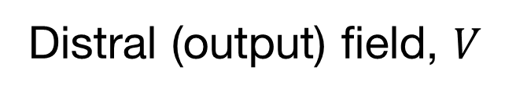
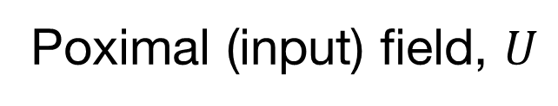
Bends in Optical Fibre are Bad
Bent optical fibre
Poximal (input) field, $U$
Distral (output) field, $V$
❤️
Cold and heartless!
💔😭
Simulated using pyMMF: Sébastien M. Popoff, “wavefrontshaping/pyMMF: 0.7”. Zenodo, Sep. 14, 2024. doi: 10.5281/zenodo.13763018.

Slide 3
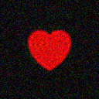
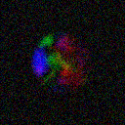


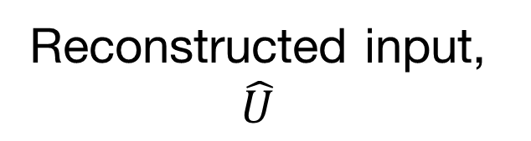
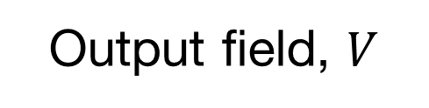
Bends in Optical Fibre are Bad
misunderstood
Input field, $U$
Output field, $V$
❤️
💖
💔
$$d$$
🤪
❤️‍🩹
Neural Network
(or other black box)
🥹
🫠
Reconstructed input, $\hat{U}$

Slide 4
Deep learning the Digital Twin of Bent Optical Fibre
Joshua R. Jandrell
Mitchell A. Cox
MSc Student,
Optical Communication Lab
THIS

Slide 5
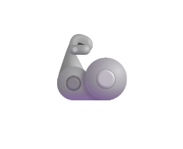
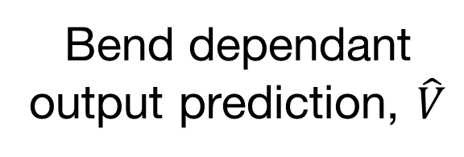
The Digital Twin
Input field, $U$
Actually really cool
Output field, $V$
💖
$$d$$
🤪
🙌
Digital Twin
🤖
🦾
Pretty helpful
😎
Physics
🍎💡📚
Bend dependant output prediction, $\hat{V}$

Slide 6

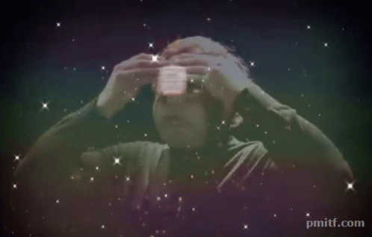
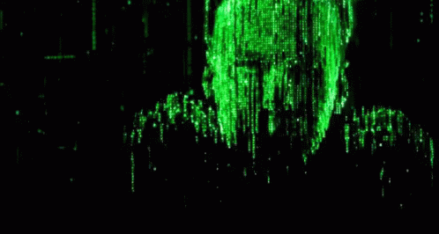
Why do we care about modelling defamations?
What if the bends
Better understanding
Improved simulation
Asking the wrong question.
worked for us?
Gifs from Tenor

Slide 7
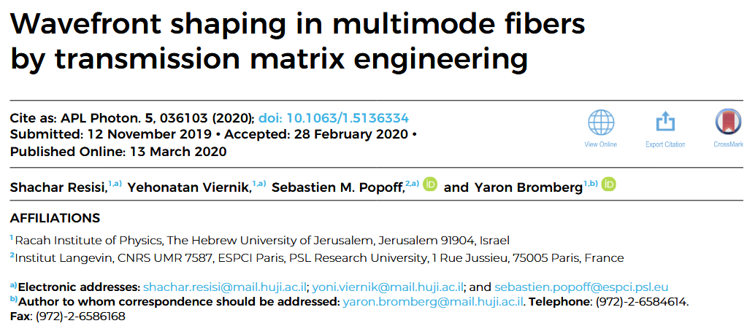
Bends are friends
(not food)

Slide 8
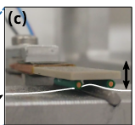
Bends are friends
(The fibre piano)
Voltage Controlled Actuator
(An image form the paper)

Slide 9
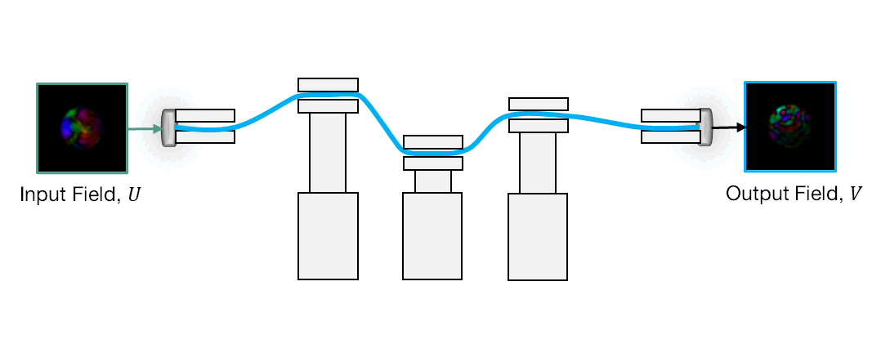
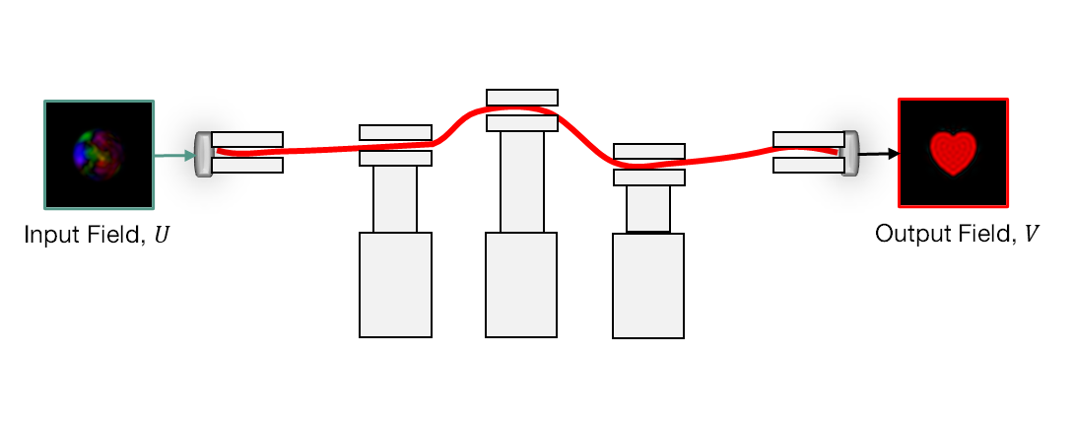
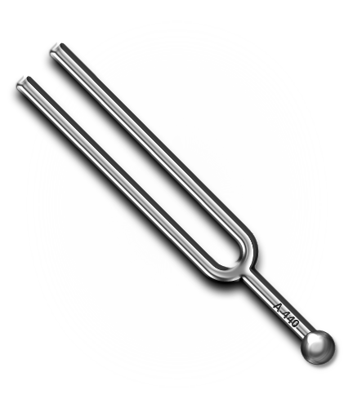
The Fibre Piano Concept
Need to be tuned
Wavefront Shaping
Optical Communications
Optical Quantum Circuits
Reservoir Computing

Slide 10

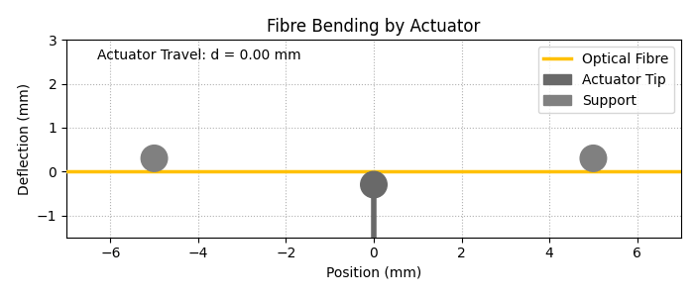
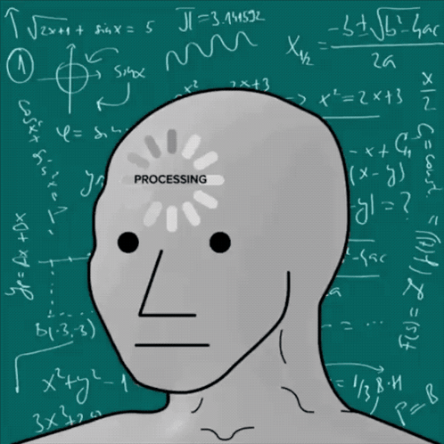
The Fibre Piano: Tuning Trouble
Do the Maths
Numerical Methods

Slide 11


The Fibre Piano: Tuning Trouble
Do the Maths
Swarm Algorithms
Make a Dictionary
Complicated
Misses nuance
Computer go brrrr
Tedious
Clumsy
Need a physical system
That’s a lot of data
Experimentally intensive
Not transferable

Slide 12

Why Neural Nets?
Interpolation
Compression
+
+
+
+
+
+

Slide 13

We has some data…

Slide 14
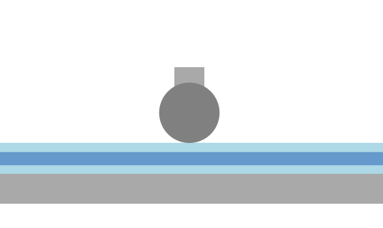
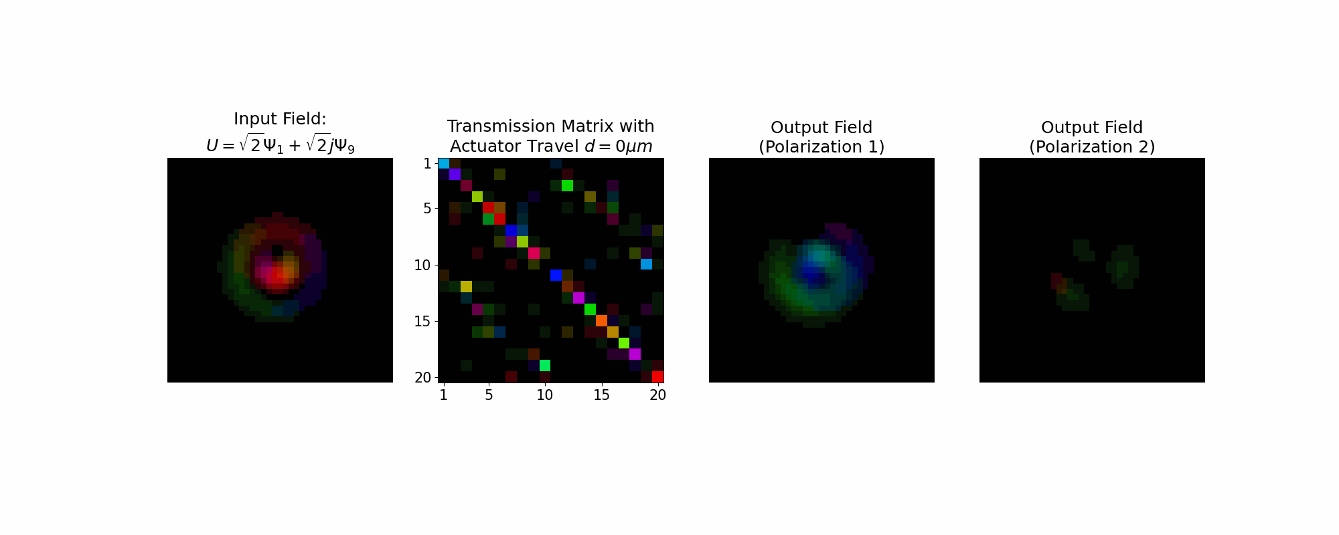
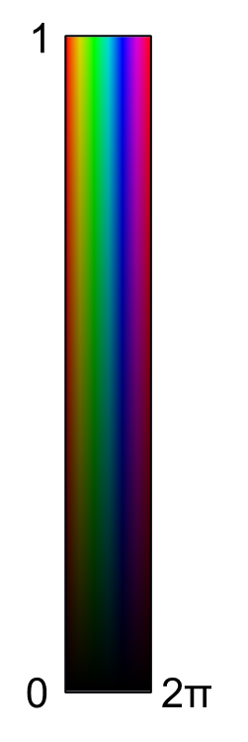
We has some data…
(Kinda…)

Slide 15
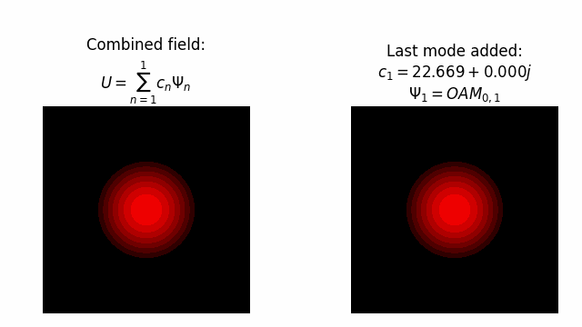
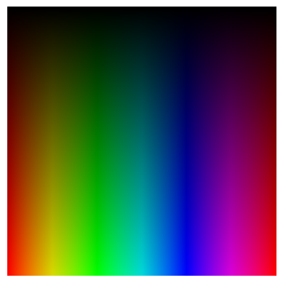
But what is modal decompaction?
Mode profiles
Complex weights
2π
0
1

Slide 16
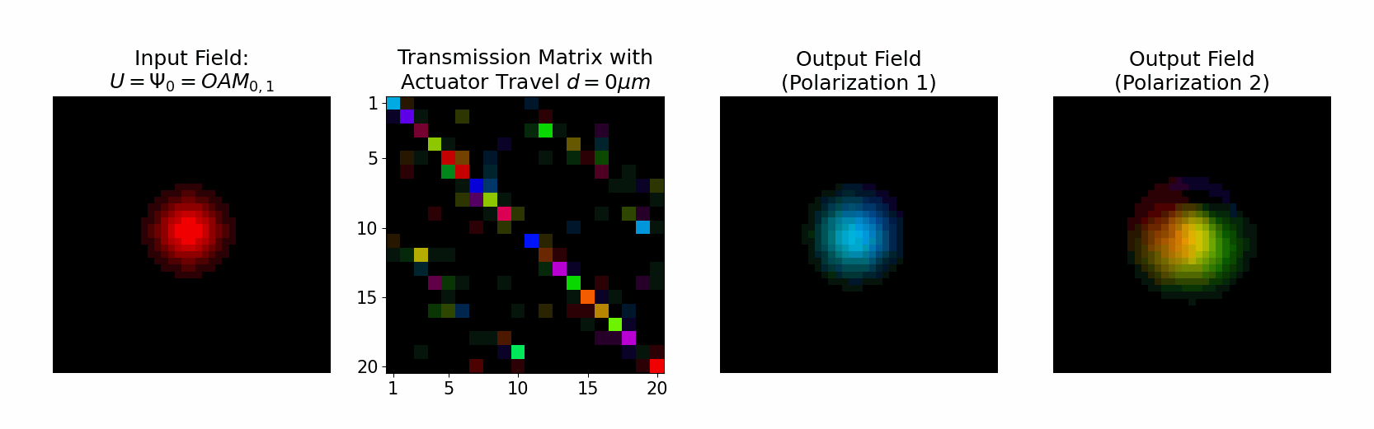
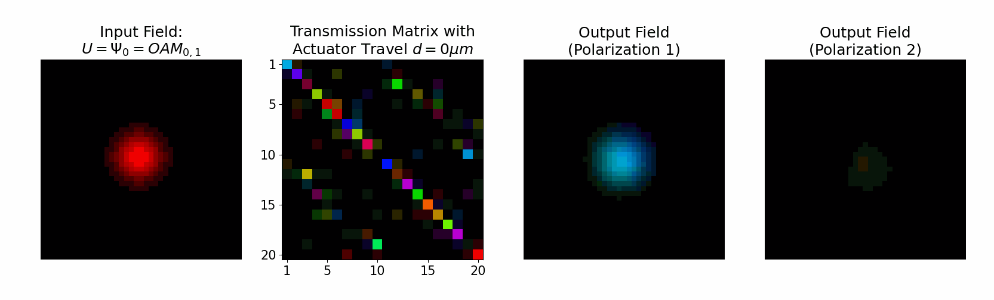

A Practical Example
↻
↻
↺
↻
↺
2π
0
1

Slide 17
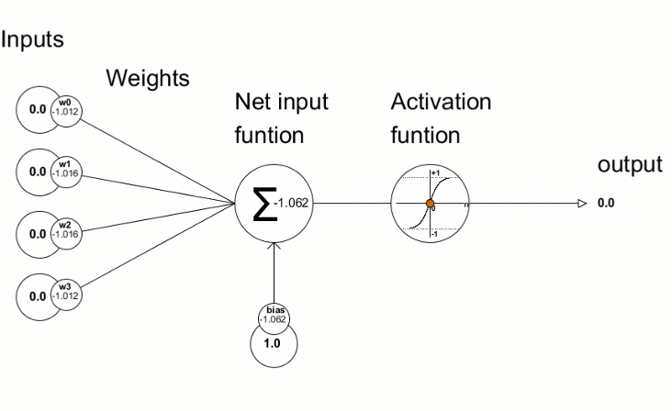






How do Neural Nets Work?
$$x_{0}$$
Trainable Parameters
$$x_{1}$$
$$\sum_{i=0}{x_{i}w_{i}+bias}$$
$$\sum_{i=0}{x_{i}w_{i}+bias}$$
$$x_{2}$$
$$x_{3}$$
Animation from twardsai.net [https://towardsai.net]

Slide 18

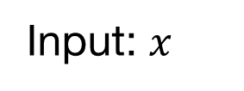


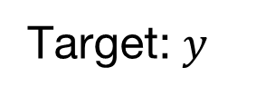


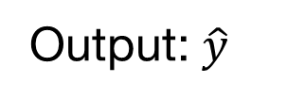




Multi-Layer Perceptron
$$x_{0}$$
$${\hat{y}}_{0}$$
$$x_{1}$$
$${\hat{y}}_{1}$$
$$x_{2}$$
$${\hat{y}}_{2}$$
$$x_{3}$$
$${\hat{y}}_{3}$$
Output: $\hat{y}$
Input: $x$
Target: $y$
Hidden layers
Loss Function:$ℓ\left(\hat{y},y\right)$
Back propagation

Slide 19
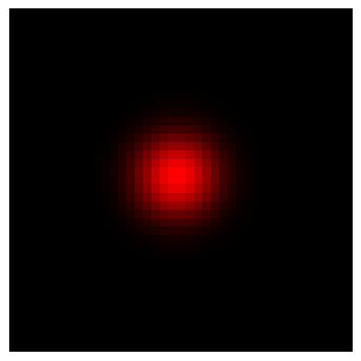
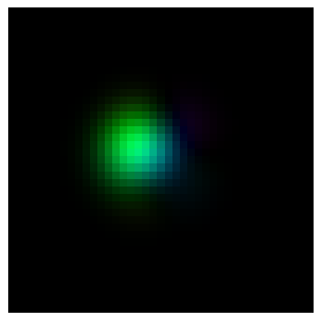
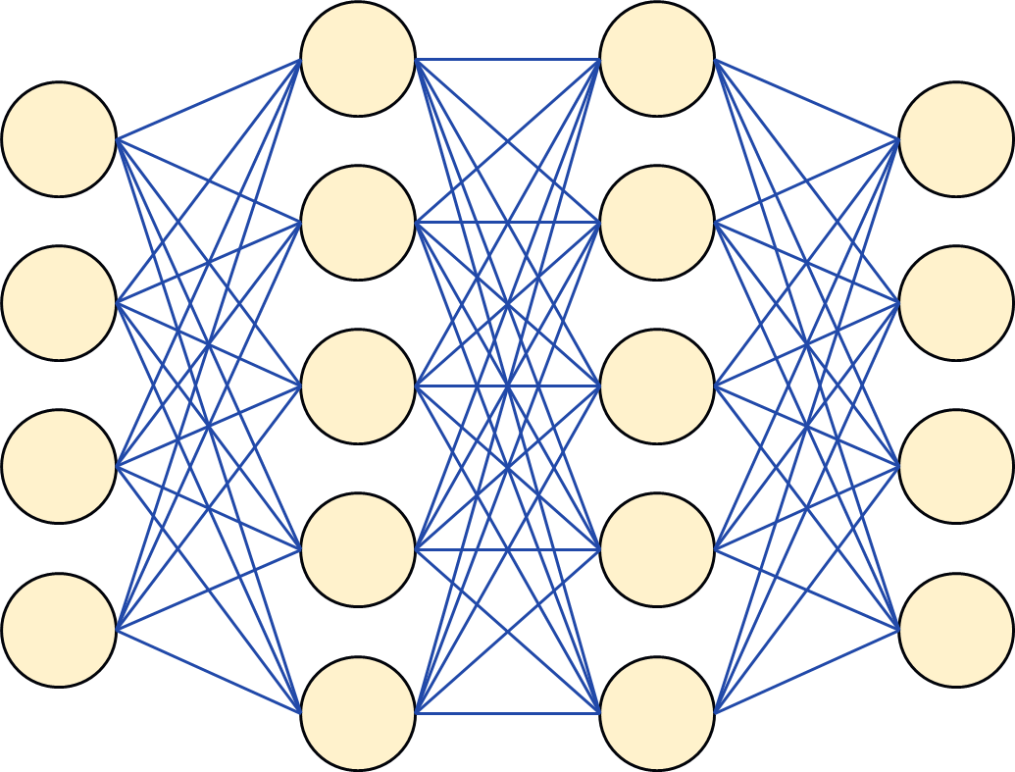

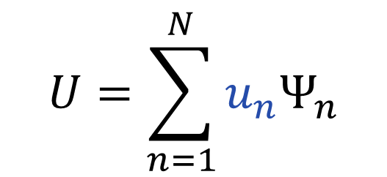


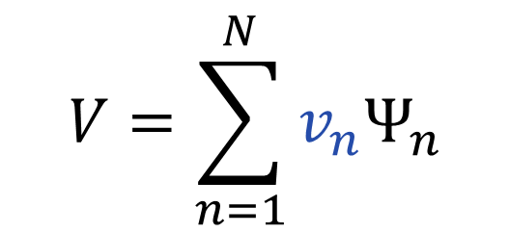
A Simple Model
Actually it’s quite complex
Input field weights
Sum output weights
$$U=\sum_{n=1}^{N}{u_{n}Ψ_{n}}$$
$$|u⟩$$
$$|v⟩$$
$$V=\sum_{n=1}^{N}{v_{n}Ψ_{n}}$$
Neural Net
Actuator travel
(normalized)
$$d$$

Slide 20








A Simple Model
Actually it’s quite complex
$$U$$
$$\hat{V}$$
Input field weights
Sum output weights
$$|u⟩$$
$$|v⟩$$
$$\hat{V}=\sum_{n=1}^{N}{v_{n}Ψ_{n}}$$
$$U=\sum_{n=1}^{N}{u_{n}Ψ_{n}}$$
$$U=\sum_{n=1}^{N}{u_{n}Ψ_{n}}$$
Neural Net
Actuator travel
(normalized)
$$d$$
$$d$$
Complex Weights!

Slide 21


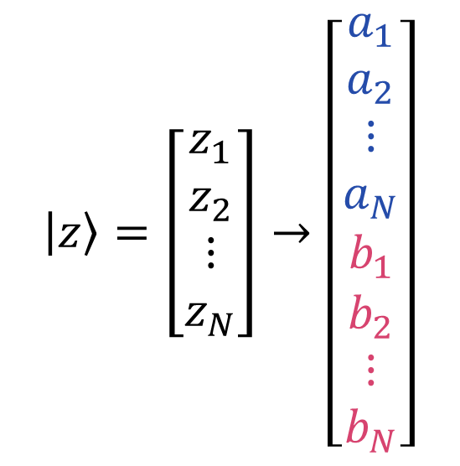

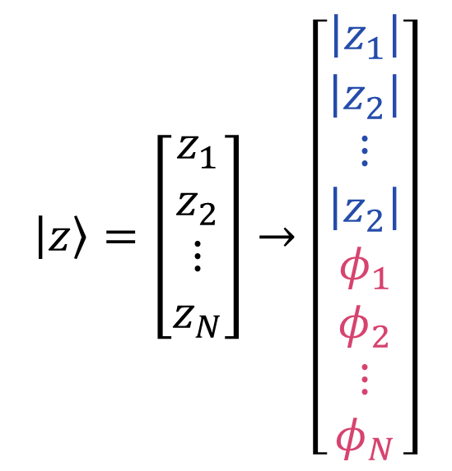
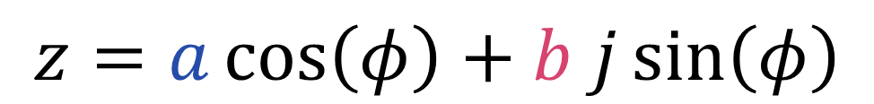
A Simple Model
Actually it’s quite complex
Argument
Imaginary
$$z=\left|z\right|e^{φj}$$
$$z=a\cos\left(φ\right)+b j\sin\left(φ\right)$$
Modulus
Real
$$\left|z\right\rangle =\left[\begin{matrix}z_{1} \\ z_{2} \\ ⋮ \\ z_{N}\end{matrix}\right]→\left[\begin{matrix}\left|z_{1}\right| \\ \left|z_{2}\right| \\ ⋮ \\ \left|z_{2}\right| \\ φ_{1} \\ φ_{2} \\ ⋮ \\ φ_{N}\end{matrix}\right]$$
$$\left|z\right\rangle =\left[\begin{matrix}z_{1} \\ z_{2} \\ ⋮ \\ z_{N}\end{matrix}\right]→\left[\begin{matrix}a_{1} \\ a_{2} \\ ⋮ \\ a_{N} \\ b_{1} \\ b_{2} \\ ⋮ \\ b_{N}\end{matrix}\right]$$
$$2N$$
$$2N$$

Slide 22










A Simple Model
Actually it’s quite complex
$$Re\left[u⟩]\right]$$
$$Re\left[\hat{v}⟩]\right]$$
$$|u⟩$$
$$|v⟩$$
$$|\hat{v}⟩$$
$$|u⟩$$
$$Im\left[u⟩]\right]$$
$$Im\left[\hat{v}⟩]\right]$$
$$d$$
Neural Net
$$d$$
Mean Square Error: $MSE\left(\hat{y},y\right)=\frac{1}{N}\sum_{n=1}^{N}{{\left({\hat{y}}_{n}−y\right)}^{2}}$

Slide 23
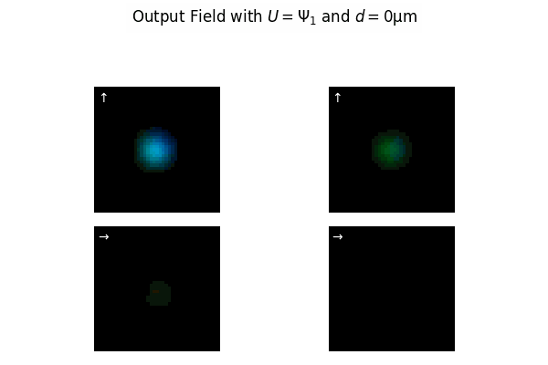


The results…
I’m at a loss…
Target, $V$
Prediction, $\hat{V}$
↻
↻
↺
↺

Slide 24
Add Energy Loss
Mean Square Error: $MSE\left(\hat{y},y\right)=\frac{1}{N}\sum_{n=1}^{N}{{\left({\hat{y}}_{n}−y\right)}^{2}}$
Energy Loss: $E\left(\hat{y},y\right)=\left|∑{\left|\left|\hat{v}\right\rangle \right|}^{2}−\sum{{\left|\left|v\right\rangle \right|}^{2}}\right|$

Slide 25
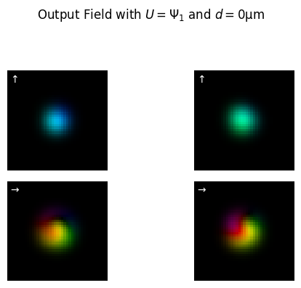
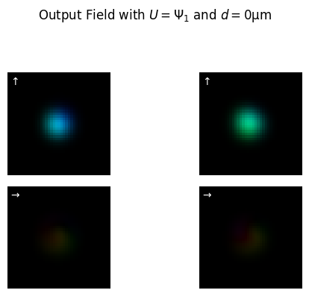


The results…
I’m at a loss…
Target, $V$
Prediction, $\hat{V}$
↻
↻
1
∠2π
0
0.175
↺
↺
∠0

Slide 26


The Results…
The neural net is unphased
Target, $V$
Prediction, $\hat{V}$
↻
↻
∠2π
0
1
↺
↺
∠0

Slide 27











The Results…
The neural net is unphased
Target, $V$
Prediction, $\hat{V}$
$$\left|V\right|$$
↻
↻
$$\left|V\right|$$
1
π
$$∠V$$
$$∠V$$
∠2π
$$\left|V\right|$$
↺
↺
0
$$\left|V\right|$$
1
∠0
$$∠V$$
$$∠V$$
0
-π

Slide 28






What’s going on!?
The neural net is unphased

Slide 29










What’s going on!?
A look a ‘the math’ (but not really)
$$Δφ∝d$$
$$Δφ∝β^{′}$$
$$Δφ=β^{′}L$$
$$F∝d$$
Hooke’s Law 🪝
$$σ∝F$$
Contant contact
$$Re\left[{\hat{v}}_{n}\right]=\left|{\hat{v}}_{n}\right|cos\left(φ+Δφ\right)$$
$$Re\left[{\hat{v}}_{n}\right]=\left|{\hat{v}}_{n}\right|\left(cos\left(f_{k}d\right)+\sin\left(f_{k}d\right)\right)$$
$$Re\left[{\hat{v}}_{n}\right]=\left|{\hat{v}}_{n}\right|cos\left(φ+f_{k}d\right)$$
$$Δn∝σ$$
Linear effect!
$$γ\left(d\right)=\left[\cos\left(df_{1}\right),\sin\left(df_{1}\right),…,\cos\left(df_{k}\right),\sin\left(df_{k}\right) \right]$$
$$Δβ∝Δn$$
Seems legit

Slide 30








A Simple Model
Actually it’s quite complex
$$Re\left[u⟩\right]$$
$$Re\left[\hat{v}⟩\right]$$
$$|u⟩$$
$$|\hat{v}⟩$$
$$|v⟩$$
$$Im\left[u⟩\right]$$
$$Im\left[\hat{v}⟩\right]$$
Neural Net
$$d$$
Sinusoidal Features
$$γ\left(d\right)=\left[\cos\left(df_{1}\right),\sin\left(df_{1}\right),…,\cos\left(df_{k}\right),\sin\left(df_{k}\right) \right]$$

Slide 31

The Results…

Slide 32



The Results…
The neural net is unphased
Target, $V$
Prediction, $\hat{V}$
↻
↻
1
∠2π
0
0.175
↺
↺
∠0

Slide 33
The Results…
The neural net is unphased
Target, $V$
Prediction, $\hat{V}$
1
∠2π
0
0.175
∠0

Slide 34



The Results…
Target, $V$
Prediction, $\hat{V}$
$\hat{V}$, No Features

Slide 35




The Results…
Target, $V$
$\hat{V}$, With Features
$\hat{V}$, No Features
↻
↻
↻
↺
↺
↺

Slide 36



Summary
Input field, $U$
Output field, $V$
$$d$$
🙌
Digital Twin
🤖
🦾
$$γ\left(d\right)=\left[\cos\left(df_{1}\right),\sin\left(df_{1}\right),…,\cos\left(df_{k}\right),\sin\left(df_{k}\right) \right]$$
Bend dependant output prediction, $\hat{V}$

Slide 37
Moving Forward
Improve and Optimize
Rigorously Test Performance
Measure and Train on Bend
Compare to Real System

Slide 38
Thanks and Acknowledgments
Dr Geraud Nangue Tasse

Slide 39

Thank you!
2333213@students.wits.ac.za

Slide 40
Thank you!
Deformations (bends, presses, stretches, spins, …) are Dope!
Curls look glorious
Yes!
Bend holds cable like pro
Hi mom I’m on TV
Guest squeezes into picture
Glasses deflect dangerous light
Pressure (supervisor) makes work happen fast
#bends are based
Bent arms: very cool
Bent collar: looks rad
Bends control polarization
Screwdriver Spins stuff to make setup super tight
2333213@students.wits.ac.za

Slide 41









For a bend?
(A quick aside)
$$L$$
$$⇒Δφ∝\frac{1}{R{\left(d\right)}^{2}}$$
$$R\left(d\right)=\frac{d}{2}+\frac{L^{2}}{8d}$$
$${Δφ=β}^{′}S\left(d\right)$$
$$S\left(d\right)=2R\left(d\right)\arcsin\left(\frac{L}{2R\left(d\right)}\right)$$
$$⇒S\left(d\right)∝\frac{1}{R\left(d\right)}$$
$${Δφ=β}^{′}L$$
$$β^{′}∝\frac{1}{R\left(d\right)}$$
$$R\left(d\right)=\frac{d}{2}+\frac{L^{2}}{8d}$$
$$γ\left(d\right)=\left[\cos\left(\frac{2πf_{1}}{{R\left(d\right)}^{2}}\right),\sin\left(\frac{2πf_{1}}{{R\left(d\right)}^{2}}\right) ,…,\cos\left(\frac{2πf_{k}}{{R\left(d\right)}^{2}}\right),\sin\left(\frac{2πf_{k}}{{R\left(d\right)}^{2}}\right) \right]$$
$$γ\left(d\right)=\left[\cos\left(df_{1}\right),\sin\left(df_{1}\right),…,\cos\left(df_{k}\right),\sin\left(df_{k}\right) \right]$$
$$γ\left(d\right), γ\left(d^{2}\right), γ\left(d^{−1}\right)$$

Slide 42
But what is modal decompaction?
Mode profiles
Complex weights
2π
0
1

Slide 43















































Fibre Eigenmodes
Linearly Polarized (LP)
Orbital Angular Momentum (OAM)
$$LP_{0,1}$$
$$β=17.286957$$
$${OAM}_{0,1}$$
$$\vec{E}=Ψ\left(r,φ\right)e^{j\left(ωt−βz\right)}$$
$$\vec{E}=Ψ\left(r,φ\right)e^{j\left(ωt−βz\right)}$$
$$\vec{E}=Ψ\left(r,φ\right)e^{j\left(ωt−βz\right)}$$
Optical Mode
Propagation constant
$$LP_{1,1a}$$
$$LP_{1,1b}$$
$$β=17.279687$$
$${OAM}_{1,1}$$
$${OAM}_{−1,1}$$
$$LP_{2,1a}$$
$$LP_{2,1b}$$
$$β=17.270345$$
$${OAM}_{2,1}$$
$${OAM}_{−2,1}$$
$$LP_{0,2}$$
$$β=17.267374$$
$${OAM}_{0,2}$$
$$LP_{3,1b}$$
$$LP_{3,1b}$$
$$β=17.259263$$
$${OAM}_{3,1}$$
$${OAM}_{−3,1}$$
$$LP_{1,2a}$$
$$LP_{1,2b}$$
$$β=17.254314$$
$${OAM}_{1,2}$$
$${OAM}_{−1,2}$$

Slide 44
Fibre Eigenmodes
Linearly Polarized (LP)
Orbital Angular Momentum (OAM)
$$LP_{0,1}$$
$$β=17.286957$$
$${OAM}_{0,1}$$
$$LP_{1,1a}$$
$$LP_{1,1b}$$
$$β=17.279687$$
$${OAM}_{1,1}$$
$${OAM}_{−1,1}$$
$$LP_{2,1a}$$
$$LP_{2,1b}$$
$$β=17.270345$$
$${OAM}_{2,1}$$
$${OAM}_{−2,1}$$
$$LP_{0,2}$$
$$β=17.267374$$
$${OAM}_{0,2}$$
$$LP_{3,1b}$$
$$LP_{3,1b}$$
$$β=17.259263$$
$${OAM}_{3,1}$$
$${OAM}_{−3,1}$$
$$LP_{1,2a}$$
$$LP_{1,2b}$$
$$β=17.254314$$
$${OAM}_{1,2}$$
$${OAM}_{−1,2}$$

Slide 45







The transmission matrix
$$V=\sum_{n=1}^{N}{v_{n}Ψ_{n}}$$
$$U=\sum_{n=1}^{N}{u_{n}Ψ_{n}}$$
Output: $|v⟩$
Input: $|u⟩$
$$\left[\begin{matrix}T_{1,1} & T_{1,2} & ⋯ & T_{1,n} \\ T_{2,1} & T_{2,2} & ⋯ & T_{2,n} \\ ⋮ & ⋮ & ⋱ & ⋮ \\ T_{n,1} & T_{n,2} & ⋯ & T_{n,n}\end{matrix}\right]$$
$\left[\begin{matrix}u_{1}e^{β_{1}Lj} \\ u_{2}e^{β_{2}Lj} \\ ⋮ \\ u_{N}e^{β_{N}Lj}\end{matrix}\right]=\left[\begin{matrix}v_{1} \\ v_{2} \\ ⋮ \\ c_{N}\end{matrix}\right]=\left[\begin{matrix}e^{β_{1}Lj} & 0 & ⋯ & 0 \\ 0 & e^{β_{2}Lj} & ⋯ & 0 \\ ⋮ & ⋮ & ⋱ & ⋮ \\ 0 & 0 & ⋯ & e^{β_{N}Lj}\end{matrix}\right]$ $\left[\begin{matrix}u_{1} \\ u_{2} \\ ⋮ \\ u_{N}\end{matrix}\right]$
Transmission Matrix: $T$

