Slide 1

Seeing through random media with topological light
Tatjana Kleine, Kelsey Everts, Cade Peters, Pedro Ornelas and Andrew Forbes
Structured Light Laboratory, School of Physics

Slide 2
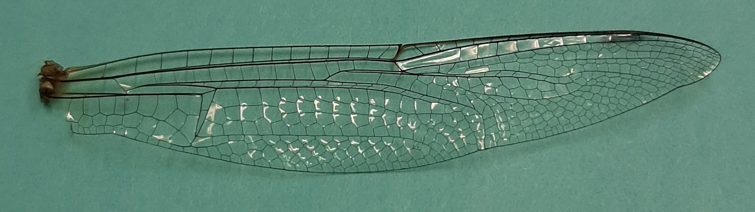
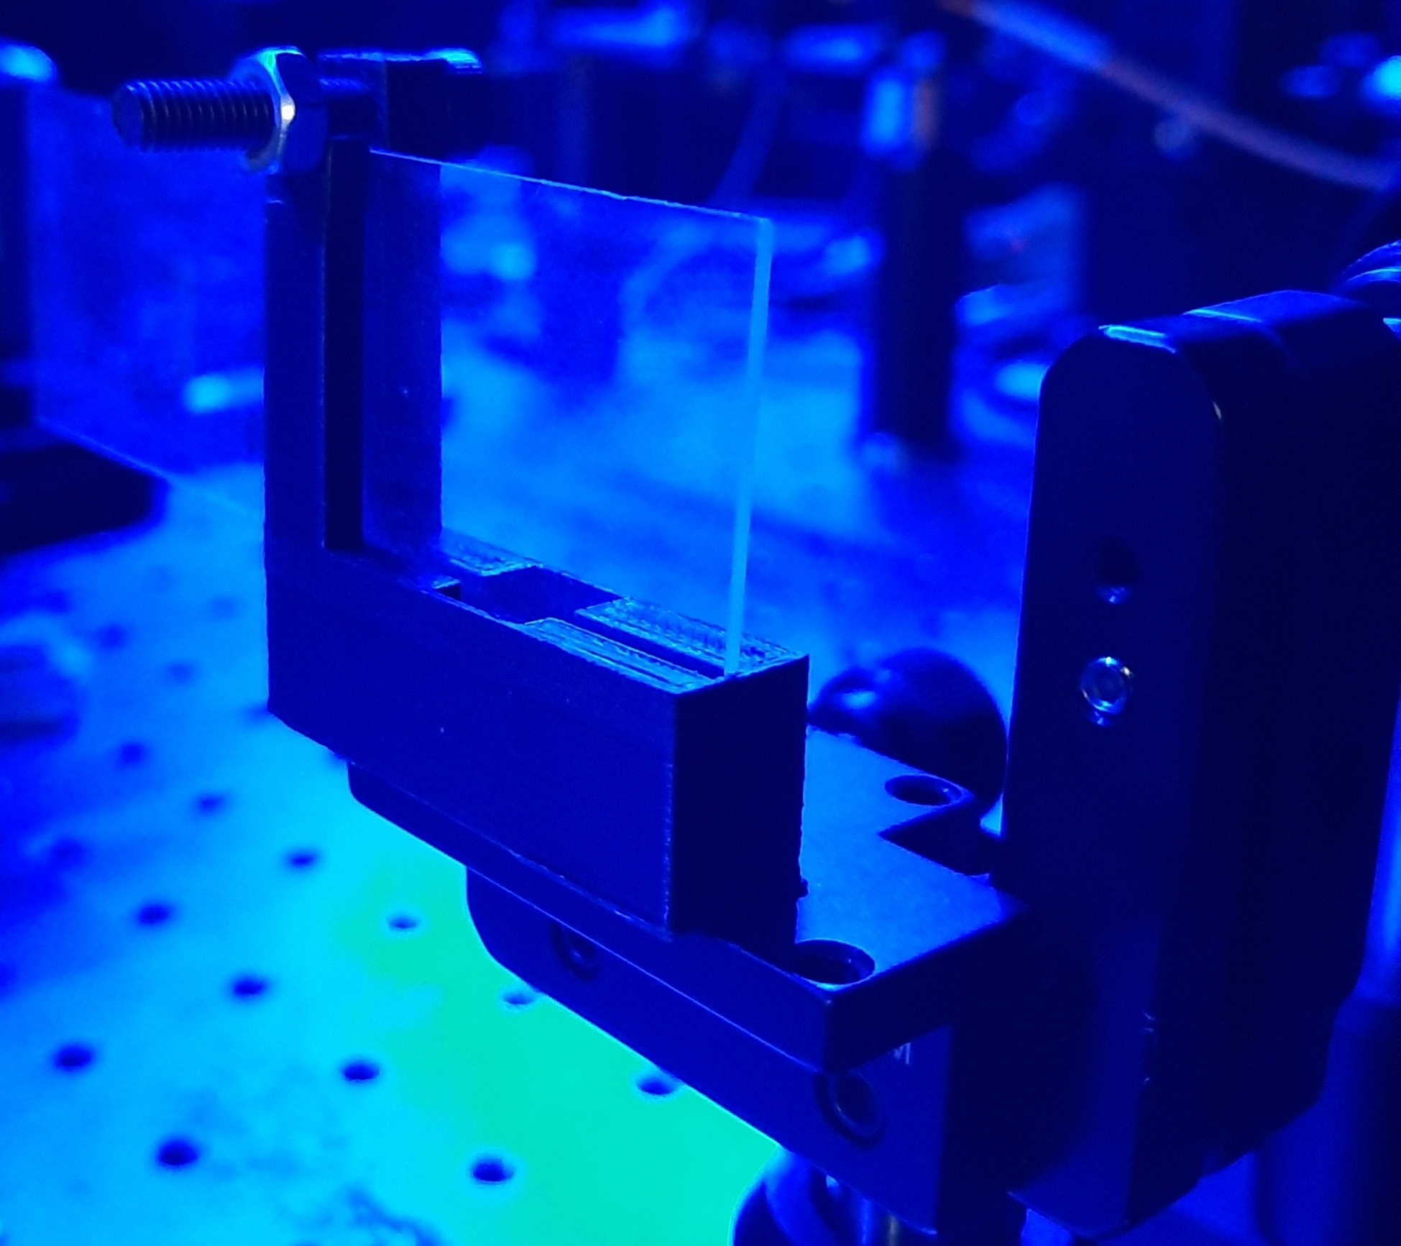
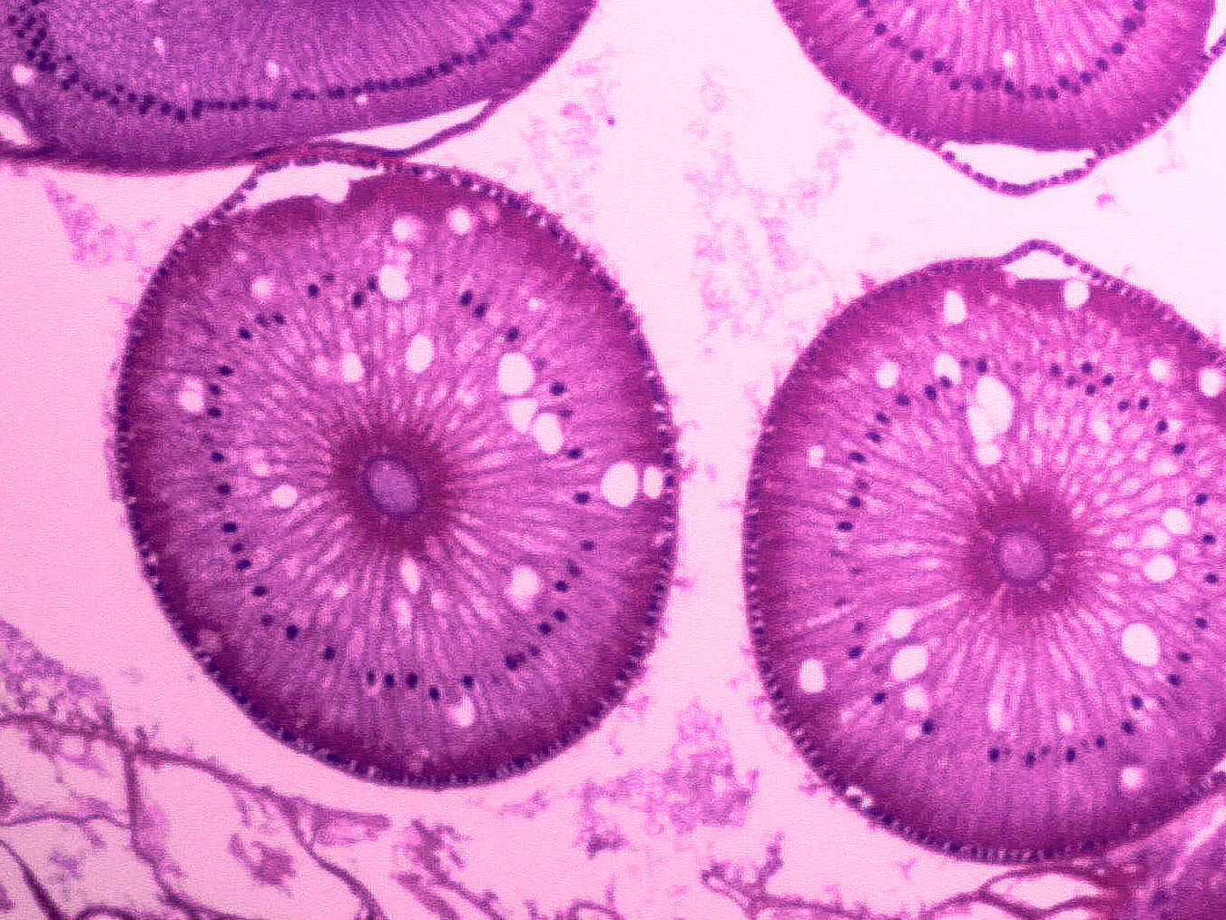
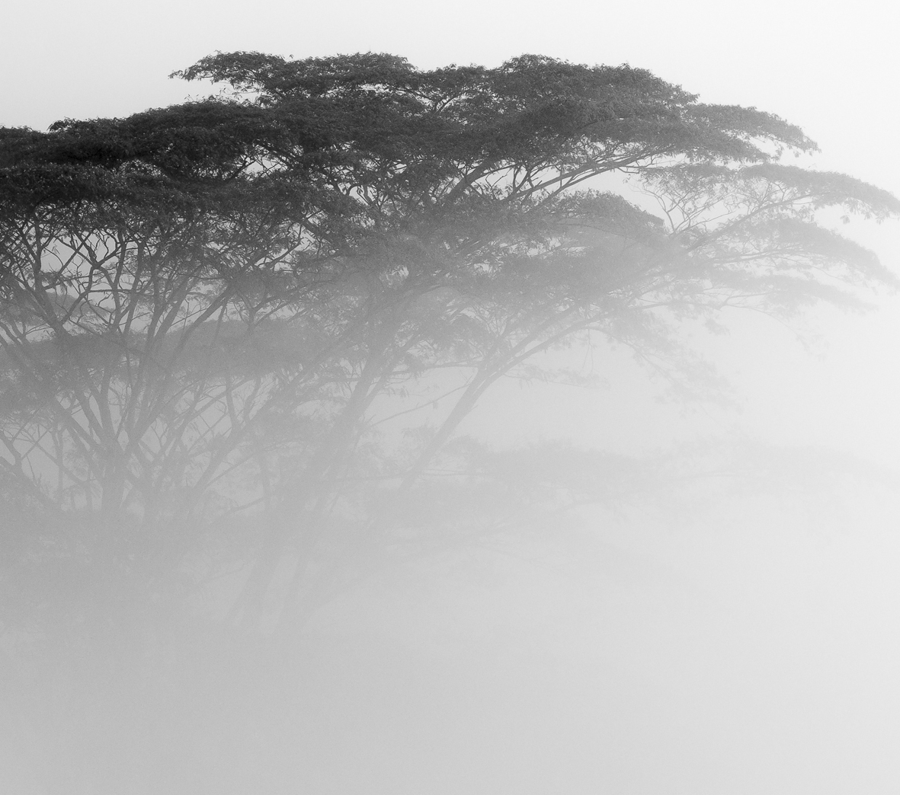
What is random media?
Notes:
What reader must know: What random media generally is in the real world.
Let’s begin with, what is random media and why do we want to see through it.
What is this random media? Well, it could be fog, tissue, scratched optics or living tissue.
This random media fundamentally limits imaging and spectroscopy techniques because we can’t see through it. It scatters incoming light.
So it would be nice if we could see through randomness and get information through it. But how do we do this?
What could we use that could survive randomness?

Slide 3
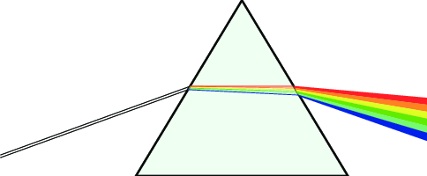

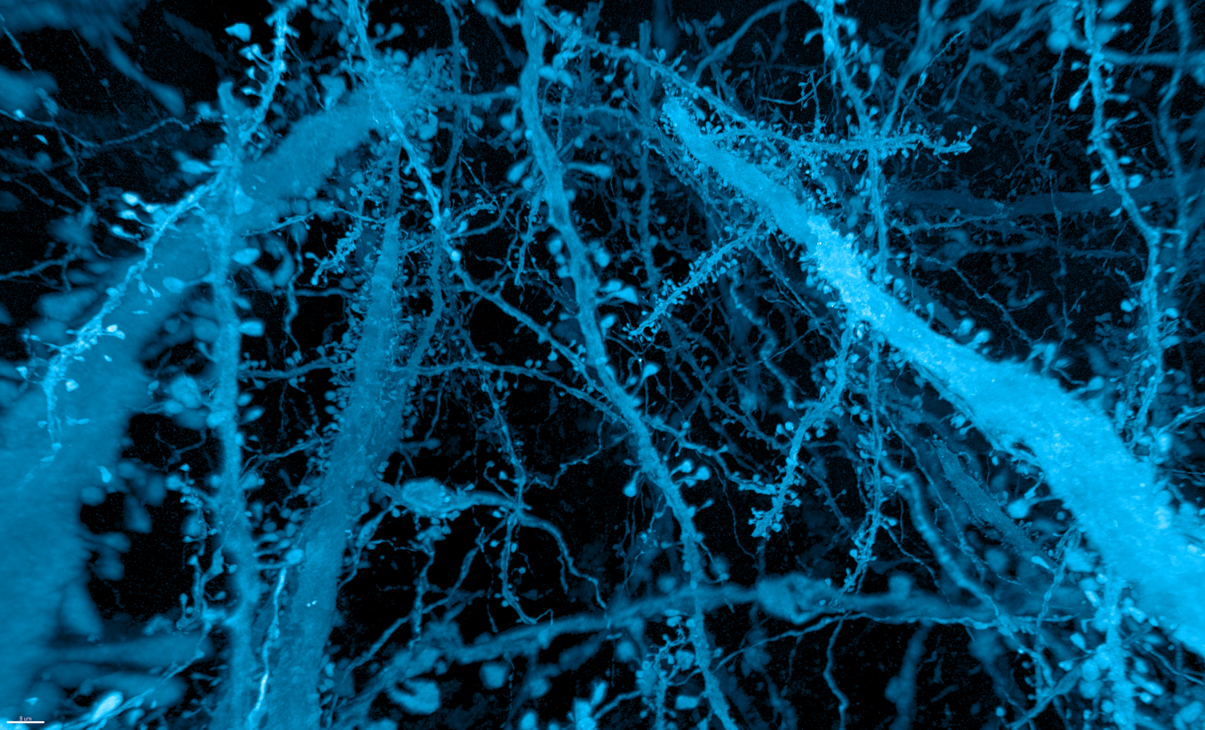
Where does it cause problems?
Source
Slit
Monochromator
Sample
Slit
Detector
Notes:
Main idea: Issue in spectroscopy and imaging.
Diagram of a spectroscopic set up, but we have issues when our samples or sample containers aren’t transparent and light gets scattered significantly.
We use spectroscopy since it’s a very cheap accessible technique, but it’s limitations limit our use of it.
Would be nice to see through turbid samples.

Slide 4

Current methods available to see through random media
I
t
Notes:
Main point: We can see through fog and turbid media.
We are able to see through fog as follows, we send photons through the fog, some travel straight through the fog and out the other side, these are ballistic photons.
But a lot of the other photons bounce around and scatter inside of the fog before exiting and thus exit much later.

Slide 5
Some shortcomings of detecting ballistic photons
I
Processing
Δt
t
Notes:
Main point: Our current methods are difficult and need post processing.
To detect the ballistic photons we need a really short collection time so we don’t catch the photons that have been scattered around. We also need to start detecting almost as soon as we send the light through the sample (after all these are travelling at the speed of light).
In reality there are far more scattered photons arriving at our detector than the ballistic ones, some scattered paths are also only fractionally longer than the ballistic photons path, so we need a way to remove the contribution of these and detect them in the first place.
We need a lot of sophisticated equipment to make this happen, and even so can we really remove all those scattered photons from our ballistic signal?

Slide 6

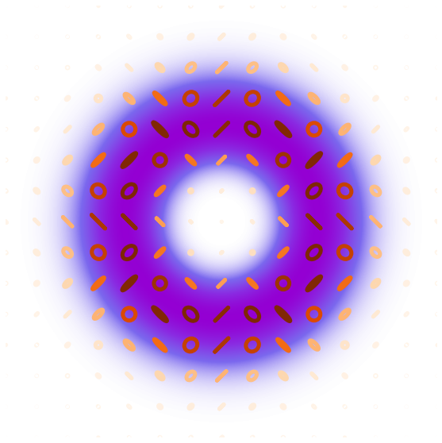
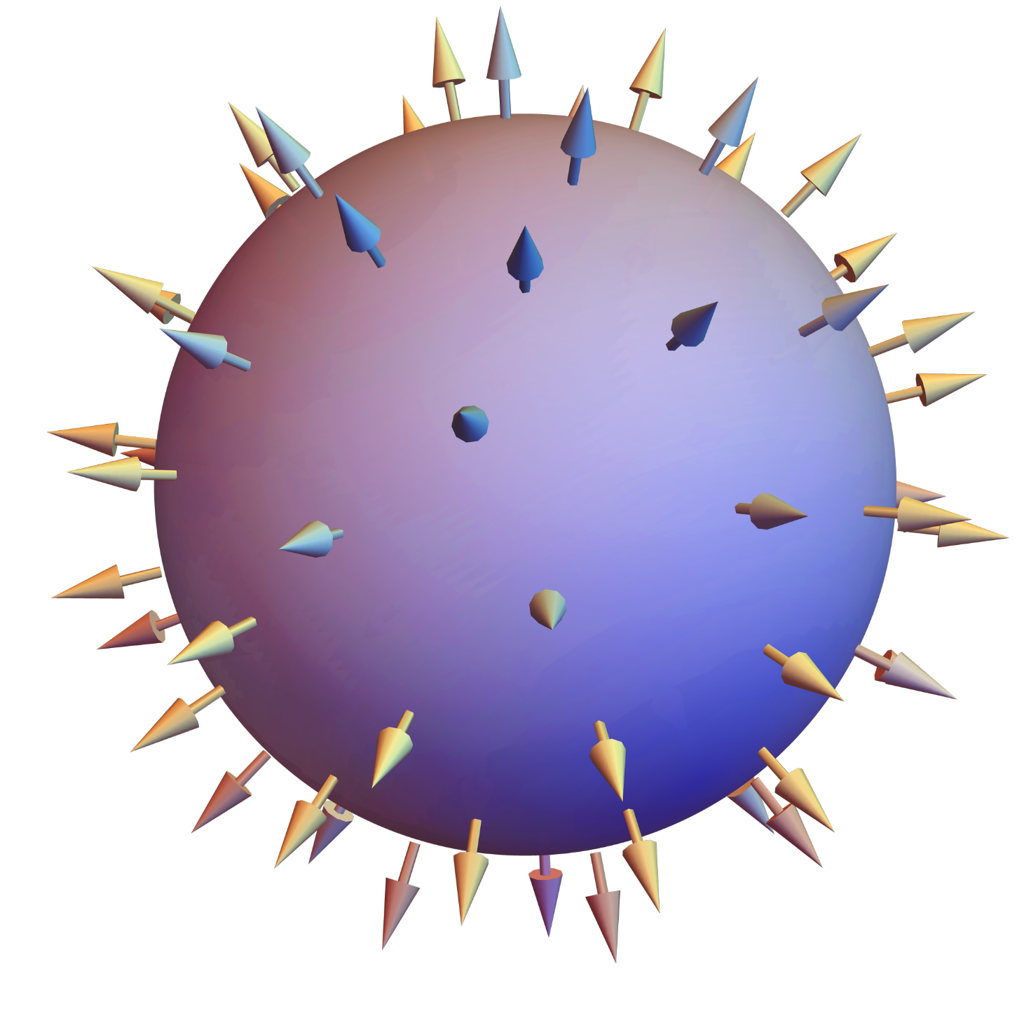
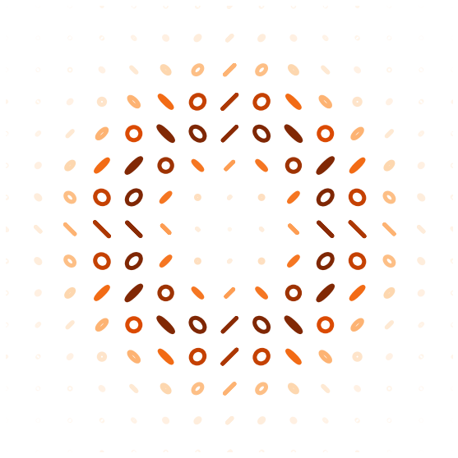
Where does topology come from?
Notes:
We could use topology to do this, because topology has been shown to be robust to smooth deformations.
But what is topology?
Topology arises from non-seprable parameters where the one maps onto the other, what are these parameters in our light?
A beam of light at a particular point contains spatial information, but at that particular point it also has polarisation information.
If you were to move to another point in space that point would have different polarisation information.
The spatial and polarisation information for a classical vector beam are non separable, to know the one, we must first know the other and take a measurement.
This mapping from spatial to polarisation is what gives rise to the topology.
A fantastic property of topology is it can undergo smooth deformations and still be conserved. Making it an excellent candidate for transmitting information through random media.
We’ve investigated if topology is resilient to random media, because if it is, it could open many doors in the fields of imaging and spectroscopy and communication.
But we first needed a way to check if this will work before moving to real samples.

Slide 7
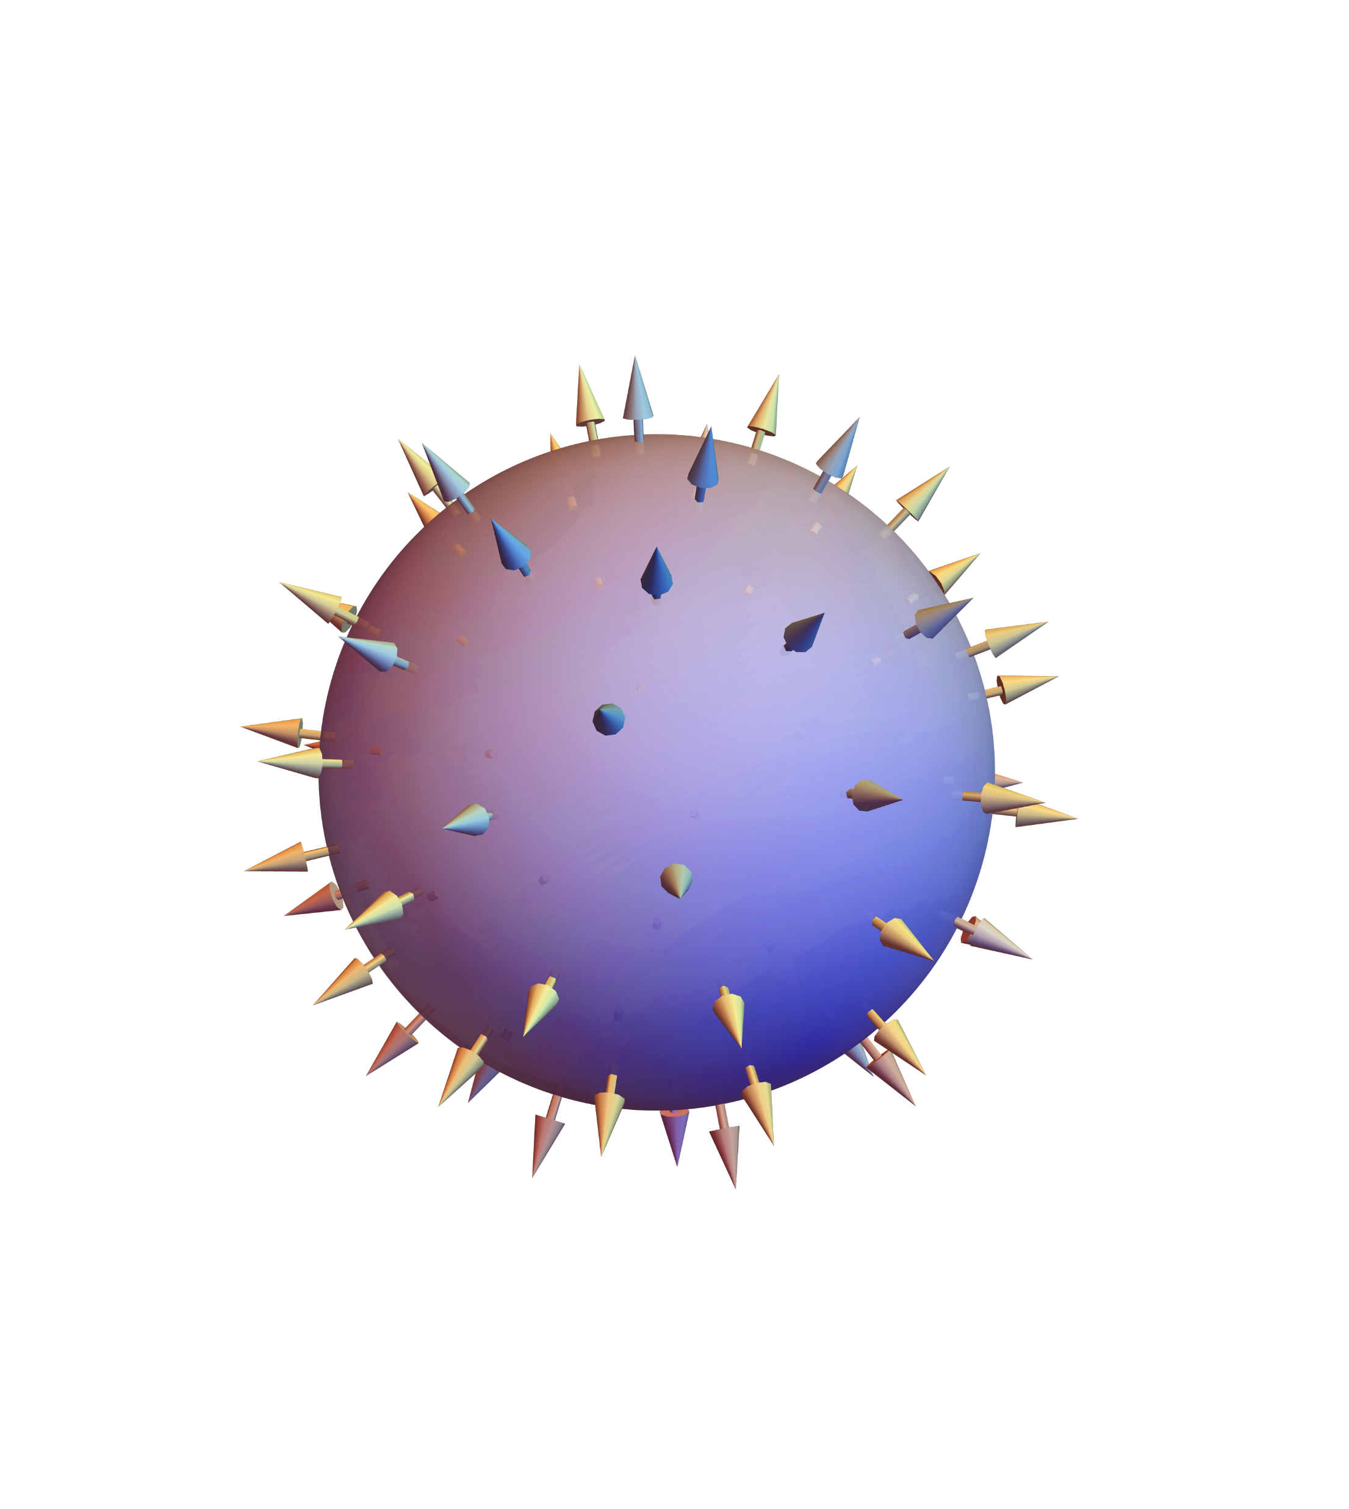
Why use topology?
N = 1
N = 1
Notes:
Main take away: Why topology is robust and a great candidate.
We can pass our Skyrmions through stuff and they do come out distorted, but all their underlying information is still there, so the Skyrme number remains invariant.

Slide 8
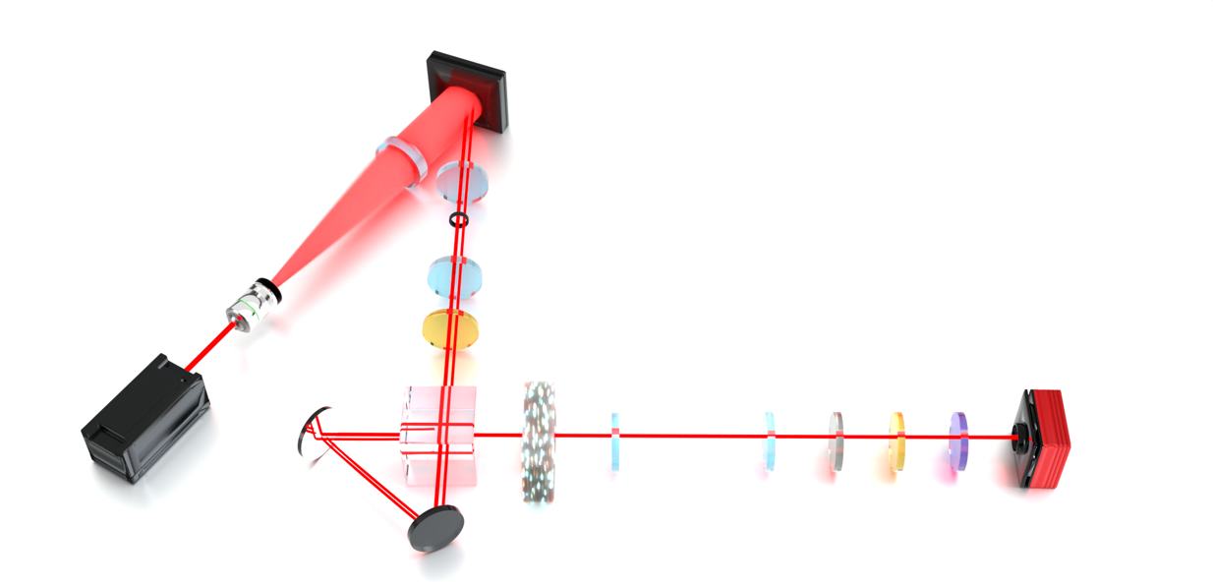
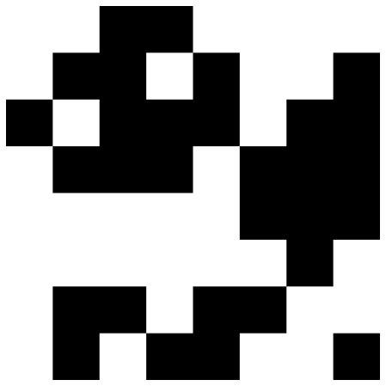
Generating topology
SLM
Lens
Lens
Spatial Filter
Lens
Lens
HWP
Laser
PBS
Mirror
Lens
Lens
QWP
HWP
LP
Sample
CCD
Mirror

Slide 9







How random phase masks simulate distortion
$$d$$
$$d$$
$$l_{0}$$
Increasing distortion strength (ω)
+
=
Hologram with vortex
Mask
Final hologram
Notes:
Main take away: We first show control by simulating randomness by using spatial light modulators.
We produce binary phase screens that consist of pixels that oscillate between pi and 0. Where pi is black and white is zero.
Their distortion strength is defined by a dimensionless parameter omega which is the ratio between the superpixel size represented by d and the SLM screen size represented by l0.
As omega increases and the size of the superpixel gets smaller the distortion strength increases.
These masks are projected onto the SLM, we have the hologram with a vortex that we use to create our vector beams, we add the mask on top and this is what the final holograms look like.

Slide 10

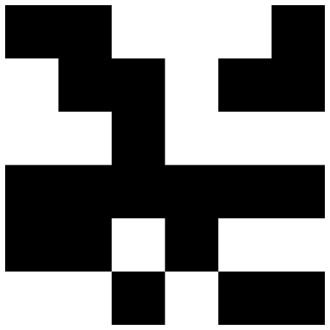
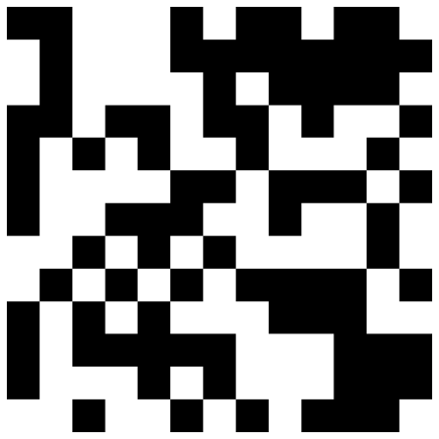

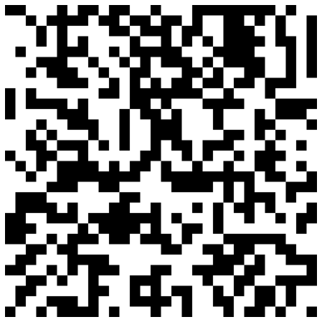
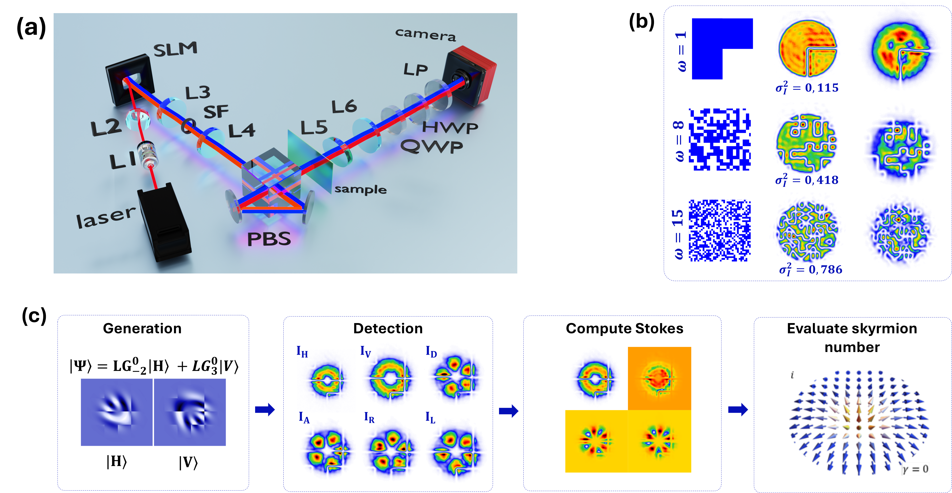
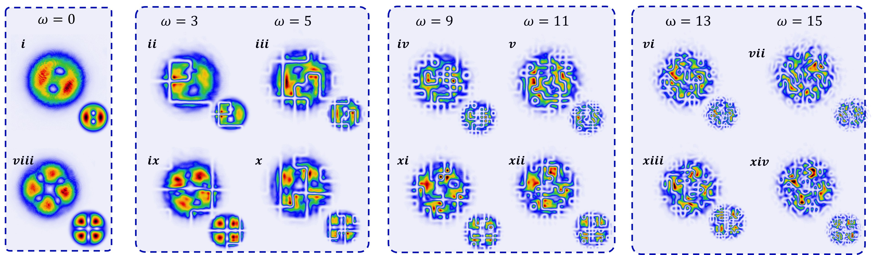
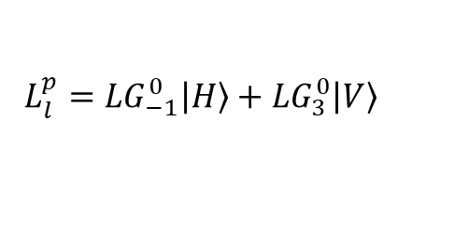



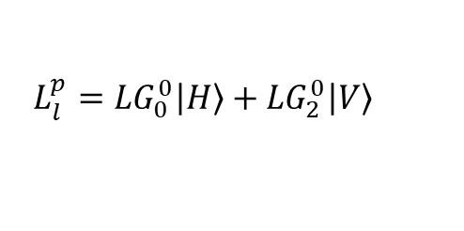
Effects of the phase masks on the beams
$$L_{l}^{p}={LG}_{0}^{0}\left|\left.H\right\rangle \right.+{LG}_{2}^{0}\left|\left.V\right\rangle \right.$$
$$N=2$$
$$L_{l}^{p}={LG}_{−1}^{0}\left|\left.H\right\rangle \right.+{LG}_{3}^{0}\left|\left.V\right\rangle \right.$$
$$N=−4$$
Notes:
Main point: The masks mess up the beams significantly.
Here’s an example of how the beams generating two different kinds of Skyrme numbers are distorted by the random masks, as we move from left to right the distortion strength of the masks increases and we struggle to see the beams original features.
End with: Will the topology still be conserved after this?

Slide 11

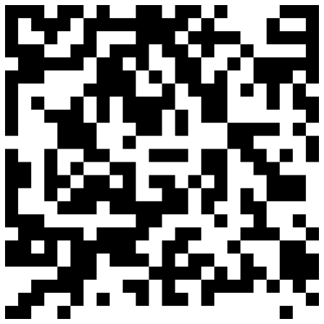
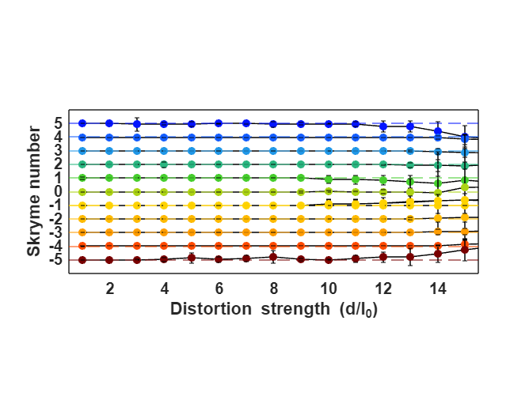
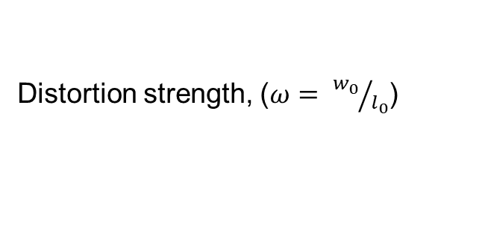
Topology remains intact through various distortion strengths
Weak
Moderate
Strong
5
4
3
2
1
Skyrme number
0
-1
-2
-3
-4
-5
2
4
6
8
10
12
14
Distortion strength, ($ω= {w_{0}}/{l_{0}}$)
Notes:
All the Skyrme numbers survive.
We tested 11 Skyrme numbers with 15 different strength phase masks, AND each point seen here the Skyrme number was computed for 100 phase masks and averaged.
There were three distinct regions tested, the weak region, moderate and strong, and for each one there is an example of the kind of phase mask used.
Around a distortion strength of 12 we start to see some deviation, but it’s important to see that only the larger Skyrme numbers start to drop in value.
It’s really only when we cross into the strong region that all the Skyrme numbers start to get affected.
This was great, topology was conserved for the phase masks over a large range of distortion strengths, we have now shown control in a digital case and can move on to real samples.

Slide 12
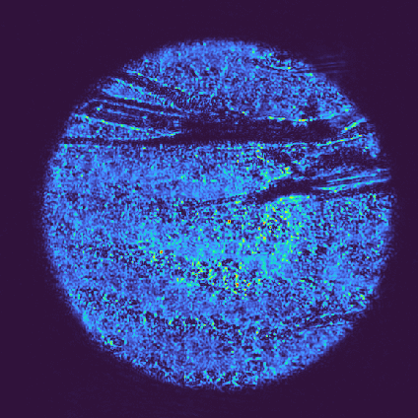
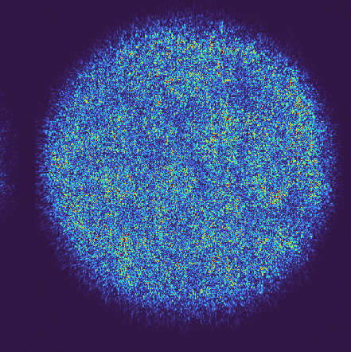
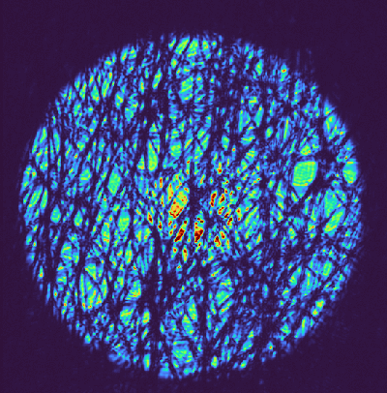
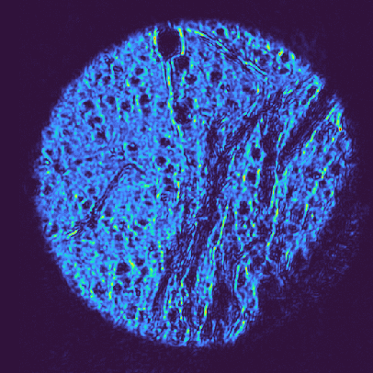
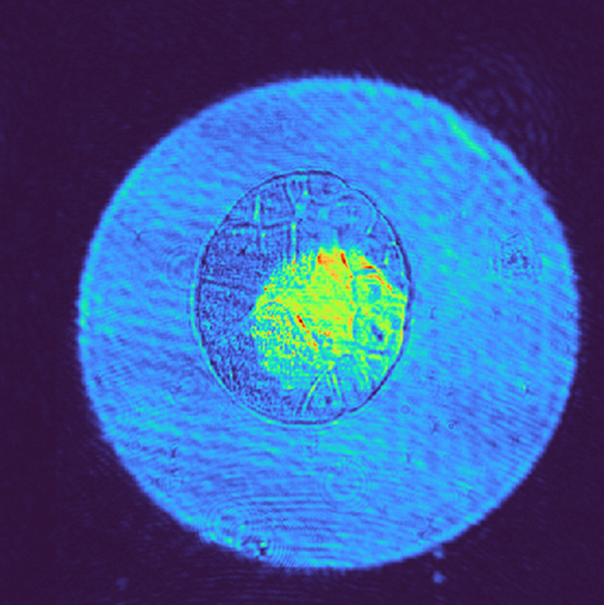
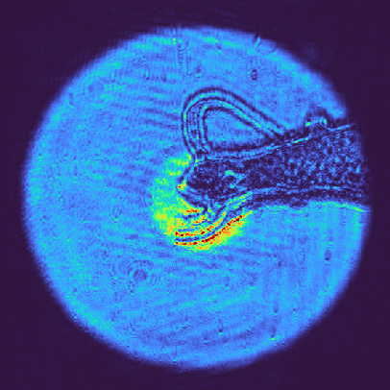
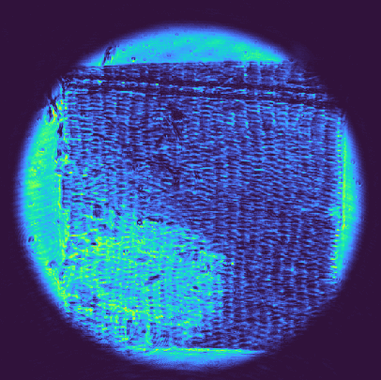
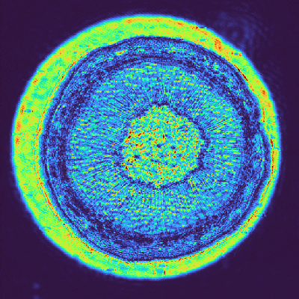
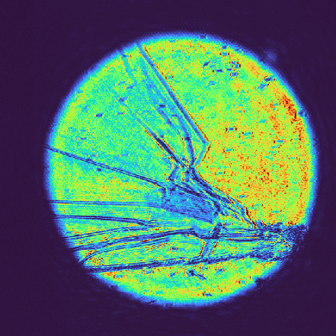
The selection of real samples investigated
Single sided tape on glass
Parafilm
Lens paper
Bubble wrap
Rana ova
Hydra
Butterfly scales
Cork
Fly wing
Notes:
What were the real samples?
Well we had a mix of inorganic samples and biological samples.
You may look at the pictures and think that you could probably move these samples around so that the light encounters a less scattering region.
This can be done, so what we did was move a few of the samples around so that the beam encountered regions of stronger scattering.
Because in an imaging application we may have no ability to move the sample, so we wanted this to be robust.

Slide 13
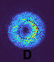
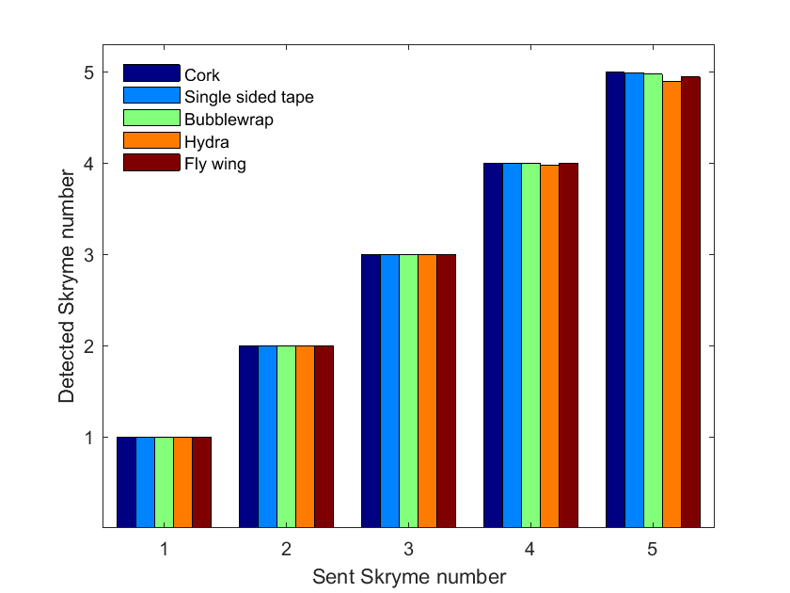
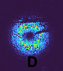
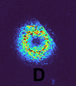
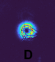
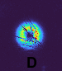
How Skyrme numbers react to samples of moderate distortion strength
Moderate distortion
Notes:
There were so many samples we had to pick just a few to show on the summary slide.
We sent beams with certain Skyrme numbers through various scattering strength samples and recorded to Skyrme number received on the other side.
Here we have some samples that only had a moderate distortion strength. Only the larger Skyrme numbers begin to deteriorate.
We also had samples that strongly distorted the light, you may see the same sample here and in the moderate region, this is because the sample was moved to a more strongly scattering region.
Again only the larger Skyrme numbers deteriorate.
Overall the Skyrme number sent was also received, so the topology was conserved even when passing through real world samples! We could communicate through a piece of bubblewrap.
Although I’ve spoken quite a bit about communication, so how was this tested?

Slide 14
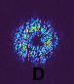
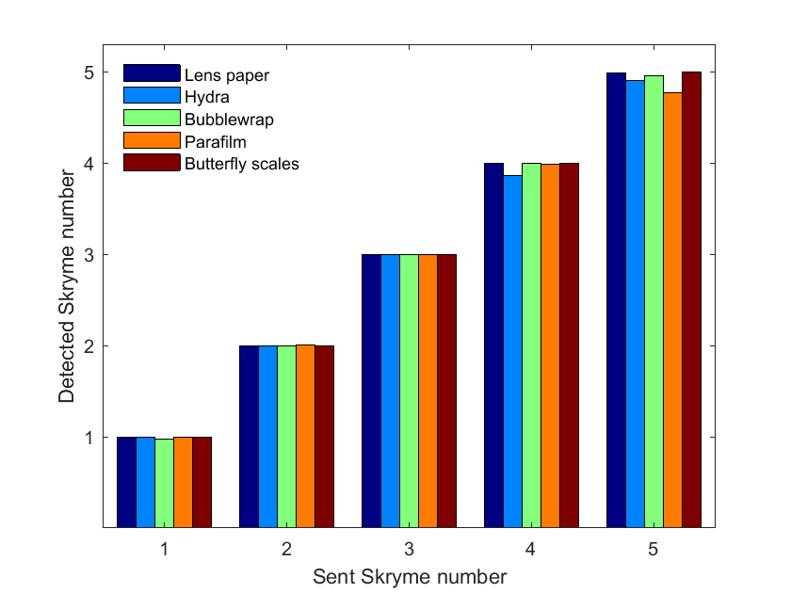
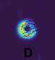
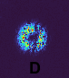
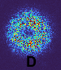
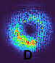
How Skyrme numbers react to samples of strong distortion strength
Strong distortion

Slide 15
Use topology to see through random media without post processing
I
Δt
t
N
t
Notes:
Main point: Our current methods are difficult and need post processing.
To detect the ballistic photons we need a really short collection time so we don’t catch the photons that have been scattered around. We also need to start detecting almost as soon as we send the light through the sample (after all these are travelling at the speed of light).
In reality there are far more scattered photons arriving at our detector than the ballistic ones, some scattered paths are also only fractionally longer than the ballistic photons path, so we need a way to remove the contribution of these and detect them in the first place.
We need a lot of sophisticated equipment to make this happen, and even so can we really remove all those scattered photons from our ballistic signal?

Slide 16
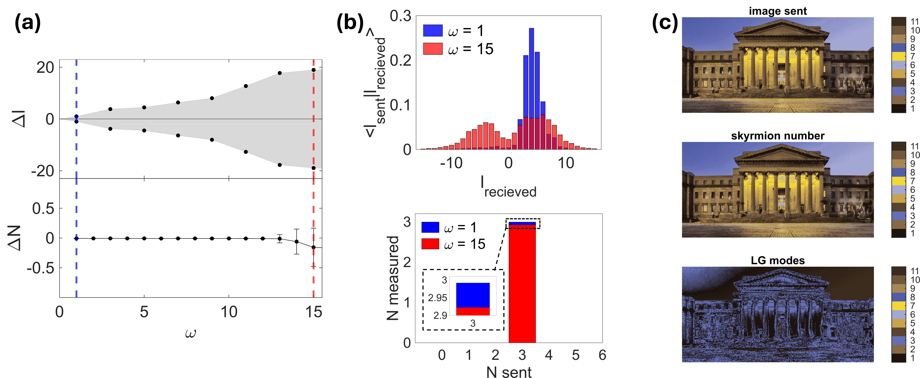
Sending messages with topology
Notes:
Main idea: We have lots of Skyrme numbers so can send messages!
We had 11 Skyrme numbers, so we can make use of this large number by using then to send messages.
Here we have a picture that we can break up into 11 different colours, and we’ll assign a colour to a Skyrme number.
Now we’ll send these Skyrme numbers through some random media and see if we can construct the image on the other side.
We do get the image back on the other side and it looks the same!
If we were to use only OAM to do this the picture would look like this, and clearly using topology is far better.

Slide 17
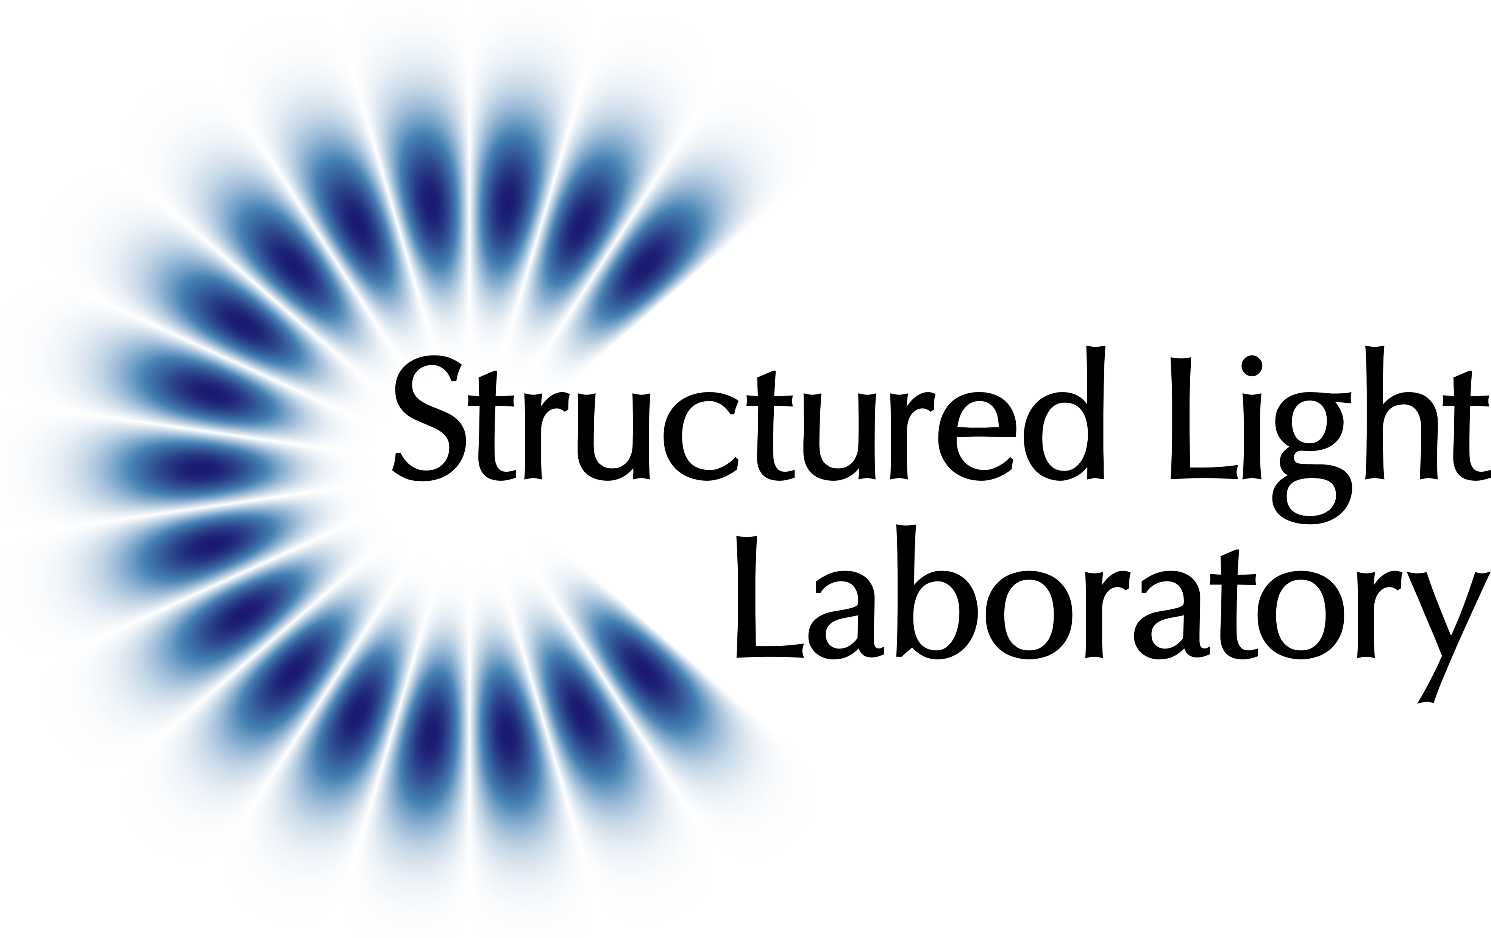

Thank you
structured-light-lab.org​
3050649@students.wits.ac.za

