Slide 1




Energy Loss as a Probe of Quark-Gluon Plasma Formation Across Collision System Size
Coleridge Faraday
frdcol002@myuct.ac.za
PhD Candidate, University of Cape Town, South Africa
SAIP 2025
Based on CF and W. A. Horowitz, arXiv:2505.14568 [hep-ph] (2025); and
CF and W. A. Horowitz, Phys. Lett. B 864, 139437 (2025).

Slide 2
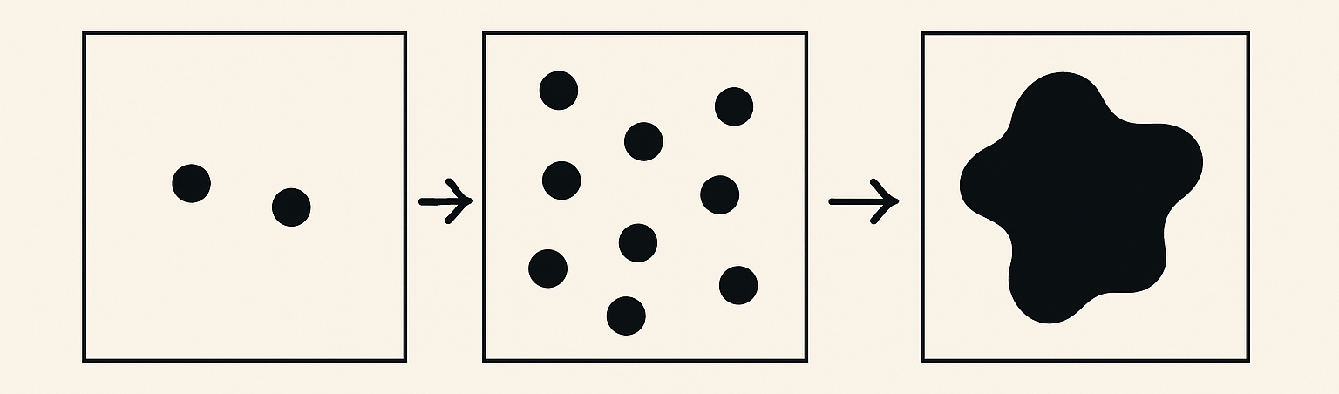
How many particles for collectivity?

Slide 3
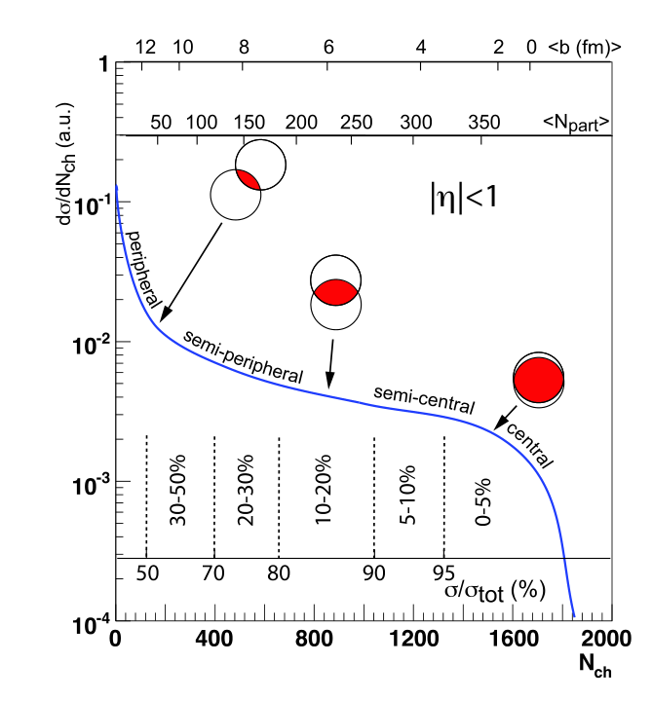
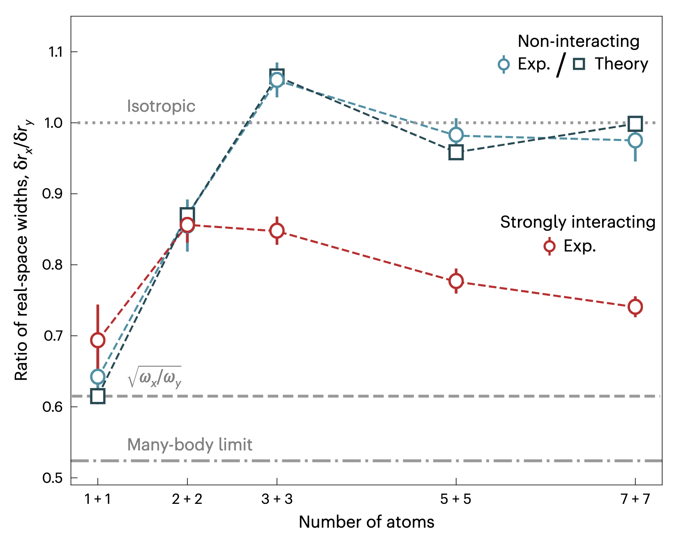
Surprising Lessons from Cold Atoms
Free
  Cold atom experiments indicate that the answer is 6!
Strongly interacting
3+3 atoms leads to collective behaviour!
S. Brandstetter, et al., Nat. Phys. 21, 1 (2025).

Slide 4
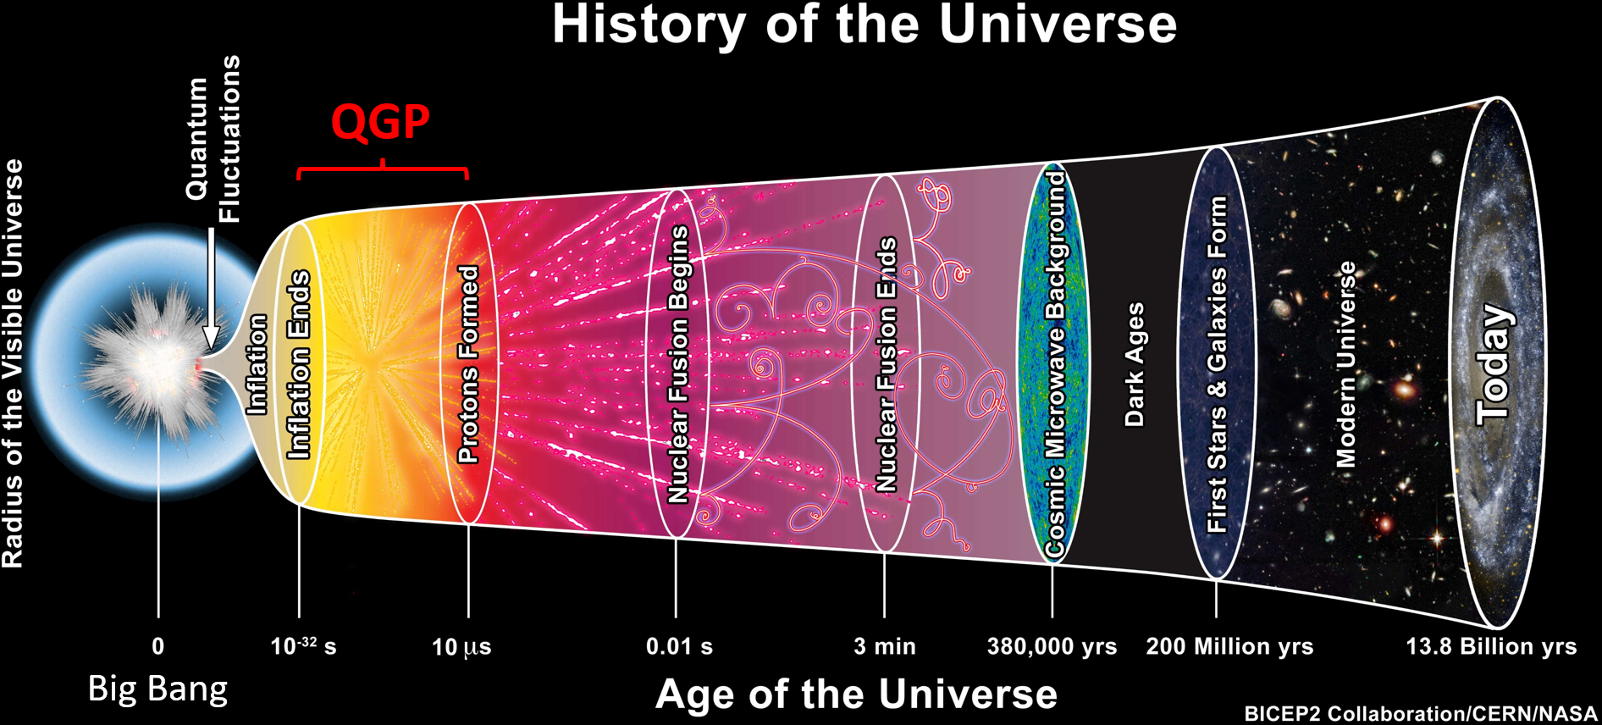
Turning up the Temperature
The early universe was made up of a dense, hot soup of quarks and gluons: the quark gluon plasma

Slide 5

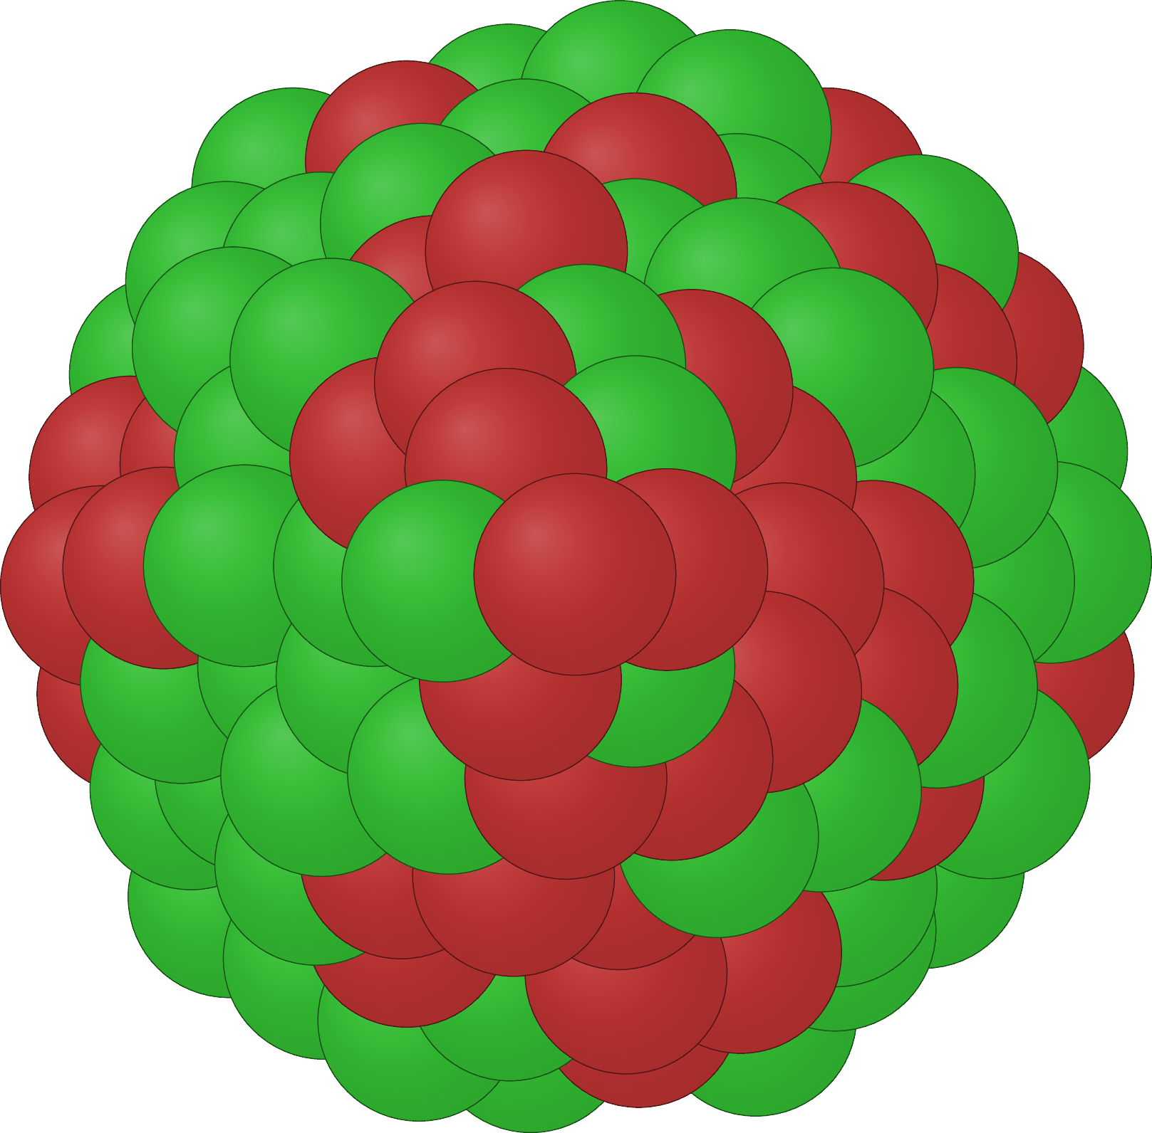
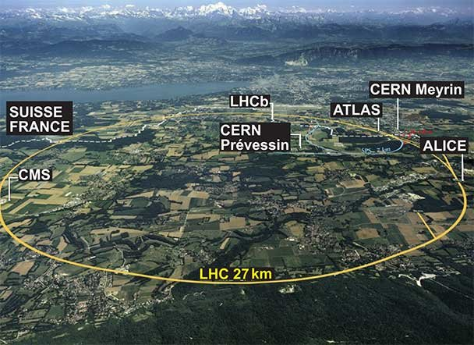
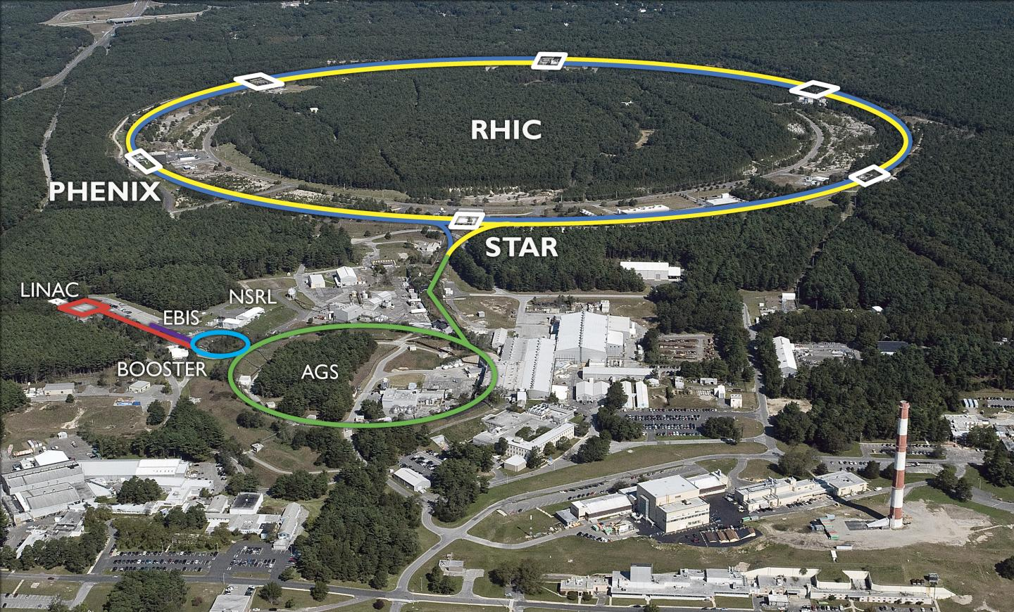
Heavy-ion collisions
>99.9999% of the speed of light
RHIC at BNL
LHC at CERN

Slide 6
How many particles for collectivity?
From statistical mechanics, you might say ~ 1 mole ~ ${10}^{23}$

Slide 7
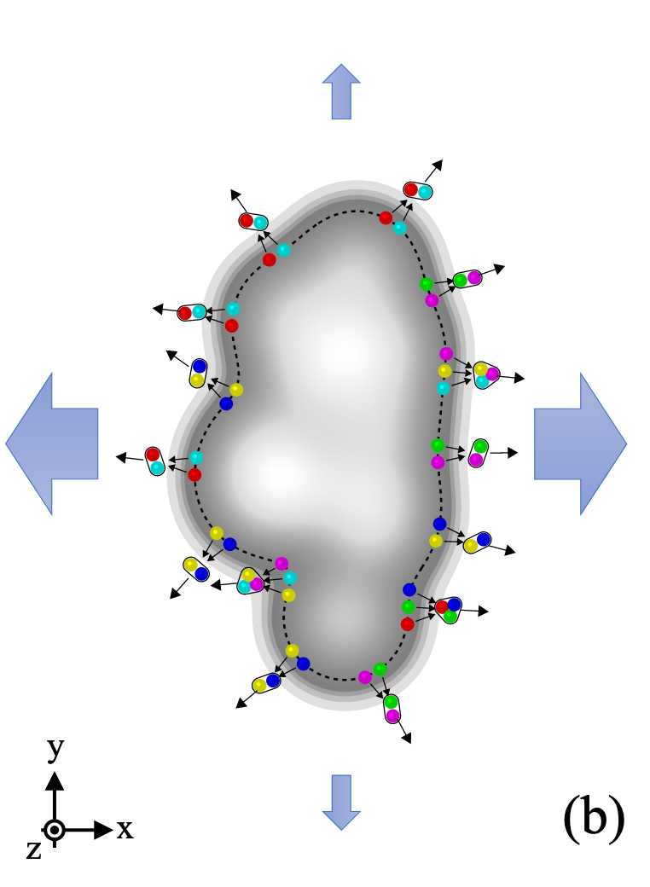
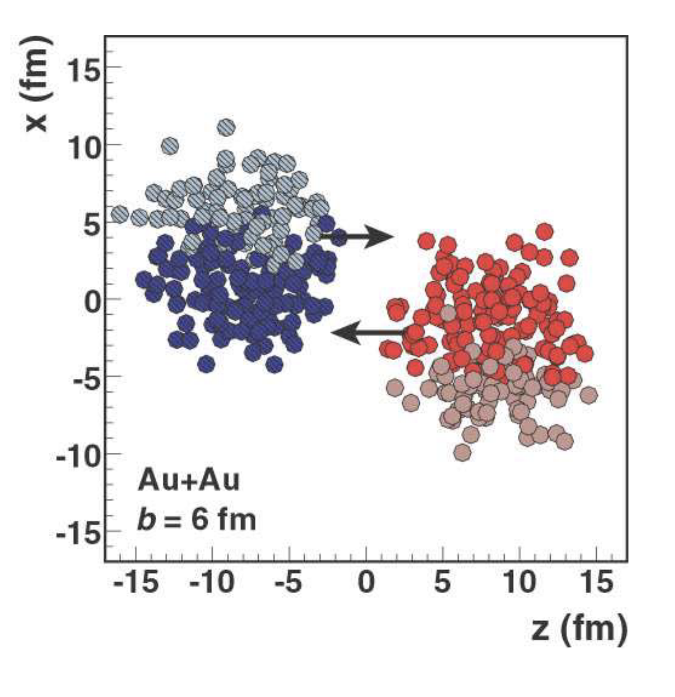
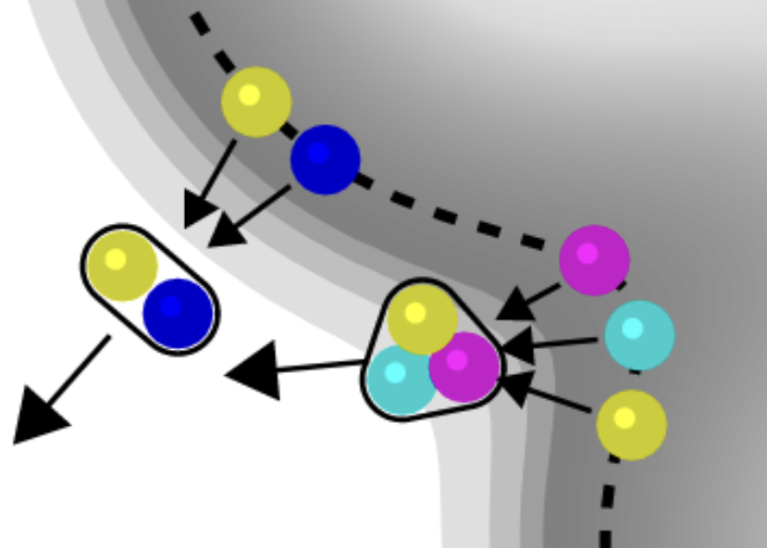
Lessons from Heavy-Ion Physics
(a)
M. L. Miller, K. Reygers, S. J. Sanders, and P. Steinberg, Ann. Rev. Nucl. Part. Sci. 57, 205 (2007).
ALICE, arXiv:2411.09323 [nucl-ex] (2024).

Slide 8
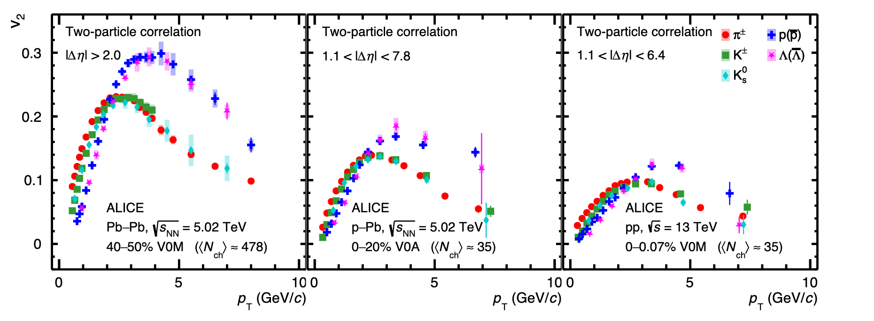

How many particles for (hot) collectivity?
Pb + Pb
p + Pb
p + p
Baryon-meson grouping and splitting
$⇒$ Flowing medium of quarks and gluons!
ALICE, arXiv:2411.09323 [nucl-ex] (2024).

Slide 9
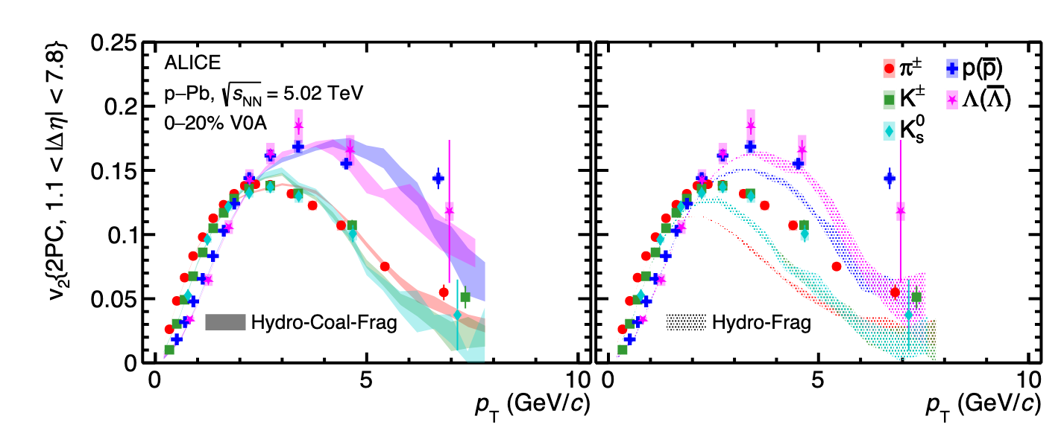
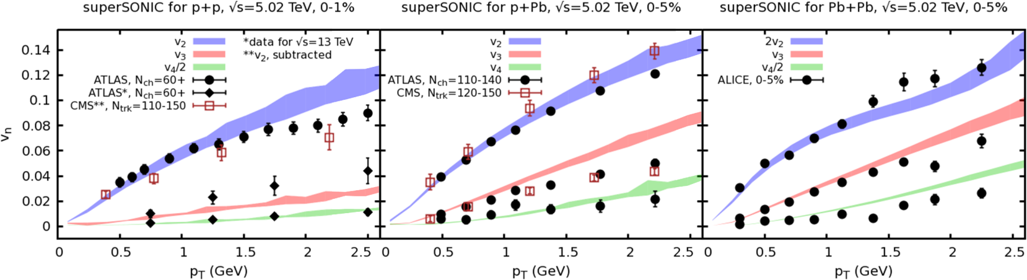
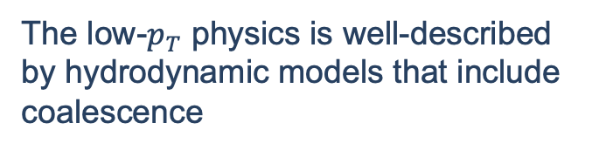

Theory describes low-$p_{T}$ in small sys.
The low-$p_{T}$ physics is well-described by hydrodynamic models that include coalescence
ALICE, arXiv:2411.09323 [nucl-ex] (2024).
Weller et al., PLB 774 (2017) 351-356

Slide 10
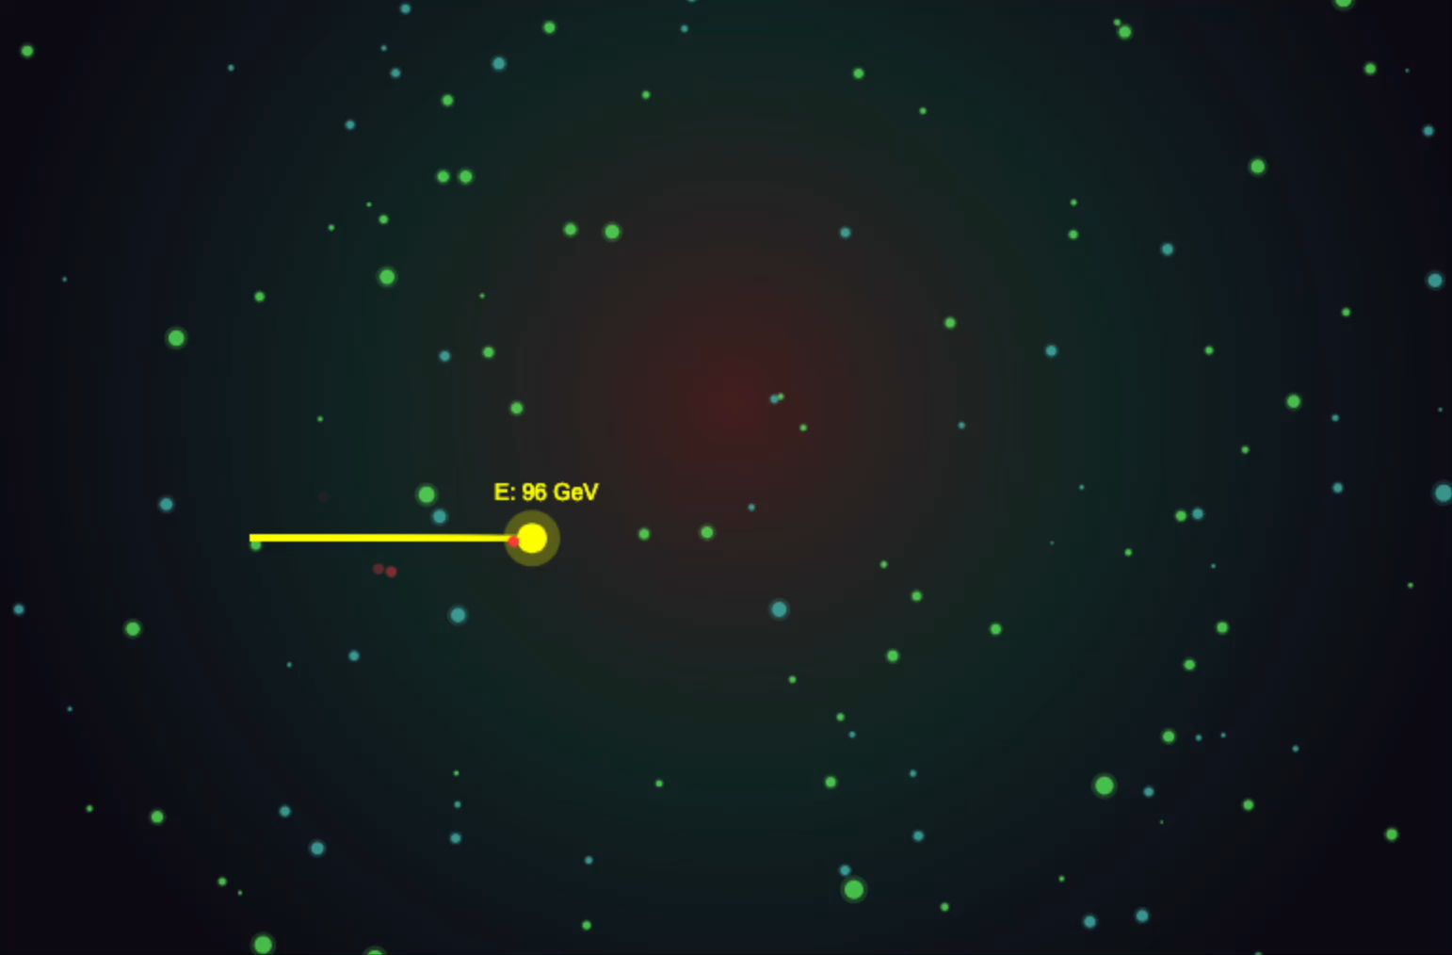
Energy Loss
One can also probe the QGP by measuring energy loss of high momentum particles

Slide 11
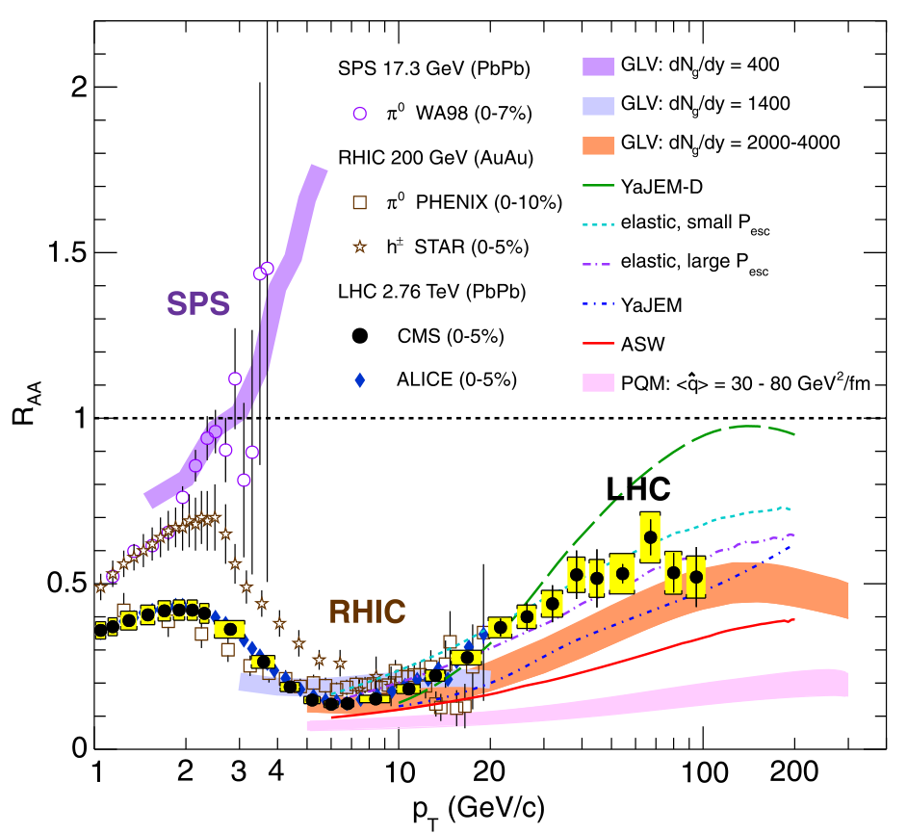
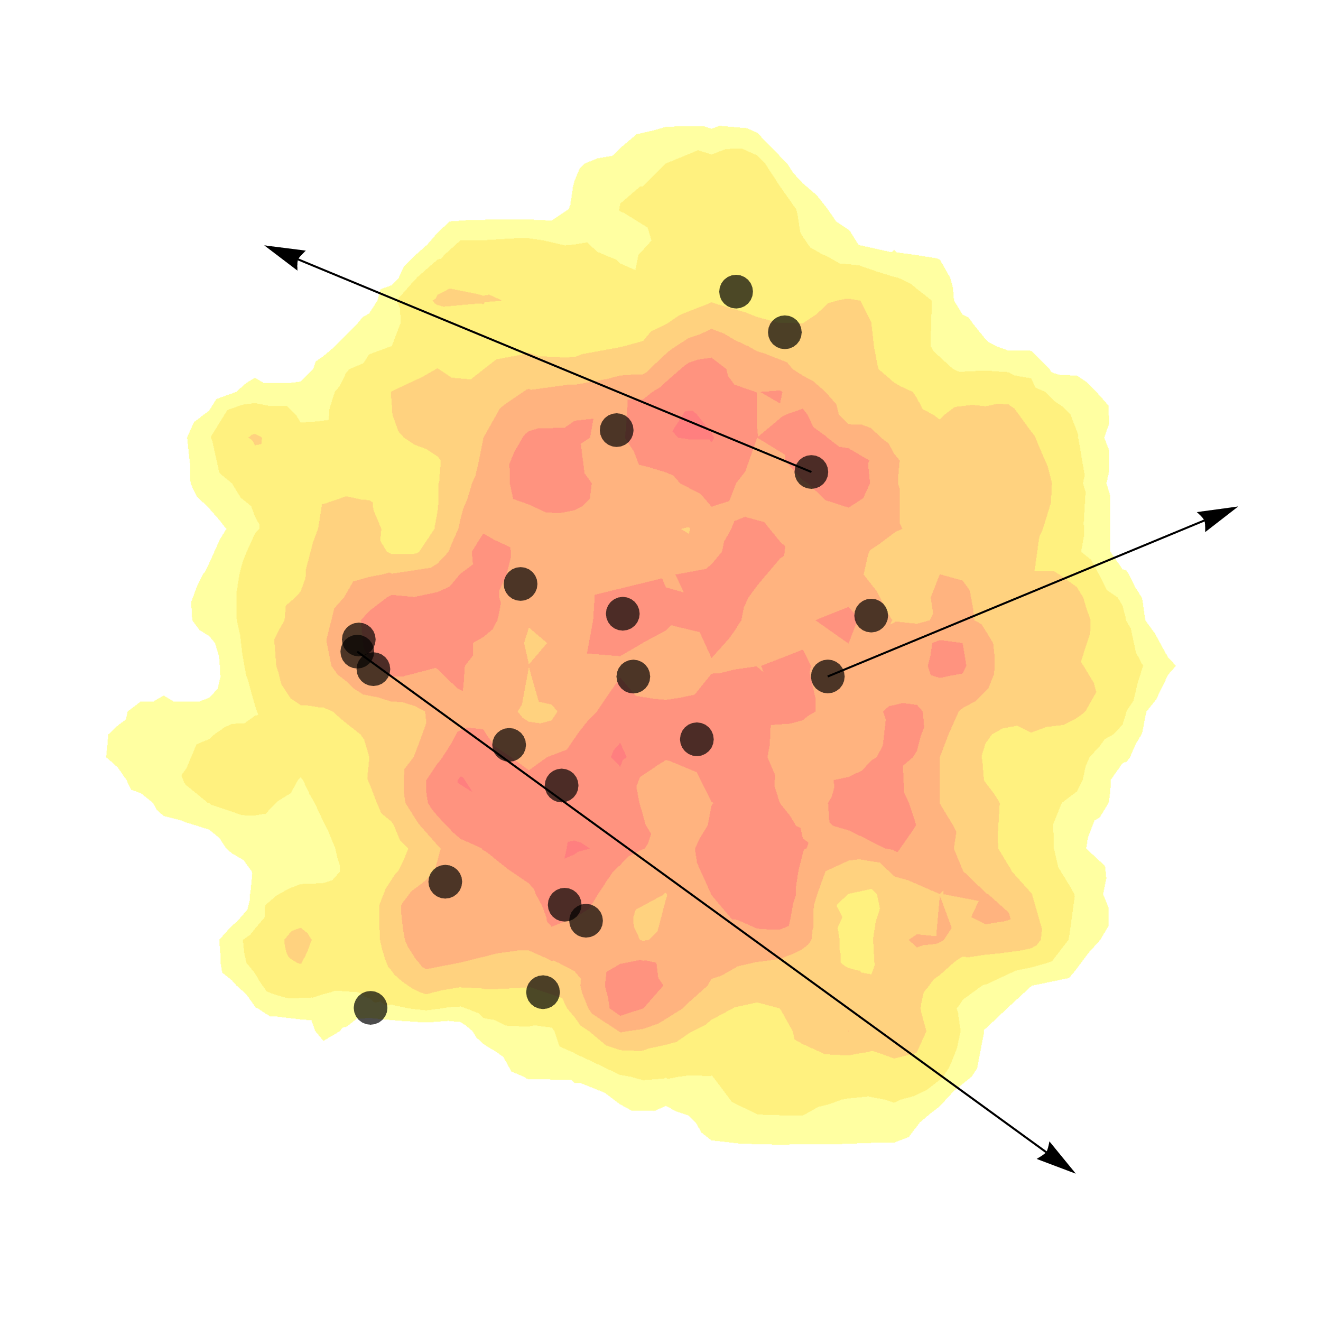
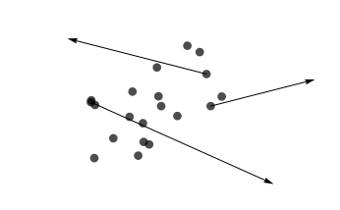
Measuring Energy Loss
=
Quantifies how much energy is lost by high momentum particles

Slide 12
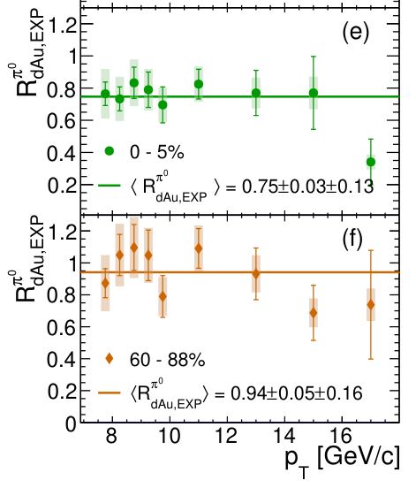
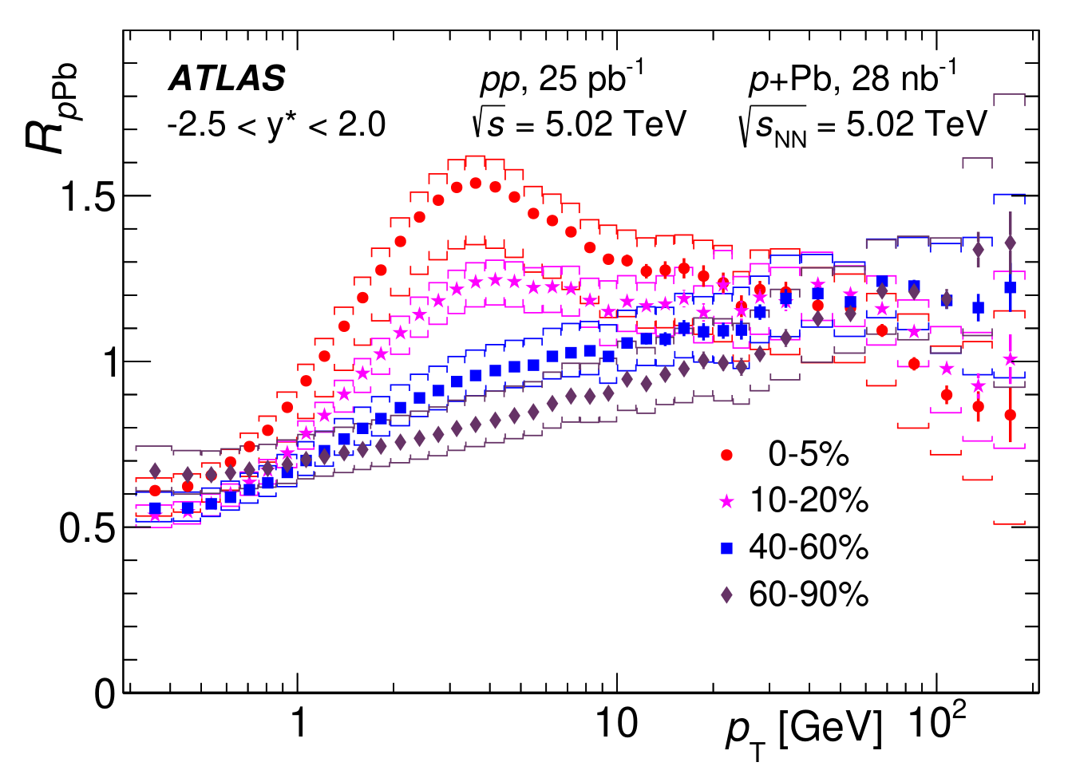

Nuclear Modification in Small Systems
Small system suppression pattern not clear
Apparent tension between RHIC and LHC suppression results?
Direct $γ$
No suppression!
Glauber
Suppression ~0.75!
→ Theoretical input needed
ATLAS, JHEP 07 (2023) 074
PHENIX, Phys. Rev. Lett. 134, 022302 (2025).

Slide 13
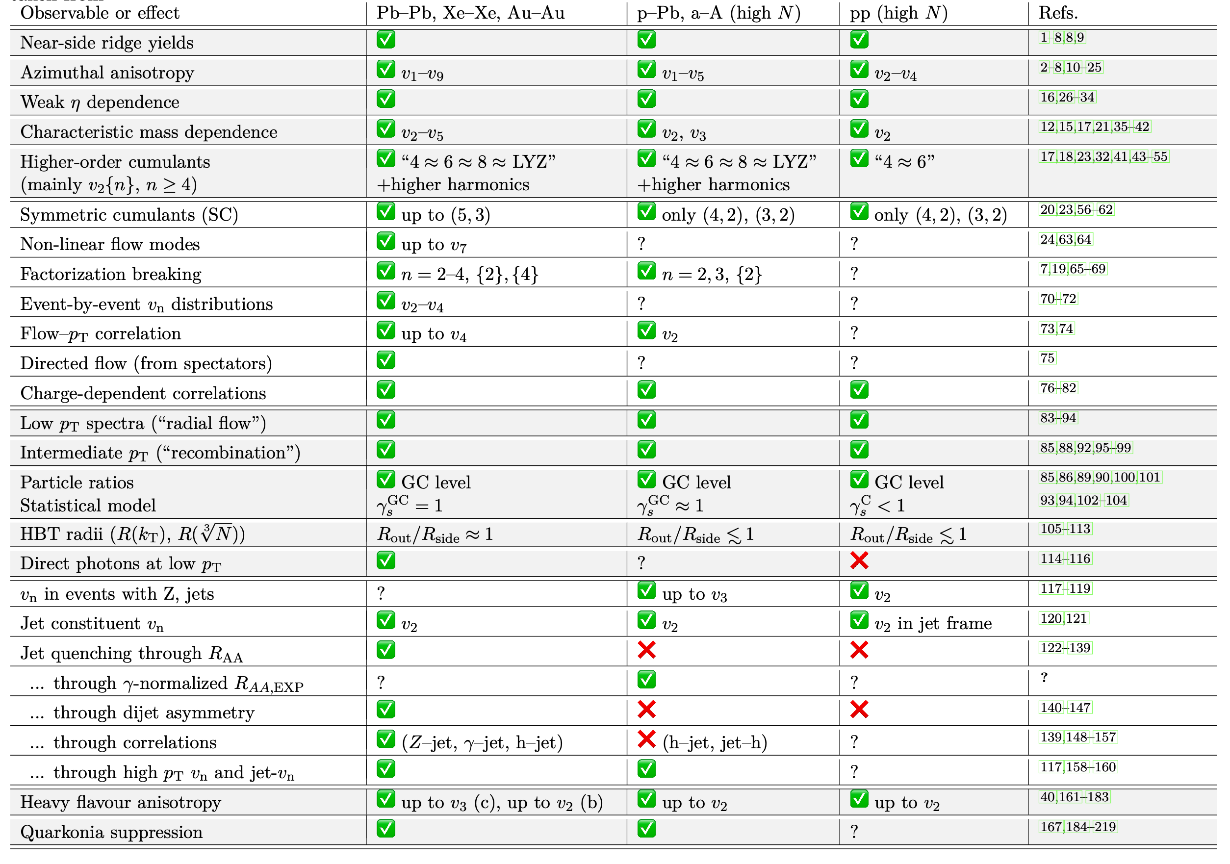



$$A + A$$
$$p + A$$
$$p +p$$
Flow
✅ = observed
❌ = not observed
? = not measured
Correlations
Mixed messages?
Hard probes are the missing piece of the puzzle!
Freezeout
properties
Hard probes
Adapted from J. F. Grosse-Oetringhaus and U. A. Wiedemann, arXiv:2407.07484 [hep-ex] (2024).
See backup slides for references
Heavy-flavor

Slide 14
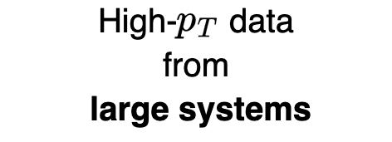

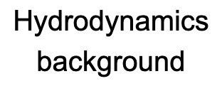
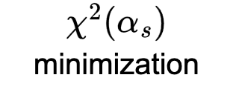


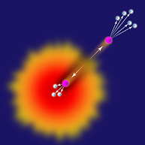
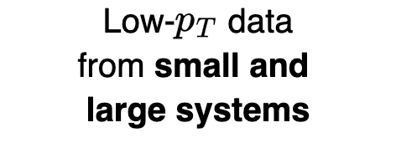
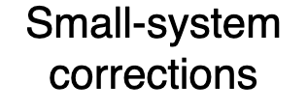
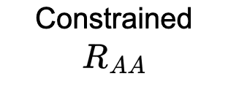
Our Approach

Slide 15
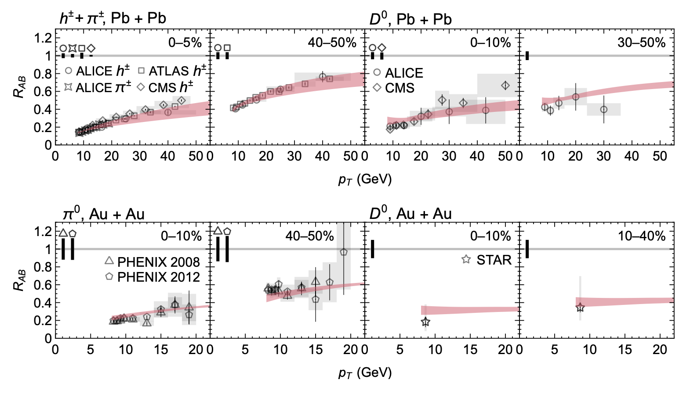
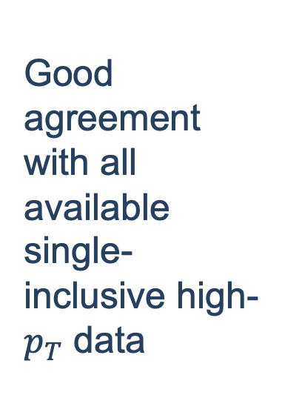
Results in Large Systems
Good agreement with all available single-inclusive high-$p_{T}$ data

Slide 16
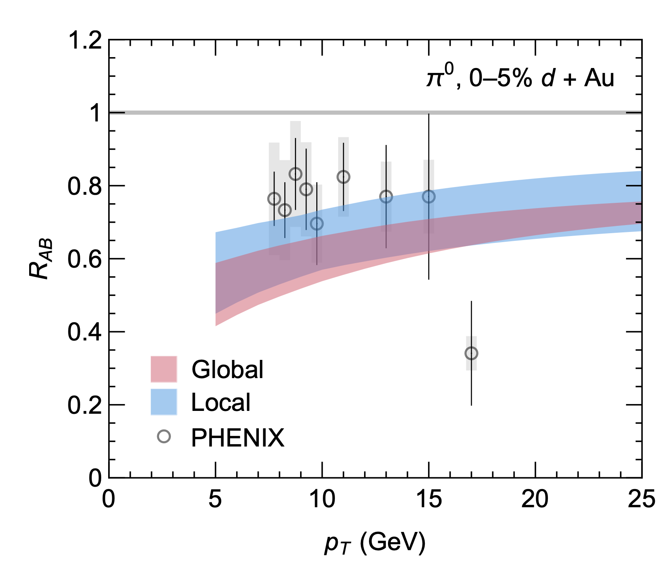
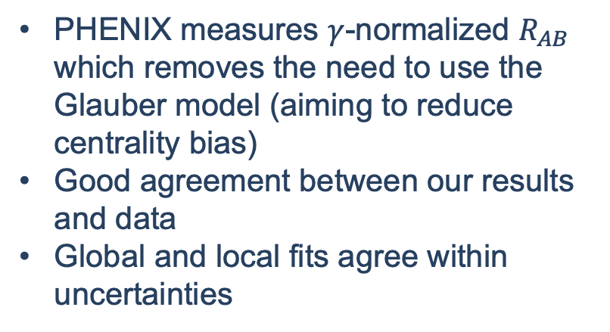
Small system suppression at RHIC
PHENIX measures $γ$-normalized $R_{AB}$ which removes the need to use the Glauber model (aiming to reduce centrality bias)
Good agreement between our results and data
Global and local fits agree within uncertainties
PHENIX, Phys. Rev. Lett. 134, 022302 (2025).
CF and W. A. Horowitz, arXiv:2505.14568 [hep-ph] (2025).

Slide 17
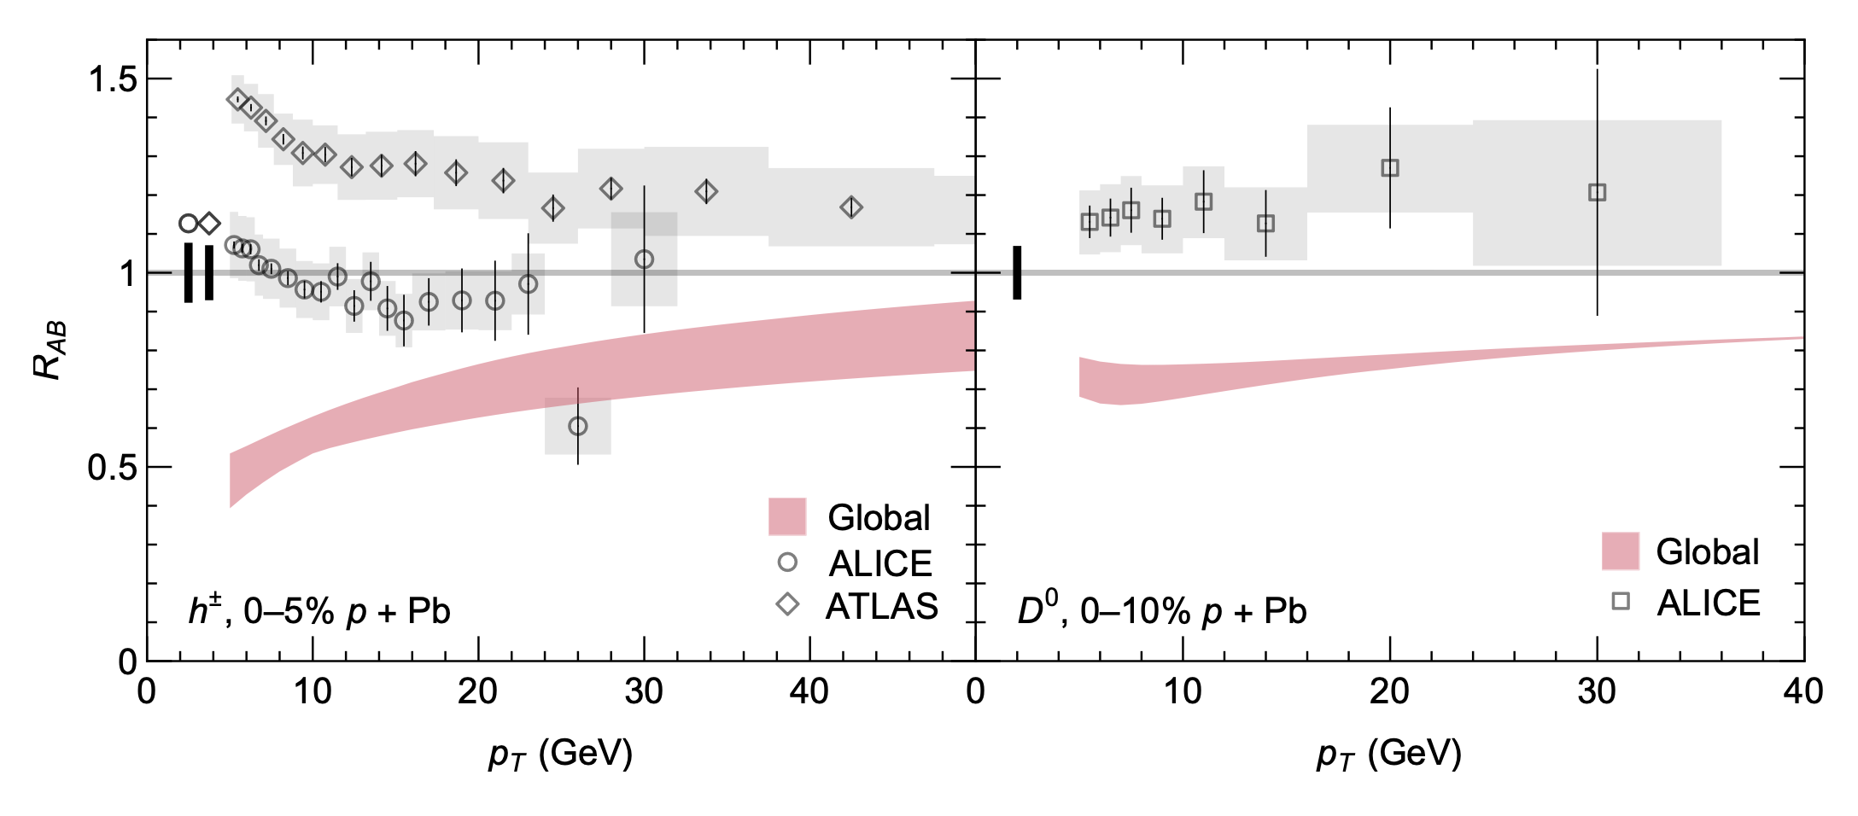
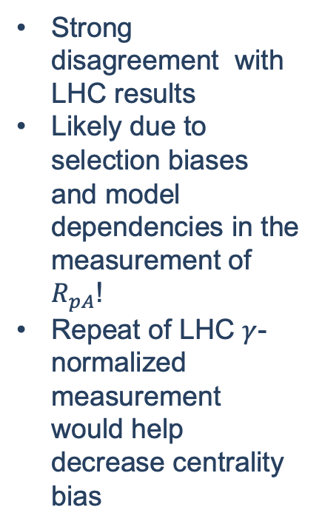
Small system suppression at LHC
Strong disagreement with LHC results
Likely due to selection biases and model dependencies in the measurement of $R_{pA}$!
Repeat of LHC $γ$-normalized measurement would help decrease centrality bias
ALICE, Phys. Rev. C 91, 064905 (2015).
ATLAS, JHEP 07, 074 (2023).
ALICE, JHEP 12, 092 (2019).

Slide 18
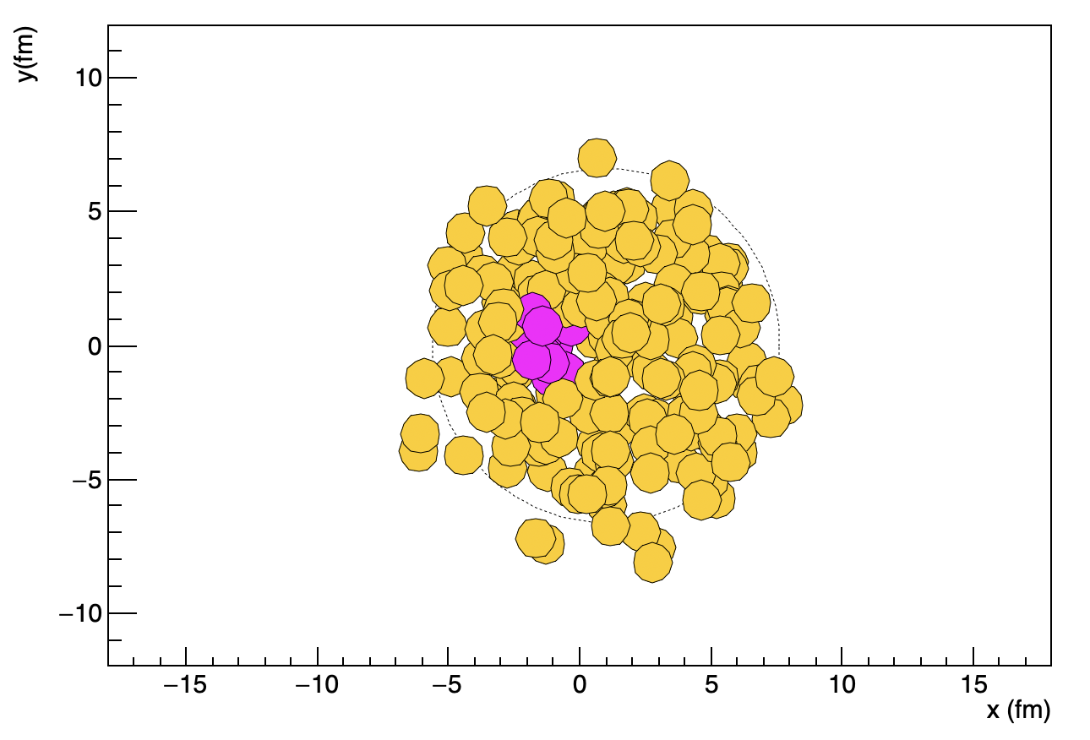
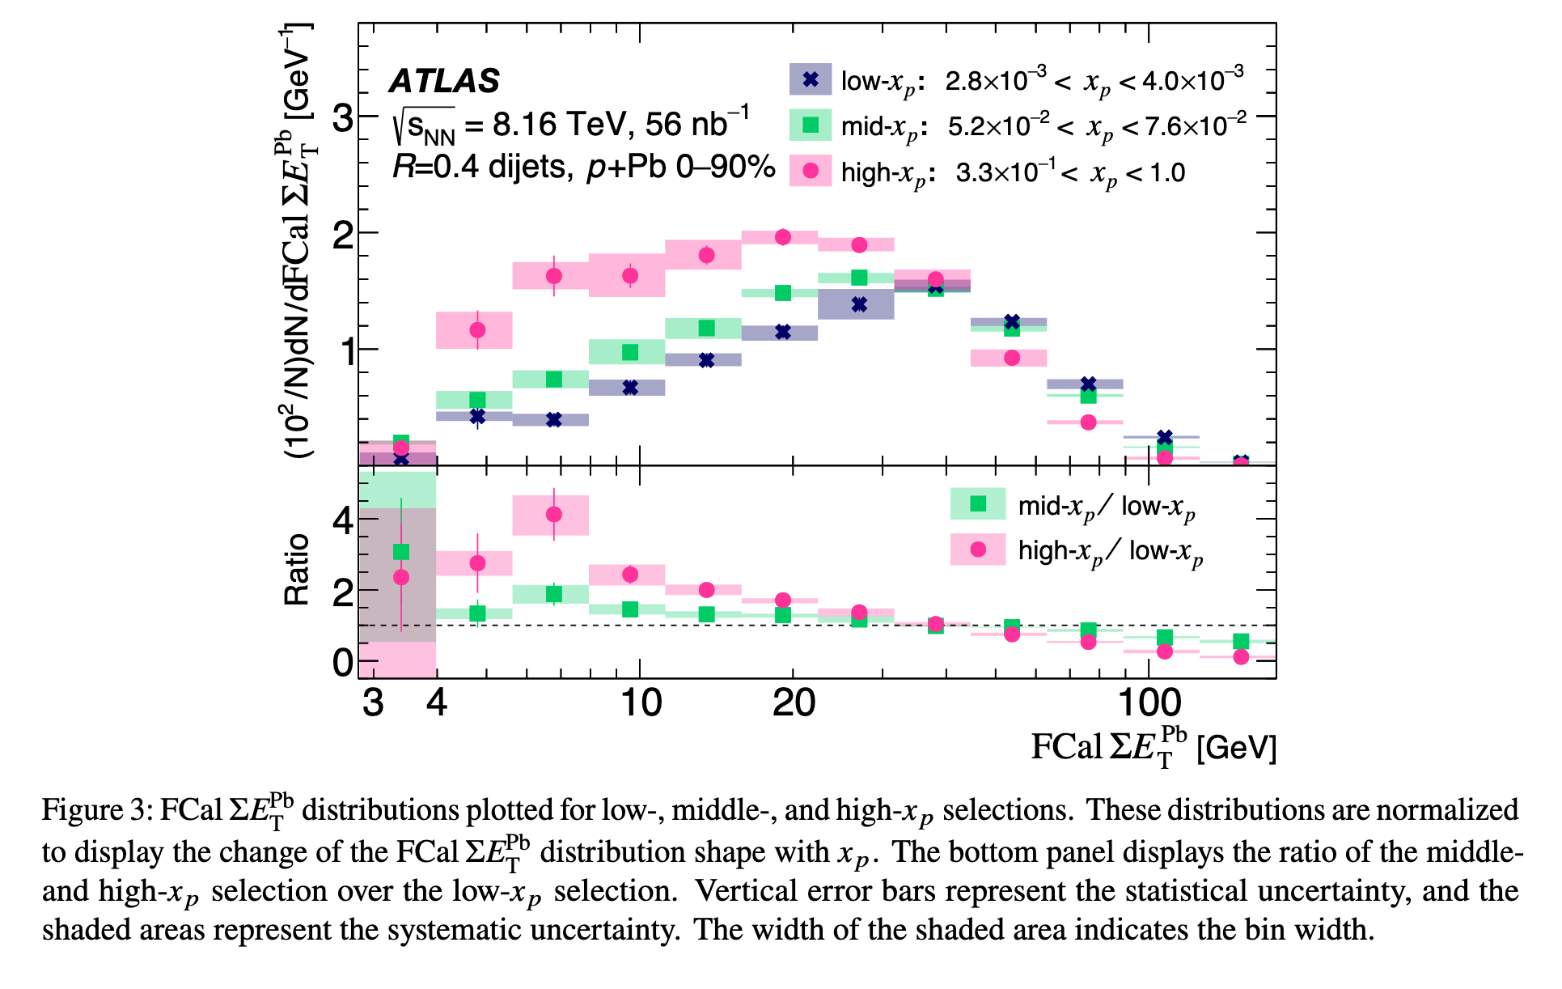
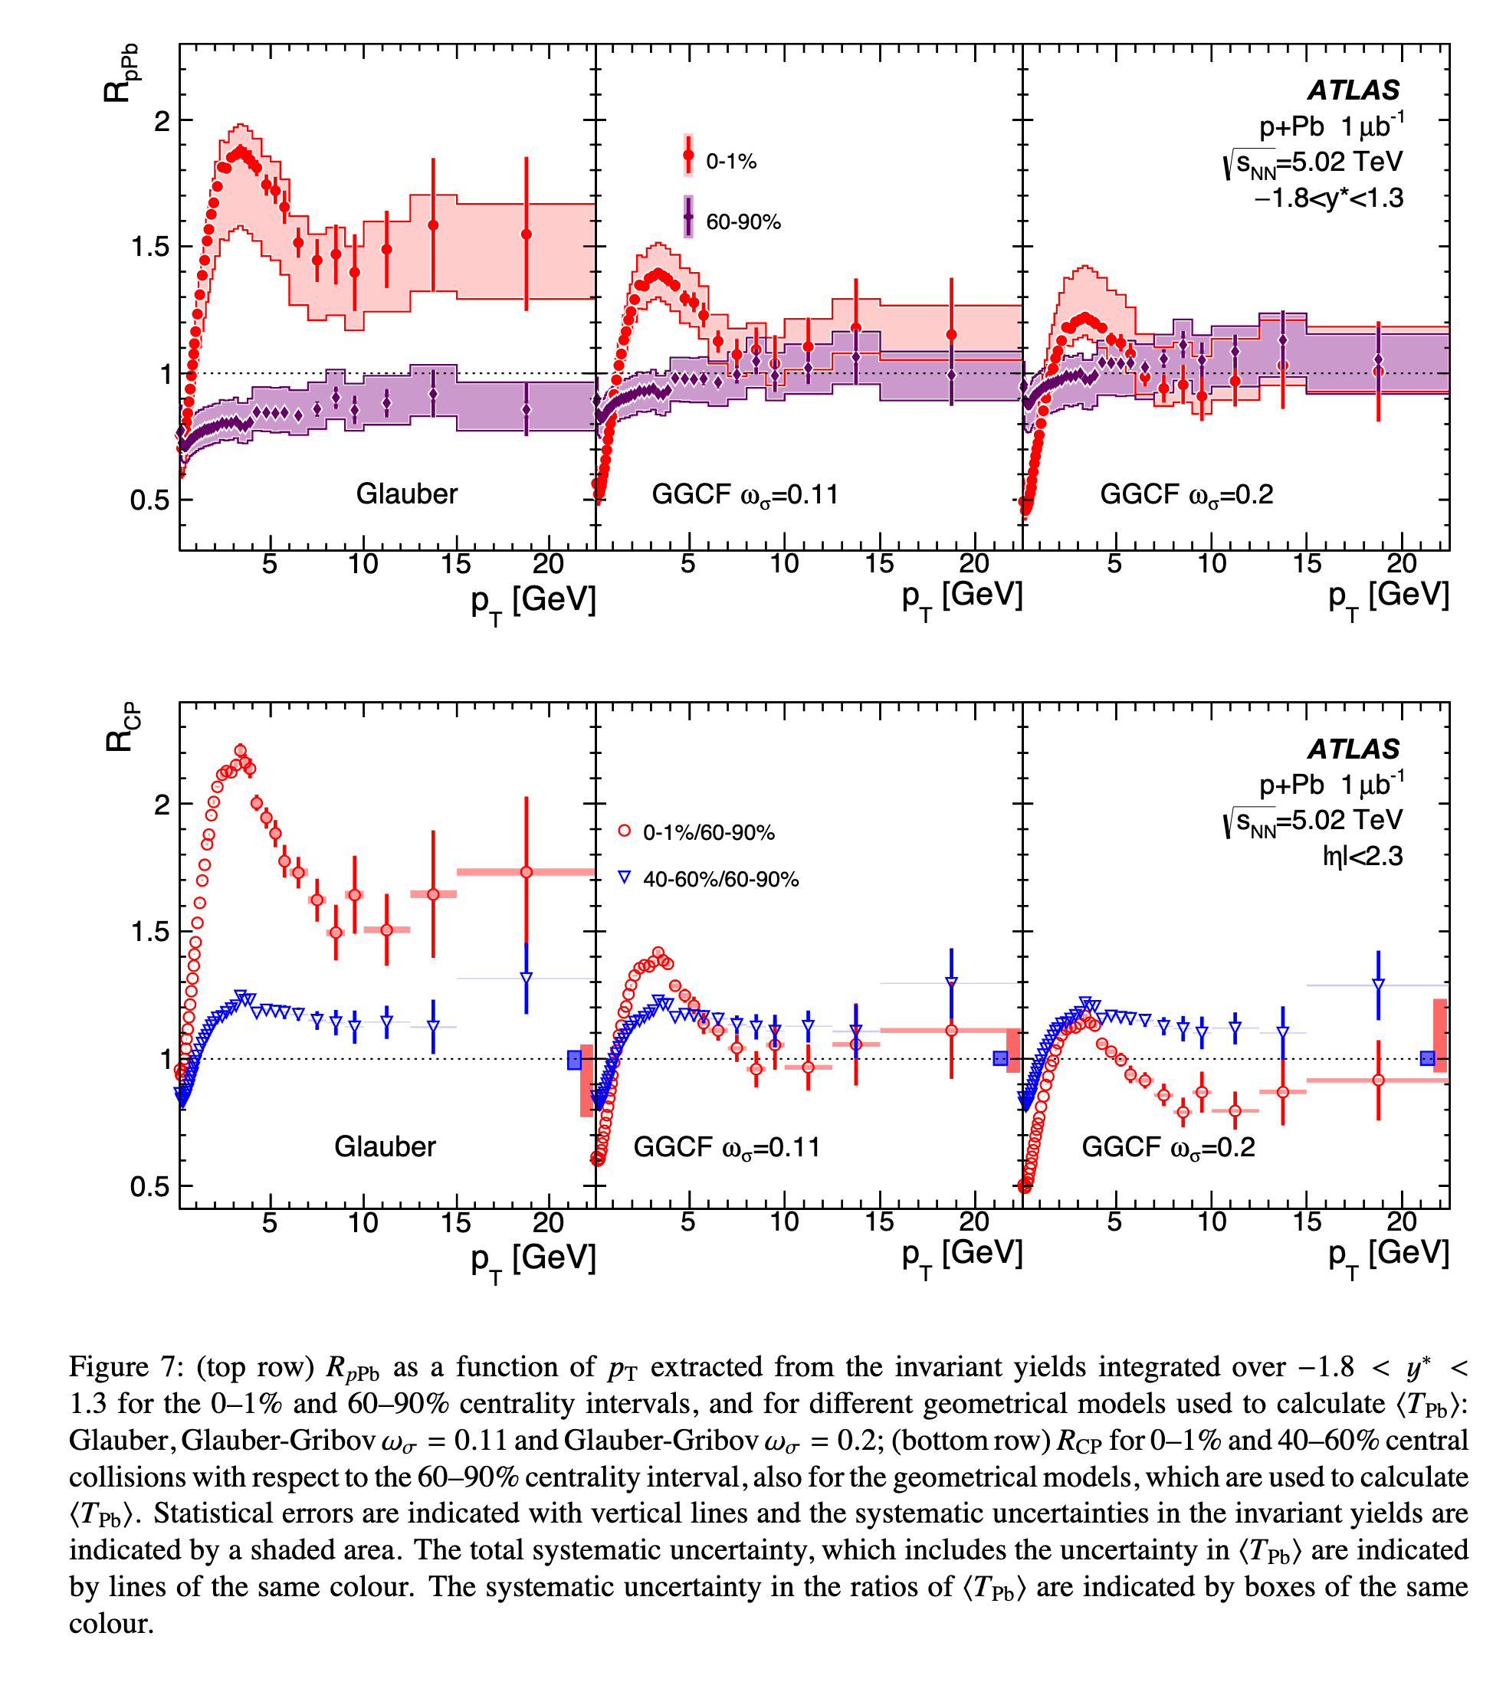
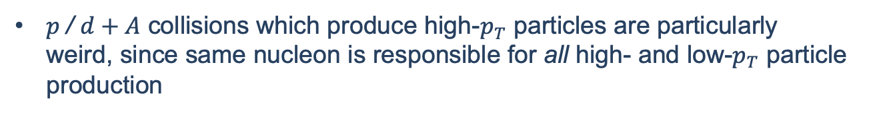


Hard / soft correlations
Sample $p+\text{Pb}$
$p$/ $d+A$ collisions which produce high-$p_{T}$ particles are particularly weird, since same nucleon is responsible for all high- and low-$p_{T}$ particle production
Is $R_{pA}$ simply a flawed observable?
Correlations between total number of particles and high momentum particle production have been measured
Significant Glauber model dependence in determining $N_{coll}$
Open question: do these correlations effect only centrality categorization or do they effect the size and temperature of the produced QGP?
ATLAS, Phys. Lett. B 763, 313 (2016).
ATLAS, arXiv:2504.02638 [nucl-ex] (2025).

Slide 19
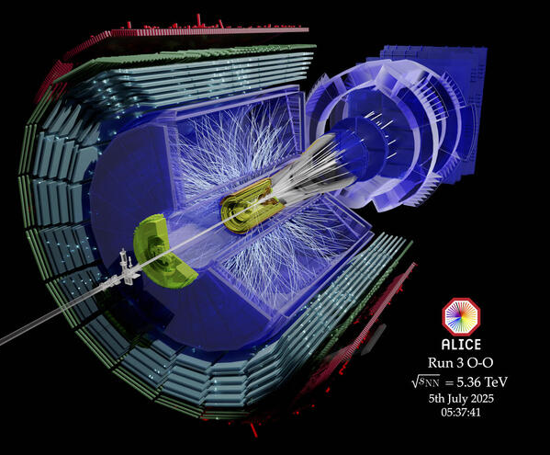
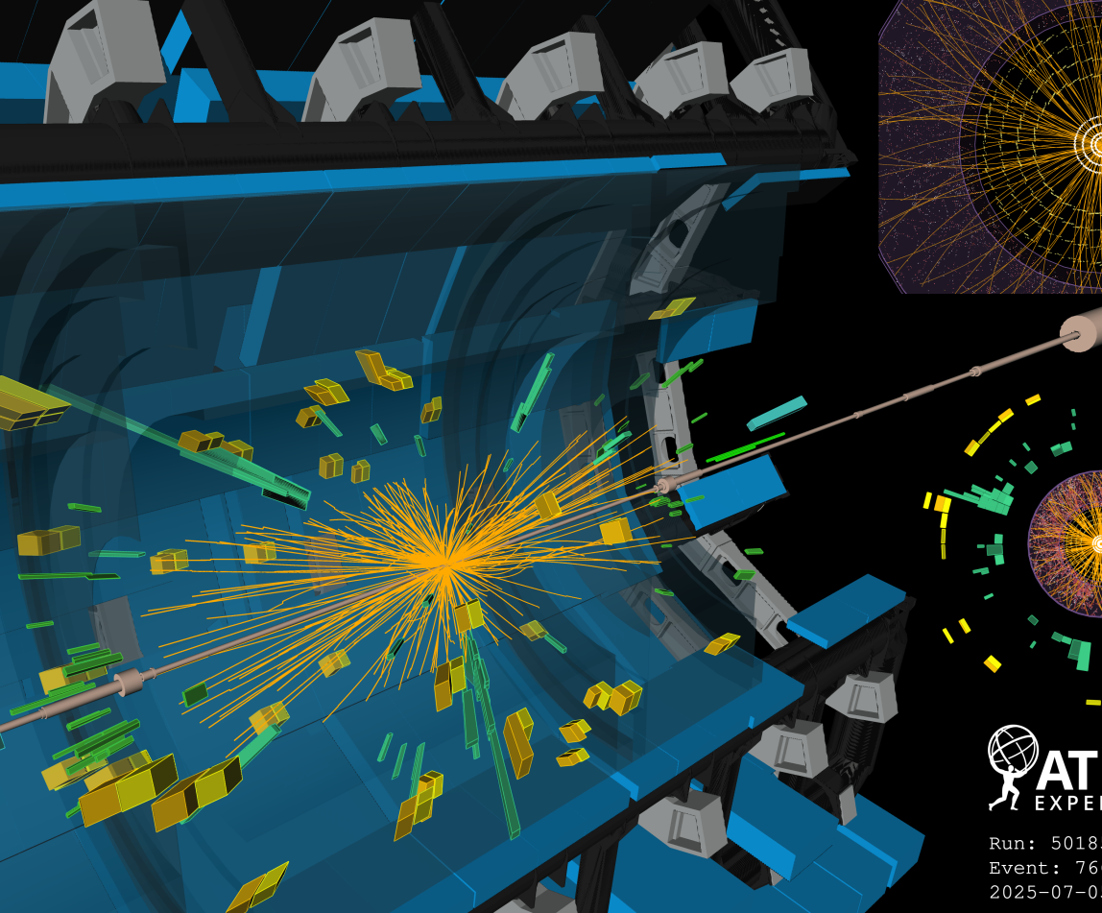
Oxygen Collisions
First oxygen collisions at LHC finished this week!

Slide 20
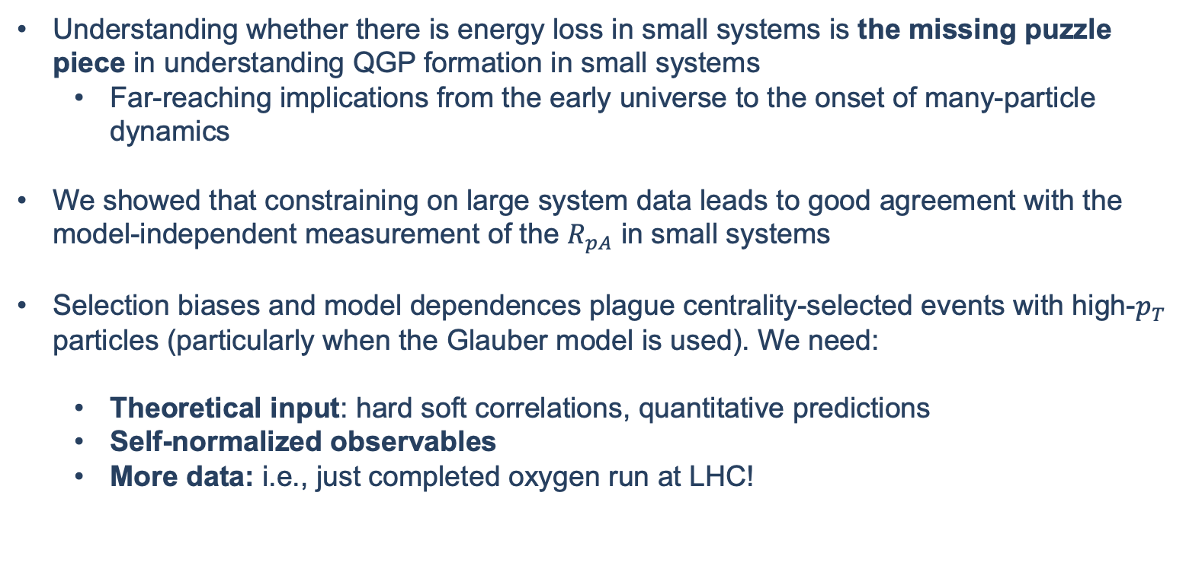
Outlook
Understanding whether there is energy loss in small systems is the missing puzzle piece in understanding QGP formation in small systems
  Far-reaching implications from the early universe to the onset of many-particle dynamics
We showed that constraining on large system data leads to good agreement with the model-independent measurement of the $R_{pA}$ in small systems
Selection biases and model dependences plague centrality-selected events with high-$p_{T}$ particles (particularly when the Glauber model is used). We need:
  Theoretical input: hard soft correlations, quantitative predictions
  Self-normalized observables
  More data: i.e., just completed oxygen run at LHC!

Slide 21
Bonus Slides

Slide 22




Energy Loss

Slide 23
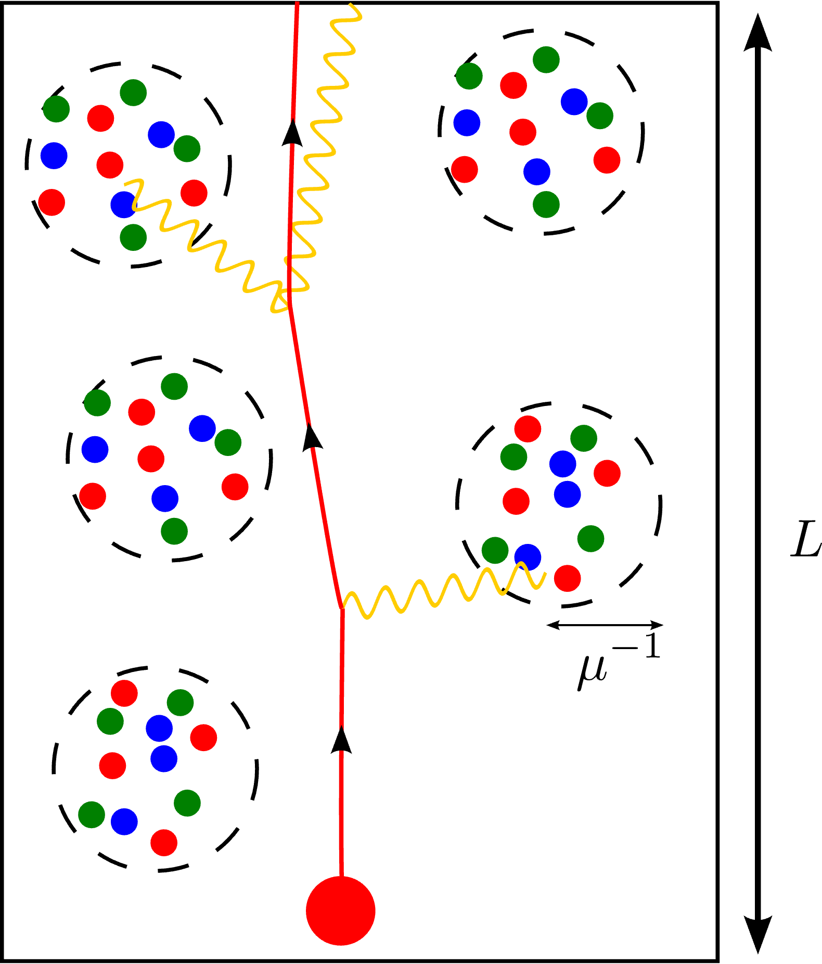
Energy loss
Medium is modelled as color-screened scattering centers
Particles lose energy through
  Radiative processes
  Collisional processes
We include small systems size corrections to both the radiative and collisional processes
M. Djordjevic and M. Gyulassy, Nucl. Phys. A 733, 265 (2004).
I. Kolbé and W. A. Horowitz, Phys. Rev. C 100, 024913 (2019).
CF, A. Grindrod, and W. A. Horowitz, Eur. Phys. J. C 83, 1060 (2023).

Slide 24
Statistical Analysis

Slide 25
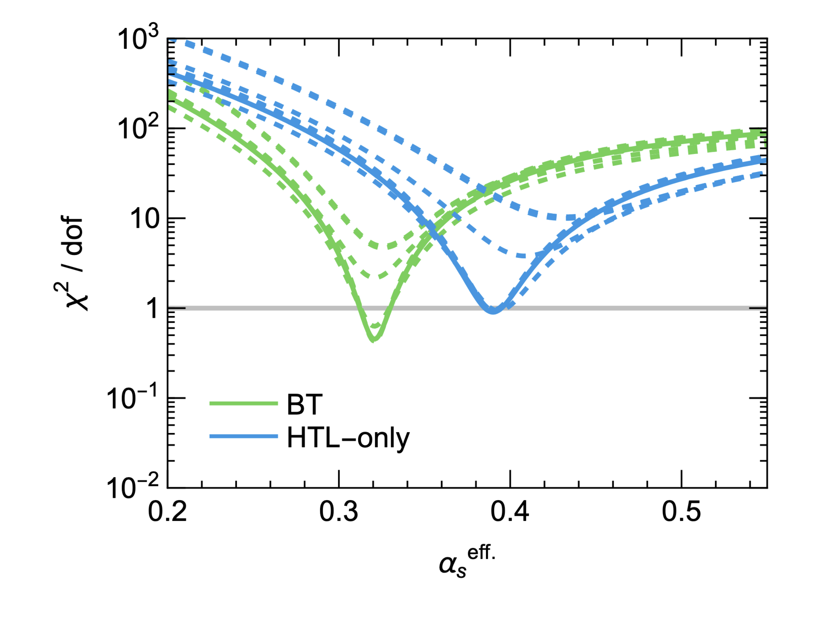


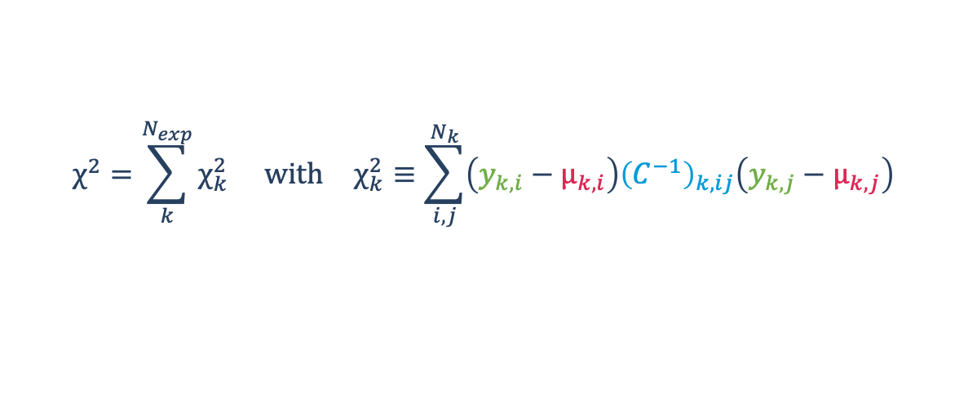

Statistical extraction of $α_{s}$
$$χ^{2}=\sum_{k}^{N_{exp}}{χ_{k}^{2}} \text{with} χ_{k}^{2}≡\sum_{i,j}^{N_{k}}{\left(y_{k,i}−μ_{k,i}\right){\left(C^{−1}\right)}_{k,ij}\left(y_{k,j}−μ_{k,j}\right)}$$
$$χ^{2}=\sum_{k}^{N_{exp. }}{χ_{k}^{2}} \text{with} χ_{k}^{2}≡\sum_{i,j}^{N_{k}}{\left(y_{k,i}−μ_{k,i}\right){\left(C^{−1}\right)}_{k,ij}\left(y_{k,j}−μ_{k,j}\right)}$$
Where
$χ^{2}$ is minimized as a function of $α_{s}$
$k$ indexes the different experimental datasets
$y_{k,i}$ are the experimental observations for the experimental result $k$ and the data point $i$
$μ_{k,i}$ are the corresponding predictions (as a function of $α_{s}$)
$C_{k}$ are the covariance matrix for the experimental data $k$
CF and W. A. Horowitz, arXiv:2505.14568 [hep-ph] (2025).

Slide 26
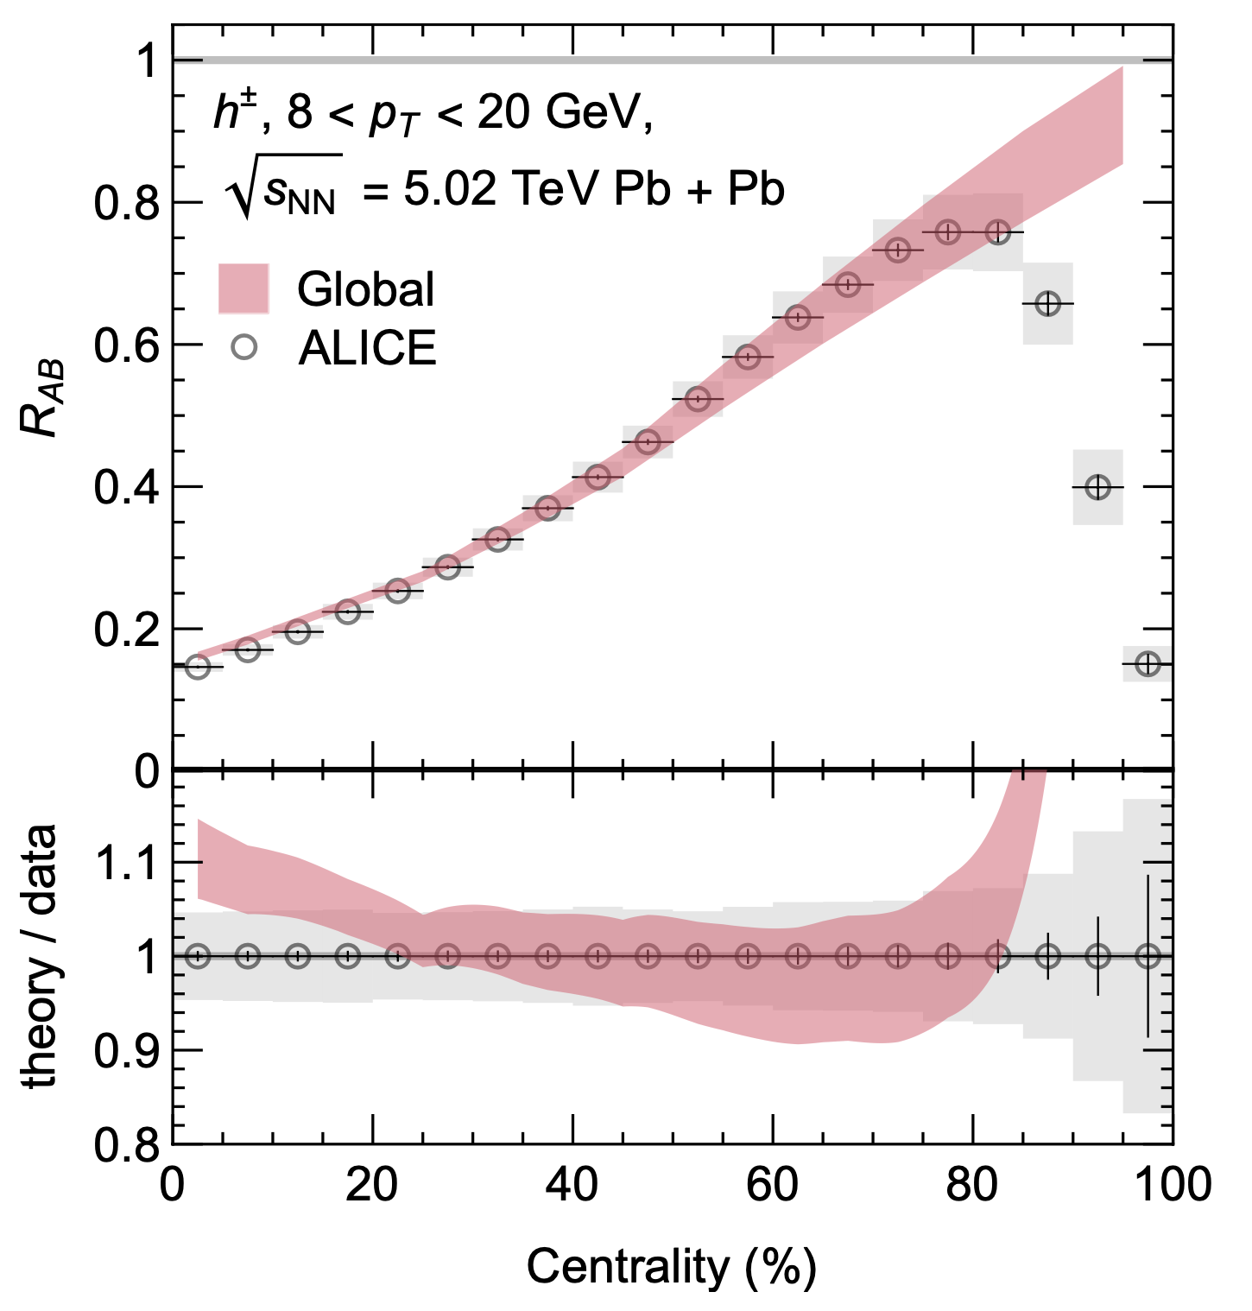
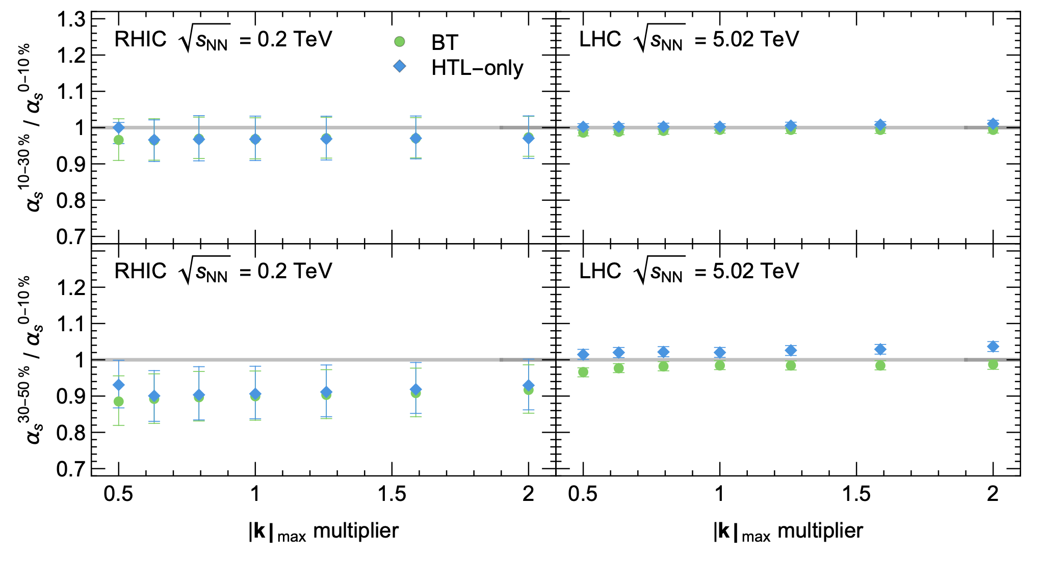

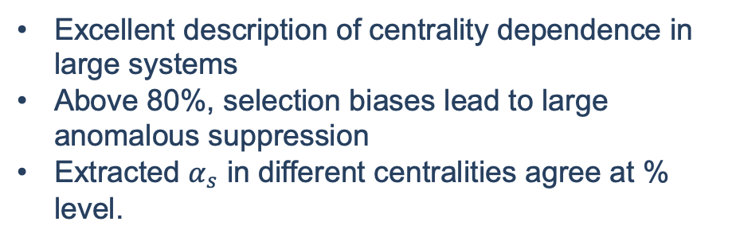
Centrality dependence of $α_{s}$ in AA
Excellent description of centrality dependence in large systems
Above 80%, selection biases lead to large anomalous suppression
Extracted $α_{s}$ in different centralities agree at % level.

Slide 27
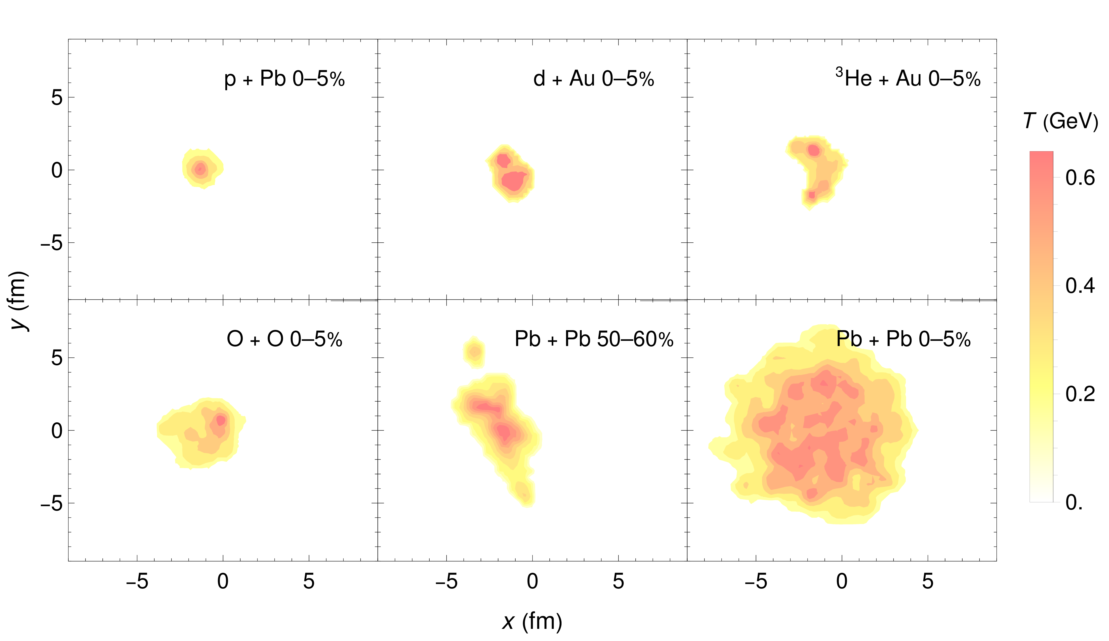
What do Small QGP’s Look Like?
REPLACE WITH VIDEO
According to hydrodynamic models:
p+Pb much smaller than Pb+Pb, but with similarly large temperatures
p+Pb has comparable length scales to peripheral PbPb collisions
B. Schenke, C. Shen, P. Tribedy, Phys.Rev.C 102 (2020) 044905 (adapted)

Slide 28
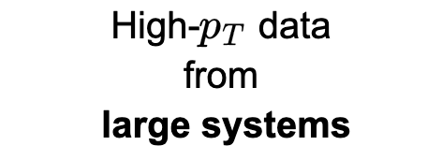










Geometry

Slide 29

QGP: drops vs droplets
Length and temperature phase space probed by experimental results (according to the hydro model we use¹)
Small systems are smaller but hotter than peripheral large systems
More peripheral
[1] B. Schenke, C. Shen, and P. Tribedy, Phys. Rev. C 102, 044905 (2020).

Slide 30

Hard probes and selection biases
Why are hard probes so difficult to interpret in small systems?
Selection biases. By requiring that there is a high-$p_{T}$ particle in the final state, “central” events are more likely to be characterized as “peripheral”.
Open question: is this a categorization mistake or a physical effect on the produced system?
Glauber model dependence. In heavy-ion collisions, the Glauber model has been extensively tested; however, the same is not true in small systems. There are reasons to think that the Glauber model (and its various modifications) break down in small systems.
ALICE, Phys. Rev. C 91, 064905 (2015).
ATLAS, Phys. Lett. B 763, 313 (2016).
ATLAS, arXiv:2504.02638 [nucl-ex] (2025).
JETSCAPE, arXiv:2407.17443 [hep-ph] (2024).
D. V. Perepelitsa, Phys. Rev. C 110, L011901 (2024).
Perhaps these difficulties mean that it is unsurprising that small system suppression is so inconclusive?

Slide 31


1. Minimum bias suppression
Minimum bias p + Pb
Fairly significant differences in the experimental measurements
Future: minimum bias O + O
Large disagreement at lower-$p_{T}$!
Washed out signal at higher-$p_{T}$

Slide 32

1. Minimum bias suppression cont.
What low-$p_{T}$ ($≤15$ GeV) physics are we missing?
Cronin effect
Nuclear PDF’s
Does QGP form in less-central systems?
Pre-thermalization time energy loss
Faster fall-off of pA temperature with time compared to Bjorken expansion
Coalescence
Correlations between hard and soft modes
All of these would move the $R_{pA}$ up at low-$p_{T}$!
W. Ke and I. Vitev, Phys. Rev. C 107, 064903 (2023).
Huss, A. Kurkela, A. Mazeliauskas, R. Paatelainen, W. van der Schee, and U. A. Wiedemann, Phys. Rev. Lett. 126, 192301 (2021).
J. Gebhard, A. Mazeliauskas, and A. Takacs, JHEP 04, 034 (2025).
CF, A. Grindrod, and W. A. Horowitz, Eur. Phys. J. C 83, 1060 (2023).
C. Zhang, L. Zheng, S. Shi, and Z.-W. Lin, Phys. Lett. B 846, 138219 (2023).
JETSCAPE, arXiv:2407.17443 [hep-ph] (2024).

Slide 33



2. Self-normalized observables
Back-to-back correlations are another useful self-normalized probe of energy loss in small systems
$I_{pA}$ consistent with no energy loss, although quantitative theoretical predictions are needed to make strong conclusions (work in progress!)
PHENIX, Phys. Rev. Lett. 134, 022302 (2025).
ATLAS, Phys. Rev. Lett. 131, 072301 (2023)

Slide 34



2. Self-normalized observables cont.
Use the number of direct, high-$p_{T}$ photons as a measure of the number of binary collisions
Finds 4.5$σ$ suppression, but interpretation may also be due to initial state effects (esp. color fluctuation model)
Selection biases may still be present in self-normalized observables.
For instance, different $⟨x⟩$ may lead to $R_{dA,EXP}<1$
PHENIX, Phys. Rev. Lett. 134, 022302 (2025); M. Alvioli and M. Strikman, Phys. Lett. B 722, 347 (2013).; D. V. Perepelitsa, Phys. Rev. C 110, L011901 (2024).

Slide 35

Small system suppression at RHIC
Agree within one-sigma with PHENIX centrality dependence
Note: all grey boxes are fully correlated systematic uncertainties
Moderately oversuppressed: no energy loss in the initial stage, soft / hard correlations, QGP formation turns off at some event-activity?
PHENIX, Phys. Rev. Lett. 134, 022302 (2025).

Slide 36



















A path to an answer
Tests and constraints on each section of the model are invaluable
However, their implications must also be evaluated within the context of the complete partonic evolution
Observables

Slide 37

Large formation time approximation
The large formation time approximation is used in both DGLV and DGLV + SPLC, but it has a much larger impact for SPLC
We previously showed that this assumption is not self-consistently satisfied in either DGLV or DGLV + SPLC, but can be tamed by restricting the phase space of the radiative gluon emission.
In this work, we vary this bound up and down by factors of two to estimate the sensitivity to this constrain.
CF, A. Grindrod, and W. A. Horowitz, Eur. Phys. J. C 83, 1060 (2023).

Slide 38

Collisional energy loss
We implement two limiting assumptions for the collisional energy loss
Braaten and Thoma (BT)
Hard Thermal Loop only (HTL only)
Uses HTL propagators for all interactions
However, keeps the full kinematics even for hard interactions, where HTL is not rigorously valid
Uses HTL propagators for soft interactions
Uses vacuum propagators for hard interactions
Agree at “leading order” in HTL expansion $O\left(ω,\frac{q}{T}\right)$
Both approach vacuum result for hard momentum transfers, but HTL only approaches this slowly
Captures theoretical uncertainty
E. Braaten and M. H. Thoma, Phys. Rev. D 44, R2625 (1991).
S. Wicks, PhD thesis, 2008.
CF and W. A. Horowitz, Phys. Rev. C 111, 054911 (2025).

Slide 39



Geometry
We assume longitudinal Bjorken expansion
$$T_{\text{eff}}\left(τ\right)≈T_{\text{eff}}\left(τ_{0}\right){\left(\frac{τ_{0}}{τ}\right)}^{1/3}≈T_{\text{eff}}\left(τ_{0}\right){\left(\frac{2τ_{0}}{L_{\text{eff}}}\right)}^{1/3}$$
And use the initial collision geometry to generate effective temperatures and lengths (but energy loss with full event-by-event hydrodynamic evolution is in the works!)
$$L_{\text{eff}}\left(x_{i},\hat{ϕ}\right)=\frac{1}{ρ_{\text{eff}}}\int_{0}^{∞}{\text{d}}zρ\left(x_{i}+z\hat{ϕ},τ_{0}\right)$$
$$ρ_{\text{eff}} ≡ \frac{\int{{\text{d}}^{\text{2}} x } ρ^{2}\left(x, τ_{0}\right)}{\int{{\text{d}}^{\text{2}} x }ρ\left(x, τ_{0}\right)} ⟺ T_{\text{eff}}^{3} ≡ \frac{\int{{\text{d}}^{\text{2}} x } T^{6}\left(x, τ_{0}\right)}{\int{{\text{d}}^{\text{2}} x }T^{3}\left(x, τ_{0}\right)}$$

Slide 40

What do Small QGP’s Look Like?
Small system ⟨L⟩ ~ 1 fm comparable to peripheral AA
Small systems have L/λ ∼ 1
  Central limit theorem inapplicable (elastic)
  Multiple soft scatter approaches inapplicable
Large systems have L/λ ∼ 5
  Central limit theorem still dubious?

Slide 41


Selection biases in $R_{pA}$
ATLAS, Phys. Lett. B 763, 313 (2016).
ALICE, Phys. Rev. C 91, 064905 (2015).

Slide 42


Statistical extraction of $α_{s}$
$$χ^{2}=\sum_{k}^{N_{exp}}{χ_{k}^{2}} \text{with} χ_{k}^{2}≡\sum_{i,j}^{N_{k}}{\left(y_{k,i}−μ_{k,i}\right){\left(C^{−1}\right)}_{k,ij}\left(y_{k,j}−μ_{k,j}\right)}$$
$$χ^{2}=\sum_{k}^{N_{exp. }}{χ_{k}^{2}} \text{with} χ_{k}^{2}≡\sum_{i,j}^{N_{k}}{\left(y_{k,i}−μ_{k,i}\right){\left(C^{−1}\right)}_{k,ij}\left(y_{k,j}−μ_{k,j}\right)}$$
Where
$χ^{2}$ is minimized as a function of $α_{s}$
$k$ indexes the different experimental datasets
$y_{k,i}$ are the experimental observations for the experimental result $k$ and the data point $i$
$μ_{k,i}$ are the corresponding predictions (as a function of $α_{s}$)
$C_{k}$ are the covariance matrix for the experimental data $k$
CF and W. A. Horowitz, arXiv:2505.14568 [hep-ph] (2025).

Slide 43

The covariance matrix $C$
Captures the correlations between uncertainties
Fully uncorrelated uncertainties contribute only to the diagonal (statistical & uncorrelated systematics)
Fully correlated uncertainties contribute only to the off-diagonal (correlated & globally correlated systematics)
In principle, there are
  correlations between experiments, centrality classes, particle species, but the form is not known.
  Contributions from theoretical uncertainties
JETSCAPE, Phys. Rev. C 109, 064903 (2024).
R. A. Soltz, D. A. Hangal, and A. Angerami, Phys. Rev. C 111, 034911 (2025).
CF and W. A. Horowitz, arXiv:2505.14568 [hep-ph] (2025).

Slide 44



Length-correlated model for $C$
We assume that systematics with unknown correlation contribute to the covariance matrix as
$$C_{ij}^{B}=\exp\left[−{\left|\frac{p_{i}−p_{j}}{ℓ_{k}}\right|}^{2}\right]σ_{i}σ_{j}$$
This allows nearby points to be correlated while far away points are uncorrelated
  $ℓ_{k}→∞$ corresponds to fully correlated limit and
  $ℓ_{k}→0$ corresponds to fully uncorrelated limit
JETSCAPE, Phys. Rev. C 109, 064903 (2024).

Slide 45


Sensitivity to correlation length
Changing correlation length changes $α_{s}$ only at large $ℓ_{corr}$
$p$-value is sensitive to the correlation length
Experimental constrains could help discern between different theories (especially in the overall slope of $R_{AA}$)

Slide 46

Short pathlength (SPL) Corr. to DGLV
DGLV 1st order in opacity
Suppressed for large L
Djordjevic and Gyulassy, Nucl. Phys. A 733 (2004) 265-298
SPL corr.
Kolbe & Horowitz, PRC 100 (2019) 024913
Breaking of colour triviality
→ we’ll see this can lead to excessively large corr. for gluons!

Slide 47

Numerics of the Short Pathlength Corr.
We see the SPL correction:
Decreases as a function of L
much larger for gluons cf quarks
Can lead to negative energy loss
Grows as a function of

Slide 48


Central Limit Theorem in Elastic E-loss
How important is central limit theorem in the elastic energy loss?
We compare:
1) HTL result with Poisson distribution (Poisson HTL)
2) HTL result with Gaussian distribution (Gaussian HTL)
(Fluctuation Dissipation Thrm)

Slide 49

Elastic Energy Loss
Uncertainty in the elastic energy loss relating to applying HTL vs Gaussian propagators
We compare two extremes to capture this uncertainty:
Gaussian BT – combination of vacuum and HTL propagators Braaten and Thoma, Phys. Rev. D 44 (1991) R2625
Poisson HTL – HTL only propagators Wicks, PhD thesis (2008)
Generically in HIC radiative E-loss > elastic E-loss

Slide 50

$$χ^{2}$$

Slide 51


Running coupling extraction ($√s$)

Slide 52


Running coupling extraction ($p_{T})$

Slide 53


Running coupling extraction ($p_{T})$ cont

Slide 54

Onset of non-perturbative effects

Slide 55

Predictions for RHIC system-size scan

Slide 56

ZDC and ET centrality selection

Slide 57

ATLAS: x-dependent dijets

Slide 58


Equal supp. in peripheral and small
CF and W. A. Horowitz, Phys. Lett. B 864, 139437 (2025).

Slide 59

All data
Lots of data!

Slide 60


Gaussian ~ Poisson?
Opposite ordering than expected according to CLT?
Strong
Gaussian distribution not a good fit for either small or large systems
→ Why is Gaussian RAA ~ Poisson

Slide 61

Why is Gaussian ~ Poisson?
One can show that:
1) In small systems: small energy loss ⇒ RAA depends mostly on average energy loss
2) In large systems: elastic energy loss small fraction compared to radiative energy loss

Slide 62
Elastic vs Radiative E-Loss Importance
Elastic ∆ E / E ≃ α² T² log (ET)/E
Radiative ∆ E / E ≃ αs ³ L² T log E / E
Strong dependence on elastic E-loss used
Small systems elastic is ~1-3x more important than radiative

Slide 63


Large Formation Time Assumption
Large contributions to SPL corr. at high energies from regions of phase space not allowed according to Large Formation Time assumption
Also impacts DGLV
Future work should include a full rederivation of DGLV with LFT assumption relaxed
Can implement a phenomenological cut in the phase space as well to limit assumption-violating contributions

Slide 64


Turning Off Elastic E-Loss

Slide 65


Gluon to Light Quark Crossover

Slide 66


Controlling the LFT approximation

Slide 67




Example contribution to SPL corr.
Pole at

Slide 68
References for small sys. E-loss table
[1] V. Khachatryan et al. (CMS), JHEP 09, 091 (2010), arXiv:1009.4122 [hep-ex].
[2] S. Chatrchyan et al. (CMS), JHEP 07, 076 (2011), arXiv:1105.2438 [nucl-ex].
[3] G. Aad et al. (ATLAS), Phys. Rev. Lett. 110, 182302 (2013), arXiv:1212.5198 [hep-ex].
[4] B. Abelev et al. (ALICE), Phys. Lett. B 719, 29 (2013), arXiv:1212.2001 [nucl-ex].
[5] S. Chatrchyan et al. (CMS), Phys. Lett. B 718, 795 (2013), arXiv:1210.5482 [nucl-ex].
[6] S. Chatrchyan et al. (CMS), Eur. Phys. J. C 72, 2012 (2012), arXiv:1201.3158 [nucl-ex].
[7] G. Aad et al. (ATLAS), Phys. Rev. C 90, 044906 (2014), arXiv:1409.1792 [hep-ex].
[8] V. Khachatryan et al. (CMS), Phys. Rev. Lett. 116, 172302 (2016), arXiv:1510.03068 [nucl-ex].
[9] S. Acharya et al. (ALICE), Phys. Rev. Lett. 132, 172302 (2024), arXiv:2311.14357 [nucl-ex].
[10] K. Aamodt et al. (ALICE), Phys. Lett. B 708, 249 (2012), arXiv:1109.2501 [nucl-ex].
[11] G. Aad et al. (ATLAS), Phys. Rev. C 86, 014907 (2012), arXiv:1203.3087 [hep-ex].
[12] A. Adare et al. (PHENIX), Phys. Rev. Lett. 114, 192301 (2015), arXiv:1404.7461 [nucl-ex].
[13] G. Aad et al. (ATLAS), Phys. Rev. Lett. 116, 172301 (2016), arXiv:1509.04776 [hep-ex].
[14] L. Adamczyk et al. (STAR), Phys. Lett. B 747, 265 (2015), arXiv:1502.07652 [nucl-ex].
[15] J. Adam et al. (ALICE), JHEP 09, 164 (2016), arXiv:1606.06057 [nucl-ex].
[16] J. Adam et al. (ALICE), Phys. Lett. B 762, 376 (2016), arXiv:1605.02035 [nucl-ex].
[17] V. Khachatryan et al. (CMS), Phys. Lett. B 765, 193 (2017), arXiv:1606.06198 [nucl-ex].
[18] M. Aaboud et al. (ATLAS), Eur. Phys. J. C 77, 428 (2017), arXiv:1705.04176 [hep-ex].
[19] S. Acharya et al. (ALICE), JHEP 09, 032 (2017), arXiv:1707.05690 [nucl-ex].
[20] A. M. Sirunyan et al. (CMS), Phys. Rev. Lett. 120, 092301 (2018), arXiv:1709.09189 [nucl-ex].
[21] S. Acharya et al. (ALICE), JHEP 09, 006 (2018), arXiv:1805.04390 [nucl-ex].
[22] C. Aidala et al. (PHENIX), Nature Phys. 15, 214 (2019), arXiv:1805.02973 [nucl-ex].
[23] S. Acharya et al. (ALICE), Phys. Rev. Lett. 123, 142301 (2019), arXiv:1903.01790 [nucl-ex].
[24] S. Acharya et al. (ALICE), JHEP 05, 085 (2020), arXiv:2002.00633 [nucl-ex].
[25] M. I. Abdulhamid et al. (STAR), Phys. Rev. Lett. 130, 242301 (2023), arXiv:2210.11352 [nucl-ex].
[26] G. Aad et al. (ATLAS), Phys. Lett. B 707, 330 (2012), arXiv:1108.6018 [hep-ex].
[27] G. Aad et al. (ATLAS), Eur. Phys. J. C 74, 2982 (2014), arXiv:1405.3936 [hep-ex].
[28] R. Aaij et al. (LHCb), Phys. Lett. B 762, 473 (2016), arXiv:1512.00439 [nucl-ex].
[29] J. Adam et al. (ALICE), Phys. Lett. B 753, 126 (2016), arXiv:1506.08032 [nucl-ex].
[30] M. Aaboud et al. (ATLAS), Phys. Rev. C 95, 064914 (2017), arXiv:1606.08170 [hep-ex].
[31] V. Khachatryan et al. (CMS), Phys. Rev. C 96, 014915 (2017), arXiv:1604.05347 [nucl-ex].
[32] A. M. Sirunyan et al. (CMS), Phys. Rev. C 98, 044902 (2018), arXiv:1710.07864 [nucl-ex].[33] G. Aad et al. (ATLAS), (2023), arXiv:2308.16745 [nucl-ex].
[34] S. Acharya et al. (ALICE), JHEP 01, 199 (2024), arXiv:2308.16590 [nucl-ex].
[35] B. Abelev et al. (ALICE), Phys. Lett. B 719, 18 (2013), arXiv:1205.5761 [nucl-ex].
[36] B. B. Abelev et al. (ALICE), Phys. Lett. B 726, 164 (2013), arXiv:1307.3237 [nucl-ex].
[37] B. B. Abelev et al. (ALICE), JHEP 06, 190 (2015), arXiv:1405.4632 [nucl-ex].
[38] V. Khachatryan et al. (CMS), Phys. Lett. B 742, 200 (2015), arXiv:1409.3392 [nucl-ex].
[39] A. Adare et al. (PHENIX), Phys. Rev. C 97, 064904 (2018), arXiv:1710.09736 [nucl-ex].
[40] A. M. Sirunyan et al. (CMS), Phys. Rev. Lett. 121, 082301 (2018), arXiv:1804.09767 [hep-ex].
[41] S. Acharya et al. (ALICE), JHEP 05, 243 (2023), arXiv:2206.04587 [nucl-ex].
[42] A. Tumasyan et al. (CMS), JHEP 05, 007 (2023), arXiv:2205.00080 [nucl-ex].
[43] K. Aamodt et al. (ALICE), Phys. Rev. Lett. 105, 252302 (2010), arXiv:1011.3914 [nucl-ex].
[44] K. Aamodt et al. (ALICE), Phys. Rev. Lett. 107, 032301 (2011), arXiv:1105.3865 [nucl-ex].
[45] S. Chatrchyan et al. (CMS), Phys. Rev. C 87, 014902 (2013), arXiv:1204.1409 [nucl-ex].
[46] G. Aad et al. (ATLAS), Phys. Lett. B 725, 60 (2013), arXiv:1303.2084 [hep-ex].
[47] S. Chatrchyan et al. (CMS), Phys. Rev. C 89, 044906 (2014), arXiv:1310.8651 [nucl-ex].
[48] S. Chatrchyan et al. (CMS), Phys. Lett. B 724, 213 (2013), arXiv:1305.0609 [nucl-ex].
[49] G. Aad et al. (ATLAS), Eur. Phys. J. C 74, 3157 (2014), arXiv:1408.4342 [hep-ex].
[50] B. B. Abelev et al. (ALICE), Phys. Rev. C 90, 054901 (2014), arXiv:1406.2474 [nucl-ex].
[51] V. Khachatryan et al. (CMS), Phys. Rev. Lett. 115, 012301 (2015), arXiv:1502.05382 [nucl-ex].
[52] J. Adam et al. (ALICE), Phys. Rev. Lett. 116, 132302 (2016), arXiv:1602.01119 [nucl-ex].
[53] M. Aaboud et al. (ATLAS), Phys. Rev. C 97, 024904 (2018), arXiv:1708.03559 [hep-ex].
[54] A. M. Sirunyan et al. (CMS), Phys. Lett. B 776, 195 (2018), arXiv:1702.00630 [hep-ex].
[55] A. M. Sirunyan et al. (CMS), Phys. Rev. C 101, 014912 (2020), arXiv:1904.11519 [hep-ex].
[56] G. Aad et al. (ATLAS), Phys. Rev. C 90, 024905 (2014), arXiv:1403.0489 [hep-ex].
[57] G. Aad et al. (ATLAS), Phys. Rev. C 92, 034903 (2015), arXiv:1504.01289 [hep-ex].
[58] J. Adam et al. (ALICE), Phys. Rev. Lett. 117, 182301 (2016), arXiv:1604.07663 [nucl-ex].
[59] S. Acharya et al. (ALICE), Phys. Rev. C 97, 024906 (2018), arXiv:1709.01127 [nucl-ex].
[60] M. Aaboud et al. (ATLAS), Phys. Lett. B 789, 444 (2019), arXiv:1807.02012 [nucl-ex].
[61] A. M. Sirunyan et al. (CMS), Phys. Rev. C 103, 014902 (2021), arXiv:1905.09935 [hep-ex].
[62] B. Aboona et al. (STAR), Phys. Lett. B 839, 137755 (2023), arXiv:2211.11637 [nucl-ex].
[63] S. Acharya et al. (ALICE), Phys. Lett. B 773, 68 (2017), arXiv:1705.04377 [nucl-ex].
[64] A. M. Sirunyan et al. (CMS), Eur. Phys. J. C 80, 534 (2020), arXiv:1910.08789 [hep-ex].

Slide 69
References for small sys. E-loss table
[65] V. Khachatryan et al. (CMS), Phys. Rev. C 92, 034911 (2015), arXiv:1503.01692 [nucl-ex].[66] M. Aaboud et al. (ATLAS), Eur. Phys. J. C 78, 142 (2018), arXiv:1709.02301 [nucl-ex].
[67] A. M. Sirunyan et al. (CMS), Phys. Rev. C 96, 064902 (2017), arXiv:1708.07113 [nucl-ex].
[68] G. Aad et al. (ATLAS), Phys. Rev. Lett. 126, 122301 (2021), arXiv:2001.04201 [nucl-ex].
[69] S. Acharya et al. (ALICE), Phys. Rev. C 107, L051901 (2023), arXiv:2206.04574 [nucl-ex].
[70] G. Aad et al. (ATLAS), JHEP 11, 183 (2013), arXiv:1305.2942 [hep-ex].
[71] A. M. Sirunyan et al. (CMS), Phys. Lett. B 789, 643 (2019), arXiv:1711.05594 [nucl-ex].
[72] S. Acharya et al. (ALICE), JHEP 07, 103 (2018), arXiv:1804.02944 [nucl-ex].
[73] G. Aad et al. (ATLAS), Eur. Phys. J. C 79, 985 (2019), arXiv:1907.05176 [nucl-ex].
[74] S. Acharya et al. (ALICE), Phys. Lett. B 834, 137393 (2022), arXiv:2111.06106 [nucl-ex].
[75] B. Abelev et al. (ALICE), Phys. Rev. Lett. 111, 232302 (2013), arXiv:1306.4145 [nucl-ex].
[76] B. Abelev et al. (ALICE), Phys. Lett. B 723, 267 (2013), arXiv:1301.3756 [nucl-ex].
[77] J. Adam et al. (ALICE), Eur. Phys. J. C 76, 86 (2016), arXiv:1509.07255 [nucl-ex].
[78] J. Adam et al. (ALICE), Phys. Rev. C 93, 044903 (2016), arXiv:1512.05739 [nucl-ex].
[79] V. Khachatryan et al. (CMS), Phys. Rev. Lett. 118, 122301 (2017), arXiv:1610.00263 [nucl-ex].
[80] S. Acharya et al. (ALICE), Phys. Lett. B 777, 151 (2018), arXiv:1709.04723 [nucl-ex].
[81] A. M. Sirunyan et al. (CMS), Phys. Rev. C 100, 064908 (2019), arXiv:1708.08901 [nucl-ex].
[82] A. M. Sirunyan et al. (CMS), Phys. Rev. C 97, 044912 (2018), arXiv:1708.01602 [nucl-ex].
[83] B. Abelev et al. (ALICE), Phys. Rev. Lett. 109, 252301 (2012), arXiv:1208.1974 [hep-ex].
[84] S. Chatrchyan et al. (CMS), Eur. Phys. J. C 72, 2164 (2012), arXiv:1207.4724 [hep-ex].
[85] B. B. Abelev et al. (ALICE), Phys. Lett. B 728, 25 (2014), arXiv:1307.6796 [nucl-ex].
[86] B. Abelev et al. (ALICE), Phys. Rev. C 88, 044910 (2013), arXiv:1303.0737 [hep-ex].
[87] S. Chatrchyan et al. (CMS), Eur. Phys. J. C 74, 2847 (2014), arXiv:1307.3442 [hep-ex].
[88] C. Andrei (ALICE), Nucl. Phys. A 931, 888 (2014), arXiv:1408.0093 [hep-ex].
[89] J. Adam et al. (ALICE), Phys. Lett. B 758, 389 (2016), arXiv:1512.07227 [nucl-ex].
[90] J. Adam et al. (ALICE), Eur. Phys. J. C 76, 245 (2016), arXiv:1601.07868 [nucl-ex].
[91] S. Acharya et al. (ALICE), Eur. Phys. J. C 77, 658 (2017), arXiv:1707.07304 [nucl-ex].
[92] J. Adam et al. (ALICE), Phys. Rev. C 95, 064606 (2017), arXiv:1702.00555 [nucl-ex].
[93] S. Acharya et al. (ALICE), Phys. Rev. C 99, 024906 (2019), arXiv:1807.11321 [nucl-ex].
[94] S. Acharya et al. (ALICE), Phys. Rev. C 101, 044907 (2020), arXiv:1910.07678 [nucl-ex].
[95] B. B. Abelev et al. (ALICE), Phys. Rev. Lett. 111, 222301 (2013), arXiv:1307.5530 [nucl-ex].
[96] B. B. Abelev et al. (ALICE), Phys. Rev. C 91, 024609 (2015), arXiv:1404.0495 [nucl-ex].
[97] J. Adam et al. (ALICE), Phys. Lett. B 768, 203 (2017), arXiv:1506.09206 [nucl-ex].
[98] J. Adam et al. (ALICE), Phys. Lett. B 760, 720 (2016), arXiv:1601.03658 [nucl-ex].[99] V. Khachatryan et al. (CMS), Phys. Lett. B 768, 103 (2017), arXiv:1605.06699 [nucl-ex].
[100] B. B. Abelev et al. (ALICE), Phys. Lett. B 728, 216 (2014), [Erratum: Phys.Lett.B 734, 409–410
(2014)], arXiv:1307.5543 [nucl-ex].
[101] J. Adam et al. (ALICE), Nature Phys. 13, 535 (2017), arXiv:1606.07424 [nucl-ex].
[102] S. Acharya et al. (ALICE), Eur. Phys. J. C 80, 693 (2020), arXiv:2003.02394 [nucl-ex].
[103] S. Acharya et al. (ALICE), Eur. Phys. J. C 81, 584 (2021), arXiv:2101.03100 [nucl-ex].
[104] S. Acharya et al. (ALICE), Eur. Phys. J. C 84, 813 (2024), arXiv:2211.04384 [nucl-ex].
[105] K. Aamodt et al. (ALICE), Phys. Rev. D 84, 112004 (2011), arXiv:1101.3665 [hep-ex].
[106] B. B. Abelev et al. (ALICE), Phys. Lett. B 739, 139 (2014), arXiv:1404.1194 [nucl-ex].
[107] J. Adam et al. (ALICE), Phys. Rev. C 91, 034906 (2015), arXiv:1502.00559 [nucl-ex].
[108] J. Adam et al. (ALICE), Phys. Rev. C 92, 054908 (2015), arXiv:1506.07884 [nucl-ex].
[109] J. Adam et al. (ALICE), Phys. Rev. C 93, 024905 (2016), arXiv:1507.06842 [nucl-ex].
[110] M. Aaboud et al. (ATLAS), Phys. Rev. C 96, 064908 (2017), arXiv:1704.01621 [hep-ex].
[111] S. Acharya et al. (ALICE), Phys. Rev. C 96, 064613 (2017), arXiv:1709.01731 [nucl-ex].
[112] A. Tumasyan et al. (CMS), Phys. Lett. B 857, 138936 (2024), arXiv:2301.05290 [nucl-ex].
[113] A. Tumasyan et al. (CMS), Phys. Rev. C 109, 024914 (2024), arXiv:2306.11574 [nucl-ex].
[114] J. Adam et al. (ALICE), Phys. Lett. B 754, 235 (2016), arXiv:1509.07324 [nucl-ex].
[115] S. Acharya et al. (ALICE), Phys. Rev. C 99, 024912 (2019), arXiv:1803.09857 [nucl-ex].
[116] S. Acharya et al. (ALICE), (2023), arXiv:2308.16704 [nucl-ex].
[117] G. Aad et al. (ATLAS), Eur. Phys. J. C 80, 73 (2020), arXiv:1910.13978 [nucl-ex].
[118] M. Aaboud et al. (ATLAS), Eur. Phys. J. C 80, 64 (2020), arXiv:1906.08290 [nucl-ex].
[119] G. Aad et al. (ATLAS), Phys. Rev. Lett. 131, 162301 (2023), arXiv:2303.17357 [nucl-ex].
[120] S. Acharya et al. (ALICE), JHEP 08, 234 (2024), arXiv:2212.12609 [nucl-ex].
[121] A. Hayrapetyan et al. (CMS), Phys. Rev. Lett. 133, 142301 (2024), arXiv:2312.17103 [hep-ex].
[122] K. Aamodt et al. (ALICE), Phys. Lett. B 696, 30 (2011), arXiv:1012.1004 [nucl-ex].
[123] B. Abelev et al. (ALICE), JHEP 09, 112 (2012), arXiv:1203.2160 [nucl-ex].
[124] B. Abelev et al. (ALICE), Phys. Lett. B 720, 52 (2013), arXiv:1208.2711 [hep-ex].
[125] S. Chatrchyan et al. (CMS), Eur. Phys. J. C 72, 1945 (2012), arXiv:1202.2554 [nucl-ex].
[126] G. Aad et al. (ATLAS), Phys. Lett. B 748, 392 (2015), arXiv:1412.4092 [hep-ex].
[127] G. Aad et al. (ATLAS), Phys. Rev. Lett. 114, 072302 (2015), arXiv:1411.2357 [hep-ex].
[128] G. Aad et al. (ATLAS), JHEP 09, 050 (2015), arXiv:1504.04337 [hep-ex].

Slide 70
References for small sys. E-loss table
[158] S. Chatrchyan et al. (CMS), Phys. Rev. Lett. 109, 022301 (2012), arXiv:1204.1850 [nucl-ex].
[159] G. Aad et al. (ATLAS), Phys. Rev. C 105, 064903 (2022), arXiv:2111.06606 [nucl-ex].
[160] A. Tumasyan et al. (CMS), JHEP 07, 139 (2023), arXiv:2210.08325 [hep-ex].
[161] E. Abbas et al. (ALICE), Phys. Rev. Lett. 111, 162301 (2013), arXiv:1303.5880 [nucl-ex].
[162] B. Abelev et al. (ALICE), Phys. Rev. Lett. 111, 102301 (2013), arXiv:1305.2707 [nucl-ex].[163] B. B. Abelev et al. (ALICE), Phys. Rev. C 90, 034904 (2014), arXiv:1405.2001 [nucl-ex].
[164] J. Adam et al. (ALICE), Phys. Lett. B 753, 41 (2016), arXiv:1507.03134 [nucl-ex].
[165] J. Adam et al. (ALICE), Eur. Phys. J. C 77, 245 (2017), arXiv:1605.06963 [nucl-ex].
[166] J. Adam et al. (ALICE), JHEP 09, 028 (2016), arXiv:1606.00321 [nucl-ex].
[167] V. Khachatryan et al. (CMS), Eur. Phys. J. C 77, 252 (2017), arXiv:1610.00613 [nucl-ex].
[168] S. Acharya et al. (ALICE), Phys. Rev. Lett. 120, 102301 (2018), arXiv:1707.01005 [nucl-ex].
[169] S. Acharya et al. (ALICE), Phys. Lett. B 780, 7 (2018), arXiv:1709.06807 [nucl-ex].
[170] S. Acharya et al. (ALICE), Phys. Rev. Lett. 119, 242301 (2017), arXiv:1709.05260 [nucl-ex].
[171] A. M. Sirunyan et al. (CMS), Phys. Rev. Lett. 120, 202301 (2018), arXiv:1708.03497 [nucl-ex].
[172] S. Acharya et al. (ALICE), Phys. Rev. Lett. 122, 072301 (2019), arXiv:1805.04367 [nucl-ex].
[173] S. Acharya et al. (ALICE), JHEP 10, 141 (2020), arXiv:2005.14518 [nucl-ex].
[174] G. Aad et al. (ATLAS), Phys. Lett. B 807, 135595 (2020), arXiv:2003.03565 [nucl-ex].
[175] A. M. Sirunyan et al. (CMS), Phys. Lett. B 813, 136036 (2021), arXiv:2009.07065 [hep-ex].
[176] A. Tumasyan et al. (CMS), Phys. Rev. Lett. 129, 022001 (2022), arXiv:2112.12236 [hep-ex].
[177] S. Acharya et al. (ALICE), Phys. Lett. B 846, 137782 (2023), arXiv:2210.08980 [nucl-ex].
[178] A. Tumasyan et al. (CMS), Phys. Lett. B 850, 138389 (2024), arXiv:2212.01636 [nucl-ex].
[179] A. Tumasyan et al. (CMS), JHEP 10, 115 (2023), arXiv:2305.16928 [hep-ex].
[180] A. Tumasyan et al. (CMS), Phys. Lett. B 850, 138518 (2024), arXiv:2310.03233 [hep-ex].
[181] S. Acharya et al. (ALICE), Phys. Rev. Lett. 123, 192301 (2019), arXiv:1907.03169 [nucl-ex].
[182] G. Aad et al. (ATLAS), Phys. Rev. Lett. 124, 082301 (2020), arXiv:1909.01650 [nucl-ex].
[183] A. M. Sirunyan et al. (CMS), Phys. Lett. B 819, 136385 (2021), arXiv:2006.07707 [hep-ex].
[184] B. Abelev et al. (ALICE), Phys. Rev. Lett. 109, 072301 (2012), arXiv:1202.1383 [hep-ex].
[185] S. Chatrchyan et al. (CMS), JHEP 05, 063 (2012), arXiv:1201.5069 [nucl-ex].
[186] S. Chatrchyan et al. (CMS), Phys. Rev. Lett. 109, 222301 (2012), [Erratum: Phys.Rev.Lett. 120,
199903 (2018)], arXiv:1208.2826 [nucl-ex].
[187] B. B. Abelev et al. (ALICE), JHEP 02, 073 (2014), arXiv:1308.6726 [nucl-ex].
[188] S. Chatrchyan et al. (CMS), JHEP 04, 103 (2014), arXiv:1312.6300 [nucl-ex].
[129] J. Adam et al. (ALICE), Phys. Lett. B 746, 1 (2015), arXiv:1502.01689 [nucl-ex].
[130] V. Khachatryan et al. (CMS), Eur. Phys. J. C 75, 237 (2015), arXiv:1502.05387 [nucl-ex].[131] J. Adam et al. (ALICE), (2016), 10.1140/epjc/s10052-016-4107-8, arXiv:1603.03402 [nucl-ex].
[132] V. Khachatryan et al. (CMS), JHEP 04, 039 (2017), arXiv:1611.01664 [nucl-ex].
[133] A. M. Sirunyan et al. (CMS), Phys. Lett. B 772, 306 (2017), arXiv:1612.08972 [nucl-ex].
[134] S. Acharya et al. (ALICE), Phys. Lett. B 793, 420 (2019), arXiv:1805.05212 [nucl-ex].
[135] S. Acharya et al. (ALICE), Phys. Lett. B 788, 166 (2019), arXiv:1805.04399 [nucl-ex].
[136] S. Acharya et al. (ALICE), JHEP 11, 013 (2018), arXiv:1802.09145 [nucl-ex].
[137] A. M. Sirunyan et al. (CMS), JHEP 10, 138 (2018), arXiv:1809.00201 [hep-ex].
[138] G. Aad et al. (ATLAS), JHEP 07, 074 (2023), arXiv:2211.15257 [hep-ex].
[139] G. Aad et al. (ATLAS), Phys. Lett. B 846, 138154 (2023), arXiv:2303.10090 [nucl-ex].
[140] G. Aad et al. (ATLAS), Phys. Rev. Lett. 105, 252303 (2010), arXiv:1011.6182 [hep-ex].
[141] S. Chatrchyan et al. (CMS), Phys. Rev. C 84, 024906 (2011), arXiv:1102.1957 [nucl-ex].
[142] S. Chatrchyan et al. (CMS), Eur. Phys. J. C 74, 2951 (2014), arXiv:1401.4433 [nucl-ex].
[143] V. Khachatryan et al. (CMS), JHEP 11, 055 (2016), arXiv:1609.02466 [nucl-ex].
[144] A. M. Sirunyan et al. (CMS), Phys. Rev. Lett. 120, 142302 (2018), arXiv:1708.09429 [nucl-ex].
[145] A. M. Sirunyan et al. (CMS), JHEP 03, 181 (2018), arXiv:1802.00707 [hep-ex].
[146] A. M. Sirunyan et al. (CMS), JHEP 05, 116 (2021), arXiv:2101.04720 [hep-ex].
[147] G. Aad et al. (ATLAS), Phys. Rev. C 108, 024906 (2023), arXiv:2302.03967 [nucl-ex].
[148] J. Adam et al. (ALICE), JHEP 09, 170 (2015), arXiv:1506.03984 [nucl-ex].
[149] J. Adam et al. (ALICE), Phys. Lett. B 763, 238 (2016), arXiv:1608.07201 [nucl-ex].
[150] M. Aaboud et al. (ATLAS), Phys. Lett. B 774, 379 (2017), arXiv:1706.09363 [hep-ex].
[151] S. Acharya et al. (ALICE), Phys. Lett. B 783, 95 (2018), arXiv:1712.05603 [nucl-ex].
[152] A. M. Sirunyan et al. (CMS), Phys. Lett. B 785, 14 (2018), arXiv:1711.09738 [nucl-ex].
[153] A. M. Sirunyan et al. (CMS), Phys. Rev. Lett. 119, 082301 (2017), arXiv:1702.01060 [nucl-ex].
[154] A. M. Sirunyan et al. (CMS), JHEP 05, 006 (2018), arXiv:1803.00042 [nucl-ex].
[155] A. M. Sirunyan et al. (CMS), Phys. Rev. Lett. 121, 242301 (2018), arXiv:1801.04895 [hep-ex].
[156] G. Aad et al. (ATLAS), Phys. Rev. Lett. 131, 072301 (2023), arXiv:2206.01138 [nucl-ex].
[157] G. Aad et al. (ATLAS), Phys. Rev. C 107, 054908 (2023), [Erratum: Phys.Rev.C 109, 029901
(2024)], arXiv:2205.00682 [nucl-ex].

Slide 71
References for small sys. E-loss table
[189] B. B. Abelev et al. (ALICE), Phys. Lett. B 740, 105 (2015), arXiv:1410.2234 [nucl-ex].
[190] B. B. Abelev et al. (ALICE), JHEP 12, 073 (2014), arXiv:1405.3796 [nucl-ex].
[191] J. Adam et al. (ALICE), JHEP 06, 055 (2015), arXiv:1503.07179 [nucl-ex].
[192] J. Adam et al. (ALICE), JHEP 05, 179 (2016), arXiv:1506.08804 [nucl-ex].
[193] J. Adam et al. (ALICE), JHEP 11, 127 (2015), arXiv:1506.08808 [nucl-ex].
[194] J. Adam et al. (ALICE), JHEP 07, 051 (2015), arXiv:1504.07151 [nucl-ex].[195] J. Adam et al. (ALICE), JHEP 06, 050 (2016), arXiv:1603.02816 [nucl-ex].
[196] J. Adam et al. (ALICE), Phys. Lett. B 766, 212 (2017), arXiv:1606.08197 [nucl-ex].
[197] V. Khachatryan et al. (CMS), Phys. Lett. B 770, 357 (2017), arXiv:1611.01510 [nucl-ex].
[198] A. M. Sirunyan et al. (CMS), Phys. Rev. Lett. 118, 162301 (2017), arXiv:1611.01438 [nucl-ex].
[199] M. Aaboud et al. (ATLAS), Eur. Phys. J. C 78, 171 (2018), arXiv:1709.03089 [nucl-ex].
[200] R. Aaij et al. (LHCb), Phys. Lett. B 774, 159 (2017), arXiv:1706.07122 [hep-ex].
[201] D. Adamová et al. (ALICE), Phys. Lett. B 776, 91 (2018), arXiv:1704.00274 [nucl-ex].
[202] A. M. Sirunyan et al. (CMS), Eur. Phys. J. C 78, 509 (2018), [Erratum: Eur.Phys.J.C 83, 145
(2023)], arXiv:1712.08959 [nucl-ex].
[203] A. M. Sirunyan et al. (CMS), Phys. Rev. Lett. 120, 142301 (2018), arXiv:1706.05984 [hep-ex].
[204] A. M. Sirunyan et al. (CMS), Eur. Phys. J. C 77, 269 (2017), arXiv:1702.01462 [nucl-ex].
[205] S. Acharya et al. (ALICE), JHEP 07, 160 (2018), arXiv:1805.04381 [nucl-ex].
[206] S. Acharya et al. (ALICE), Eur. Phys. J. C 78, 466 (2018), arXiv:1802.00765 [nucl-ex].
[207] S. Acharya et al. (ALICE), Phys. Lett. B 790, 89 (2019), arXiv:1805.04387 [nucl-ex].
[208] M. Aaboud et al. (ATLAS), Eur. Phys. J. C 78, 762 (2018), arXiv:1805.04077 [nucl-ex].
[209] A. M. Sirunyan et al. (CMS), Phys. Lett. B 790, 270 (2019), arXiv:1805.09215 [hep-ex].
[210] S. Acharya et al. (ALICE), Phys. Lett. B 806, 135486 (2020), arXiv:1910.14405 [nucl-ex].
[211] J. Adam et al. (STAR), Phys. Lett. B 797, 134917 (2019), arXiv:1905.13669 [nucl-ex].
[212] S. Acharya et al. (ALICE), Phys. Lett. B 822, 136579 (2021), arXiv:2011.05758 [nucl-ex].
[213] S. Acharya et al. (ALICE), Phys. Rev. Lett. 132, 042301 (2024), arXiv:2210.08893 [nucl-ex].
[214] S. Acharya et al. (ALICE), JHEP 07, 137 (2023), arXiv:2211.14153 [nucl-ex].
[215] G. Aad et al. (ATLAS), Phys. Rev. C 107, 054912 (2023), arXiv:2205.03042 [nucl-ex].
[216] A. Tumasyan et al. (CMS), Phys. Lett. B 835, 137397 (2022), arXiv:2202.11807 [hep-ex].
[217] S. Acharya et al. (ALICE), Phys. Lett. B 849, 138451 (2024), arXiv:2303.13361 [nucl-ex].
[218] S. Acharya et al. (ALICE), JHEP 02, 066 (2024), arXiv:2308.16125 [nucl-ex].
[219] A. Tumasyan et al. (CMS), Phys. Rev. Lett. 133, 022302 (2024), arXiv:2303.17026 [hep-ex].

