Slide 1

Indirect experimental method for constraining the ^{192,193}Ir(n,γ) cross sections
S. P. E. Magagula PhD candidate
SSC Laboratory, iThemba LABS P.O. Box 722, Somerset West 7129, South Africa
School of Physics, University of the Witwatersrand, Johannesburg 2050, South Africa
This work is based on the research supported by the National Research Foundation of South Africa (Grant Number: PMDS22070734847) and SAINTS Prestigious Doctoral Scholarship.

Slide 2
Introduction and Physics motivation
E_{x}
Continuum
Γ ≥D
Neutron Capture Cross sections – estimated using the Hauser-Feshbach model implemented in the TALYS code
NLD – Nuclear level density
GSF – Gamma strength function is a characteristic of the average electromagnetic transition properties of excited nuclei
Quasi-continuum
Γ ≤ D
Discrete states
Γ << D
g.s
Figure 1: Level density as excitation energy increases
An approach to constraining cross sections
Allows us to investigate the s-process branching point ¹⁹²Ir

Slide 3
Indirect method and why
Purple - stable
Light Purple – unstable
191Ir
192Ir
73.83 days
193Ir
194Ir
19.28 hours
190Ir
11.78 days
Figure 2: Part of the Iridium isotopic chain and half lives
Heavy element nucleosynthesis calculations and determining the abundances of elements.
The s- and r-processes are equally responsible for the formation of almost all nuclei heavier than iron
For the s-process branch-point nuclei, neutron capture cross-section data may not be available or limited to a narrow energy range
¹⁹² Ir is unstable, ¹⁹²Ir(n,γ)¹⁹³Ir
¹⁹²Os(α,tγ)¹⁹³Ir
Use ¹⁹²Os(α,dγ)¹⁹⁴Ir
¹⁹³Ir(n,γ)¹⁹⁴Ir

Slide 4
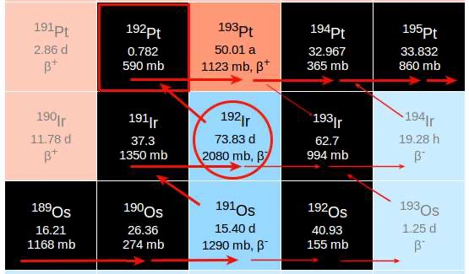
The Branching point
Bisterzo, S., et al. (2015). Monthly Notices of the Royal Astronomical Society, 449(1)
Figure 3: The ¹⁹²Ir branch feeding the s-only Pt
Element abundances e.g Pt partially depends on ¹⁹²Ir
Provides information on the s-process neutron density (beta decay – neutron capture)
Compare with existing data, to benchmark our approach (S, Athanasios, et al. 2022 )

Slide 5
Objectives
Extract the particle-gamma matrix
Extract and normalize the NLD and GSF using the Oslo method
Use the NLD and GSF to calculate the neutron capture cross section
Compare the ¹⁹⁴Ir findings with known data to benchmark our approach
Calculate Maxwellian Averaged Cross Sections (MACS)
Use the MACS for astrophysical calculations
NB: ¹⁹³Ir(n,g)¹⁹⁴Ir , ¹⁹²Ir(n,g)¹⁹³Ir

Slide 6
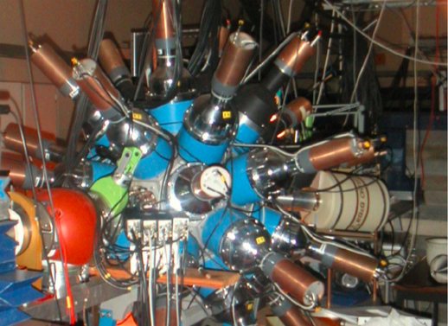
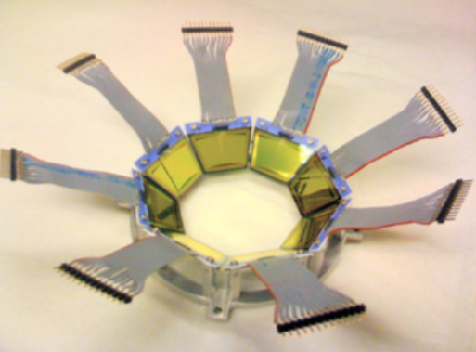
Experimental set up
CACTUS
SiRi
M. Guttormsen, et al. Nucl. Instr and Meth. in Phys doi: 10.1016 (2011)
Figure 4: The gamma ray and particle detectors at the Oslo cyclotron lab and the particle- gamma coincidence.
Gamma ray detection
26 NaI(Tl)
¹⁹²Os(α,d), ¹⁹²Os(α,t)
The experiment ran for 5 days
Charged particle detection
64 silicon telescopes placed at backward angels
30 MeV beam energy
With a 0.33mg/cm² thick ¹⁹²Os

Slide 7
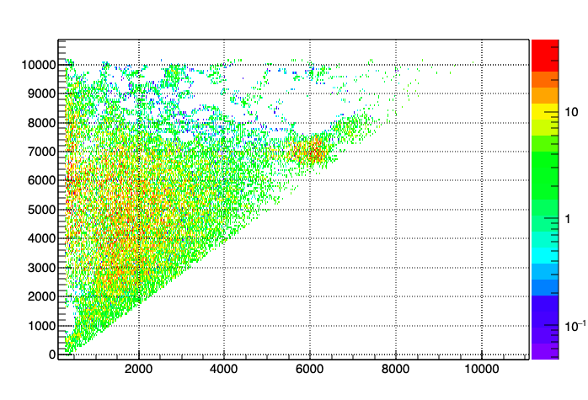
This is a combination of techniques that enables users to simultaneously extract the NLD and GSF.
The method takes the coincidence matrix as its starting point, then a set of procedures are subsequently performed, eventually leading to the desired quantities. It consists of the following steps
Oslo Method
  Unfolding the coincidence spectrum
  (M. Guttormsen et al. 1996)
  Extract primary gamma-rays
  (M. Guttormsen et al. 1987. )
  Extracting the NLD and GSF
  (A. Schiller et al 2000)
  Normalization
Ex (keV)
Eg (keV)

Slide 8
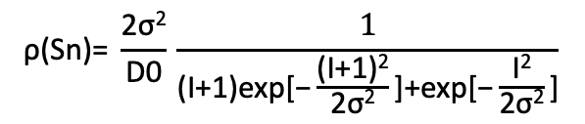
Results
$$\text{ρ}\text{(}\text{Sn}\text{​)=} \frac{\text{2}\text{σ}\text{2}}{\text{D}\text{0}}\text{​}\text{​}\frac{1}{\text{(}\text{I}\text{+1)}\text{exp}\text{[−}\frac{\text{(}\text{I}\text{+1)2}}{\text{2}\text{σ}\text{2}}\text{​]+}\text{exp}\text{[−}\frac{\text{I}\text{2}}{\text{2}\text{σ}\text{2}}\text{]​}}\text{​}$$
RIPL -2 (Index)- IAEA
Nuclear Data Services
https://www-nds.iaea.org
NNDC
https://www.nndc.bnl.gov/
Figure 5: NLD of ^{193,194} Ir

Slide 9
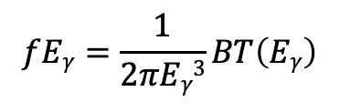
Results
$$fEγ=\frac{1}{2πEγ3}BT\left(Eγ\right)$$
EXFOR: Experimental Nuclear
Reaction Data
https://www-nds.iaea.org
Figure 6: GSF of ^{193,194} Ir,
Compared to the GDR data

Slide 10
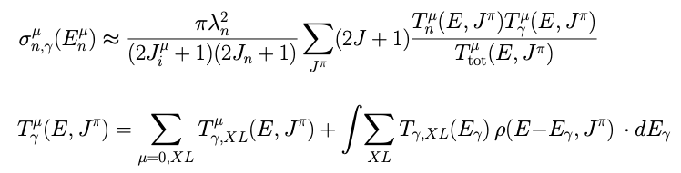
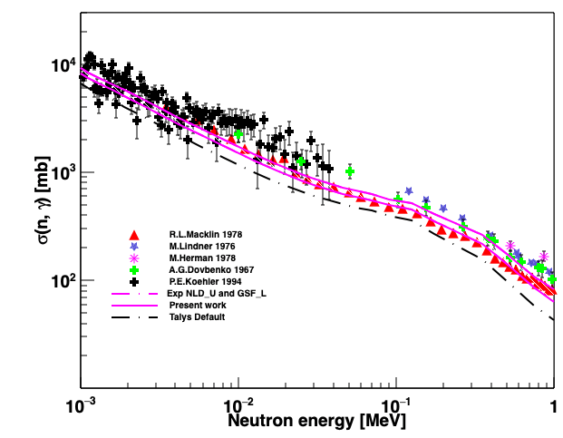
Results- Benchmark calculation
Hauser Feshbach model
GSF
NLD
Figure 7: (n,g) cross sections of ¹⁹⁴ Ir
Benchmark results
with available data to
compare with, most
From EXFOR

Slide 11
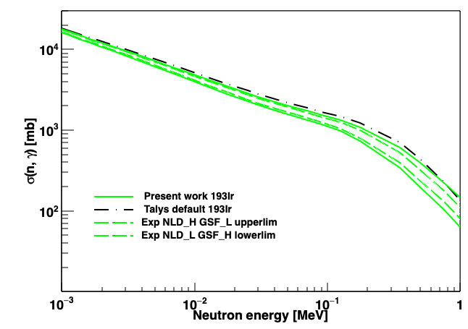
Results
Figure 8: (n,g) cross sections of ¹⁹³Ir

Slide 12
Results
E_{n} = kT
Figure 9: MACS for
¹⁹³Ir(n,g)¹⁹⁴Ir

Slide 13
Results -Preliminary
Figure 10: MACS
For 192(n,g)

Slide 14
Summary and Outlook
The particle gamma matrix was extracted for ¹⁹²Ir(n,g) and ¹⁹³Ir(n,g).
The NLD and GSF were extracted for ¹⁹²Ir(n,g) and ¹⁹³(n,g).
The neutron capture cross sections were calculated for both nuclei.
We have extracted the second experimental value for ¹⁹²Ir(n,g)Ir¹⁹³ MACS with a reduced error band.
Used the well-studied ¹⁹³Ir(n,g) to benchmark our approach by comparing to known data over all
On the outlook, s-process calculations are underway to determine elemental abundances

Slide 15





Acknowledgments
M. Wiedeking
B. V Kheswa
L Pellegri
K. L Malatji
A.C Larsen

Slide 16
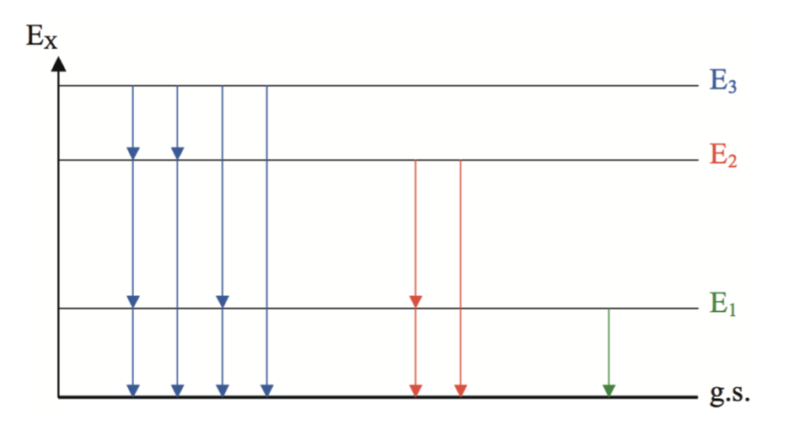
Back up slides
First gen
TALYS is a nuclear reaction program with the objective to provide a complete and accurate simulation of nuclear reactions up to energies of 200 MeV,
Device for Indirect Capture Experiments on Radionuclides (DICER) An instrument for making resonance neutron transmission measurements on very small radioactive samples to tightly constrain their neutron-capture cross sections.
at the Los Alamos Neutron Science Centre (LANSCE)

Slide 17





Branching point
branching points that mainly influence the abundance of s-only isotopes
Abundance distribution

Slide 18
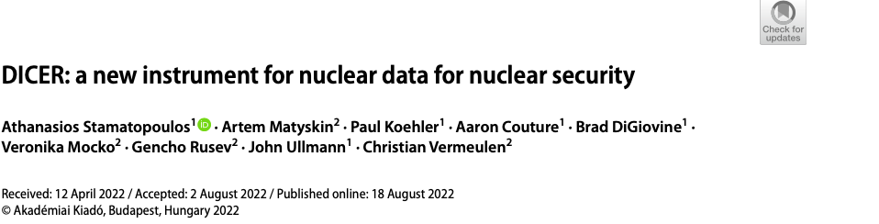
Detector resolution
Stamatopoulos, Athanasios, et al. "DICER: a new instrument for nuclear data for nuclear security." Journal of Radioanalytical and Nuclear Chemistry 331.12 (2022): 4857-4861.

Slide 19
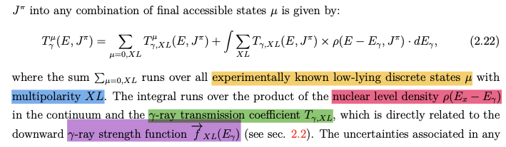
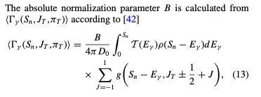
Kheswa 2017 PRC

Slide 20
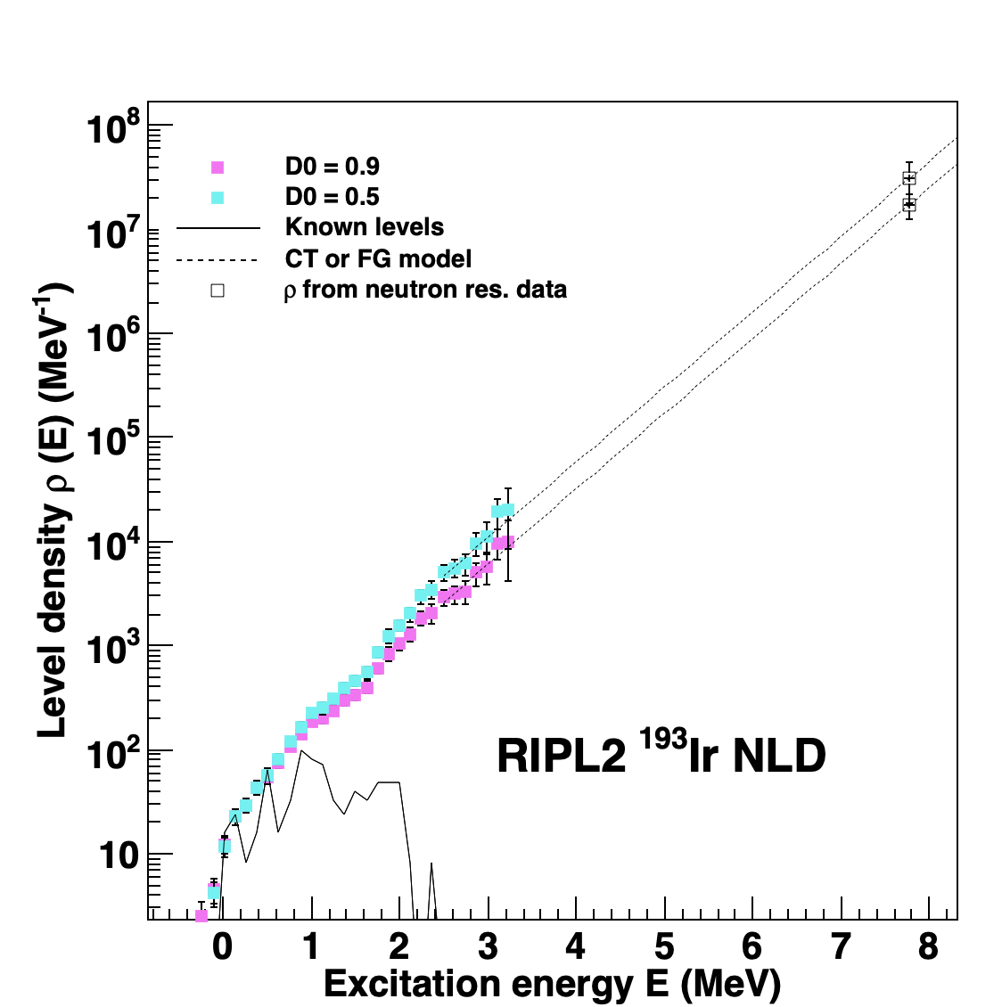
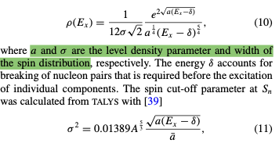
14

Slide 21
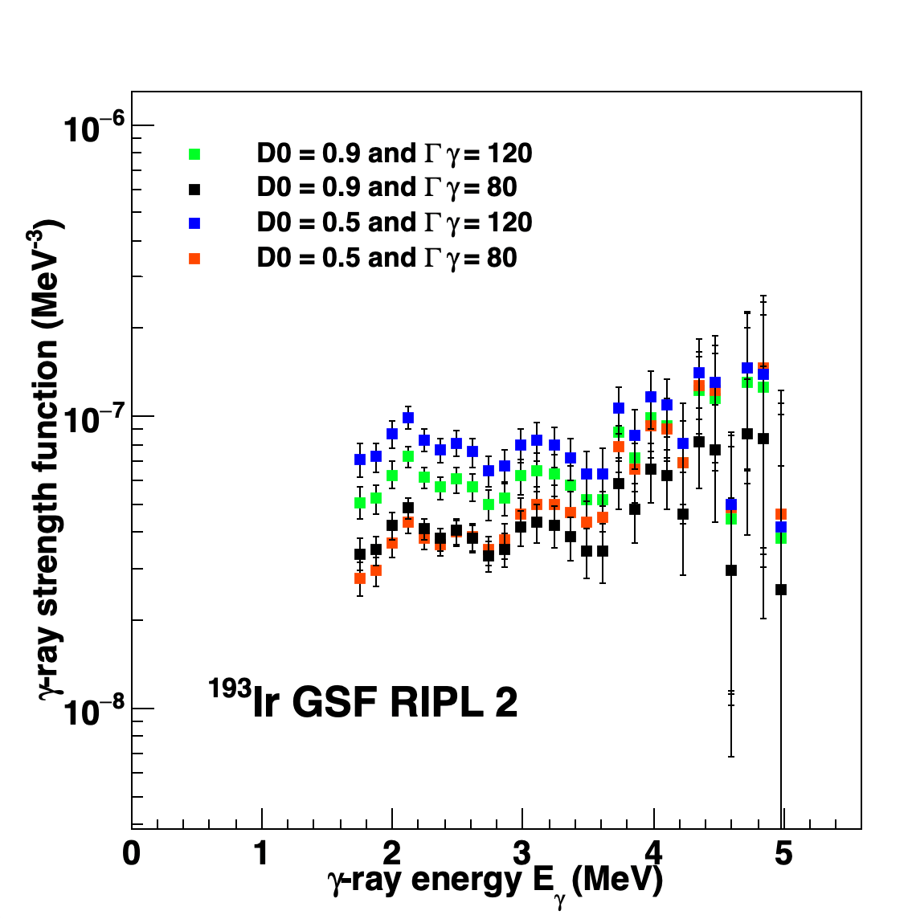
15

Slide 22
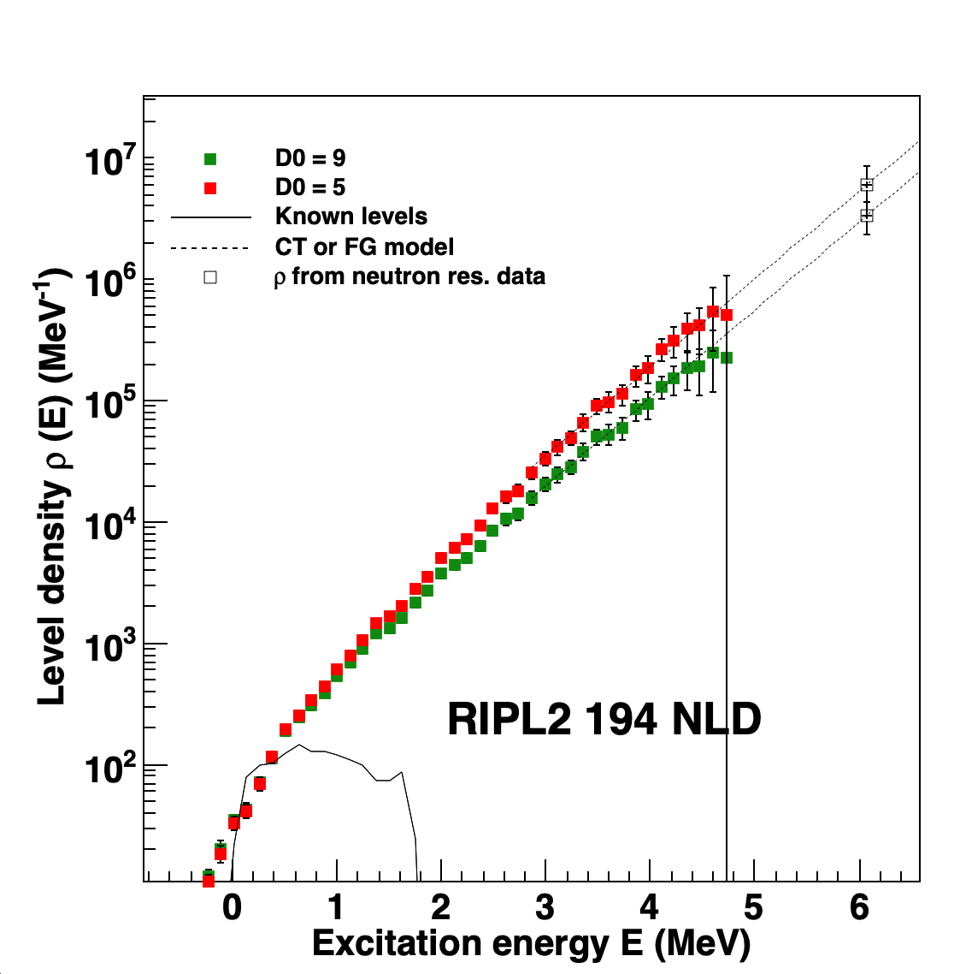
16

Slide 23
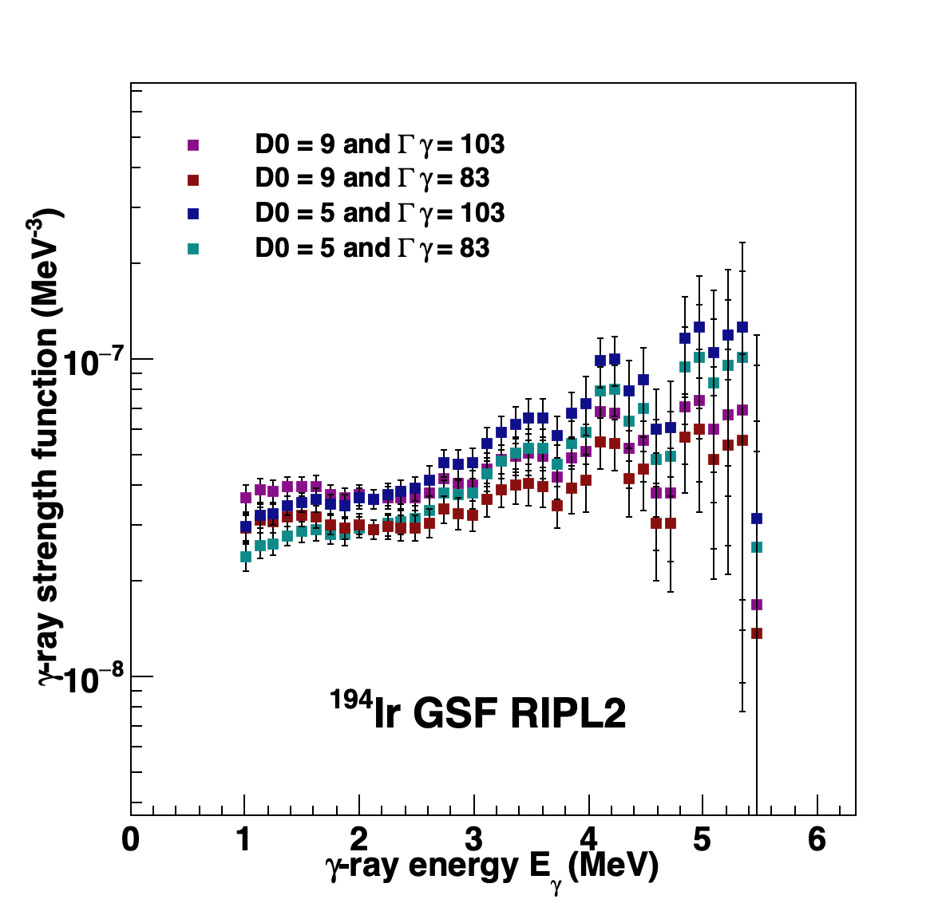
17

Slide 24
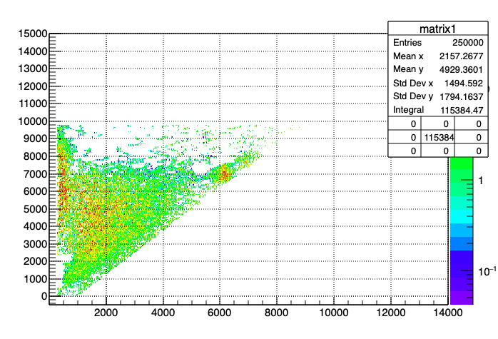
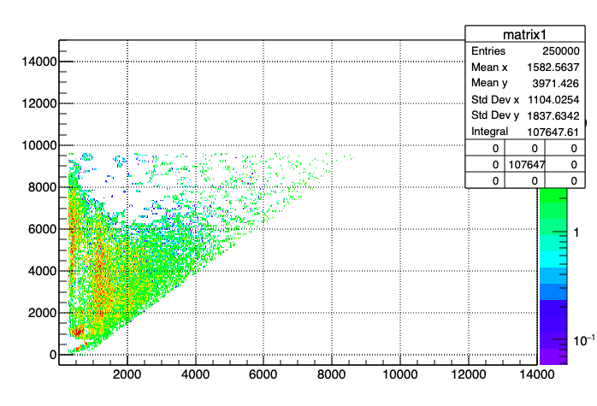
194 Ir
193 Ir
18

Slide 25
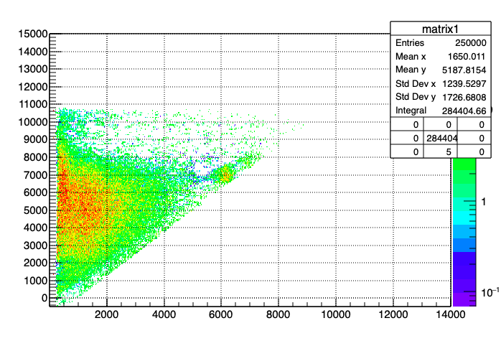
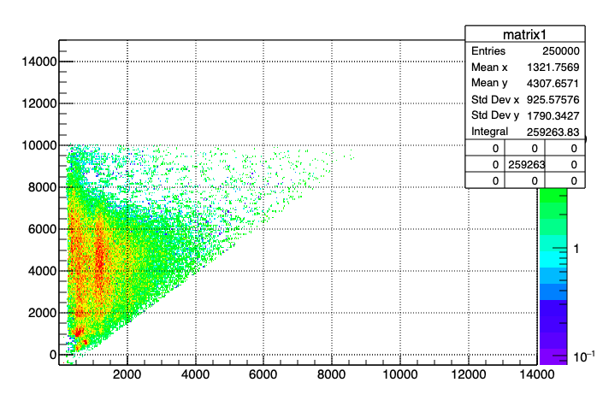
194 Ir
193 Ir
19

Slide 26
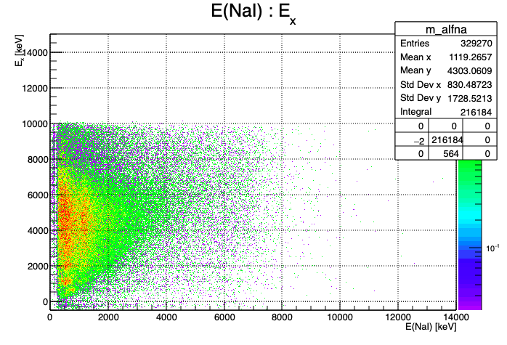
194 Ir
193 Ir
20

