Slide 1

Computing the SU(N) Shur index for N=4 super Yang-Mills
SAIP Oral Presentation
11 July 2025
Jarryd Bath

Slide 2
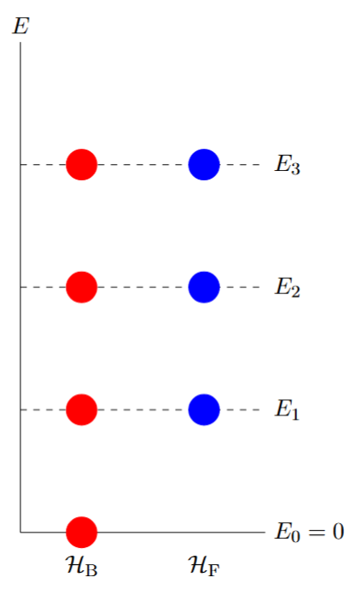
A special thanks to Doctor Sam Van Leuven for the guidance in this project

Slide 3
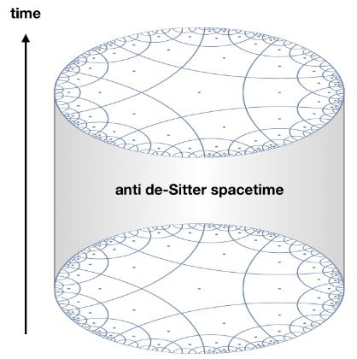


Background
The AdS/CFT correspondence conjectures a duality between string theory on anti de-Sitter space and conformal field theories
This is a strong/weak duality
Need non-perturbative results to prove conjecture: Superconformal indices
$CFT_{d}⟷AdS_{d+1}×ℳ_{9−d}$
$$\text{weak}\text{/}\text{strong}⟷\text{strong}\text{/}\text{weak}$$

Slide 4

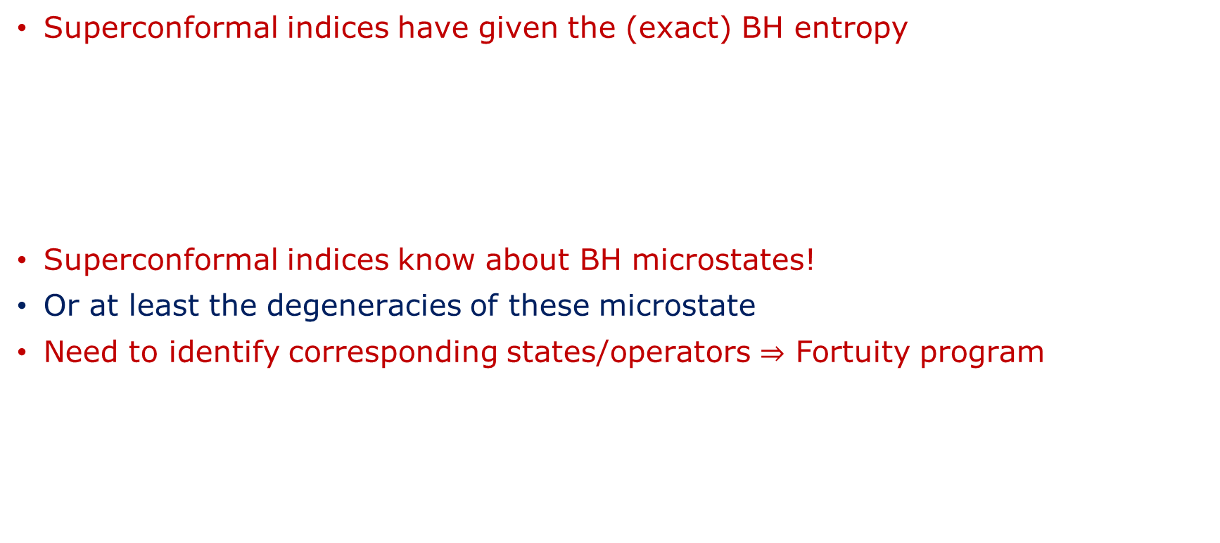
Background
Superconformal indices have given the (exact) BH entropy
Superconformal indices know about BH microstates!
Or at least the degeneracies of these microstate
Need to identify corresponding states/operators $⇒$ Fortuity program
[F. Benini, E. Milan ’18, A. Cabo-Bizet, D. Cassani, D. Martelli, S. Murthy ‘18]
$$S_{BH}=\frac{A}{4G_{N}}$$
[J. Bekenstein ‘72, S. Hawking ‘74]
[C. Chang, Y. Lin ‘24]

Slide 5
Outline
Introduce SUSY quantum mechanic and the Witten index
Briefly study the superconformal group
Define the general superconformal index
Go to the Schur limit
Introduce the techniques we used to compute the SU(2) and SU(3) Schur index

Slide 6



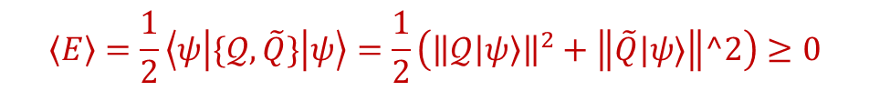
Supersymmetric Quantum Mechanic
Supersymmetric quantum mechanics name given class Hamiltonians $H$ written as:
$𝒬$ referred to as a supercharge
Energy spectrum SUSY QM non-negative: $ℋ$ Hilbert space, $\left|ψ\right\rangle ∈ℋ:$
Further:
$H=\frac{1}{2}\left\{𝒬,\tilde{𝒬}\right\}$, $𝒬^{2}={\tilde{𝒬}}^{2}=0, \tilde{𝒬}≡𝒬^{†}$
$$\left\langle E\right\rangle =\frac{1}{2}\left\langle ψ | \{𝒬,\tilde{Q}\} | ψ\right\rangle =\frac{1}{2}\left({\left\|𝒬\left|ψ\right\rangle \right\|}^{2}+\left\|\tilde{Q}|ψ⟩\right\|^2\right)≥0$$
$$E=0⟺𝒬\left|ψ\right\rangle =\tilde{𝒬}\left|ψ\right\rangle =0$$

Slide 7

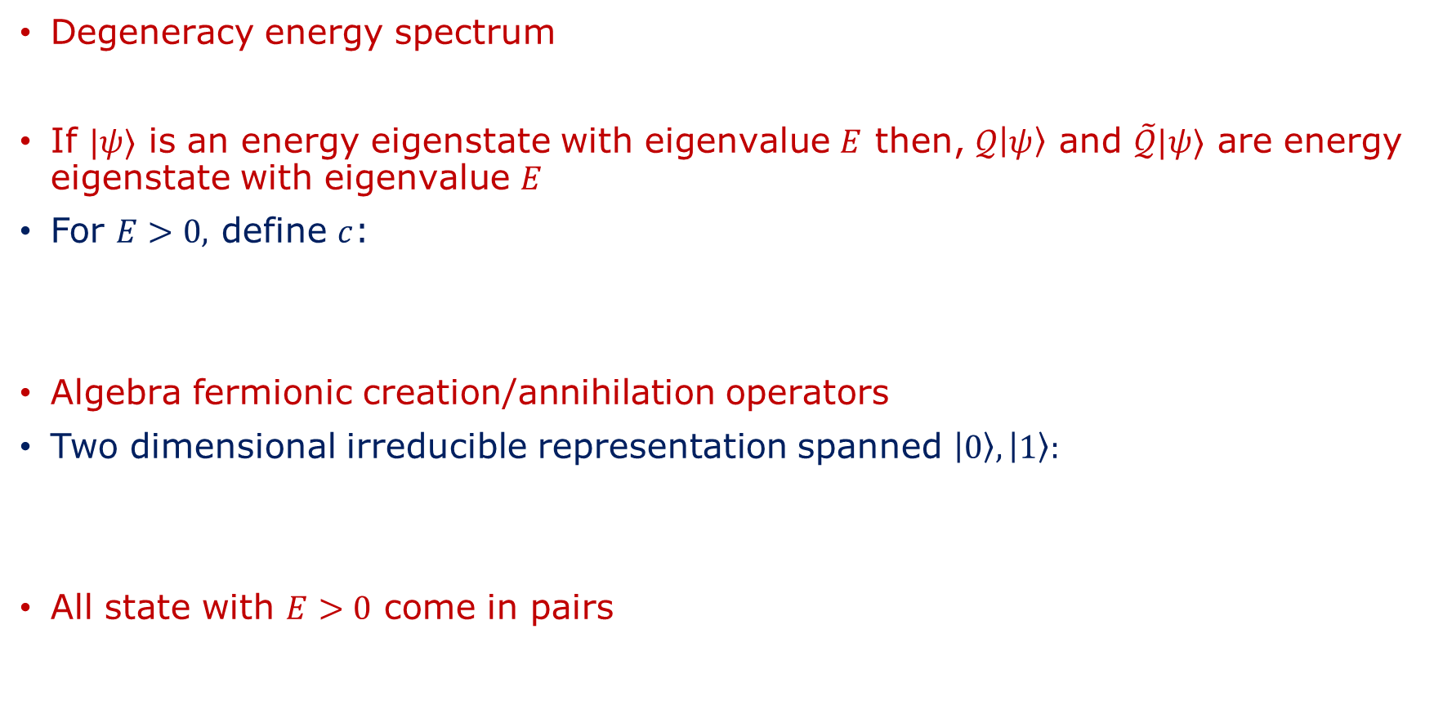


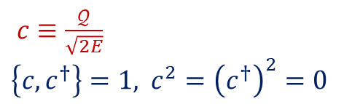
Supersymmetric Quantum Mechanics
Degeneracy energy spectrum
If $|ψ⟩$ is an energy eigenstate with eigenvalue $E$ then, $𝒬\left|ψ\right\rangle$ and $\tilde{𝒬}|ψ⟩$ are energy eigenstate with eigenvalue $E$
For $E>0,$ define $c$:
Algebra fermionic creation/annihilation operators
Two dimensional irreducible representation spanned $\left|0\right\rangle , \left|1\right\rangle :$
All state with $E>0$ come in pairs
$$\left[𝒬,H\right]=\left[\tilde{𝒬},H\right]=0,$$
$𝒬, \tilde{𝒬}$ generators symmetry
$c≡\frac{𝒬}{\sqrt{2E}}$
$\left\{c,c^{†}\right\}=1,$ $c^{2}={\left(c^{†}\right)}^{2}=0$
$$c\left|0\right\rangle =0, c^{†}\left|0\right\rangle =\left|1\right\rangle$$
$$c^{†}\left|1\right\rangle =0, c\left|1\right\rangle =|0⟩$$

Slide 8

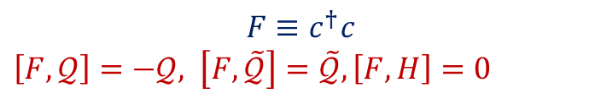

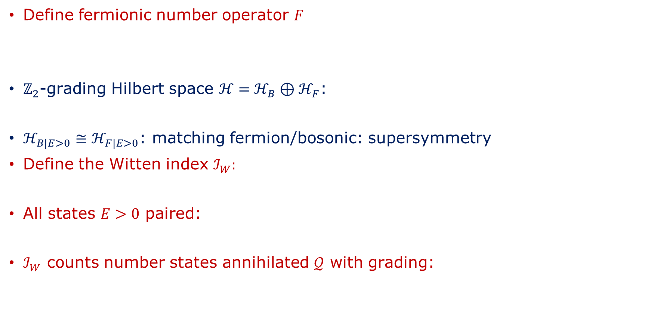


Witten Index
Define fermionic number operator $F$
$ℤ_{2}$-grading Hilbert space $ℋ=ℋ_{B}⊕ℋ_{F}$:
$ℋ_{B|E>0}≅ℋ_{F|E>0}$: matching fermion/bosonic: supersymmetry
Define the Witten index $ℐ_{W}:$
All states $E>0$ paired:
$ℐ_{W}$ counts number states annihilated $𝒬$ with grading:
$$F≡c^{†}c$$
$\left[F,𝒬\right]=−𝒬,$ $\left[F,\tilde{𝒬}\right]=\tilde{𝒬}, \left[F,H\right]=0$
$$ℋ_{B}:F=0, { ℋ}_{F}:F=1$$
$$ℐ_{W}≡{\text{tr}}_{ℋ}{\left(−1\right)}^{F}x^{H}, x≡e^{−β}$$
[E. Witten ‘82]
$${\text{Tr}}_{ℋ_{E≻0}}{\left(−1\right)}^{F}x^{H}=0$$
$β$ acts regulator formally divergent series
$$ℐ_{W}=\text{dim}ℋ_{B|E=0}−\text{dim}ℋ_{F|E=0}$$

Slide 9

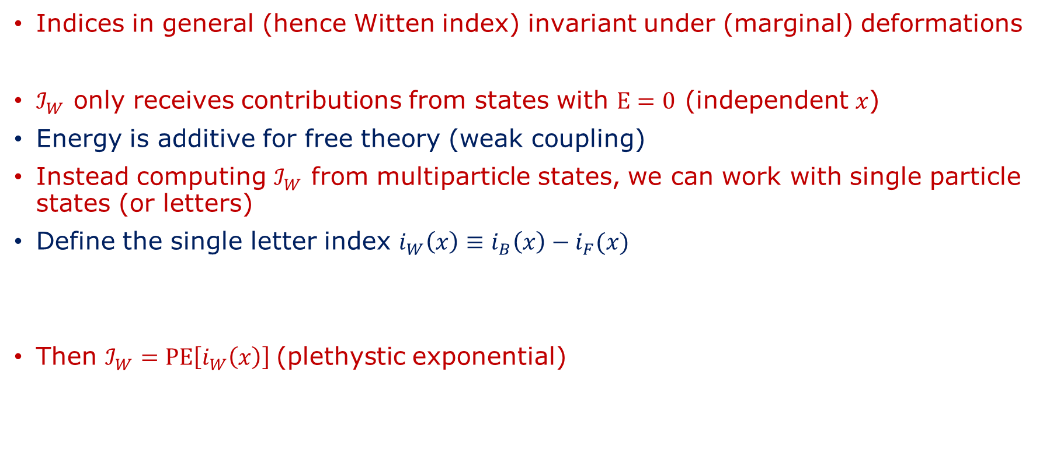
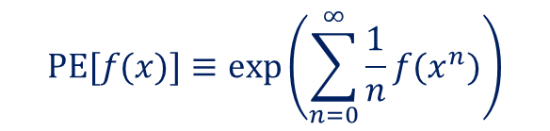
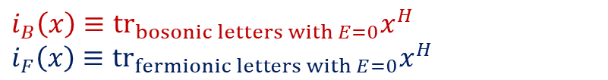
Computing the Witten index
Indices in general (hence Witten index) invariant under (marginal) deformations
$ℐ_{W}$ only receives contributions from states with $E=0$ (independent $x$)
Energy is additive for free theory (weak coupling)
Instead computing $ℐ_{W}$ from multiparticle states, we can work with single particle states (or letters)
Define the single letter index $i_{W}\left(x\right)≡i_{B}\left(x\right)−i_{F}(x)$
Then $ℐ_{W}=\text{PE}\left[i_{W}\left(x\right)\right]$(plethystic exponential)
Weak coupling $→$Strong coupling: ${ ℐ}_{W}$ invariant
$$i_{B}\left(x\right)≡{\text{tr}}_{bosonic letters with E=0}x^{H}$$
$$i_{F}\left(x\right)≡{\text{tr}}_{fermionic letters with E=0}x^{H}$$
$$\text{PE}[f(x)]≡\text{exp}\left(\sum_{n=0}^{∞}{\frac{1}{n}f(x^{n})}\right)$$

Slide 10
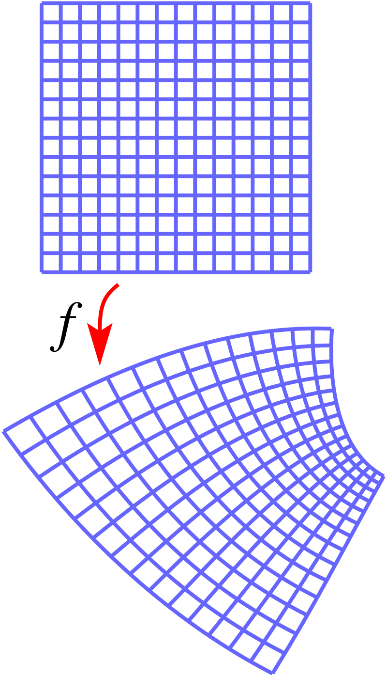

Superconformal Group
Conformal transformation: change coordinates (locally) rescales metric
Lengths don’t exist: only angles
$$x^{μ}→{\tilde{x}}^{μ}: g_{μν}→Ω^{2}\left(x\right)g_{μν}$$

Slide 11

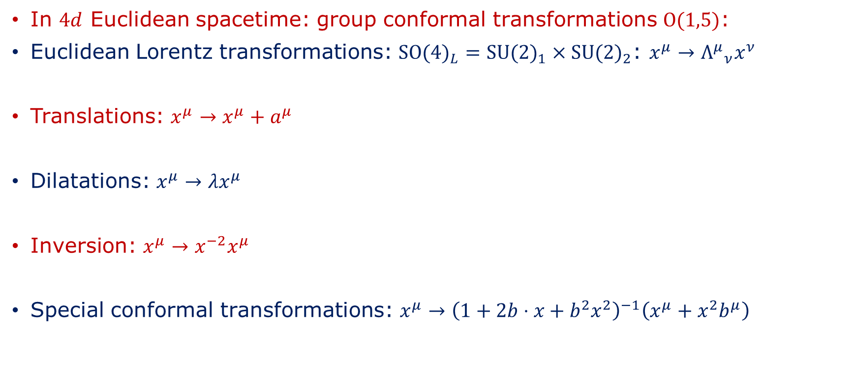
Superconformal Group
In $4d$ Euclidean spacetime: group conformal transformations $\text{O}\text{(1,5)}$:
Euclidean Lorentz transformations: ${\text{SO}\text{(4)}}_{L}={\text{SU}\text{(2)}}_{1}×{\text{SU}\text{(2)}}_{2}$: $x^{μ}→{Λ^{μ}}_{ν}x^{ν}$
Translations: $x^{μ}→x^{μ}+a^{μ}$
Dilatations: $x^{μ}→λx^{μ}$
Inversion: $x^{μ}→x^{−2}x^{μ}$
Special conformal transformations: $x^{μ}→{\left(1+2b⋅x+b^{2}x^{2}\right)}^{−1}\left(x^{μ}+x^{2}b^{μ}\right)$
(inversion$∘$translation$∘$inversion)

Slide 12
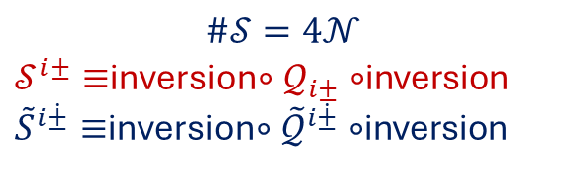



Superconformal Group
We now introduce (complex) Weyl supercharges: $𝒬_{i±}, {\tilde{𝒬}}_{i\dot{±}} (i=1,…,𝒩)$
Now we introduce corresponding superconformal charges: $𝒮^{i±}, {\tilde{S}}^{i\dot{±}}(i=1,…,𝒩)$
Symmetry acts on the index $i$: R-symmetry
$$\#𝒬=4𝒩$$
$$\#𝒮=4𝒩$$
$𝒮^{i±}≡$inversion$∘𝒬_{i±}∘$inversion
${\tilde{S}}^{i\dot{±}}≡$inversion$∘{\tilde{𝒬}}^{i\dot{±}}∘$inversion
$${\text{U}(𝒩)}_{R}={\text{U}\text{(1)}}_{R}×{\text{SU}\text{(}𝒩)}_{R}$$

Slide 13





Superconformal Group
Label states by weights Cartan subalgebra:
$$[Δ,j_{1},j_{2} ,R_{k},r]$$
Dilatations
$${\text{SU}\text{(2)}}_{1}$$
$${\text{SU}\text{(2)}}_{2}$$
$${\text{SU}\text{(}𝒩)}_{R}$$
$${\text{U}\text{(1)}}_{R}$$

Slide 14

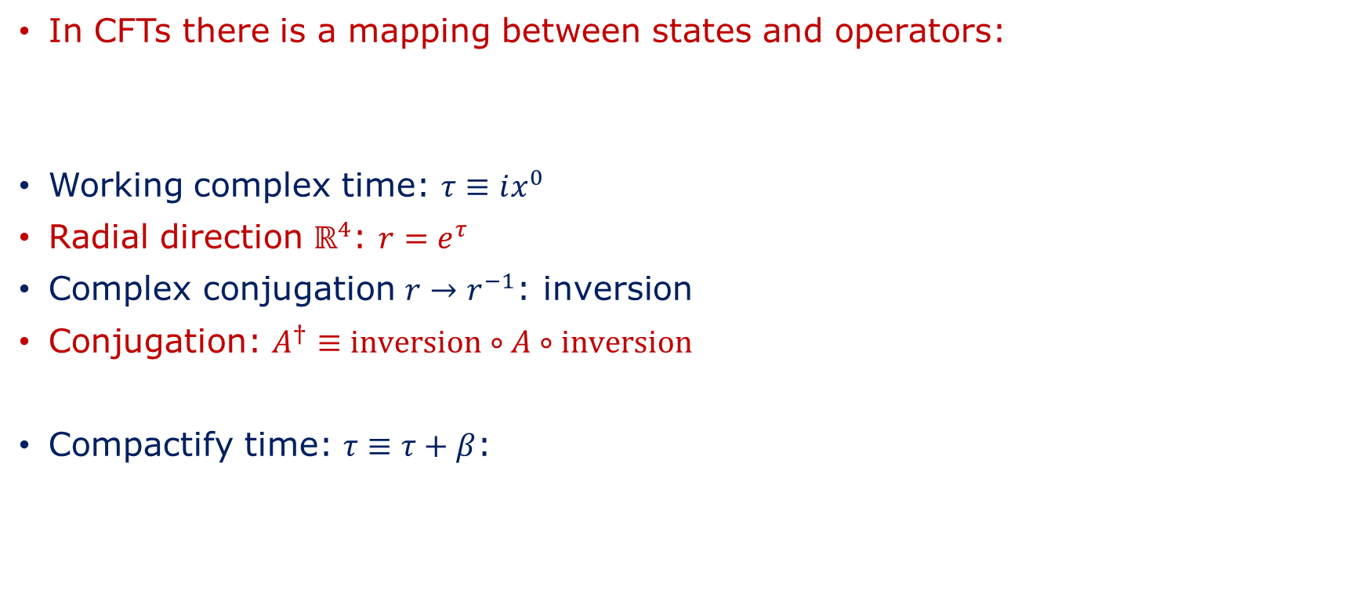

State-Operator Correspondence
In CFTs there is a mapping between states and operators:
Working complex time: $τ≡ix^{0}$
Radial direction $ℝ^{4}$: $r=e^{τ}$
Complex conjugation $r→r^{−1}$: inversion
Conjugation: $A^{†}≡\text{inversion}∘A∘\text{inversion}$
Compactify time: $τ≡τ+β$:
$$\text{States} ℝ^{1}×S^{3}⟷ \text{Operators} ℝ^{4}$$
$$\text{States} S^{1}×S^{3}⟷ \text{Operators} {S^{1}×ℝ}^{3}$$

Slide 15

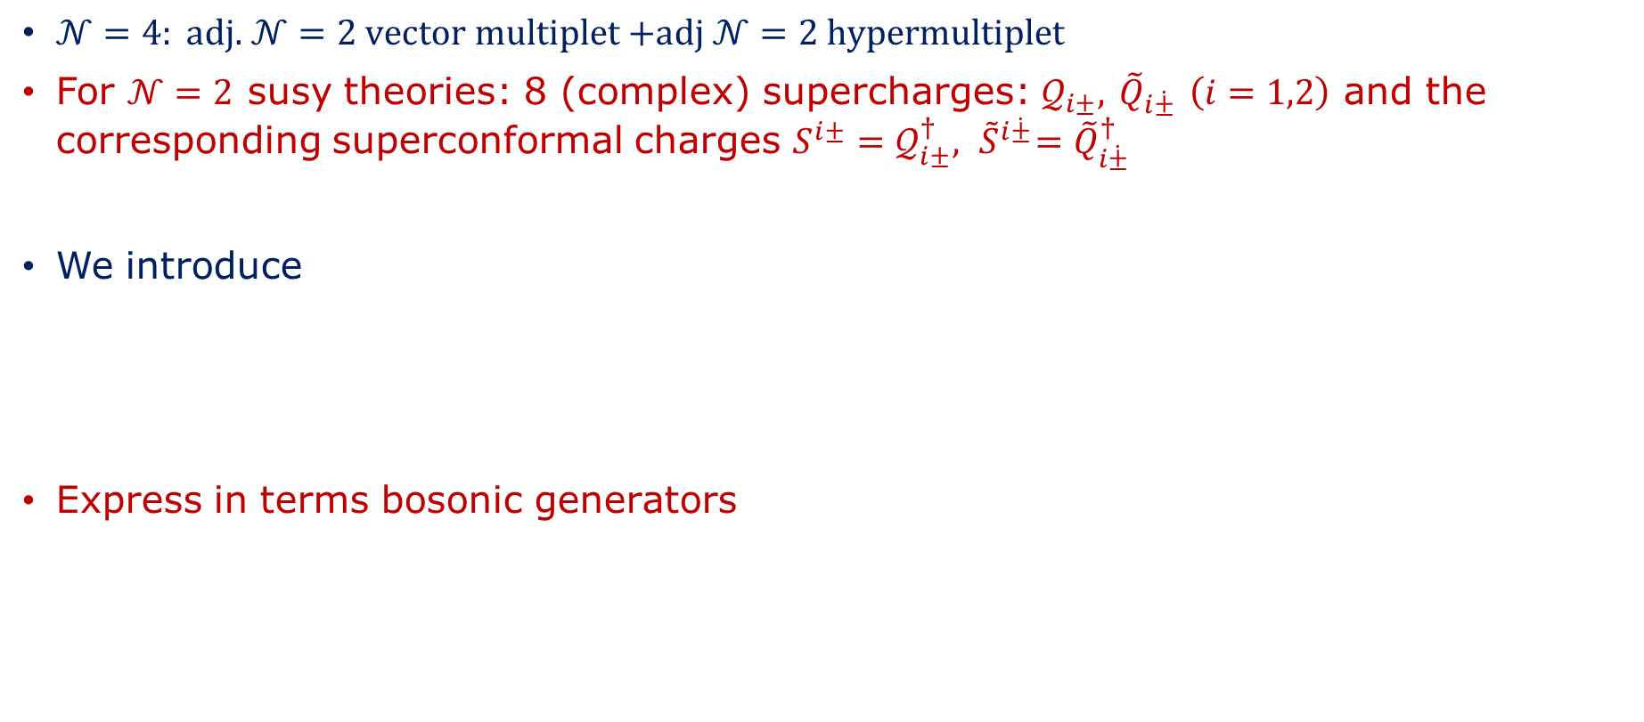
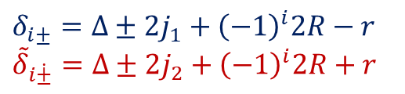
The Superconformal Index
$𝒩=4: \text{adj}\text{. }𝒩=2 \text{vector} \text{multiplet}\text{ +}\text{adj} 𝒩=2 \text{hypermultiplet}$
For $𝒩=2$ susy theories: 8 (complex) supercharges: $𝒬_{i±},$ ${\tilde{Q}}_{i\dot{±}}$ $\left(i=1,2\right)$ and the corresponding superconformal charges $S^{i±}=𝒬_{i±}^{†},{ \tilde{S}}^{i\dot{±}}={\tilde{Q}}_{i\dot{±}}^{†}$
We introduce
Express in terms bosonic generators
$$δ_{i±}≡2\left\{𝒬_{i±},𝒮^{i±}\right\}, {\tilde{δ}}_{i\dot{±}}≡2\left\{{\tilde{𝒬}}_{i±},{\tilde{𝒮}}^{i\dot{±}}\right\}$$
$$δ_{i±}=Δ±2j_{1}+{\left(−1\right)}^{i}2R−r$$
$${\tilde{δ}}_{i\dot{±}}=Δ±{2j}_{2}+{\left(−1\right)}^{i}2R+r$$

Slide 16

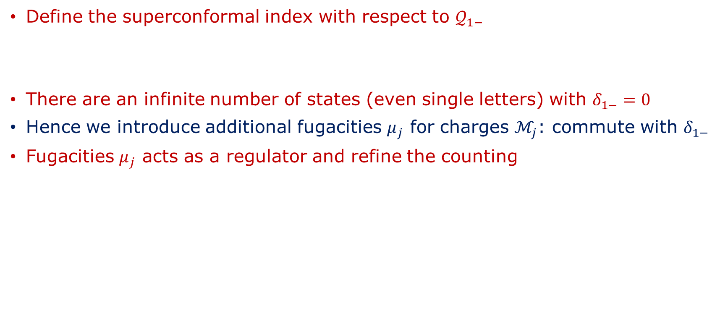

The Superconformal Index
Define the superconformal index with respect to $𝒬_{1−}$
There are an infinite number of states (even single letters) with $δ_{1−}=0$
Hence we introduce additional fugacities $μ_{j}$ for charges $ℳ_{j}$: commute with $δ_{1−}$
Fugacities $μ_{j}$ acts as a regulator and refine the counting
$$ℐ\left(μ_{i}\right)≡{\text{tr}}_{ℋ}{\left(−1\right)}^{F}x^{δ_{1−}}μ_{j}^{ℳ_{j}}$$
$ℋ:$ Hilbert space on $S^{3}$

Slide 17
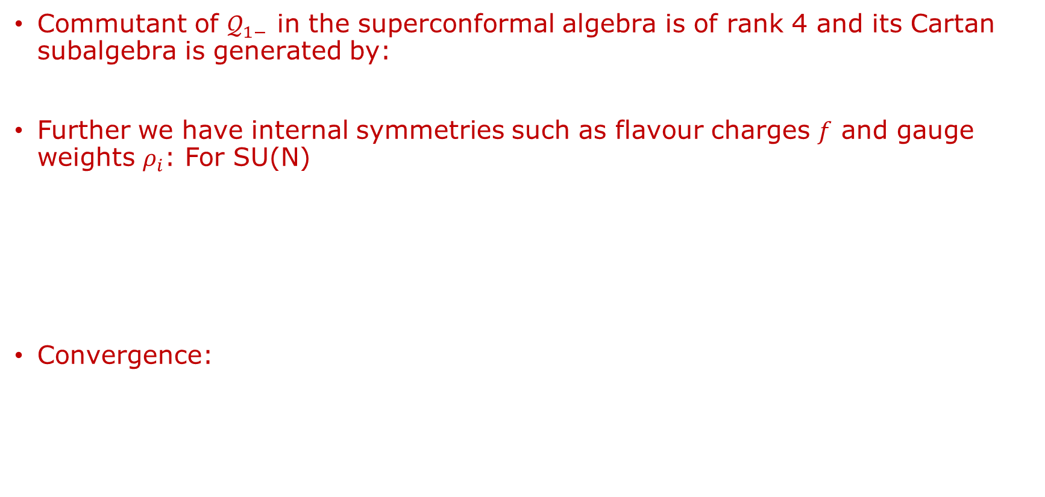


$𝒩=4$ SYM Superconformal Index
Commutant of $𝒬_{1−}$ in the superconformal algebra is of rank 4 and its Cartan subalgebra is generated by:
Further we have internal symmetries such as flavour charges $f$ and gauge weights $ρ_{i}$: For SU(N)
Convergence:
$δ_{1−}$, $δ_{2+}$, ${\tilde{δ}}_{1±}$
$ℐ\left(v;σ,ρ,τ,u\right)={\text{tr}}_{ℋ}{\left(−1\right)}^{F}σ^{\frac{1}{2}{\tilde{δ}}_{1\dot{+}}}ρ^{\frac{1}{2}{\tilde{δ}}_{1\dot{−}}}τ^{\frac{1}{2}δ_{2+}}v^{f}x^{δ_{1+}}u_{i}^{ρ_{i}},$ $i=1,…,N$
$ℐ\left(v;p,q,t,u\right)={\text{tr}}_{ℋ}{\left(−1\right)}^{F}p^{j_{1}+j_{2}−r}q^{j_{1}−j_{2}−r }t^{R+r}v^{f}x^{δ_{1+}}u_{i}^{ρ_{i}},$ $i=1,…,N$
$$p≡στ, q≡ρτ, t≡τ^{2}$$
$$\left|p\right|<1, \left|q\right|<1, \left|pq\right|<\left|t\right|<1, \left|v\right|=1$$

Slide 18
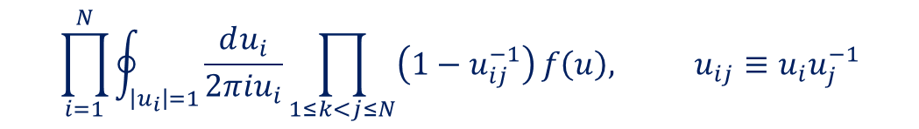

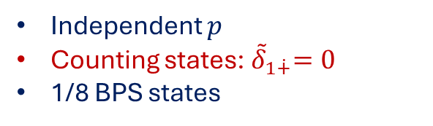
Schur Index
Schur limit is defined by: $τ→ρ$
Physical states: gauge invariant
Project gauge singlets:
$ℐ_{S}\left(v;q,u\right)={\text{tr}}_{ℋ}{\left(−1\right)}^{F}$ $q^{j_{1}−j_{2}+R }v^{f}x^{δ_{1+}}u_{i}^{ρ_{i}}$
Independent $p$
Counting states:${ \tilde{δ}}_{1\dot{+}}=0$
1/8 BPS states
$$\prod_{i=1}^{N}{\oint_{\left|u_{i}\right|=1}{\frac{du_{i}}{2πiu_{i}}\prod_{1≤k<j≤N}{\left(1−u_{ij}^{−1}\right)}}}f\left(u\right), u_{ij}≡u_{i}u_{j}^{−1}$$

Slide 19
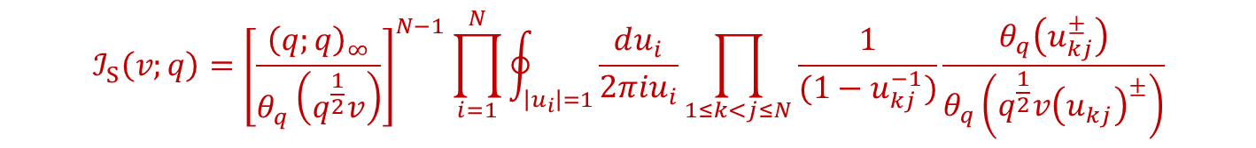

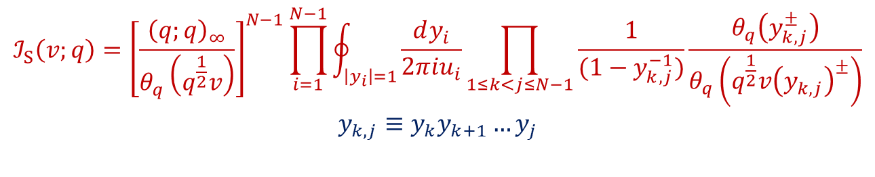
Schur Index
After one computes the single letter indices and plethystic exponentiates:
Infinitely many poles
Change of variables: $u_{i}≡y_{1}y_{2}…y_{i−1}y_{i}$
Reduces the number of integrals:
We suspect that this change of variables results in a recursive result
$$ℐ_{S}\left(v;q\right)={\left[\frac{{\left(q;q\right)}_{∞}}{θ_{q}\left(q^{\frac{1}{2}}v\right)}\right]}^{N−1}\prod_{i=1}^{N}{\oint_{\left|u_{i}\right|=1}{\frac{du_{i}}{2πiu_{i}}\prod_{1≤k<j≤N}{\frac{1}{(1−u_{kj}^{−1})}\frac{θ_{q}\left(u_{kj}^{±}\right)}{θ_{q}\left(q^{\frac{1}{2}}v{\left(u_{kj}\right)}^{±}\right)}}}}$$
Adopted from partition functions [R. de Mello Koch, A. Jevicki ‘25]
$$ℐ_{S}\left(v;q\right)={\left[\frac{{\left(q;q\right)}_{∞}}{θ_{q}\left(q^{\frac{1}{2}}v\right)}\right]}^{N−1}\prod_{i=1}^{N−1}{\oint_{\left|y_{i}\right|=1}{\frac{dy_{i}}{2πiu_{i}}\prod_{1≤k<j≤N−1}{\frac{1}{(1−y_{k,j}^{−1})}\frac{θ_{q}\left(y_{k,j}^{±}\right)}{θ_{q}\left(q^{\frac{1}{2}}v{\left(y_{k,j}\right)}^{±}\right)}}}}$$
$$y_{k,j}≡y_{k}y_{k+1}…y_{j}$$

Slide 20

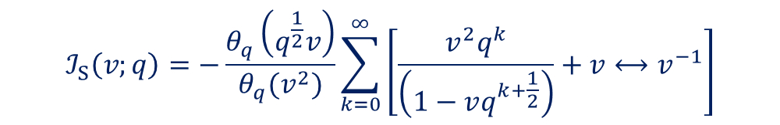
SU(2) Schur Index
We consider:
Poles at $t=v^{±}q^{k+\frac{1}{2}}$, $k≥0$:
$$ℐ_{S}\left(v;q\right)=−\left[\frac{{\left(q;q\right)}_{∞}^{2}}{θ_{q}\left(q^{\frac{1}{2}}v\right)}\right]\oint_{\left|t\right|=1}{\frac{dt}{2πit}\frac{t}{1−t}\frac{θ_{q}\left(t^{±}\right)}{θ_{q}\left(q^{\frac{1}{2}}vt^{±}\right)}}=−\left[\frac{{\left(q;q\right)}_{∞}^{2}}{θ_{q}\left(q^{\frac{1}{2}}v\right)}\right]\oint_{\left|t\right|=1}{\frac{dt}{2πit}\frac{t}{1−t}F_{q,1}(t)}$$
$$ℐ_{S}\left(v;q\right)=−\frac{θ_{q}\left(q^{\frac{1}{2}}v\right)}{θ_{q}(v^{2})}\sum_{k=0}^{∞}{\left[\frac{{v^{2}q}^{k}}{\left(1−vq^{k+\frac{1}{2}}\right)}+v⟷v^{−1}\right]}$$

Slide 21
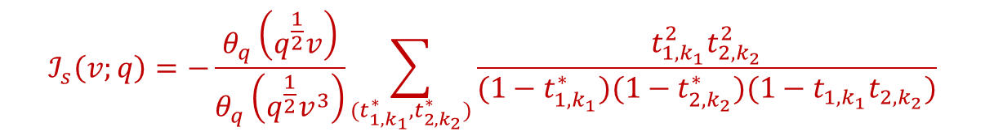
SU(3) Schur Index
We have found the following generic form of the Schur index for SU(3):
There are just some slight complications involving the classification of the poles (nearly ironed out)
Believe linearise equations
$$ℐ_{s}\left(v;q\right)=−\frac{θ_{q}\left(q^{\frac{1}{2}}v\right)}{θ_{q}\left(q^{\frac{1}{2}}v^{3}\right)}\sum_{(t_{1,k_{1}}^{∗},t_{2,k_{2}}^{∗})}{\frac{t_{1,k_{1}}^{2}t_{2,k_{2}}^{2}}{(1−t_{1,k_{1}}^{∗})(1−t_{2,k_{2}}^{∗})(1−t_{1,k_{1}}t_{2,k_{2}})}}$$

Slide 22
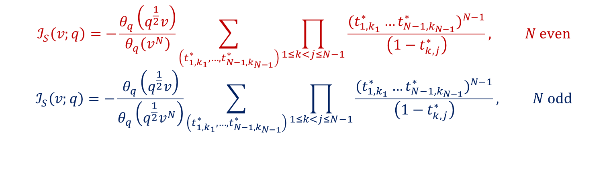
SU($N$) Schur
Based on the computations done so far we highly suspect the following form for the general case:
$$ℐ_{S}\left(v;q\right)=−\frac{θ_{q}\left(q^{\frac{1}{2}}v\right)}{θ_{q}\left(v^{N}\right)}\sum_{\left(t_{1,k_{1}}^{∗},…,t_{N−1,k_{N−1}}^{∗}\right)}{\prod_{1≤k<j≤N−1}{\frac{{{(t}_{1,k_{1} }^{∗}…t_{N−1,k_{N−1}}^{∗})}^{N−1}}{\left(1−t_{k,j}^{∗}\right)}}}, N even$$
$$ℐ_{S}\left(v;q\right)=−\frac{θ_{q}\left(q^{\frac{1}{2}}v\right)}{θ_{q}\left(q^{\frac{1}{2}}v^{N}\right)}\sum_{\left(t_{1,k_{1}}^{∗},…,t_{N−1,k_{N−1}}^{∗}\right)}{\prod_{1≤k<j≤N−1}{\frac{{{(t}_{1,k_{1} }^{∗}…t_{N−1,k_{N−1}}^{∗})}^{N−1}}{\left(1−t_{k,j}^{∗}\right)}}}, N odd$$

Slide 23
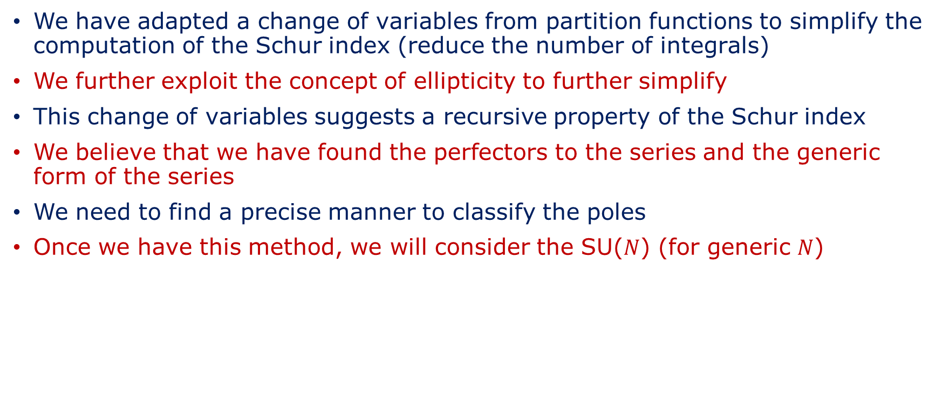
Conclusion
We have adapted a change of variables from partition functions to simplify the computation of the Schur index (reduce the number of integrals)
We further exploit the concept of ellipticity to further simplify
This change of variables suggests a recursive property of the Schur index
We believe that we have found the perfectors to the series and the generic form of the series
We need to find a precise manner to classify the poles
Once we have this method, we will consider the SU($N$) (for generic $N$)

Slide 24
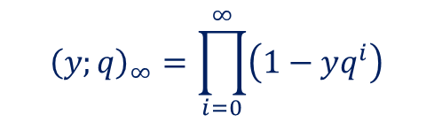

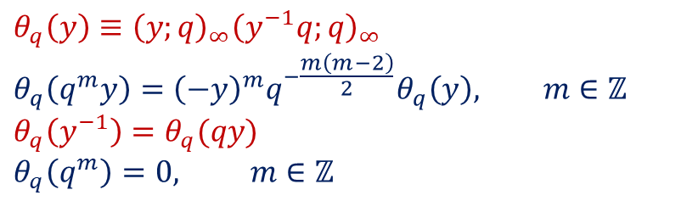
Important functions
$q$-Pochhammer symbol:
$q−θ$ function:
$${\left(y;q\right)}_{∞}=\prod_{i=0}^{∞}{\left(1−yq^{i}\right)}$$
$$θ_{q}\left(y\right)≡{\left(y;q\right)}_{∞}{\left(y^{−1}q;q\right)}_{∞}$$
$$θ_{q}\left(q^{m}y\right)={\left(−y\right)}^{m}q^{−\frac{m\left(m−2\right)}{2}}θ_{q}\left(y\right), m∈ℤ$$
$$θ_{q}\left(y^{−1}\right)=θ_{q}(qy)$$
$$θ_{q}\left(q^{m}\right)=0, m∈ℤ$$

Slide 25
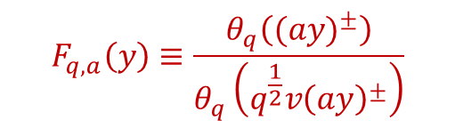

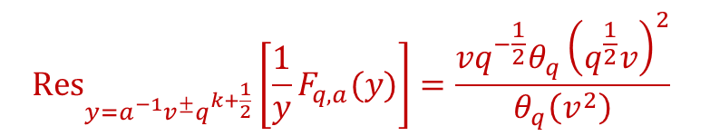
Important Functions
Elliptic Function $q−F$:
$q−F$ is elliptic in $q:$ $F\left(qy\right)=F(y)$
$q−F$ is symmetric: $v⟷v^{−1}$
$q−F$ has poles at $y=a^{−1}v^{±}q^{k+\frac{1}{2}}, k∈ℤ$
$$F_{q,a}\left(y\right)≡\frac{θ_{q}\left(({ay)}^{±}\right)}{θ_{q}\left(q^{\frac{1}{2}}v{\left(ay\right)}^{±}\right)}$$
$${\text{Res}}_{y=a^{−1}v^{±}q^{k+\frac{1}{2}}}\left[\frac{1}{y}F_{q,a}(y)\right]=\frac{{vq}^{−\frac{1}{2}}θ_{q}{\left(q^{\frac{1}{2}}v\right)}^{2}}{θ_{q}\left(v^{2}\right)}$$

