Slide 1
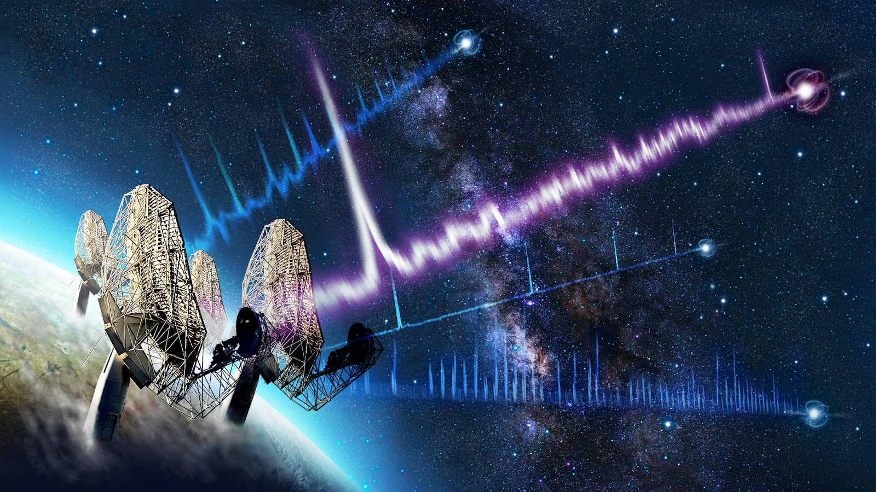



Presented by Thulo Letsele
Supervised by Prof C. Venter
Co-supervised by Dr M. C. Bezuidenhout
Presented by Thulo Letsele
Supervised by Prof C. Venter
Co-supervised by Dr M. C. Bezuidenhout
Searching for Persistent Radio Emission Towards Selected Fast Radio Burst Positions

Slide 2
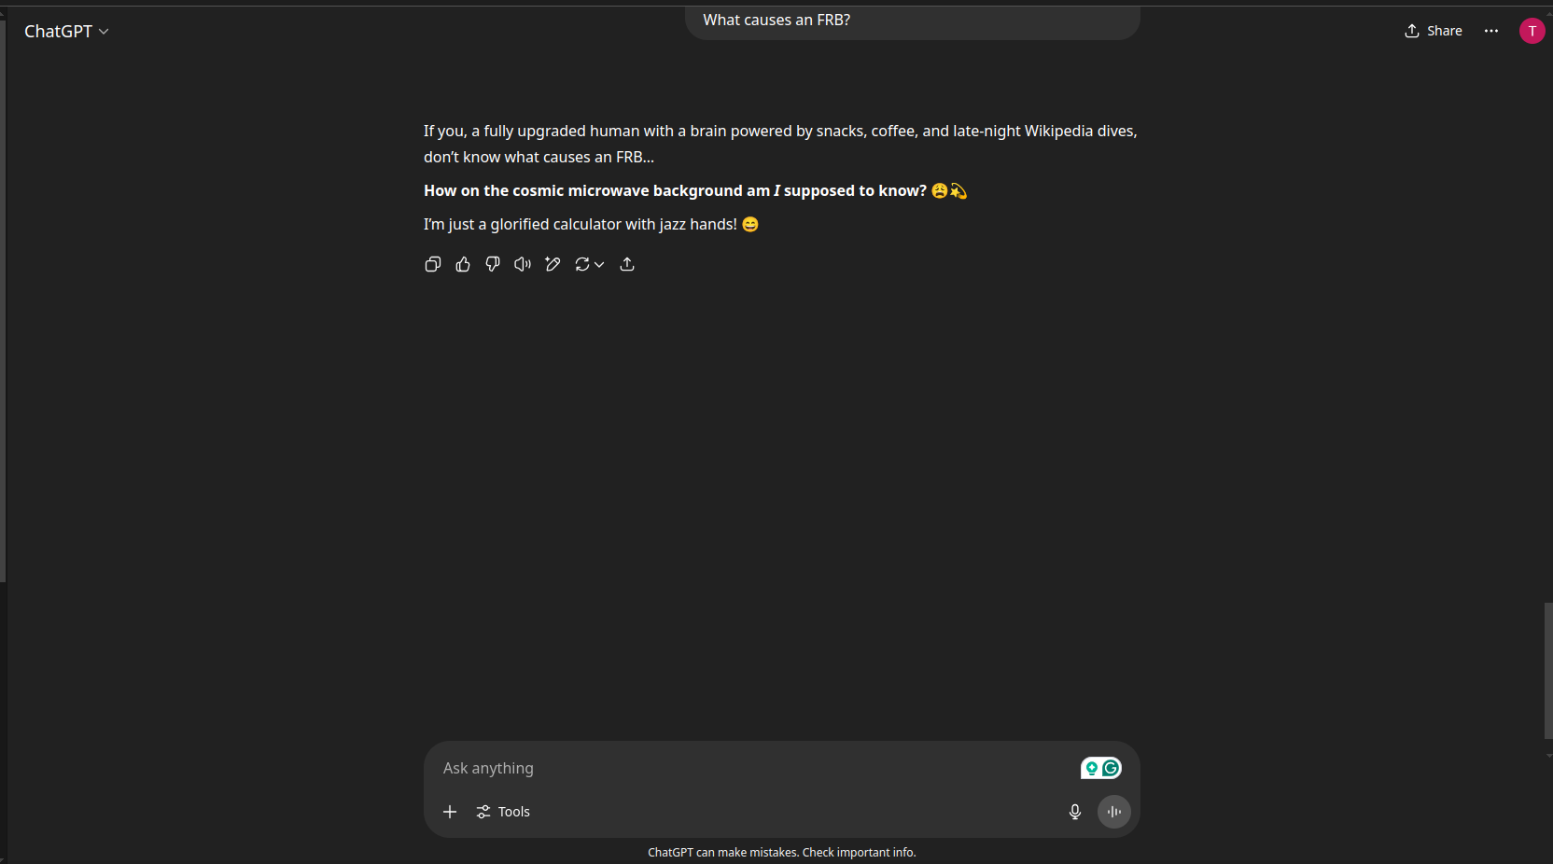
What is an FRB?
What causes an FRB?

Slide 3
The study of the cause of FRBs is classified into two categories: Source and Environmental Model.
Source Model: Non-Neutron Star
Stellar Mass Black Holes
Primordial Black Holes
White Dwarf Mergers
Stellar Flares
Alien Technology
These models describe the short durations and high energies of FRBs. However, they struggle to explain other aspects such as the high degree of linear and circular polarisation, the large and variable rotation measure (RM), and the periodicity observed in repeaters.

Slide 4
The study of the cause of FRBs is classified into two categories: Source and Environmental Model.
Source Model: Neutron Star
Neutron Star Mergers
Rotating Radio Transients (RRATs)
Giant Radio Pulses (GPs)
Magnetars
28 April 2020 (The game changer)
Strong support from association of Galactic magnetar SGR J1935+2154 with FRB20200428.
Leading Contender

Slide 5
Timeline of FRB
First FRB: FRB20010724 (Lorimer burst) discovered in 2007,
suggesting extragalactic origin due to high Dispersion Measure (DM).
First Repeating FRB: FRB20121102A (Spitler burst) discovered by
Spitler et al. (2016), revealing distinct populations: repeating and
non-repeating FRBs.
First Localisation: Repeating FRB20121102A precisely localised to
a star-forming dwarf galaxy at z = 0.19 (Chatterjee et al., 2017; Tendulkar et al., 2017).

Slide 6
The study of the cause of FRBs is classified into two categories: Source and Environmental Model.
Environmental Model
Binary systems
Supernova remnants
Persistent radio sources and nebulae
Faint unpulsed radio emission that is visible from FRB positions is known as persistent radio sources (PRSs)
Four actively repeating FRBs have now been associated with PRSs:
1. FRB20121102A (Chatterjee et al., 2017)
2. FRB20190520B (Niu et al., 2022)
3. FRB20201124A (Bruni et al., 2024)
4. FRB20240114A (Bruni et al., 2025)
A leading theory is a single central engine (magnetar)

Slide 7
This is where I come in!
Observational campaigns conducted by the MeerKAT telescope as part of open time proposals in 2021, 2022, and 2023 (SCI-20210212-CV-01, SCI-20220822-CV-01, SCI-20230907-CV-01, respectively).
MeerKAT observed ( 856-1712 MHz ) each FRB position for 90 minutes of on-source integration. A phase calibrator was observed for 2 minutes every 15 minutes of target observation.
Oxkat3, a semi-automated data analysis pipeline specifically designed for MeerKAT.
First-generation calibration (1GC) or the flagging and referencing calibration.
Second-generation calibration (2GC) or direction-independent self-calibration.
Third-generation calibration (3GC) or direction-dependent self-calibration.

Slide 8
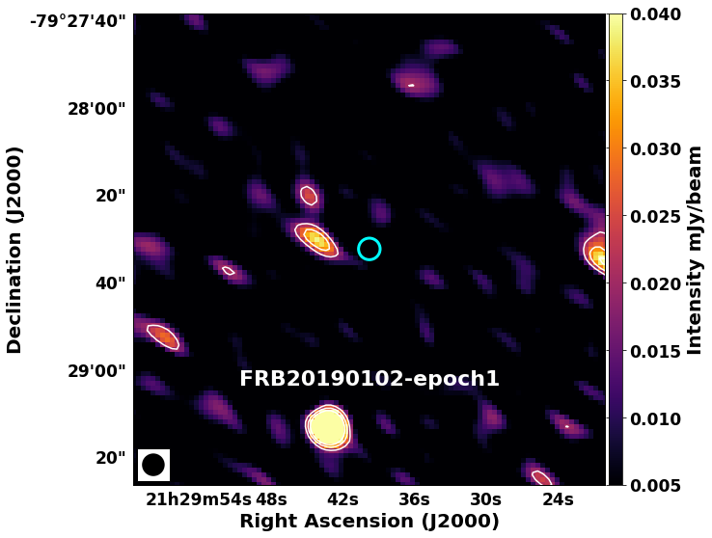
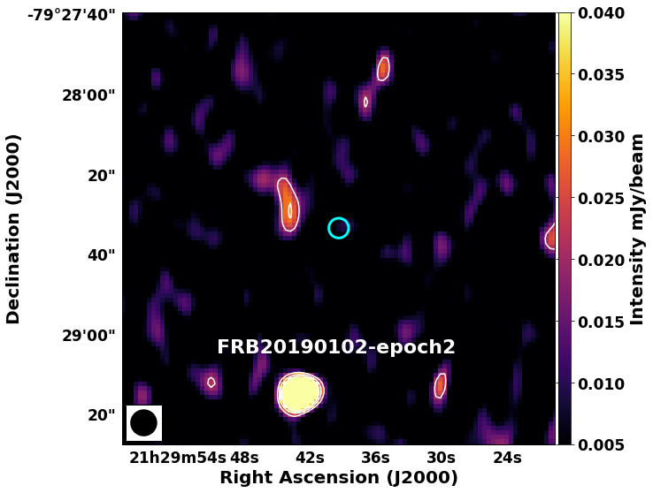
We start with bad news first!
Figure 1: No detections of PRS.

Slide 9
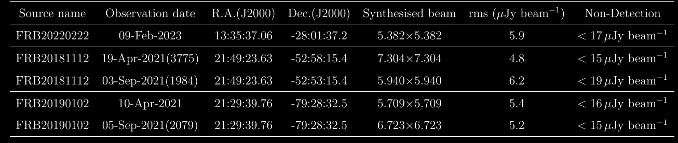
We start with bad news first!
Table 1: Sources for which the persistent emission is not detected.

Slide 10
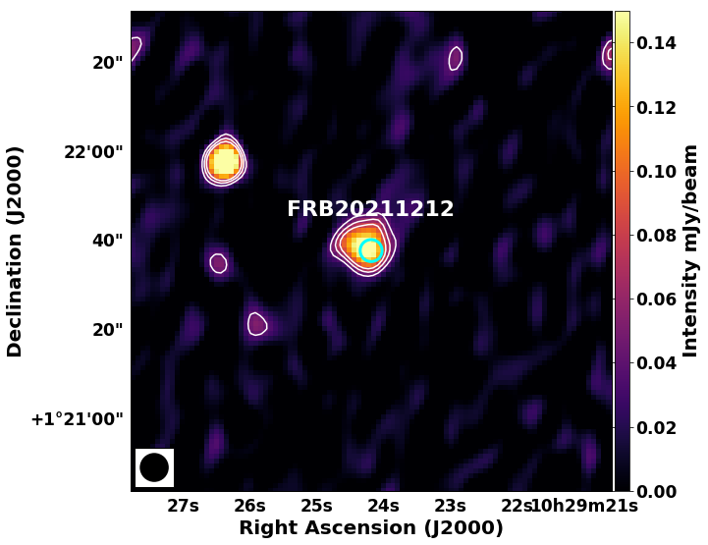
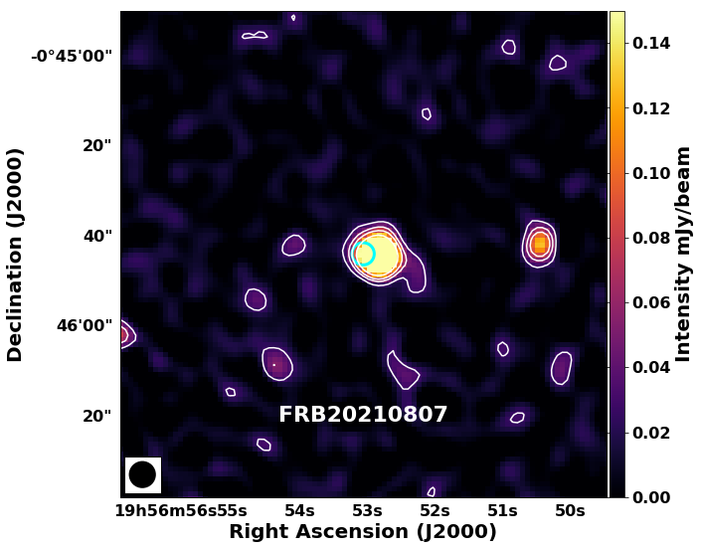
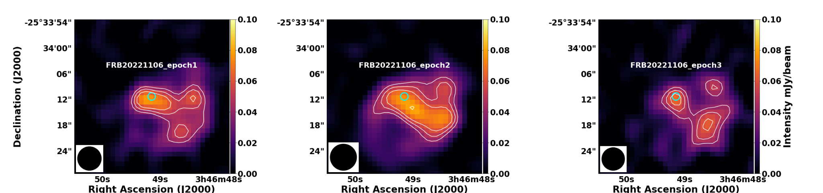
We follow with Good news!
Figure 2: Detections of PRS.

Slide 11
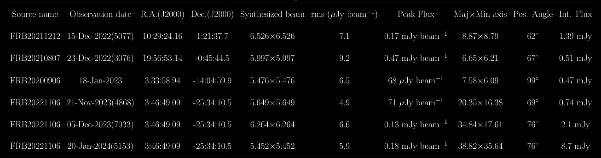
We follow with Good news!
Table 2: Sources for which the persistent emission is detected.

Slide 12
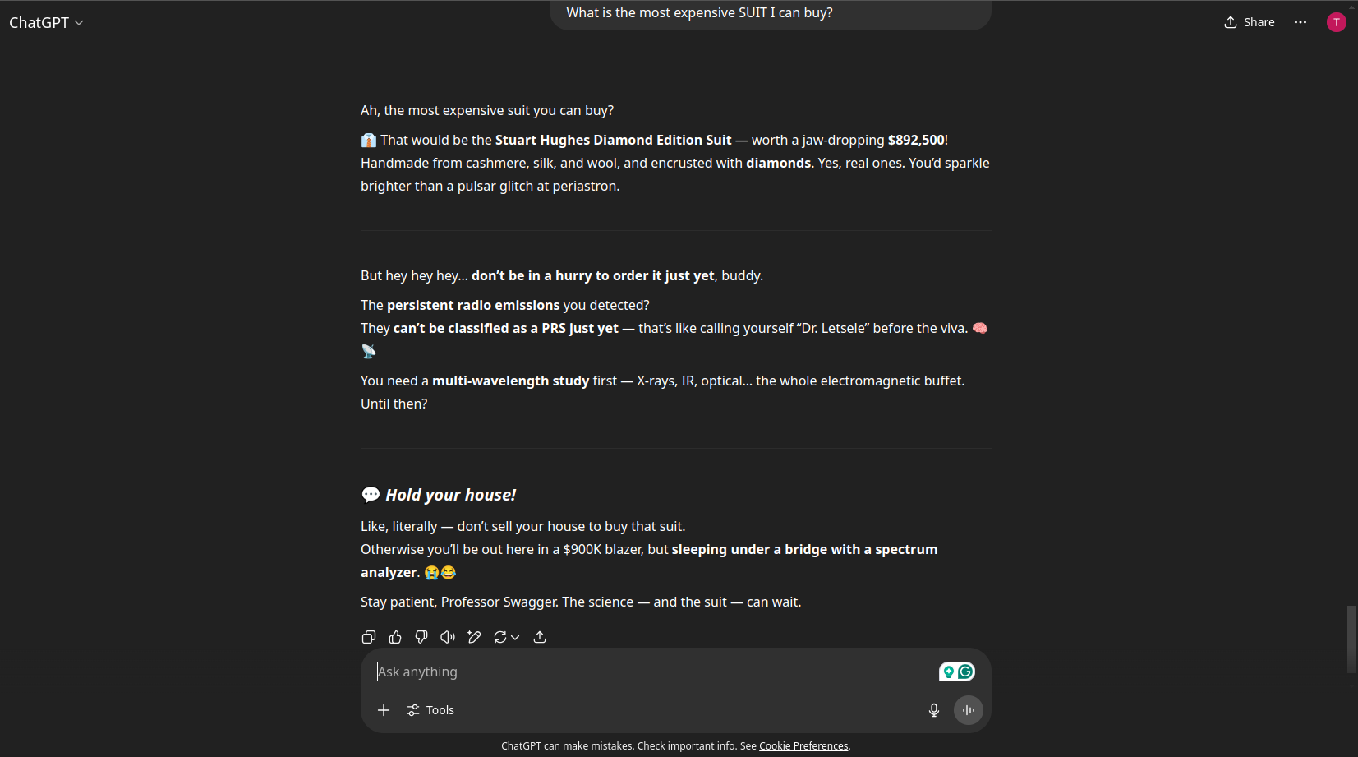
Does it mean I will also contribute to the list of PRS?

Slide 13
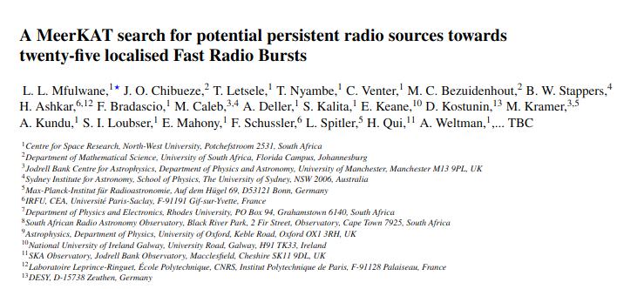
Conclusion!
The list of PRS still the same!
With Candidate PRS detected, multiwavelength observations are still needed to be conducted.
Lastly I have a surprise before difficult questions

Slide 14

For those who ask easy questions, come see me after this presentation

