Slide 1

Correlating HI and large scale structure surveys
Moumita Aich
Wits Anglo American Digital Dome
University of the Witwatersrand
SAIP, Astrophysics & Space Science
8 July 2025
https://hirax.ukzn.ac.za/
Notes:
1

Slide 2
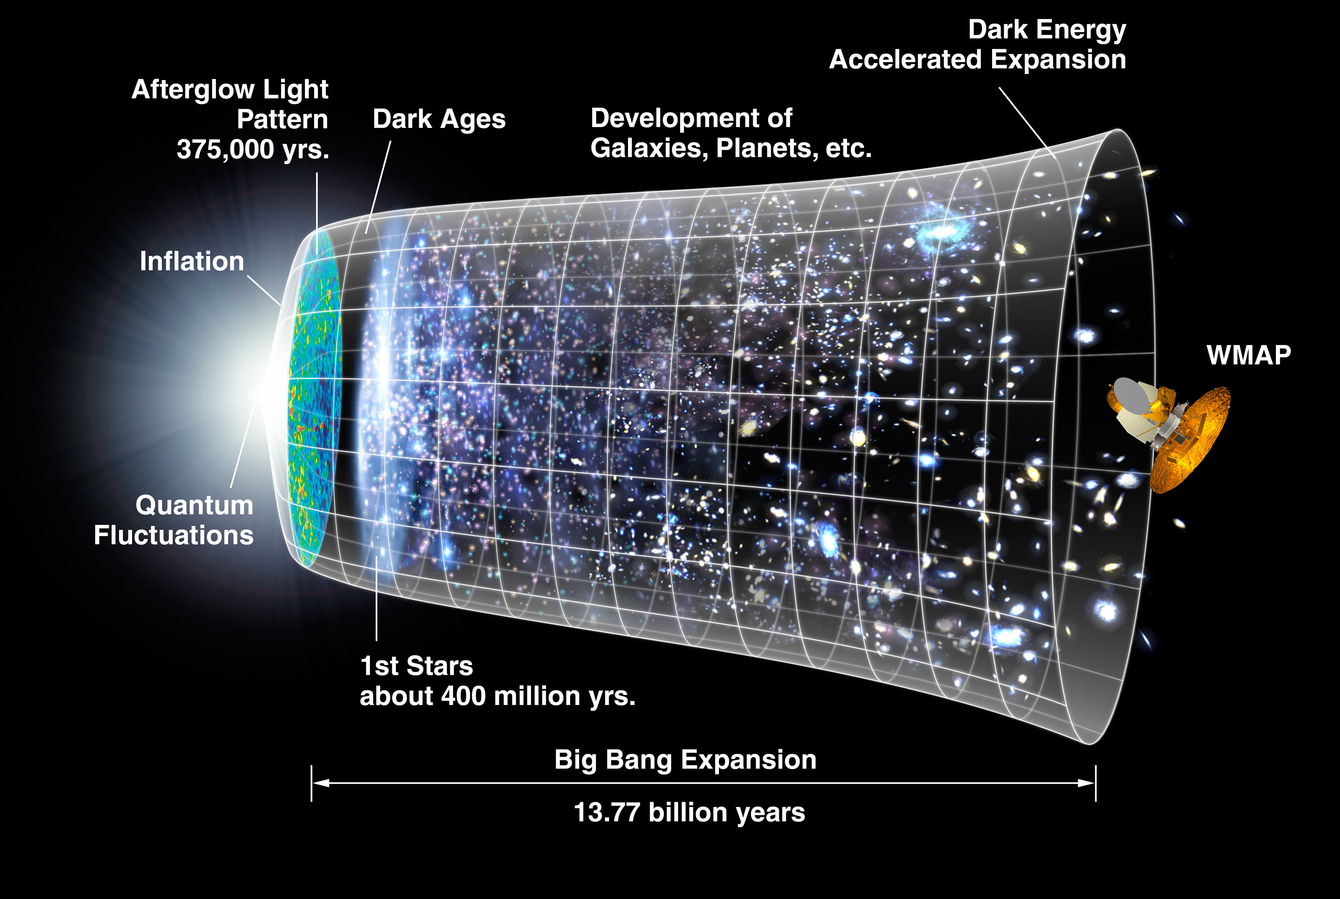
Timeline of the
Universe
Wilkinson Microwave Anisotropy Probe (WMAP) team

Slide 3

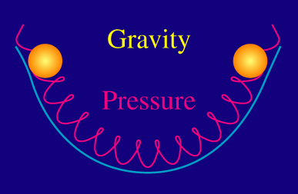
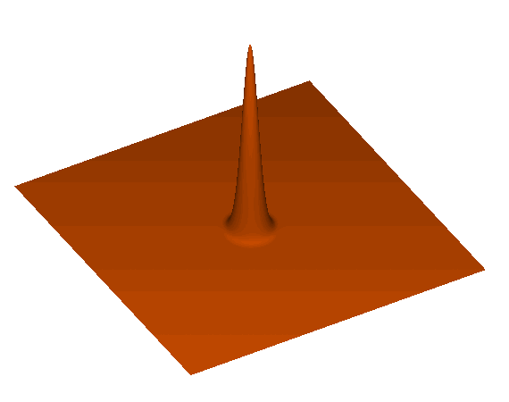
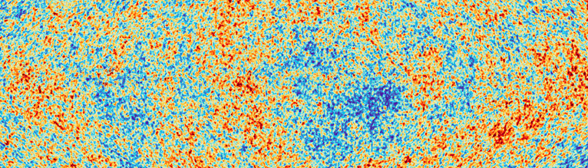

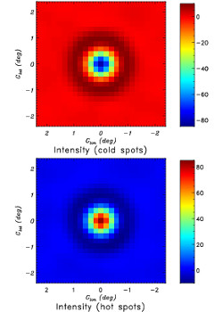
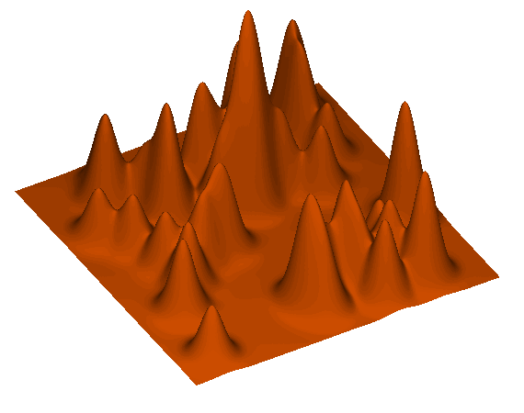
Baryon Acoustic Oscillations to CMB
Image credits: Wayne Hu
Image : Daniel Eisenstein
Adam Hincks
Notes:
Primordial density fluctuations generated during inflation + gravity generate pressure waves in the early, radiation-dominated universe
Acoustic waves propagate in the coupled baryon-photon fluid
Photons decouple from the baryons, and the imprint of these waves are locked into the relic radiation → CMB fluctuations
These same acoustic waves leave an imprint on matter fluctuations from which large-scale structure will later evolve.
The sound wave stops propagating shortly after electron/proton recombination leaving an overdensity at the same fixed scale, everywhere.

Slide 4
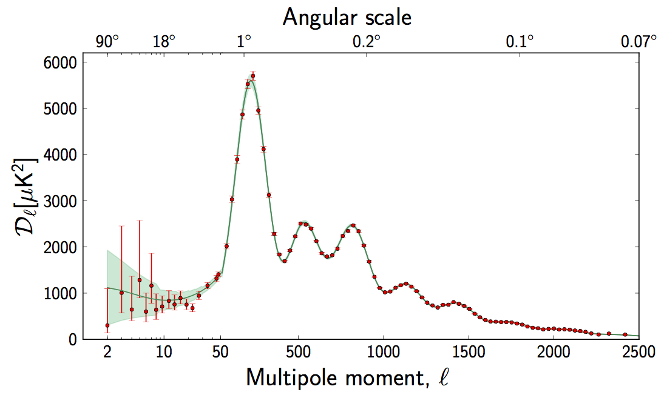
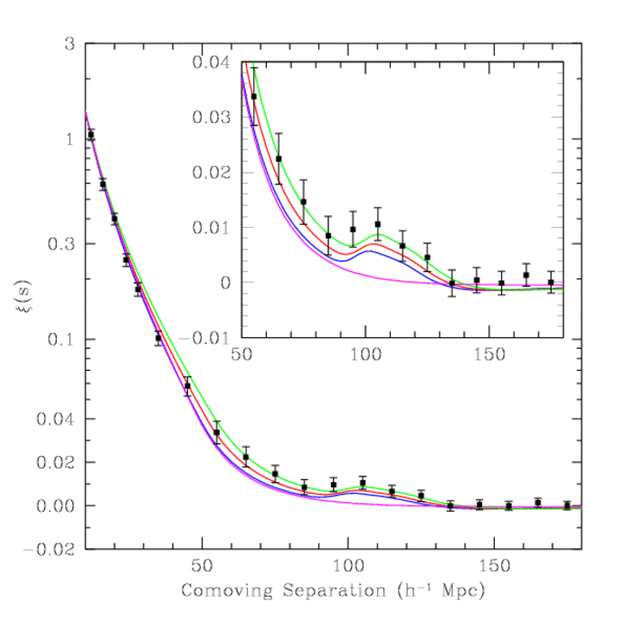
Baryon acoustic oscillations: CMB and galaxies
Imprints left by the baryon-photon plasma oscillations prior to decoupling
Effects on dark matter and visible matter (galaxies) during structure formation after decoupling
The BAO scale provides a standard ruler
The same comoving length scale is observed over many epochs
Observed angular scale over different redshifts provides geometric measure of expansion history: At late times, particularly useful for dark energy constraints (0.8 < z < 2.5)
Planck ESA
BAO scale ~ 150 Mpc
Eisenstein et al. (2005)

Slide 5

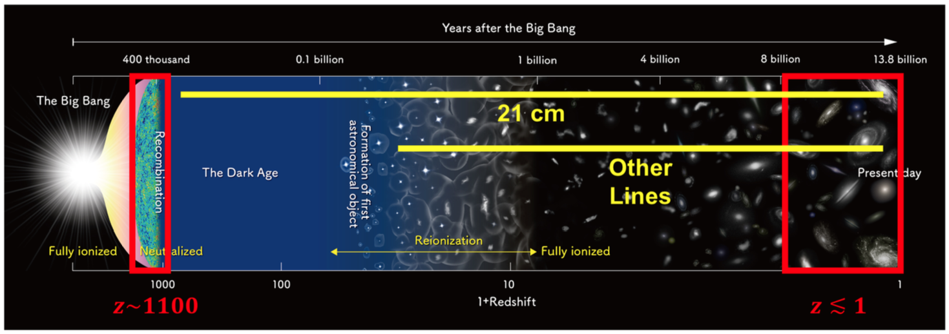
Probing dark energy with BAOs via 21-cm (Hydrogen) intensity mapping
https://hirax.ukzn.ac.za/
E. Kovetz

Slide 6
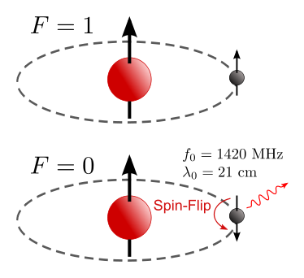

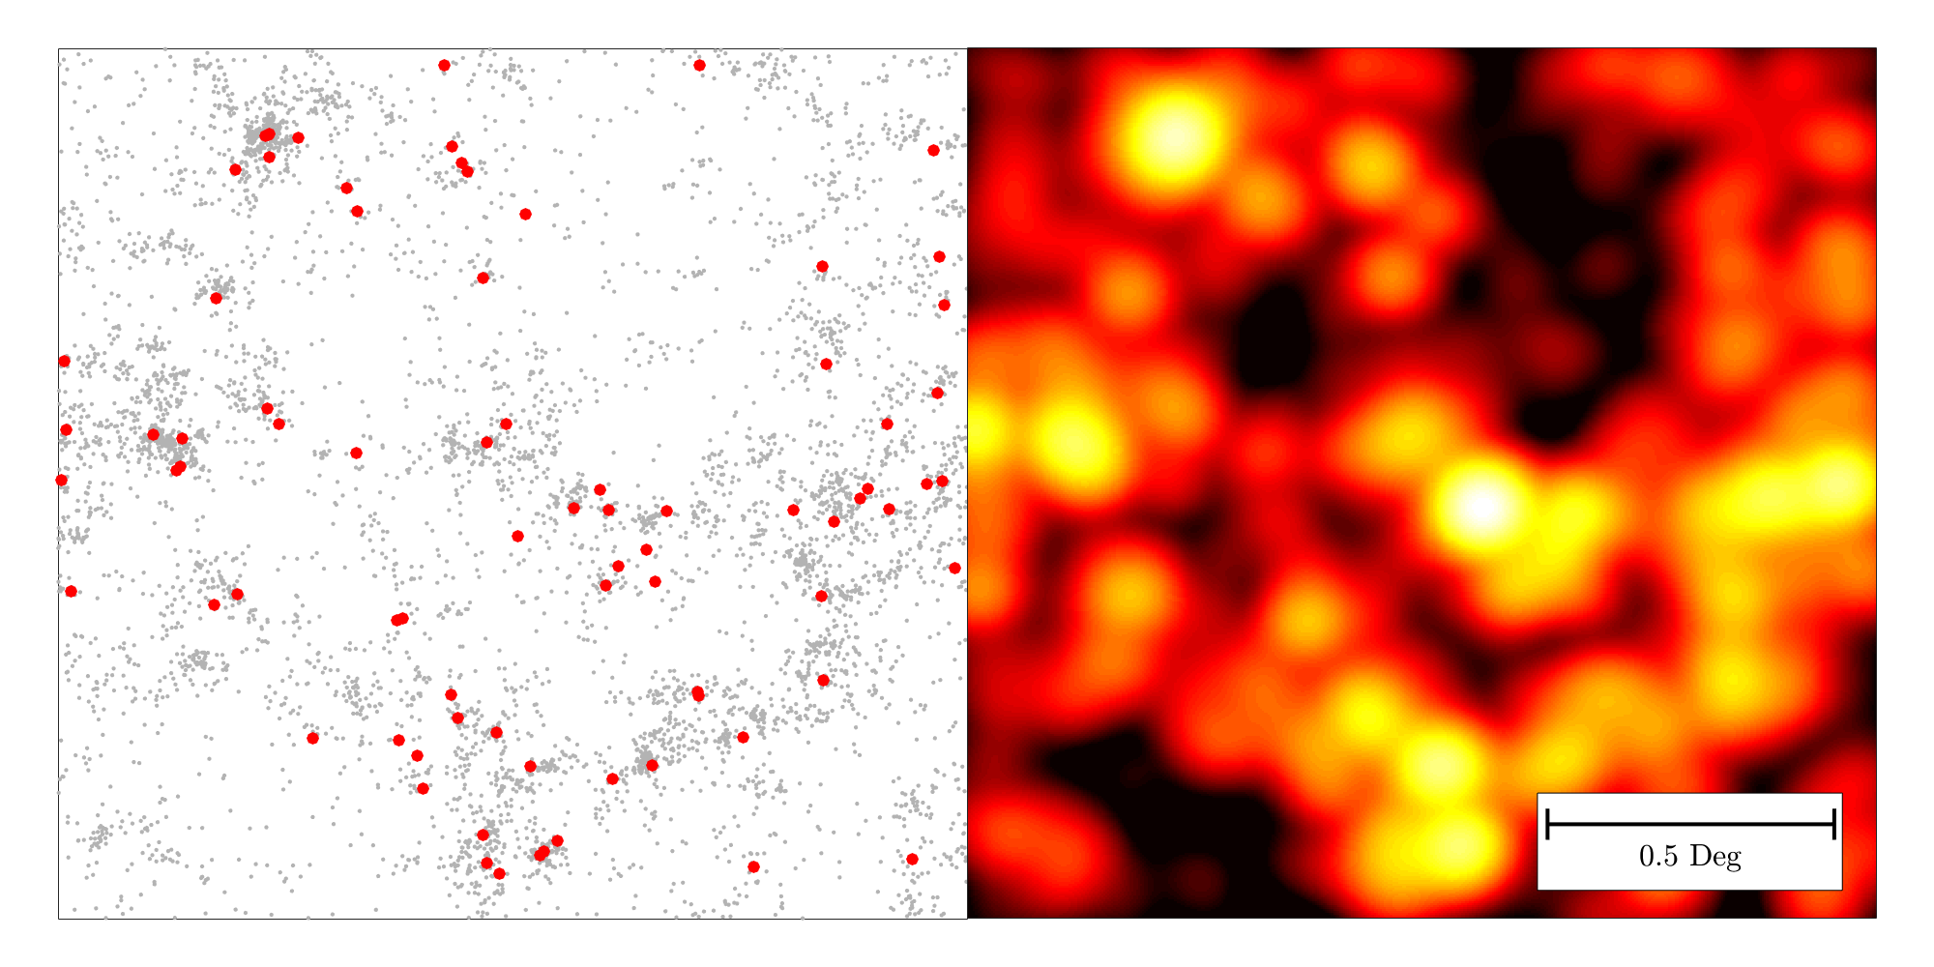
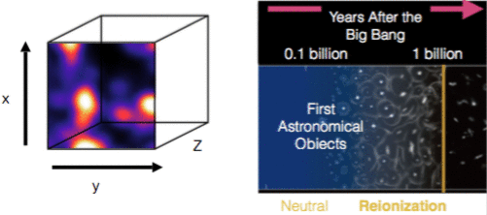
21 cm (HI) emission
Intensity mapping
VLA, 27 dishes, ~4500 hours
Detect ~ 1% of total CO-emitting galaxies
Single-dish CO Mapping Array Pathfinder (COMAP), ~1500 hours
Produce a map of the intensity fluctuations sensitive to emission throughout the field.
Line-Intensity Mapping: 2017 Status Report - E. Kovetz
Notes:
A simulated 2.5 deg² field with galaxy positions (Left) and the corresponding CO intensity map (Right). Luminosities were drawn from a Schechter function model (Breysse et al. 2016). Sources bright enough to detect with 1 hour of VLA time are marked in red.

Slide 7


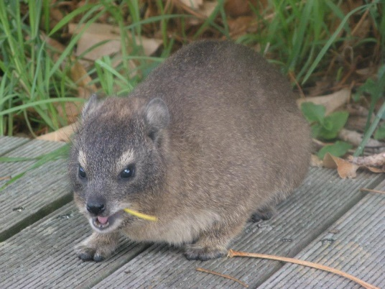
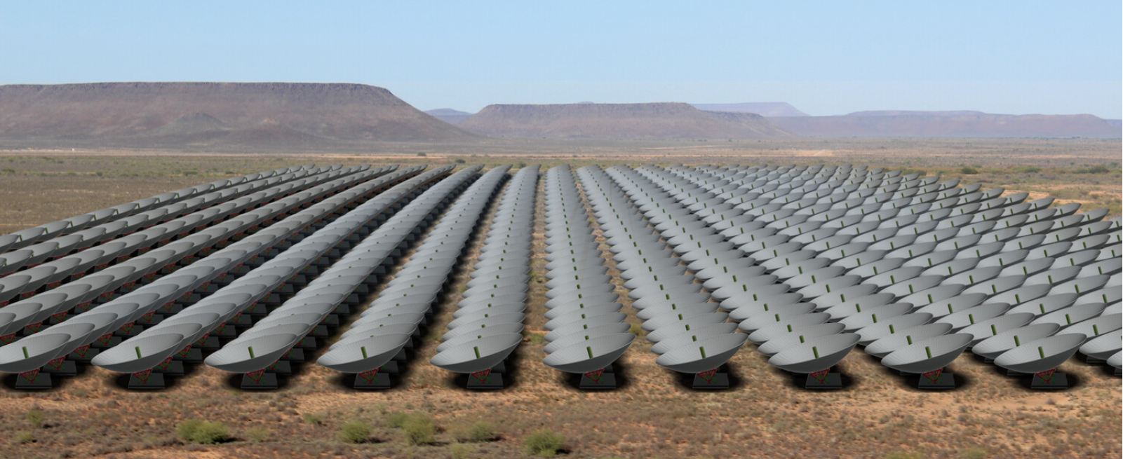
The Hydrogen Intensity and Real-time Analysis eXperiment
Rock hyrax/dassie
1024 closely packed 6 m stationary dishes (can be manually tilted)
Survey area ~ 15,000 deg², daily sensitivity 12 Jy, repoint every 150 days, 4 years for full survey
Measure BAOs to characterize dark energy
Radio transients + pulsar searches
Neutral hydrogen absorbers, diffuse polarization of Galaxy
Frequency range | 400 – 800 MHz (0.8 < z < 2.5)
Frequency resolution | 390 kHz, 1024 channels
Dish size | 6 m diameter
Interferometric layout | 32x32 square grid, 7 m spacing
Field of view | 15 deg² – 56 deg²
Resolution | ~ 5’ – 10’
Beam crossing time | 17 – 32 minutes
System temperature | 50 K

Slide 8
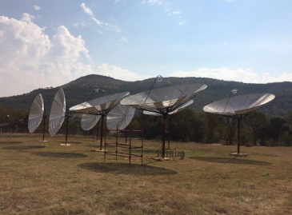
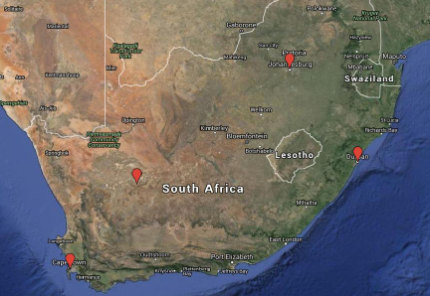
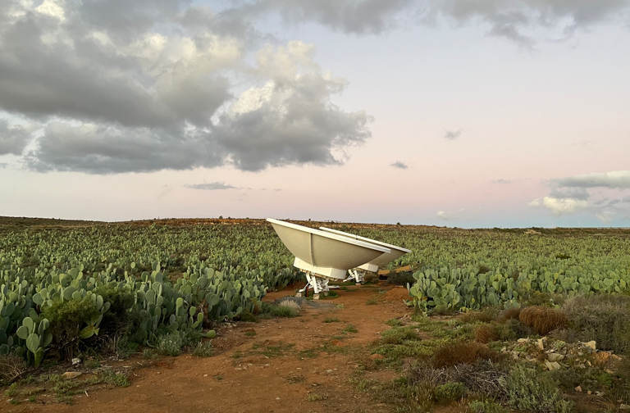


HIRAX: Location and status
HartRAO eight element 6m prototype,
5mm pointing accuracy
HartRAO (8 dishes)
2 dishes at Klerefontein
Image credit: Dr Anthony Walters
SKA site: Klerefontein
Durban
Losberg
Cape Town
(128
256 512 1024 dishes)
HartRAO: moderately radio-quiet zone, excellent
infrastructure and support staff
https://hirax.ukzn.ac.za/

Slide 9
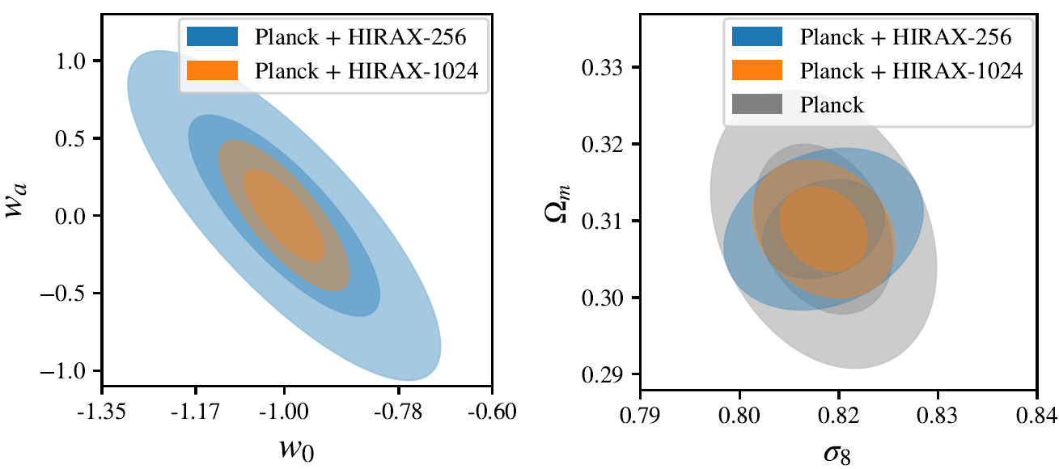
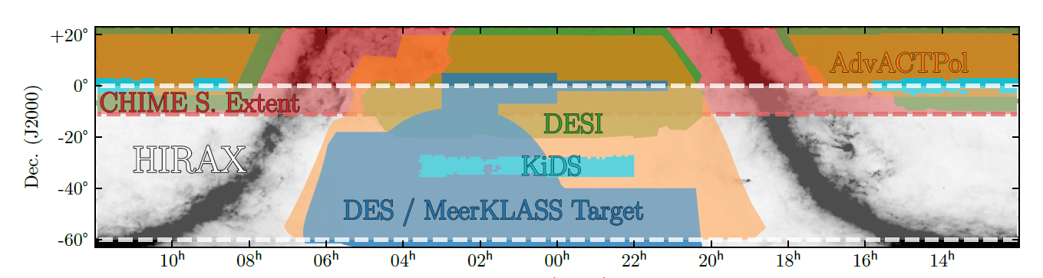
Case for radio-optical cross-correlations
First detections of the 21cm IM signal, GBT x WiggleZ - Chang et al 2010, Masui et al 2013
Complementary physical constraints: different probes, spectroscopic/photometric
Cross-confirmation of results, mutual support (e.g., redshifts), breaks parameter degeneracies
D. Crichton, M. Aich, et al. 2021
DESI: 2018 - 2022, 25 million galaxies, z < 2
DES: Aug 2013 +5 years, 300 million galaxies, z < 1.4
LSST: 2020 — 2030, ~billions galaxies, z < 3
Notes:
Complementary physical constraints (different probes, spectroscopic/photometric)
Cosmological probe – clustering, BAOs, red-shift space distortions (RSD), lensing (cosmic shear, convergence)
Growth probe – RSD, lensing
Expansion probe – BAOs, lensing
Cross-confirmation of results and mutual support (e.g. redshifts)
Rubin provides photometric redshifts for HI continuum survey
HIRAX HI redshifts can calibrate LSST photo-z, using cross-correlation
Cross-correlation of 21cm IM surveys with galaxy surveys can help us understand
how hydrogen is distributed in galaxies (Wolz et al 2017), and
correlation between hydrogen & tracer galaxies (Pourtsidou et al 2015, 2016).
cross-correlation with photometric surveys e.g. LSST can provide photo-z calibration (Alonso et al 2017)
illuminates HI distribution in galaxies (small scales), and correlation b/w HI in ICM and tracer galaxies (large scales).

Slide 10
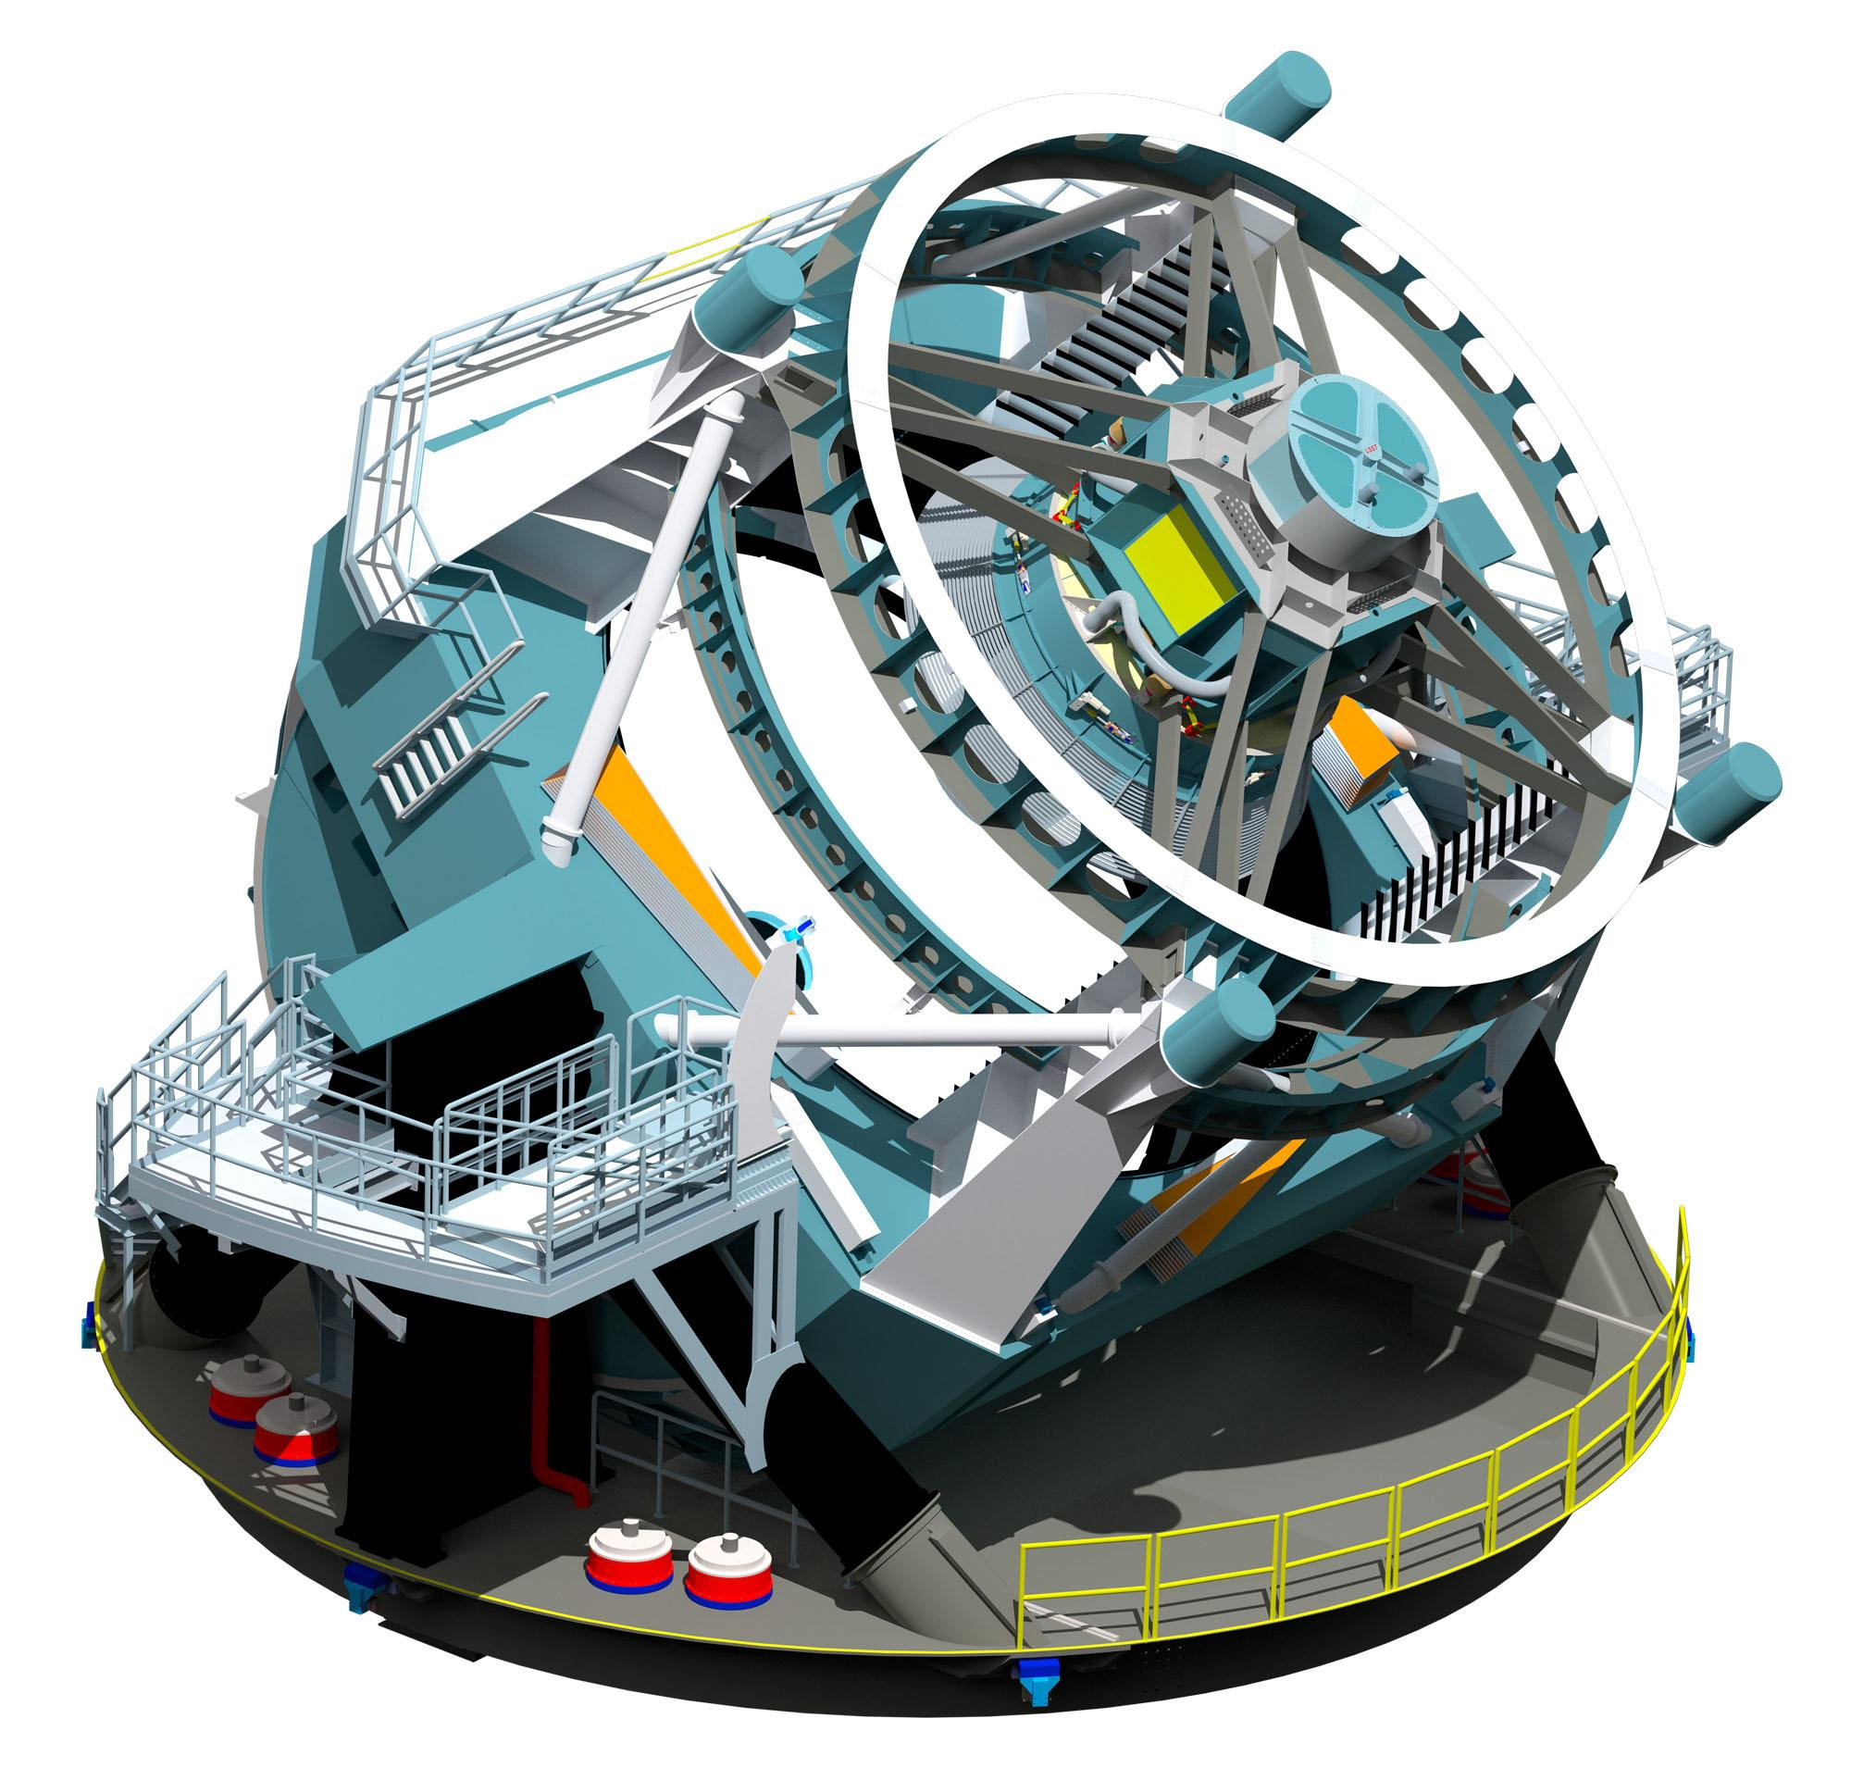
Vera Rubin Observatory (Legacy Survey of Space and Time)
The
Conduct a 10-year survey of the sky, to address
Probing dark matter and dark energy
hazardous asteroids and the remote Solar System
transient optical sky
formation and structure of the Milky Way
Two key probes in the Rubin-LSST dark energy programme
  Cosmic shear - probes the growth of structure and the geometry of the universe
  Baryon Acoustic Oscillation (BAO) signature - probes the growth of structure and the geometry of the universe
HI intensity mapping surveys - biased tracer of the large-scale structure, correlates with the galaxy (trace stars) and shear distributions (trace dark matter)
Joint power spectra - probe relationship between neutral hydrogen, stars and dark matter, sensitive to cosmological quantities, breaks parameter degeneracies present in any single probe
Contiguous overlapping imaging of over half the sky
6 bands (ugrizy, 320–1050 nm)
Large field of view (9.6 deg²)
0.2×0.2 arcsec² pixels
Effective diameter of 6.5m
3.2 Giga pixels
Cerro Pachón in northern Chile
Notes:
Main task will be carrying out a synoptic astronomical survey, the Legacy Survey of Space and Time. Rubin will cover about 18,000 deg2 of the southern sky with six filters in its main survey. Scientific goals are

Slide 11
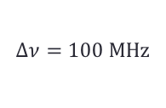
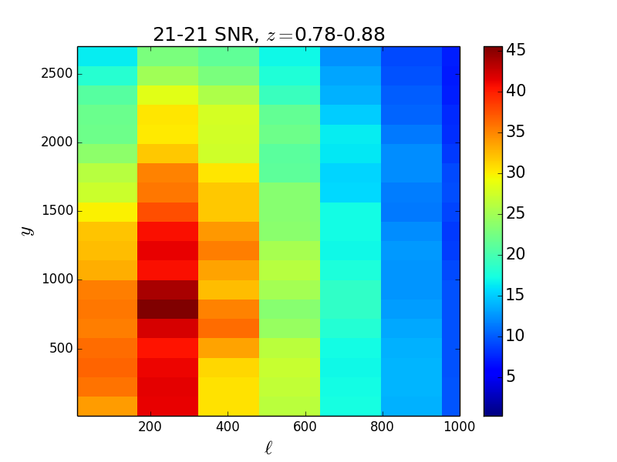
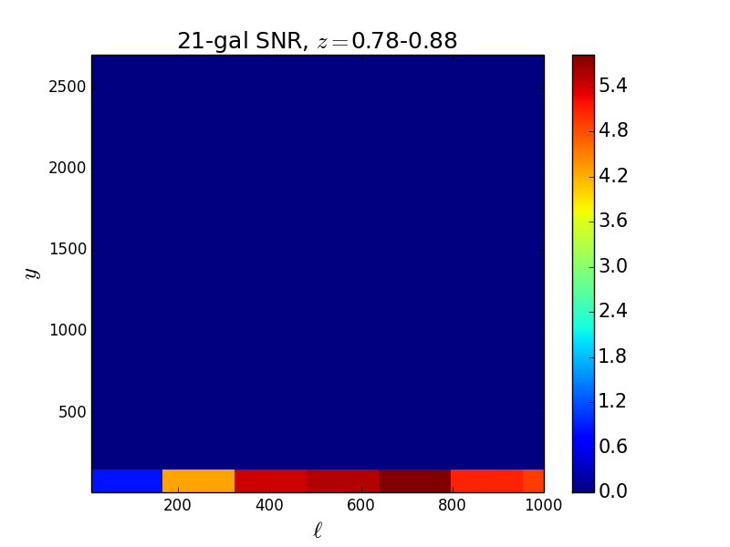
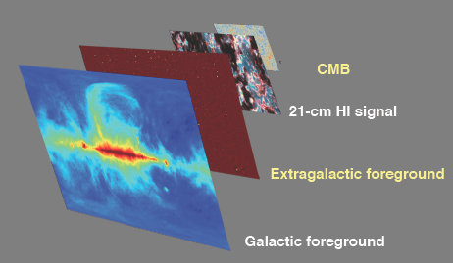



Cumulative signal to noise ratio (SNR) auto- and cross-correlations
Observational Fourier coordinates
Foregrounds contaminate the large scale frequency modes (small k_{parallel})
Dominant effect of foreground removal is that we become insensitive to power at low k_{parallel}
Avoid k_{parallel} < 0.01 Mpc⁻¹

Slide 12
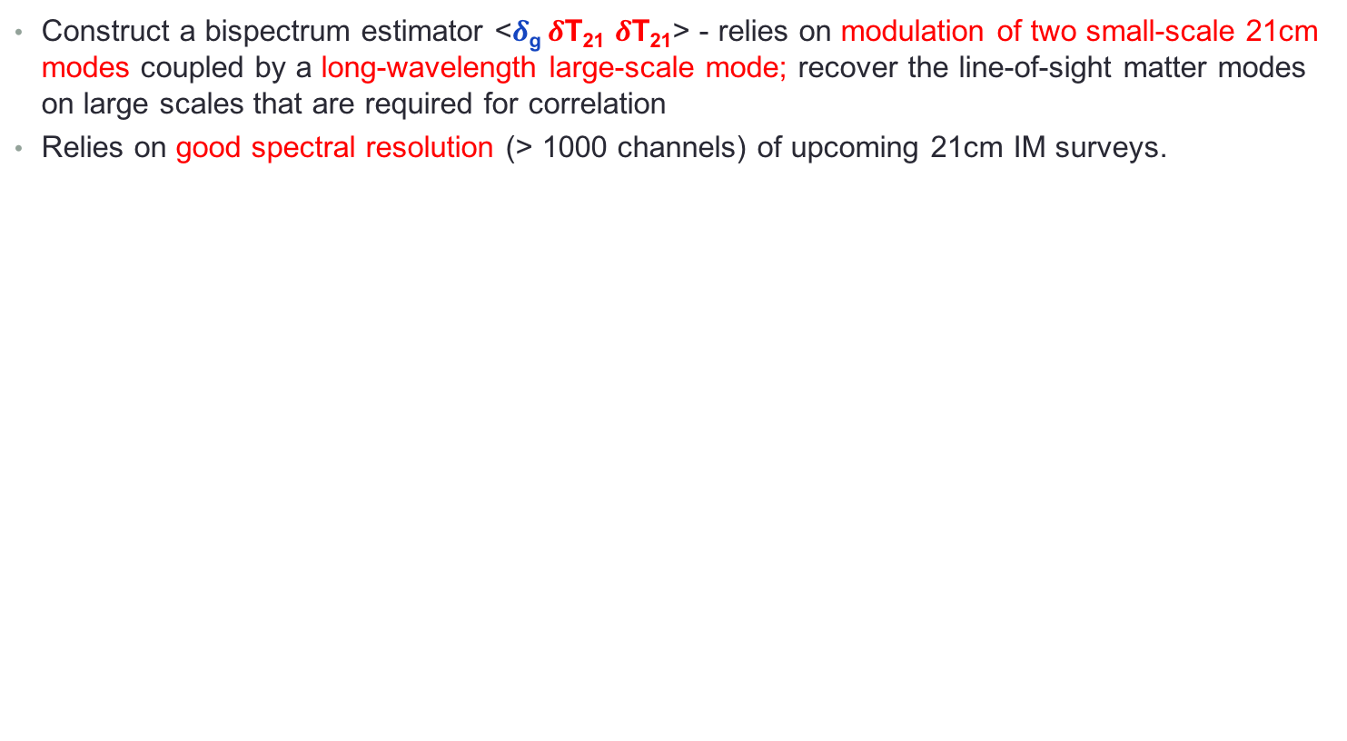
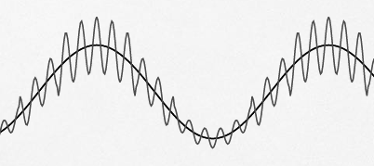


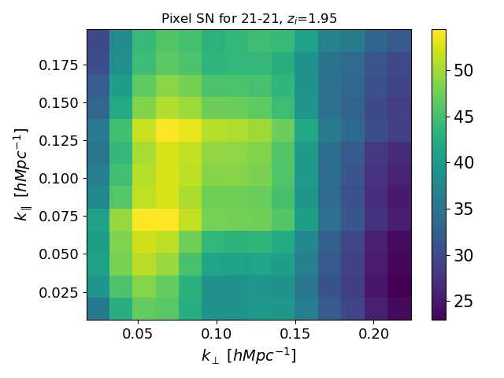
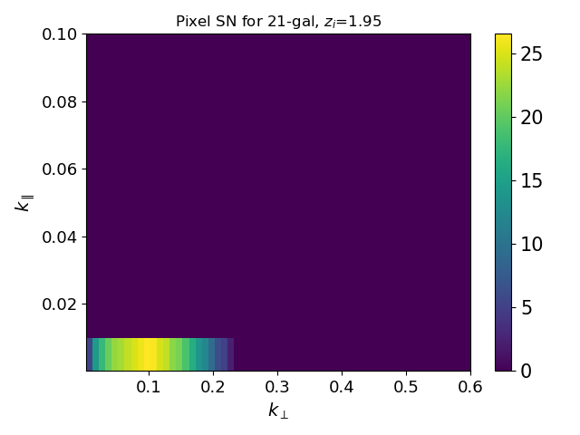
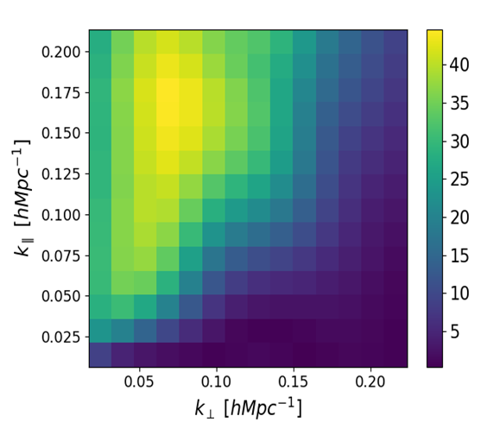
Higher order correlations: bispectrum
Density fluctuations are higher in regions
with a higher background over-density
HI – HI
HI – gal
HI – HI - gal
Notes:
We will see how the bispectrum helps in recovering the SNR. It relies on modulation of two small scale 21-cm modes coupled by a long wavelength large-scale mode, recovering the line-of-sight matter modes on large scales that are required for correlation, as density fluctuations are higher in regions with a higher background over-density. It relies on good spectral resolution (>1000 channels) for upcoming 21-cm IM surveys, which HIRAX has. As you can see from these figures for the auto, cross, and bispectrum for one redshift bin, the HI-HI-gal bispectrum recovers more SNR than the cross-spectra. Similar for shear.

Slide 13
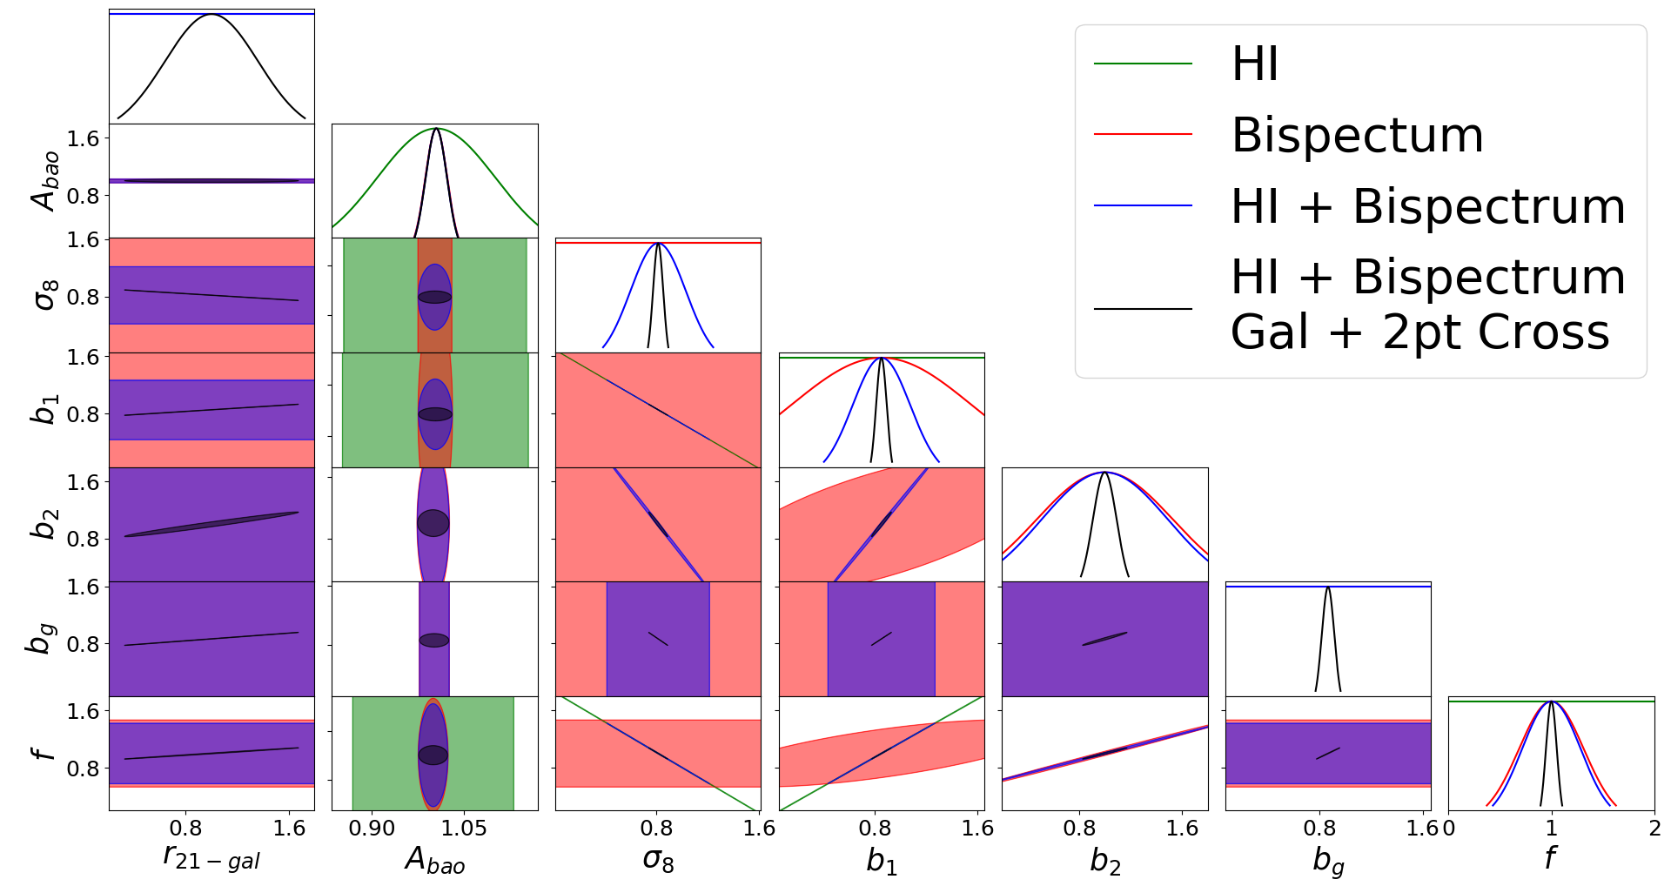
Fisher analysis: higher order correlations
(HI-HI-galaxy bispectrum)
Different combinations of the cosmological parameters appear in the auto, cross, and the bi-spectrum, which helps in breaking parameter degeneracies.
Plot from W. Naidoo
W. Naidoo, M. Aich, K. Moodley (in prep)
Notes:
Complicated since we have f and b degenerate with sigma_8
Gal measurement has b_gal \sigma_8 as well
2 point cross and HI + gal still leaves the sigma_8 degenerate with f, b and bgal.
r21gal parameter which is also degenerate with sigma_8
bispectrum to break all degeneracies

Slide 14
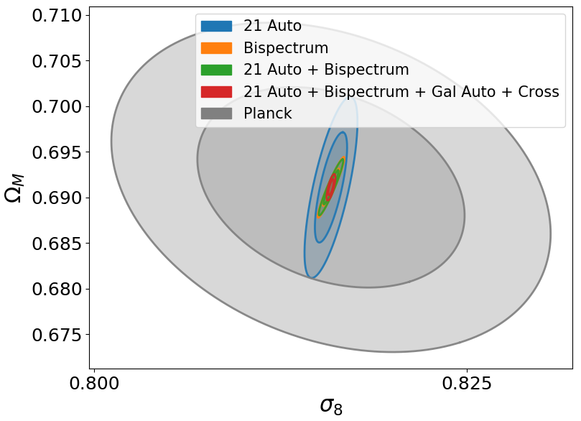
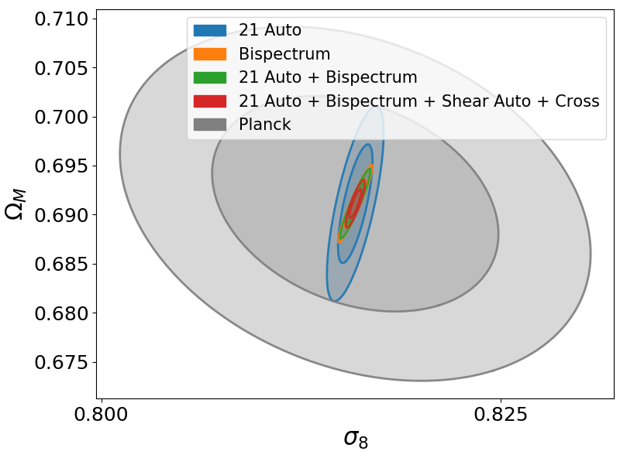
Constraints on Ω_{M} and σ₈
HI-HI-galaxy
HI-HI-shear
M. Aich W. Naidoo, K. Moodley (in prep)

Slide 15
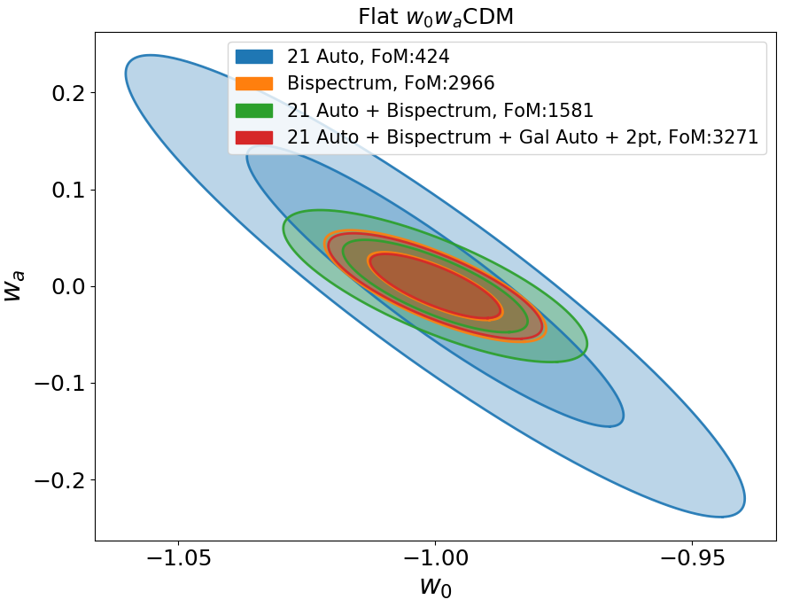

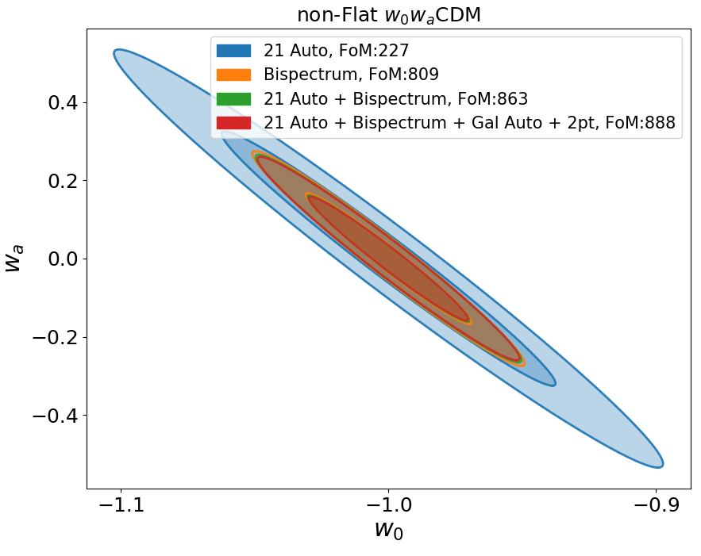
Dark energy parameter constraints: HI-HI-galaxy
with curvature
without curvature
M. Aich W. Naidoo, K. Moodley (in prep)

Slide 16
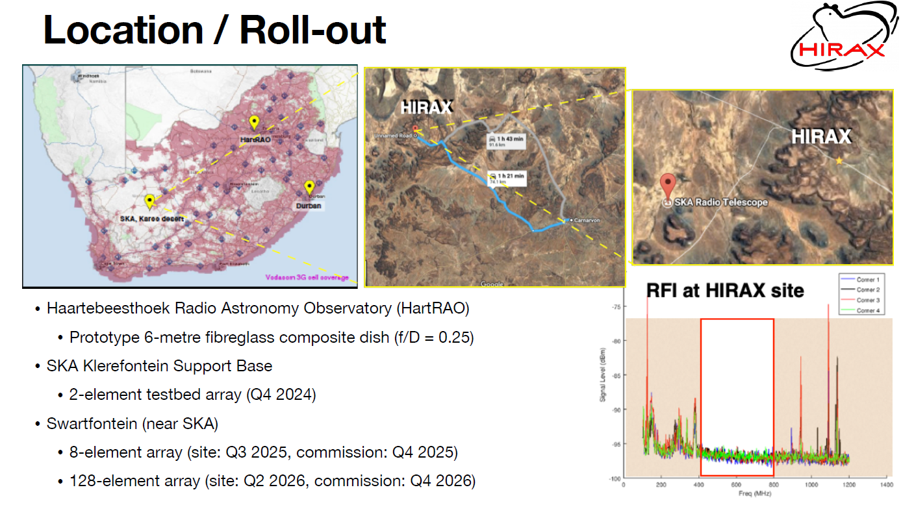
HIRAX status (slide from Dr Anthony Walters)
, 256 dishes approved

Slide 17
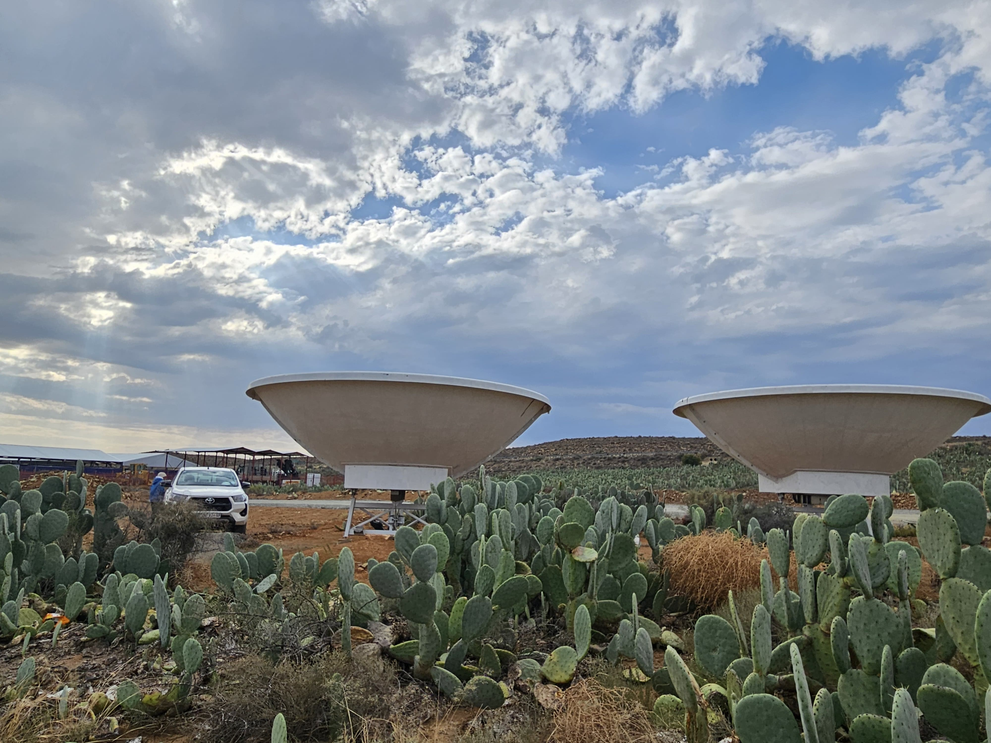
Summary
Intensity mapping cross-correlation with LSS - robust way to test cosmological parameters.
Cross-power spectrum – loss of SNR and foregrounds, further loss of SNR.
Use bispectrum to recover large modes which are lost in foreground removal.
With auto-correlations, the bispectrum breaks parameter degeneracies.
Image credit: Tasmiya Papiah

Slide 18
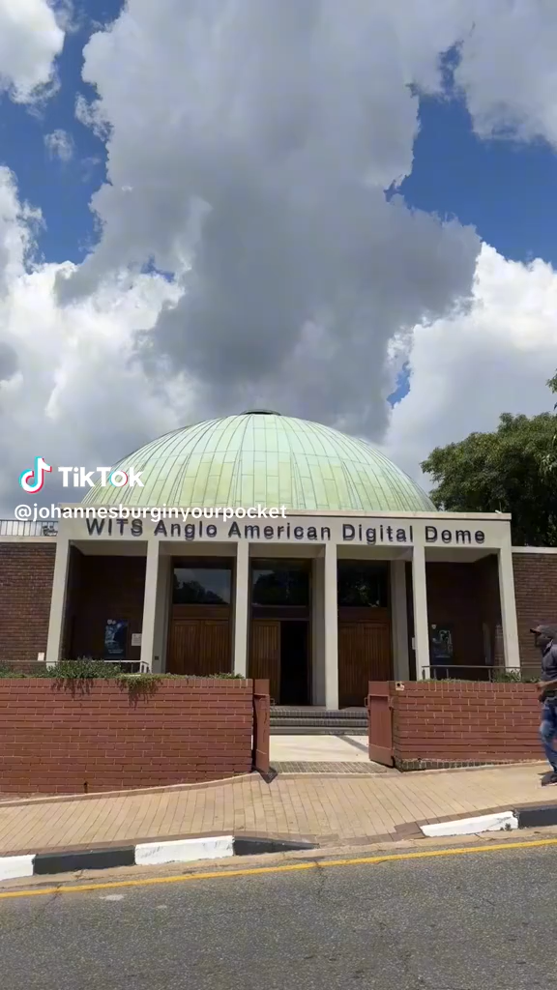
Visiting Johannesburg? Please visit!
Johannesburg Planetarium
12 October 1960
→
Wits Anglo American Digital Dome 12 November 2024
https://digitaldome.wits.ac.za/
Free Shows for SAIP attendees on 8, 9, and 10 July from 18:00
Thanks!

