Slide 1
Investigating the influence of Boundary Layer Dynamics on Aerosol Optical Properties over Pretoria using Ceilometer and Cimel Sun Photometer.
Zimbini Faniso-Mnyaka¹, Edwin Magidimisha¹, Seelen Naodoo¹ and Patrick Malatji¹
¹ CSIR, D&S, OSS, Mearing Naude Road, Pretoria, 0001, South Africa
SAIP Conference
Presenter: Zimbini Faniso-Mnyaka
10 July 2024

Slide 2
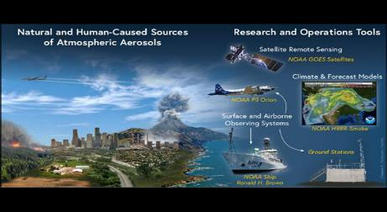
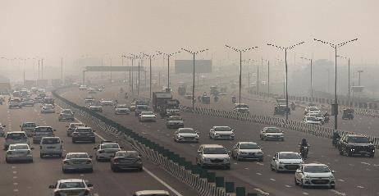
Introduction
Atmospheric Aerosols
  Atmospheric Aerosols: Air quality, human health, climate and satellite remote sensing.
Sources:
  They can originate from natural sources such as dust ,sea spray or volcanic ash or
  Human activities such as industrial emissions and vehicle exhaust
Atmospheric Boundary Layer(ABL)
  Lowest parts of the atmosphere influenced by surface conditions.
  Controls aerosol dispersion, vertical mixing and transport.
  Low ABL height- Pollutant trapped near Earth Surface
  High ABL height-Polluted air is diluted

Slide 3
Introduction Continuation
Aerosol Optical Properties include
  Aerosol Optical Depth
    A measure of the extinction of sunlight by aerosol particles in the atmosphere.
    It indicates the concentration of aerosols.
  Angstrom Exponent
    Describes the wavelength dependency of aerosols optical depth
    Provides information about particle size distribution
Understanding the interaction between ABL dynamics and aerosol loading is essential.

Slide 4
Importance of studying urban area ABLH and Aerosol Optical Properties
Urban Area Aerosol
  Composed of human activity sources like industrial emissions and agricultural activities, which can have high absorption effect and influence local air temperature and precipitation.
  Contain high levels of pollutants leading to serious health issues like bronchitis and cardiovascular diseases.
  Pollutants such dust can reduce visibility impacting transportation and daily activities.
Understanding the distinct properties and behaviours of the urban environments helps in developing targeted environmental policies and regulations.

Slide 5

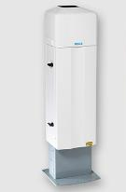
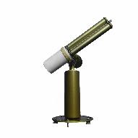

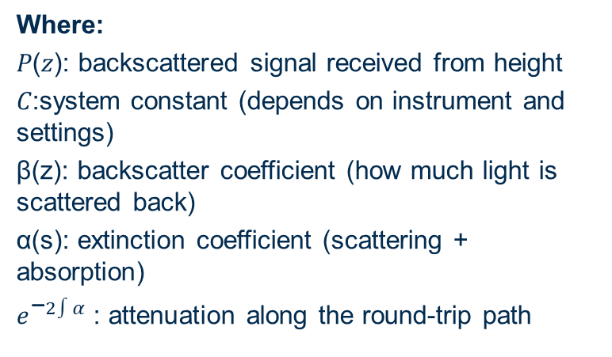
ABL data algorithm vs AOD data algorithms
Ceilometer and Cimel Sun Photometer use Beer –Lamberts Law.
A law that describes how light intensity decreases as it travels through the medium containing particles.
Ceilometer
  The ceilometer sends out a laser pulse.
  As the pulse passes through the atmosphere, particles scatter and absorb some of the light.
  The remaining light bounces back from aerosols or clouds.
  The ceilometer measures how much light comes back and at what heights, then uses Beer-Lambert’s law to estimate particle concentration and detect boundaries in the atmosphere
For Ceilometer :
where I(z): intensity of the laser light at distance 𝑧
𝐼0 : initial intensity of the laser
τ(z): optical depth at height which depends on aerosol concentration and absorption
LiDAR equation
Where:
𝑃(𝑧): backscattered signal received from height
𝐶:system constant (depends on instrument and settings)
β(z): backscatter coefficient (how much light is scattered back)
α(s): extinction coefficient (scattering + absorption)
${\text{e}}^{\text{−}2∫α}$: attenuation along the round-trip path
Ceilometer
Cimel Sun Photometer

Slide 6


ABL vs AOD methods
Cimel Sun Photometer
Typically measures solar irradiance at several wavelengths of 340 nm, 380 nm, 440 nm, 500 nm, 675 nm, 870 nm, 1020 nm.
Measures direct sunlight to determine the amount of light absorbed and scattered by aerosols.
AOD
  It uses collected data to calculate the aerosol Optical properties such as AOD, Angstrom exponent etc.
  AOD Algorithm: Beer –lambart law is utilised where the measured irradiance is noted as (𝐼_{𝜆}) at a given wavelength (𝜆) is related to the top-of-atmosphere irradiance (𝐼_{0𝜆}) and the optical depth (𝜏_{𝜆}):
AOD
where m is the air mass factor (the relative path length through the atmosphere)
Extracting AOD:
To extract the AOD a rearrangement of the Beer-lambart law to solve for optical depth (τλ​)

Slide 7
Results and Discussion
  Data taken from 2014 to 2015 will be used
  A ceilometer ABL data will be compared to the Cimel AOD data
  Random days that showed different Atmospheric Boundary layer view were selected . And integrated with the Cimel sun photometer data.
  Traces and comparison was made on the two data sets to see if there's any correlation.

Slide 8
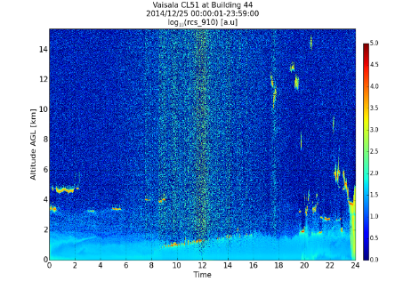
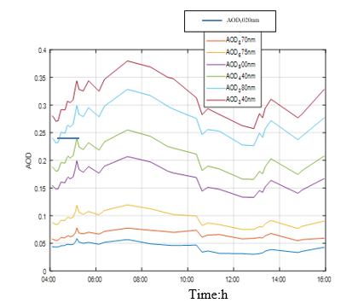
Results (BLH –AOD)
The ABL is very low in the early mornings
There’s a gradual rise in the mixing height after sunrise
The AOD is increasing from 8:30, then decrease around 10:00.
Followed by clear flow of AOD level
Ceilometer
Cimel

Slide 9
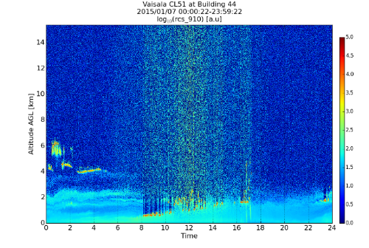
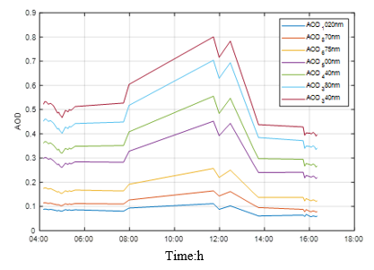
Results Continuation (BLH –AOD)
BHL –AOD
Intense concentration of Aerosols around 8 until 14:00 and
An increase on the Cimel data is peaked around the same time.
Cimel
Ceilometer

Slide 10
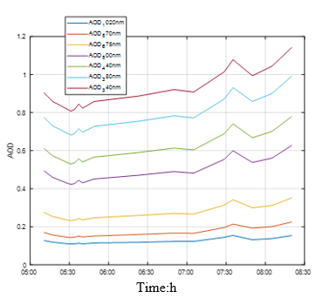
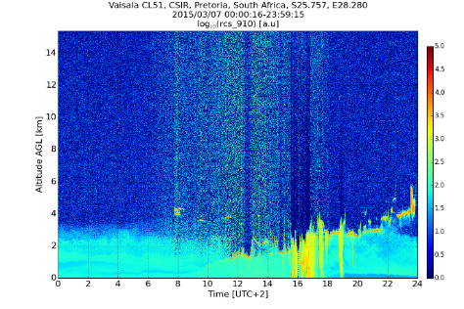
Results Continuation (BLH –AOD)
Ceilometer: Clear sky with LOW ABL in the morning until 8:30.
A thick layer is building up from 8:30, very heavy around 16:00 with height of upto 4km above surface and this shows high aerosol vertical mixing.
BLH –AOD
Cimel: Low AOD values observed from 5:00 in the morning,
At 8:30 it was a beginning of heavy aerosol distribution which led to the sensor looking down and not taking measurements.

Slide 11
Conclusion
Boundary Layer Dynamics influence the aerosol optical properties in Pretoria.
Integrated use of Ceilometer and Cimel Sun Photometer enables better understanding of vertical and columnar aerosol behavior.
A clear relationship was observed between ABLH and AOD.
Low BLH especially in the mornings resulted into low AOD levels
How ever Higher BLH showed an increase in AOD levels due to aerosol dispersion.
However heavy aerosol mixing lead to no AOD reading due to how the system operates

Slide 12
Thank you

