Slide 1

The effects of Sn addition on the structural, magnetic, electronic and vibrational properties of MnAl alloy
T Mokwena*¹, R G Diale², P E Ngoepe¹ and H R Chauke¹
1 Materials Modelling Centre, University of Limpopo, Private Bag X 1106, Sovenga, 0727, South Africa
2 Advanced Materials Division, MINTEK, Private Bag X 3015, Randburg, 2125, South Africa
7-11July 2025

Slide 2
Outline
Introduction
Applications
Phase diagram
Methodology
Results and discussion
Conclusion
Acknowledgements

Slide 3
Introduction
A permanent magnet (PM) is a material that can generate and maintain its magnetic field without the use of an external power source [1].
Amongst permanent magnets, Alnico, Nd₂Fe₁₄B, Sm₂Co₅, and ferrites have been used in advanced technology in the production of devices such as transport devices, biomedical devices, and memory devices [2].
Magnets made of neodymium are more readily available than magnets made of other materials.
Mn-based (L1₀ τ-MnAl phase) intermetallic compounds have attracted a great deal of attention due to their interesting high magnetic crystalline anisotropy constants and high Curie temperatures and low cost to raw material [4].
However, MnAl alloy faces several drawbacks such as brittleness and limited thermodynamic stability [5].
In this study, the effect of Sn on MnAl alloy is investigated using first-principles calculation employing density functional theory (DFT).
The aim of the investigate the stability and magnetic strength of the binary alloy MnAl and ternary MnAl-Sn
[1] A.J.J. Koch, P. Hokkeling, M.G.v.d. Steeg, K.J. de Vos, J. Appl. Phys. 31 (1960) S75-S77.
[[2] J. M. D. Coey, J. Phys. Condens. Matter 26 (2014) 064211.
[3] J. Cui, M. Kramer, L. Zhou, F. Liu, A. Gabay, G. Hadjipanayis, B. Balasubramanian, D. Sellmyer, Acta Mater. 158 (2018) 118-137.
[4] J. M. D. Coey Scr. Mater. 67 (2012), 524-529.
[5] R. F. C. Farrow, R. F. Marks, S. Gider, A. C. Marley, S. S. P. Parkin and D. Mauri, J. Appl. Phys. 81 (1997) 4986.
Notes:
Also talk about the Magnese abundance which is about 75 % of the Mn in the world,

Slide 4

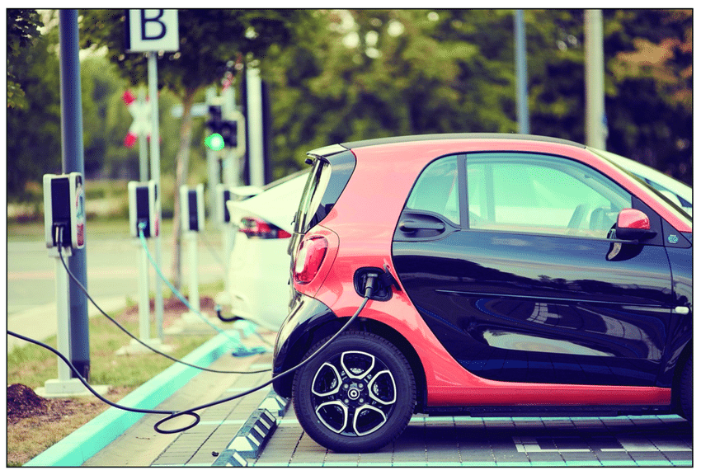
Applications
Wind turbine
Used in generator
Electric vehicle
Used in the magnetic components in the engine
Notes:
Magnets are a primary component in electric motors. A motor operates when a coil of wire, encircled by strong magnets, spins. The electric current induced in the coil emits a magnetic field, which opposes the magnetic field emitted by the strong magnets. This creates a repulsive effect, much like putting two north-pole magnets next to each other.
This repulsion causes the coil to spin or rotate at a high speed. This coil is attached to an axle and the rotation drives the wheels of the vehicle.

Slide 5
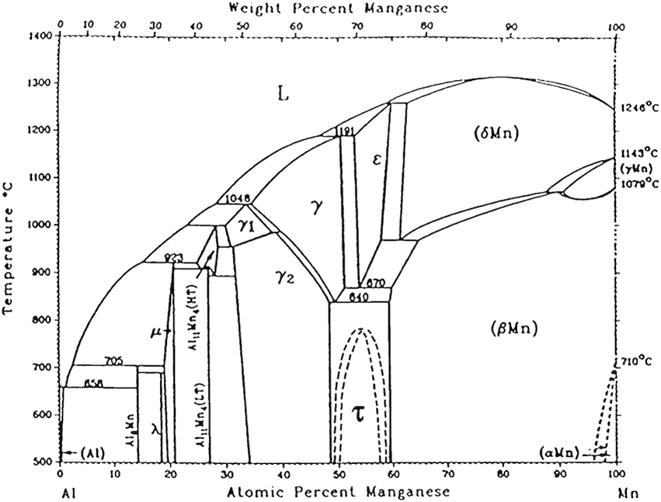
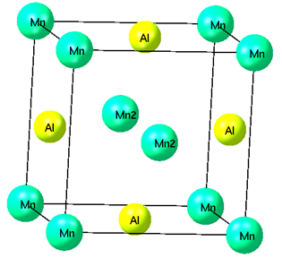
Phase Diagram of Mn-Al
L1₀ Mn₅₀Al₅₀ (P4/mmm)
a=b≠c
Figure 1: The phase diagram of the binary Mn-Al and the area of interest is at the 50 atomic percentage Al.
[6]W. Jorg, K.A. Yanar, and C.S. William. MMTA (2011) 42. 594-604.
Notes:
Talk about the oxidation of Mn²⁺ and the different Mn on the Phase and at what atomic percentage is there tetragonal MnAl. Talk about which Manganese give you the L1₀-MnAl.

Slide 6
Methodology
Approach
DFT[6,7]
VASP[8]
Functional: GGA PBE[9]
Phonon Code[10]
Structure
Built a 2X2X2 supercell of L1₀ MnAl
Substitutional search tool: substitute Al with Sn
Calculations
Convergence test
K-points: 13X13X10
Plane wave cut-off: 500 eV
Thermodynamic
Magnetic
Elastic
Geometry
optimization
Properties
Phonon dispersion curves
[6] Hohenberg P. and Kohn W., Phys. Rev. B, 136 (1964) 864-871.
[7] Kohn W. and Sham L.J., Phys. Rev. A, 140 (1965) 1133-1138.
[8] Kresse G. and Hafner J., Phys. Rev. B, 47 (1993) 558-561.
[9] Perdew J.P., Burke K. and Ernzerhof M., Phys. Rev. Lett., 77 (1996) 3865-3868
[10] Parlinski K., Li Z. Q. and Kawazoe Y., Phys. Rev. Lett. 78 (1997) 4063-4066

Slide 7
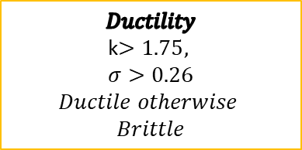
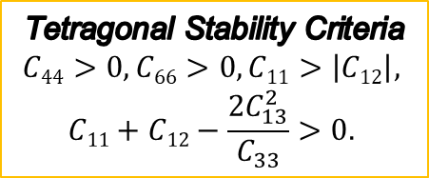
Properties of L1₀-MnAl
Table 1: Equilibrium lattice parameters (Å), Formation energy (eV/atom), Elastic properties (GPa) and magnetic moments (Bohr magnetons) of L1₀ MnAl magnet.
Properties | L1₀ MnAl [11,12,13]
 | Calculated | Experimental
a=b | 2.75 | 2.75
c | 3.49 | 3.50
ΔH_{f} | -0.26
C₁₁ | 283.76 | 292.80
C₁₂ | 41.48 | 43.09
C₁₃ | 102.32 | 89.18
C₃₃ | 146.25 | 165.06
C₄₄ | 120.72 | 119,79
C₆₆ | 62.71 | 75.75
C’ | 242.28 | 249,71
Pugh ratio (k) | 1.46 | 1.35
Poisson ratio (𝜎) | 0.22 | 0.22
Magnetic Moment | 2.35 | 2.37
$$\text{Tetragonal} \text{Stability} \text{Criteria}$$
$$C44>0, C66>0, C11>\left|C12\right|,$$
$$C11+C12−\frac{{2C}_{13}^{2}}{C_{33}}>0.$$
$$Ductility$$
k$>1.75,$
$$\text{σ}>0.26$$
$$Ductile otherwise$$
$$Brittle$$
The MnAl is metastable.
MnAl is brittle due to the Pugh and Poisson ratio being less than their critical values.
The calculated magnetic moment shows ferromagnetic behaviour suggesting that the material has magnetic strength.
[11]. I. D. Sebe, M. E. Sithole, R. Modiba, SAIP proc. (2022).
[12]. C. Bhandari, G. N. Nop, T. Lograsso, and D. Paudyal, arXiv preprint, (2024)
[13]. J.H. Park, Y.K. Hong, , S. Bae, J.J. Lee, J. Jalli, G.S. Abo, N. Neveu, S.G. Kim, C.J. Choi, and J.G. Lee,Appl. Phys.,2010

Slide 8
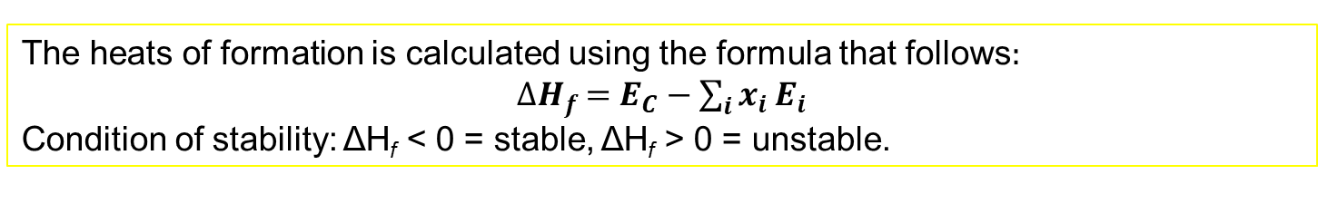
Structural, thermodynamic and magnetic properties
Table 2: Equilibrium lattice parameters (Å), Heats of formation (eV/atom), and magnetic moments (Bohr magnetons) of L1₀ Mn₅₀Al_{50-x}Sn_{x} alloys.
Structure | a=b | c | Heats of formation (eV/atom) | Total magnetic moment (Bohr magnetons)
Mn₅₀Al₅₀ | 2.749 (2.750) [11] | 3.493 (3.500) [11] | -0.261 | 2.351
Mn₅₀Al_{43.75} Sn_{6.25} | 2.763 | 3.587 | -0.183 | 2.357
Mn₅₀Al_{37.5}Sn_{12.5} | 2.785 | 3.662 | -0.100 | 2.378
Mn₅₀Al_{31.75}Sn_{18.75} | 2.801 | 3.727 | -0.040 | 2.393
Mn₅₀Al₂₅Sn₂₅ | 2.850 | 3.751 | 0.053 | 2.462
The heats of formation is calculated using the formula that follows:
${∆H}_{f }=E_{C}−\sum_{i}{x_{i}}E_{i}$
Condition of stability: ΔH_{f} < 0 = stable, ΔH_{f} > 0 = unstable.

Slide 9
Electronic properties of Mn₅₀Al_{50-x}Sn_{x} alloys
Figure 1: total and partial DOS of Mn₅₀Al_{50-x}Sn_{x} alloys (0≤x≤12.5).
These magnetic alloys exhibit a significant difference between spin-up and spin-down, which leads to net magnetism.

Slide 10
Electronic properties cont.
Figure 2: total and partial DOS of Mn₅₀Al_{50-x}Sn_{x} alloys (18.75≤x≤25).

Slide 11

Elastic properties of Mn₅₀Al_{50-x}Sn_{x} alloys
$$\text{Tetragonal} \text{Stability} \text{Criteria}$$
$$C44>0, C66>0, C11>\left|C12\right|,$$
$$C11+C12−\frac{{2C}_{13}^{2}}{C_{33}}>0.$$
Figure 3: Elastic constant for Mn₅₀Al_{50-x}Sn_{x} alloys (0≤x≤25).
All the compositions are mechanically stable as they all satisfy the tetragonal stability criteria, demonstrating positive elastic constants for all compositions.
Notes:
The equality of C13​ and C44​ highlights a balance in how the material handles different stress types, which can be crucial in applications where uniform mechanical behavior is desired.C12=C66 are indicating similar mechanical responses to shear and compression stresses, are a sign of being balanced, stable mechanical properties in the material

Slide 12
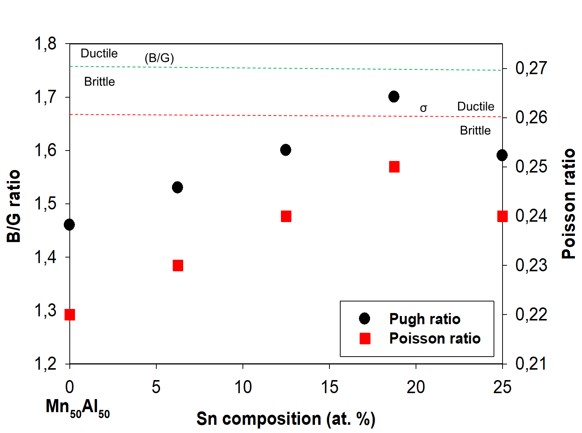
Ductility of Mn₅₀Al_{50-x}Sn_{x}
Figure 4: The Pugh and Poisson ratio of Mn₅₀Al_{50-x}Sn_{x} alloy
The figure demonstrates that adding Sn to MnAl improves the Pugh and Poisson ratios howover they are still than the critical values,indicating the system remains brittle.

Slide 13
Vibrational properties of MnAl-Sn
Figure 5: the phonon dispersion curves of Mn₅₀Al_{50-x}Sn_{x} alloys (0≤x≤12.5).
The absence of soft modes in the phonon dispersion curves indicates that the structures are vibrationally stable. This demonstrates that Sn maintains MnAl's vibrational stability.

Slide 14
Vibrational properties (Cont…)
Figure 6: the phonon dispersion curves of Mn₅₀Al_{50-x}Sn_{x} alloys (18.75≤x≤25).

Slide 15
Conclusion
DFT was successfully used to explore the structural, magnetic, elastic and vibrational properties of Mn₅₀Al_{50-x}Sn_{x} alloys.
Lattice parameters of MnAl were found to be quite consistent with the known experimental values to within 5%.
The results suggested that the addition of Sn compromises the stability of MnAl alloy, since the heats of formation increase with composition.
Doping MnAl with Sn enhanced the magnetic strength due to an increase in magnetic moments.
All the elastic constants are positive, indicating that the Mn₅₀Al_{50-x}Sn_{x} compositions are mechanically stable.
Furthermore, Mn₅₀Al_{50-x}Sn_{x} alloys were found to be vibrationally stable since there were no soft modes observed in the phonon dispersion curves.
The addition of Sn to MnAl increases the Pugh and Poisson ratios but the ductility criteria are not met, demonstrating that the system remains brittle.
Future magnetic components may be developed using the present findings.

Slide 16

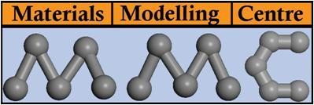


Acknowledgements

Slide 17

Thank You

