Slide 1





Seebeck and SBS studies on buried amorphous carbon channels in Diamond
Presented by SR Naidoo

Slide 2
1. Summary of Results from 3 publications
2. Who? Why?
3. How?
4. What Next?

Slide 3
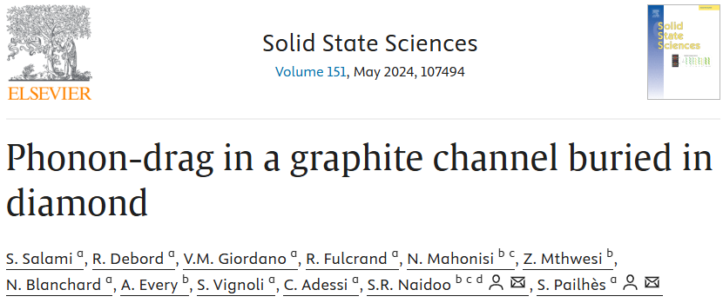
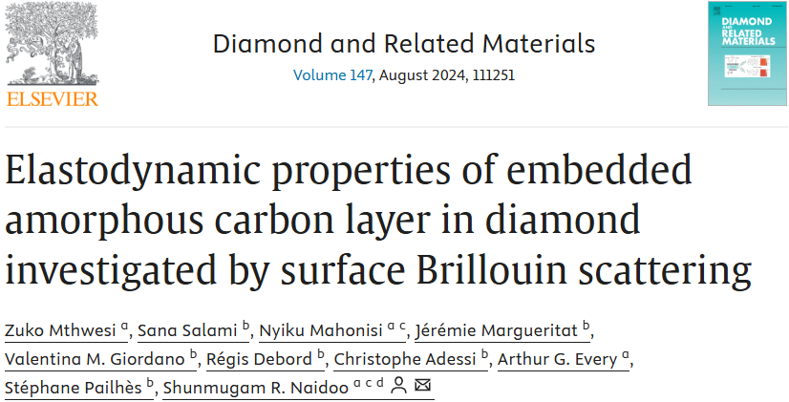
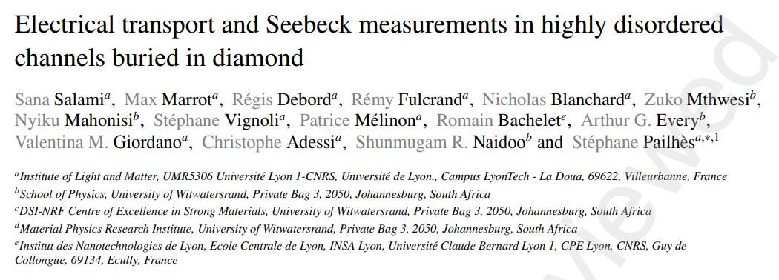
Summary of Results from 3 publications

Slide 4
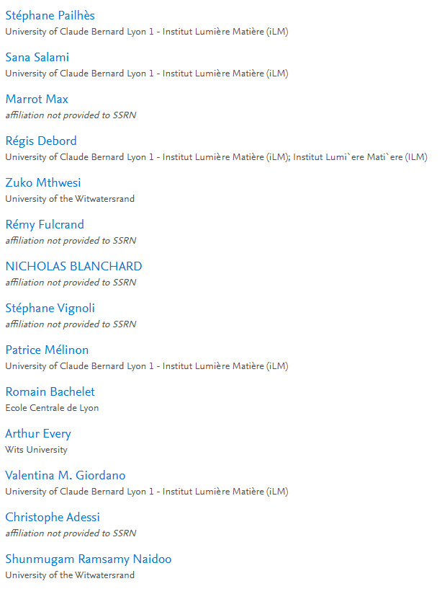
Who?

Slide 5
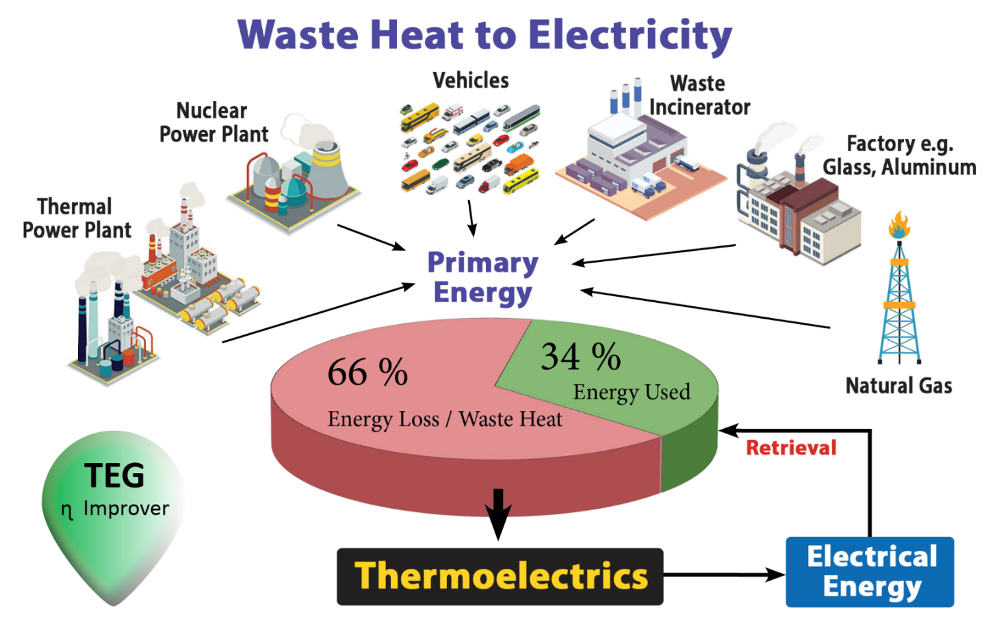
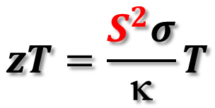
Thermoelectricity
Why?
$$zT=\frac{S^{2}σ}{\text{k}}T$$
PROBLEM

Slide 6
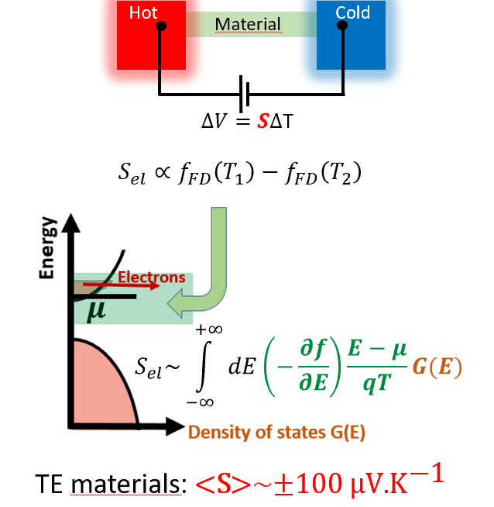
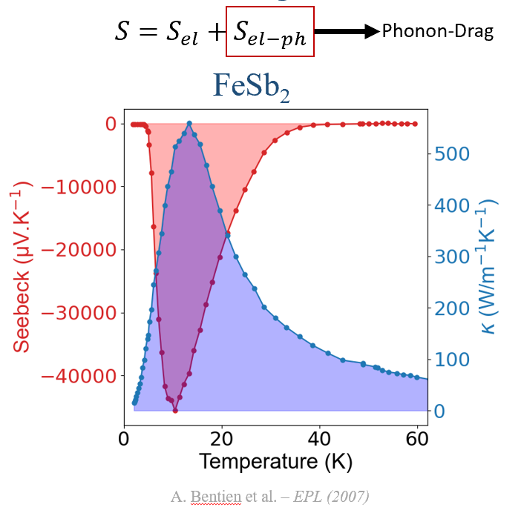

Slide 7
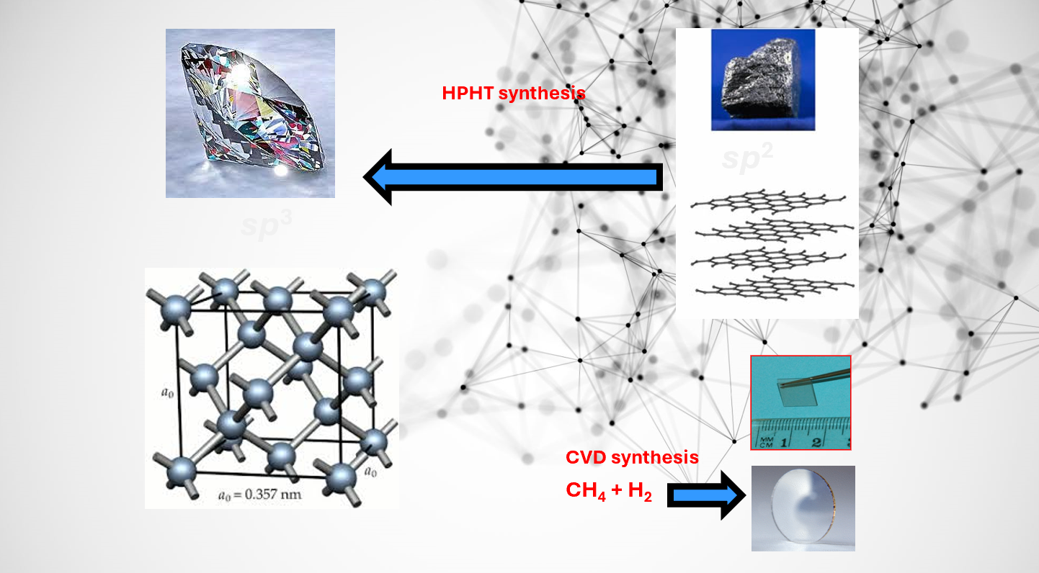

Slide 8
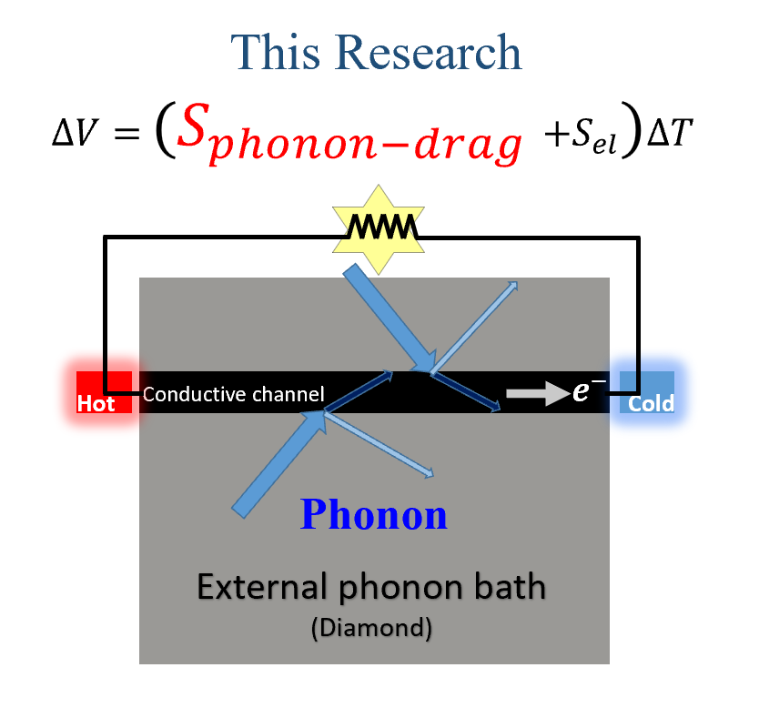
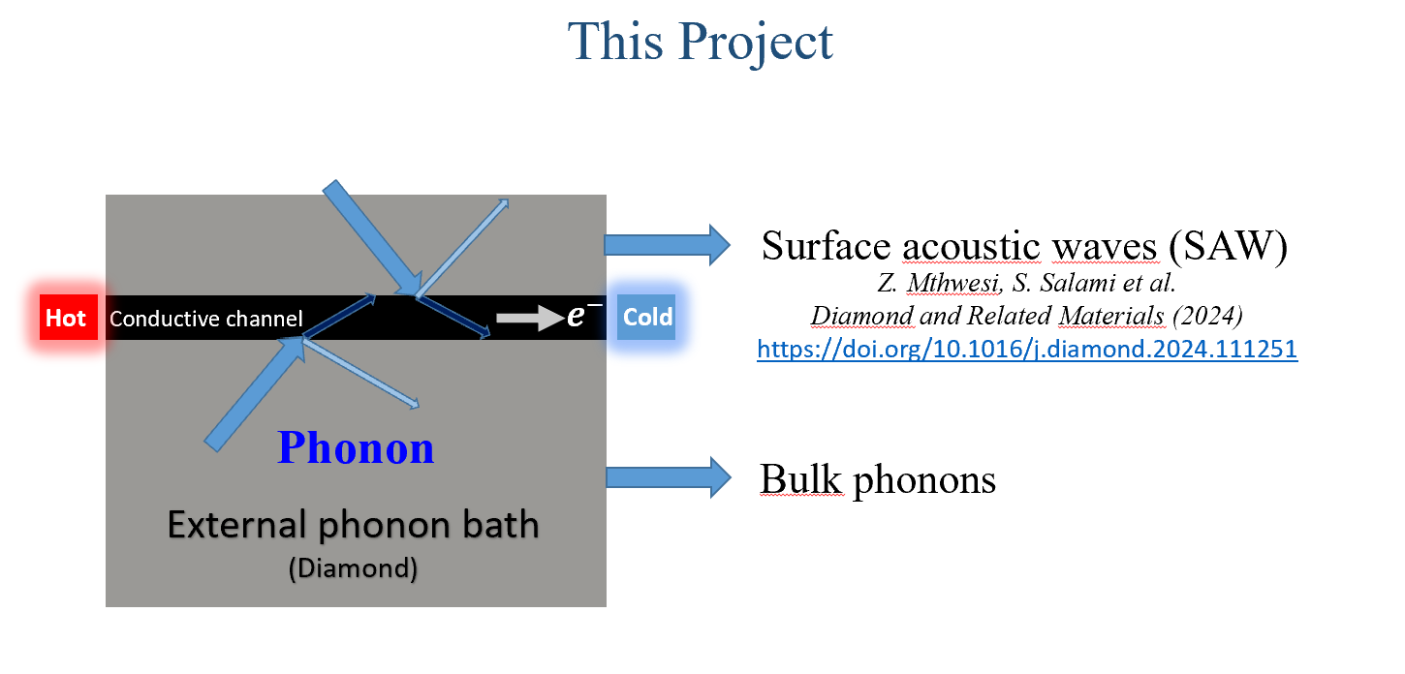

Slide 9
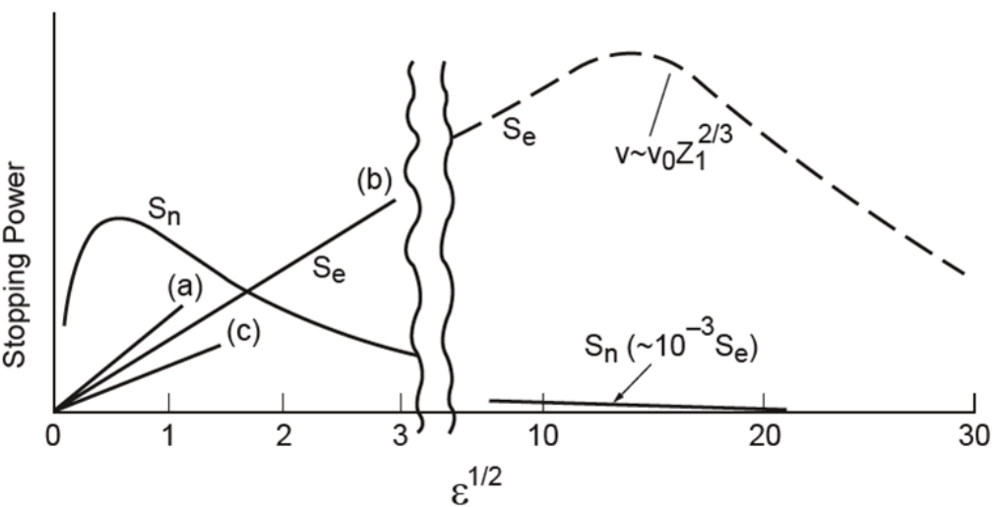
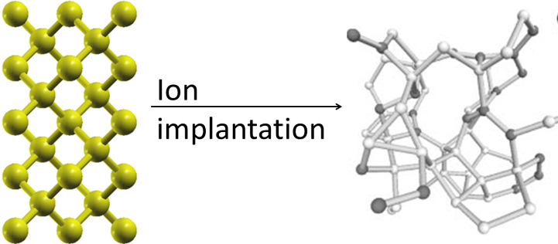

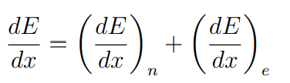

Any ionised atom
Radiation damage
Accelerated ions (typically in the keV to MeV range) enter a material are slowed down by
Electronic stopping – when implanted ions are traveling at high speeds (electrons interact – inealstic scattering))
Nuclear stopping – when implanted atoms are moving at low speeds – displacement of atoms of target lattice site

Slide 10
Diamond is a peculiar material in the group 4 elements – Si and Ge are relatively straightforward to dope preselected areas and recover the ‘diamond’ structure after thermal annealing. What is now understood is that diamond will not recover its crystal structure if the structure has been sufficiently disrupted – and transforms to an amorphous carbon material where sp³ bonds assume sp² and sp bonds.
The transformation is well studied and various optical and imaging techniques have successfully demonstrated this transformation.
This behaviour of diamond to transform to a graphitic amorphous region when the implanted fluence has disrupted the bonded sp³ configuration and created sp² ‘seeds’ is what we are using to create buried conductive channels
Density changes occur in the implanted layer Diamond (3.52 g/cm³) to amorphous carbon 2-3 g/cm³

Slide 11
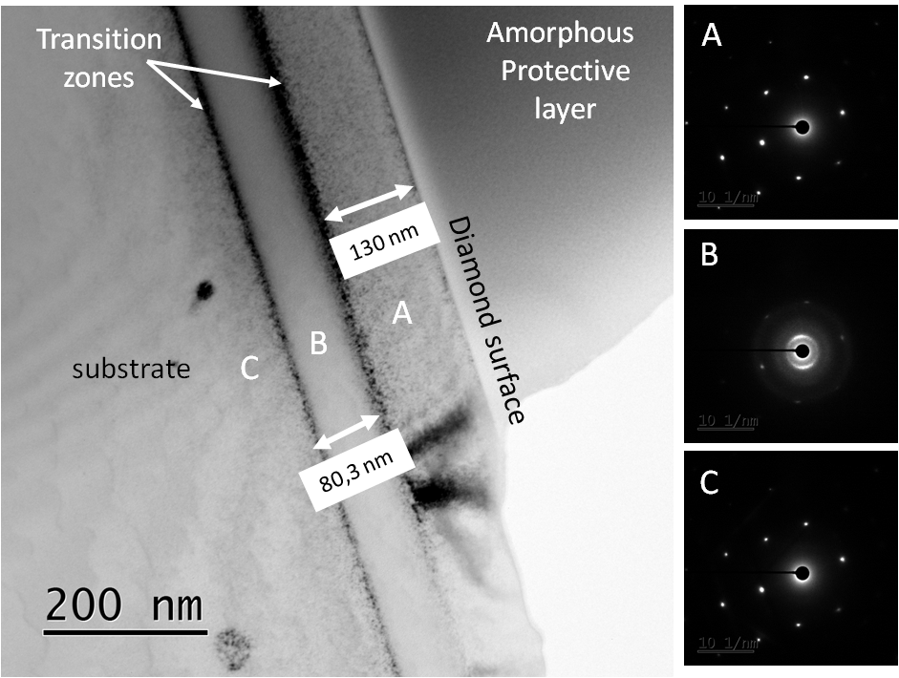
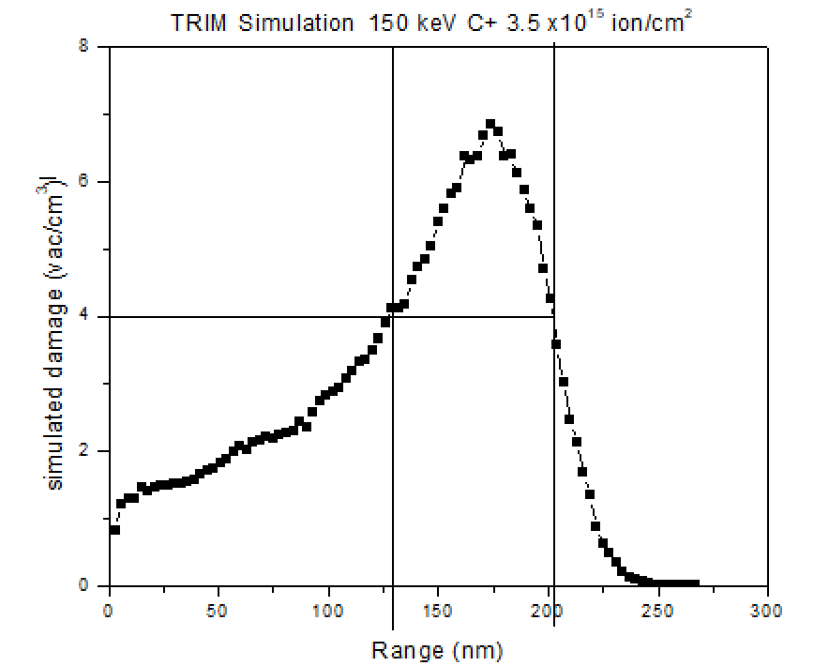
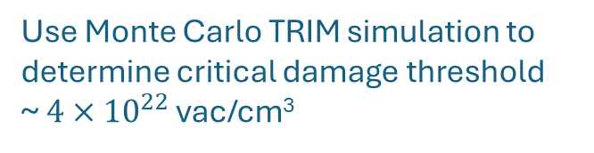
Use Monte Carlo TRIM simulation to determine critical damage threshold
~ $4×{10}^{22}$ vac/cm³
Bright field TEM with SAD (As implanted)
TRIM does not take into account crystallinity of the sample. It assumes the same stopping power throughout
the simulation. Implantation is done ~ 5-7$°$of axis ({100} orientated faces of CVD samples)

Slide 12
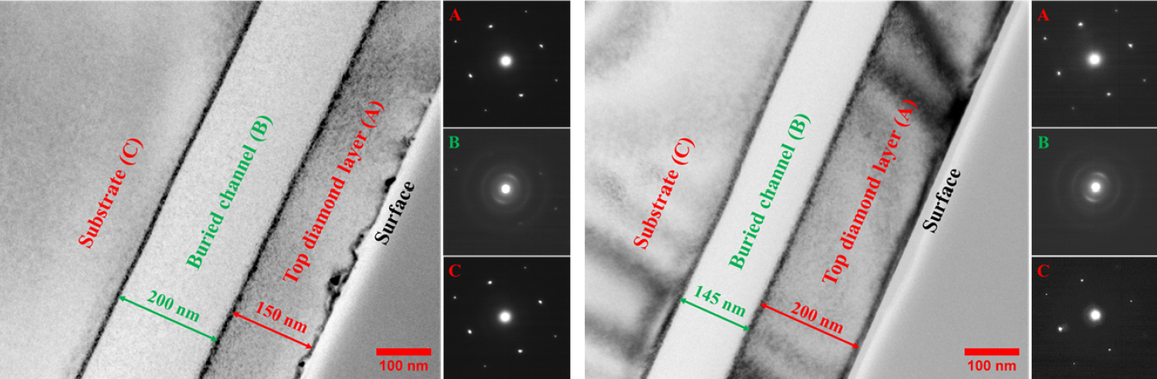

He 80 keV implanted at RT; annealed at 1200 $℃$
He 80 keV implanted at LN2; annealed at 1200 $℃$
Both for fluence of $3×{10}^{16}$ ions/cm²
Cold implantation rapid annealing technique reduces the channel width by 55 nm for the conditions listed
CIRA physics based on Damage in diamond being generated by point defects generated in the collision cascade. If you
Implant ‘cold’ – point defects remain immobile. This increases the probability of vacancy-interstitial recombination upon
Thermal annealing hence better recover of the diamond structure.

Slide 13
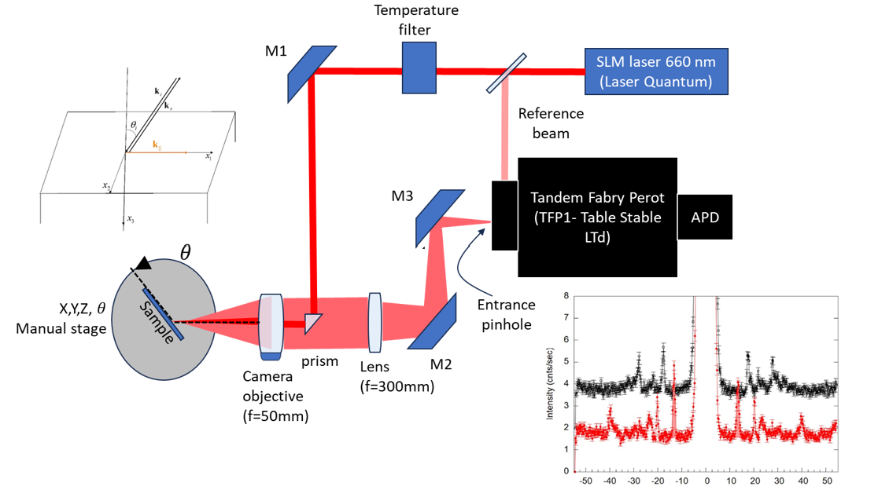
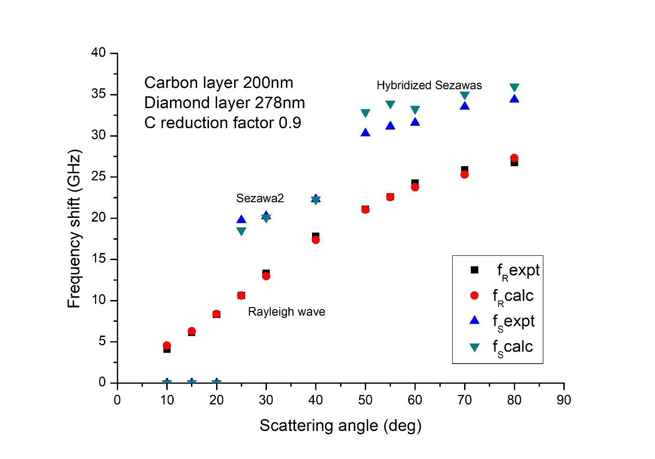
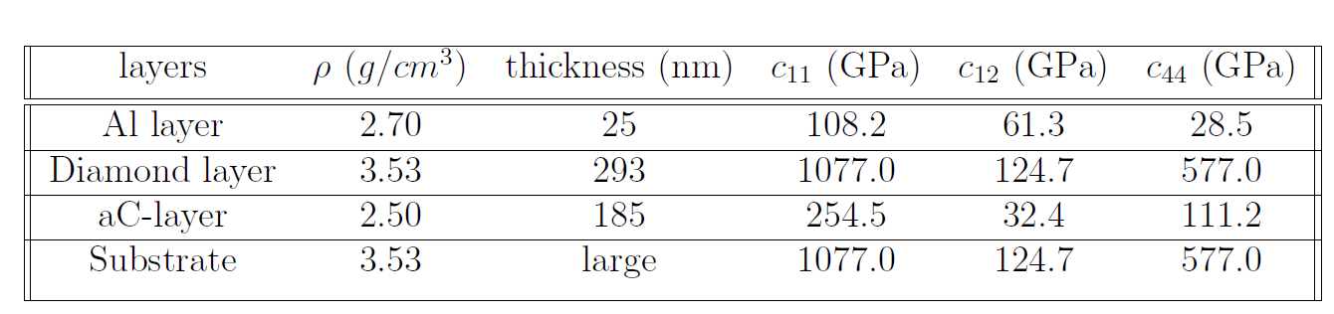
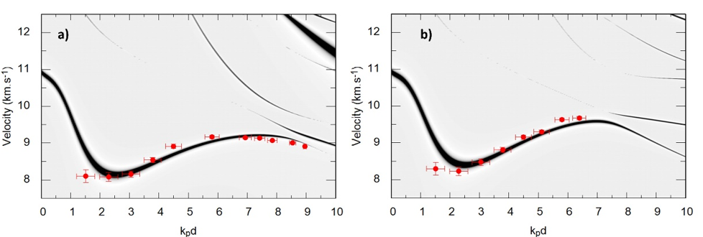

Slide 14
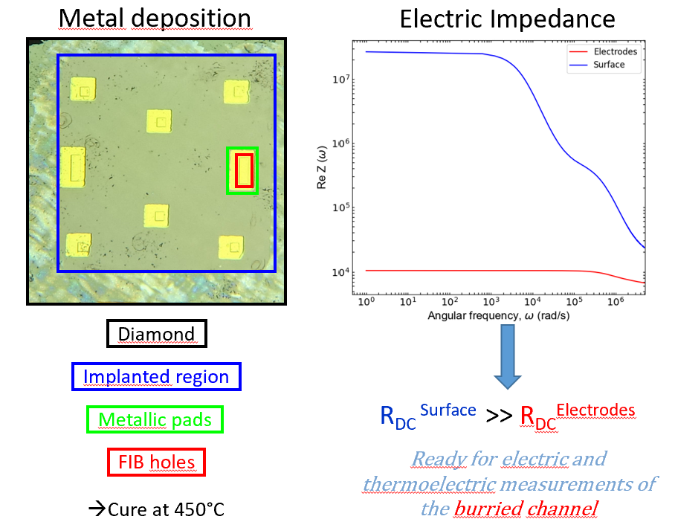
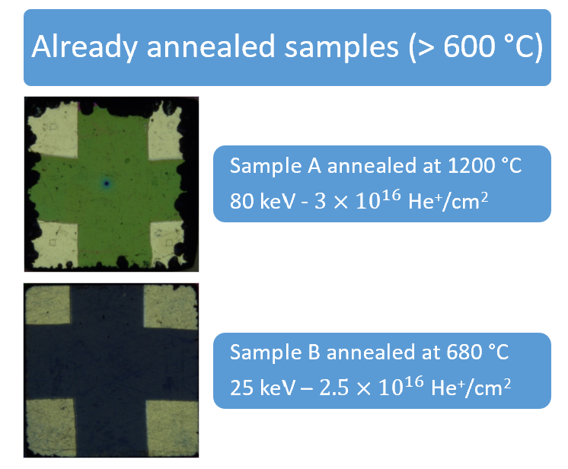
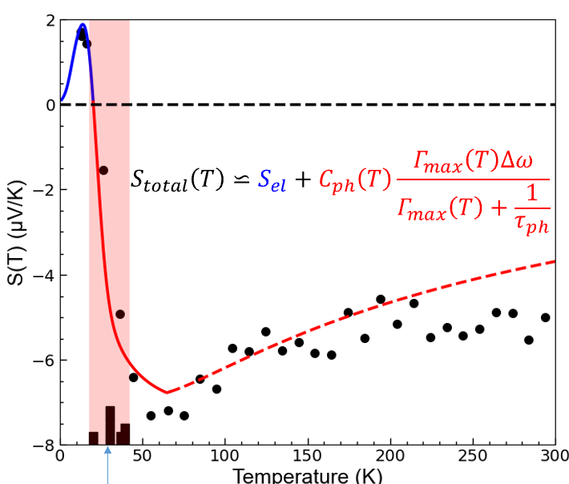
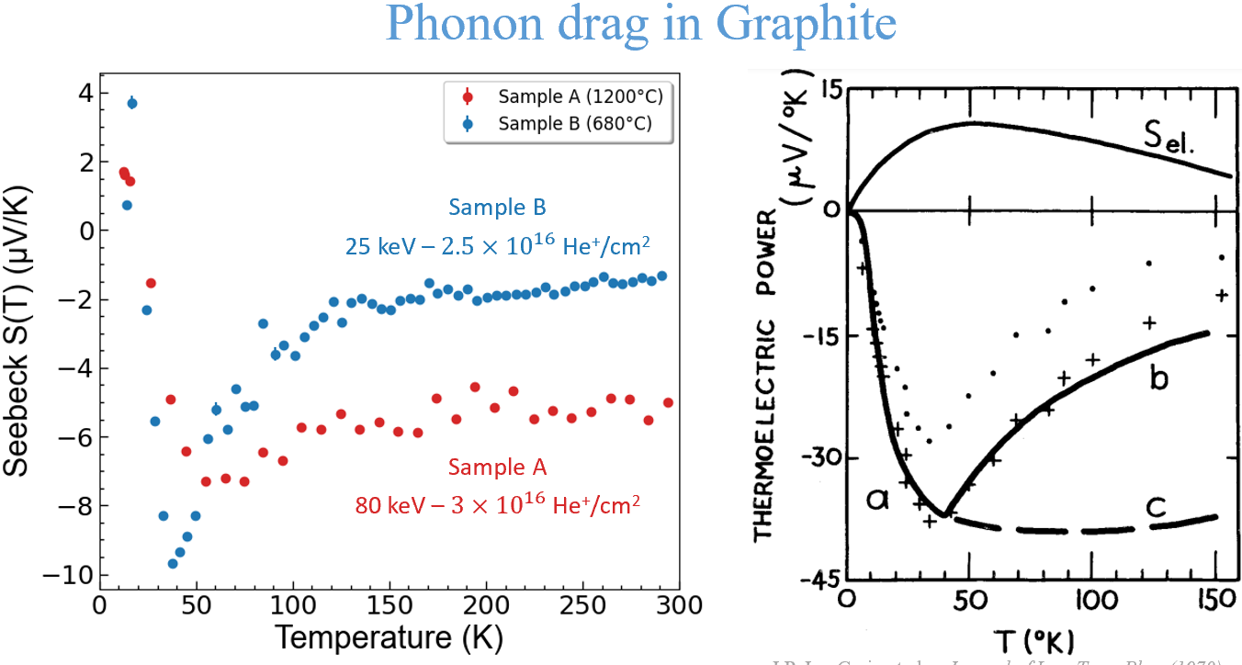
J.P. Jay-Gerin et al. – Journal of Low Temp Phys (1970)

Slide 15
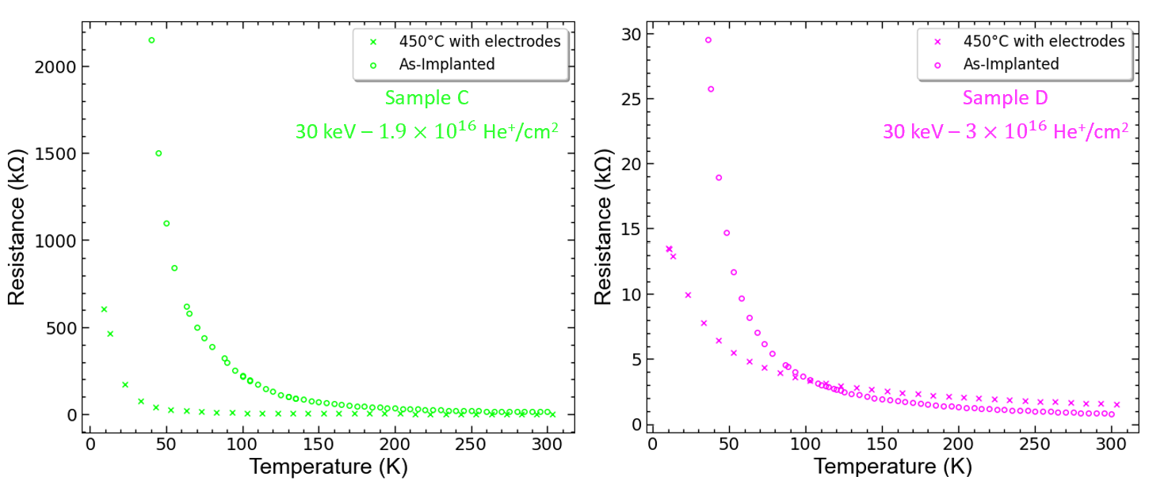
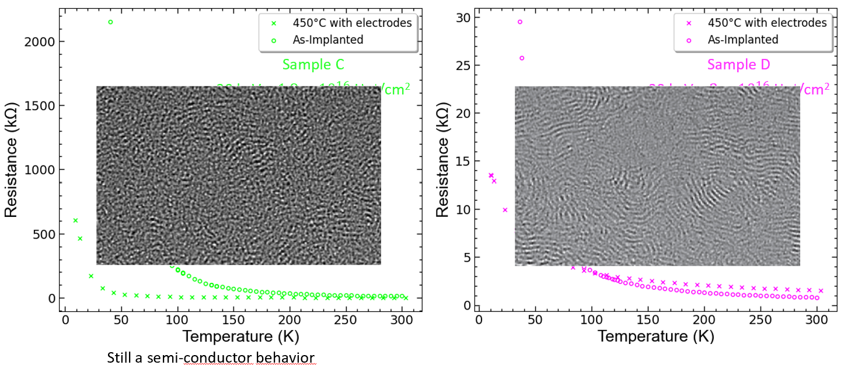

Slide 16
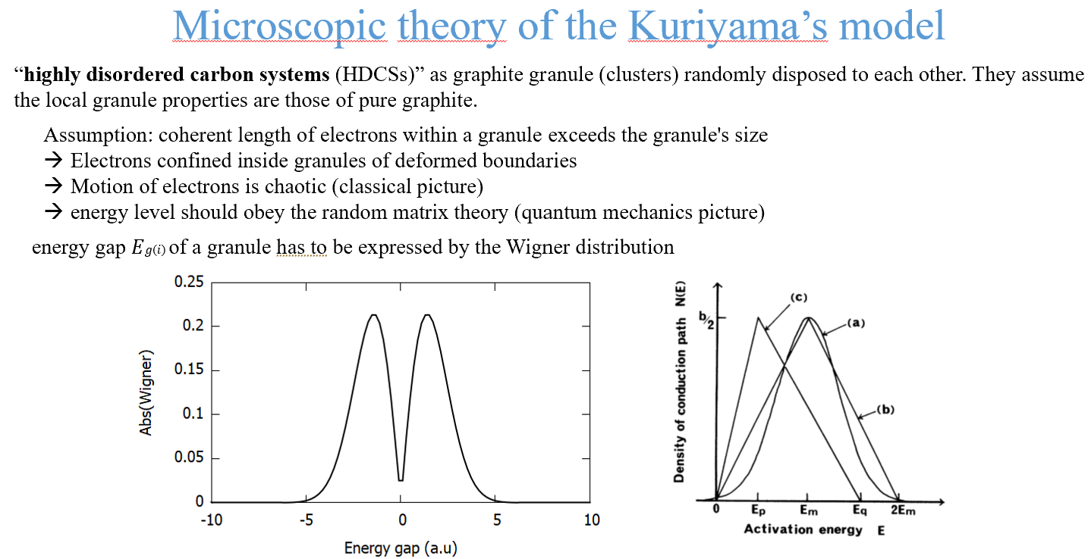
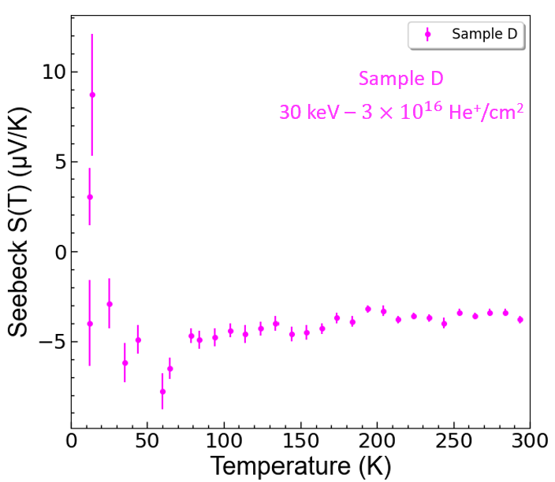
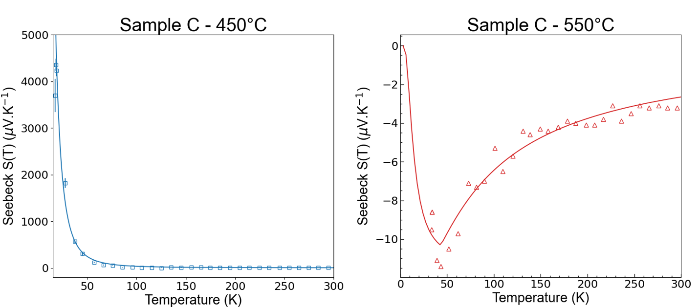

Slide 17
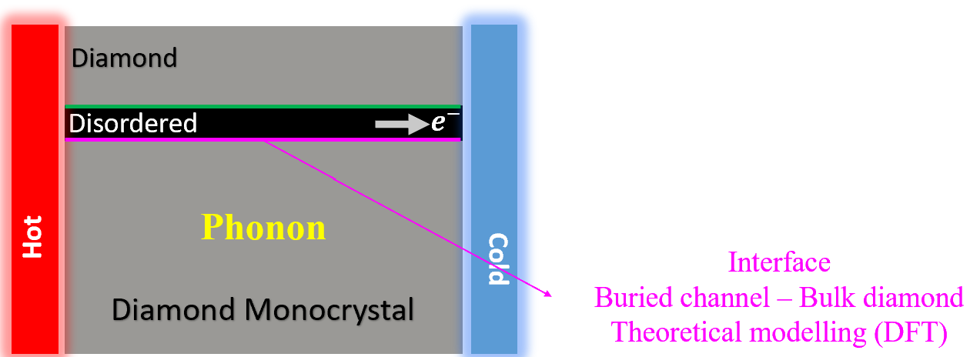
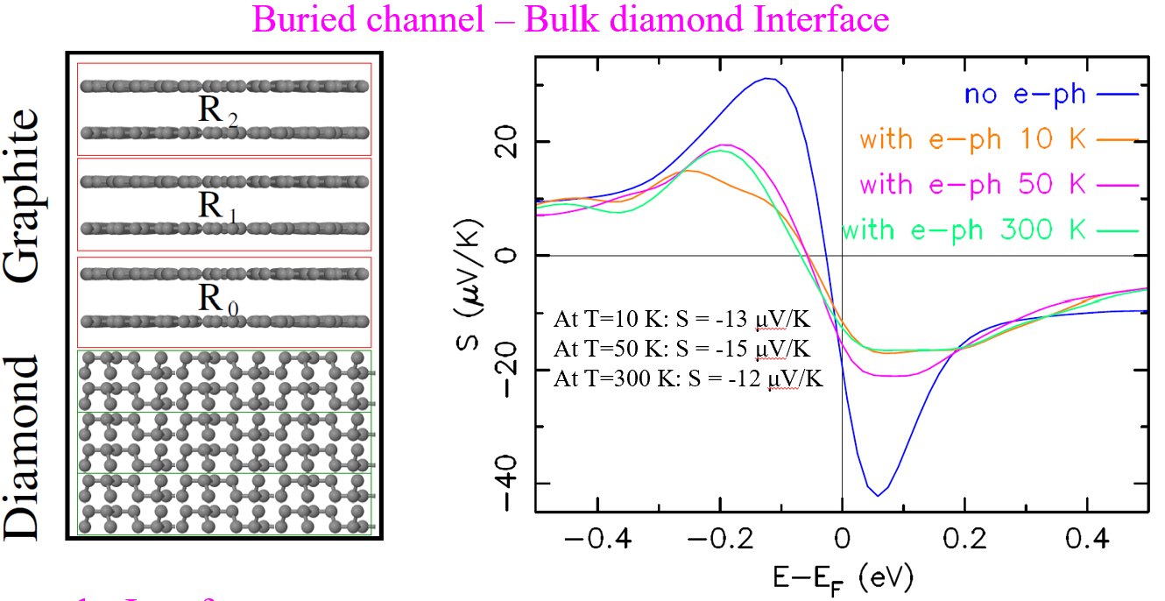
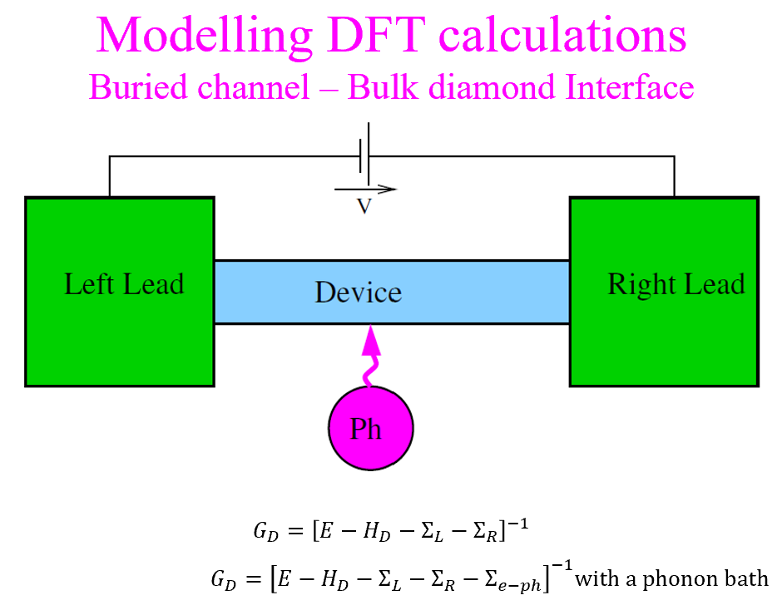
. What Next?

Slide 18

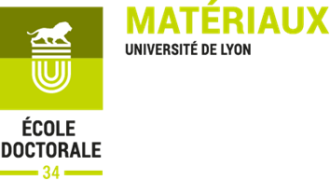



Thank you for your attention!!
Funding:
CNRS - University of the Witwatersrand joint PhD program
PHC PROTEA (NRF South Africa)
SAQUATI
School of Physics, MPRI
- DSI-NRF Centre of Excellence in Strong Materials

