Slide 1
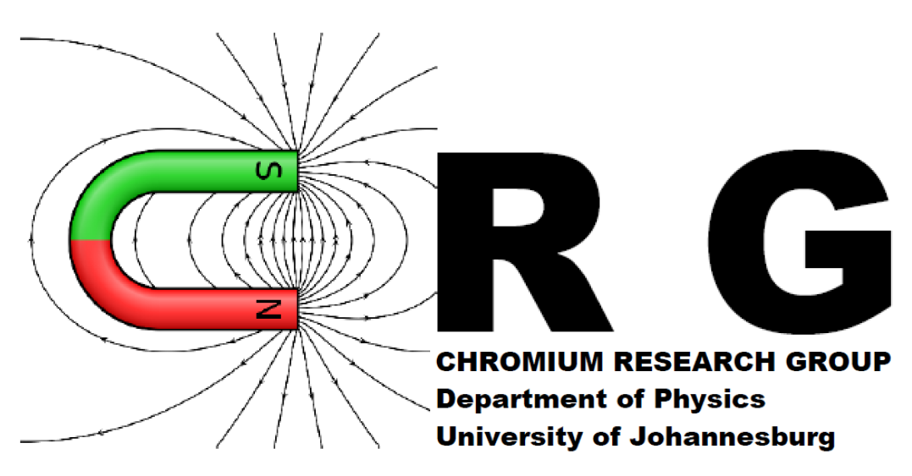



Transport properties of Co₂Ti_{1−x}Cr_{x}Al Heusler compounds
M. Mulibana, A.R.E. Prinsloo, C.J. Sheppard, B.S. Jacobs
Chromium Research Group (CRG), Department of Physics, University of Johannesburg (UJ)
Email address: mureim@uj.ac.za

Slide 2
Outline
Introduction
Motivation and Aim
Methodology:
  Synthesis
  Characterization
Results:
  Temperature dependence of resistivity (four-point probe configuration)
  Density of states (DOS)
Conclusion

Slide 3
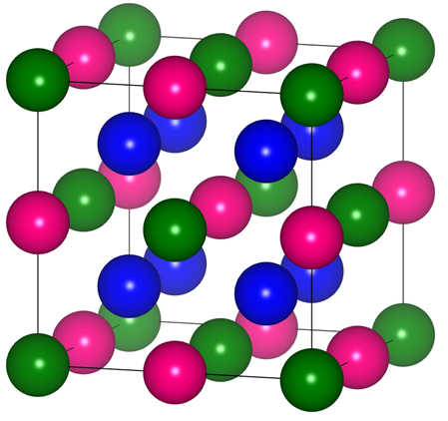
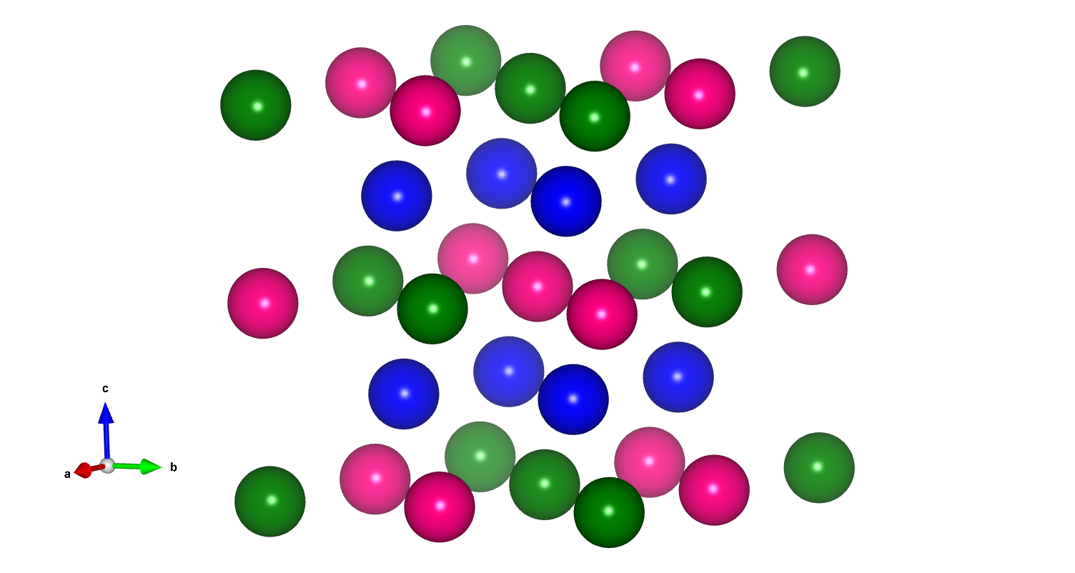
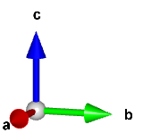
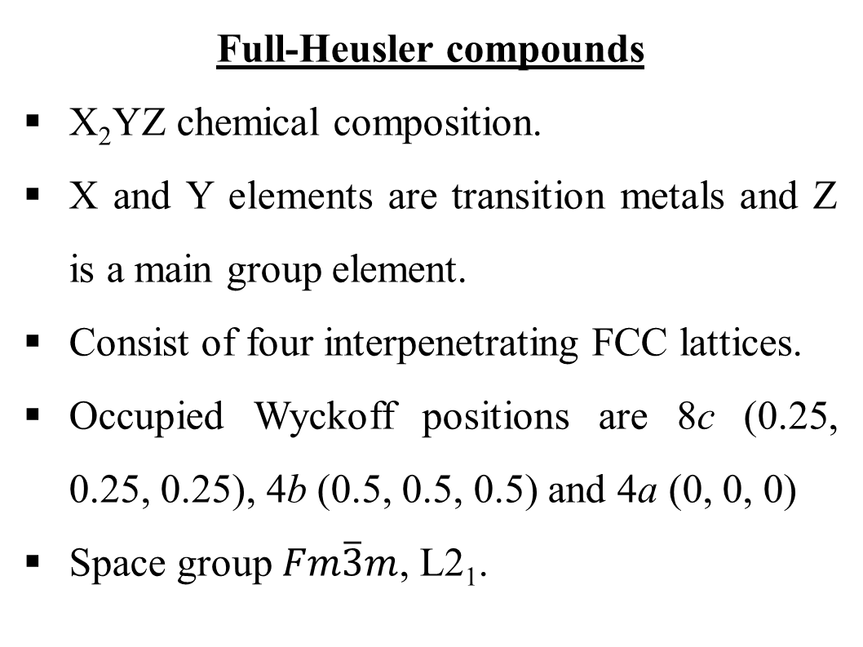
Introduction: Structure
X
Full-Heusler compounds
X₂YZ chemical composition.
X and Y elements are transition metals and Z is a main group element.
Consist of four interpenetrating FCC lattices.
Occupied Wyckoff positions are 8c (0.25, 0.25, 0.25), 4b (0.5, 0.5, 0.5) and 4a (0, 0, 0)
Space group $Fm\overline{3}m$, L2₁.
Y
Z
Figure 1. Crystal structure of an X₂YZ Heusler compound. The blue, pink, and green spheres represent atoms at the X site (8c), Y site (4b) and Z site (4a). The Figure was generated using VESTA [1].
[1] K. Momma and F. Izumi, J. Appl. Crystallogr. 44 (2011) 1272.

Slide 4
Introduction: History
Observation of a large negative magnetoresistance effect in Co₂Cr_{0.6}Fe_{0.4}Al by Block et al. [4]
Discovery of ferromagnetism in Cu₂MnAl by Fritz Heusler [1].
1983
2003-2025
1903
2003
Prediction of half-metallic property in Co₂MnZ (Z = Al, Sn) by Ishida et al. [2] and Kübler et al. [3] using density of state (DOS) and band structure calculation.
The search for new and unique properties for X₂YZ with X = Co, using both theoretical and experimental techniques for spintronic application.
[1] T. Graf et al., Prog. Solid State Chem. 39 (2011) 1.
[2] S. Ishida et al., J. Phys. Soc. Jpn. 48 (1980) 814.
[3] J. Kübler et al., Phys. Rev. B. 28 (1983) 1745.
[4] T. Block et al., J. Solid State Chem. 176 (2003) 646.

Slide 5
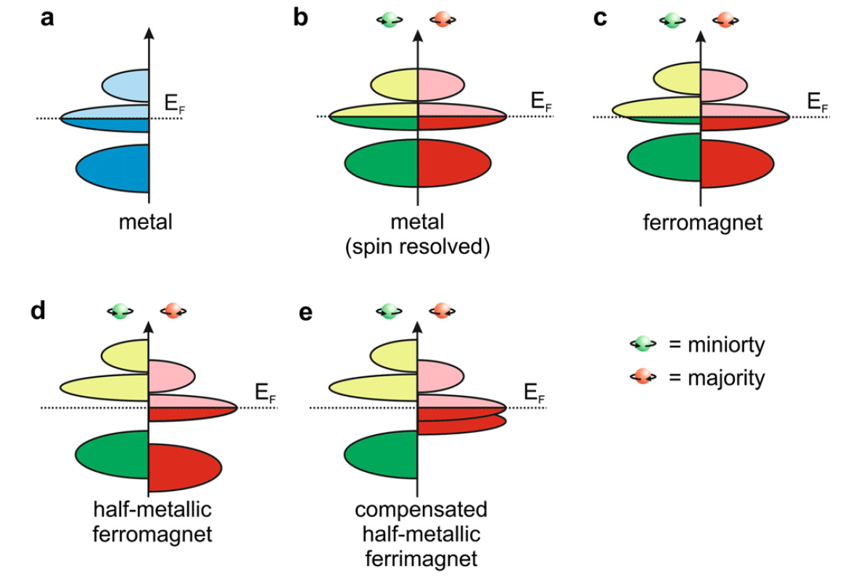
Half-metallic ferromagnets
(a)
(b)
(c)
(d)
Metal
(Total DOS)
Metal
(Spin resolved)
ferromagnet
(Spin resolved)
Half-metallic
ferromagnet
(Spin resolved)
Figure 2. Schematic illustration of the density of states of (a) a metal, (b) a metal (spin resolved), (c) a ferromagnet, and (d) a half-metallic ferromagnet.
[1] T. Graf et al., Prog. Solid State Chem. 39 (2011) 1.

Slide 6
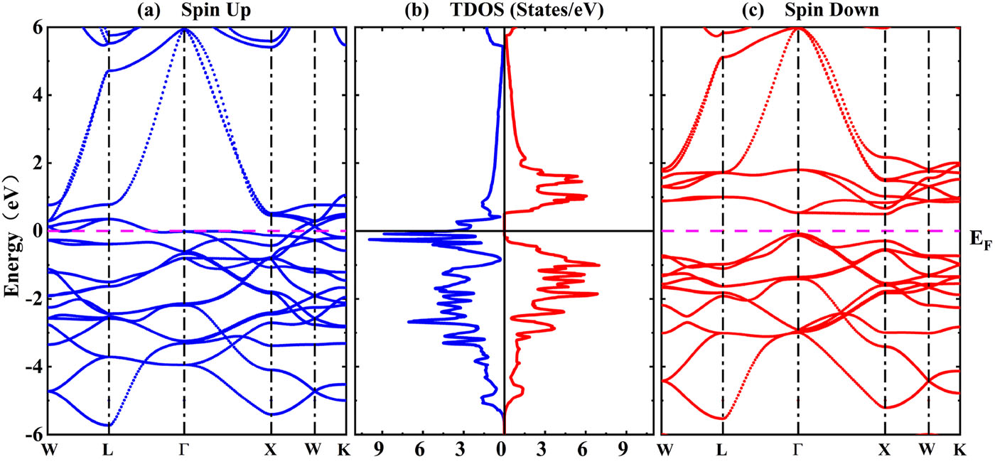
Half-metallic ferromagnets
Figure 3. (a)-(c) Band structure and total density of states of Co₂CrAl for spin up and spin down. Reproduced with permission from [1].
[1] K. Qu et al., AIP Advances, 14 (2024) 055311.

Slide 7
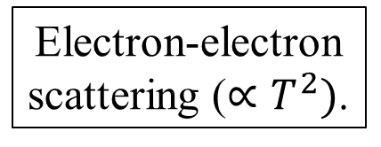
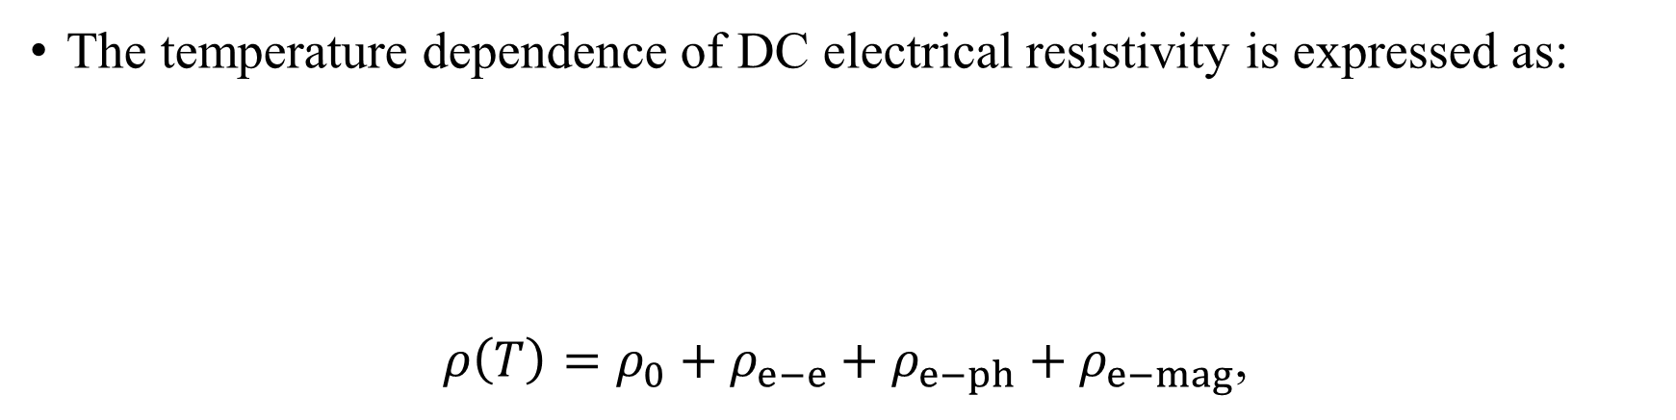
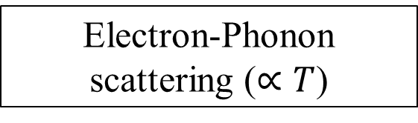
Temperature dependent resistivity
The temperature dependence of DC electrical resistivity is expressed as:
$ρ\left(T\right)=ρ_{0}+ρ_{e−e}+ρ_{e−ph}+ρ_{e−mag}$,
Electron-electron scattering ($∝T^{2})$.
Electron-magnon scattering.
Residual resistivity (temperature independent)
Electron-Phonon scattering ($∝T$)
[1] Chatterjee et al., J. Phys.: Condens. Matter. 34 (2022) 013001.

Slide 8
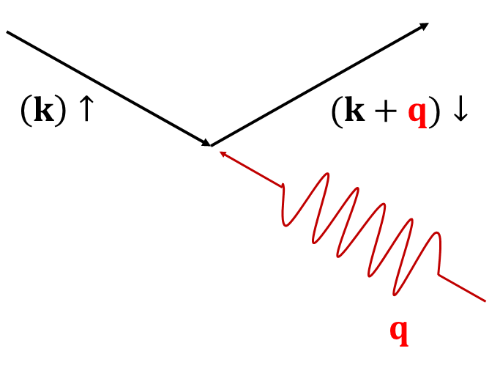
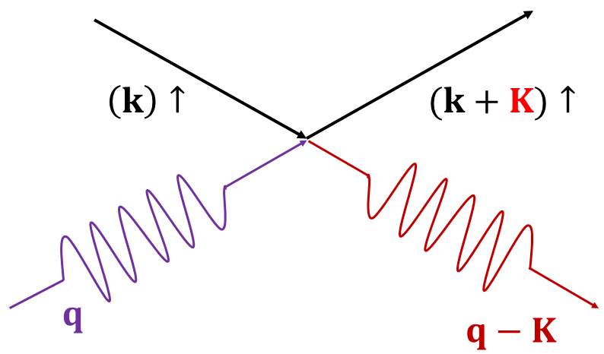
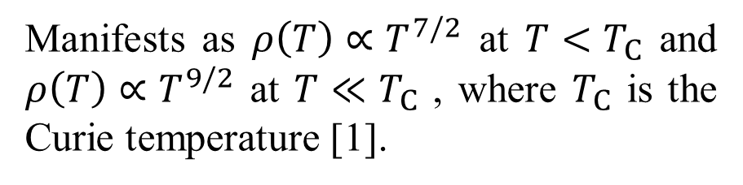
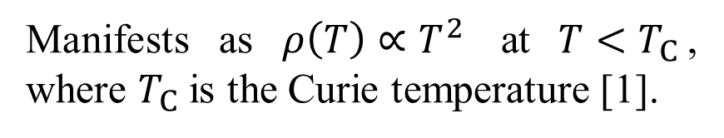
Electron-Magnon scattering
(A) Typical ferromagnets:
One-magnon scattering
(B) Half-metallic ferromagnets:
Two-magnon scattering
Manifests as $ρ\left(T\right)∝T^{7/2}$ at ${T<T}_{C}$ and $ρ\left(T\right)∝T^{9/2}$ at ${T≪T}_{C}$ , where $T_{C}$ is the Curie temperature [1].
Manifests as $ρ\left(T\right)∝T^{2}$ at ${T<T}_{C}$, where $T_{C}$ is the Curie temperature [1].
[1] V. Y. Irkhin and M. I. Katsnel’son, Phys.-Usp. 37 (1994) 659.

Slide 9
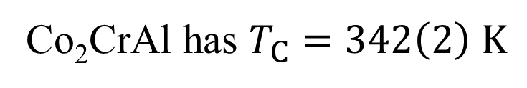
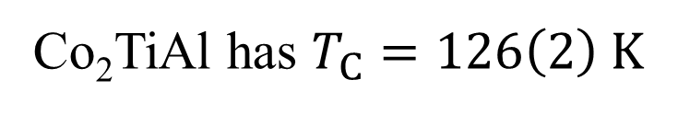
Aim and Motivation
Motivation:
Most of the studies reporting half-metallic properties in Co₂YZ are based on theoretical structures.
Is it possible to experimentally synthesize a half-metallic Co₂YZ Heusler compound?
Aim:
Synthesize and experimentally investigate the half-metallic property of Co₂Ti_{1−x}Cr_{x}Al.
?
Co₂TiAl has $T_{C}=126\left(2\right) K$
Co₂CrAl has $T_{C}=342\left(2\right) K$

Slide 10
Synthesis of samples
Arc-melting method was used to synthesize Co₂Ti_{1−x}Cr_{x}Al compounds using high purity elements (>99.9 %).
Melting was done in an arc furnace under an argon (Ar) atmosphere.
The elements were melted with crushing in between melts to promote homogeneity.
Resulting ingots were cut into specific geometries using spark erosion for characterization.

Slide 11
Characterization
The samples were characterized using x-ray powder diffraction (XRD) for structural analysis.
Transport properties were probed by measuring the temperature dependence of resistivity using the four-point probe method.
Electronic properties were investigated using density of state (DOS) calculations using GPAW [1] and CIF from Rietveld refinement:
  Plane wave basis (PW) with cut-off energy of 500 eV on a 15×15×15 k-point grid [2].
  Generalized Gradient Approximation within the Perdew-Burke-Ernzerhof (PBE) formulation [3].
[1] J. J. Mortensen et al., J. Chem. Phys. 160 (2024) 092503.
[2] J. P. Perdew et al., Phys. Rev. Lett. 77 (1996) 3865.
[3] J. D. Pack and H. J. Monkhorst, Phys. Rev. B. 16 (1977) 1748.

Slide 12
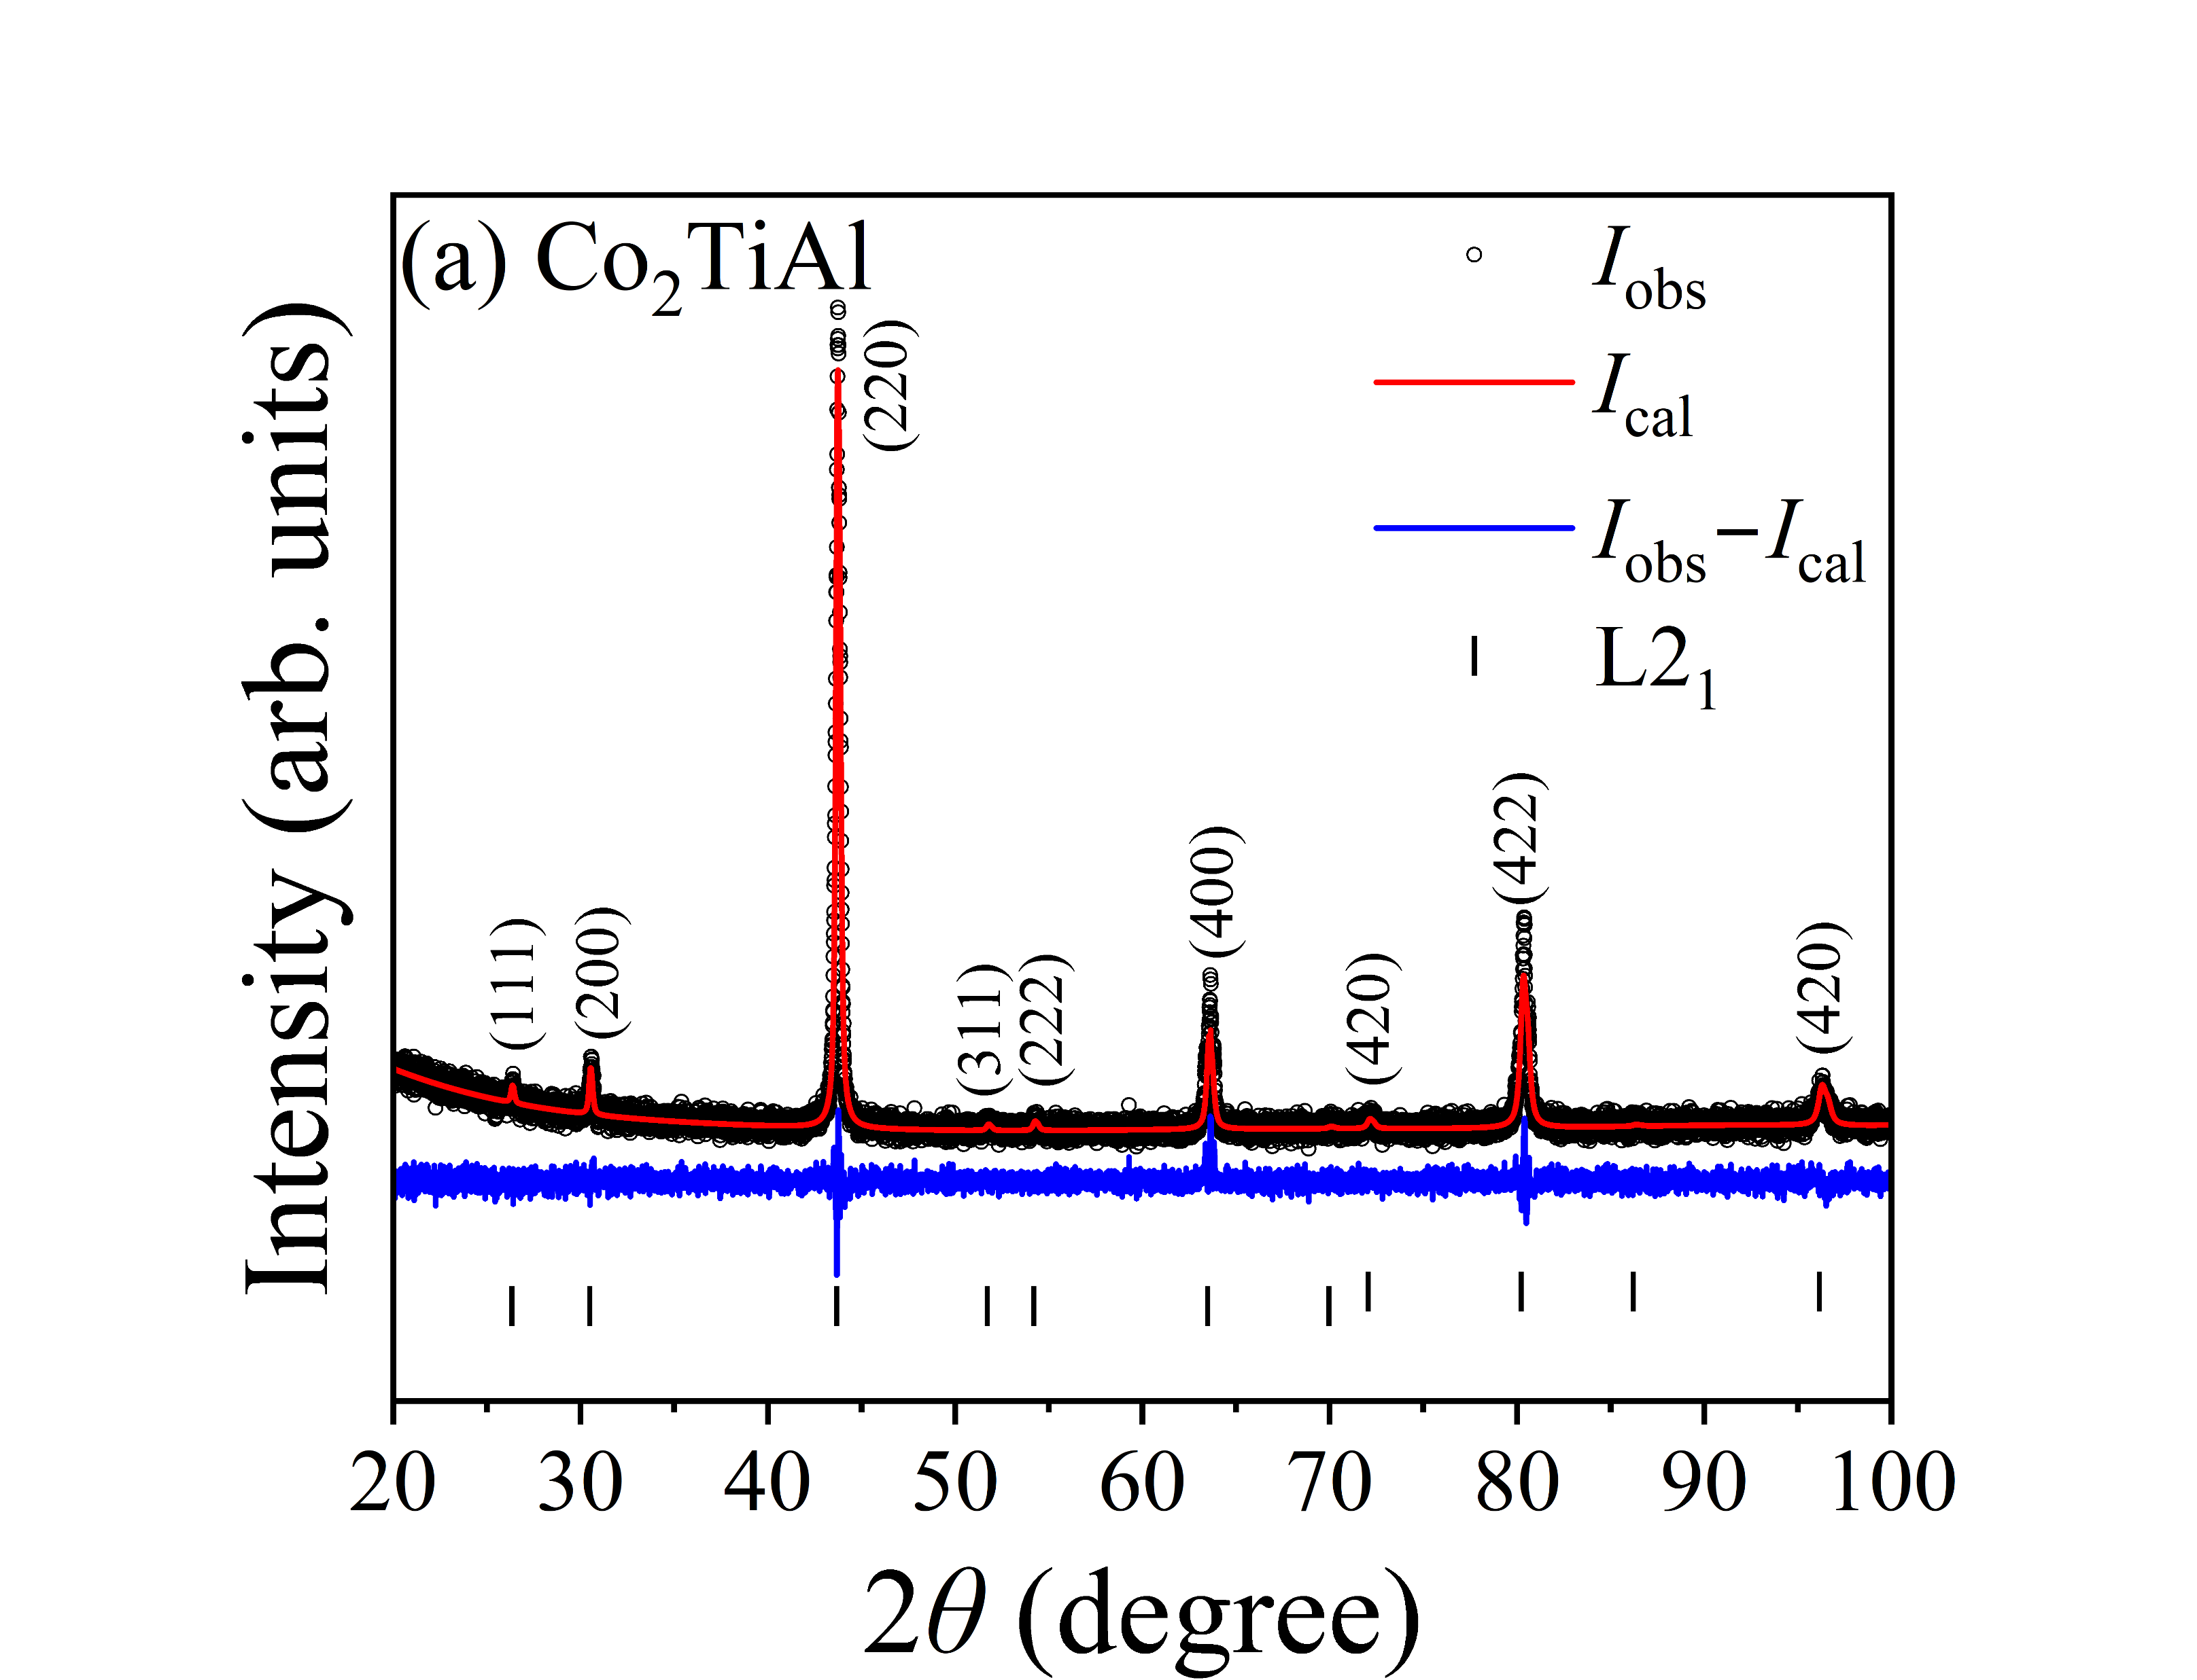
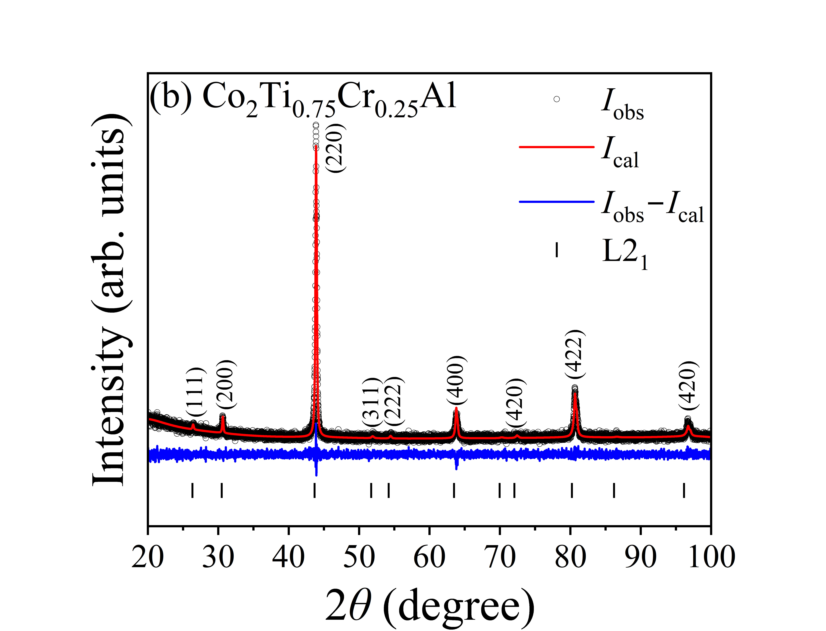
X-ray diffraction
Figure 4. Rietveld refined room temperature XRD data for Co₂Ti_{1−x}Cr_{x}Al with (a) x = 0, and (b) x = 0.25. The open black circle (I_{Obs}) denotes the experimental data, solid red line (I_{Cal}) is the calculated data, blue line is the difference between I_{Obs} and I_{Calc}, the black solid vertical lines denote the Bragg positions belonging to L2₁ ($Fm\overline{3}m$) phases.

Slide 13
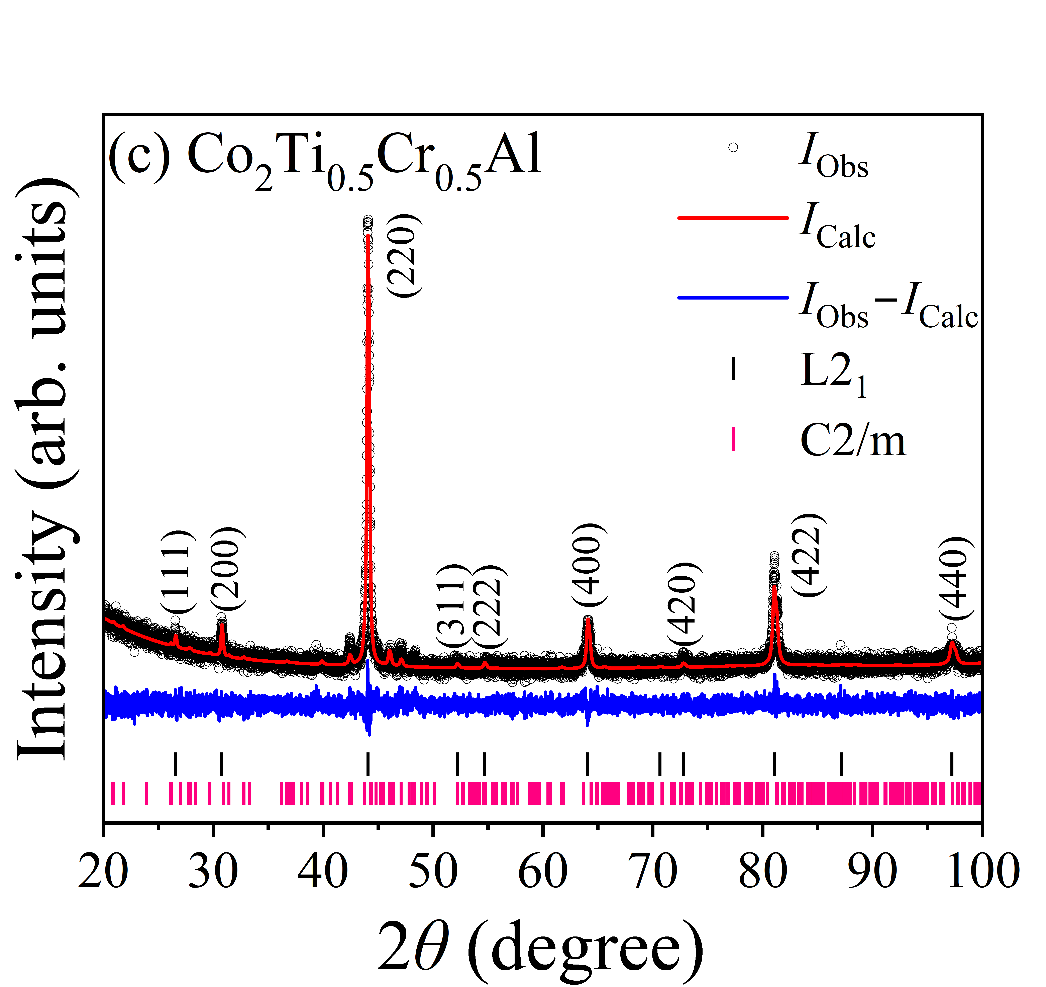
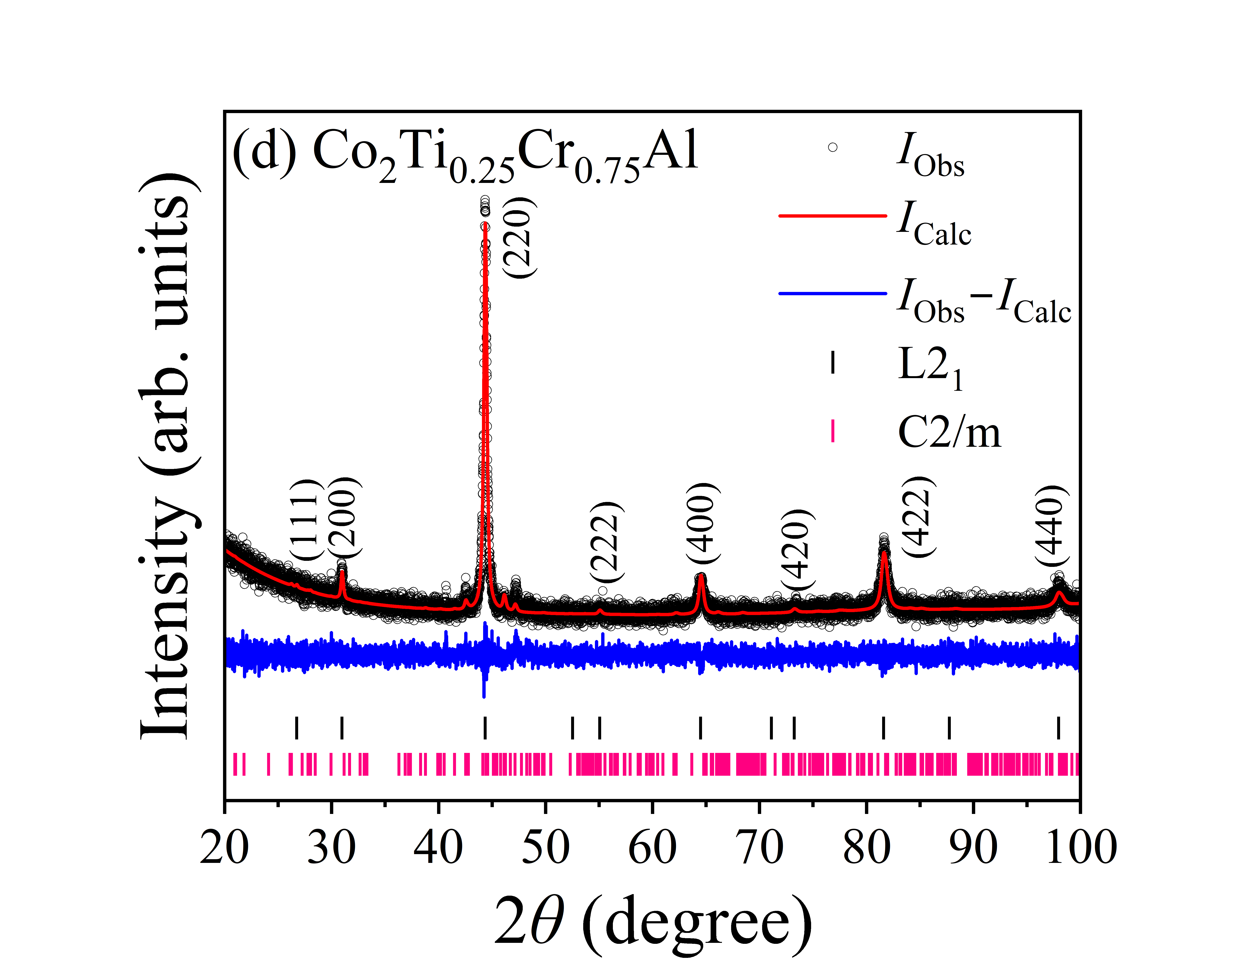
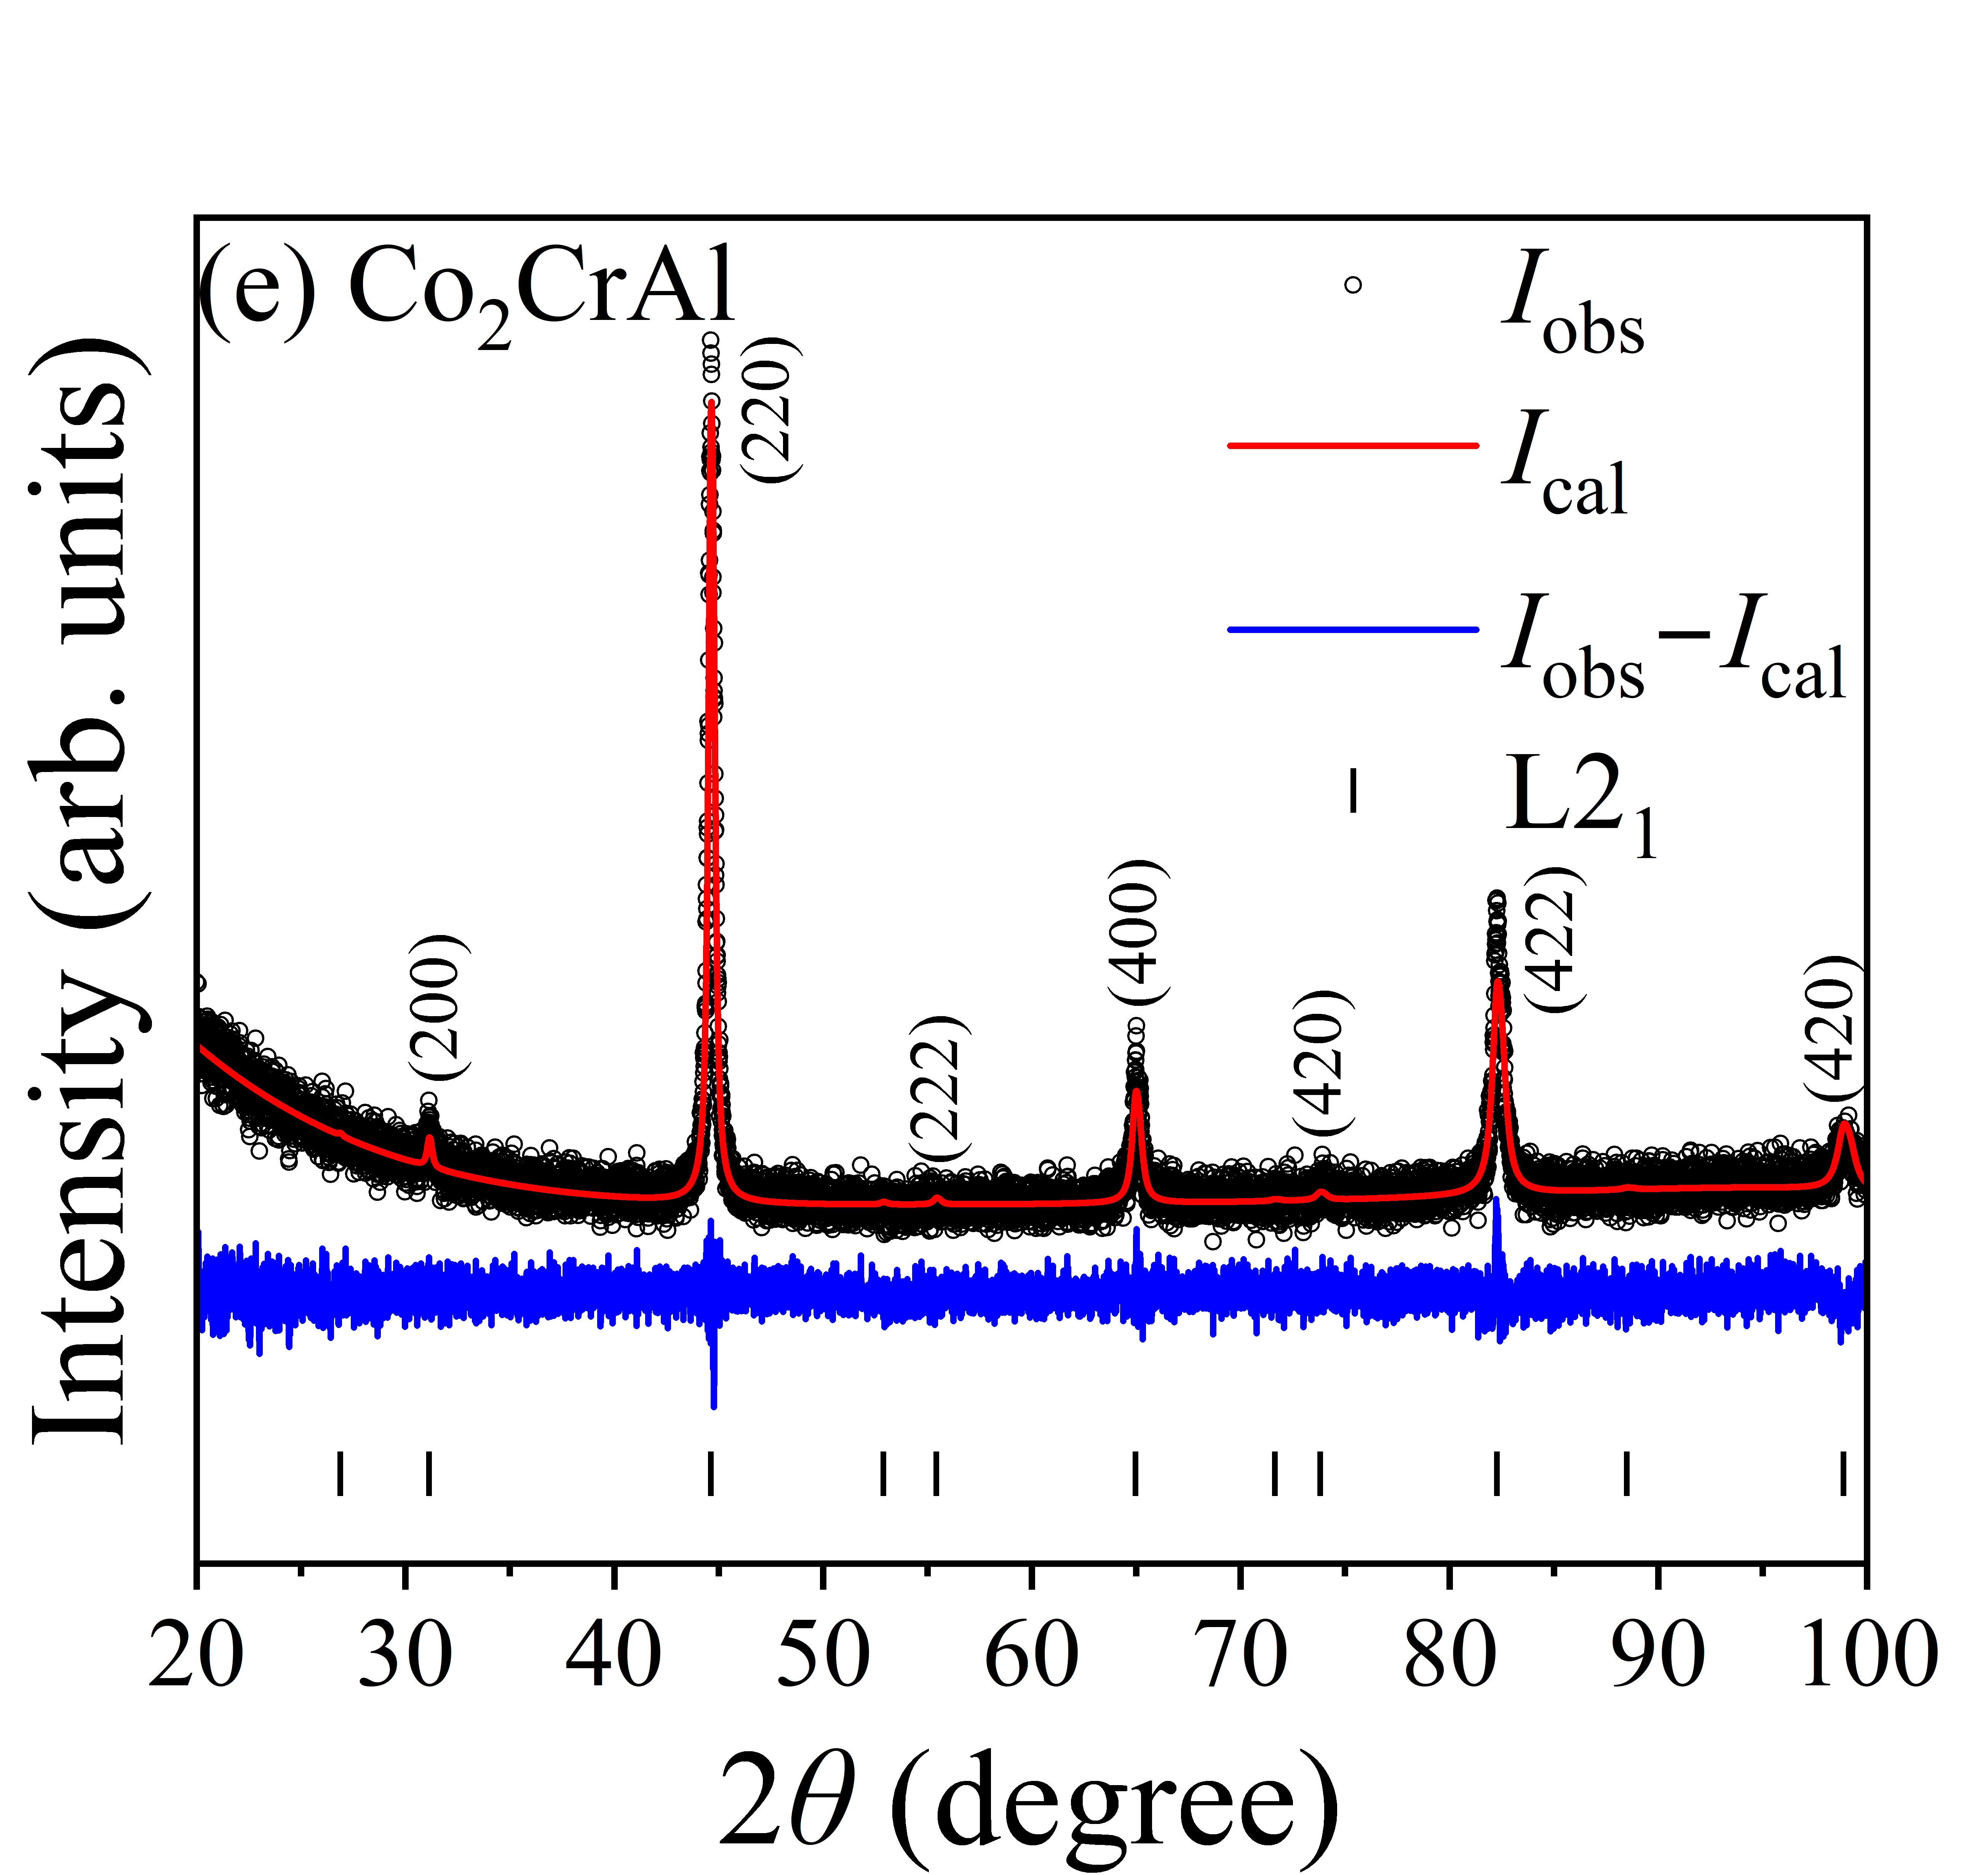
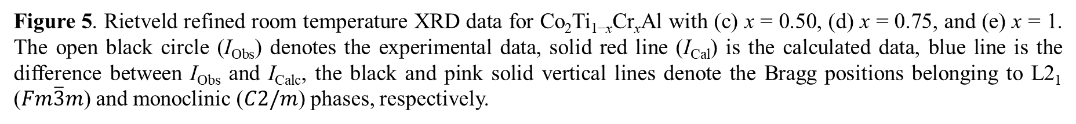
X-ray diffraction
Figure 5. Rietveld refined room temperature XRD data for Co₂Ti_{1−x}Cr_{x}Al with (c) x = 0.50, (d) x = 0.75, and (e) x = 1. The open black circle (I_{Obs}) denotes the experimental data, solid red line (I_{Cal}) is the calculated data, blue line is the difference between I_{Obs} and I_{Calc}, the black and pink solid vertical lines denote the Bragg positions belonging to L2₁ ($Fm\overline{3}m$) and monoclinic ($C2/m$) phases, respectively.

Slide 14
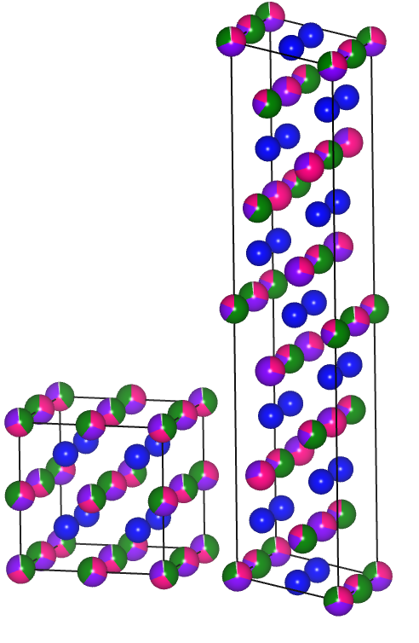
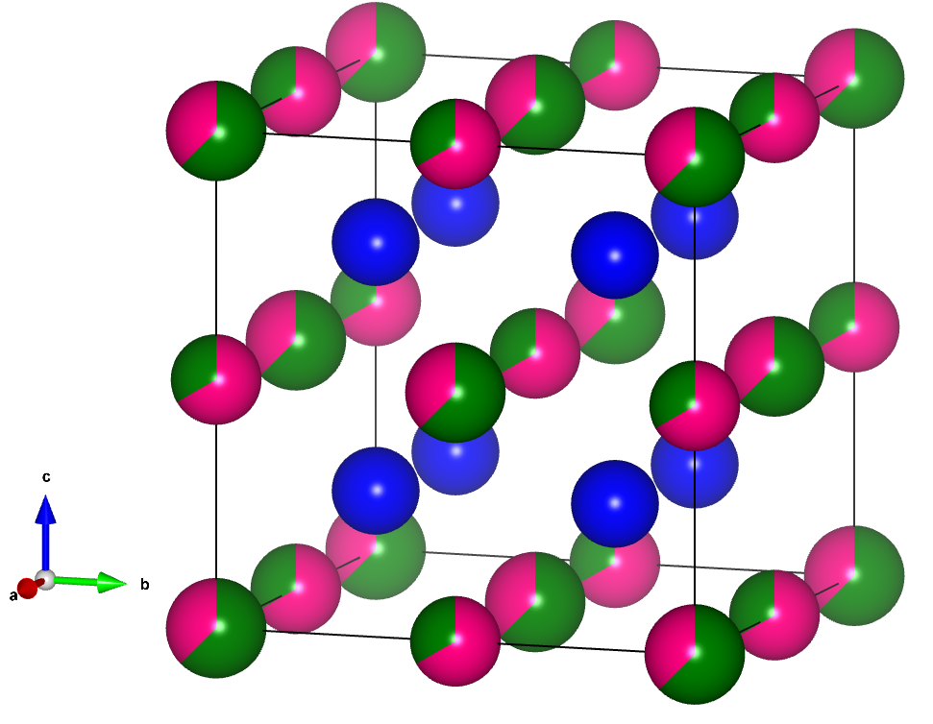
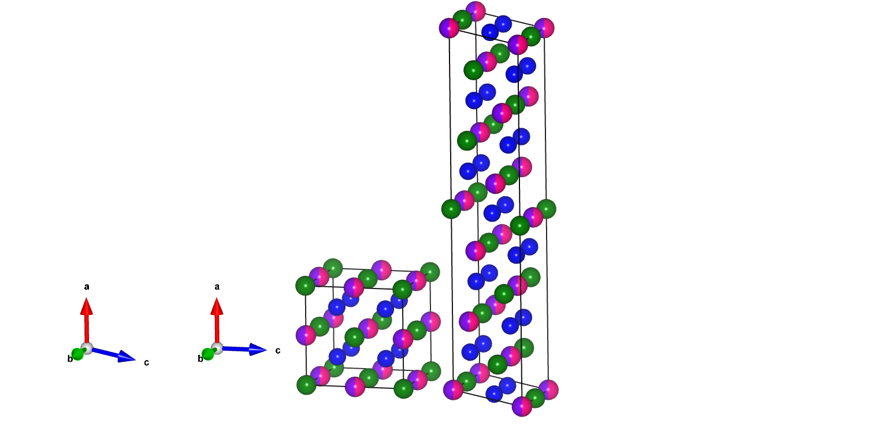
X-ray diffraction
(a) Single Phase:
(b) Binary Phase:
Figure 6. Crystal structure of (a) single-phase and (b) binary-phase Co₂Ti_{1−x}Cr_{x}Al compound. Figures were generated using VESTA software [1].
[1] K. Momma and F. Izumi, J. Appl. Crystallogr. 44 (2011) 1272.

Slide 15
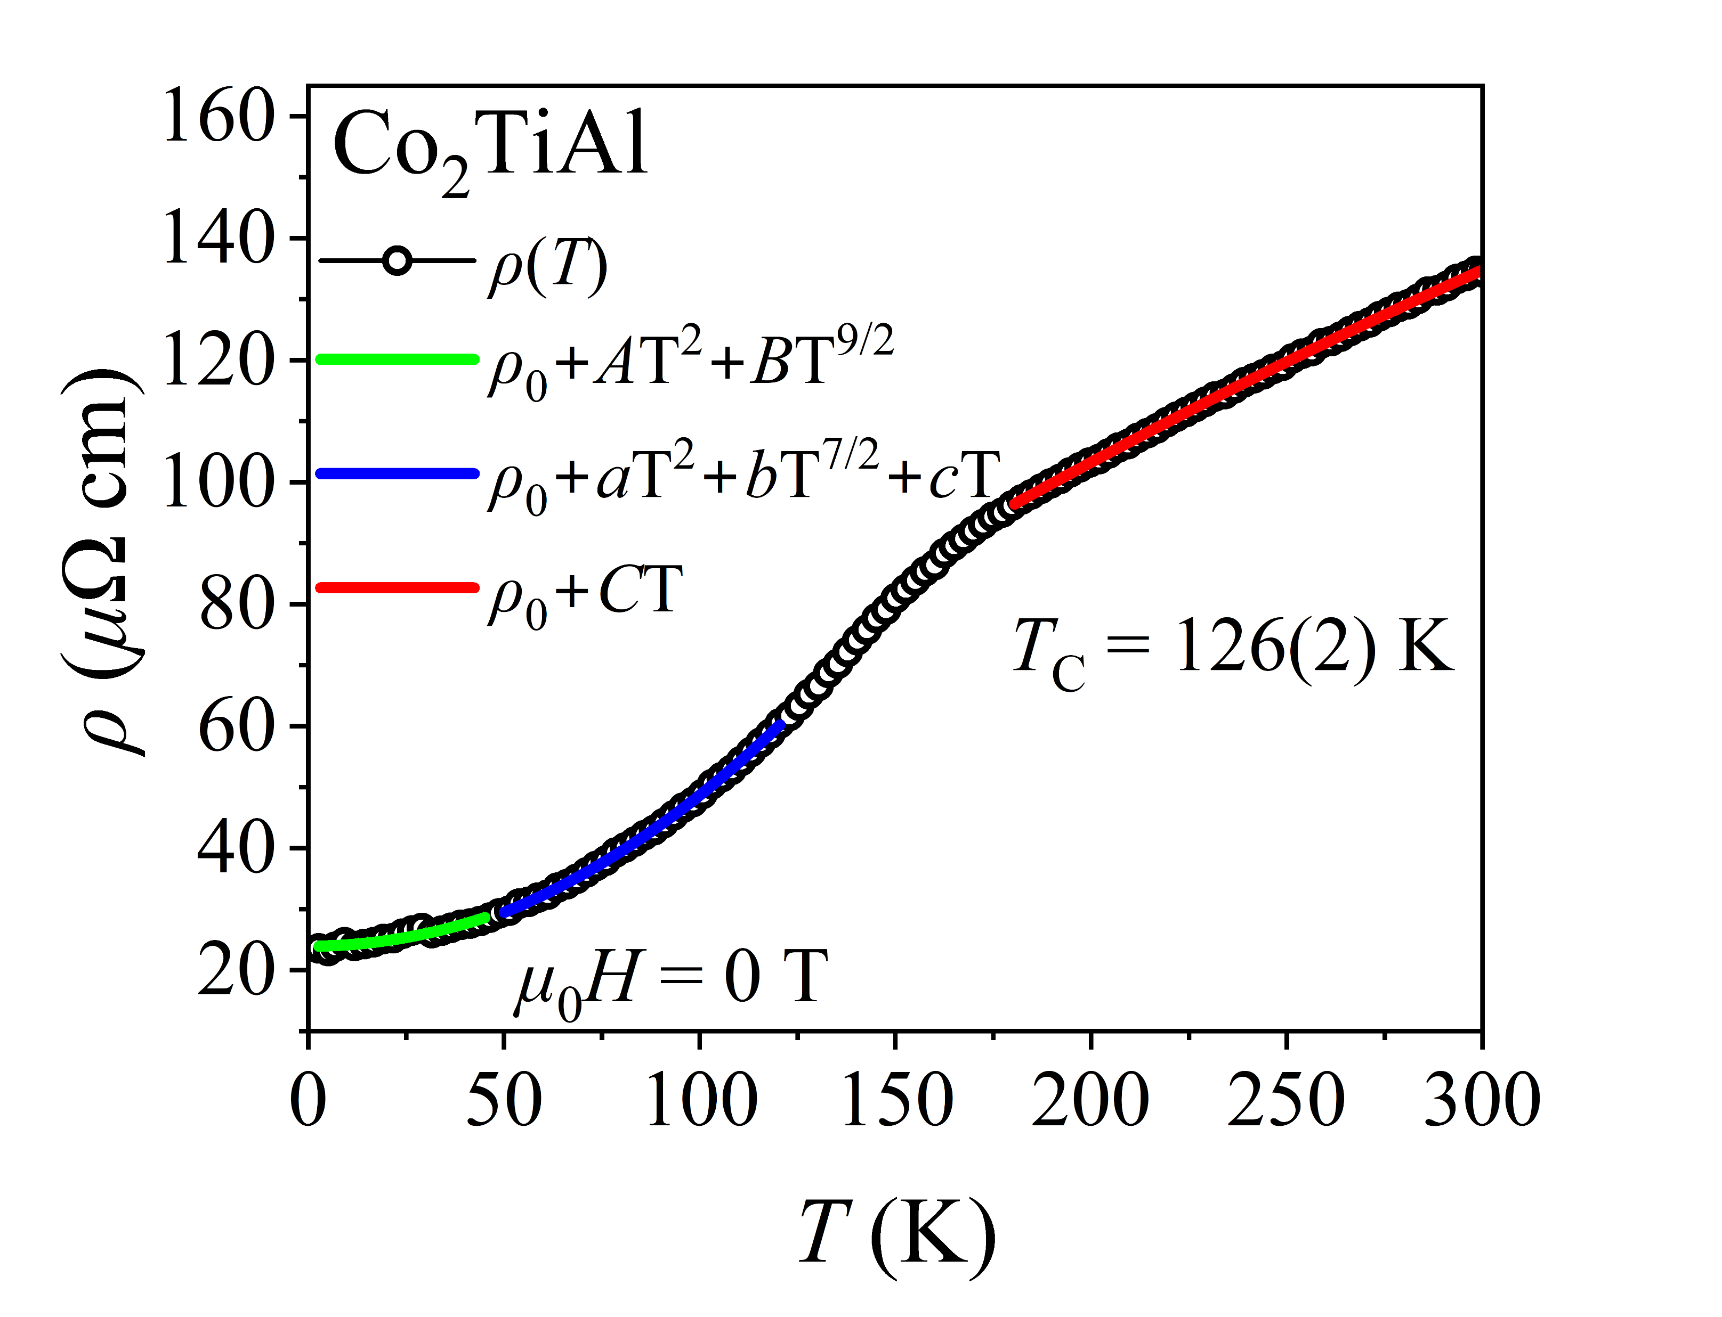
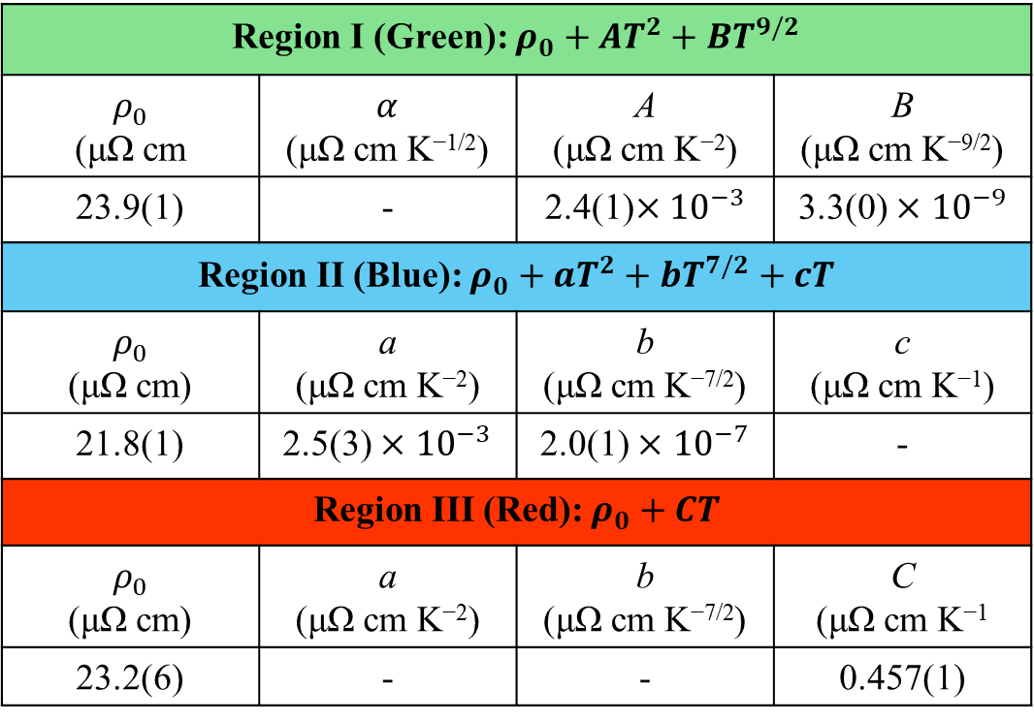
Temperature dependent resistivity
Region I (Green): $ρ_{0}+AT^{2}+BT^{9/2}$
$ρ_{0}$ (μΩ cm | $α$ (μΩ cm K^{−1/2}) | A (μΩ cm K⁻²) | B (μΩ cm K^{−9/2})
23.9(1) | - | 2.4(1)$×{10}^{−3}$ | 3.3(0) $×$ ${10}^{−9}$
Region II (Blue): $ρ_{0}+aT^{2}+bT^{7/2}+cT$
$ρ_{0}$ (μΩ cm) | a (μΩ cm K⁻²) | b (μΩ cm K^{−7/2}) | c (μΩ cm K⁻¹)
21.8(1) | 2.5(3) $×$ ${10}^{−3}$ | 2.0(1) $×$ ${10}^{−7}$ | -
Region III (Red): $ρ_{0}+CT$
$ρ_{0}$ (μΩ cm) | a (μΩ cm K⁻²) | b (μΩ cm K^{−7/2}) | C (μΩ cm K⁻¹
23.2(6) | - | - | 0.457(1)
Figure 7. Temperature dependence of resistivity of Co₂TiAl measured from 4 K to 300 K.

Slide 16
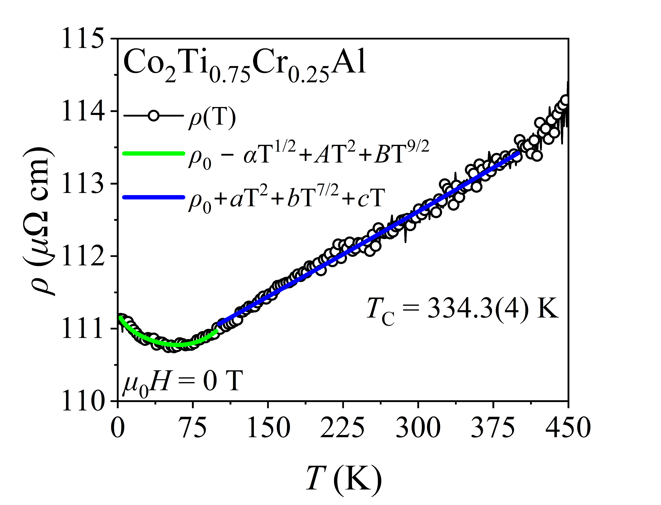
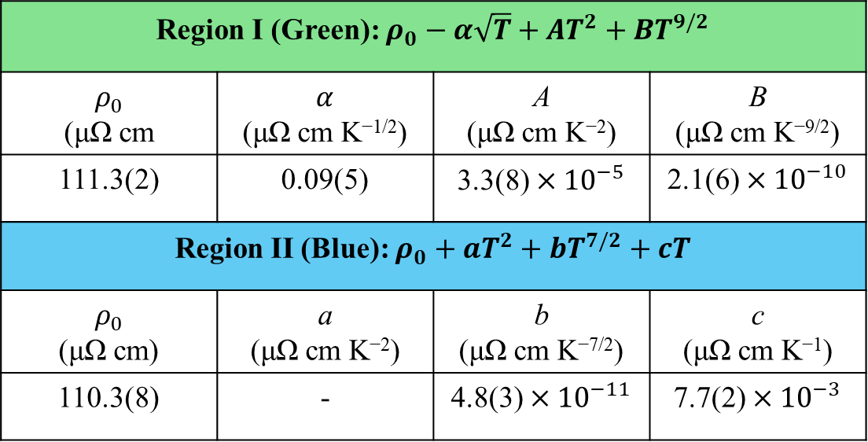
Temperature dependent resistivity
Region I (Green): $ρ_{0}−α\sqrt{T}+AT^{2}+BT^{9/2}$
$ρ_{0}$ (μΩ cm | $α$ (μΩ cm K^{−1/2}) | A (μΩ cm K⁻²) | B (μΩ cm K^{−9/2})
111.3(2) | 0.09(5) | 3.3(8) $×{10}^{−5}$ | 2.1(6) $×{10}^{−10}$
Region II (Blue): $ρ_{0}+aT^{2}+bT^{7/2}+cT$
$ρ_{0}$ (μΩ cm) | a (μΩ cm K⁻²) | b (μΩ cm K^{−7/2}) | c (μΩ cm K⁻¹)
110.3(8) | - | 4.8(3) $×{10}^{−11}$ | 7.7(2) $×{10}^{−3}$
Figure 8. Temperature dependence of resistivity of Co₂Ti_{0.75}Cr_{0.25}Al measured from 4 K to 450 K.

Slide 17
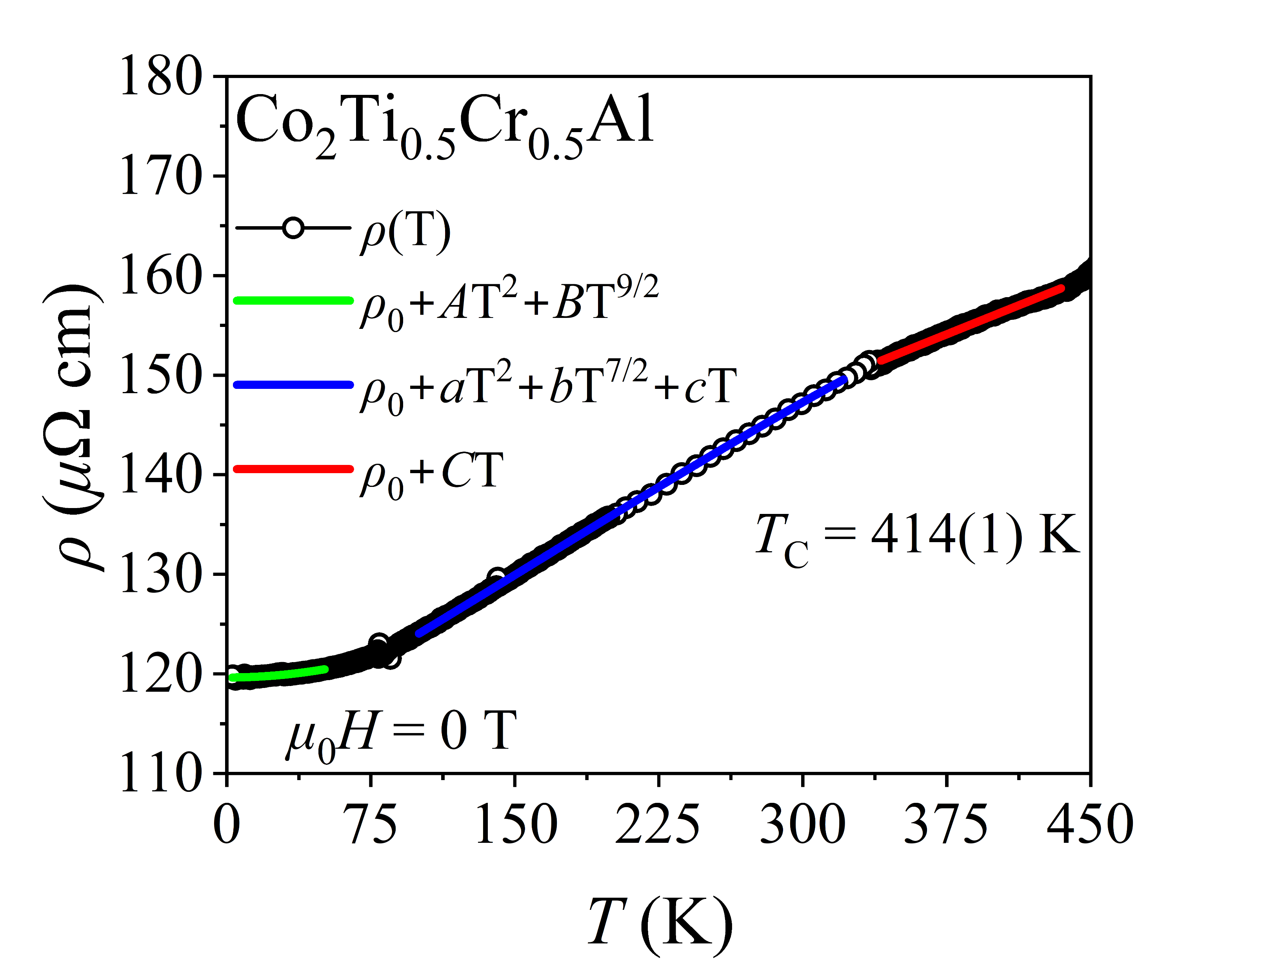
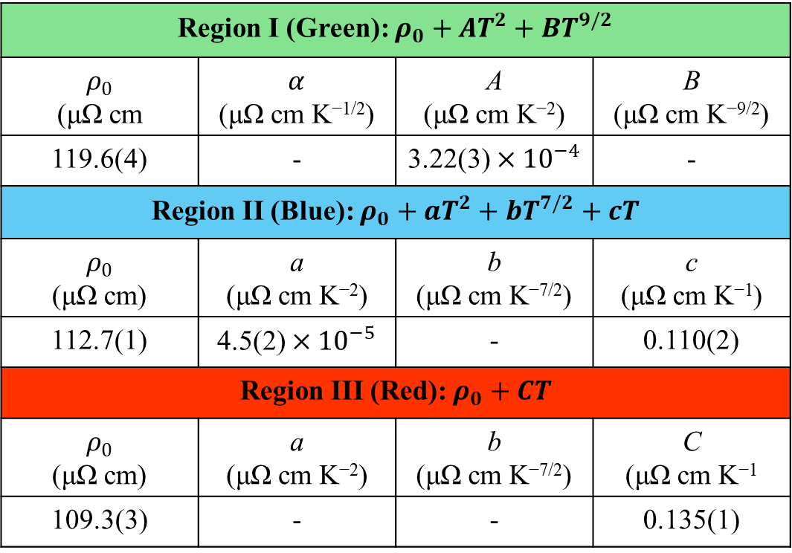
Temperature dependent resistivity
Region I (Green): $ρ_{0}+AT^{2}+BT^{9/2}$
$ρ_{0}$ (μΩ cm | $α$ (μΩ cm K^{−1/2}) | A (μΩ cm K⁻²) | B (μΩ cm K^{−9/2})
119.6(4) | - | 3.22(3) $×{10}^{−4}$ | -
Region II (Blue): $ρ_{0}+aT^{2}+bT^{7/2}+cT$
$ρ_{0}$ (μΩ cm) | a (μΩ cm K⁻²) | b (μΩ cm K^{−7/2}) | c (μΩ cm K⁻¹)
112.7(1) | 4.5(2) $×{10}^{−5}$ | - | 0.110(2)
Region III (Red): $ρ_{0}+CT$
$ρ_{0}$ (μΩ cm) | a (μΩ cm K⁻²) | b (μΩ cm K^{−7/2}) | C (μΩ cm K⁻¹
109.3(3) | - | - | 0.135(1)
Figure 9. Temperature dependence of resistivity of Co₂Ti_{0.5}Cr_{0.5}Al measured from 4 K to 450 K.

Slide 18
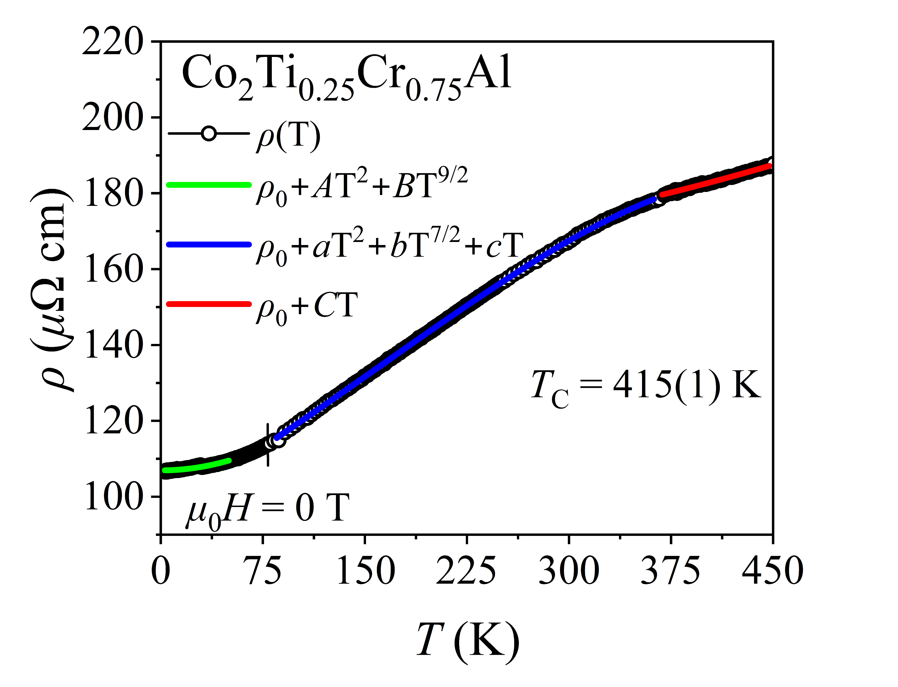
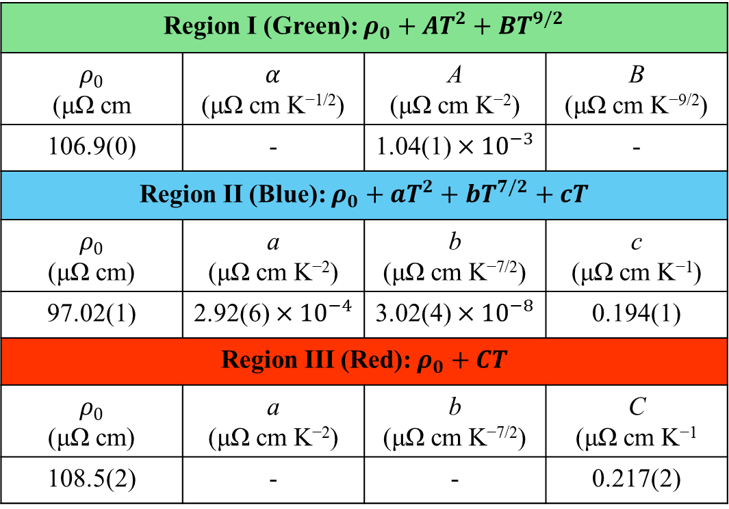
Temperature dependent resistivity
Region I (Green): $ρ_{0}+AT^{2}+BT^{9/2}$
$ρ_{0}$ (μΩ cm | $α$ (μΩ cm K^{−1/2}) | A (μΩ cm K⁻²) | B (μΩ cm K^{−9/2})
106.9(0) | - | 1.04(1) $×{10}^{−3}$ | -
Region II (Blue): $ρ_{0}+aT^{2}+bT^{7/2}+cT$
$ρ_{0}$ (μΩ cm) | a (μΩ cm K⁻²) | b (μΩ cm K^{−7/2}) | c (μΩ cm K⁻¹)
97.02(1) | 2.92(6) $×{10}^{−4}$ | 3.02(4) $×{10}^{−8}$ | 0.194(1)
Region III (Red): $ρ_{0}+CT$
$ρ_{0}$ (μΩ cm) | a (μΩ cm K⁻²) | b (μΩ cm K^{−7/2}) | C (μΩ cm K⁻¹
108.5(2) | - | - | 0.217(2)
Figure 10. Temperature dependence of resistivity of Co₂Ti_{0.25}Cr_{0.75}Al measured from 4 K to 450 K.

Slide 19
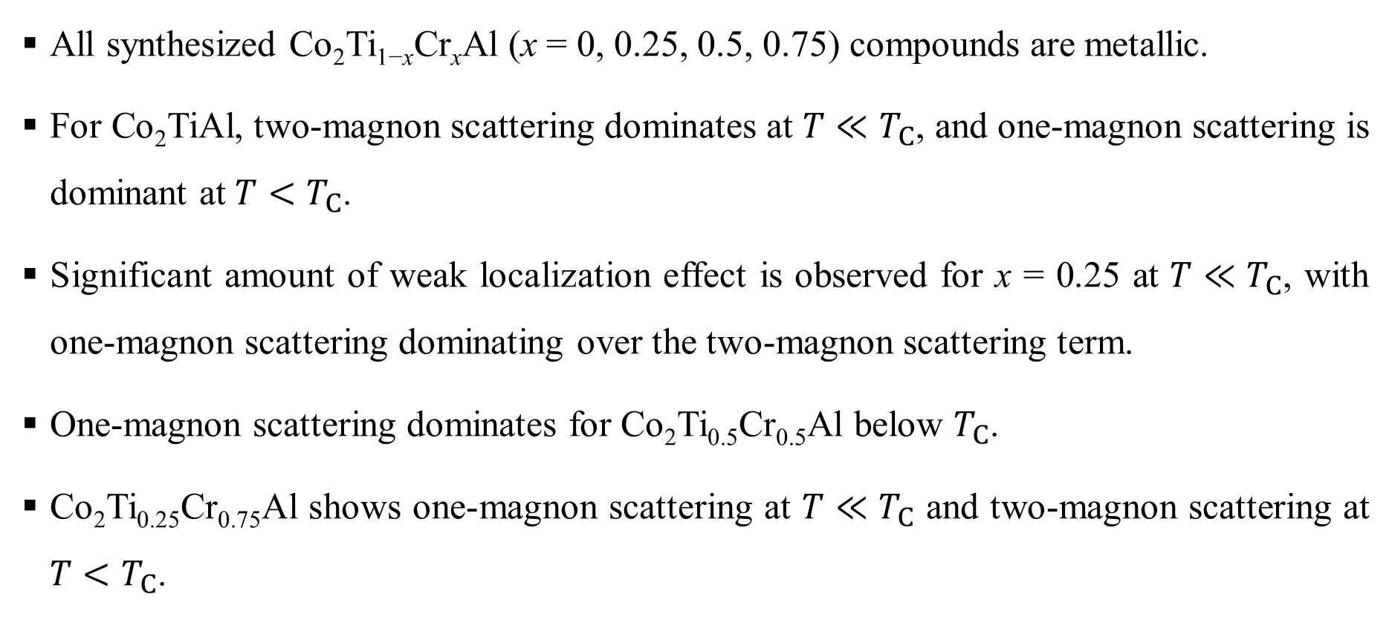
Temperature dependent resistivity
All synthesized Co₂Ti_{1−x}Cr_{x}Al (x = 0, 0.25, 0.5, 0.75) compounds are metallic.
For Co₂TiAl, two-magnon scattering dominates at $T≪T_{C}$, and one-magnon scattering is dominant at $T<T_{C}$.
Significant amount of weak localization effect is observed for x = 0.25 at $T≪T_{C}$, with one-magnon scattering dominating over the two-magnon scattering term.
One-magnon scattering dominates for Co₂Ti_{0.5}Cr_{0.5}Al below $T_{C}$.
Co₂Ti_{0.25}Cr_{0.75}Al shows one-magnon scattering at $T≪T_{C}$ and two-magnon scattering at $T<T_{C}$.

Slide 20
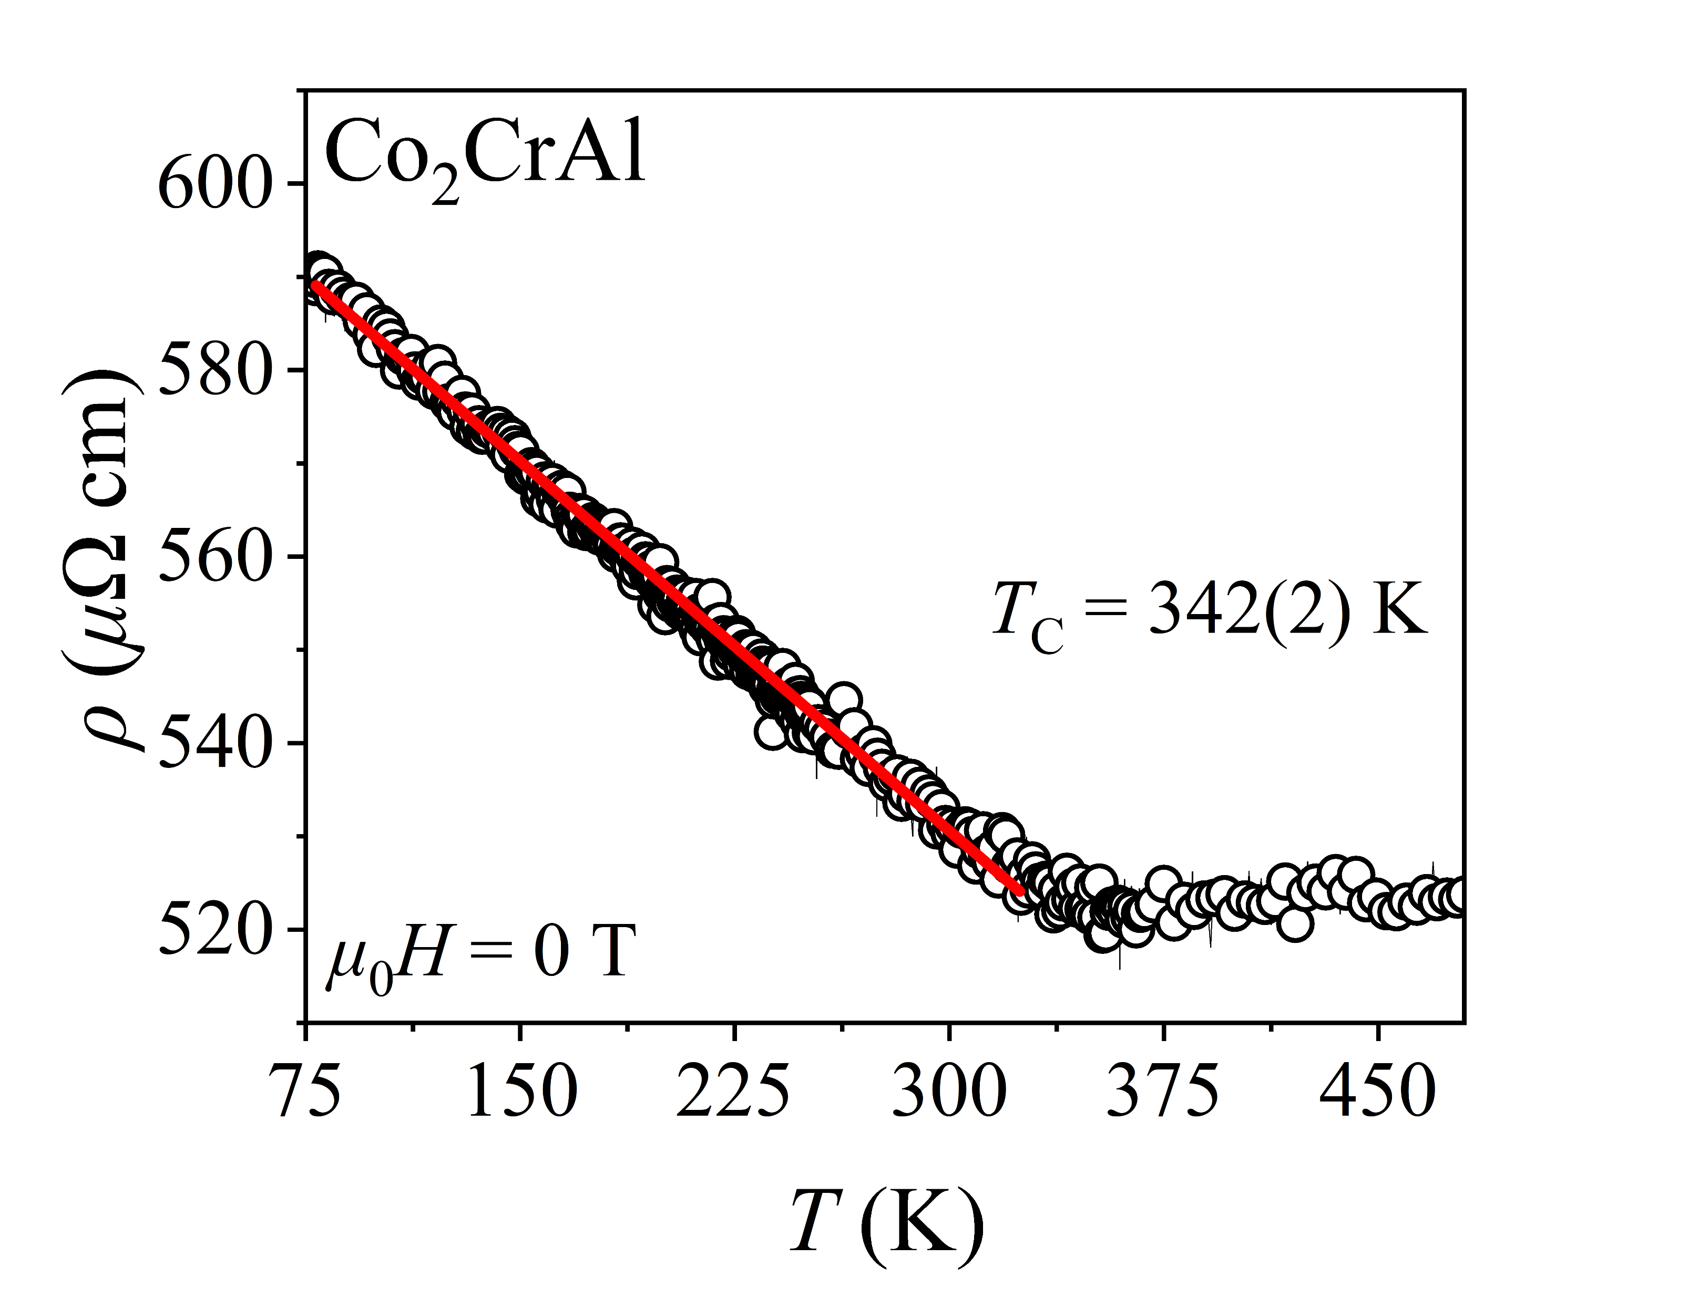
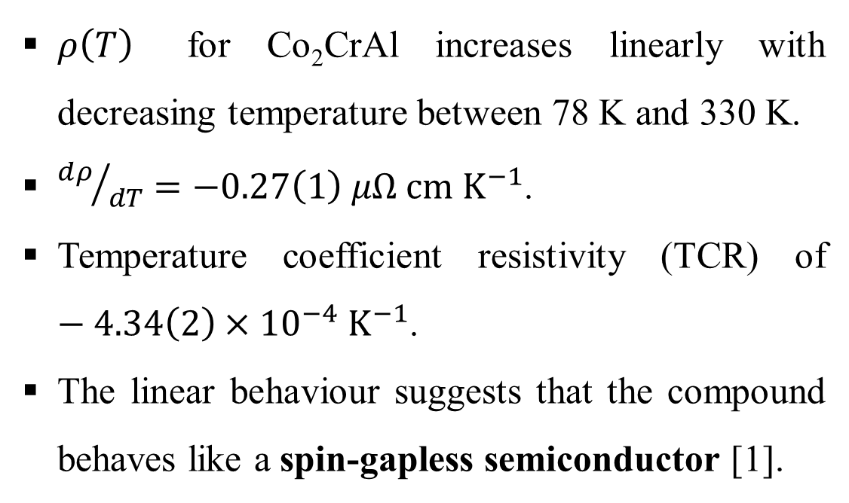
Temperature dependent resistivity
$ρ\left(T\right)$ for Co₂CrAl increases linearly with decreasing temperature between 78 K and 330 K.
${dρ}/{dT}=−0.27\left(1\right) μΩ cm K^{−1}$.
Temperature coefficient resistivity (TCR) of $−4.34\left(2\right)×{10}^{−4} K^{−1}$.
The linear behaviour suggests that the compound behaves like a spin-gapless semiconductor [1].
Figure 11. Temperature dependence of resistivity of Co₂CrAl 78 K to 480 K.
[1] Rani et al., J. Appl. Phys. 128 (2020) 220902.

Slide 21
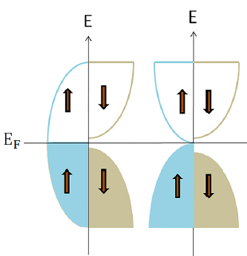
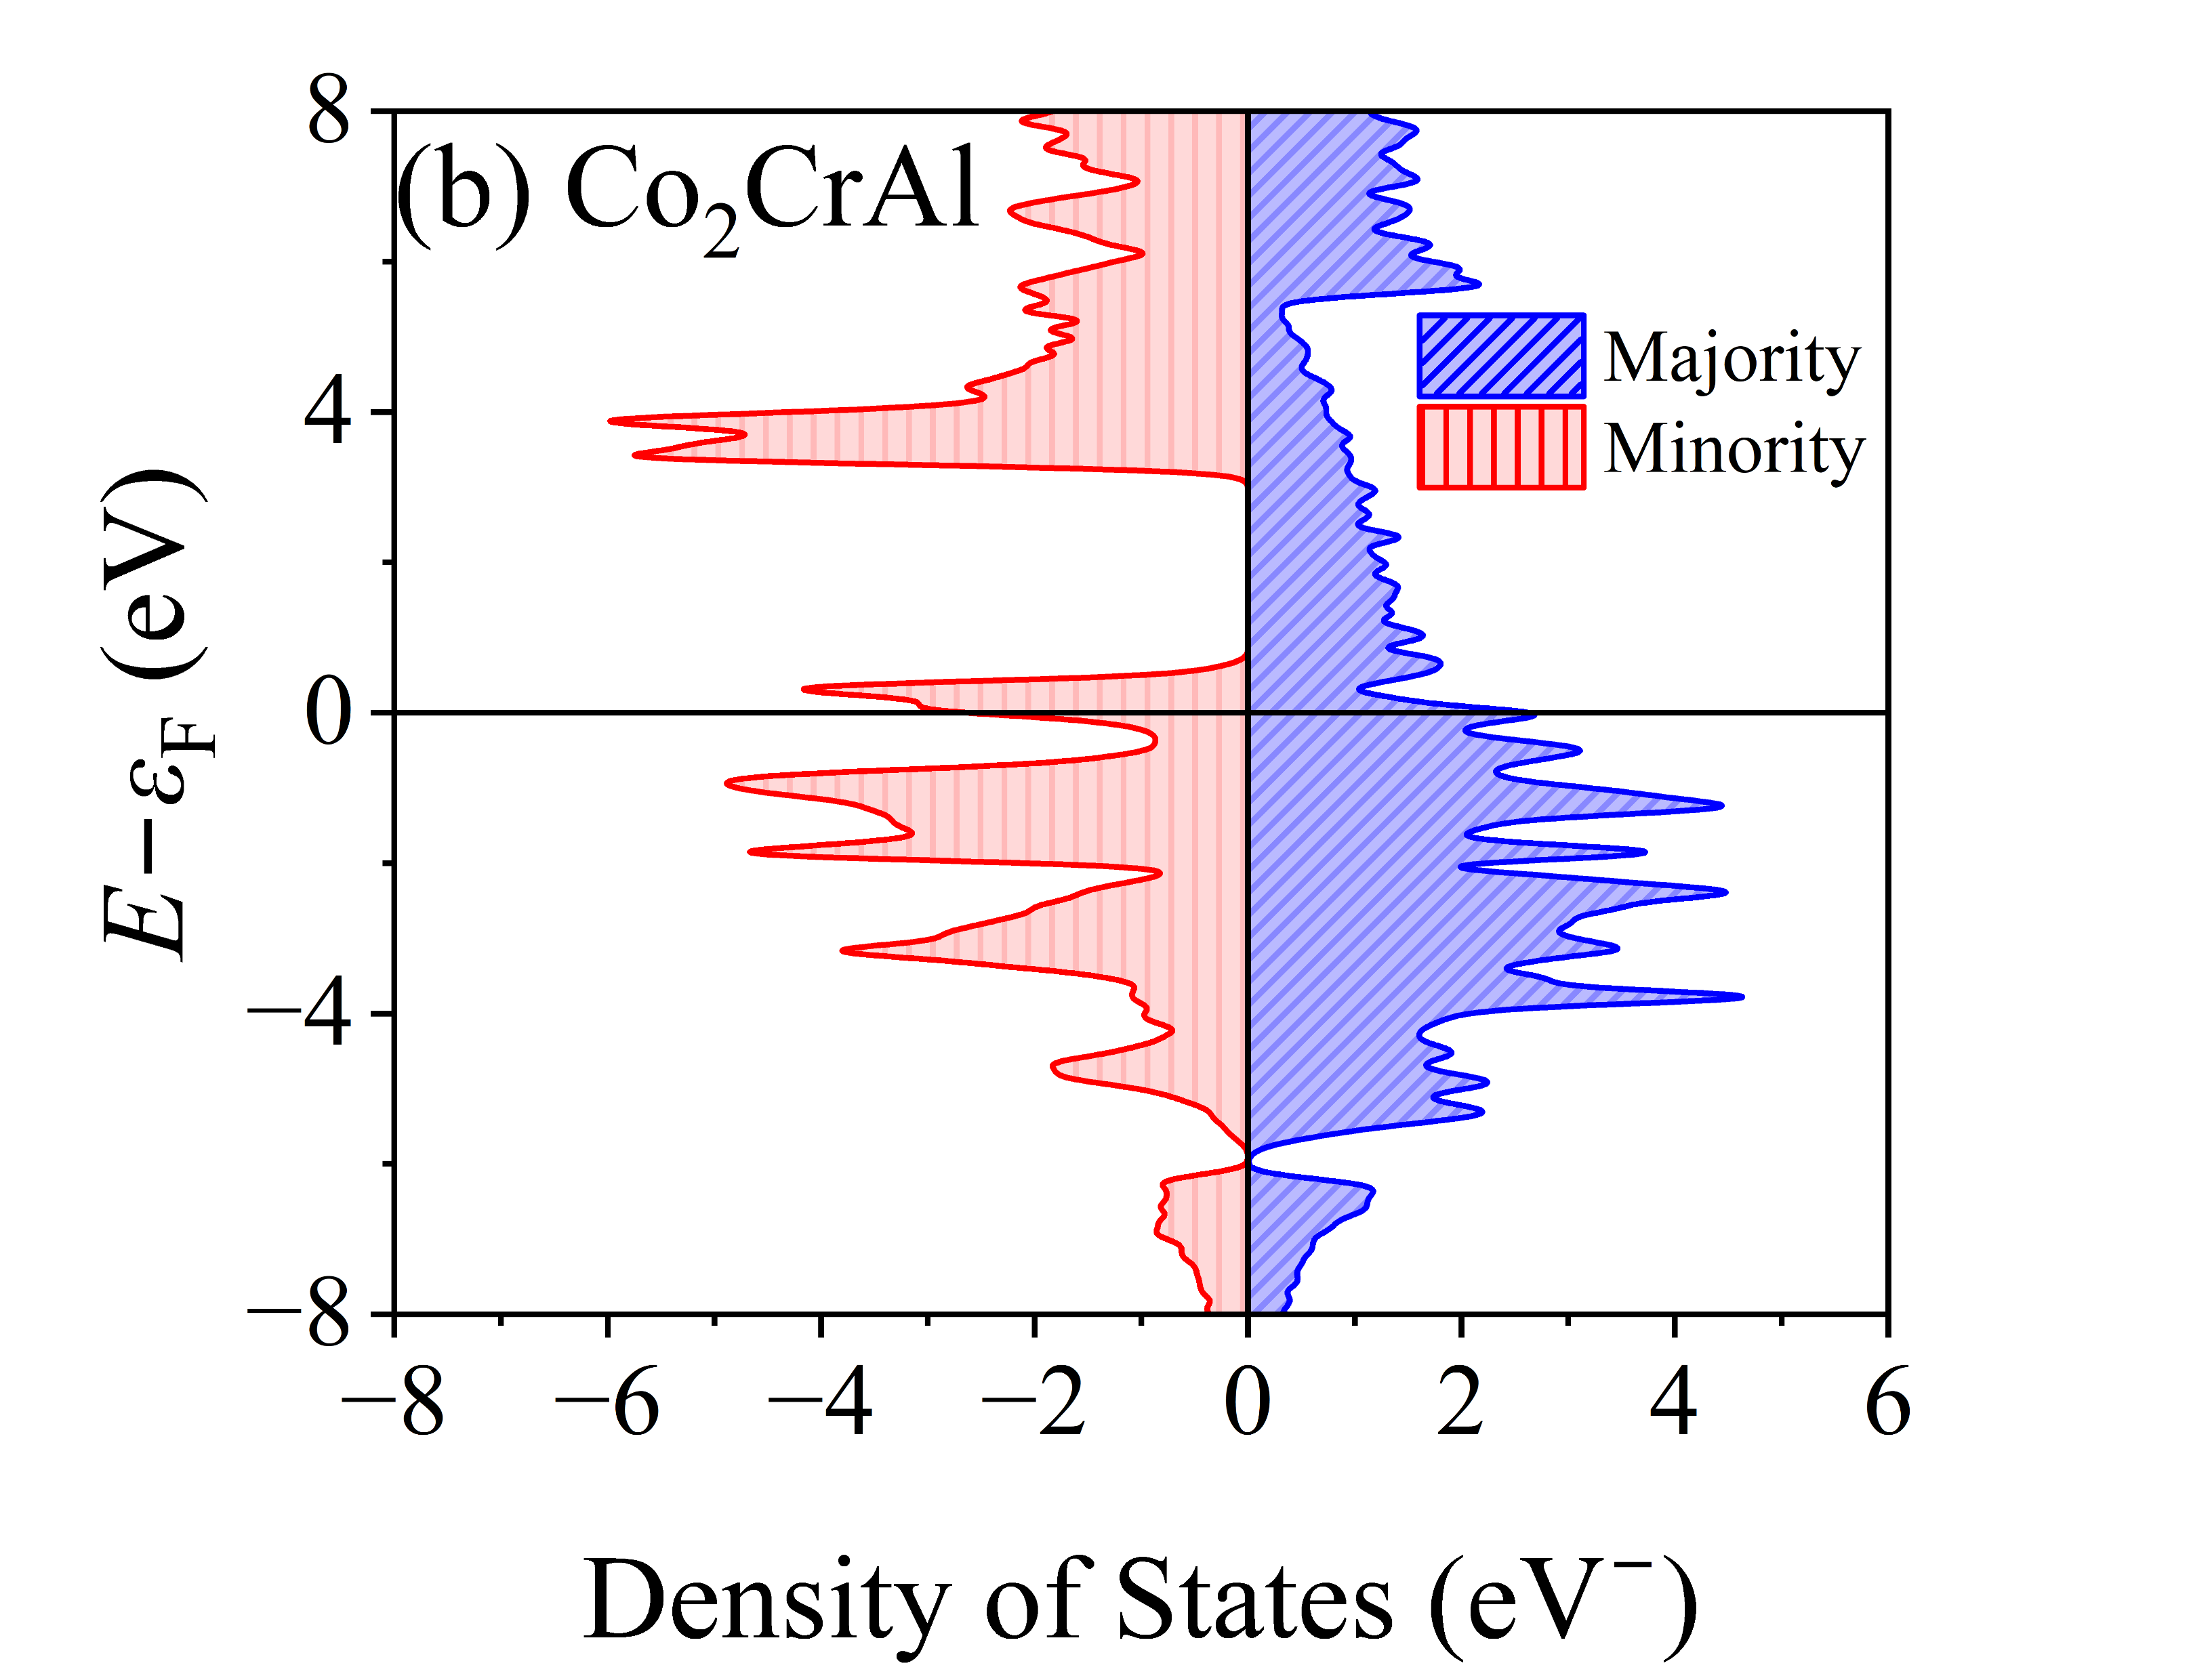
Temperature dependent resistivity
(a)
HM
SGS
Figure 12. (a) Schematic illustration of the density of states of a Half-metal (HM) and spin-gapless semiconductor (SGS) [1]. (b) Spin-resolved density of state of Co₂CrAl calculated using GPAW.
[1] Rani et al., J. Appl. Phys. 128 (2020) 220902.

Slide 22
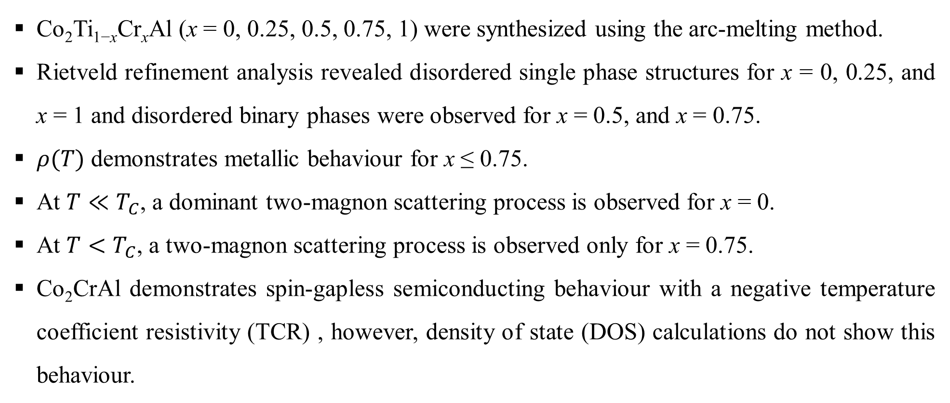
Summary
Co₂Ti_{1−x}Cr_{x}Al (x = 0, 0.25, 0.5, 0.75, 1) were synthesized using the arc-melting method.
Rietveld refinement analysis revealed disordered single phase structures for x = 0, 0.25, and x = 1 and disordered binary phases were observed for x = 0.5, and x = 0.75.
$ρ(T)$ demonstrates metallic behaviour for x ≤ 0.75.
At $T≪T_{C}$, a dominant two-magnon scattering process is observed for x = 0.
At $T<T_{C}$, a two-magnon scattering process is observed only for x = 0.75.
Co₂CrAl demonstrates spin-gapless semiconducting behaviour with a negative temperature coefficient resistivity (TCR) , however, density of state (DOS) calculations do not show this behaviour.

Slide 23
Acknowledgement
Financial aid from the SANRF (Grant no. SHUG2204041966 and 138329) and the UJ/FRC are acknowledged.
University of Johannesburg (UJ) URC and FRC (Grant No. 282810 and 083135).
Use of NEP Cryogenic Physical Properties Measurement System at UJ, obtained with financial support from SANRF (Grant no: 88080) and UJ, is acknowledged.
The use of the Spectrum Facility in the Faculty of Science (FOS) at UJ is acknowledged.

Slide 24


Slide 25
Supplementary information

Slide 26
DFT calculation details
Density functional theory (DFT) calculations were performed using GPAW [1]. The code is based on Projector augmented wave (PAW) method. The generalized gradient approximation (GGA) within the Perdew-Burke-Ernzerhof (PBE) formulation [2] was used to treat the electronic exchange and correlation effects. The wave functions were expanded using plane wave (PW) basis with a cutoff energy of 500 eV. A k-point mesh of the Monkhorst-Pack type [3] was used with 15×15×15 grid sample in the irreducible Brillouin zone (IBZ).
[1] Mortensen J J et al., (2024), GPAW: An open Python package for electronic structure calculations J. Chem. Phys. 160
[2] Perdew J P et al., (1996), Generalized Gradient Approximation Made Simple, Phys. Rev. Lett. 77 3865–8
[3] Pack J D and Monkhorst H J, (1977), special points for Brillouin-zone integrations, Phys. Rev. B 16 1748–9

Slide 27
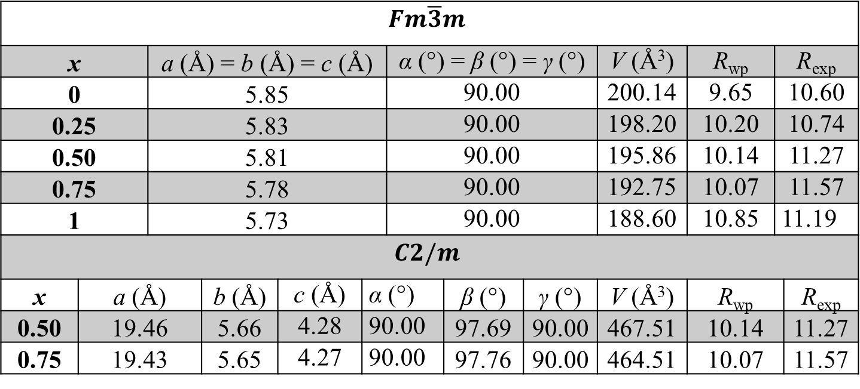
X-ray diffraction
Table 1. Crystal structure parameters and refinement parameters obtained from Rietveld analysis of Co₂Ti_{(1−x)}Cr_{(x)}Al (x = 0, 0.25, 0.50, 0.75, 1) XRD data using a cubic ($Fm\overline{3}m$) structure and monoclinic ($C2/m$) structure.
$$Fm\overline{3}m$$
x | a (Å) = b (Å) = c (Å) | a (Å) = b (Å) = c (Å) |  |  |  | α (°) = β (°) = γ (°) |  |  | V (Å³) | R_{wp} | R_{exp} | R_{exp}
0 | 5.85 | 5.85 |  |  |  | 90.00 |  |  | 200.14 | 9.65 | 10.60 | 10.60
0.25 | 5.83 | 5.83 |  |  |  | 90.00 |  |  | 198.20 | 10.20 | 10.74 | 10.74
0.50 | 5.81 | 5.81 |  |  |  | 90.00 |  |  | 195.86 | 10.14 | 11.27 | 11.27
0.75 | 5.78 | 5.78 |  |  |  | 90.00 |  |  | 192.75 | 10.07 | 11.57 | 11.57
1 | 5.73 | 5.73 |  |  |  | 90.00 |  |  | 188.60 | 10.85 | 11.19 | 11.19
$$C2/m$$
x | a (Å) | b (Å) | b (Å) | c (Å) | α (°) |  | β (°) | γ (°) | V (Å³) | R_{wp} |  | R_{exp}
0.50 | 19.46 | 5.66 | 5.66 | 4.28 | 90.00 |  | 97.69 | 90.00 | 467.51 | 10.14 |  | 11.27
0.75 | 19.43 | 5.65 | 5.65 | 4.27 | 90.00 |  | 97.76 | 90.00 | 464.51 | 10.07 |  | 11.57

Slide 28
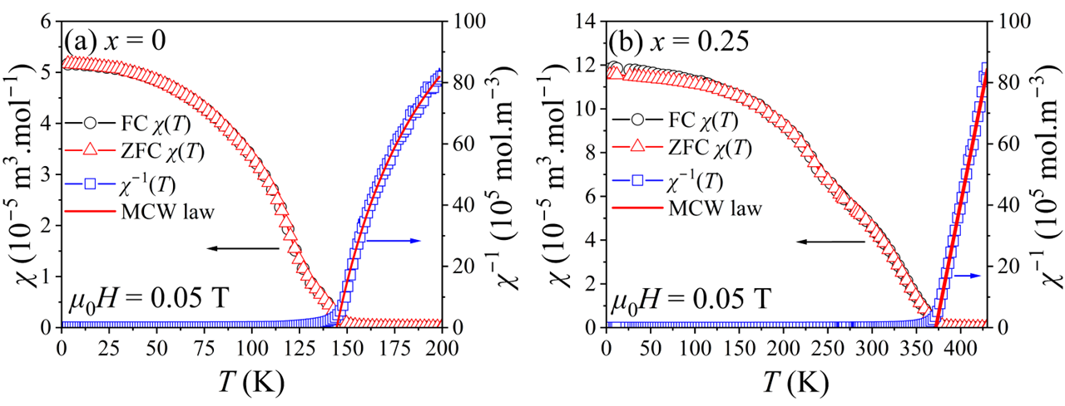
Temperature dependent magnetization
Figure 13. Field-cooled (FC) and zero-field cooled (ZFC) temperature dependence of magnetic susceptibility ($χ$), inverse magnetic susceptibility ($χ^{−1}$) for Co₂Ti_{(1−x)}Cr_{(x)}Al with (a) x = 0 and (b) x = 0.25.

Slide 29
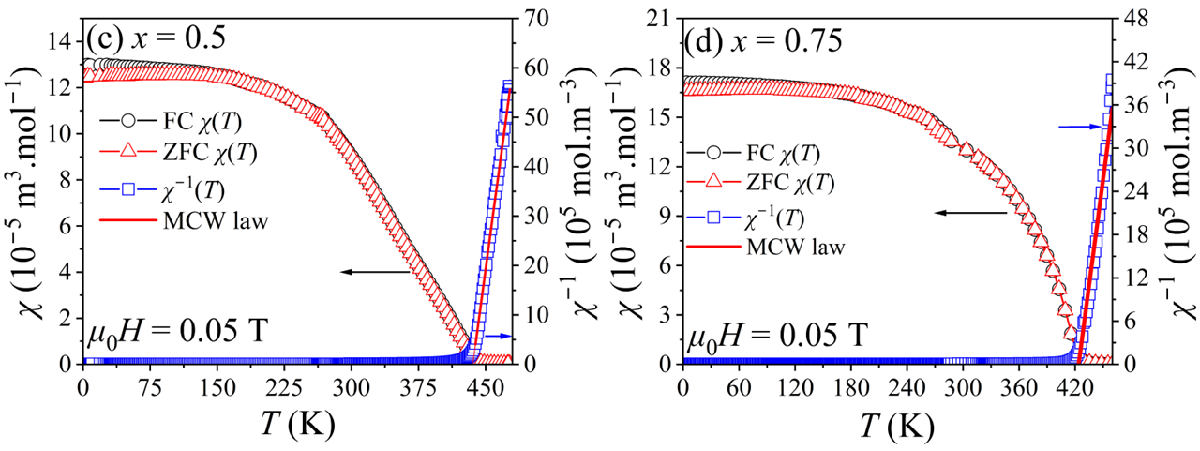
Temperature dependent magnetization
Figure 14. Field-cooled (FC) and zero-field cooled (ZFC) temperature dependence of magnetic susceptibility ($χ$), inverse magnetic susceptibility ($χ^{−1}$) for Co₂Ti_{(1−x)}Cr_{(x)}Al with (c) x = 0.5 and (d) x = 0.75.

Slide 30
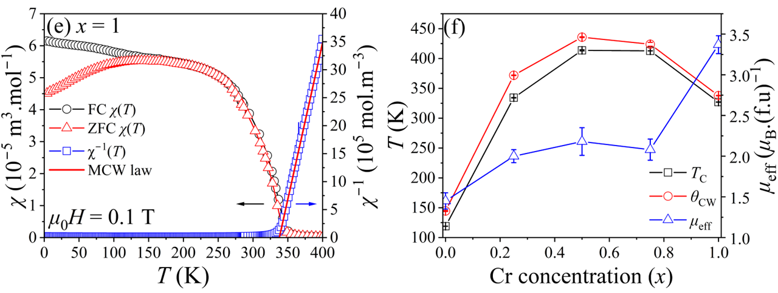
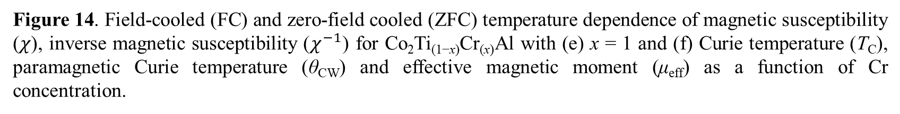
Temperature dependent magnetization
Figure 14. Field-cooled (FC) and zero-field cooled (ZFC) temperature dependence of magnetic susceptibility ($χ$), inverse magnetic susceptibility ($χ^{−1}$) for Co₂Ti_{(1−x)}Cr_{(x)}Al with (e) x = 1 and (f) Curie temperature (T_{C}), paramagnetic Curie temperature (θ_{CW}) and effective magnetic moment (μ_{eff}) as a function of Cr concentration.

Slide 31
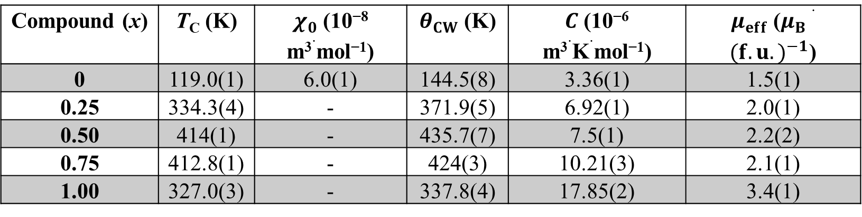
Temperature dependent magnetization
Table 2. Critical temperature (T_{C}) obtained from fitting $[dχ/dT](T)$ with a Voigt function, fitting parameters $χ_{0}$, $θ_{cw}$, and $C$, and the effective moment ($μ_{eff}$).
Compound (x) | T_{C} (K) | $χ_{0}$ (10⁻⁸ m³$⋅$mol⁻¹) | $θ_{CW}$ (K) | $C$ (10⁻⁶ m³$⋅$K$⋅$mol⁻¹) | $μ_{eff}$ ($μ_{B}⋅{(f.u.)}^{−1}$)
0 | 119.0(1) | 6.0(1) | 144.5(8) | 3.36(1) | 1.5(1)
0.25 | 334.3(4) | - | 371.9(5) | 6.92(1) | 2.0(1)
0.50 | 414(1) | - | 435.7(7) | 7.5(1) | 2.2(2)
0.75 | 412.8(1) | - | 424(3) | 10.21(3) | 2.1(1)
1.00 | 327.0(3) | - | 337.8(4) | 17.85(2) | 3.4(1)

