Slide 2
SAIP PRESENTATION
Electrical and structural properties in Mo-Re alloys:
a study on their superconductivity.
By Treatwell K Pamhidzayi
Supervisors:
Prof C.J. Sheppard and Prof A.R.E. Prinsloo
2

Slide 3
Contents
Literature Review.
Experimental Procedure.
Results.
Conclusion.
3

Slide 4
LITERATURE REVIEW
4

Slide 5
Mo_{(1-x)}Re_{x}

Slide 6
Mo_{(1-x)}Re_{x}
T_{sc} of the alloy is higher than that of constituent elements [1], 0.92 K and 1.7 K Mo and Re respectively.
For x = 0.65, there’s a large T_{sc} of 12.6 K.
Alloys have two electronic topological transitions (ETT), with critical concentrations of x_{c1} and x_{c2} of 0.05 and 0.11, respectively [2-4].
ETTs form when the Fermi surface’s topology changes with the movement of E_{F} in a van Hove singularity, as observed in the density of states (DOS).
[1] Ignat’eva, T.A., 2007, p.403-412.
[2] Ignatyeva, T.A., et al., 2002. p.403-411.
[3] Krause, C.W., et al., 1971.
[4] Belovol, V., et al., 1982. p.185-187.
6
Notes:
As EF moves, it causes a change in the topology (shape/connectivity) of the Fermi surface.
This change is called an ETT (also known as a Lifshitz transition), where the nature of the Fermi surface—such as forming or breaking a pocket—suddenly changes.
A sharp peak in the DOS corresponds to a van Hove singularity, a point in the band structure where the group velocity of electrons becomes zero, causing a high DOS.
When EF moves through this singularity, an ETT occurs, which can affect physical properties like conductivity, superconductivity, or magnetic transitions.

Slide 7
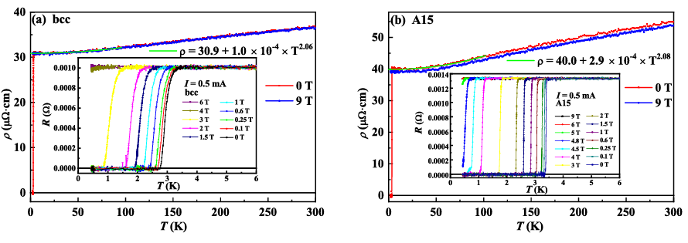
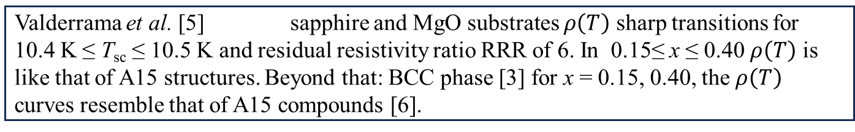
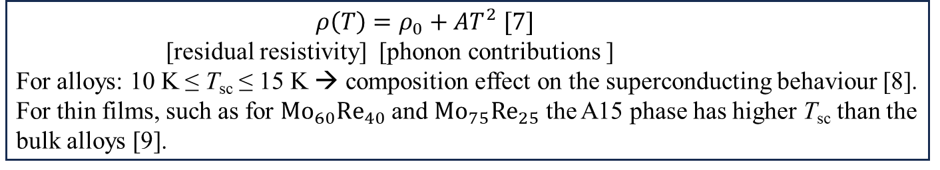
Valderrama et al. [5] sapphire and MgO substrates $ρ\left(T\right)$ sharp transitions for 10.4 K ≤ T_{sc} ≤ 10.5 K and residual resistivity ratio RRR of 6. In 0.15≤ x ≤ 0.40 $ρ\left(T\right)$ is like that of A15 structures. Beyond that: BCC phase [3] for x = 0.15, 0.40, the $ρ\left(T\right)$ curves resemble that of A15 compounds [6].
Mo_{(1-x)}Re_{x}
      $ρ\left(T\right)=ρ_{0}+AT^{2}$ $[7]$
      [residual resistivity] [phonon contributions ]
For alloys: 10 K ≤ T_{sc} ≤ 15 K → composition effect on the superconducting behaviour [8]. For thin films, such as for ${Mo}_{60}{Re}_{40}$ and ${Mo}_{75}{Re}_{25}$ the A15 phase has higher T_{sc} than the bulk alloys [9].
[3]Krause, C.W., et al., 1971.
[5]Valderrama, E., et al., 2011.
[6]Zhu, Z., et al.,2022. p.475602.
[7]Milewits, M., et al., 13(12), p.5199.
[8]Khim, S., et al., 84(10), p.104502.
[9]Poker, D.B., et al., 1982., 26(12), p.7012.
Figure 1: Temperature dependence of resistivity from 2 K to 300 K under magnetic fields of 0 T and 9 T (a) for samples with bcc structure and (b) for samples with A15 structure.

Slide 8
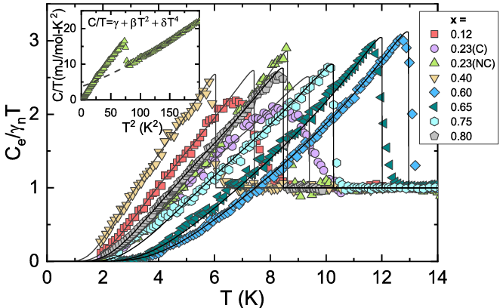
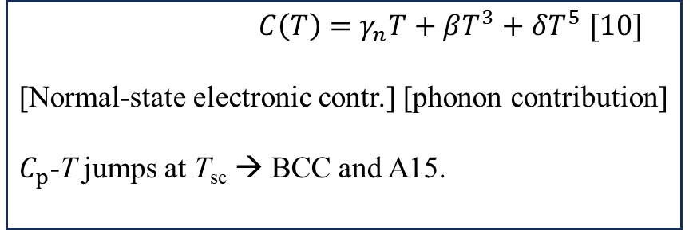
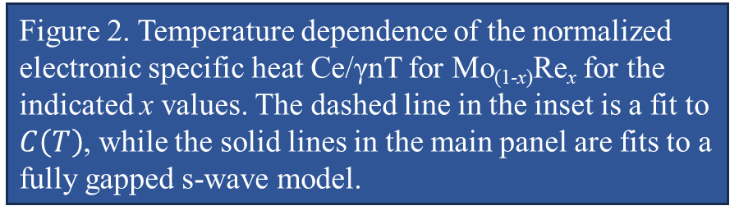
Mo_{(1-x)}Re_{x}
$C\left(T\right)=γ_{n}T+βT^{3}+δT^{5}$ $[10]$
[Normal-state electronic contr.] [phonon contribution]
$C_{p}$-T jumps at T_{sc} → BCC and A15.
Figure 2. Temperature dependence of the normalized electronic specific heat Ce/γnT for Mo_{(1-x)}Re_{x} for the indicated x values. The dashed line in the inset is a fit to $C\left(T\right)$, while the solid lines in the main panel are fits to a fully gapped s-wave model.
[10]Andreone, A., et al., 1989. p1972-1975.
[11]Lerner, E., et al., 1966. p.251.
Notes:
Jump in heat capacity is indicative of a second-order phase transition, and it directly reflects the change in the thermodynamic properties of the material as it enters the superconducting state.
As the system crosses Tsc​, the electrons suddenly form Cooper pairs, and the gap Δ\DeltaΔ opens up.
Because of this sudden shift in the microscopic degrees of freedom (from unpaired to paired electrons), Cp(T) shows a discontinuous jump — the slope of entropy changes abruptly due to the formation of the condensate.
If the solid lines fitting the main panel's Cp(T) data follow the low-T exponential decay, and match BCS s-wave theory predictions, this confirms that:
The material is fully gapped.
The superconducting pairing is s-wave.
No nodes or significant anisotropy in the superconducting gap.
As a result, the electronic specific heat falls off exponentially at low temperatures:
Cel(T)∝exp⁡(−ΔkBT) This is distinct from other symmetries:
d-wave (with nodes in the gap) → Cp∝T^2
gapless or anisotropic → power-law dependence

Slide 9
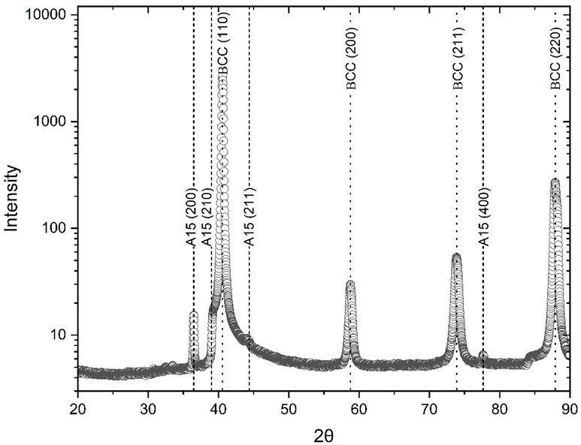
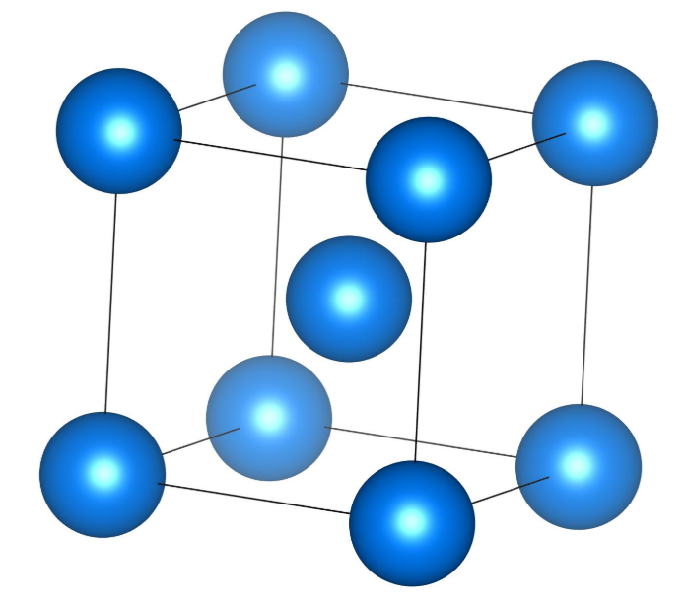
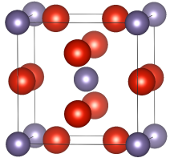
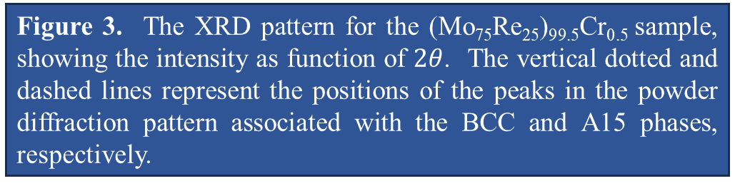
Mo_{(1-x)}Re_{x}
The Rhenium-rich: lattice parameter about 3.19Å (lm-3m) [12,13] → crystallite size about 30nm [5].
From x-ray diffraction (XRD) analysis, the system exhibits both A15 and BCC crystal structures.
a
b
Figure 4: Crystal structures of (a) BCC and (b) A15 phases, showing the simpler cubic arrangement of BCC and the complex, multi-atom unit cell of A15, often found in superconducting compounds
[5]Valderrama, E., et al., 2011.
[12]Yu, X.J., et al.,, 2013, p.329-338.
[13]Massalski T.B., et al., 1986. (Vol. 1, No. 2).
[14]K. Momma, et al., 2011, 44, 1272-1276.
[15]T. K. Pamhidzayi, et al., 2024, p. 195 - 202.
Figure 3. The XRD pattern for the (Mo₇₅Re₂₅)_{99.5}Cr_{0.5} sample, showing the intensity as function of $2θ$. The vertical dotted and dashed lines represent the positions of the peaks in the powder diffraction pattern associated with the BCC and A15 phases, respectively.
Notes:
The body-centered cubic (BCC)
-atoms occupy each corner of a cube and one atom sits at the center,
-2 atoms per unit cell and a coordination number of 8.
A15 structure (β-tungsten structure) is a more complex cubic structure with eight atoms per unit cell, typically found in intermetallic compounds such as Nb₃Sn or Mo₃Re.

Slide 10
Experimental Procedure
10

Slide 11

Experimental Procedure
Synthesis Method: Arc furnace.
Materials: High-purity (99.9999%) molybdenum and rhenium in Argon atmosphere.
Process:
  Elements melted into a solid ingot, then remelted together.
  Formed a homogeneous bulk alloy.
  Button-shaped ingot underwent three cycles of crushing and remelting.
  Each melting phase involved at least three flips in the arc furnace for homogeneity.
SYNTHESIS
Arc-Melting technique
ALLOYS

Slide 12
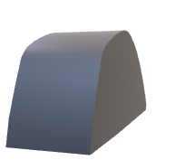
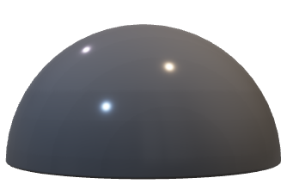
CHARACTERIZATIONS
Composition Confirmation: Energy Dispersive X-ray Spectroscopy (EDX).
Phase Properties: Solid sample characterized using X-ray Diffraction (XRD) analysis.
The phase purity of the samples was analyzed using X-ray diffraction techniques with an Empyrean Panalytical X-ray diffractometer (Cu–Kα radiation, λ = 1.54056 Å), recording XRD patterns in a 2θ range from 10° to 90°.
XRD
EDX.
Experimental Procedure
Notes:
inots

Slide 13

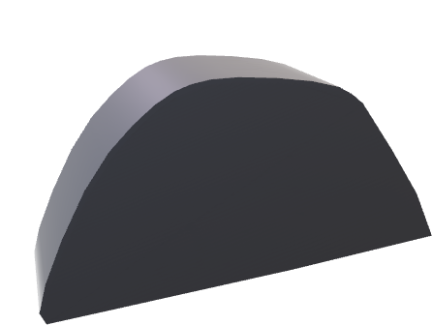

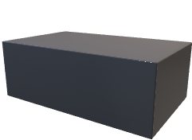
CHARACTERIZATIONS
Post-Synthesis: Bulk material cut with a spark cutter for further measurements.
Resistivity Measurement:
  Method: Four-probe method.
  Temperature Range: From 300 K to 1.8 K.
Specific Heat Measurement:
  Type: AC Cp conducted under various magnetic fields.
  In AC heat capacity measurement, an alternating current induces periodic heating, allowing the determination of heat capacity from temperature oscillations [16].
  Made use of a K-type thermocouple as a temperature change sensor.
  The sample mass used was approximately 2 micrograms
  Same temperature range as resistivity.
4 point Probe
Resistivity and Cp
AC-Cp: 3He insert, cryogenic
Experimental Procedure
[13] Li, Y.S., et al., 2020. Review of Scientific Instruments, 91(10).
Notes:
In the 4-point setup:
2 outer probes apply current.
2 inner probes measure voltage.
This setup bypasses contact resistance and lead resistance, making it highly accurate for measuring the true material response.
In AC calorimetry or AC specific heat (AC Cp) measurements, a K-type thermocouple is typically used as a temperature sensor to detect the oscillatory temperature response of the sample when it's periodically heated.

Slide 14
RESULTS
14

Slide 15
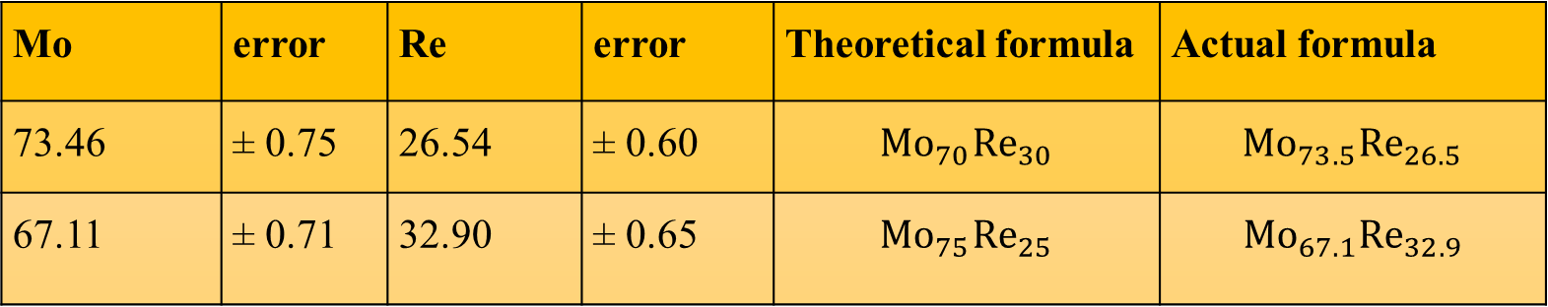
RESULTS
Table 1: Electron microprobe: Nominal atomic percentages in the Mo-Re alloy.
Mo | error | Re | error | Theoretical formula | Actual formula
73.46 | $\text{±}$ 0.75 | 26.54 | $\text{±}$ 0.60 | $${Mo}_{70}{Re}_{30}$$ | $${Mo}_{73.5}{Re}_{26.5}$$
67.11 | $\text{±}$ 0.71 | 32.90 | $\text{±}$ 0.65 | $${Mo}_{75}{Re}_{25}$$ | $${Mo}_{67.1}{Re}_{32.9}$$

Slide 16
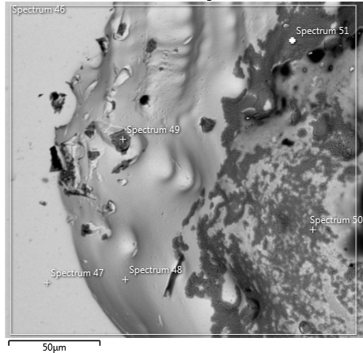
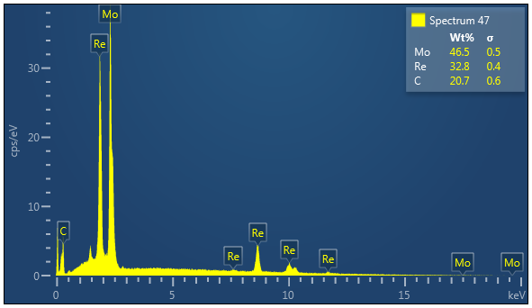

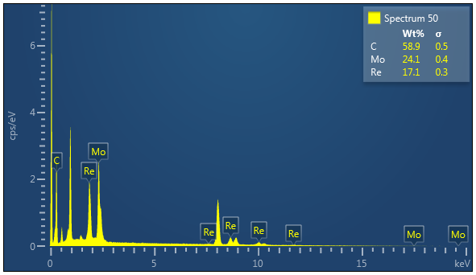

b
RESULTS
c
a
Figure 5. The EDS analysis for ${Mo}_{67.1}{Re}_{32.9}$ , showing a) the BSE image of the sample and the EDS analysis of points b) 47 and c) 50. All points seem to contain Mo, Re and C, from the carbon coat.
Notes:
If both light and dark regions contain Mo and Re but differ in brightness, it likely indicates variations in Re content, not elemental purity. You are probably observing microstructural phase separation, such as BCC (Mo-rich) and A15 (Mo₃Re-type) regions.

Slide 17
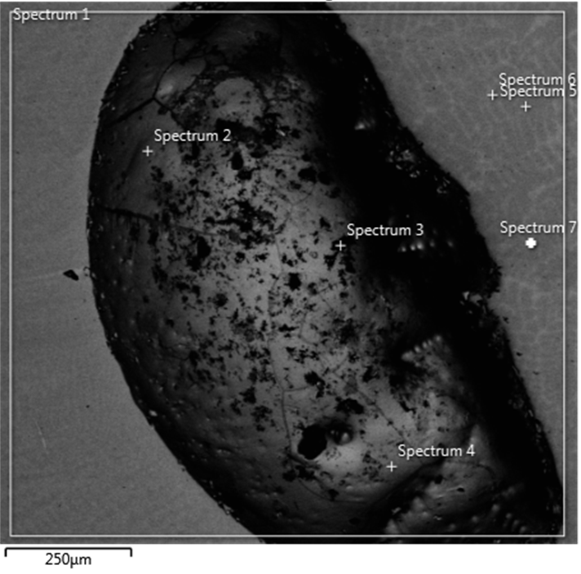
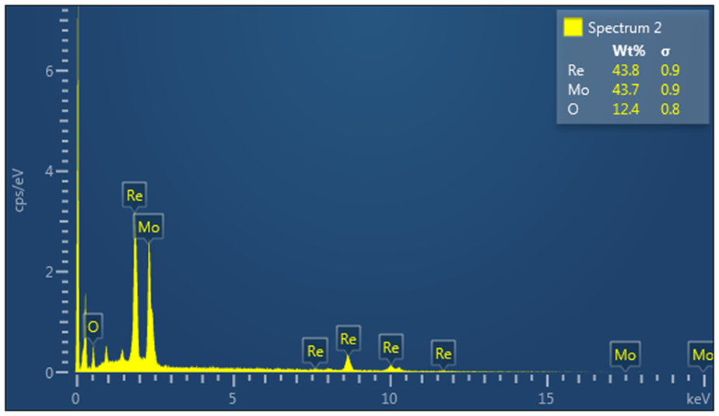
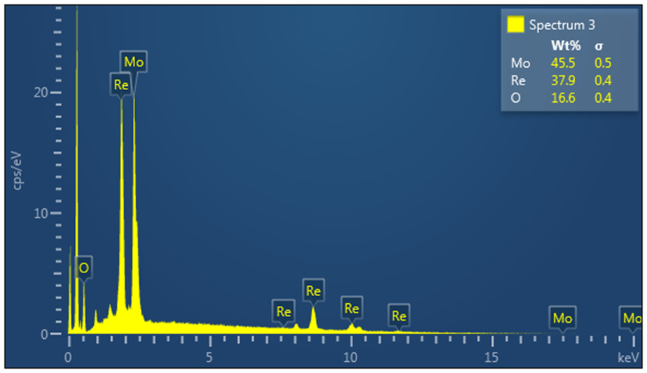
b
c
RESULTS
a
Figure 6. The EDS analysis for ${Mo}_{73.5}{Re}_{26.5}$, showing a) the BSE image of the sample and the EDS analysis of points b) 2 and c) 3. Both points seem to contain Mo, Re and O.

Slide 18
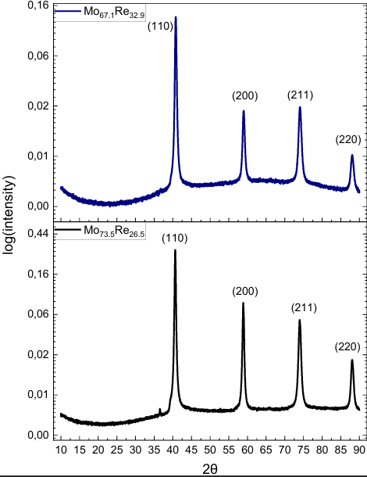
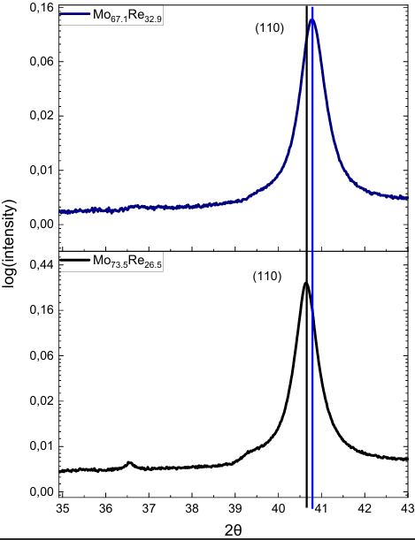
a
b
RESULTS
Figure 7. a) The XRD patterns for all samples, showing the intensity as a function of $2θ$. All samples show BCC phases by the four major peaks. b) Zoom in on the (110) peak to show a shift in peak position.

Slide 19
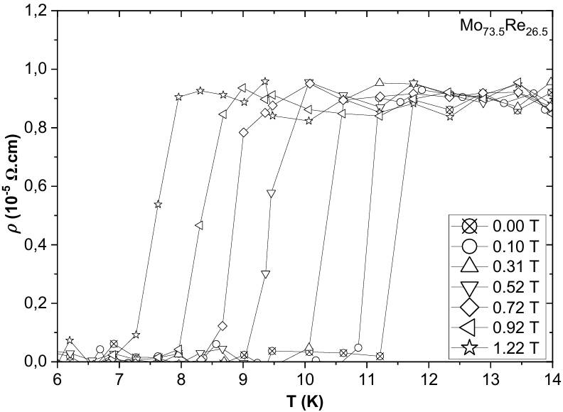
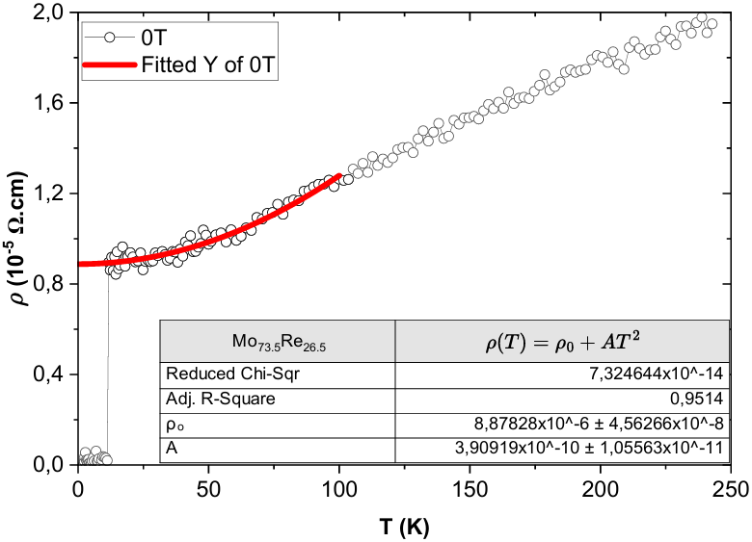
RESULTS
a
b
Figure 8. The resistivity, $ρ,$ as a function of temperature T for Mo_{73.5}Re_{26.5} with a) unfitted and b) fitted with the Fermi liquid model.

Slide 20
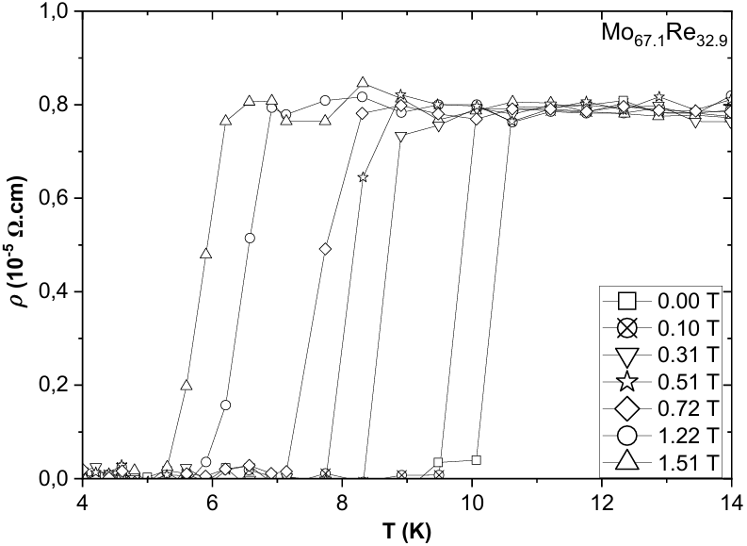
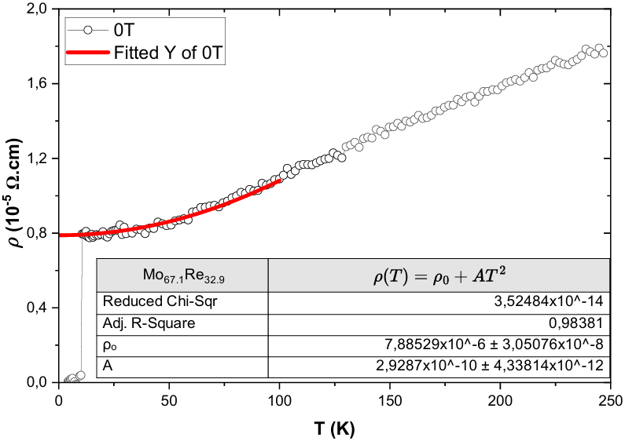
a
b
Figure 9. The resistivity, $ρ,$ as a function of temperature T for Mo_{67.1}Re_{32.9} with a) unfitted and b) fitted with the Fermi liquid model.
RESULTS

Slide 21
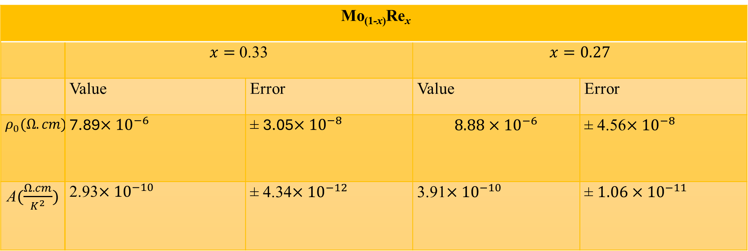
RESULTS
Table 2: The residual resistivities, $ρ_{0}$, and the electron-electron scattering amplitude, A, of the Mo-Re alloys.
Mo_{(1-x)}Re_{x}
 | $x=$ 0.33 |  | $$x=0.27$$
 | Value | Error | Value | Error
$$ρ_{0}(Ω.cm)$$ | 7.89$×{10}^{−6}$ | $\text{±}$ 3.05$×{10}^{−8}$ | $$8.88×{10}^{−6}$$ | $\text{±}$ 4.56$×{10}^{−8}$
A$(\frac{Ω.cm}{K^{2}})$ | 2.93$×{10}^{−10}$ | $\text{±}$ 4.34$×{10}^{−12}$ | 3.91$×{10}^{−10}$ | $\text{±}$ $1.06×{10}^{−11}$

Slide 22
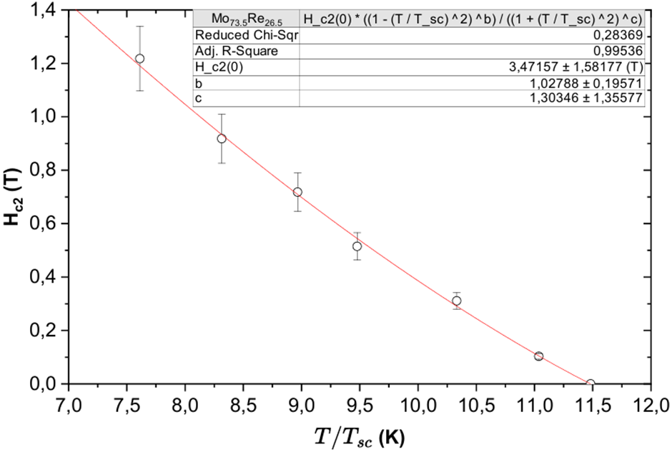
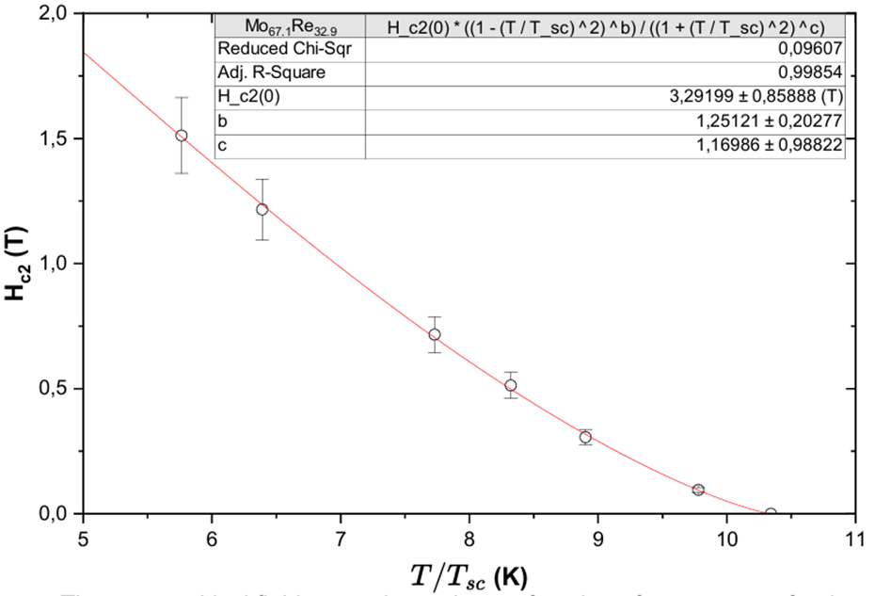
RESULTS
a
b
Figure 10. The upper critical field strength as a function of temperature for the (a) ${Mo}_{73.5}{Re}_{26.5}$, (b) ${Mo}_{67.1}{Re}_{32.9}$ alloy.

Slide 23
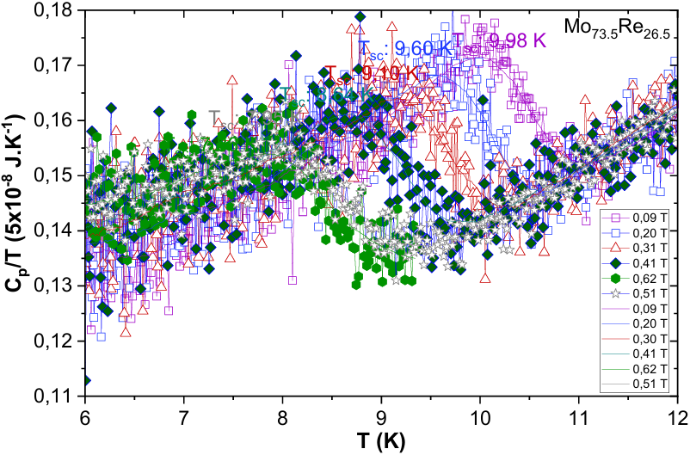
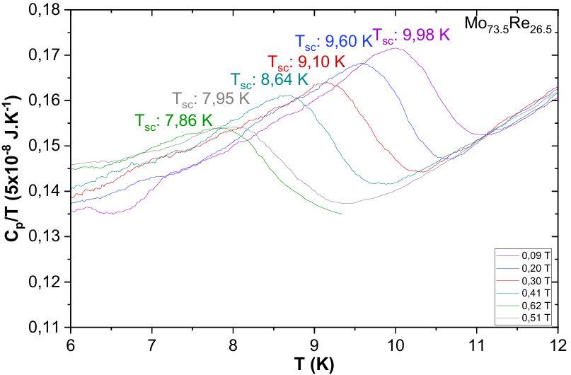
a
b
Figure 11. Heat capacity (C_{p}) as a function of temperature (T) for Mo_{73.5}Re_{26.5} alloy with a) raw and b) smooth data.
RESULTS

Slide 24
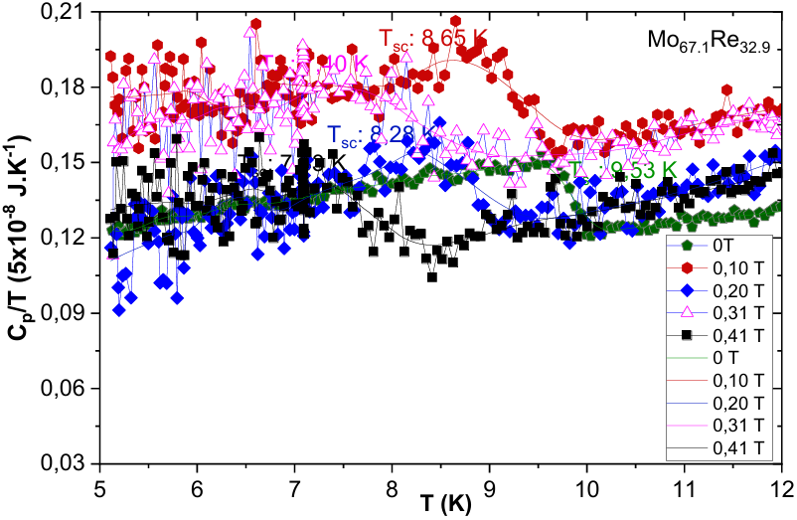
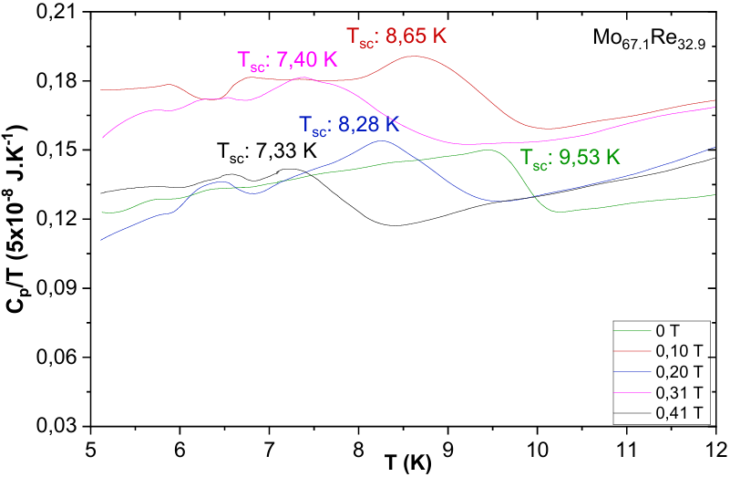
a
b
Figure 12. Heat capacity (C_{p}) as a function of temperature (T) for Mo_{67.1}Re_{32.9} alloy with a) raw and b) smooth data.
RESULTS

Slide 25
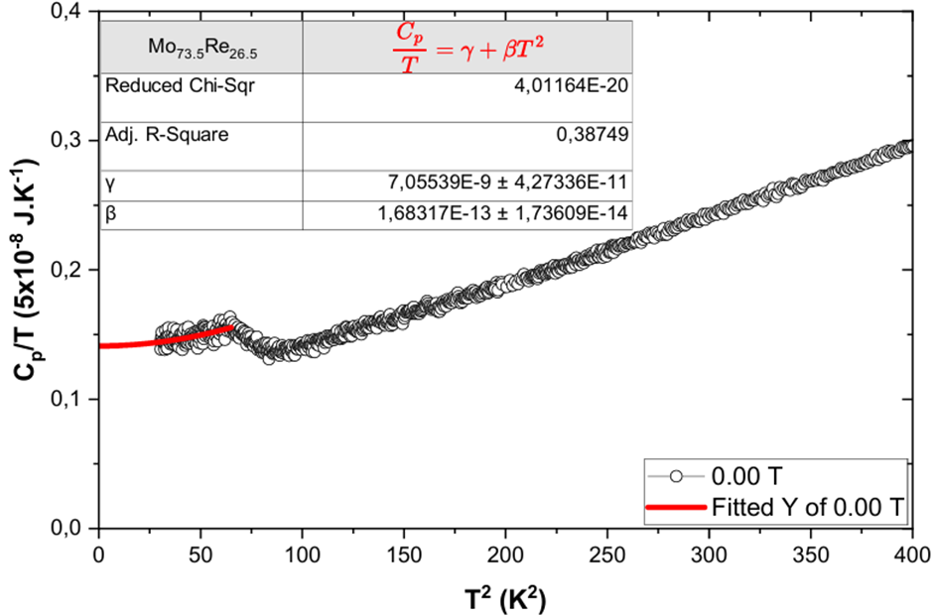
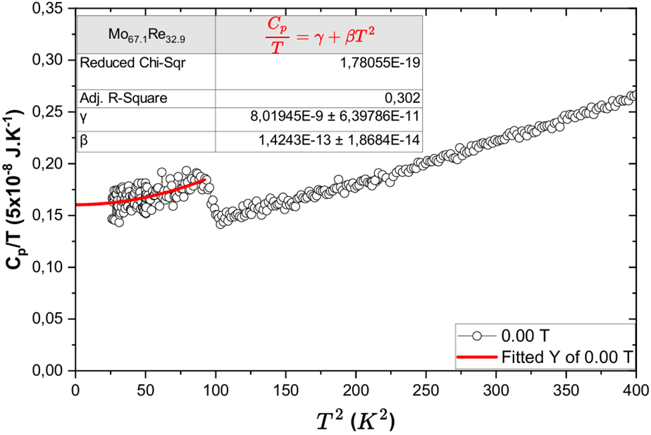
RESULTS
a
b
Figure 13. The heat capacity, C_{p}, as a function of squared temperature, $T^{2}$, curves for a) Mo_{73.5}Re_{26.5} and b) Mo_{67.1}Re_{32.9} alloys. The red line shows the Sommerfeld-Debye model fitting.

Slide 26
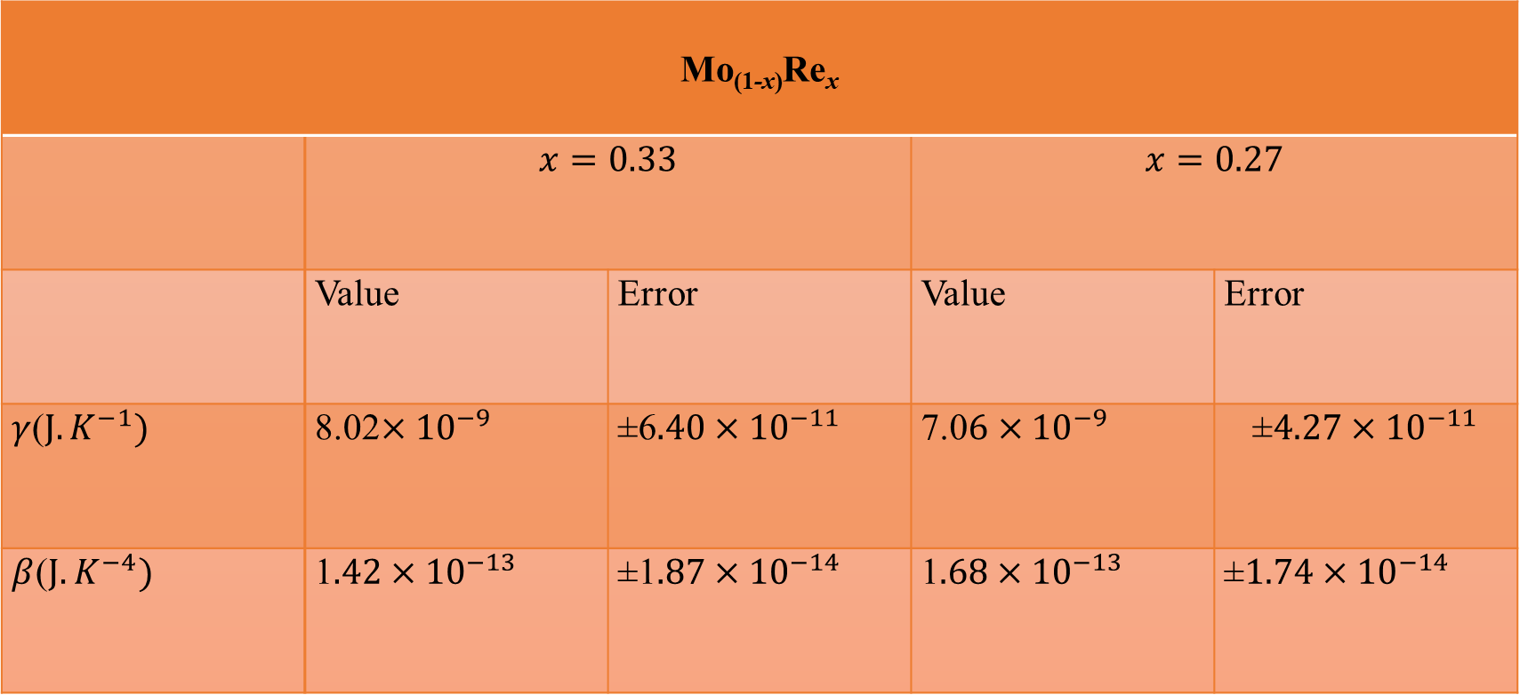
Table 3: The Sommerfield coefficients and the specific heat coefficients for the samples
Mo_{(1-x)}Re_{x}
 | $$x=0.33$$ |  | $$x=0.27$$
 | Value | Error | Value | Error
$γ$($J.K^{−1})$ | 8.02$×{10}^{−9}$ | $\text{±}$6$.40×{10}^{−11}$ | 7.0$6×{10}^{−9}$ | $$\text{±}4.27×{10}^{−11}$$
$β$($J.K^{−4})$ | 1$.42×{10}^{−13}$ | $\text{±}$1$.87×{10}^{−14}$ | 1$.68×{10}^{−13}$ | $$\text{±}1.74×{10}^{−14}$$
RESULTS
Notes:
Sommerfeld Coefficient (γ)
Represents the electronic contribution to heat capacity.
Proportional to the density of states (DOS) at the Fermi level:
γ∝N(EF)\gamma \propto N(E_F)γ∝N(EF​)
Larger γ implies:
Higher DOS at EFE_FEF​
Possibly stronger electron correlations
Potential for enhanced superconductivity (if pairing is favored)
May indicate proximity to a quantum critical point or a van Hove singularity
Implication of different γ values across samples:
Suggests changes in the electronic structure, perhaps due to composition, disorder, or phase changes.
In Mo–Re alloys, incr

Slide 27
CONCLUSION
27

Slide 28
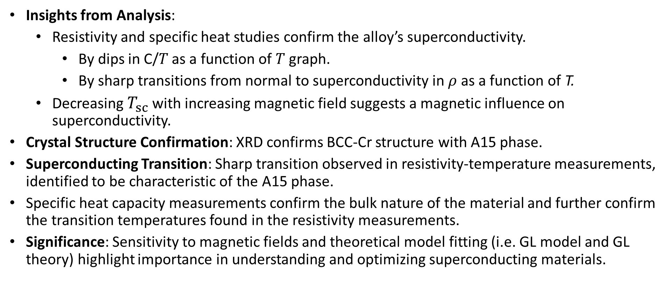
CONCLUSION
Key Findings and Prospects:
Insights from Analysis:
  Resistivity and specific heat studies confirm the alloy’s superconductivity.
    By dips in C/𝑇 as a function of 𝑇 graph.
    By sharp transitions from normal to superconductivity in $ρ$as a function of T.
  Decreasing $T_{sc}$ with increasing magnetic field suggests a magnetic influence on superconductivity.
Crystal Structure Confirmation: XRD confirms BCC-Cr structure with A15 phase.
Superconducting Transition: Sharp transition observed in resistivity-temperature measurements, identified to be characteristic of the A15 phase.
Specific heat capacity measurements confirm the bulk nature of the material and further confirm the transition temperatures found in the resistivity measurements.
Significance: Sensitivity to magnetic fields and theoretical model fitting (i.e. GL model and GL theory) highlight importance in understanding and optimizing superconducting materials.

Slide 29
Acknowledgements
The authors would like to thank the South African National Research Foundation (SANRF) (Grant no. SHUG2204041966) and the University of Johannesburg (UJ) URC and FRC for financial support. The use of the NEP Cryogenic Physical Properties Measured Systems at UJ was obtained with financial support from the SANRF (Grant No:88080) and UJ.
THANK YOU!

Slide 30
REFERENCES
[1] Ignat’eva, T.A., 2007. Electron localization during an electronic-topological transition in Mo-Re alloys. Physics of the Solid State, 49, p.403-412.
[2] Ignatyeva, T.A. and Velikodny, A.N., 2002. Features of the thermopower of Mo–Re and Mo–Re–Nb alloys and the electronic– topological transition in these systems. Low Temperature Physics, 28(6), p.403-411.
[3] Krause, C.W., Collver, M.M. and Hammond, R.H., 1971. FLUCTUATION PAIR CONDUCTIVITY IN DISORDERED SUPERCONDUCTING TRANSITION METAL FILMS.
[4] Belovol, V., Derevyanko, V. and Finkel, V., 1982. Exponential contribution to the electric resistance of the superconducting compound Nb 3 Al 0.75 Ge 0.25 and the anomalous temperature dependence of its crystal-lattice parameter. Soviet Physics- JETP, 55(1), p.185-187.
[5] Valderrama, E., James, C., Krishnan, M., Zhao, X., Seo, K., Stevie, F.A. and Maheshwari, P., 2011. Mo-Re films for SRF applications. In Proceedings of 15th International Conference on RF Superconductivity, Chicago, USA.
[6] Zhu, Z., Zhang, Y.J., Li, Y., Li, Q., Duan, W. and Wen, H.H., 2022. Comparative studies on superconductivity in Cr3Ru compounds with bcc and A15 structures. Journal of Physics: Condensed Matter, 34(47), p.475602.

Slide 31
REFERENCES
[7] Milewits, M., Williamson, S.J. and Taub, H., 1976. Exponential temperature dependence of the electrical resistivity of V 3 Si. Physical Review B, 13(12), p.5199.
[8] Khim, S., Lee, B., Kim, J.W., Choi, E.S., Stewart, G.R. and Kim, K.H., 2011. Pauli limiting effects in the upper critical fields of a clean LiFeAs single crystal. Physical Review B, 84(10), p.104502.
[9] Poker, D.B. and Klabunde, C.E., 1982. Temperature dependence of electrical resistivity of vanadium, platinum, and copper. Physical Review B, 26(12), p.7012.
[10] Andreone, A., Barone, A., Di Chiara, A., Mascolo, G., Palmieri, V., Peluso, G. and Di Uccio, U.S., 1989. Mo-Re superconducting thin films by single target magnetron sputtering. IEEE transactions on magnetics, 25(2), p.1972-1975.
[11] Lerner, E. and Daunt, J.G., 1966. Thermal and electrical conductivities of Mo-Re alloys in the superconducting and normal states. Physical Review, 142(1), p.251.
[12] Yu, X.J. and Kumar, K.S., 2013. The tensile response of Mo, Mo–Re and Mo–Si solid solutions. International Journal of Refractory Metals and Hard Materials, 41, p.329-338.
[13] Massalski, T.B., Okamoto, H., Subramanian, P., Kacprzak, L. and Scott, W.W. eds., 1986. Binary alloy phase diagrams (Vol. 1, No. 2). Metals Park, OH: American society for metals.

Slide 32
REFERENCES
[14] K. Momma and F. Izumi, "VESTA 3 for three-dimensional visualization of crystal, volumetric and morphology data," J. Appl. Crystallogr., 44, 1272-1276 (2011).
[15] T. K. Pamhidzayi, C. J. Sheppard, and A. R. E. Prinsloo, “Impact of Cr doping on Mo-Re alloys.,” in The Proceedings of SAIP2024, the 68th Annual Conference of the South African Institute of Physics., (UJ) Prof. Aletta Prinsloo, p. 195–202, 2024.
[16] Li, Y.S., Borth, R., Hicks, C.W., Mackenzie, A.P. and Nicklas, M., 2020. Heat-capacity measurements under uniaxial pressure using a piezo-driven device. Review of Scientific Instruments, 91(10).

