Slide 1
Structural, Morphological, Thermodynamic, and Magnetic Properties of Sm₂Ni₂O₅: Influence of Sol-Gel vs Co-precipitation Synthesis
Khethiwe Cele
Supervisors
Sibusiso Nqayi, Leelakrishna Reddy and Buyisiwe Sondezi
Rare Earth-Based Oxides and Nano Group, Department of Physics, University of Johannesburg, Cnr Kingsway Avenue and University Road, Auckland Park 2006, South Africa

Slide 2
Table of contents
Overall Objectives
Literature Review
Synthesis Methods Comparison
XRD Refinement
Williamson–Hall (W-H) and Debye–Scherrer (D-S) methods
Scanning Electron Microscope (SEM) / Energy-Dispersive Spectroscopy (EDS) Results
Specific Heat Properties
Magnetic Properties
Conclusion
1

Slide 3
Overall Objectives
To synthesize phase-pure brownmillerite Sm₂Ni₂O₅ nanoparticles (SNONPs) for comparison between sol-gel and co-precipitation methods.
To perform a full crystallographic analysis to determine crystal structure, space group, and lattice parameters.
To compare the crystallite size estimated using the D–S equation with the crystallite size and microstrain determined from the W–H method.
To evaluate the thermodynamic stability and magnetic properties of the materials using Vibrating Sample Magnetometer (VSM).
To understand how the choice of synthesis methods (sol-gel vs co-precipitation) affects the structural, physical, and magnetic properties of brownmillerite-type oxides.
2

Slide 4
Literature Review
SmNiO₃ crystallizes in a distorted perovskite structure (Pbnm), known for its metal-insulator transition around 400 K and antiferromagnetic (AFM) ordering below ~250 K [3].
The compound exhibits Jahn–Teller (JT) distortions (Ni³⁺ ) and elongation of NiO₆ octahedra, contributing to electron localization and structural phase transitions [4].
Lattice strain and octahedral tilting in SmNiO₃ reduce the Ni–O–Ni bond angle from ~180° to ~153°, which weakens the Ni–O–Ni superexchange interaction, suppresses metallic conduction, and contributes to the onset of the insulating phase and magnetic ordering [1], [2].
The sol-gel method offers better precursor mixing and phase purity, often resulting in smaller crystallites and homogeneous particle morphology [5], [6].
Co-precipitation is more scalable but may lead to rapid particle growth, non-uniform cation distribution, and secondary phase formation [7], [8].
This study shifts focus to Sm₂Ni₂O₅ (SNO), a brownmillerite-structured compound that introduces a higher concentration of oxygen vacancies and disrupts the Ni–O–Ni superexchange pathways present in SmNiO₃.
3

Slide 5
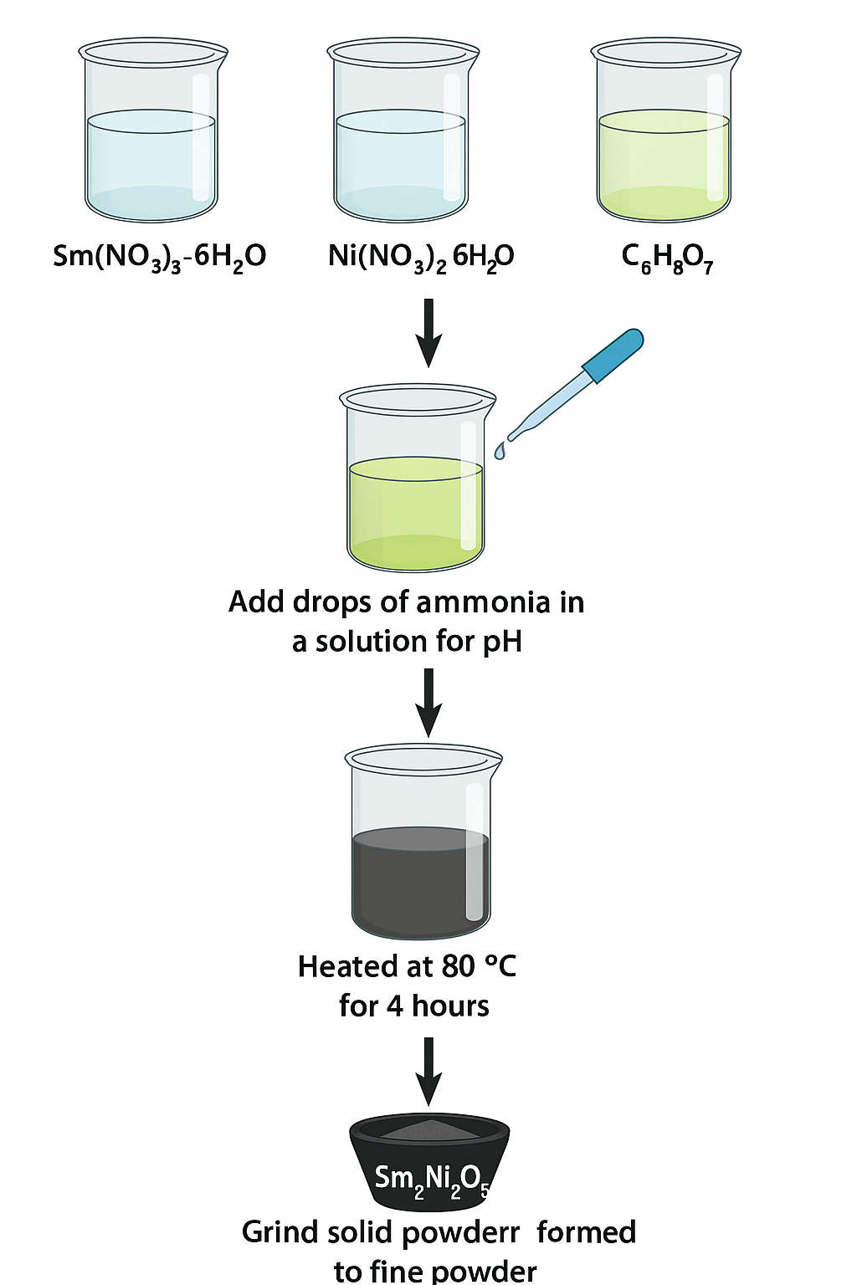
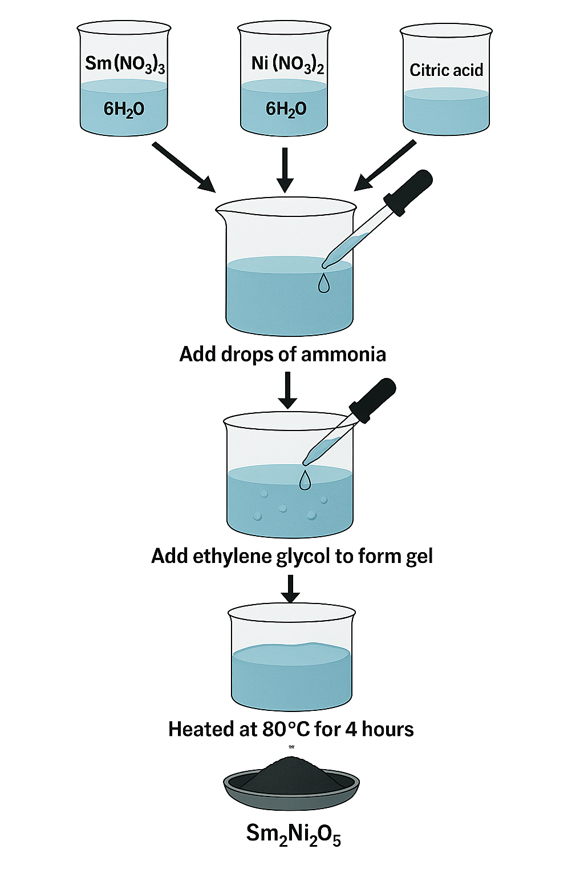
Synthesis Methods
The co-precipitation steps
The sol-gel steps
Figure 1: Schematic diagrams illustrating the step-by-step procedures of both the co-precipitation and sol-gel synthesis methods.
4

Slide 6
Characterization Techniques
XRD: Phase identification, crystallite size (W–H & D–S methods)
SEM/EDS: Surface morphology and elemental composition
Specific Heat: Thermal behavior and possible transitions
Magnetic Susceptibility (VSM): Magnetic response vs. temperature
5

Slide 7
Comparing co-precipitation and sol-gel methods
Figure 2: Rietveld-refined XRD patterns for SNONPs synthesized via (a) co-precipitation, and (b) sol-gel methods, confirming single-phase formation.
6

Slide 8
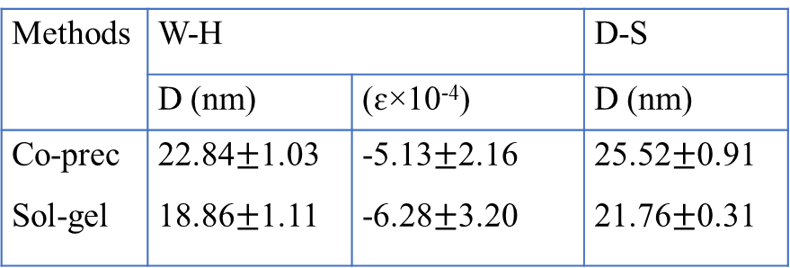
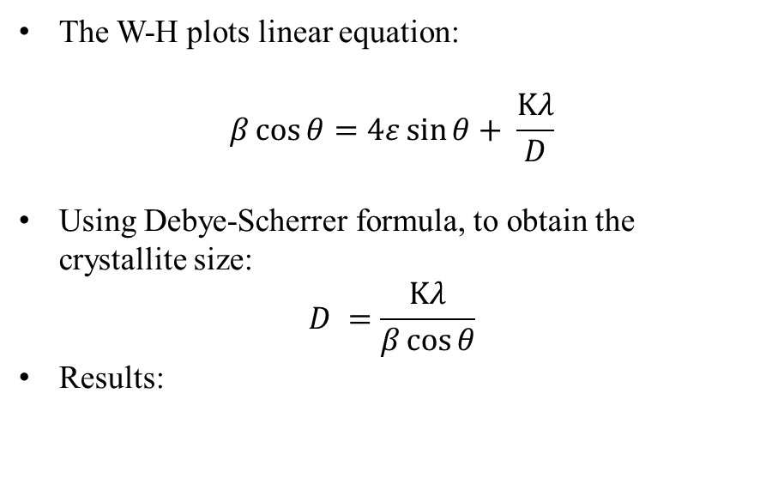
W-H Plot versus D-S equation
The W-H plots linear equation:
$$β\cos{θ}=4ε\sin{θ}+ \frac{Κλ}{D}$$
Using Debye-Scherrer formula, to obtain the crystallite size:
$$D =\frac{Κλ}{β\cos{θ}}$$
Results:
Methods | W-H |  | D-S
 | D (nm) | (ɛ×10⁻⁴) | D (nm)
Co-prec Sol-gel | 22.84$±$1.03 18.86$±$1.11 | -5.13$±$2.16 -6.28$±$3.20 | 25.52$±$0.91 21.76$±$0.31
Figure 3: W–H plots for both synthesis methods, revealing differences in crystallite size and microstrain.
7

Slide 9
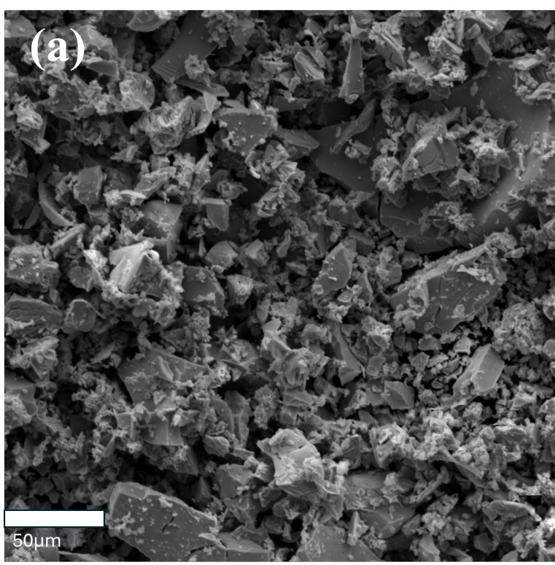
SEM of Co-prec and Sol-gel Methods
(b)
50 µm
Figure 4: (a) SEM micrograph of SNONPs synthesized via the co-prec method at 50 μm magnification, (b) SEM micrograph of SNONPs synthesized via the sol-gel method at 50 μm magnification.
8

Slide 10
EDS of Co-prec and Sol-gel Methods
(d)
Figure 5: (c) - (d) corresponding EDS spectrum confirming elemental composition repectively.
9

Slide 11
Specific heat of SNONPs via co-prec and sol-gel
Figure 6: Temperature-dependent heat capacity of SNONPs synthesized by co-precipitation and sol-gel methods: (a) Cp vs. T; (b) insert of (a) showing low-temperature Cp(T) features.
10

Slide 12
Specific heat of SNONPs via co-prec and sol-gel
The behaviour of Cp/T observed around 9 K indicates the Néel temperature (T_{N} = 9 K) marking the onset of AFM ordering from Ni²⁺ sublattices.
As temperature increases, another anomaly occurs at 43.6 K, which is interpreted as a Curie temperature (T_{C} = 44 K). This feature corresponds to a spin reorientation, of ferromagnetic (FM) contributions from the Ni²⁺-O-Ni³⁺ sublattice.
As in higher temperatures the presence of Ni mixed valence states disrupts the FM alignments to a long-range paramagnetic (PM) order.
Figure 7: (c) Cp/T vs. T, highlighting magnetic transitions.
11

Slide 13
Magnetic Susceptibility of SNONPs via co-prec and sol-gel
Figure 8: (a) Temperature-dependent magnetic susceptibility (χ) measured under a 0.5 T field of both methods, (b) Co-precipitated SNONPs with sol-gel showing dχ/dT.
12

Slide 14
Conclusion
SNONPs confirmed to be a single-phase material with an orthorhombic structure of the Ima2 space group.
Both characterization methods supported the single-phase nature of SNO.
Magnetic ordering is governed by both the 4f electrons of Sm³⁺–O–Sm³⁺ and the 4d electrons of Ni²⁺–O–Ni² ⁺ , Ni³⁺–O–Ni²⁺ ions.
At low temperatures, spin freezing arise due to Sm³⁺–O–Sm³⁺ coupling.
As temperature increases, the system transitions into an AFM state, influenced by the Ni²⁺–O–Ni²⁺ sublattice.
At higher temperatures, thermal effects lead to a PM phase dominated by mixed Ni spins dynamics.
The tunable magnetic behavior and structural flexibility make SNO a promising material for spintronic devices.
13

Slide 15
References
[1] Girardot, C., Kreisel, J., Pignard, S., Caillault, N., & Weiss, F. (2008). Raman scattering investigation across the magnetic and metal-insulator transition in rare earth nickelate RNiO₃ (R = Sm, Nd) thin films. Physical Review B, 78(10), 104101. https://doi.org/10.1103/PhysRevB.78.104101
[2] Liu, H., Díaz-Chao, P., Sániz, R., et al. (2020). Pressure-induced suppression of charge disproportionation and metal–insulator transition in SmNiO₃. Physical Review B, 101(12), 121105. https://doi.org/10.1103/PhysRevB.101.121105
[3] Serrano-Sánchez, F.; Fauth, F.; Martínez, J. L.; Alonso, J. A. Experimental Observation of Monoclinic Distortion in the Insulating Regime of SmNiO₃ by Synchrotron X-ray Diffraction. Inorganic Chemistry, 2019, 58 (18), 11828–11835. https://doi.org/10.1021/acs.inorgchem.9b02013
[4] Nishimura, Y.F., Kondo, Y., Oka, H.: Estimation of the average oxidation number of nickel in a nickel oxide based on local structural information. J Power Sources. 446, 227351 (2020). https://doi.org/10.1016/j.jpowsour.2019.227351
[5] Zhang, Y., Ru, Y., Gao, H.-L., Wang, S.-W., Yan, J., Gao, K.-Z., Jia, X.-D., Luo, H.-W., Fang, H., Zhang, A.-Q., Wang, L.-Z.: Sol-gel synthesis and electrochemical performance of NiCo2O4 nanoparticles for supercapacitor applications. Journal of Electrochemical Science and Engineering. 9, 243–253 (2019). https://doi.org/10.5599/jese.690
[6] Bokov, D., Turki Jalil, A., Chupradit, S., Suksatan, W., Javed Ansari, M., Shewael, I.H., Valiev, G.H., Kianfar, E.: Nanomaterial by Sol‐Gel Method: Synthesis and Application. Advances in Materials Science and Engineering. 2021, (2021). https://doi.org/10.1155/2021/5102014
[7] Besenhard, M.O., LaGrow, A.P., Hodzic, A., Kriechbaum, M., Panariello, L., Bais, G., Loizou, K., Damilos, S., Margarida Cruz, M., Thanh, N.T.K., Gavriilidis, A.: Co-precipitation synthesis of stable iron oxide nanoparticles with NaOH: New insights and continuous production via flow chemistry. Chemical Engineering Journal. 399, 125740 (2020). https://doi.org/10.1016/j.cej.2020.125740
[8] Petcharoen, K., Sirivat, A.: Synthesis and characterization of magnetite nanoparticles via the chemical co-precipitation method. Materials Science and Engineering: B. 177, 421–427 (2012). https://doi.org/10.1016/j.mseb.2012.01.003
14

Slide 16
THANK YOU
QUESTIONS OR SUGGESTIONS

