Slide 1

DFT-based evaluation of Li₂MnO₃ as a promising cathode coating material for lithium-ion batteries
M.Z. Kgasago¹, K.W. Phoshoko², P. E. Ngoepe¹ and R.S. Ledwaba¹
1. Materials Modelling Centre, School of Physical and Mineral Sciences
University of Limpopo, Private Bag x 1106, Sovenga, 0727, South Africa
2. Data Intensive Research Initiative of South Africa, Council for Scientific and Industrial Research,
P.O. Box 395, Pretoria, 0001, South Africa
Email: Kgasagomogau@gmail.com

Slide 2
Introduction
A perfect cathode material for lithium-ion batteries does not yet exist [1,2].
LiCoO₂
LiMn₂O₄
LiFePO₄
LiMn₂O₄’s spinel structure has 3D lithium pathways and offers abundance, low cost, and good thermal stability [2].
J Guo, S Li, B Zhu, H Zhang, X Gao, Y Wu, S Zhang, N Wen, X Wang, Y Lai, Z Zhang, Chemical Engineering Journal, 471, 1-10, (2023).
J Xu, S Zhu, Z Xu, H Zhu, Computational Materials Science, 229, 1-7, (2023).

Slide 3
Drawbacks of spinel
The spinel LiMn₂O₄ presents the following key challenges as a cathode material:
Jahn–Teller distortion causes structural instability [2]
Capacity fading due to transition metal dissolution [2]
Many methods have been introduced to modify the properties and morphology of this structure to enhance its stability and performance.
Doping [4]
Surface coating [3]
Core-shell design [4]
2. J Xu, S Zhu, Z Xu, H Zhu, Computational Materials Science, 229, 1-7, (2023).
3. NM Jobst, G Gabrielli, P Axmann, M Hölzle, M Wohlfahrt-Mehrens, Journal of The Electrochemical Society, 168, 1-8, (2021).
4. C Tomon, S Sarawutanuku, N Phattharasupakun, S Duangdangchote, P Chomkhuntod, N Joraleechanchai, P Bunyanidhi, M Sawangphruk, 552, 1-12, 2022

Slide 4
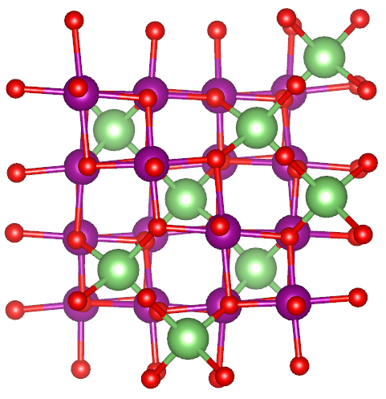
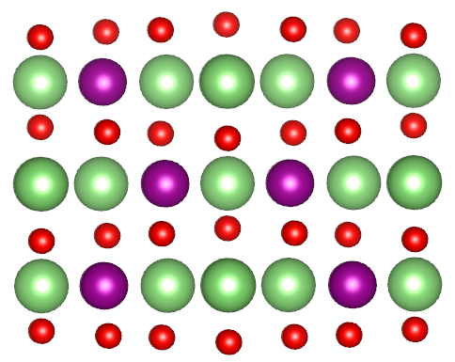

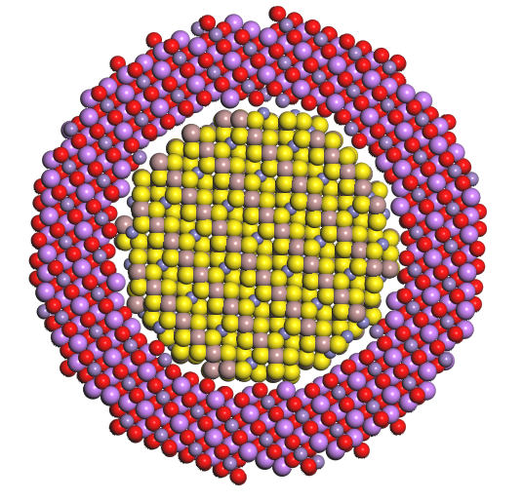
A core-shell design
Spinel Fd-3m
Layered C/2m
LiMn₂O₄
Li₂MnO₃
The advantages of the core-shell design:
Mitigate phase transition [5].
Minimize unwanted reactions.
Prevent electrode-electrolyte interactions.
In this study, we use density functional theory (DFT) to investigate the compatibility of Li₂MnO₃ as a shell material for LiMn₂O₄
5. Xu J, Zhu S, Xu Z, Zhu H, Computational Material Science, 229, 1-7, (2023).

Slide 5
Methodology
Density functional theory (DFT) [6]
Vienna Ab-initio Simulation Package (VASP) code [7]
Convergence test
Energy cut-off: 500 eV k-points-
LiMn₂O₄: 5x5x5 Li₂MnO₃: 4X4X4
GGA+U [8]
U-parameter
LiMn₂O₄=4 Li₂MnO₃=5
Spin configurations
FM vs AFM
Structural properties
Electronic properties
6. W Kohn, LJ Sham, Physical Review, 140, A1133-A1138, (1965).
7. G Kresse, J Hafner. Physical Review B, 49 14251 – 14269 (1994)
8. J P Perdew, K Burke, and M Ernzerhof, Physical Review Letter, 77, 3865 (1996).

Slide 6
Structural properties
System | Lattice parameters (Å)
 | GGA+U
 | FM | AFM | Experimental
LiMn₂O₄ f-3m | 8.35 | 8.33 | 8.24 [9]
Li₂MnO₃ C/2m | a=5.01 b=8.65 c=5.08 | a=4.95 b=8.54 c=5.03 | a=4.94 [10] b=8.53 c=5.05
For both systems, the AFM configuration consistently provides better agreement with experimental lattice parameters compared to the FM configuration.
LiMn₂O₄
Li₂MnO₃
FM
AFM
9. Y Idemoto, K Horiko, K Ui, N Koura , Electrochemistry, 72, 10, 680-687, (2004).
10. P Strobel, B Lambert-Andron, Journal of Solid-State Chemistry, 75, 90-98, (1988).

Slide 7
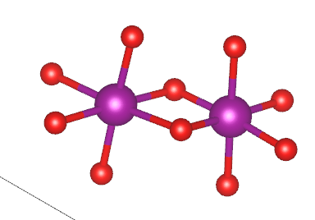
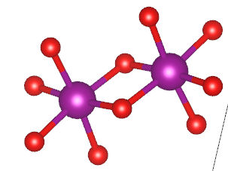
Bond lengths
LiMn₂O₄
Li₂MnO₃
1.994
1.971
1.918
1.930
1.925
2.179
1.927
1.918
1.925
1.926
1.948
1.902
Mn⁴⁺
1.976
Mn³⁺
1.930
1.925
1.918
Mn⁴⁺
2.178
Mn⁴⁺
1.918
1.950
1.941
1.925
1.918
1.938
Material | Valence State | Average Bond lengths (Å)
LiMn₂O₄ | Mn³⁺ | 2.0325
 | Mn⁴⁺ | 1.9418
Li₂MnO₃ | Mn⁴⁺ | 1.9235
In LiMn₂O₄, Mn³⁺–O bonds are longer due to Jahn–Teller distortion, causing structural instability.
Li₂MnO₃ shows uniform Mn⁴⁺–O bond lengths, reflecting a more stable structure.

Slide 8
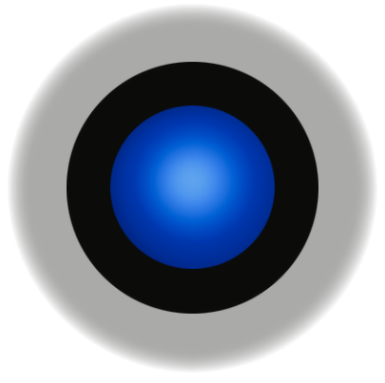
Magnetic Behavior of Mn
Material | Valence State | Magnetic Moments (µB)
LiMn₂O₄ | Mn³⁺ | 3.8
 | Mn⁴⁺ | 3.0
Li₂MnO₃ | Mn⁴⁺ | 3.1
LiMn₂O₄ shows two distinct magnetic moments, confirming Mn³⁺/Mn⁴⁺ coexistence.
Li₂MnO₃ shows uniform moments, consistent with Mn⁴⁺.
Electrolyte
Layered
The uniform Mn⁴⁺ coating acts as a barrier between the spinel core and the electrolyte, preventing direct contact and thereby suppressing Mn dissolution.
Spinel

Slide 9
Density of states
LiMn₂O₄
Li₂MnO₃
LiMn₂O₄ has a small band gap (~0.5 eV), classified as a semiconductor.
Li₂MnO₃ has a wider band gap (~2.1 eV), also classified as a semiconductor.

Slide 10
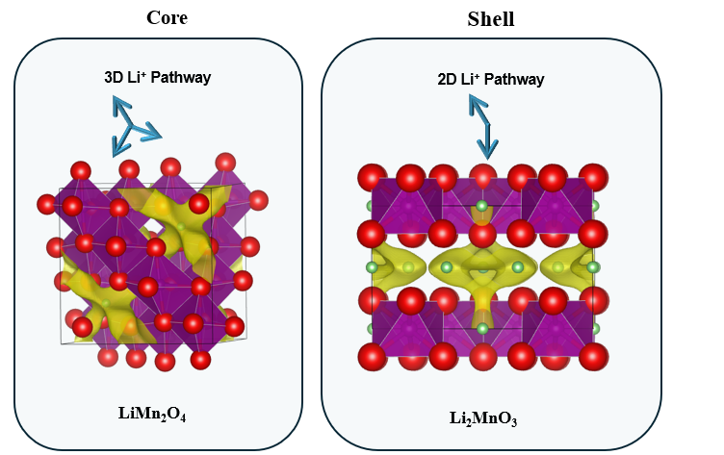
Diffusion pathways
LiMn₂O₄
Li₂MnO₃

Slide 11
Conclusion
This study aimed to assess the compatibility of Li₂MnO₃ as a shell material for stabilizing a LiMn₂O₄ spinel core using DFT.
Structural analysis showed that LiMn₂O₄ suffers from Jahn–Teller distortion, while Li₂MnO₃ remains structurally stable.
Magnetic moments confirmed Mn³⁺/Mn⁴⁺ disorder in the core and uniform Mn⁴⁺ states in the shell.
DOS results showed that Li₂MnO₃ is a wide-gap semiconductor, helping reduce unwanted surface redox activity.
The layered Li₂MnO₃ shell will potentially act as a barrier between the spinel core and the electrolyte, helping suppress Mn dissolution and enhance cathode stability.

Slide 12




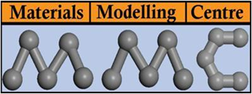
Acknowledgements

Slide 13

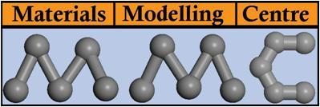
Thank You

