Slide 1



Exploring Long-term variations of Ionospheric Total Electron Content over South Africa
Modiri Mokaila
MSc Student (CSR-NWU)
Dr. Daniel Mojalefa Moeketsi
Centre for Space Research, North-West University, 11 Hoffman Street, Potchefstroom, South Africa
Prof. John-Bosco Habarulema
South African National Space Agency, Hospital Street, Hermanus 7200, South Africa
Prof SES Ferreira
Centre for Space Research, North-West University, 11 Hoffman Street, Potchefstroom, South Africa

Slide 2
OUTLINE
The Sun, and Solar Cycle
Ionosphere
Global Navigation Satellite System
Total Electron Content
Software Technique
Results
Summary and Future work

Slide 3
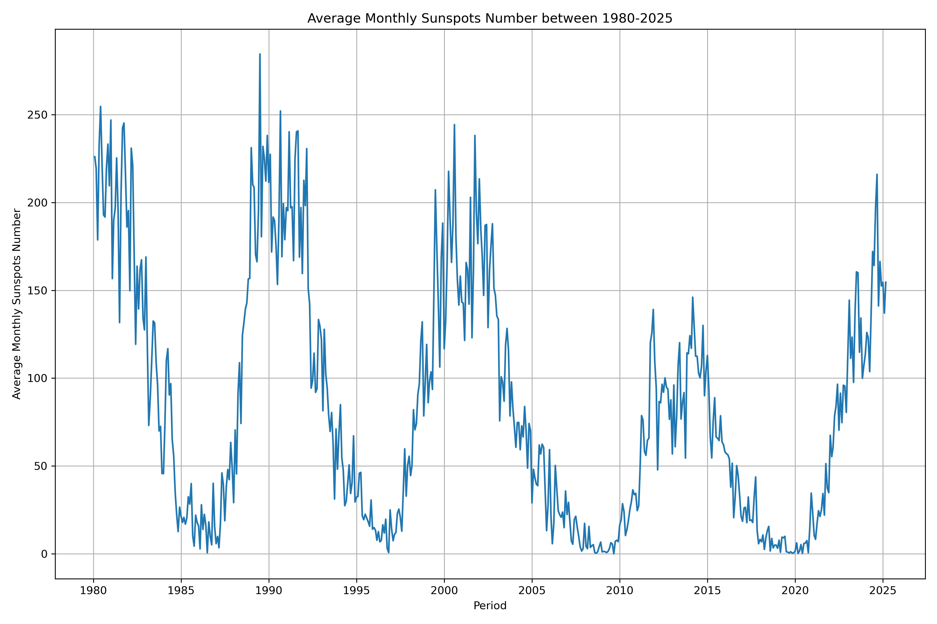
The SUN AND SOLAR CYCLE
Primary driver of atmospheric and geo-magnetic variability of the Earth
Spatial, temporal nature of Earth atmosphere depend on solar activity, solar cycle (SS) progression, geomagnetic activity, seasons, local time
Solar activity can be characterized by different solar proxies:
  11-year cycle using sunspot numbers (R),
SS 21
SS 22
SS 23
SS 25
SS 24

Slide 4
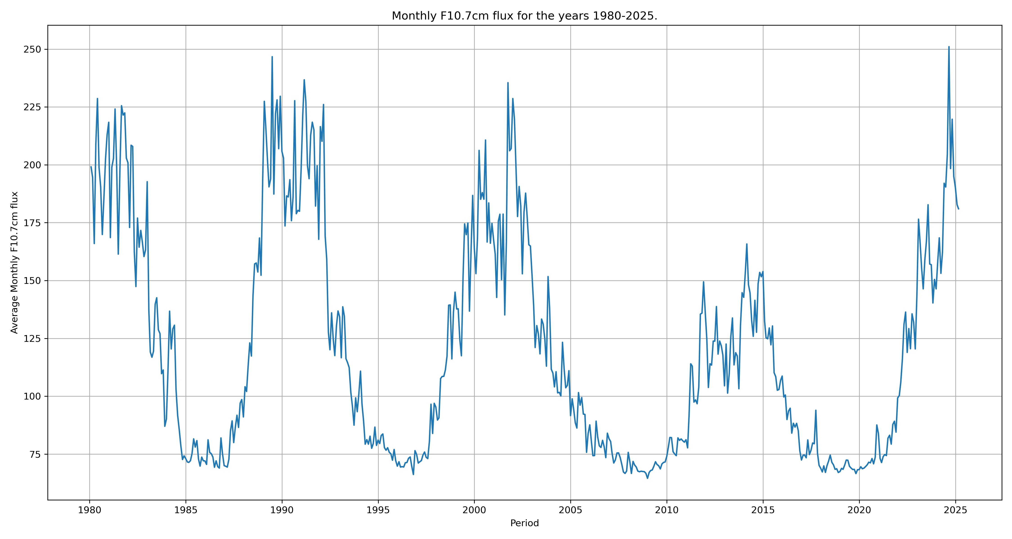
The SUN AND SOLAR CYCLE(cont…)
Can be characterized by different solar proxies:
  A 10.7 cm solar radio flux (F10.7),

Slide 5
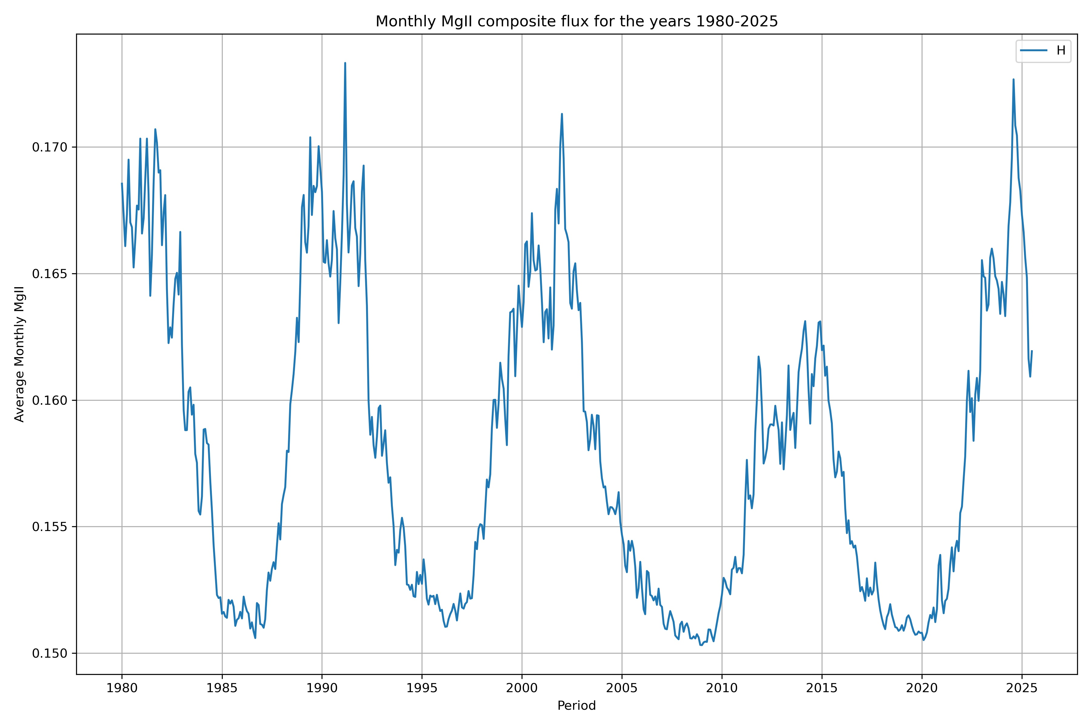
The SUN AND SOLAR CYCLE(cont…)
Can be characterized by different solar proxies:
  the ratio of the h (279.9nm) & k (280.3nm) lines of the magnesium II emission (MgII)

Slide 6
Ionosphere
Ionized layer between ~60km – 1000km (stratosphere, mesosphere, thermosphere), EUV , X-rays
Effect on radio waves propagation (dispersive plasma), HF communications, navigation, remote sensing
Understanding the dynamics allows proper calibration of astronomic equipment for better observation
Better understanding of the influence of the sun on earth systems and technology, space weather monitoring, by studying long-term changes in the ionosphere

Slide 7
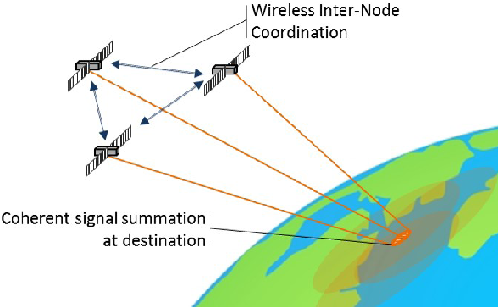
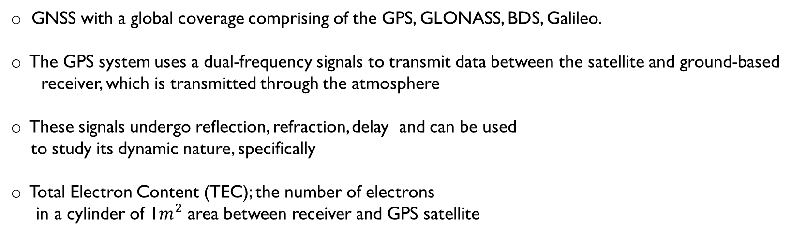
Global Navigation Satellite System (GNSS) AND tec
GNSS with a global coverage comprising of the GPS, GLONASS, BDS, Galileo.
The GPS system uses a dual-frequency signals to transmit data between the satellite and ground-based
receiver, which is transmitted through the atmosphere
These signals undergo reflection, refraction, delay and can be used
to study its dynamic nature, specifically
Total Electron Content (TEC); the number of electrons
in a cylinder of 1$m^{2}$ area between receiver and GPS satellite

Slide 8
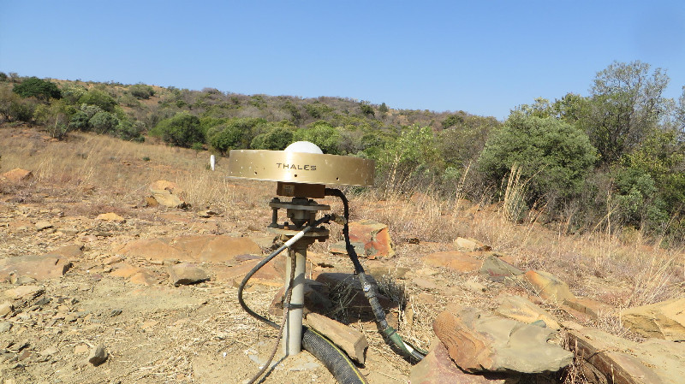
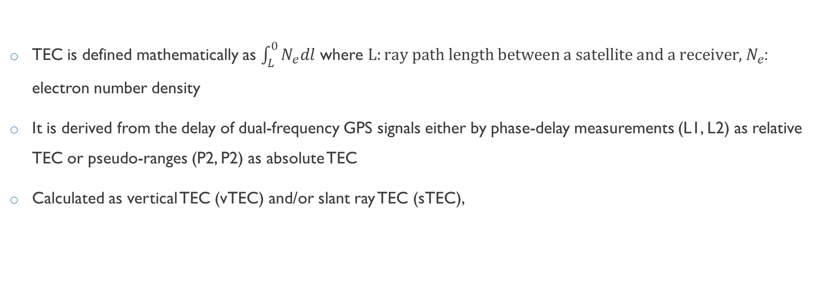
Gnss AND tec (cont…)
TEC is defined mathematically as $\int_{L}^{0}{N_{e}dl}$ where $L:ray path length between a satellite and a receiver,{ N}_{e}$: electron number density
It is derived from the delay of dual-frequency GPS signals either by phase-delay measurements (L1, L2) as relative TEC or pseudo-ranges (P2, P2) as absolute TEC
Calculated as vertical TEC (vTEC) and/or slant ray TEC (sTEC),
Figure 5: GPS ground receiver. Source:https://www.sonel.org/spip.php?page=gps&idStation=699

Slide 9

Software
Novel regularized Estimation technique of VTEC/STEC from GPS data (https://www.ionolab.org/index.php?page=tec&language=en ) Arikan et. al. 2004, 2005 and Nayir et. al 2007
This technique combines multiple GPS signals at a given receiver for 24hrs at 30s resolution and assumes the ionosphere to be a single layer at 428.8 km
Provides short-term and long-term variations in GPS-TEC

Slide 10
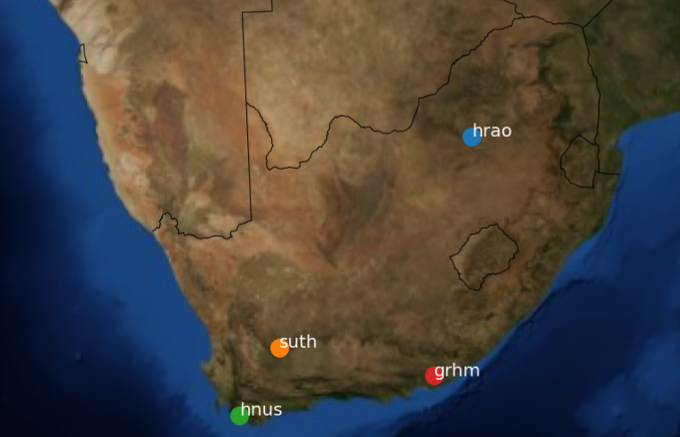
Modelling
Sutherland (SUTH) and Hartebeeshoek (HRAO) GPS station data is used, at a 25 years period
To calculate trends in TEC, model data by linear regression
TEC_mod = A + B*solarproxy
Solar proxy: R, MgII, F10.7 as they eliminates solar cycle effects
To calculate trends, we use residuals:
residuals = TEC_obs – TEC_mod, perform another regression
with residuals = C + ß*time (monthly & yearly averages)
Current Work
Future Work stations

Slide 11
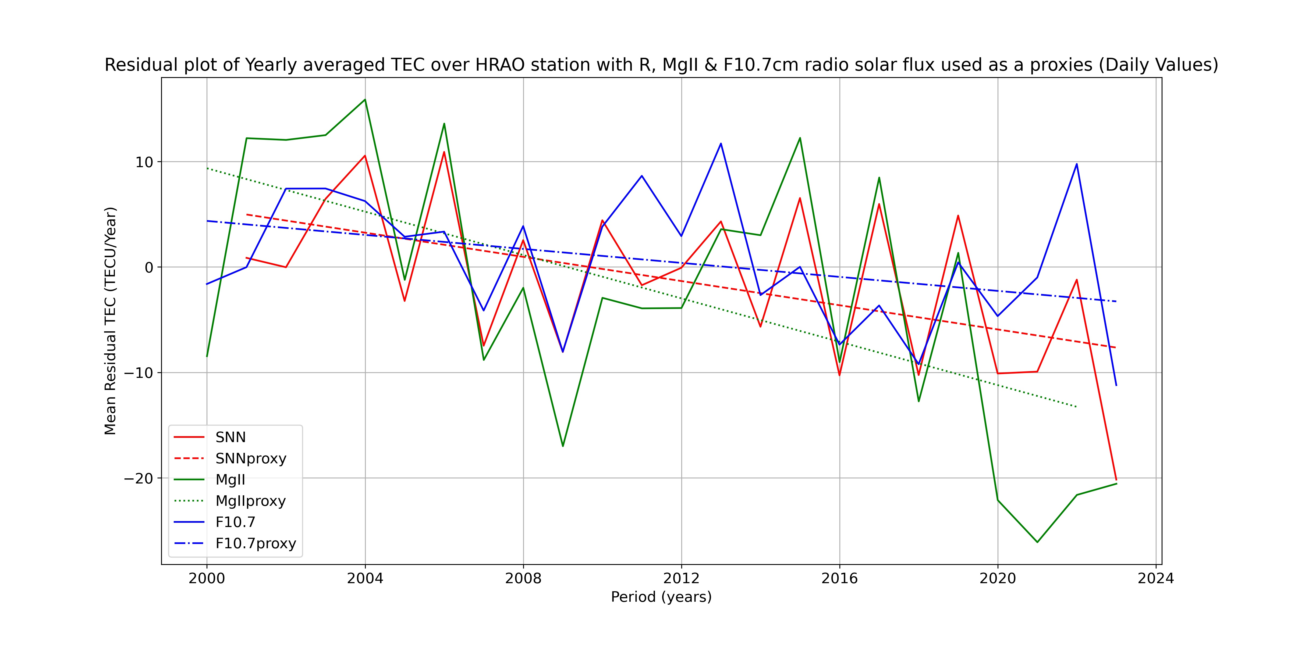

Slide 12
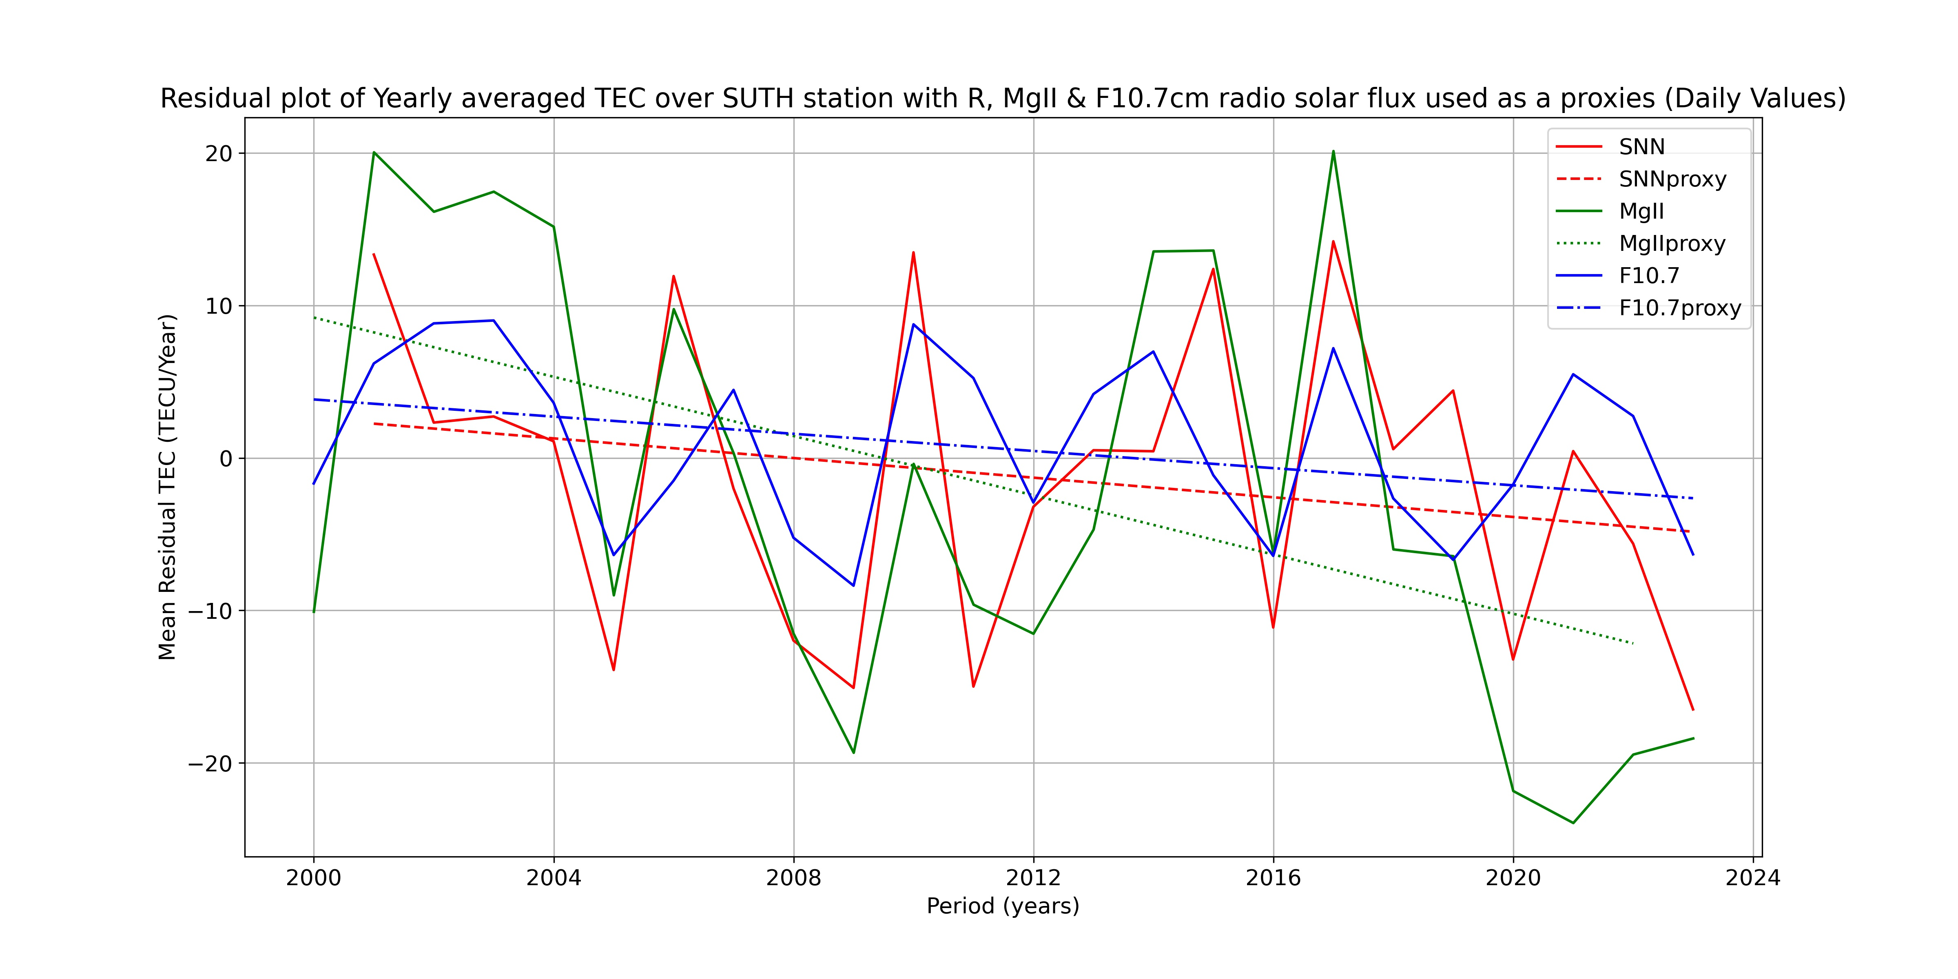

Slide 13
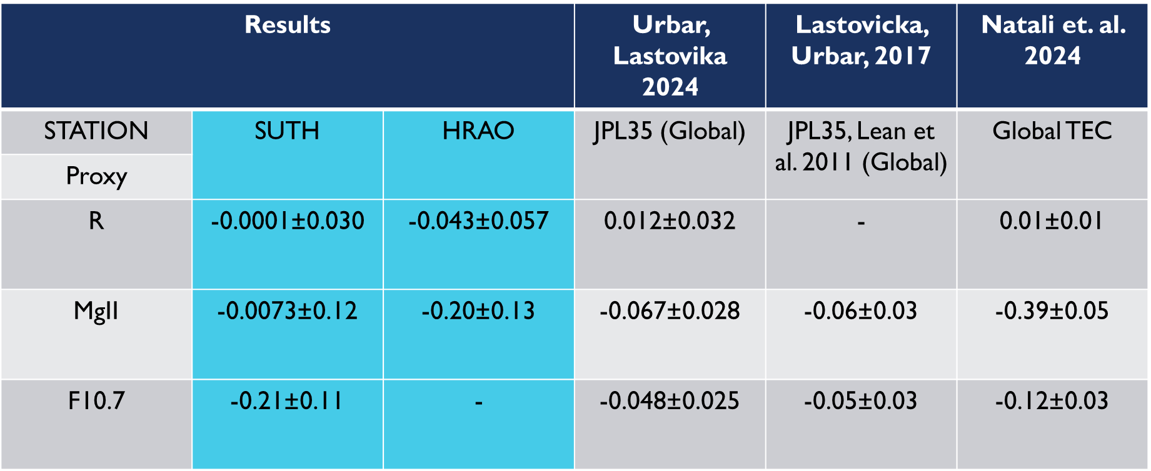
ReSULTS
These values show the coefficient ß against 3 literature articles

Slide 14
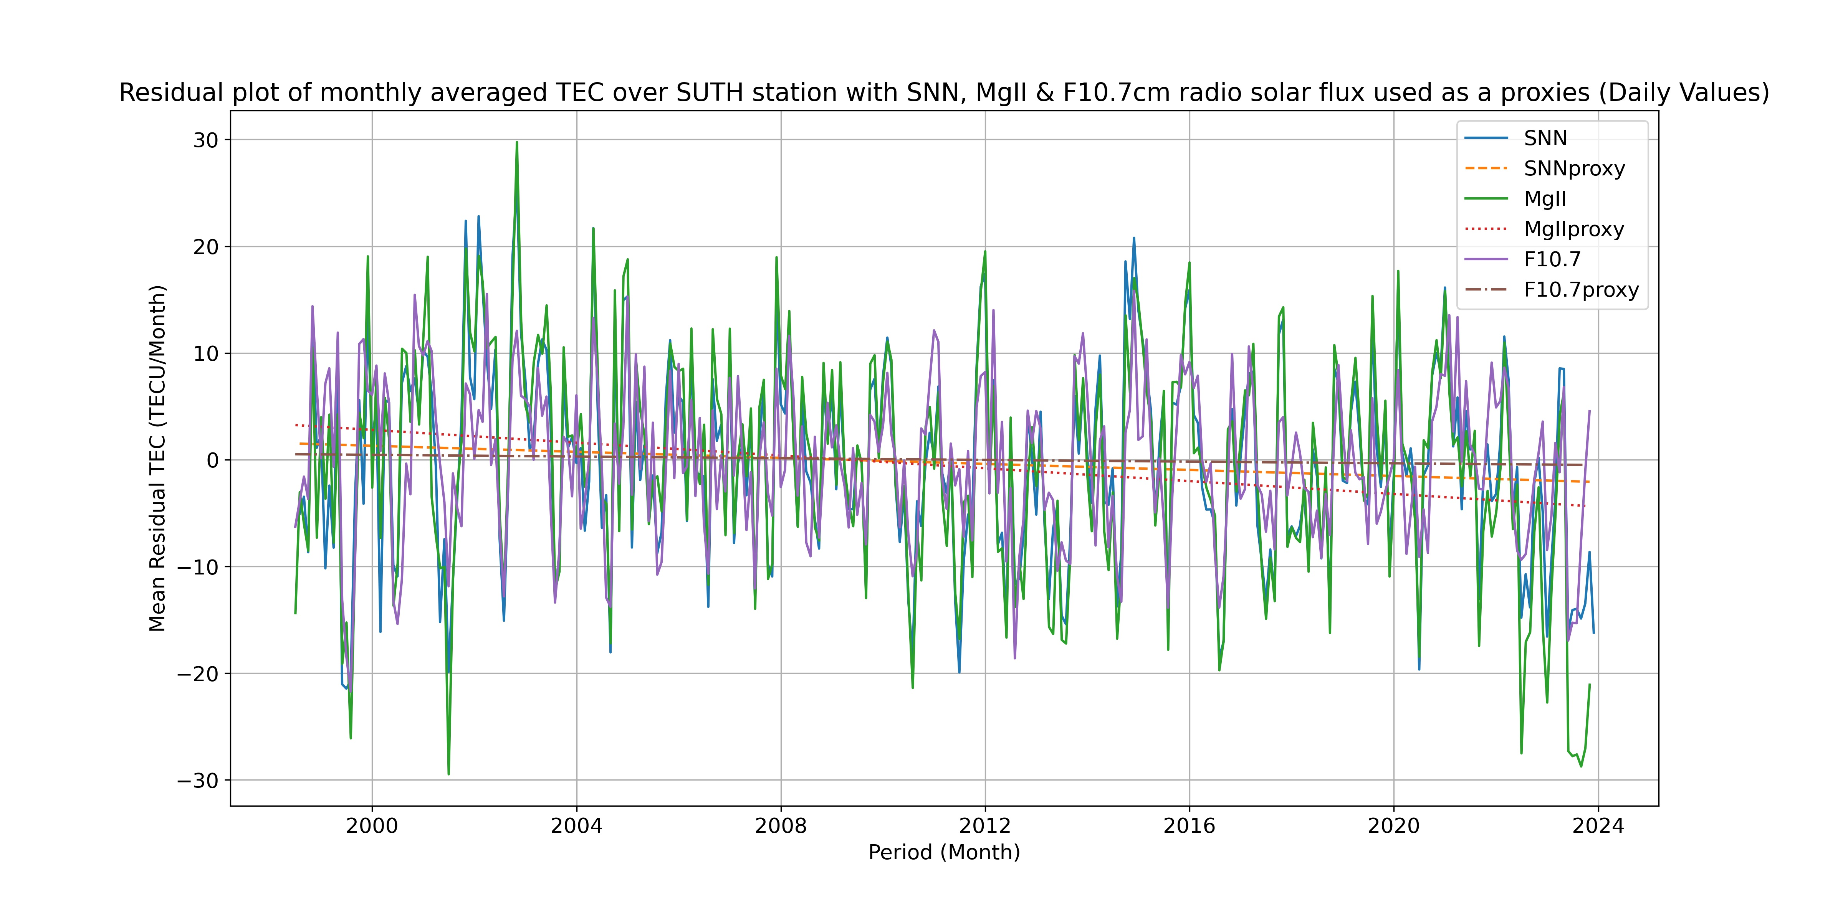

Slide 15
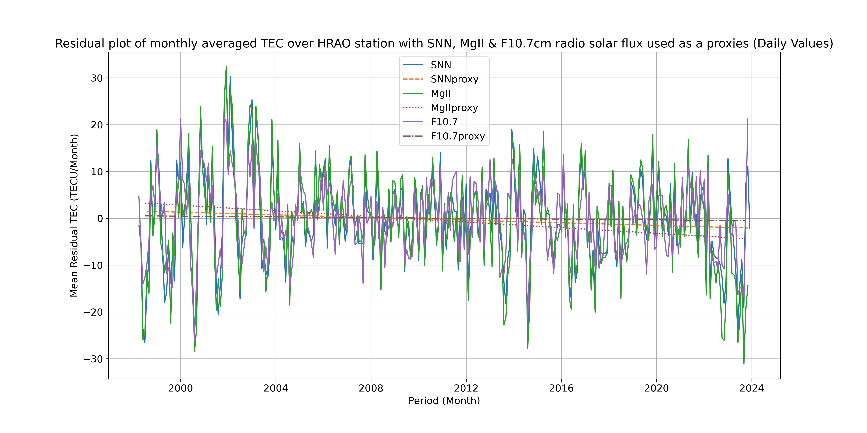

Slide 16
Results |  |  | Urbar, Lastovika 2024 | Lastovicka, Urbar, 2017 | Natali et. al. 2024
STATION | SUTH | HRAO | JPL35 (Global) | JPL35, Lean et al. 2011 (Global) | Global TEC
Proxy
R | -0.15±0.064 | 0.0029±0.056 | 0.012±0.032 | - | 0.01±0.01
MgII | -0.3478±0.091 | -0.1814±0.054 | -0.067±0.028 | -0.06±0.03 | -0.39±0.05
F10.7 | -0.2638±0.074 | -0.0906±0.052 | -0.048±0.025 | -0.05±0.03 | -0.12±0.03

Slide 17
Summary and Future Work
Study used 2 stations to investigate long-term changes in the ionosphere over the South African midlatitude
Linear regression provides a close approximation of the model of observed data
R, MgII & F10.7 verifies a negative trend similar to literature
The ionosphere is slowly decreasing over this region
Ingest South African TrigNET from HNUS and GRHM stations data into the IONOLAB algorithm

Slide 18
END
THANK YOU

