Slide 1


Modelling Earth’s magnetic field over the South Atlantic Anomaly region using Swarm satellite and ground-based data
Sanele Lionel Khanyile¹˒²*, Emmanuel Nahayo¹, and John Bosco Habarulema¹˒² ˒³
¹South African National Space Agency (SANSA), Hospital Street, Hermanus 7200, South Africa
²Department of Physics and Electronics, Rhodes University, Makhanda 6140, South Africa
³Centre for Space Research, North-West University, Potchefstroom 2520, South Africa
Tel: +27 28 285 0077, Email address: skhanyile@sansa.org.za

Slide 2
Outline
Introduction
Data selection and processing
Methodology (Revised Spherical Cap Harmonic Analysis (R-SCHA))
Results and discussions
Conclusion

Slide 3
Introduction
The South Atlantic Anomaly (SAA), located between Southern Africa and South America, is a key region of interest due to its notably weak magnetic field, which impacts satellite operations, increases radiation exposure, and affects space weather (Konradi et al., 1994; Gubbins et al., 2000, 2000b; Smith et al., 2016).
Recent studies using global models like IGRF-13 (Rother et al., 2021) and CHAOS-7 (Finlay et al., 2020) show that the South Atlantic Anomaly is deepening, expanding, and moving westward due to complex core processes. However, these models may miss fine-scale features, highlighting the need for detailed regional studies.
This study models the Earth's magnetic field over the SAA using high-resolution Swarm satellite data (Olsen et al., 2013) and ground-based observations. Applying the R-SCHA technique, it aims to better understand the region’s ongoing magnetic field intensity decrease.

Slide 4
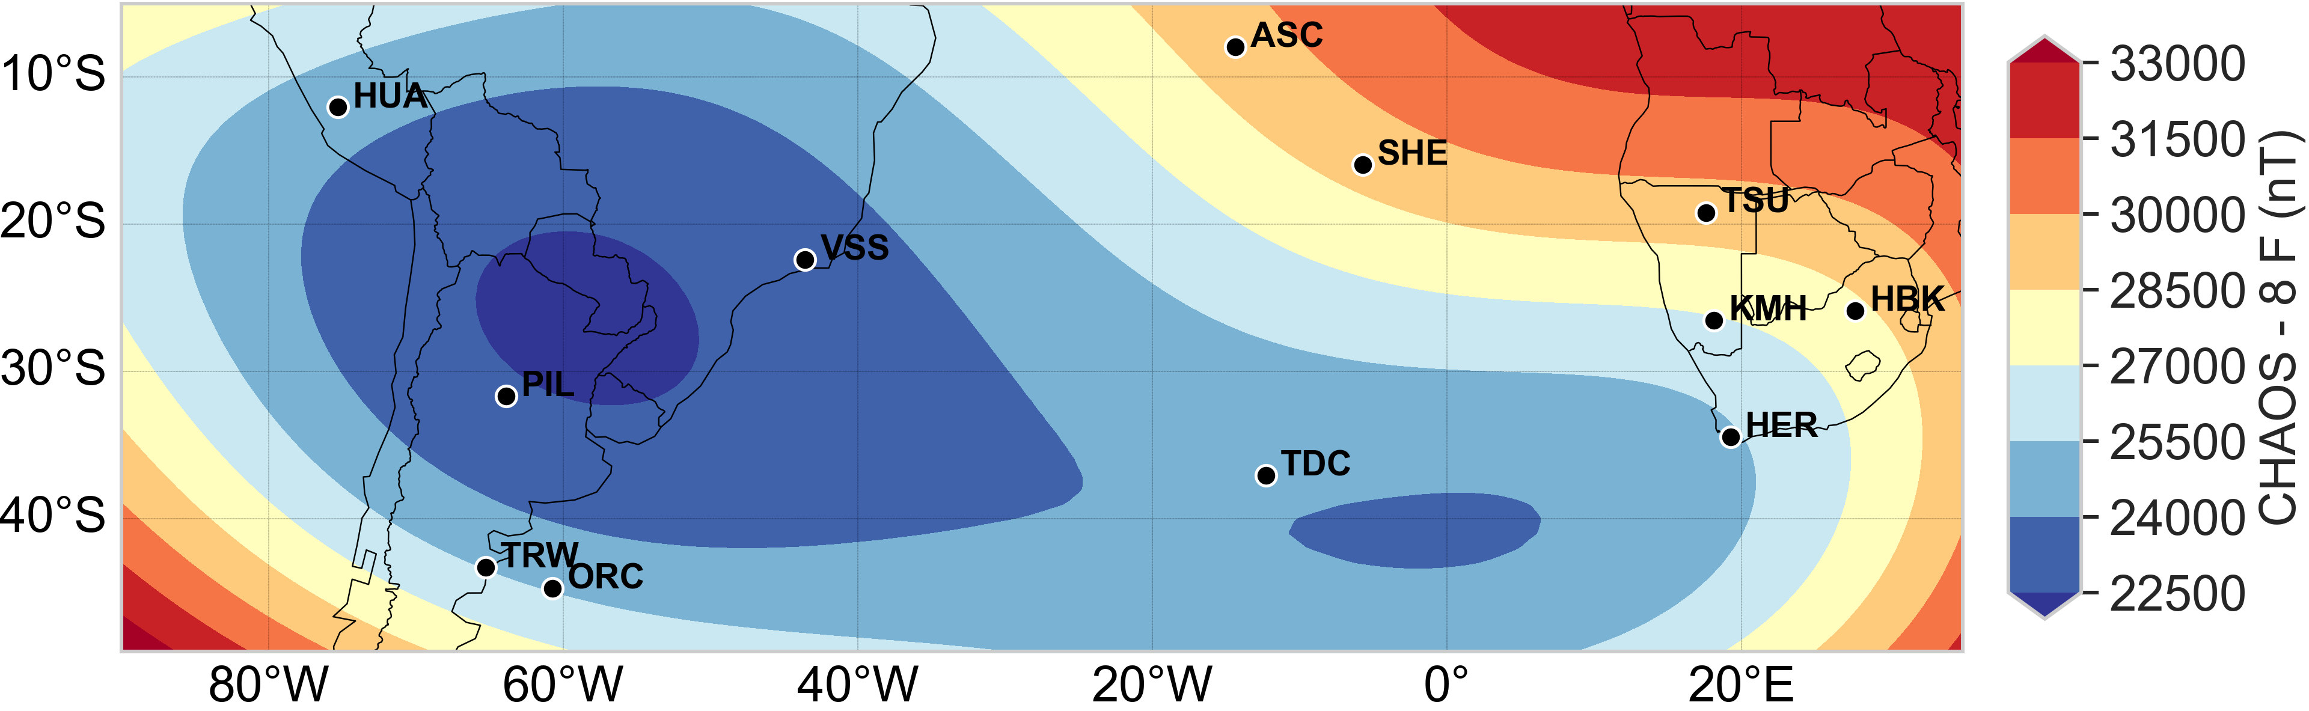
Introduction (cont.)
The map shows total magnetic field intensity at ground level for epoch 2020.0, based on the CHAOS-8.1 model, with black dots marking magnetic observatory locations in the region.

Slide 5
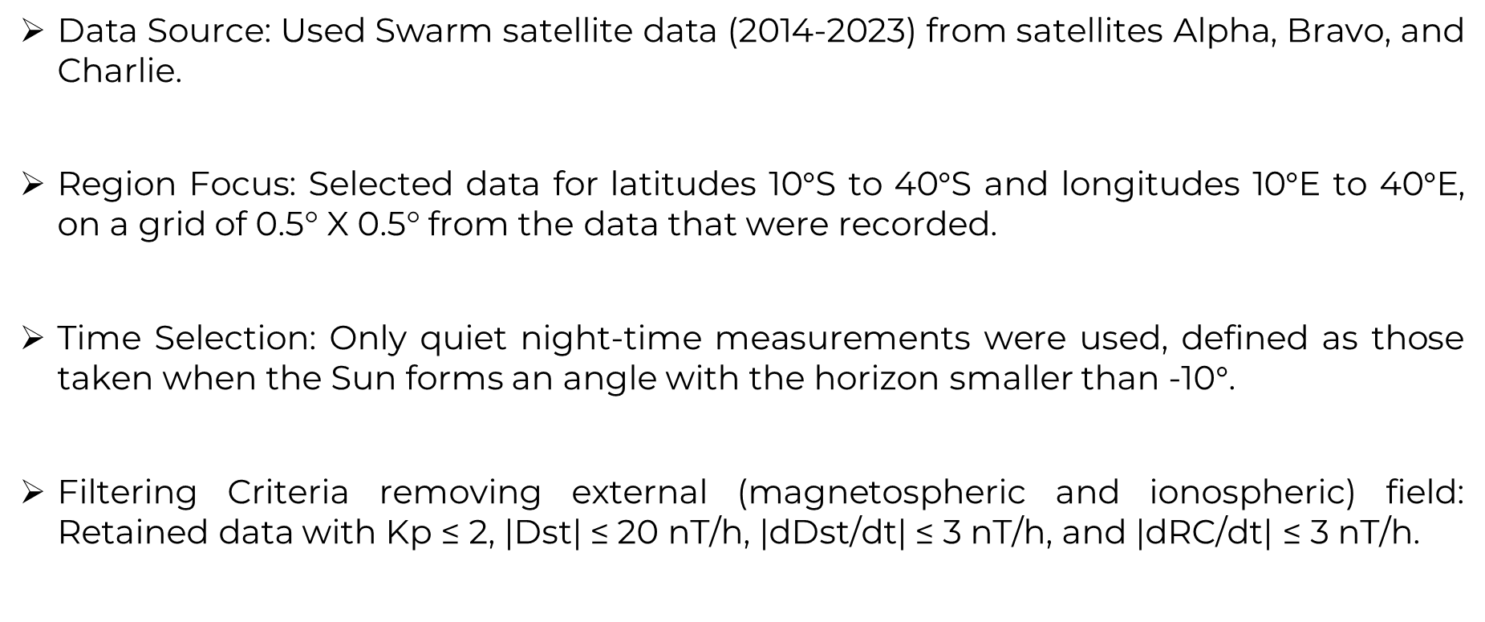
Data selection and processing
Data Source: Used Swarm satellite data (2014-2023) from satellites Alpha, Bravo, and Charlie.
Region Focus: Selected data for latitudes 10$°$S to 40$°$S and longitudes 10$°$E to 40$°$E, on a grid of 0.5° X 0.5° from the data that were recorded.
Time Selection: Only quiet night-time measurements were used, defined as those taken when the Sun forms an angle with the horizon smaller than -10$°$.
Filtering Criteria removing external (magnetospheric and ionospheric) field: Retained data with Kp ≤ 2, |Dst| ≤ 20 nT/h, |dDst/dt| ≤ 3 nT/h, and |dRC/dt| ≤ 3 nT/h.

Slide 6
Data selection and processing (cont.)
Lithospheric Magnetic Field: Removed using the MF7 lithospheric field model (Maus, 2010).
The external field contributions: Removed using the CHAOS-8.1 global geomagnetic field model (Finlay et al., 2020).
Data Decimation: Reduced model input data by retaining only data recorded inside 0.2° radius bins on the grid of 0.5° X 0.5°, and retaining a single point per epoch, resulting in 83,266 vector data points.

Slide 7
Data selection and processing (cont.)
Data Source: Used hourly mean data from four magnetic observatories: Hermanus (HER), Tsumeb (TSU), Hartebeesthoek (HBK), and Keetmanshoop (KMH).
Selection Criteria: Applied the same criteria as for satellite data selection.
Daily Averaging: Daily means were calculated by averaging the selected hourly data.
Data Retained: A total of 10,812 vector data points were retained from the observatory data.
Crustal Bias Removal: Removed biases from the observatory using methods by Korte and Thebault (2007); Mandea and Langlais (2002). Biases (Xc, Yc, Zc) were calculated as differences between observatory measurements (Xi, Yi, Zi) and model predictions (Xm, Ym, Zm) using the CHAOS-8.1 model.

Slide 8
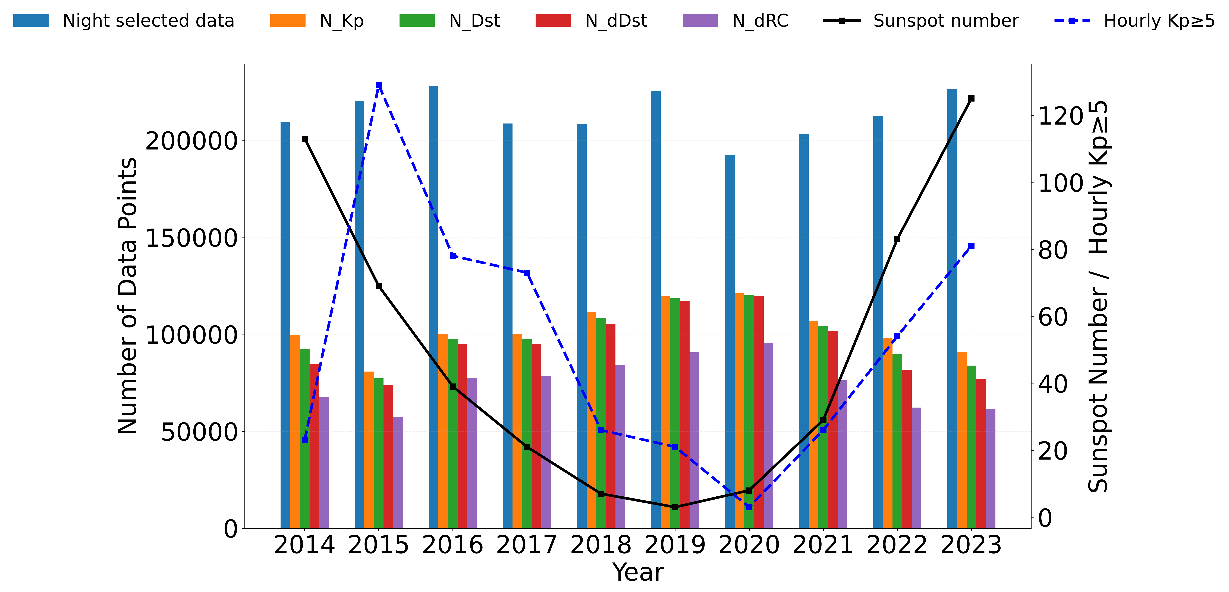
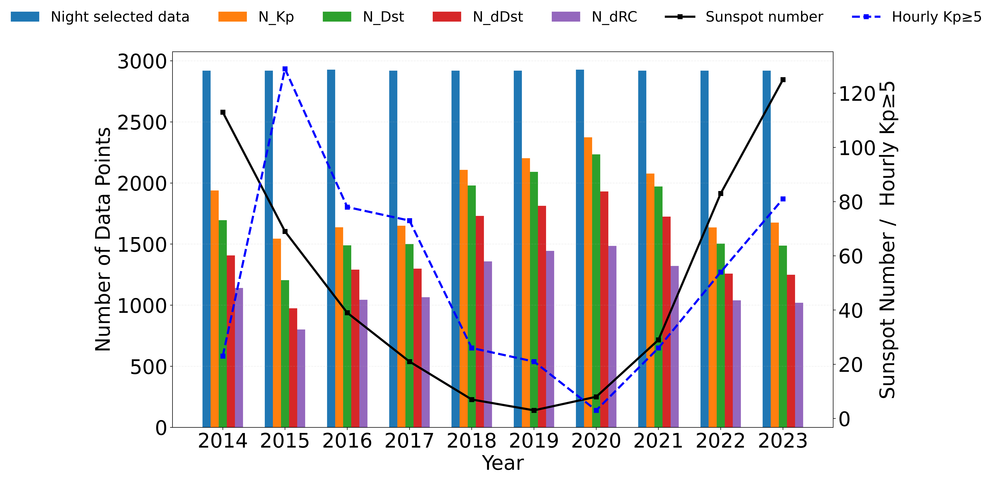
Data selection and processing (cont.)
Data selected during nighttime periods, filtered using geomagnetic indices, with corresponding solar activity included for illustration purposes.

Slide 9
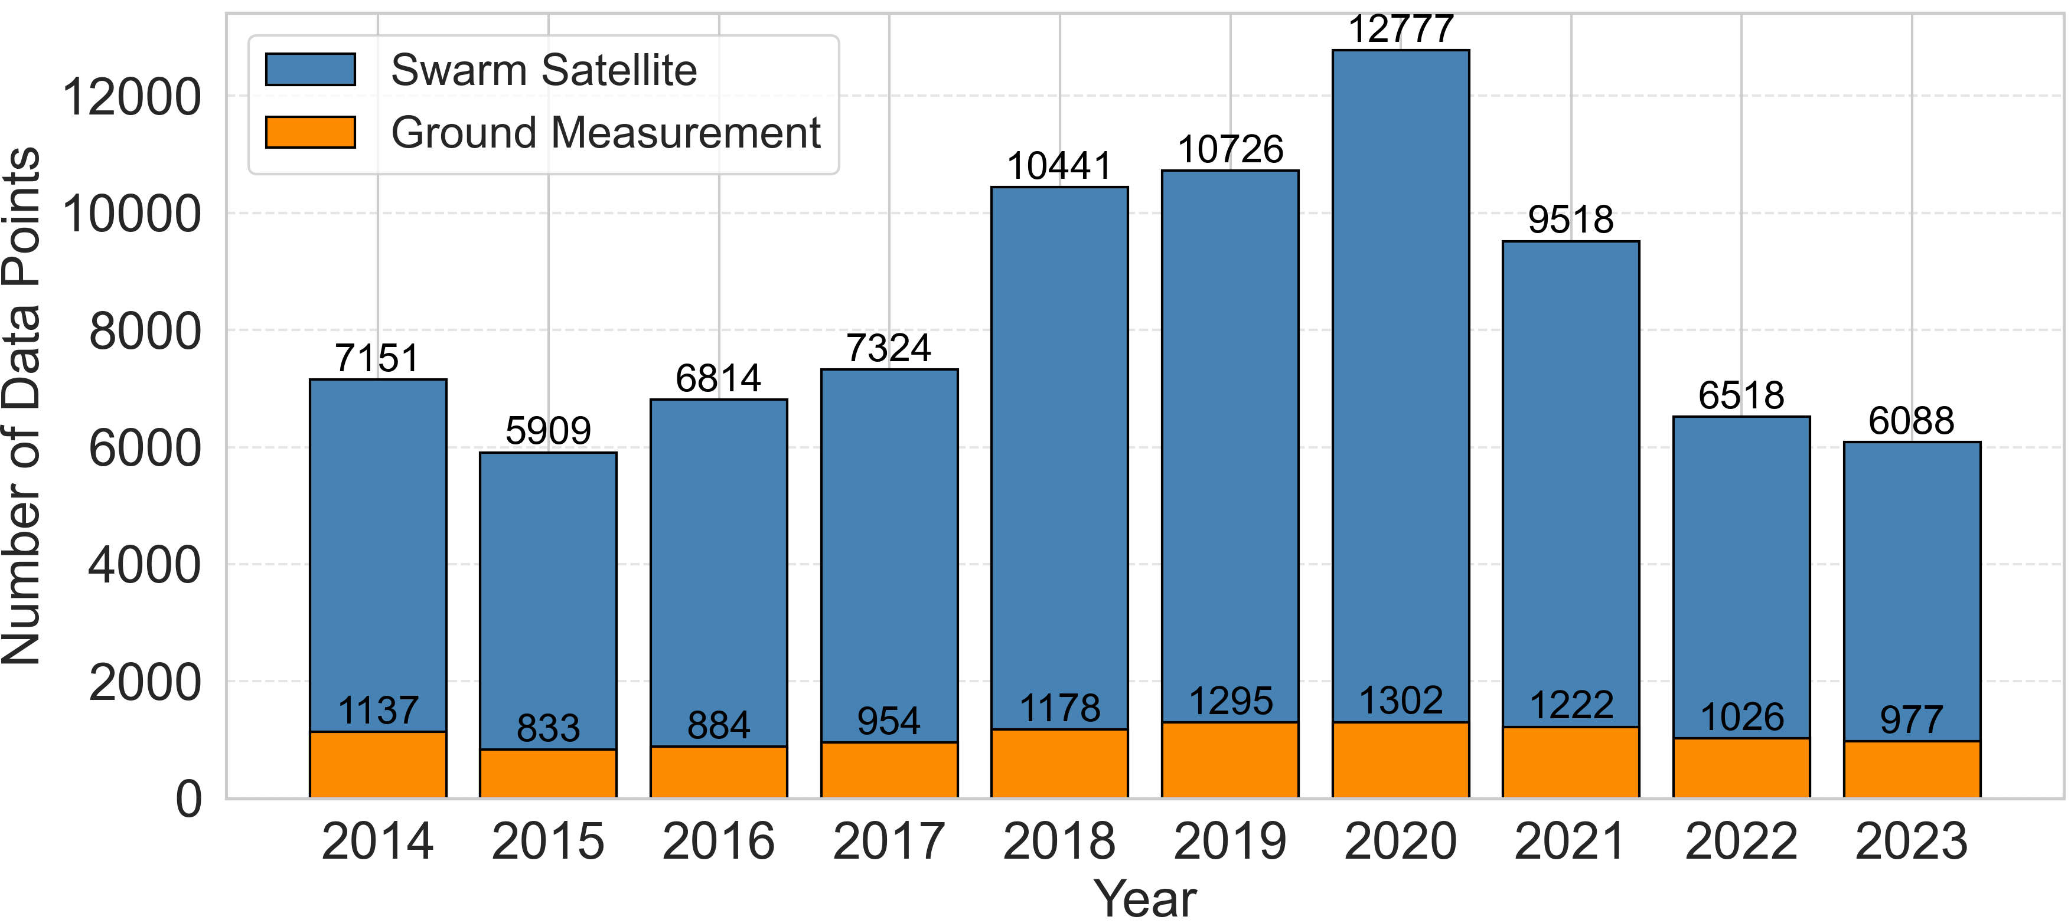
Data selection and processing (cont.)
Annual distribution of input data points used in the R-SCHA regional model.

Slide 10
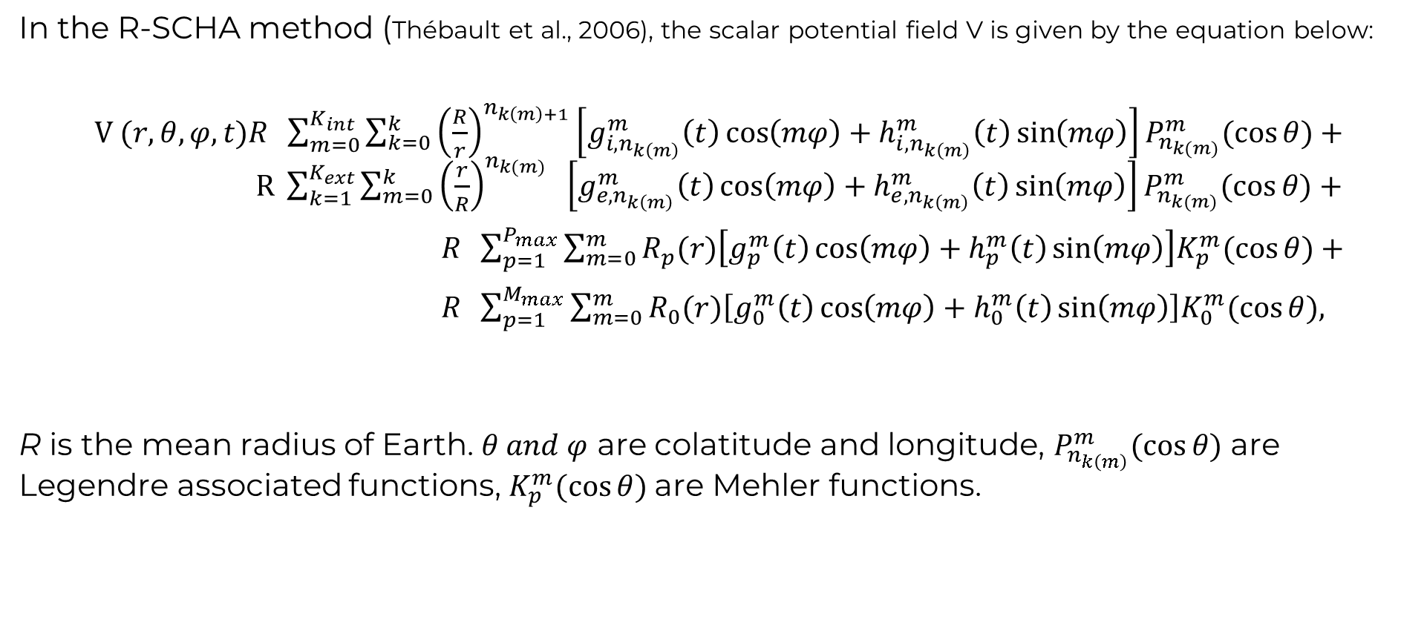
Methodology R-SCHA
In the R-SCHA method (Thébault et al., 2006), the scalar potential field V is given by the equation below:
$V (r,θ,φ,t)R \sum_{m=0}^{K_{int}}{\sum_{k=0}^{k}{{\left(\frac{R}{r}\right)}^{n_{k\left(m\right)+1}}\left[g_{i,n_{k\left(m\right)}}^{m}\left(t\right)\cos\left(mφ\right)+h_{i,n_{k\left(m\right)}}^{m}\left(t\right)\sin\left(mφ\right)\right]P_{n_{k(m)}}^{m}(\cos{θ)+}}}$ $R \sum_{k=1}^{K_{ext}}{\sum_{m=0}^{k}{{\left(\frac{r}{R}\right)}^{n_{k(m)}} \left[g_{e,n_{k\left(m\right)}}^{m}\left(t\right)\cos\left(mφ\right)+h_{e,n_{k\left(m\right)}}^{m}\left(t\right)\sin\left(mφ\right)\right]}}P_{n_{k(m)}}^{m}(\cos{θ)+}$
$R \sum_{p=1}^{P_{max}}{\sum_{m=0}^{m}{R_{p}(r)\left[g_{p }^{m}\left(t\right)\cos\left(mφ\right)+h_{p }^{m}\left(t\right)\sin\left(mφ\right)\right]K_{p}^{m}(\cos{θ)+}}}$
$R \sum_{p=1}^{M_{max}}{\sum_{m=0}^{m}{R_{0}(r)\left[g_{0 }^{m}\left(t\right)\cos\left(mφ\right)+h_{0 }^{m}\left(t\right)\sin\left(mφ\right)\right]K_{0}^{m}(\cos{θ),}}}$
R is the mean radius of Earth. $θ and φ$ are colatitude and longitude, $P_{n_{k\left(m\right)}}^{m}(\cos{θ)}$ are Legendre associated functions, $K_{p}^{m}(\cos{θ) }$are Mehler functions.

Slide 11
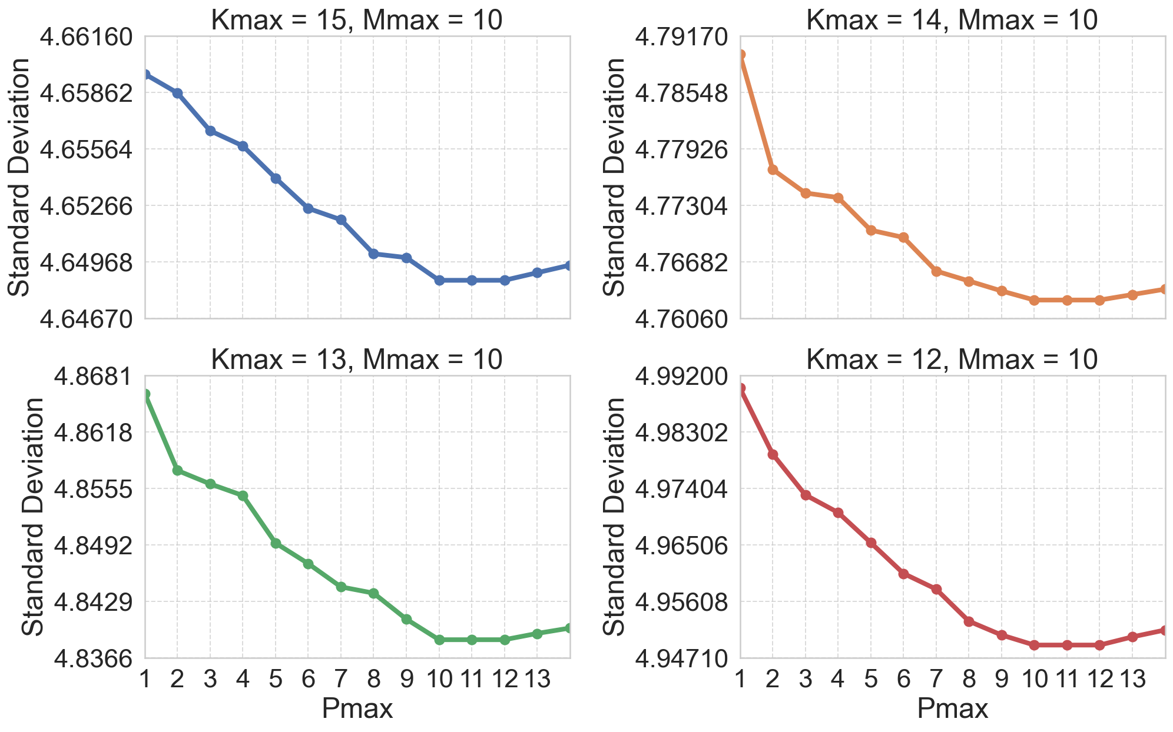
Data selection and processing (cont.)
Optimization of Legendre Expansion Limits $K_{max}$ and $M_{max}$ and the Mehler Conical Function $P_{max}$.

Slide 12
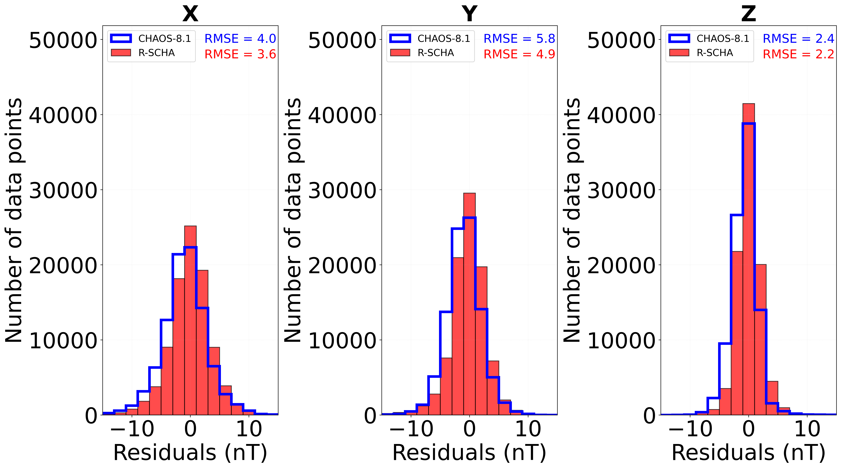
Results and discussions
Residuals between model inputs and predictions from R-SCHA and CHAOS-8.1 models

Slide 13
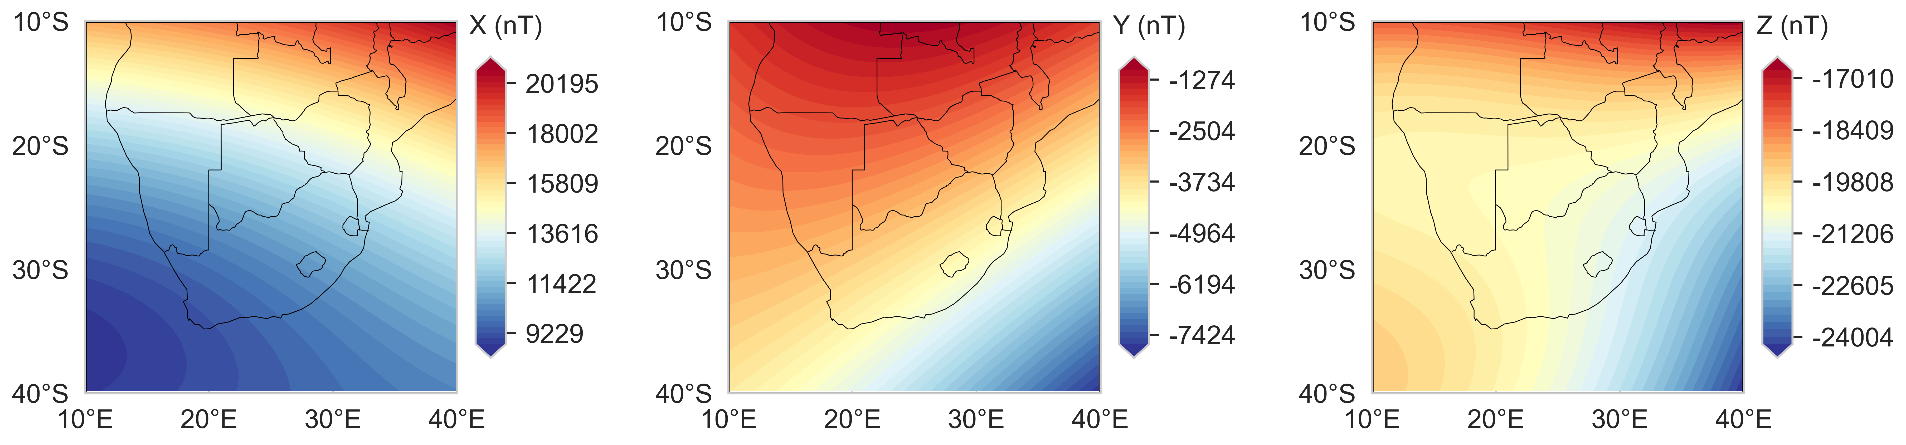

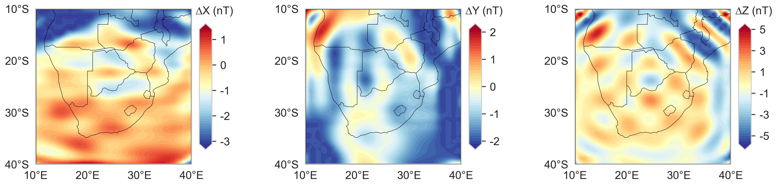
Results and discussions (cont.)
Differences between the two models at satellite altitude (450 Km) for the epoch 2019.0.
R-SCHA
CHAOS-8.1
Differences

Slide 14
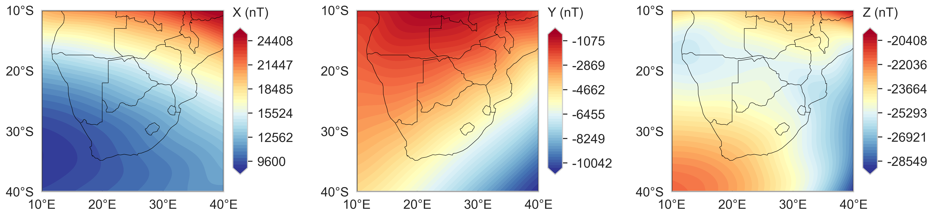
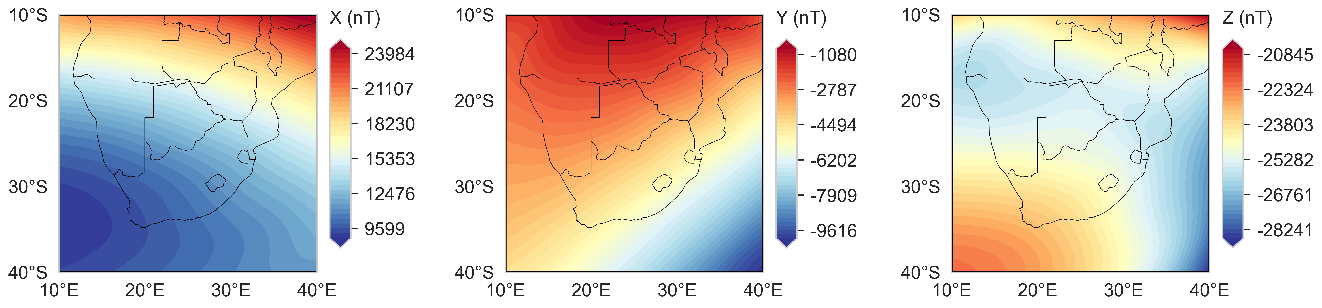
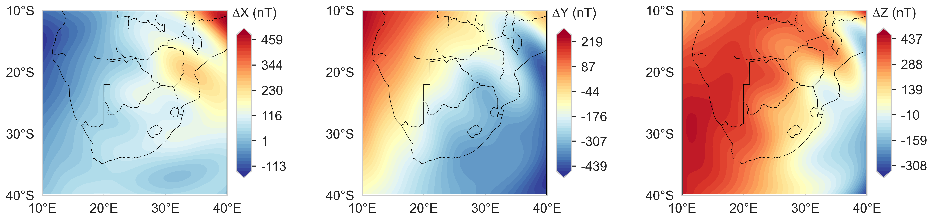
Results and discussions (cont.)
Core field change between 2018.5 and 2023.5, as predicted from the R-SCHA at ground level (0 Km).
2023.5
2018.5
Change

Slide 15
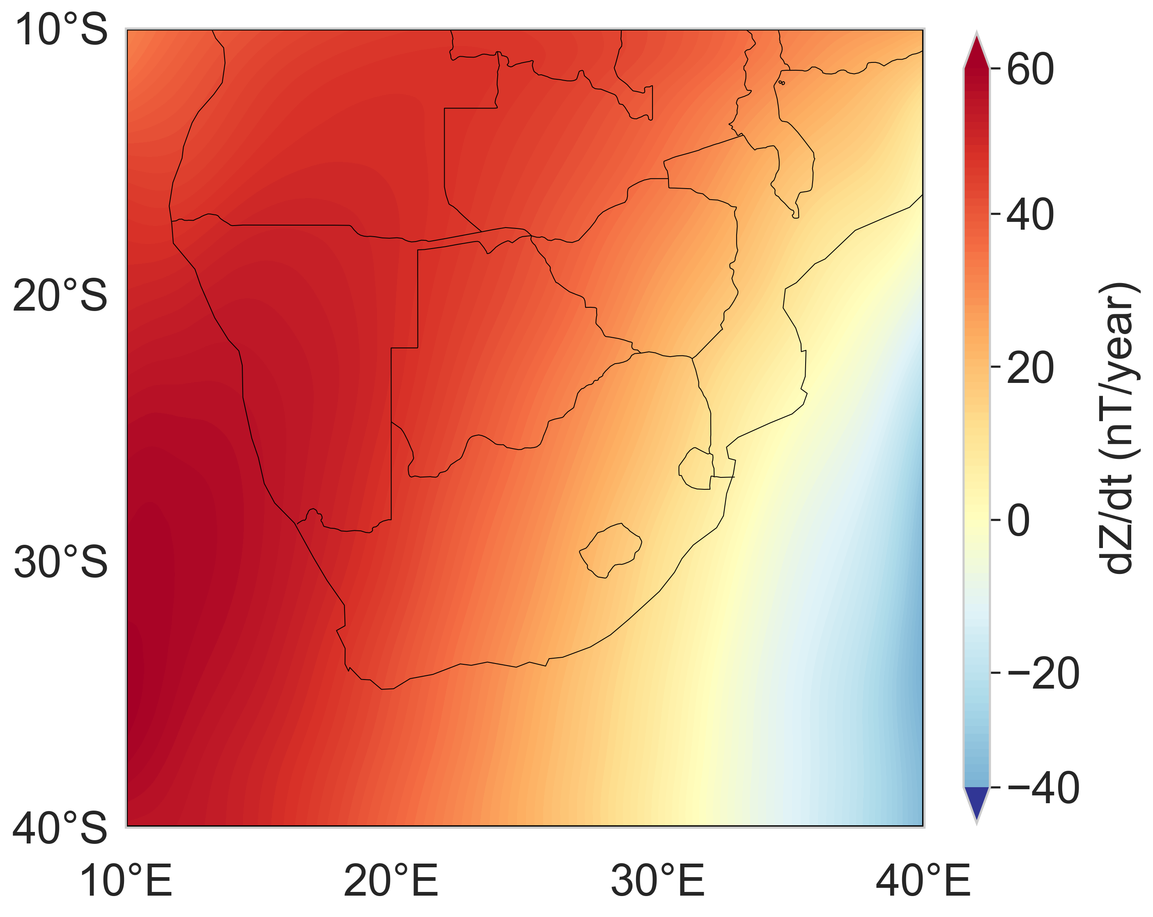
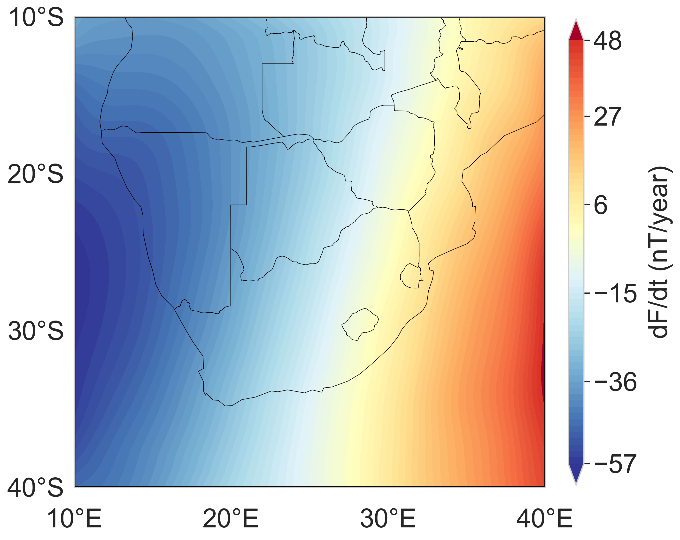
Results and discussions (cont.)
Average rate of change in nT/year between epochs 2018.5 and 2023.5, as predicted by the R-SCHA regional model at satellite altitude (450 Km).
Vertical field component Z
Total field F

Slide 16
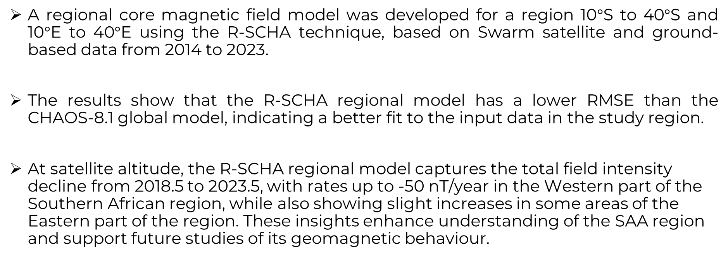
Conclusion
A regional core magnetic field model was developed for a region 10$°$S to 40$°$S and 10$°$E to 40$°$E using the R-SCHA technique, based on Swarm satellite and ground-based data from 2014 to 2023.
The results show that the R-SCHA regional model has a lower RMSE than the CHAOS-8.1 global model, indicating a better fit to the input data in the study region.
At satellite altitude, the R-SCHA regional model captures the total field intensity decline from 2018.5 to 2023.5, with rates up to -50 nT/year in the Western part of the Southern African region, while also showing slight increases in some areas of the Eastern part of the region. These insights enhance understanding of the SAA region and support future studies of its geomagnetic behaviour.

Slide 17
Acknowledgments
Authors acknowledge the European Space Agency for the Swarm satellite data, the International Service of Geomagnetic Indices for indices used in this work, and the South African National Space Agency for the ground-based data.

Slide 18
References
Gubbins, D., Barber, C.N., Gibbons, S., Love, J.J., (2000). Kinematic dynamo action in a sphere. I. Effects of differential rotation and meridional circulation on solutions with axial dipole symmetry. doi:10.1098/rspa.2000.0565.
Gubbins, D., Barber, C.N., Gibbons, S., Love, J.J., (2000). Kinematic dynamo action in a sphere. II. Symmetry selection. The Royal Society, 456(1999), 1333-1353. doi:10.1098/rspa.2000.0581.
Rother, M., Korte, M., Morschhauser, A., Vervelidou, F., Matzka, J., & Stolle, C. (2021). The mag.num core field model as a parent for IGRF-13, and the recent evolution of the South Atlantic Anomaly. doi:10.1186/s40623-020-01277-0.
Thébault, E., Schott, J. J., Mandea, M. (2006). Revised spherical cap harmonic analysis (R-SCHA): Validation and properties, doi:10.1029/2005JB003836.
Maus, S. (2010). Magnetic field model MF7. CIRES, Colo.
Finlay, C.C., Kloss, C., Olsen, N., Hammer, M.D., (2020). The CHAOS-7 geomagnetic field model and observed changes in the South Atlantic Anomaly. Earth Planets Space, 72, 1-31. doi:10.1186/s40623-020-01252-9.
Olsen, N., Friis-Christensen, E., (2013). The Swarm Satellite Constellation Application and Research Facility (SCARF) and Swarm data products. Earth Planet Space, 65, 1. doi:10.5047/eps.2013.07.001.
Haines, G. V. (1985a), Spherical cap harmonic analysis, J. Geophys. Res., 90, 2583– 2591. doi:10.1029/2005JB003836 .

Slide 19





References
THANK YOU
www.sansa.org.za
@SANSA7
South African National Space Agency
South African National Space Agency
South African National Space Agency (SANSA)

