Slide 1

Some roles of physics in climate science and sustainability science with examples in Southern Africa
I.M.A. Gledhill

Slide 2
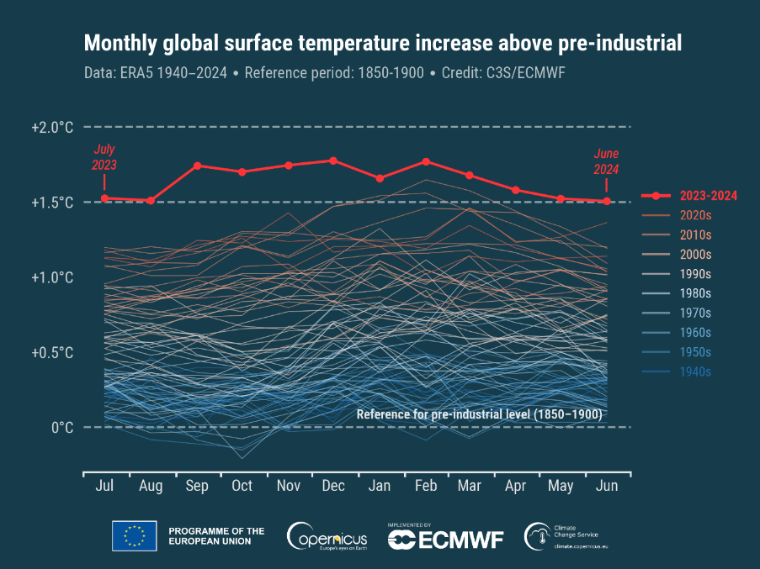
Evidence
https://unfccc.int/sites/default/files/english_paris_agreement.pdf
Copernicus Climate Change Service (C3S), Global Climate Highlights 2024 (2025)
https://climate.copernicus.eu/global-climate-highlights-2024
Copernicus Climate Change Service /ECMWF
https://climate.copernicus.eu/sites/default/files/custom-uploads/June%20CB/temp/timeseries_era5_monthly_2t_global_anomalies_preindustrial_up_to_june_2024.png

Slide 3
Introduction
Physics is well embedded in climate and sustainability science.
All existing research in the region is acknowledged; this is not a review
Institutes, departments, scientists and companies are respectfully acknowledged but very few are mentioned.
Aims of this work…
show the expanding roles of physics
provide a few examples relevant to Southern Africa in the global context
Highlight: less frequently mentioned aspects of the role of physics as a basic or fundamental science
Seek: a systematic way of finding gaps by linking physics to climate and sustainability science

Slide 4
Introduction
Physics is well embedded in climate and sustainability science.
All existing research in the region is acknowledged; this is not a review
Institutes, departments, scientists and companies are respected but few are mentioned.
Aims of this work…
show the expanding roles of physics
provide a few examples relevant to Southern Africa in the global context
Highlight: less frequently mentioned aspects of the role of physics as a basic or fundamental science
Seek: a systematic way of finding gaps by linking physics to climate and sustainability science

Slide 5



Prompted by:
International Union of Pure and Applied Physics
  Recognition of the existential crisis
  The role that physics can and should play in these sciences.

Slide 6
“Case study” examples
Attribution: the KZN floods of April 2022
Prediction: The Southern African drought of 2024
Climate: Theoretical physics, stochastic theory
Models: Africa and thunderstorms
Sea ice mechanics and dynamics: Antarctic research
Health science: quantum science and malaria
Stability and stochasticity in power grid networks
Almost everything has not been covered.

Slide 7

How can we structure the interaction between physics and climate/sustainability science, a vast field?

Slide 8
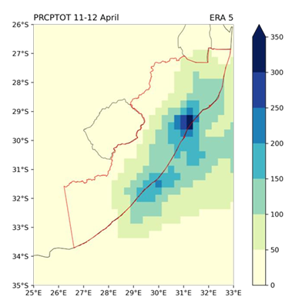
Attribution: the KZN floods of April 2022
2-day rainfall, extreme flooding, fatalities, and damage
Warnings were issued, limited effect
The warnings were not received by all
People did not know what to do
Disproportionate effect on marginalised communities
Rainfall in mm/2 days April 11-12 2022
I Pinto et al.
https://www.worldweatherattribution.org/wp-content/uploads/WWA-KZN-floods-scientific-report.pdf

Slide 9
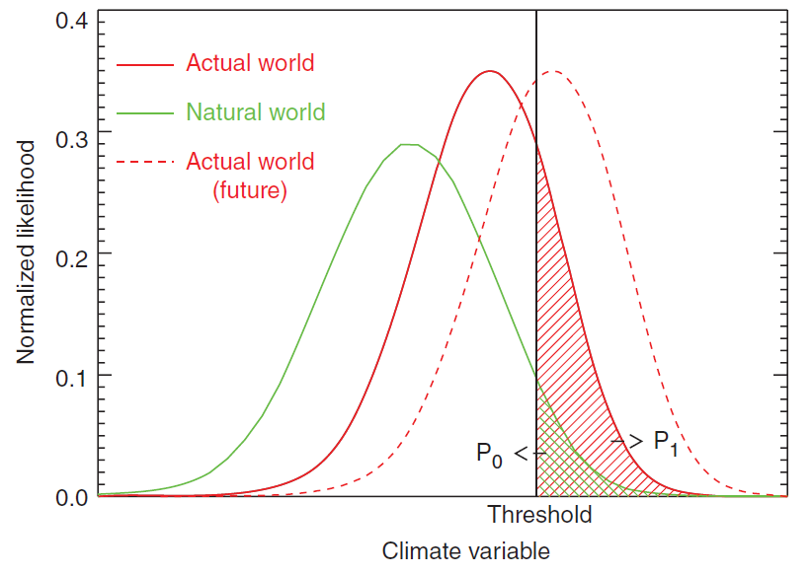
Attribution
Probability ratio P_{t}/P₀
…the degree to which
a specific extreme event was made
more (or less) likely and/or intense
because of climate change.
KZN floods: return time
  today’s climate: 20 years
  natural climate: 40 years
I Pinto et al.
https://www.worldweatherattribution.org/wp-content/uploads/WWA-KZN-floods-scientific-report.pdf

Slide 10
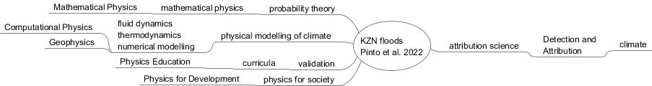

Role of physics
Note that this diagram is intended to represent the path of input from physics to attribution via one example, and therefore does not include, for example, observation or modelling on the climate side.

Slide 11
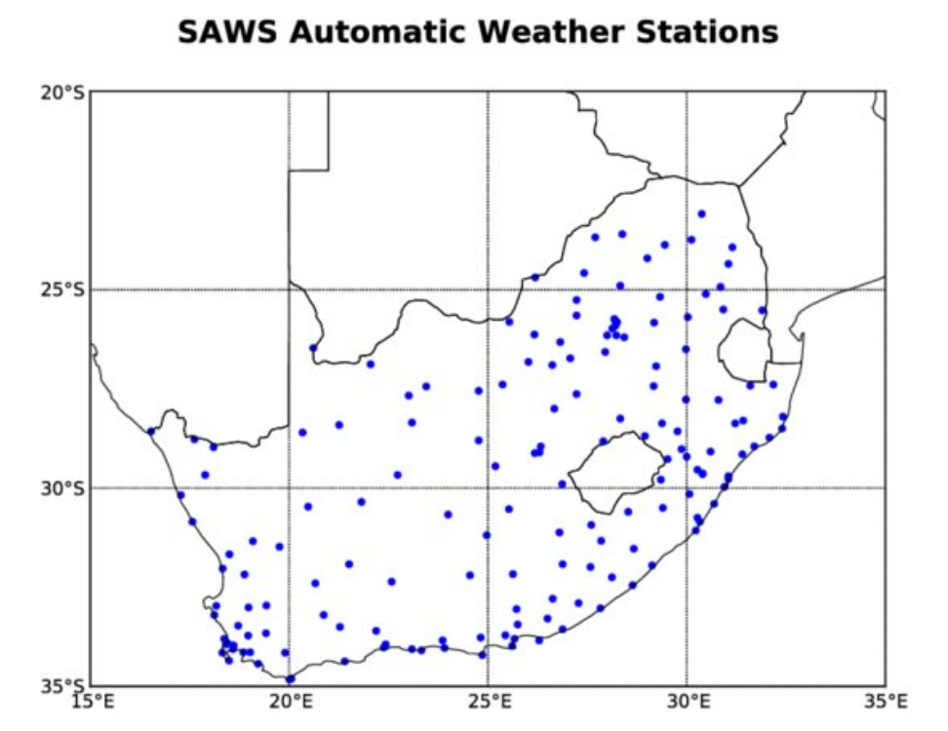
Gaps
Included among the SA Weather Service stations
SAWS stations include
231 automatic weather stations
12 Climate Stations
14 Met. Radar Stations
2 Ozone spectrophotometers
6 Lightning detector stations
Ground station data
Disaster planning
Early Warning System effectiveness
Weather and climate stations:
The coverage is sparse,
with only
164 stations in 1.2 million km²
S Sinclair and GGS Pegram 2009
https://www.researchgate.net/publication/40892393
https://www.weathersa.co.za/home/overview

Slide 12
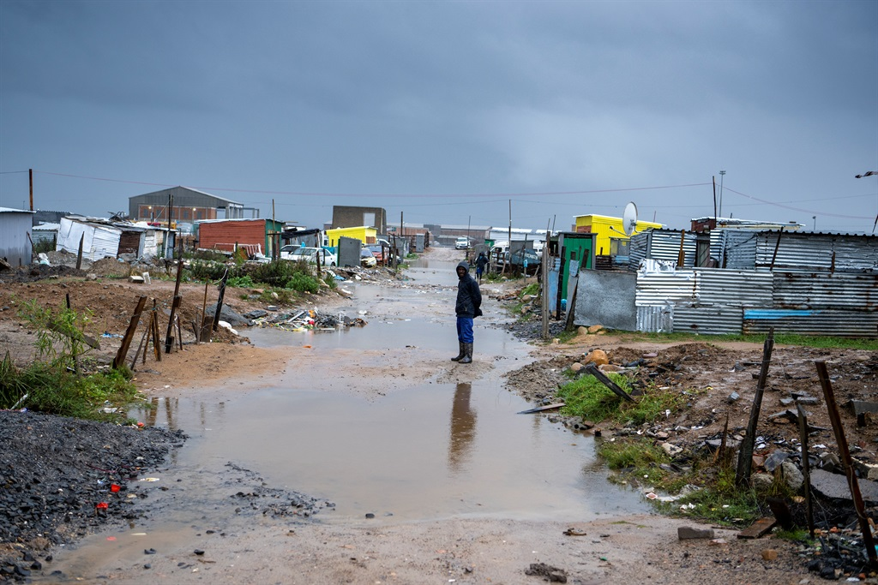
Role of physics??
Physics in my Village
Disaster warning?
Thinking the problem though
  What (real) needs does a community have?
  Long term goals, what conditions are needed
  People are the key
Use of Indigenous knowledge
https://www.theoryofchange.org/what-is-theory-of-change/
https://www.news24.com/southafrica/news/pics-winter-of-discontent-we-just-want-decent-houses-say-flood-hit-cape-town-residents-20220618

Slide 13
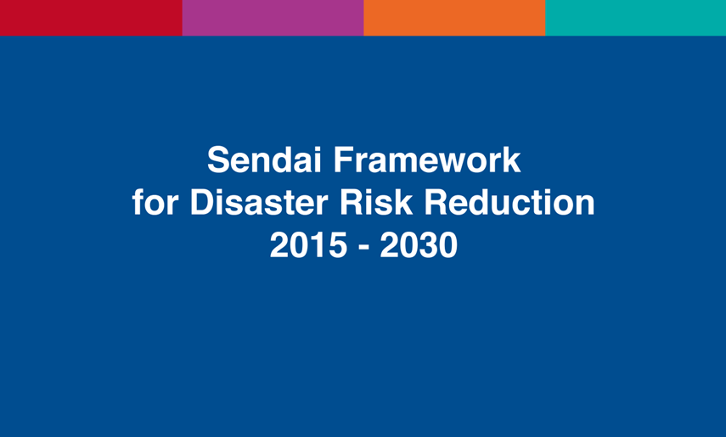
Disasters and Early Warning: climate impact and drought
Heatwaves, droughts, storms, wildfires and floods
Drought: duration and frequency increasing
https://www.undrr.org/publication/sendai-framework-disaster-risk-reduction-2015-2030

Slide 14
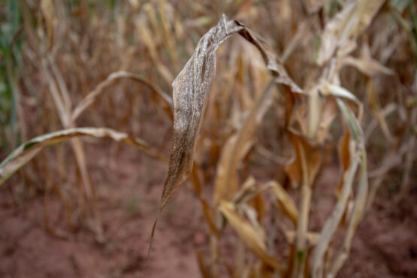
Southern African drought of 2024
Zimbabwe, Zambia, Malawi, Angola,
Mozambique and Botswana
<20% of expected rainfall, Feb 2024
  prolonged drought
  crop failure among rain-fed subsistence farms
  famine.
Image Bloomberg
S. Frazer-Baxter, El Niño key driver of drought in highly vulnerable Southern African countries
Kimutai et al. https://spiral.imperial.ac.uk/bitstream/10044/1/110770/2/Report2.pdf
Antony Sguazzin, El Niño to trigger drought insurance payouts in four Southern African countries, Moneyweb, 18 April 2024
https://www.moneyweb.co.za/news/africa/el-nino-to-trigger-drought-insurance-payouts-in-four-southern-african-countries/

Slide 15
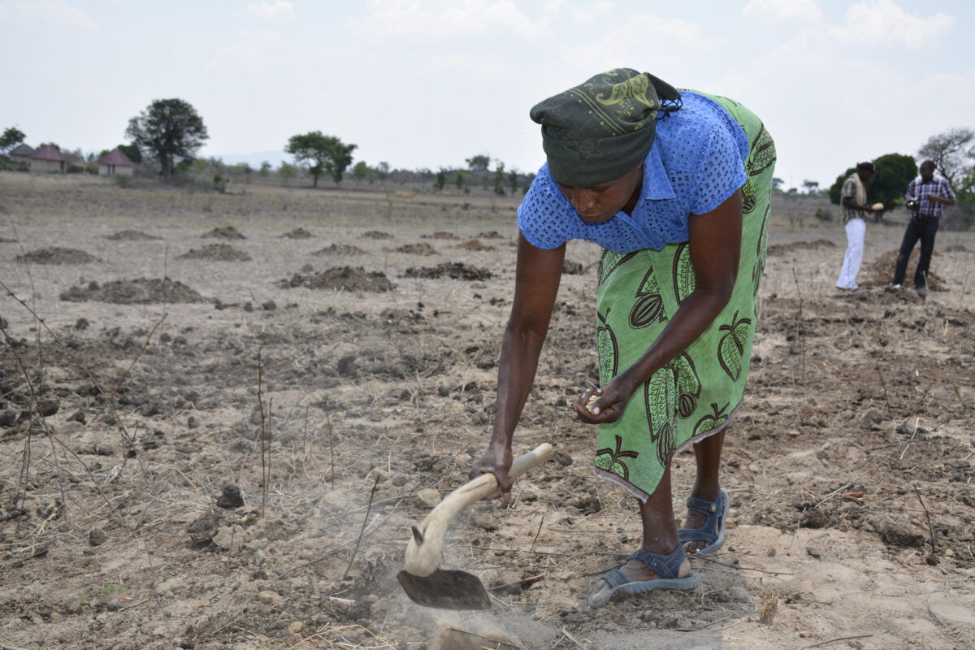
Southern African drought of 2024
Abnormally Dry (D0), Moderate Drought (D1),
Severe Drought (D2), Extreme Drought (D3),
and Exceptional Drought (D4)
S. Frazer-Baxter, El Niño key driver of drought in highly vulnerable Southern African countries
Kimutai et al. https://spiral.imperial.ac.uk/bitstream/10044/1/110770/2/Report2.pdf

Slide 16
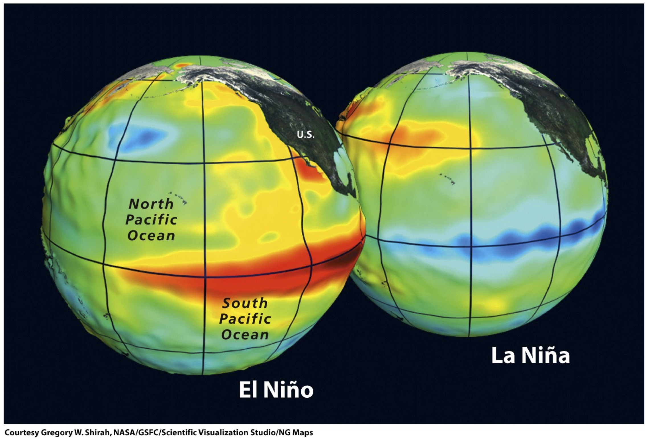
Southern African drought of 2024
Climate attribution studies of the Southern African drought of 2024:
multiple drivers -
recovery from floods
  Low resilience
  High vulnerability
the prolonged drought was twice as likely during El Niño years than in the natural climate
/
Kimutai et al. https://spiral.imperial.ac.uk/bitstream/10044/1/110770/2/Report2.pdf
https://ifurtado.org/el-nino-southern-oscillation/

Slide 17
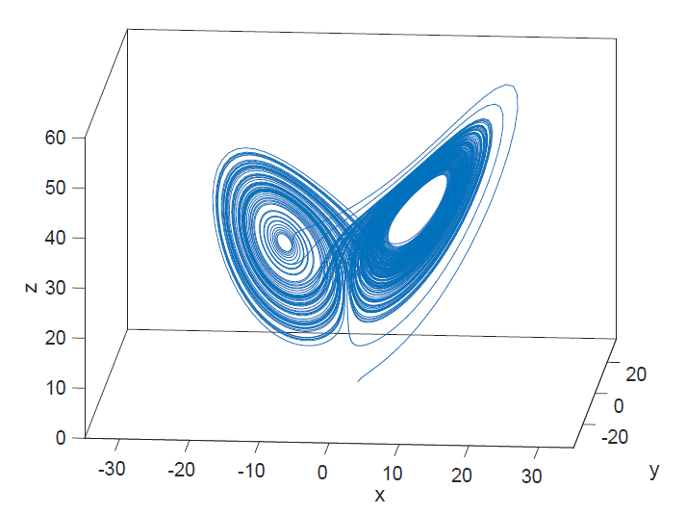
Can we predict major Southern African droughts?
Predicting el Niño: future research
Understanding the dynamics of the formation and evolution of ENSO events
Identifying precursor events
Characterizing teleconnections to Southern Africa
ENSO as a chaotic non-linear system?
Weady, Scott, et al. "Circuit bounds on stochastic transport in the Lorenz equations.
" Physics Letters A 382.26 (2018): 1731-1737.
https://ifurtado.org/el-nino-southern-oscillation/

Slide 18
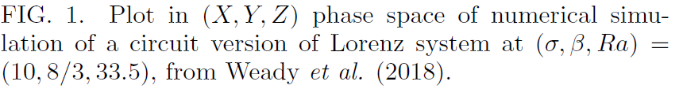
Complex systems; nonlinear dynamics
Nobel Prizes 2021stochastic nonlinear dynamic systems
Non-linear stochastic systems
Probabilistic models
Bistable systems
The work of Hasselman and Parisi: from weather to climate
Weady, Scott, et al. "Circuit bounds on stochastic transport in the Lorenz equations.
" Physics Letters A 382.26 (2018): 1731-1737.
The Nobel Committee for Physics, Scientific Background on the Nobel Prize in Physics 2021 (2021)
Https://www.nobelprize.org/uploads/2021/10/sciback_fy_en_21.pdf

Slide 19
Climate: Theoretical physics, stochastic theory
The Nobel Committee for Physics, Scientific Background on the Nobel Prize in Physics 2021 (2021)
Https://www.nobelprize.org/uploads/2021/10/sciback_fy_en_21.pdf

Slide 20
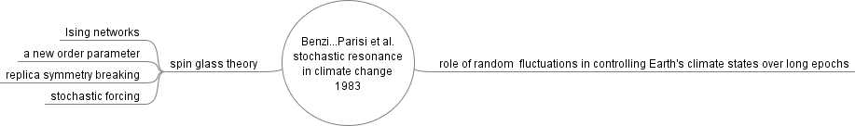
Climate: Theoretical physics, stochastic theory
Benzi, Roberto and Parisi, Giorgio and Sutera, Alfonso and Vulpiani, Angelo, A Theory of Stochastic Resonance in Climatic Change, (1983)
The Nobel Committee for Physics, Scientific Background on the Nobel Prize in Physics 2021 (2021)
Https://www.nobelprize.org/uploads/2021/10/sciback_fy_en_21.pdf

Slide 21
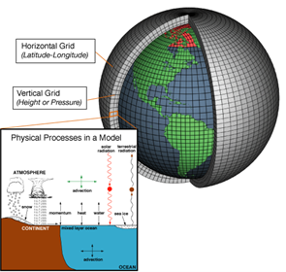
Models: Africa and thunderstorms
Global Climate Models,
Earth System Models
Wide range of space and time scales
Energy balance, thermodynamics, fluid dynamics
Atmosphere, ocean, cryosphere
Fundamental work of Manabe
Public domain, NOAA National Ocean and Atmospheric Administration, USA

Slide 22
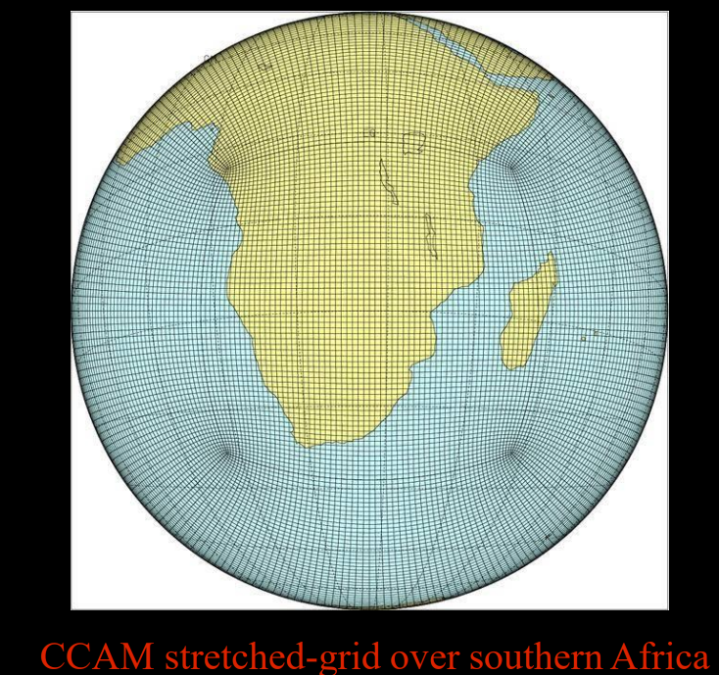
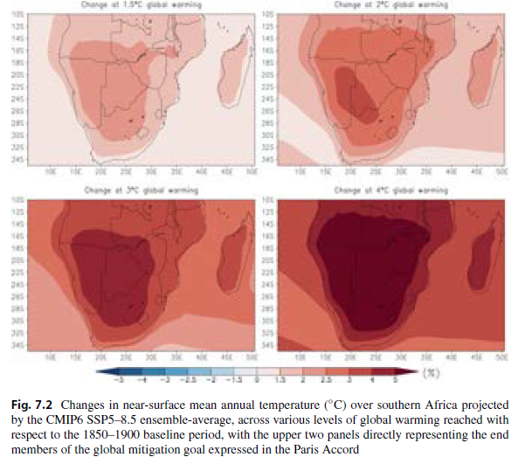
Models: Africa and thunderstorms
An Earth Systems Model for Africa
Global Change Institute Wits
Tipping points
F. Engelbrecht, Numerics of the African-based Earth System Model and key applications, GCI, 2019,
https://wgne.net/wp-content/uploads/2019/10/THUR_Engelbrecht_WGNE34_NumericsAfricanESM.pdf
Engelbrecht, Francois A., et al. "Projections of future climate change in Southern Africa and the potential for regional tipping points., 2024
https://link.springer.com/content/pdf/10.1007/978-3-031-10948-5_7.pdf

Slide 23
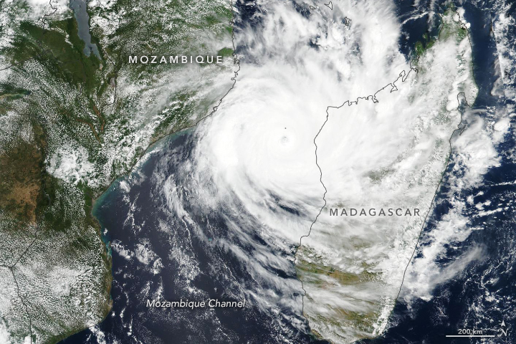
Models and Tipping points Predicted in 2020
Day Zero drought in Gauteng
More frequent and intense multi-year droughts and heat waves
More frequent and intense heat waves
impact on human health and mortality
More frequent, more Intense tropical cyclones
Zimbabwe, Zambia, Malawi, Angola, Mozambique and Botswana Feb 2024: famine
finding: in 2023, infants and adults older
than 65 years experienced a new record high of 13·8 days of
heatwave per person, on average
Idai as a category 3 cyclone on March 11, 2019 NASA Earth Observatory image by Lauren Dauphin,
using VIIRS data from the Suomi National Polar-orbiting Partnership
Kimutai et al. https://spiral.imperial.ac.uk/bitstream/10044/1/110770/2/Report2.pdf
https://www.tedxjohannesburg.com/talks/four-tipping-points-africa-can-expect-from-climate-change
M. Romanello et al., The 2024 report of the Lancet Countdown on health and climate change (2025)
The Lancet, 404 (10465), 1847 – 1896 https://doi.org/10.1016/S0140-6736(24)01822-1

Slide 24
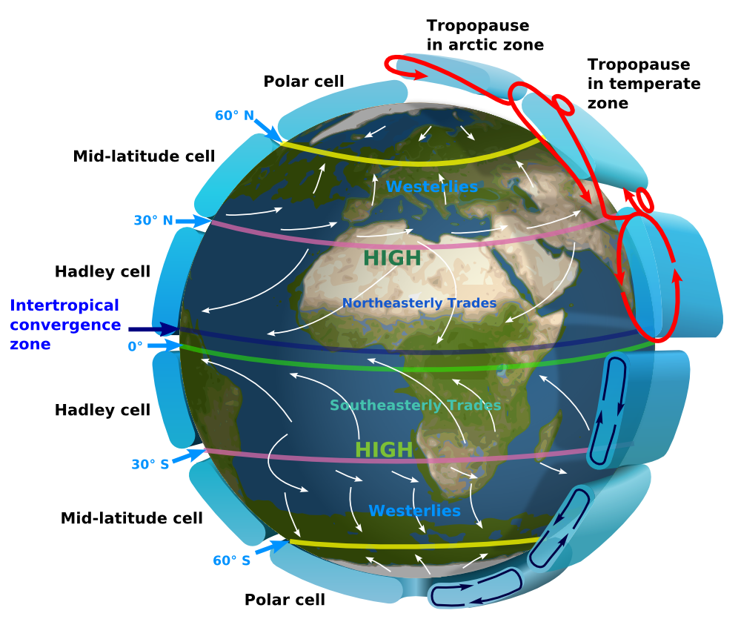
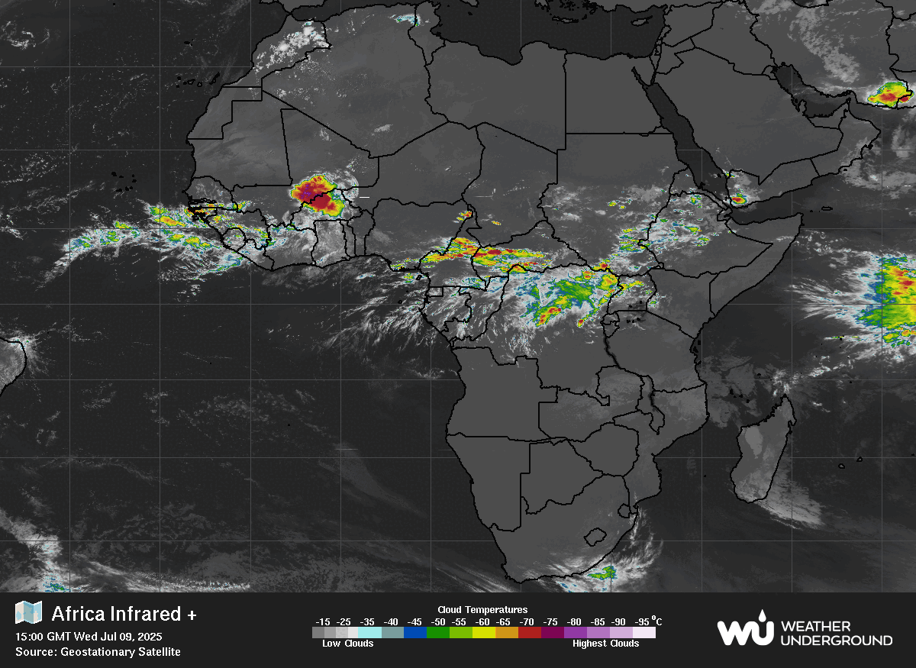
Influence of ICTZ thunderstorms on African weather
https://weather.com/maps/satellite/europe-africaweathermap
https://oceans.mit.edu/news/featured-stories/the-sticky-intertropical-convergence-zone.html

Slide 25
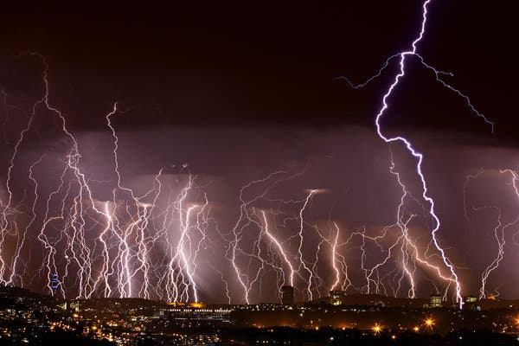
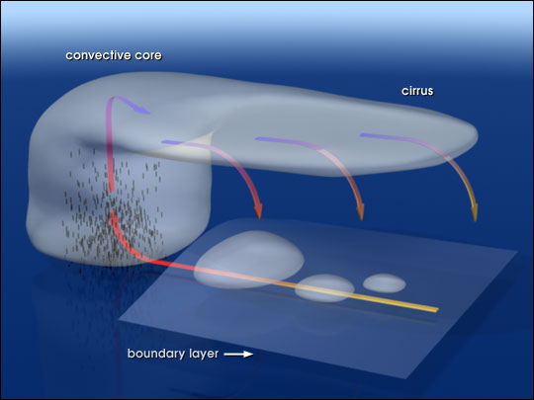
Above-anvil cirrus plumes
NASA https://en.m.wikipedia.org/wiki/File:Anvil_convection.jpg
Image Francois Loubscer/https://www.dreamstime.com/magdaloubser_info
https://www.nytimes.com/2020/02/10/climate/lightning-africa-climate-change.html

Slide 26
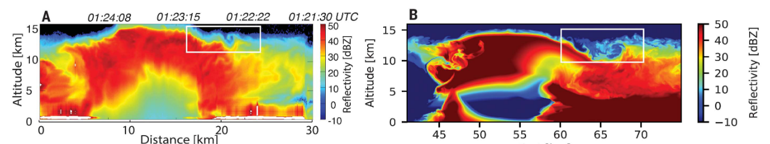


Hydraulic jump
Left : Observation, 24 May 2011
Doppler Ku-band radar reflectivity
Simulated reflectivity
Turbulent Large Eddy Simulations
Breaking gravity waves at the tropopause: Kelvin-Helmholtz
Hydraulic jump at the tropopause
Morgan O’Neill, Leigh Orf, Gerald M. Heymsfield, and Kelton Halbert, Hydraulic jump dynamics above supercell thunderstorms,
Science 373 (6560) 1248-1251 2021 https://www.science.org/doi/epdf/10.1126/science.abh3857

Slide 27
Modelling: Antarctica
Why Antarctica is important to Africa
measurable southwards trend in the tracks of extratropical storms
Less frequent storms More frequent storms
Number Density per unit area per month
Scholes, R.J., Engelbrecht, F. and Vogel, C., 2020,,
https://www.safsc.org.za/wp-content/uploads/2020/06/Climate-Science-Doc_June-2020.pdf

Slide 28
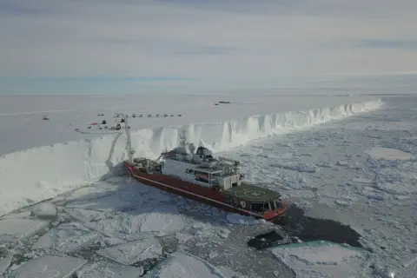
Sea ice dynamics: Antarctic research
SANAP South African National Antarctic Programme
MARiS Marine and Antarctic Research Centre for Innovation and Sustainability UCT

Slide 29
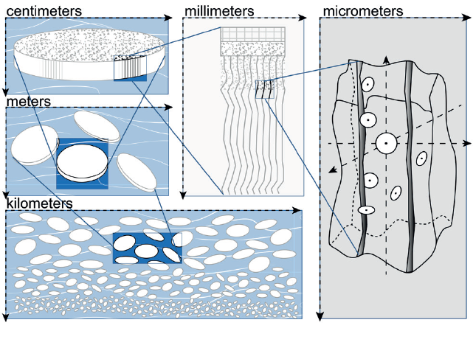
Sea ice dynamics [11]
Scales
Paul et al. Sea ice mechanics Computer Methods in Material Science 2023, vol. 23, no. 3, 5–54
https://doi.org/10.7494/cmms.2023.3.0816

Slide 30
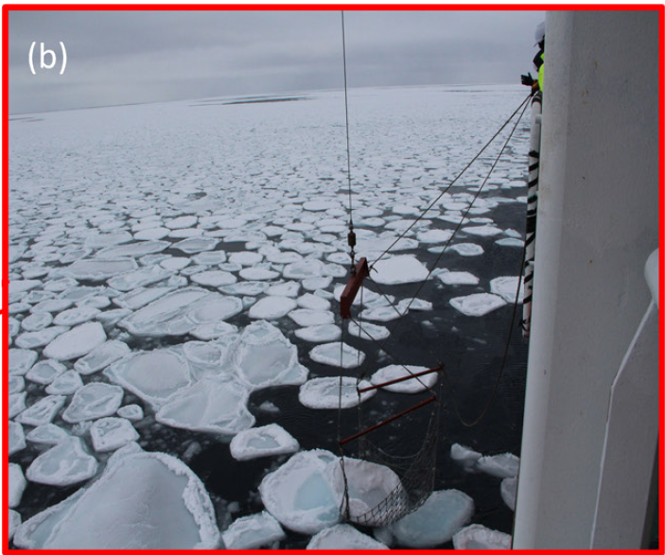
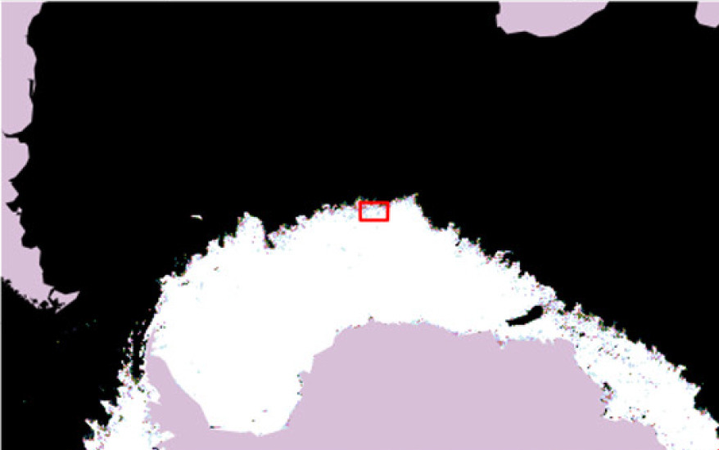
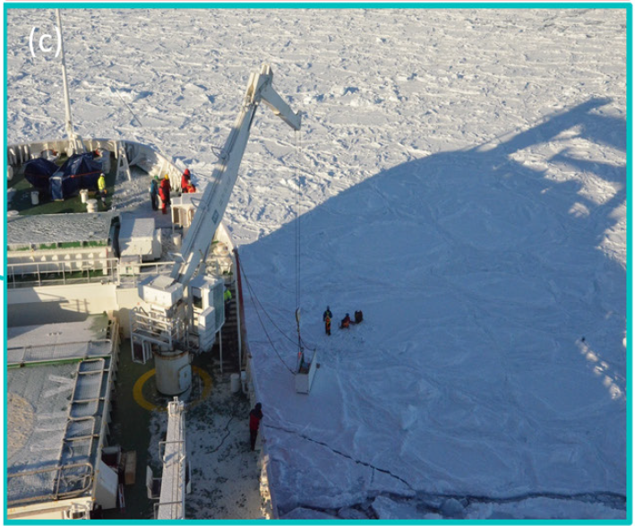
Drifting ice data stations
Ice drift
Core samples
Biogeochemical samples
Paul et al. Sea ice mechanics Computer Methods in Material Science 2023, vol. 23, no. 3, 5–54
https://doi.org/10.7494/cmms.2023.3.0816

Slide 31
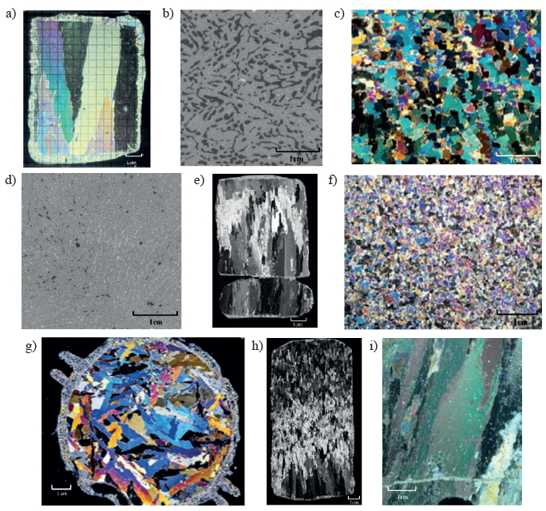
Scales
Collage of sea ice textures and structures imaged
using cross-polarization and μCT scan imaging
Paul et al. Sea ice mechanics Computer Methods in Material Science 2023, vol. 23, no. 3, 5–54
https://doi.org/10.7494/cmms.2023.3.0816

Slide 32
Gaps
Most ice properties are measured in Arctic conditions
Young’s modulus, viscosity, yield strength, etc.
Environmental conditions are different in the Antarctic
Growth process in Marginal Ice Zone; fracture processes
Rheology of sea ice at all scales
Atmosphere modelling over sea ice

Slide 33
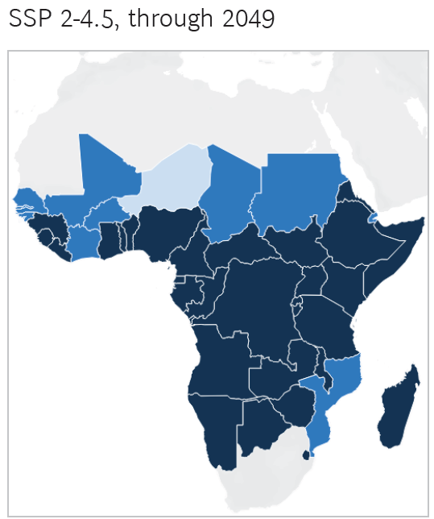
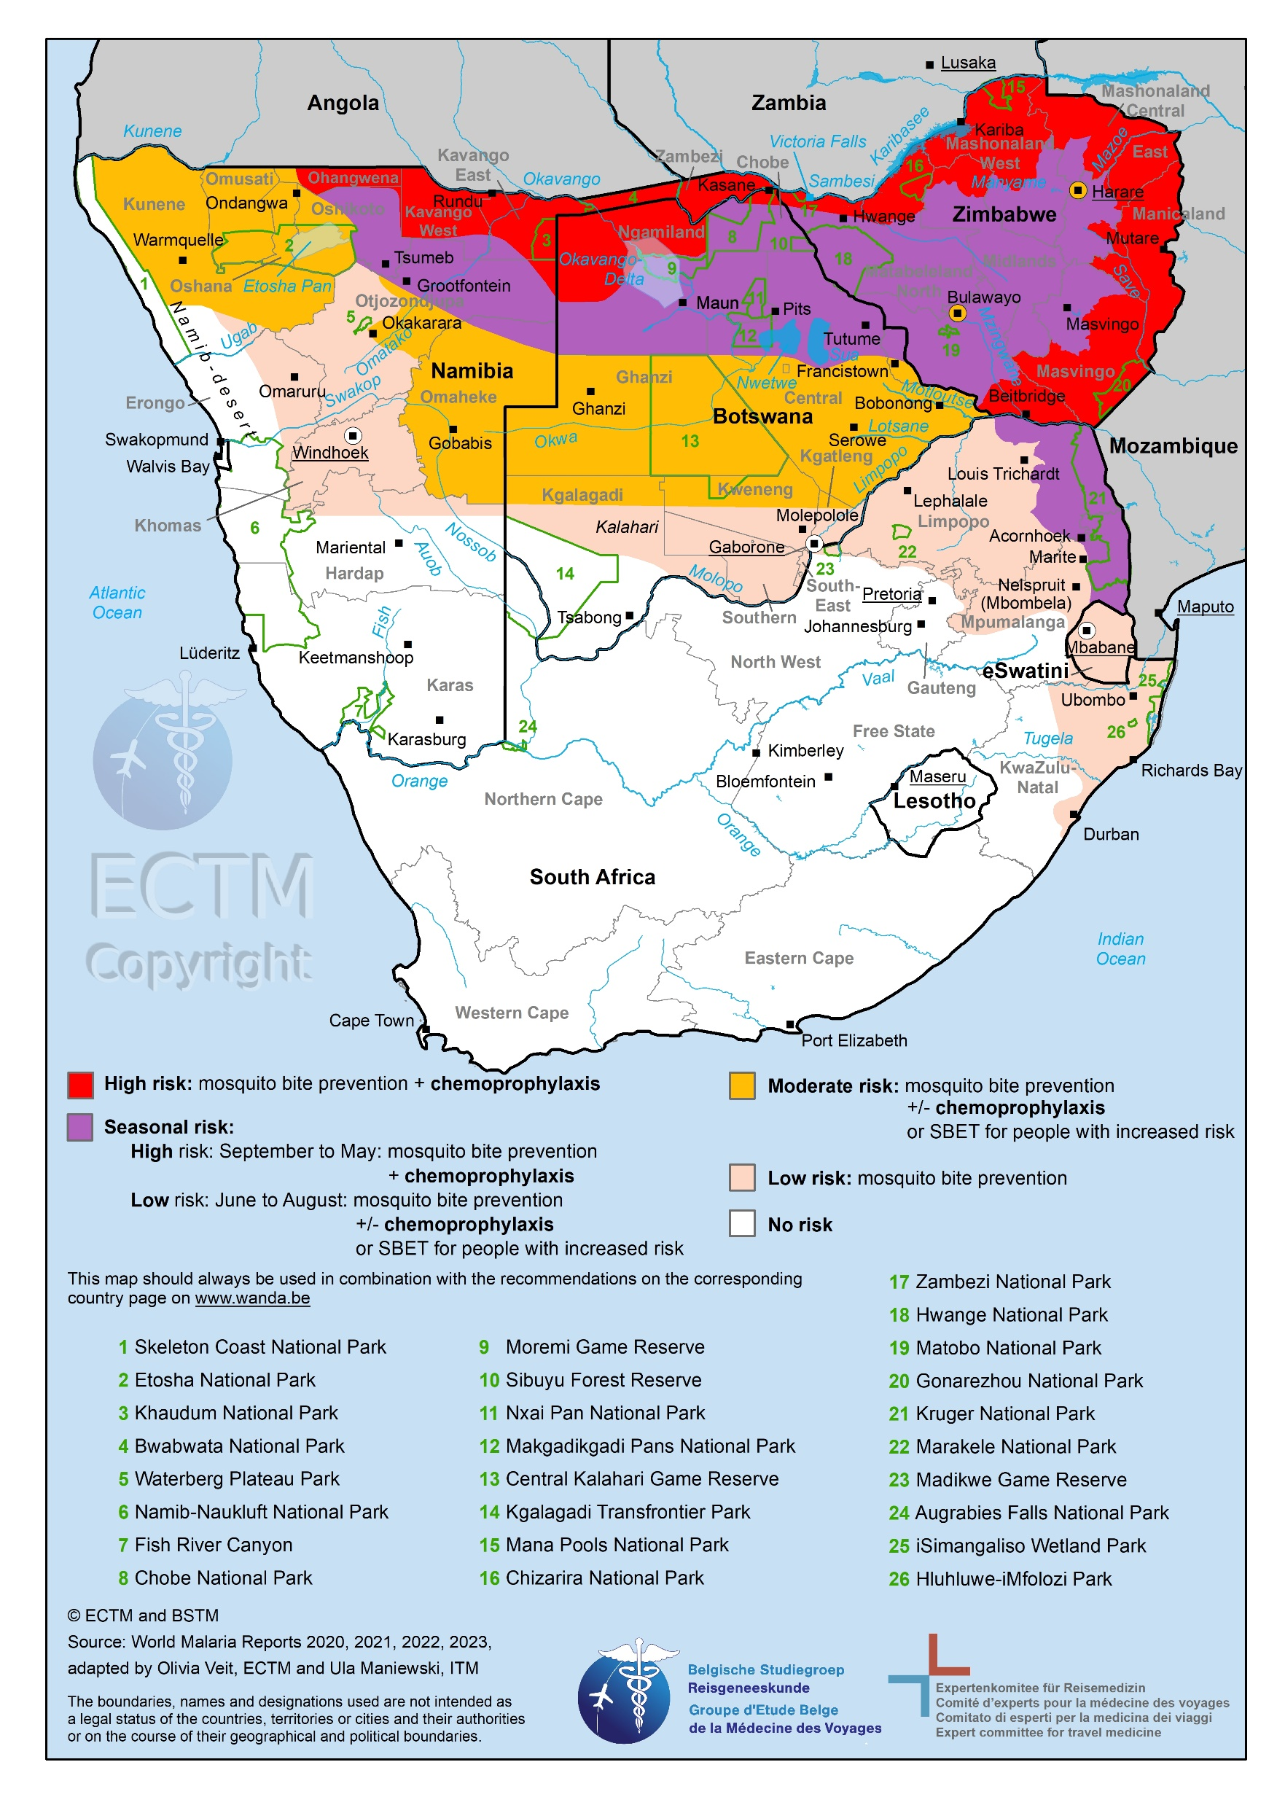
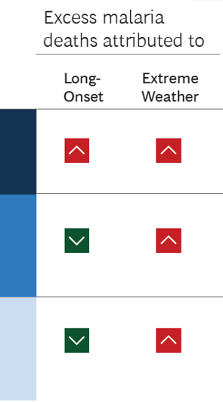
Health science examples: quantum science and malaria
Malaria now
Malaria by 2049 climate change only
More flooding
More frequent, intense cyclone impacts
>550 000 additional malaria deaths from 2030 to 2049
https://www.wanda.be/en/a-z-index/malaria-map-of-south-africa/
Malaria Atlas Project, Climate Impacts on Malaria in Africa, November 2024
https://malariaatlas.org/project-resources/climate-change/

Slide 34
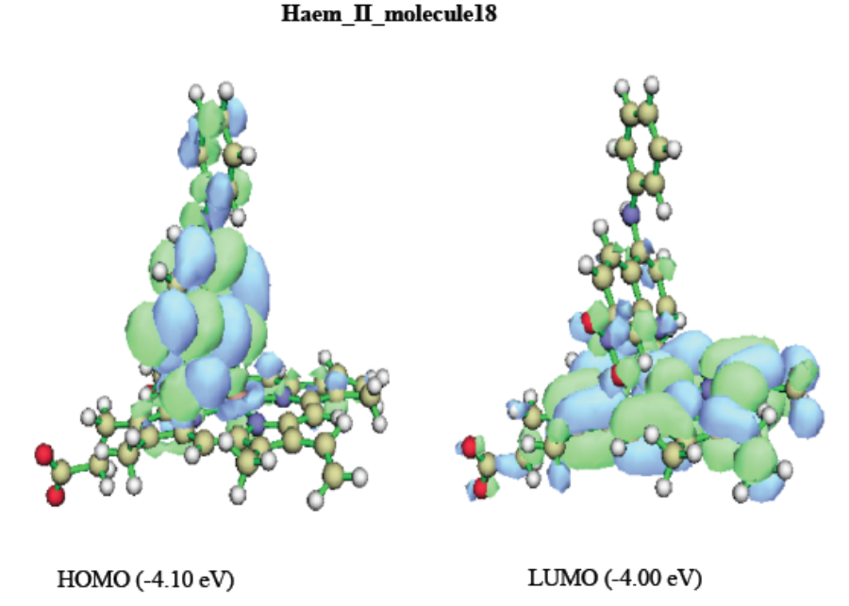
Health science: quantum science and malaria
Density Functional Theory
a.k.a. Theoretical Chemistry
Schrödinger eq.
→ Assume n electrons represented by electron density (electron gas)
→Kohn-Sham eq. non-interacting electrons in effective potential
+ exchange and correlation between electrons
→ African School of Electronic Structure Methods ASESMA
https://www.asesma.org/
Pélagie Manwal A. Mekoung, Kevin A. Lobb and Ibrahim N. Mbouombouo,
2025, DOI: https://doi.org/10.2174/0109298673346612250320080402

Slide 35
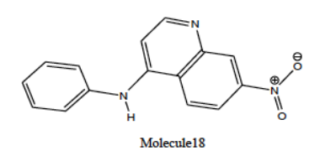
Health science: quantum science and malaria
DFT now routinely used in designing lead molecules
Example: develop new anti-malarials that target Plasmodium sp. digestion of heme molecule
Pélagie Manwal A. Mekoung, Kevin A. Lobb and Ibrahim N. Mbouombouo,
2025, DOI: https://doi.org/10.2174/0109298673346612250320080402
https://www.cdc.gov/dpdx/resources/pdf/benchAids/malaria/Pfalciparum_benchaidV2.pdf

Slide 36
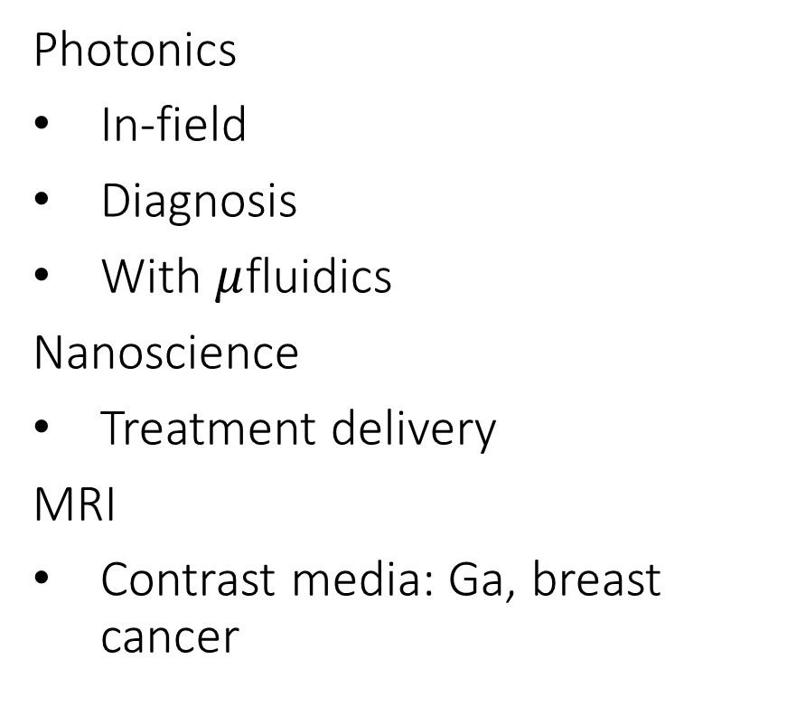
Health science: quantum science
Photonics
In-field
Diagnosis
With $μ$fluidics
Nanoscience
Treatment delivery
MRI
Contrast media: Ga, breast cancer

Slide 37
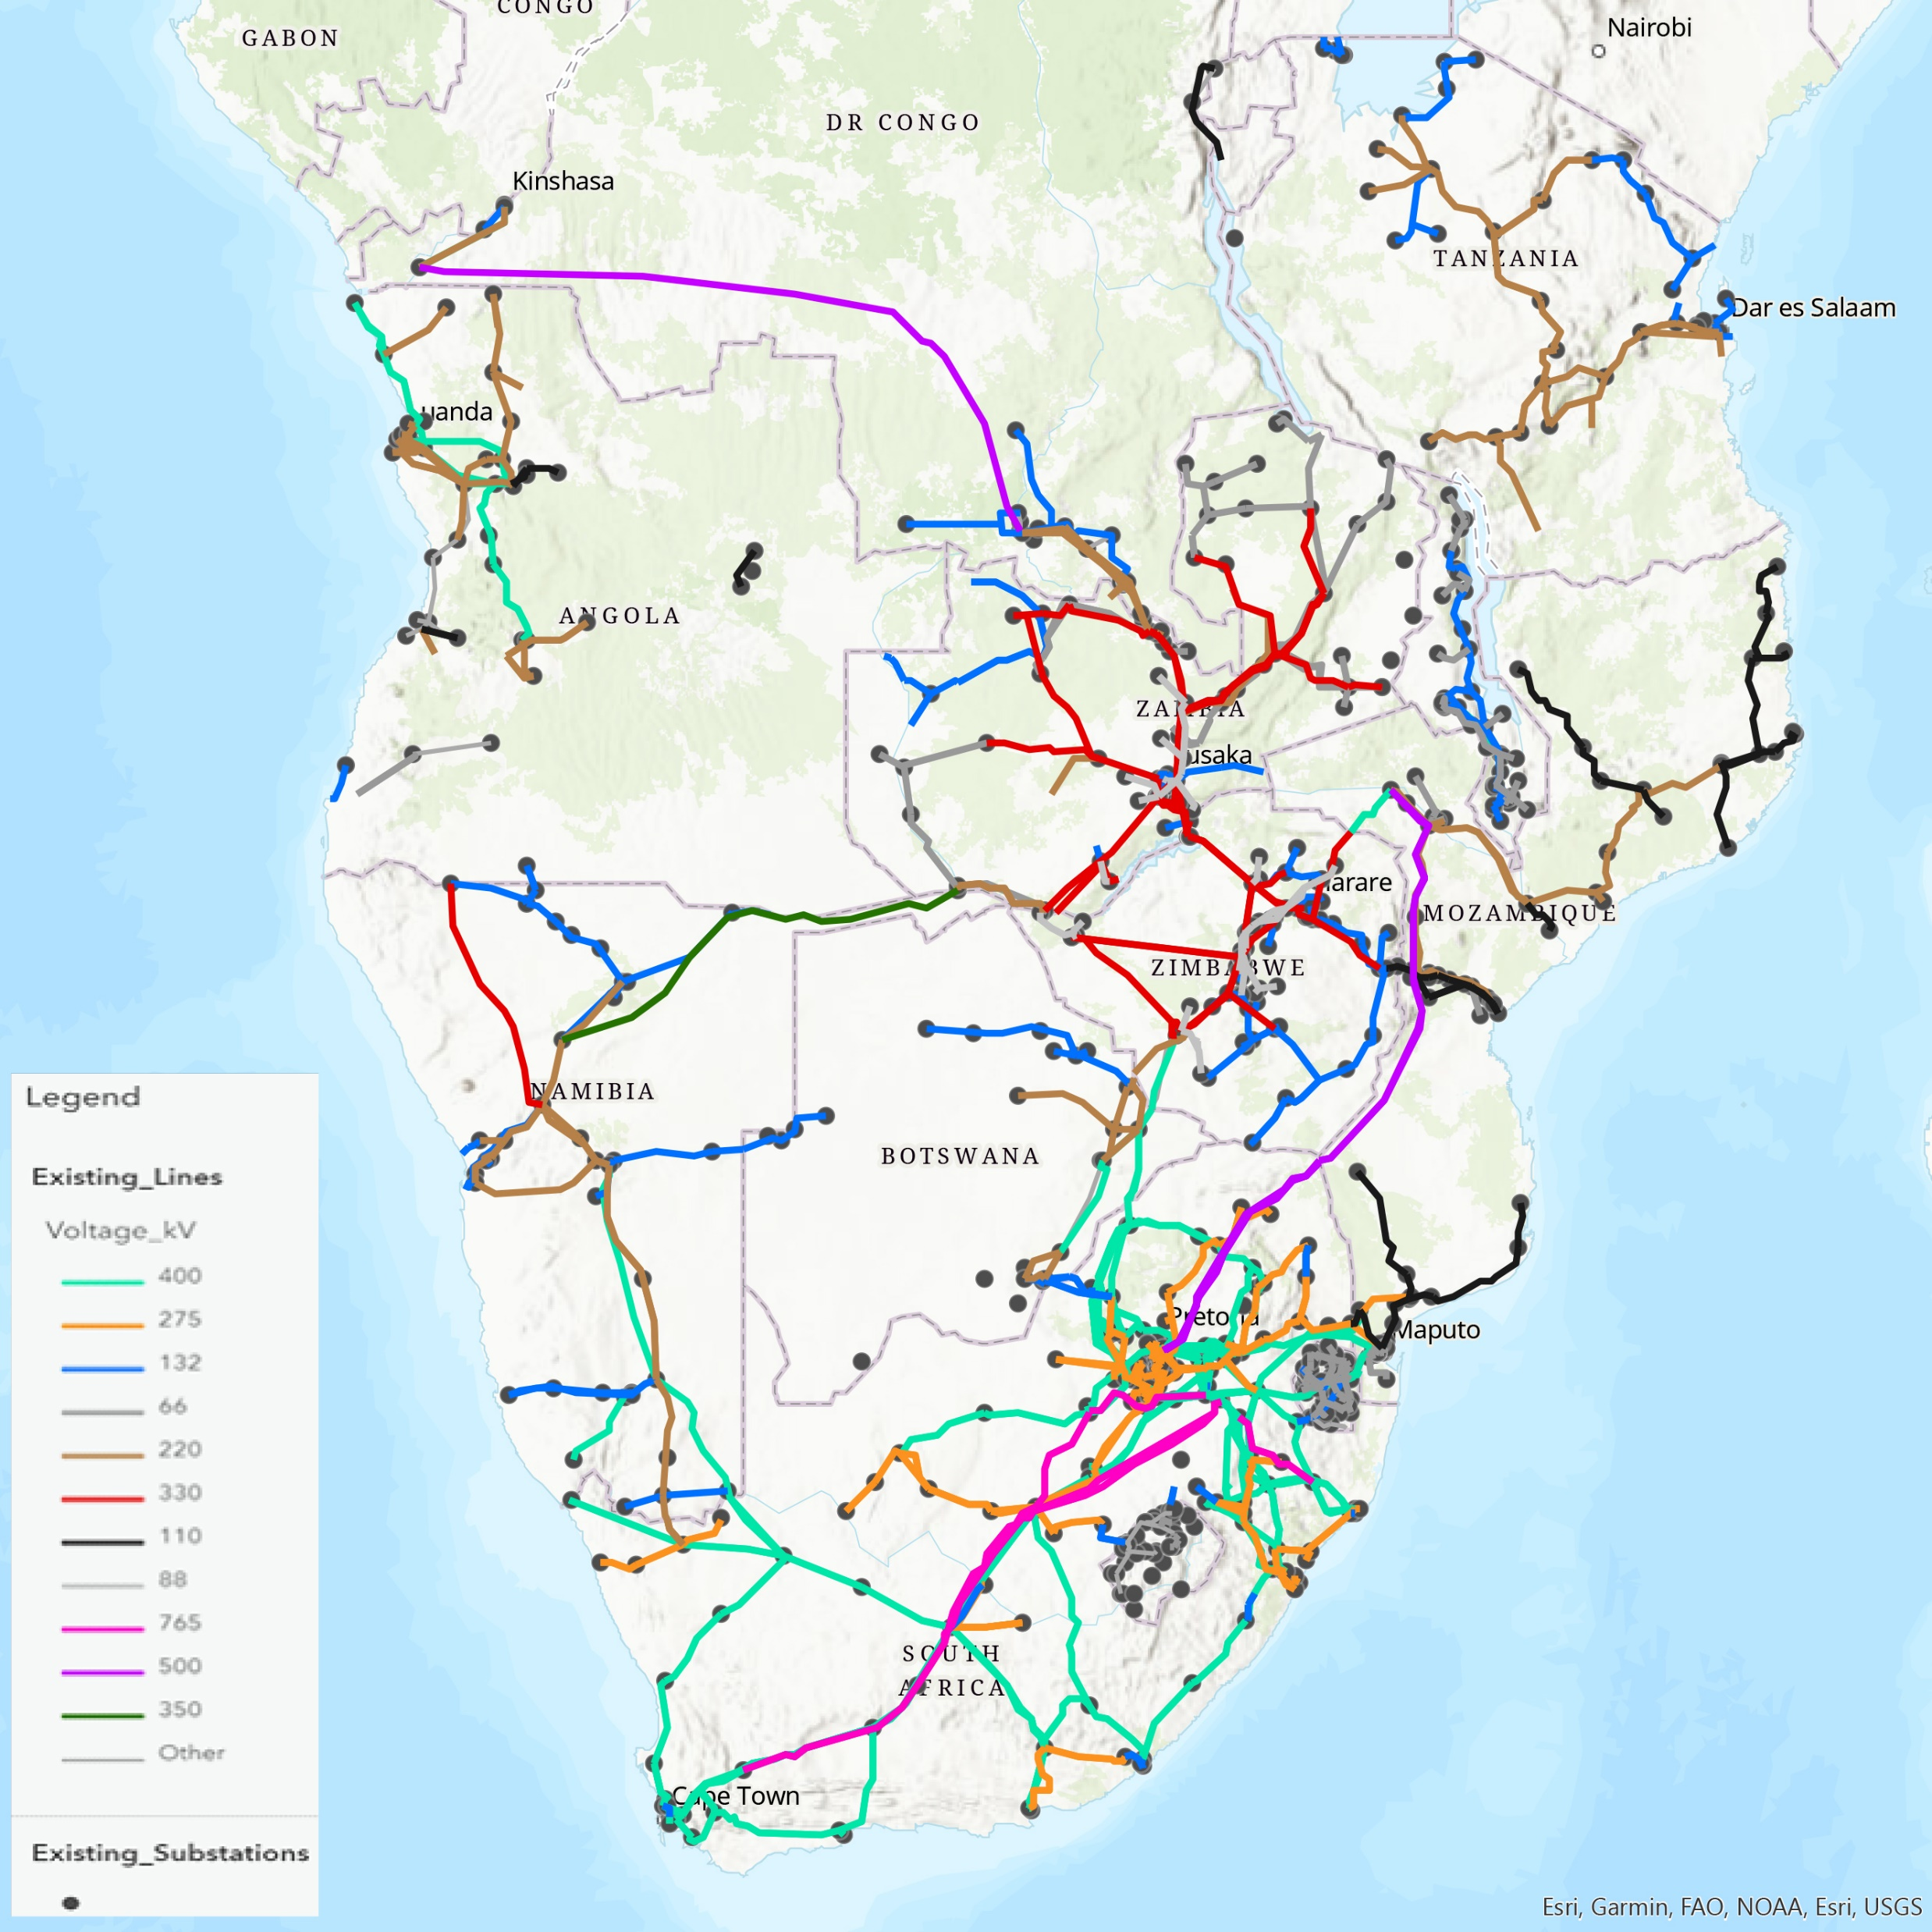
Sustainability
Major research across Africa acknowledged
Here: cover a lesser-known aspect
Power distribution
  Network stability
https://www.sapp.co.zw/sapp-sadc-grid-map
Leonardo Rydin Gorjão and Jacques Maritz, Exploring the Useful Stochastic Layer of Power Grids,
African Physics Newsletter Issue 18 July 2023 https://www.aps.org/publications/african-physics-newsletter

Slide 38
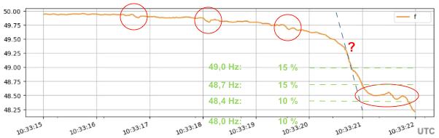
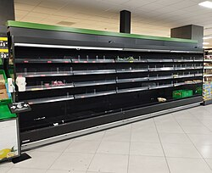
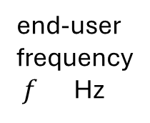
Iberian power failure 2025
surge in voltage that the grid was unable to absorb
Local grid did not have sufficient thermal power plants on line for load
Blackout and black start
  Spain, Portugal, Andorra, France, Morocco, Greenland
end-user
frequency
$f$Hz
10:33:15
10:33:21
Power frequency in Southern Spain just before the blackout in orange (5 cycle average) and ROCOF in blue.
Dashed lines in green indicate the thresholds for under-frequency load shedding (UFLS).
By Luis Badesa, Blackout in Spain and Portugal: What do we know so far?, CC0,
https://commons.wikimedia.org/w/index.php?curid=165043734
https://en.wikipedia.org/wiki/2025_Iberian_Peninsula_blackout

Slide 39
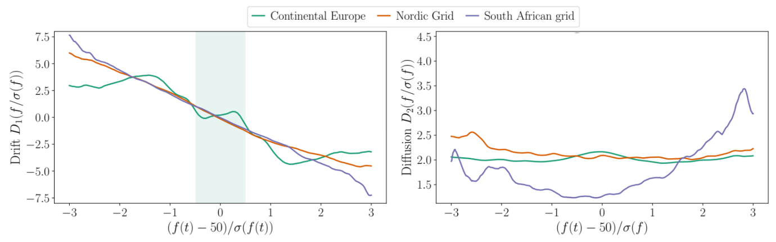
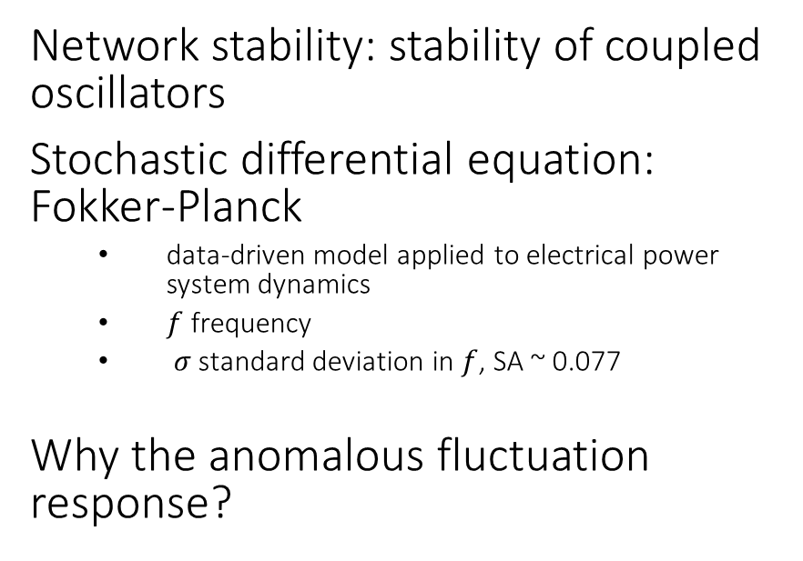
Stability and stochasticity in power grid networks gaps
Solar, wind and loadshedding are highly intermittent, affect most of SADC
  In SA, non-technical outages: illegal connections, overloading, vandalism
Network stability: stability of coupled oscillators
Stochastic differential equation: Fokker-Planck
  data-driven model applied to electrical power system dynamics
  $f$ frequency
  $σ$ standard deviation in $f$, SA ~ 0.077
Why the anomalous fluctuation response?
fluctuation amplitude
Gorjão and Maritz The stochastic nature of power-grid frequency in South Africa 2023
J. Phys. Complex. 4 015007 https://iopscience.iop.org/article/10.1088/2632-072x/acb629/pdf

Slide 40
New opportunities in physics to consider
As a fundamental science in its own right
as well as
A partner in transdisciplinary work

Slide 41
Conclusions
Aims of this work…
This work showed
show the expanding roles of physics
provide a few examples relevant to Southern Africa in the global context
Highlight: less frequently mentioned aspects and role of physics as a basic or fundamental science
Seek: a way of finding gaps by linking physics to impact
Ways of relating physics to climate science, sustainability science, etc.
Selected examples
Fundamental physics is valuable in itself, not only as a multi/transdisciplinary contributor
A hand-operated way of relating disciplines has been demonstrated
Automate a literature survey?

Slide 42
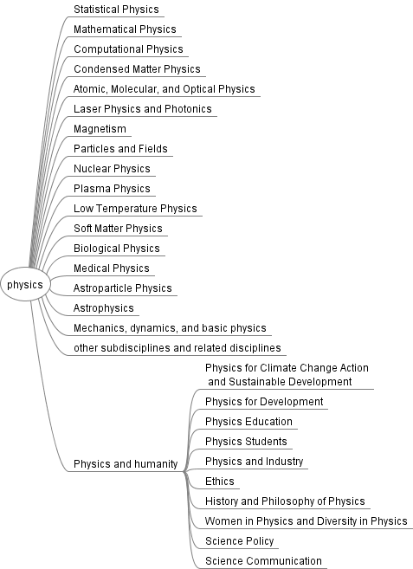
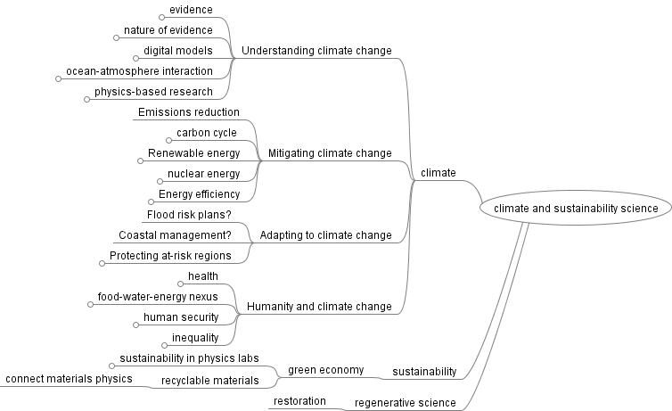
What would an automated project look like?
IPCC AR6 Reports 2021-2023, WGI, WGII, WGIII, Synthesis
https://www.ipcc.ch/assessment-report/ar6/

Slide 43
Need more information?

Slide 44
Almost all items have NOT been covered in these notes
Renewable energy in all aspects
  Especially photovoltaics, condensed matter physics
Nuclear energy
Sustainability within physics
  Lab and institutional sustainability
Data centres
AI
Notably
University curricula in physics
- e.g. basic climate and sustainability concepts in physics
Regenerative development
- e.g. complex systems in restoring sea grass beds
Food-water-energy nexus
Water security, food security, human security
Care-climate nexus
Mitigation
Regenerative development
Science communication and diplomacy

Slide 45
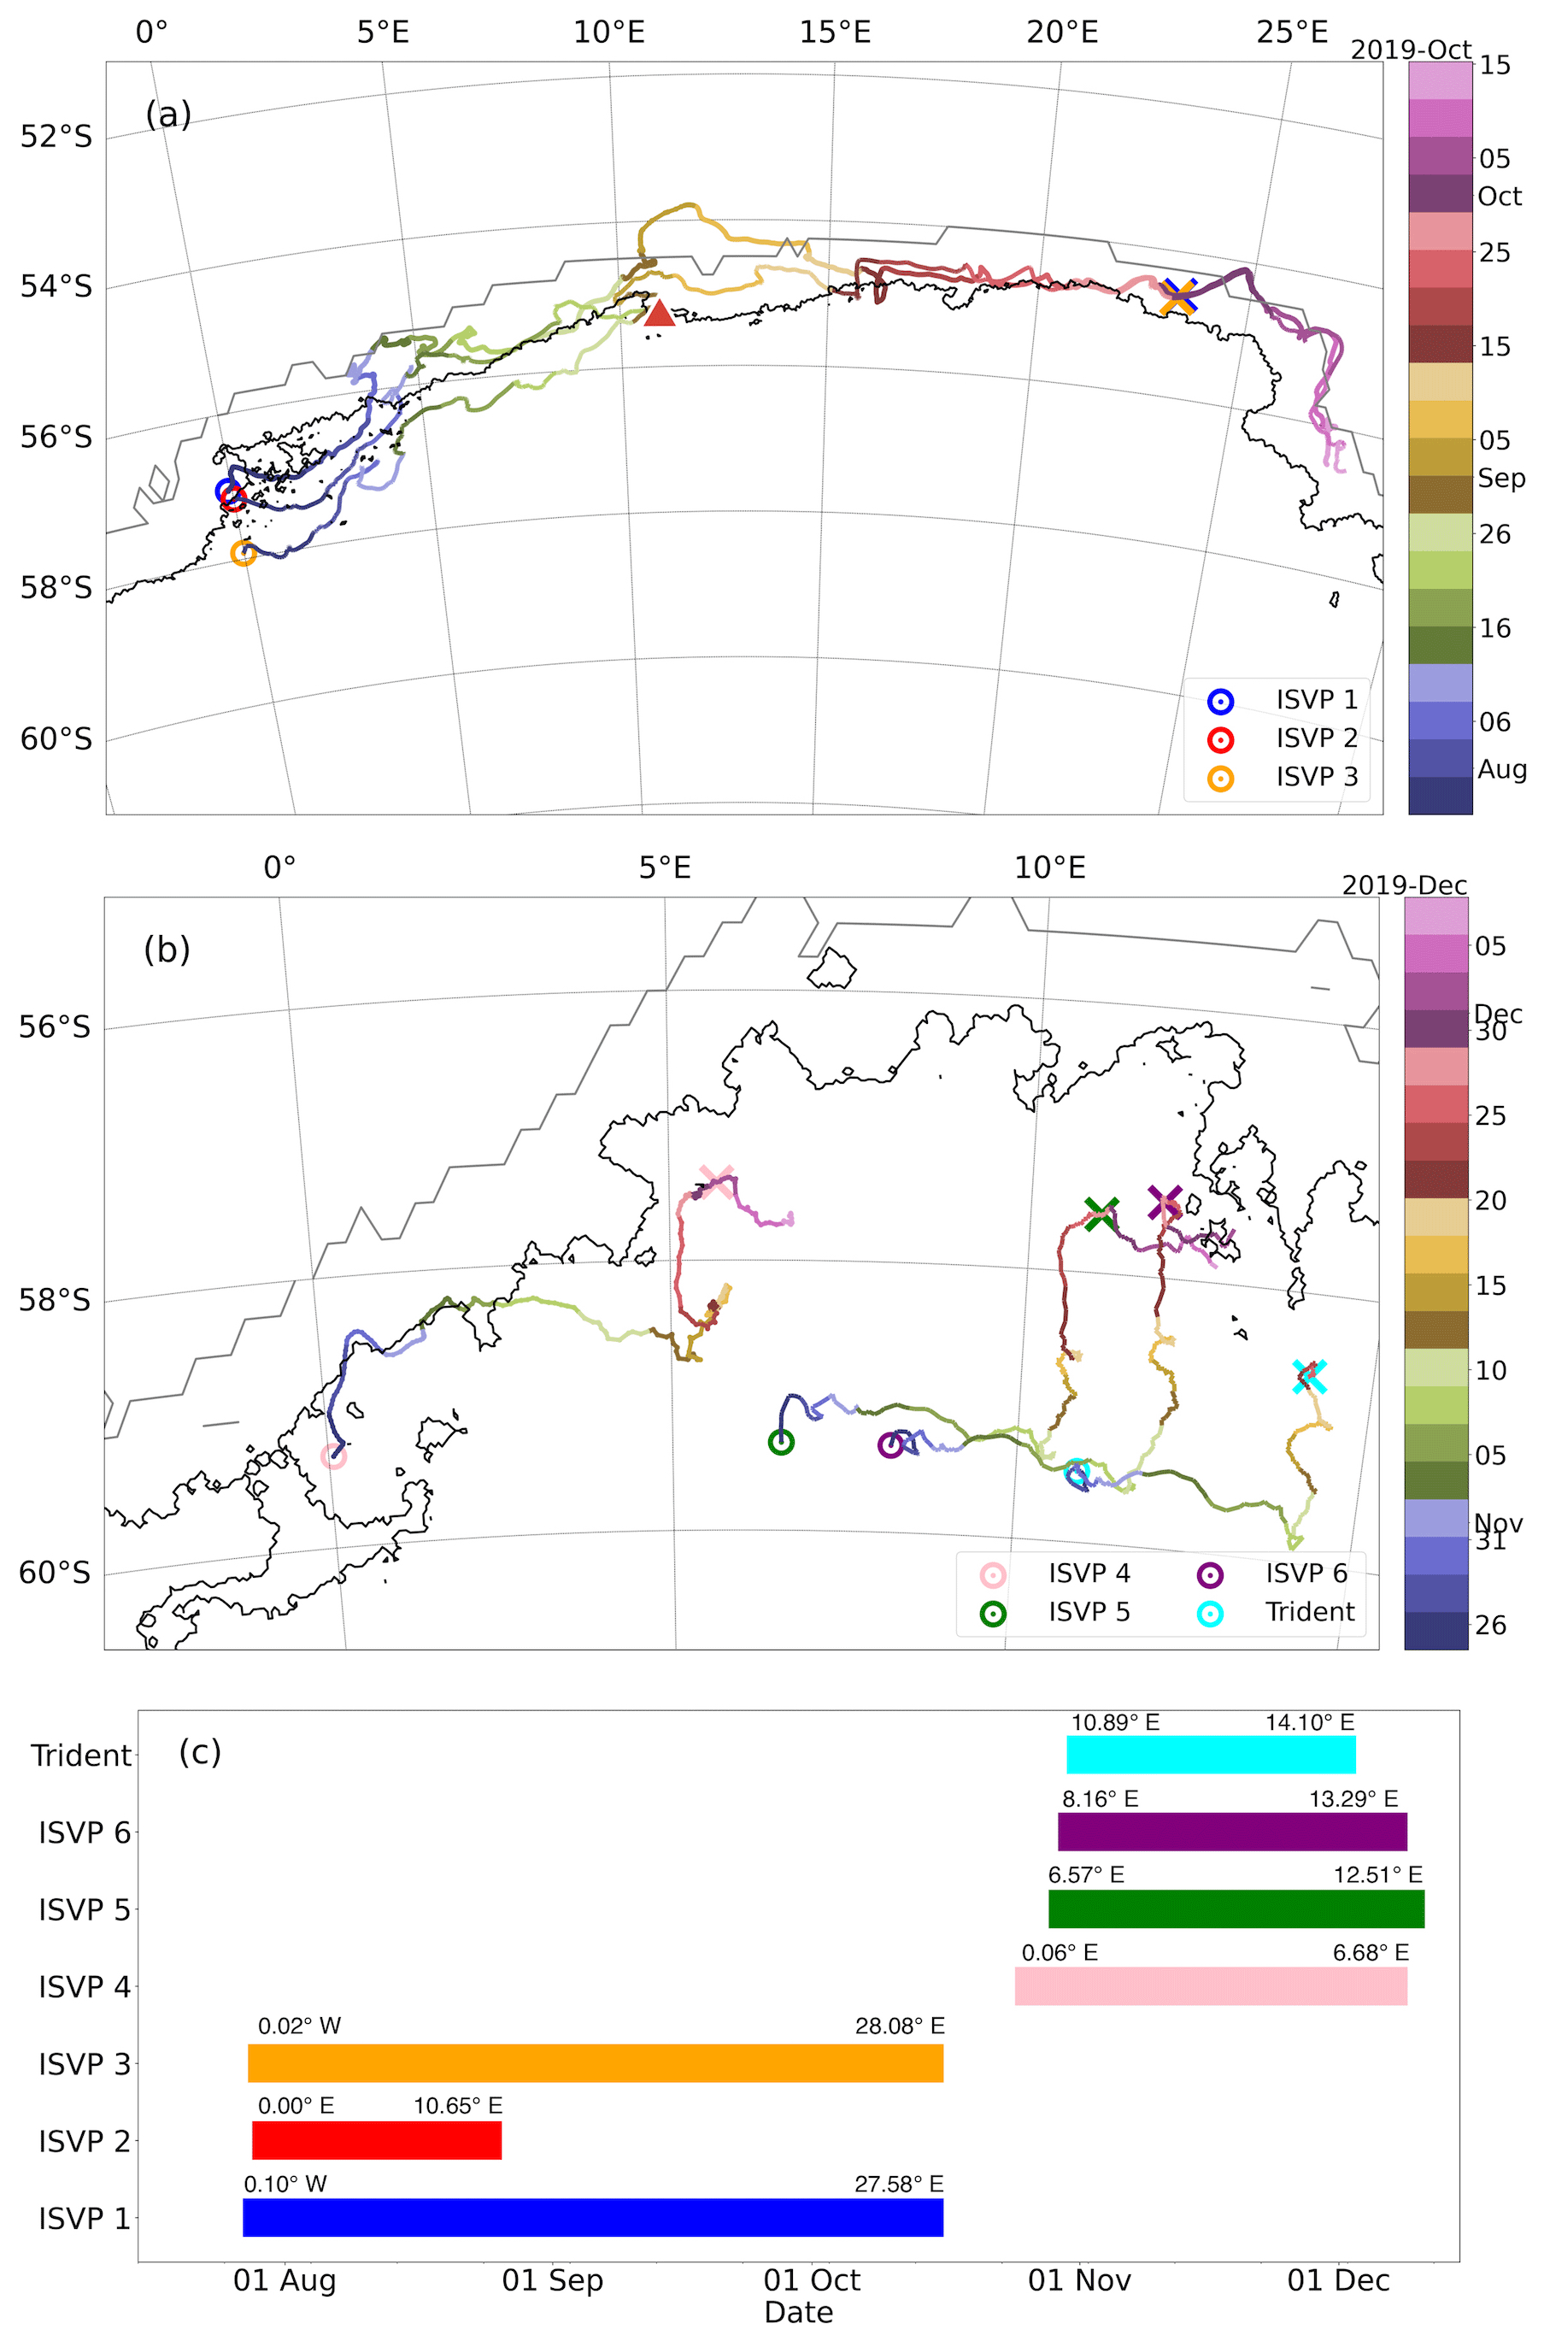
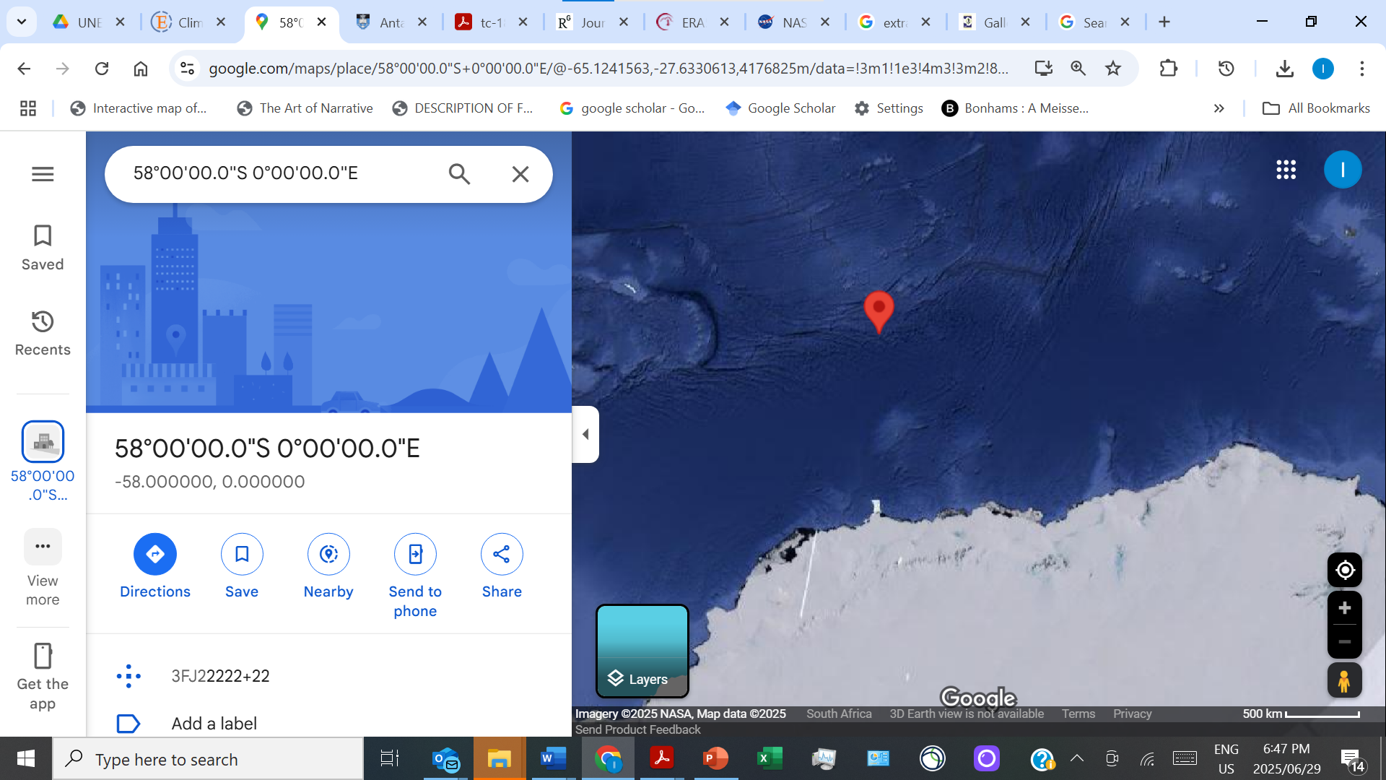
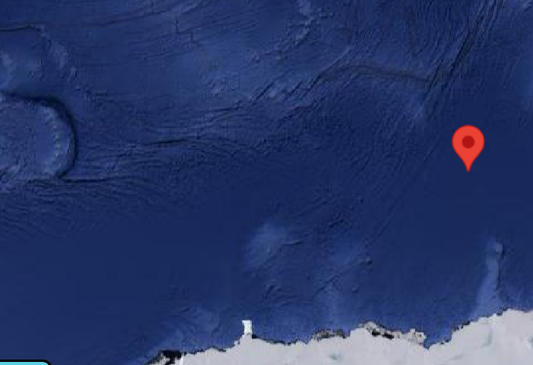
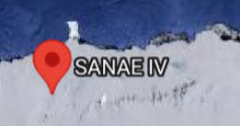
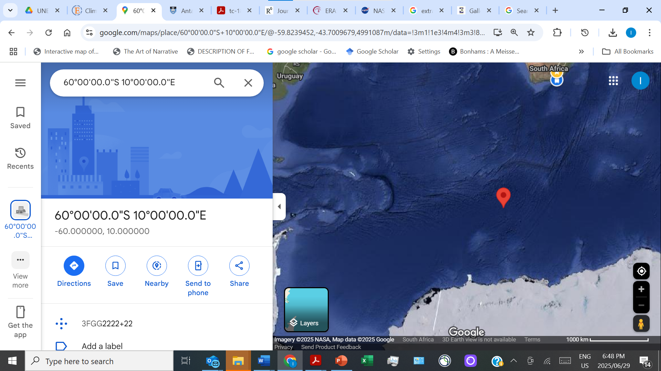
Ensemble trajectories, dispersion and drift [12]
Winter
Spring
Winter dominated by Antarctic Circumpolar Current and atmospheric forcing
Spring dominated by inertial drift, surface heat conditions, ice breakup;
Decoupled from atmospheric forcing
The black (grey) contour denotes the AMSR2 (SSMIS) 0 % sea ice concentration on 30 September 2019 – the date of approximate austral sea ice maximum.
Circles are initial positions.
Paul et al. Sea ice mechanics Computer Methods in Material Science 2023, vol. 23, no. 3, 5–54
https://doi.org/10.7494/cmms.2023.3.0816

Slide 46
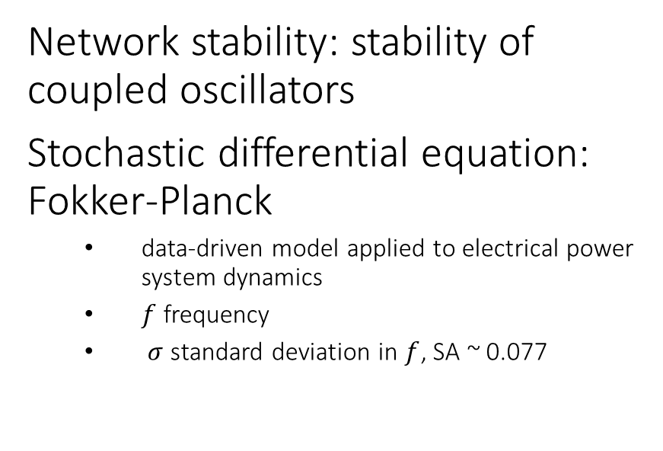
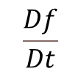
Stability and stochasticity in power grid networks
Solar, wind and loadshedding are highly intermittent, affect most of SADC
  In SA, non-technical outages: illegal connections, overloading, vandalism
Network stability: stability of coupled oscillators
Stochastic differential equation: Fokker-Planck
  data-driven model applied to electrical power system dynamics
  $f$ frequency
  $σ$ standard deviation in $f$, SA ~ 0.077
$$\frac{Df}{Dt}$$
fluctuation amplitude
Gorjão and Maritz The stochastic nature of power-grid frequency in South Africa 2023
J. Phys. Complex. 4 015007 https://iopscience.iop.org/article/10.1088/2632-072x/acb629/pdf

