Slide 1
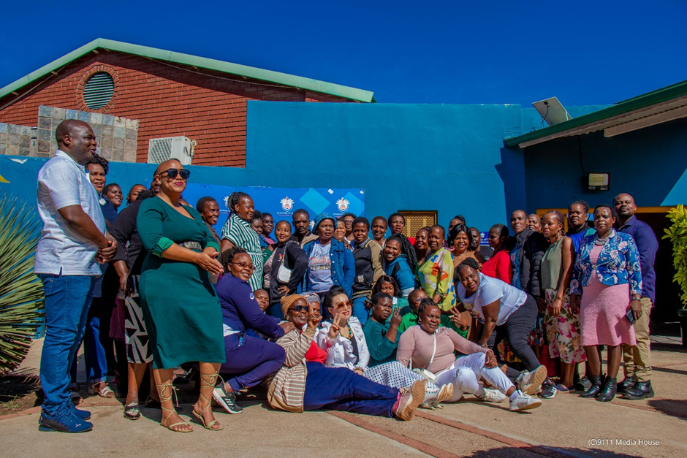



Practitioners’ understanding of integrating basic science into lessons in the Early Childhood Development playroom eeE
By
Prof SA Mulovhedzi
Date: 09 July 2025
Venue: University of the Witwatersrand

Slide 2

Introduction
Scope of presentation
Statement of Problem
Aim of the study
Pilot training
Research design and Methodology
Data collection and the Theoretical framework
Conclusions

Slide 3
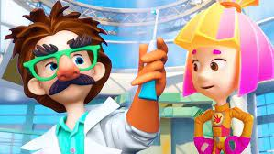
Introduction
Brenneman and Louro (2023) explore how early childhood playrooms can be rich environments for fostering scientific thinking.
They emphasise the importance of play-based learning and inquiry-led exploration, showing that activities like building, sorting, water play, and nature observation help children develop foundational scientific skills such as prediction, observation, and experimentation.

Slide 4

Cont…..
Early Childhood Development (ECD) lays the foundation for lifelong learning.
Basic science education fosters:
Curiosity
Critical thinking
Problem-solving skills
However, integration into ECD playroom activities remains a challenge for many practitioners.

Slide 5

Problem Statement
Despite the importance of integrating early science education in ECD centres:
A gap exists in practitioners' understanding of integrating basic science into lessons in the early childhood development playroom.
Unsure how to embed science in play-based environments.

Slide 6

The aim of the study
This pilot study focuses on using targeted training to enhance practitioners' understanding and capacity to integrate basic science into lessons within the Early Childhood Development (ECD) playroom."
Through structured training, the study explores how professional development can strengthen science teaching in early childhood settings."

Slide 7

Pilot study
This study serves as a pilot intervention aimed at improving ECD practitioners’ understanding of basic science concepts and their ability to effectively integrate these into playroom activities.

Slide 8
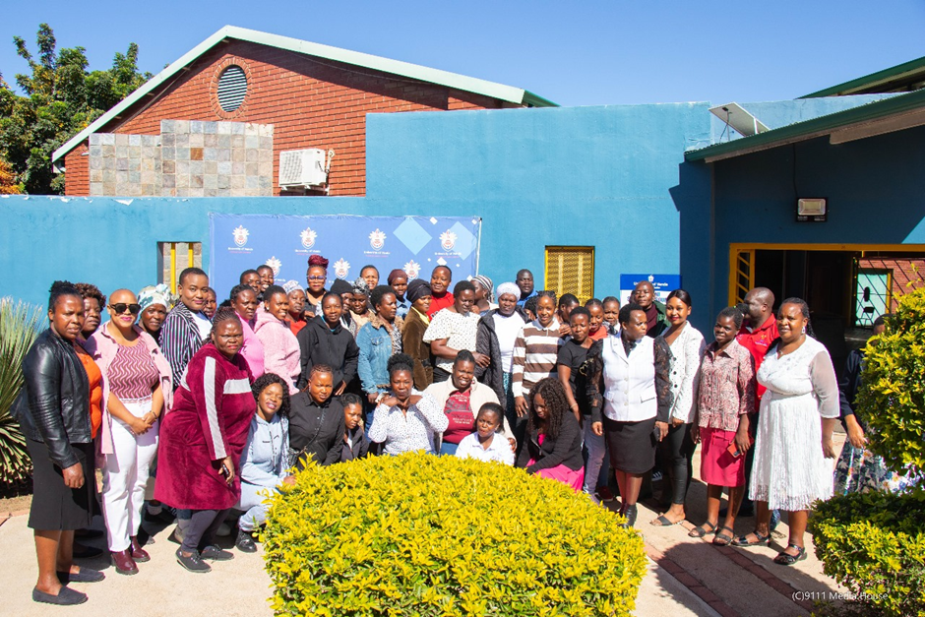
Pilot Training
Assess practitioners’ initial understanding of basic science integration.
Provide hands-on training and teaching strategies for science in play-based contexts.
Evaluate the impact of training on pedagogical knowledge and classroom practice.

Slide 9
Number of ECD centres and practitioners
30 ECD Centres
All qualified ECD practitioners
Diverse experience levels (new vs. experienced)

Slide 10
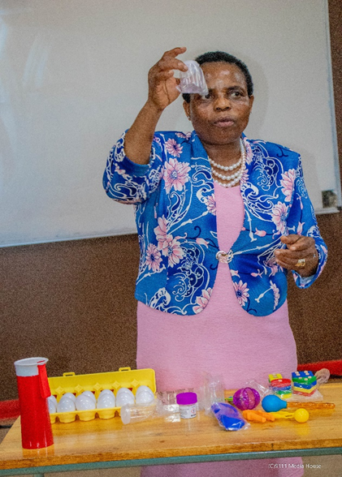
Training Approach
Duration
Format: Interactive workshop + practical demonstrations
Themes Covered:
Understanding science in ECD
Integrating science into storytelling, sensory play, and nature-based activities
Designing lesson plans with science outcomes
Using local materials for science activities

Slide 11


Pre-Training Assessment
Practitioners completed a questionnaire and participated in group discussions.
Assessed their conceptual understanding of science in ECD
Confidence in teaching science

Slide 12
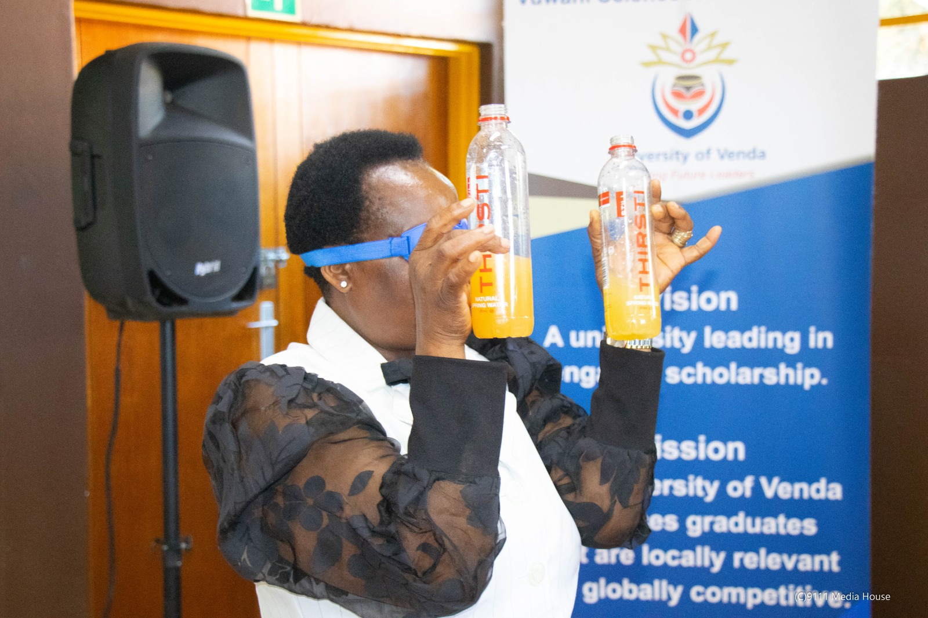
Training Activities
Demonstrations: Water exploration, plant growth, magnets, and shadows.
Reflection sessions: Discussing barriers and opportunities in their contexts.

Slide 13
Observations
Increased confidence in integrating science into play
Practitioners valued:
Practical examples
Hands-on activities
Peer collaboration

Slide 14

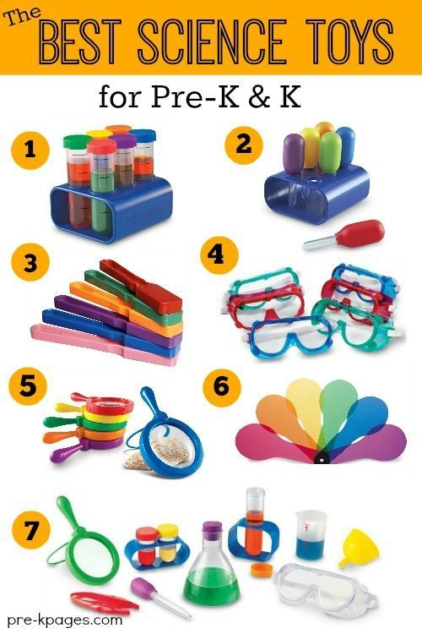
Introduce discovery table
1. Test Tube Set
2. Jumbo Droppers with Stand
3. Magnetic Wands
4. Safety Goggles
5. Measuring Cups & Sifter
6. Colour Paddles
7. Magnifying Glass & Science Tools Kit

Slide 15
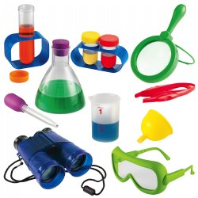
Challenges noted
Limited resources
Time constraints in daily routines
Need for continued mentorship
Science tools

Slide 16


Early Outcomes and Recommendations
Improved lesson planning with clear science objectives
Increased use of exploratory activities in playrooms
More intentional use of local materials to teach science
Positive attitude shift toward science teaching
Scale up training to other ECD centres
Provide ongoing support through mentoring or follow-ups
Develop simple resource packs for science activities
Encourage collaborative learning and peer support among practitioners.

Slide 17
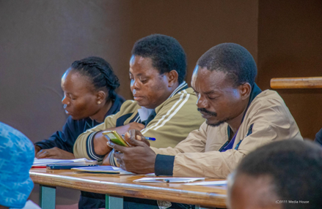
Research design and methodology
Approach: Qualitative research
Design: Exploratory case study
Gain in-depth insights into practitioners’ understanding and pedagogical strategies for integrating basic science in ECD playroom

Slide 18

Theoretical Framework: Vygotsky’s Sociocultural Theory
Learning occurs through social interaction and guided play.
Emphasizes:
Zone of Proximal Development (ZPD)
Scaffolding by more knowledgeable others
Supports science learning through play-based social activities

Slide 19

Data Collection Techniques
Semi-structured interviews: Elicit practitioners' personal experiences and beliefs
Classroom observations: Capture real-time science integration practices
Document analysis: Evaluate lesson plans and activity guides for science objectives

Slide 20
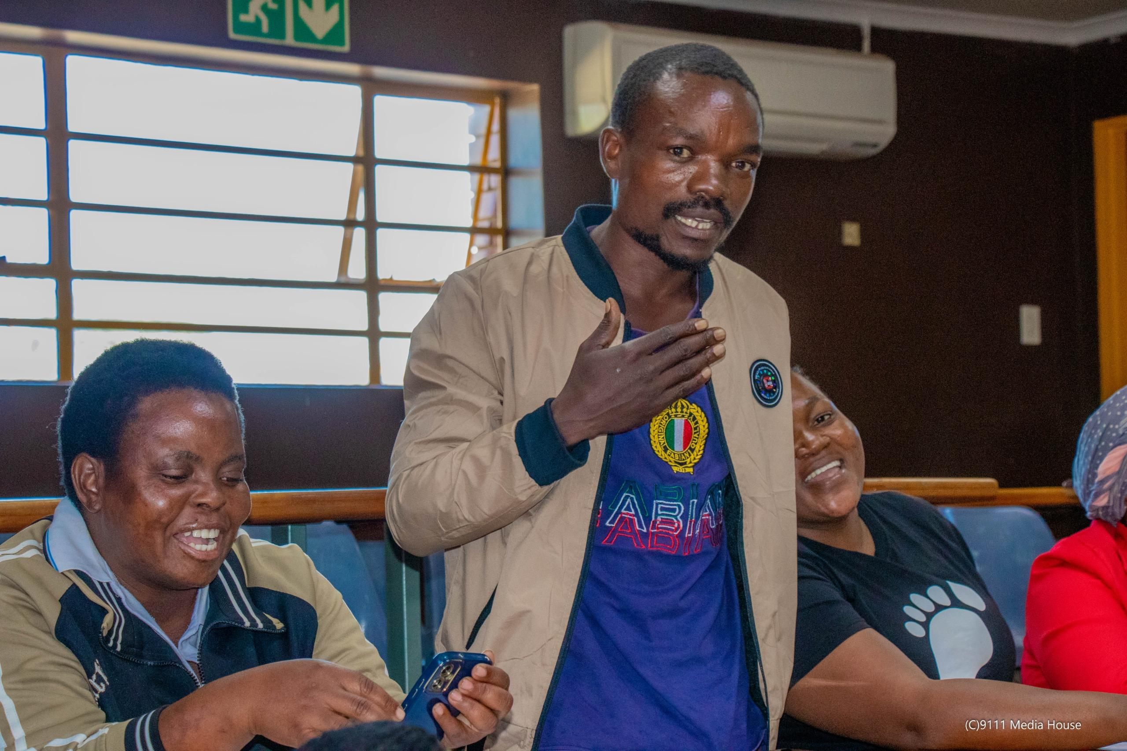
Conclusion
Pilot demonstrated that targeted training can build practitioners’ capacity to integrate science in ECD settings.
With the right support, play-based science learning can be embedded into everyday practice.
Investing in early science education prepares children for lifelong inquiry and learning.

Slide 21


Cont…..
Integrating basic science in ECD playrooms is both necessary and achievable
With proper training, support, and collaboration, practitioners can spark scientific thinking from the earliest stages of learning

Slide 22

End note
(Hesterman & Hunter, 2023)
“When young children have uninterrupted time to playfully and independently explore, discover, investigate and experiment in stimulating, safe and varied environments, critical thinking and scientific inquiry are promoted.”

Slide 23


References
Brenneman, K., & Louro, I. F. (2023). Science in the early childhood classroom: Capitalizing on children's natural curiosity. Early Childhood Research Quarterly, 62, 48–58.

Slide 24


End: Ndi a livhuwa/ thank you
The voice of physics in ECD centres
Aa!

