Slide 1

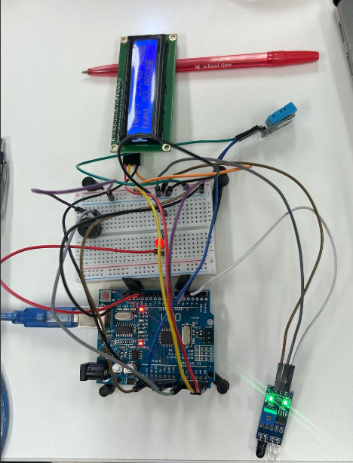
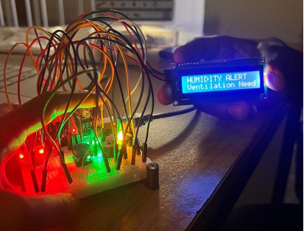
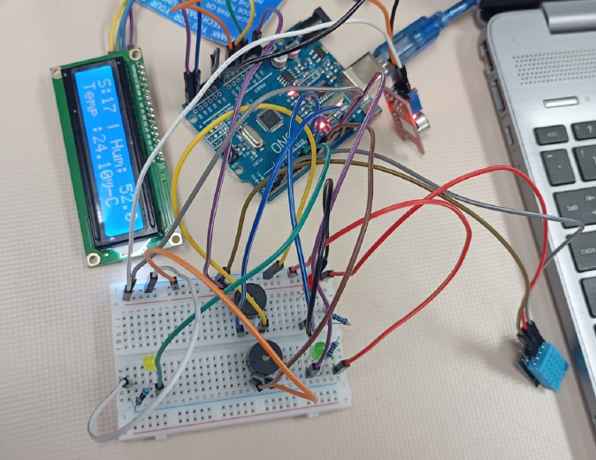
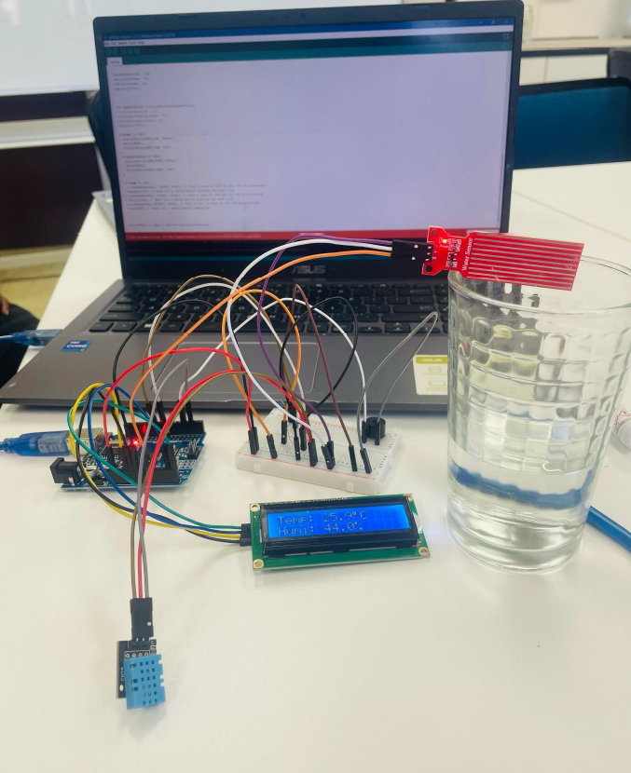
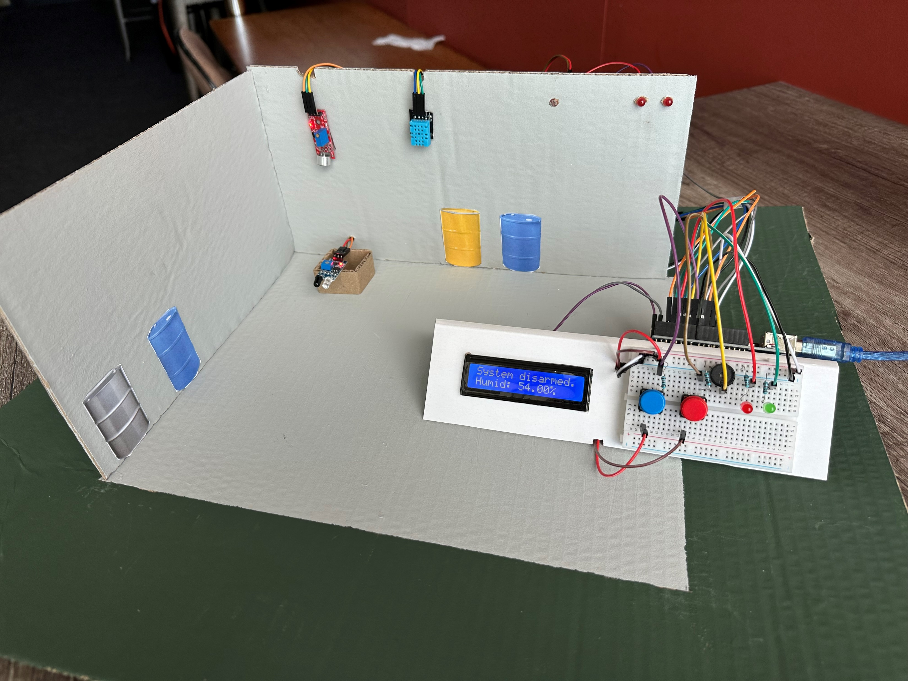
An Approach to Using Arduino in University Practicals
An Introduction to NMU’s Arduino Fundamentals Practical
Presented by: Elizabeth Hagemann
Authors: EM Hagemann, FJ Vorster, EE van Dyk and MT Sivewright
69th Annual Conference of the South African Institute of Physics [ 7-11 July 2025 ]
Notes:
Good morning and welcome to my presentation on the second year practicals at Nelson Mandela University which are run on the Arduino platform.

Slide 2
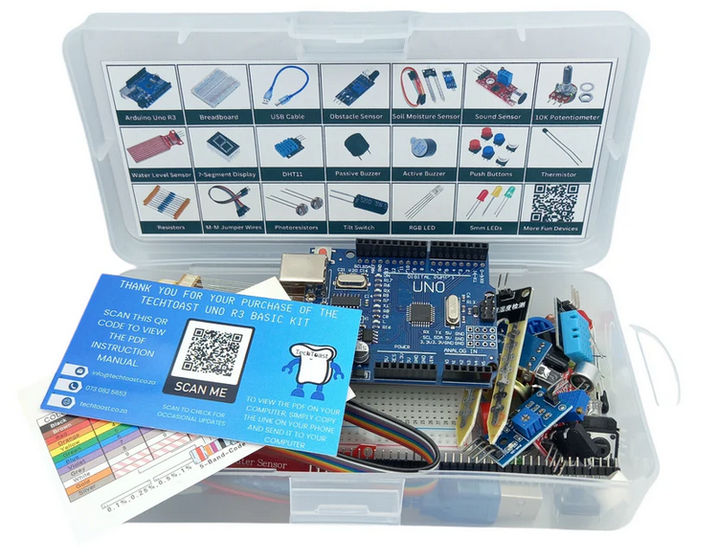
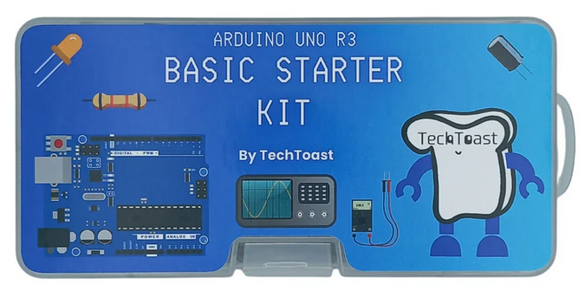
Introduction
Aim and Objectives
An Introduction to the Arduino Platform
The NMU Arduino Kit
The Practical Layout
  Sessions 1, 2 and 3
The Coding Challenge
Student Attempts
Conclusion
Further Improvements
2
[1]
Notes:
This is an outline of my presentation. It will focus on the the practical layout which is 3 3-hour sessions which are supervised and a coding challenge which was independent work.

Slide 3
Aim and Objectives
The aim is to develop a series of practical sessions that integrate Arduino technology to enhance students’ understanding of physics concepts while promoting student engagement.
Objectives:
To design an Arduino-based practical supporting physics fundamentals.
To ensure the activity is accessible for students with no prior Arduino experience.
To encourage critical thinking, problem-solving, and student collaboration.
3
Notes:
The aim of the practicals sessions was to introduce students to the Arduino platform and ultimately incorporate Arduino technology with physics concepts.
The objectives include designing the practicals, ensuring the practicals are accessible to students with no to minimal coding experience and finally encouraging student critical thinking, problem solving and collaboration.

Slide 4
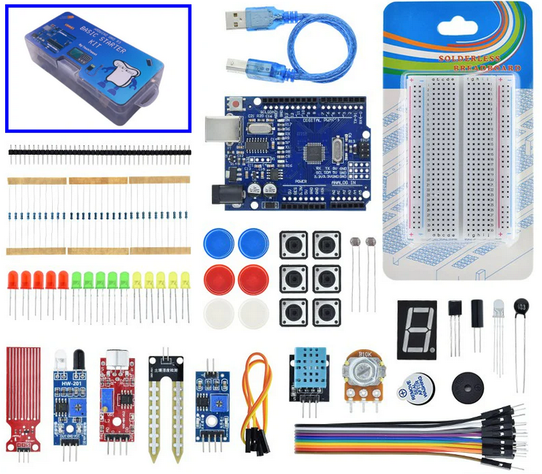
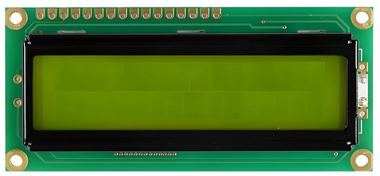
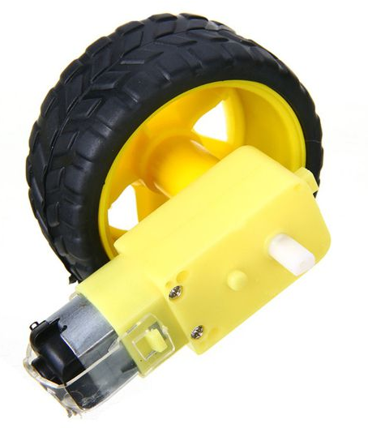
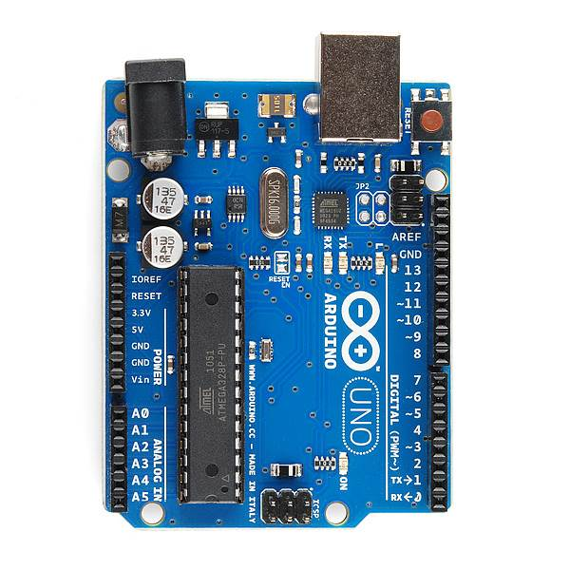
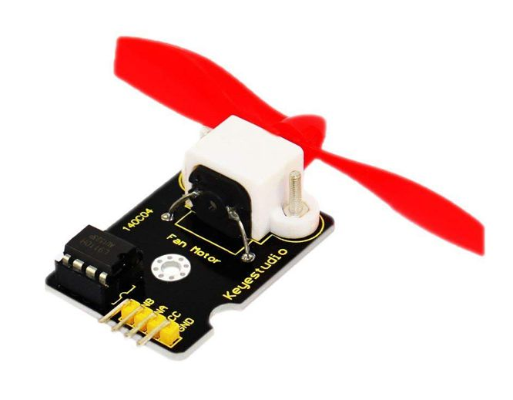
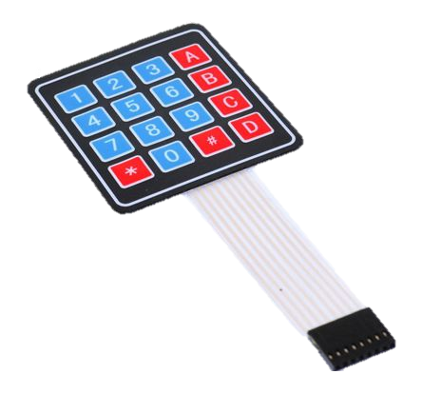
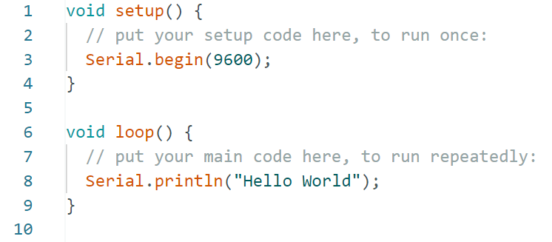

Introduction to the Arduino Platform
Input Devices
Output Devices
Controller
Microcontroller – Arduino UNO
Logic – Coding
[1]
[2]
User Input
IoT
[1]
[2]
4
Notes:
We start with an introduction to the Arduino platform for those who haven’t had the opportunity to use it.
It begins with an input signals, whether this be a device such as a sensor or it is user input in the form of buttons or keywords.
These are read in by the controller. In this practical we use an Aurduino UNO for it is easily available and relatively cheap.
This controller then uses code to make decisions whether this be to control an output device such as a motor, display a message or store data values either directly or via IoT.

Slide 5
Introduction to the Arduino Platform
Digital (discrete) signals are either ON or OFF.
Analog signals are anything that can be a full range of values.
Digital Signal
Analog Signal
5V
5V
0V
0V
Time
Time
Analog Sensors | Thermistor, Photoresistor (LDR), Water Level Sensor, Sound Sensor, Soil Humidity Sensor and IR Obstacle Avoidance Module
Digital Sensors | DHT11
5
Notes:
Students also learn that an Arduino UNO interpret signals that are either discrete or analog. Discrete signals are either an on or off, 0 or 5V. Analog signals, are a full range of values.
Both sensors are available in the kits.

Slide 6
Things in our NMU Arduino Kit
. . \, >
In the TechTaost Kit:
Arduino UNO and USB programming cable
Breadboard
Yellow, green, red and RGB LEDs
Button switches and a tilt switch
M2M jumper cables
Resistors and a potentiometer
Active and passive buzzers and 7-segment display
Thermistor, LDR, DHT11 (temperature and humidity) sensor, water level sensor, sound sensor, soil humidity sensor and IR obstacle avoidance module
Output Devices
Input Devices
6
https://techtoast.co.za/products/arduino-uno-r3-basic-starter-kit
[1]
Notes:
The kits that NMU bought are from a brand called TechTaost.
The included an Arduino UNO, a clone board, the necessary cables, a breadboard, jumper cables, buttons, output devices, and a lot of input devices, including sensors for temperature, water levels, noice and obstacles.

Slide 7
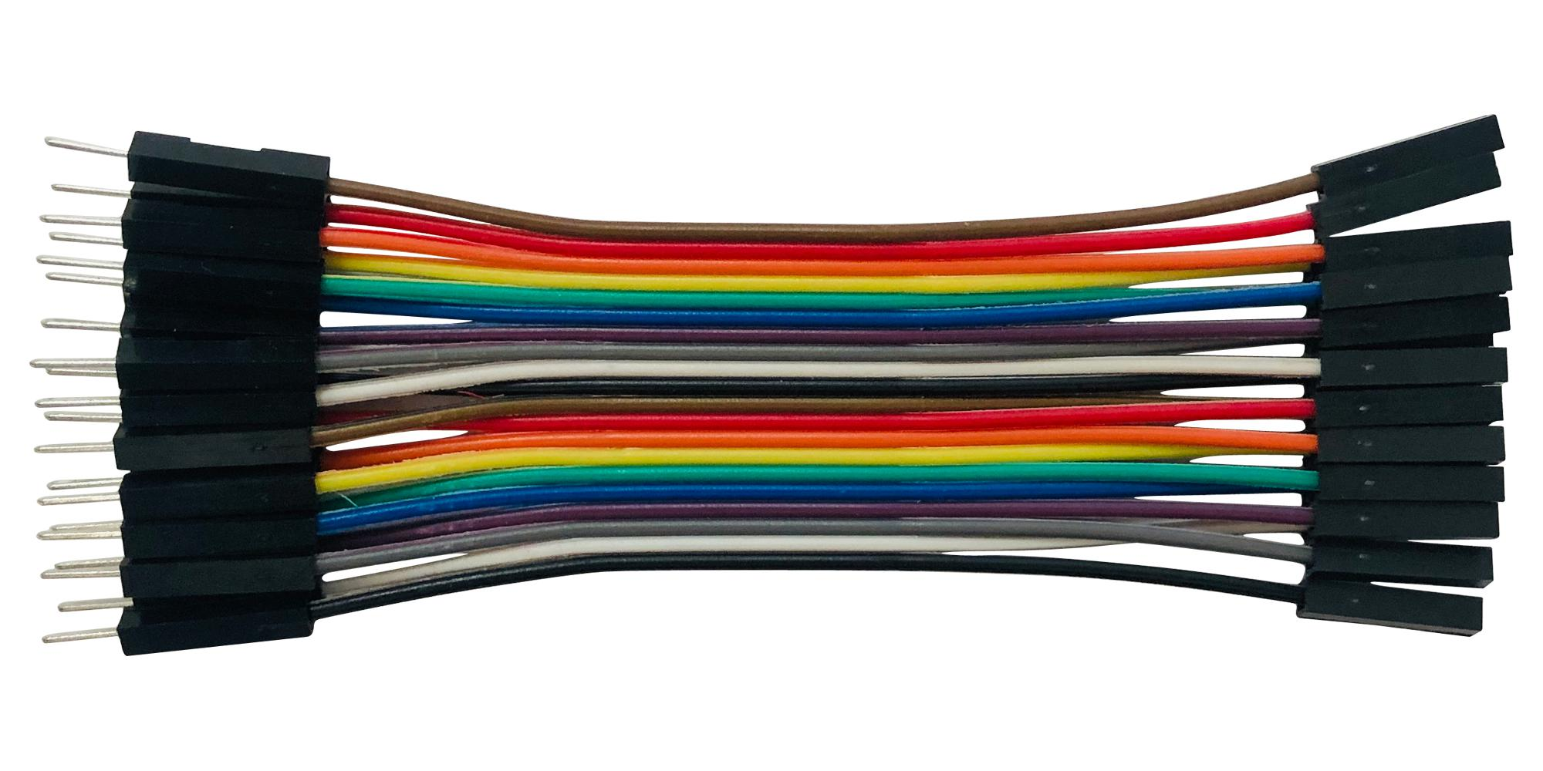
Things in our NMU Arduino Kit
Additional purchases in each kit:
M2M and M2F jumper cables
LCD display with I2C backpack
Components temporarily removed
All input devices from the TechToast Kit except DHT11
All output devices from the TechToast Kit
Additional components for the Coding Challenge
Based on this year’s student feedback
Keypad, electric fan, electric motor and wheels
Ultrasonic reflective sensor
7
[2]
Notes:
We then purchased additional items for the kits that we needed in order to create a comprehensive practical. This included additional jumper cables, both male2male and male2female, as well as an LCD for message displays.
We then temporarily removed most of the components from the kit. So I removed all the sensors with the exception of the DHT11 which is a digital temperature and humidity sensor, as well as all the output devices as with the extra componants the kits were full.
During the coding challenge, which I will discuss later, the students have access to all the components that were in their boxes as well as additional components we have purchased. This was based on student feedback.

Slide 8
Practical Session Layout
Session 1
1. Introduction to Arduino
Session 2
1. Building Circuits with Buttons
Session 3
2. Serial Communication
2. Executing Example Code
3. Building Circuits with LEDs
2. Using Arduino Libraries
3. Interfacing with an LCD
1. Temperature and Humidity Sensor
Coding Challenge
Supervised
Independent
8
Notes:
The is a roadmap and the layout for the practical. There are 3-hour sessions which are supervised learning in an campus lab. Each session is then divided into 3 or 2 activities.
Then, once having learnt the skills under the guidance of a demonstrator, the students are able to take their kits home, including picking from extra components we removed, to complete independent learning in the form of a Coding Challenge.

Slide 9
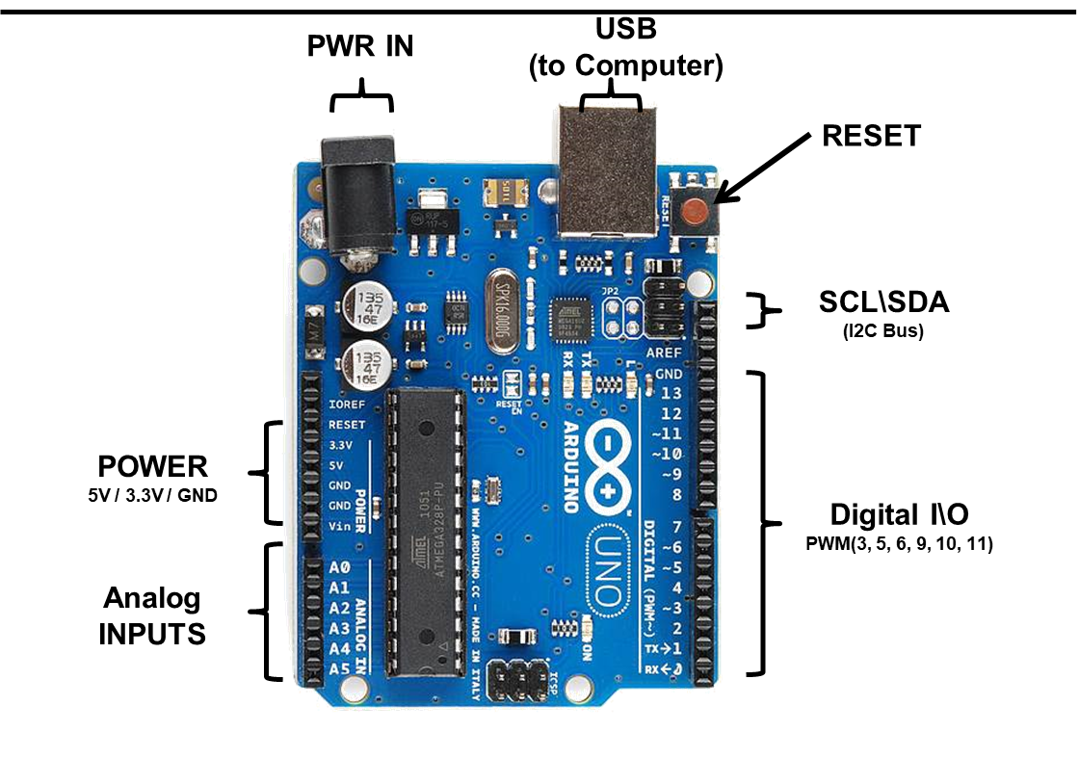


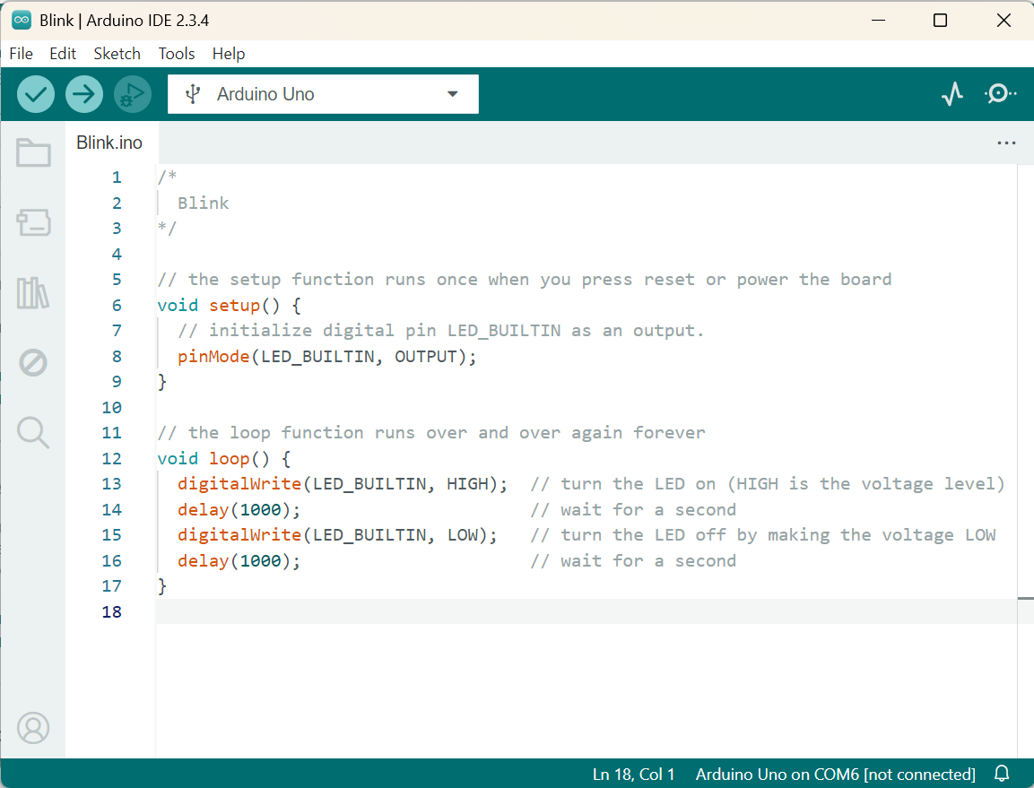
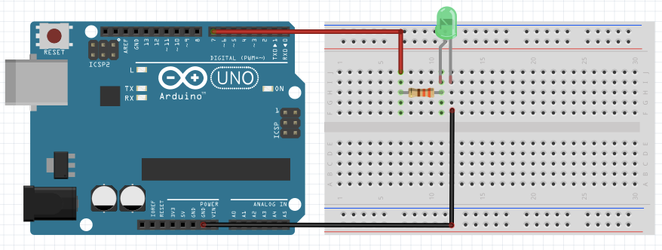
Practical Session 1
Session 1
1. Introduction to Arduino
2. Executing Example Code
3. Building Circuits with LEDs
Arduino UNO Arduino IDE Coding Keywords void setup() pinMode() void loop() digitalWrite() | Example Code File > Examples > Basics > Blink Uploading Code to the Arduino UNO | Electrical circuits Building the ‘Example Code’ circuit Expanding to other scenarios Additional LEDs Varying logic
5V
[3]
9
Notes:
So, Practical 1 is the introduction. We start by introducing the Arduino UNO and what the pins do. Then we introduce the Arduino IDE, which is the environment developed for these devices. It is very similar to It is similar if slightly lower machine level than C# and python. We also introduce keywords that they need for the coding.
The next activity involves example code. Students run a code called ‘Blink’ and once they connect the UNO, an onboard light blinks. This “Example code” is a big advantage of using Arduino IDE over other applications.
The last activity is involves using blink and building an external circuit on the breadboards. So students are introduced to electrical circuits and symbols, and electronic components. Students are then required to expand to other scenarios including changing the frequency and additional LEDs.

Slide 10
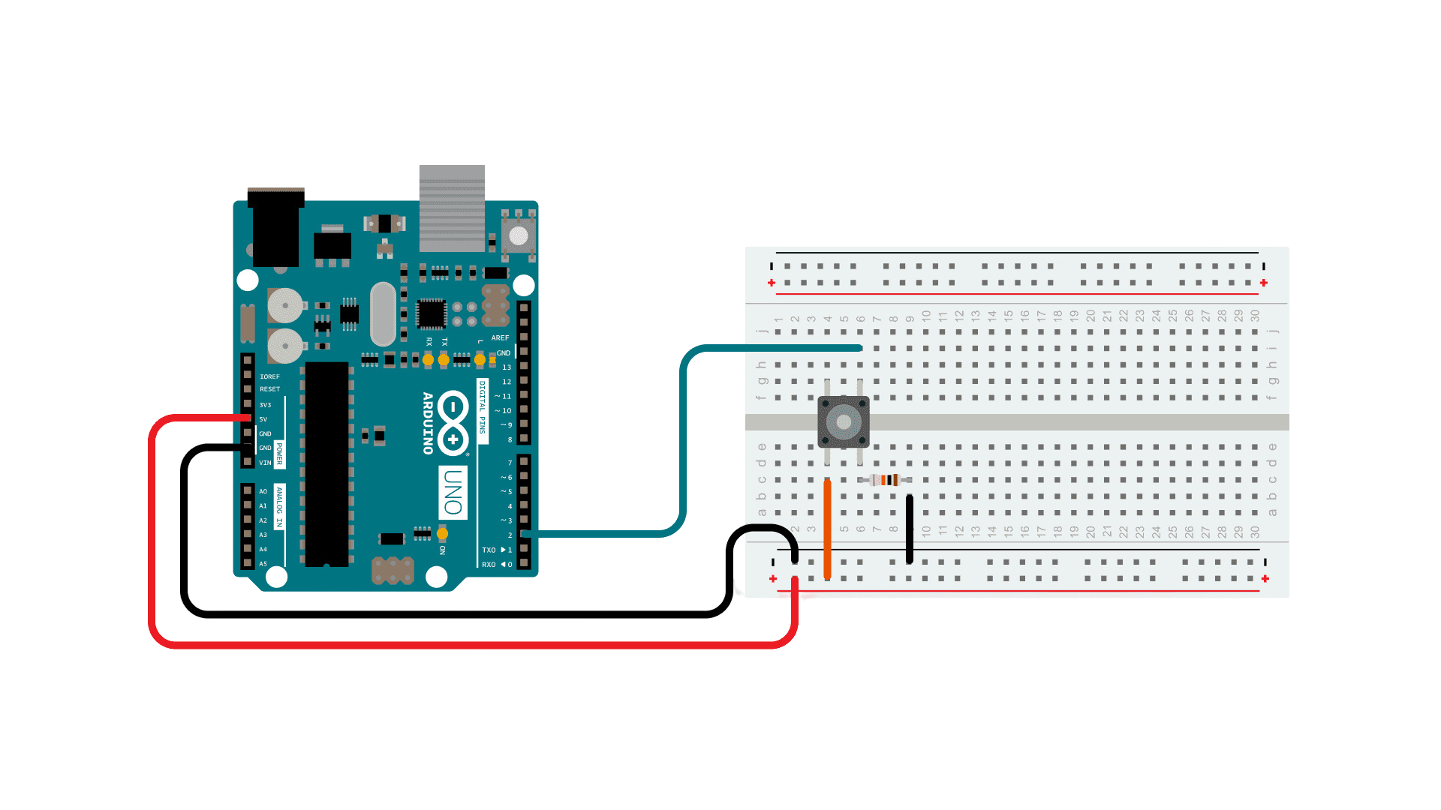
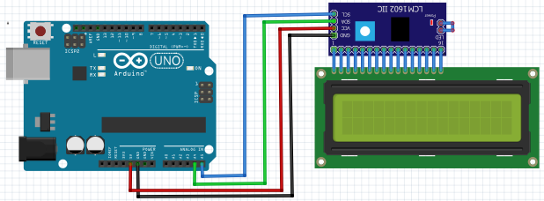
Practical Session 2
Session 2
1. Building Circuits with Buttons
2. Using Arduino Libraries
3. Interfacing with an LCD
Example Code File > Examples > Digital > Button Expanding to other scenarios Buttons and LEDs Varying logic | Arduino libraries are used to simplify code and extend functionality. The ‘Wire’ and ‘LiquidCrystal’ libraries for the LCD are used in the 3rd activity. Sketch > Include Library > Add .Zip Library | Interfacing the LCD with supplied code Expanding to other scenarios Varying logic Buttons as counters
[5]
[4]
10
Notes:
Session 2 starts with an example code called button. Similar to the LED in session 1, the students draw the circuit, build the circuit on a breadboard and expand to other scenarios.
Next students learn about libraries. For those that that don’t code, libraries allow you to simply code by using other peoples code. We introduce them importing the libraries from the internet and from the IDE itself and how to use the keywords.
Lastly, for this session, students use the Wire and LiquidCrystal libraries to interface with an LCD. They are then able to display messages such as their name and a button counter.

Slide 11
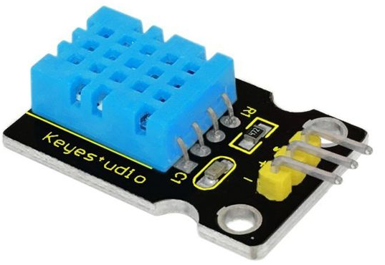
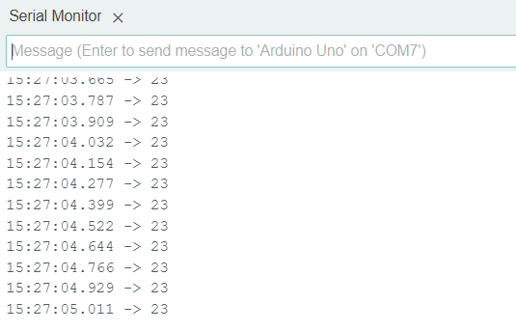
Practical Session 3
Session 3
2. Serial Communication
1. Temperature and Humidity Sensor
DHT11 - Temperature and Humidity Sensor DHT Sensor Library by Adafruit | Link between computer and Arduino UNO Can be used for debugging
[2]
11
Notes:
Session 3 is the shortest session to accommodate facility the beginning of the Coding challenge.
Students use the DHT11 and its library to measure temperature and humidity.
Students are introduced to serial communication. This is the link between devices such as the computer and the UNO and most commonly can be used for debugging or displaying variables.

Slide 12

Coding Challenge
A hazardous chemical site - build a safety system to detect danger
Scenario
Supervised Learning – DHT11, LED, and LCD
Independent Learning – Buzzer, an extra sensor or display
System
Demonstration
Wiring Diagram
Pictures of the Setup
Code
Explanations
Report
12
Notes:
Finally, our coding challenge.
This starts with the students receive in a scenario “They are physics and chemists in a hazardous chemical plant and need to help design a system that monitors and warns people of danger”.
The requirements for the system are to utilise knowledge from the supervised learning to implement the DHT11 and if the temperature is above a value ur an LED on and if the humidity os above a value turn a buzzer on, students are also required to use their LCD to display real time values. The independent learning is the buzzer, as well as a least one sensors are output that I took out the kits.
Once built, the students were required to demonstrate their systems working as well as writing a report which including a wiring diagram, pictures, their code and explanations for their choice of sensors.

Slide 13
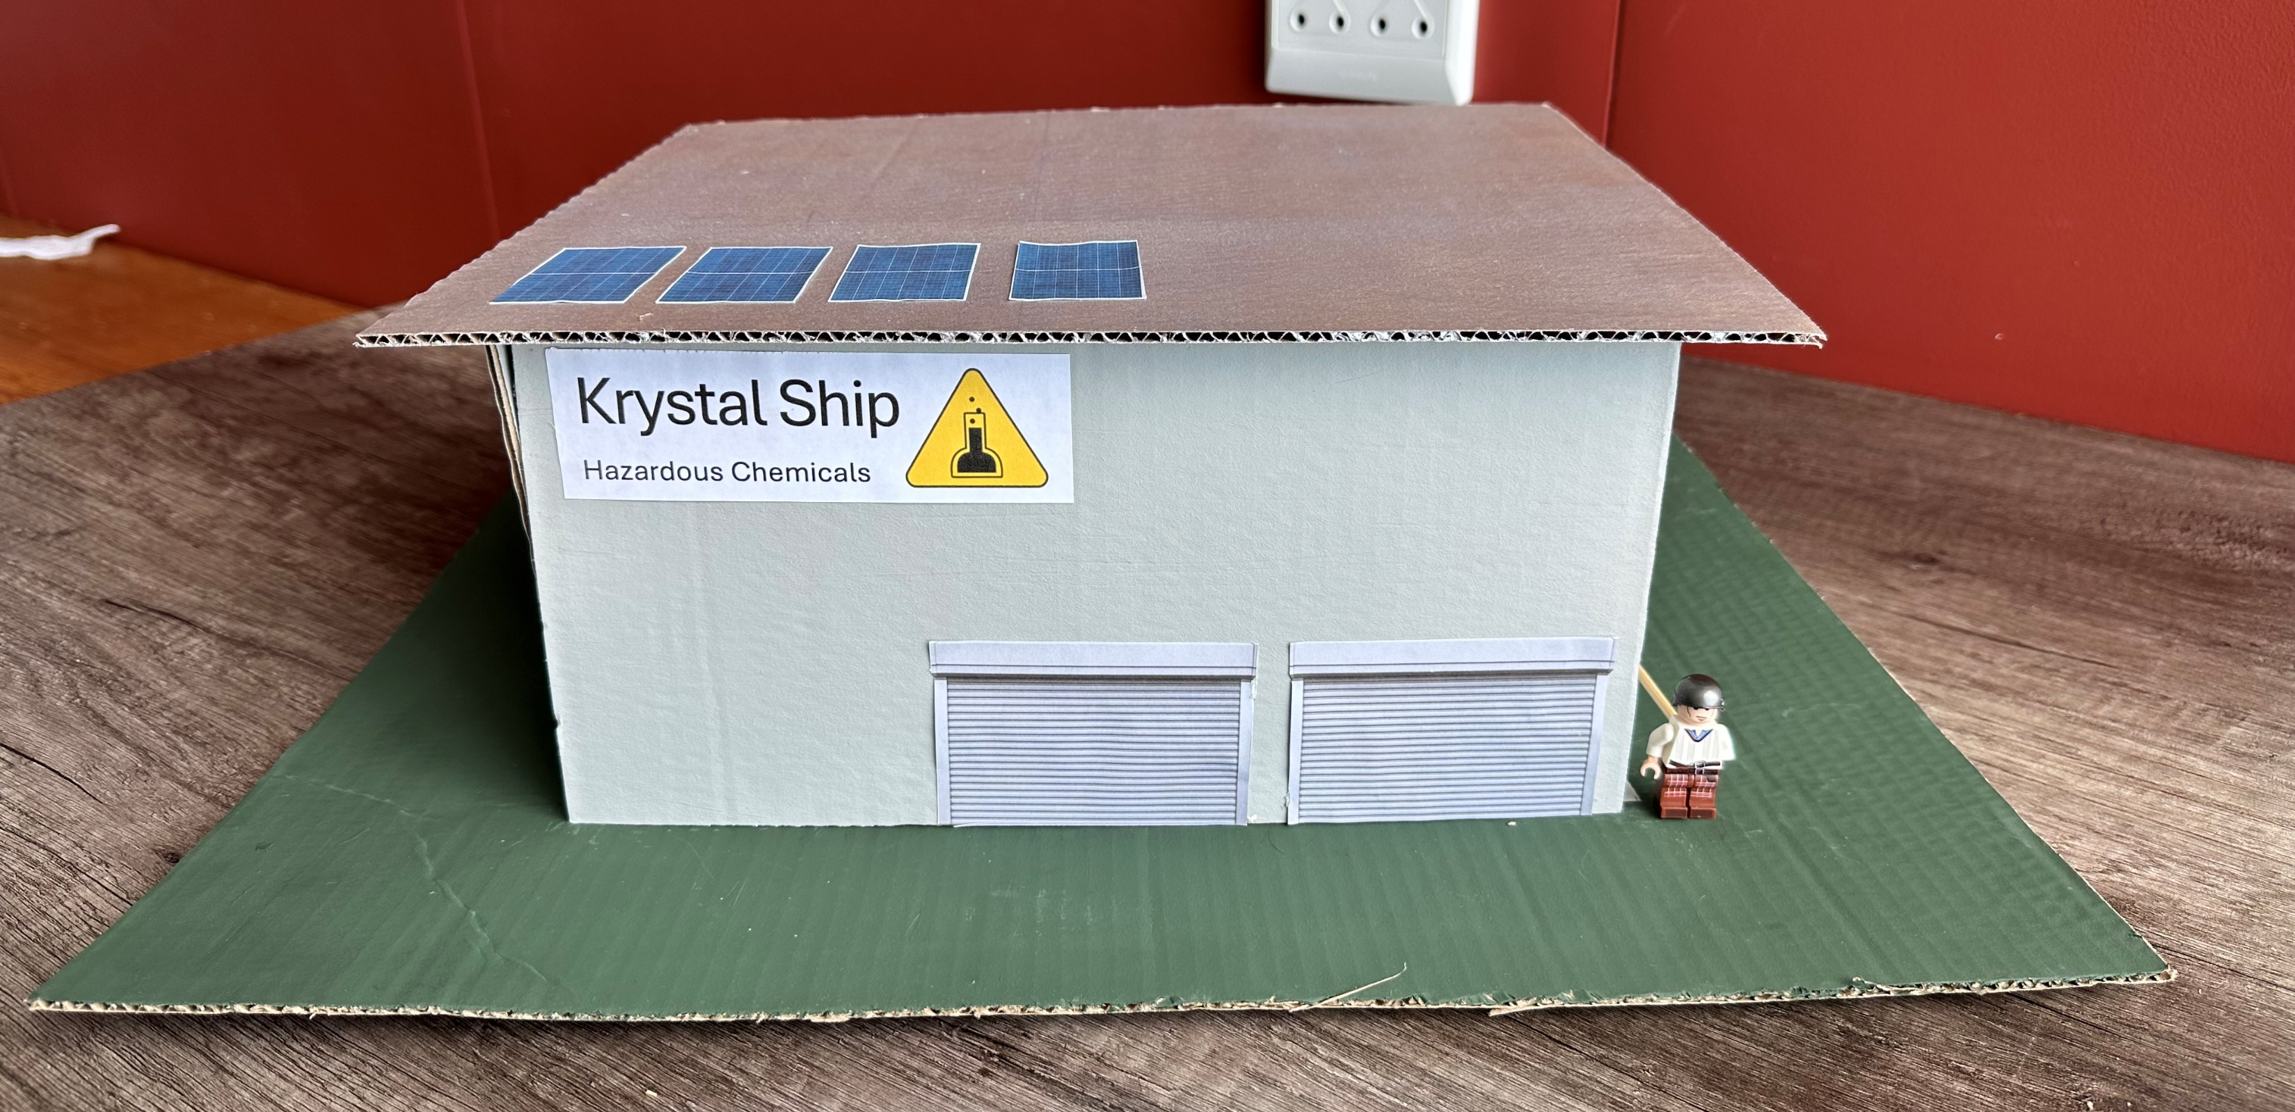
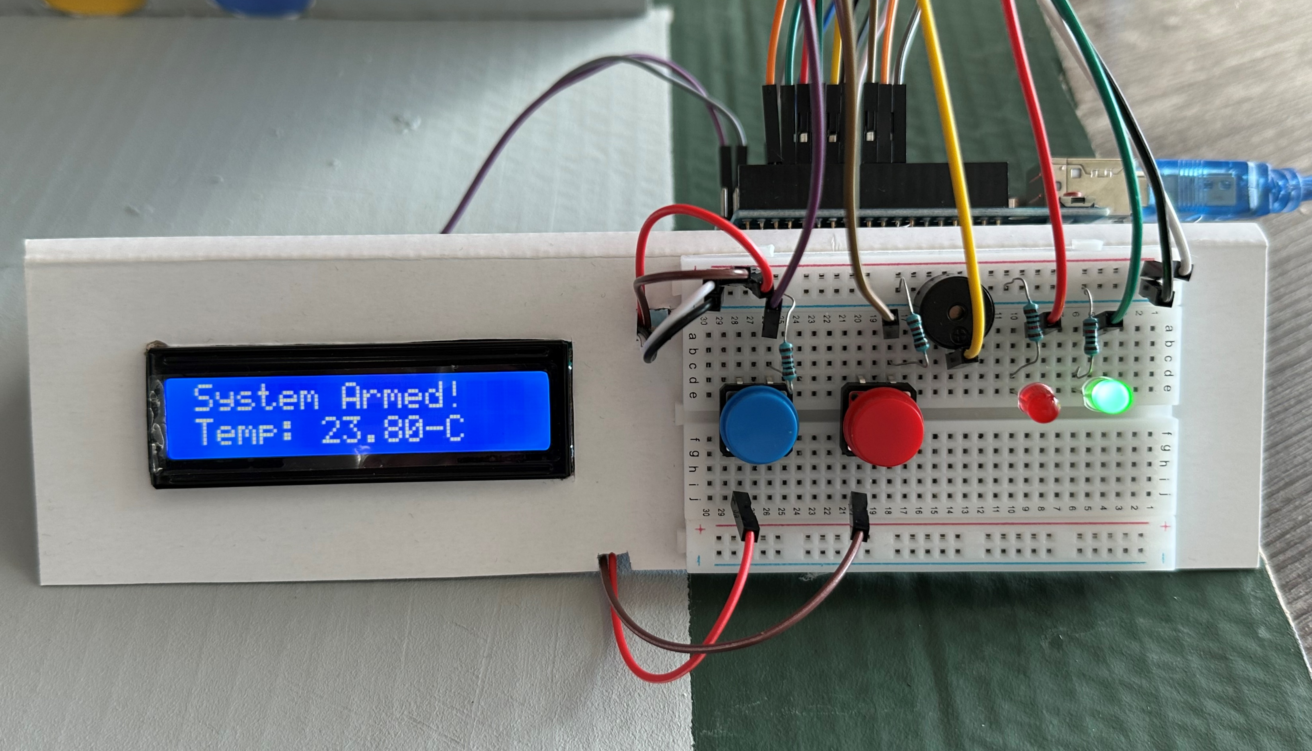
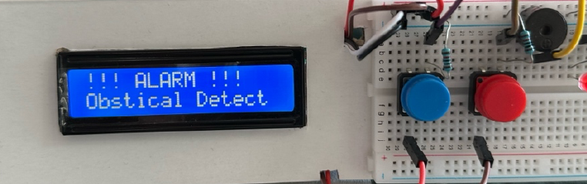
Coding Challenge – Student Attempts
13
Notes:
Here are some of the students who very proudly took pictures of the works and were willing to share them. The red circles show the additionally sensors than just the 1 required as well as the use of buttons to arm and disarm their system.

Slide 14
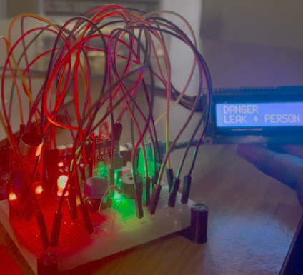
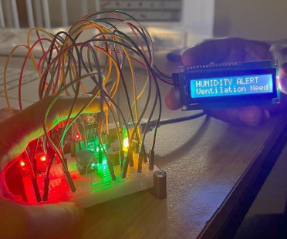
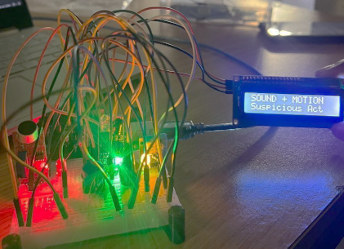
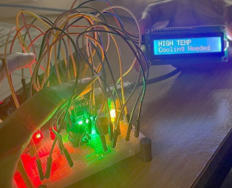
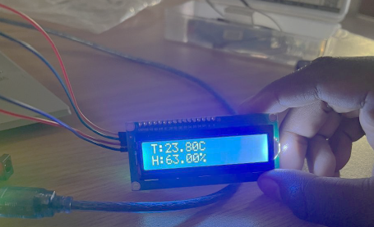
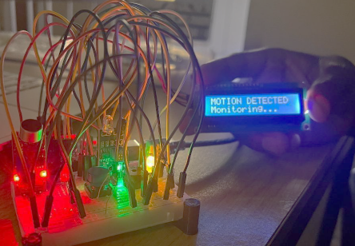
Coding Challenge – Student Attempts
14
Notes:
These students took advantage of the LCD and every state had a corresponding message such as if the sound and motion sensors weer activated it become a “suspicious action”.

Slide 15
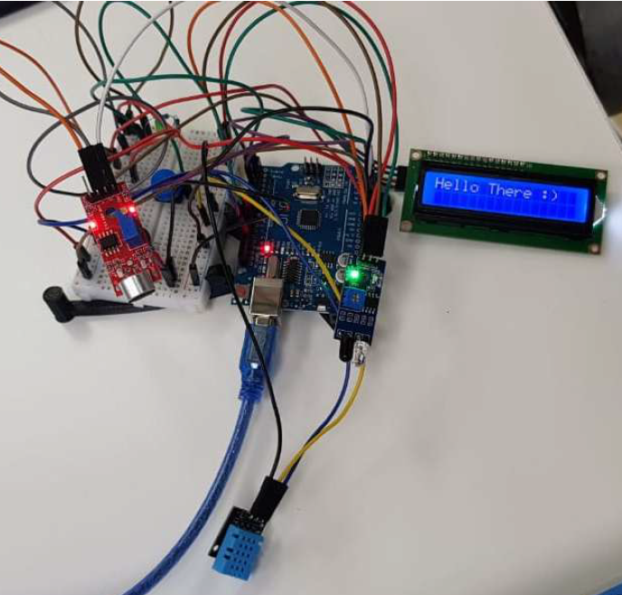
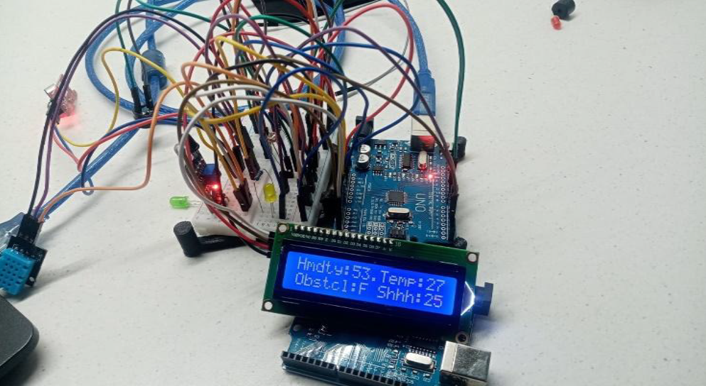
Coding Challenge – Student Attempts
15
Notes:
Here you can the use of the sound sensors and a group that used plenty jumper wires to accommodate all their sensors.

Slide 16
Coding Challenge – Student Attempts
16
Notes:
Here you can see the water sensor, which students encounter accuracy issues with. Being a cheaper sensor it basically was sensing wet or not wet and the students cleverly decided that it can’t be put in the vat to monitor chemical level but rather can be on the floor to monitor a spill.
Lastly, to mention, students who had used the sound sensors had calibrate them in the quite of their own homes. This led to them having to adjust the maximum noise level in the demonstration session.

Slide 17
Conclusion and Ultimate Purpose
Both supervised and independent learning
Improved student understanding of:
  Electrical diagrams
  Coding and logic
  Sensors, sensor sensitives, actuators and systems as a whole
  Report writing, documenting a project and demonstration skills
Creative thinking
‘Education's purpose is to replace an empty mind with an open one.’ – Malcolm Forbes.
17
Notes:
In conclusion, our students ere extremely positive about the practicals and what they managed to build.
They had both supervised and independent learning as well as an improved understanding of electrical diagrams,coding and logic, sensors, sensor sensitives, actuators and systems as a whole and report writing, documenting a project and demonstration skills.
Lastly, they were able to creatively think and design.

Slide 18
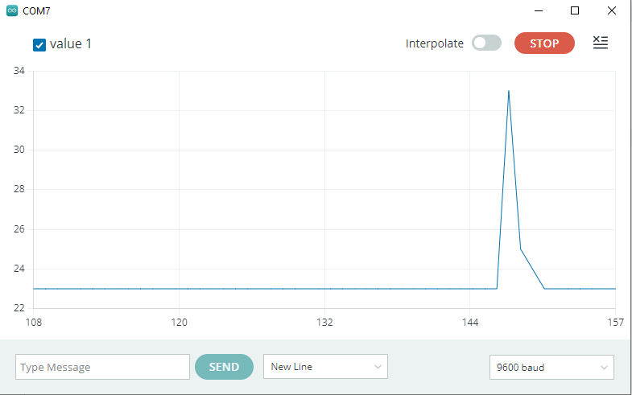
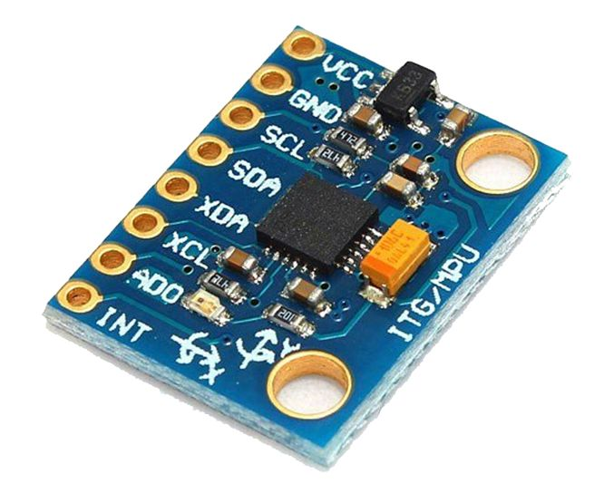
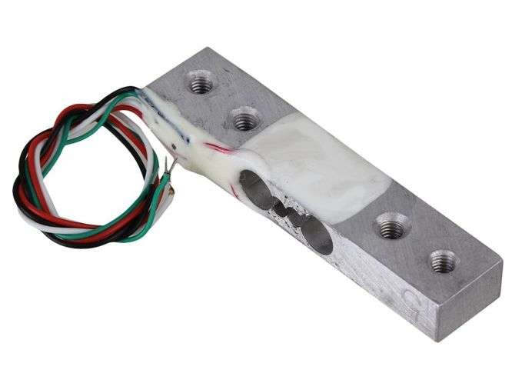
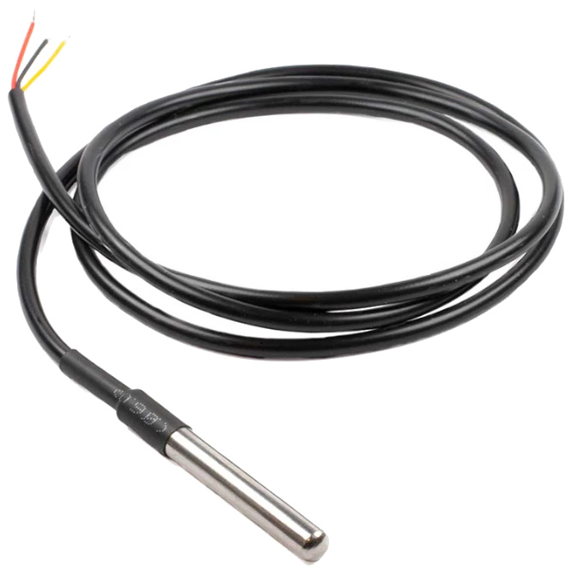
Further Improvements
Additional sensors, actuators and sessions focused on Arduino used for ‘Experimental Data Capturing’
Serial plotting
Update the Coding Challenge to a new scenario where students use a waterproof temperature sensor to monitor the heating of water and learn about calorimetry
Gyroscope and Accelerometer
Load Cell Sensor
Waterproof Temperature Sensor
[2]
18
Notes:
Finally, in an effort to make the practical more physics based, Arduino offers a serial plotting feature that can be used for experimental analysis and with the use of a few additional sensors, such as accelerometers, gyroscopes and waterproof temperature sensors, the students can be building their own practicals for physics concepts.

Slide 19
Other Arduino Courses
Uli Raich
He has created many hands-on courses on micro-controllers.
Nelson Mandela University
InnoVenton offers short learning program
University of Johannesburg
TechnoLab offers a workshop on Arduino
University of Cape Town
Department of Electrical Engineering offers an sustainable energy/Arduino programme
Makerspace
Stellenbosch University and University of the Witwaterstrand
19
Notes:
I would like to mention that this is not the first Arduino practical. Uli Raich offered assistance in setting up this practical and he runs course world wide.
Other university, mainly the engineering departments, offer microcontroller course.

Slide 20
References
[1] Arduino Uno Kit: Arduino starter kit (no date) TechToast. Available at: https://techtoast.co.za/products/arduino-uno-r3-basic-starter-kit (Accessed: 11 June 2025).
[2] Products (no date) MANTECH Electronics (Pty) Ltd. Available at: https://www.mantech.co.za/Categories.aspx (Accessed: 11 June 2025).
[3] Maccattack213 (no date) Arduino - Blinking LED, Instructables. Available at: https://www.instructables.com/Arduino-Blinking-LED/ (Accessed: 11 June 2025).
[4] ARDUINO.CC (5 July 2025) How to Wire and Program a Button. Available at: https://docs.arduino.cc/built-in-examples/digital/Button/ (Accessed: 11 June 2025).
[5] JunezRiyaz (no date) How to connect I2C LCD display to Arduino Uno, Instructables. Available at: https://www.instructables.com/How-to-Connect-I2C-Lcd-Display-to-Arduino-Uno/ (Accessed: 11 June 2025).
20
Notes:
These are the references.

Slide 21


Acknowledgements:
DSI and Nelson Mandela University
FJ Vorster, EE van Dyk, MT Sivewright and TechToast
Notes:
Acknowledgements and thanks go to the Department of Science Innovation and the Physics department at Nelson Mandela University as well as supervisors, Dr Vorster who tested the initial practicals, prof van Dyk who supported the ideas and assisted with the students and to Matthew who helped me run the practicals sessions.

Slide 22

Notes:
Thank you. Are there any questions?

