Slide 1



Energy Balance Closure Analysis Based on Eddy Covariance Flux Tower Observations
Lufuno Takalani
                Supervisor: Dr. T.S. Mulaudzi
                Co-supervisor: Prof. N.E. Maluta
1

Slide 2


INTRODUCTION
DO YOU BELIEVE IN CLIMATE CHANGE?
YES/NO
YES!
NO!

Slide 3
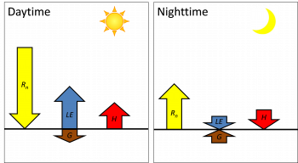
Energy Balance Closure (EBC) refers to how well the measured incoming and outgoing energy components at the Earth's surface balance out, according to the law of conservation of energy.
Energy balance closure is a fundamental principle in micrometeorology, ensuring that all energy fluxes within an ecosystem are properly accounted for.
Figure 1. energy fluxes during daytime and nighttime
2

Slide 4
Aim and Objectives
Study Area – Skukuza EC Site
Aim:
Analyze energy balance closure
Objectives:
Evaluate closure using Rn - G = H + LE.
Identify drivers of imbalance energy interactions.
Located in Kruger National Park, semi-arid savanna biome.
Vegetation: Combretum and Acacia trees.
Climate: Distinct wet and dry seasons.
Continuous EC measurements since 2000.
3

Slide 5
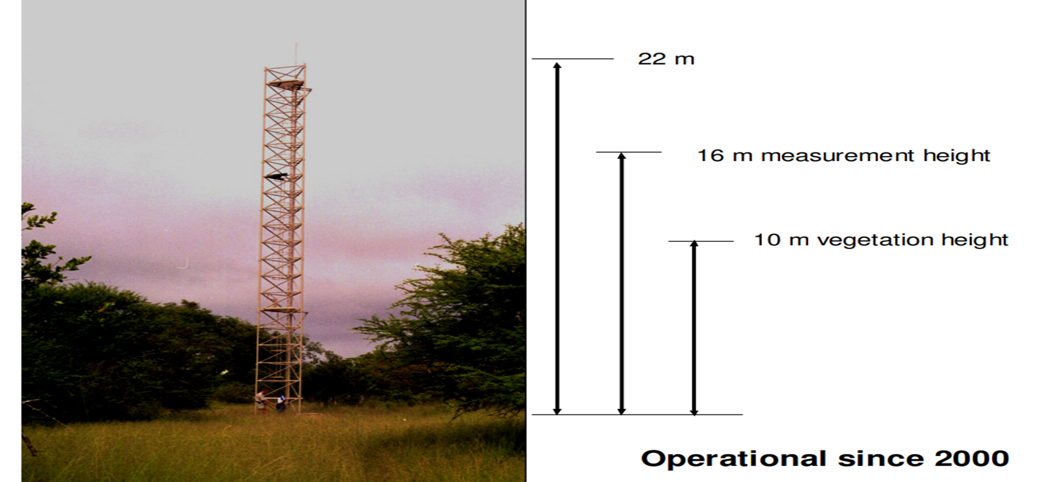
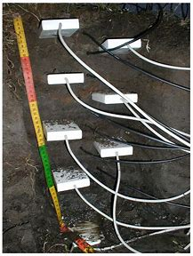
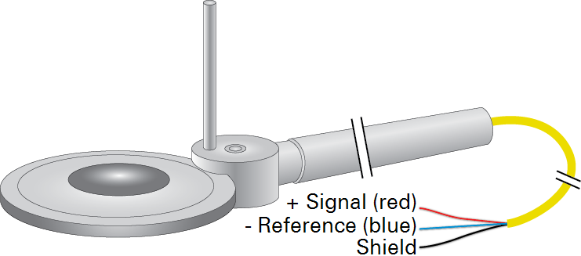
Measurement Type | Instrument(s)
Gas fluxes | LI-7500 infrared gas analyzer
Wind & heat fluxes | Gill WindMaster Pro & Campbell CSAT3 ultrasonic anemometers
Radiation | Kipp & Zonen albedometers and pyrgeometer
Micrometeors | Air temperature, humidity, rain gauge
Soil moisture | CS615L TDR probes at multiple depths
Data handling | Data loggers, tower-top computers, periodic on-site visits
Figure 2 The Skukuza FLUXNET tower
Figure 3 Radiation shields
Figure 4 The soil heat flux sensor
4

Slide 6
The problem of not having Energy Balance Closure (EBC)
The problem of not having Energy Balance Closure (EBC) arises when the measured energy inputs and outputs at the land surface do not balance,
meaning: 𝑅𝑛−𝐺≠𝐻+𝐿𝐸 – no closure
𝑅𝑛−𝐺 = 𝐻+𝐿𝐸 energy closure
This form is often used to assess the partitioning of net radiation into turbulent heat fluxes only.
𝑅𝑛−𝐺 = 𝐻+𝐿𝐸 + 𝐺 Surface energy closure
𝑅𝑛= 𝐻+𝐿𝐸 simplified form of the surface energy balance equation
The time scale is long enough (daily or longer), so G ≈0
Where: 𝑅𝑛​ = Net radiation
𝐺 = Ground heat flux
𝐻 = Sensible heat flux
𝐿𝐸 = Latent heat flux
Lack of energy balance closure undermines the reliability of micrometeorological measurements, especially in flux networks like FLUXNET, and makes it harder to use the data confidently for research, agriculture, and climate modeling.
5

Slide 7
Why It's Important?
Energy balance closure is a quality check for eddy covariance data used in climate, hydrology, and ecosystem studies.
Poor closure could indicate incomplete or biased measurements, reducing confidence in results like evapotranspiration rates or carbon fluxes.
6

Slide 8

Causes of unclosed energy balance
Inaccurate Flux Estimates Eddy covariance (EC) systems may underestimate latent and/or sensible heat fluxes, especially under complex terrain or atmospheric conditions.
Uncertainty in Evapotranspiration (ET)Latent heat flux (𝐿𝐸) is used to estimate ET. If the energy balance doesn't close, ET estimates may be wrong, affecting water resource management and climate modeling.
Model Calibration Errors Land surface and climate models rely on accurate flux data. An unclosed energy balance can lead to biased model parameters or incorrect conclusions about surface processes.
Misinterpretation of Ecosystem Function Energy imbalance may give false impressions of ecosystem productivity, stress, or water-use efficiency.
Difficulty in Comparing Sites or Years Without closure, comparing flux data across sites or seasons becomes problematic because you can't distinguish between true variation and instrumental or methodological errors.
Data Correction Challenges Researchers often apply post-processing corrections (e.g., Bowen ratio energy balance closure, residual methods), which introduce assumptions and potential biases.
7

Slide 9
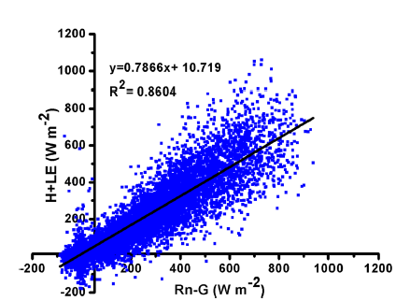
RESULTS & DISCUSSION
The energy balance closure obtained is 78% using half hourly data for the whole period of study (figure 6 ), which is within the acceptable limit (53–99%) as reported from 22 FLUXNET sites (Wilson et al. J. Earth Syst. Sci. (2018) 127:94
In a study conducted in the semi-evergreen primary forest of Kaziranga National Park, Assam, India (Feb 2016–Jan 2017), energy balance closure reached up to 83% under neutral conditions. Latent heat flux dominated, indicating strong evapotranspiration and reliable surface energy flux measurements.
Figure 5: Energy balance closure of the whole study period
considering half hourly averaged data.
8

Slide 10
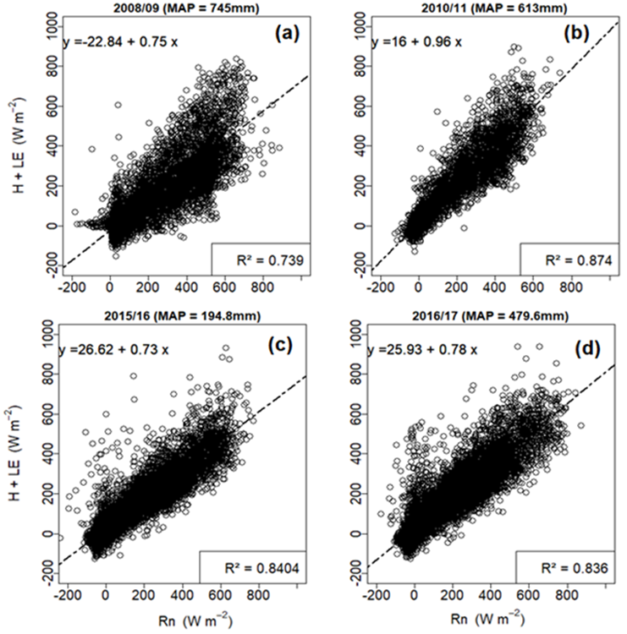
(a) 2008/09 (Mean Annual Precipitation(MAP) = 745 mm):
R² = 0.739; Moderate correlation with a slope of 0.75 indicates ~74% of net radiation is converted into turbulent fluxes, but energy imbalance remains.
(b) 2010/11 (MAP = 613 mm):
R² = 0.874; Very strong correlation with near-unity slope (0.96) suggests best energy balance closure and accurate turbulent energy partitioning.
(c) 2015/16 (MAP = 194.8 mm):
R² = 0.8404; Strong correlation with a slope of 0.73 under dry conditions shows good energy relationship despite reduced rainfall and lower energy closure.
(d) 2016/17 (MAP = 479.6 mm):
R² = 0.836; High correlation with a slope of 0.78 reflects improved energy balance under moderate rainfall but still underestimates full closure.
Figure 6. Regression relationships between available energy (Rn) and turbulent fluxes (H + LE).
9

Slide 11
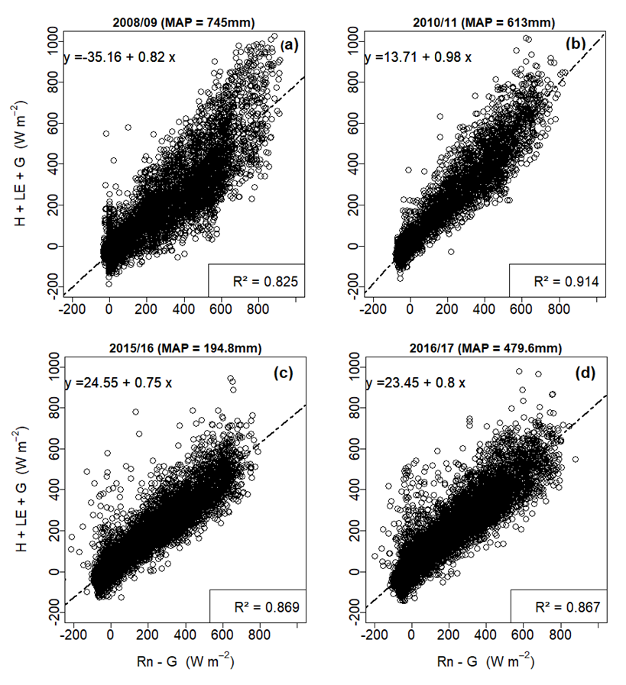
Figure 8.The surface energy closure at Skukuza
10

Slide 12
Table 1. Summary of Skukuza findings
Year | R² | Slope | Interpretation | Reason for Energy Non-Closure
2008/09 | 0.739 | 0.75 | Moderate EBC; ~74% of Rn partitioned to H+LE | Surface heterogeneity, storage terms (G, biomass), instrument error
2010/11 | 0.874 | 0.96 | Best EBC; strong coupling of Rn to H+LE | Minimal imbalance; possible underestimation of minor energy sinks
2015/16 | 0.840 | 0.73 | Good EBC despite drought; weak moisture fluxes | Sparse vegetation, reduced LE, soil moisture limitations
2016/17 | 0.836 | 0.78 | High EBC; ~78% closure | Residual storage (G), unmeasured advection, canopy effects
11

Slide 13
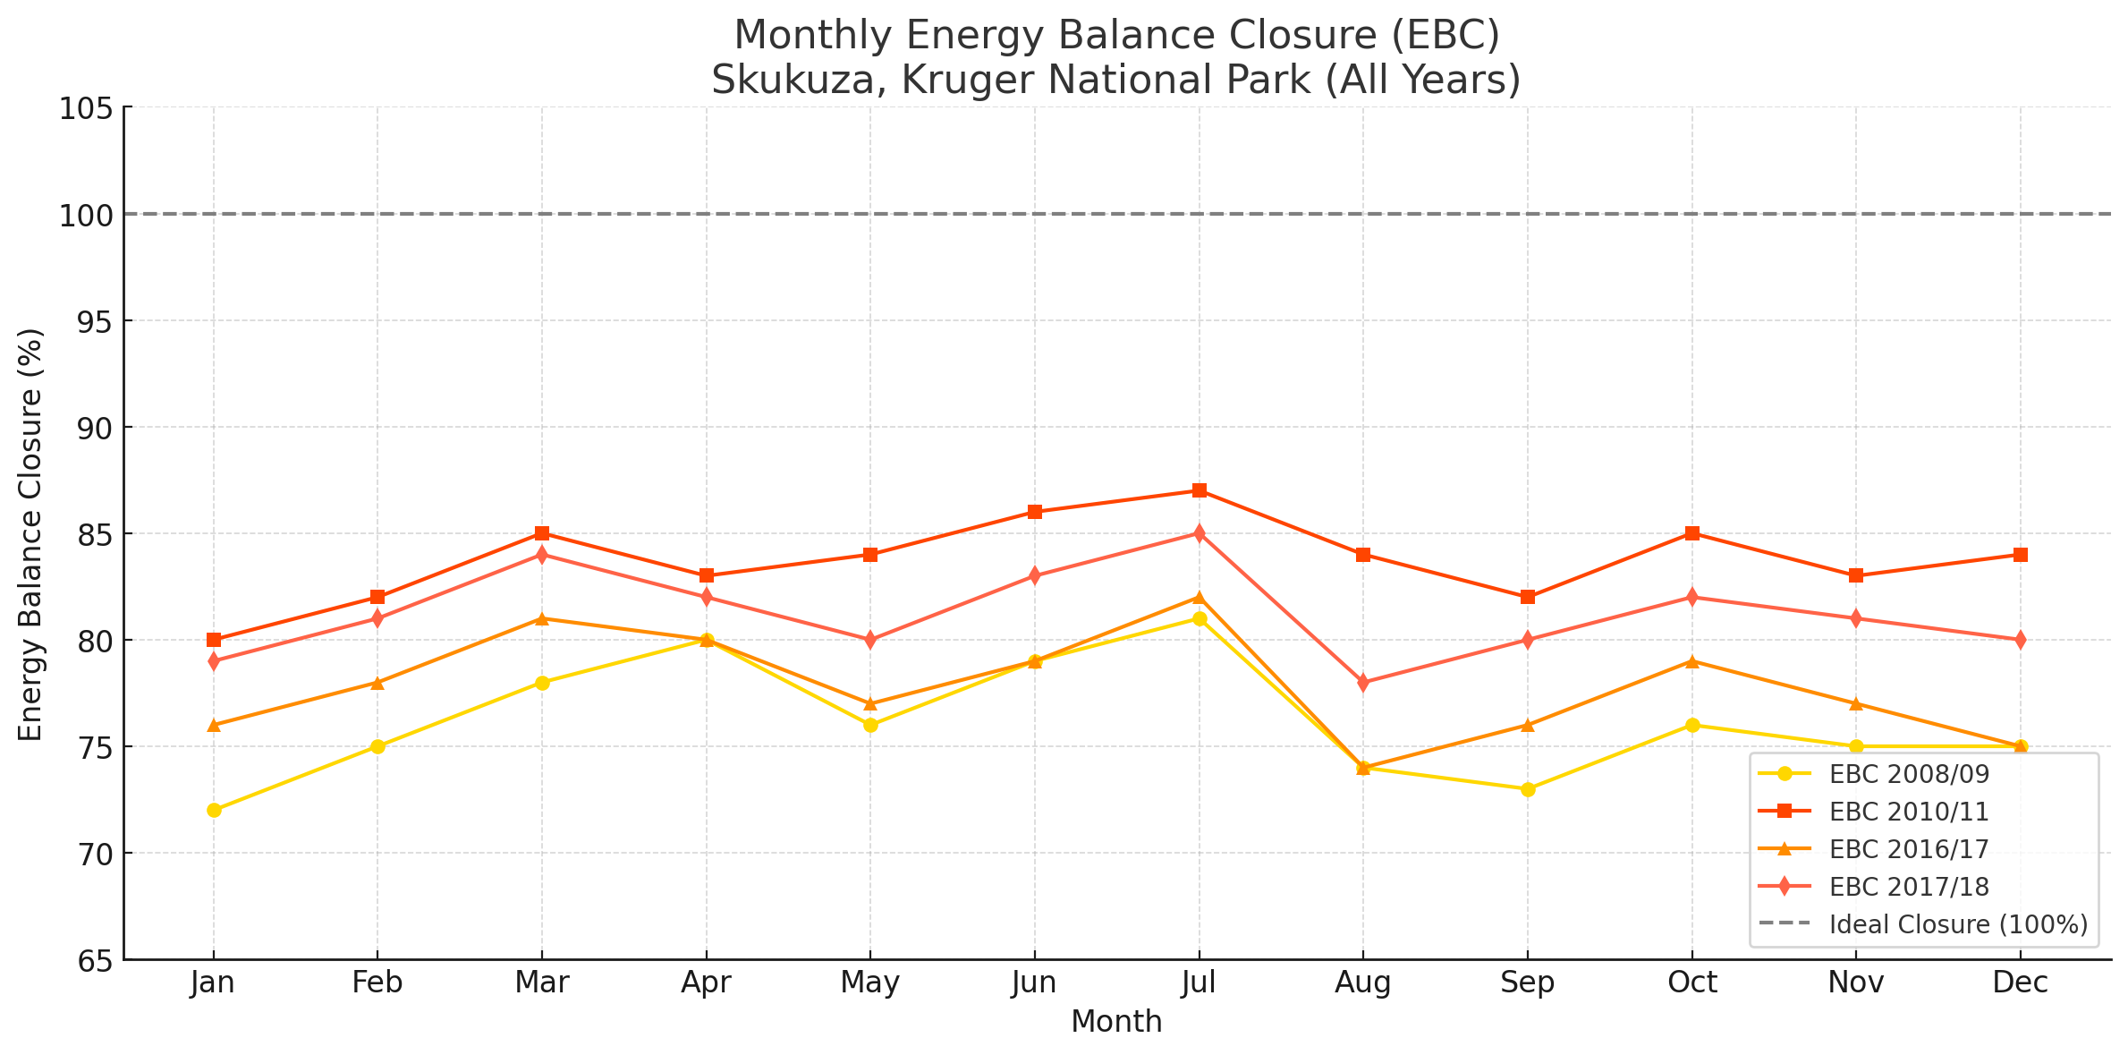
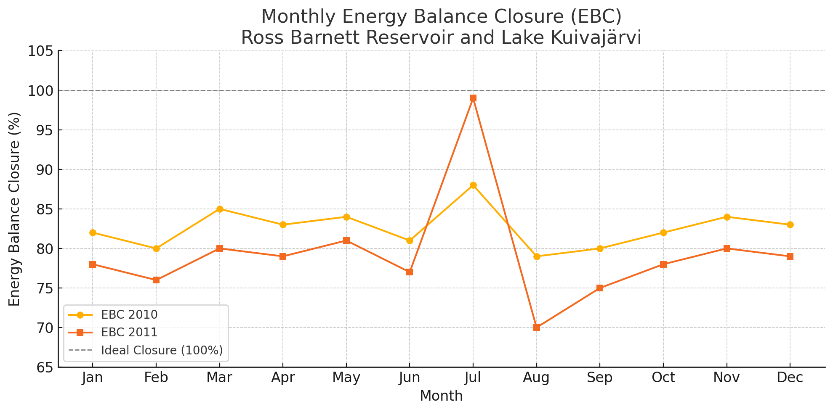
Figure 10. Monthly Energy Balance Closure (EBC) for 2010 and 2011 at Ross Barnett Reservoir and Lake Kuivajärvi.
Figure 9. Combined plot of Monthly Energy Balance Closure (EBC) for Skukuza, Kruger National Park across four years:
Observations:
All years show seasonal variation, with July–October often having higher EBCs.
2010/11 and 2017/18 generally had the highest closure values (up to ~87%).
All values are below the ideal 100% closure, which is typical due to surface heterogeneity, instrument limitations, and energy storage terms.
12

Slide 14
Table 2: Mean, Minimum, and Maximum Energy Fluxes by Time Scale
variable | timescale | Mean (w/m²) | Min (w/m²) | Max (w/m²)
H | 30 min | 57.364382 | -99.854800 | 791.68050
H | hourly | 57.981717 | -97.872495 | 699.85275
H | daily | 57.631191 | -21.818418 | 192.77799
H | monthly | 57.300458 | 27.586035 | 111.73484
LE | 30 min | 40.634973 | -100.186630 | 598.58887
LE | hourly | 41.131123 | -89.087500 | 581.62402
LE | daily | 41.819508 | -13.349158 | 218.25352
LE | monthly | 44.411374 | 3.897861 | 140.17394
Rn | 30 min | 120.399084 | -421.500000 | 1060.50000
Rn | hourly | 120.308692 | -309.300000 | 1002.50000
13

Slide 15

Conclusion
A review of studies at Ross Barnett Reservoir and Lake Kuivajärvi showed monthly energy balance closure ranging from 70% to 99%, with annual averages of 83% (2010) and 79% (2011). The effective transfer coefficients for heat aligned with previous lake studies, validating the use of bulk transfer models (Nordbo et al., 2011; Xiao et al., 2013).
Study at Skukuza (Kruger National Park),show energy balance closure ranged around 80% across years, with better closure during wet seasons. For example, 2010/11 showed improved closure compared to 2008/09, indicating seasonal and interannual variability in energy partitioning.
Challenges were due to turbulence, sensor placement, and terrain.
Suggestion is integrating EC with remote sensing, upscaling and modeling.
14

Slide 16


Acknowledgements
Supervisors and collaborators
15

Slide 17
THANK YOU !!

